Slide 1
Muon Campus Status
D. Vander Meulen
AD Friday 09:00 Meeting
June 09, 2023

Slide 2
This Week ...
Beam to G-2 on Friday until early afternoon when cryo trouble caused a magnet slow dump. The problem was not fixed before the chilled water leak turned us off for the remainder of the week.
Delivery Ring / Extraction / M4 access.
Instrumentation installation work in M4 line.
Repair of DR D50 upstream sump pump. Replacement was not necessary – pump impeller was plugged with a rag.
AP-0 air conditioning work is still on hold. The A/C contractor started other work offsite because of stand-down - expected to resume June 20th(?).
M5 ion pump IP000 trouble today. Will be looking into this.

Slide 3
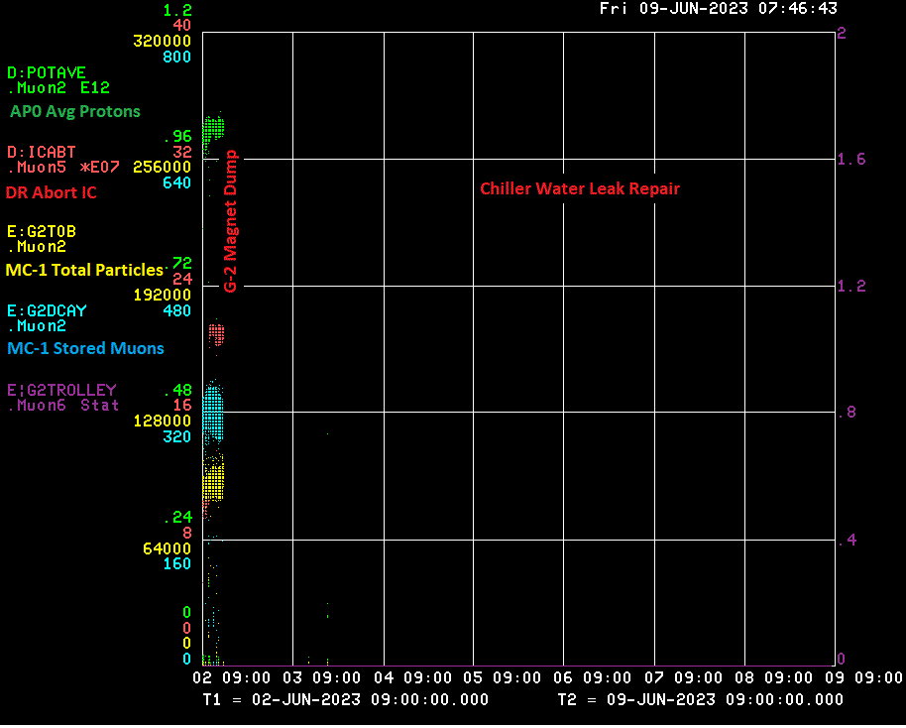

Slide 4
Down Time ...
Muon Campus: (None)
G-2:
Magnet Slow Dump: ?? hrs

Slide 5
Today / Weekend …
We are planning to be out of the tunnels in the early afternoon, and request unlock / turn on.
Tune up to G-2 if beam becomes available
Run to G-2 as requested

Slide 6
Next Week ...
8 GeV studies (proposed):
Monday: 08:00 – 1600
Tuesday: 08:00 – 16:00
Thursday: 12:00 – 1600
Running to G-2 as requested

