Slide 1
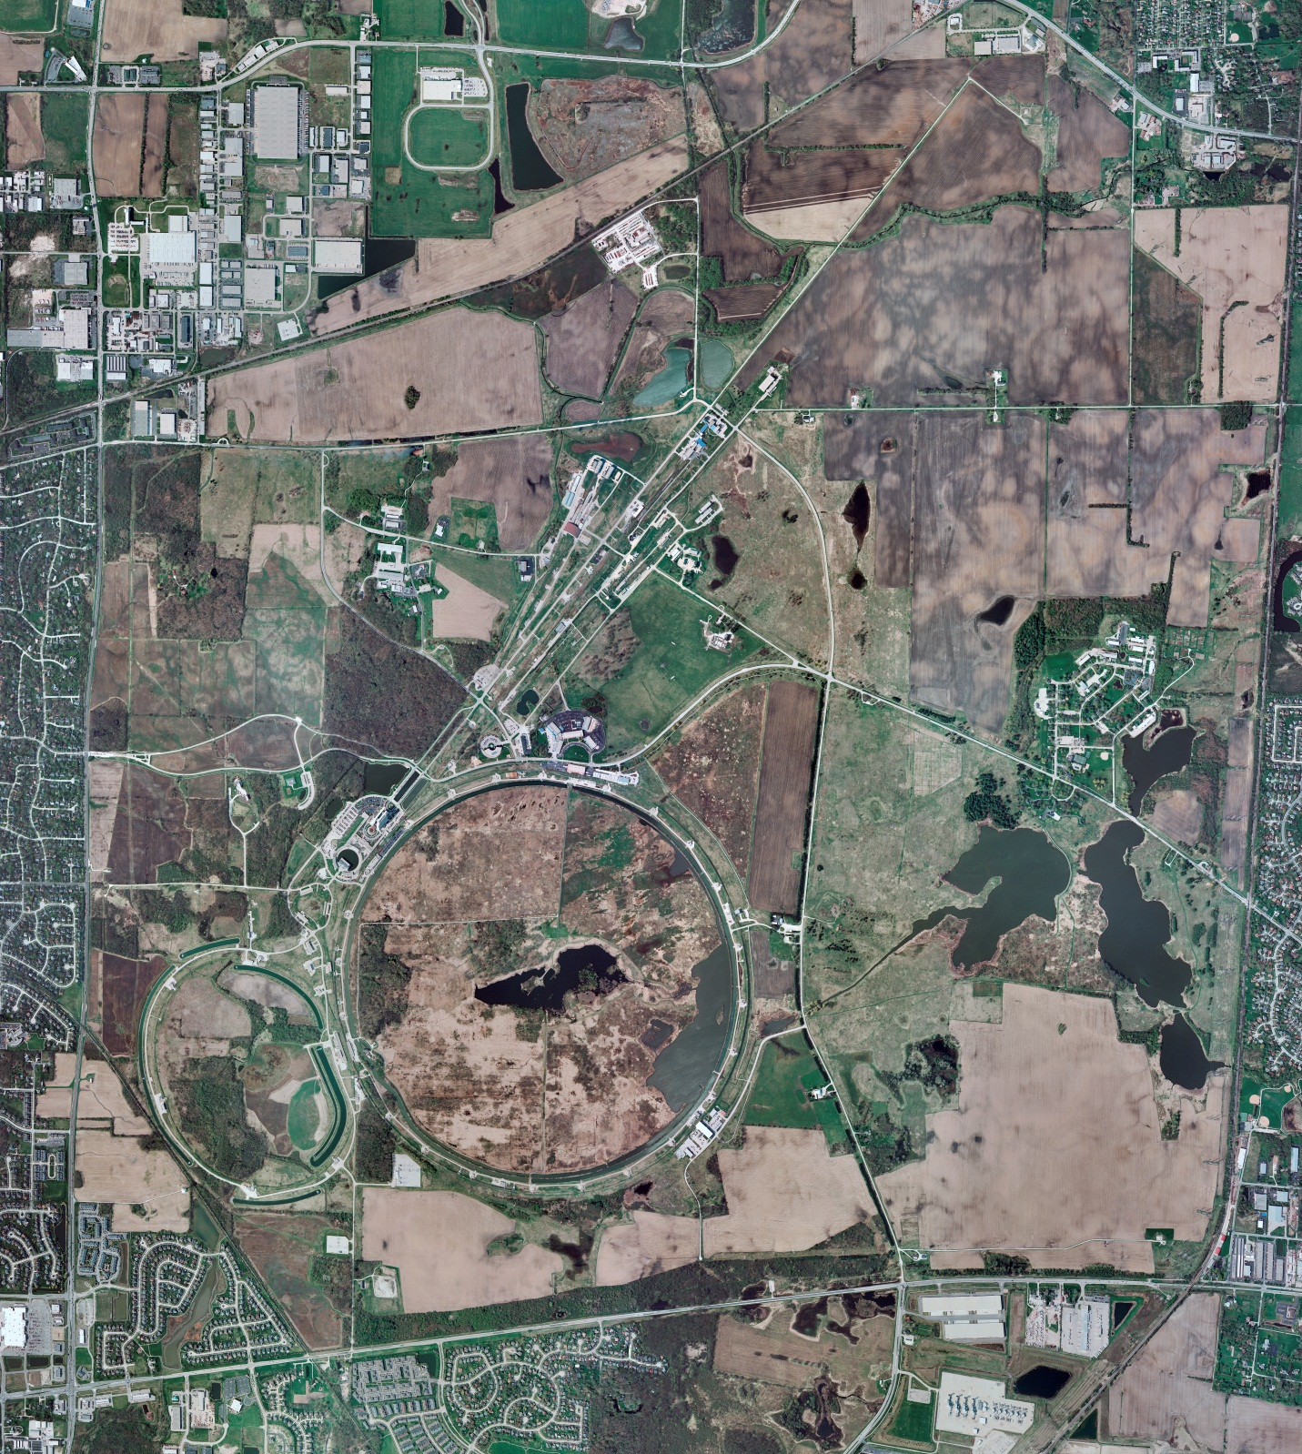
Helium Cryogenics
Status 6/9/2023 J.Makara
CMTF: SCP is cold and operating fine
CMTS: HECM25 installation continues, though delayed due to work stoppage and personnel availability
PIP2IT: SSR1 at RT
HB650 CM at 2 K with ongoing RF and cryo testing; controlled warmup to RT may start next week
MCTF: cryo system is cold and running fine in standby
MDB/HTS: at RT
MDB/STC: at RT awaiting LB650 (??) installation
MDB Magnet: at RT
NML/FAST: Cryo system is cold and running fine
CC1: cold at 2 K
CC2: cold at 2 K
CM: cold at 2 K
IB1: cryo system is cold and running fine
Muon Campus: A0 comprs (3) online with MC-1 g-2 cryogenic system running fine at 5 K, though poor LN2 vacuum/quality resulted in magnet dump
Misc:. Significant delays in various cryo activities due to work stoppage order

