Slide 1
ARD Department Business
ARD Department Meeting
9 June 2023

Slide 2
AD ESH Support
AD DSO Bob Aitken has resigned
Eric Schlatter is acting AD DSO
ND DSO Jonny Staffa will be providing additional senior ESH onsite coverage as needed
Directorate Safety Specialists
  Mia Arcus
  Jason Hartman

Slide 3
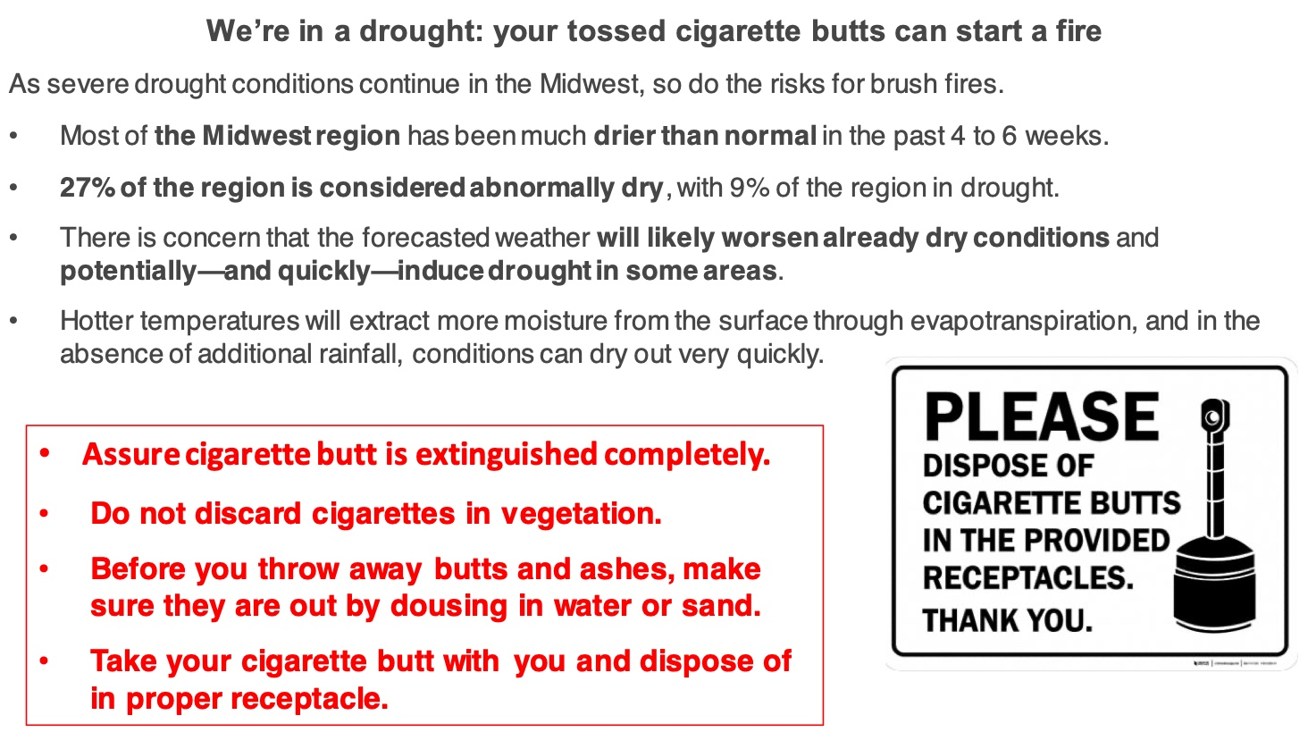
Safety Moment

Slide 4
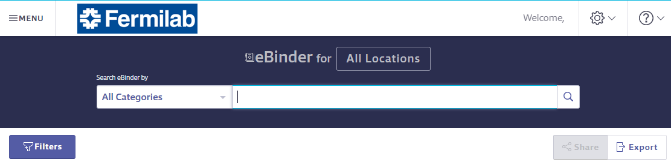
SDSOnline
NEW! SDS repository available to everyone
Replaces previous homegrown SDS database (archived and still available but not update)
Gives Fermilab access to millions of SDS’s, making it easier to find what you’re looking for
Automatic updates – latest version SDS always available
Cloud based application provides easy access from phone or tablet using weblink or QR code (Service logon required)

Slide 5


SDSOnline - Procurement
Prior to purchase, chemicals require approval and acquisition of an SDS
  Requirement for DSOs/DSSs to approve all chemical purchases remains the same
    Find the SDS in SDSOnline and request it be added to Fermilab's eBinder
    DSO/DSS will receive the request and have access to the SDS

Slide 6

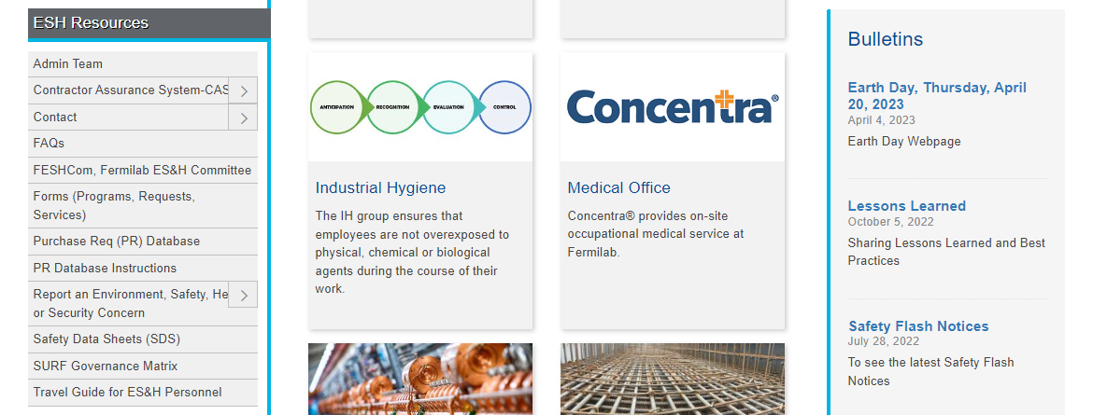
SDSOnline - Access
Linked from the ES&H Website https://eshq.fnal.gov/atwork/

Slide 7
FESHM updates during May
The following chapters have been updated for the month of May 2023. A brief summary of this is provided below.
QAM Chapter 12110 – Human Performance Improvement
Added requirement about recording Root Cause Analysis method and reviewing a sample for effectiveness.
Added new timeframe requirement for entering CAPs for specific item types.
FESHM Chapter 7090 – Tech Shop Safety
Changed Division/Section to Division/Associate Lab Directorate.
Added Miter Saw training course.
Added requirement for Shop POC to enter inspections into database.
FESHM Chapter 9130 – Management and Use of Cable Tray Systems
Added Responsibilities section.
Deleted Technical Appendix on grounding information technology equipment since it was moved to a more appropriate location in FESHM Chapter 9190 on grounding.

Slide 8
FESHM updates during May
FESHM Chapter 10100 - Overhead Cranes and Hoists
Revised reference to ISD (Infrastructure Services Division) from FESS.
Revised reference to Work Planning and Control/Training Group from WDRS Professional Development and Learning.
Revised reference to ALD/DD/PM - Associate Lab Director, Division Director, and Project Manager from Division/Section/Project Head (D/S/P).
Revised operator training requirements.
Added new definition, “Hand-Chain-Operated Chain Hoist”.
Added new definition, “Lever Hoist”.
Added new training requirements for hand-chain-operated chain hoists and lever hoists.
Added new section to Technical Appendix FESHM 10100TA on Hand-Chain-Operated Chain Hoists and Levers

Slide 9







Slide 10
Timeline
Performance Reviews
June 20, 2023 | Self-Evaluation Launched in FermiWorks
July 28, 2023 | Manager Evaluation Due
August 11, 2023 | Division Ratings Finalized
Early September 2023 | Merit Increase Assignment Process
End of September/Early October 2023 | Performance Review Discussions
October 1, 2023 | Merit Increase Effective Date
Mid-November 2023 | Goal Setting for fiscal year 2024
Performance Overview and Timeline:
https://hr.fnal.gov/employment/performance-review/
** Make sure Goals have been entered by Friday, June 16th **

