Slide 1

2x2 Water Cooling System
Mike Zuckerbrot
ArgonCube 2x2 Cryogenics
June 2023

Slide 2
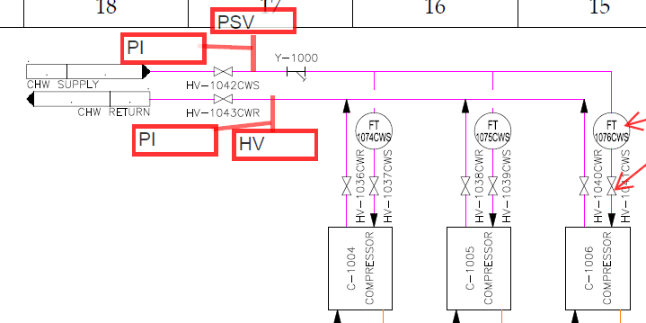
Water Cooling System
Purpose: Cryocooler compressors (x3) require ~2 gpm of water cooling each
Will tie into existing CHW closed loop cooling system
  Has supply/return tie in points we can use
Components:
  Wye strainer
  Manual flow control valves and flow transmitters on each circuit
  Block valves and circuit outlets
  Bleed valve on return
  Supply/return pressure gauge
  Relief valve
  Manifolds rigid 3/4 sch. 80 PVC
    Threaded fittings
  Flexible tubing to/from compressors
    Push to connect fittings

Slide 3
Water Cooling System
Installation: Likely prefab manifolds at PAB
  Connection to existing CWH piping consists of 1.5 pipe unions, no cutting/welding
  Nearby Unistrut under catwalk to be used for support
  We have green light from ISD to tap in at our convivence
Testing: Design pressure of system is 100 psig
  No credible way for system to exceed 75 psig, e.g. relief valve is mostly a precaution
  Category D system – code only requires operational testing e.g. 80% of design pressure
  Will bench test main components once assembled at PAB
Operation: Should be simple
  Set manual flow controls valves to provide 2+ gpm
  Shouldn’t require much more unless main CHW system has issues

Slide 4
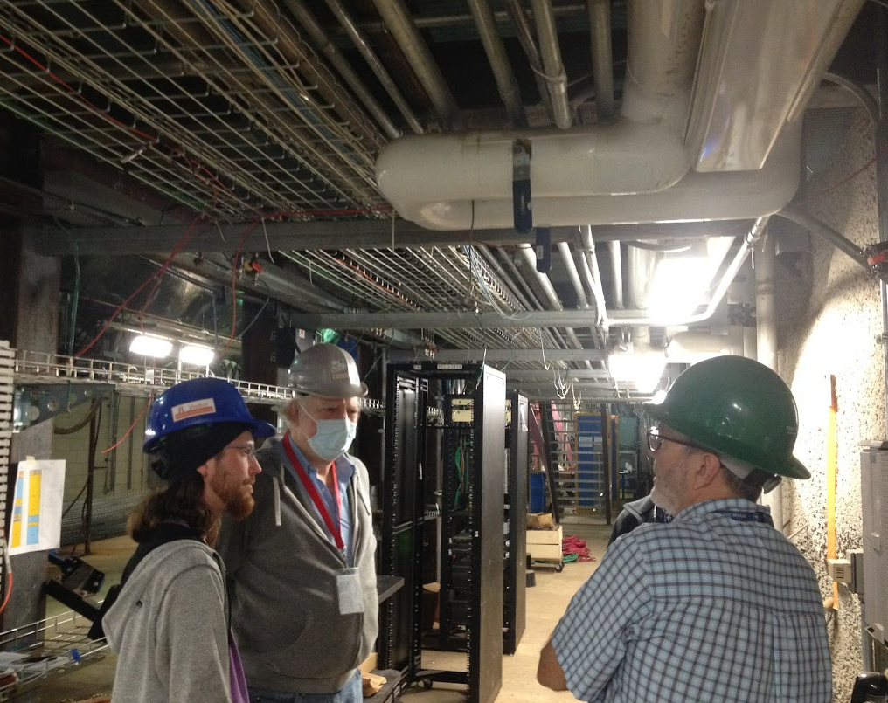
Water Cooling System
Rigid PVC
FCV, FT on each circuit
Existing CHW System
Pipe Union – Connection Points
-Flexible tubing supply/return x3
-Will run along existing columns etc. as much as possible to protect lines
Compressors x3

