Slide 1
Muon Spin Rotation Spectroscopy
Utilizing Muons in Solid State Physics
Andreas Suter
Laboratory for Muon Spin Spectroscopy
Paul Scherrer Institute, Switzerland

Slide 2
µSR Facilities around the World
pulsed (50Hz) muon beams
continuous muon beams
continuous muon beams
J-PARC (2009)
pulsed (25Hz) muon beams
from “µSR brochure” by J.E Sonier, Simon-Fraser-Univ., Canada, 2002. http://musr.org/intro/musr/muSRBrochure.pdf

Slide 3

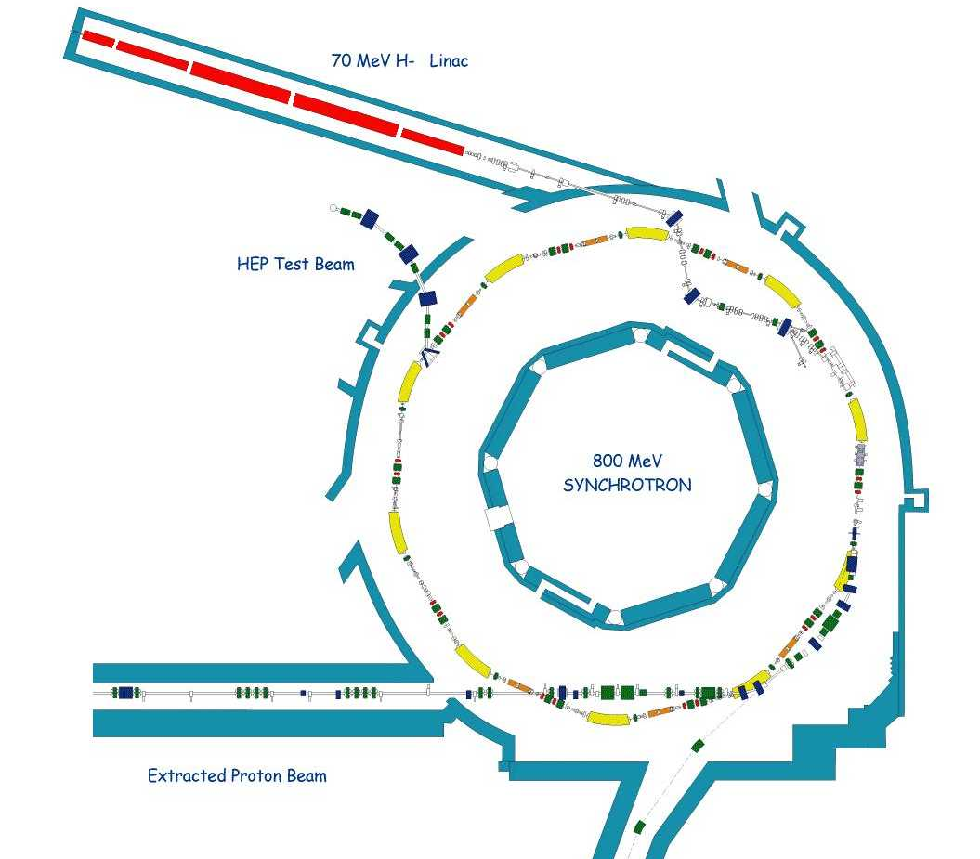
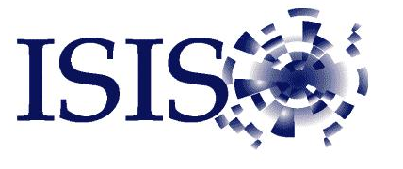
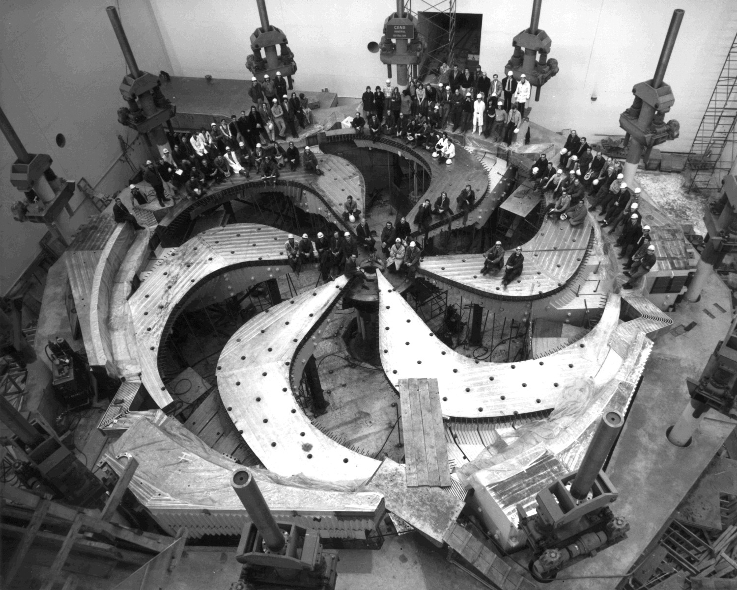


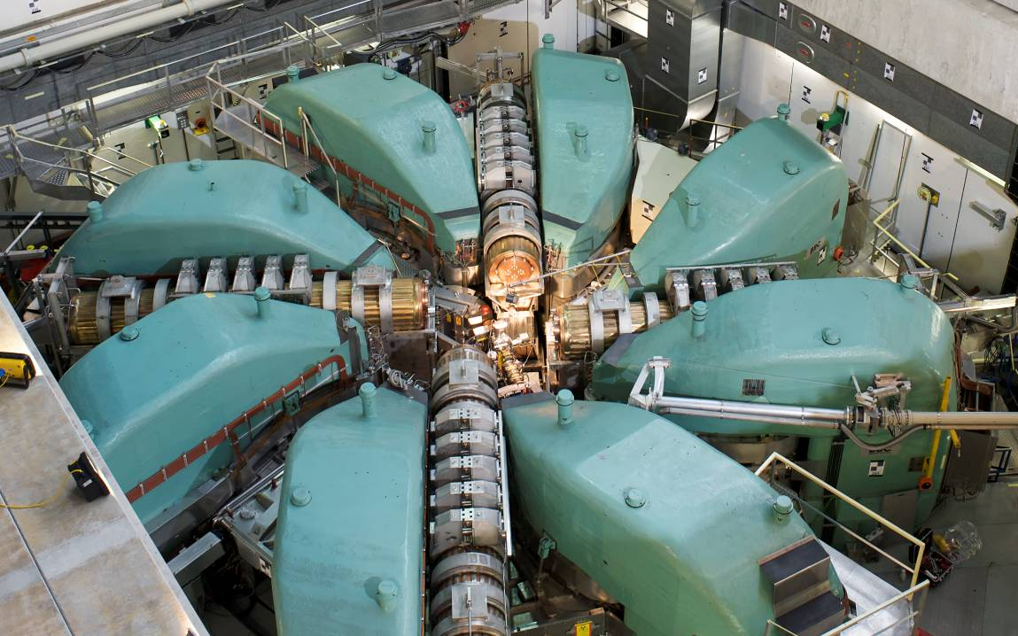
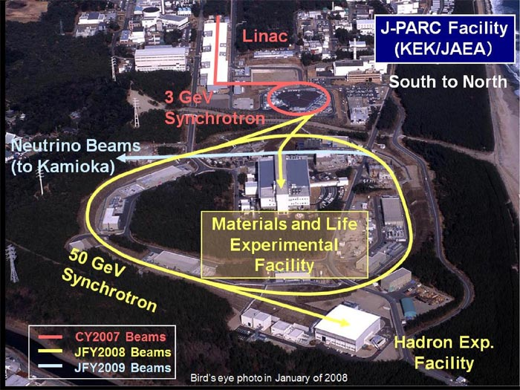
µSR Facilities around the World
Cyclotron (1972)
590 MeV Ring Cyclotron

Slide 4
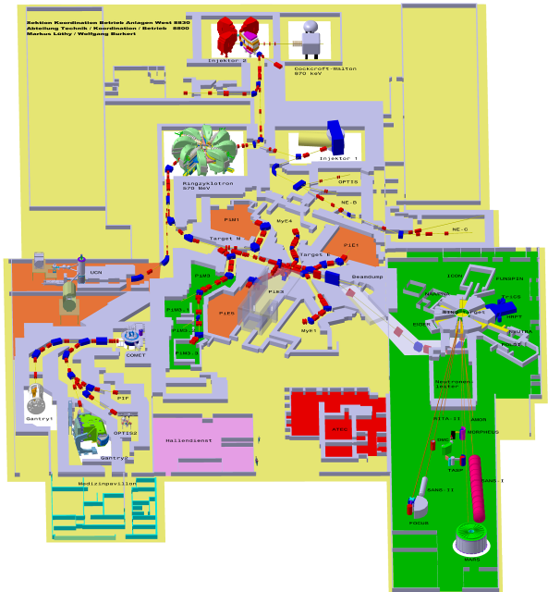
Proton Accelerator at PSI
Injector II Cyclotron 72 MeV
Cockcroft Walton 870keV
Ring Cyclotron 590 MeV
2.2 mA / 1.3 MW
Ultra Cold Neutrons
SINQ
Neutron Spalation Source
Pion/Muon
Production Targets
Center for
Proton Therapy
(250MeV SC Cyclotron)

Slide 5
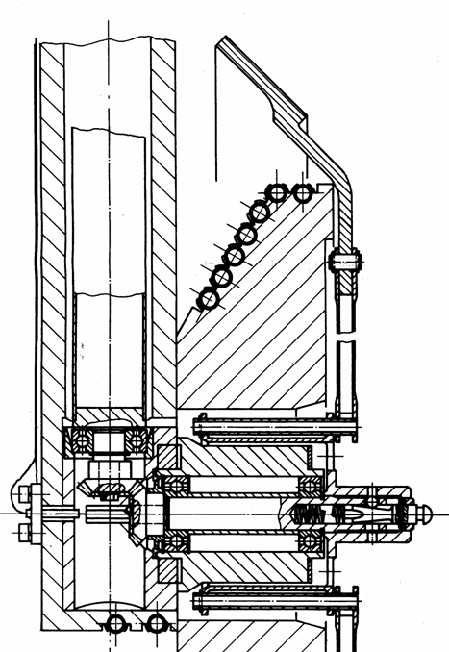
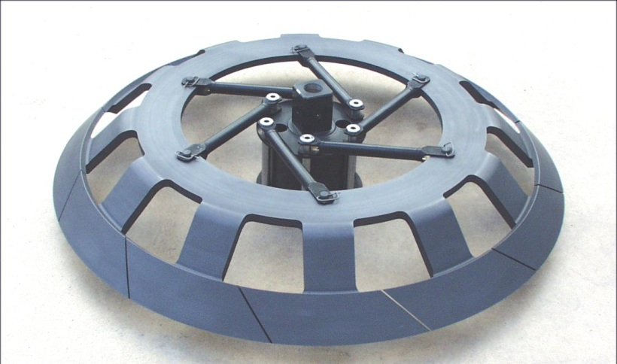
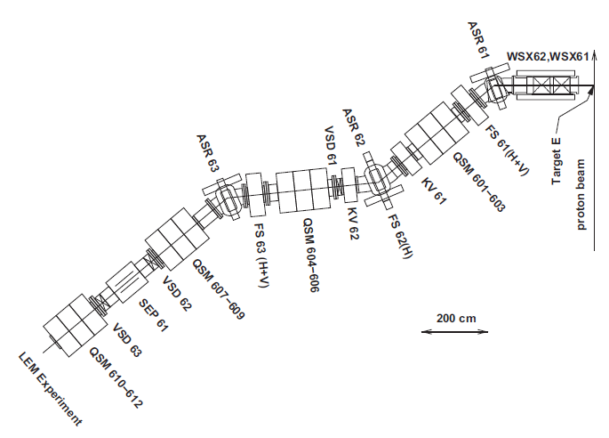
Muon Production – Example: Target E at PSI
Rotating Graphite Target (1 Hz)
Radiation Cooled, T_{avg} = 1700K
Thickness t=40 mm; h=6 mm; ∅ 450 mm
Radiation Losses 30%
h
Pions / Muons
t
590 meV p beam
rotation axis
Target E
solenoids
quadrupoles
2200 μA ≈ 1.4∙10⁶ p/sec →
≈ 10⁷ – 10⁸ μ+/sec
100% polarized
Surface Muons: ≈ 4 MeV
μE4 beamline at PSI: 4 ∙ 10⁸ μ+/sec
T.Prokscha et al NIM-A (2008)

Slide 6
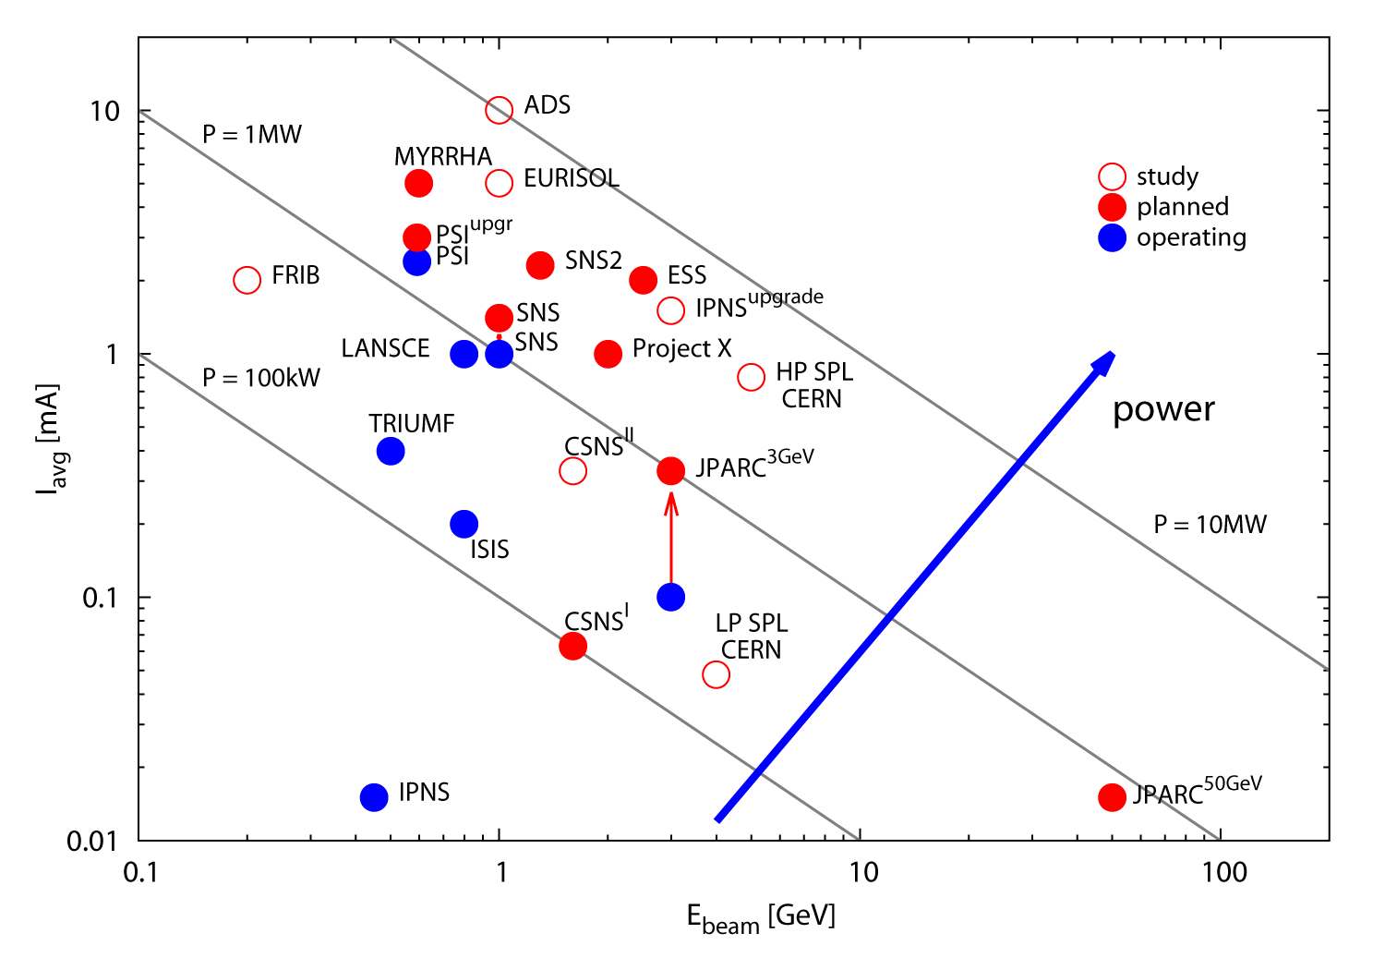
Beam Power of Accelerators World Wide
from M.Seidel, GFA, PSI

Slide 7
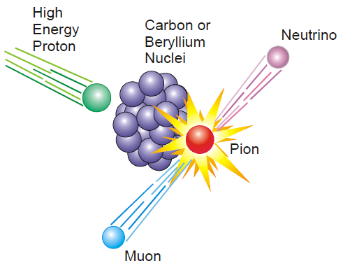
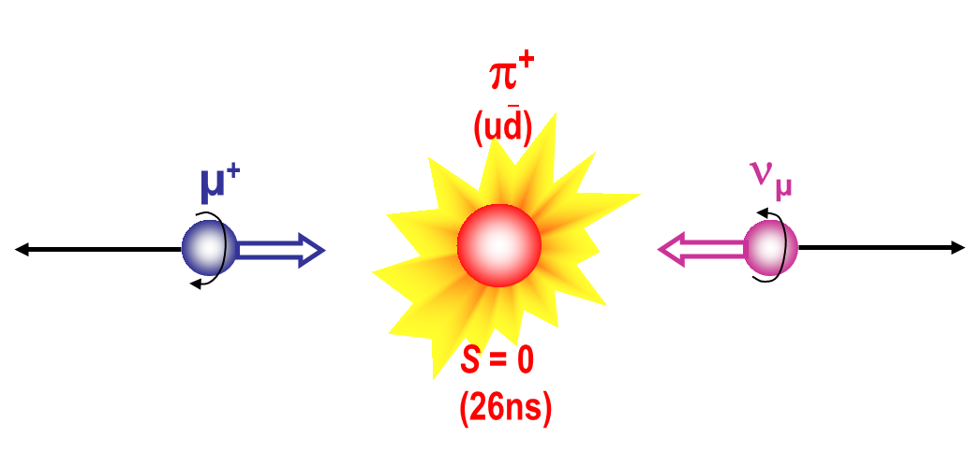
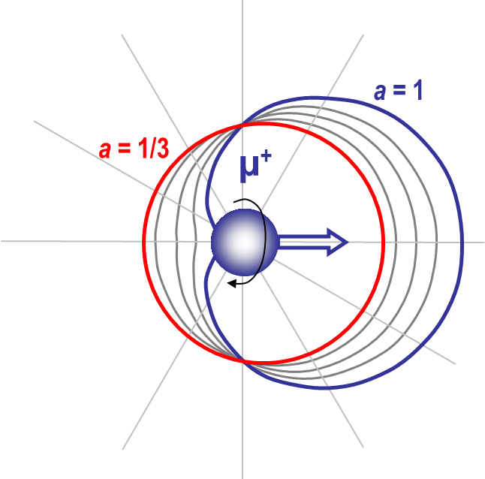

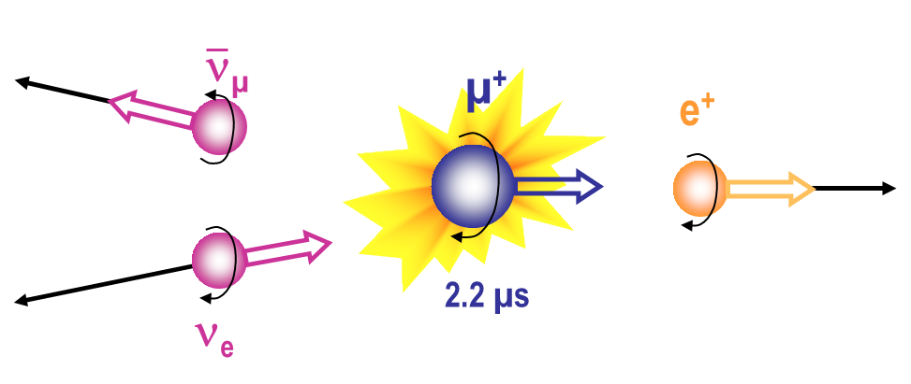
Parity Violation is at the Heart of μSR
1st step:
100% polarized muon, i.e. P=1
(NMR: P ≈ 10⁻⁵)
φ
2nd step:
Positrons preferentially emitted
along the direction of
muon spin at decay time

Slide 8
Surface Muons Stopping in Matter
Muon
Production
Surface Muons
Energy: 4.1 MeV
v ≈ 0.27 c
Ionization of atoms
10⁵ – 10⁶ excess e–
2-3 keV
v ≈ 0.007 c
Total stopping time in
matter < 0.1 ns
Only electrostatic processes
→ no loss of polarization!
Penetration ≈ 0.1 mm
Sample
Muonium formation (μ⁺e–)
charge cycling
100 eV
v ≈ 0.0013 c
mainly elastic collisions
(dissociation, μ⁺e– → μ⁺)
stop typically at
an interstitial site
Low Energy Muons:
much less excess electrons
Penetration ≈ 1 – 200 nm
thermalized μ⁺

Slide 9
Different Energies for Different Studies
Cu
Cosmic muons
Bulk µSR:
“Normal” samples (sub-mm)
Bulky samples or samples in containers or pressure cells
LE-µSR:
Depth-selective investigations (1–200 nm)
Decay beam
Bulk µSR
Surface beam
LE µSR

Slide 10
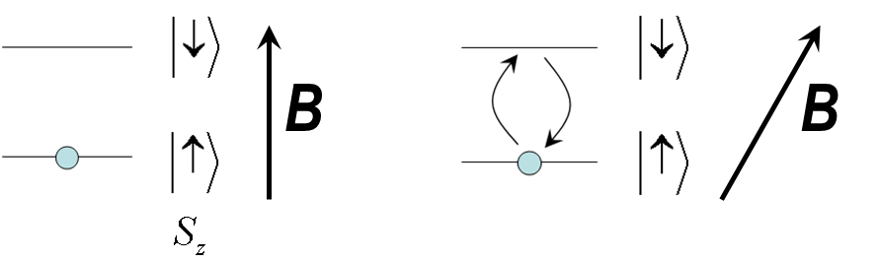
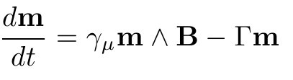


Muon Spin Precession – Bloch Equation
Left side:
S_{z} is an eigenstate and hence
nothing happens.
(spont. emission rate at 10T: 10⁻¹²sec)
Right side:
S_{z} is NOT an eigenstate and hence
the state due mix → precession
Ehrenfest
Theorem
B
m
Bloch Equation
θ
Larmor frequency
Dissipation due
to a heat bath

Slide 11
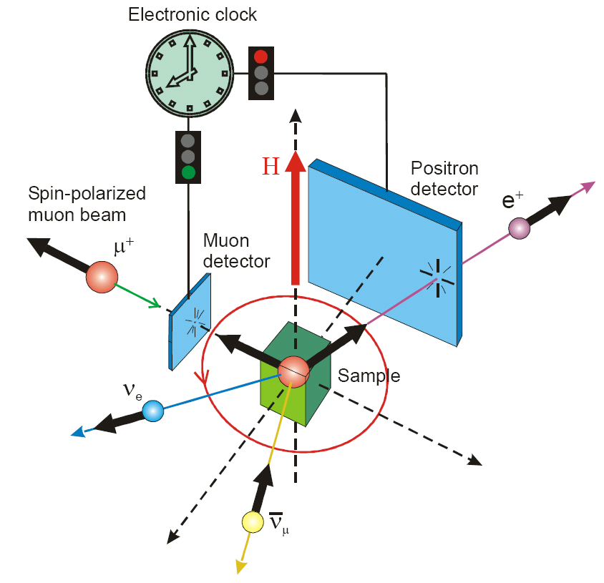
Principle Setup for Time Differential μSR
B_{μ} internal or external field
B_{µ}
G(t) contains the physics

Slide 12
μSR Spectra
Frequency  Value of field
at muon site
Damping  Field distribution
aG(t) ~ Muon Spin Polarization

Slide 13
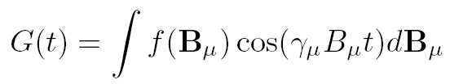
μSR Spectra - Fourier
f(B_{µ})
<B_{µ}>
B_{μ}
θ angle between magnetic field and muon polarization at t = 0
By choosing θ = 90°, one obtains:
θ
P(0)
P(0) cos²θ
P(0) sin²θ cos(γ B_{μ} t=0)

Slide 14
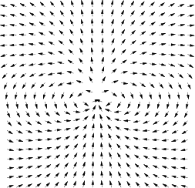

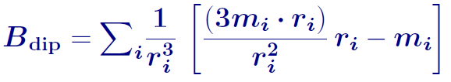



μSR: Time Window and Sensitivity
m
Internal field at the muon site:
µSR time window: 10-20 µsec
 Frequencies down to 50 kHz detectable
Fields of few Gauss
Distributions of few tens of a Gauss
(perfect earth field compensation required!!)
contact field
 static moments as low as 0.001 μ_{B}
can be detected by μSR

Slide 15

μSR: Magnetic Volume Fraction
Homogenous
Inhomogenous
Amplitude = Magnetic Volume Fraction
Frequency = Value of the field at the muon site
Damping = Magnetic field distribution

Slide 16
μSR Techniques
Zero-Field / Longitudinal Field (ZF / LF),
B parallel to the muon spin
LF: distinguish between static and
dynamic contributions
Transverse Field (TF)
B perpendicular to the muon spin
→ precession
Avoided Level Crossing (ALC)
B parallel to the muon spin
→ spin flip and spin flip-flop transitions
Radio Frequency-µSR (RF-µSR)
time-differential µSR
N_{i}(t) = N_{i}(0)exp(-t/t_{µ})[1+aG(t)] + Bkg
(ZF, LF, TF, RF-µSR)
time-integral µSR
N_{i} = ∫ N_{i}(t) dt
Forward-Backward asymmetry
(F-B)/(F+B)= ∫e^{-st} aG(t) dt, s=1/t_{µ},
Laplace transform of aG(t)
(LFQ, ALC, RF-µSR)

Slide 17

Muon Beam Time Structure
Triumf
ISIS
324 ns
FWHM
68 ns
(26ns)
(26ns)
(26ns)
(26ns)
20 ms
20 ms
26ns wide pulses every 43ns
double pulse structure
every 5th pulse missing (goes to TS2)
PSI
J-Parc
600 ns
FWHM
65 ns
26ns wide pulses every 20ns
40 ms
40 ms
double pulse structure
with gaps to fill the 50GeV ring

Slide 18
Difference between CW and Pulsed Beams
Continuous Muon Beams
Pulsed (50Hz) Muon Beams
Very good time resolution
(down to ~60 ps)
→ Detection of large magnetic fields
→ Detection of fast relaxing signals
No negligible background
(this can be improved by MORE)
Reduction of the muon rate
to avoid “pileup”
Very low background
→ measure slow relaxation
High muon rates possible, but this
requires highly segmented detector systems
Limited time resolution (~ 10-20 ns)
→ Detection of large magnetic fields and/or
fast relaxing signals impossible

Slide 19
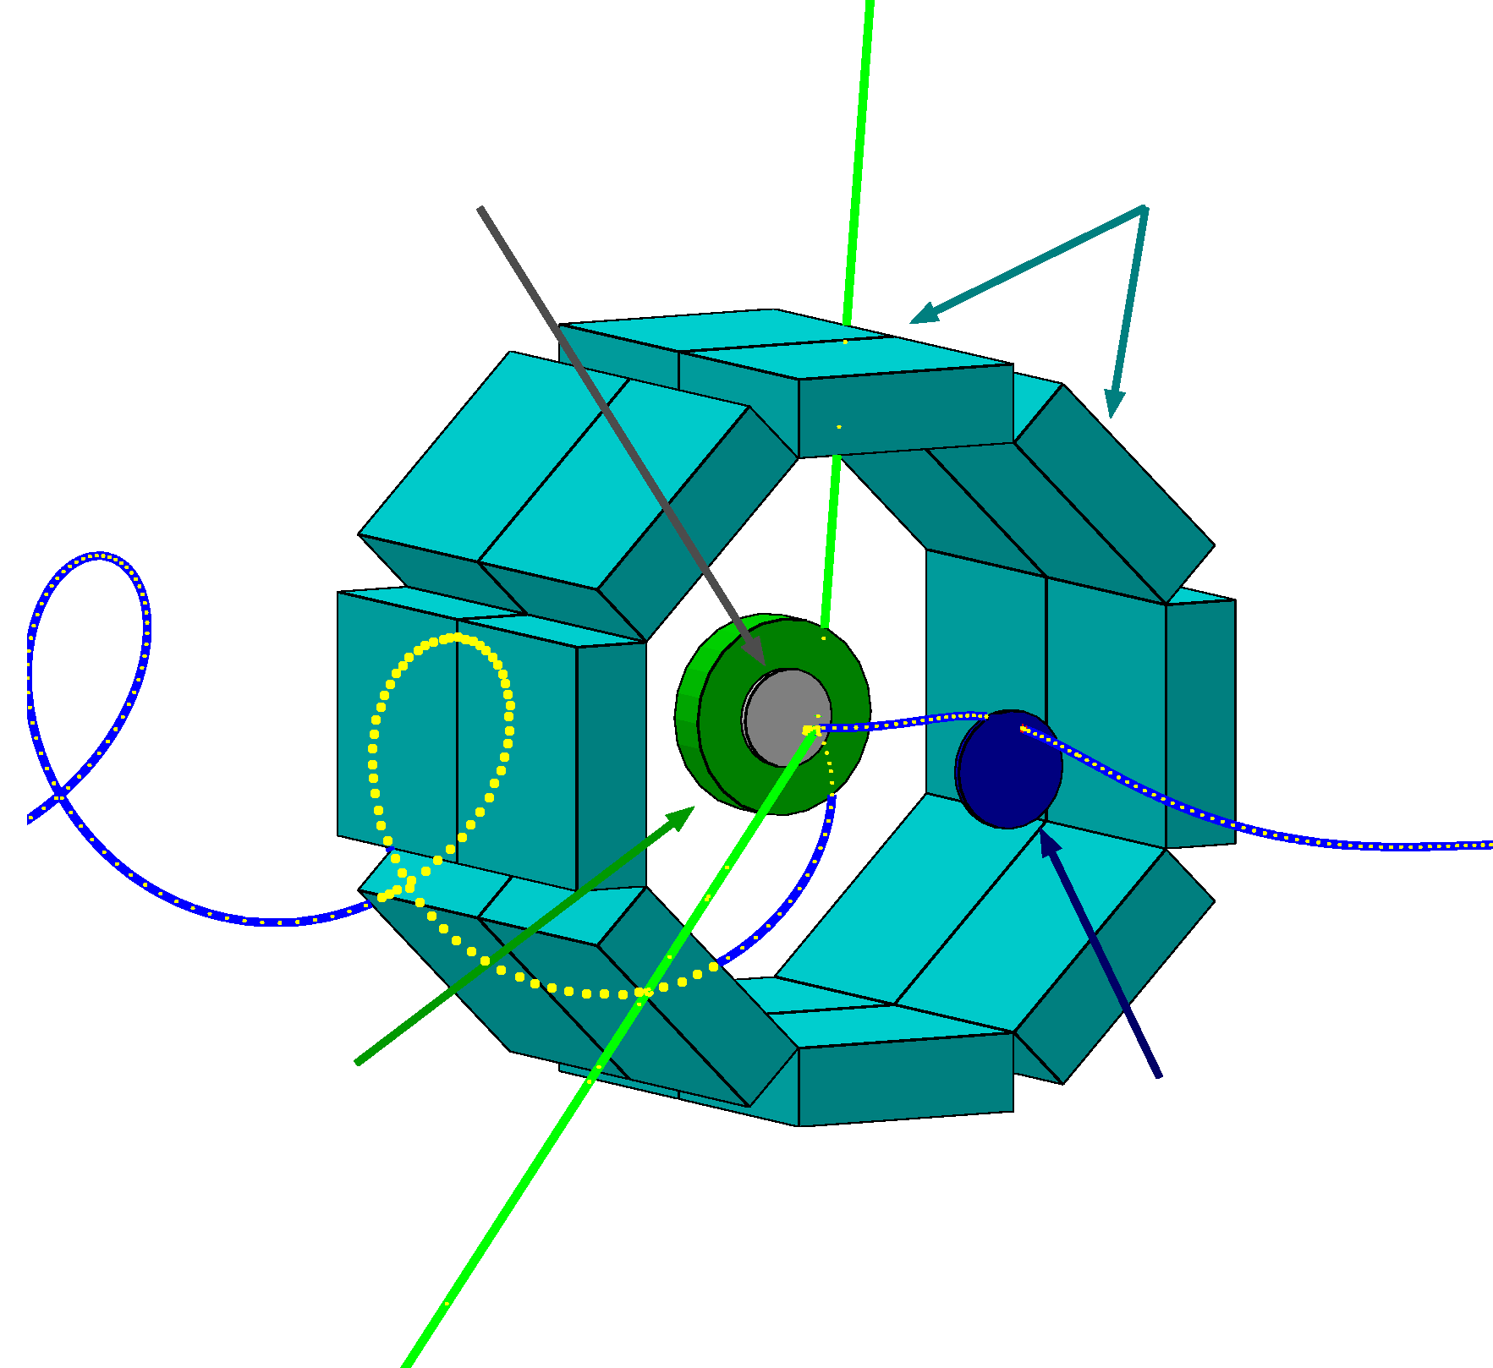
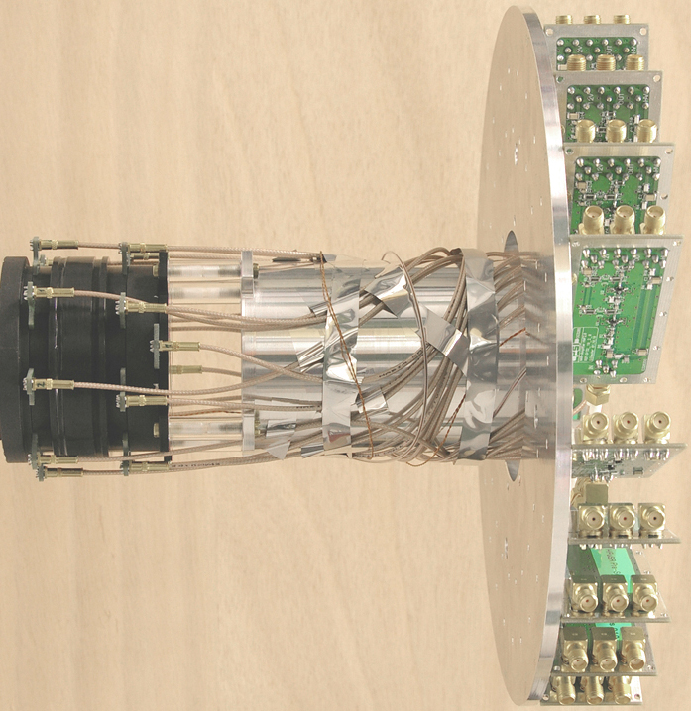
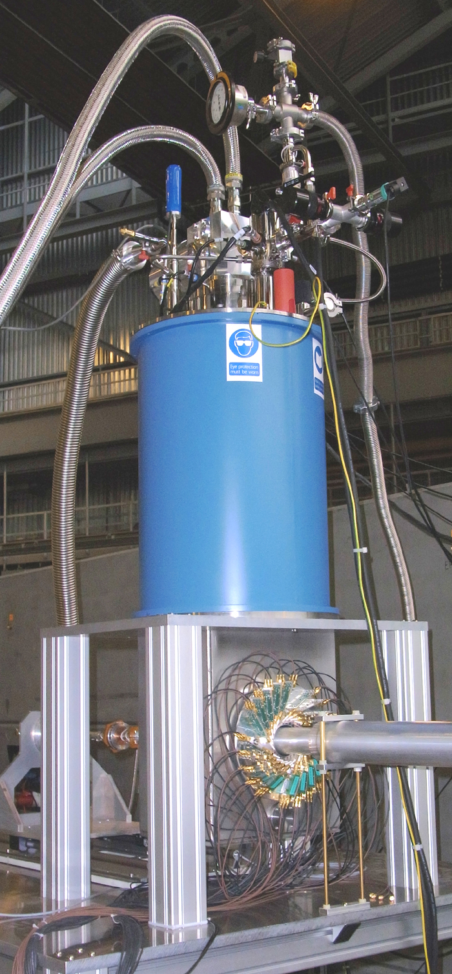
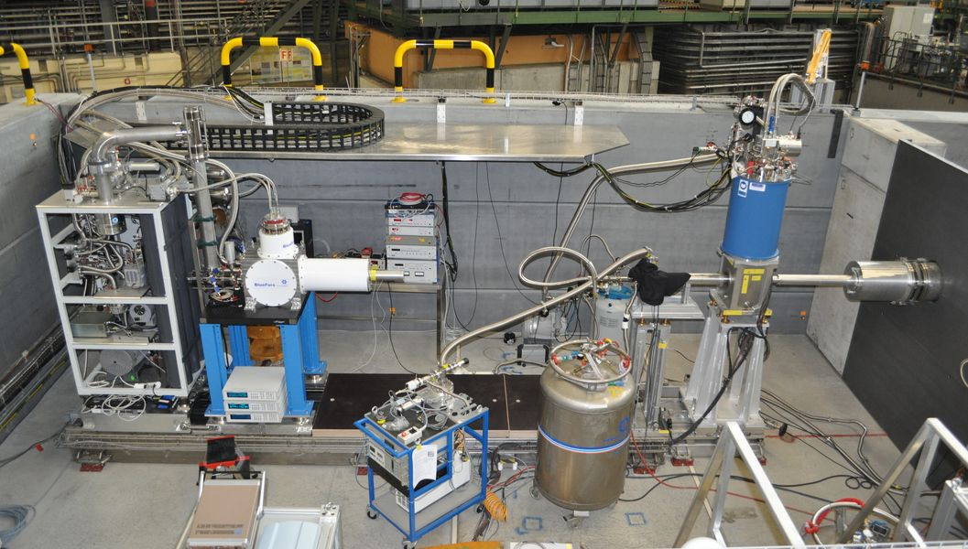
What means good timing? The High Field Instrument at PSI
ν
Oxford Instruments 8 / 9.5T
Recondensing System
Sample
Scintillators
APD Spectrometer
Ø 32mm
e⁺
μ⁺
Veto
counter
Muon
counter
A. Stoykov et al. Physics Procedia 30, 7, (2012)
http://lmu.web.psi.ch/facilities/facility.html
Notes:
TDC V1290A Caen
CFD950 PSI

Slide 20
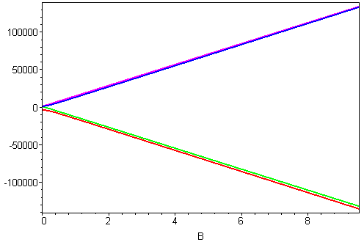
What means good timing? The High Field Instrument at PSI
Mu
1
2
ν₁₂
E/ħ (MHz)
ν₃₄
3
4
B (T)
Muonium in synthetic quartz crystal @ 8.0T
→ Time resolution from amplitude ratios

Slide 21
Typical Research Fields of μSR
Magnetism
Superconductivity
Semiconductor Physics
Chemistry

Slide 22
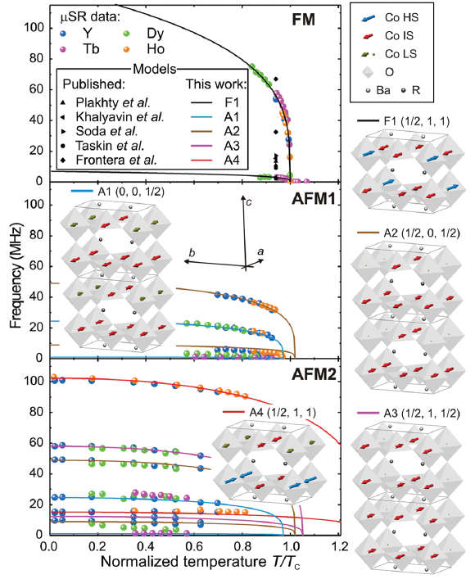
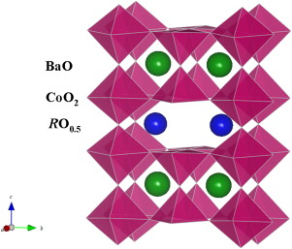
Typical Research Fields of μSR
ZF-μSR on YBaCo₂O_{5.49}
Magnetism
Superconductivity
Semiconductor Physics
Chemistry
Spin State Ordering in RBaCo₂O_{5.5} / Luetkens et al. PRL101, 017601 (2008)

Slide 23
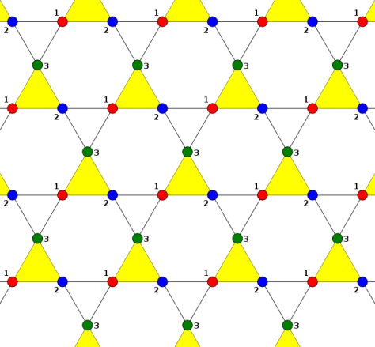
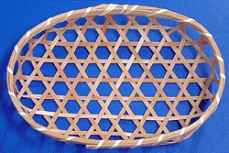
Typical Research Fields of μSR
Magnetism
Superconductivity
Semiconductor Physics
Chemistry
x=1
?
AF
AF
AF
Frustrated magnets: Twoards an Ideal Kagomé Lattice Zn_{x}Cu_{4-x}(OH)₆Cl₂
P. Mendels et al. PRL98, 077204 (2007)

Slide 24
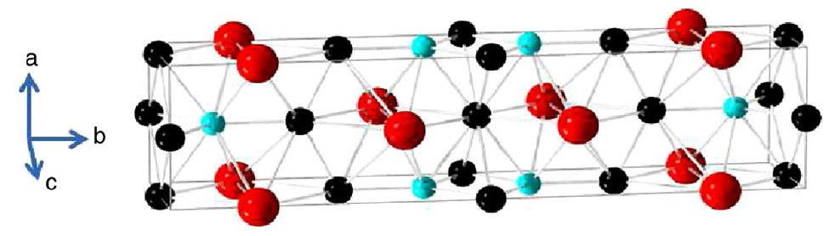
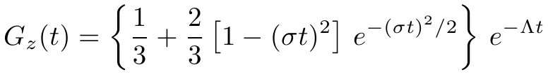
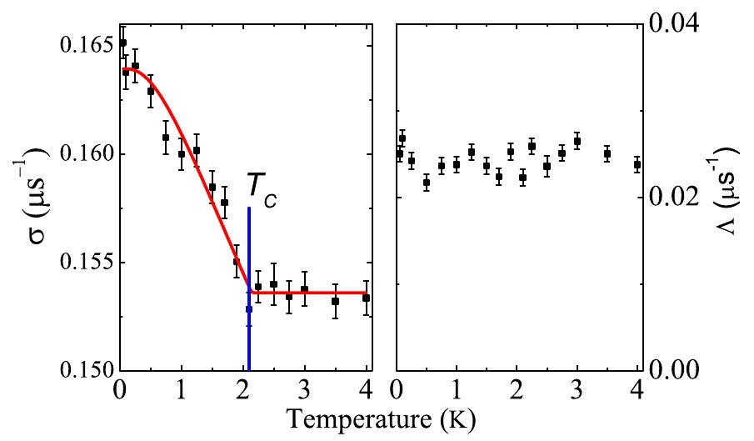
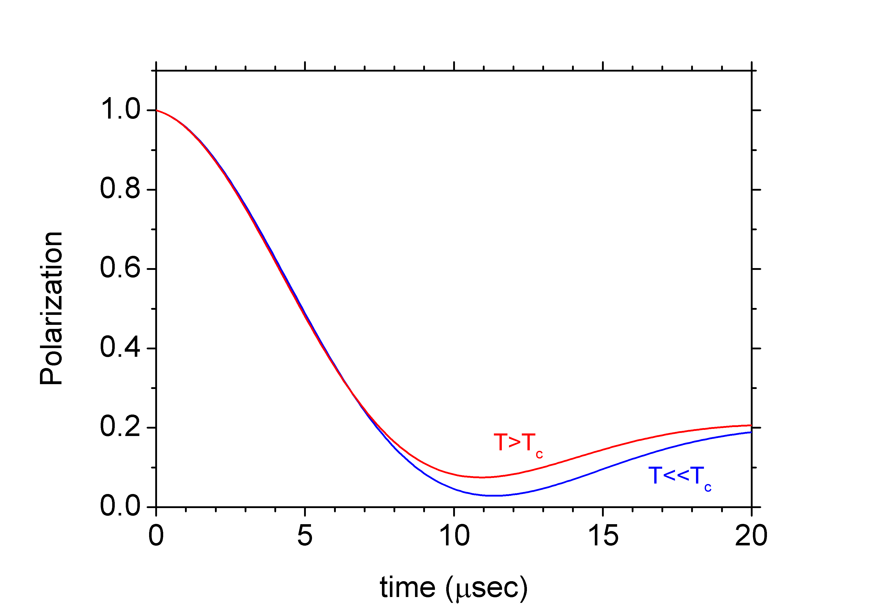
Typical Research Fields of μSR
Magnetism
Superconductivity
Semiconductor Physics
Chemistry
Exotic Superconductivity: Nonunitary Triplet Pairing in the
Centrosymmetric Superconductor LaNiGa₂
A.D. Hillier et al. PRL109, 097001 (2012).

Slide 25
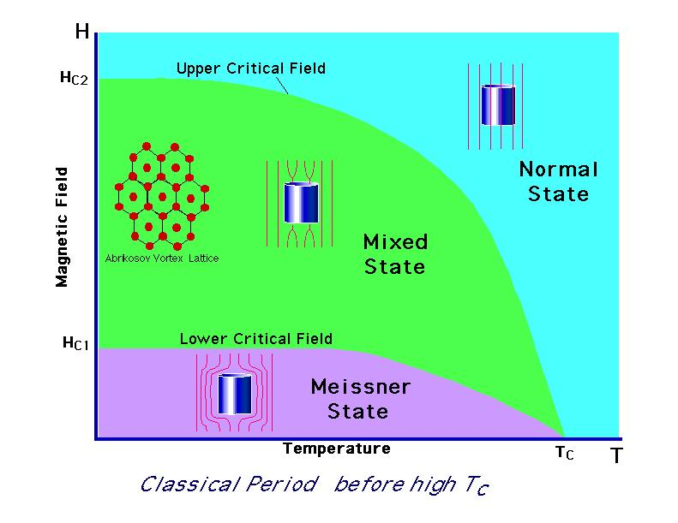
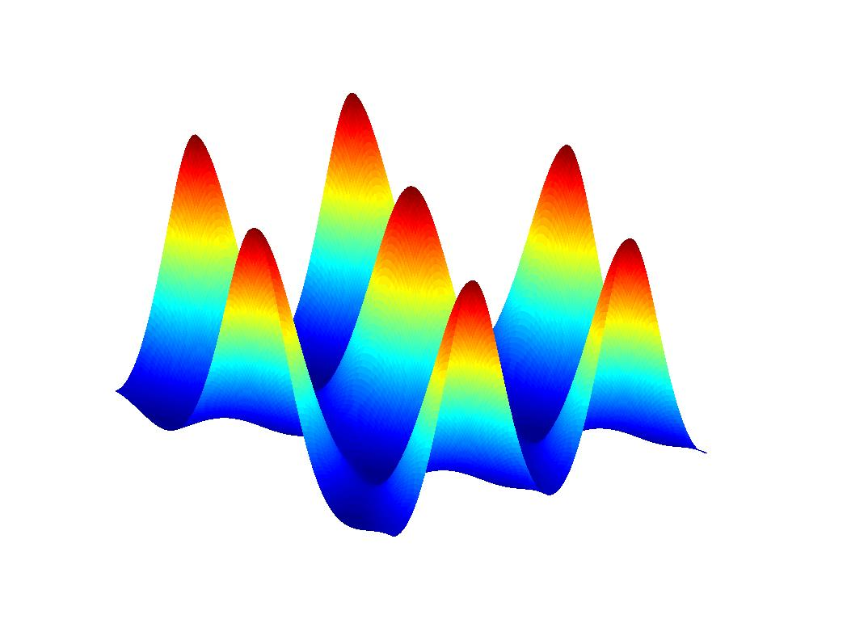
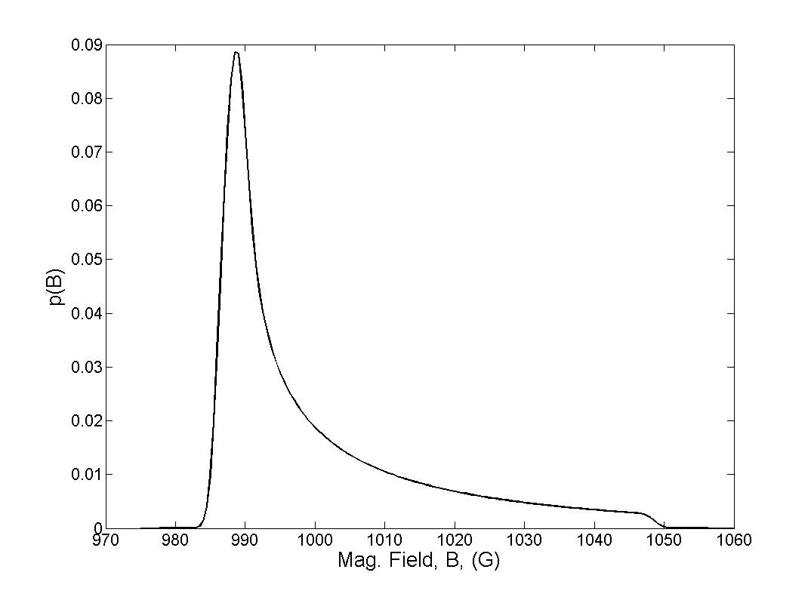
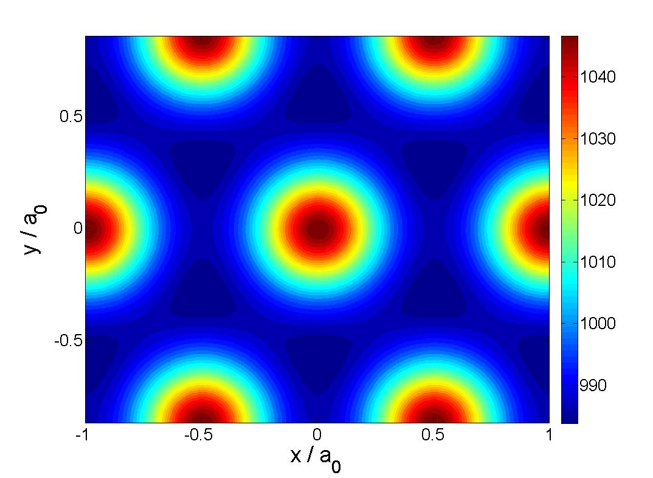
Typical Research Fields of μSR
Magnetic Field Distribution
due to Vortices
Magnetism
Superconductivity
Semiconductor Physics
Chemistry
B_{ext}
B_{ext}

Slide 26
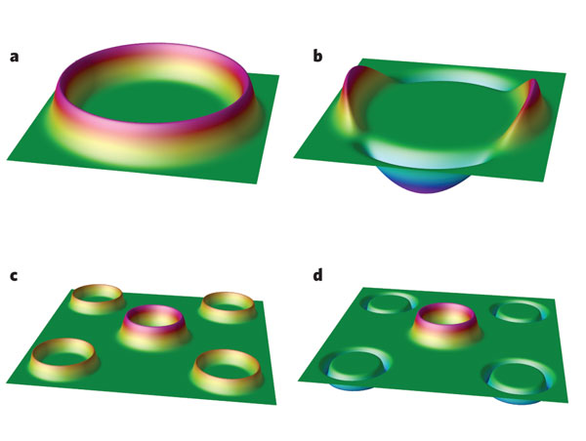
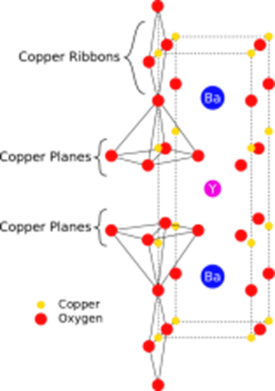
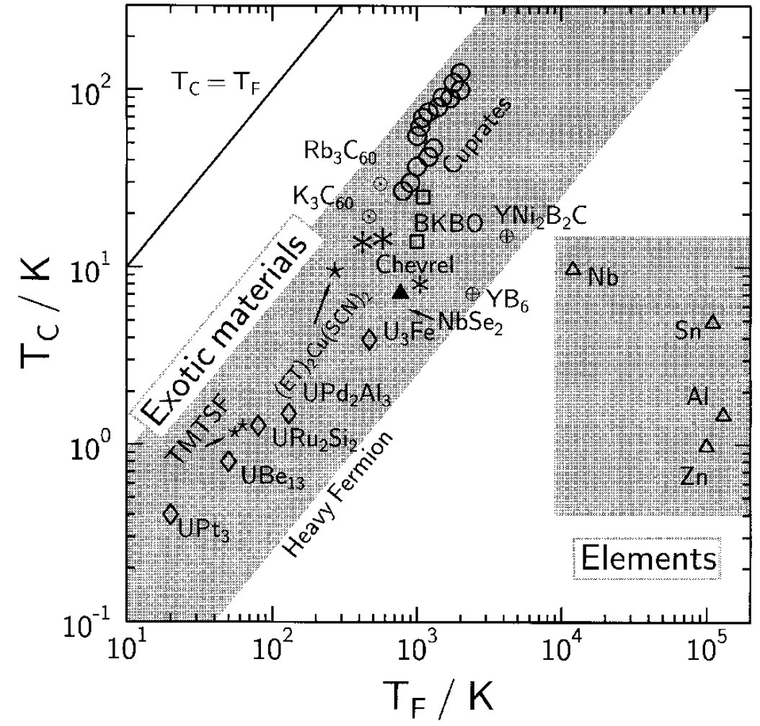
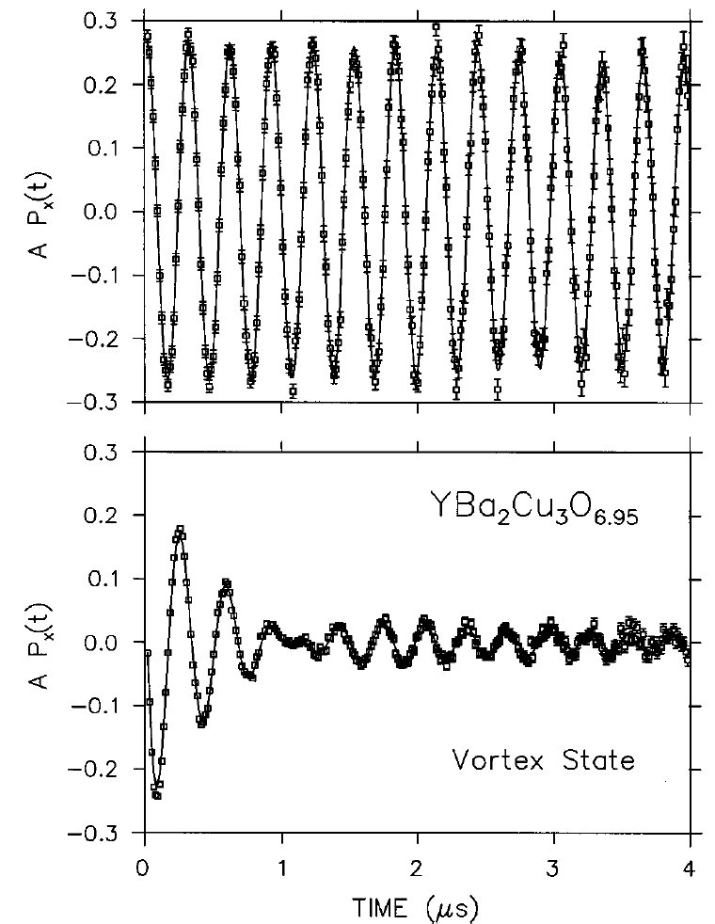
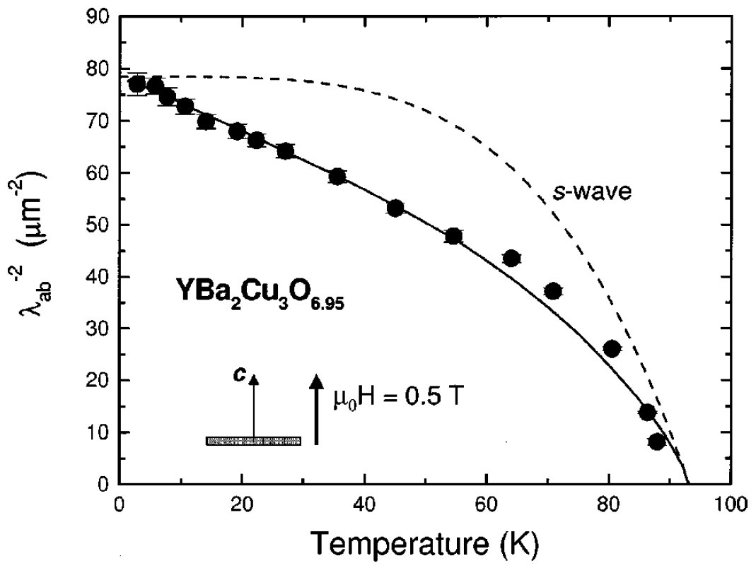
Typical Research Fields of μSR
s-wave
Magnetism
Superconductivity
Semiconductor Physics
Chemistry
T>T_{c}
T<T_{c}
d-wave
Uemura et al. PRL66, 2665 (91)
damping, σ
→ magnetic penetration depth, λ (via theory)
→ Uemura plot: classification of superconductors
μSR studies of the vortex state in type-II superconductors, J.E. Sonier et al., RMP 72, 769 (2000)

Slide 27
Typical Research Fields of μSR
C.G. Van de Walle & J. Neugebauer, Nature 423, 626 (2003)
Magnetism
Superconductivity
Semiconductor Physics
Chemistry
Universal alignment of hydrogen levels in semiconductors, insulators and solutions
E.A. Davis et al., APL82, 592 (2003)

Slide 28
Typical Research Fields of μSR
Magnetism
Superconductivity
Semiconductor Physics
Chemistry
static
Pol.
Dynamics of Muoninated C₆H₆Mu
Roduner et al., J. Phys. Chem. A 102, 7591 (1998)
Notes:
Delta0: muon-proton spin flip-flop
Delta1: muon spin flip
Delta2: muon-proton spin flip-flip

Slide 29
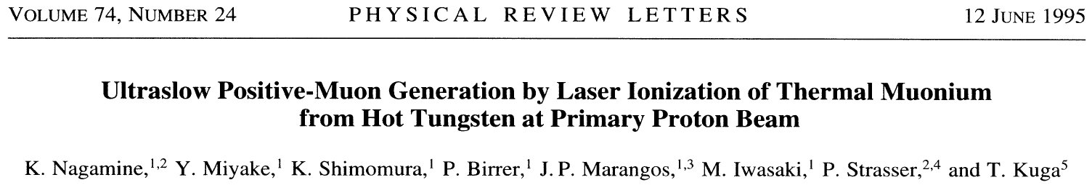
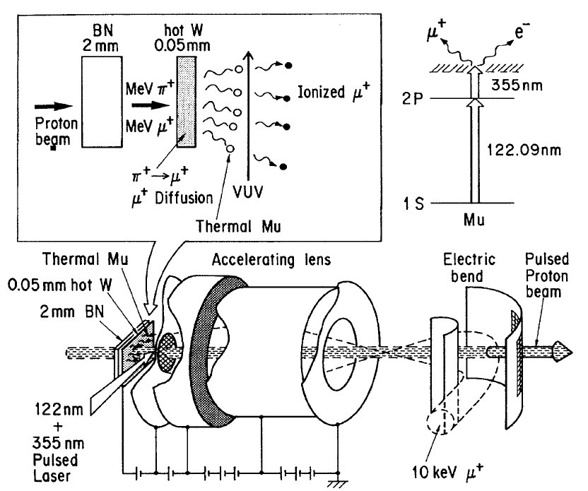
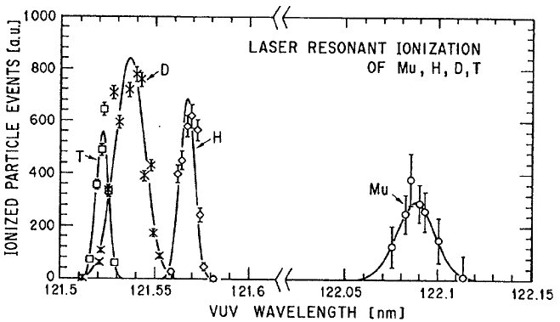
Generation of Thermal μ⁺ at a Pulsed Muon Beam
Pulsed beam (25Hz) @ RIKEN-RAL:
Intensity: ~15 LE-μ⁺/sec
Polarization: ~50%
Beam Spot: 4mm
P. Bakule,Y.Matsuda,Y.Miyake, K. Nagamine, M. Iwasaki,
Y. Ikedo, K. Shimomura, P. Strasser, S. Makimura
Nucl. Instr Meth. B 266, 335 (2008)

Slide 30
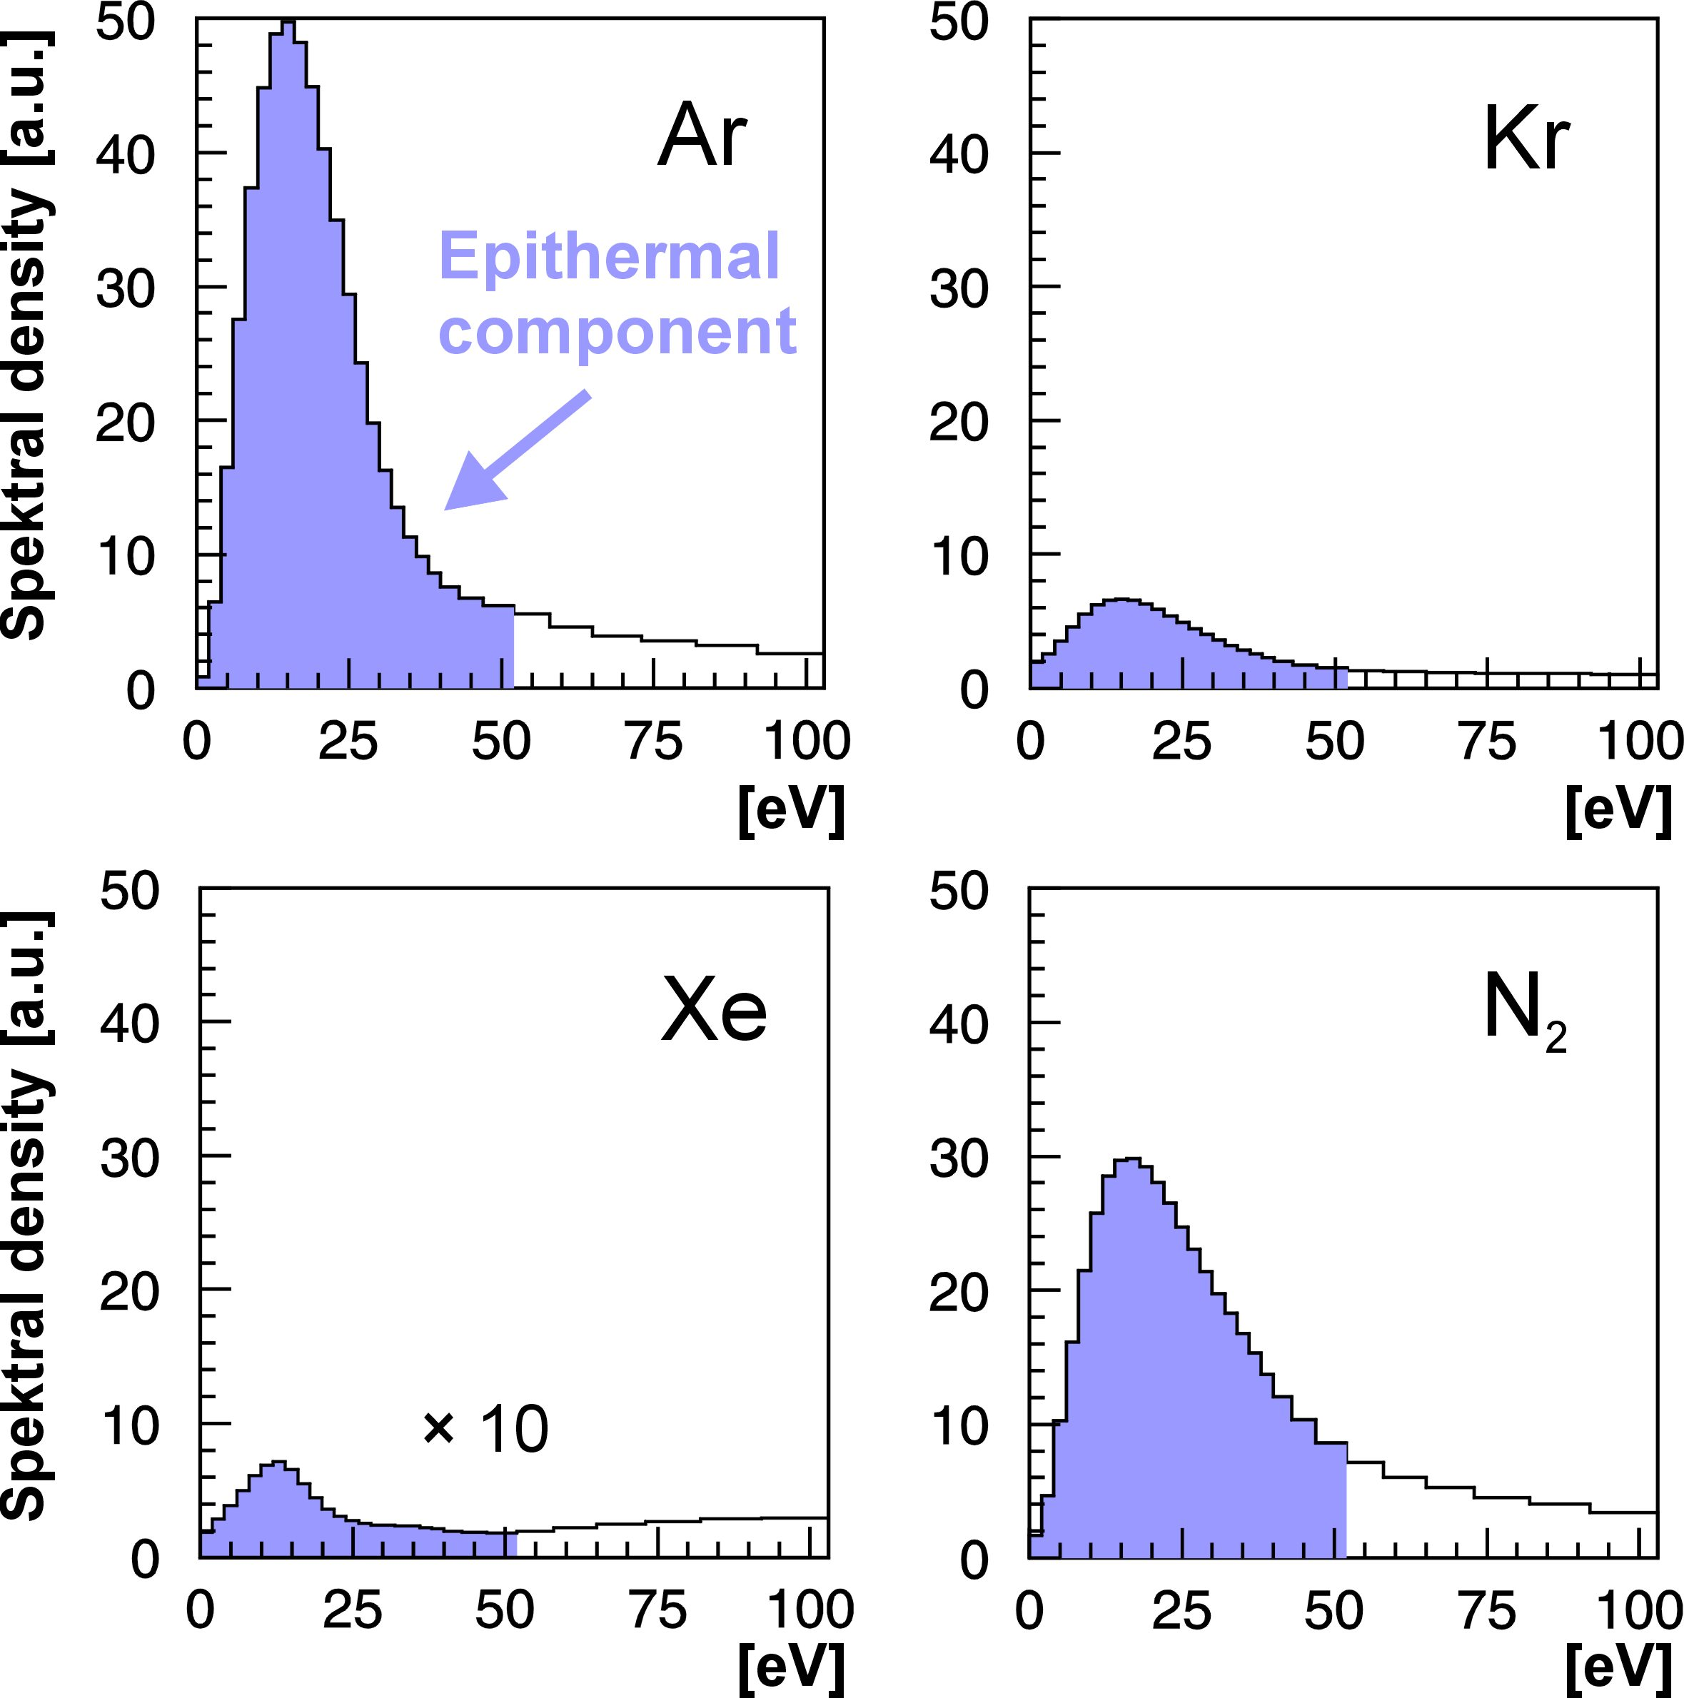
Generation of Polarized Epithermal μ⁺
„Surface“
Muons
∼ 4 MeV
∼ 100% polarized
∼100 μm Ag
∼ 500 nm
s-Ne, Ar,
s-N₂
6 K
motivated by experiments for positron moderation
T. Prokscha et al., Appl. Surf. Sci. 172, 235 (2001).
T. Prokscha et al., Phys. Rev. A58, 3739 (1998).
E. Morenzoni et al,. J. Appl. Phys. 81, 3340 (1997).
D. Harshmann et al., Phys. Rev. B36, 8850 (1987).

Slide 31
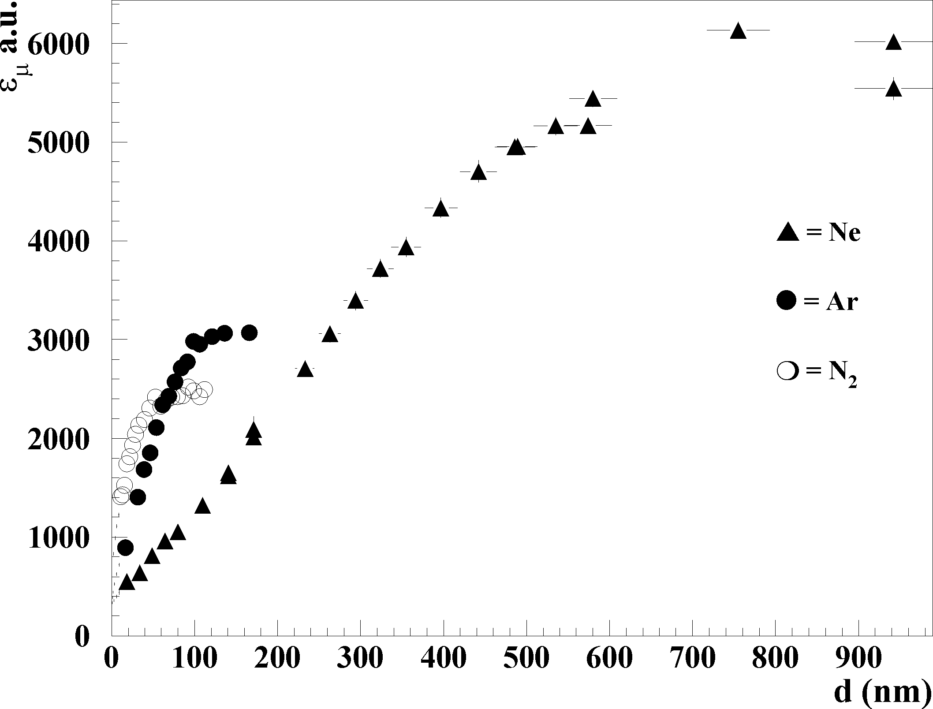
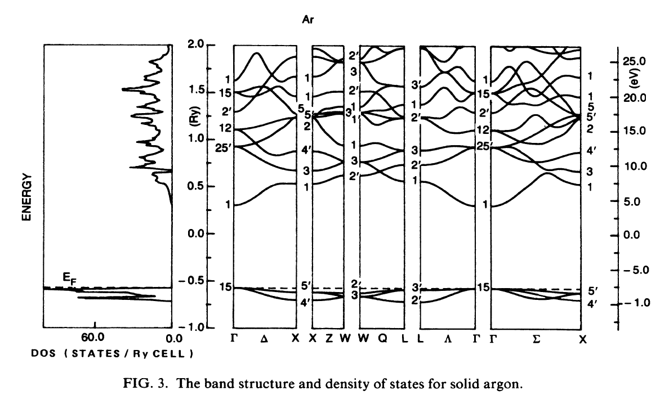
Characteristics of Epithermal μ⁺
Efficiency [a.u.]
E_{g}
Layer Thickness [nm]
AP(t)
suppression of electronic energy loss for E<E_{g} (E_{g} ~ 10-20eV)
large escape depth L~ 50-200nm
moderation efficiency:
no loss of polarization during the moderation
P(0) ≅1
time [μsec]
E. Morenzoni, et al. Phys.Rev.Lett. 72, 2793 (1994).

Slide 32
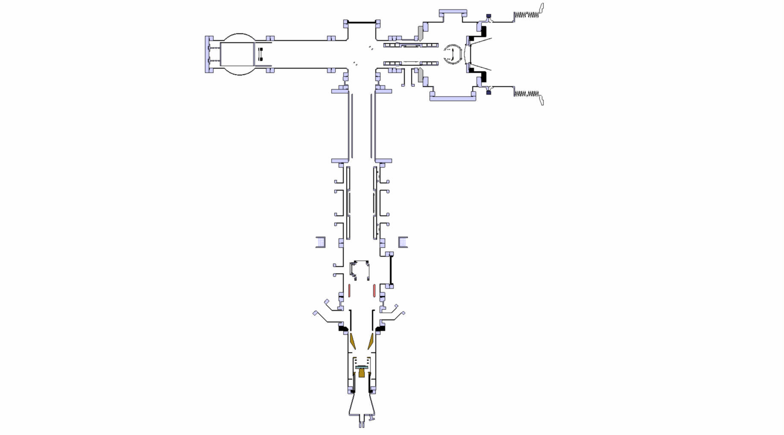
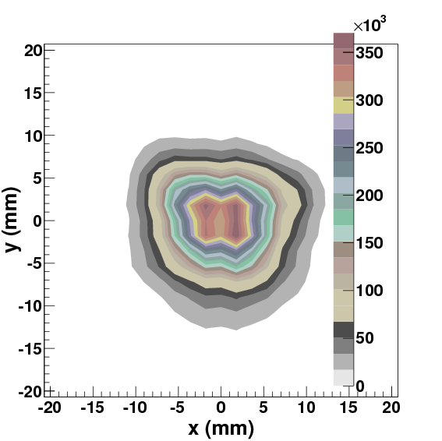
Low Energy μ⁺ Beam and Setup for LE- μSR
Surface μ⁺ beam
≈ 4MeV
≈ 1.7 ∙ 10⁸ μ⁺/sec
Spin
Polarized Low Energy Muon Beam
Energy: 0.5 - 30 keV
ΔE, Δt: 400 eV, 5 ns
Depth: ≈ 1 – 300 nm
Polarization: ≈ 100 %
Beam Spot: 10-20 mm
≈ 1.1 ∙ 10⁴ μ⁺/sec
accelerate up to
20keV
UHV chambers, 10⁻¹⁰ mbar
All transport elements LN₂ cooled
Beamspot at the
sample position
≈ 4500 μ⁺/sec
T = 2.5 – 320 K
B = 0 – 0.3 T

Slide 33








Low Energy μ⁺ Beam and Setup for LE-μSR
Spin-Rotator / Separator
Sample Cryo
Muon Spin
Muon Momentum
E-Field
B-Field
Moderator
low energy μ⁺
source
Trigger
implantation time
Mirror
energy filter

Slide 34

μE4 Beamline at PSI
At 2 mA proton current:
≈ 4.0 ∙ 10⁸ μ⁺/s total, Δp/p = 9.5% (FWHM) ≈ 1.7 ∙ 10⁸ μ⁺/s on LEM moderator
T. Prokscha, E. Morenzoni, K. Deiters, F. Foroughi,
D. George, R. Kobler, A. Suter and V. Vrankovic
Nucl. Instr. Meth. A 595, 317 (2008).

Slide 35

Meissner State Measurements
B(z)
Superconductor
in the Meissner State
B_{ext}
λ
z
0

Slide 36



keV μ⁺ Stopping Profiles in Matter
YBa₂Cu₃O_{7-δ}
E. Morenzoni et al., Nucl. Instr. and Methods B 192, 254 (2002 )

Slide 37

Absolute Determination of the Magnetic Penetration Depth
A. Suter et al., PRB 72, 024506 (2005).

Slide 38




Example: Anisotropy of the Meissner State in YBa₂Cu₃O_{6.95}
samples produced by
R. Liang, W. Hardy, D. Bonn, Univ. of British Columbia
← effective mass
← superfluid density
Allows to measure the temperature
dependence of n_{S} (T), and hence, i.e.
the gap symmetry.

Slide 39







Example: Anisotropy of the Meissner State in YBa₂Cu₃O_{6.95}
100 K
8 K, 14.1 keV
8 K
at low T for a d-wave SC:
λ_{a} = 126(1.2)nm, λ_{b} = 105.5(1.0) nm, λ_{a}/λ_{b} =1.19(1)
R.F. Kiefl et al., PRB 81, 180502(R), (2010).

Slide 40



Fermilab Nb Cavity Meissner Screening
Clear difference of the Meissner response
between cold and hot parts!

Slide 42




Spatially homogeneous ferromagnetism of (Ga,Mn)As
Mn-doped GaAs potential ‘spintronics’ material
great interest in fundamental research:
evolution from a paramagnetic insulator to ferromagnetic metal
controversy if FM is associated with intrinsic spatial inhomogeneity
Low-energy µSR (in combination with conductivity and DC/AC magnetization) results:
sharp onset of FM order, developing homogeneously in the full volume
fraction, in both insulating and metallic films.
smooth evolution of ordered moment size across metal-insulator transition
at x ~ 0.03
FM coupling between Mn before full emergence of itinerant hole carriers
muon decay asymmetry (10 mT TF top) and zero field (ZF) relaxation rate (bottom) as a function of temperature and doping
S.R. Dunsiger, et al., Nature Materials 9, 299 (2010).

Slide 43


Dimensionality Control of Electronic Phase Transitions
Motivation
Dimensional tuning of collective electronic phases in order to stabilize new phases.
LaNiO3 is a correlated metallic paramagnet down to the lowest temperatures,
whereas RNiO3 are typically showing a metal-insulator transition, accompanied by
a magnetic phase transition, e.g. NdNiO3. Hence LaNiO3 is an interesting case.
Results
LaNiO₃/LaAlO₃ N=4 superlattices are
similar to LaNiO₃ bulk.
LaNiO₃/LaAlO₃ N=2 superlattices show
a metal-insulator transition, and at lower
temperature a magnetic phase transition
(likely to be antiferromagnetic).
Contrary to bulk, T_{MI} ≠ T_{N}.
Strain is NOT the driving mechanism
since both superlattices grown on
LaSrAlO₄ or SrTiO₃ substrates show a
similar behaviour.
A.V. Boris et al., Science 332, 937 (2011).

Slide 44



Measuring the Spin-Diffusion Length in a Functional Organic Spin Valve
Motivation / Questions
Organic semiconductors are very
promising candidates for spintronic
devices (cheap, flexible, long spin
coherence times).
Is it possible to measure the
spin–diffusion length in an operational
device, i.e. within buried interfaces?
Results
Measurement of the spin-diffusion
length in an operational device is
possible.
In principle, the spin-diffusion length
can be related to the
magneto-resistance.
A.J. Drew et al., Nature Mater. 8, 109 (2009).

Slide 45




La_{2-x}Sr_{x}CuO₄ Heterostructures – Giant Proximity Effect
entire ‘barrier’ layer of thickness d much larger than typical c-axis coherence exhibits Meissner effect for temperatures well above T_{c}’
Supercurrents flow in c-direction and ab-planes.
Results:
The measured Meissner screening is not
expected within conventional proximity effect
theory and constrains the theory of HTS and
our understanding of the pseudogap phase.
E. Morenzoni, et al., Nat. Commun. 2, 272 (2011).

Slide 46



Cold Muonium Source
Thermalized Muonium from mesoporous
thin SiO₂ films.
At T=250K, >2 x more than from
SiO₂ powder at room temperature
Allows cw laser spectroscopy of 1S-2S
interval from which the muon mass can
be determined ≈ 1 order of magnitude
more precise than previously measured.
A. Antognini et al., PRL 108, 143401 (2012).

Slide 47



Low Dimensional Magnetism – La_{2-x}Sr_{x}CuO₄ Superlattices
A. Suter et al., PRL 106, 237003 (2011).
A few-unit-cells thick LaCu₂O₄ layers synthesized
by MBE are antiferromagnetically ordered. Below a
thickness of about 5 CuO₂ layers the long-range
ordered state breaks down, and a magnetic state
appears with enhanced quantum fluctuations and
a reduced spin stiffness.

