Slide 1
Possibilities with the Fermilab Muon Campus
Chris Polly
Project X Muon Spin Rotation Forum
October 18, 2012

Slide 2
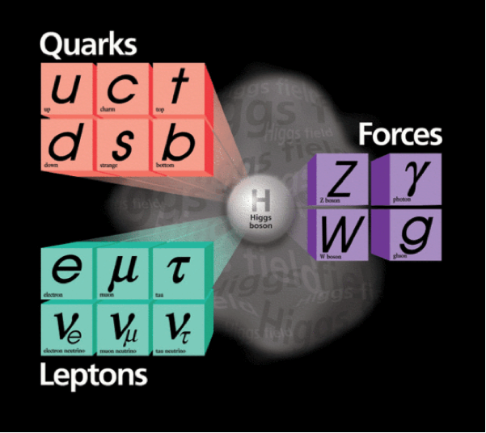
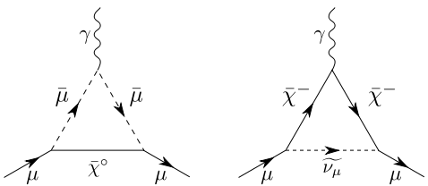
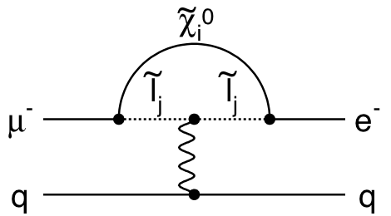
Muons and the intensity frontier
Muons can be extremely good probes of the Standard Model
  Can be produced copiously
  BR(π±→μ± ν)=99.9877%
  No confinement considerations
  Relatively long life time 2.2 μs
  Relatively heavy (m_{μ}/m_{e})² = 40000
Planning to develop a program at Fermilab based on muons
  Muon g-2 (data ~2016)
  Mu2e (data ~2019)
  Future possibilities include muon EDM, other CLFV channels, muon collider R&D, or even a surface muon beam for basic or applied physics
2
Chris Polly, Project X muSR Forum, October 18, 2012

Slide 3
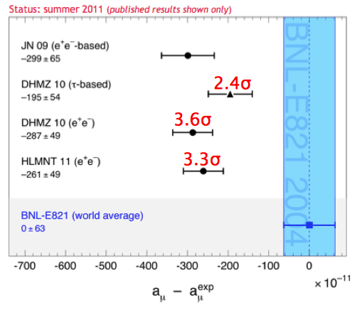
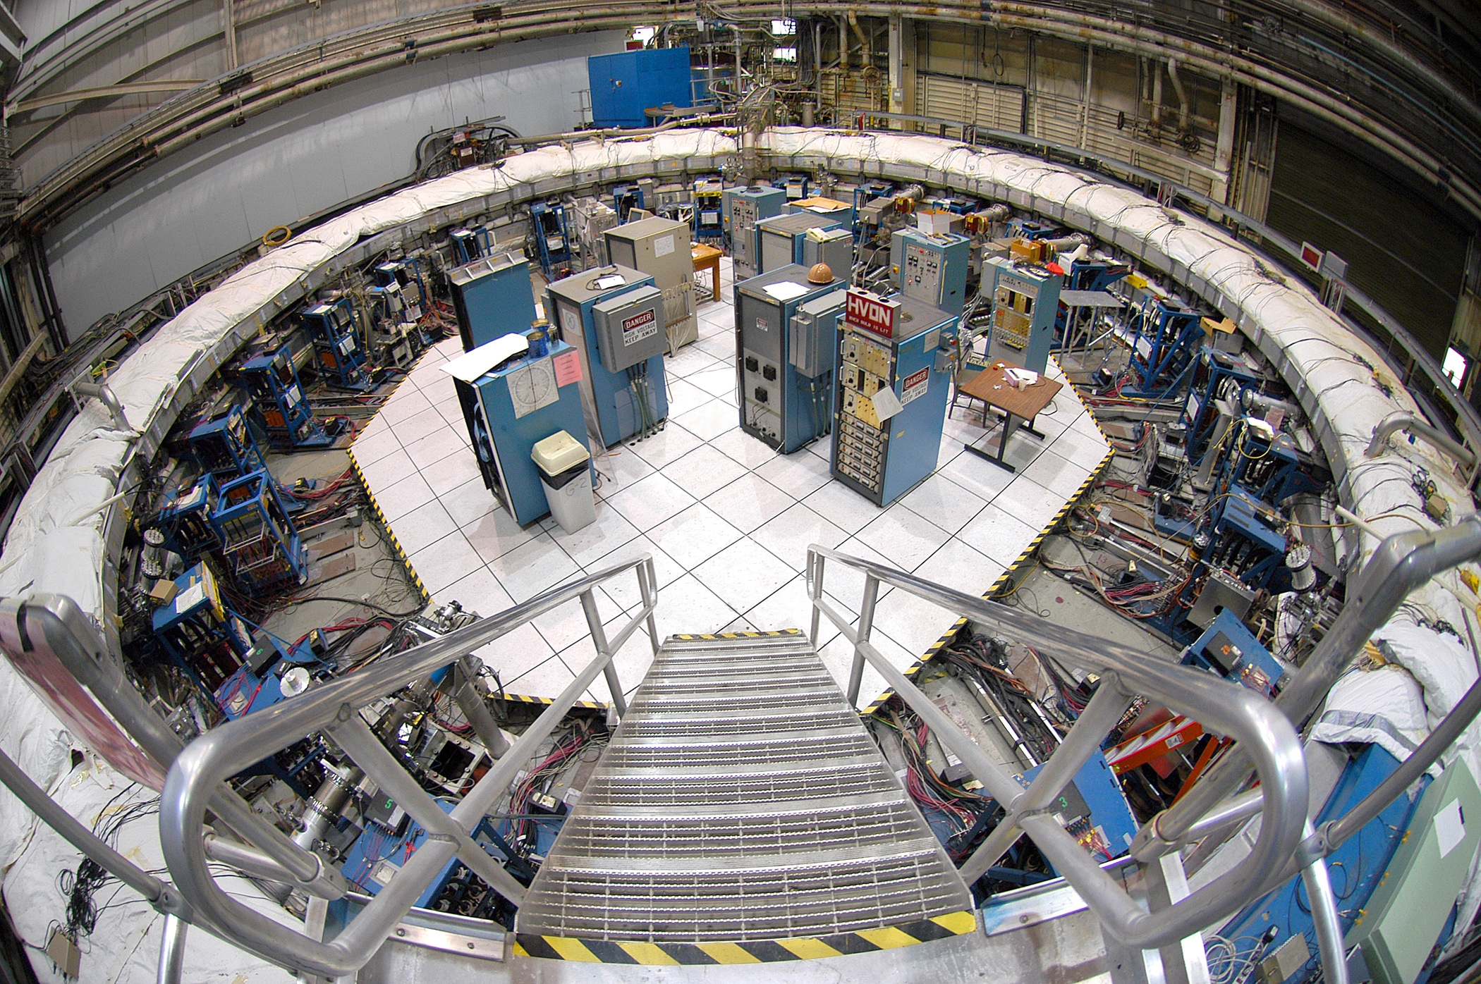
Muon g-2 at Fermilab
Goal of E989...bring the apparatus from BNL to FNAL and improve the experimental precision x 4-5
  High physics merit, BNL expt stat-limited, citations > 2000
  Reuse of BNL experiment apparatus fairly low risk & short timeline
  Unique possibility at FNAL due to available infrastructure post-Run II
If the current discrepancy persists,
reducing the exp error to 16 x 10⁻¹¹
⇒ 5.6σ discovery
arXiv:1010:4180
3
Chris Polly, Project X muSR Forum, October 18, 2012

Slide 4
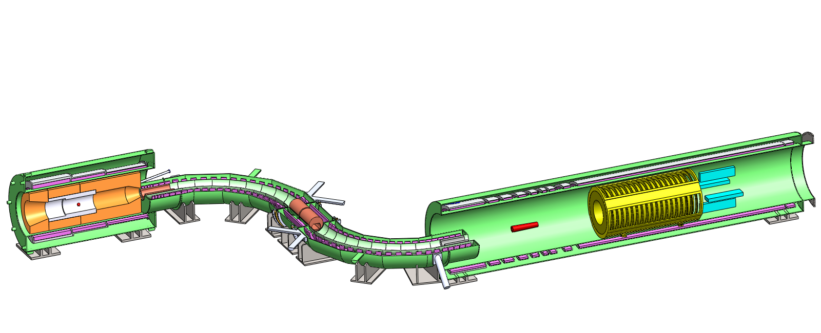
Mu2e at Fermilab
Mu2e goal…improve sensitivity to muon conversion by 4 orders of magnitude
  Solenoid fabrication is schedule driver…data start in 2019
Mu2e at Fermilab
Proton Beam
Production Solenoid
1 T
2.5 T
Detector Solenoid
4.6 T
Transport Solenoid
1 T
2 T
Production Target
Calorimeter
4
Tracker
Chris Polly, Project X muSR Forum, October 18, 2012

Slide 5
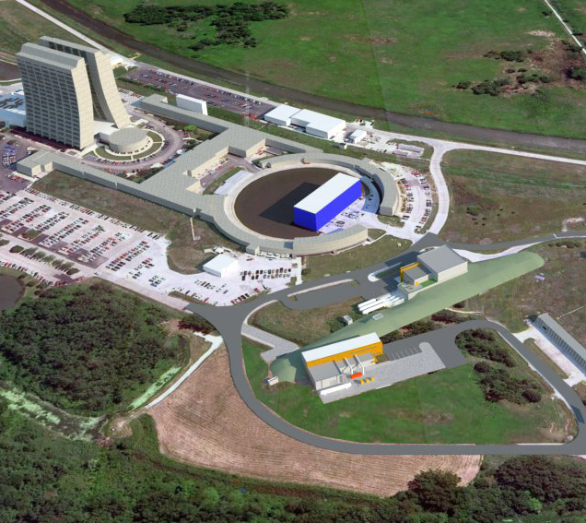
The new Muon Campus at Fermilab
  The Muon Campus plan emerged as the best strategy for mounting the g-2 & Mu2e experiments in a way that…
    keeps the experiments mutually compatible,
    maximizes reuse of Tevatron Run II equipment,
    and minimizes the total cost of the muon program by sharing infrastructure where possible.
  This facility offers a number of future possibilities as we enter the Stage I Project X era
  A muSR program at FNAL could start here as early as 2021 or 2022 (IF we get Project X Stage 1 onto a compatible timeline)
5
Chris Polly, Project X muSR Forum, October 18, 2012

Slide 6
This is a large program at the laboratory
Mu2e Project
Muon Campus
  It is going forward..
    CD-0 for g-2/CD-1 for Mu2e
    In FY13, $10M going into Muon Campus alone
    Transport of g-2 equipment from BNL (highest risk part of project) is on track for shipping in October 2013
    Relevant for the particular plan presented here today because g-2 needs to finish before muSR starts
Accelerator
Civil Construction
Solenoids
Muon Channel
Tracker
Calorimeter
CRV
DAQ
Project Management
Total cost ~$230M
MC-1 Building GPP
MC Beamline Enclosure GPP
MC Site Prep GPP
MC Cryo Plant AIP
Recycler Upgrades AIP
Delivery RIng Upgrades AIP
Total cost ~$50M
Muon g-2 Project
g-2 Accelerator
Ring Reassembly/Upgrades
E821 Equipment Transfer
Project Management
Total cost ~$40M
6

Slide 7
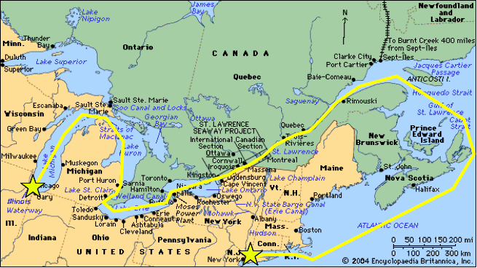
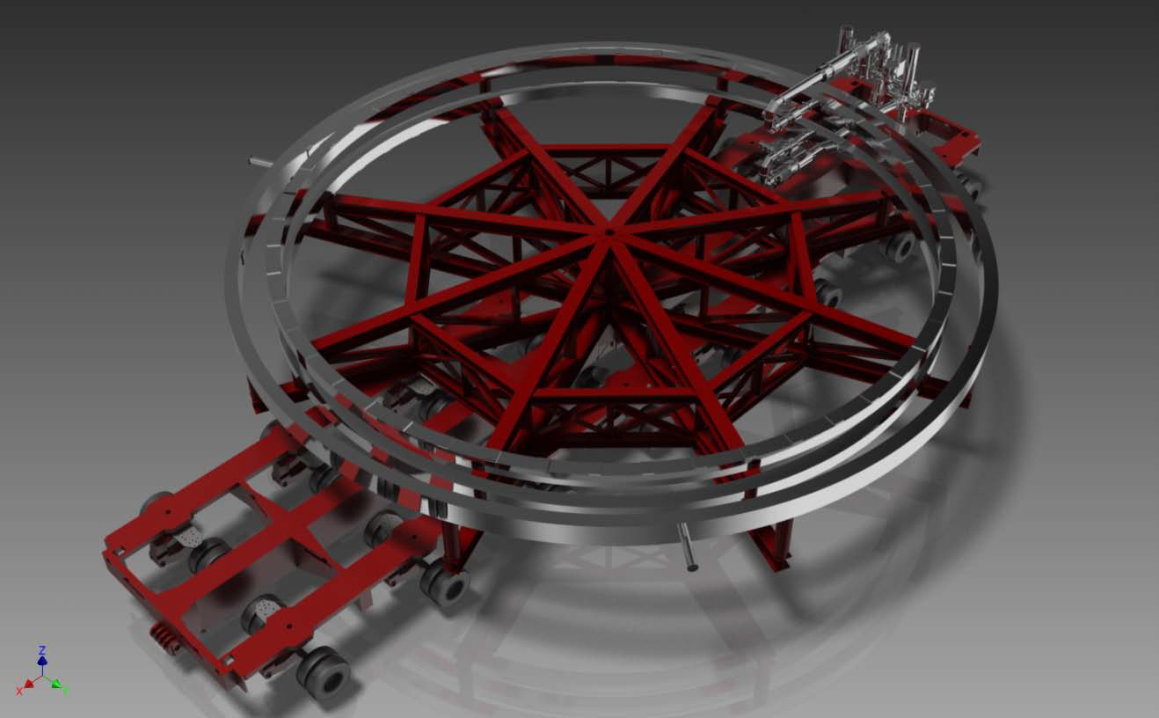
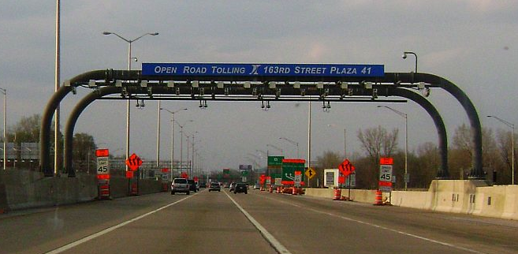
Aside on g-2 transport
  Superconducting coils are 14m in diameter and do not come apart
    Logistics similar to moving space shuttle
  Successful transport review held last month with magnet experts, transport vendors, IDOT, tollway authority, etc.
    Plan approved, bid for transport contract to be awarded Nov 16.
    Keeps data start on track for 2016, run time probably 5 years.
7

Slide 8
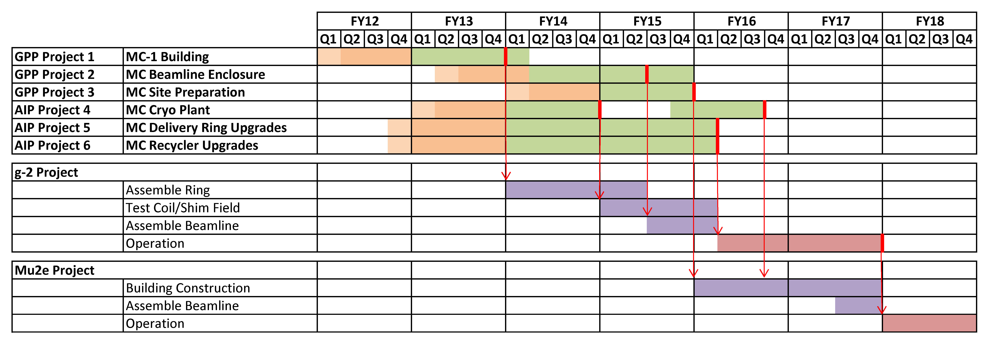
Schedule being proposed in master plan
  Everything you see in this table is currently fully funded in the FY13 budget
  $7.5M MC-1 Building, $400k Beamline design, $400k Cryo Plant design, $700k Recycler technical design, $1.1M Delivery Ring technical design, and$4.7M to advance Muon g-2 project, and $25M for Mu2e
8
Chris Polly, Project X muSR Forum, October 18, 2012

Slide 9
Highlighted portion potentially useful for muSR
Mu2e Project
Muon Campus
    This infrastructure is the part we could consider incorporating into an initial muSR program
    Potentially very important, as the the $ required to build the accelerator will force us to maximize reuse of facilities, at least initially
    “Day 1 (or 2) physics” is an important catch-phrase
    Success of an initial program (mounted with minimal additional cost) could lead to a more elaborate, longer-term possibilities
Accelerator
Civil Construction
Solenoids
Muon Channel
Tracker
Calorimeter
CRV
DAQ
Project Management
Total cost ~$230M
MC-1 Building GPP
MC Beamline Enclosure GPP
MC Site Prep GPP
MC Cryo Plant AIP
Recycler Upgrades AIP
Delivery RIng Upgrades AIP
Total cost ~$50M
Muon g-2 Project
g-2 Accelerator
Ring Reassembly/Upgrades
E821 Equipment Transfer
Project Management
Total cost ~$40M
9

Slide 10
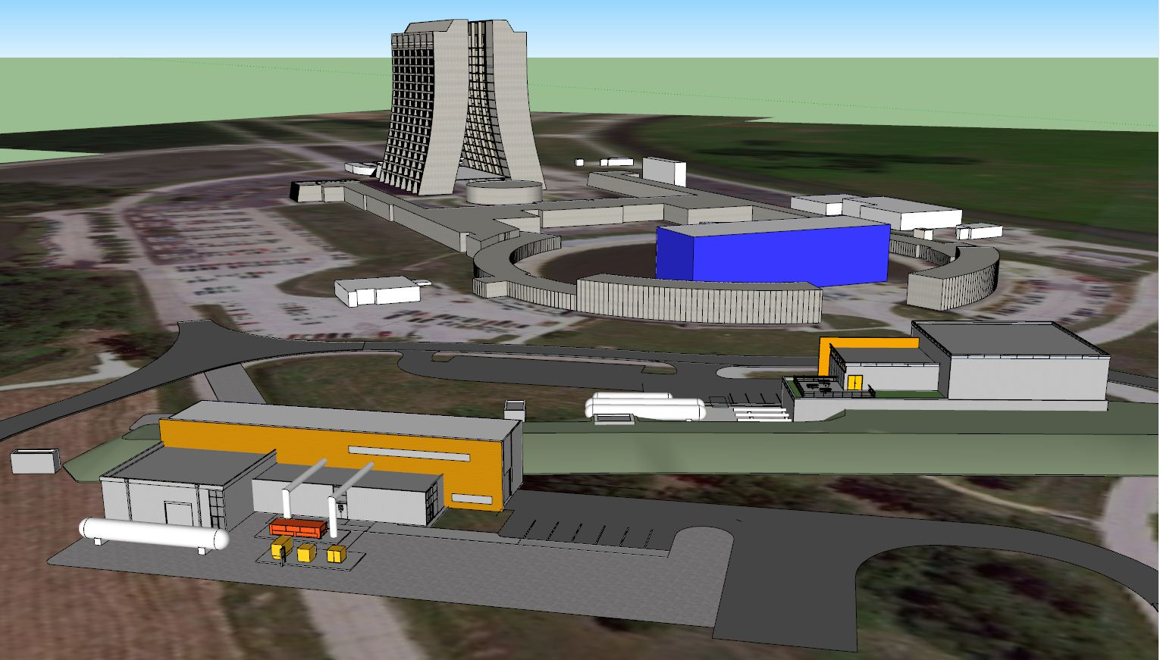
Overview of infrastructure available after g-2
Muon g-2
Building (MC-1)
New cryo
plant
Mu2e running starts in 2019 and will continue in Project X Stage 1 era (not part of muSR)
New unnel that connects Muon Campus to rest of FNAL
10
Chris Polly, Project X muSR Forum, October 18, 2012

Slide 11
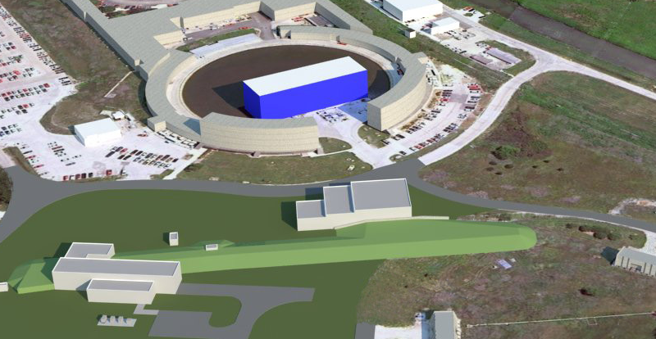
Overview of plan for cryo plant
Compressed He
from existing TeV
compressors
New transfer line for
compressed He built
from recycled parts
Cold He lines
to experiments
Four TeV refrigerators installed in MC-1 (two dedicated to each building)
  Each TeV frig capable of about 625 W at 4.5 K
  Plant capable of independent operations at either facility
11
Chris Polly, Project X muSR Forum, October 18, 2012

Slide 12
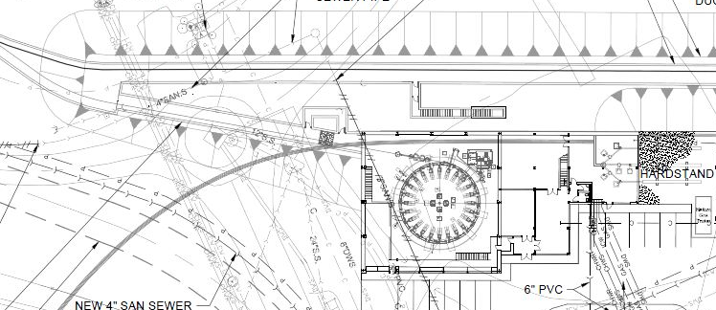
Muon Campus aerial view
50 m
24 m
  Tunnel splits into 50 m branch to bring 3 GeV muon beam into MC-1
  Building high-bay is 24m x 24m
12
Chris Polly, Project X muSR Forum, October 18, 2012

Slide 13
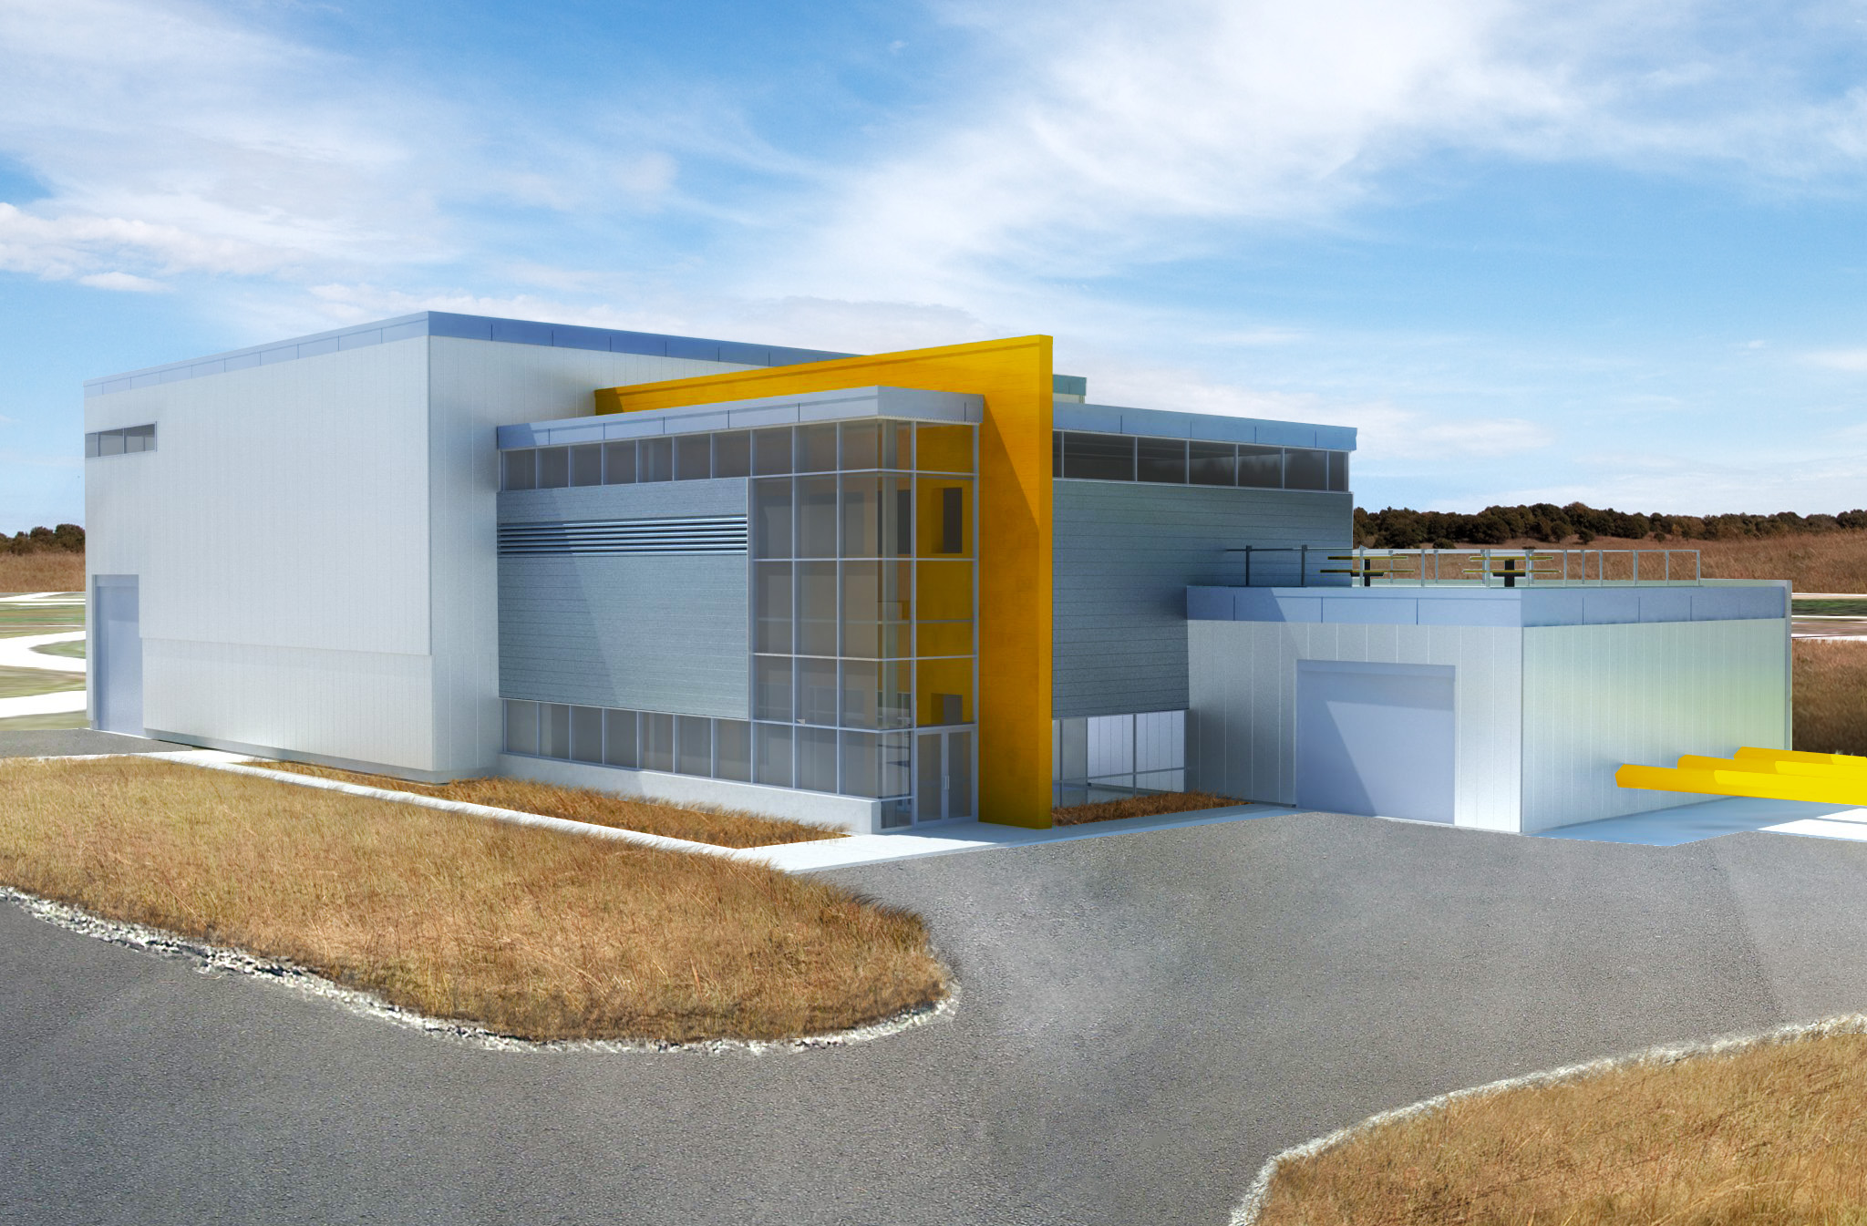
MC-1 Building
13
Chris Polly, Project X muSR Forum, October 18, 2012

Slide 14
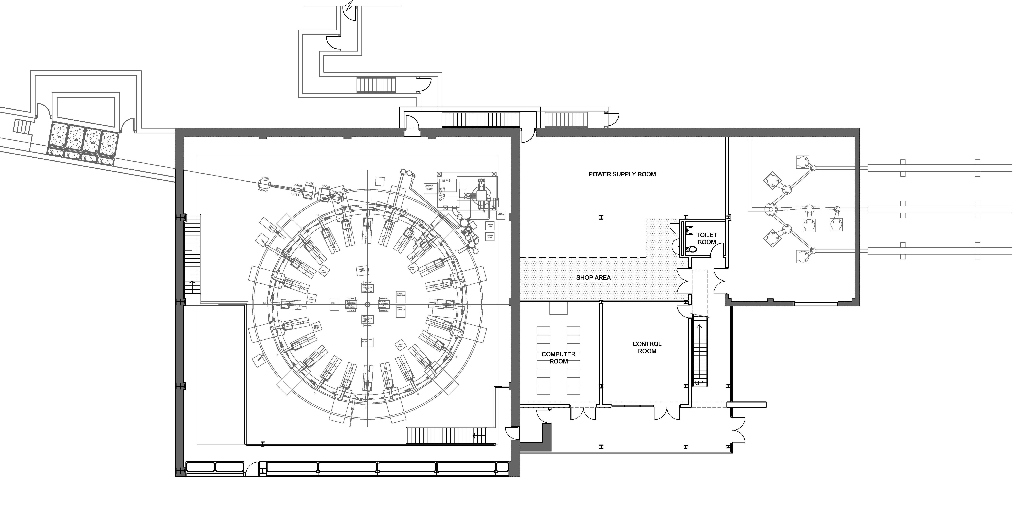
Muon Campus offers many advantages
14
Chris Polly, Project X muSR Forum, October 18, 2012

Slide 15
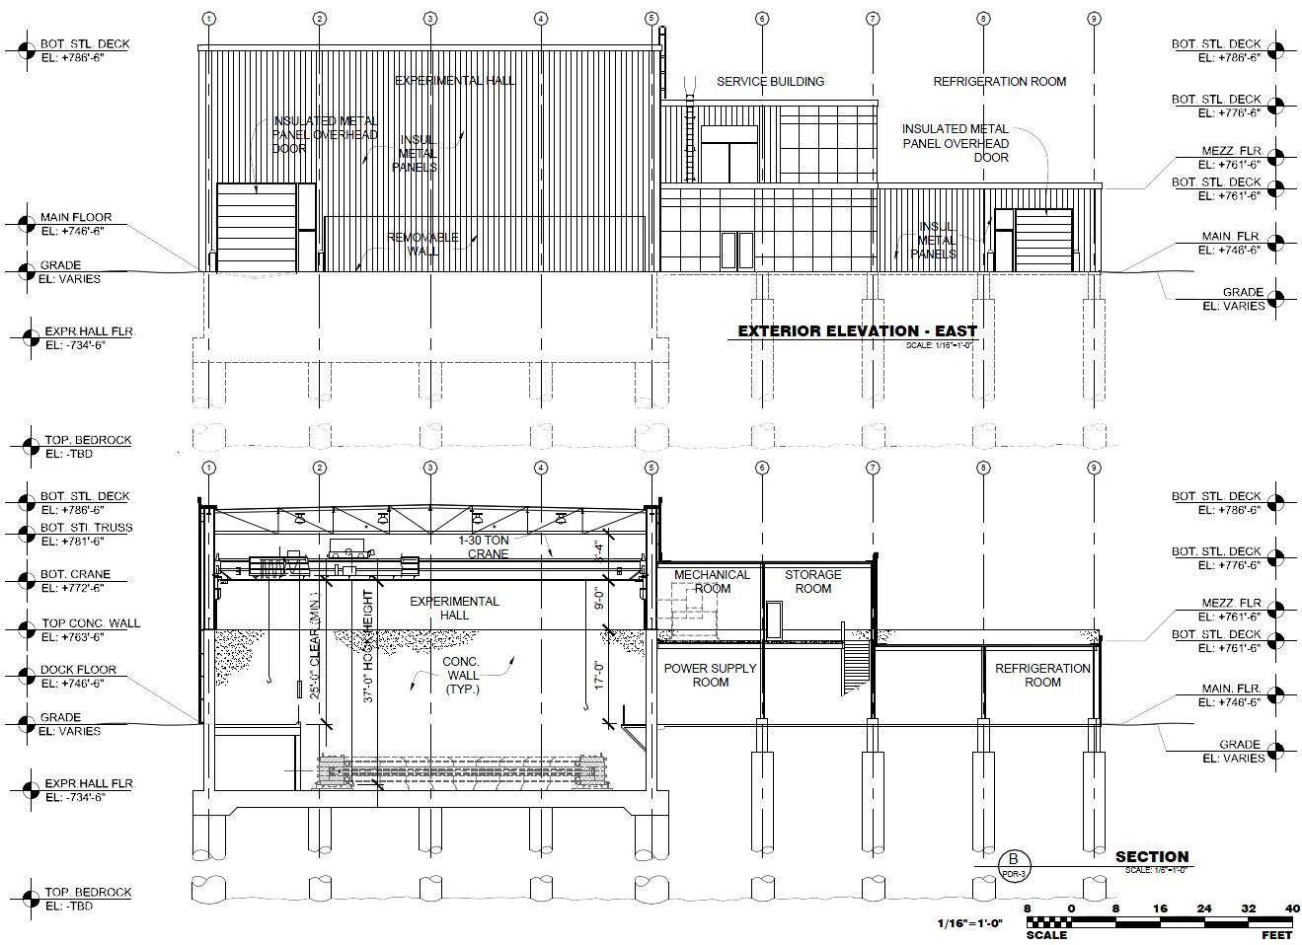
Muon Campus offers many advantages
15
Chris Polly, Project X muSR Forum, October 18, 2012

Slide 16
Switching to Stage 1 Project X era…
16
Chris Polly, Project X muSR Forum, October 18, 2012

Slide 17
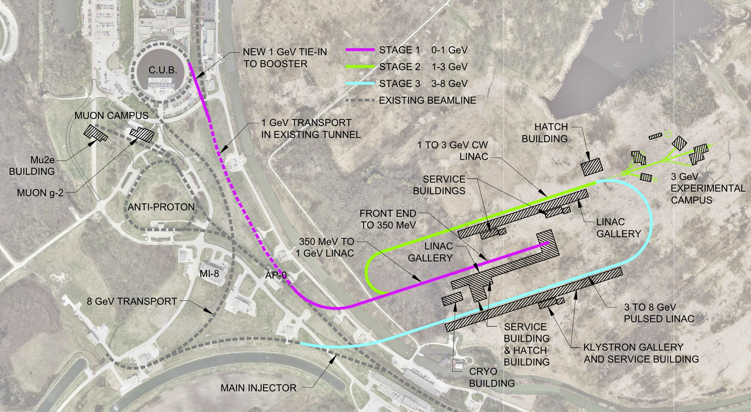
Stage 1 Project just includes pink part
  Stage 1 capable of delivering 1 MW at 1 GeV, upgradeable to 2 MW
  Dashed pink connects Stage 1 to Booster increasing beam power by 70% through existing chain…Booster, Recycler, Main Injector, Delivery Ring, Muon Campus
17
Chris Polly, Project X muSR Forum, October 18, 2012

Slide 18
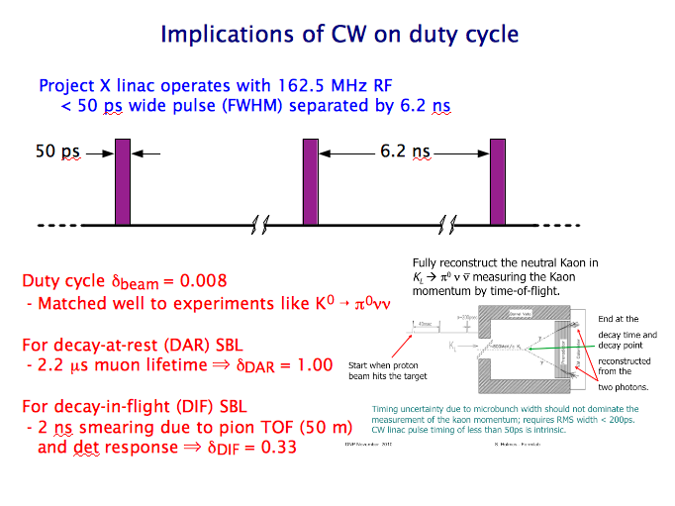
Simple primer on Project X beam structures

Slide 19
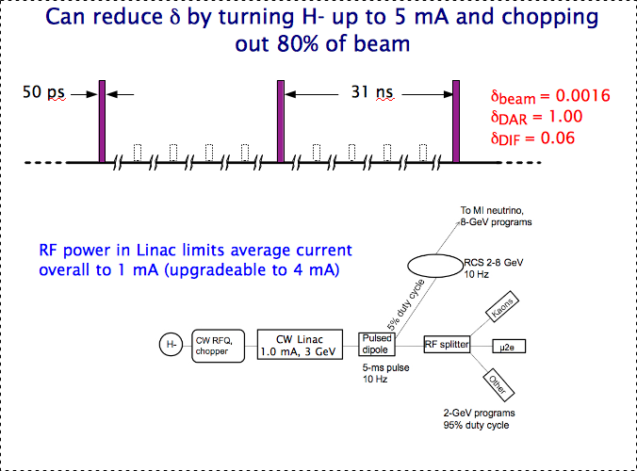
Simple primer on Project X beam structures

Slide 20
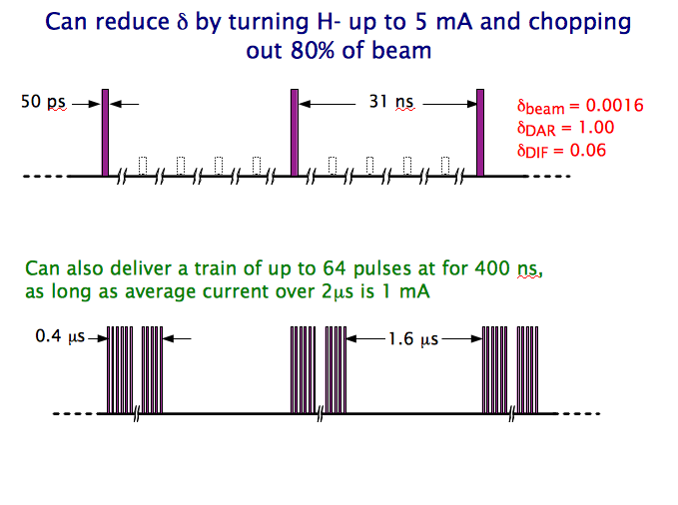
Simple primer on Project X beam structures

Slide 21
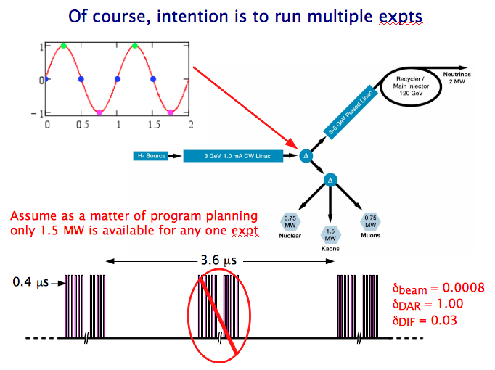
Simple primer on Project X beam structures

Slide 22
Just from feeding Booster with new linac
  Potentially very interesting for existing experiments like NOvA, MicroBooNE, g-2, & Mu2e
  Bridging the program with existing experiments ($600M, 700 users) works well if increase in beam power start in 2020…more aggressive timescale than currently planned
22
Chris Polly, Project X muSR Forum, October 18, 2012

Slide 23
Connecting 1 GeV beam into the Muon Campus
  A future upgrade to Mu2e (>2023) strongly motivates making the orange connection
  CW linac timing nearly perfect, will allow Mu2e beam power to increase by factor of 10
23
Chris Polly, Project X muSR Forum, October 18, 2012

Slide 24
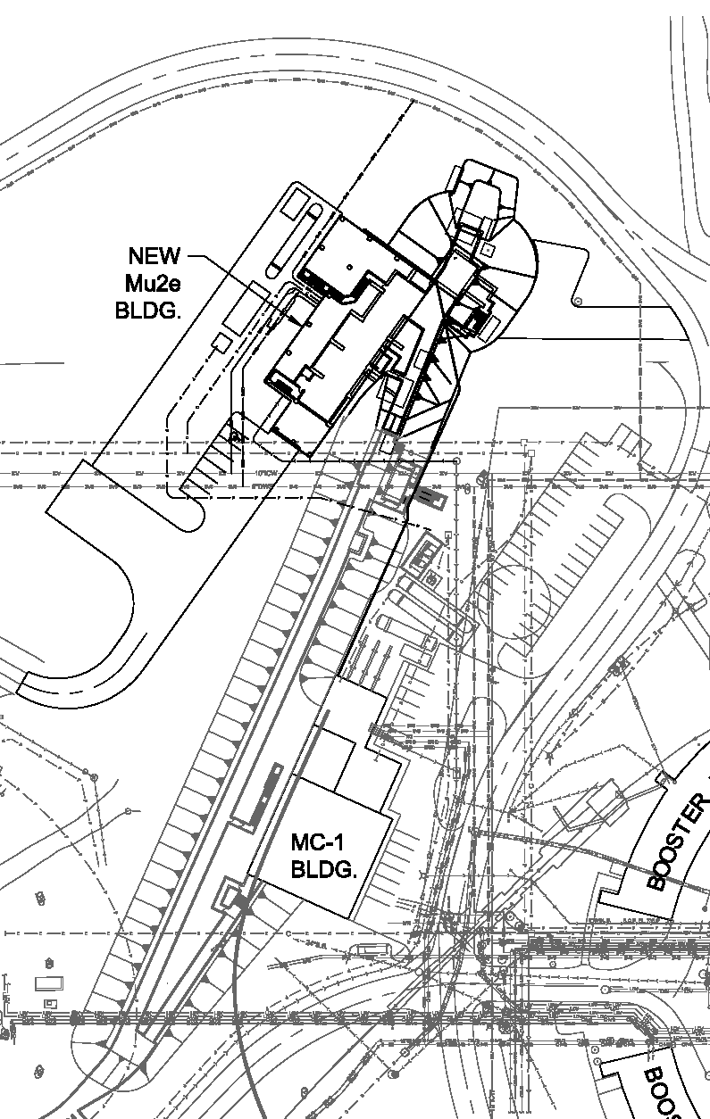
Can a natural evolution of the Muon Campus support a muSR program?
Stage 1 Project X, 975 kW CW beam enters Muon Campus
Beam passes through muon production target, depositing 15% of power, leaving 825 kW.
Build two beamlines viewing production target, transport 50m to MC-1
Build muSR facility in MC-1, one beamline to initiate a materials muSR program & one reserved for physics in HEP mission
Upgrade Mu2e to use 80-150kW of 1 GeV beam
Remaining 675 kW passed to new facility for n production experiments, or more elaborate muSR facility.
6
5
4
    Why not just put 2, 3, 4, into new facility at 6 or closer to the Linac?
    Timing. 3 & 4 available as early as 2021, while it is not clear when the funding profile will allow the construction of a new, more glorious experimental facility at 6 to be constructed.
3
1
2
24
Chris Polly, Project X muSR Forum, October 18, 2012

Slide 25
Big questions in need of answers to
decide if worth pursuing…
6
    Is there enough demand in North America to justify development of FNAL muSR?
    Think the answer is yes, but clearly depends on ability of facility to meet demand (CW vs pulsed, μ/s, spot size, ability to span useful Eμ range)
    Can the infrastructure in 2, 3, 4, be justified as a first step to a broader program?
    Take this small, exploratory facility as a test- case and use it to prove muSR demand. Move to bigger facility if/when available
    Is the beam energy, timing a showstopper?
    Is there an avenue for joint development with our TRIUMF colleagues?
    Are there steps we should be taking now to maintain this possibility as construction of the Muon Campus starts this year?
5
4
3
1
2
25
Chris Polly, Project X muSR Forum, October 18, 2012

Slide 26
No Conclusions…
Just looking to the experts at this workshop for answers to questions.
Thank you
26
Chris Polly, Project X muSR Forum, October 18, 2012

Slide 27
Booster and Main Injector Timeline
20 Booster cycles per NOvA cycle (1.33 sec)
12 NOvA cycles stored in Recycler before transfer to MI
Remaining 8 Booster cycles available for other experiments
Protons to Mu2e
Main Injector
Energy
Booster
Cycles
Protons to g-2
Protons to NOvA
Protons to MicroBooNE
27

