Slide 1
Current Plans and Future Vision for the Fermilab Accelerator Complex Stuart Henderson
Project X MuSR Forum October 18, 2012

Slide 2
Outline
Mission and Strategy for Accelerator Activities at Fermilab
Fermilab’s Accelerator Complex
Evolution of the Accelerator Complex
Building the Future: Project X
Broader Impacts of Accelerators

Slide 3
What We Do: Mission of the Accelerator Sector
Enable the U.S. scientific community to tackle the most fundamental physics questions of our era by
Operating the accelerator complex at the highest levels of performance, efficiency and safety
Operations
Capability
Acceler- ator Science
Technology Develop- ment
Future Facilities
Maximizing the capabilities of the accelerator complex through upgrades and improvements
Designing and building the next generation accelerator facilities for particle physics
Developing and nurturing those technologies that will enable the accelerators of the future
Advancing scientific understanding of beams and accelerators

Slide 4
Ten-Year Goals
Fermilab is the world leader on the Intensity Frontier of Particle Physics
Fermilab plays a leadership role in developing the technology for next generation accelerators
Fermilab is a recognized leader in Advanced Accelerator R&D and Accelerator Science
Fermilab plays a leading role in applying accelerator technology to society’s problems

Slide 5
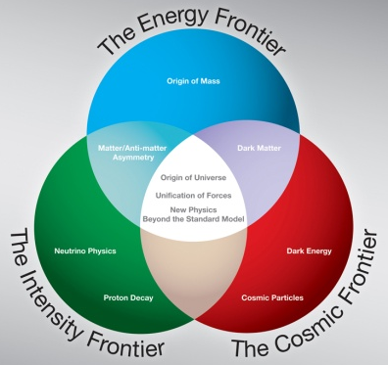
Laboratory Strategy for the Accelerator -Based Particle Physics Program
Particle Physics is described and understood as consisting of three research “frontiers”
Our strategy is to build upon our strengths to establish a world-leading program at the Intensity Frontier, enabled by a world-class facility
The currency for Intensity Frontier accelerators is beam power

Slide 6
Overview of Fermilab’s Accelerator Complex

Slide 7
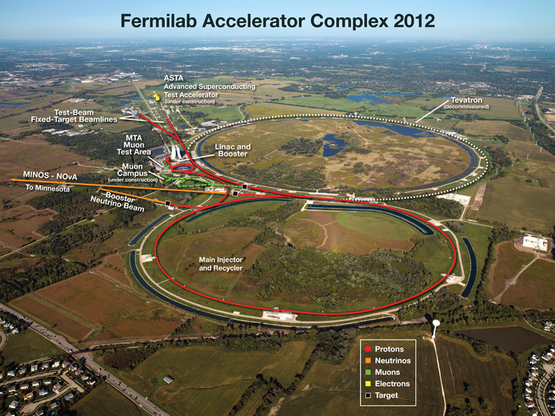

Slide 8
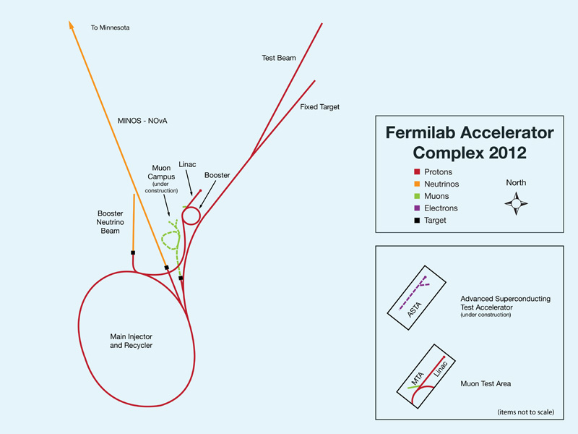
Present Accelerator Complex

Slide 9
Proton Linac:
400 MeV, ~2 kW
Booster Synchrotron
8 GeV, 474m, ~35kW
Recycler Ring
8 GeV permanent magnet
3.3 km
Main Injector Synchrotron
120 GeV, 3.3 km, ~350 kW
Neutrino Beamlines
8 and 120 GeV target/horn systems and beanlines

Slide 11
Strategy for Evolution of the Complex: Near Term
We need to get the most out of the existing accelerator complex to satisfy the near-term Particle Physics program throughout this decade
Science drivers:
Long-baseline neutrino experiments
A muon program focused on precision/rare processes
To meet the needs, we will
Double the beam power capability of the Booster
Double the beam power capability of the Main Injector
Build-out the muon campus infrastructure and capability based on the 8 GeV proton source

Slide 12
Proton Improvement Plan (2012-2018):
Double beam power of the proton source by increasing rep-rate
Muon Campus (2013-2017):
Convert antiproton source to meet needs of the muon program
Accelerator Upgrades for NuMI (2012-2013):
Double beam power from Main Injector by stacking beam in the Recycler and decreasing MI cycle time

Slide 13
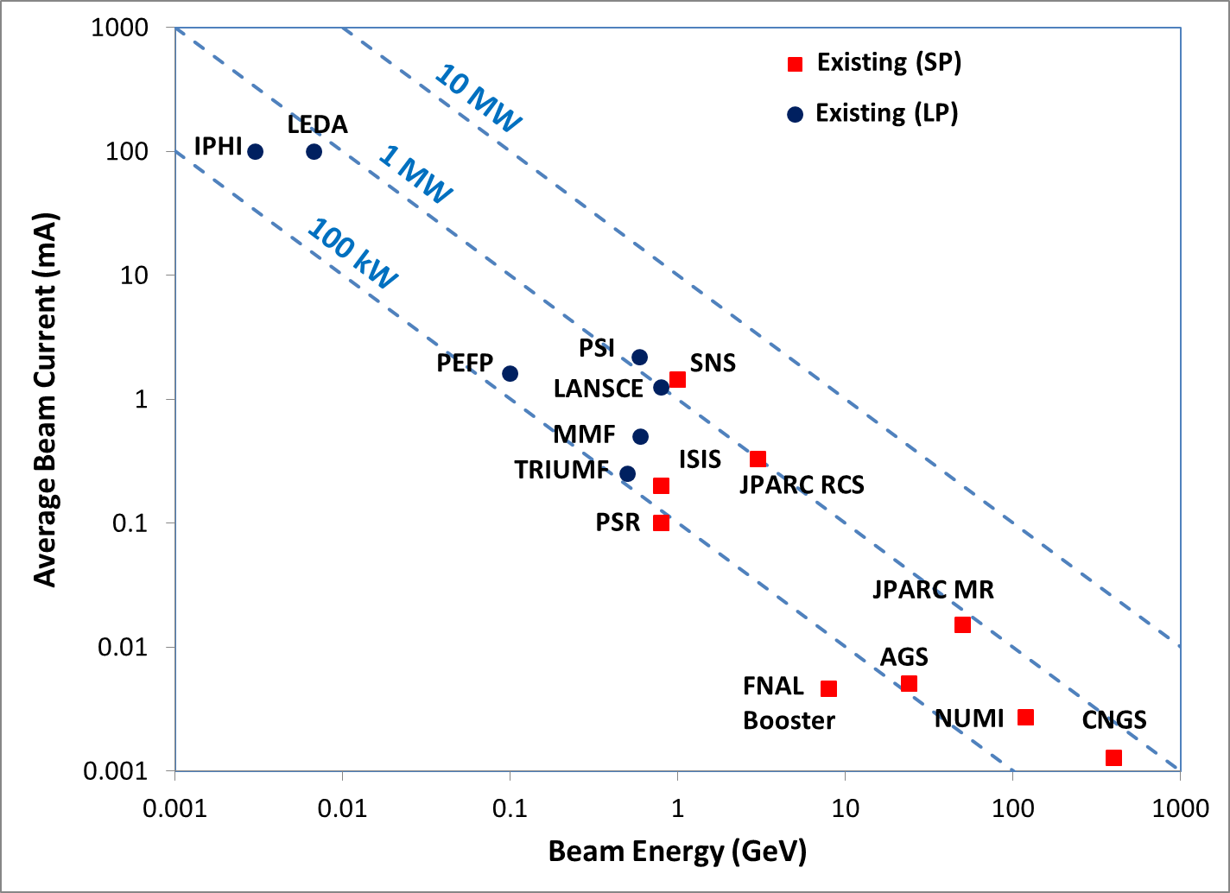
The Beam Power Landscape
Near-term Upgrades

Slide 14
Strategy for Evolution of the Complex: Long-Term
However, we recognize that even these improvements will not meet the long-term needs of the Intensity Frontier community
Science Drivers:
Long-baseline neutrino experiments to unravel neutrino sector, CP-violation, etc., require Multi-MW beams
Rare and precision measurements of muons, kaons, neutrons to probe mass-scales beyond LHC require MW-class beams
We intend to build a modern, flexible, Multi-MW proton accelerator that supports the ambitions of the Intensity Frontier community: Project-X

Slide 15
Building the Future: Project X

Slide 16
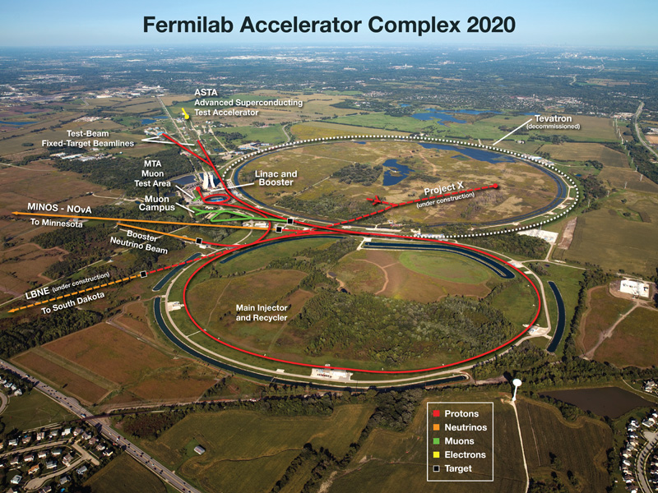
Project-X Will…
Be the leading high power proton accelerator facility in the world
Provide unique capability to deliver multi-MW beams to multiple experiments simultaneously, with variable bunch formats, across a broad range in energy: 1-120 GeV
Enable a world-leading program in Intensity-Frontier particle physics
Enable very powerful programs with broader impact beyond HEP
Be carried out as a collaboration between 15 institutions in the US and India

Slide 17
Project-X Scientific Mission
Long Baseline Neutrino Experiments
2 MW at 60-120 GeV
Kaon, Muon, Nuclei & Neutron precision experiments
3MW at 3 GeV
Platform for evolution to a Neutrino Factory and Muon Collider
Future upgrade to 4MW
Broader Impacts: Materials Science, Nuclear Technology
1 MW at 1 GeV

Slide 18
as;lkjfda;lskdjf;salkjfd
1 MW @ 1 GeV
3 MW @ 3 GeV
200 kW @ 8 GeV
2 MW @ 120 GeV

Slide 19
The Beam Power Landscape
Project-X

Slide 20
Broader Impacts of Accelerator Technology

Slide 21
Accelerator Stewardship Within DOE Office of Science
There is growing recognition that, in addition to their role in Discovery Science, accelerators are vital to industry, medicine, national security, and have potential in energy and environment
DOE Office of High Energy Physics serves as the steward of accelerator technology
We are actively seeking out opportunities in which HEP accelerator technology can have a broader impact

Slide 22
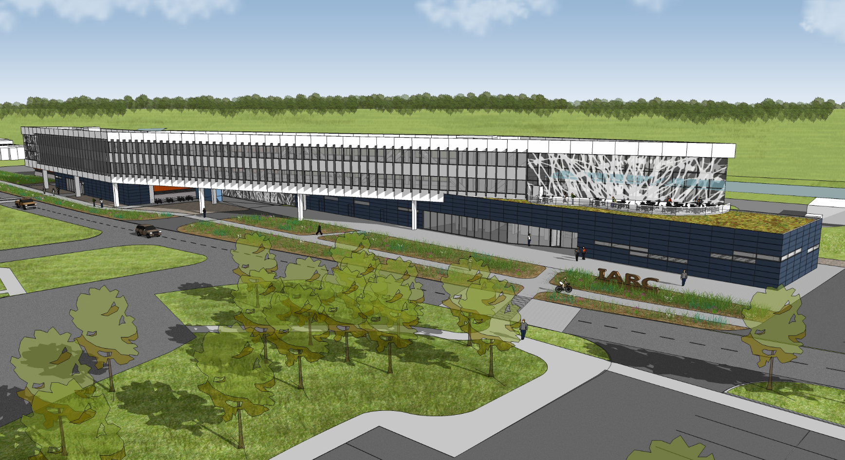
Illinois Accelerator Research Center
A partnership between Department of Energy and the State of Illinois
To encourage and enable Fermilab to work closely with industry and universities to solve problems of national importance
To develop new accelerator technology-based products and high tech industries in the U.S. and in Illinois
To promote education in accelerator science & technology

Slide 23
Project X as a National Resource with Application Beyond HEP

Slide 24
Project-X Beyond HEP
We recognize that a multi-MW high energy proton accelerator is a national resource, with potential application that goes beyond particle physics
Such facilities are sufficiently expensive that the U.S. will not invest in multiple facilities with duplicative capabilities
We are engaging the potential user communities for utilization of high power proton beams beyond HEP
We are very excited about the possibility of building a muon program for materials science

Slide 25
Applications of High Power Proton Accelerators
Materials Science
Neutron Sources
Muon Sources
Particle Physics
Proton Drivers for HEP
Nuclear Physics
High-power ISOL
Neutron, nuclear EDMs
Energy & Environment
Materials Irradiation
Accelerator Driven Systems
Medicine
Isotope production
National Security
Proton Radiography

Slide 26
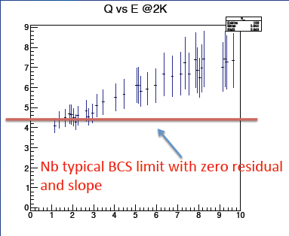
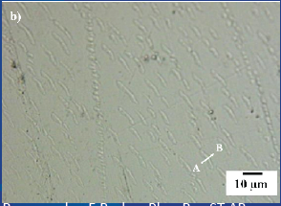
Fermilab Interest in Materials Science
In fact, we have a very active program to explore, understand and improve the performance of SC materials for accelerators
The size and cost of future accelerators will depend on our success in improving performance of SC materials
Hydride precipitates and role in SC resonator quality factor
Niobium Nitride surface treatment for SC resonators
Quality Factor (10¹⁰)
A. Romanenko, F. Barkov, PRST-AB
E (MV/m)
A. Grassellino et. al., LINAC12

Slide 27
Summary
We intend to build the world’s most capable proton accelerator facility
Multi-MW beam power
Multiple programs simultaneously
With variable and adjustable bunch format
Across a wide range in beam energies
We have a tremendous opportunity to develop an extremely powerful MuSR Facility
We are eager to explore these possibilities with you and to consider the next steps

Slide 28
Reference Design Performance Goals
CW Linac
Particle Type | H-
Beam Energy | 3.0 GeV
Average Current | 2 mA/1mA (1 GeV/3GeV)
Beam Power to 1 GeV Program | 1 MW
Beam Power to 3 GeV Program | 2.87 MW
Pulsed Linac
Beam Energy | 8.0 GeV
Pulse Rate and Width | 10 Hz, 4.3 msec
Cycles to Main Injector/Recycler | 6
Particles per Cycle to MI/Recycler | 2.7×10¹³
Linac output beam power | 340 kW
Beam Power to 8 GeV Program | 170 kW
Main Injector/Recycler
Beam Energy | 120 GeV (max)
Cycle Time | 1.2 sec
Particles per Cycle | 1.5×10¹⁴
Beam Power to 120 GeV Program | 2.4 MW
simultaneous

Slide 29
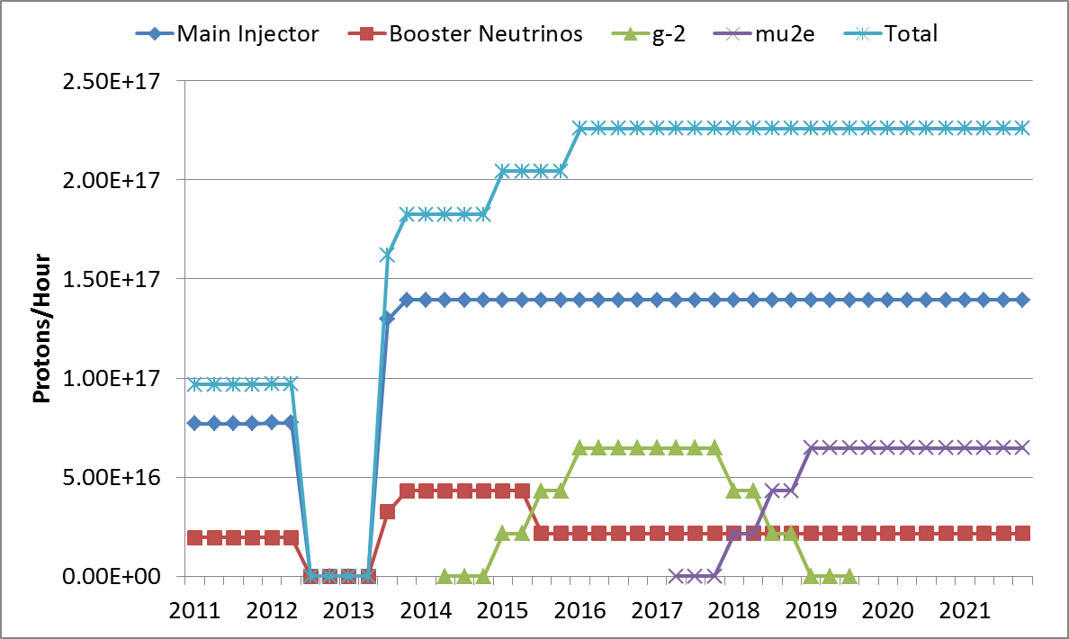
Proton Source Throughput Goals (Planning Basis)
NOvA Shutdown
120 GeV ν
LBNE
g-2
Mu2e
8 GeV ν

Slide 30
Project X Reference Design Siting
3 GeV Experimental Area
CW Linac
Beam Transfer
8 GeV Linac

Slide 31
Collaboration
Organized as a “national project with international participation”
Fermilab as lead laboratory
International participation via in-kind contributions, established through bi-lateral MOUs.
Collaboration MOUs for the RD&D phase outline basic goals, and the means of organizing and executing the work. Signatories:
ANL ILC/ART RRCAT/Indore
BARC/Mumbai IUAC/Delhi SLAC
BNL LBNL TJNAF
Cornell ORNL/SNS VECC/Kolkata
Fermilab MSU
India Institutes-Fermilab Collaboration Meeting: October 2010
Week of October 23: Visits to IUAC, RRCAT, BARC, VECC
India Workshop on Intensity Frontier Physics: January 2011 Mumbai
IHEP-Fermilab Workshop on Proton Accelerators February 2011 Beijing
Project X Collaboration Meeting April 12-14 2011 at SNS, Oak Ridge
Notes:
Spelling of Kolkata. Put IIFC as a sub-bullet

