Slide 1
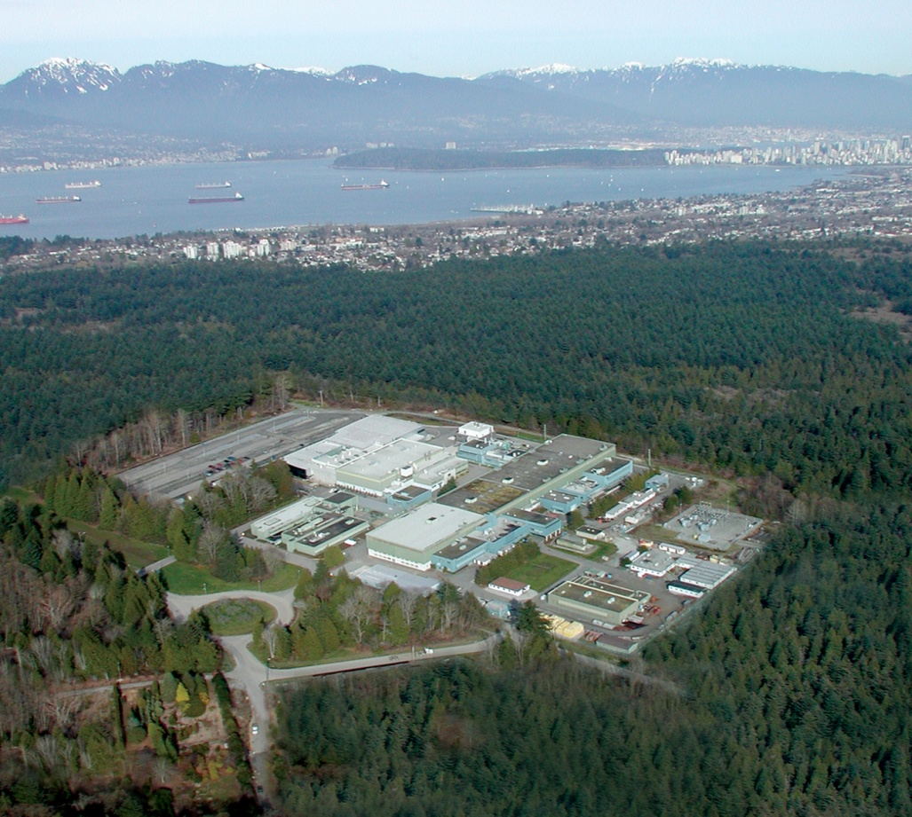
FNAL, Project X 2012
Condensed Matter Physics at a next Generation Muon Source
R.F. Kiefl, UBC and CIFAR
Photo: TRIUMF

Slide 2
Plan
1. What are the necessary elements for a next generation muon source?.
2. How would it affect science output?
Notes:
I’ll start with a general introduction about interfaces and why they are interesting.
Quick review of beta-NMR by way of comparison with NMR, mSR and LEmSR. Briefly dedcribe some essential parts of the instruments i.e polarizer and spectometers.
The remainder of the talk will be on recent results which span a range of topics. Some are compeleted others in progress and a few just beginning. Much of this can be found on the website.

Slide 3
Introduction
By definition a next generation muon source must be significantly more “powerful” than any existing muon sources in regard to either intensity and level of control on the stopping distribution for muons in space and time.
What do we need in order to significantly improve or expand on experiments from the current generation muon sources?

Slide 4
What does a next generation muon source look like?
The proton pulses should be less than the pion lifetime of 26 ns
and spaced by 20 microsec. Need a high luminosity surface muon beam
and a pulse width of 10-20 ns and a pulse rate of 50 KHz.
[Note such a time structure (at 28 MeV/c) can also be used with an incoming muon
detector by lowering the rate to an average of one muon per pulse.
This would be equivalent to MORE at a CW machine such as PSI
and TRIUMF.
2. With no incoming muon detector and thin windows one should be able to create
a 10 mm diameter beam at the sample with ~2x10^2 muons per pulse
yielding a good e+ event rate in of 3x10^6 /s . (a factor of 300 greater than
TRIUMF or PSI).

Slide 5
3. If one inserts an iris at an intermediate focus, followed by suitably positioned defection plates, it should be possible to create a small beam spot (2 mm) that can be moved across the sample (muon milliscope). This would allow multiple samples to be run at a time or study different parts of the same sample e.g. Use SRF cavities Nb as an example.
4. Need a high acceptance muon channel and thick target to get 50,000 μ+/s CW or pulsed. This would yield a good event rate ~10^4/s. The low energy muons have a small phase space (ΔE=20 eV, Δx=5 cm) and they come off the cryogenic target with a well defined time structure. It may be possible to build a low energy muon beamline /linac that you can bunch, chop, store, cool, accelerate . This would a unique instrument for exploring thin films and interface. Accelerating it from 30—300 keV would open up an unexplored mesoscopic length scale to muSR. This will attract a large world wide user group.

Slide 6
Impact on science using examples from the past
1. Structure of BC muonium in Si
2. Magnetic phase diagram in YBa2Cu3Ox
Search for time reversal symmetry breaking YBCO .
4. Cooperative paramagnetism in Tb2Ti2O7.
5. Magnetic vortices in underdoped YBCO
6. Measurement of lambda in the Meissner state of exotic superconductors.

Slide 7
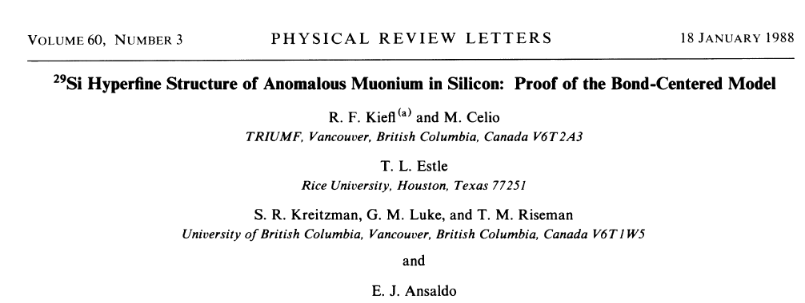
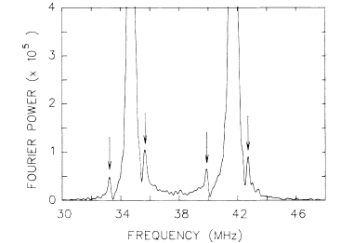
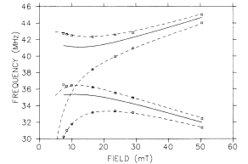

Slide 9
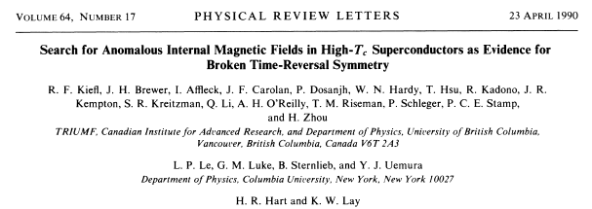
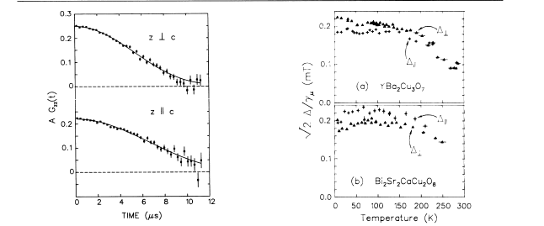
What is effect of nuclear spins? Is the broken TRS on a finer scale?

Slide 10
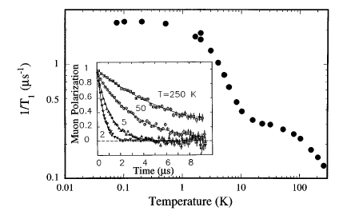
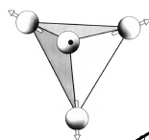
What happens below 50 mK? What is energy dependence between
30 keV and 3 MeV?

Slide 11
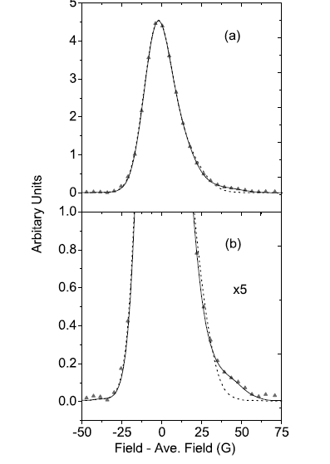
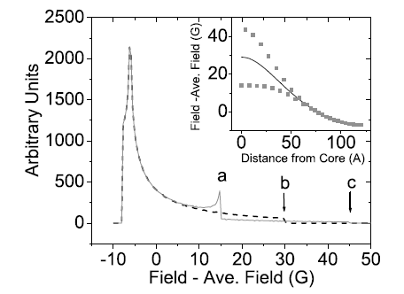
What is the detailed field distribution at the core?

Slide 12
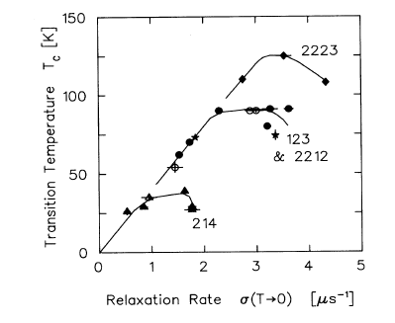
How valid is the Uemura relation?

Slide 13
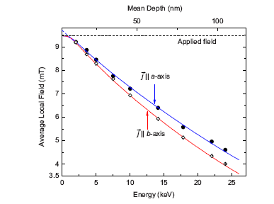
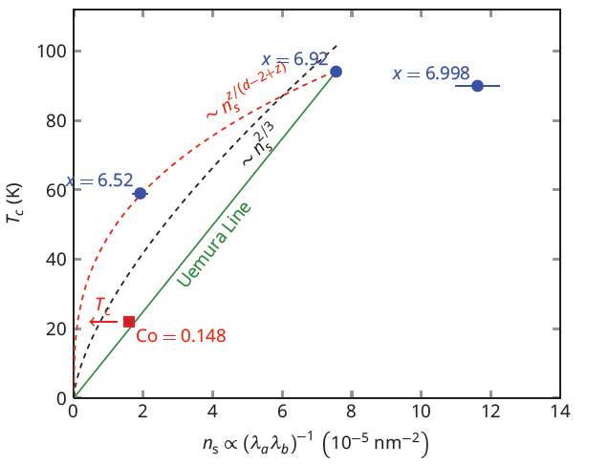
Ph.D thesis M. Hossain 2012
?

Slide 14
Comparison of conventional NMR with LEμSR and βNMR
NMR LEμSR β-NMR
Polarization <0.01 >0.8
detection electronic anisotropic
method pickup β decay
Sensitivity 10¹⁷ spins 10⁷ spins
T₁ range (s) 10 ⁻⁵ − 10 ² 10⁻⁸ − 10 ⁻⁴ 10 ⁻³ − 10 ³
range N/A 10 Å −3000 Å*
Applied field > 1 T any
(frequency)
* Depth Sensitivity!

Slide 15
General Scientific Motivation: Exploring the collective behaviour of electrons near an interface
A
B
-superconductor/vacuum, e.g. YBa2Cu3Ox
E1041, E1095, E1100, M1153
-metal/insulator e.g. Pd/STO, E1042, M1355
insulator/vacuum, SrTiO3 E1094
ferromagnet /metal, e.g. Ag/Fe M1093
semiconductor/ferromagnet, spintronics e.g. EuO/Si M1165, M1176,
insulator/insulator SrTiO₃ /LaAlO3 M1226,
-
superconductor/metal, proximity effect M1153.
topological insulator/vacuum M1306 M1352
NMR
Neutrons
μSR
LEμSR
Resonant
Xray scatt.
βNMR
ARPES
STM
Notes:
It is easy to justify the science
Hard condensed matter is the study of collective many body effects associated with electrons in any given material A.
If you bring two materials together the behaviour of electrons near the interface within some length scale (LA+LB) is in general quite distinct from that Found in A or B. It is really a different system with its own distinct electronic and magnetic properties. The chemical analogy is two atoms
They are important to understand from a practical point of view since you can’t make any useful device without interfaces. More than that they can have unsual and interesting properties.

Slide 16
Conclusions
The next generation muon source will revolutionize muSR increasing sensitivity to the magnetic environment and at the same time allow new types of experiments e.g lower temperatures 1 nK and higher fields 15T . In Addition it will be possible to run multiple samples at the same time greatly increasing the scientific output. There will be a world wide user group many from the U.S.
North America needs a low energy muon source. This should be given the highest priority. The muon can play a dominant role in studies of thin films and interfaces . This is emerging branch of ccndensed matter physics. Low energy muSR is one of the few methods that can be used in a depth controlled manner.
- Would DOE fund anything but the world’s best muon source? Whatever you do has to be compatible with this option.

Slide 17
