Slide 1
Single-Electron Tracking in IOTA (SETI)
Aleksandr Romanov, Giulio Stancari, James Santucci and Jonathan Jarvis
Studies in IOTA during Run4 (2023)

Slide 2
Motivation
Previous single electron studies at IOTA:
Longitudinal dynamics
Slowly changing mode amplitudes
Proof of principle measurement of betatron phases
Experimental tracking of an electron in a real accelerator opens a new class of accelerator diagnostics with wide range of capabilities. Some are available with conventional tools but with less accuracy. Some are unique, relying on the point-like nature of an electron:
Long term tracking of dynamic variables, such as invariants of motion
High-precision and high-rep-rate measurements of betatron and synchrotron tunes
Chromaticities
Dependance of tunes on mode amplitudes

Slide 3
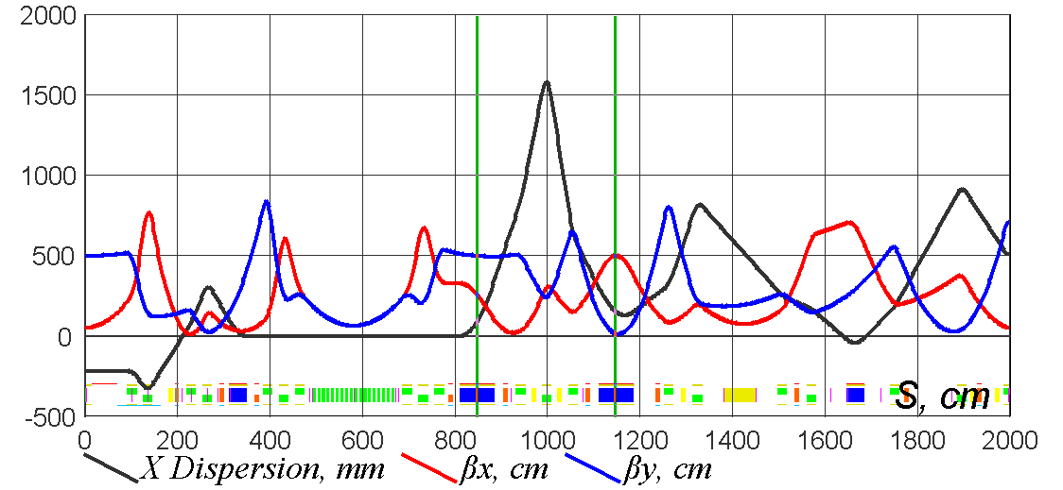
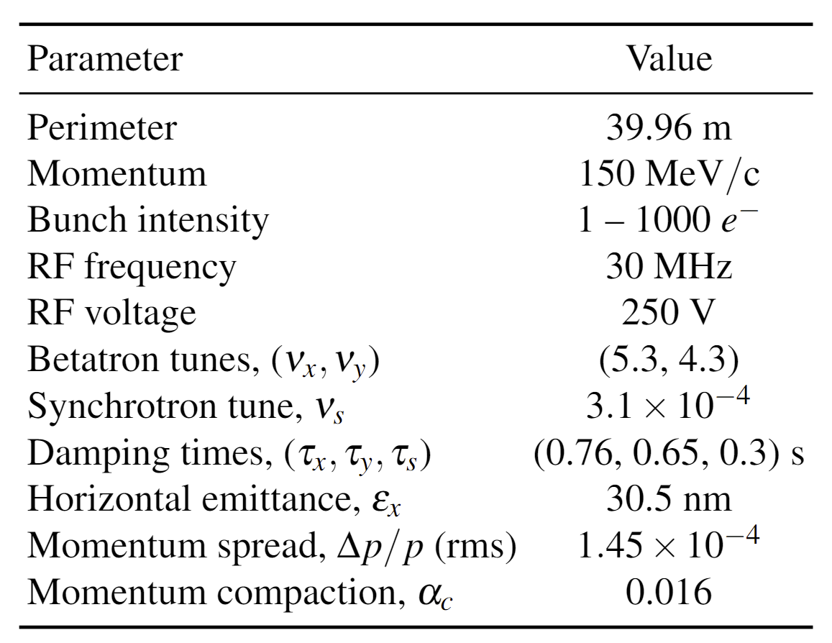
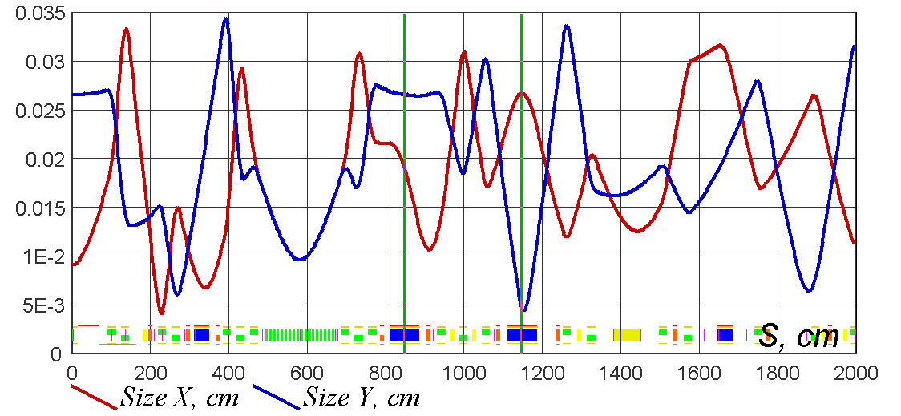
Special lattice configuration
Special lattice with parameters that simplifies 6D tracking was designed. It can be implemented if tracking would be problematic in already implemented lattice (NIO).

Slide 4
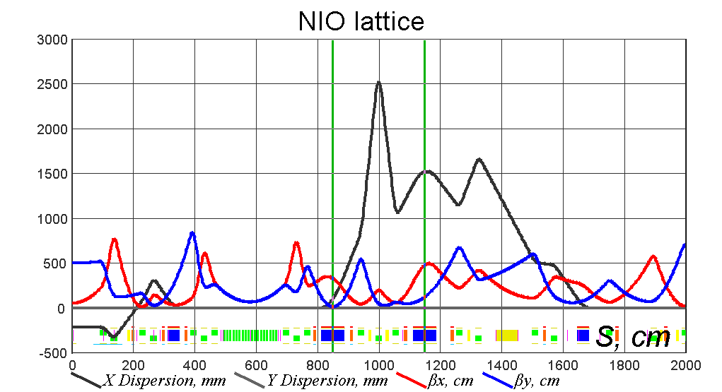
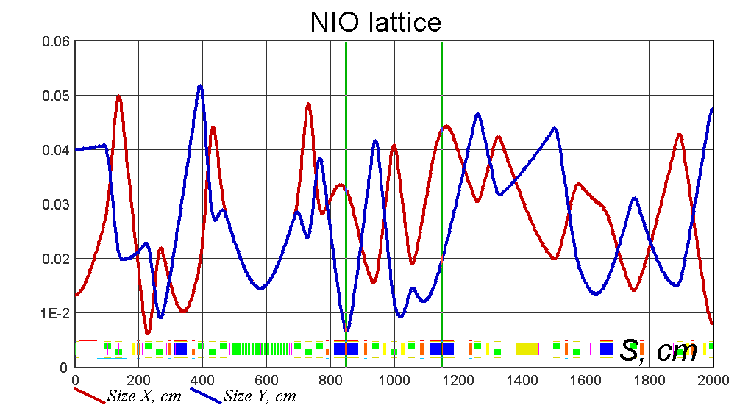
NIO lattice

Slide 5
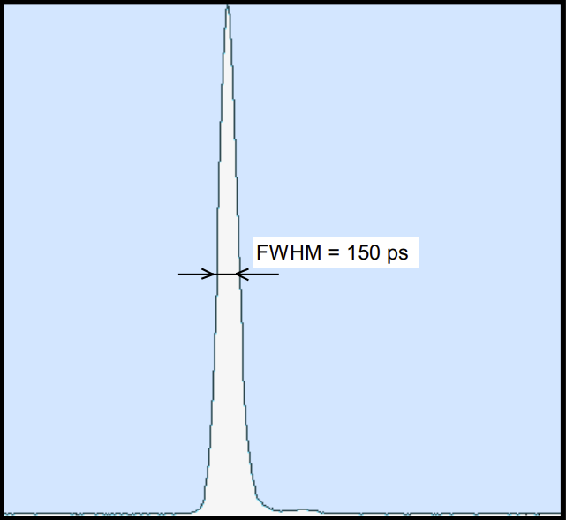
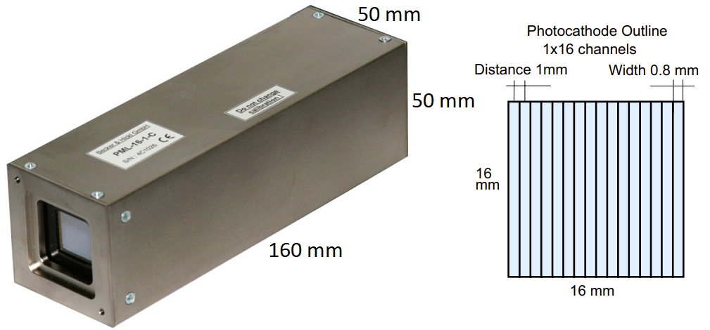
Electron tracking tools
Two multianode PMTs (PML-16) from the Becker-Hickl were bought for the experiment.
Dark noise rate from all channels is about 600 Hz
Time resolution ~0.15 ns
Two PML-16 must be connected to a Windows PC with ~3 m long cables

Slide 6
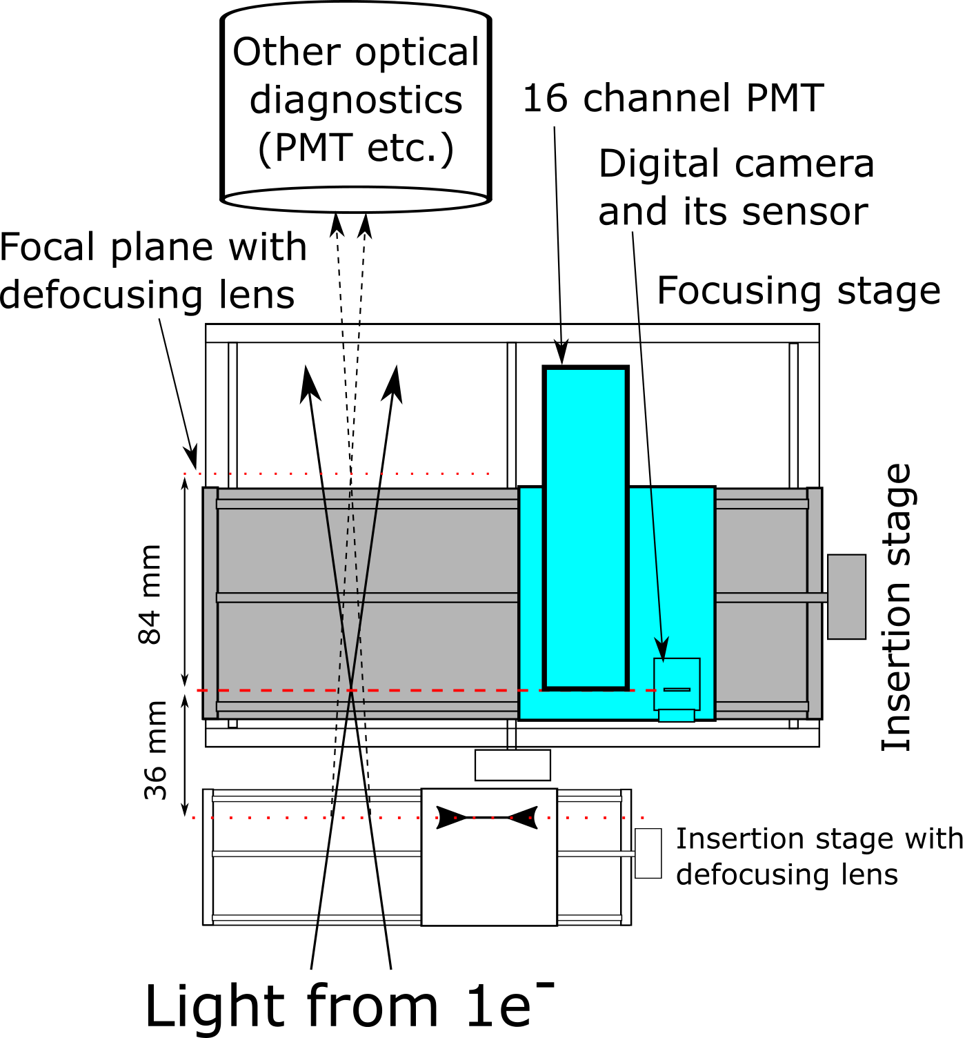
Experimental setup M3L
Both 16ch PMT and a digital camera (blue shaded) are located on a stack of movable stages. Focusing stage can move insertion stage (grey shaded) to position sensors in the focal planes. The insertion stage can position either one of the sensors on axis of the light beam or let the light pass through to other detectors. Additional insertion stage can move a defocusing lens in and out of the photons path changing magnification factor from 88% to 400% which matches beam size to the size of 16ch PMT

Slide 7
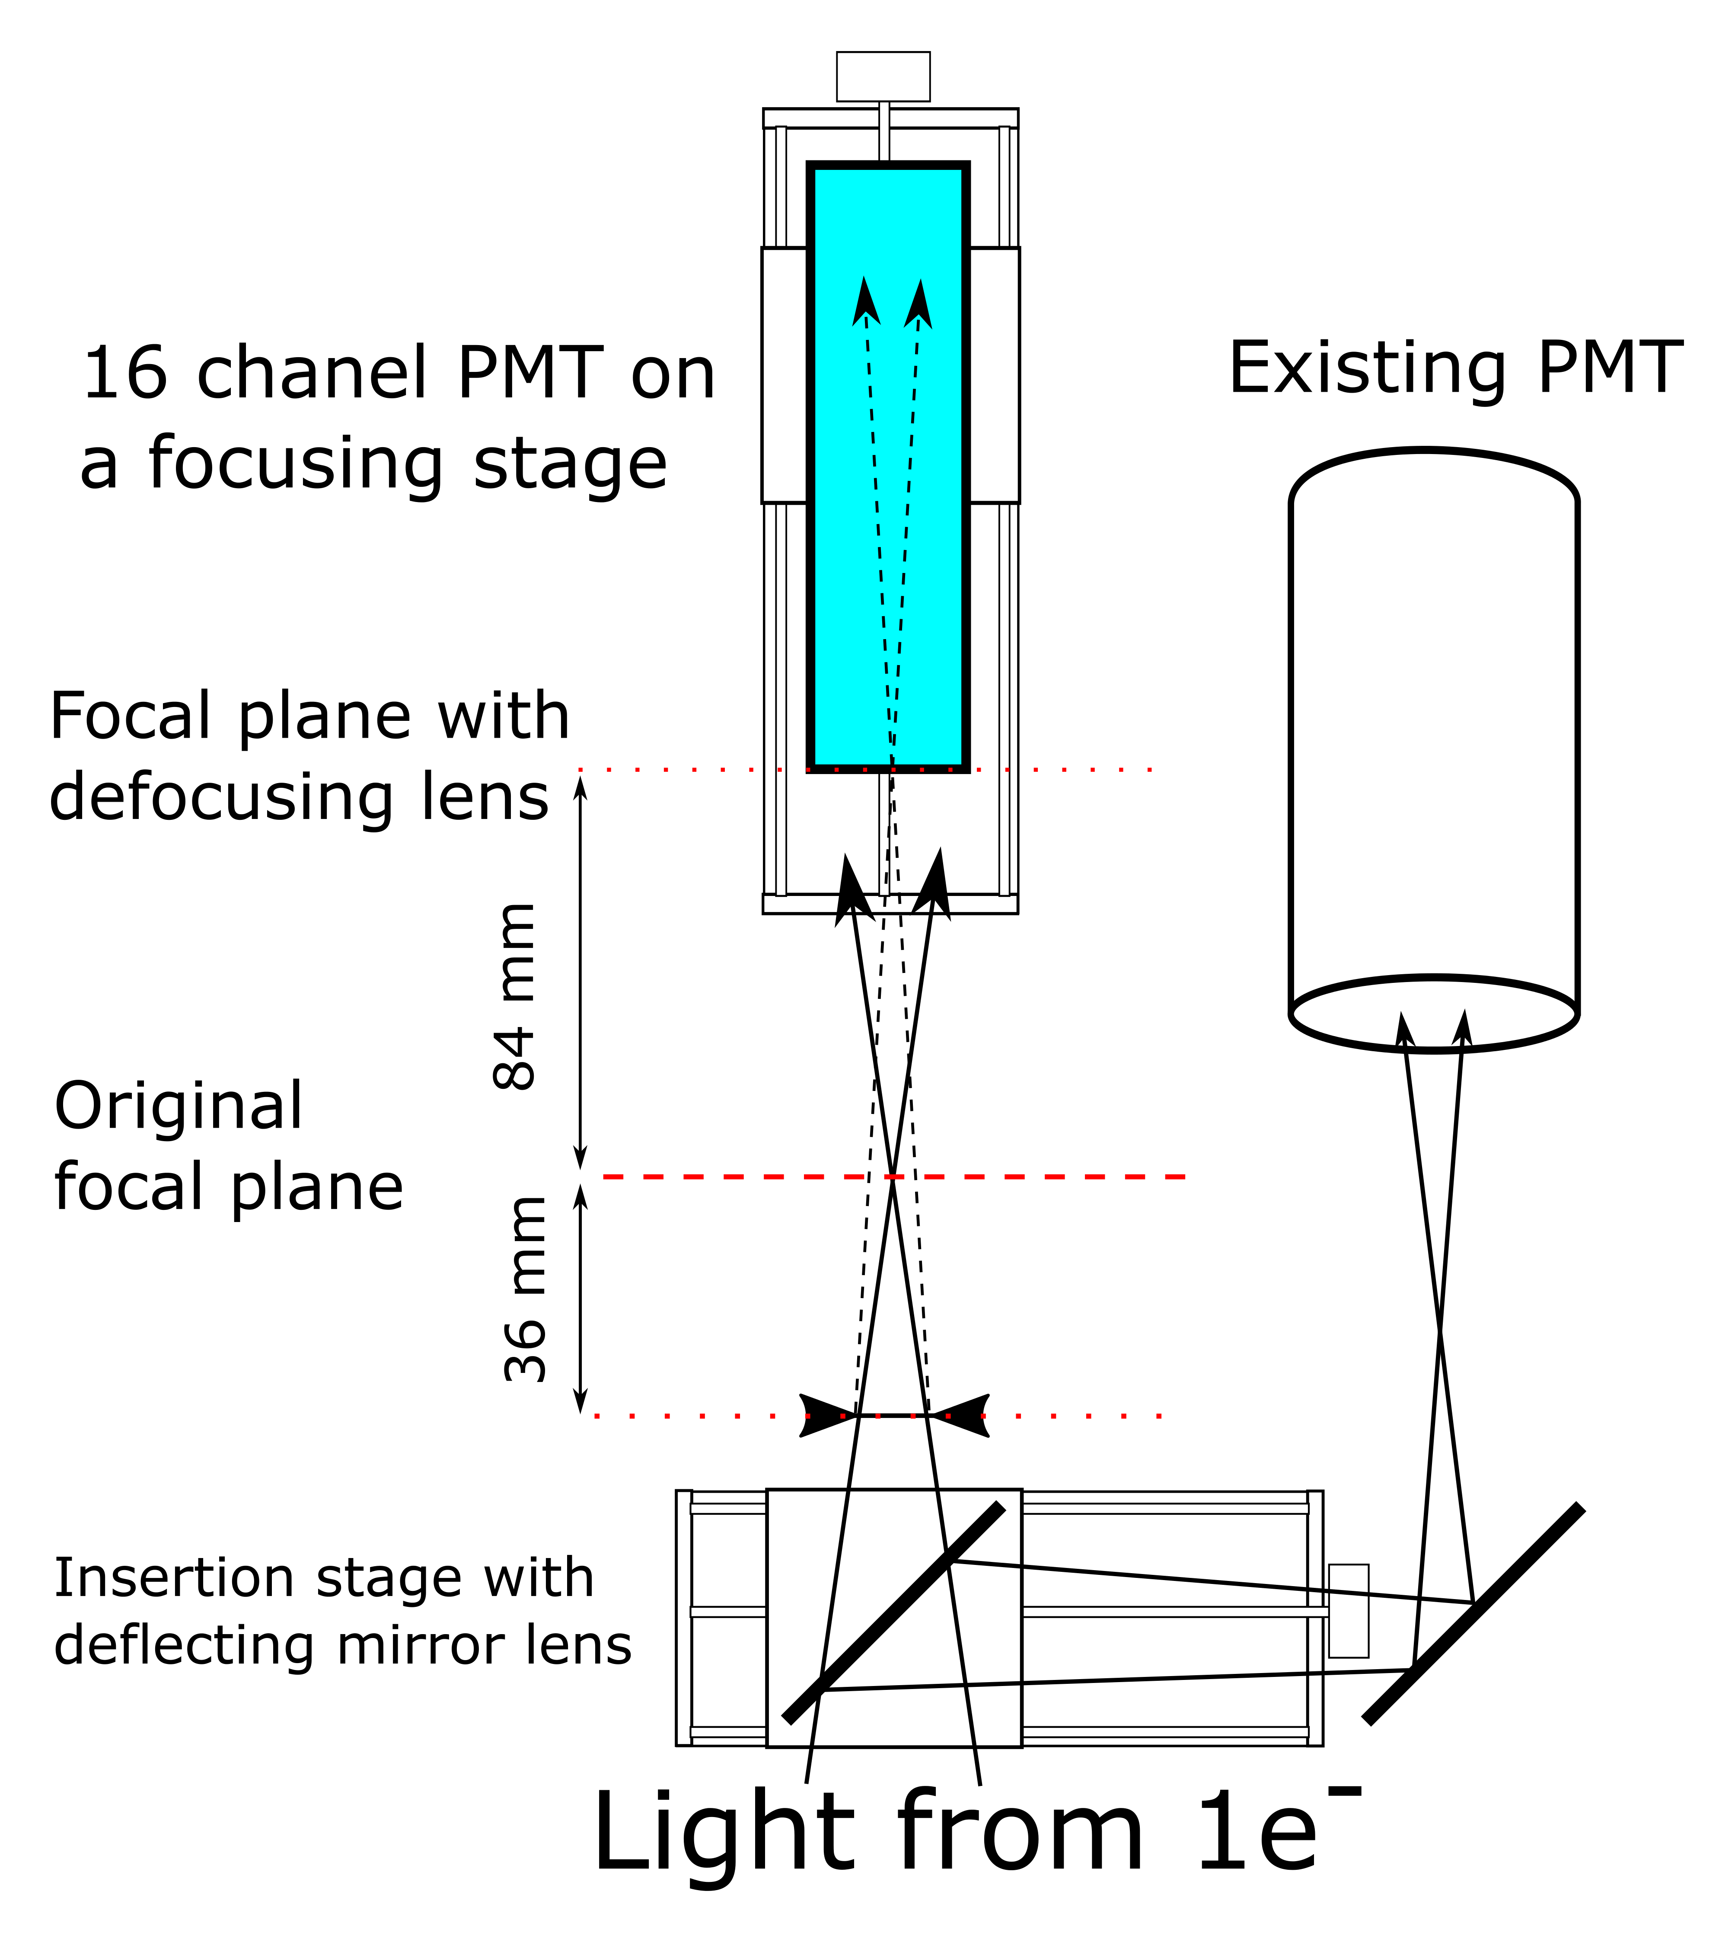
Experimental setup M2L
PML-16 replaces digital camera which also used to verify proper focusing after installation of the fixed magnification lens.
Magnification factor is approximately the same as for M3L station

Slide 8
Experimental data
PML-16 record continuous series of data entries for individual photons. Each entry consists of the following:
Absolute turn number
Detection time within the turn
Number of a segment that detected the photon
Service information
Two detectors are synchronized, and each produce a record of its own data series
Duration of the data recording and fine tuning of signal processing can be controlled with graphical user interface

Slide 9
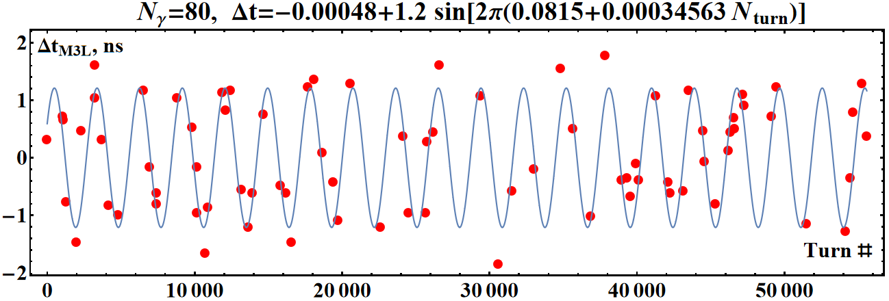
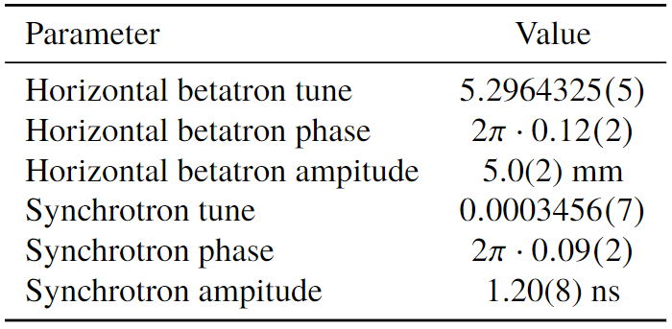
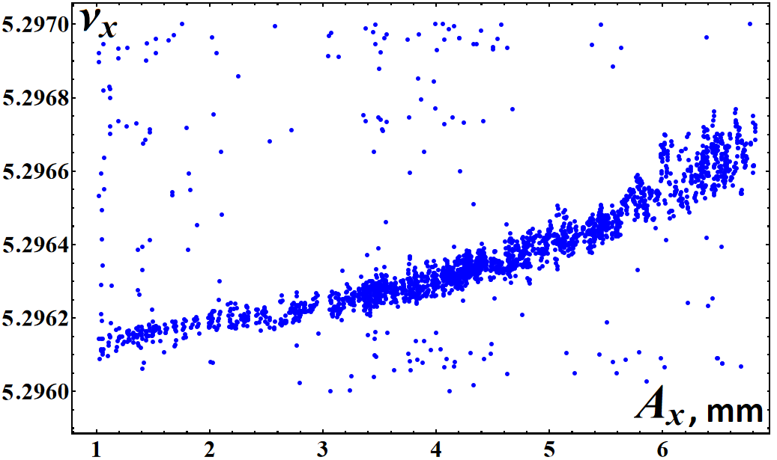
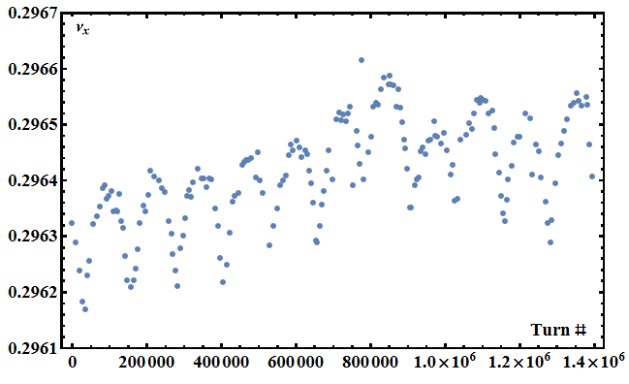
Preliminary data
The first PML-16 detector was installed in the ring for diagnostics enhancement.
Results from the commissioning of the apparatus are very encouraging
Parameters of the 4D electron trajectory measured using 80 photons over 60000 turns.

Slide 10
Studies plan
Already done as part of enhancing IOTA capabilities:
8, 2, 4 and 4 hours of access for upgrading M3L station.
The first access was used for installation
Consecutive accesses were necessary to track and fis problems caused by bad cable
2- and 1-hour of access time for a modification of M2L station
4-, 2- and 1-hour opportunistic shifts for initial commissioning of the data acquisition system
Planned activities:
2 of 1-hour of short accesses to finish M2L modification
2 of 8-hour shifts for 6D tracking in a linear lattice
3 of 8-hour shifts for 6D tracking in the NIO lattice

