Slide 1
Secure High Performance Networking at BNL
Winter 2013 ESCC Meeting
Honolulu Hawaii
John Bigrow

Slide 2
Objectives:
Highlight the BNL security techniques for RHIC and ATLAS
Current Architecture
User Access and Controls
Configuration Management
Vulnerability Scanners
Autoblocker
Illustrate our proposed 100gb/sec Science DMZ
100 gb/sec. full mesh architecture
100 gb/sec. production migration

Slide 3
Dark Fiber Deployment
Dedicated fiber infrastructure
Protected ring topology
A North Shore and South Shore loop
South Shore has mid-span repeater
North Shore Point-to-Point (BNL - NYC)
Lots of dark strands (spares) available
Classical Routing and Light Path connections

Slide 4
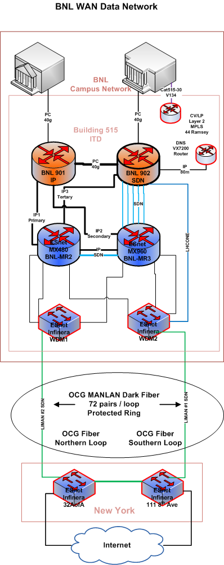

Slide 5
Basic Architecture
Dedicated security appliances are not available
ES net modified “Science DMZ” configuration
Separate data and control channel networks
WAN NIC – can’t firewall here
Campus NIC – can firewall here
Host-based firewall (IP tables) on dCache servers (WAN)
Policy Based Routing (PBR) on ATLAS links
Default Free Routing for High Performance Links
PBR for others (reverse logic)
Autoblocker (router ACL) on Internet interfaces
Minimal block is 4 hours

Slide 6
Basic Architecture cont.
Dedicated High Bandwidth Links
Directly connected to border routers
Virtual Gateway (HSRP) for fault tolerance
No network-based access controls on data path
No Firewall or Router ACL’s
Secure the “Control Channel”
Firewall or Load Balancer
Host based ACL’s

Slide 7
Basic Architecture cont.
Tiered Firewall Architecture for BNL Campus Access
PDN Firewall / Proxies
Access is either firewalled or proxied
Load Balancer on PDN Proxies
One IP address / service
Limits outside access into BNL
Secures ATLAS control channel
Internal Firewalls / Proxies
Access is either firewalled or proxied
Limits intra-campus access into RHIC / ATLAS
Slightly more liberal access controls

Slide 8
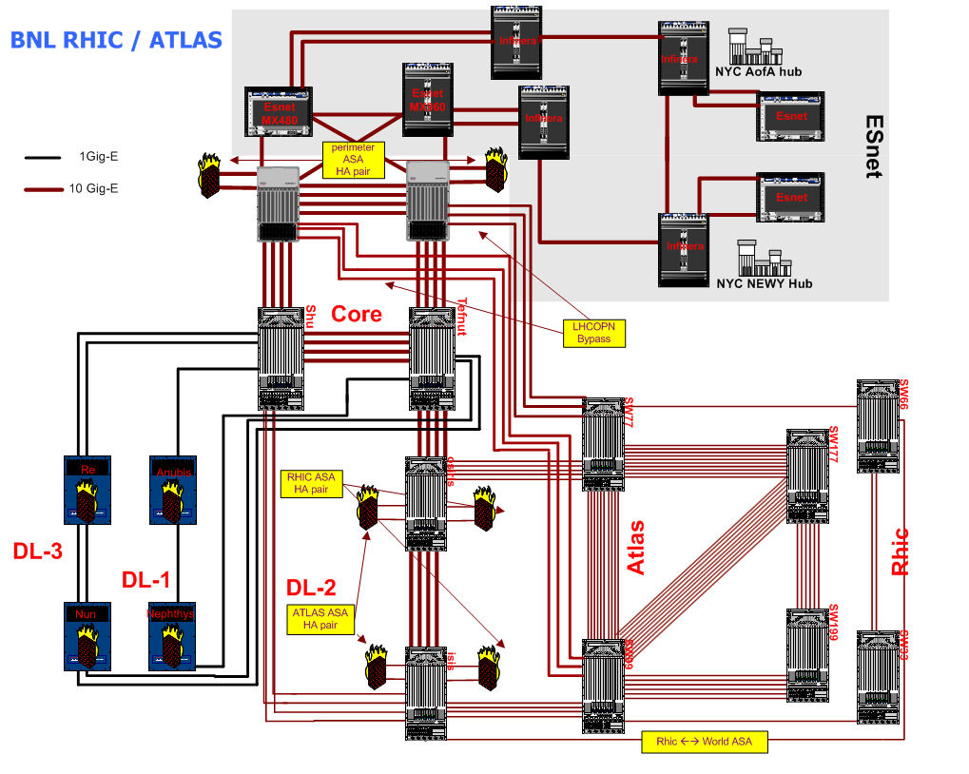

Slide 9
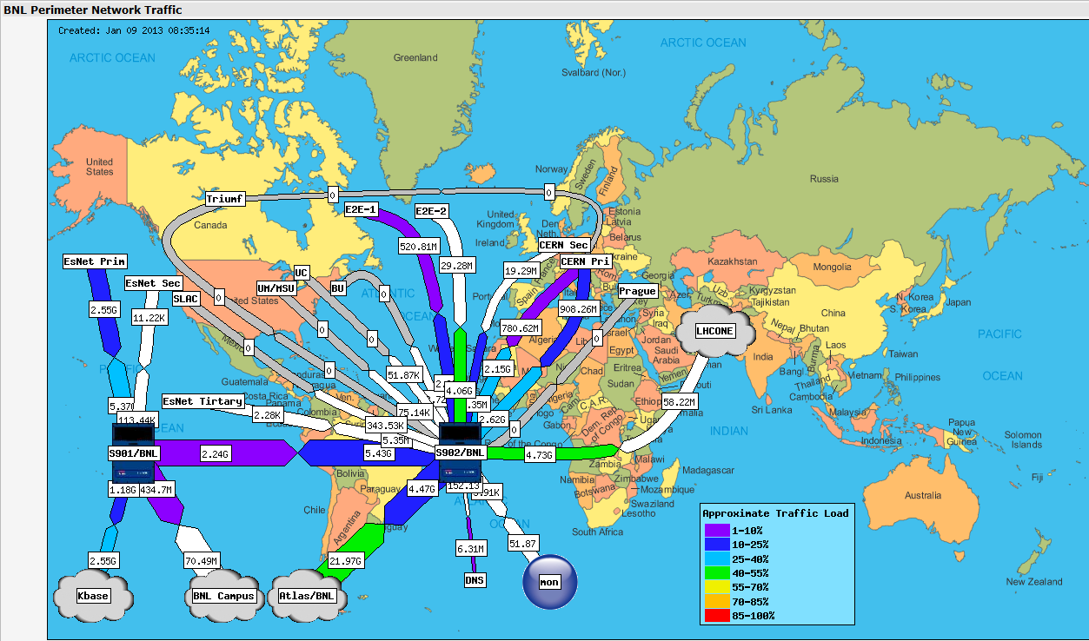

Slide 10
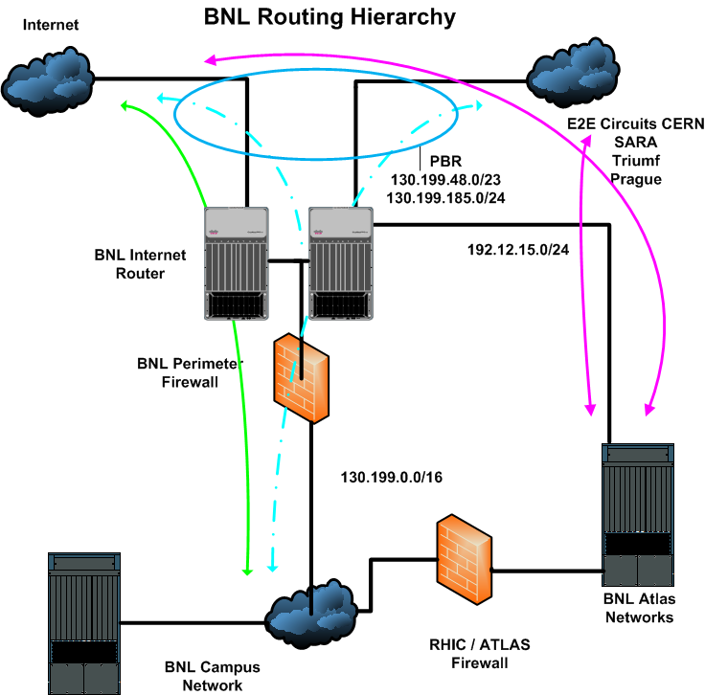

Slide 11
RHIC ATLAS Internal Architecture
Internal Access
Access is either firewalled or proxied
Limits intra-campus access into RHIC – ATLAS
Slightly more liberal access controls than PDN

Slide 12
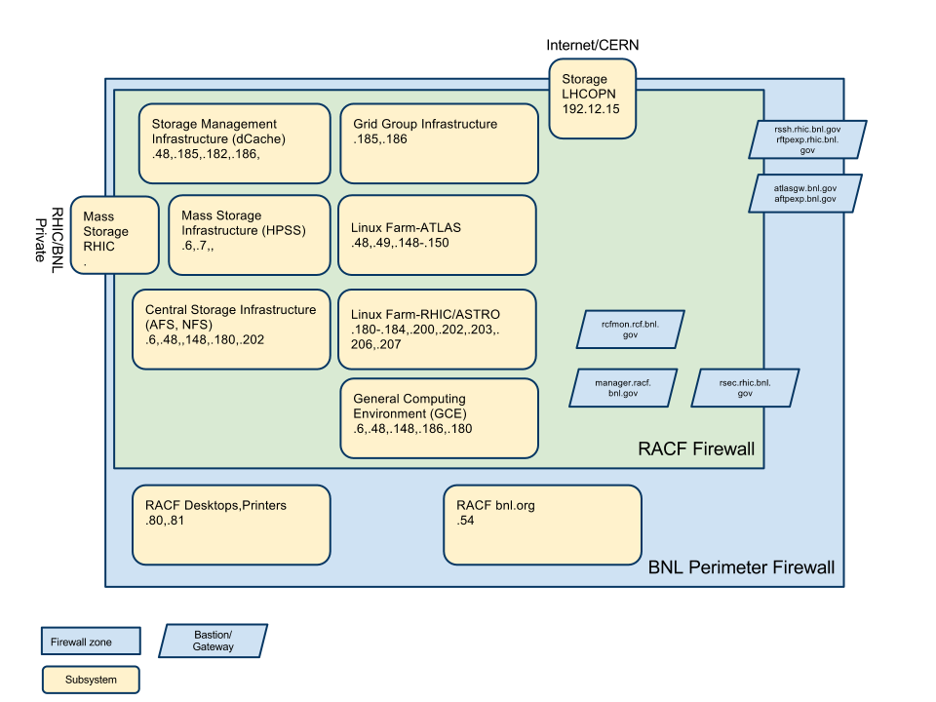

Slide 13
User Authentication
Internal RHIC / ATLAS Access
User access is either firewalled or proxied
Kerberos authentication
Active Directory for Windows environment
Centrify Active Directory for Unix
X.509 Certificates for grid
SSH Keys
Local Accounts

Slide 14
Configuration Management
RHIC / ATLAS uses Puppet
ITD uses CFEngine and RedHat Satellite Server
ORDO in-house tool for host configuration
Collects config files and emails them to the ordo master
Runs on multiple Unix-like OS’s

Slide 15
Vulnerability Scanners
Both External and Internal scanners
External scans are more intensive
Must pass scans to maintain firewall conduit
Quarterly, daily and continuous scanning
Quarterly are the most intensive
Continuous for high risk vulnerabilities

Slide 16
Autoblocker
Pseudo real-time dynamic ACL generator
Emulates a network engineer manually configuring an ACL
ACL blocks at the Generic Internet links
Time-based penalty box with cumulative sentence
Data sources include
Netflow / Sflow records
Centralized System Log Analysis applications
Manual additions and deletions

Slide 17
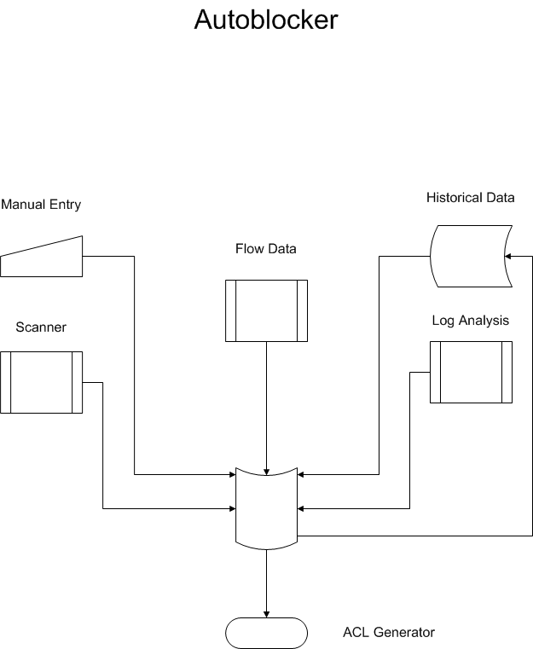

Slide 18
100gb Science DMZ Entry Level
100gb/sec
Provides native 100gb/sec. interfaces LR-4
2 port layer-3 cards
Can interface to ANI and Production waves
Ether channel between Nexus units
2 attachment ports at 100gb/sec

Slide 19
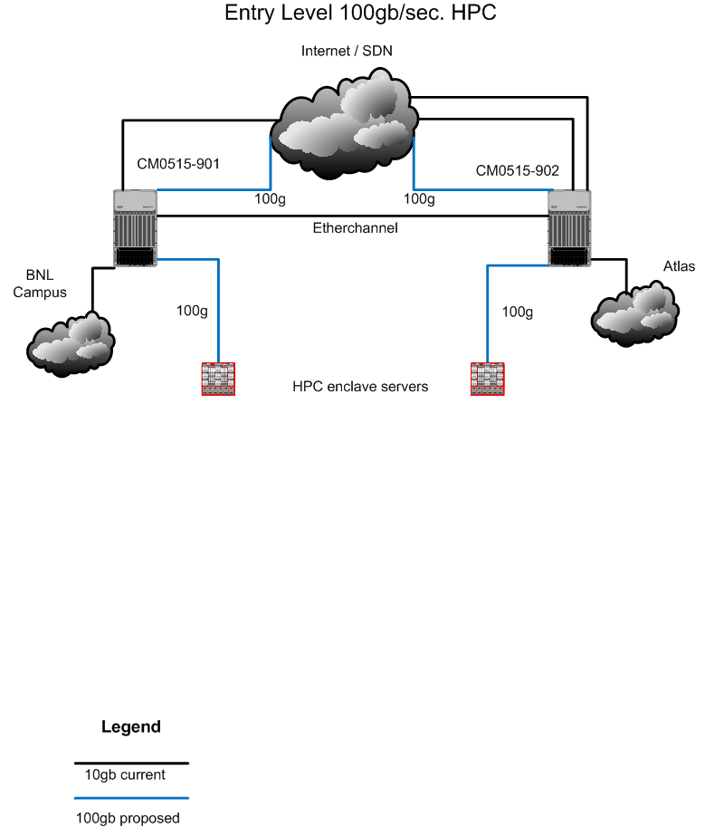

Slide 20
100gb Science DMZ Full Blown
100gb/sec full mesh
Provides native 100gb/sec. intefaces
Can interface to ANI and Production waves
Supports multiple 10gb/sec. and 40gb/sec. connections
2 attachment ports at 100gb/sec.

Slide 21
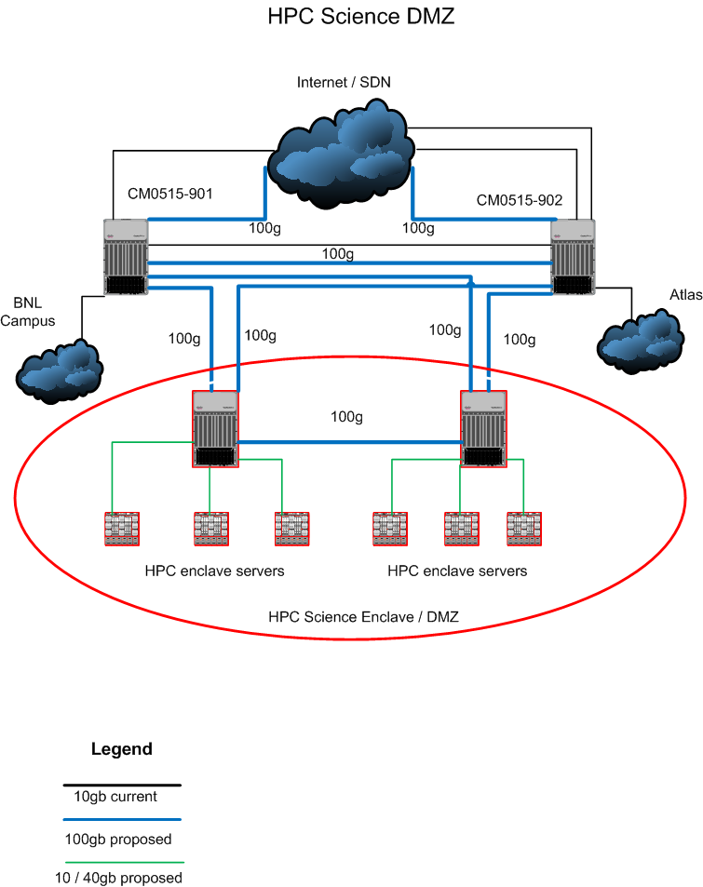

Slide 22
??? Thank You

