Slide 1
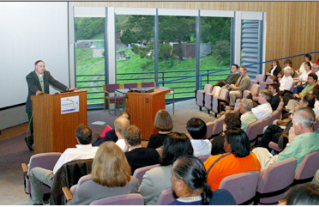
Summer 2013 ESCC planning
Thursday, July 18 – Friday, July 19^{th,} 2013
Lawrence Berkeley National Lab, Building 66 Auditorium
Program committee will be formed by Phil and myself
Joint ESnet/Internet2 “focused and frugal” meeting prior
Brian and Inder will be in touch for feedback from ESCC for topic ideas
Questions:
Hotel – on campus or downtown Berkeley?
Tours – ALS, Molecular Foundry?
Social Event – SF Giants on July 19th? Or explore other idea for July 18th?
DOE conference planning database for Q4, registration fee TBD
Winter ESCC – TBD, will need to plan, thoughts? Survey forthcoming!

