Slide 1
View from Washington and Germantown
Vincent Dattoria
ESnet Program Manager, Facilities Division, Office of Advanced Scientific Computing Research
January 17th, 2013

Slide 2
Talk Outline
SC Organization
ASCR Org Chart (old)
2013 ASCR Budget Request
DOE Conference Reporting (updated)
ASCR Facilities Strategic Planning
Notable Activities

Slide 3
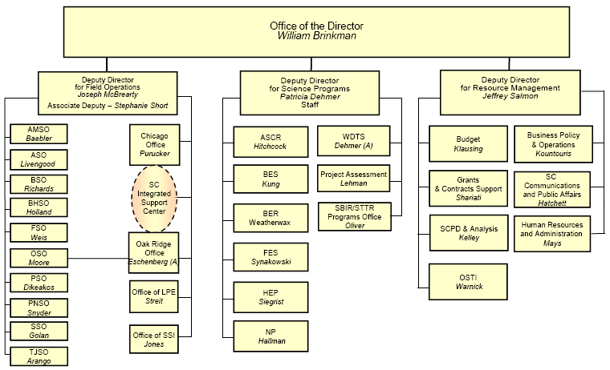
SC Organization

Slide 4
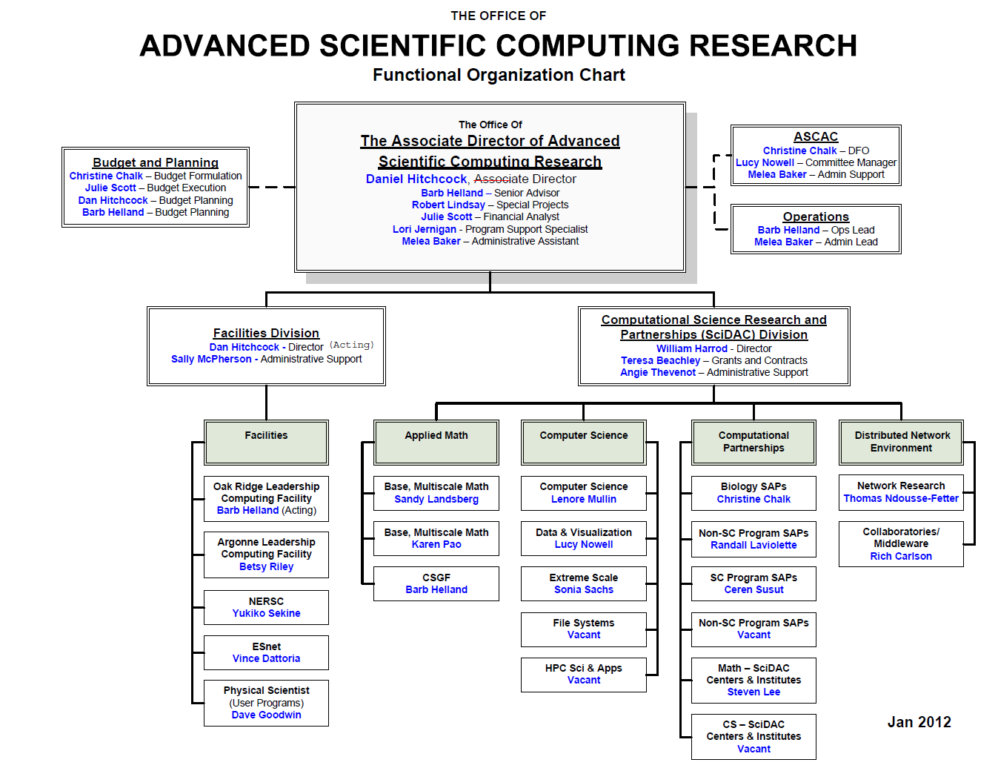
ASCR Org Chart

Slide 5
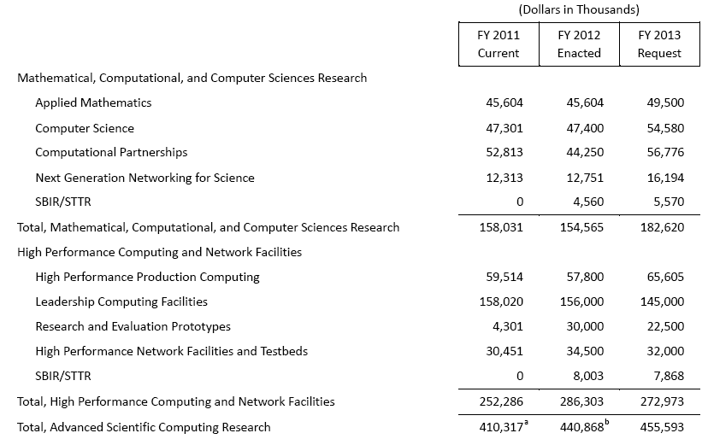
2013 ASCR Budget Request

Slide 6
DOE Conference Reporting
OMB policy for conference sponsorship, hosting, and attendance.
Data requested annually and updated quarterly (w/actuals).
Hosting a conference with 30 or more participants and at least half on official travel
Sending 15 or more participants from the organization
Conference expenditures >$100K (travel, fees, etc.) (SC)
Entered into conference database before authorizations begin
Scope: Feds and DOE contractors
Different approval levels based on costs:
AD/SC-2 for <$100K or operational in nature
Dep Sec for $100K-$500K
Secretary waiver for >$500K “exceptional circumstances”
Notes:
6

Slide 7
ASCR Facilities Strategic Planning
Strategic planning retreat- GTN
Each ASCR scientific user facility (ALCF, ESnet, NERSC, OLCF
Presentations in A.M., discussions in P.M.
ASCAC observers
Charge to Advisory Committee
Sent to each SC advisory committee
10-year view (2014-2024)
Subcommittee reviews plans and suggests subtractions or additions (>$100M)
Report due March 22, 2013
Notes:
7

Slide 8
Notable Activities
Upcoming-
ASCAC (Wash, AGU): Mar
ASCR Facilities Strategic Retreat (GTN, MD): Jan 30
2013 Exascale Operating and Runtime Systems (proposals due): Feb 18
NERSC/FES Program Requirements Review Workshop (Rockville, MD): Mar 19-20
ESnet/HEP-NP Program Requirements Review Workshop (Wash DC metro): Summer
ESnet On-site Operational Assessment (LBNL): Mar
ESnet customer satisfaction surveys due prior…

