Slide 1
Network Engineering Group Update
Joe Metzger, Network Engineer
ESnet Network Engineering Group
ESCC
January 17 2013

Slide 2
Outline
Current Network Status
Short-term next steps (6 months)
What comes after that?

Slide 3
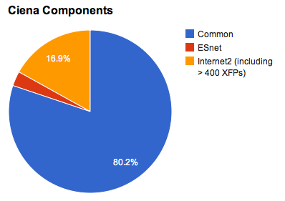
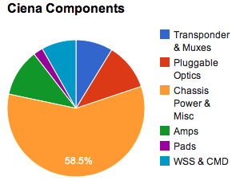
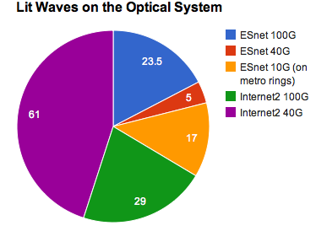
Current Status ESnet5 Transport Network
Shared Optical System
  All common components deployed & commissioned
  Dec 4th Optical System Inventory report has 6495 components!
    341 nodes total, 60+ are add/drop/regen
    80% are common, the rest are dedicated to ESnet or Internet2 (over 500 are XFPs.)
    Sunnyvale has 4 32-slot shelves
    Sacramento is a 7-direction node
  Still refining processes for sharing spectrum, chassis, configuration, management, etc.

Slide 4
ESnet5 Optical System January 2012
Geography is
only representational

Slide 5
ESnet5 Optical System January 2012
Lit Waves
Notes:
The long path from NERSC to Starlight is the 100G Testbed wave.

Slide 6
ESnet5 Routed Network
Routers
  16 new Alcatel Lucent (ALU) 7750-SR12
    10-slot router with up to 200G per slot
    56 100G interfaces & 200+ 10G interfaces
  35 existing Juniper MX’s
    Used in 10G hubs, commercial exchange points, sites
  12 existing Juniper M7i & M10i
    For terminating links slower than GE
  5 very old Cisco 7206
    For terminating links slower than GE
Services
  Standard routed IP (including full Internet services)
  Point to Point Dynamic Virtual Circuits using OSCARS
  Various overlay networks (Private VPN’s, LHCONE VRF)

Slide 7
ESnet5 January 2013
SEAT
100
10
PNNL
BOST
NEWY
MIT/
PSFC
STAR
10
10
INL
CLEV
AOFA
100
10
10
FNAL
100
10
100
EQCH
100
10
BNL
JGI
SACR
BOIS
10
10
LBNL
10
PPPL
100
10
ANL
10
10
100
AMES
1
100
100
GFDL
MANLAN
100
SUNN
100
PU Physics
NERSC
10
Salt Lake
10
100
SNLL
100
100
CHIC
WASH
JLAB
10
LLNL
10
SLAC
100
DENV
KANS
ORNL
1
LASV
LANL
100
100
LOSA
10
10
ALBQ
100
SNLA
100
SDSC
10
NASH
CHAT
100
GA
ATLA
ELPA
100
HOUS
SUNN
ESnet PoP/hub locations
100
100
ESnet managed 100G routers
Routed IP 100 Gb/s
Routed IP 4 X 10 Gb/s
3rd party 10Gb/s
Express / metro 100 Gb/s
Express / metro 10G
Express multi path 10G
Lab supplied links
Other links
Tail circuits
10
ESnet managed 10G router
10
100
Site managed routers
LOSA
ESnet optical node locations (only some are shown)
ESnet optical transport nodes (only some are shown)
commercial peering points
R&E network peering locations
LBNL
Major Office of Science (SC) sites
Geography is
only representational
LLNL
Major non-SC DOE sites
Notes:
7

Slide 8
Example: Optical System in Sunnyvale

Slide 9
Next 6 Months
  100G production connections to:
    ANL, BNL, FNAL, LBNL, LLNL, NERSC & ORNL
  100G production connections to exchange points & R&E peers:
    MANLAN, Starlight, PACWAVE, WIX, Internet2
  40G into Equinix Ashburn & re-arranging our Washington DC ring to provide diverse backbone connections for JLAB & other sites in the area
  Diverse fiber laterals & diverse optical nodes at ANL & FNAL
  Deploying diverse routers at ORNL
  Lots of cleanup & consolidation at the hubs, moving connections from the MX’s to the ALUs
  Normalize 100G Testbed infrastructure
  Swap out our un-supported ‘third party’ 10x10 MSA CFPs in our Ciena interfaces with Ciena supported ones covered by 4-hour on-site maintenance contract

Slide 10
Disclaimer for rest of this slide deck
  The rest of this slide deck makes all sorts of assumptions
    Some have been carefully thought out
    Some haven’t had much thought at all
    Some we don’t even realize we are making
    Some of them are sure to be violated
  It is intended to spur thought and discussion.
    Not to come up with the right answers today, but to make sure we are not missing any important questions.

Slide 11
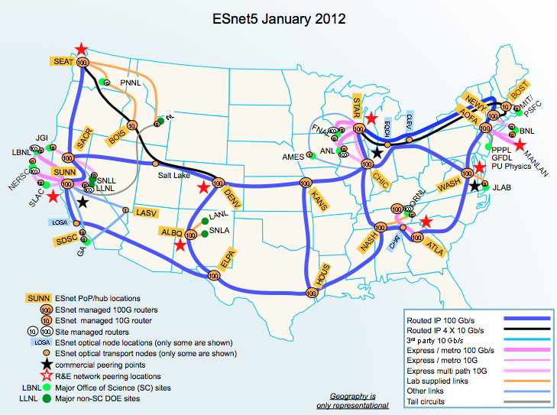
Backbone & Traffic Metrics
Backbone Bisection Bandwidth:
Average Accepted Traffic:
Sum of Links crossing the red line
Sum of inbound traffic crossing red line from Sites & Peers, converted to Gb/s
Site
Peers
Site
Peers
ESnet
Peers
Site
Peers
Site
Notes:
11

Slide 12
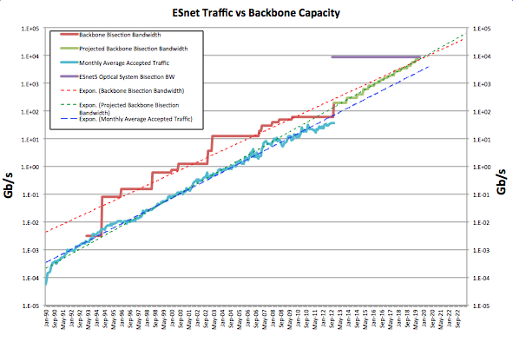
Notes:
Discuss slope of lines.

Slide 13
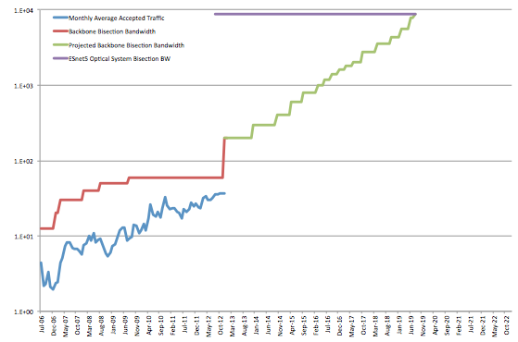
Projections for next 7 years

Slide 14
Projections for next 7 years
Optical System full in 2020 at 88x100G assuming no 400G Waves
ESnet5
ESnet4
ANI Prototype
10x100G on all routes by 2017
Next Wave Fall 2013
(Testbed?)

Slide 15
Cost Inflection Points next 7 years
Add routers & optical chassis incrementally with wave adds from 2015 on
Hit optical system capacity at current spectral efficiency in 2020
Need to start deploying next generation network 2017 or 2018
ESnet5
Routed network exceeds ESnet4 complexity 2016
ESnet4
ANI Prototype
Contract on Shared Optical System expires 10/31/19

Slide 16
Things to consider
  How much ‘head-room’ is enough
    Need less ‘bisection bandwidth’ if traffic is local vs cross-country
    Need more for unpredictable users
    Need less for predictable steady-state users
      Could automated science work-flow systems be more predictable, and sustain utilization >75%?
  Some changes that could drive growth faster than projected
    Science DMZ adoption reducing impacts of poorly performing firewalls & security infrastructure
    PerfSONAR adoption & deployment allowing people to discover & fix broken infrastructure
    Data mobility tools enhancement & adoption
    Commercial Adoption rate of 100GE will affect the price curve of 100G components driving up lab adoption rates
    Changes in science data access models could affect growth rates in either direction
Notes:
----- Meeting Notes (1/10/13 12:13) -----
REwrite last bullet

Slide 17
Evolution of ESnet5
  Simplifying Hubs where possible
    Removing ‘extra’ points of failure
  Optical Express circuits
    Some circuits could bypass all routers
  Expanding International reach, capacity & control
  For now, we have collapsed Nx10GE of IP & SDN traffic onto single 100G circuits using QOS for logical separation.
  We anticipate moving back to physical separation of traffic onto different links as additional circuits are added.

Slide 18
Evolution of Site Interconnections
  Goal: provide the best possible service within the constraints
    Dimensions of ‘best’ that are important:
      Bandwidth
      Reliability
      Predictability
      Risk tolerance
      Debug-ability
      Flexibility
      Cost
    Discussion Question: What are the comparative weights of the different dimensions?

Slide 19
Diversity Examples
Notes:
The site at the top has 5 routers and 4 links which are single-points-of-failure strung in series.
The ex4200 and m7i in the hubs are essentially media converters to step down speeds and generations of technology.
The site at the bottom does not have any single points of hardware failure.

Slide 20
Which is better?
Notes:
The top lab would have ESnet measurement infrastructure connected to the MX on-site, as well as the ability to provide interfaces for misc enclaves such as site-wireless, Operations office, remote lab disaster recovery lan, etc,
What is the impact of eliminating site routers?
What is the impact of limiting or reducing the number of physical connections to different enclaves at a site?
Is 10G backup enough?
Does the ability to do optical protection/mesh restoration of the 100G make a difference?
Where does the Science DMZ go?

Slide 21
Site Connections beyond 200G
Is the architecture this simple?

Slide 22
Possible Additions to Network Services Portfolio
  Looking at additional types of overlay networks
    Layer2 VPNs
      Point to Point
      Multipoint
    Layer3 VPN’s
      IPV4 and IPV6
    We haven’t figured out which subset we need to support
    Please let us know if you anticipate future requirements for overlay networks so we can take your needs into consideration
Notes:
I need more context on this

Slide 23
Additional NEG Updates
DNS DOS Rate Limiting
Improving site interactions
Trying to figure out how to move from ad-hoc and event driven interactions to something that is more organized and intentional
NEG Ambassador?

Slide 24
Questions?
Thanks!
Joe Metzger – metzger@es.net
http://www.es.net/
http://fasterdata.es.net/

