Slide 1

26 June 2023 FD2 PDS Module Design Workshop:
Overview and Schedule
David Warner
6/26/23

Slide 2
Outline
History of mechanical development
PD module description
  Module dimensions, general design outline
  SiPM spring loading
  Electronics housing
  HV protection
  Filter plate mounting
  Assembly and shipping plan
PD mounting in detector
  Cathode mounting
  Membrane mounting
Testing plan and schedule
  Photon Collection Efficiency measurements
  Module 1
  Schedule summary

Slide 3
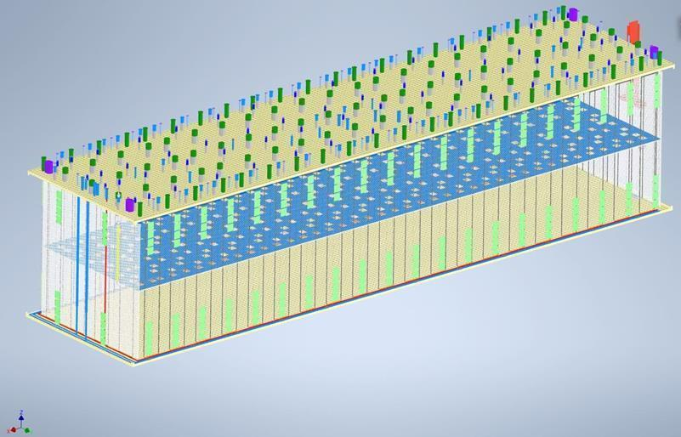
PD module arrangement on TPC
Membrane mount modules
(20 strings of 8 modules
Per side, 320 total)
Cathode modules
(80 cathodes, 4 modules
Per cathode, 320 total)
End wall modules (16 per
End, 32 total

Slide 4
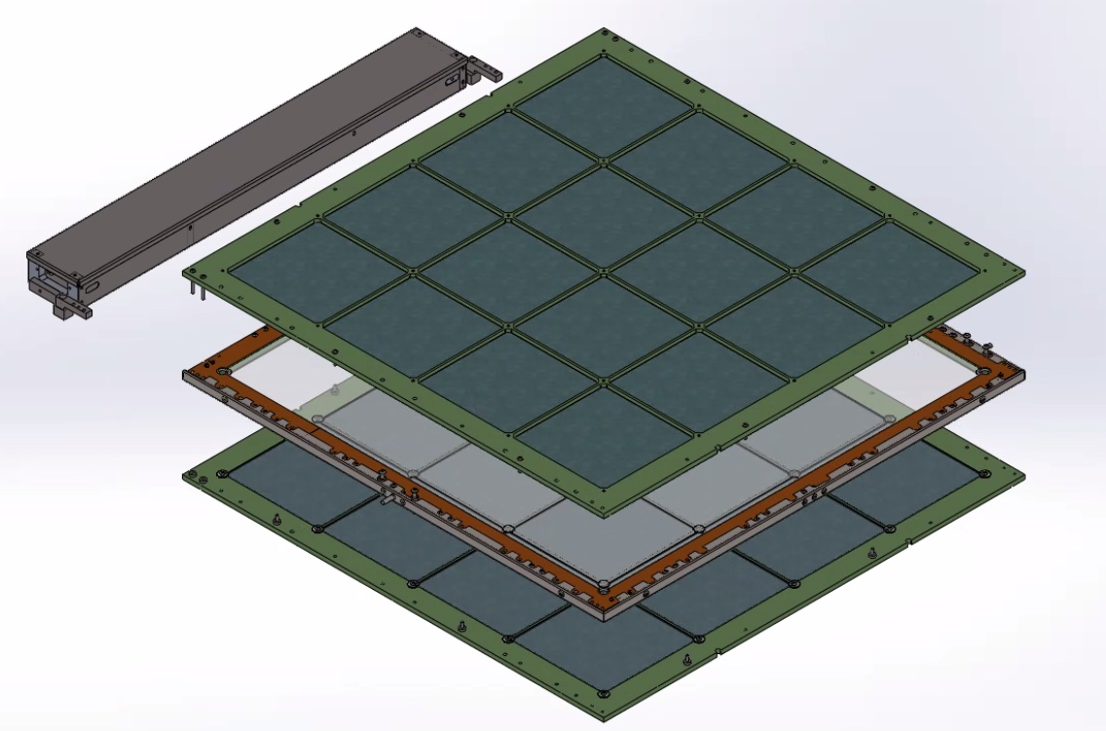
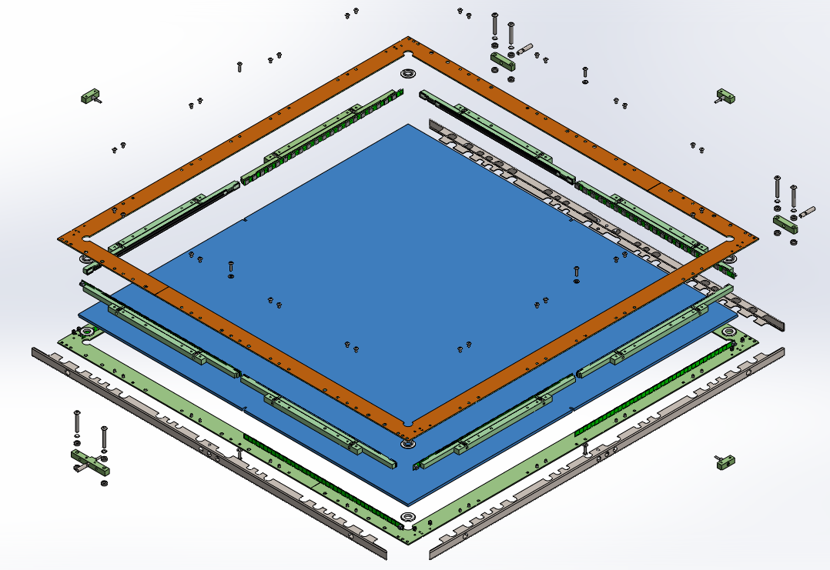
Module concept
Drawings: https://edms.cern.ch/project/CERN-0000240991
Models: https://edms.cern.ch/project/CERN-0000240990

Slide 5
PD system layout (by the numbers)
320 Cathode modules
  73.4 X 65.3 X 3cm³
  8.8 kg (dry) 2.7kg (submerged)
  160 SiPMs (51,200 total)
  2 readout channels
  32 WLS plates (144 X 144mm²)
  2-sided readout
  1 WLS plate
352 Membrane modules
  74.6 X 65.3 X 2.6cm³
  8.8 kg (dry) 2.7kg (submerged)
  44 readout columns (8 modules each)
  160 SiPMs (51,200 total)
  2 readout channels
  16 WLS plates (144 X 144mm²)
  1-sided readout
  1 WLS plate
44 Membrane mount module support assemblies
40 flange assemblies
88 monitoring system kits
  44 top, 44 bottom kits.
  176 light diffusers (mounted to field cage supports, one per membrane mount column).
  176 flasher channels.
Most inner module surfaces lined with Vikuiti reflective foil to increase light collection.

Slide 6
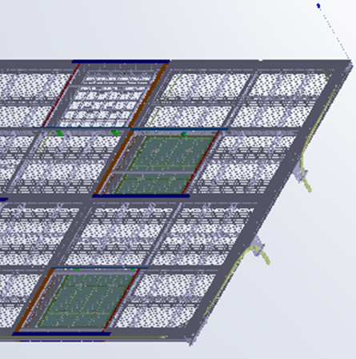
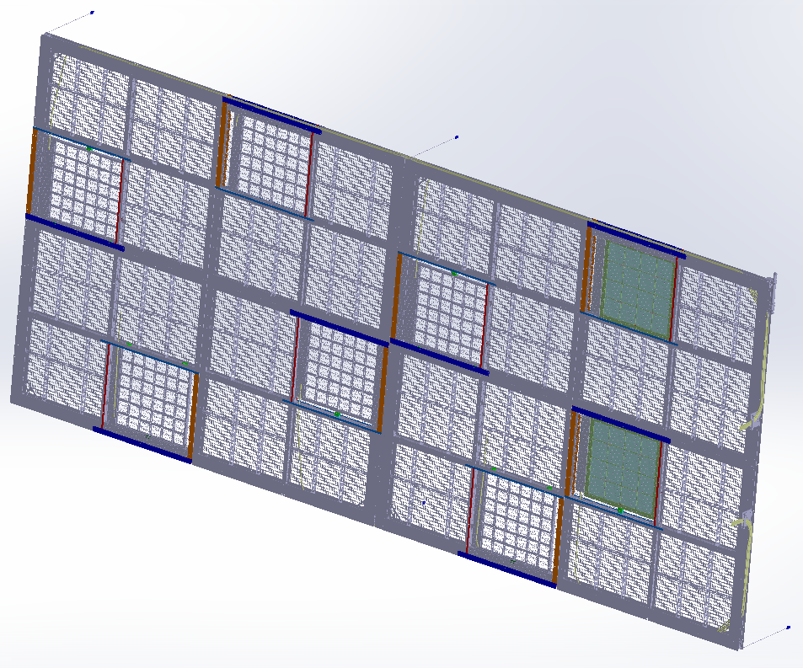
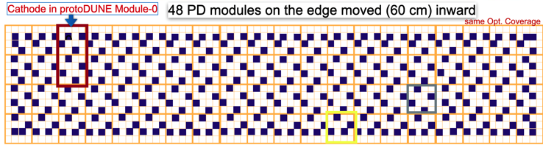
Cathode mounted modules
Fiber routing path
Fiber exit points
Note: field cage side
Modules stepped back
From edge (HV protection)

Slide 7
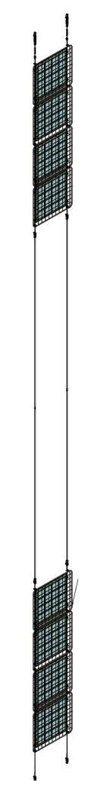
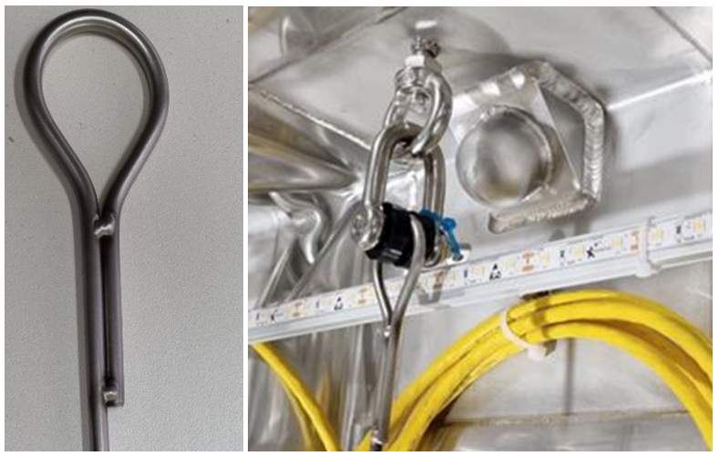
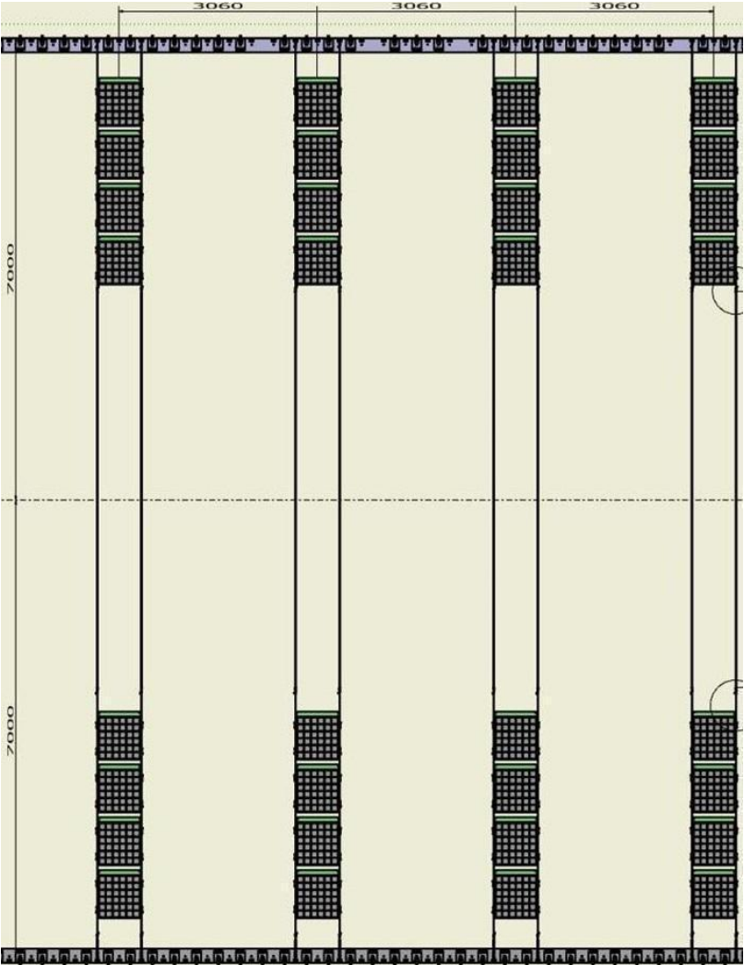
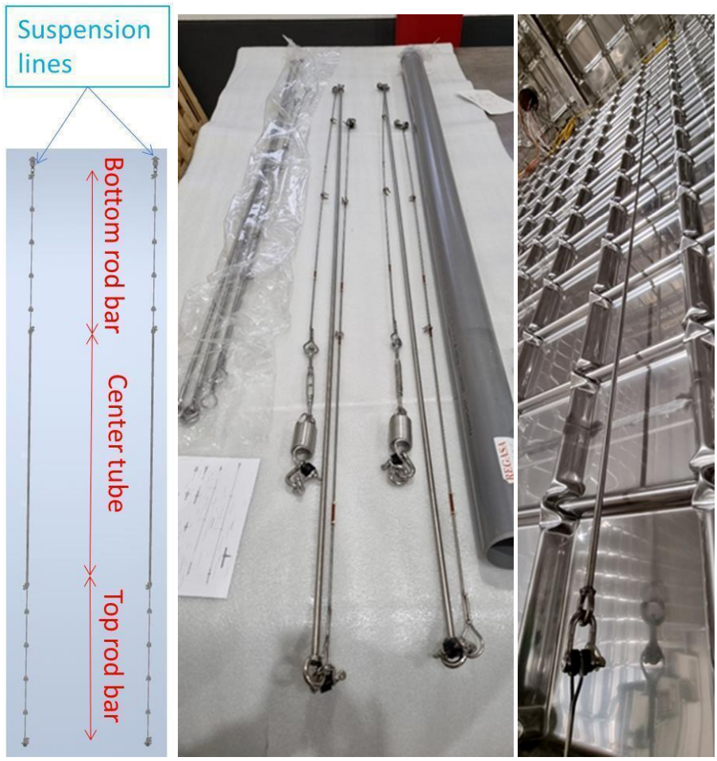
Membrane mount
PD modules are suspended in front of membrane wall.
2 stainless steel suspension lines anchored to membrane at top and bottom (M10 screw).
HV
Protection
Mesh

Slide 8
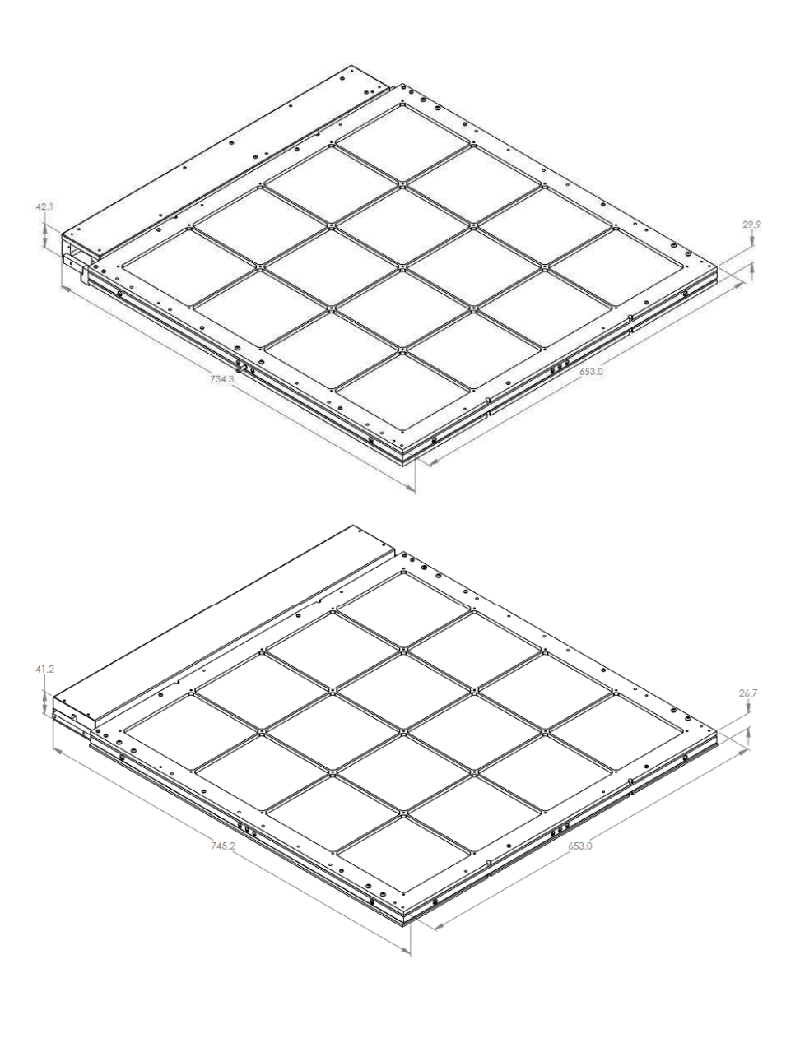
Module assemblies
PD modules are composed of 4 main components:
  Core (SiPMs, WLS plate).
  Filter frames (two, or one plus one backing plate for membrane module).
  Electronics enclosure.
Cathode Module
Membrane Module
Note: Replaced with FR4 backing plate
(Vikuiti lined) for membrane module

Slide 9
Core- Exploded view
1 Oz Copper-clad FR4
CU-clad one side only)
(Change to single piece?)
SiPM Spring
Loading
Custom stainless
Steel channel
(Optimize to reduce bending?)
WLS Plate
(No dimples? 5mm thick?)

Slide 10
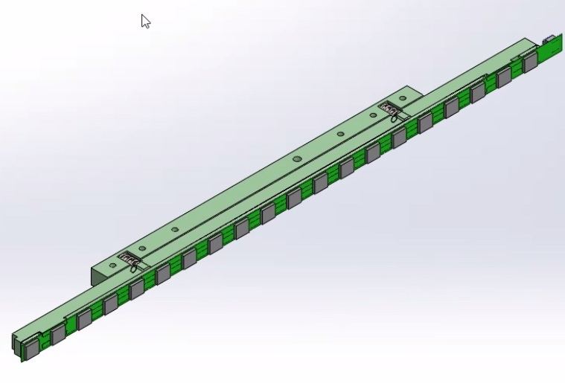
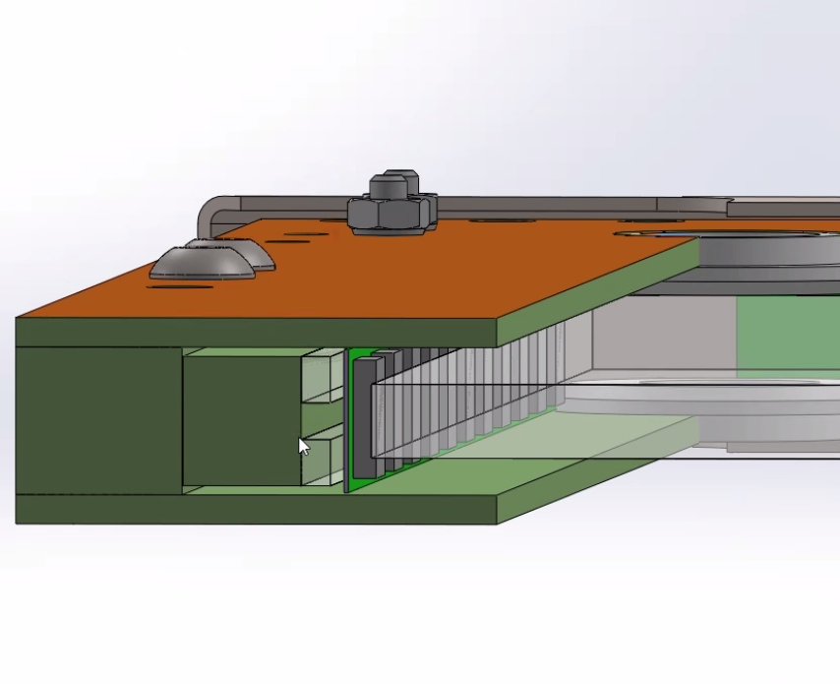
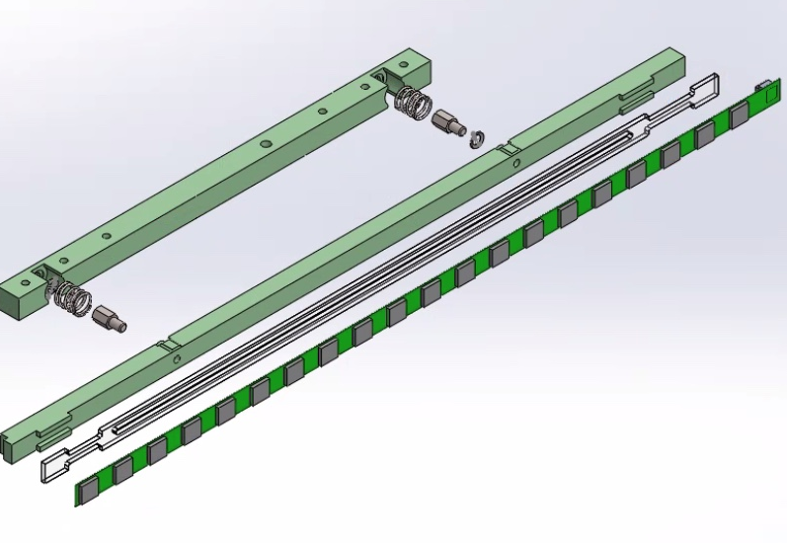
Core- Spring-loaded SiPM mounting
2 springs push SiPMs against WLS plate
Designed to accommodate full relative WLS plate motion during cooldown (~6mm total)
Acrylic shoe behind flexi PCB to manage contraction of PCB relative to spring structure.
Need to optimize Vikuiti on SiPM PCBs.
Vikuiti here

Slide 11
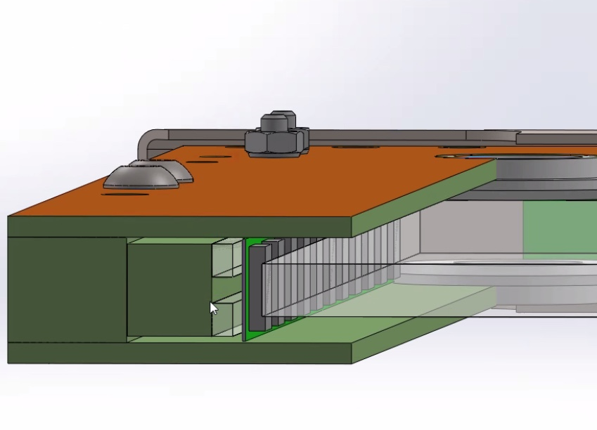
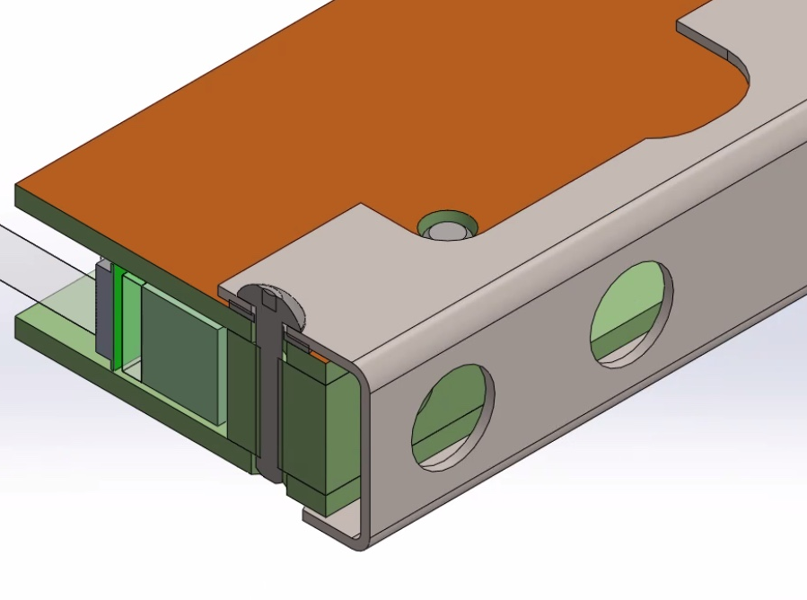
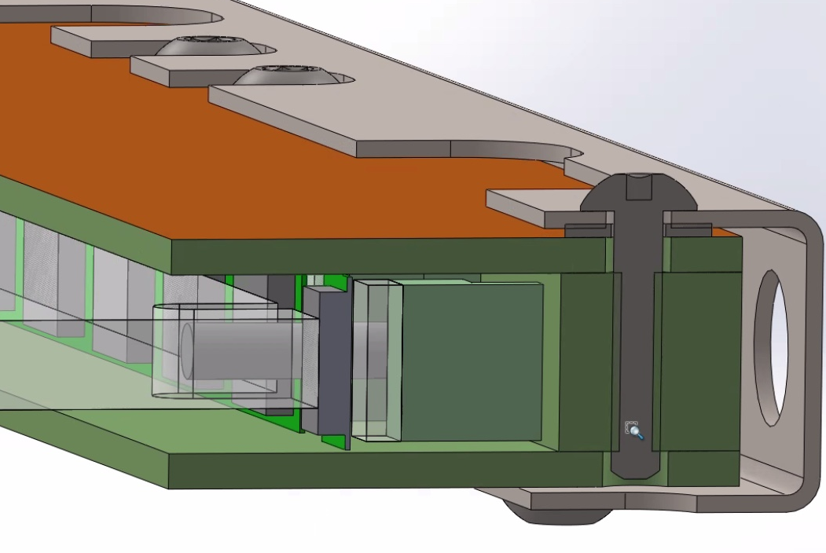
Core- Cathode HV breakdown protection
3-sided Faraday cage (single-sided copper-clad FR4, stainless steel backing channel) provides protection for SiPMs and cables.
Connected to electronics box ground.
Enclosure designed to protect SiPMs after thermal contraction of WLS plate.
Validated by simulations at FNAL, BNL.
Need to optimize Vikuiti application
Vikuiti?
Tyvek?

Slide 12
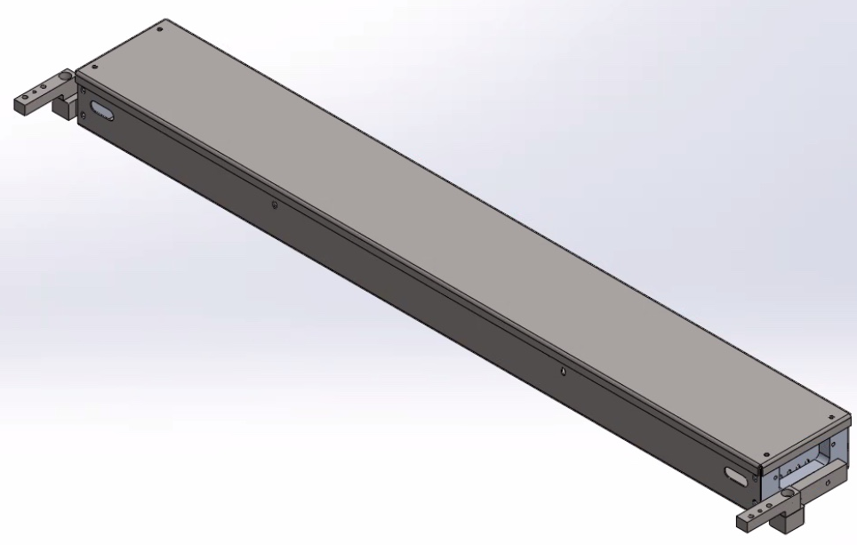
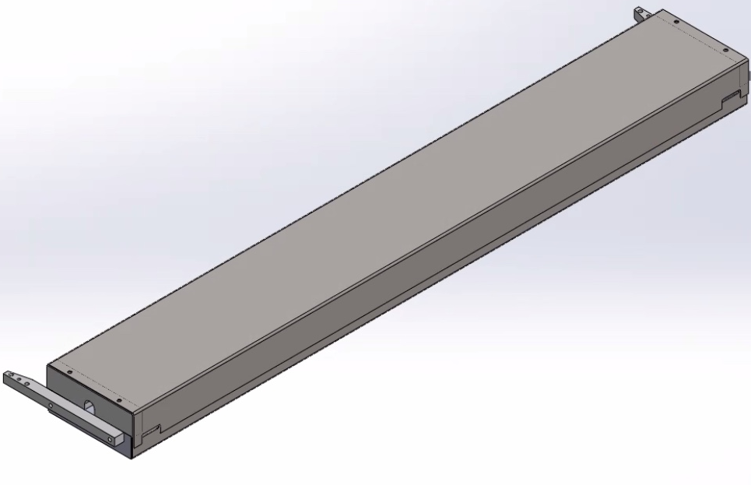
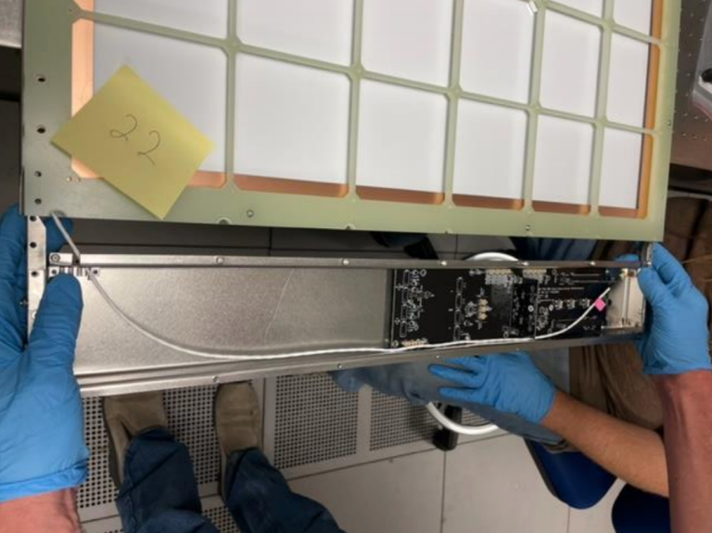
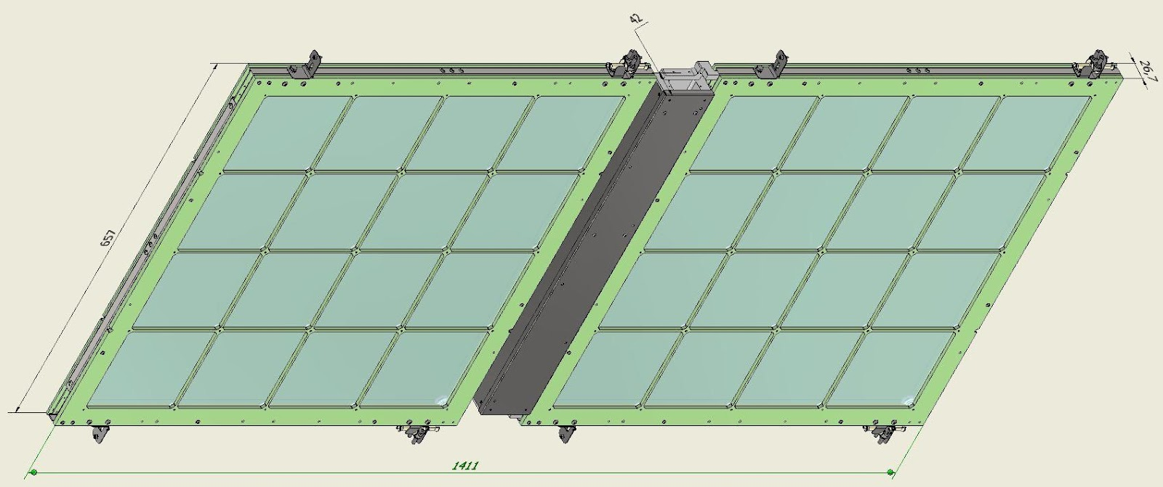
Electronics enclosures
Ground
Isolation
Here
(Membrane)
Folded stainless-steel sheet metal box.
Top cover can be removed after assembly to allow electronics hookup following installation in cryostat.
Extends module Faraday cage around electronics.
Provides light shield around POF and SOF to protect module
Can house both membrane (Copper) and cathode (POF, SOF) electronics
Shared box for two membrane modules
Protected from Faraday cage electrical contact
Cathode electronics box
“Fork lift” mounting arms
Membrane electronics box
(note openings in back)
Membrane module shared electronics box

Slide 13
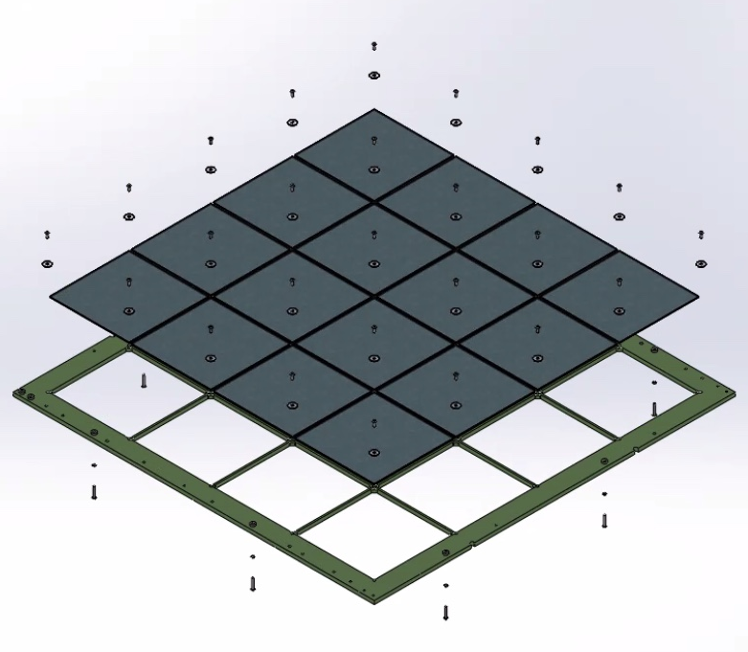
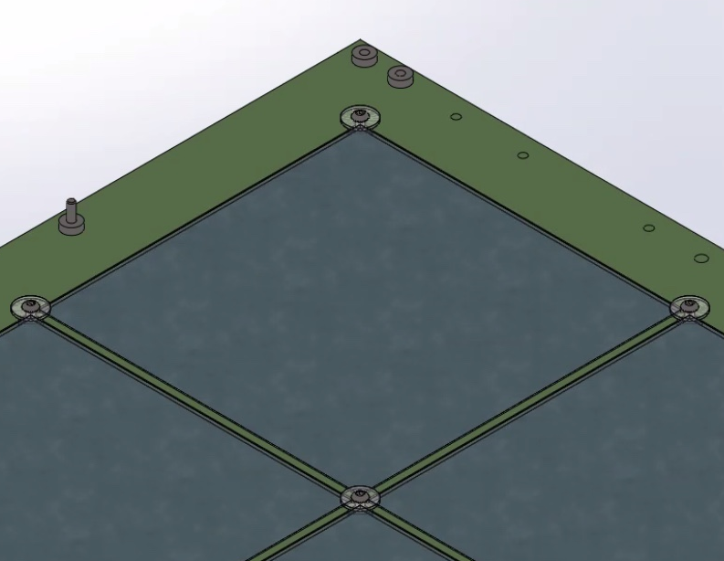
Filter Frame Assembly
Dichroic filters are supported in pockets in FR-4 G-10 frames (16 per frame). (Can we accommodate 200 X 200mm filter plates if they become available?)
Held in place by polycarbonate washers with M3 screws.
Assembly time is approximately 30 minutes per frame.
Frame ribs covered with Vikuiti to increase light collection. (Need to optimize application)
Filters flush with inner surface of frame (optimize ARAPUCA effect).
Rib height minimized to avoid light loss. (Can we reduce shadowing on front face? Thinner sheet?)
Vikuiti-covered
ribs
Polycarbonate
Washers

Slide 14
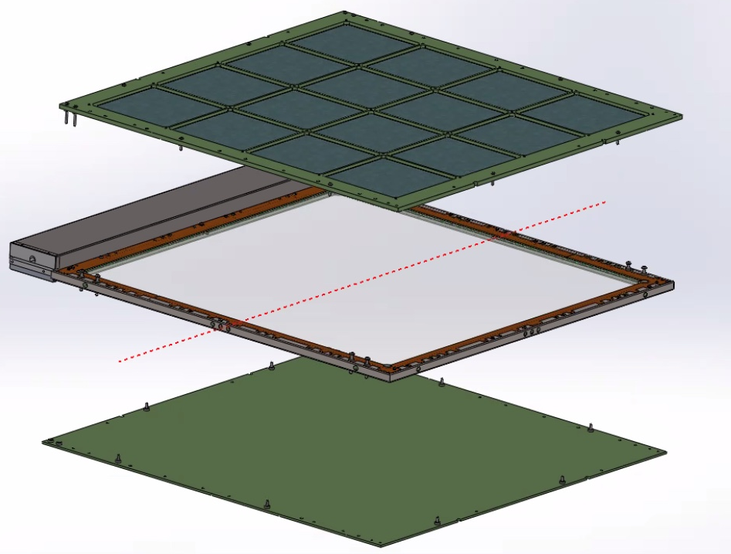
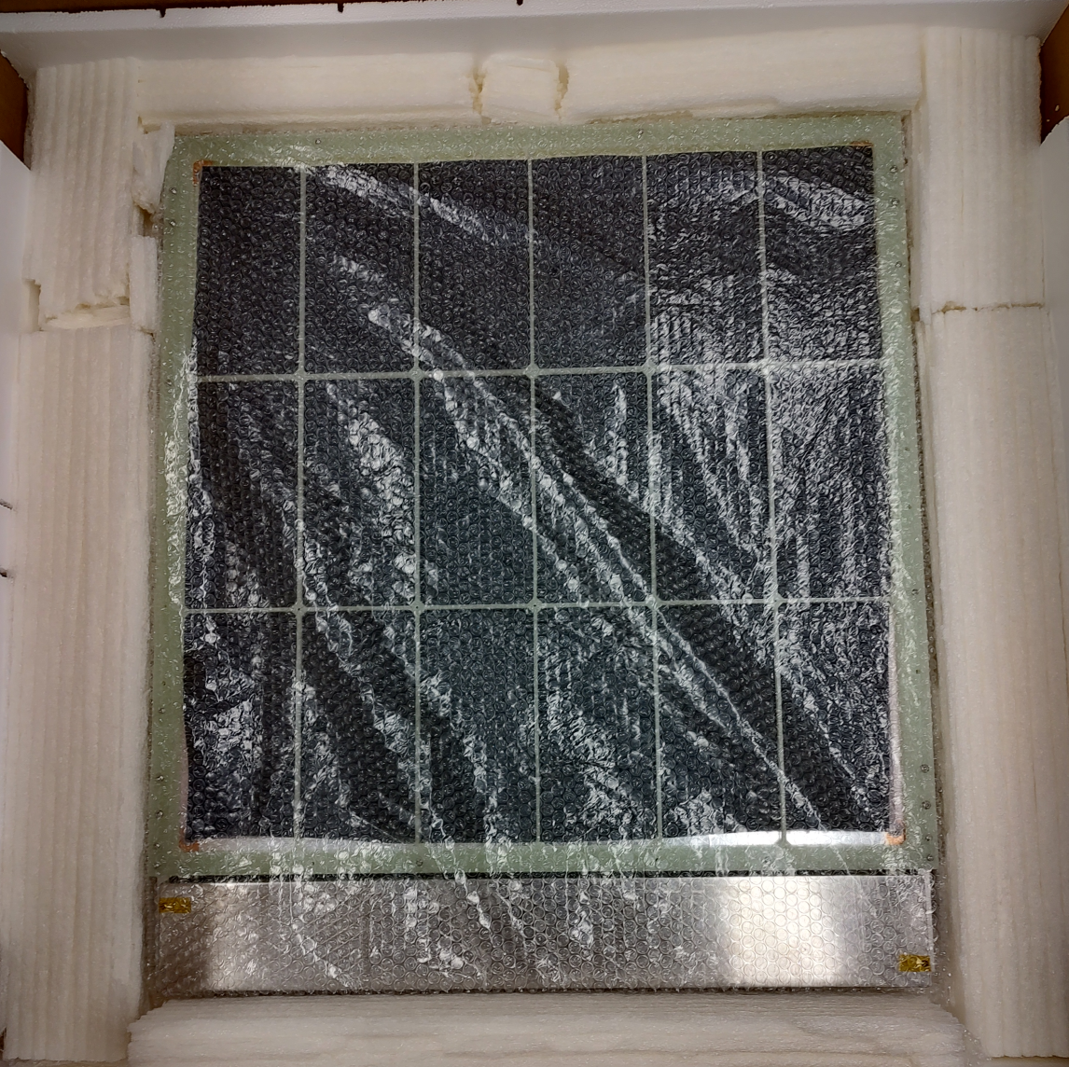
Shipping/ assembly plan
PD modules to be shipped in 3 pieces:
  Core assembly (including SiPMs, WLS, electronics box, Faraday cage) pre-assembled at assembly sites.
  Filter frame assemblies and backing plate for membrane module.
  Dichroic filter plates
Assembly at SURF will consist of:
  Loading filters into frame ~ 30 minutes per frame. (Question: Can we pre-load filters in frame?)
  Screwing frames to module core (~10 minutes per frame).

Slide 15
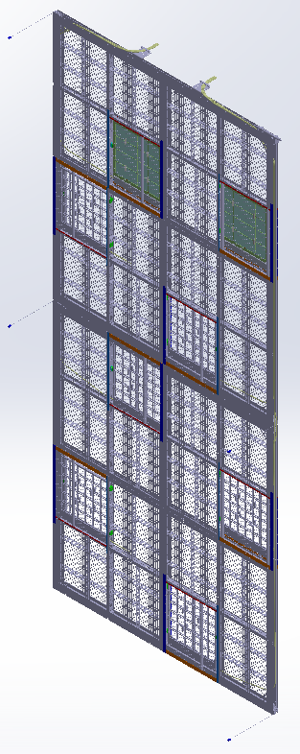
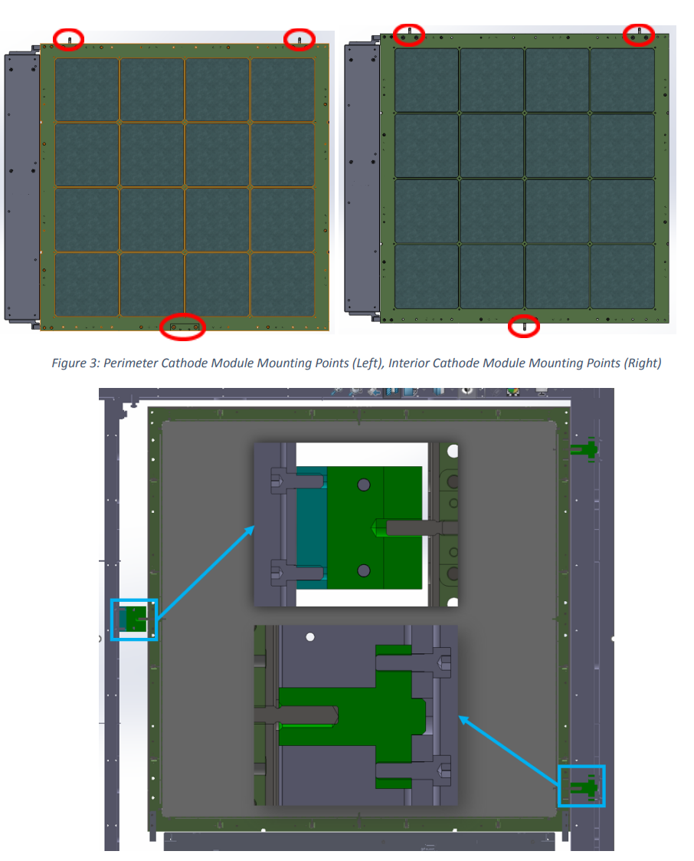
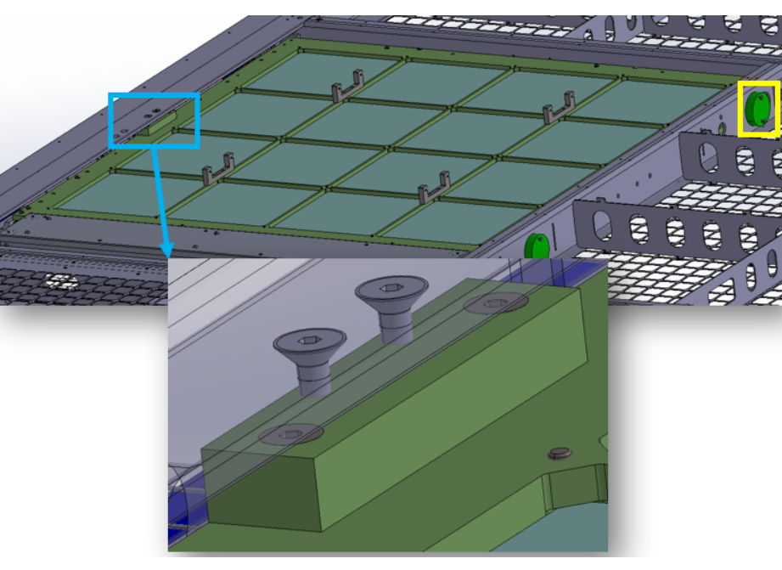
Cathode mounting points
PD modules mounted in cathode with 3-point suspension.
Two configurations: Perimeter and interior mounting.
Any changes from ProtoDUNE VD?
Perimeter
Interior

Slide 16
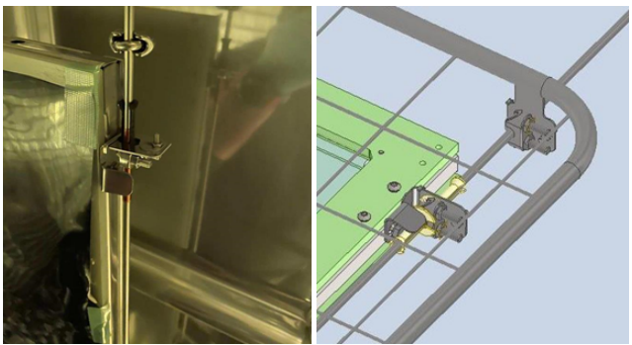
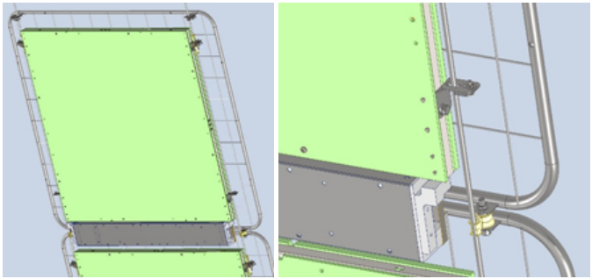
Module mounts to membrane suspension lines
Modules attach to suspension lines at 4 points using a single M5 screw for each support.
Mounting system designed to address thermal expansion of module relative to suspension lines:
  Upper supports carry weight, restricts motion in plane perpendicular to cable.
  Lower supports allow motion along suspension line, restrict motion in plane perpendicular to cable.
HV shielding meshes attach with similar supports.
Electrically isolated from membrane mount system?
Upper constraint.
Lower Constraint

Slide 17
2023 Module Test Campaign:
Photon Collection Efficiency (PCE) Testing
  Measurements of photon collection efficiency at multiple positions across module (Initial results needed early-mid August 2023)
  INFN Naples:
    Cryogenic test stand prepared, validated
    Module delivered and assembled
    Radioactive source ready
    Readout electronics in final preparation
  CIEMAT
    Cryogenic test stand in final stages of preparation
    Module will be delivered shortly (Week of 7/3?)
    Radioactive source ready
    Readout electronics in final preparation
Possible additional testing:
  Investigation of optimal Vikuiti positioning
  Validation of simulation results to allow rapid module optimization.

Slide 18
Module 1 Test:
CERN Cold Box Test
  Final operational test prior to Production readiness review (PRR)
  4 cathode modules with POF, SOF
  2 membrane modules (1/2 area?)
  Measurements of photon collection efficiency with pulsed neutron source?
    Test both DMEM and DCEM configurations
  Initial cold box test late September 2023
Possible additional testing:
  Rebuild 4 cathode modules into membrane modules and replace lower membrane modules in Module 0
    October 2023?
  Additional cold box testing at CERN?
    Will we require additional modules if we have installed cathode modules in Module 0 test?

Slide 19
PCE/ Module 1 Schedule Summary
PCE Tests: July/August 2023
Final module 1 design complete: Week of July 23, 2023
  Includes ½ area module for membrane
Begin module assembly: Week of July
Module 1 Delivery to CERN:
  4 Cathode modules: Week of September 4
  2 membrane modules: Week of September 11
Cold box test: Week of September 25 through week of October 13

Slide 20
FD2 Production Schedule

Slide 21
  Backups

Slide 22
Mechanical design evolution
Module design
  Evolution of successful FD1 PD design (60 X 12 cm² -> 60 X 60cm²) active cells.
  Similar to FD1 construction materials (FR-4 G-10 frames, Acrylic WLS plates, glass dichroic filter plates).
  Similar common design for membrane and cathode modules.
  Special FD2 module features include:
    SiPMs spring-loaded to WLS plates to follow relative thermal contraction, improving optical contact.
    3-sided “Faraday cage” included to shield SiPMs from discharges of HV system.
    Minimized support frame occlusion of optically active area.
    Provision for simplified assembly at SURF.
  Module frame design evolved through 5 design permutations and tested in CERN NP-02 cold box.
  Internal consortium expert review to finalize design prior to Module 0.
Interface with Cathode and Cryostat for PD mounting closely controlled.

Slide 23
QA/QC/Manufacturing summary
(Details in https://edms.cern.ch/document/2730720/2
Remaining QA/Validation for mechanicals:
  All major design decisions for the FD2 PDS mechanics have been taken.
  Final PRR preparation (“Module 1”) modules to be fabricated in summer 2023 for autumn 2023 testing in NP02 cold box.
    Minor changes for ease of fabrication implemented- no conceptual changes.
    Resolve electronics mounting prior to PRR.
  ProtoDUNE-II VD represents extremely valuable QA/Validation opportunity!
Manufacturing plans under development.
  Fabrication assembly sites selected (US for cathode, Spain for membrane).
  Manufacturing/contracting will follow local procurement procedures in the US and Spain.
QC testing planned in detail, described in QA/QC document.
  Warm scans at fabrication sites prior to shipping.
  All modules tested in LN2 cryogenic test stations (US and Spain).
  Warm scan prior to installation in cathode/membrane mounting.
  Final installation verification procedure (in-situ test).
  All QC data stored in DUNE QC database.

Slide 24
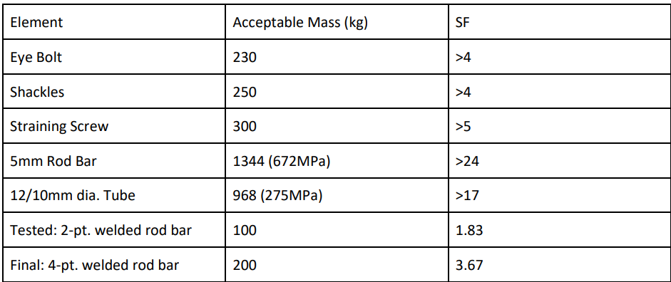
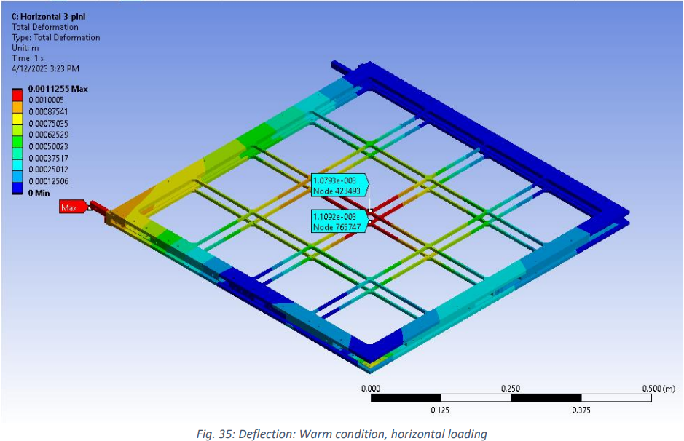
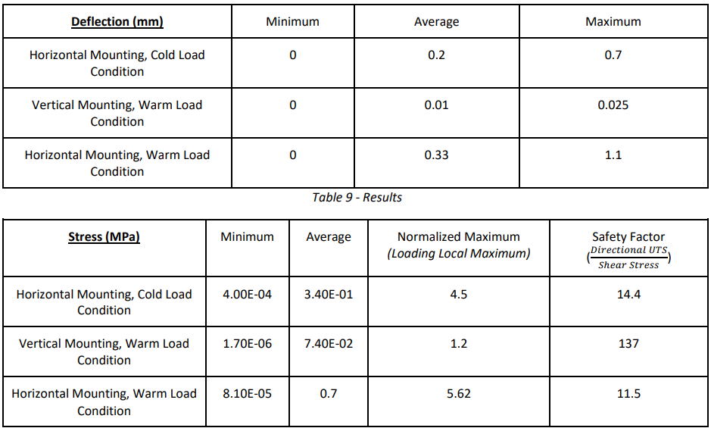
Compliance Office Analysis
Documents
Analysis results for membrane mount supports
Analysis plan submitted to compliance office. https://edms.cern.ch/document/2883231/1
Analysis report submitted to compliance office. https://edms.cern.ch/document/2883232/1
All loads and deflections within reasonable safety factors
Compliance office preliminary reply at
https://edms.cern.ch/document/2883233/1
Analysis results for module deflections in cathode support

Slide 25
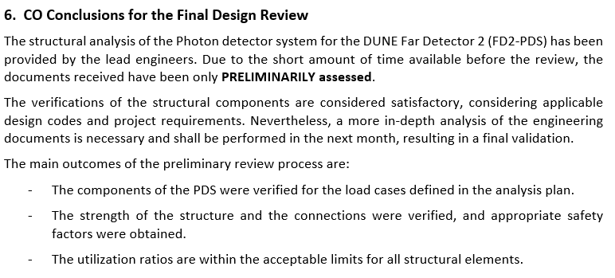
Compliance Office Analysis
Documents PRELIMINARY assessment

Slide 26
Conclusions
Extensive testing in the NP02 cold box and Module 0 have resulted in a well-proven mechanical system.
Multiple phases of design evolution and internal reviews have led to an easy to assemble, reliable module design.
Manufacturing and QC plans are well advanced and reasonable.
Engineering analysis show that the support systems are reliable and meet required safety factors.
The PD mechanical system is well advanced and ready to prepare for the Production Readiness Review.

Slide 27
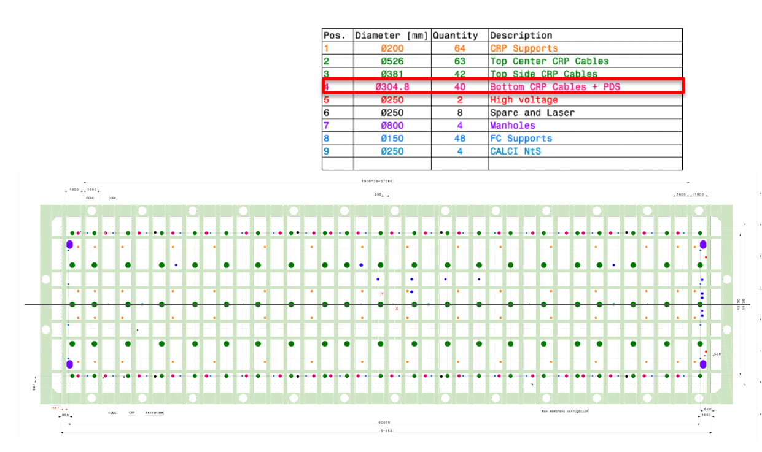
PDS Port Assignments

Slide 28
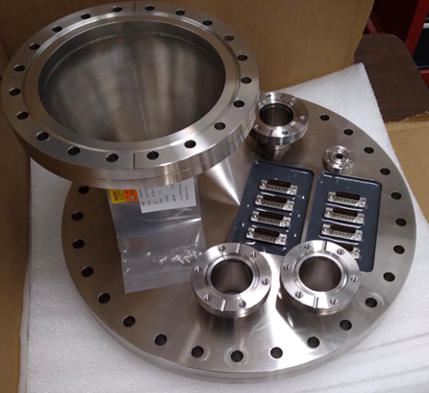
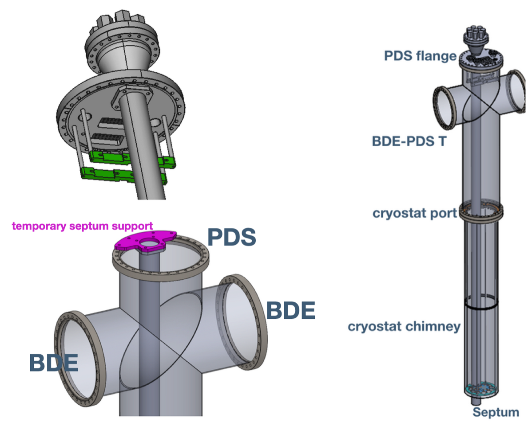
FD2 PDS flange/cable/fiber routing

Slide 29
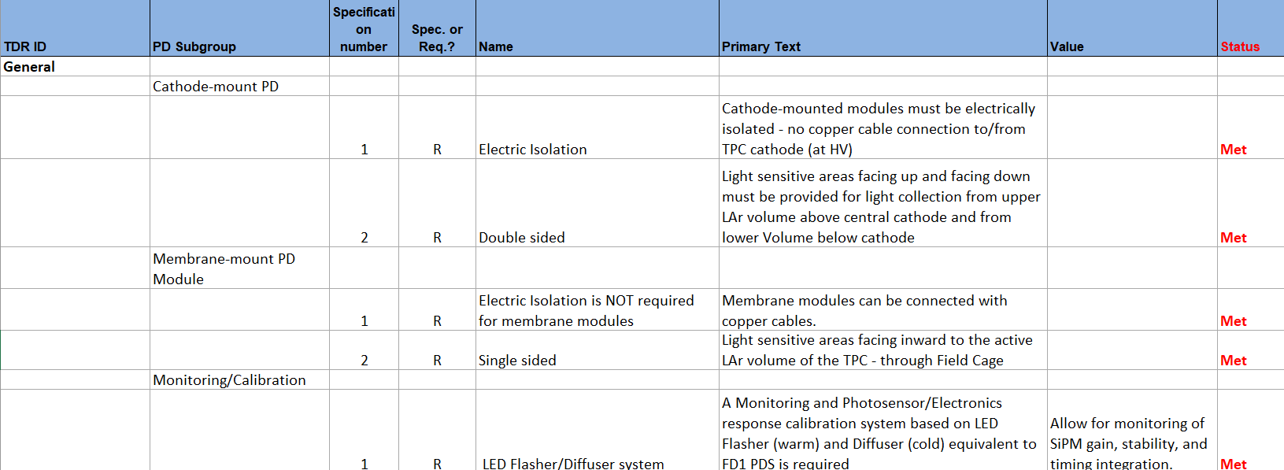
Consortium-Held Requirements (I, General)

Slide 30
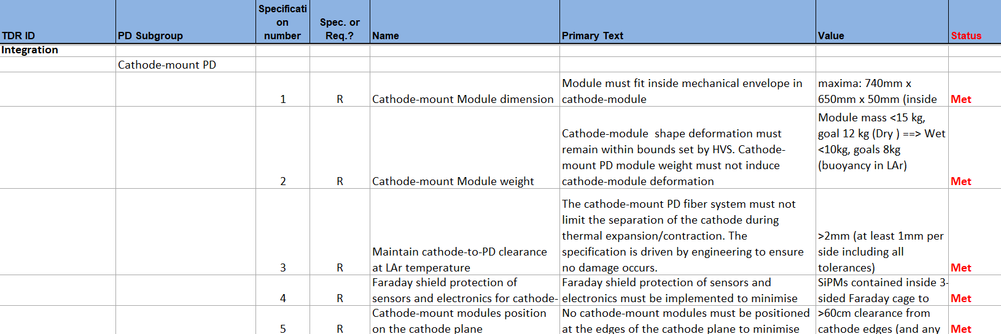
Consortium-Held Requirements (ii, Integration, cathode mount)

Slide 31
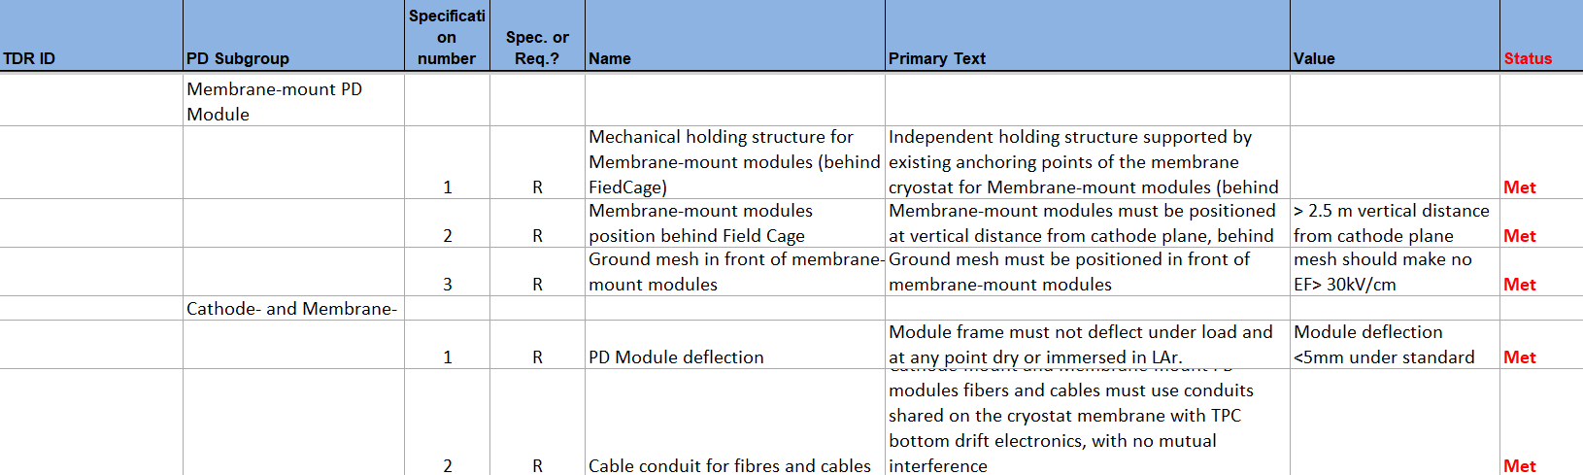
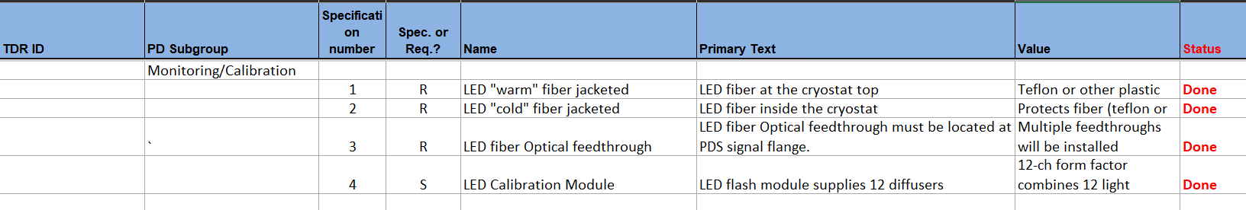
Consortium-Held Requirements (iii, Integration, membrane mount)

Slide 32
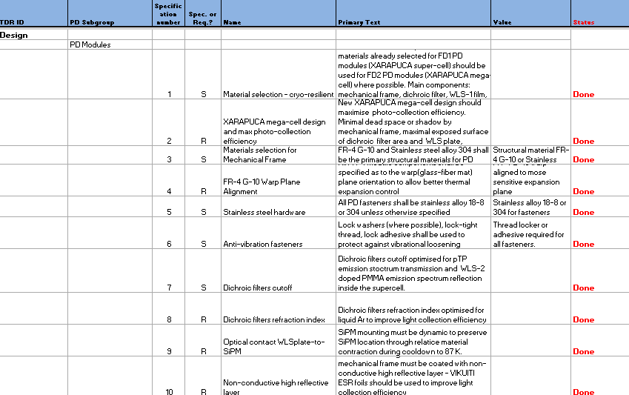
Consortium-Held Requirements (iv, Design)

Slide 33
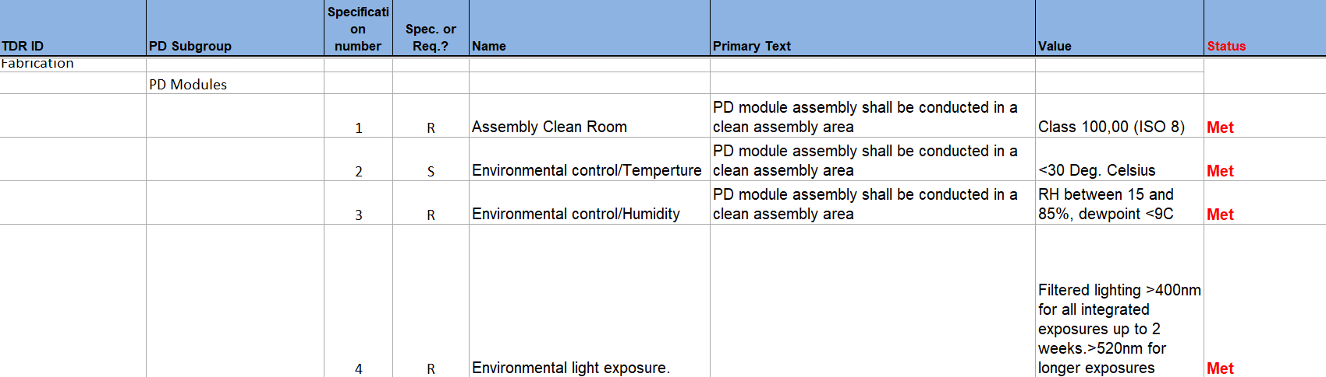
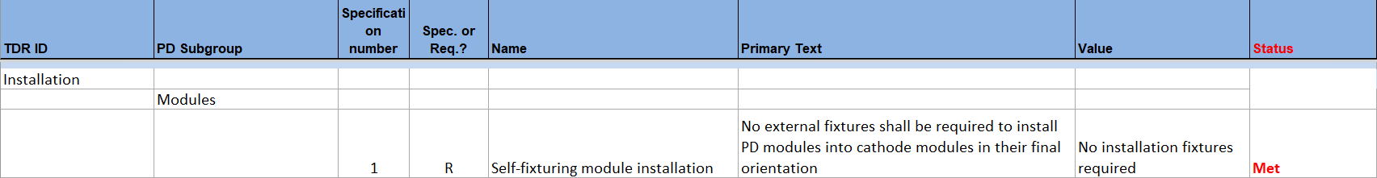
Consortium-Held Requirements (v, Fabrication, Installation)

Slide 34
Cathode mounted modules
Fiber routing path
Fiber exit points
Note: field cage side
Modules stepped back
From edge (HV protection)

Slide 35
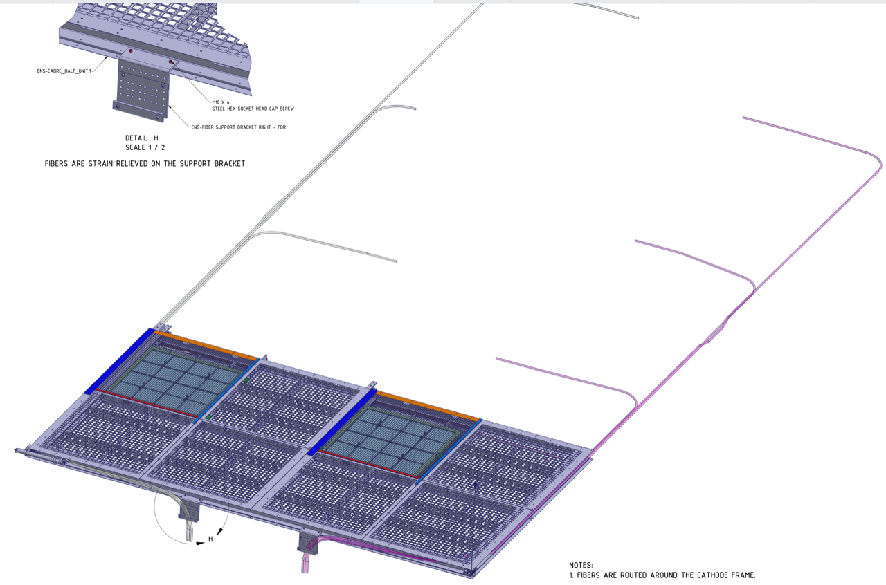
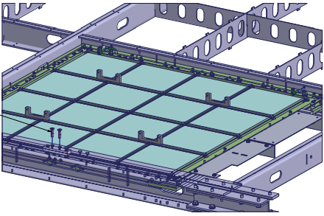
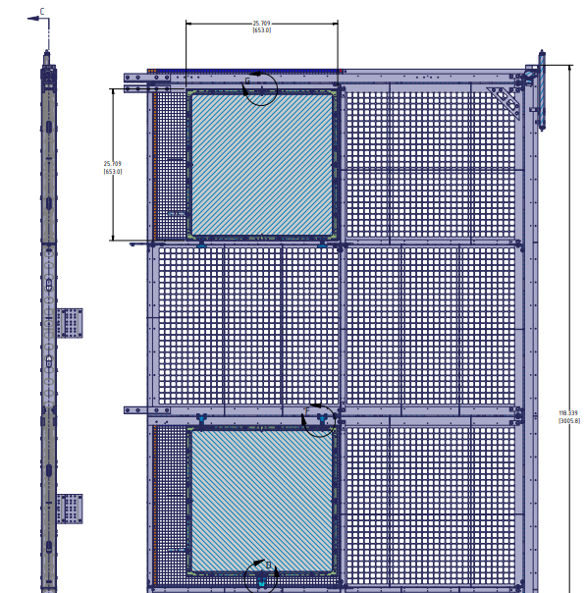
Module layout in cathode controlled in PDS/HV Interface control documents (https://edms.cern.ch/document/2619007/2)

Slide 36
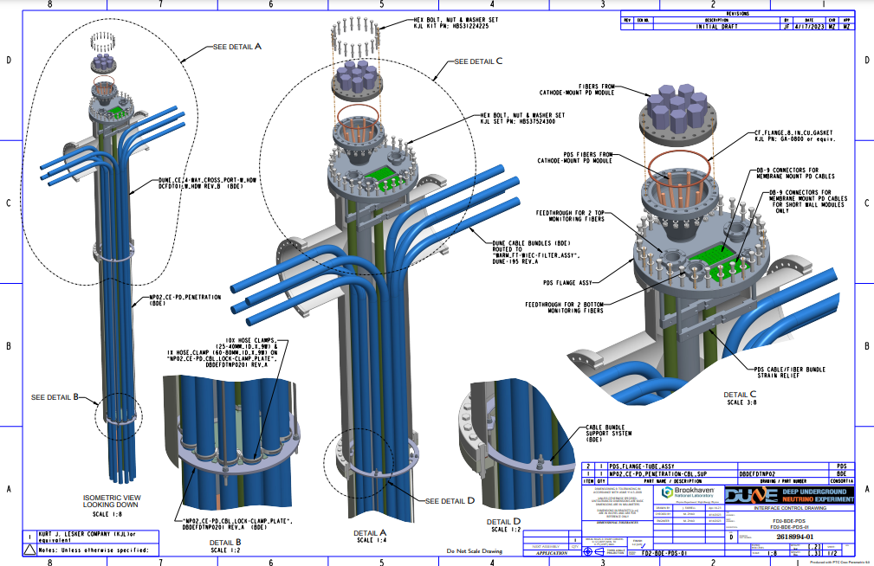
Shared BDE/PDS Crossing tube/cable/fiber routing

Slide 37
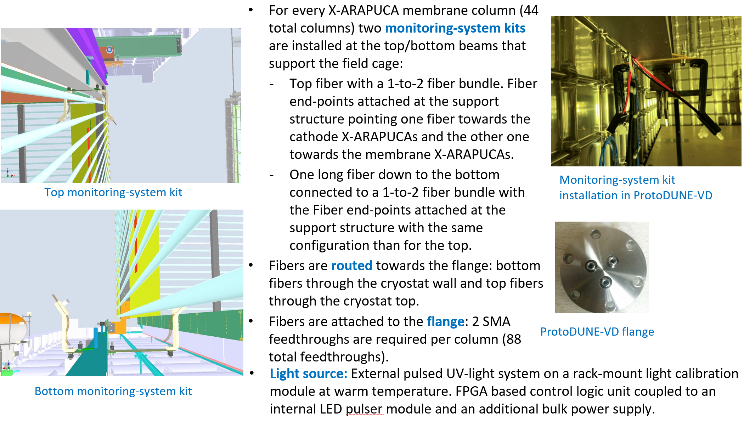
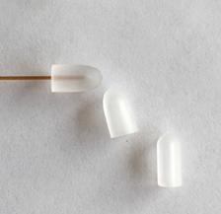
Monitoring system mechanicals
Possible fiber
end diffusers

