Slide 1

XARAPUCA Module 1
Assembly and Warm Testing
XARAPUCA MODULE 1 WORKSHOP, June 2023
Kurt Francis (Northern Illinois University)
for FD2 PD Consortium
6/26/2023

Slide 2
Outline
Module 1 XARAPUCA Assembly Plans
Plans for Warm Testing
Conclusion

Slide 3
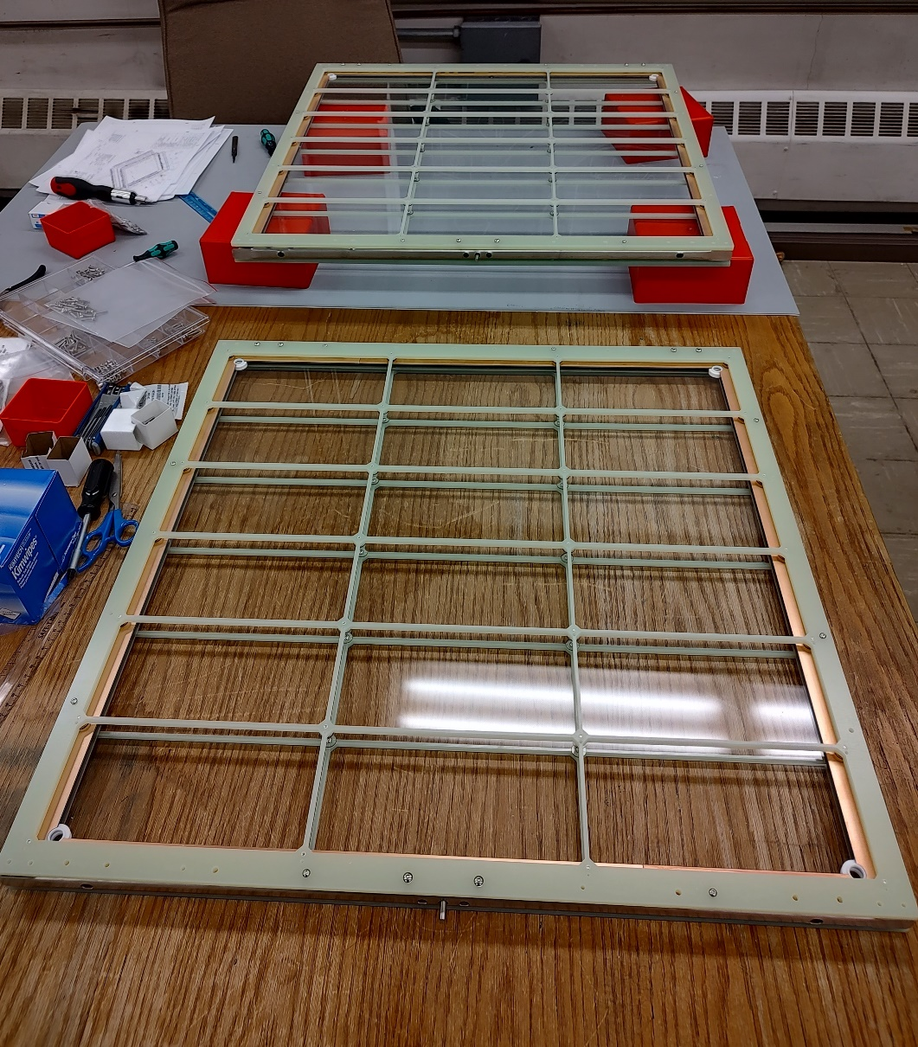
Assembly
Assumptions
  4 cathode mount
  2 half sized membrane mount
NIU would receive
  Custom fabricated parts ( G10 Frames, copper cladding, c-channels) from CSU
  WLS plates (4 and 2 ½ plates) Carla?
  Flex circuits 4 * 8 +2 *4 = 40 flex circuits or 800 SIPMs
  Cables for flex circuits, 40 cables J.Ameel Michigan
  DCEM electronics from Fermilab
  Electronics boxes from Iowa(?)
  NIU would order bulk hardware from vendors (McMaster-Carr)
Assembly and warm testing without filters would be done at NIU

Slide 4
Assembly Schedule
Assembly done at NIU - we would need 2 weeks from the time we receive all the parts to assemble and then warm test the modules
From Dave W. presentation: he suggests that assembly start 7/31 (first week of August)
Does that mean the design is finished by 7/31 and then subcontractors need to fabricate parts
NIU would need to complete assembly and warm testing by end of August so that we can ship to CERN

Slide 5
Warm Testing Options
NIU should perform a preliminary test at room temperature before sending to CSU for cold(LN2, LAr) testing
Warm test should confirm that:
  Flex Circuits, cables are connected correctly
  When the WLS is included it detects light
Expect Flex circuits and DCEM to be testing before we receive them

Slide 6
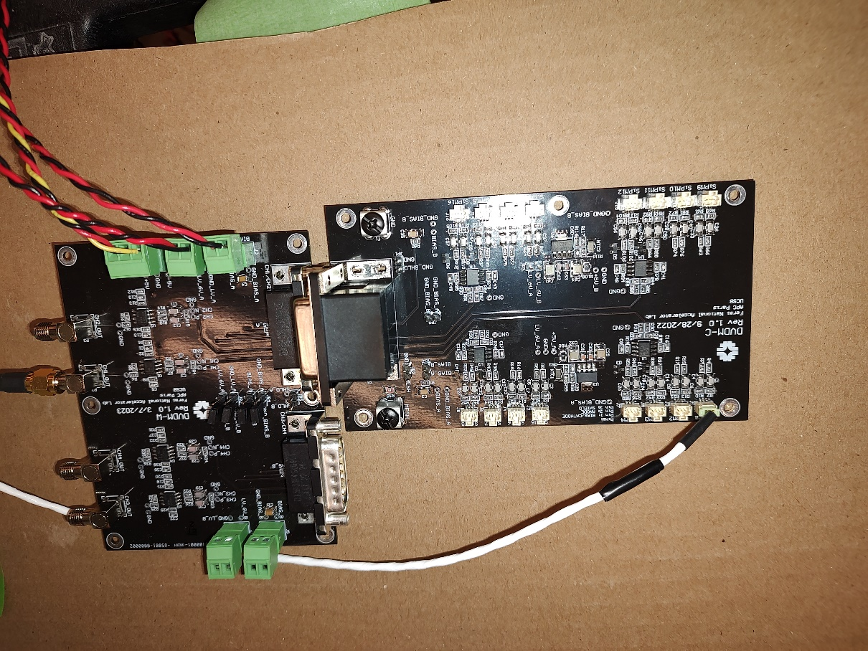
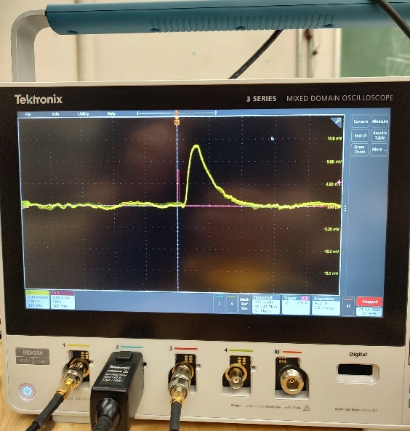
Warm Testing – Pulse Measurements
We will use a DVDM-C / DVDM-W combination
Read out through an oscilloscope
The objective is to confirm that the flex circuit/cable are correctly connected and in good working order
We will each of the 8 flex circuit cables to the DVDM-C electronics one by one to confirm good connection and operation
Next the four cables will be connected together to be sure that

Slide 7
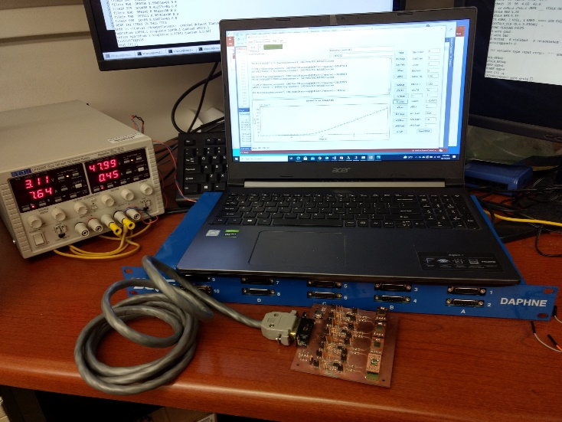
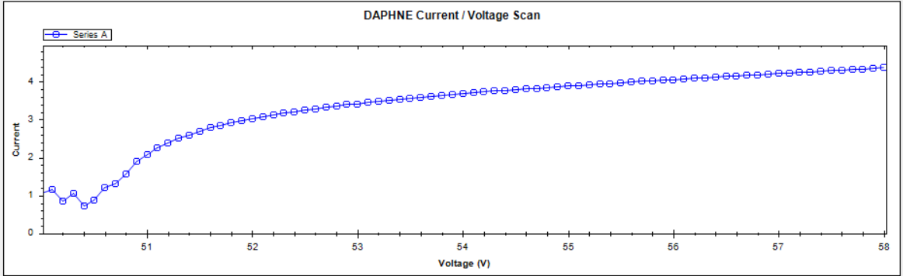
Warm Testing – Current Measurements
Do we need to do pulse measurements during warm testing of the XARAPUCA.
I think we could just do IV measurements to confirm that the connections are right.
We can’t really test the cold electronics since they work differently when cold.
The real confirmation of the system is during the cold testing at CSU.
We need to be sure that everything is connected right before we ship but I think that could be achieved with just current measurements.
DAPHNE development station at NIU
Vbreakdown ~ 50.5V
Example Current Voltage Scan
collected using DAPHNE and NIU amplifier board

Slide 8
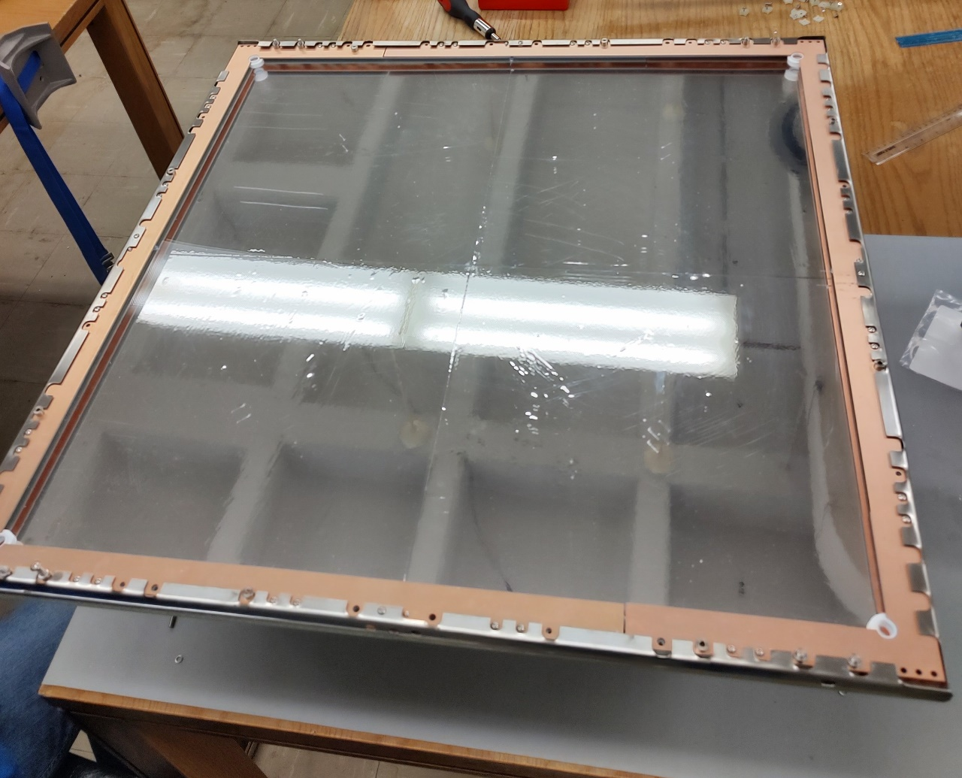
Warm Testing Conclusions
Would like 8 flex circuits and 8 cables to finalize warm test setup
We may be able to test with DCEM installed if the board still has way to supply power in a way that bypasses the Power Over Fiber
The plan is to use an LED at 9 points over the WLS and collect Pulse measurements from each of the two channels

Slide 10
Backup Slides…

