Slide 1


Module-1 Cold Testing
Franciole Mirinho (ITA)
Jay Jablonski (CSU)
Dante Totani (UC Santa Barbara)

Slide 2
Goals
Test Mod-1 Cathode modules
  Build on lessons learned from Mod-0 testing
    DanteTotani_1-25-23_
  POF
  SOF
Completely submerge in LN2
Isolate in the dark
TEST (1pc min)
  Functionality at cryogenic temperatures
    Dark count
    Light collection
      Flash array of LED’s
        Confirm uniform distribution-not absolute measurement
Mod-0 Cold Test Stand

Slide 3
Assembly & Testing Plan
University of Iowa
  Component Fabrication
  Component QC
Northern Illinois University
  Hardware procurement
  WLS frame assembly
  WLS frame QC
Colorado State University
  Reception test
  Cold test
  Post-Dunk test
CERN/SURF
  Filter plate installation
  Final QC
Mod-0 Cold test signal

Slide 4
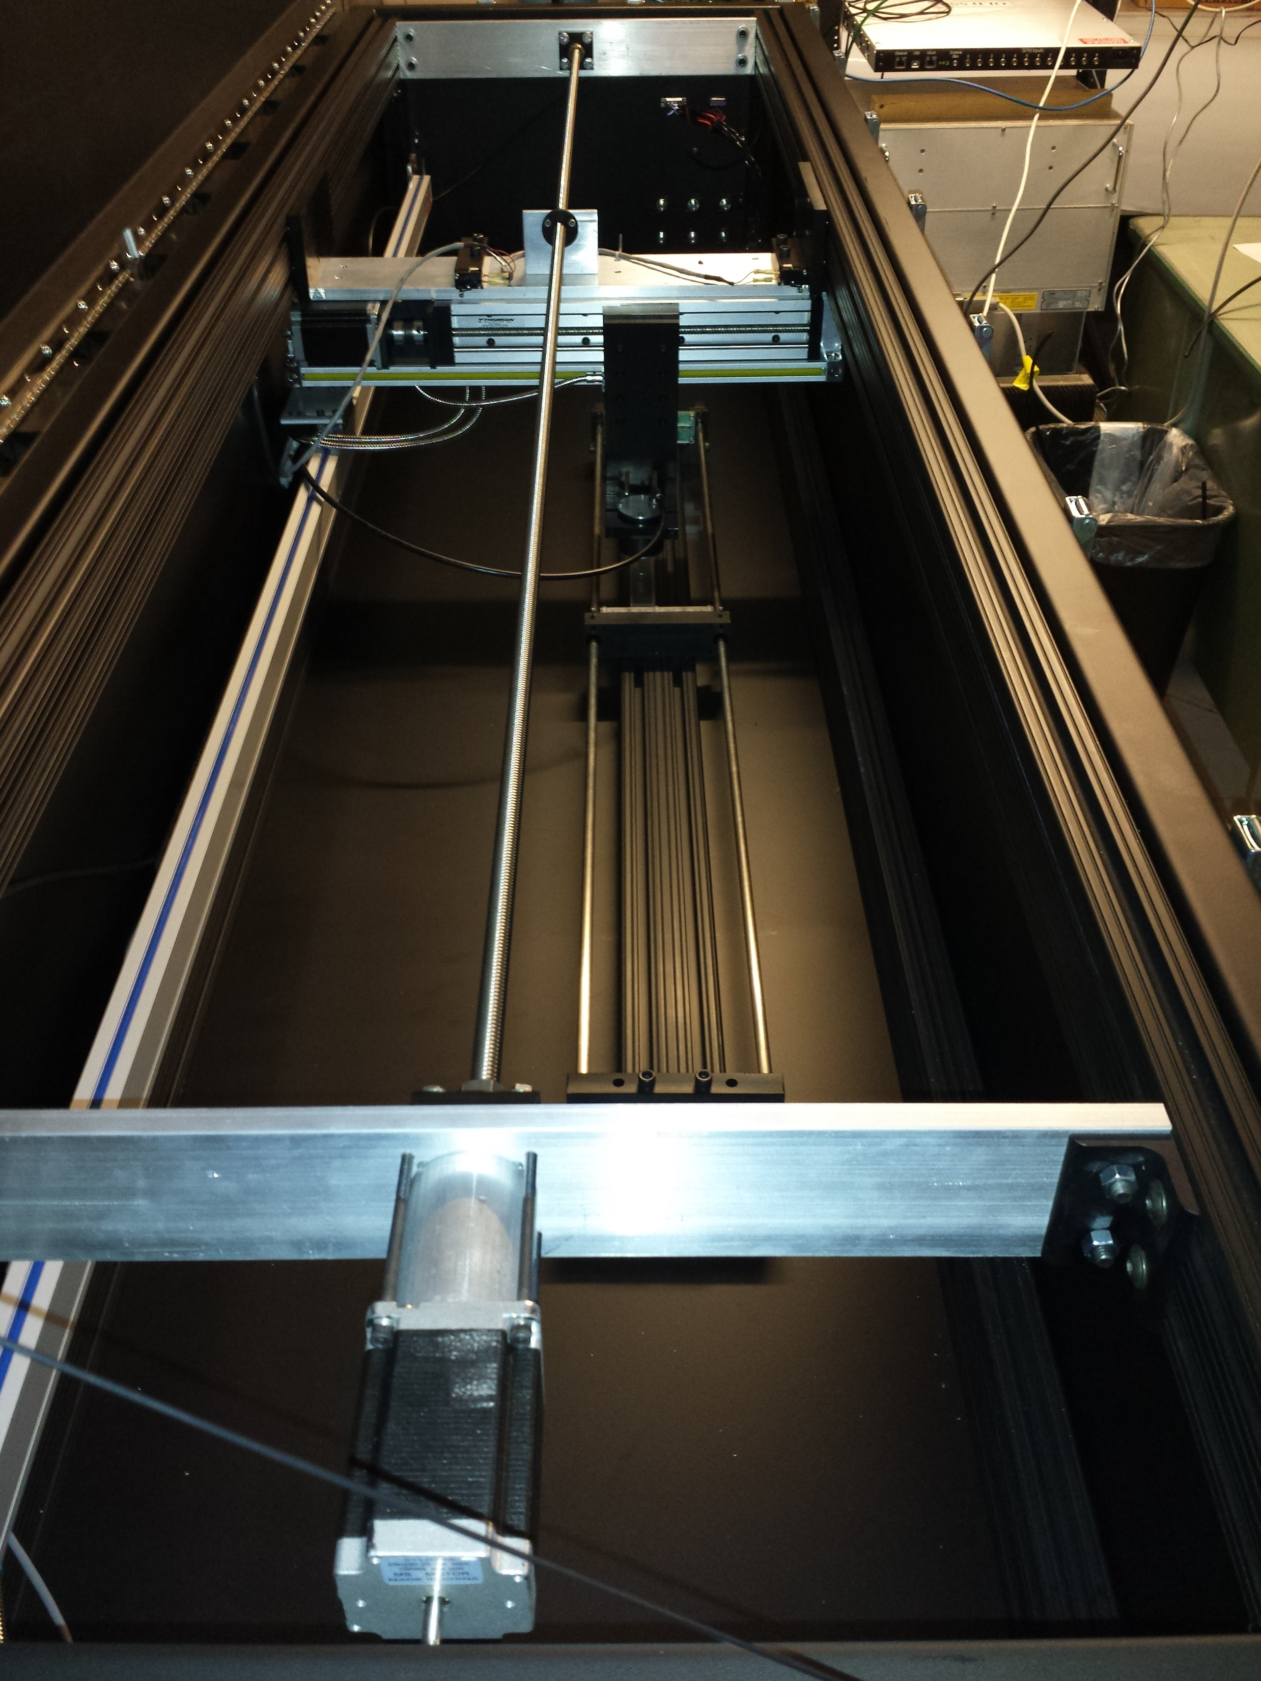
Testing-CSU
Reception-Warm Test
  Physical Inspection
  Dark Box-UV LED
Cold Test
  Complete submersion of module & electronics enclosure
  LED flash test
  Test Power Over Fiber
  Test Signal over Fiber
  Dark Count Rate
Post-Dunk-Warm test
  Physical Inspection
  Dark Box-UV LED
    Compare to pre-dunk scan
CSU Resources
  1 FTE Technician
  0.5-1.0 FTE Post Doc
  Large team of undergrad & graduate students
HD PDS Scanner

Slide 5
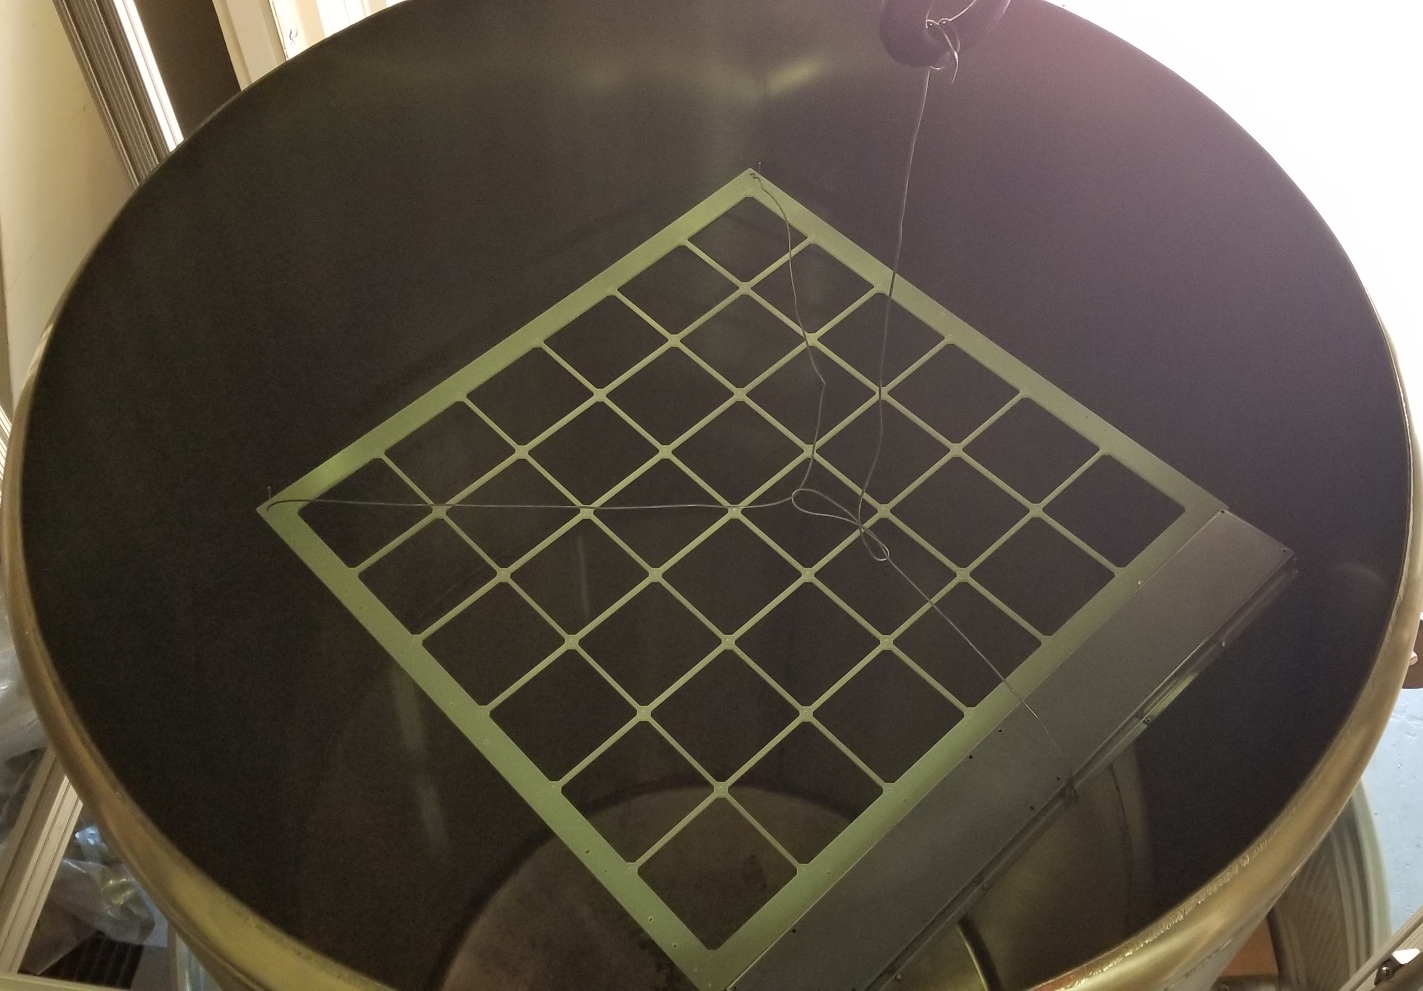
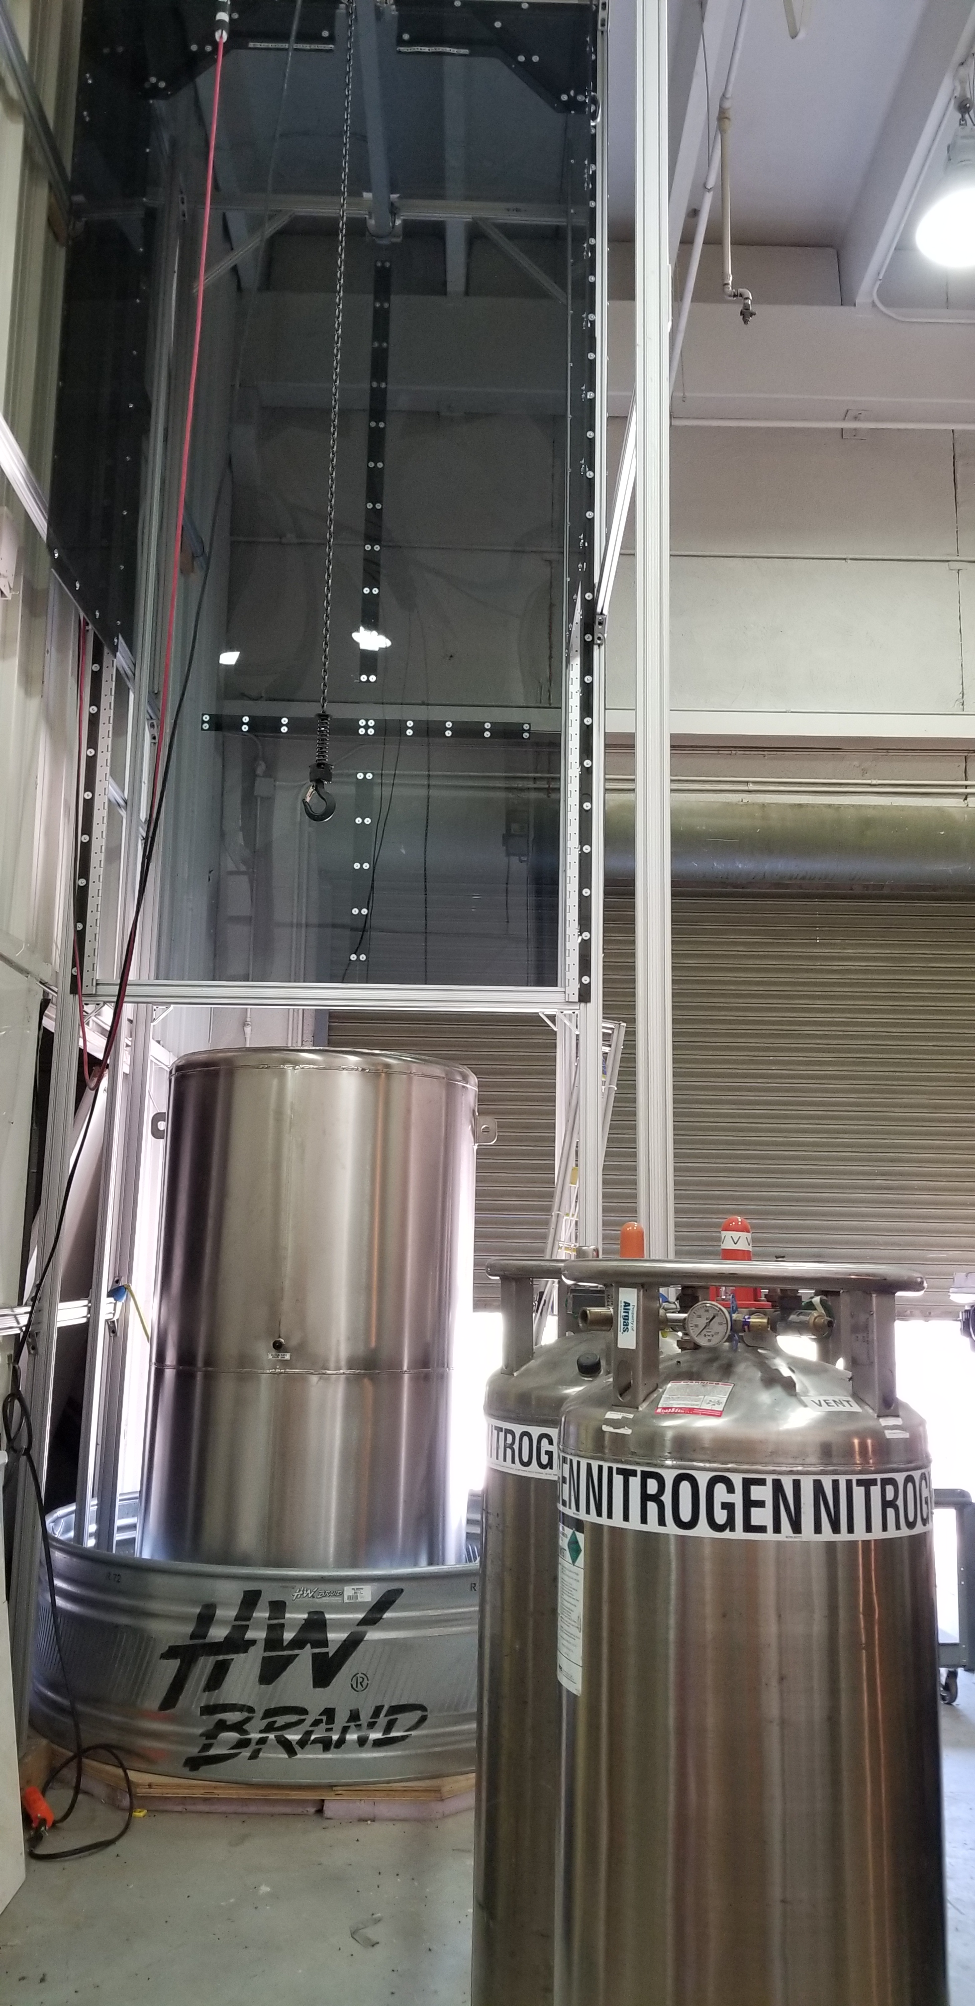
Cryogenic Detector Development Facility-CSU
XL Dipper
  Cryofab CF-4380
    1900L capacity
    LN2/LAr-Industrial
  Polycarbonate Enclosure
    Cryogenic safety
    LN2/LAr gas volume
  ½ ton precision crane
  Stepper motor-controlled submersion (August 2023)
    Similar design to HD system
      Slow controlled insertion & extraction (1cm/min)
  Horizontal test configuration
    1-8 modules per test
Horizontal test configuration
XL-Dipper

Slide 6
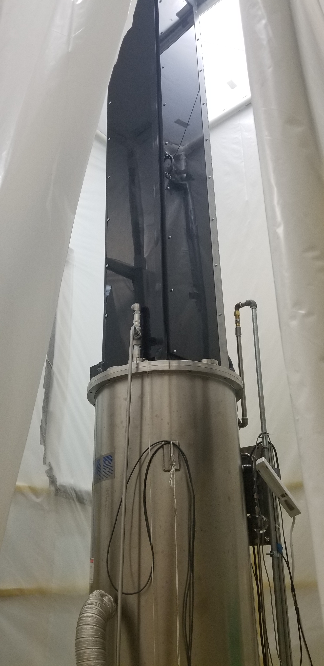
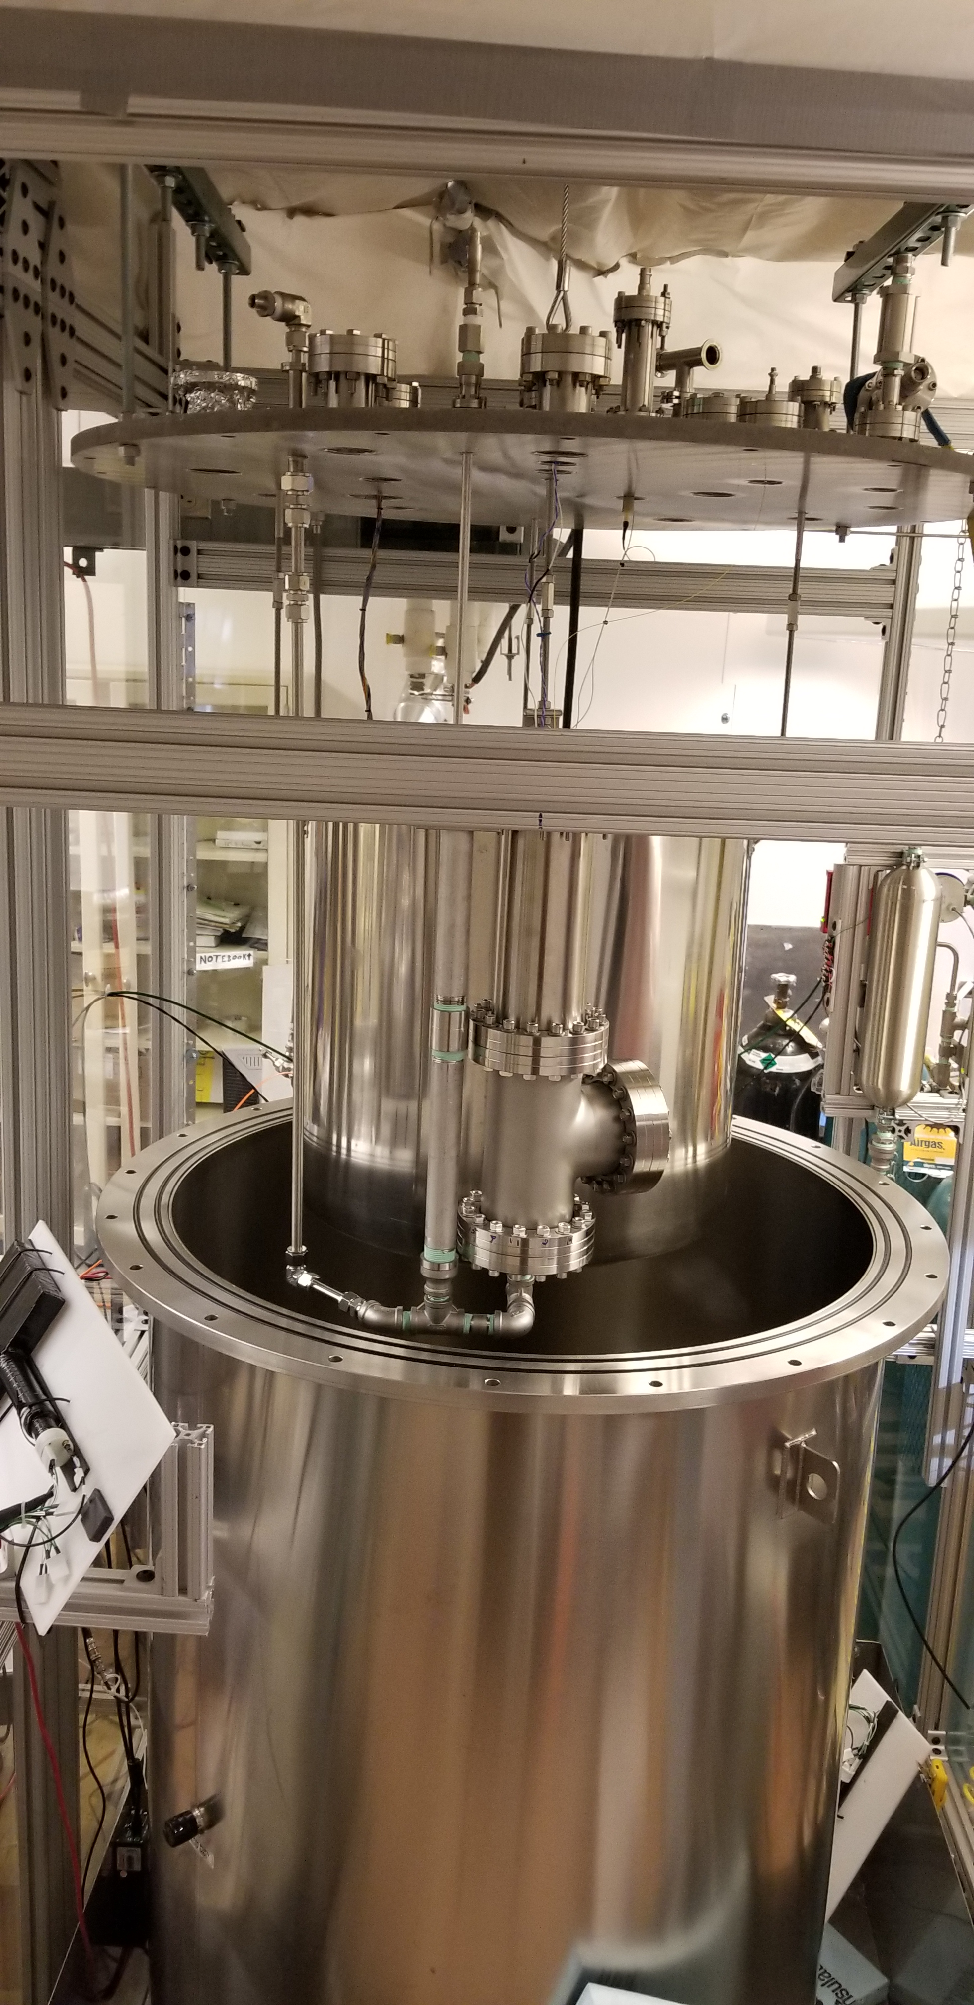
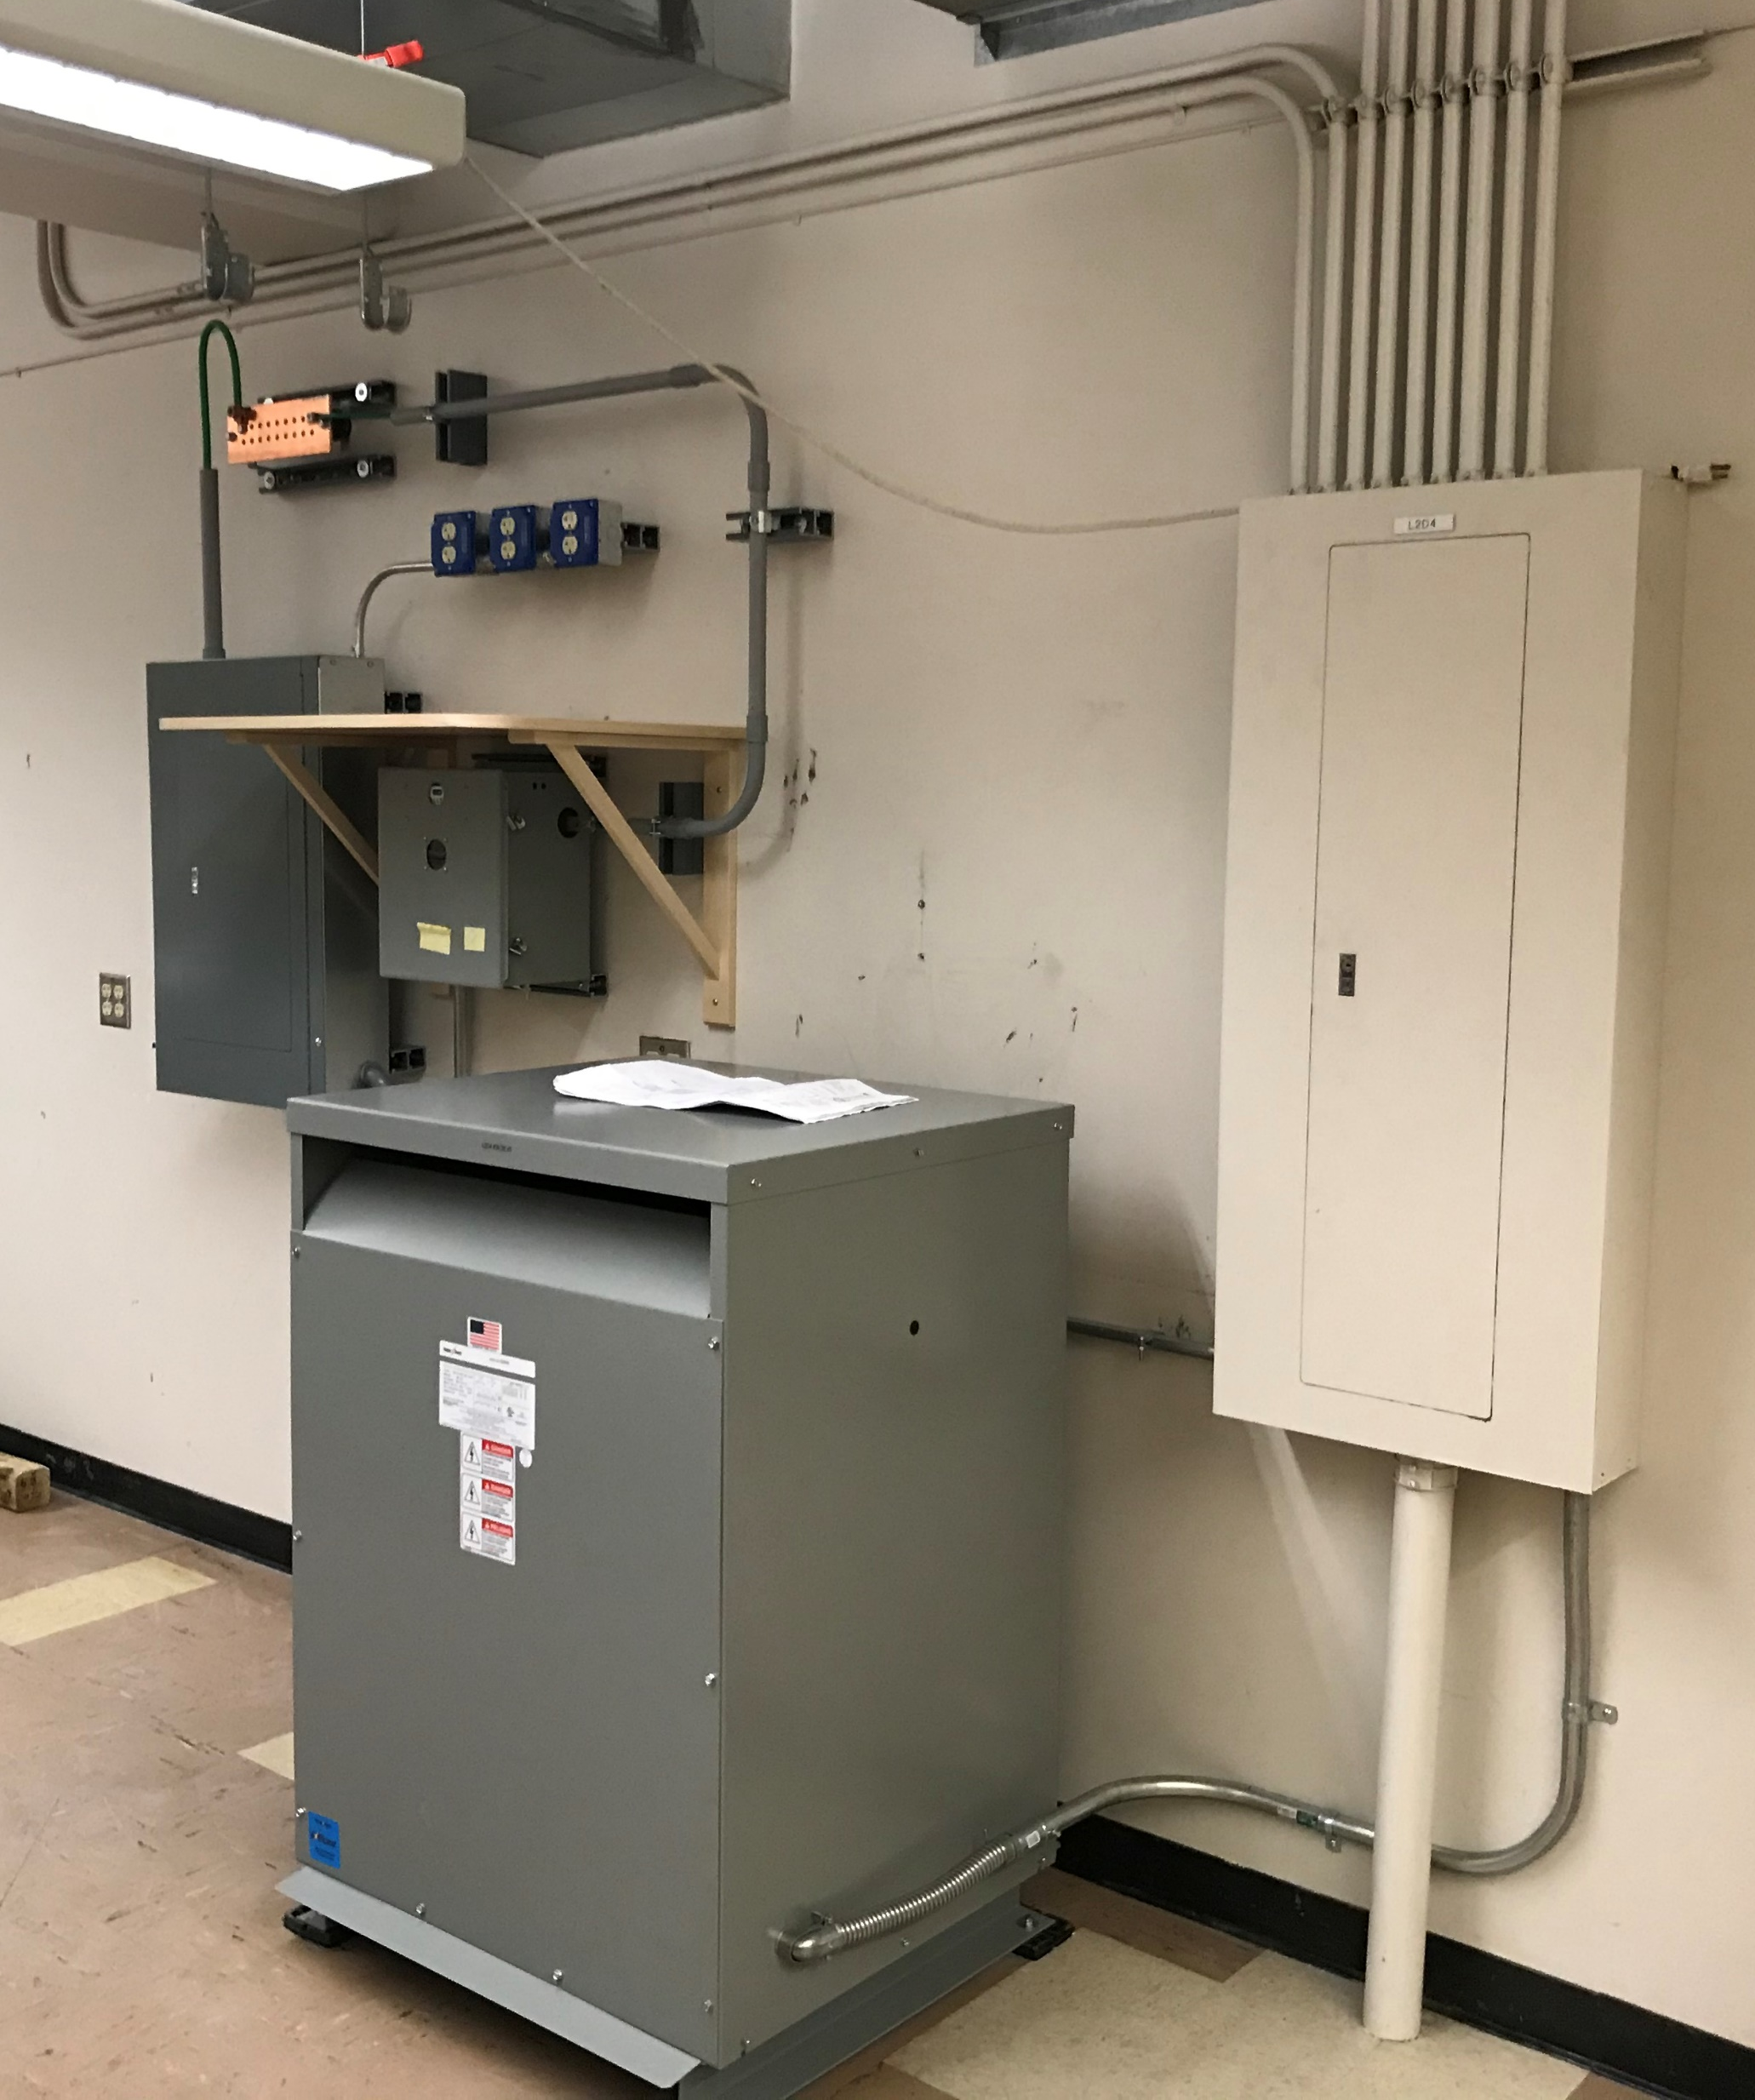
Additional Testing-Available at CSU
ND-LAr Test Stand/Cryostat
  Cryofab CF-3640
    700L capacity
    UHP LAr-LBL Filter Design
    DUNE ground isolation system
Big Dipper
  Cryofab CF-20120
    600L capacity
    LN2/LAr-Industrial
    Fully enclosed
    Stepper motor drive
Small Dipper/Cryostat
    Cryofab CF-1248
    90L capacity
    LN2/LAr-Industrial
    UHP LAr
    Stepper motor drive
Ground isolation system
ND-LAr test stand
Big Dipper

Slide 7
Safety
Meet all CSU Cryogenic safety and ESH requirements
Adhere to all ESH codes/standards established by LBNF/DUNE Project
Fermilab laser safety review

Slide 8
Questions
Test in LN2
  Industrial LAr
  UHP LAr – ND-LAr test stand
Schedule
  POF/SOF electronics for cold testing at CSU?
  Will cold electronics be ready in time for cold testing of all Mod-1 units?

