Slide 1
IOTA Proton Injector Update
Dean (Chip) Edstrom
06/23/2023

Slide 2
IPI Project Schedule
Schedule for Remaining Project
Already Behind…
Immediate Items:
  No movement yet on Dipole Bend Chamber Purchase
    Steve Wesseln coordinates purchase with ADMS Engineer…
      Still operating under the no-work for IPI purchasing by Mayling
  Need new beamsheet to accommodate last-minute changes
    Sasha Romanov has been working on this.

Slide 3
IPI Project Schedule
Task Name | Duration | Start
Mechanical - MEBT Stands Drafting | 80 hrs | 06/15/23
Purchasing - Dipole Bend Chambers | 90 days | 06/15/23
Mechanical - Spoolpieces Drafting | 40 hrs | 06/29/23
Mechanical - Spoolpieces Fabrication | 1 mon | 07/05/23
Main Complex Shutdown | 12 wks | 07/09/23
Mechnical - MEBT Stands Engineering Note | 6 wks | 07/15/23
Mechanical - Variable Coupler Note | 1 wk | 07/15/23
Mechanical - Vacuum Cross Fabrication | 10 wks | 07/15/23
Commissioning - Instrumentation | 20 wks | 07/15/23
FAST/IOTA Shutdown | 20 wks | 07/15/23
Mechanical - Variable Coupler Purchase | 1 mon | 07/20/23
Mechanical - Vacuum Review | 1 mon | 08/21/23
Purchasing - MEBT Stands | 6 wks | 08/24/23
Cable Pull - RF Penetration | 5 days | 08/28/23
Cable Pull | 2 wks | 09/04/23
Mechanical - Variable Coupler Assembly | 1 wk | 09/15/23
Mechanical - Circulator Stand Assembly | 1 wk | 09/15/23
Assembly - HLRF Gallery Distribution | 2 wks | 09/20/23
Mechanical - Cave LCW Instrumentation | 2 wks | 10/01/23
Mechanical - Gallery LCW Instrumentation | 2 wks | 10/01/23
Commissioning - Magnets | 2 wks | 10/01/23
Assembly - HLRF Cave Distribution | 2 wks | 10/03/23
Assembly - MEBT Stands | 1 wk | 10/04/23
Mecanical - Stand Installation | 1 wk | 10/10/23
Mechanical - Gallery LCW Connections | 1 wk | 10/15/23
Mechanical - Cave LCW Connections | 1 wk | 10/19/23
Commissioning - Klystron Conditioning | 1 mon | 10/20/23
Assembly - Beamline | 1 mon | 11/01/23
Commissioning - RFQ | 1 mon | 11/16/23
Commissioning - Source | 1 mon | 12/01/23
Commissioning - Beamline | 1 mon | 12/24/23
Shielding Assessment / Addendum | ??? | ???
CDC/RF/ESS/CR Beamswitch System Integration | ??? | ???
Critical Path Items:
  Cable Pull
    Meeting with Dave Featherston next Monday (6/26)
    Still waiting on backordered cable (24-Conductior)
      Next earliest shipment date is next week
    Still anticipating cable pull early Sept.
  ADMS
    Steve Wesseln: bend chamber purchase/fabrication
    Bob Steinberg: variable coupler note
  325 MHz RF
    LLRF upgrade in progress
    Xformer Adapter Plate and LV Feedthrough
      Need to be verified/changed before oil-fill
  Duoplasmatron Source
    HV ORC: HV Enclosure Work Remaining: ~1 Week
    Source Characterization ORC: Many items remain…
  Radiation Safety
    Permission to run in the Source Test Cage
    Requirements for SAD amendments, etc… (Cave)

Slide 4
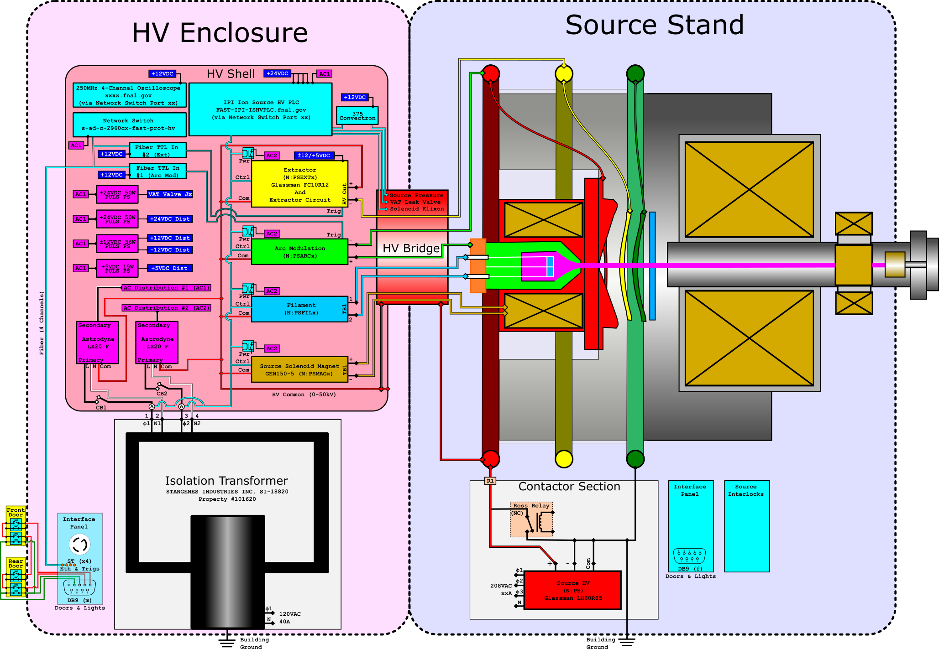
IPI Duoplasmatron HV ORC
Remaining Items (~1 Week):
  Window cut in HV Enclosure for the Bridge
  Holes for the Interface Panel
  Make all bridge connections and terminate in the HV enclosure
  Temp Termination for the VAT leak valve +24VDC Solid State Relay
    Order not originally placed due to purchasing Mix-up! Currently Back-ordered!
  Establish HV Enclosure Grounding
  Check HV Common to all points
  Verify bridge alignment with Shell
Inspection & Mitigation (ORC)
  Dave Mertz, Kermit, Greg Saewert,
  Dan Bollinger…

Slide 6
IPI Duoplasmatron Characterization ORC
Patch in HV Enclosure Door Interlocks
Fix Ground Stick Interlock Logic
Finish Programming MEBT PLC for IPI IS
  Establish control over Hydrogen Distribution Instrumentation
Finish Programming HV PLC
  Ext control changes somewhat with triggering
Permission from Radiation Safety
Nilanjan is working on formulating a permanent solution to the interlocks kludge in place.

