Slide 1
LIGO Computing and Software
Duncan Macleod

Slide 2
Overview
LIGO data handling
What primary data are created
What secondary data are created
How are data archived and distributed
How do researchers access data
LIGO software model
What software is used
How is software developed
How is software distributed
LIGO workflow model
How are large workflows executed

Slide 3
Who am I?
PhD | Cardiff University
LIGO data analysis and detector characterisation
Postdoctoral researcher | LSU
LIGO software development
Research Fellow | Cardiff University
(Senior) Research Software Engineer | Cardiff University
Chair of LIGO Computing and Software Working Group since 2019
Coordinate collaboration computing activities, priorities, interfaces with other WGs
Chair of LIGO-Virgo-KAGRA Software Change Control Board (SCCB)
Principal developer/maintainer of GWpy | https://gwpy.github.io
Widely used utilities library for GW research
Primary maintainer of IGWN Conda Distribution

Slide 4
LIGO data handling
LIGO records timeseries data
Primary ‘strain’ measurement
Single channel at 16 kHz
State information at 16 Hz
Secondary ‘auxiliary’ data
~250,000 channels per observatory
16 Hz (many) – 16 kHz (few)
Custom ‘GWF’ binary data format
Data files created at Observatory, replicated to LIGO Lab central data archive
1.5 petabyte per year per observatory
LIGO Data Management Plan
Strain data are indexed and distributed as part of the Open Science Data Federation (OSDF)
Single ‘origin’ at LIGO
Global network of caches
Available (to authorised users only) from anywhere
POSIX interface via CVMFS
LIGO data ‘discovery’ service
In: (dataset name, start time, stop time)
Out: list of data URLs (file://, https://)

Slide 5
LIGO software model
Huge quantity of bespoke LIGO analysis software
Data I/O
Signal processing
Astrophysical signal detection
Astrophysical inference
Mostly C/C++ for CPU intensive work, Python for everything else
Almost all projects use git on GitHub or LIGO GitLab instance
free ultimate education license, self-hosted
Policy for all LIGO software to be open-source (OSI definition)
Developers encouraged to target conda-forge for binary distribution
Centrally-curated IGWN Conda Distribution
Built using GitLab-CI
Distributed with CVMFS for Linux x86_64
Available on all LIGO compute resources
Change request procedure
Increasing use of application-specific containers (built on Docker, run with Apptainer)

Slide 6
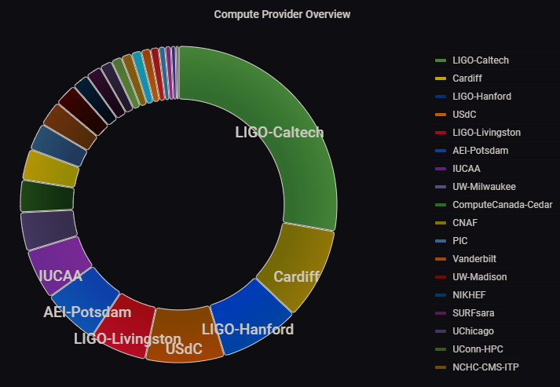
LIGO workflow model
LIGO computing demand dominated by single-thread CPU jobs
Highly-parallelisable, high-throughput
LIGO member institutions pledge compute resources
A few large isolated HTCondor pools (including Cardiff) | Legacy
New compute resources added to central shared pool
Single access point operated by LIGO Lab
Workflow jobs execute on any connected resource
Output files returned to access point
Legacy workflows slowing adoption of new distributed HTC model
Plan workflows with as few implicit requirements as possible
Increasing demand for multi-thread/core and GPU resources

Slide 7
Extra slides

Slide 8
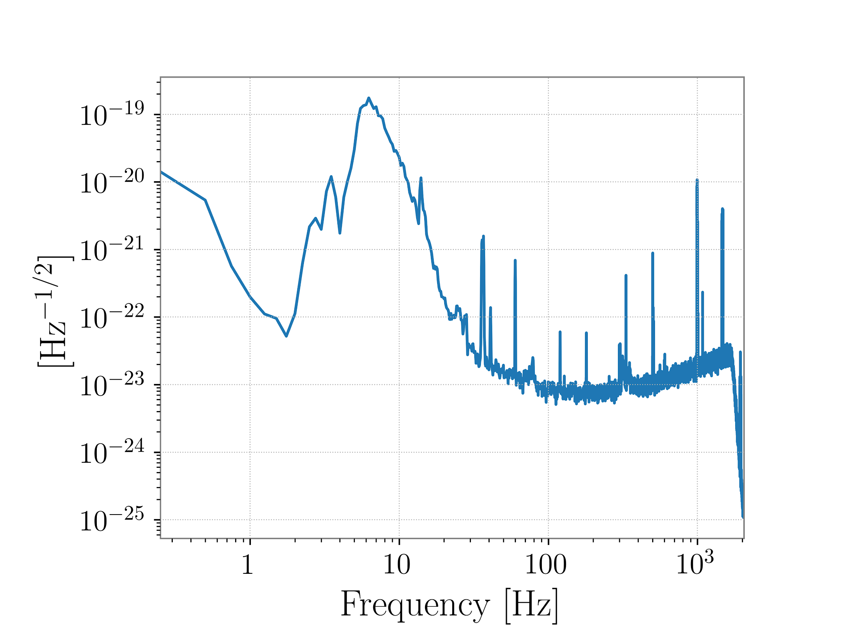
Universal software for basic things
GWpy provides basic routines for
Data discovery and I/O
Basic signal processing
Visualisation
De-facto standard for boring stuff
Similar ‘standard’ packages for standard things
PyCBC (CBC signal detection)
Bilby / Asimov (Astrophysical inference)
…
New ‘innovative’ algorithms should be added as plugins, to reuse the basic infrastructure

