Slide 1
Experiments on Electron Cooling and Intense Space-Charge at IOTA
Rough ideas

Slide 2
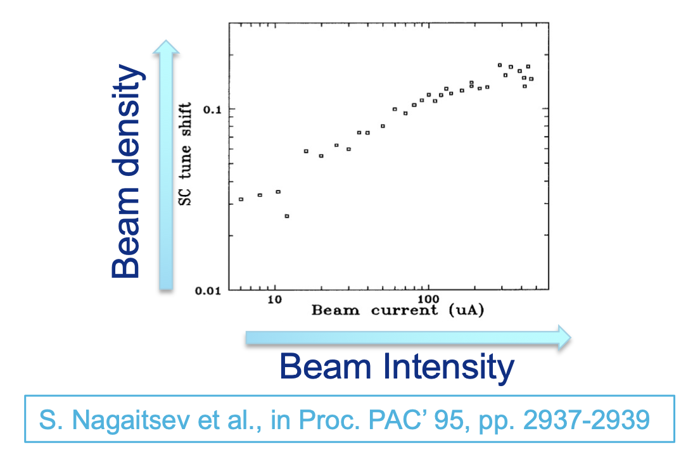
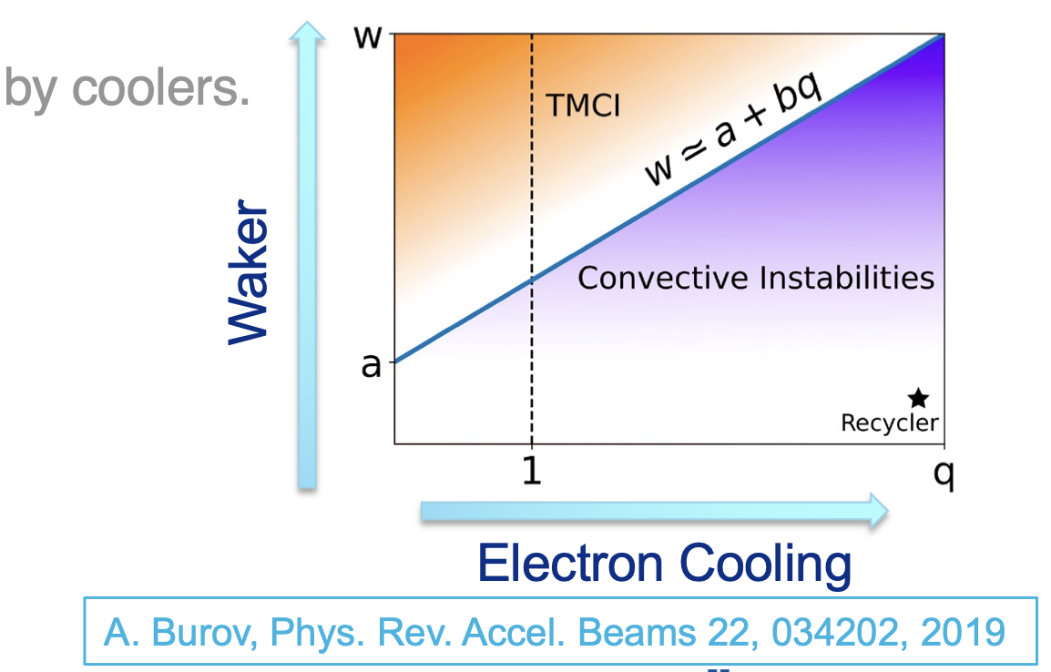
Original Motivations
Maximize tune shift achieved through electron cooling.
Study convective instabilities.
Combine electron cooling with integrable optics.

Slide 3
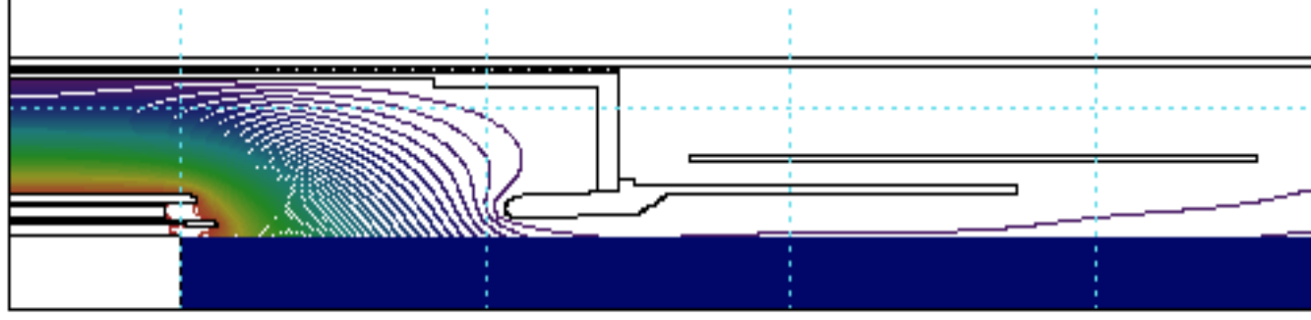
Current Status
Specified electron cooler and designed electron source.
Developed simulations of electron cooling with space-charge
To Do:
Error studies. (ongoing)
Accurately model proton injection.
Model bunched beam dynamics.

Slide 4
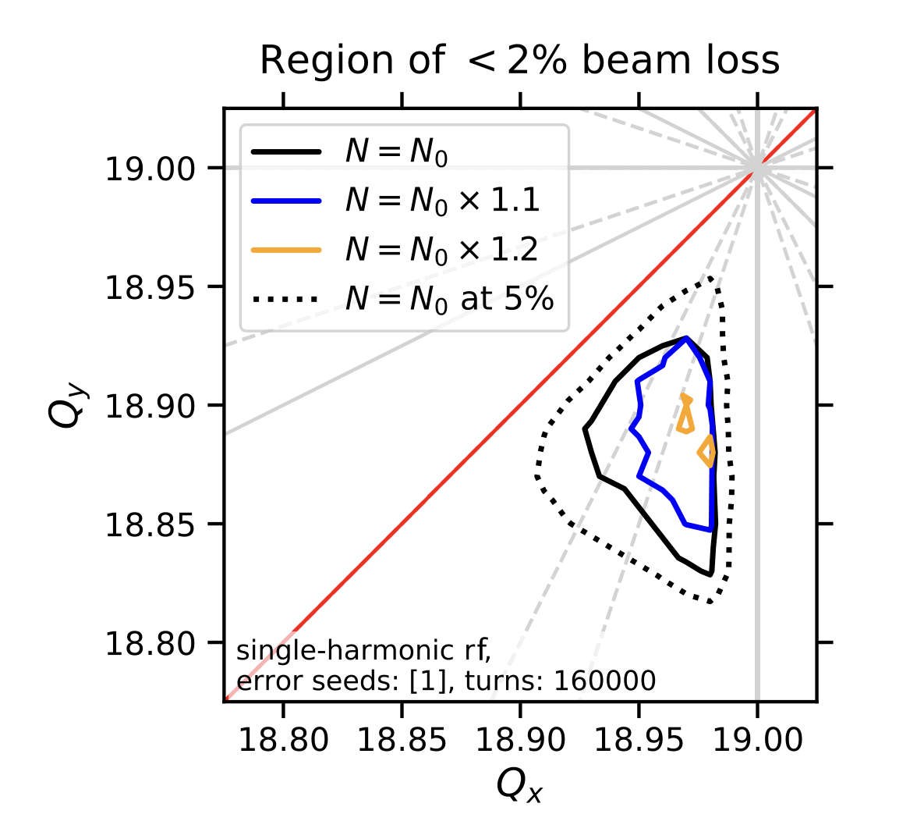
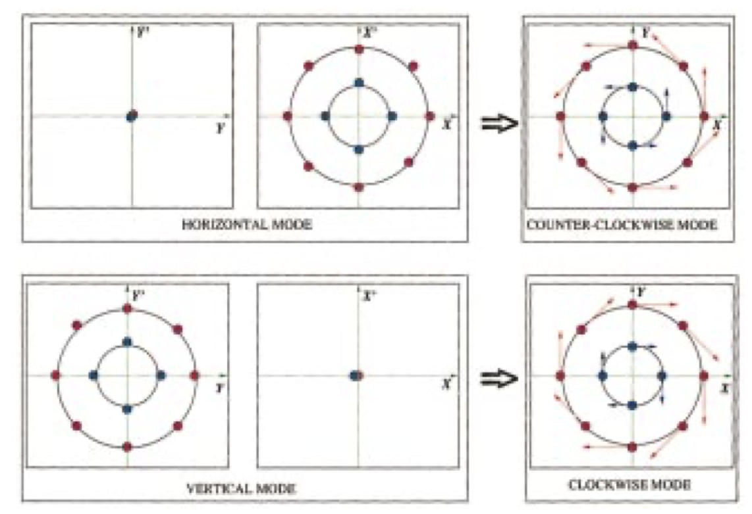
Possible Experiments
Study of space-charge limit with nominal lattice.
Effect of transverse coupling on space-charge limit.
Effect of lattice periodicity on space-charge limit. – V. Shiltsev’s suggestion.
Study of convective instabilities.
Diagnostics research. Eg. Cyclotron radiation monitor.
Combine cooling with NIO.
Study circular mode beams. Will require painted injection scheme.
A. Oeftiger et al., Phys. Rev. Accel. Beams 25, 054402, 2022
A. Burov, S. Nagaitsev and Y. Derbenev, Phys. Rev. E 66, 016503, 2002.

