Slide 1
USQIS Summer School 2023
Superconducting Quantum Circuit Design, Fabrication, and Packaging
David P. Pappas, Rigetti Computing
Mustafa Bal, Fermi National Accelerator Laboratory
Notes:
Good morning! Thanks for the great introduction and for inviting Mustafa and I to present at this first USQIS for SQMS. I’ll be presenting the slides while Mustafa is doing the lab demos for the Superconducting Quantum Circuits.

Slide 2
The Quantum Computing Challenge
Coherence time
Speed
David DiVincenzo’s Criteria For QC:
Define physical qubits
Reliable state preparation
Long coherence times
Universal gates & interactions
Strong measurement
Quantum dots (e⁻s)
Superconducting Circuits
NV diamond
NMR in molecules
Neutral atom trap
Ion in traps
Photons
DiVincenzo, Fortschritte der Physik. 48 (9–11): 771–783 (2000)
Notes:
This technology is just one of many promising approaches to quantum computing currently being pursued. This field was motivated by visionaries such as Richard Feynman, and more than 20 years ago the challenges were summarized by David DiVincenzo in these 5 criteria whereby he expressed the need to first define the physical qubits, initialize them, achieve good coherence, interact them, and measure them.
Of these approaches, as we go from solid state to atomic and even photon-based approaches the coherence times tend to improve, but on the other hand, there are significantly faster interactions times achievable with these solid state systems.
For SQMS, we’re focusing on the superconducting approach, where we get fast interactions and reasonably good coherences. and Anna has asked Mustafa and I to kick off and present on the first two criteria, i.e. how these qubits are defined and initialized.

Slide 3
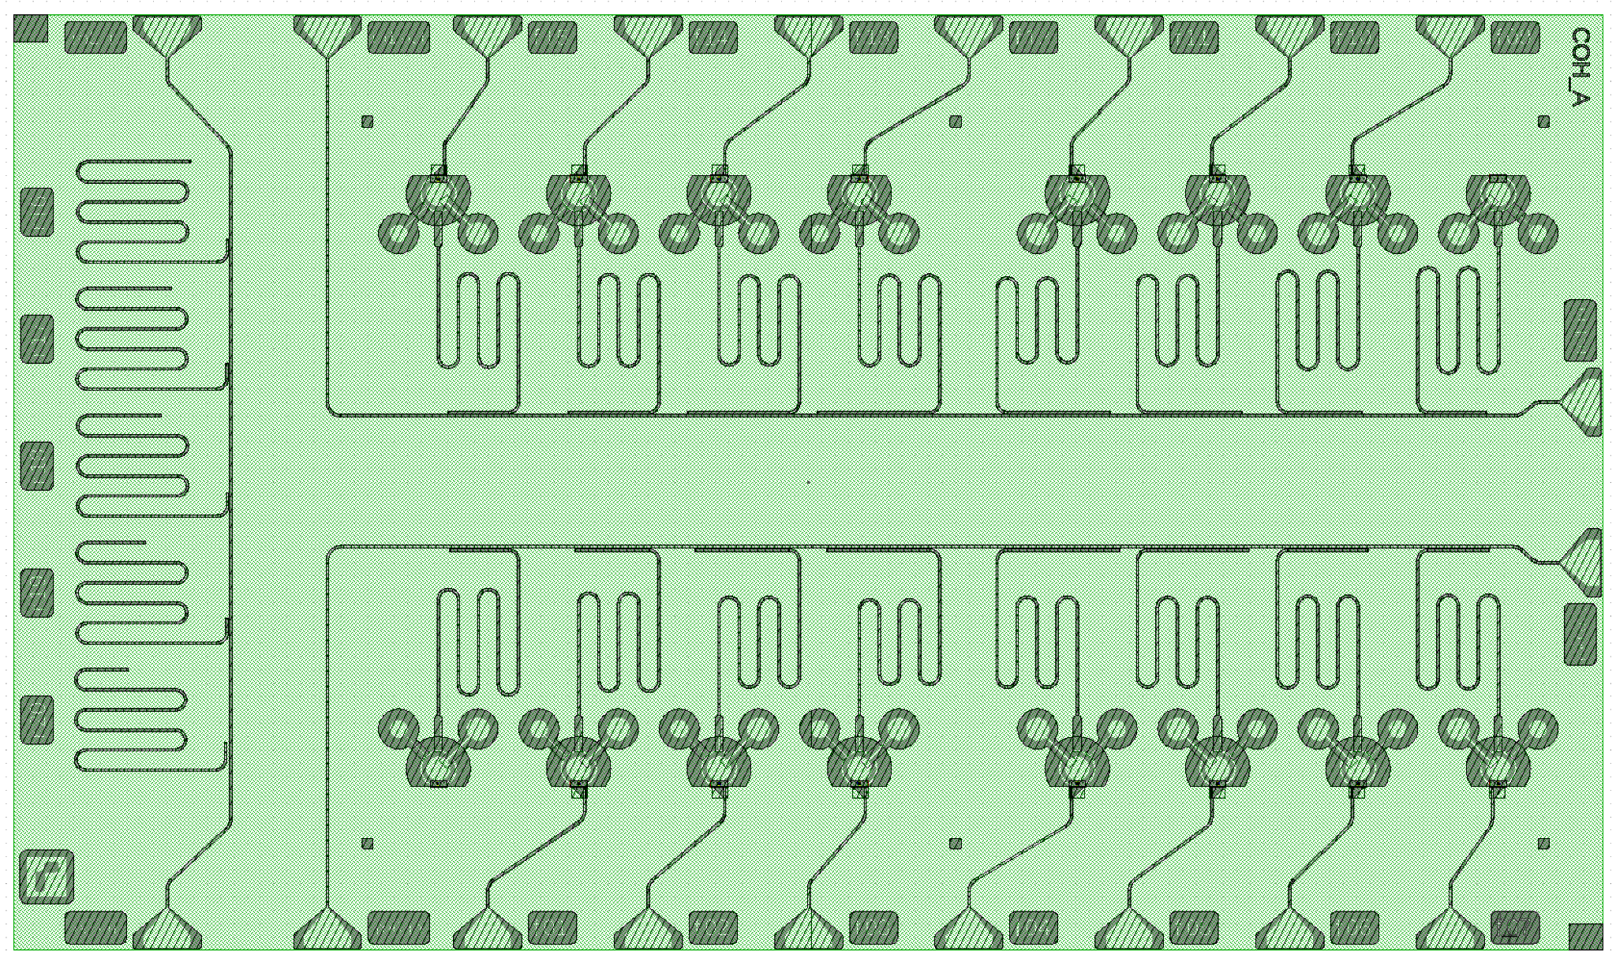
Focus today on Transmon qubits
SQMS Round Robin Chip
  Define Qubits
  - Design & Nanofabrication of
  circuit
  Initial State: Qubit environment
  Packaging of Qubits for RR
https://sites.google.com/view/junlings-research-homepage/thesis
https://rsl.yale.edu/sites/default/files/files/RSL_Theses/SchusterThesis.pdf
Notes:
Specifically, I’ll focus on the first two, te definition of the transmon qubits, including the design and nanofabrication b, and how the environment is important for the initial state preparation.
As an example, I’ll pick the chip that was designed and fabricated on a flat Si substrate for the SQMS Round Robin as an example, shown here, and hopefully, towards the end, motivate and describe the Round Robin study. In particular, we start by focusing on just this one part of the chip and then zoom out.

Slide 4
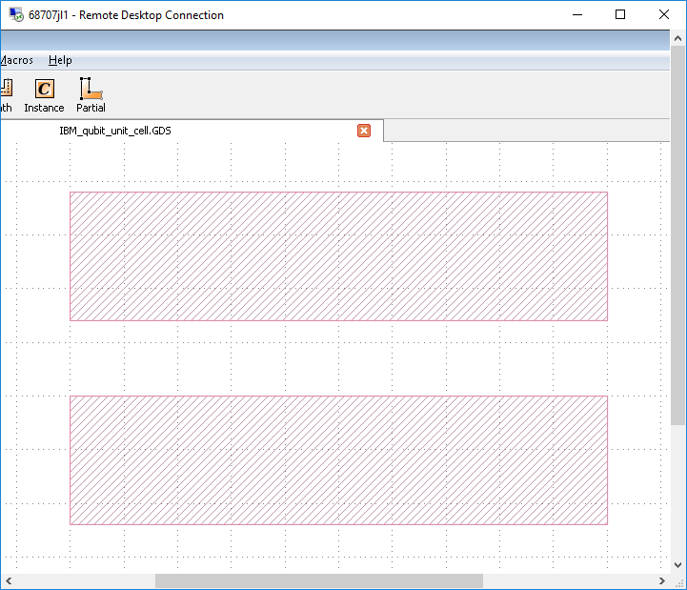
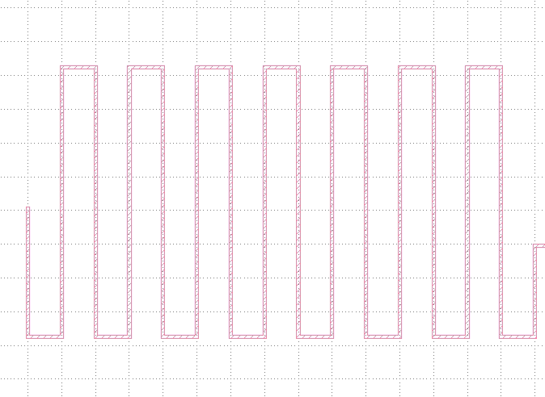
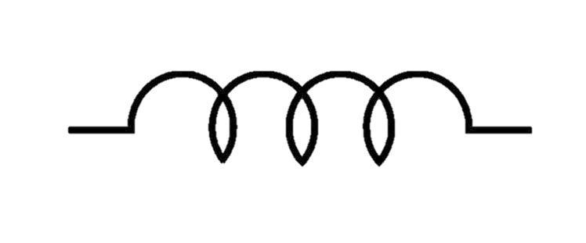
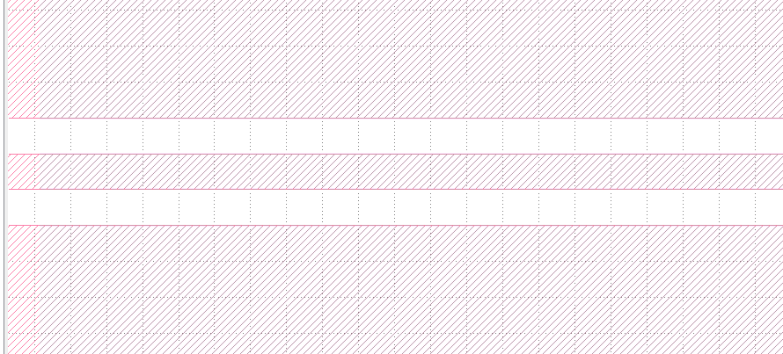
Basic components in the design
Name | Symbol | Equivalent rep. | Top view
Capacitor
Inductor
Transmission line (CPW)
Josephson Junction
gnd
gnd
BE
100nm
TE
Notes:
First, let’s define some of the circuit elements we’ll be seeing through the design. We start with capacitors. Usually, you’d make a capacitor from parallel plates, but in our designs these are fabricated on the surface of the chip, for reasons descrived later are usually implemented as two pads on the surface. Similarly Inductors are then usually made as long, thin lines, typically meandering to get enough inductance for the line. These can be combined into coplanar transmission line wavedguides, drawn as chain of inductance and capacitance/unit length, where the inductive line between two ground planes.
Finally, we’ll discuss how these Josephson junctions are made, These typically look like two crossed lines, a bottom and top electrode, with a very thin oxide barrier between them. , The circuit representation is essentially a capacitor and non-linear inductor in parallel. The nonlinearity inductance means just that the effect inductance reduces slightly depending on the amount of current in the device.

Slide 5
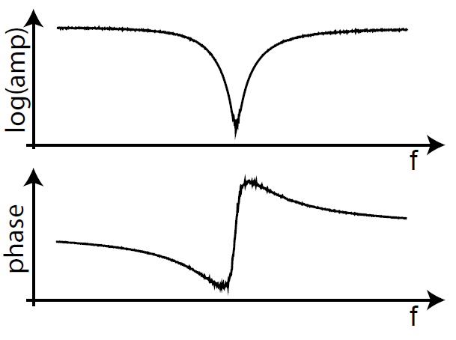
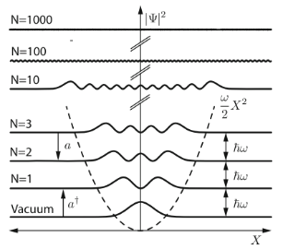

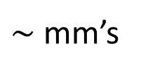
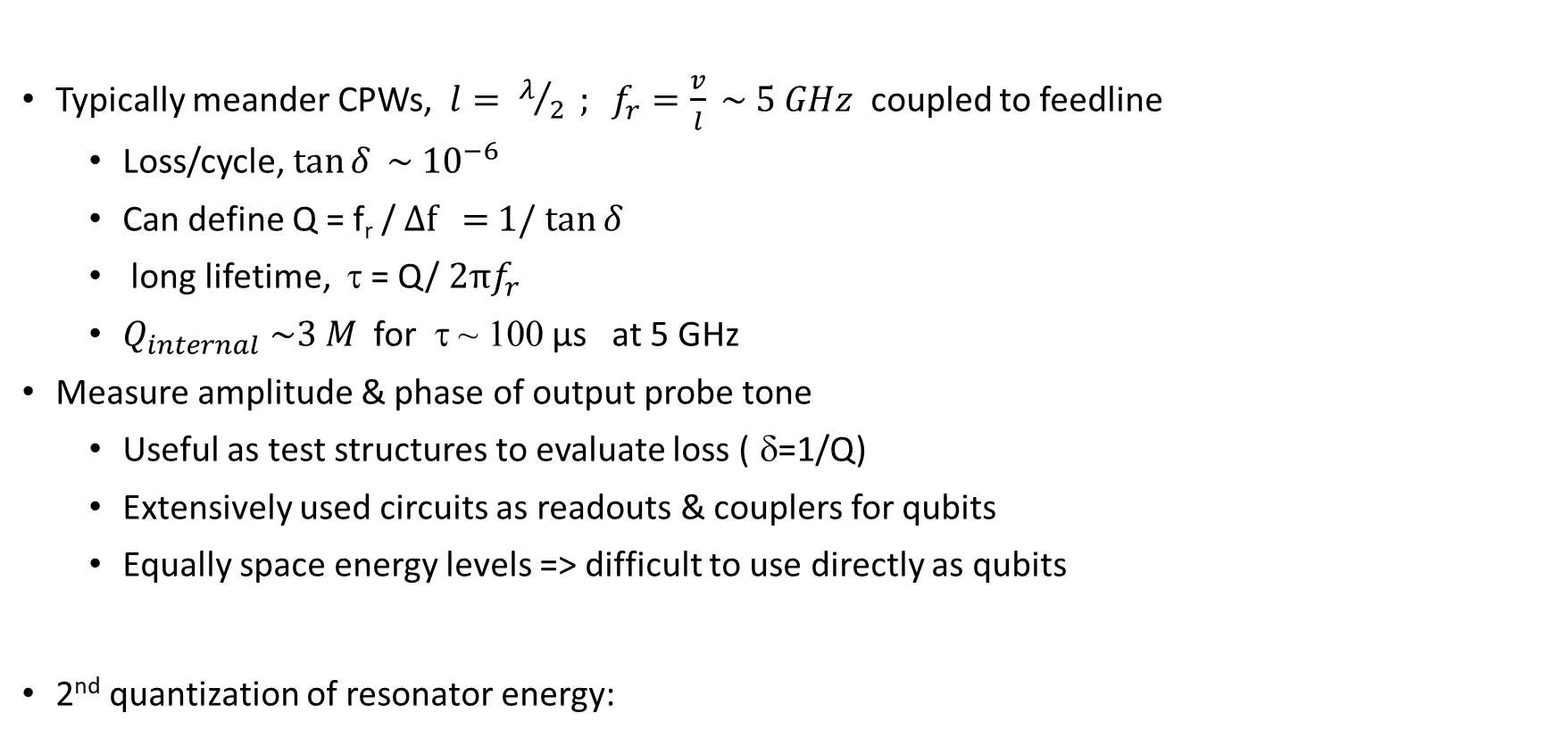


1st key component of superconducting circuits - resonators
Typically meander CPWs, $l= λ/2 ; f_{r}=\frac{v}{l} \sim 5 GHz$ coupled to feedline
  Loss/cycle, $\tan{δ} \sim {10}^{−6}$
  Can define Q = f_{r} / ∆f = 1/ $\tan{δ}$
  long lifetime, τ = Q/ $2πf_{r}$
  $Q_{internal} \sim 3 M$for τ ~ 100 µs at 5 GHz
  Measure amplitude & phase of output probe tone
  Useful as test structures to evaluate loss ( δ=1/Q)
  Extensively used circuits as readouts & couplers for qubits
  Equally space energy levels => difficult to use directly as qubits
2nd quantization of resonator energy:
1
$$l$$
1
2
$\sim$ mm’s
2
$$∆f$$
S₂₁
$$f_{r}$$
Putz, “C-QED…” Springer (2017)
Notes:
In particular, I consider one of the key components of these devices to be the superconducting implementation of the garden variety resonator – typically transmission line that is open on one or both ends to create a resonant cavity, whereby the frequeny is just defined by the length.
The resonant frequencies are typically in the accessible range of 5-10 GHz, so on the order of mm’s in size, and when a probe tone is sent from port 1 to port 2, sharp absorbtion resonance and phase shift in the response is observed due to low-loss of the superconductor and, hopefully, of substrate materials.
A couple of definitions that are important is the loss tangent, i.e. how much energy is lost every cycle of the resonator, and in superconducting circuits this can get well below 1 in a million.
The quality factor, i.e. the sharpeness of the resonance, is then related to the loss tangent just 1 over tan delta.
Using the loss/cycle, or Q-factor, gives the general scale that we see in the best superconducting circuits, i.e. quality factors on the order of 3 million in order achieve reasonable time constants of about 100 microseconds at 5 GHz.
At very low temperatures that we operate at, we can cool them to their ground state and put individual excitations on them.
Resonators are useful as readouts and couplers for the circuits as well as diagnostic tools to measure the loss in the system.
Note, however, that they have equally spaced energy levels, and a quantum description of these devices is given by the resonant frequency and the raising and lowering operators.

Slide 6
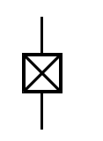
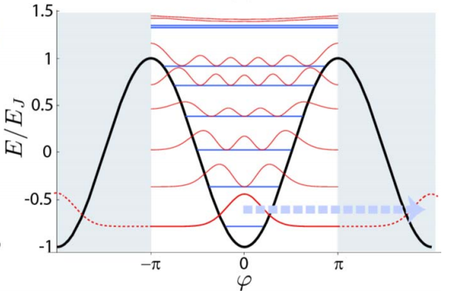







2nd key component – Josephson junction
BE
Wavefunction tunnels across barrier from top electrode to bottom electrode
Ultra-thin $\text{amorphous}\text{−}\text{AlOX}$
  small to reduce loss
  $\text{Thermal} \text{oxidation}\text{, }\text{thickness} \text{d}\text{\sim 1.8 }\text{nm}\text{:}$
    $\text{tunneling} \text{current} \text{I} \text{∝ }\text{exp}\text{(−}\text{d}\text{/λ)}$
  $φ$ = phase across junction, Josephson relations
    $\left\{\begin{aligned}I=I_{0}\sin\left(φ\right) \\ V=\frac{Φ_{0}}{2π}\frac{dφ}{dt}\end{aligned}\right\}$
Nonlinear Oscillating solution: “Plasmons”
Lifts degeneracy between levels
  Lowest transition could be used as a quantum binary transition “qubit”
$$ψ$$
$\sim$ 100 nm
BE
$$ψe^{iφ}$$
100nm
TE
TE
$$I_{0}=\frac{π}{2e} \frac{∆_{S.C.}}{R_{n}}$$
(Ambegoaker – Baratoff
Relation)
$$E_{12}$$
$$E_{01}$$
Koch et al., PR A 76, 042319 2007
Notes:
The second key component, as you may have expected, is the Josephson tunneling junction. Formed using an ultra-thin layer of aluminum oxide, we usually use very small ones, on order of 100 nm diameter, in order to avoid loss due to defects in the amorphous materials of the junctions.
They are made using thermal oxidation of, for example, an aluminum surface, allowing for current to tunnel through the junction, from the bottom to the top.
When the electrodes are superconducting, the current varies sinusoidally across the junction due to the phase difference across it. The maximum current, I_0, would just be that found when the voltage across the junction is more than the superconducting gap of the electrodes, so I_0 is proportional to the gap voltage divided by the normal resistance from ohms law, with some prefactors, and gives the Abegoakar-Baratoff relationship.
Josephson realized that the voltage response would resist a change in the phase, and from these Josephson relations for the current and voltage, there are oscillating solutions that are typically referred to as plasmons.
Because the voltage and current vary nonlinearly, the frequencies of the excitations go down as the number of photons is increased. It was recognized early on that if this lowest energy excitation could be isolated, it could be used at two-state “quantum bit”, or qubit.

Slide 7
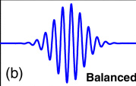
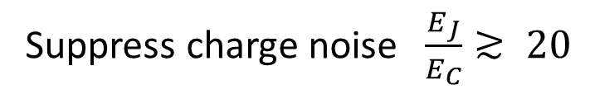
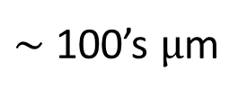







Add a capacitor in parallel to JJ to tune it to drive with a pulse
Circuit element energies:
  $$E_{C}=e^{2}/2C$$
  $E_{J}=I_{0}Φ_{0}/2π$
Capacitor
$\sim$ 100’s μm
$${hf=E}_{01}≅\sqrt{8E_{J}E_{C}}; f\sim 5 GHz$$
JJ
Suppress charge noise$\frac{E_{J}}{E_{C}}≳ 20$
$${α=E}_{01}−E_{12} ≅E_{C}; δf\sim 300 MHz$$
E _{C}
$$E_{J}$$
|2⟩
RF
$$E_{12}$$
|1⟩
|↑⟩
$$E_{01}$$
|0⟩
|↓⟩
Koch et al., PR A 76, 042319 2007
Notes:
This was practically achieved by Jens Koch and collaborators at Yale, where they added a capacitor in parallel to the junction. This allowed them to define two parameters, the capacitance and charging energy, which can be adjusted to set the frequency of the first transition, find a regime where the charge noise is suppressed exponentially, and set the anharmonicity (i.e between the first and second excitation energy,) allowing them to address just the first transition.
To first order, then the computational space of the system includes just the first level and a Pauli spinor, which is why – and 1 states are sometimes referred to as the up and down. Note the excited states are still there, and need to be considered when designing the circuits.

Slide 8
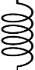
Capacitively couple: Transmission line + Plasmon = “Transmon”
Qubit + capacitor+ Resonator
Q_{q}
Q_{r}
C_{r}
L_{r}
C_{Σ}
L_{j}
Equivalent circuit
Qubit state shifts the resonator frequency slightly => readout qubit!
Jaynes-Cummings, Proc. IEEE (1963)
Koch et al., PR A 76, 042319 2007
Notes:
The Yale team then realized they could couple the capactcively shunted junction to a transmission line, making a “Transmon”, where now the state of the qubit shifts the resonator frequency slightly

Slide 9
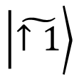


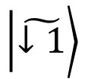
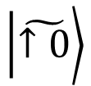
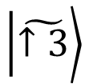
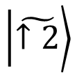
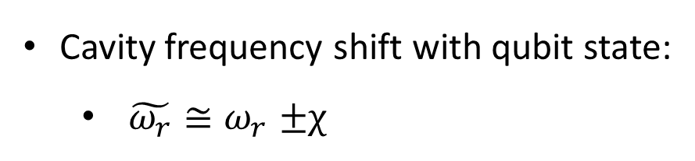

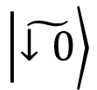
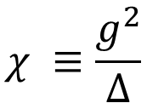
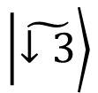
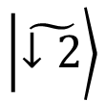
Read out qubit with resonator frequency shift
In the dispersive regime, atom is strongly detuned from the cavity:
$$\left.\left|\tilde{↑3}\right.\right\rangle$$
$$\left.\left|\tilde{↓3}\right.\right\rangle$$
$$\left.\left|\tilde{↑2}\right.\right\rangle$$
the Hamiltonian can be approximately(2nd order) diagonalized:
$$\left.\left|\tilde{↓2}\right.\right\rangle$$
$$\left.\left|\tilde{↑1}\right.\right\rangle$$
$$\left.\left|\tilde{↓1}\right.\right\rangle$$
$$ω_{r}−χ$$
$$\left.\left|\tilde{↑0}\right.\right\rangle$$
$$χ ≡\frac{g^{2}}{Δ}$$
$$ω_{r}+χ$$
$$\left.\left|\tilde{↓0}\right.\right\rangle$$
$$Δ$$
Cavity frequency shift with qubit state:
  $\tilde{ω_{r}}{≅ω}_{r}±χ$
Qubit ground
Qubit excited
Shuster Thesis, Yale (2007)

Slide 10
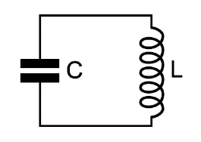
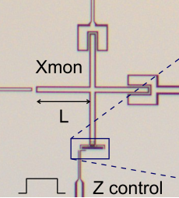
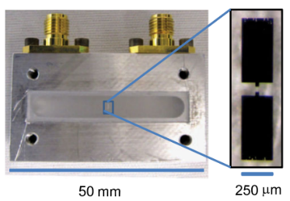
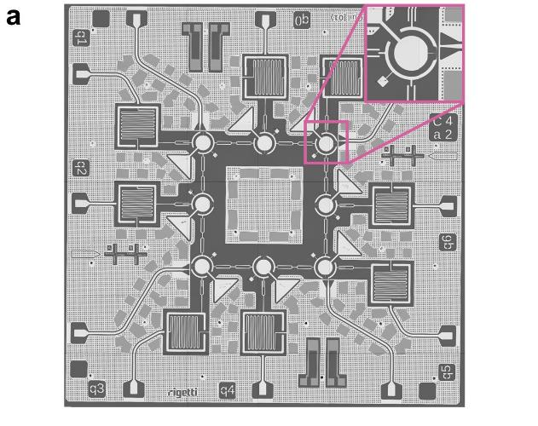
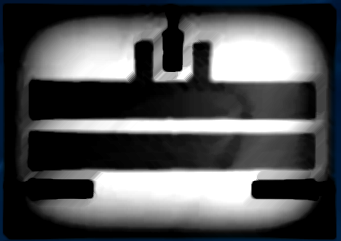

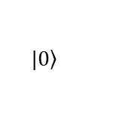




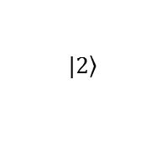
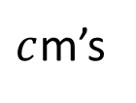



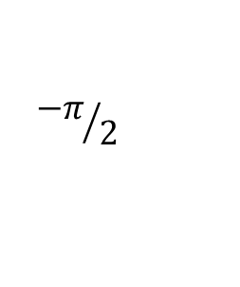
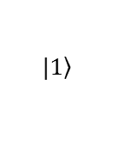

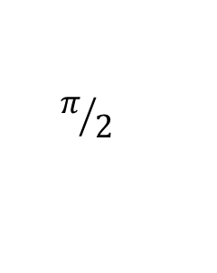
Typical superconducting transmon qubit circuit
Readout resonator
Frequency response
RF
Readout
$$C_{readout}$$
$$π/2$$
Resonator
| $1$⟩
| $0$⟩
$$Res$$
$$Res$$
Phase
frequency
$$C_{coupling}$$
$${−π}/2$$
RF
$$C_{Σ}$$
$$L_{J}$$
$$f_{01}$$
Qubit
$$\left.|2\right\rangle$$
$$\left.|1\right\rangle$$
Qubit
$$\left.|0\right\rangle$$
$c$m’s
“3D” - Paddle in cavity
2D - Dumbell
On silicon
Concentric
On silicon
“Xmon”– 2D
Paik, et. al. PRL (2011), Barends PRL (2013), Sandberg APL (2013)
Notes:
Implementations and variations of this idea quickly exploded. A few of these are shown here, with the first devices being parallel-plate paddle capacitors and Josephson junction on a sapphire chip mounted in resonant cavity with SMA connectors. Subsequently, researchers put similar capacitors on Si with paddles, concentric plates (to suppress radiation loss), and the “X-mon”, which uses an isolated electrode and the ground as the second plate.
So let’s first look at how these qubits are prepared - A given qubit is addressed with an RF pulse, coupled to a resonator and feedline, and the resonator response is measured from the phase or frequency shift of a test tone that reflects off of it.
Additional frequency multiplexed readouts and qubits can be addressed on the same line,
So, this leads to the design of the SQMS resonator chip.

Slide 11
Test chip example – SQMS Round Robin Chip
SQMS Round Robin Chip
10
Readout Resonators
Frequency (GHz)
5
Qubits
5 test resonators along the top
16 qubits (8 + 8)
  Each has it’s own readout resonator
  2 fixed frequency
  14 tunable frequency
Notes:
This is an example of the Round Robin chip, how the frequencies could be allocated for multiplexing. There are 3 feed lines with 5 test resonators across the top.
For example, on the left side this qubit can coupled to a resonator at this frequency, and the frequencies of the other readout resonators are just shifted.
In addition, on this chip we’ve include extra junctions on these lower qubits so they can be tuned.

Slide 12
Circuit design – steps and objectives
Connectivity
Compactivity
Target desired frequencies
Reduce circuit loss
- materials
Target desired Hamiltonian
  Qubit-qubit control
Minimize the cross talk
Physics-Hamiltonian
Layout
Circuit model

Slide 13
Minimizing loss in quantum circuits to get long coherence
Side view, Cross-section:
E
vacuum
AlO_{x} Junction
Material | Loss (10-6)
CVD a-SiO_{X} | 3000
a-AlO_{X} | 9.8
a-SiN (N-rich) (Si-rich) | 200 25
a-Si:Sputtered :Hydrogen | 600 25
bulk-Si (intrinsic) | <1
Al2O3 (sapphire) | <<1
Vacuum | 0
Plate 1
Plate 2
substrate
D
Loss appears in amorphous materials
  Contamination, disorder at interfaces, surfaces
  Amorphous AlOx junction material
  Substrates hold much of the energy
“Bare circuits”
  Superconductors on low loss substrates
  Minimize crossovers & lossy dielectrics (no SiOx!)
  Use small junctions
Paik PRL (2010); O’Connel (2008); Wang APL 107,162601 (2015); Simmonds PRL (2004)

Slide 14
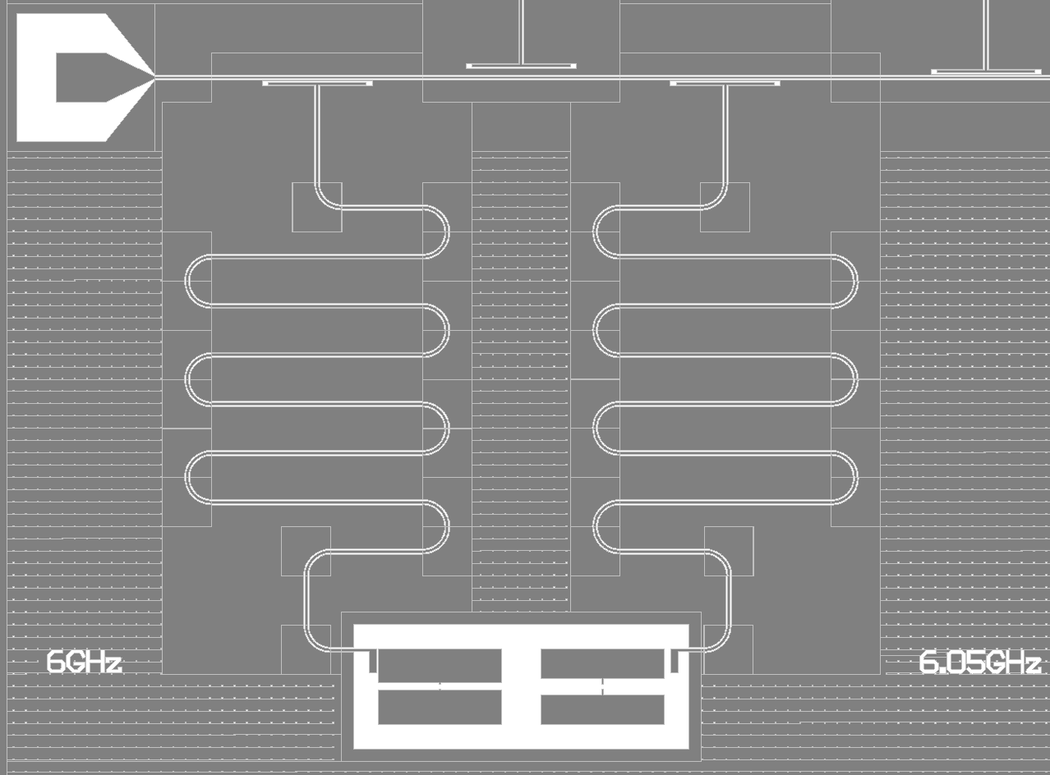
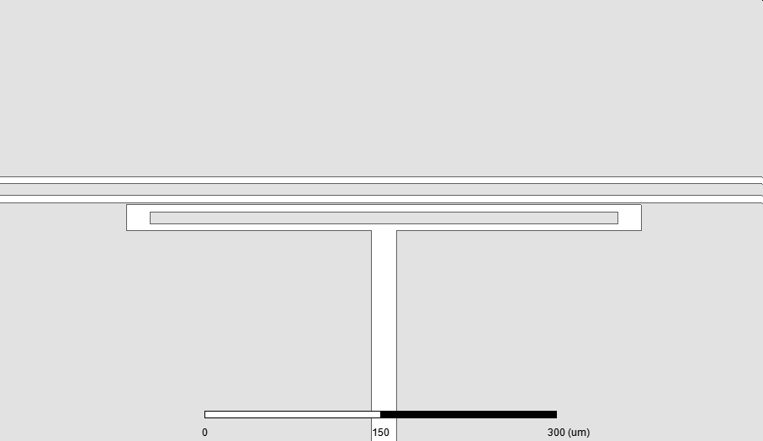
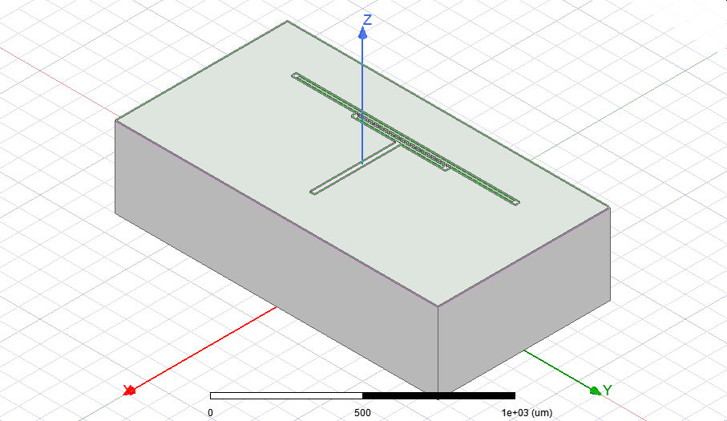
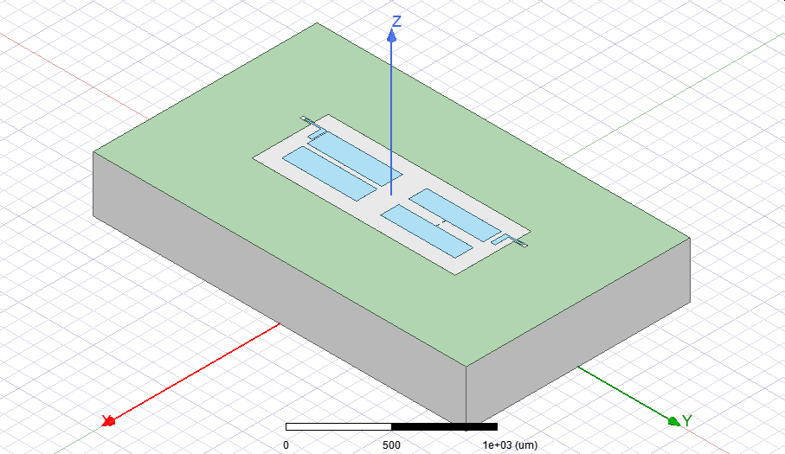
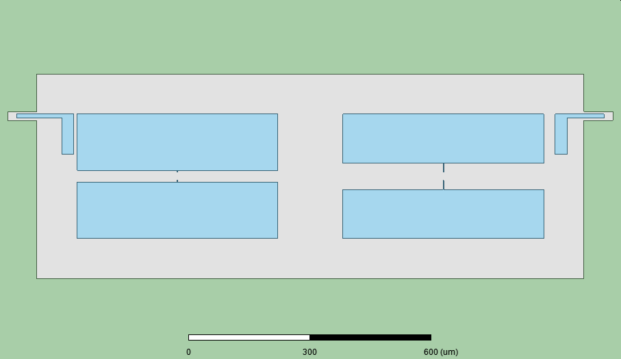
From drawing to circuit model
Values of Josephson junctions are chosen and matched in fabrication.
Parameters of transmission lines are calculated using analytical expressions or simulated in HFSS.
Capacitance matrices are simulated numerically (COMSOL AC/DC module, Ansys Maxwell, Q3D, and CST).
Readout1
Readout2
Qubit 1
Qubit 2

Slide 15
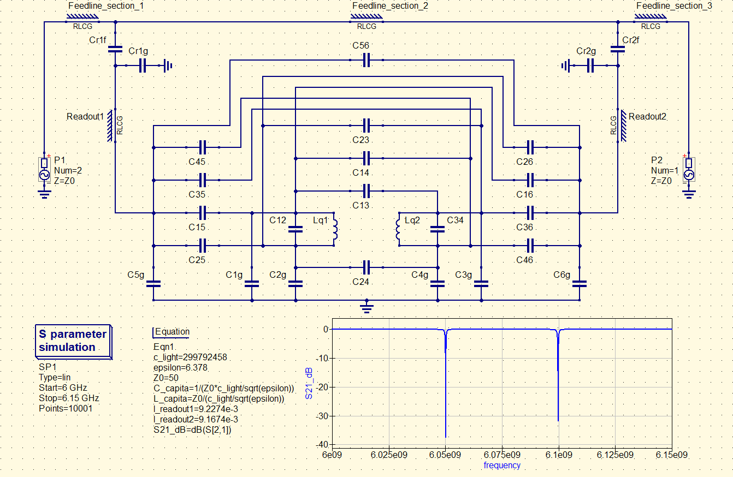
Full drawing of circuit model for 2 qubits– include all parasitic capacitances!
Readout1
Readout2
Qubit 1
Qubit 2
Readout1
Readout2

Slide 16
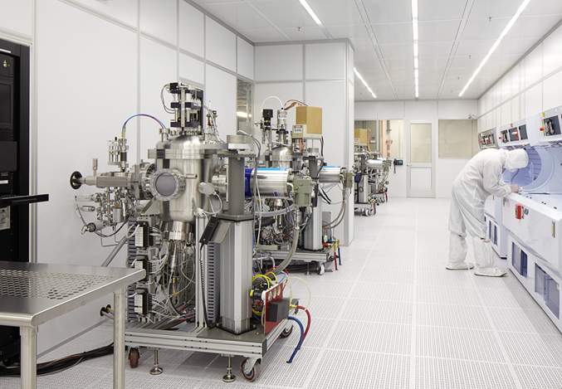
Processing in Micro/Nano Fabrication Facility
Deposition Tools
Wet Processing Benches
Etching Tools
Imaging & Characterization
Tools
Lithography Tools
Post-processing & Packaging Tools

Slide 17
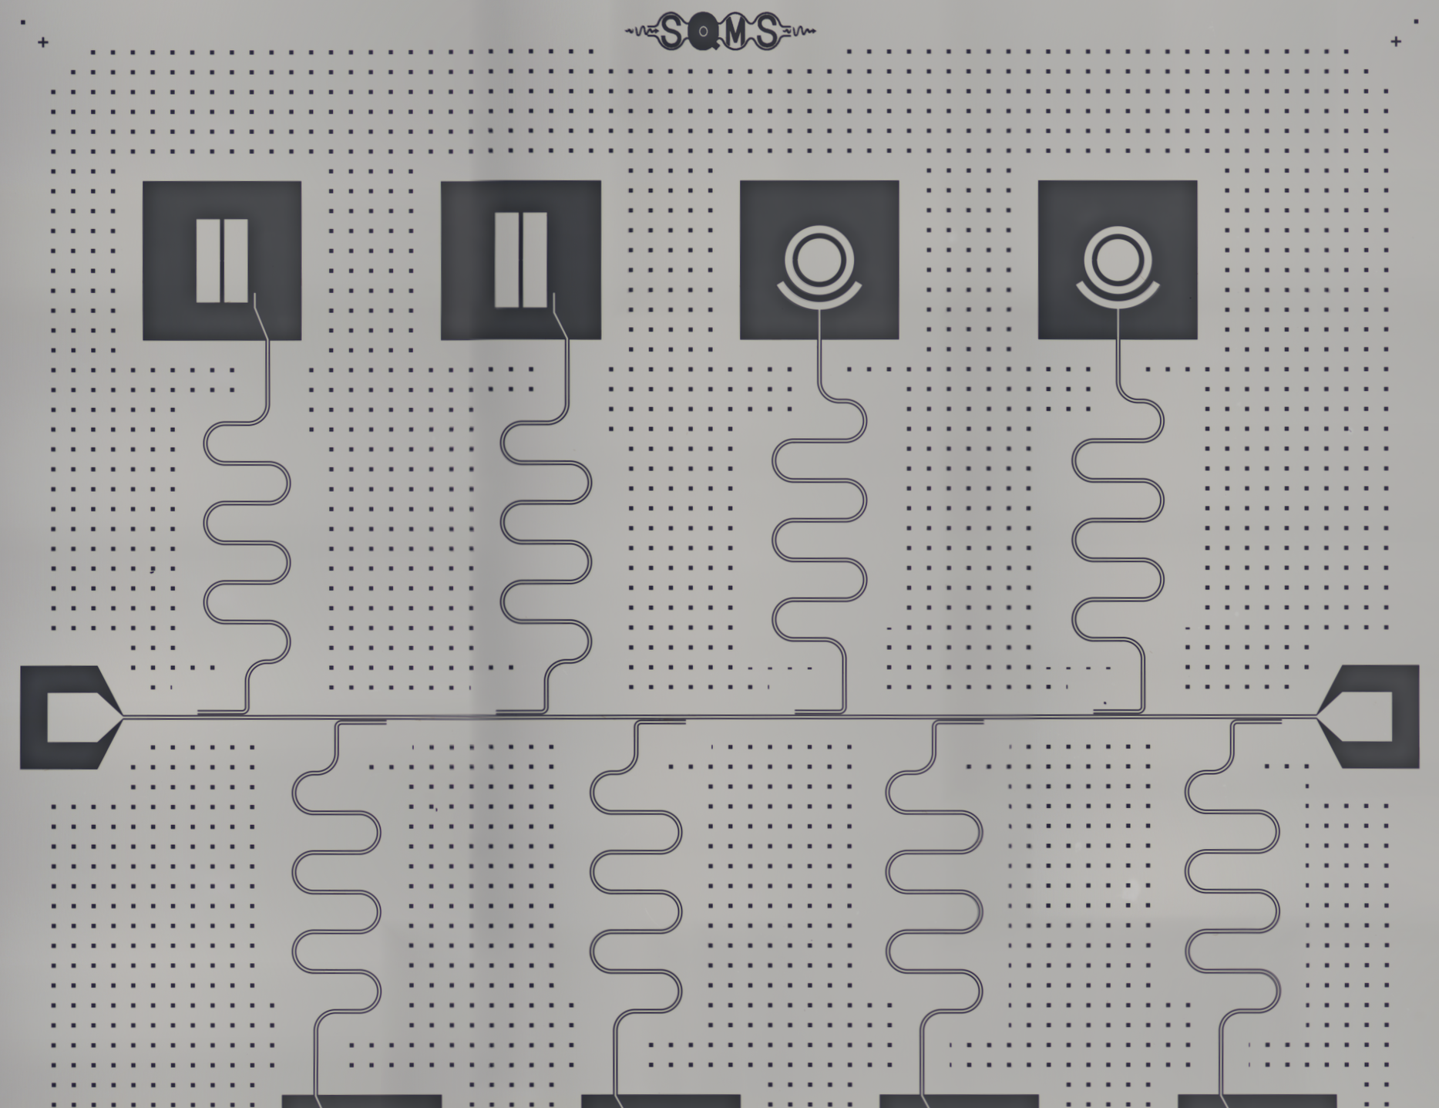
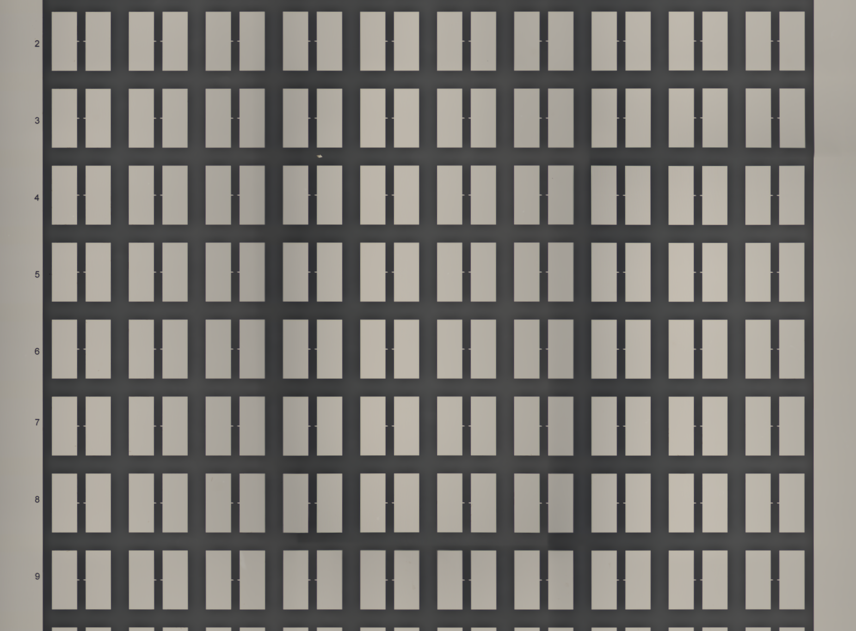
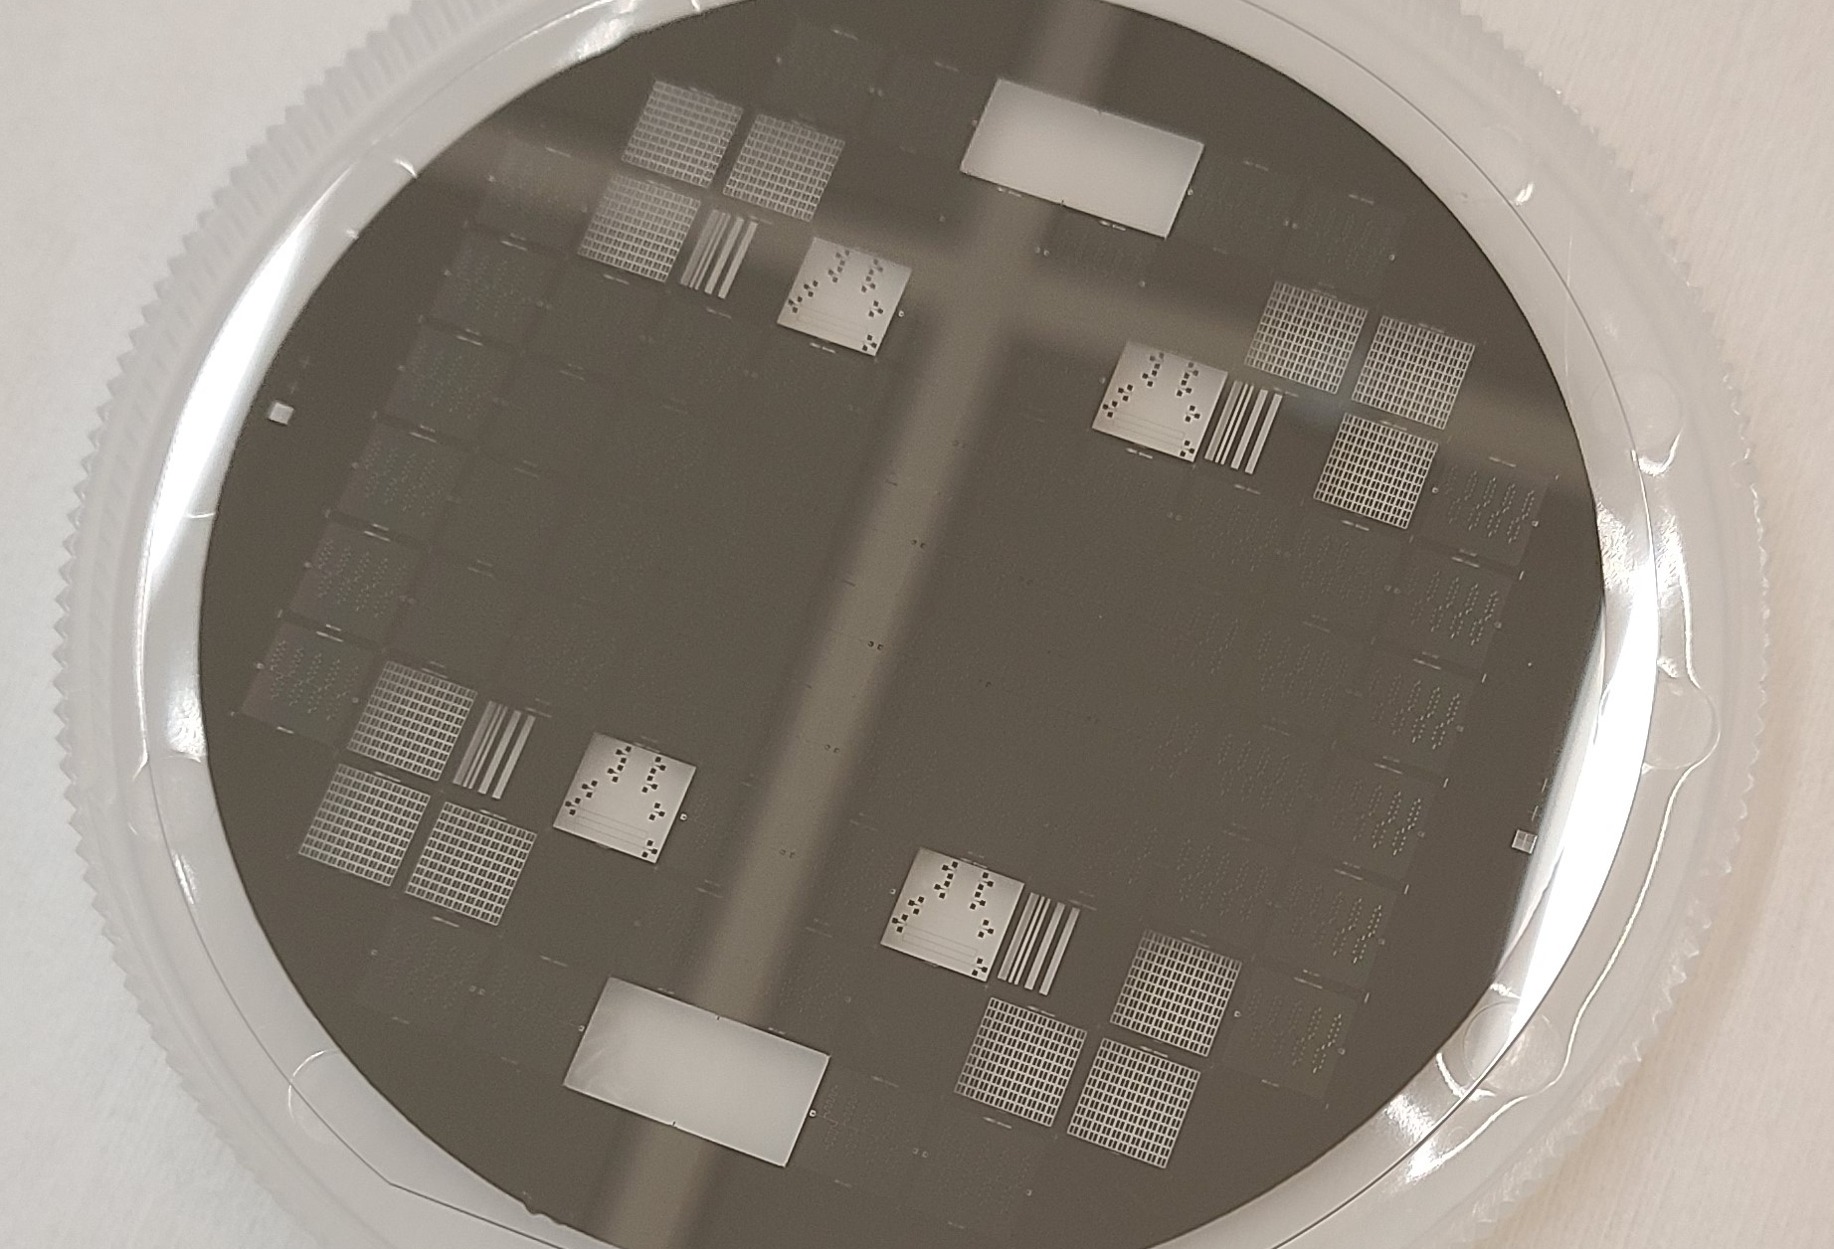


From Substrate to Device:
- Subtractive etching
- Additive lift-off

Slide 18
Subtractive etching process
UV Exposure
Resist
mask
Substrate
Substrate
Deposit Metal
Spin Coat Resist
Substrate
Expose Resist
Substrate
Substrate
Substrate
Strip Resist
Etch Metal
Develop Resist

Slide 19





Resonators, circuitry typically patterning using subtractive etching
Heidelberg MLA 150
Maskless aligner
Plasma-Therm ICP RIE

Slide 20
Lift off Process (additive)
e-beam
PMMA
MMA (8.5) MAA
Substrate
Substrate
Substrate
Spin Coat Resist
E-beam Expose
Develop Resist
Substrate
Substrate
Solvent Lift Off
Metal Deposition

Slide 21



Liftoff typically used to fabricate submicron Al/AlOx/Al Junctions
Shadow evaporation with tilt, “Dolan bridge” –
Single pattern step, single pumpdown
1) Pattern, deposit 1st layer, oxidize, tilt,
deposit 2nd layer
Overlap junction - 2 patterns, pumpdowns
Pattern
pumpdown
LO BE
Pattern
pump down
mill BE & oxidize LO TE
100nm
X. Wu, et. al APL (2017)
M. Steffen et. al, PRL97, 050502 (2006)
“Bridgeless” – shadow evaporatioin high aspect tilt
“Manhattan style” – shadow evaporation
Use rotation between the two depostions and oxidation
F. Lecocq et al Nanotechnology (2011)
J M Kreikebaum et al 2020 Supercond. Sci. Technol. 33 06LT02

Slide 22


Josephson junctions - sensitive to atomic-level defects
Aluminum oxidation is conformal, ~ 1.8 nm thick Al/AlOx/Al
Thickness variations with exponential dependence of current
  Less than 10% of total barrier active
  Strong inhomogeneity of tunnel current across junction
Amorphous materials are lossy – make junctions small
=> Junction properties vary significantly from across wafer
Xian Wu et al., APL 111, 032602 (2017)
BE
100x100 nm
TE
100nm
Cross-section TEM
TEM
20 nm
Zeng, J. Phys. D: Appl. Phys. 48 (2015) 395308

Slide 23


Josephson Junction Process at FNAL (Dolan bridge)
Raith EBPG5200 E-Beam lithography system (100 kV)
Electrodes are deposited at +22 / -22 degree angles relative to the normal of the substrate.
2’15” (45”/45”/45” at +60/0/-60 degree) Ar ion milling to remove oxide on Nb.
Bottom/Top electrode thicknesses are 40 nm/90 nm.
The Oxidation is 20 mBar for 12 minutes (Ar/O2 (85/15) mixture)
The Junction area is approximately given by (D+t) x W
  Uncertainty in the area can affect the junction resistance and I₀
Plassys MEB550S

Slide 24


Josephson Junction Characterization at Fermilab
Shadow evaporation Dolan bridge array
  many widths, overlap distances
Measure junction resistance at room temperature
  => R_{n}
Compile results:
Bottom Electrode Thickness (t)
Overlap Width (W)
Overlap distance

Slide 25






Estimating Junction Properties based on RT Resistance Measurement
$$I_{0}=\frac{π}{2e} \frac{∆_{Al}}{R_{n}}$$
$R_{n}$ vs. 1/area
Use
$${hf=E}_{01}≅\sqrt{8E_{J}E_{C}}$$
  $E_{J}=I_{0}Φ_{0}/2π$ =>

Slide 26








Qubit initialization and (de)coherence
Initialize the qubits by letting them all settle into their ground stage
Set qubit in desired state with pulse of RF
  Quantum States have two degrees of freedom
  Total coherence time T₂: $\frac{1}{T_{2}}=\frac{1}{{2T}_{1}}$ + $\frac{1}{τ_{φ}}$
| $↑$⟩
| $↓$⟩
$$|\left.↑\right\rangle$$
Energy decay
T₁ = energy lost/absorbed – (Materials, Radiation, RF noise, Temp.)
x
y
$$|\left.↓\right\rangle$$
                τ_{φ} = dephasing time (noise – Magnetic, RF, materials, thermal, …)
$$φ$$

Slide 27



Measurements: Dilution refrigerator & packaging
Room temperature
T ~ 300 K
Qubits are initialized by cooling to start in |0>
Low T ensures pure initial state preparation
Need:
  T < 22 mK for to stay in |0> with P>99.99%
    reduces radiation that might affect qubit state after initialization
  Good thermalization – Au plated Cu boxes
    RF hygiene – coaxial cables
    -70 dB attenuation on RF lines
  Magnetic & RF shielding
    Reduces noise and protects SQUIDS that are used for tuning qubits, couplers
Qubit excitation ~ 5 GHz
$ℏω$ = 3 x 10⁻²⁴ joules (yocto)
|1⟩
|0⟩
Excited state population vs. T
$$\overline{n}=\frac{1}{e^{ℏω/k_{B}T} −1}$$
T < 0.02 K ~RT/15,000

Slide 28





At bottom – magnetic shield, cold finger, sample boxes
Extensive simulation work (Solidworks, Comsol, HFSS)
  Magnetic field attenuation > 10⁴
  Thermalization
  Vibration norm mode analysis
  Boxes - E-M mode analysis

Slide 29







Sample box for Chips (packaging)

Slide 30





Package for the SQMS Round Robin study
Compare, contrast: coherence (f₁₀, T₁,T₂)
  Background radiation effects, reproducibility, stability, etc.
  Need to make sure box is robust

Slide 31


Optimize the package for best possible performance
Completely enclosed, light-tight cavity
Analyze modes of both box and circuit board
  Ensure frequencies far from the qubits & resonators
  Don’t overlap spatially

Slide 32

Sample Box and Silicon Chip with Wirebonds

Slide 33

Add Copper Plating to Inside Wall of Board to Shield the Chip

Slide 34

Add Vias to the Board Study Higher Frequency Modes

Slide 35

Ensure Cavity Modes with the Silicon Chip are far from qubit, resonators

Slide 36

Wirebondering Packages
Demonstration in the lab

