Slide 1
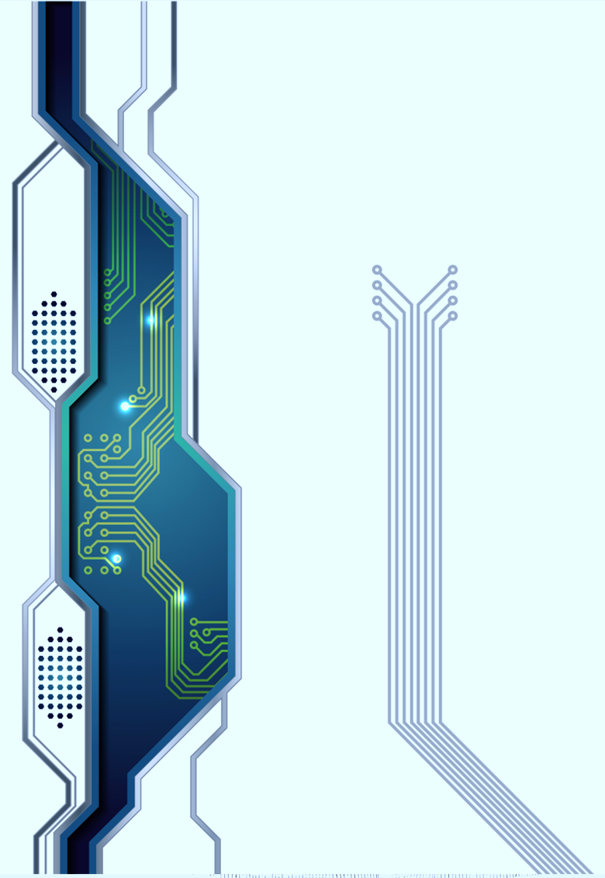

U.S. Quantum Information Summer School 2023
Introduction to Superconducting Quantum Circuits
Jens Koch, Northwestern University

Slide 2

?
WHAT
TO DO
ON
SUNDAY

Slide 3
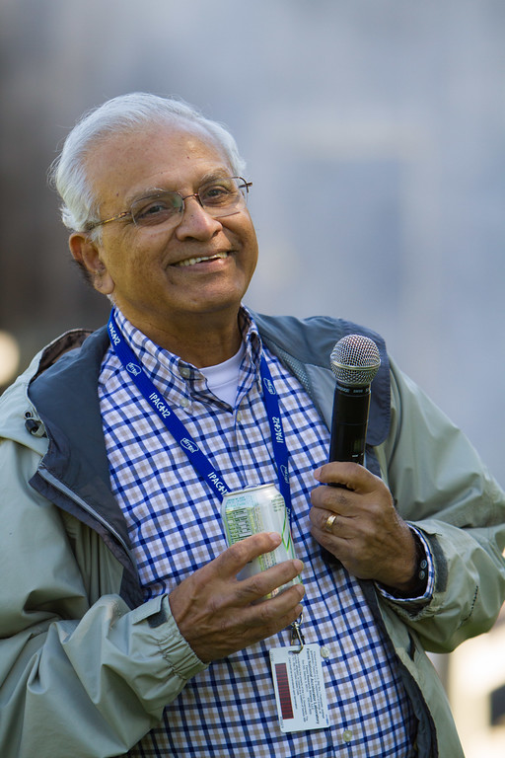
Hasan Padamsee
Prof. emer., Cornell University
SQMS Advisory Board

Slide 4
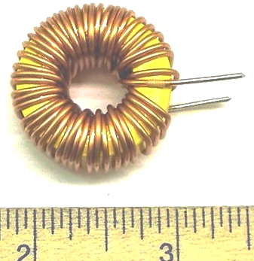
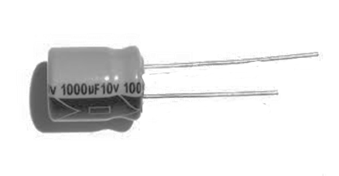

?
Building quantum bits from circuits
C
L
Ohmic losses
energy dissipation,
interaction with the environment
dramatically reduces
quantum effects

Slide 5
Building quantum bits from superconducting circuits
E
superconductor
dissipationless (no Ohmic resistance)
provides nonlinearity via Josephson effect
2Δ ~ 1 meV
superconducting gap

Slide 6

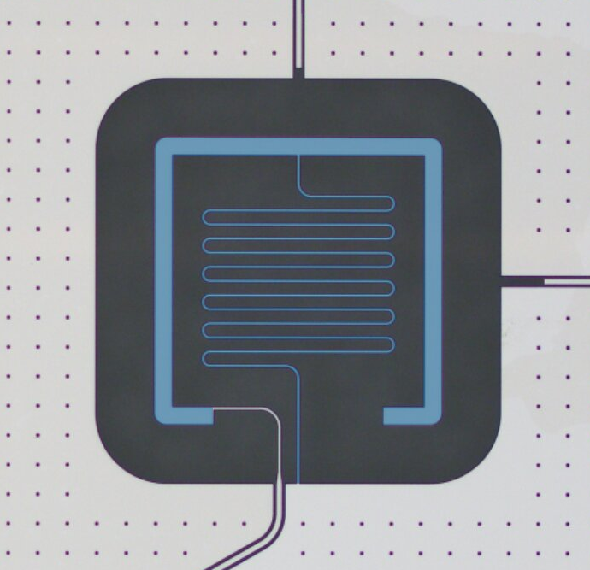
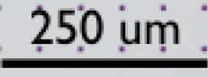
Building quantum bits from superconducting circuits
“artificial atoms”
discrete energy levels
anharmonic spectrum
coupling to EM field

Slide 7
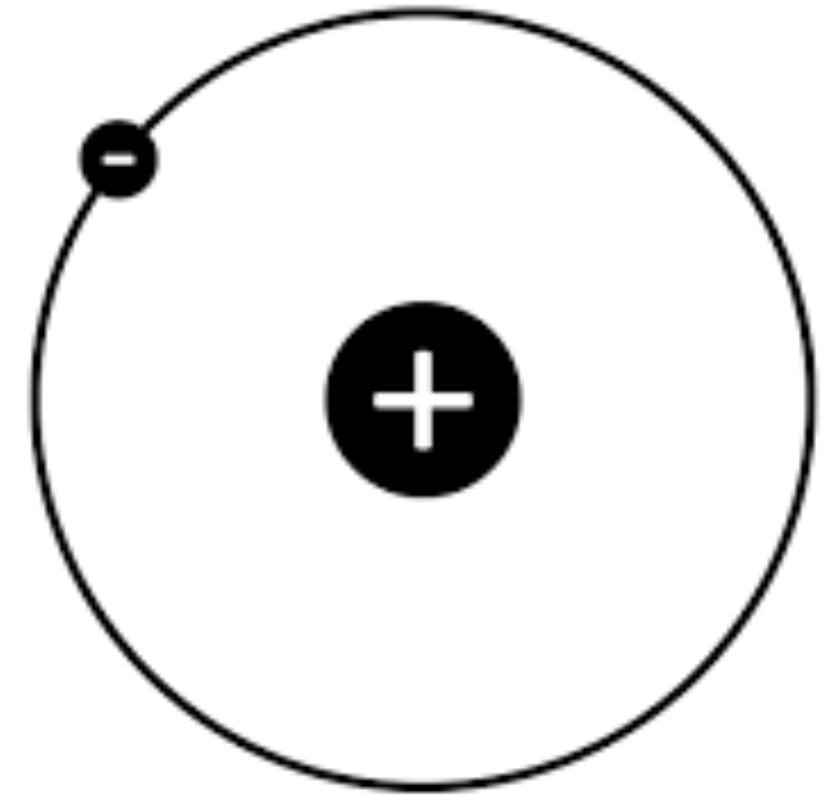
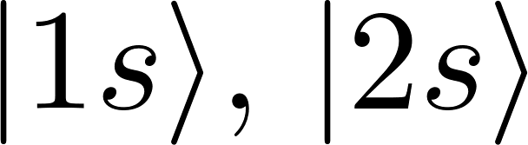
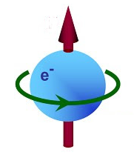
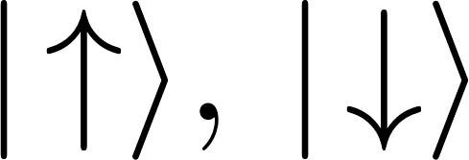


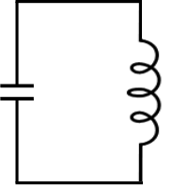
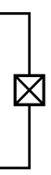
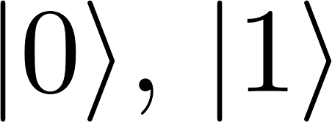
atoms
ions
NV centers
quantum
computing
hardware
spins
photons
superconducting
circuits
and cavities

Slide 8
Circuit elements
C
L
JJ
Capacitance
Inductance
Josephson junction

Slide 9
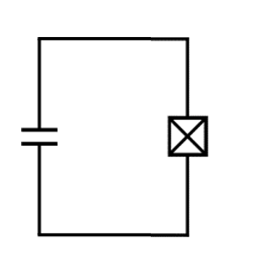
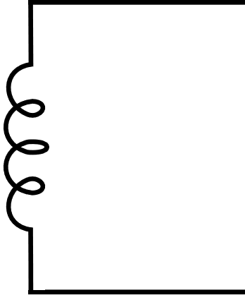
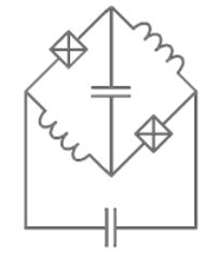
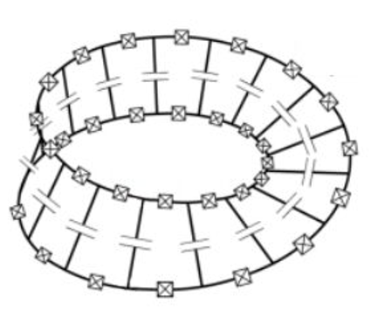
Building quantum bits from superconducting circuits
C
L

Slide 11

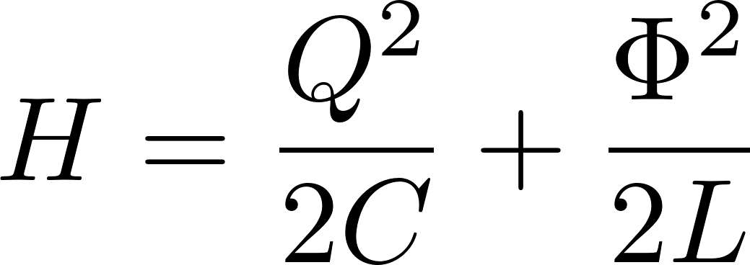


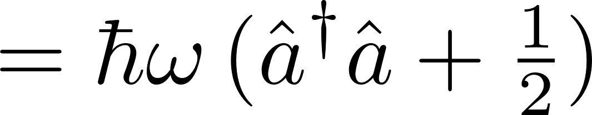
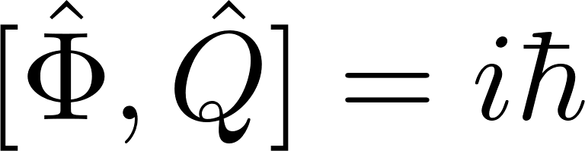
Ф
Q
++++
- - - -
charging
energy
inductive
energy

Slide 12

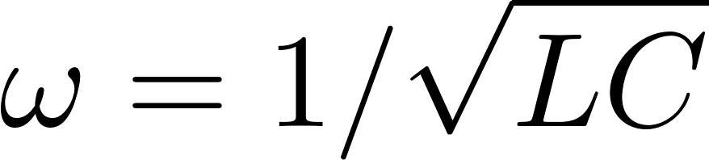

Slide 13
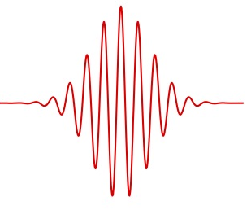
Quantum
LC oscillator
as a qubit?
not a good qubit…
need nonlinearity

Slide 14
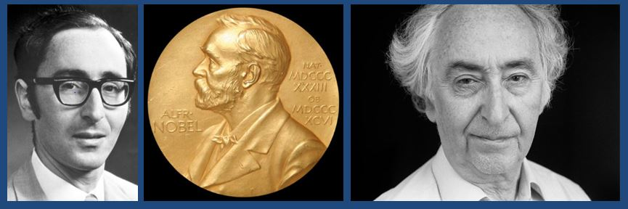




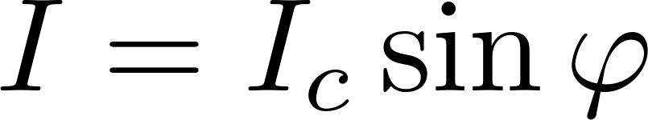
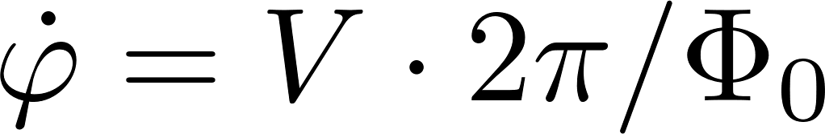
From LC oscillator to transmon
Brian Josephson
Nobel Prize 1973
Josephson effect
current-phase relation:
phase evolution equation:

Slide 15
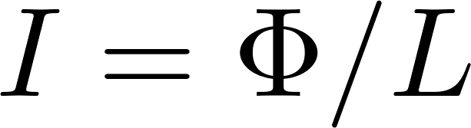

Josephson junction

Slide 16
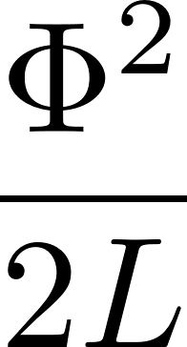
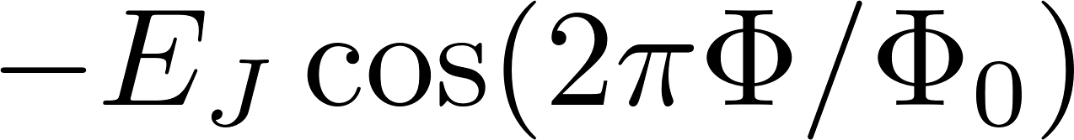

Slide 18
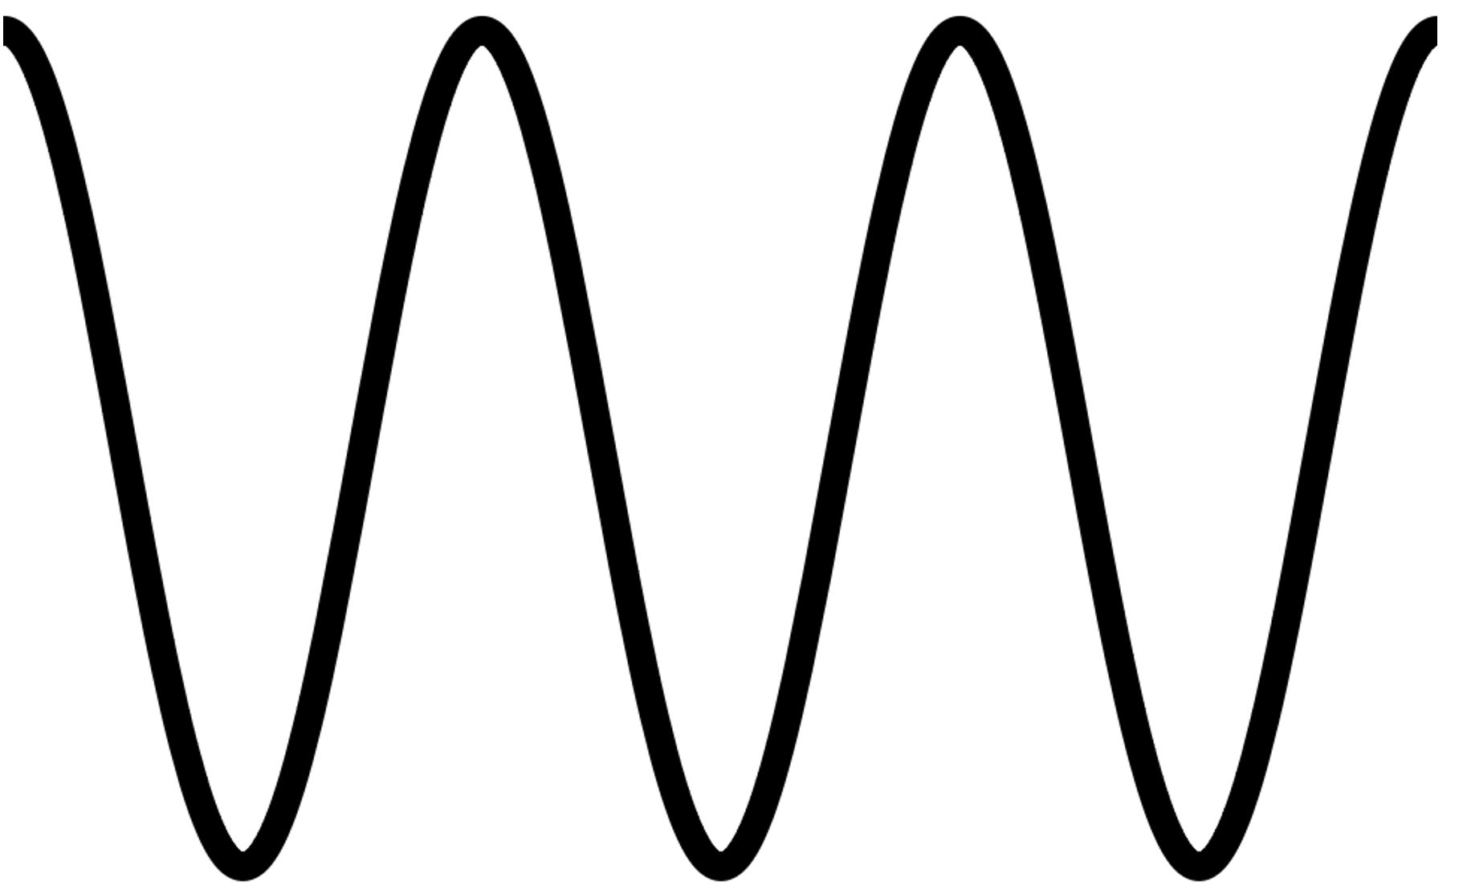

Slide 19
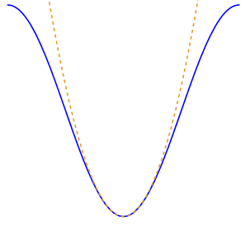
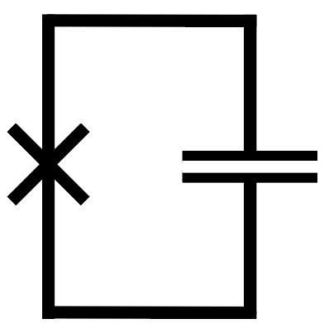
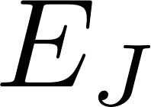


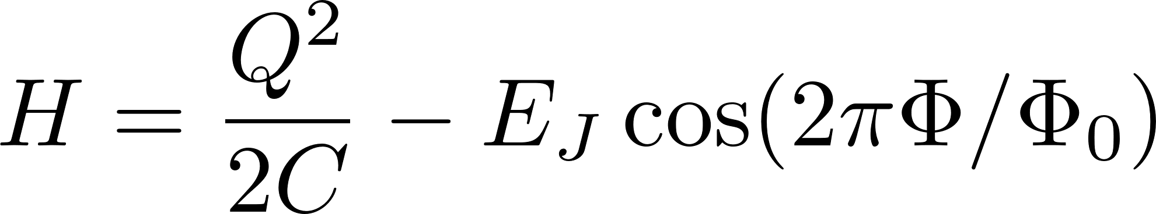

Introduce nonlinearity:
replace inductor with
Josephson junction

Slide 20
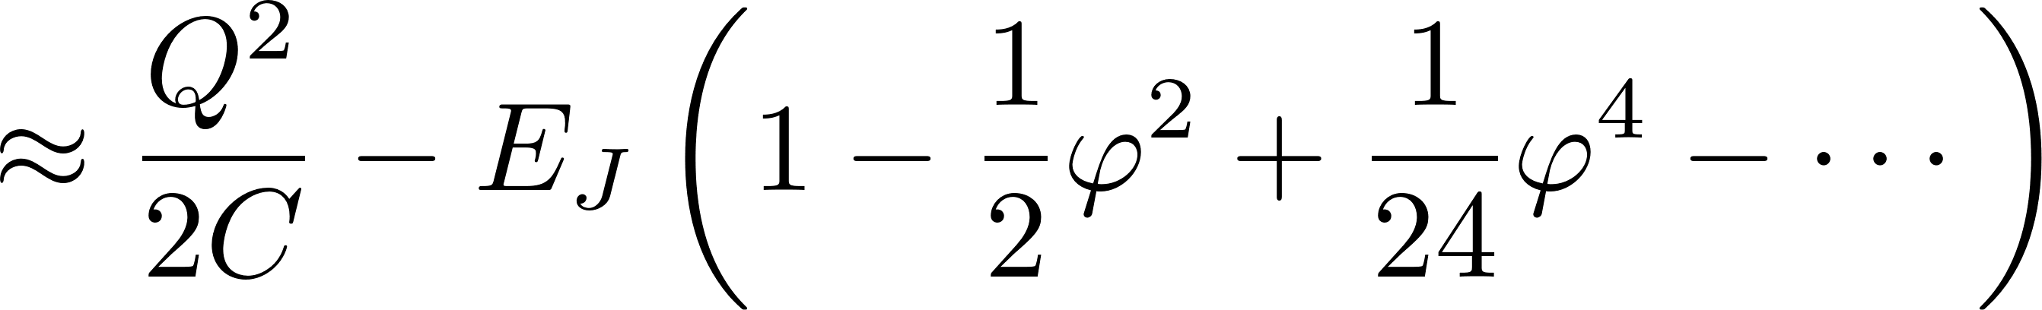
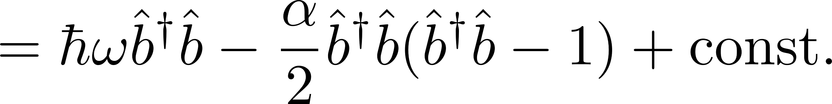
Introduce nonlinearity:
replace inductor with
Josephson junction

Slide 21
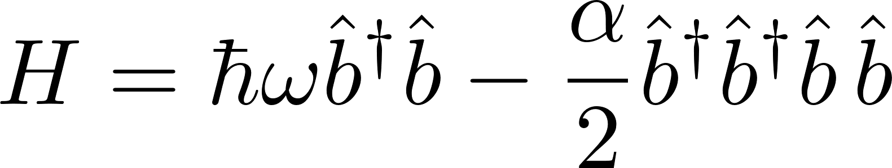
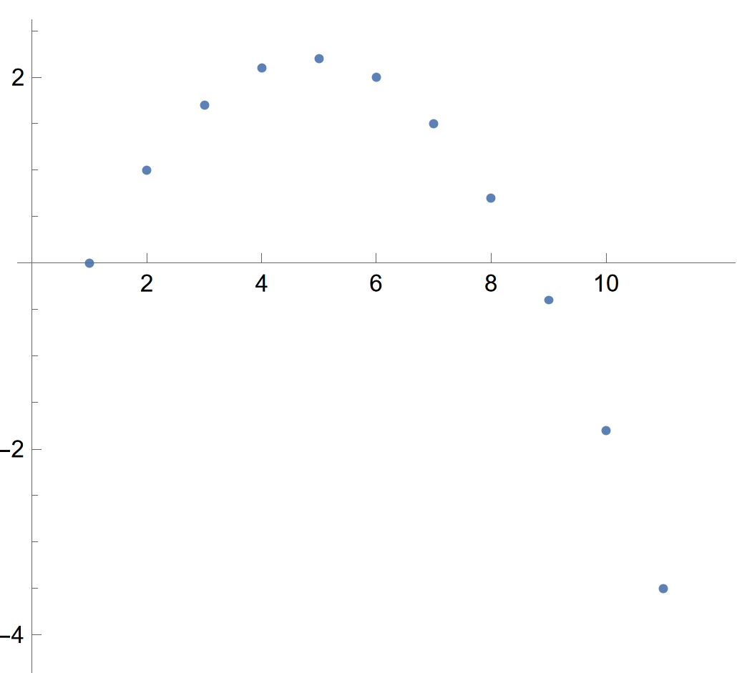



Hamiltonian
eigenenergies
spectrum
not bounded
from below
…

Slide 22
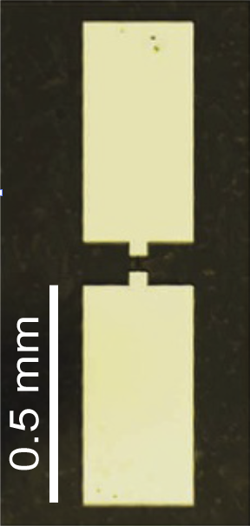
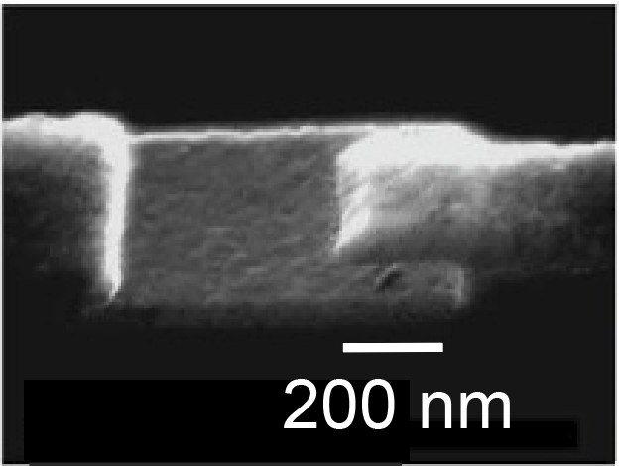
Transmon device image
Nb
sapphire
Al
AlOx
Al
Wang et al., Nature Comm. 5, 5836 (2014)

Slide 23
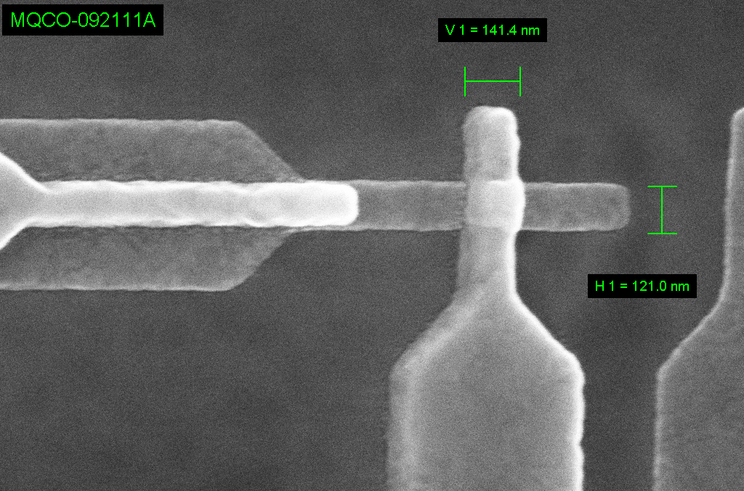
Credit: IBM Quantum
Josephson Junction
Bottom
SC electrode 1 (Al)
Top
SC electrode 1 (Al)
Credit: IBM Quantum

Slide 24














Credit: IBM Quantum
Josephson Junction
Credit: IBM Quantum
Credit: IBM Quantum
Jens Koch 24

Slide 25
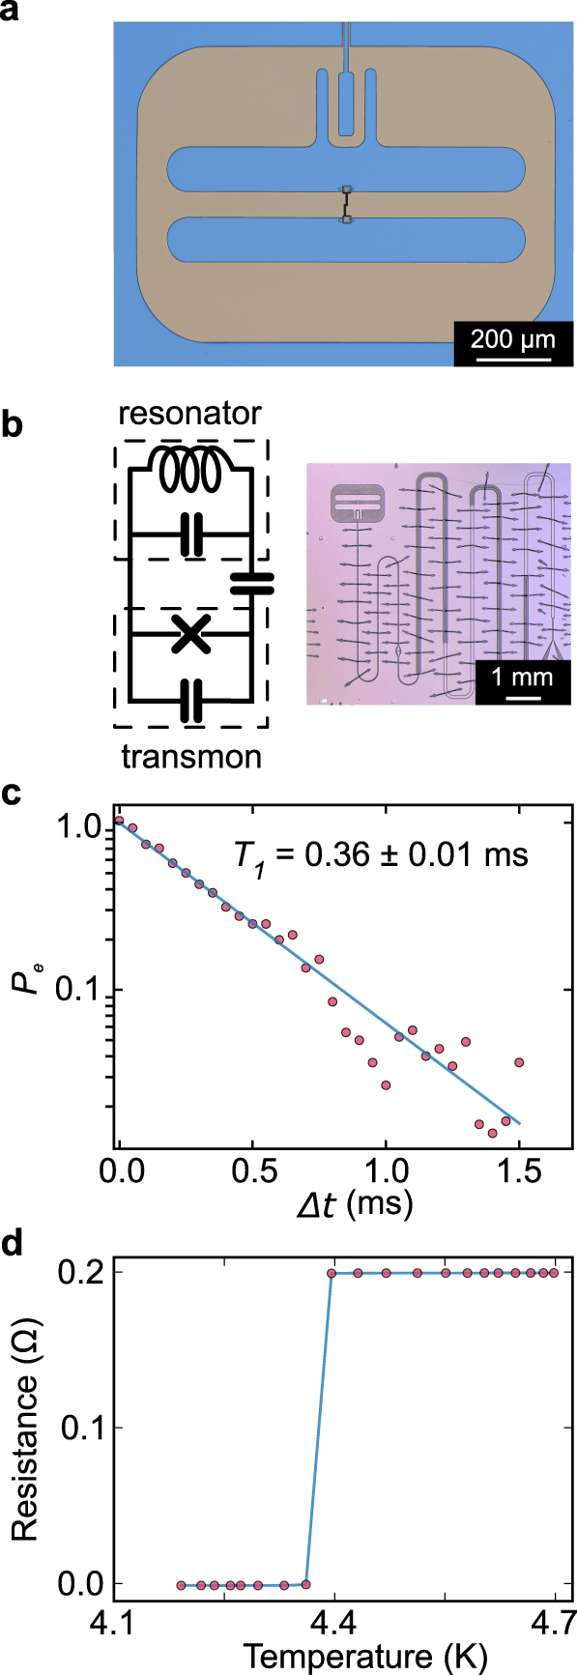
Transmon
Example from Houck lab, Princeton
transmon
tantalum
resonator
sapphire

Slide 26
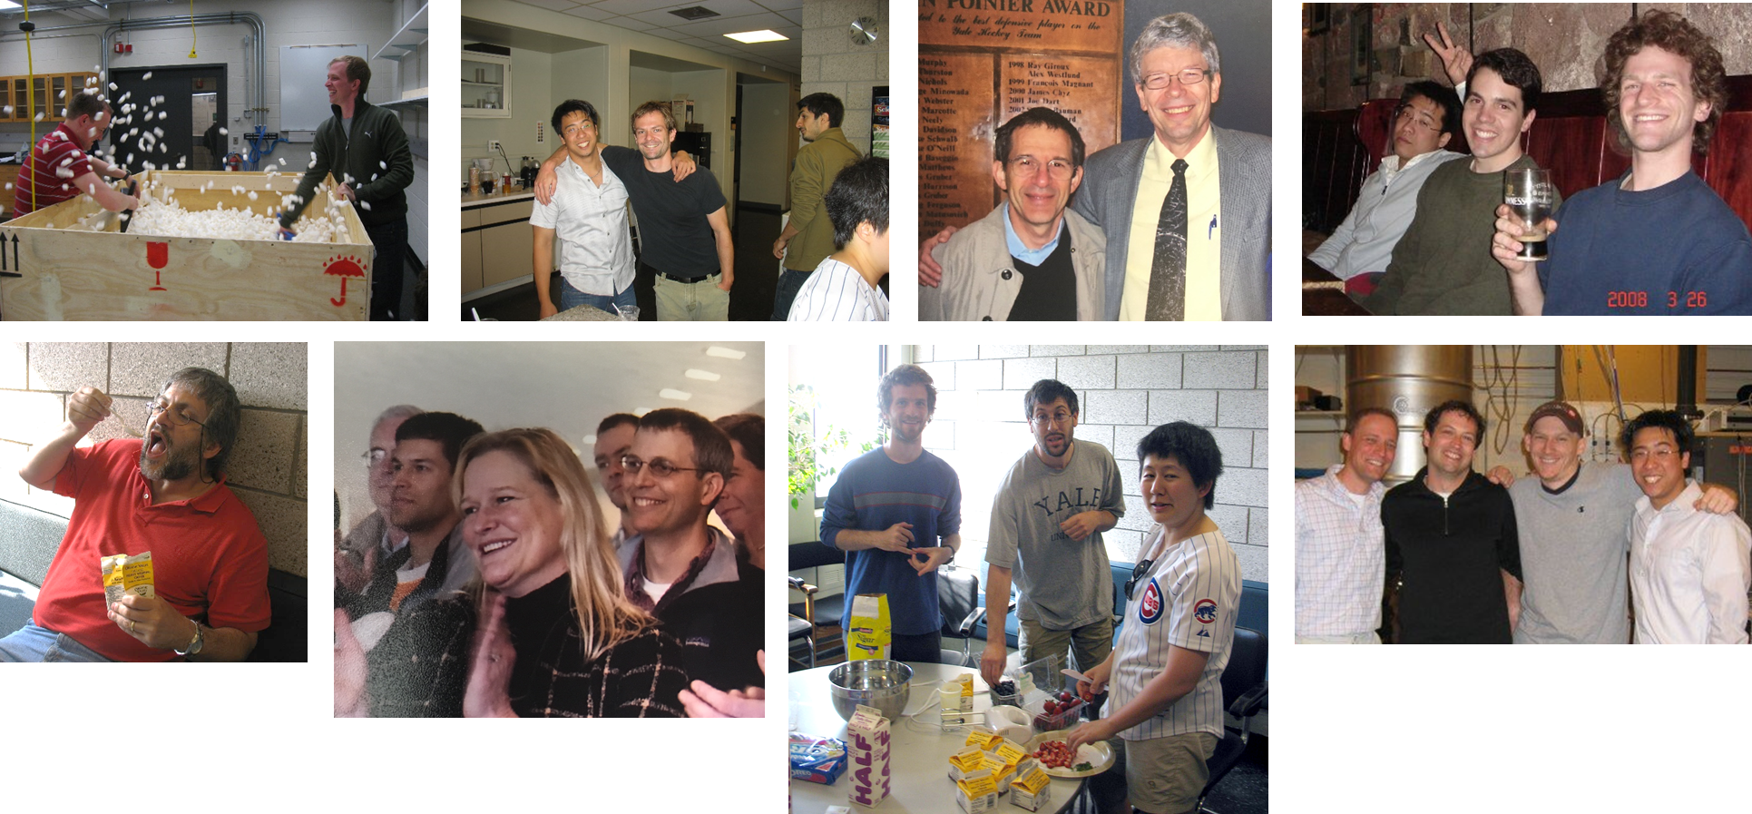
Michel
Devoret
Steve
Girvin
Rob
Schoelkopf
2007
Johannes
Majer
Jay
Gambetta
Jerry Chow
David Schuster
Andrew Houck

Slide 27

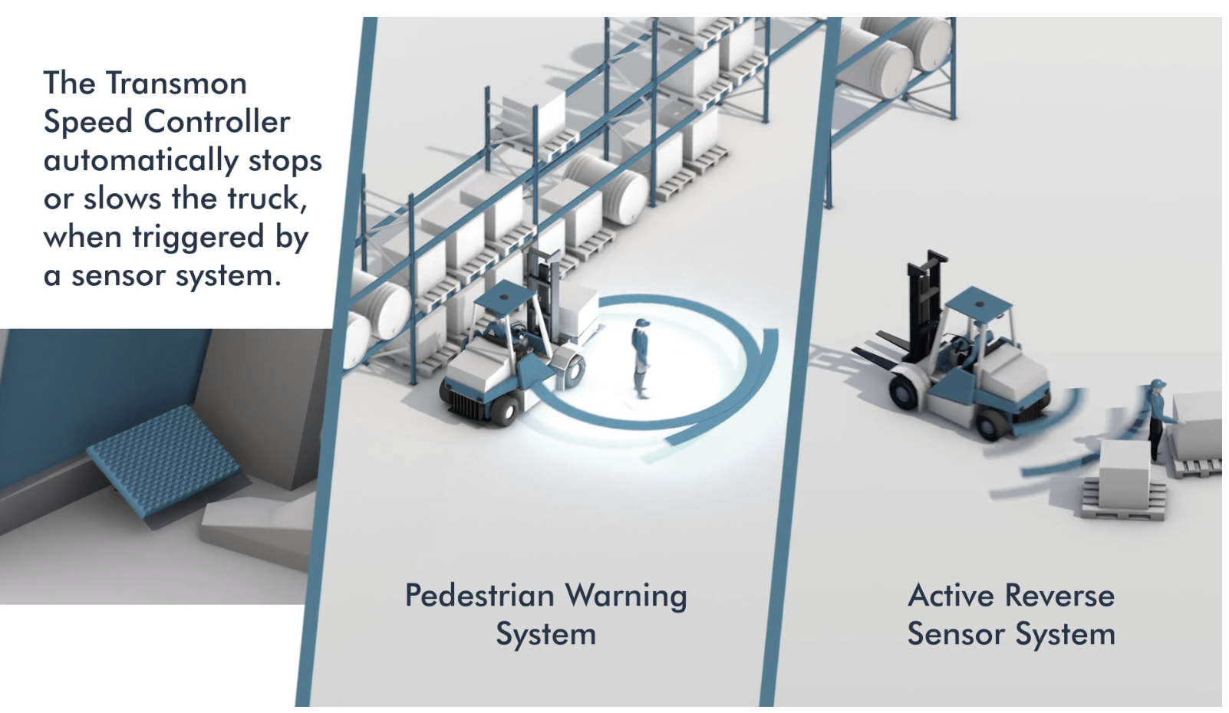
established in 1996, Transmon Engineering Ltd has remained at the forefront of the forklift and materials handling sector
https://www.transmon.co.uk/

Slide 28
1
2
parameter
spread
fixed vs. tunable
qubit
performance
T₁ & T_{φ}
3
control
& readout
Jaynes-Cummings model
dispersive regime

Slide 29

Parameter spread
no two transmons are ever identical
qubit frequencies depend
on device parameters
parameters deviate from
design values by up to 20% (chip to chip)
on-chip variations ~5%
main culprit: Josephson energy
(area of small junction & oxide thickness)
workaround:
flux-tunable transmons
(but at cost of worse dephasing)
Credit: IBM Quantum

Slide 30





Qubit
performance
Coherence (T₁ & T_{φ})
→ Gate fidelities

Slide 31

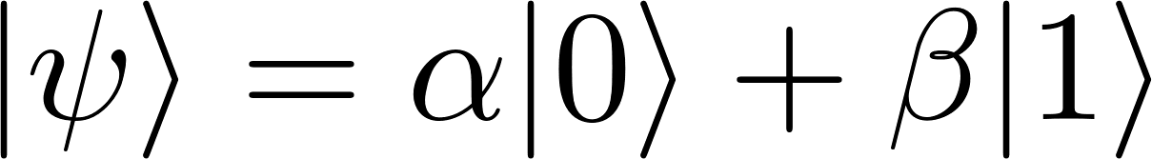

noise
QUBIT
DECOHERENCE
/ ERRORS
1/f charge noise
1/f flux noise
critical current noise
dielectric loss
photon shot noise
Purcell decay
nonequilibrium quasiparticles
…
Your qubit ran into a problem that it couldn’t
handle, and now it needs to restart.
HBAR_DIED_A_HORRIBLE_DEATH
Notes:
Until quantum error correction is in place, we care about noise and ways to mitigate it. No qubit is ever alone in the universe. Every qubit couples - hopefully weakly – to uncontrolled degrees of freedom in the environment. For superconducting qubits, a variety of important noise channels are known (though not necessarily well understood in their microscopic origin).
The presence of noise reduces gate fidelities and ultimately leads to errors in the execution of a quantum algorithm. So without some strategy for handling errors, a future quantum computer will keep crashing with a blue screen like this: …
To try and rescue hbar from this horrible death, it is helpful to remember and distinguish the two primary modes of decoherence – so allow me to run through a very quick recap.

Slide 32
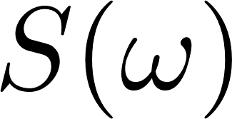


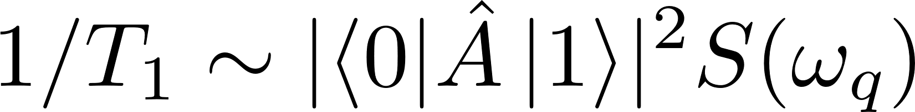
QUBIT
noise
DECOHERENCE
depolarization
(T₁)
rate: (Fermi’s golden rule)
transition
matrix
element
noise
spectral
density
Notes:
First of all, there is depolarization with characteristic time scale T1. In the simplest case, depolarization corresponds to the spontaneous relaxation of a qubit state to the ground state.
The rate at which this occurs can be computed by Fermi’s golden rule. This involves the noise spectral density S(omega) evaluated at the qubit frequency, as well as a transition matrix element, where A is the operator by which the qubit couples to the bath in question.

Slide 33
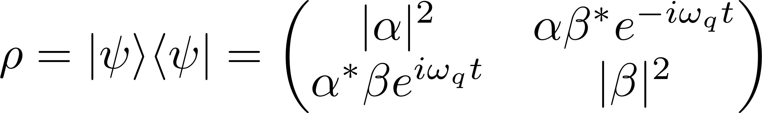

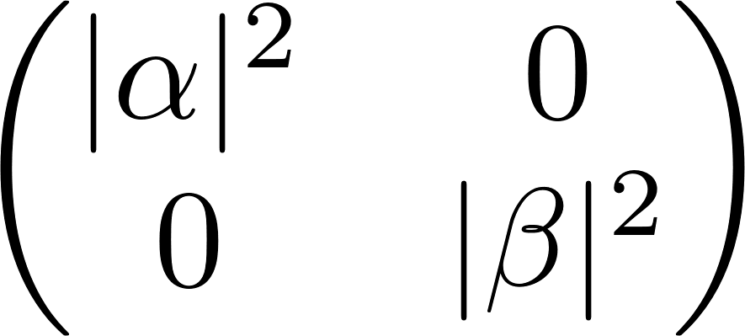
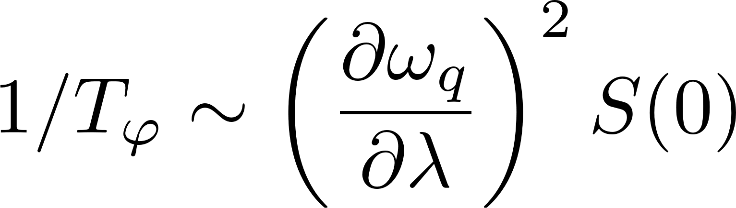
noise
QUBIT
DECOHERENCE
depolarization
(T₁)
pure dephasing
(T_{φ})
rate: (Fermi’s golden rule)
linear sensitivity
of qubit freq. to noise
Notes:
The second mode of decoherence is pure dephasing. We can picture its origin as noise induced slow fluctuations of the qubit energy splitting. These random fluctuations scramble the dynamical phase factors and hence relative phase information in the offdiagonal elements of the density matrix. After some characteristic time Tphi, a coherent superposition state thus collapses into a statistical mixture of the computational basis states – no good for quantum computing.
The corresponding rate is approximated again perturbatively. In this case, S is evaluated at zero frequency, and the derivative of the qubit frequency with respect to the noise parameter quantifies how sensitive the qubit splitting is to fluctuations in lambda.

Slide 34



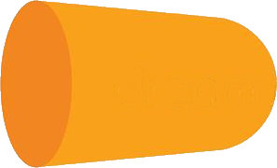

error mitigation strategies
…
 ❶
reduce noise
(materials science, fabrication,
microwave engineering, …)
 ❷
intrinsic noise protection
(develop circuits that are insensitive to noise)
 ❸
active quantum error correction
(monitor for errors, apply correction steps
when required in feedback loop)

Slide 35

1/f noise
charge noise Cooper pair box
flux noise rf SQUID qubit, 3-junction flux qubit

Slide 36


Cooper pair box

Slide 37




Cooper pair box
same circuit as transmon!
V Bouchiat et al., Phys. Scr. 1998, 165 (1998)

Slide 38







charge noise
dephasing
energy
► dephasing
n_{g}

Slide 39



Spectra: CPB vs. transmon
1
2
charging regime
transmon regime
Transmon
- weakly anharmonic
- charge dispersion
exp. small
- protected from
charge noise
Fig. 6 from RMP 93, 025005 (2021)

Slide 40





SQMS & Qubit Coherence
FNAL/UChicago - Pritzker Nanofabrication Facility
Group | Best T₁ (μs) | Freq. (GHz) | Substrate | Primary Material | Publication Year
Yu | 503 | 3.8-4.7 | Sapphire | Ta, dry etch | 2022
SQMS | 451 | 4.5-5 | Silicon | Ta/Nb, dry etch | 2023
Houck | 360 | 3.1-5.5 | Sapphire | Ta, wet etch | 2021
IBM | 340 | ~4 | Silicon | Nb, dry etch | 2022
IBM | 234 | 3.808 | Silicon | Al, dry etch | 2021
SQMS | 198 | 4.5-5 | Sapphire | Ta/Nb, dry etch | 2023
NIST - Boulder Microfabrication Facility
Rigetti - Fab-1 Integrated Circuit Foundry, CA
arXiv:2304.13257v2

Slide 41





basics of
qubit control & readout
AWG or FPGA / DAC
ADC

Slide 42



3d
2d
REVIEW: Blais et al., RMP 93, 025005 (2021)

Slide 43

transmon
& harmonic mode
lumped element
model
Jaynes-Cummings
model

Slide 44



microwave
drive
control and readout
SINGLE QUBIT GATES: drive at qubit freq.
DISPERSIVE READOUT: drive near oscillator freq.
TWO-QUBIT GATES: various schemes
microwave drives
flux biasing
use of higher levels
…

Slide 45



Jaynes-Cummings model
Two-level system coupled to oscillator
exactly solvable
…
Fred Cummings
1931 - 2019
qubit
oscillator
Historical perspective and reminiscence:
Edwin Jaynes
1922 - 1998
Frederick W Cummings, J. Phys. B: At. Mol. Opt. Phys. 46 220202 (2013)
Greentree, JK, Larsson J. Phys. B: At. Mol. Opt. Phys. 46 220201 (2013)

Slide 46


Jaynes-Cummings spectrum
…
0
1
qubit
oscillator
Total excitation number:
(conserved quantity)

Slide 47







Jaynes-Cummings spectrum
…
Total excitation number:
spectrum of :
qubit
oscillator
eigenstate(s) | tot. excitations | subspace
 | 0 1 2 | 1-dim 2-dim 2-dim
…
…

Slide 48





Jaynes-Cummings spectrum
…
total excitation number is conserved
qubit
oscillator
JC eigenstates & eigenvalues
eigenstate(s) | eigenvalue | degeneracy
 | 0 1 2 | non-deg. 2-fold 2-fold
ground state:
N-excitation subspace:
…
…

Slide 49
Jaynes-Cummings spectrum
JC eigenstates & eigenvalues
ground state:
N-excitation subspace:

Slide 50

Jaynes-Cummings spectrum
JC eigenstates & eigenvalues
ground state:
N-excitation subspace:
Find eigenvalues and
eigenvectors;
it’s just a 2x2 matrix!

Slide 51

Jaynes-Cummings spectrum
JC eigenstates & eigenvalues
ground state:
N-excitation subspace:

Slide 52







Jaynes-Cummings spectrum: on resonance
JC eigenstates & eigenvalues
SPECIAL CASE: (“on resonance”)
ground state:
N-excitation subspace:
spec :
quton & phobit

Slide 53



Jaynes-Cummings spectrum: on resonance
Important difference from
mode splitting in coupled
harmonic oscillators:
scaling with

Slide 54



Jaynes-Cummings spectrum
JC eigenstates & eigenvalues
ground state:
: detuning
N-excitation subspace:
where

Slide 55






Jaynes-Cummings spectrum: dispersive regime
ground state:
N-excitation subspace:
: detuning
For perturbation theory, want:
often (over-)simplified to:
breakdown of
perturbative treatment
for given :

Slide 56
Jaynes-Cummings spectrum: dispersive regime
Perturbation theory in
1
Stationary PT for energies and states
2
Take exact solution and directly expand in
3
Schrieffer-Wolff transformation
Idea: perturbative corrections to eigenstates
correspond to rotation (unitary transform) of
unperturbed states
instead, apply the (inverse) rotation
to the unperturbed Hamiltonian
Obtain new effective Hamiltonian
in which interaction is eliminated up to desired order
ACTIVE rotation
PASSIVE rotation

Slide 57
Jaynes-Cummings spectrum: dispersive regime
Perturbation theory in
1
Stationary PT for energies and states
2
Take exact solution and directly expand in
3
Schrieffer-Wolff transformation
(aka “adiabatic elimination”)
Good place to learn:
“Atom-photon interactions”
by Cohen-Tannoudji, Grynberg, Dupont-Roc
Chap. I.B₁

Slide 58



Jaynes-Cummings spectrum: dispersive regime
Perturbation theory in
Schrieffer-Wolff transformation
up to second order:
Lamb shift:
ac Stark shift:

Slide 59


Jaynes-Cummings spectrum: dispersive regime
Perturbation theory in
Schrieffer-Wolff transformation
up to second order:
qubit-state dependent shift
of resonator frequency
→ dispersive qubit readout
photon-number dependent shift
of qubit frequency
→ number splitting

Slide 60



Dispersive qubit readout
S₂₁
(transmission)
Simple transmission (single-tone) measurement
transmitted
signal
drive freq.
oscillator
mode
freq.

Slide 61



Dispersive qubit readout
S₁₂
(transmission)
Simple transmission (single-tone) measurement
transmitted
signal
drive freq.

Slide 62

Dispersive regime: including a drive
Perturbation theory in
Schrieffer-Wolff transformation
up to second order (RWA):
induces
RABI OSCILLATIONS

Slide 63




Single-qubit gates
induces
RABI OSCILLATIONS
TRACK 3 activities this afternoon!
occupation
probability

Slide 64





Superconducting Qubits in Python
Open source
( BSD license)
URL: tiny.cc/qubit
Jens Koch
Northwestern University

Slide 65




Research tool
speed up simulation of sc qubits / cQED
Education resource
integrate quantum engineering into undergraduate classes
Training in scientific coding
debugging, version control, unit testing, …
NEW
scqubits
on YouTube

Slide 66
- transmon (fixed | tunable)
- fluxonium
- 3-jct. flux qubit
- 0-π qubit
- cos(2φ) qubit
- oscillator | Kerr oscillator
GUIs for beginners
significant extensions
NEW
OVERVIEW
Qubits etc.
- energies
- wavefunctions
- matrix elements
- parameter sweeps
Spectral properties
(compute and visualize)
couple qubits & oscillators -
custom interaction terms -
explore using ipywidgets GUI -
QuTiP interface -
Composite Hilbert spaces
- estimate T₁ and T₂
- various common noise channels
- default noise amplitudes, Q factors from
recent literature
Coherence times
multi-parameter scans -
transition plots -
multi-core support -
Parameter sweeps
- user-specified circuits
- symbolic and numerical treatment
Custom circuits
NEW
Eigensolver routing

Slide 67

scqubits download count (conda only)
# downloads
142,772
last review
91,890
v3.2
v3
v2
v1
Dec 2019

Slide 68
Take-aways
Superconducting circuits behave quantum mechanically
  discrete energy levels like atoms
  simplest example: transmon/Cooper pair box
  transmon solves dephasing problem: charge-noise insensitivity
  control and readout:
  couple transmon to resonator
  drive resonator at qubit frequency: single-qubit rotations
  drive resonator near its own resonance: dispersive readout

Slide 69

Postdoc opportunity at NU

Slide 70

(easy)
exercises
1

Slide 71

(easy)
exercises
2

Slide 72

(medium)
exercises
3

Slide 73

(advanced)
exercises
4

