Slide 1
The U.S. Department of Energy
National Quantum Information Science Research Centers:
Mission, Activities, USQIS
Anna Grassellino, SQMS Center Director
Travis Humble, QSC Director
Aug. 6, 2023
Notes:
Presenter: Andrew

Slide 2
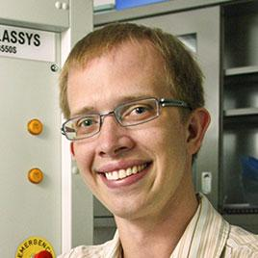
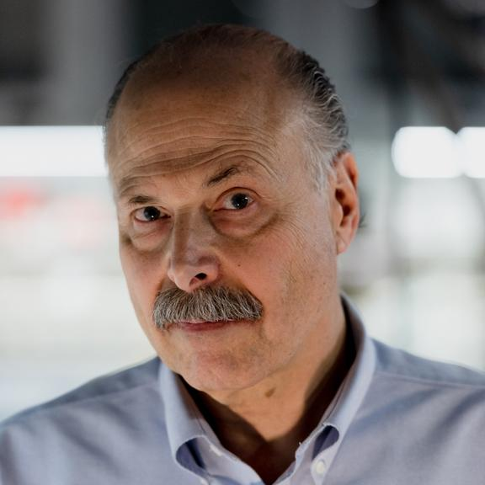
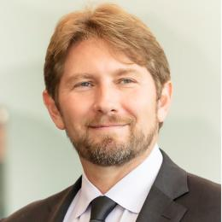
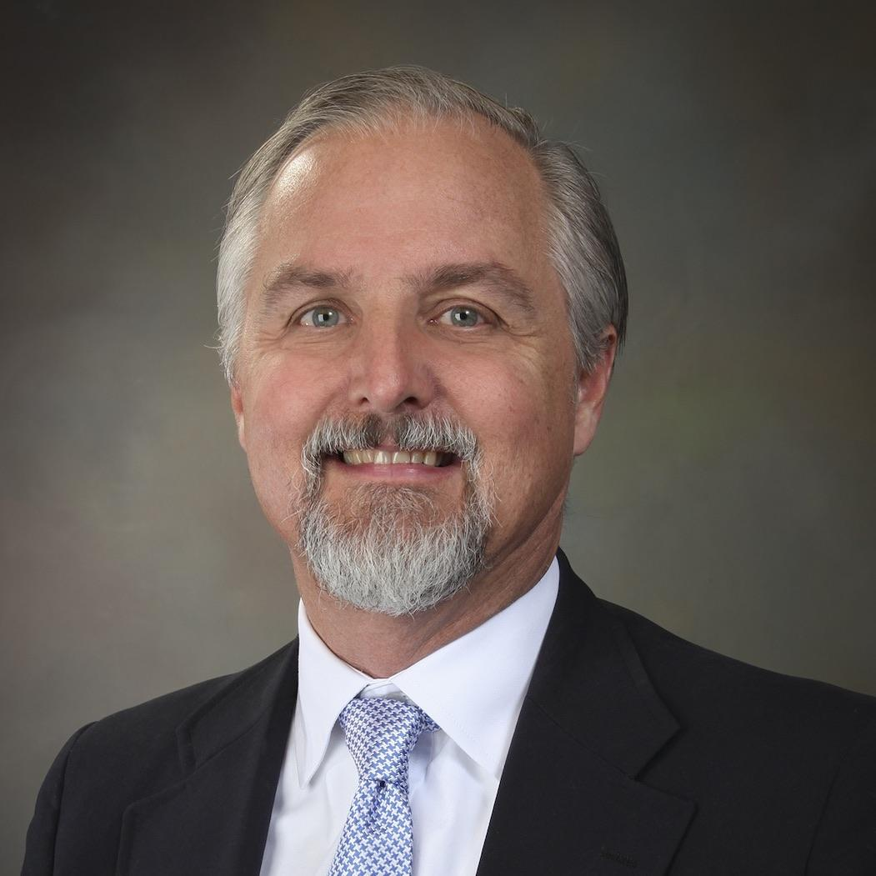
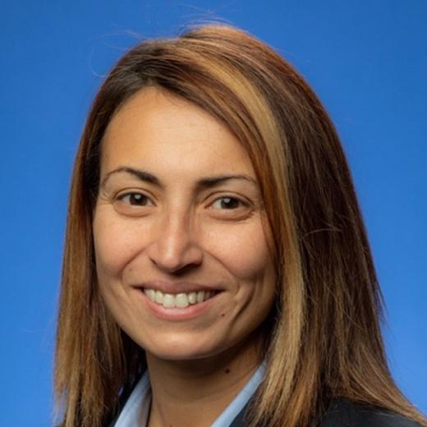
DOE National Quantum Information Science Research Centers
Andrew Houck, Director
David Awschalom, Director
Lead lab: Brookhaven
Lead lab: Argonne
Travis Humble, Director
Rick Muller, Director
Lead lab: Oak Ridge
Lead lab: Berkeley
Anna Grassellino, Director
Lead lab: Fermilab
Notes:
Presenter: Andrew
Good to meet you. I serve as the Director of C2QA and I am this year’s National QIS Research Center Executive Council chair.
The DOE National Quantum Information Science Research Centers were established in 2020 under the National Quantum Initiative Act passed in 2018.
Five centers launched in fall 2020, each led by a national laboratory and representing a partnership of labs, universities and industry.
Total funding: $575 million over 5 years, subject to appropriations
The centers take distinct yet complementary approaches to tackle major cross-cutting challenges in areas of significant national impact.
The centers leverage DOE investments in user facilities and other resources.
The centers play a central role in stewardship of the QIS ecosystem, including broad industry engagement and support for the development of a diverse and inclusive workforce.
Coordination across the centers is maintained by an executive council.

Slide 3
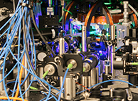
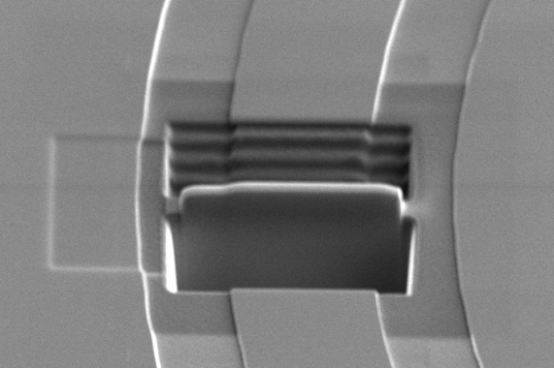
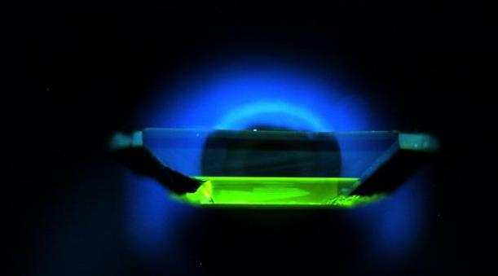
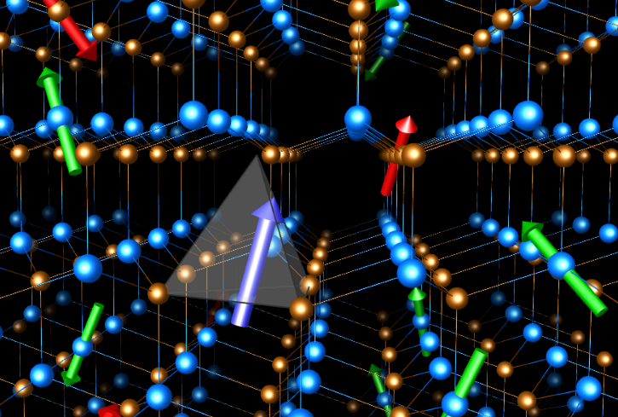
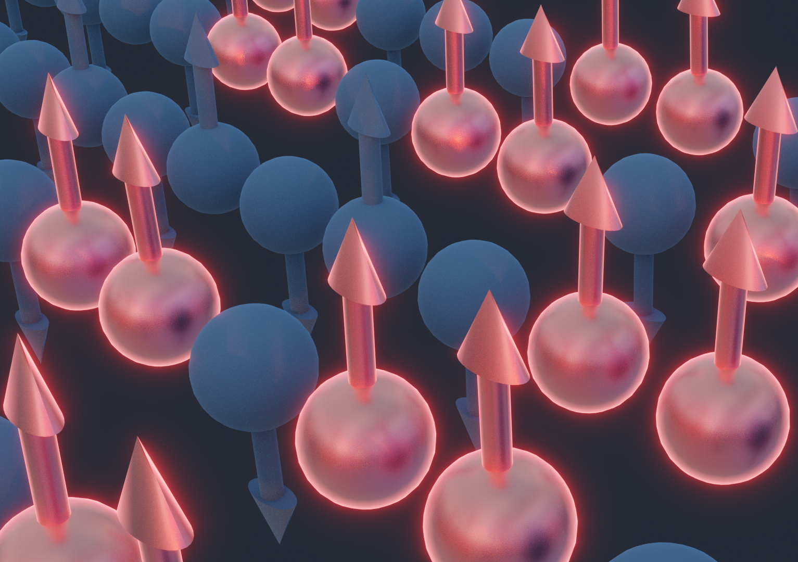
Complementary science, broad impact
Each center tackles major scientific and technological challenges in quantum information science in unique ways using complementary approaches. Together, we advance quantum computing, communication, networking, sensing, and materials in ways that will have impacts in science, energy, security, communication, medicine, finance, and logistics.
Quantum
Systems
Accelerator
Co-designing powerful programmable quantum prototypes with algorithms that maximize performance of hardware in three technologies: neutral atoms, trapped ions, and superconducting circuits
Demonstrating optimal applications in computing, materials science, and fundamental physics
Identifying and mitigating loss channels in superconducting quantum devices
Designing and building prototypes of quantum computers and sensors for scientific discovery
Overcoming the current limits of quantum computing systems to achieve quantum advantage
Developing quantum co-design principles to target software and algorithms, devices, and materials
Developing the technology to store, control and distribute entangled states of matter
Delivering quantum communications links, networks of ultraprecise sensors, and novel simulation test beds
Designing quantum materials, algorithms to enable more precise manipulation of quantum information
Implementing new quantum devices and sensors to characterize topological states, detect dark matter
Notes:
Presenter: Travis
Each center has its own unique portfolio of research that spans the technical areas of materials, computing, communication, and sensing among many others. However, they are working in tandem to advance the broader field of QIS and ultimately the readiness of quantum technology. Here, I would like to highlight some of the technical scope from each center and how they fit together into a broader strategy.
At QSA, we are developing new prototypes of quantum hardware that can be used to test the principles of quantum computing. Todays quantum hardware is noisy and the QSA is developing algorithms for key applications areas that can be tailored toward error-prone environments. This includes calculations for materials science, and fundamental physics.
PICTURE:??
The SQMS is taking a complementary approach by developing new type of quantum computing based on superconducting materials that can also be tailored toward high-energy physics problems. SQMS is using their ability to design new hardware device to mitigate and negate the effects of loss and errors as a means of tuning the performance.
PICTURE: ??
This essential principle of codesign is being developed further at C2QA, where they are integrating advances in hardware, software, and algorithms toward establishing quantum computational advantage. Quantum advantage marks a key milestone in the development of quantum technology.
PICTURE: ??
At Q-NEXT, they tackle the fundamental problem of how quantum information can be reliably, stored, controlled, and distributed over quantum communication links. This is a fundamental step toward the development of quantum networks, which require advances in quantum materials as well as optical technologies.
PICTURE: represents the electronic and coherence properties of spin defects in silicon carbide. Taken from Giulia Galli Group at UChicago.
Finally, within QSC, we are developing materials for efficient and scalable quantum technologies that are naturally resilient to errors. By advancing the synthesis and fabrication of so-called quantum materials, we will be able to support the long-term development of quantum computation and quantum sensing applications.
PICTURE: Spin chains in a quantum system undergo a collective twisting motion as the result of quasiparticles clustering together.

Slide 4
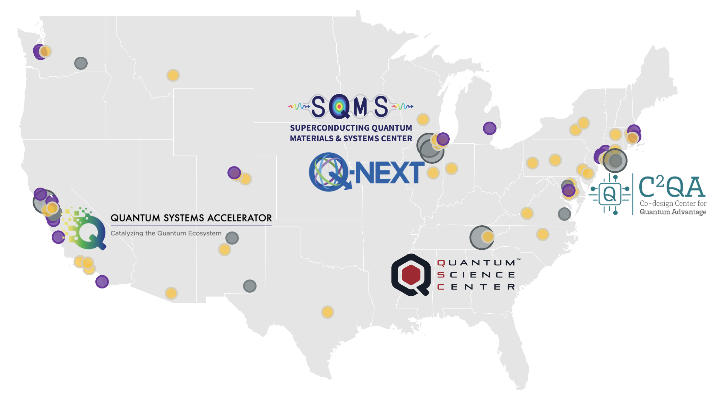
Partnerships across academia, industry and national labs
The centers bring together multidisciplinary collaborations of more than 1,200 experts, including 600 students and postdocs, across over 80 academic, industry and national science institutions in more than 22 states and DC.
Through institutional partnerships,
the centers unite unique capabilities, expertise and facilities.
Solving key challenges in QIS thanks to the unique strength of multi-institutional and multidisciplinary collaborations
Leveraging DOE user facilities for advanced materials analysis and device fabrication
Developing and deploying new quantum facilities, foundries and testbeds for the Centers as well as the national ecosystem
Training a new and diverse quantum workforce
Technology transfer – rapid cycle from discovery to commercialization
Developing national standards and roadmaps for quantum technology that incorporate processes, metrology and testing data
Lead DOE national laboratory
National laboratory or science institution
Technology company
University
Notes:
Anna

Slide 5
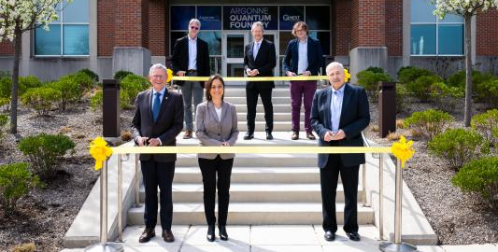
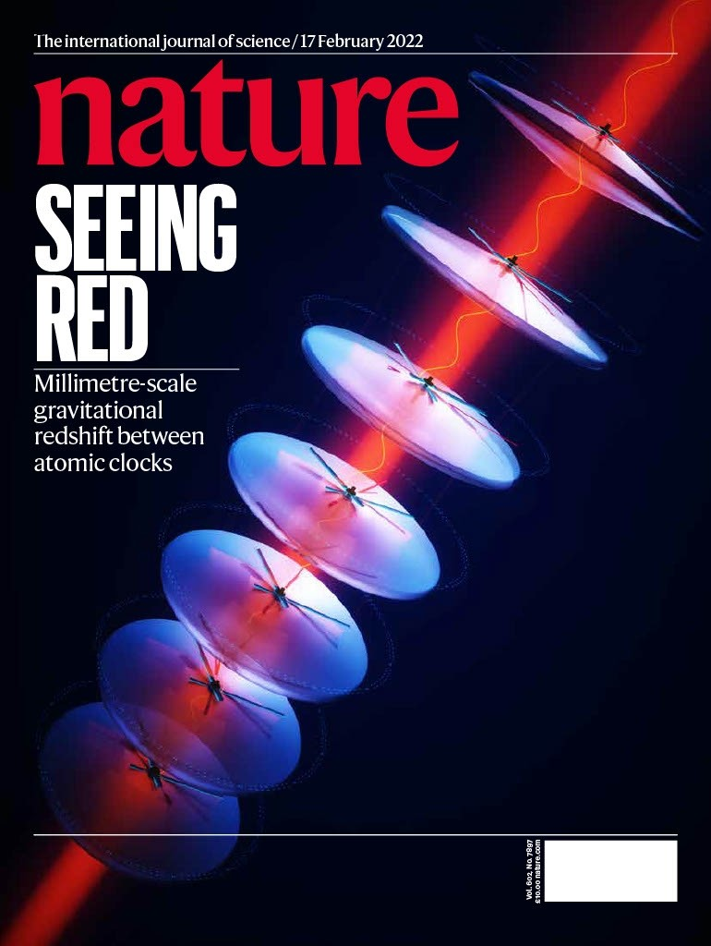
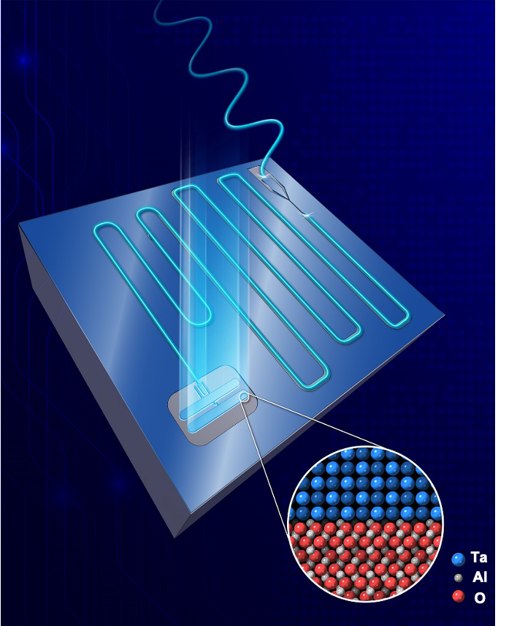
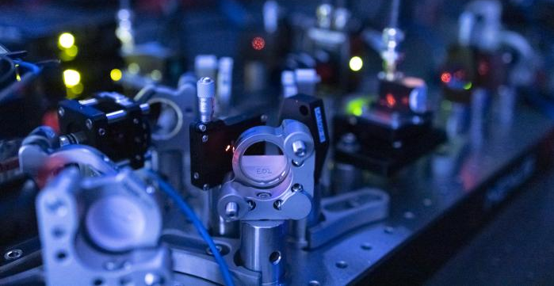
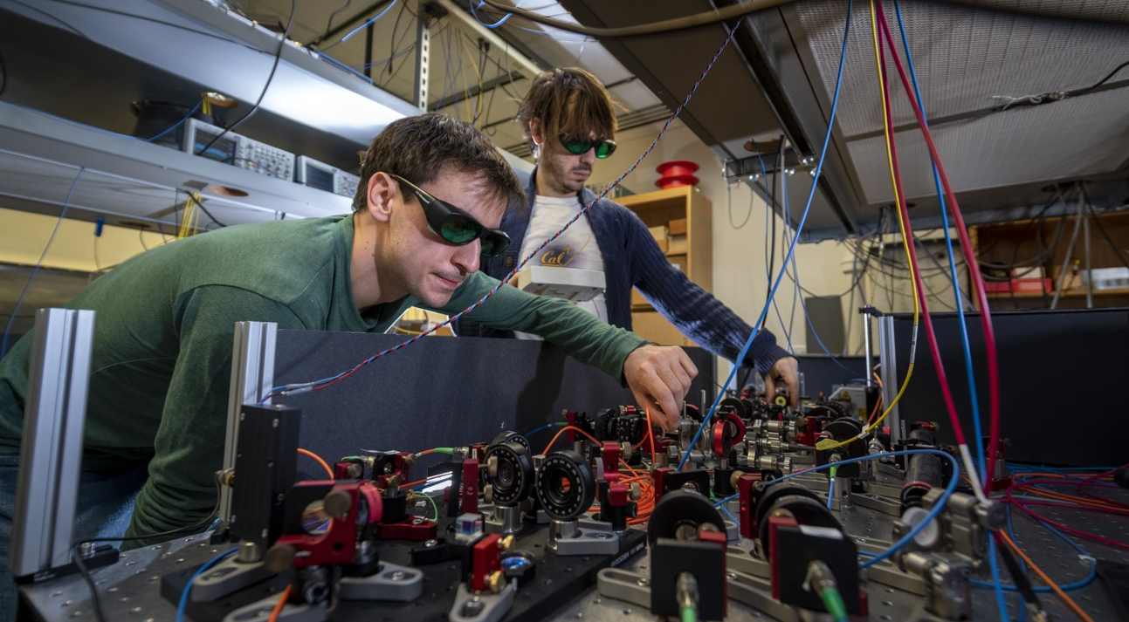
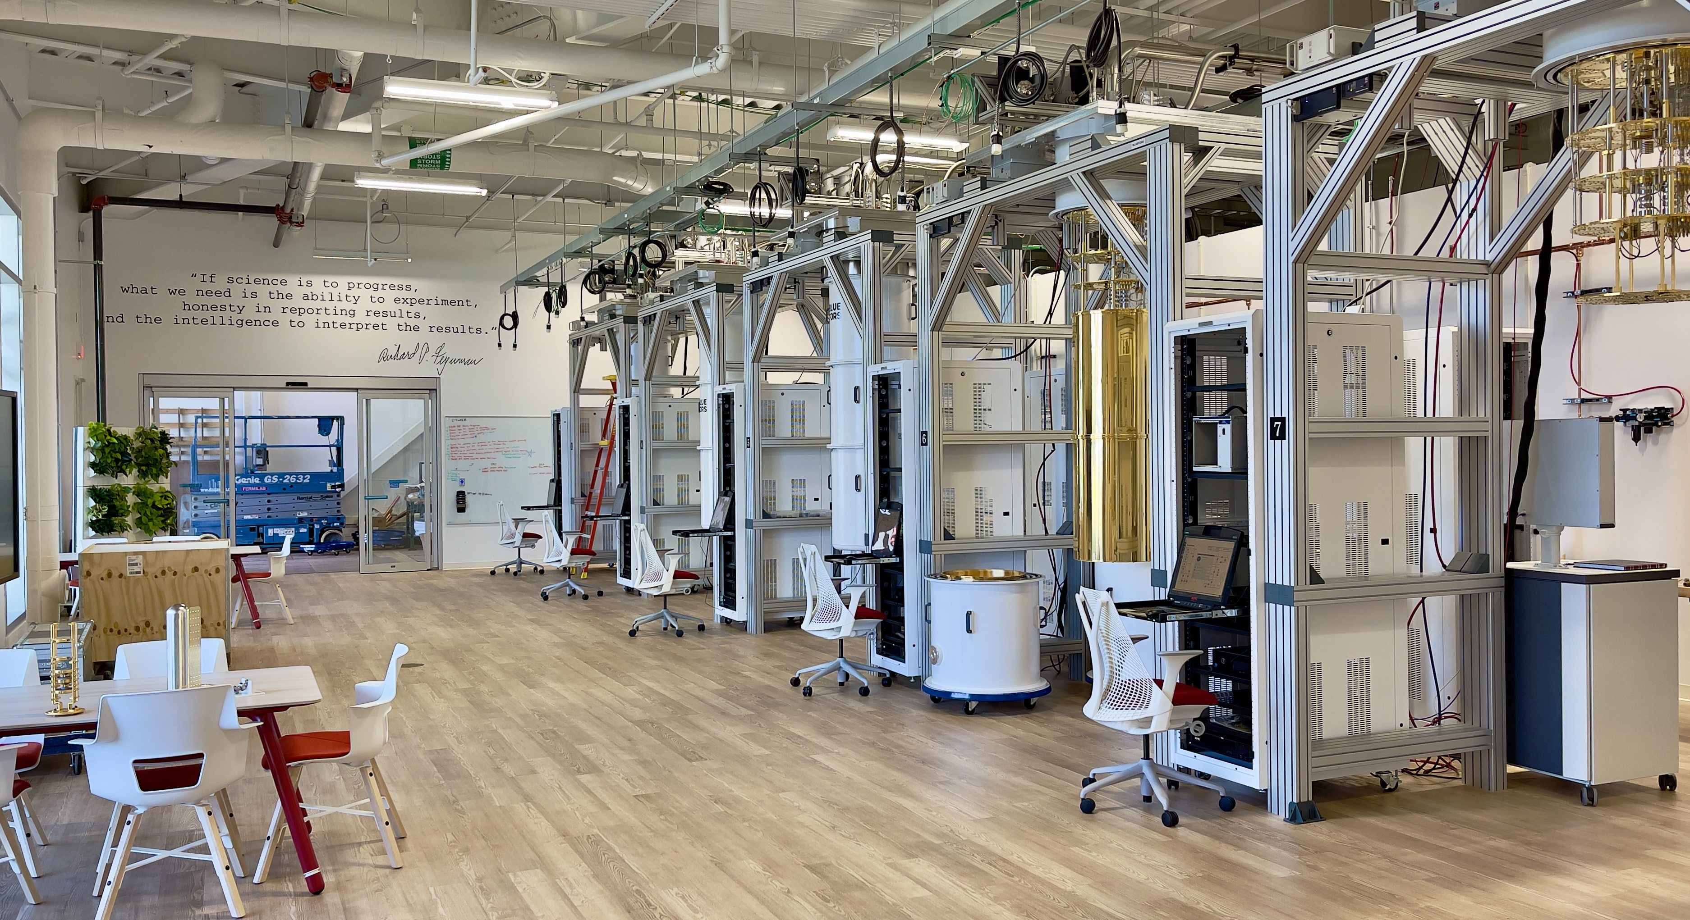
Three years of achievements: science and technology
In the first three years, the five centers facilitated scientific and technological breakthroughs.
Science and technology
Built a 256-qubit programmable quantum simulator and used it to observe new states of quantum matter.
Built an underground cryogenic test stand to evaluate the influence of atmospheric radiation on quantum technologies.
Co-developed with industry the first superconducting commercial quantum processor to be installed and operated at a DOE national laboratory.
Developed a method for creating a core qubit component, a Josephson junction, from niobium. The junctions exhibit 100-fold improvement in loss and can operate at higher frequencies and temperatures compared to standard aluminum junctions.
New tools and databases
Officially opened the Argonne Quantum Foundry, which meets a critical need for quantum science by providing a robust supply chain of materials for semiconducting quantum devices and systems.
Established a national-scale task force to evaluate qubit performance, build devices, and develop standards for next-generation, consistently high-performance qubits.
Commissioned the new 6,000-square-foot quantum laboratory at Fermilab, featuring six new dilution refrigerators.
Notes:
Andrew

Slide 6
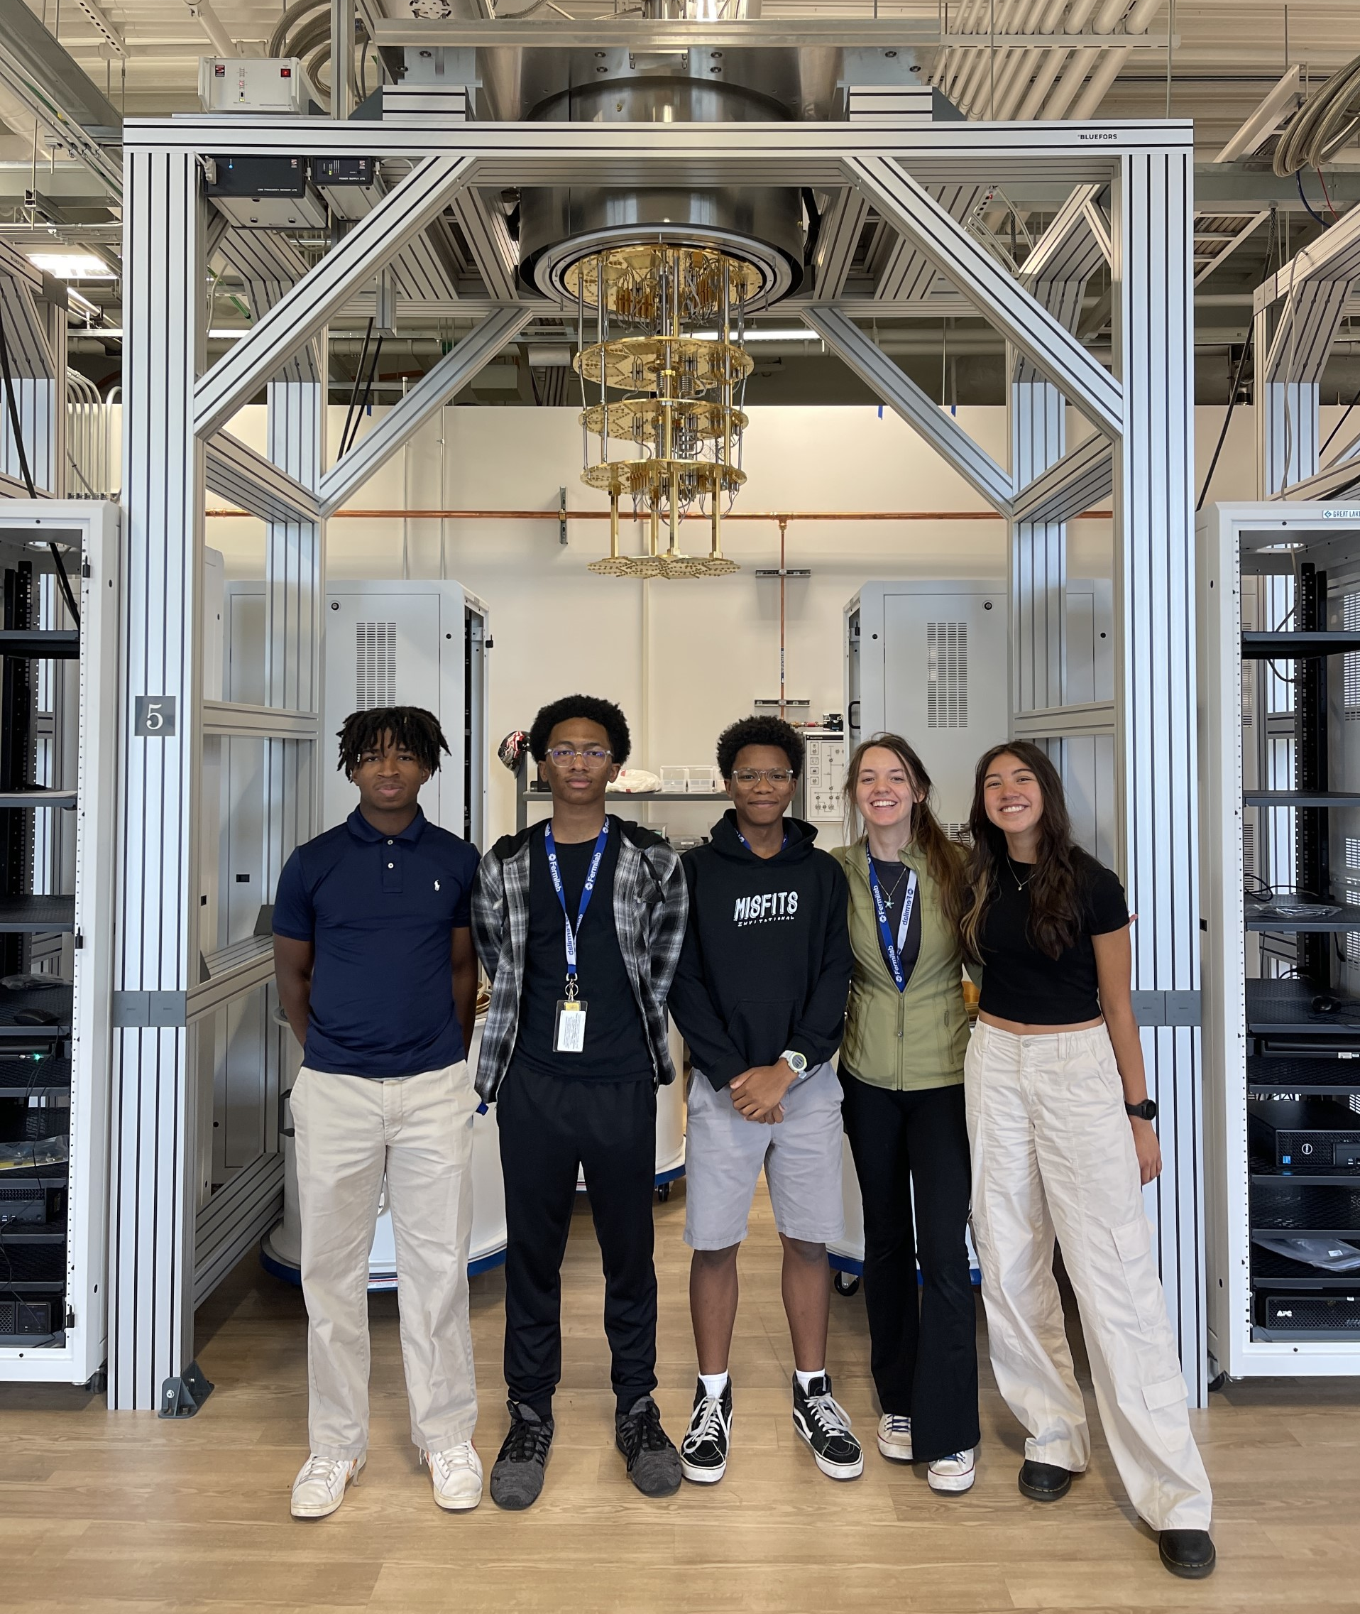
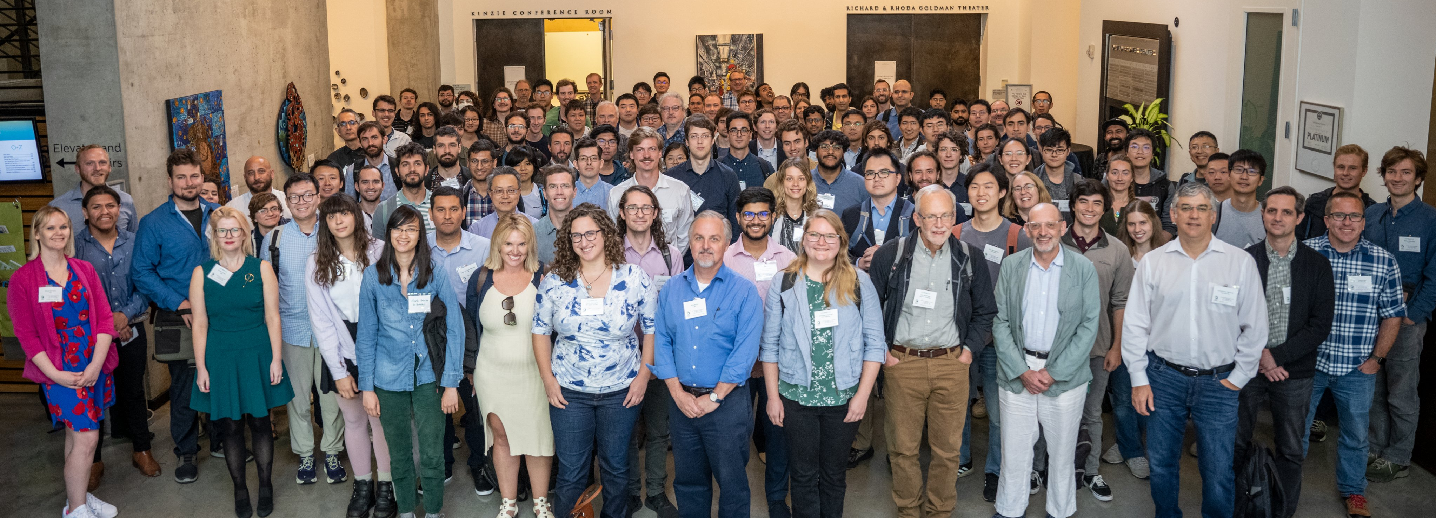
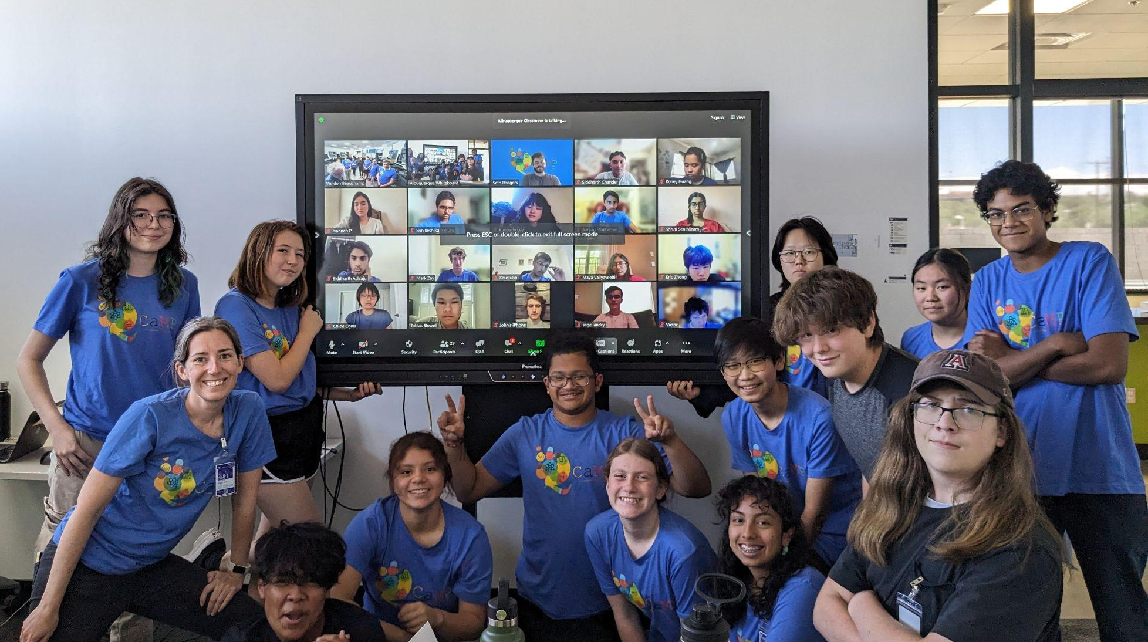
Three years of achievements: ecosystem and workforce
During the first three years, the five centers worked together to promote cooperation in quantum information science R&D and raise awareness of opportunities in the field.
Workforce development
Trained hundreds of young researchers through summer schools, internships, fellowships and workshops to help students at all education levels.
Organized the U.S. Quantum Information Science School, the largest in-person federally funded school focused on quantum information science and technology. The program is facilitated by the five centers and will be held August 6-15 at Fermilab. Over 200 participants and instructors will attend.
Hosted faculty development programs aimed at partnerships with minority serving institutions.
Hosted annual virtual Quantum Information Science Career Fairs with nearly 1,000 registrants each.
Partnerships and ecosystem
Held collaboration annual meetings and workshops with hundreds of experts from the national and int'l ecosystems, including industry partners, to discuss and advance key QIS goals.
Organized and led scientific sessions at events such as AAAS, IEEE, APS March, international scientific conferences and more.
Published “A Roadmap for Quantum Interconnects,” which details key imperatives for quantum interconnects research to have future impact. Thirty-nine experts, including 10 from seven leading U.S. companies, contributed.
Experts from across the five centers have contributed to National Quantum Initiative and cross-agency coordination groups.
Notes:
Presenter: David
The single biggest obstacle to advancing QIS is the thin workforce. Current engine of producing students doesn’t hit the numbers you need in this field.
Career fair:
Increased registrations year over year (~850 in 2021 vs. ~940 in 2022), and users that logged in (~350 in 2021 vs. ~490 in 2022).
76% of all attendees consisted of the target audience of students and postdocs:
27% undergrads, 39% graduate students, 10% postdocs
Total exhibit booth visitors: 4,537; total unique booth visitors: 2,485.
Over 100 registrants applied to jobs directly from the vFairs QIS Career Fair platform.
Federal Lab Consortium workshop – QSA (Berkeley): The FLC is ‘the formally chartered, nationwide network of over 300 federal laboratories, agencies, and research centers’ that focuses on technology transfer and commercialization opportunities from national laboratories to industry. The QSA workshop sessions reviewed federal investments in QIS, discussed how industry can engage with national laboratory efforts in QIS, and reviewed what technology transfer and IP policies are for the labs around QIS.
AAAS Meeting – represented the centers at the largest annual scientific meeting in the world, shining a spotlight not only on QIS R&D but also how QIS connects to society. The session was titled: ‘Quantum for the people: connecting quantum information science and society.’
Presenters were
Alexandra Boltasseva, Purdue and Quantum Science Center: From basic research to a quantum-smart society: merging AI and quantum science
Charles Brown, then at Berkeley Lab (now at Yale): Quantum opportunities: the quantum-material revolution, science and society
Monika Schleier-Smith, Stanford and Q-NEXT: Quantum science: from philosophy to technology
Moderator was
Silvia Zorzetti of Fermilab and SQMS

Slide 7
USQIS Summer School First School Coordinated by all Five DOE National Quantum Centers
Goal
Provide educational and professional development opportunities for students, postdocs, professionals, while promoting exchange of ideas across Centers, by holding a school with broad participation across the five Centers.
First Edition of the School – host by SQMS, in collaboration with QSC
Focus on Superconducting Qubits, Architectures, and HEP and CMP Applications
Future editions will focus on different quantum platforms and applications
Notes:
Structure based roughly on the Trimester interstitial slides.

Slide 8
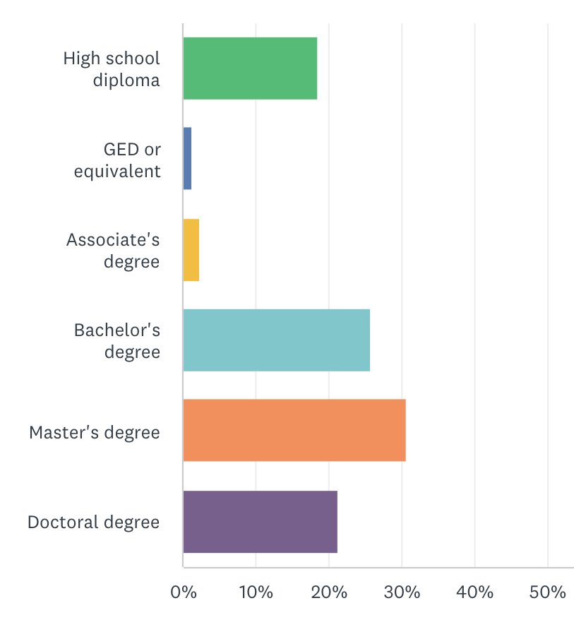
USQIS Summer School - Participants
Students
~150 students accepted
Attendees from > 72 different institutions (national labs, universities, industry); 5 international institutions
Bachelor, master/Ph.D. students, postdocs, professors, scientists, engineers and industry employees; very diverse group
Instructors
~50 instructors from all 5 Quantum Centers, from industry, academia, DOE labs, NIST, NASA…
> 300 applicants

Slide 9
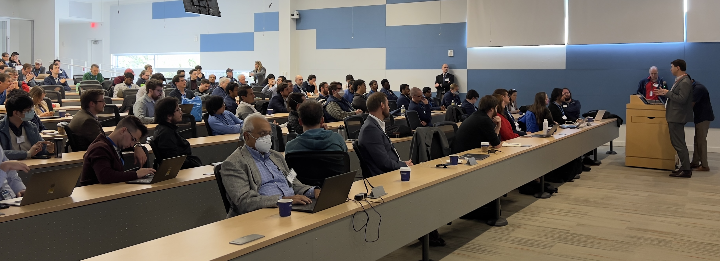
USQIS Summer School – Curriculum
Morning Lectures
Introduction to Quantum Computing, Superconductivity, Cryogenics, Superconducting Circuits, Radio Frequency Superconductivity, Cavity QED, Material Science for QIS, State of the Art SC Commercial QPUs, Quantum Sensing..
Afternoon Tracks
Track 1: Qubits and Cryogenics Setups and measurements
SQMS Quantum Lab 1 and Quantum Garage
Track 2: Qubits Fabrication and Material Characterization
SQMS/APSTD Material Science Labs and Quantum Garage
Track 3: Qubits Simulation, Quantum Software, Algorithms, Applications
Lecture Hall
Strong Focus on Hands-on, experimental training using cutting edge tools and large-scale facilities

Slide 10
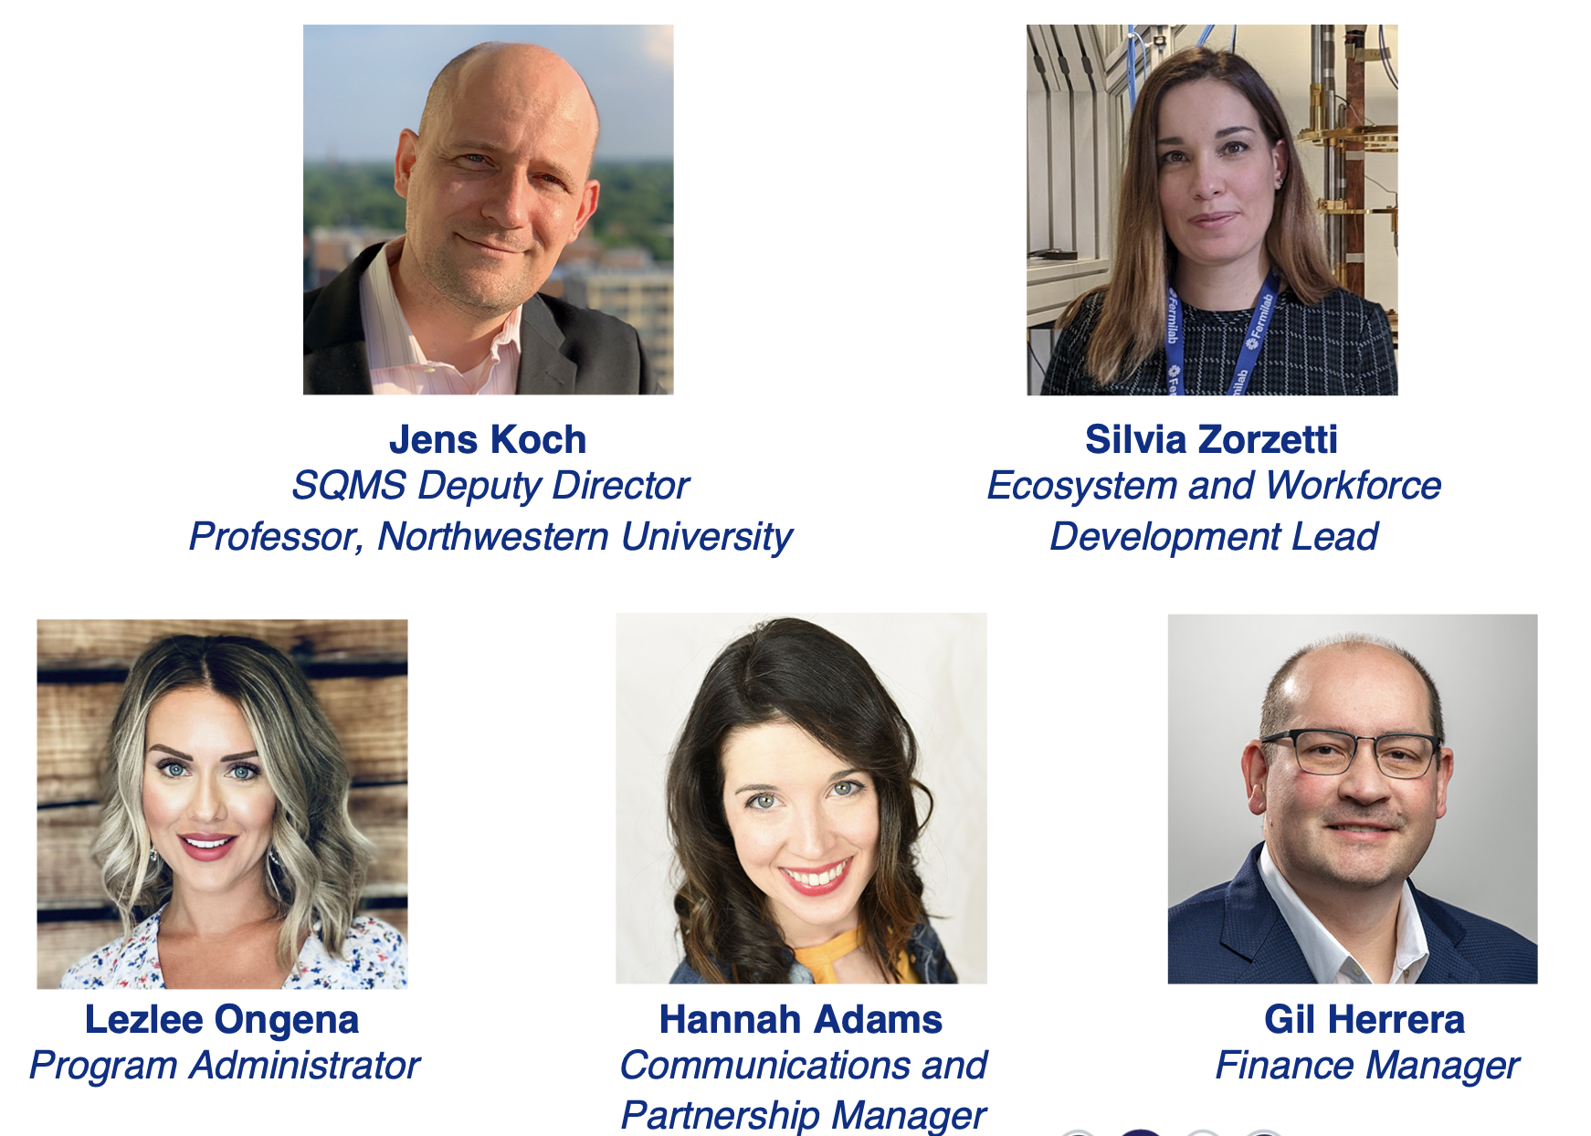
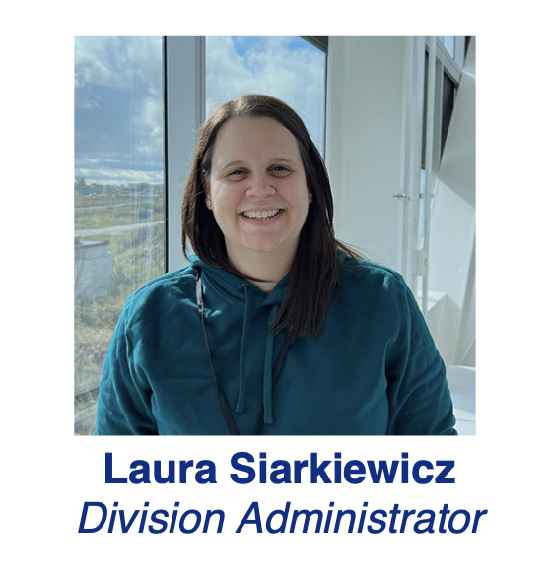
Thanks to all instructors and special thanks to the team who is making USQIS possible!
Good Luck to all
participants!
Thanks to FNAL
and DOE for the Support!

Slide 11
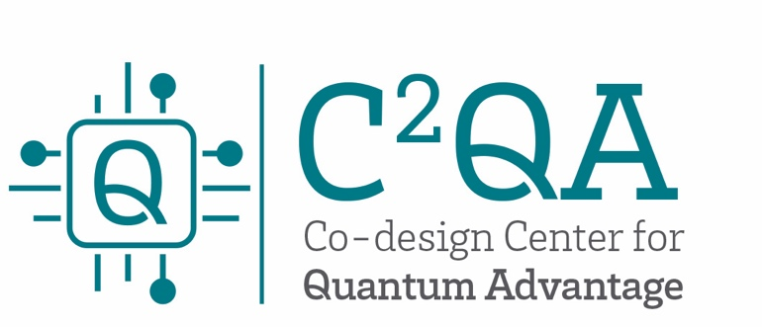
Thank you
Notes:
Presenter: Rick
Open the floor for questions.

