Slide 1
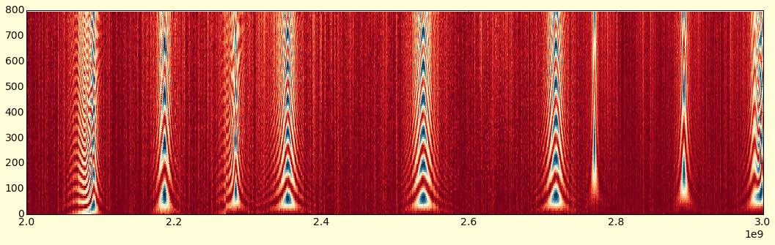
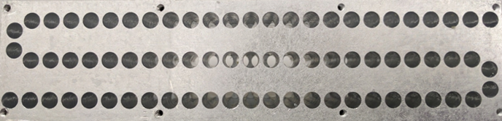





Quantum Computing with 3D Cavity QED
Srivatsan Chakram
Rutgers, The State University of New Jersey
U.S. Quantum Information Summer School 2023
Notes:
Hello everyone. Thank you all for coming. It’s an honor to be invited to speak at this session. My name is Srivatsan. I am an assistant professor of physics at Rutgers

Slide 2
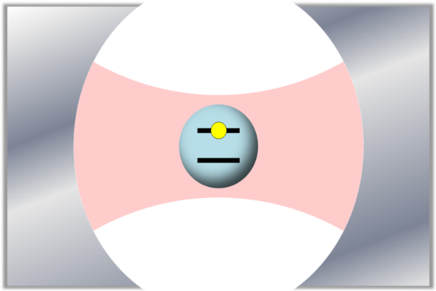
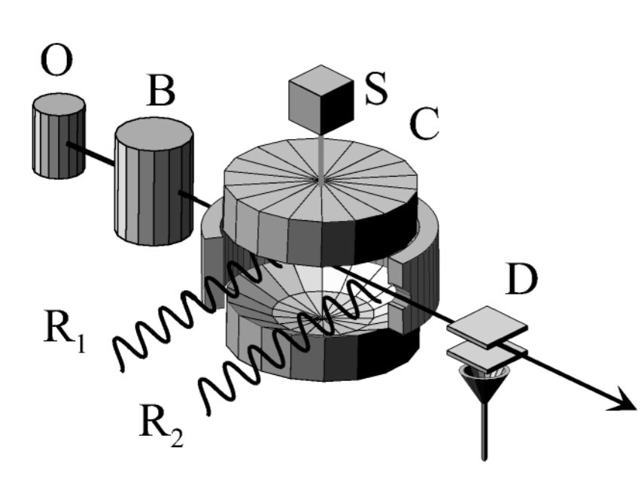
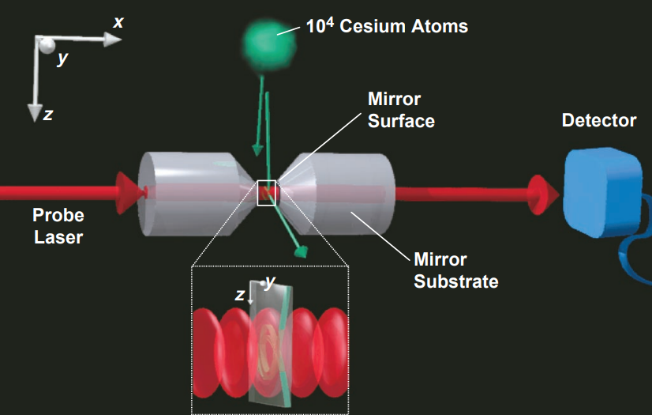
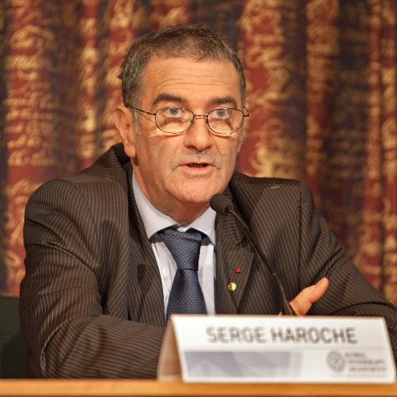



Cavity Quantum Electrodynamics
Study of the interactions between light confined in a cavity and atoms
  Coherent coupling between single-photons and a quantum object (atom)
  Atom can be real or artificial (superconducting qubits)
  Light field can be at optical or microwave frequencies
$$ω_{q}$$
$$g$$
$$ω_{c}$$
Serge Haroche
2012 Nobel Prize
with David Wineland
C. J. Hood et al., H. J. Kimble, Science 287, 1447 (2000)
A. Rauschenbeutel et al., S. Haroche, Science 288, 2024 (2000)
Notes:
Segway using high-cooperativity
They also have restricted decay channels
Perfect cavity only has photon loss
Error correction using higher Fock states

Slide 3
Quantum Computing with 3D Circuit QED
Srivatsan Chakram
Rutgers, The State University of New Jersey
U.S. Quantum Information Summer School 2023
Notes:
Hello everyone. Thank you all for coming. It’s an honor to be invited to speak at this session. My name is Srivatsan. I am an assistant professor of physics at Rutgers

Slide 4
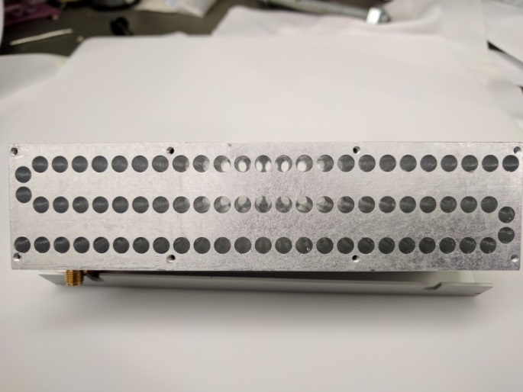
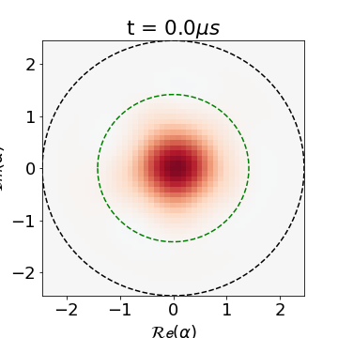

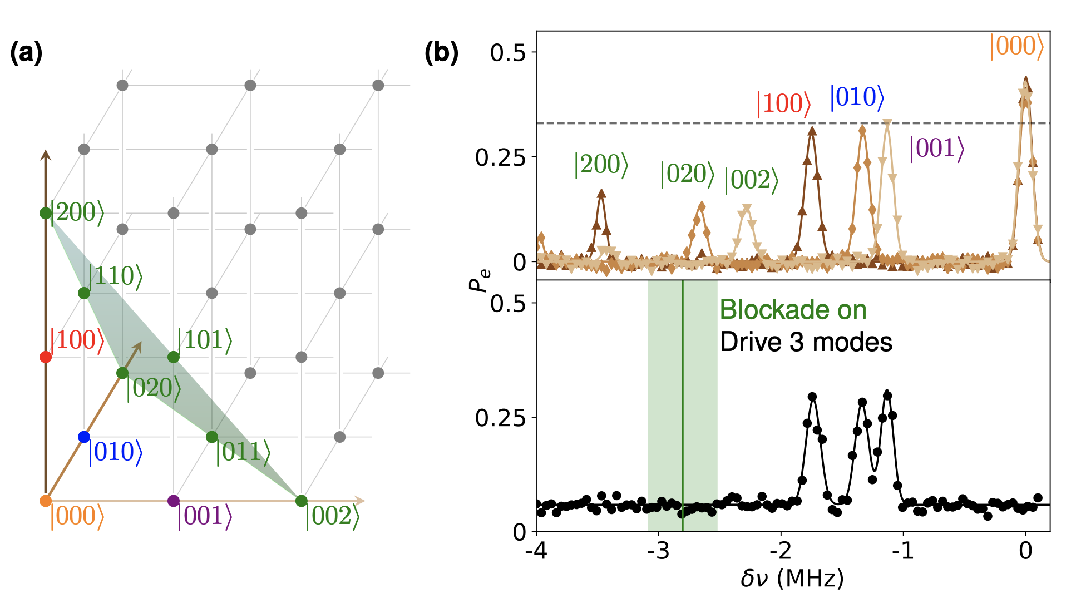

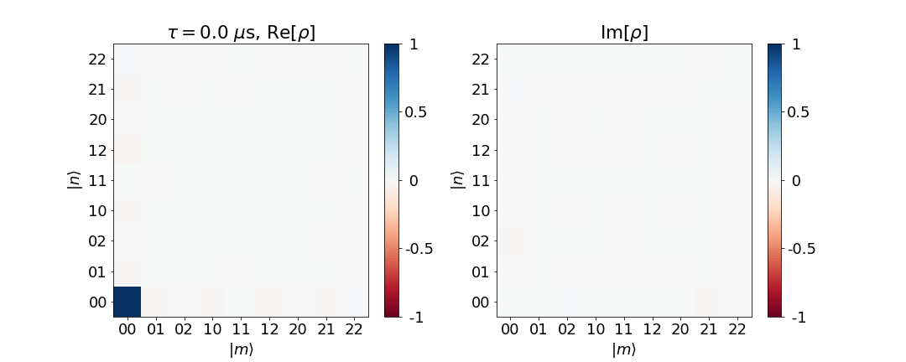
Outline
Introduction to 3D circuit QED
Extracting the cQED Hamiltonian
  Black box quantization
Quantum control using a transmon
  4-wave mixing
  SNAP gates
  Photon blockade
  Conditional displacements
Multimode operations
Notes:
Add pictures. Too many points.

Slide 5
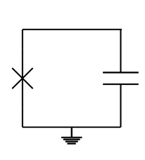
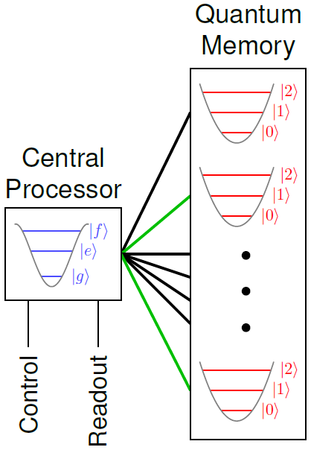
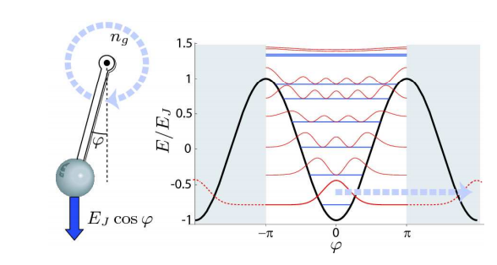
Our artificial atom - the transmon
Key element – Josephson junction
Phase difference – macroscopic quantum DOF
Junction acts as a nonlinear inductor
Non-linearity of junction used to perform gate operations
ω_{ge} ≠ ω_{ef}
Notes:
You cannot do quantum information processing with only linear objects. In superconducting systems, the key element that provides a non-linearity is a josephson junction.
provides a non-linearity is a Joesphson junction. The josephson junction is awesome because it provides a dissipationless non linearity. The phase difference across the junction serves as a macroscopic quantum degree of freedom, behaving as a single particle in a cosine potential, realizing a quantum pendulum. A transmon qubit consists of a capacitor shunted by a josephson junction. Effectively the junction for our purposes realizes a nonlinear inductor. To lowest order this realizes an anharmonic oscillator. The lowest two levels form our qubit, and the anharmonicity is typically 10% of the qubit frequency. The transmon is itself a charge qubit, made from adding a capacitor to a cooper pair box.
There are many flavors of qubits out there. The transmon itself is a charge qubit. There are other qubits that use other circuit elements, notably linear inductors, and these have given rise to qubits like the flux qubit and the fluxonium. The fluxonium, has recently come back into prominence. I will mention it briefly again at the end of my talk.

Slide 6
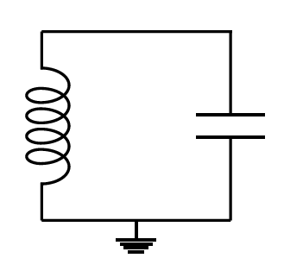
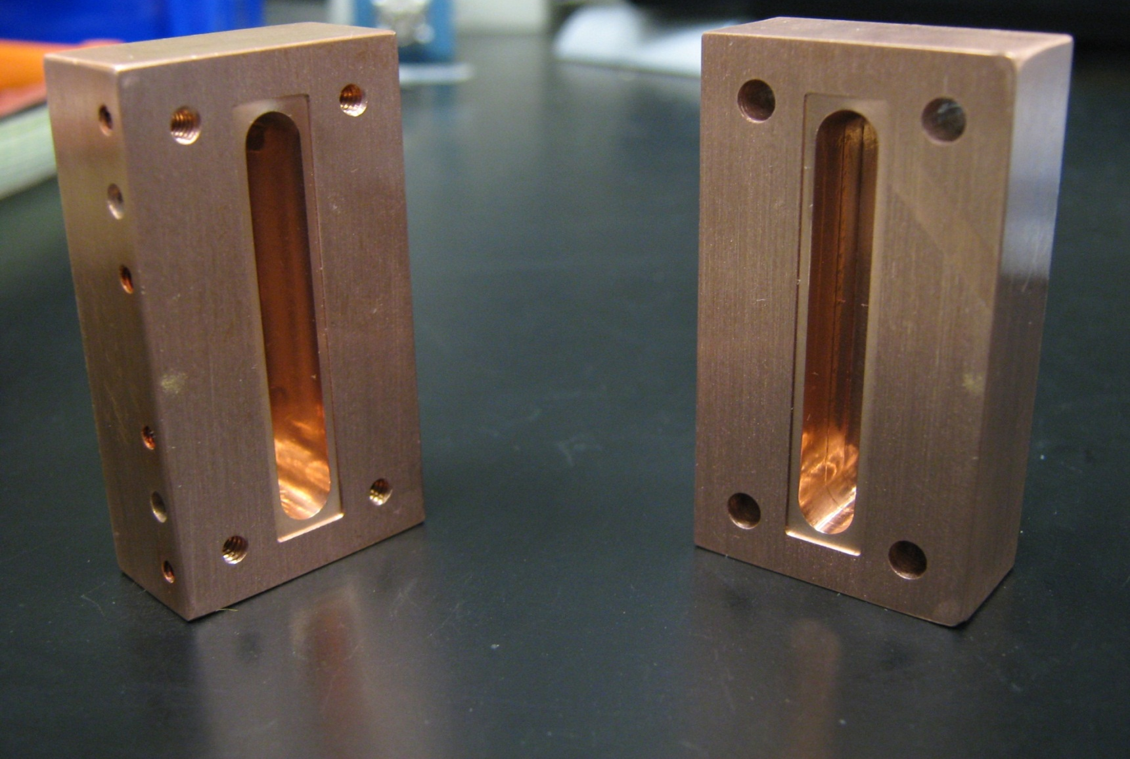
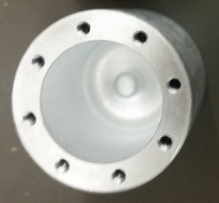
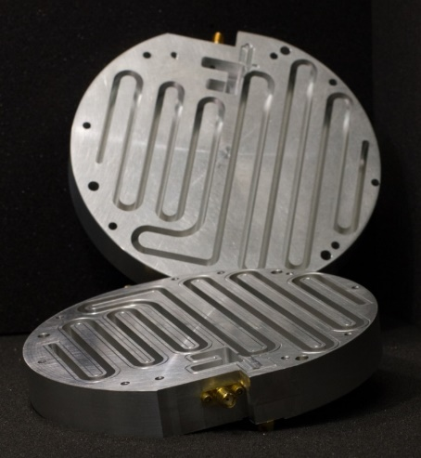
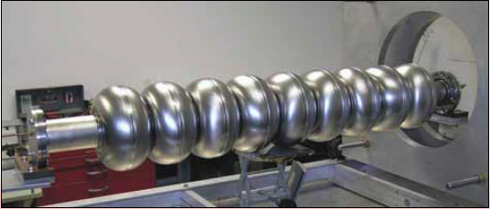
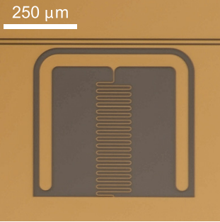
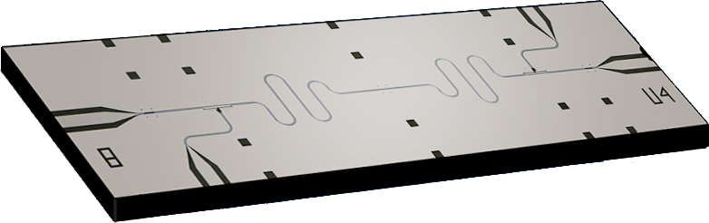
Microwave cavities come in many flavors
The simplest superconducting circuit is an LC oscillator
Single resonant mode of any box
Many types of “boxes”
3D cavities
Notes:
Superconducting cirtcuits, as the name suggests, are electrical circuits made out of superconductors. The simples superconducting circuit is an LC oscillator, with equally spaced energy levels. These LC circuits can be realized in 2 dimensions using lithography, in lumped element form, or as a coplanar waveguide, 2D version of a BNC cable. Or alternately, any single mode of a metallic or superconductingf box is a harmonic oscillator. And there are a variety of superconducting boxes we can make. If you just have a harmonic system, you cant do any quantum information. After if you make a coherent state with only a few photons, its still a classical state.

Slide 7
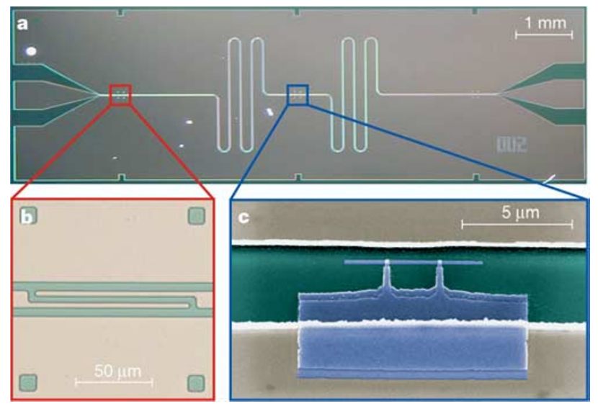



Circuit quantum electrodynamics
Coupling a superconducting qubit to a microwave cavity
Cavity-QED with a macroscopic artificial atom
$$ω_{q}$$
$$g$$
$$ω_{c}$$
Cavity: Coplanar waveguide resonator
Atom: Cooper pair box
A. Walraff et al., 431, 162–167 (2004)
$$ω_{q}$$
$$g$$
$$ω_{c}$$
Notes:
Circuit QED is the paradigm of coupling a superconducting qubit to a microwave cavity. This is like cavity QED with a macroscopic artificial atom.
The state of the transmon is readout out by coupling the transmon to a cavity. This is analogous to a cavity QED system where the transmon is like an atom, and the microwave cavity is like an optical cavity, with the atom and the cavity being way off resonance. In this regime that atom is like a bead of glass causing a phase shift and a shift in the cavity resonance frequency, that importantly depends on the atomic state of the atom.
Typically our transmon circuits have a frequency of around 5-10 GHz or so, which corresponds to a few 300 mK in temp.

Slide 8
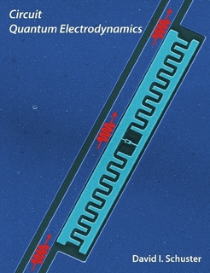
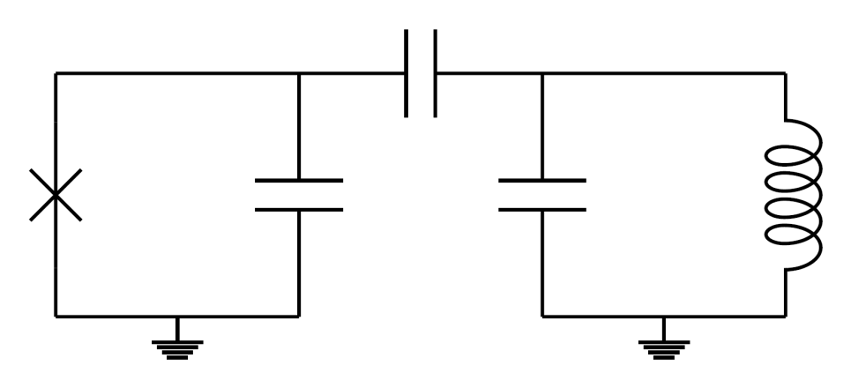
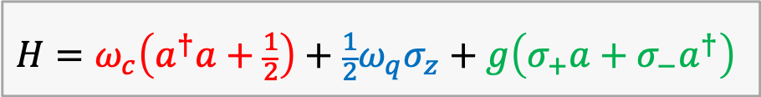



Circuit quantum electrodynamics
Coupling a superconducting qubit to a microwave cavity
Cavity-QED with a macroscopic artificial atom
$$ω_{q}$$
$$g$$
$$H=ω_{c}\left(a^{†}a+\frac{1}{2}\right)+\frac{1}{2}ω_{q}σ_{z}+g\left(σ_{+}a+σ_{−}a^{†}\right)$$
$$ω_{c}$$
Qubit
Cavity
$$ω_{q}$$
$$g$$
$$ω_{c}$$
Protects the qubit from the environment
Readout qubit by probing cavity
Use qubit for universal cavity control
$$ω_{q}$$
$$g$$
$$ω_{c}$$
Notes:
Circuit QED is the paradigm of coupling a superconducting qubit to a microwave cavity. This is like cavity QED with a macroscopic artificial atom.
The state of the transmon is readout out by coupling the transmon to a cavity. This is analogous to a cavity QED system where the transmon is like an atom, and the microwave cavity is like an optical cavity, with the atom and the cavity being way off resonance. In this regime that atom is like a bead of glass causing a phase shift and a shift in the cavity resonance frequency, that importantly depends on the atomic state of the atom.
Typically our transmon circuits have a frequency of around 5-10 GHz or so, which corresponds to a few 300 mK in temp.

Slide 9
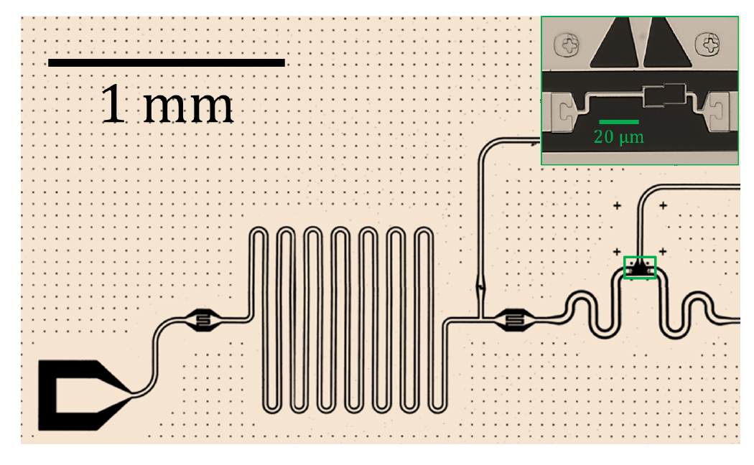
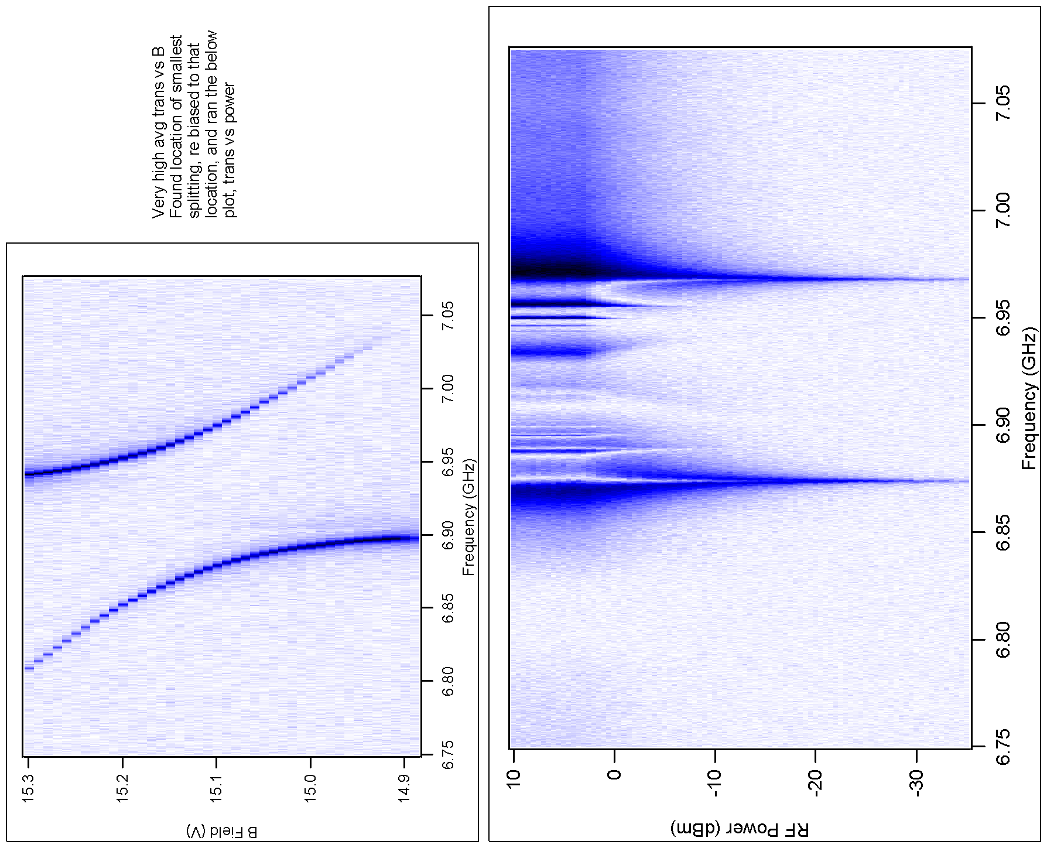
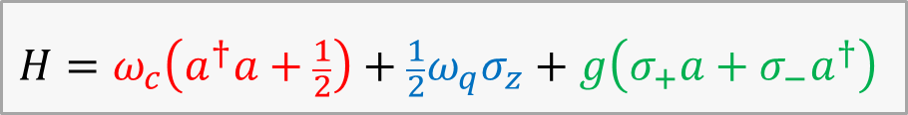
Circuit quantum electrodynamics
Cavity-QED with a macroscopic atom
Cavity size ~ wavelength
$$ω_{q}$$
$$g$$
$$H=ω_{c}\left(a^{†}a+\frac{1}{2}\right)+\frac{1}{2}ω_{q}σ_{z}+g\left(σ_{+}a+σ_{−}a^{†}\right)$$
$$ω_{c}$$
7.05
Cavity
Qubit
Frequency (GHz)
g ~ 100 MHz
6.75
Magnetic field (a.u.)
$$ω_{q}$$
$$g$$
$$ω_{c}$$
Notes:
The state of the transmon is readout out by coupling the transmon to a cavity. This is analogous to a cavity QED system where the transmon is like an atom, and the microwave cavity is like an optical cavity, with the atom and the cavity being way off resonance. In this regime that atom is like a bead of glass causing a phase shift and a shift in the cavity resonance frequency, that importantly depends on the atomic state of the atom.
Typically our transmon circuits have a frequency of around 5-10 GHz or so, which corresponds to a few 300 mK in temp.

Slide 10
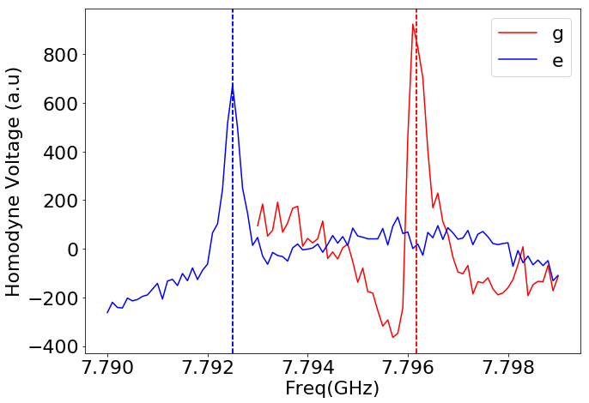
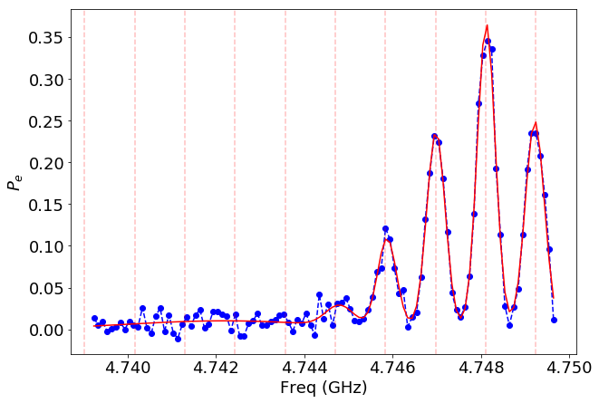


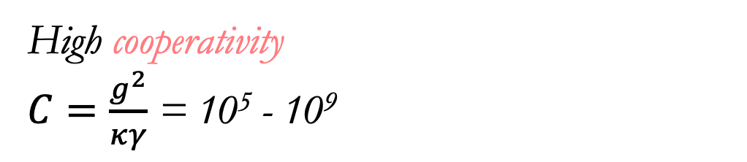





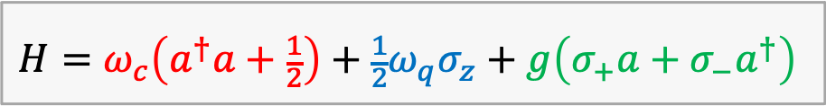
Circuit quantum electrodynamics
Dispersive approximation
Qubit and cavity are off-resonant
$$ω_{q}$$
High cooperativity
$C=\frac{g^{2}}{κγ}$ = 10⁵ - 10⁹
$$g$$
$$Φ$$
$$H=ω_{c}\left(a^{†}a+\frac{1}{2}\right)+\frac{1}{2}ω_{q}σ_{z}+g\left(σ_{+}a+σ_{−}a^{†}\right)$$
H_{I}$= \frac{χ}{2}\left(a^{†}a\right)σ_{z}$
$$ω_{c}$$
Cavity shift based on qubit state
Qubit shift from cavity photon number
$$$$
$$$$
Dispersive shift
$$ω_{q}$$
$$g$$
$$ω_{c}$$
Notes:
The state of the transmon is readout out by coupling the transmon to a cavity. This is analogous to a cavity QED system where the transmon is like an atom, and the microwave cavity is like an optical cavity, with the atom and the cavity being way off resonance. In this regime that atom is like a bead of glass causing a phase shift and a shift in the cavity resonance frequency, that importantly depends on the atomic state of the atom.
Typically our transmon circuits have a frequency of around 5-10 GHz or so, which corresponds to a few 300 mK in temp.

Slide 11

Circuit quantum electrodynamics
Dispersive approximation
Qubit and cavity are off-resonant
High cooperativity
$C=\frac{g^{2}}{κγ}$ = 10⁵ - 10⁹
$$Φ$$
H_{I}$= \frac{χ}{2}\left(a^{†}a\right)σ_{z}$
Cooperativity: Dimensionless measure of coherence of a cavity QED system
$g=$coupling strength
$κ=$Cavity decay rate
$γ=$Qubit decay rate
Qubit shift from cavity photon number
$$$$
Dispersive shift
$$ω_{q}$$
$$g$$
$$ω_{c}$$
Notes:
The state of the transmon is readout out by coupling the transmon to a cavity. This is analogous to a cavity QED system where the transmon is like an atom, and the microwave cavity is like an optical cavity, with the atom and the cavity being way off resonance. In this regime that atom is like a bead of glass causing a phase shift and a shift in the cavity resonance frequency, that importantly depends on the atomic state of the atom.
Typically our transmon circuits have a frequency of around 5-10 GHz or so, which corresponds to a few 300 mK in temp.

Slide 12
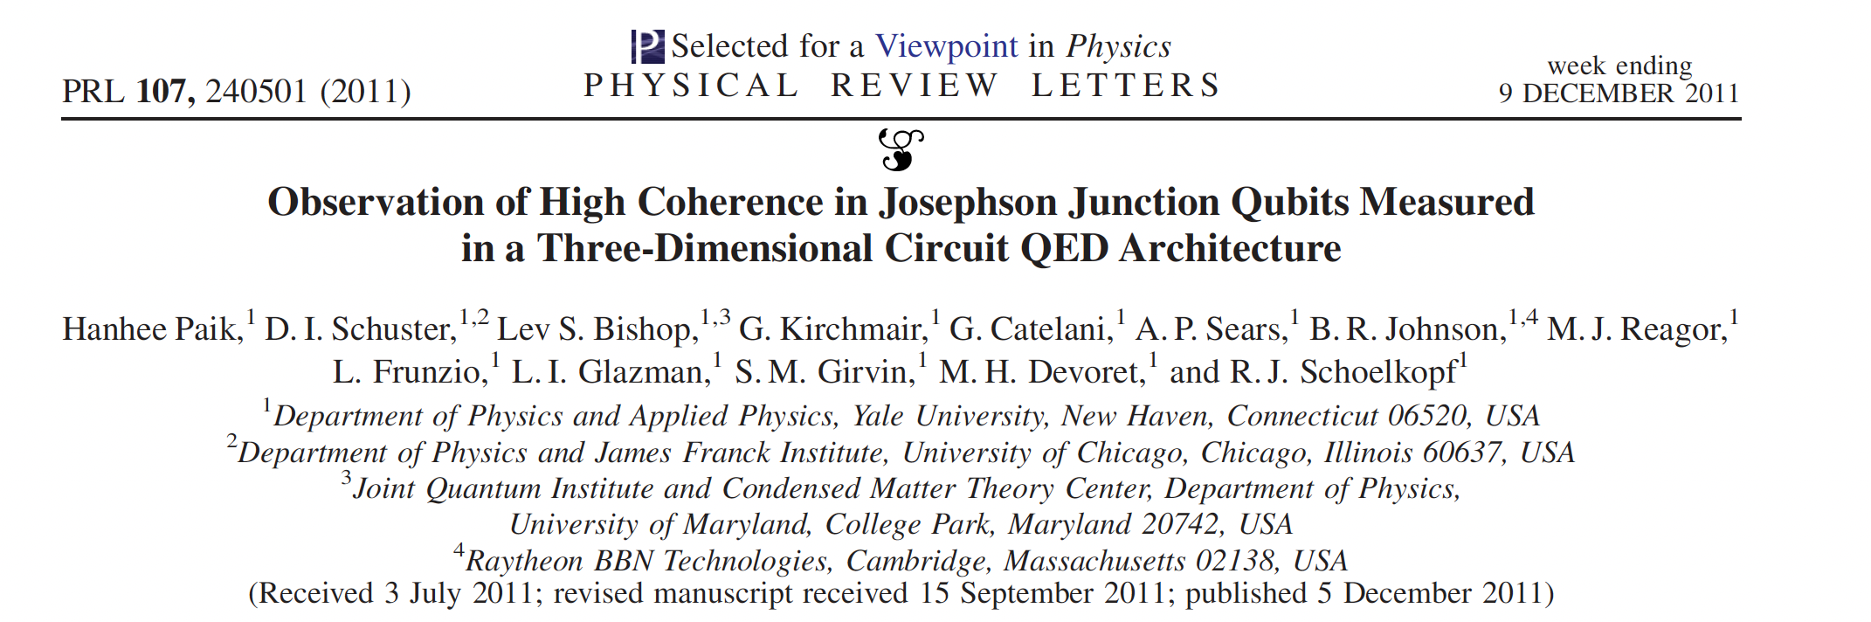
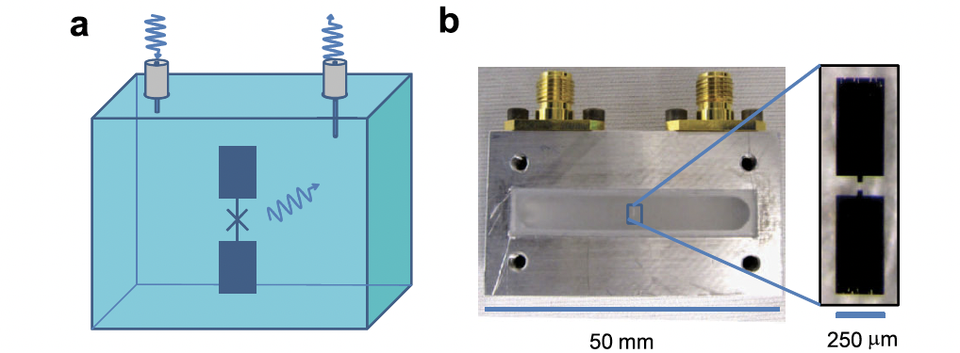
3D circuit quantum electrodynamics
Reduce dielectric loss by diluting electric field
Demonstrations that junctions can be sufficiently low loss
3D cavity just used for readout
$$ω_{q}$$
$$g$$
$$ω_{c}$$
Notes:
The state of the transmon is readout out by coupling the transmon to a cavity. This is analogous to a cavity QED system where the transmon is like an atom, and the microwave cavity is like an optical cavity, with the atom and the cavity being way off resonance. In this regime that atom is like a bead of glass causing a phase shift and a shift in the cavity resonance frequency, that importantly depends on the atomic state of the atom.
Typically our transmon circuits have a frequency of around 5-10 GHz or so, which corresponds to a few 300 mK in temp.

Slide 13
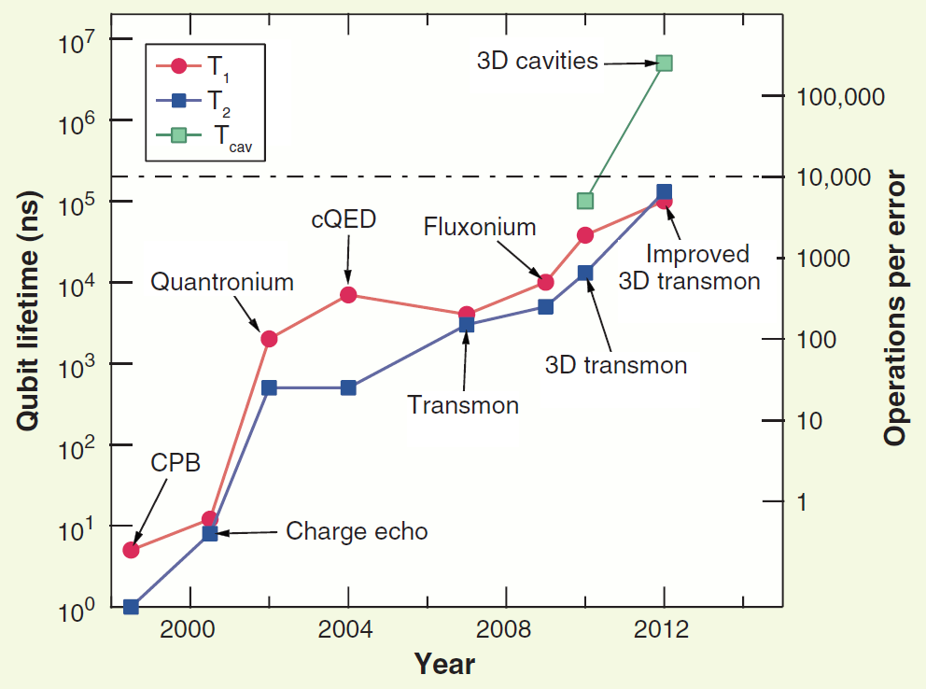
Moore’s law for superconducting qubits
10x improvement in coherence every 3 years
Transmon coherence times ~ 100-500 μs
Fermilab SRF Cavity
Fluxonium (Maryland/UChicago)
New 2d/3d transmons
(Princeton)
Cavities still have the best coherences!
Devoret, Schoelkopf, Science (2013)
2023
Notes:
Segway using high-cooperativity
They also have restricted decay channels
Perfect cavity only has photon loss
Error correction using higher Fock states

Slide 14
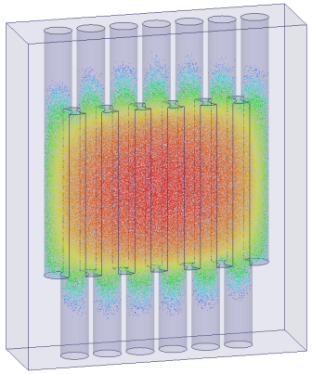
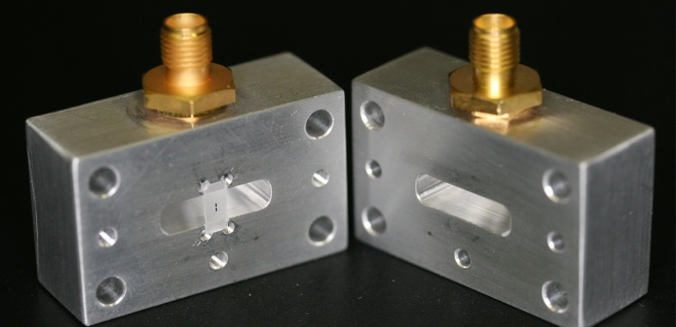
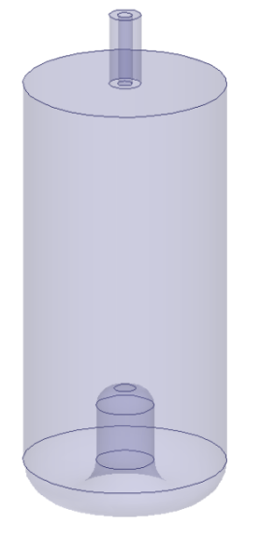
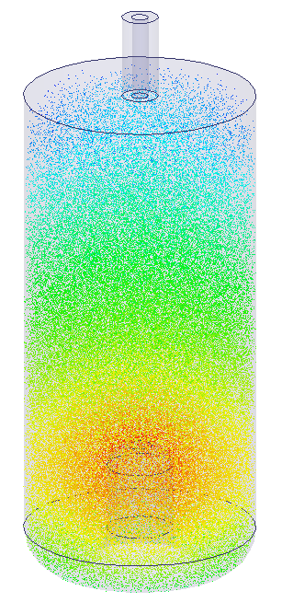
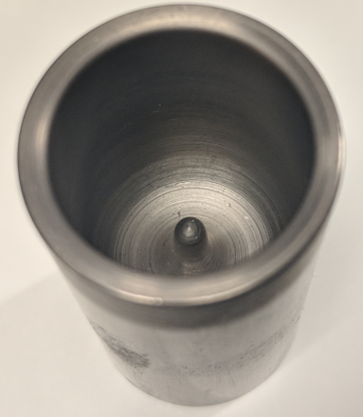
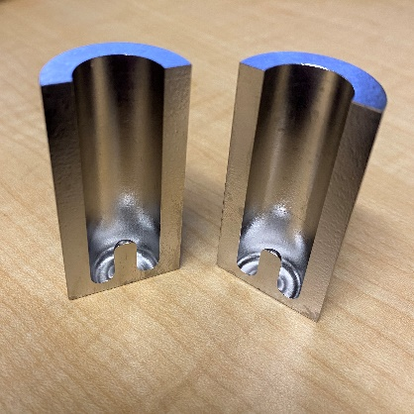
Seamless cavities
Three sources of loss in 3D cavities:
  Dielectric
  Conduction
  Seam
Traditional 3D cavities suffer from loss at seam between pieces of the cavity
Seamless cavities
  Coax cavities
  Flute cavities
  Lifetimes ~ 1 ms
SRF cavities (seams eliminated by e-beam welding)
  Lifetime ~ 1s
Notes:
The coaxal cavity I mentioned is also a seamless cavity

Slide 15

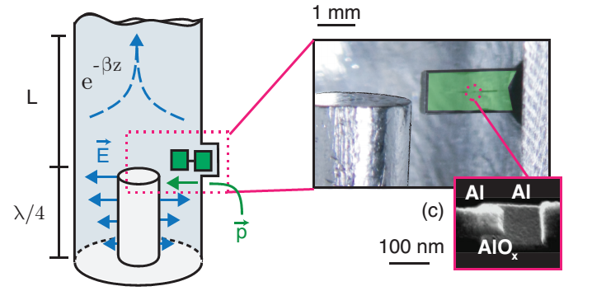
Microwave cavities as quantum memories
Coaxial quarter wave cavities
Q ~ 100 million
T₁ ~ 1-2 milli seconds
Longest lifetimes in circuit-QED
Can be controlled using a transmon circuit
Devoret, Schoelkopf, Science (2013)
M. Reagor et al., PRB (2016)
Fermilab accelerator cavities
Q ~ 20 billion @ 1.3 GHz
T₁ ~ seconds
2020
D. Gonella et al., JoAP (2016)
A. Romanenko et al., Phys. Rev. Applied (2020)
Notes:
Segway using high-cooperativity
They also have restricted decay channels
Perfect cavity only has photon loss
Error correction using higher Fock states

Slide 16
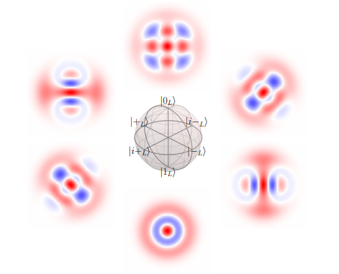
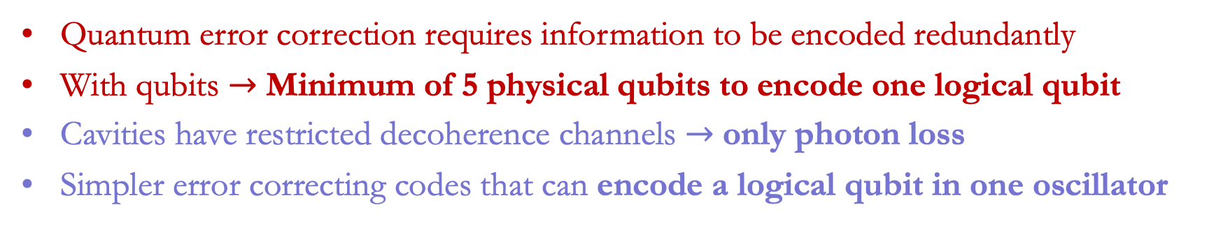
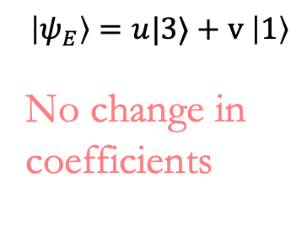
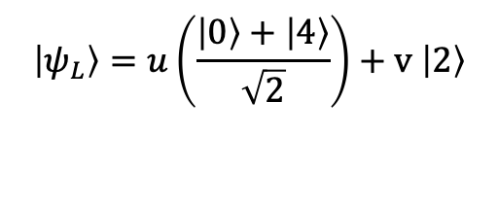
Bosonic quantum error correction
Quantum error correction requires information to be encoded redundantly
With qubits $→$ Minimum of 5 physical qubits to encode one logical qubit
Cavities have restricted decoherence channels $→$ only photon loss
Simpler error correcting codes that can encode a logical qubit in one oscillator
Binomial code
$$\left|ψ_{L}\right\rangle =u\left(\frac{\left|0\right\rangle +\left|4\right\rangle }{\sqrt{2}}\right)+v \left|2\right\rangle$$
Same mean photon #
Photon loss
$$\left|ψ_{E}\right\rangle =u|3⟩+v \left|1\right\rangle$$
No change in coefficients
$$\left|ψ_{L}\right\rangle$$
Error syndrome = Parity
S. Rosenblum et al., 9, 652 Nat. Comm. (2018),
L. Hu et al., Nat. Phys. 15, 503–508 (2019)
Notes:
Segway using high-cooperativity
They also have restricted decay channels
Perfect cavity only has photon loss
Error correction using higher Fock states

Slide 17
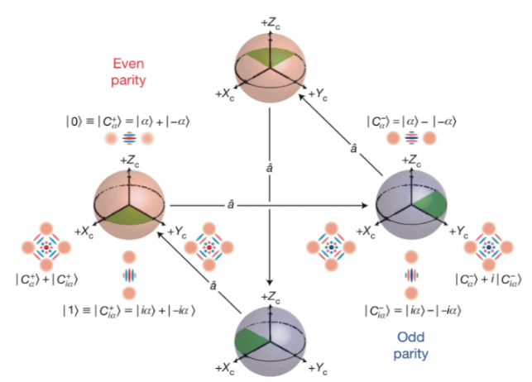
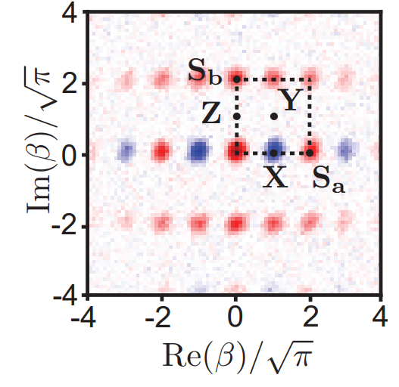
Bosonic quantum error correction
Quantum error correction requires information to be encoded redundantly
With qubits $→$ Minimum of 5 physical qubits to encode one logical qubit
Cavities have restricted decoherence channels $→$ only photon loss
Simpler error correcting codes that can encode a logical qubit in one oscillator
Cat code
Binomial code
GKP
N. Ofek et al., Nature 536, 441–445 (2016)
S. Rosenblum et al., 9, 652 Nat. Comm. (2018),
L. Hu et al., Nat. Phys. 15, 503–508 (2019)
P. Campagne-Ibarq et al.,
Nature 584, 368–372(2020)
Notes:
Segway using high-cooperativity
They also have restricted decay channels
Perfect cavity only has photon loss
Error correction using higher Fock states

Slide 18
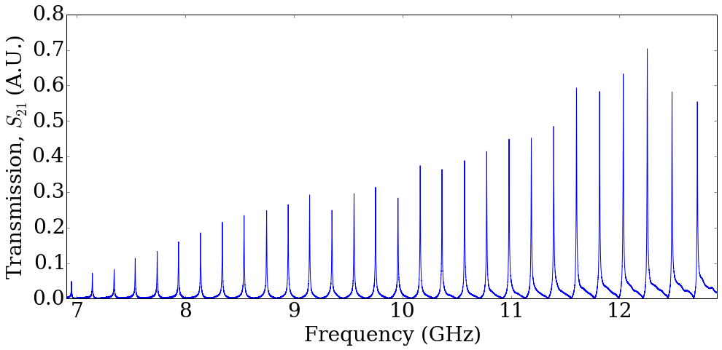
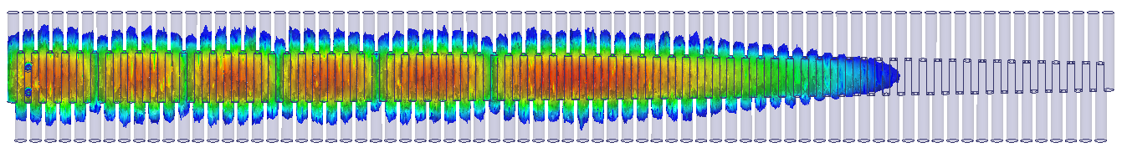



Seamless multimode rectangular flute cavity
99.999% purity Al
$$15 cm$$
Transmon coupled at one end
$$\sim 50 cm$$
Straightforward design of a variety of spectra and spatial distributions
Taper the cavity to create equally spaced modes
Notes:
Show a dot for the E field
Location and cartoon for 3D transmon
Indicate the cavity length stretched out..

Slide 19




Coupling a 3d cavity to a transmon
Add a 3D readout cavity and a bridge transmon
Bridge transmon
Readout
How do we calculate the expected system Hamiltonian?
Storage cavity
Notes:
Fix this slide. Don’t use middle figure

Slide 20
Outline
Introduction to 3D circuit QED
Extracting the cQED Hamiltonian
  Black box quantization
Quantum control using a transmon
  4-wave mixing
  SNAP gates
  Photon blockade
  Conditional displacements
Multimode operations
Notes:
Add pictures. Too many points.

Slide 21

Black box quantization
Finding the effective Hamiltonian for a system of weakly anharmonic superconducting circuits coupled to an arbitrary EM environment
First treat the junction as a linear object with some inductance/capacitance
Find correct basis by solving the coupled linear problem
Parameters extracted from impedance $Z(ω)$
Perturbatively add back the non-linear terms while rewriting in the new basis
  m
Black-Box Superconducting Circuit Quantization, S. Nigg et. al., PRL 108, 240502 (2012)
Notes:
2) Here is an outline of the talk. I will start by presenting the kind of quantum computing architecture we have in mind.
I will then present results of a random access quantum information processor module realized in a 2D architecture. The processor consists of a chain of strongly coupled CPW resonators, with the memory bits consisting of photons in the resonator modes. These photonic states are stored and retrieved using a single transmon circuit serving as a central processor. We use the transmon to then perform universal quantum operations between arbitrary modes.
I will then discuss our progress towards realizing a 3D version of the same architecture, controlling the quantum state of the high-Q seamless cavities that Ravi had described in the previous talk, using transmon circuits, and plans for the future.

Slide 22

Black box quantization
The relevant parameter to be extracted from $Z(ω)$is the participation of each of the normal modes at the junction
Total impedance found by combining that of the EM environment and the junction in parallel
  ${Z (ω)}^{−1}= Y\left(ω\right)=Y_{C}\left(ω\right)+Y_{J}\left(ω\right)$
  $Y_{J}\left(ω\right)=jωC_{j}+\frac{1}{jωL_{J}}$
Forster’s theorem : $Z\left(ω\right)$can be synthesized as a series of LCR oscillators
Notes:
2) Here is an outline of the talk. I will start by presenting the kind of quantum computing architecture we have in mind.
I will then present results of a random access quantum information processor module realized in a 2D architecture. The processor consists of a chain of strongly coupled CPW resonators, with the memory bits consisting of photons in the resonator modes. These photonic states are stored and retrieved using a single transmon circuit serving as a central processor. We use the transmon to then perform universal quantum operations between arbitrary modes.
I will then discuss our progress towards realizing a 3D version of the same architecture, controlling the quantum state of the high-Q seamless cavities that Ravi had described in the previous talk, using transmon circuits, and plans for the future.

Slide 23




Extracting the admittance of the cavity using HFSS
Use finite element software
  ANSYS HFSS
Compute the admittance as seen by the junction
Assign the junction as a lumped port with high impedance
Sample particularly near the expected locations of the modes and the range of transmon frequencies

Slide 24



Finding the locations of the modes
Add the admittance of the junction by hand to get to the total admittance
  $Y\left(ω\right)=Y_{C}\left(ω\right)+Y_{J}\left(ω\right)$
  $Y_{J}\left(ω\right)=jωC_{j}+\frac{1}{jωL_{J}}$
Modes are found from the zeroes of the admittances
Admittance near the modes is used to extract capacitances and inductances
  mc
Readout
Transmon
Storage
cavity

Slide 25



Diagonalized linear Hamiltonian of circuit + cavity
Hamiltonian of the linearized system in terms of flux/charge or number/phase
Write zero-point phase fluctuations at the junction from each of the modes
Rewriting the junction phase in terms of normal modes
  mc

Slide 26




Mapping to a multimode Jaynes-Cummings model
Multimode JC Hamiltonian with a single transmon
The normal modes can be found to lowest order by doing a dispersive transformation
$g,χ^{′}s$ extracted using
  mc

Slide 27







Reintroducing the nonlinearity
Reintroduce the quartic nonlinear term and rewrite $φ$ in terms of the normal modes
  mc
$$φ$$
  Lamb shift
  Cross-Kerr interaction/dispersive shift
Notes:
Don’t need to write in terms of E_{CJ}. That’s just to match with the black box paper

Slide 28




Extracting the dispersive shifts and cross-Kerr interactions
Reintroduce the quartic nonlinear term and rewrite $φ$ in terms of the normal modes
  mc
$$φ$$
  Lamb shift
  Cross-Kerr interaction/dispersive shift
Notes:
Don’t need to write in terms of E_{CJ}. That’s just to match with the black box paper

Slide 29



Hamiltonian parameters for a 3D circuit QED system
Multimode Jaynes-Cummings Hamiltonian
$$H=\frac{1}{2}ω_{q}σ_{z}+\sum_{i}^{n}{ω_{i}\left({a_{i}}^{†}a_{i}+\frac{1}{2}\right)}+ g_{i}\left(σ_{+}a_{i}+σ_{−}{a_{i}}^{†}\right)$$

Slide 30


Multimode circuit QED system
Cavity modes are far detuned from the transmon
Dispersive approximation
$$H=\sum_{i}^{n}{\frac{χ_{i}}{2}\left({a_{i}}^{†}a_{i}\right)} σ_{z}$$
Notes:
As I pointed out before, the transmon is not just a qubit.

Slide 31

Putting it all together
Add a 3D readout cavity and a bridge transmon
Light tight packaging
T₁ = 86 µs
T₂* = 65-120 µs
n_{th}^{q} = 0.5 – 1%
n_{th}^{R} = 0.1-0.5%
Readout
Storage cavity
Notes:
Fix this slide. Don’t use middle figure

Slide 32

Packaging, shielding, and filtering matters!

Slide 33

Multimode coherences
  For 9 modes
  Q ~ 70-95 million
  T₁ ~ 2 ms
  T₂ ~ 2 - 3.5 ms
S.Chakram*, A. Oriani*, R.Naik, .., D.Schuster,
Phys. Rev. Letters (2021)
Notes:
Average the T2 data
Mention properties of the transmon
Mention the changes that were made to achieve the coherences
Compare with the previous results from 2D
Say something about the fidelity of the SWAP operations

Slide 34
Outline
Introduction to 3D circuit QED
Extracting the cQED Hamiltonian
  Black box quantization
Quantum control using a transmon
  4-wave mixing
  SNAP gates
  Photon blockade
  Conditional displacements
Multimode operations
Notes:
Add pictures. Too many points.

Slide 35

Schemes for control using a fixed frequency transmon
  Resonant charge sideband interactions
  SNAP Control - number resolved transmon and cavity drives
  Cavity drive and photon blockade
  Conditional displacement gates
Rely on the Josephson nonlinearity
4-wave mixing
Dispersive interaction
$$χ\left(a^{†}a\right)|e⟩⟨e|$$

Slide 36

Cavity control with charge sideband transitions
4-wave mixing using the non-linearity of the Josephson junction
f0-g1 charge sideband transition
Drive
A. Wallraff et al, Phys. Rev. Lett. (2007)
M. Pechal, Phys. Rev. X (2014)
S. Rosenblum et al, Nat. Comm. (2017)
Notes:
No equation. Too much.

Slide 37

Cavity control with charge sideband transitions
4-wave mixing using the non-linearity of the Josephson junction
Drive
A. Wallraff et al, Phys. Rev. Lett. (2007)
M. Pechal, Phys. Rev. X (2014)
S. Rosenblum et al, Nat. Comm. (2017)
Notes:
No equation. Too much.

Slide 38




Addressing the cavity modes through sidebands
Any single-mode gate operation
T₁ = 1.95 ± 0.1 ms
T₂ = 2.4 ± 0.3 ms
SWAP
Notes:
Get this data with sidebands for the multimode flute for 1 mode.

Slide 39


Addressing the cavity modes through sidebands
Storage cavity
Transmon
Readout
f0-g1 SWAP
Drive

Slide 40







Beam splitter operations between cavity modes!
4-wave mixing with two drive tones
$$\left|g10\right\rangle$$
ν_{a}
Cavity modes
$$\left|g01\right\rangle$$
ν_{b}
ν₁
$$\left|e00\right\rangle$$
Drive tones
ν₂
$$\left|g00\right\rangle$$
Drive 1
ν_{a} -ν_{b} = ν₁ -ν₂
Drive 2

Slide 41





Beam splitter operations between cavity modes!

Slide 42
Schemes for control using a fixed frequency transmon
  Resonant charge sideband interactions
  SNAP Control - number resolved transmon and cavity drives
  Cavity drive and photon blockade
  Conditional displacement gates

Slide 43






Universal control using the dispersive interaction
Uses the dispersive interaction
Cavity displacements
Selective number dependent
arbitrary phase (SNAP)
Number selective transmon pulses

Slide 44

Optimal control SNAP pulses
SNAP allows universal control
Can numerically find optimal
control pulses
N. Leung, M. Abdelhafez, J. Koch, and D.Schuster,
Phys. Rev. A 95, 042318 (2017)

Slide 45




Optimal control SNAP pulses
SNAP allows universal control
Can numerically find optimal
control pulses
  Speed up gates
  Improve fidelities
$$\text{Gate} \text{time} \sim \frac{1}{χ}$$
Error $\sim \frac{γ}{χ}$

Slide 46









Parity measurements and Wigner tomography
Uses the dispersive interaction
$$χ\left(a^{†}a\right)|e⟩⟨e|$$
$$\frac{1}{2χ}$$
Parity measurement
  Ramsey after idling $\frac{1}{2χ}$
Partial fourier transform of density matrix
Negativity - non-classicality
Wigner Tomography
  Displace cavity
  Measure Parity
$$|0⟩$$
$$|1⟩$$
p
x
Notes:
Fourier transform of the density matrix.
Make all the wigner functions square. Regenerate them.
Label x and y axis in the graph
1/2chi is pi phase shift.

Slide 47


Schemes for control using a fixed frequency transmon
  Resonant charge sideband interactions
  SNAP Control - number resolved transmon and cavity drives
  Cavity drive and photon blockade
  Conditional displacement gates
$$\text{Gate} \text{time} \sim \frac{1}{χ}$$
Error $\sim \frac{γ}{χ}$

Slide 48



Quantum dynamics with photon blockade
A pure cavity drive can only generate classical states
Notes:
Add ellipsis to indicate more levels

Slide 49












Quantum dynamics with photon blockade
Use a number selective transmon pulse
Blockade specific photon numbers
Blockade of $|2⟩$
$$ε≪Ω≪χ$$
$$ε≪Ω≪χ$$
$$\text{\sim }\text{10 }\text{kHz}≪\text{\sim }\text{100 }\text{kHz}≪\sim 1 MHz$$
$$ε$$
Cavity drive results in a Rabi oscillation
L. Bretheu,…,B.Huard, Science, 348, 6236 (2015)
Notes:
Remove title on figure
Cite houck photonic qubit paper
Flip colors
Keep the epsilon at the end
Maybe mention its trivial to calibrate

Slide 50

Quantum dynamics with photon blockade
Use a number selective transmon pulse
Blockade specific photon numbers
Blockade of $|2⟩$
$$ε≪Ω≪χ$$
$$\text{\sim }\text{10 }\text{kHz}≪\text{\sim }\text{100 }\text{kHz}≪\sim 1 MHz$$
Notes:
Get a wigner tomography plot for no blockade..
R corresponding to green highlight saying it is sqrt(2)
For upto r = 2 and no population there

Slide 51




Quantum dynamics with photon blockade
Use a number selective transmon pulse
Blockade specific photon numbers
$$ε≪Ω≪χ$$
$$\text{\sim }\text{10 }\text{kHz}≪\text{\sim }\text{100 }\text{kHz}≪\sim 1 MHz$$
  Blockade infidelity
Leakage to $\left|+2\right\rangle ,\left|−2\right\rangle$
Purcell decay of $\left|g1\right\rangle$ by blockade drive
$$γ$$
$$\frac{ε^{2}}{Ω^{2}}×γ× \frac{1}{ε} +\frac{Ω^{2}}{χ^{2}}×γ×\frac{1}{ε} ≥ \frac{γ}{χ}$$
$$γ$$
Same infidelity as SNAP gates
for a lossless cavity
Notes:
Get a wigner tomography plot for no blockade..

Slide 52






Quantum dynamics with photon blockade
Blockade of higher photon numbers
Blockade of $|3⟩$
Blockade radius increases as $\sqrt{n}$

Slide 53




Quantum dynamics with photon blockade
Can use blockade multiple photon numbers
Rabi oscillation between $|1⟩$and $|2⟩$

Slide 54
Universal qudit control with photon blockade
Can achieve arbitrary qudit control just by driving the cavity
S. G. Schirmer, H. Fu, C. Solomon, Phys. Rev. A, 63, 063410 (2001)
Optimal control
Numerically find pulses
using gradient descent
N. Leung, M. Abdelhafez, J. Koch, and D.Schuster,
Phys. Rev. A 95, 042318 (2017)
Notes:
Increase time font size
Y axis of optimal control curve change to kHz

Slide 55






Universal qudit control with photon blockade
Can achieve arbitrary qudit control just by driving the cavity
$ℱ$= $0.953±0.02$
$$\left|1\right\rangle$$
$$ε(t)$$
$ε(t)=Re[\left(x+iy\right)e^{iω_{cav}t}$]
Notes:
Increase time font size
Y axis of optimal control curve change to kHz
Indicate green is blockade
And |1> where it

Slide 56




Universal qudit control with photon blockade
Can achieve arbitrary qudit control just by driving the cavity
$ℱ$= $0.963±0.02$
$$\left|2\right\rangle$$
$$ε(t)$$
$ε(t)=Re[\left(x+iy\right)e^{iω_{cav}t}$]
Notes:
Increase time font size
Y axis of optimal control curve change to kHz

Slide 57

Schemes for control using a fixed frequency transmon
  Resonant charge sideband interactions
  SNAP Control - number resolved transmon and cavity drives
  Cavity drive and photon blockade
  Conditional displacement gates
All schemes have similar infidelity in the absence of cavity decay
Gate error $\sim \frac{γ}{χ}$

Slide 58




Conditional displacement gates
Use a large displacement to enhance the dispersive interaction
Gate speed $\sim χ→χα$
GKP
P. Campagne-Ibarq et al., …, M. H. Devoret, Nature 584, 368–372(2020)
A. Eickbusch, S. Elder, ..., R. Schoelkopf, M. Devoret, V31.00005, March meeting (2021)
Notes:
Add ellipsis to indicate more levels

Slide 59

Schemes for control using a fixed frequency transmon
  Resonant charge sideband interactions
  SNAP Control - number resolved transmon and cavity drives
  Cavity drive and photon blockade
  Conditional displacement gates
All schemes have similar infidelity in the absence of cavity decay
Gate error $\sim \frac{γ}{χ}$
Gate error $=? \frac{γ}{χα}$ < $\frac{γ}{χ}$

Slide 60
Outline
Introduction to 3D circuit QED
Extracting the cQED Hamiltonian
  Black box quantization
Quantum control using a transmon
  4-wave mixing
  SNAP gates
  Photon blockade
  Conditional displacements
Multimode operations
Notes:
Add pictures. Too many points.

Slide 61






Multimode interactions through photon blockade
Modes typically have different dispersive shifts
Qubit cannot distinguish between modes with same $χ$
Blockade drive generates interactions between modes
Blockade drive frequency
Drive mode 6
Mode 6
Mode 5
Mode 6
Mode 2
Disallows $\left|20\right\rangle , \left|02\right\rangle$and $\left|11\right\rangle$
Notes:
This slide sucks. Show number splitting with and without dressing.

Slide 62


Multimode interactions through photon blockade
Modes typically have different $χ$ shifts
Qubit cannot distinguish between modes if $χ$shifts are the same
Blockade drive generates interactions between modes
Blockade drive frequency
Drive mode 5
Mode 6
Mode 5
Disallows $\left|20\right\rangle , \left|02\right\rangle$and $\left|11\right\rangle$
Notes:
This slide sucks. Show number splitting with and without dressing.

Slide 63


Multimode interactions through photon blockade
Modes typically have different $χ$ shifts
Qubit cannot distinguish between modes if $χ$shifts are the same
Blockade drive generates interactions between modes
Blockade drive frequency
Entangling gate
Mode 6
Mode 5
Drive mode 6 after
adding a photon in mode 5
Disallows $\left|20\right\rangle , \left|02\right\rangle$and $\left|11\right\rangle$
Notes:
This slide sucks. Show number splitting with and without dressing.

Slide 64




Multimode interactions through photon blockade
Entanglement can also be generated if the $χ^{′}s$are different
Blockade by driving the $\left|g11\right\rangle →\left|e11\right\rangle$ of the transmon
$$\frac{|g01⟩+ |g10⟩}{\sqrt{2}}$$
Blockade drive frequency
Mode 2
Mode 3
Drive both cavities simultaneously
Notes:
This slide sucks. Show number splitting with and without dressing.
Blockade should be green

Slide 65

Multimode interactions through photon blockade
Blockade drive used to disallow a hyperplane of states
Realizes a pure N-body interaction
S.Chakram*, K. He*, .., L. Jiang, D. Schuster, arXiv:2010:15292 (2020)
$Ω=227$ kHz
Notes:
1 and 0 photons, blockading 3 photons.

Slide 66

Multimode W state preparation
Blockade at mean frequency of all 2-photon peaks
Drive all cavity modes simultaneously
3 mode W state
Notes:
This slide sucks. Show number splitting with and without dressing.

Slide 67

Multimode W state preparation
Blockade at mean frequency of all 2-photon peaks
Drive all cavity modes simultaneously
4 mode W state
Notes:
This slide sucks. Show number splitting with and without dressing.

Slide 68

Multimode W state preparation
Blockade at mean frequency of all 2-photon peaks
Drive all cavity modes simultaneously
5 mode W state
Notes:
This slide sucks. Show number splitting with and without dressing.

Slide 69




Multimode Wigner tomography
2-mode Bell state tomography
$$|mn⟩$$
$$\frac{|g01⟩+ |g10⟩}{\sqrt{2}}$$
$$|mn⟩$$
$$|mn⟩$$
$$|mn⟩$$
Notes:
X and y axis label |mn>
Make Re and Im bigger or nex t to colorbar

Slide 70

Multimode Wigner tomography
2-mode joint Wigner functions
$$|mn⟩$$
$$|mn⟩$$
$$|mn⟩$$
$$|mn⟩$$

Slide 71





Multimode Wigner tomography
3-mode W state tomography
Consistent with master equation simulations
$ℱ$ (2-mode) = $0.92±0.02$
$ℱ$ (3-mode) = $0.87±0.02$
Entanglement Witness
Tripartite entangled
Notes:
This slide sucks. Show number splitting with and without dressing.
Add fidelity of the blockade
Mneiton phases
Add outlook after this
Compare 2, 3 and 4
Add Kevin talk
Mention the actual numbers below in the inequalitly
Mention next steps
Quote fiditlies
And statement of the limitation

Slide 72
Summary
Introduction to 3D circuit QED
Extracting the cQED Hamiltonian
  Black box quantization
Quantum control using a transmon
  4-wave mixing
  SNAP gates
  Photon blockade
  Conditional displacements
Multimode operations
Notes:
Add pictures. Too many points.

Slide 73



Chakram lab @ Rutgers
Positions open for students and postdocs!
Contact: schakram@physics.rutgers.edu

Slide 74
Thank you!
Questions?

Slide 75




Energy participation method
Computes the participation of the modes in the junction using eigenmode rather than driven modal simulations.
Again - solve the linear problem and then add the nonlinearity back
$φ_{p}$ extracted from inductive participation factor
GOAL- find $φ_{p}$
Obtained in black-box from impedances

Slide 76




Energy participation method
Participation factors obtained from total electric and magnetic energies in each mode
In the case of no junction $ℰ_{elec}=ℰ_{mag}$ by Virial theorem
With additional lumped elements $ℰ_{ind}=ℰ_{cap }$
$ℰ_{kin}$ is the total inductive energy of the Josesphson Junctions
Participation factor is therefore
Calculator based on the above @
$$ℰ_{cap}=ℰ_{elec}$$
$${ ℰ}_{ind}=ℰ_{mag}+ℰ_{kin }$$
$$p_{m}=\frac{ℰ_{elec}−ℰ_{mag }}{ℰ_{elec}}$$
https://github.com/zlatko-minev/pyEPR

