Slide 1
First USQIS³ edition - wrap up
Anna Grassellino, Jens Koch
SQMS Center Director, Deputy Director
Aug. 15, 2023
Notes:
Presenter: Andrew

Slide 2
The U.S. QIS School: first school to be host by the 5 DOE quantum centers; SQMS leading the first edition at FNAL
Largest U.S. school to educate in quantum information science including lab experience;
More than 300 applicants, accepted 150 participants : students, professionals from labs and industry
More than 40 instructors, top national experts in QIS from the 5 quantum centers (DOE, academia, industry)

Slide 3
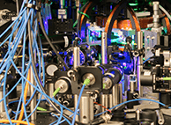
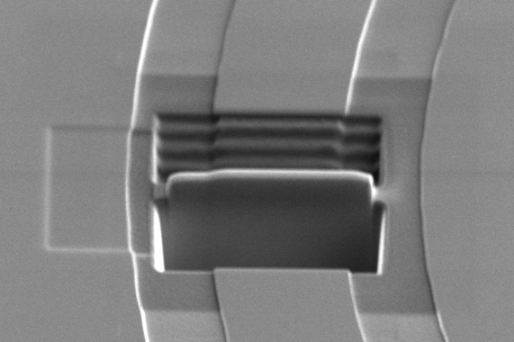
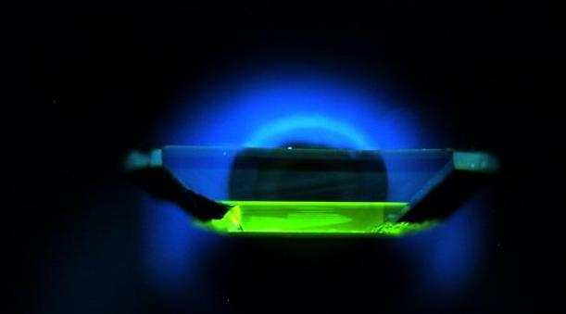
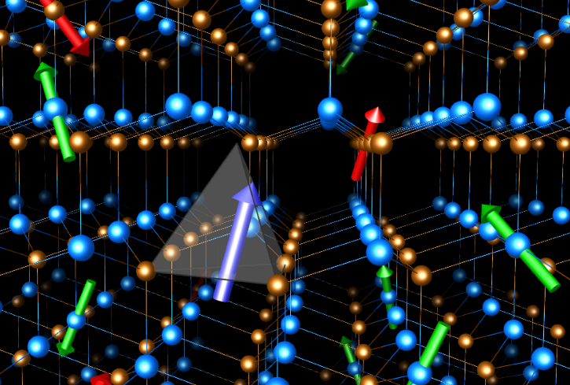
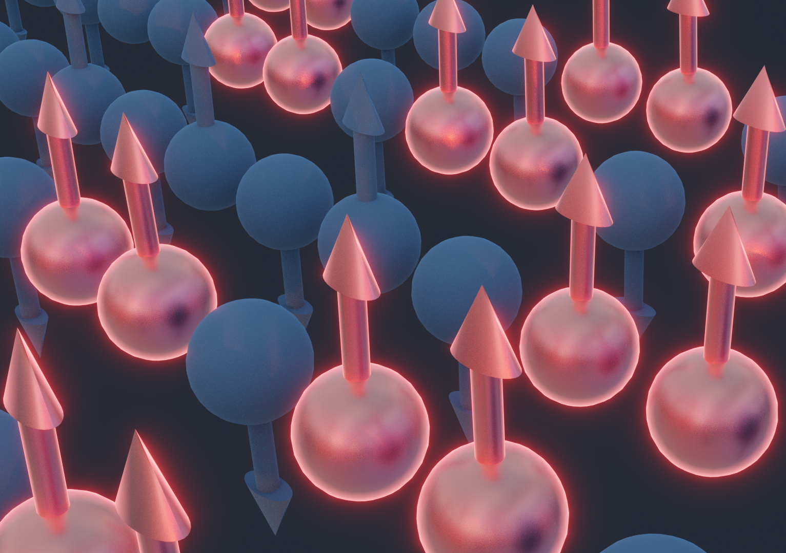
National quantum centers: complementary science, broad impact
Each center tackles major scientific and technological challenges in quantum information science in unique ways using complementary approaches. Together, we advance quantum computing, communication, networking, sensing, and materials in ways that will have impacts in science, energy, security, communication, medicine, finance, and logistics.
Quantum
Systems
Accelerator
Co-designing powerful programmable quantum prototypes with algorithms that maximize performance of hardware in three technologies: neutral atoms, trapped ions, and superconducting circuits
Demonstrating optimal applications in computing, materials science, and fundamental physics
Identifying and mitigating loss channels in superconducting quantum devices
Designing and building prototypes of quantum computers and sensors for scientific discovery
Overcoming the current limits of quantum computing systems to achieve quantum advantage
Developing quantum co-design principles to target software and algorithms, devices, and materials
Developing the technology to store, control and distribute entangled states of matter
Delivering quantum communications links, networks of ultraprecise sensors, and novel simulation test beds
Designing quantum materials, algorithms to enable more precise manipulation of quantum information
Implementing new quantum devices and sensors to characterize topological states, detect dark matter
Notes:
Presenter: Travis
Each center has its own unique portfolio of research that spans the technical areas of materials, computing, communication, and sensing among many others. However, they are working in tandem to advance the broader field of QIS and ultimately the readiness of quantum technology. Here, I would like to highlight some of the technical scope from each center and how they fit together into a broader strategy.
At QSA, we are developing new prototypes of quantum hardware that can be used to test the principles of quantum computing. Todays quantum hardware is noisy and the QSA is developing algorithms for key applications areas that can be tailored toward error-prone environments. This includes calculations for materials science, and fundamental physics.
PICTURE:??
The SQMS is taking a complementary approach by developing new type of quantum computing based on superconducting materials that can also be tailored toward high-energy physics problems. SQMS is using their ability to design new hardware device to mitigate and negate the effects of loss and errors as a means of tuning the performance.
PICTURE: ??
This essential principle of codesign is being developed further at C2QA, where they are integrating advances in hardware, software, and algorithms toward establishing quantum computational advantage. Quantum advantage marks a key milestone in the development of quantum technology.
PICTURE: ??
At Q-NEXT, they tackle the fundamental problem of how quantum information can be reliably, stored, controlled, and distributed over quantum communication links. This is a fundamental step toward the development of quantum networks, which require advances in quantum materials as well as optical technologies.
PICTURE: represents the electronic and coherence properties of spin defects in silicon carbide. Taken from Giulia Galli Group at UChicago.
Finally, within QSC, we are developing materials for efficient and scalable quantum technologies that are naturally resilient to errors. By advancing the synthesis and fabrication of so-called quantum materials, we will be able to support the long-term development of quantum computation and quantum sensing applications.
PICTURE: Spin chains in a quantum system undergo a collective twisting motion as the result of quasiparticles clustering together.

Slide 4
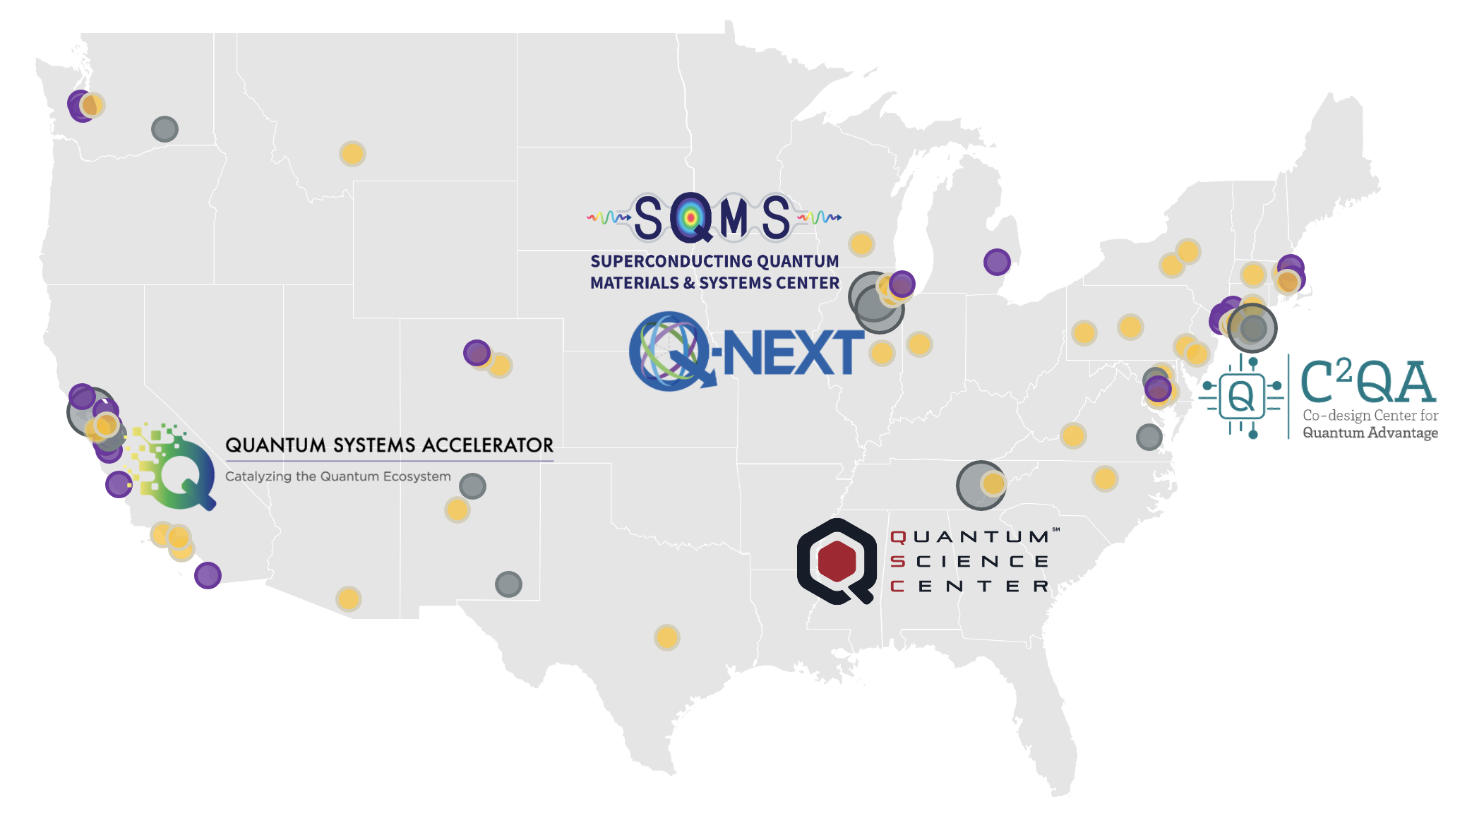
Partnerships across academia, industry and national labs
The centers bring together multidisciplinary collaborations of more than 1,200 experts, including 600 students and postdocs, across over 80 academic, industry and national science institutions in more than 22 states and DC.
Through institutional partnerships,
the centers unite unique capabilities, expertise and facilities.
Solving key challenges in QIS thanks to the unique strength of multi-institutional and multidisciplinary collaborations
Leveraging DOE user facilities for advanced materials analysis and device fabrication
Developing and deploying new quantum facilities, foundries and testbeds for the Centers as well as the national ecosystem
Training a new and diverse quantum workforce
Technology transfer – rapid cycle from discovery to commercialization
Developing national standards and roadmaps for quantum technology that incorporate processes, metrology and testing data
Lead DOE national laboratory
National laboratory or science institution
Technology company
University
Notes:
Anna

Slide 5
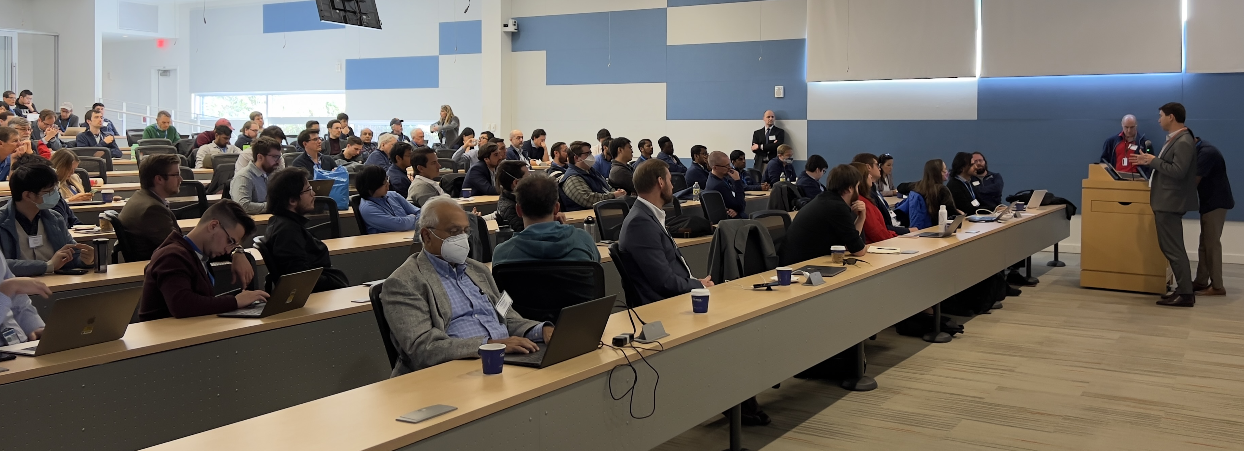
USQIS Summer School – Curriculum
Morning Lectures
Introduction to Quantum Computing, Superconductivity, Cryogenics, Superconducting Circuits, Radio Frequency Superconductivity, Cavity QED, Material Science for QIS, State of the Art SC Commercial QPUs, Quantum Sensing..
Afternoon Tracks
Track 1: Qubits and Cryogenics Setups and measurements
SQMS Quantum Lab 1 and Quantum Garage
Track 2: Qubits Fabrication and Material Characterization
SQMS/APSTD Material Science Labs and Quantum Garage
Track 3: Qubits Simulation, Quantum Software, Algorithms, Applications
Lecture Hall
Strong Focus on Hands-on, experimental training using cutting edge tools and large-scale facilities

Slide 6
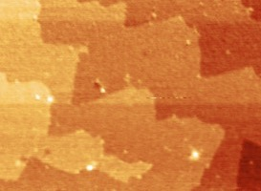
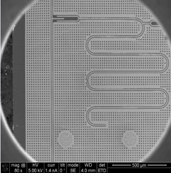
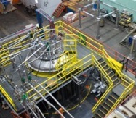
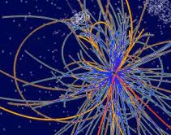
First school focused on superconducting cavities and qubits …and you learnt to study/measure the best ones in the world!
Materials
High-coherence devices
Systems integration
New platforms for quantum computing & sensing
Quantum advantage
Developing a full understanding of sources of decoherence
Demonstrating devices with systematically higher coherence
Integrating devices into quantum processors
Deploying quantum computing and sensing facilities
Demonstrating quantum computing and sensing advantage
Fundamental science, to engineering, to applications spanning from basic science to societal impact

Slide 7
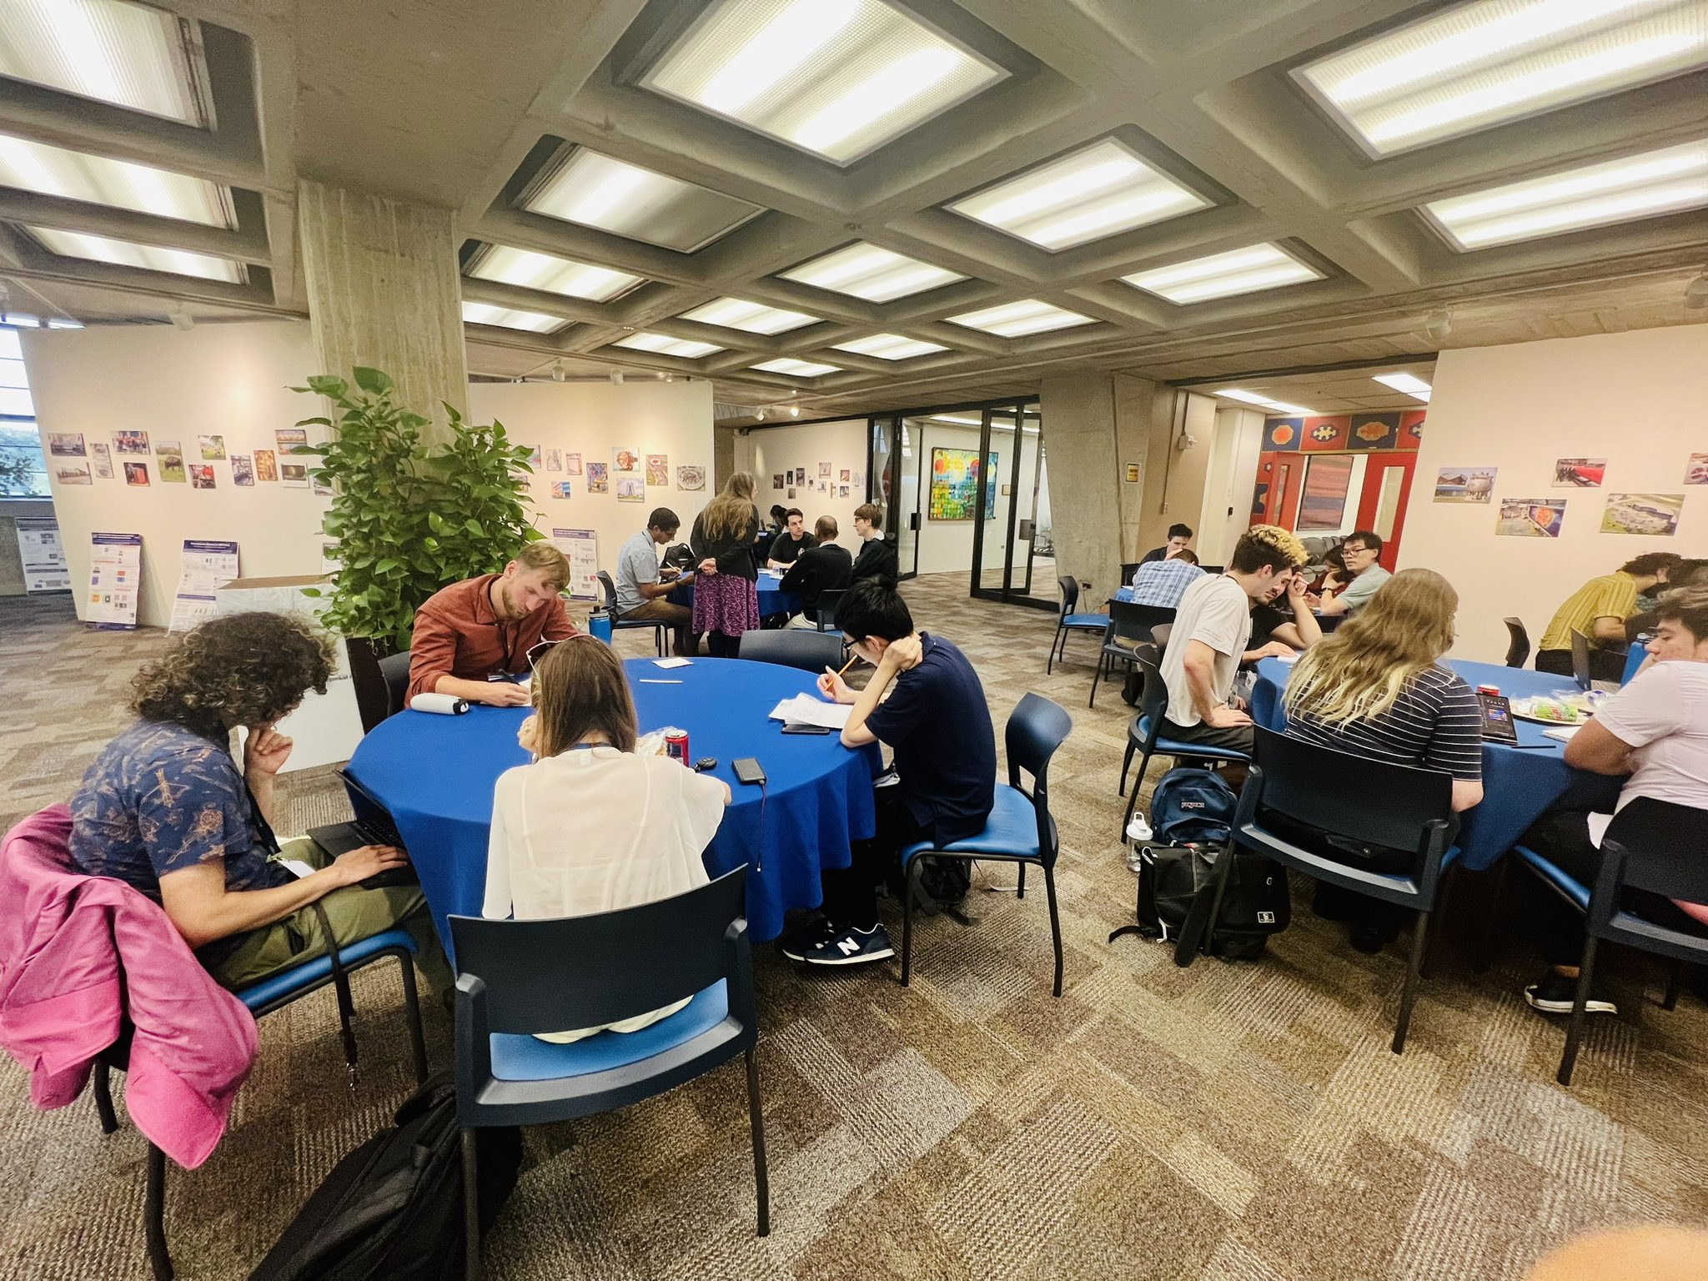
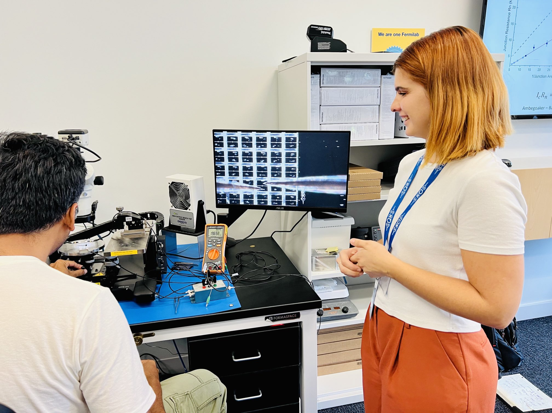
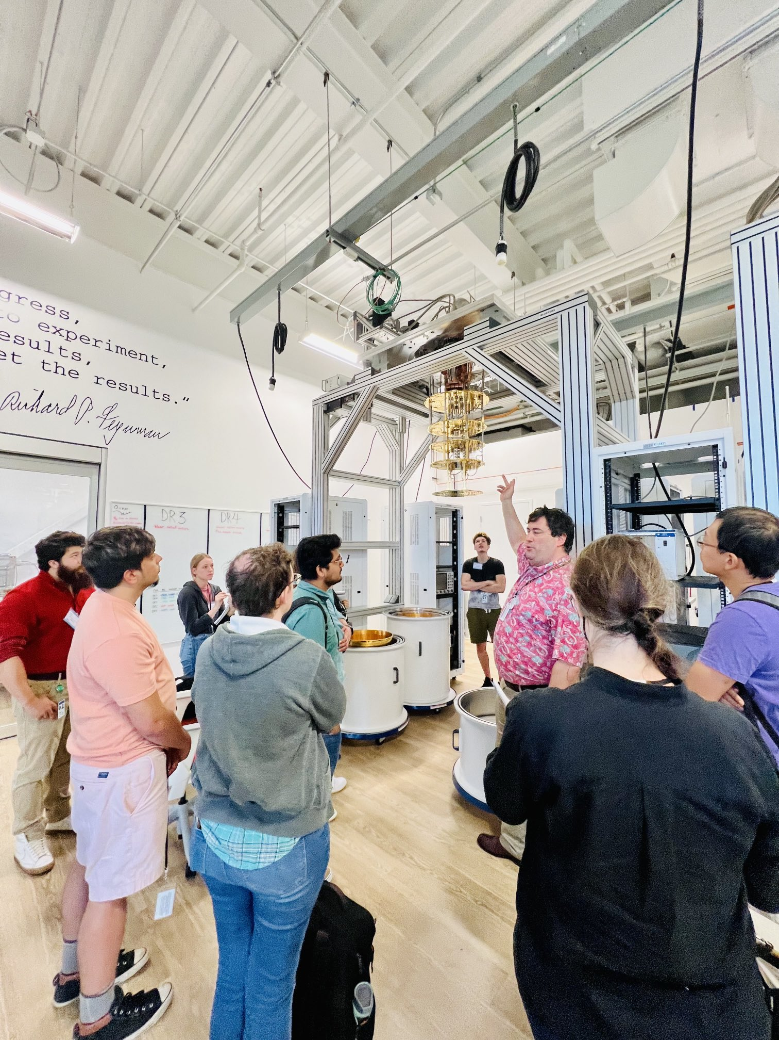
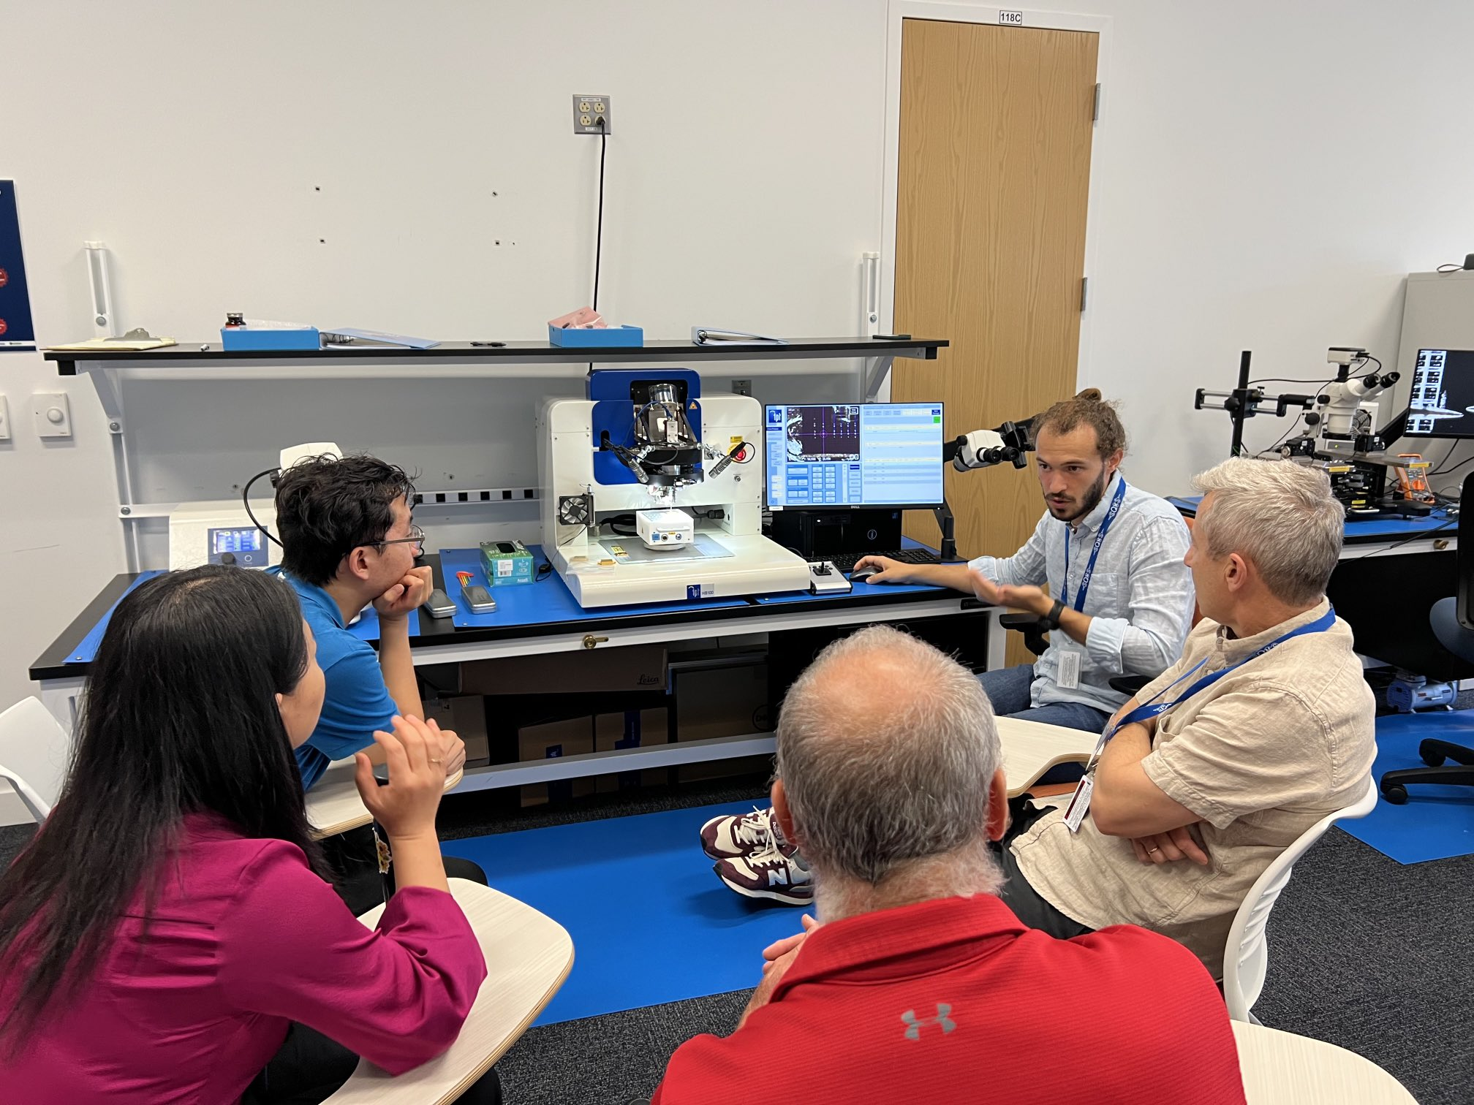
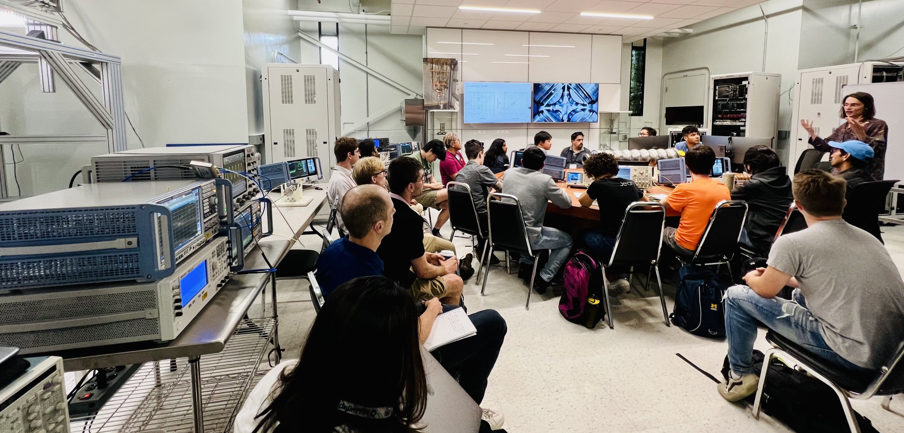
USQIS SCHOOL 2023

Slide 8
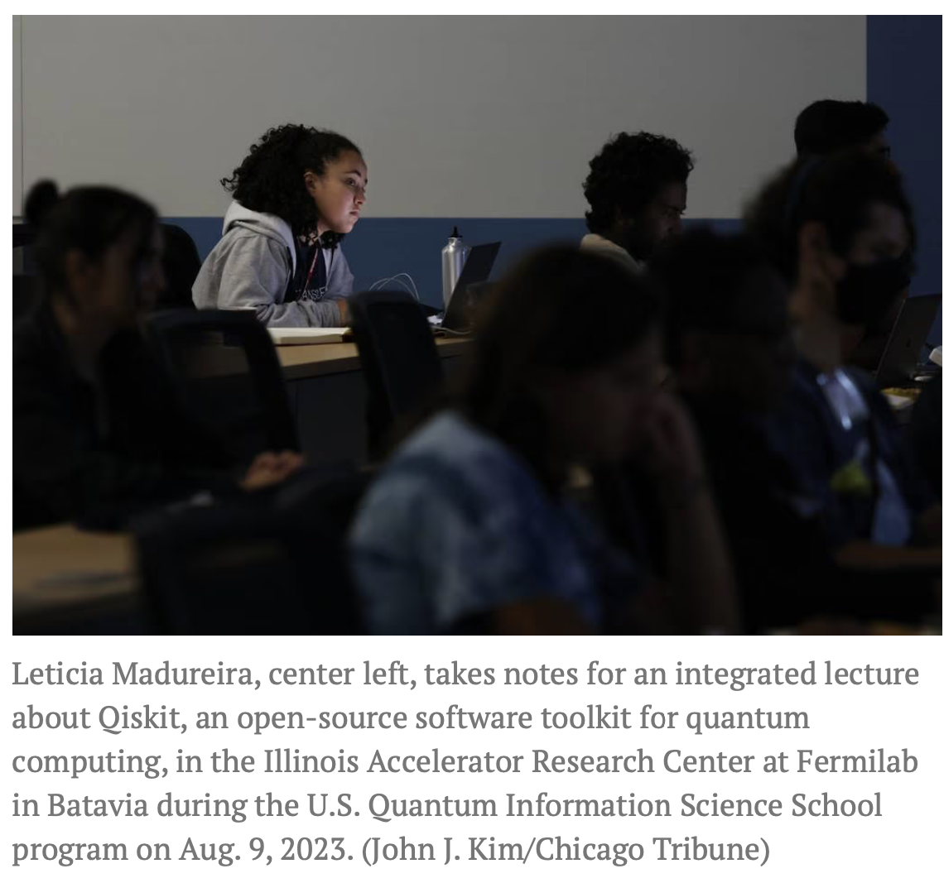
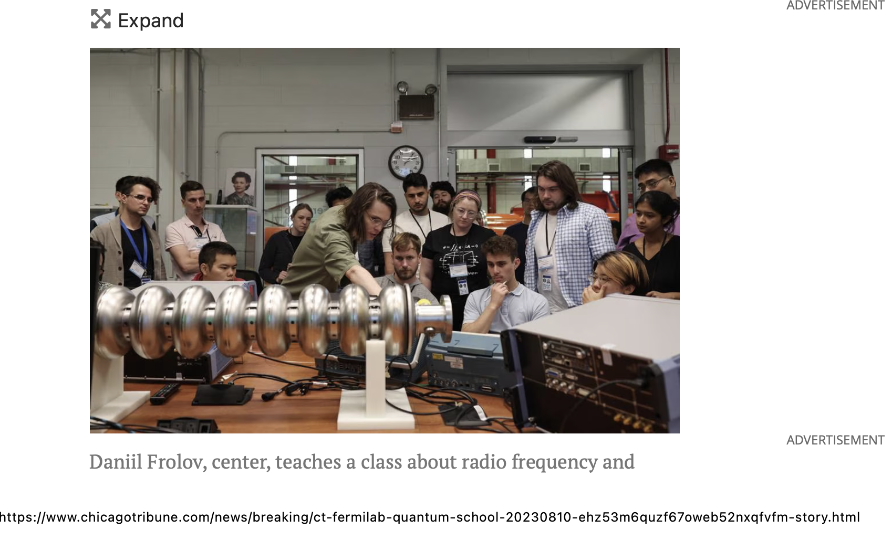

Slide 9
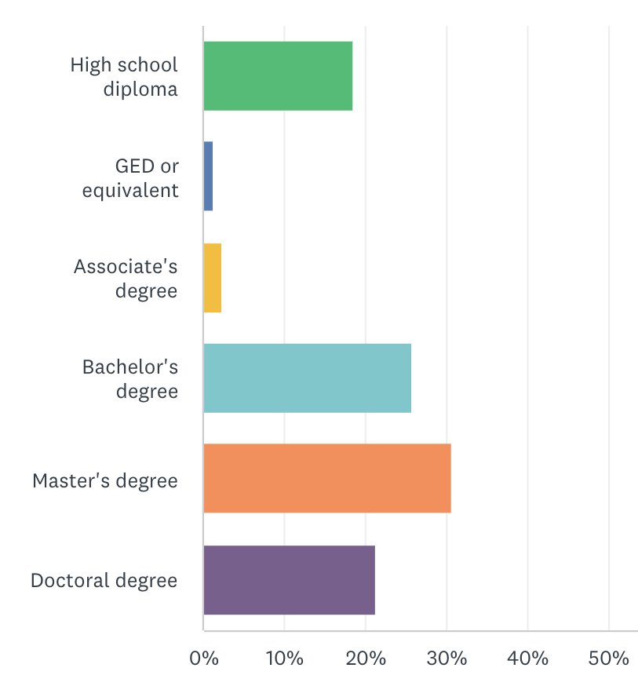
USQIS Summer School - Participants
Students
~150 students accepted
Attendees from > 72 different institutions (national labs, universities, industry); 5 international institutions
Bachelor, master/Ph.D. students, postdocs, professors, scientists, engineers and industry employees; very diverse group
Instructors
~50 instructors from all 5 Quantum Centers, from industry, academia, DOE labs, NIST, NASA…
> 300 applicants

Slide 10
exit quiz
score average
entry quiz
score average
49%
64%

Slide 11
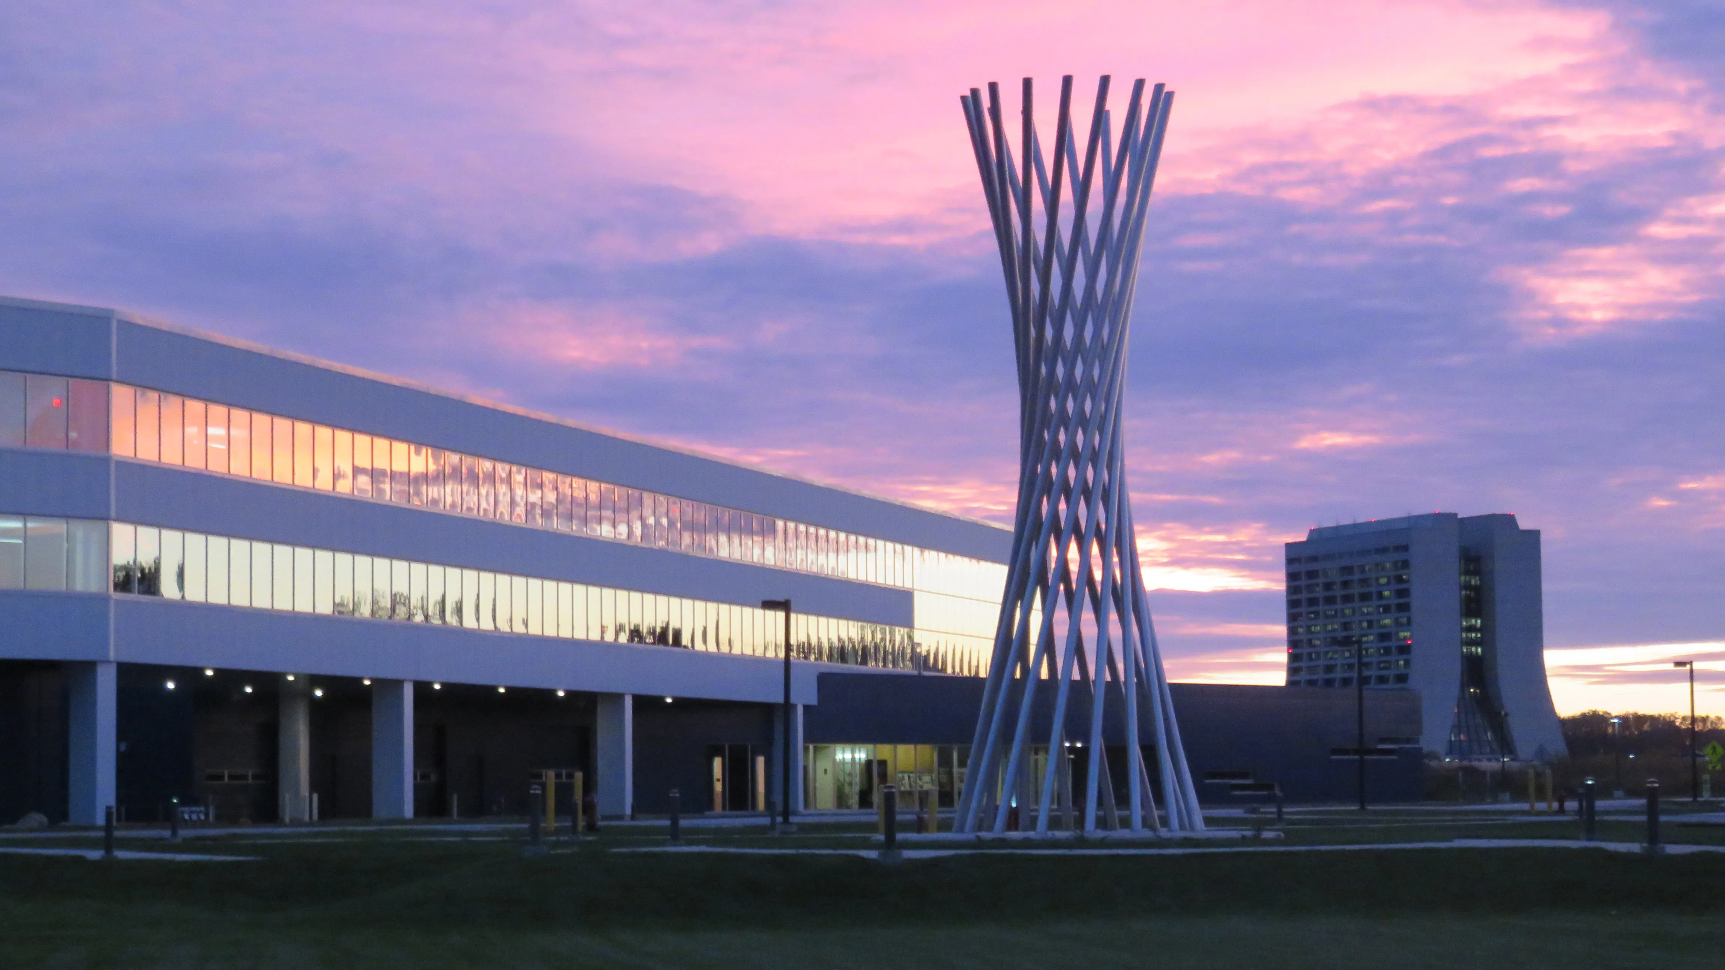
Top Students Awards

Slide 12
USQIS Summer School, Second Edition….
Notes:
Structure based roughly on the Trimester interstitial slides.

Slide 13
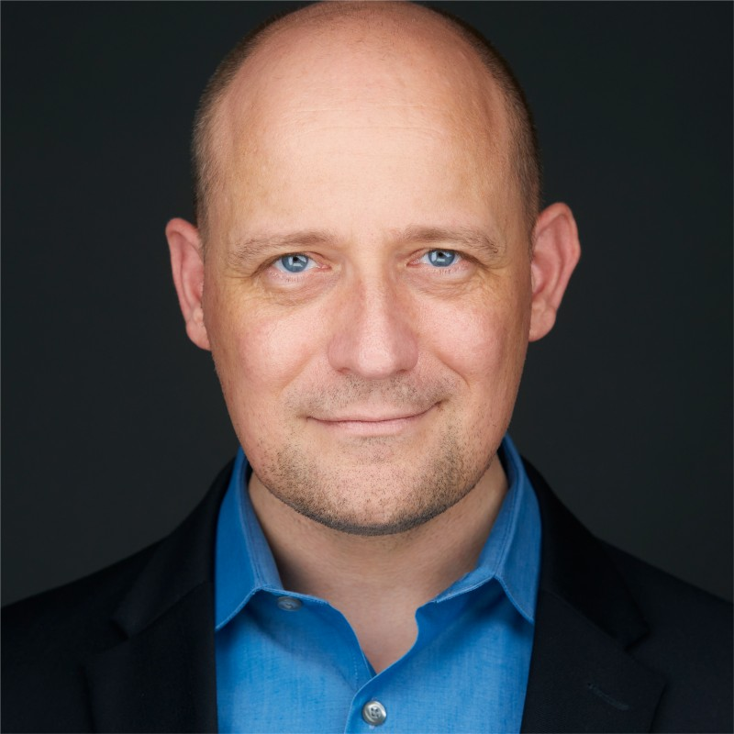
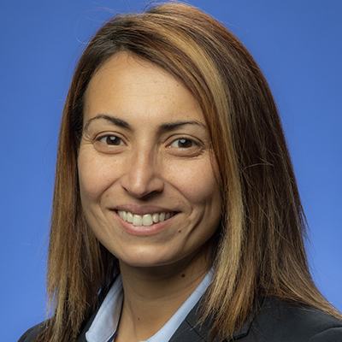
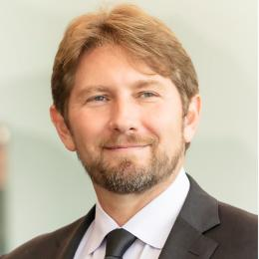
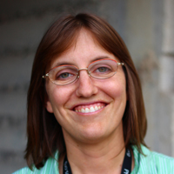
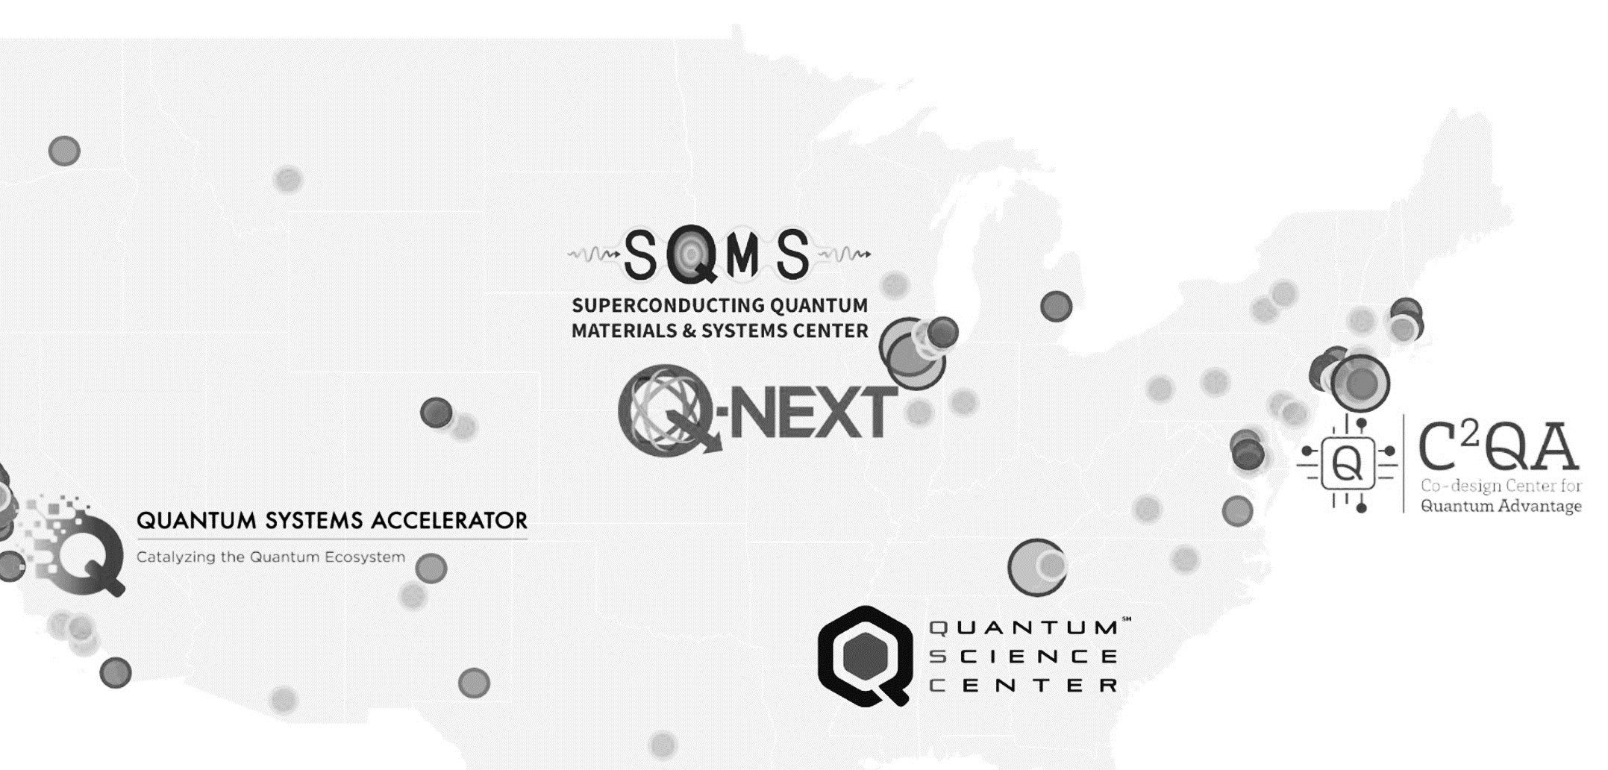
2024
QSC to host USQIS 2024!
Stay tuned for updates

Slide 14
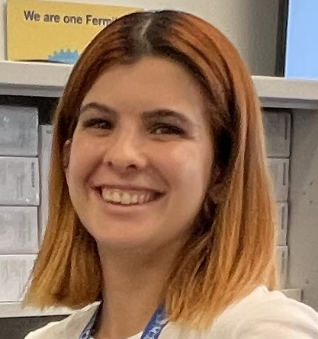
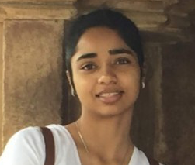
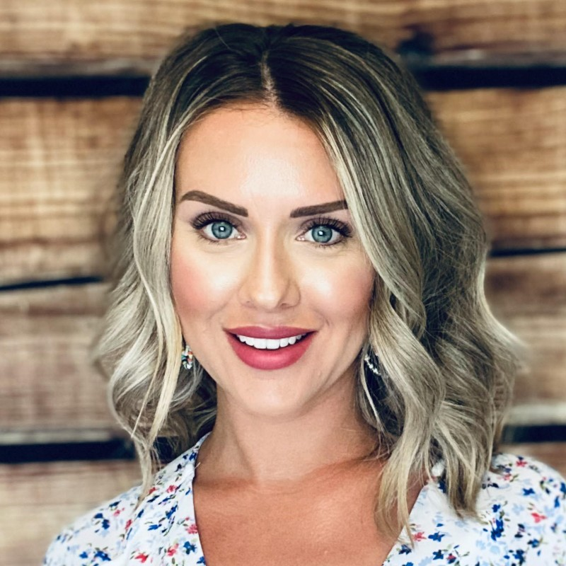
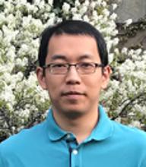
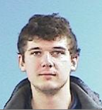
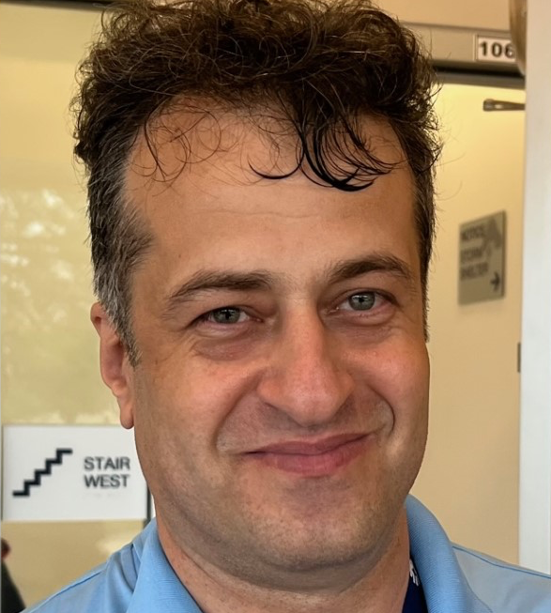
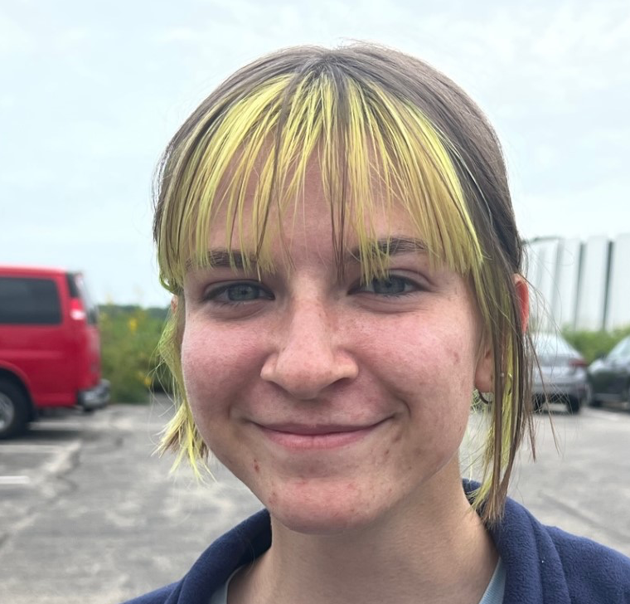
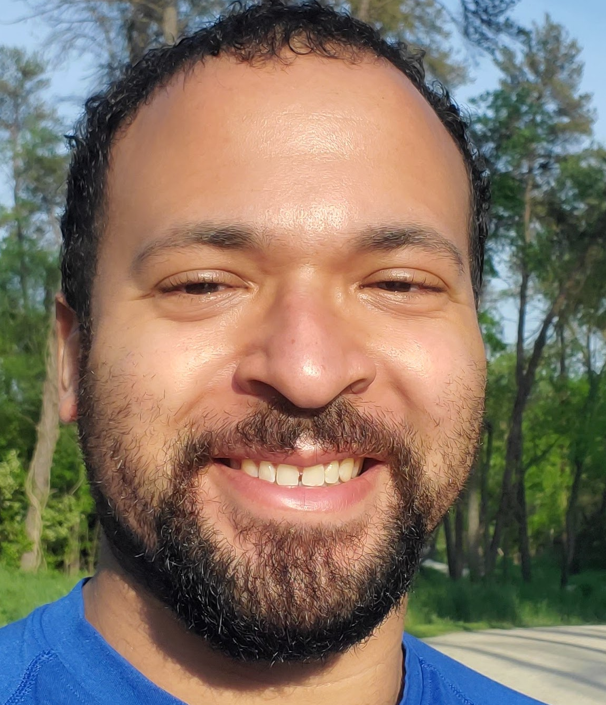
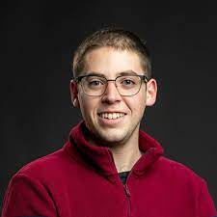
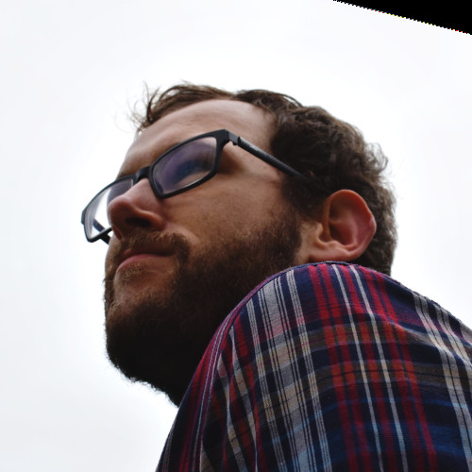
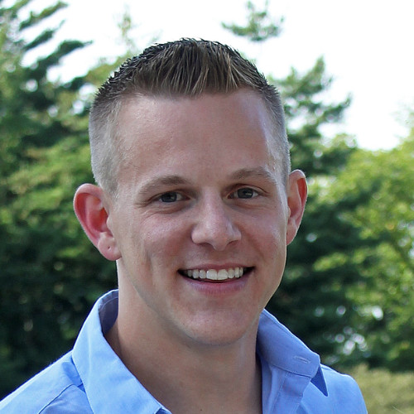
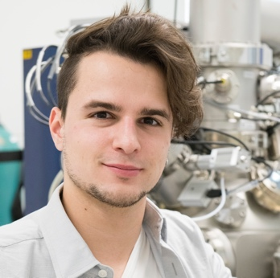
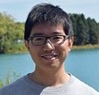
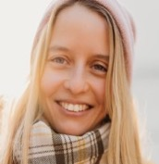
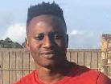
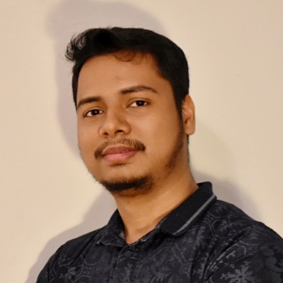
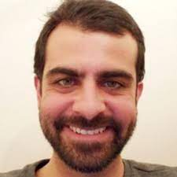
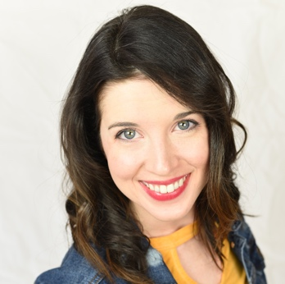
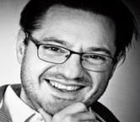
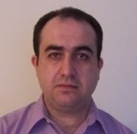
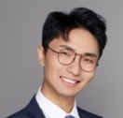
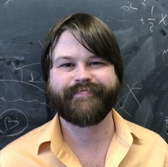
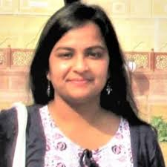
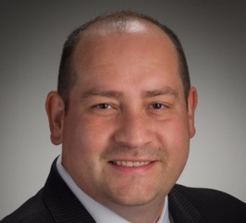
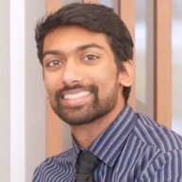
Thank you to the many SQMS members who made this possible!

Slide 15
Thanks to all instructors and special thanks to the team who made USQIS possible!
Thanks to FNAL
and DOE for the Support!

Slide 16
QIS Career Fair
Quantum Information Science (QIS) Career Fair (September 13, 2023)
https://www.bnl.gov/nqisrccareerfair/
Speakers and panelists from numerous areas of QIS
Grad students, postdocs, and senior researchers will talk about their educational paths

Slide 17
Opportunities in QIS
C²QA:
Postdocs: https://www.bnl.gov/quantumcenter/openings.php.
C²QA Project Coordinator: https://bit.ly/3KDmDHy
QSA: https://quantumsystemsaccelerator.org/
Active job postings https://osqs.quantumsystemsaccelerator.org/quantum-jobs
QSC:
https://www.physics.purdue.edu/leogroup/positions.html
https://jobs.ornl.gov/job/Oak-Ridge-Postdoctoral-Research-Associate-Materials-Theory-TN-37909/1046251800/
Q-NEXT: https://q-next.org/opportunities/
SQMS: https://sqmscenter.fnal.gov/
LinkedIN: https://www.linkedin.com/company/sqms-center/
Twitter: twitter.com/sqmscenter
Contact us: Anna Grassellino annag@fnal.gov , Jens Koch jens-Koch@northwestern.edu , Silvia Zorzetti zorzetti@fnal.gov

Slide 18
Follow us!
@SQMSCenter
Twitter, Instagram, LinkedIn, Facebook
@QuantumSciCtr
Twitter
@ChicagoQuantum
Twitter, Instagram

Slide 19
Send us your photos from the week!
sqmscenter@fnal.gov
We will follow up with a survey for feedback and for staying in touch!

Slide 20
Thank you
Notes:
Presenter: Rick
Open the floor for questions.

