Slide 1
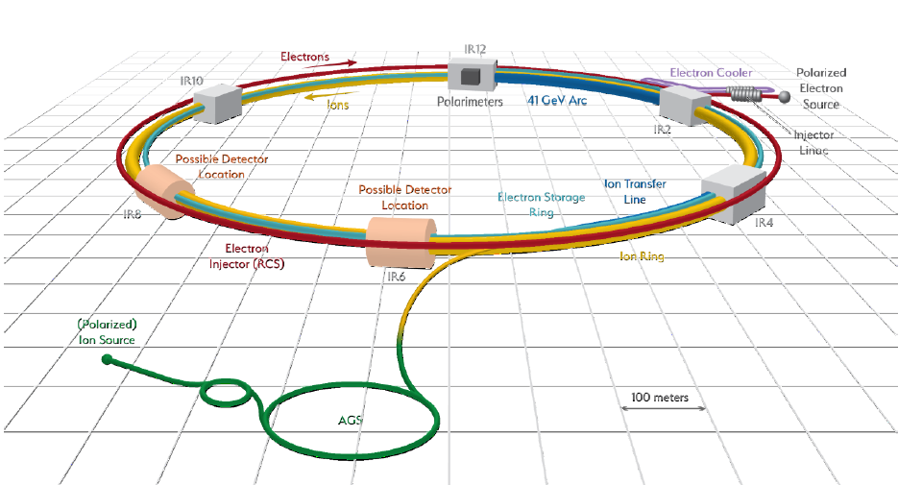
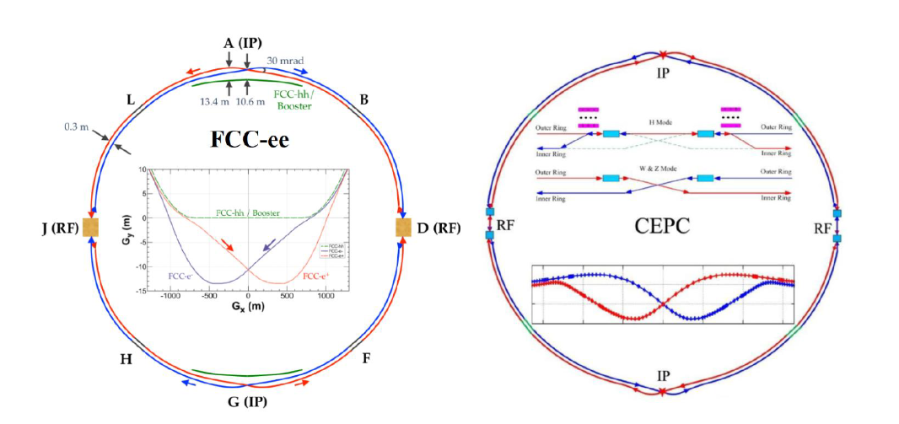
Overview of SRF cavities for coming & future circular lepton and electron-ion colliders
EIC
Jiquan Guo, JLab

Slide 2
Acknowledgements
Contents from large groups of colleagues from different teams
FCC-ee team especially F. Peauger
CEPC team especially J. Gao and J. Zhai
EIC team from both BNL and JLab
All the systems development evolving quickly

Slide 3
Outline
Introduction
FCC-ee SRF systems
CEPC SRF systems
EIC SRF systems
Summary

Slide 4
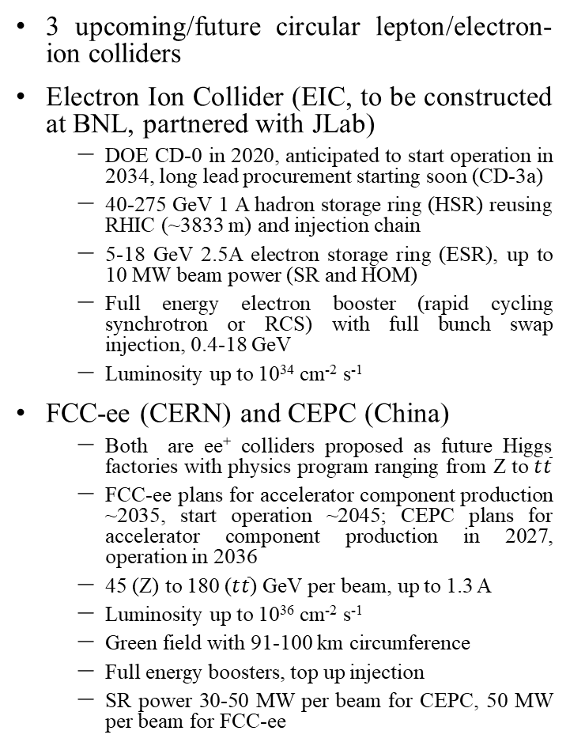
Introduction
3 upcoming/future circular lepton/electron-ion colliders
Electron Ion Collider (EIC, to be constructed at BNL, partnered with JLab)
  DOE CD-0 in 2020, anticipated to start operation in 2034, long lead procurement starting soon (CD-3a)
  40-275 GeV 1 A hadron storage ring (HSR) reusing RHIC (~3833 m) and injection chain
  5-18 GeV 2.5A electron storage ring (ESR), up to 10 MW beam power (SR and HOM)
  Full energy electron booster (rapid cycling synchrotron or RCS) with full bunch swap injection, 0.4-18 GeV
  Luminosity up to 10³⁴ cm⁻² s⁻¹
FCC-ee (CERN) and CEPC (China)
  Both are ee⁺ colliders proposed as future Higgs factories with physics program ranging from Z to $t\overline{t}$
  FCC-ee plans for accelerator component production ~2035, start operation ~2045; CEPC plans for accelerator component production in 2027, operation in 2036
  45 (Z) to 180 ($t\overline{t}$) GeV per beam, up to 1.3 A
  Luminosity up to 10³⁶ cm⁻² s⁻¹
  Green field with 91-100 km circumference
  Full energy boosters, top up injection
  SR power 30-50 MW per beam for CEPC, 50 MW per beam for FCC-ee

Slide 5
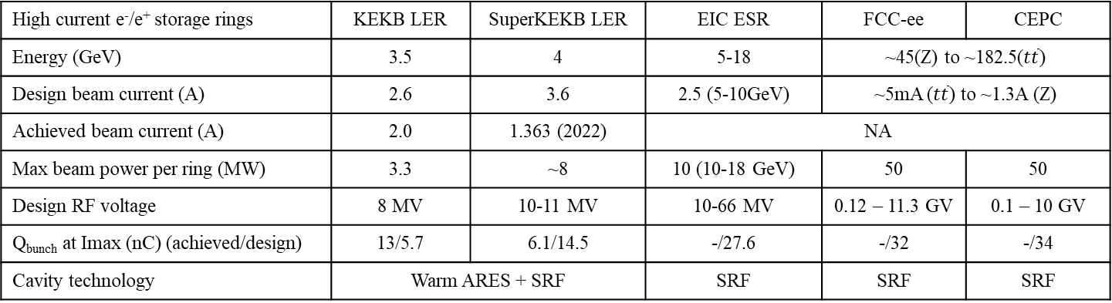
Introduction: Challenges for the SRF Systems of the Future Colliders
For all the 3 upcoming/future colliders’ SRF systems, the lepton storage rings’ main SRF systems will replenish the synchrotron radiation/HOM power and energy loss of the amp class beam
The high luminosity will require
  high beam power (10-50 MW per ring) and RF power, requiring high power FPC and RF sources
  high beam current/high bunch charge, associated with strong wakefield and stringent total impedance budget, especially with large number of cavities; transient beamloading could also be an issue
  EIC ESR low energy operation comparable to SuperKEKB LER, high energy operation similar to HER
Variable beam energy and system voltage/current, large range of optimum coupling
  Higgs factories: factor of ~100 swing in voltage and ~250 in current, impossible to use the same cavities
  FCC-ee: staged SRF installation as energy/voltage goes up
  CEPC: bypass lines with different types of SRF cavities
  EIC: variable Qext or reversed phase operation for factor of ~10 swing in voltage/current
High current e⁻/e⁺ storage rings | KEKB LER | SuperKEKB LER | EIC ESR | FCC-ee | CEPC
Energy (GeV) | 3.5 | 4 | 5-18 | ~45(Z) to ~182.5($t\overline{t}$)
Design beam current (A) | 2.6 | 3.6 | 2.5 (5-10GeV) | ~5mA ($t\overline{t}$) to ~1.3A (Z)
Achieved beam current (A) | 2.0 | 1.363 (2022) | NA
Max beam power per ring (MW) | 3.3 | ~8 | 10 (10-18 GeV) | 50 | 50
Design RF voltage | 8 MV | 10-11 MV | 10-66 MV | 0.12 – 11.3 GV | 0.1 – 10 GV
Q_{bunch} at Imax (nC) (achieved/design) | 13/5.7 | 6.1/14.5 | -/27.6 | -/32 | -/34
Cavity technology | Warm ARES + SRF |  | SRF | SRF | SRF

Slide 6
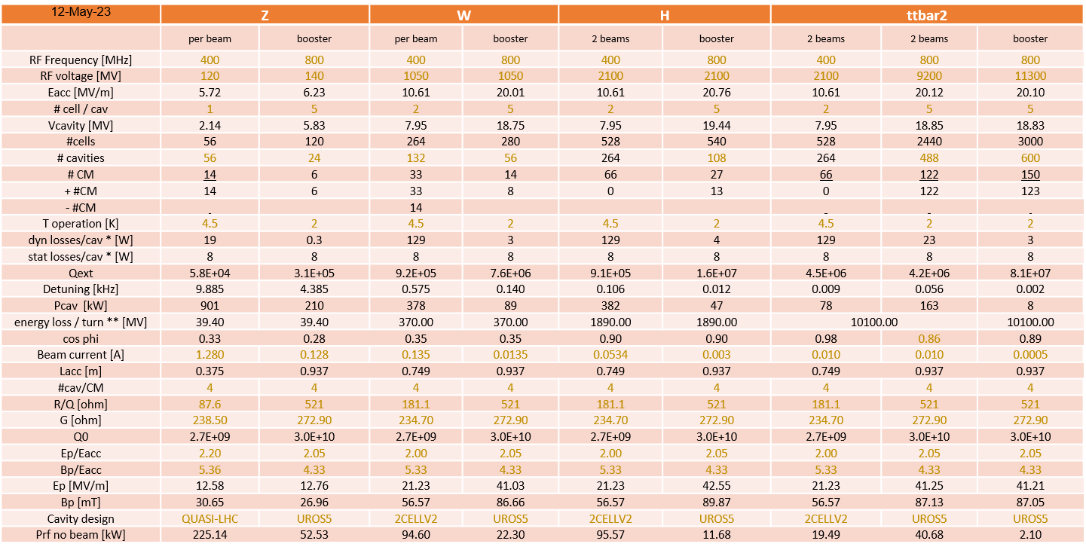
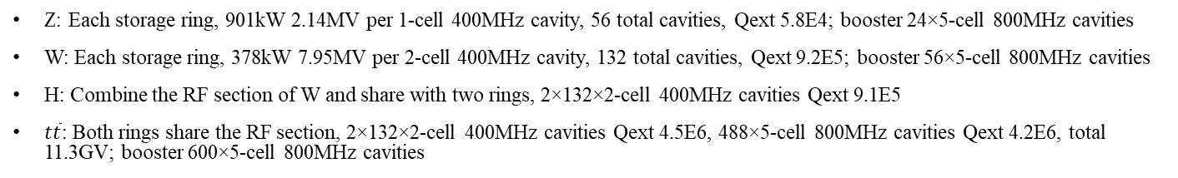
FCC-ee: SRF system parameters
Z: Each storage ring, 901kW 2.14MV per 1-cell 400MHz cavity, 56 total cavities, Qext 5.8E4; booster 24×5-cell 800MHz cavities
W: Each storage ring, 378kW 7.95MV per 2-cell 400MHz cavity, 132 total cavities, Qext 9.2E5; booster 56×5-cell 800MHz cavities
H: Combine the RF section of W and share with two rings, 2×132×2-cell 400MHz cavities Qext 9.1E5
$t\overline{t}$: Both rings share the RF section, 2×132×2-cell 400MHz cavities Qext 4.5E6, 488×5-cell 800MHz cavities Qext 4.2E6, total 11.3GV; booster 600×5-cell 800MHz cavities

Slide 7
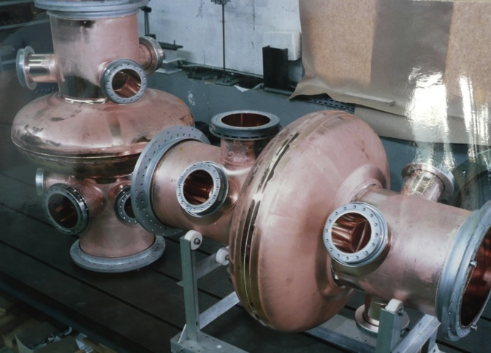
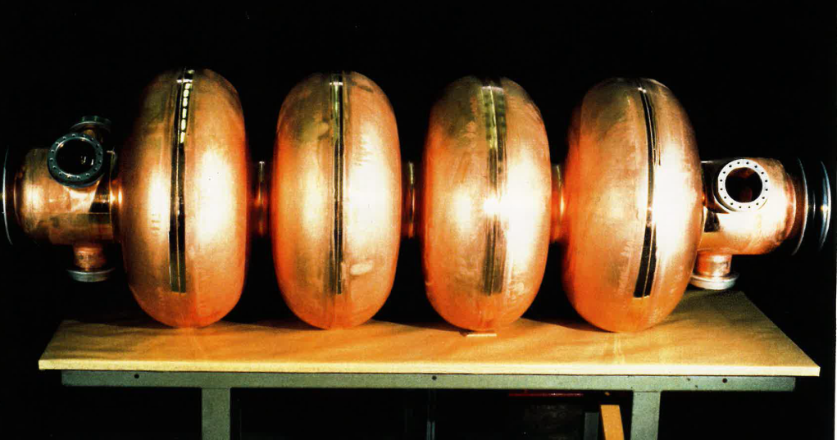
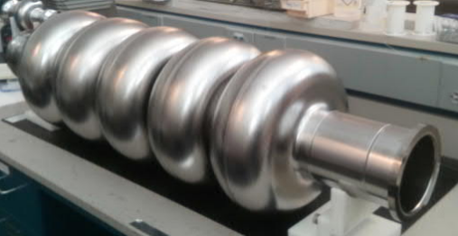

FCC-ee: SRF Cavity Baseline
Z
W, H
$t\overline{t}$,
booster
LHC
LEP
FCC 800 MHz (JLAB)
400 MHz 1-cell cavities
Nb/Cu, 4.5 K
800 MHz 5-cell cavities
Bulk Nb, 2 K
400 MHz 2-cell cavities
Nb/Cu, 4.5 K
Low frequency (400 MHz), low R/Q cavity shape optimized to minimize the higher order modes (HOM) population.
Powered by a 1 MW RF coupler and high efficiency klystron.
Very high RF voltage achieved by multicell cavities.
Higher frequency cavities to reach high gradient and reduce overall footprint.
Significant RF power (200 kW) per cavity limiting the frequency to the second harmonic (800 MHz)
Moderate accelerating gradient and HOM damping requirements.
500 kW RF per cavity allowing the re-use of the 1 MW klystrons already installed for the Z machine.

Slide 8
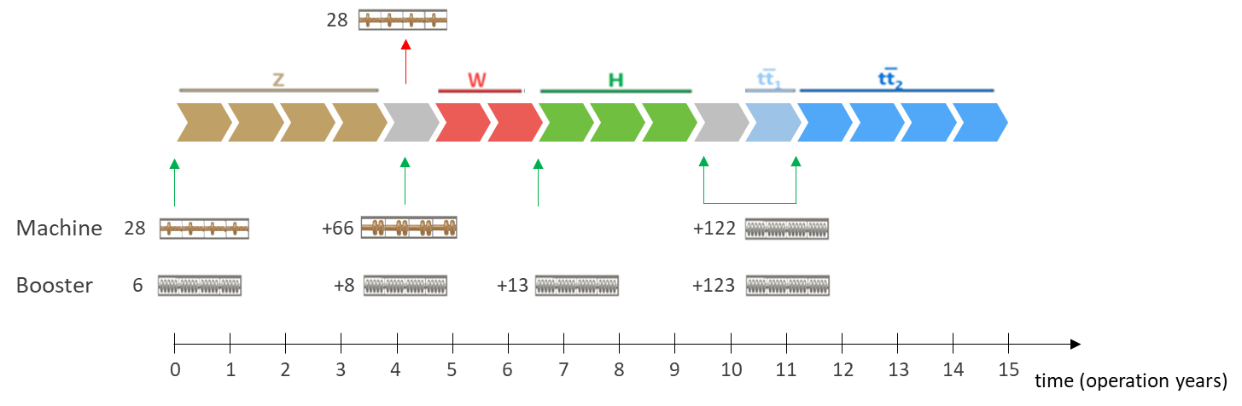
FCC-ee: RF installation sequence baseline
Start by running the machine four years at the Z-pole with 14 cryomodules (CM) per beam for the collider and 6 CM for the booster
Removal of the single cell cavities and installation 66 + 8 CM needed for the W RF system. Preparation and pre-testing of the RF stations are important to respect the planning.
The evolution from W to H requires 13 additional CM for the booster ring as well as the realignment of the beam on a common axis.
Massive installation of a total of ~1000 bulk Nb cavities during a long shutdown
Alternative scenario with bypass lines allowing the start at the H production energy under study

Slide 9
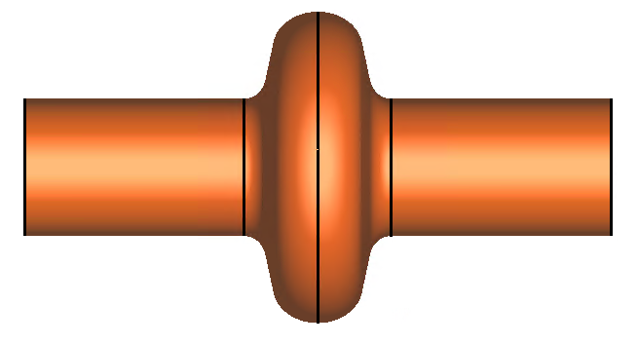
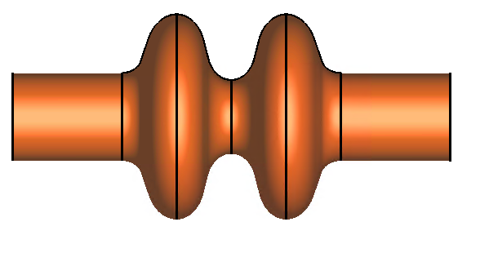
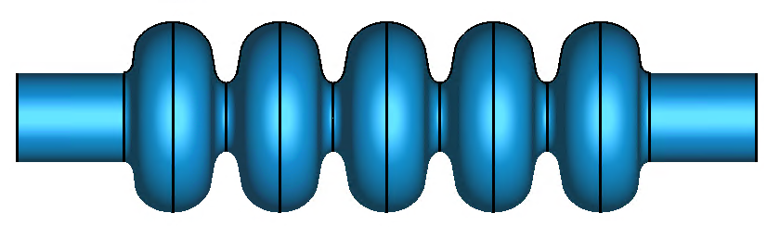
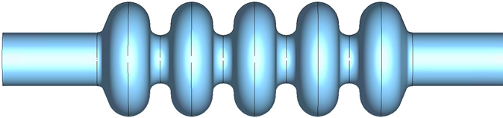
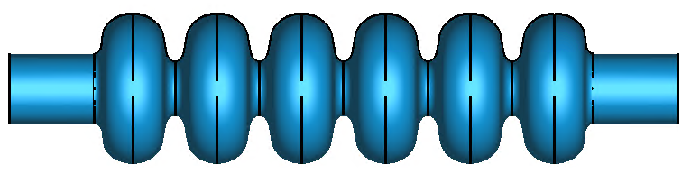
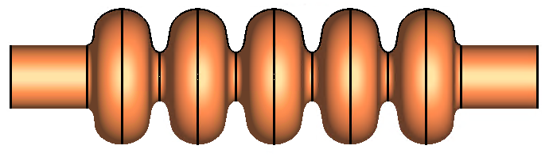
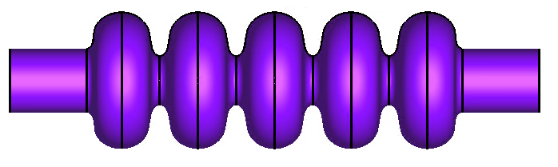
FCC-ee: RF installation sequence options
Z
W
H
ttb
booster
Comments
Solid scheme with good margin for reliable operation
Clear R&D paths identified (seamless copper cavities, HiPIMS coating, High Q0 bulk Nb cavities)
see Oleg, Anne-Marie, Alice, Shahnam, Joanna, Carlota, Akira, Sam, Vittorio’s talks
Baseline
removed
Higgs first
Less optimized for the planning and workload
(~100 additional cryomodules to install or remove)
removed
removed
Higgs “only”
Alternative 800 MHz cavity specially designed for high current operation - see Sosoho’s talk
Z with 2-cell
Very promising to optimize the cost and schedule
The beam current at Z might be slightly reduced
Partially removed/re-installed
Z with 2-cell
ttbar with 6-cell
6-cell (or more) at 800 MHz allowing a reduction of the number of cavities - see Shahnam’s talk
Partially removed/re-installed
6-cell
Full thin films
Very ambitious, allows for material cost savings
Ideal to push the Nb/Cu technology towards the high gradient world
Full 4.5 K with A15 (Nb3Sn) materials
Extremely ambitious (?) for very high operational savings. RF tuning will be a challenge.

Slide 10
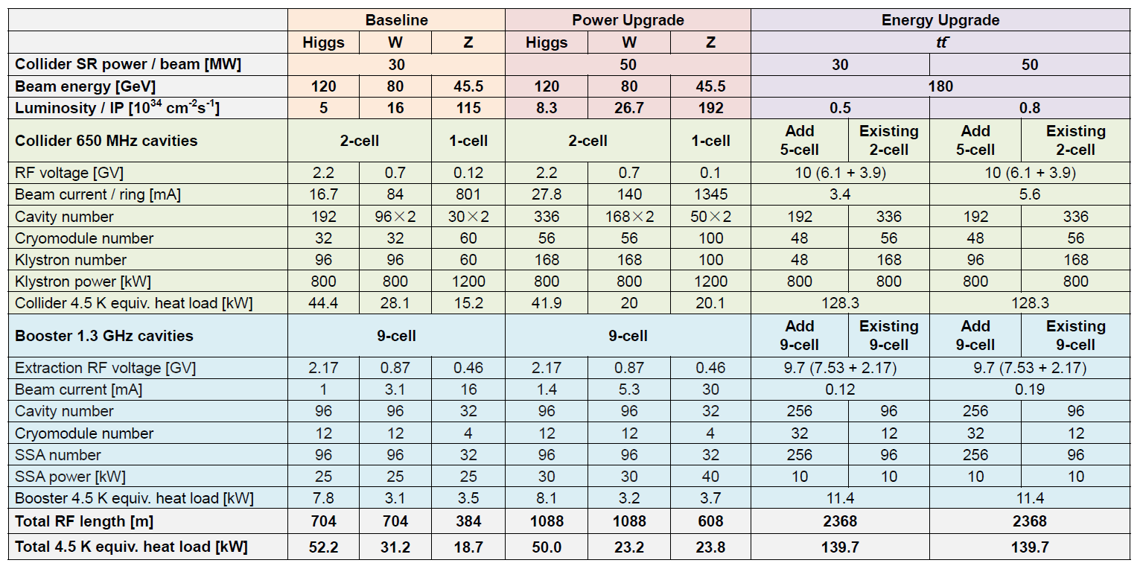
CEPC: SRF parameters for different operation scenarios
Beam parameters similar to FCC-ee
Beam power upgradable from 30MW to 50MW per beam
Multiple bypass lines to switch between different operating energy
1/2/5-cell 650 MHz cavities in the storage rings, 9-cell 1.3GHz cavities in the boosters

Slide 11
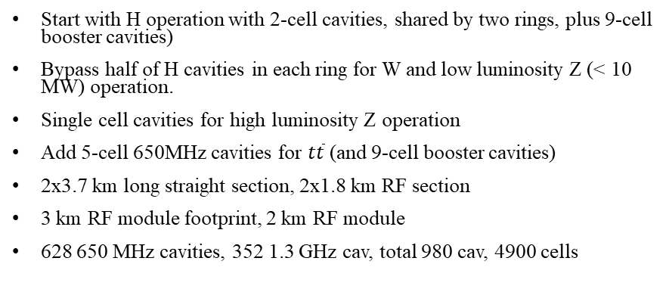
CEPC: RF Layout
Collider RF Staging and Bypass Scheme
Start with H operation with 2-cell cavities, shared by two rings, plus 9-cell booster cavities)
Bypass half of H cavities in each ring for W and low luminosity Z (< 10 MW) operation.
Single cell cavities for high luminosity Z operation
Add 5-cell 650MHz cavities for $t\overline{t}$ (and 9-cell booster cavities)
2x3.7 km long straight section, 2x1.8 km RF section
3 km RF module footprint, 2 km RF module
628 650 MHz cavities, 352 1.3 GHz cav, total 980 cav, 4900 cells

Slide 12
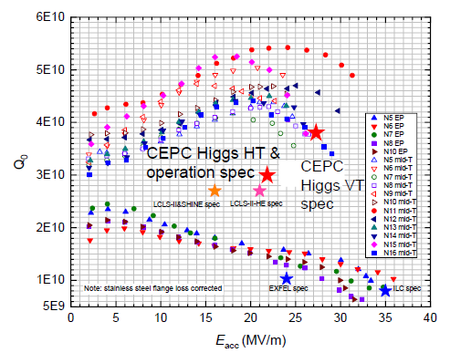
CEPC: 650MHz 2-cell and 1.3GHz 9-cell cavities R&D
650 MHz 2-cell BCP
1.3 GHz 9-cell EP / mid-T
650 MHz 1-cell EP / mid-T bake
650 MHz 2-cell cavity: 3.8E10 @ 25 MV/m, > 31MV/m (achieved in 1-cell) . Six cavities in the module.
1.3 GHz 9-cell cavity: 3.6E10 @ 21.8 MV/m, > 27MV/m (increase gradient). 16 cavities in two modules

Slide 13
CEPC: 650MHz 2-cell and 1.3GHz 9-cell Cryomodule
650MHz: 6×2-cell cavities per cryomodule
Two coax HOM damper per cavity (~1kW/each) plus warm BLAs (~5kW each) outside vacuum vessel
1.3GHz: 8×9-cell cavities per cryomodule, very similar to TESLA cryomodules, without superconducting magnet and cold BPM in the module
100K low power BLAs between cavities

Slide 14
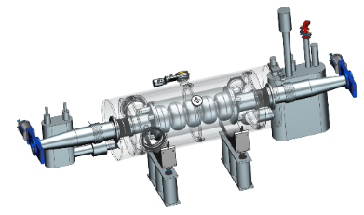
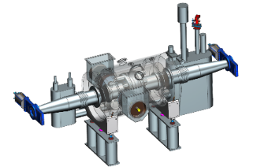
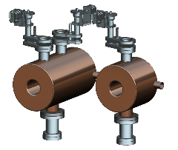
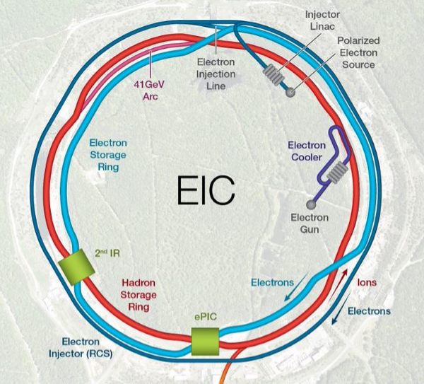
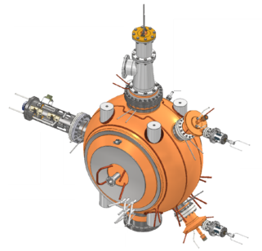
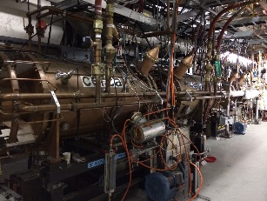
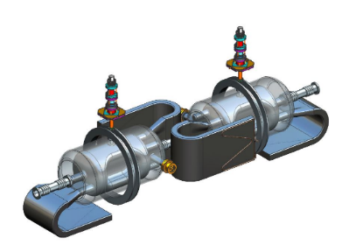
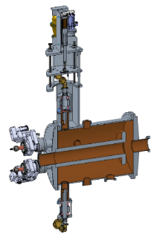
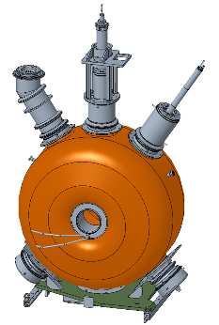
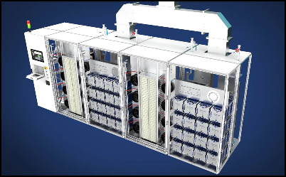
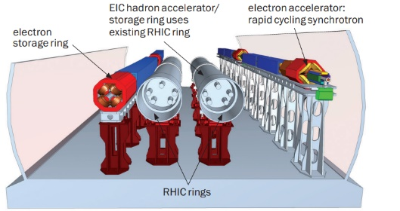
EIC: RF systems
Hadron Cooling - 591 MHz acceleration cavity
10 CMs, Electron Cooler, IR02
Hadron Storage Ring
591 MHz bunch compression cavity
3 to 5 CMs, IR10
RCS injection harmonic RF kicker, IR12
6 ea 197 QWR, 3 ea 591 SC Cavities (Not shown)
3 CMs, ERL Injector / Linac, IR02
1773 MHz 3rd Harmonic (4) Cavities (Not shown)
1 CM, Electron Cooler, IR02
Electron Storage Ring
591 MHz Single Cell Cavity Cryomodule
17 CMs, IR10
RCS – 148MHz and 296MHz bunch merger cavities IR04
Hadron Storage Ring – 24.6 MHz acceleration cavity IR04
Crab Cavities (per IR) | HSR (Cavities/CMs) | ESR (Cavities/CMs)
197 MHz | 8/4 | –
394 MHz | 4/4 | 2/2
Rapid Cycling Synchrotron
591 MHz Five-Cell Acceleration Cavity Cryomodule
3 CMs, IR10
Both rings –
Crab cavities, IR06
Hadron Storage Ring – 49.2 MHz and 98.5 MHz bunch splitter cavities IR04
Hadron Storage Ring - 197 MHz bunch compression cavity IR04
RF power and distribution
400kW×34 new SSAs for ESR 591MHz cavities, various power level for other cavities

Slide 15
EIC: RF Cavity Count
RF System | Sub System Functions | Freq [MHz] | Type | Location | # Cavities
Electron Storage Ring | Accel / Store | 591 | SRF, 1-cell | IR-10 | 17
Rapid Cycling Synchrotron | Accel / Store | 591 | SRF, 5-cell | IR-10 | 3
 | Harmonic Kickers | 591 | NCRF, QWR, 1-mode NCRF, QWR, 2-mode | IR-12 | 1 1
 | Bunch Merge Type 1 | 295 | NCRF, Reentrant | IR-4 | 2
 | Bunch Merge Type 2 | 148 | NCRF, Reentrant | IR-4 | 1
Hadron Storage Ring | Capture / Accel | 24.6 | NCRF, QWR | IR-4 | 4
 | Bunch Split 1 | 49.2 | NCRF, QWR | IR-4 | 2
 | Bunch Split 2 | 98.5 | NCRF, QWR | IR-4 | 2
 | Store 1 | 197 | NCRF, Reentrant | IR-4 | 7
 | Store 2 | 591 | SRF, 1- or 2-cell | IR-10 | 5 or 3
Strong Hadron Cooling / Energy Recovery Linac | ERL Injector | 197 591 | SRF, QWR SRF, 1-cell | IR-2 | 2 1
 | ERL Low Energy Linac | 197 591 | SRF, QWR SRF, 1-cell | IR-2 | 4 2
 | ERL Fundamental | 591 | SRF, 5-cell | IR-2 | 10
 | ERL Third Harmonic | 1773 | SRF, 5-cell | IR-2 | 4 (1 CM)
Crab Cavities | Hadron | 197 | SRF, RFD | IR-6 | 8 (4 CM)
 | Hadron/Electron | 394 | SRF, RFD | IR-6 | 6
CD-1 R&D scope: ESR 591MHz single cell and HSR 197MHz crab cavities prototype, FPC and BLA. First article cryomodules of these two cavities design started with CD-1, procurement and assembly will start after CD-3a
B. Xiao’s talk this afternoon on crab cavities

Slide 16
EIC: ESR Single Cell Cavity Requirements
Major RF related parameters for selected ESR operation cases
Due to the wide range of cavity voltage and beam current, wide range of cavity coupling is required for stable operation with affordable RF power, in the case of traditional all focusing operation. An external Qext tuner is needed to achieve this range.
RF FODO operation is possible to eliminate the need for variable Qext. SuperKEKB has tested this concept, but long term operation has not been demonstrated.
Low R/Q (76Ω) to mitigate transient beam loading
Iterations of transient beam loading analysis (CalPoly)
Meet the stringent space constraints in an existing tunnel with 3 rings in parallel
RF drive frequency 591.149 MHz, operation resonant frequency range 591.149 ± 220kHz, tuning range 600 kHz
Case |  | 18GeV 17 Cav | 10GeV 17 Cav |  | 5GeV 17 Cav
Vtot (MV) |  | 61.5 | 21.7 |  | 9.84
Beam current (A, exc gap) |  | 0.272 | 2.72 |  | 2.72
Beam current (A, average) |  | 0.25 | 2.5 |  | 2.5
Veff (SR+HOM loss, MV) |  | 37.13 | 3.93 |  | 0.992
Beam power, avg, total, MW |  | 9.28 | 9.83 |  | 3.41
All Focusing scheme | Vcav (MV) | 3.62 | 1.28 |  | 0.58
 | Optimal Qext per cav | 2.9E5 | 3.4E4 |  | 2.0E4
 | Opt Pfwd/FPC(kW) | 296 | 314 |  | 109
 | Qext per cav | 2.0E5 | 6E4 |  | 2.5E4
 | Pfwd/FPC(kW) | 307 | 340 |  | 110
RF FODO scheme, Focusing Cav | Vcav (MV) |  | 3.9 |  | 3.71
 | Qext |  | 3.2E5 | 2.0E5 | 8.5E5 | 2.0E5
 | Pfwd/FPC(kW) |  | 316 | 333 | 105 | 171
RF FODO scheme, Defocusing Cav | Vcav (MV) |  | 3.59 |  | 3.9
 | Qext |  | 2.7E5 | 2.0E5 | 9.6E5 | 2.0E5
 | Pfwd/FPC(kW) |  | 316 | 323 | 105 | 183
 | # of defocusing cavs |  | 6 |  | 7

Slide 17
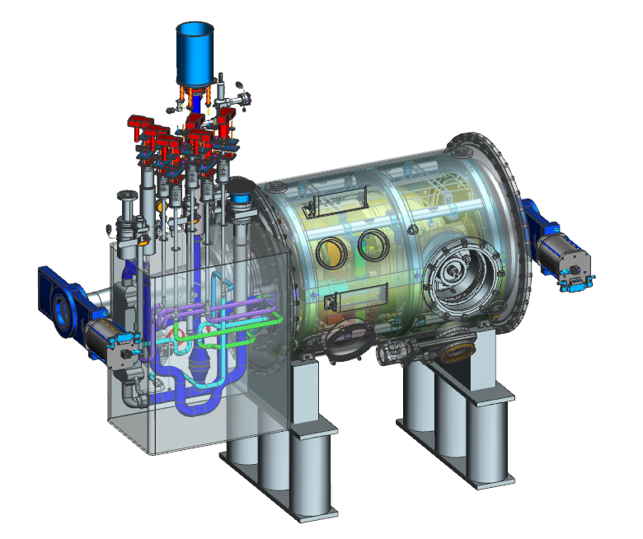
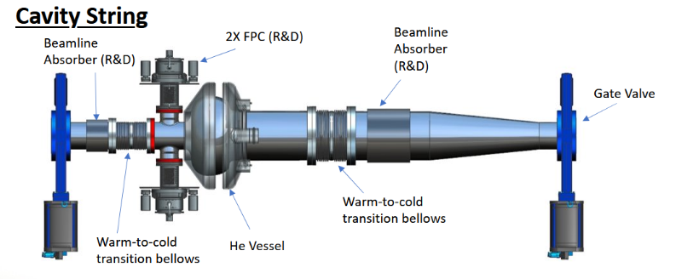
EIC: 591MHz single cell cavity design
Designed for the ESR, may be used for the HSR too
Strong HOM excitation from the high beam current and short bunches, damped by two BLAs
Asymmetric design with R75mm beampipe on one side (matching the largest possible gatevalve fits the geometry constraints), R137mm on the other side to damp the lowest dipole HOM and lower the fundamental mode R/Q, but needs to be tapered to R75mm
Intrinsic Qext set at 2E5, possible to tune down to 2.5E4 with external tuning network
Single cavity cryomodule
Parameters | Value
Nominal voltage (MV) | 3.9
Nominal gradient (MV/m) | 17.3
R/Q (Linac Def) (Ω) | 76
Epk/Eacc | 2.01
Bpk/Eacc (mT/(MV/m)) | 4.87
G (Ω) | 307
FPC tip penetration for Qext ~2E5 (mm) | 9
Loss factor (with FPC, 2 BLAs, exc FM, 7mm bunch) | 0.883 V/pC
Estimated total length (gate valve to gate valve) | 2.8m

Slide 18
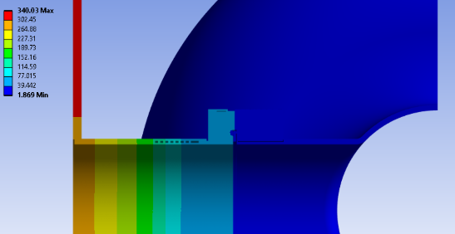
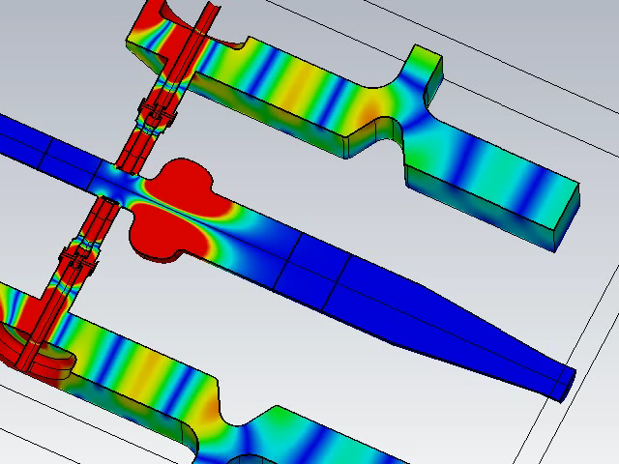
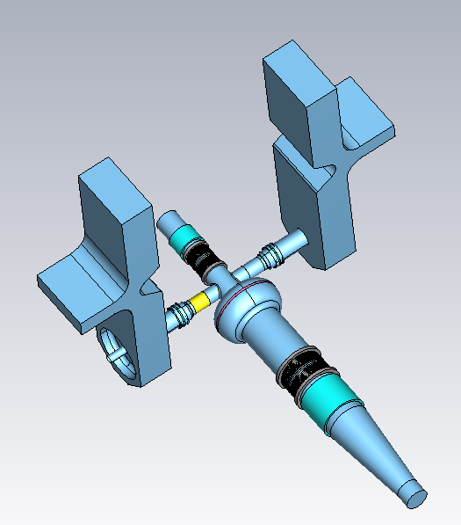
EIC: 591MHz cavity Qext tuning and FPC warm-to-cold transition
Qext tuned by shorted stub on matched T
  When Qext needs to be tuned lower, there will be strong standing wave between the FPC tip and the T. Those cases require less cavity voltage and likely lower RF power
  Reasonable sensitivity to T location errors
RF/thermal analysis made under different operation scenario
  Beam loading is included in the simulation
  10 GeV 2.5A operation with all focusing is considered as the worst case for heat load.
WTC traced cooled with 5K He gas
  ~20W in 2K load and ~140W in He gas load per cavity with 100mg/s flow and heaters
FPC WTC temperature for the worst heat load case
RF magnetic field in the FPC for the worst heat load case
Qext tuner with matched T plunger

Slide 19
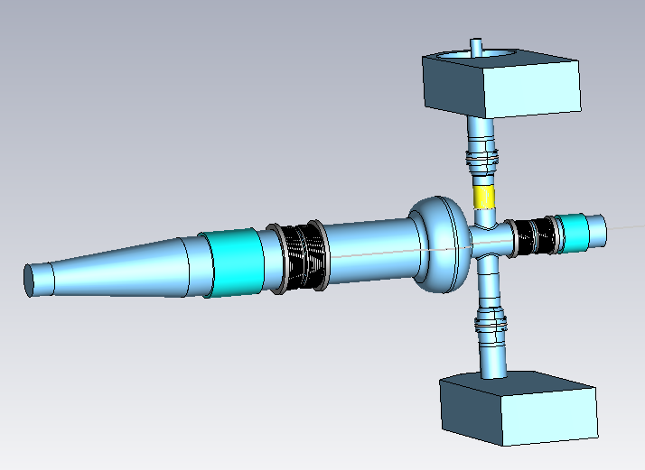
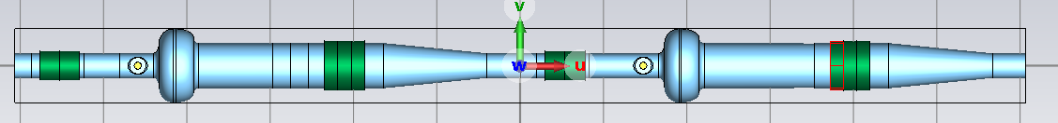
EIC: ESR 591MHz Cavity HOM Damping and Optimization
Baseline design
  a 12cm long R75mm BLA and a 24cm long R137mm BLA per cavity
  proven design at APS-U with ~0.2W/mm² loss density (11 kW for the R75mm BLA and 41 kW for the R137mm)
HOM impedance analysis:
  Long range wake simulation with the model including BLAs and the taper using CST
  Baseline design meets the impedance goals (factor of 10 margin compared to threshold) for ESR
  No updates since the cavity string PDR, but planning more rounds of simulation after more proposed changes
HOM power flow:
  Short range wake simulation with BLAs and FPCs using CST
  For the worst case in the baseline design, total HOM power per cavity is ~61 kW
  The small BLA has significant self heating ( ~15 kW for the 12cm long without the cavity)
  ~26.5 kW maximum power in the R75mm BLA for the baseline (~0.47W/mm²)
  For the longer 24cm small BLA design, the loss density goes down to ~0.34W/mm², while the total HOM loss per cavity is ~71kW
HOM loss power flow, baseline
7mm 27.6nC bunches, 2.5A
18.7kW
32.7kW
7.8kW
1.7kW
Baseline with 12cm long small BLA
29.7kW
37.8kW
Beam direction
0.8kW
19.8kW
0.8kW
19.8kW
HOM power flow with 24cm long small BLA

Slide 20
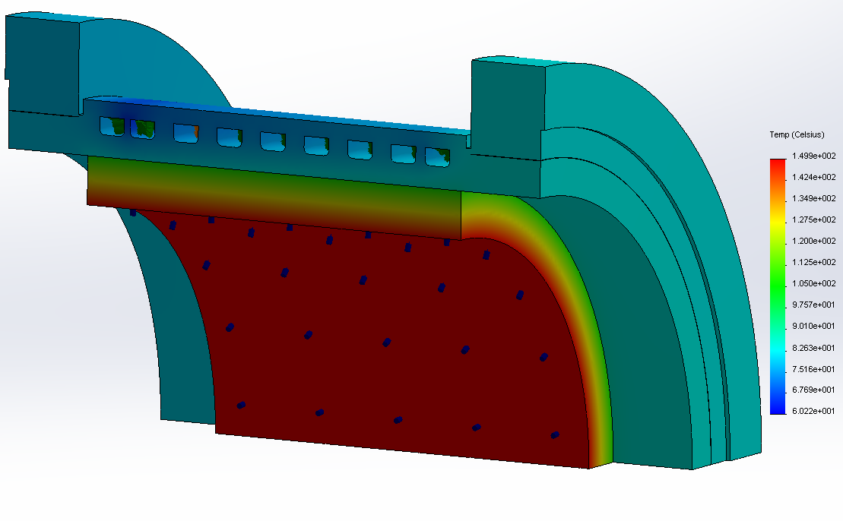
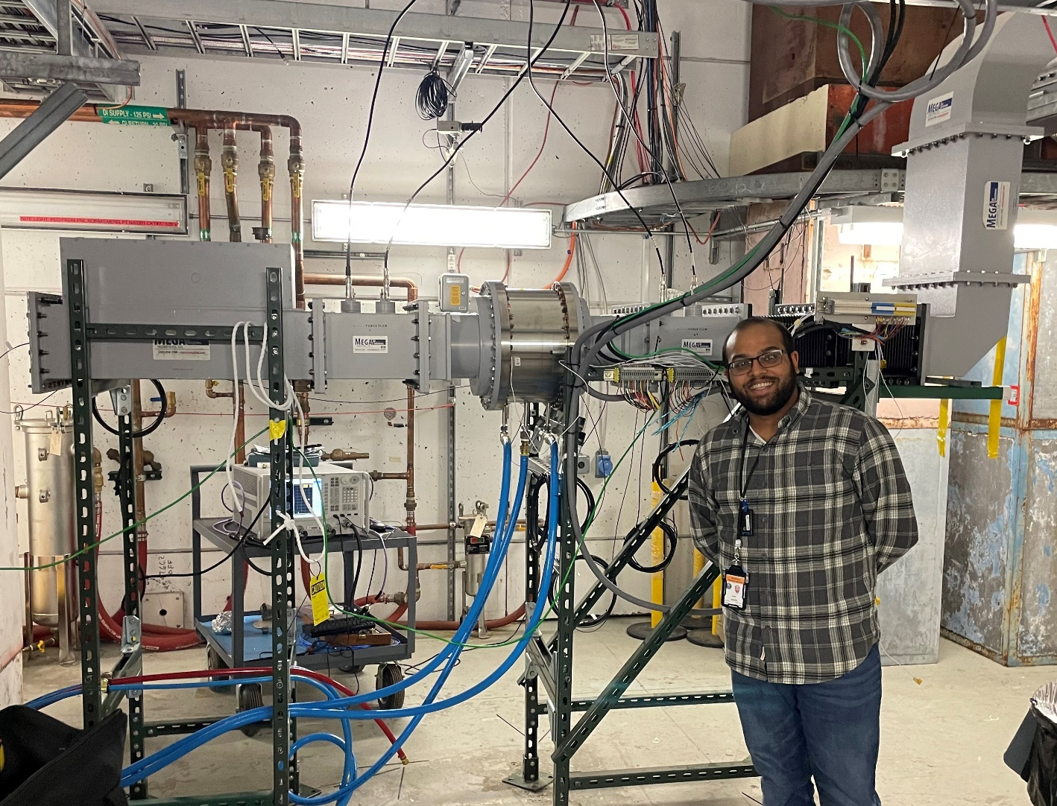
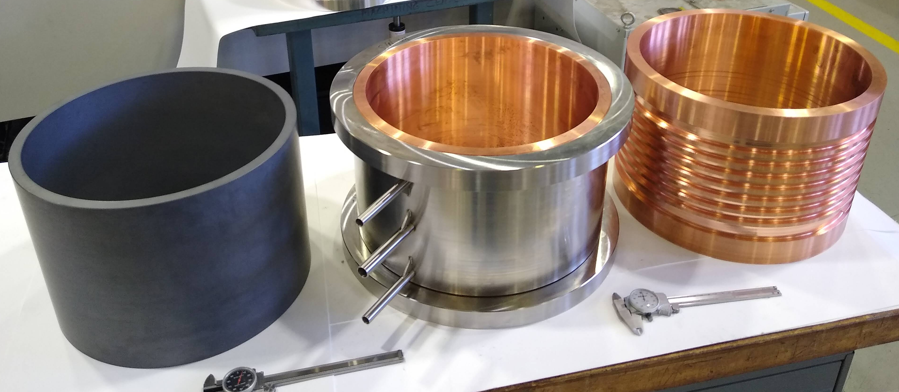
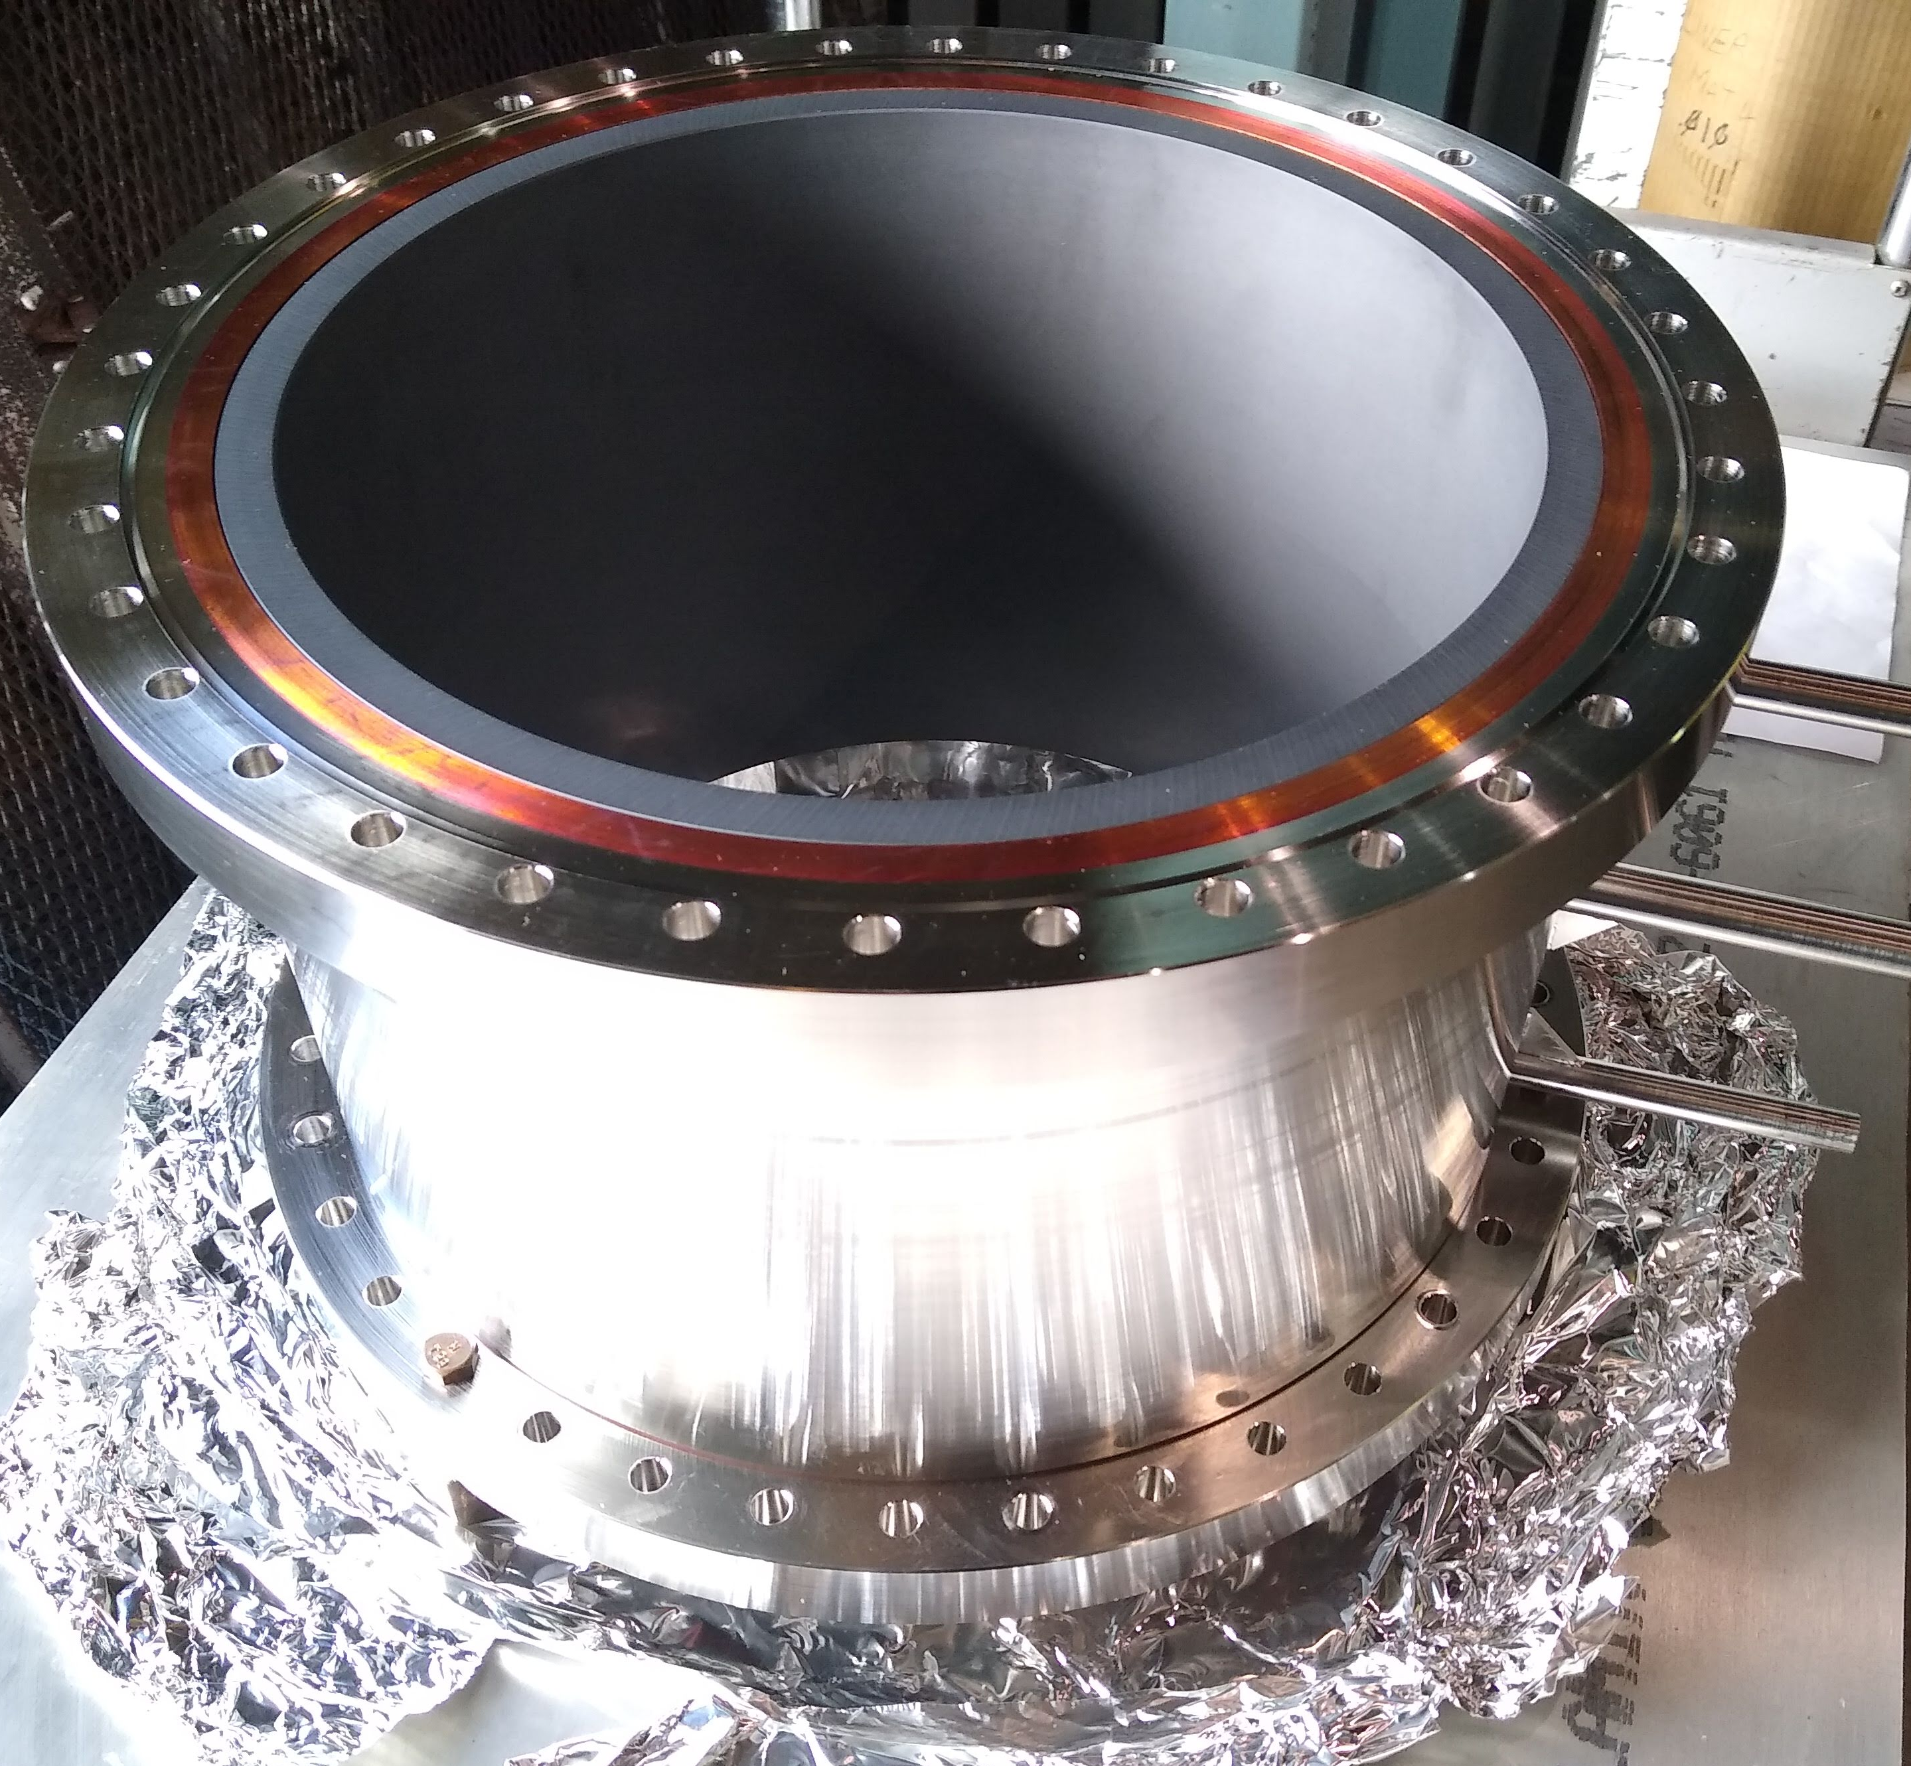
EIC: ESR BLA Development
Shrink fit SiC cylinder BLA design (APS-U style), currently choosing Coortek SC-35 as the absorber
An R154mm prototype developed at BNL under LDRD program
  Under high power test at BNL, currently already tested up to 70kW (~0.3W/mm²)
BLA thermal analysis:
  The 12cm long R75mm BLA will have ~120C temperature rise from inlet water with 23 kW heat
Possible BLA optimizations
  Geometry of the R75mm BLA
  New material
  Chilled water
Inlet: 5 GPM @ 30 C
Outlet: 5 GPM @ 48.5 C
34C ΔT at
SiC to Copper interface
1x10^4 W/K-m^2
Conduction from SiC to copper
6 kW heat load on 1/4 model
(23 kW total)
L12cm R75mm BLA thermal analysis
R154mm shrink fit BLA, BNL LDRD
R154mm BLA high power test at BNL

Slide 21
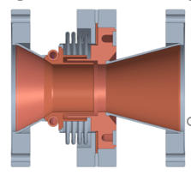
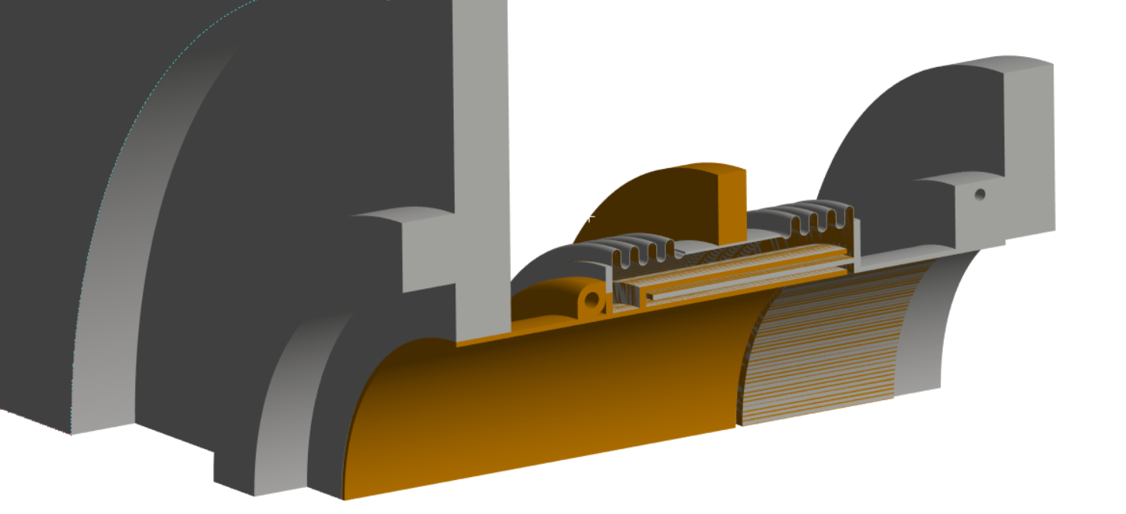
EIC: Beampipe Warm-to-Cold Transition
Preliminary ESR 150mm beampipe WTC bellow
50K Shield (Straps Behind)
4.5K
He (g)
300K
Amb
2K
He (l)
BESSY VSR shielded cold bellow
BLA
300K LCW
EIC baseline cylindrical cryomodule design requires beampipe bellows to provide the thermal isolation and mechanical compliance between the cavity and the cryomodule endcap, with minimum contribution to impedance
Requires contactless RF shield
Currently use BESSY VSR choke type shielded bellow as reference
  A design has been tested with beam
The major concern is the beam induced trapped HOM modes heating with the high beam current, especially when the bellow deforms.
  Analysis and optimization ongoing, possible to remove the majority of heat to room temperature

Slide 22
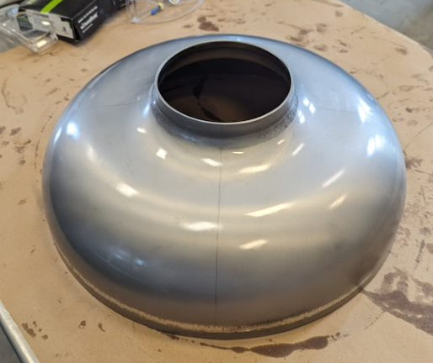
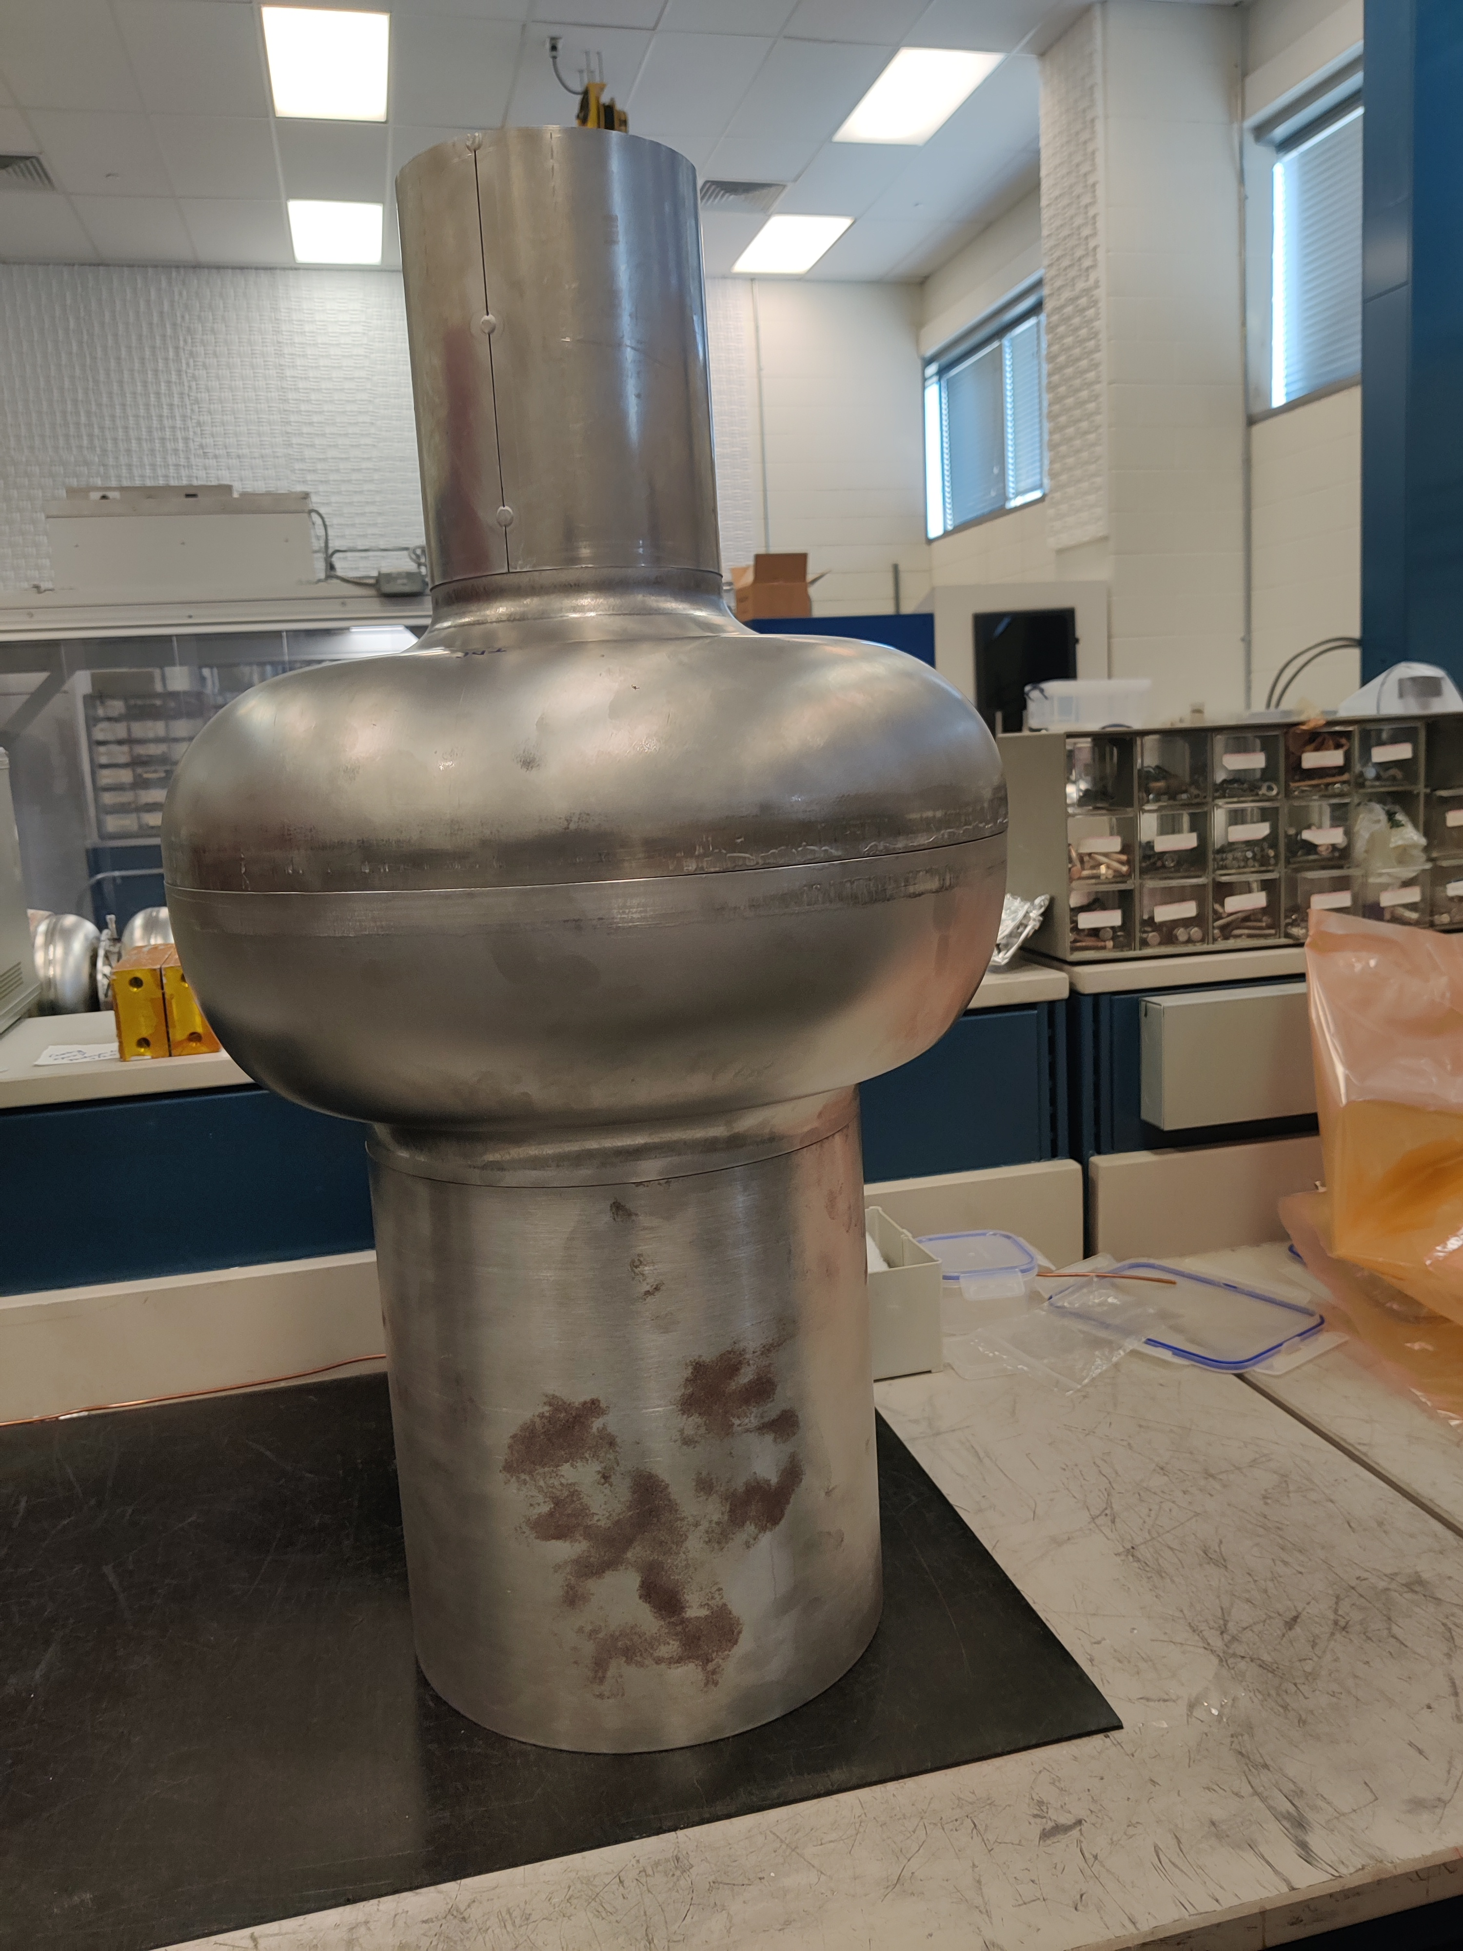
EIC: ESR 591MHz cavity prototype fabrication
Both Nb half cells stamping complete, waiting for the final trimming
Small beampipe testing for nipple-pull with aluminum
Stamped half cell (small beampipe side)
ESR single cell prototype fabrication plan
Stacked two Nb half cells with mockup beampieps

Slide 23
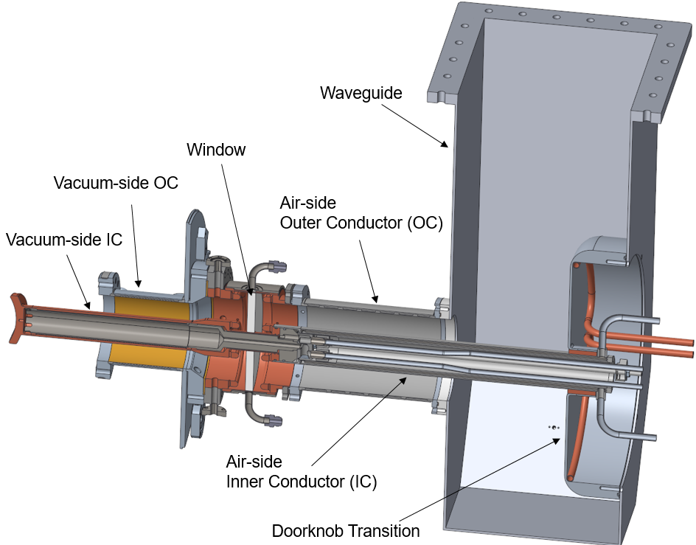
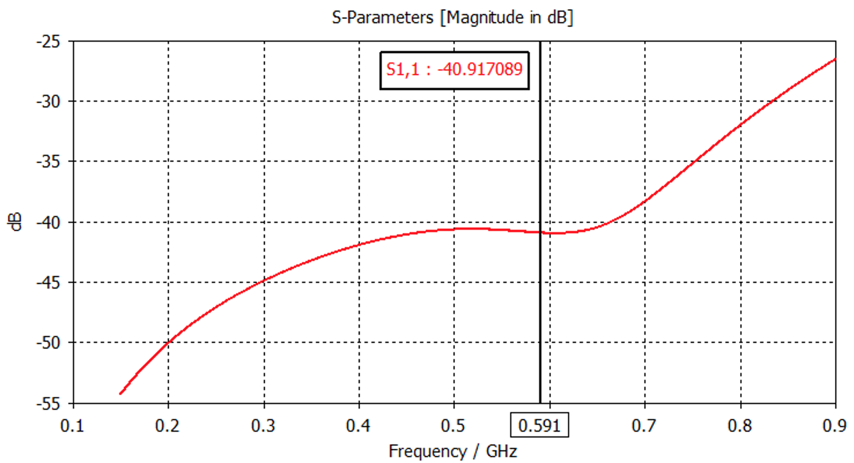
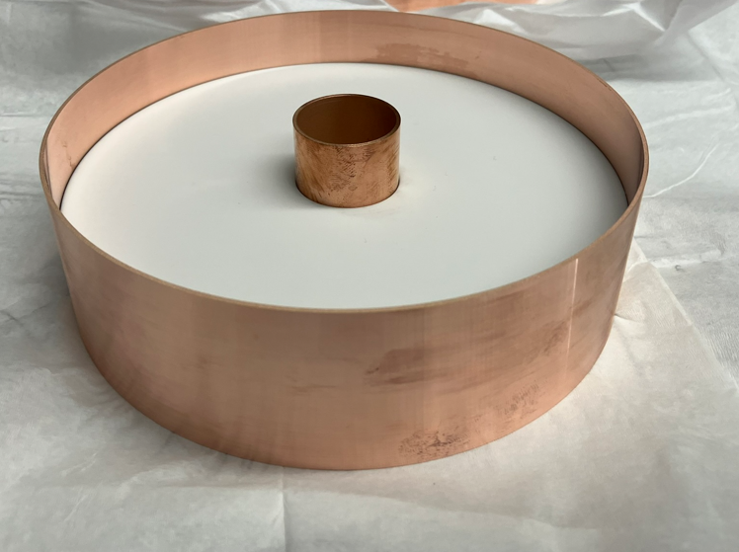
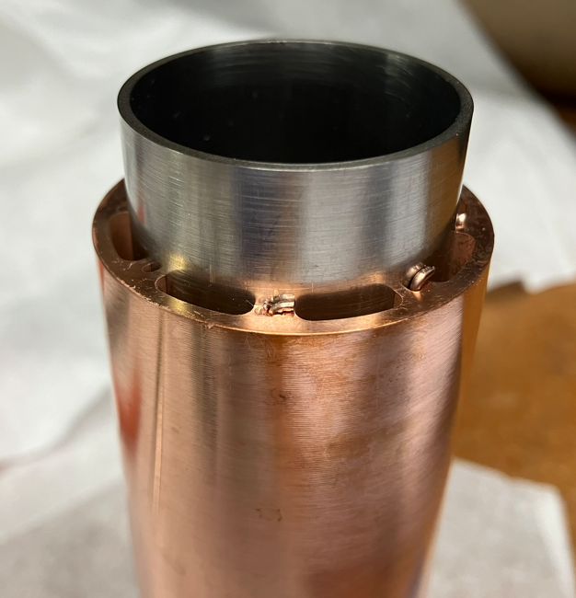

EIC: FPC development
In the scope of CD-1 R&D, developed at BNL
Design focus on the ESR FPC requirements, but can be applied to most of the other EIC SRF cavities
  ~380kW power, designed for ~1MW traveling wave or 500kW full reflection
  5g shock load
An Al₂O₃ variation based on the KEKB/Tristan/SNS/BNL BeO high power window
Broadband matching
Brazing test
First window brazing

Slide 24

EIC: 5-cell 591MHz Cavity
Could use the same 5-cell design for RCS and cooler ERL
Baseline is the scaled BNL eRHIC 650MHz 5-cell with BLAs, which has been prototyped and meets the impedance requirements
Possible to adapt the PERLE type coaxial HOM damper with smaller and shorter beampipes
Parameters | RCS (1GeV merging) | ERL
Nominal frequency (MHz) | 591.1492
Operation frequency range | ± 120kHz | Small
Cavity voltage [MV] | 20
Number of cavities | 3 | 10
Acceleration rate (MV/turn) | 2.2 | NA
Max. RF power [kW] | 65 | small
Longitudinal impedance threshold | ~2MΩ (< 1GHz) ~2MΩ-GHz (>1GHz) | Not a concern
Transversal impedance threshold | 12MΩ/m | 1MΩ/m
EIC RCS/ERL 591MHz cavity requirements
5-cell 591MHz cavity scaled from eRHIC ERL 650MHz

Slide 25
Summary
The three upcoming/future circular lepton or electron-ion colliders are all progressing quickly in the SRF systems development
The three projects all need to develop a variety of SRF cavities for different subsystems and/or different operation cases, with different voltage and beam current/power requirements.
There are plenty of interesting physics/engineering challenges in these SRF systems.
Lot of synergy among the 3 projects, especially in impedance control and high power couplers.

