Slide 1
FPC & HOM Technology Challenges, FCC
R. Calaga, E. Montesinos, S. Zadeh
CERN
Dec 5, 2023
Ack: I. Karpov, F. Peauguer (CERN), S. Udonwgo (Rostock University)

Slide 2
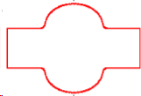
FPC
HOM-C
Coupling RF power into the cavity
Coupling beam power out of the cavity
narrowband
broadband
Typically coaxial-type or waveguide-type couplers
Depending on frequency & power levels, adapted couplers are chosen
For the Future Circular Collider, up to 1 MW input and 10’s kW output is expected

Slide 3
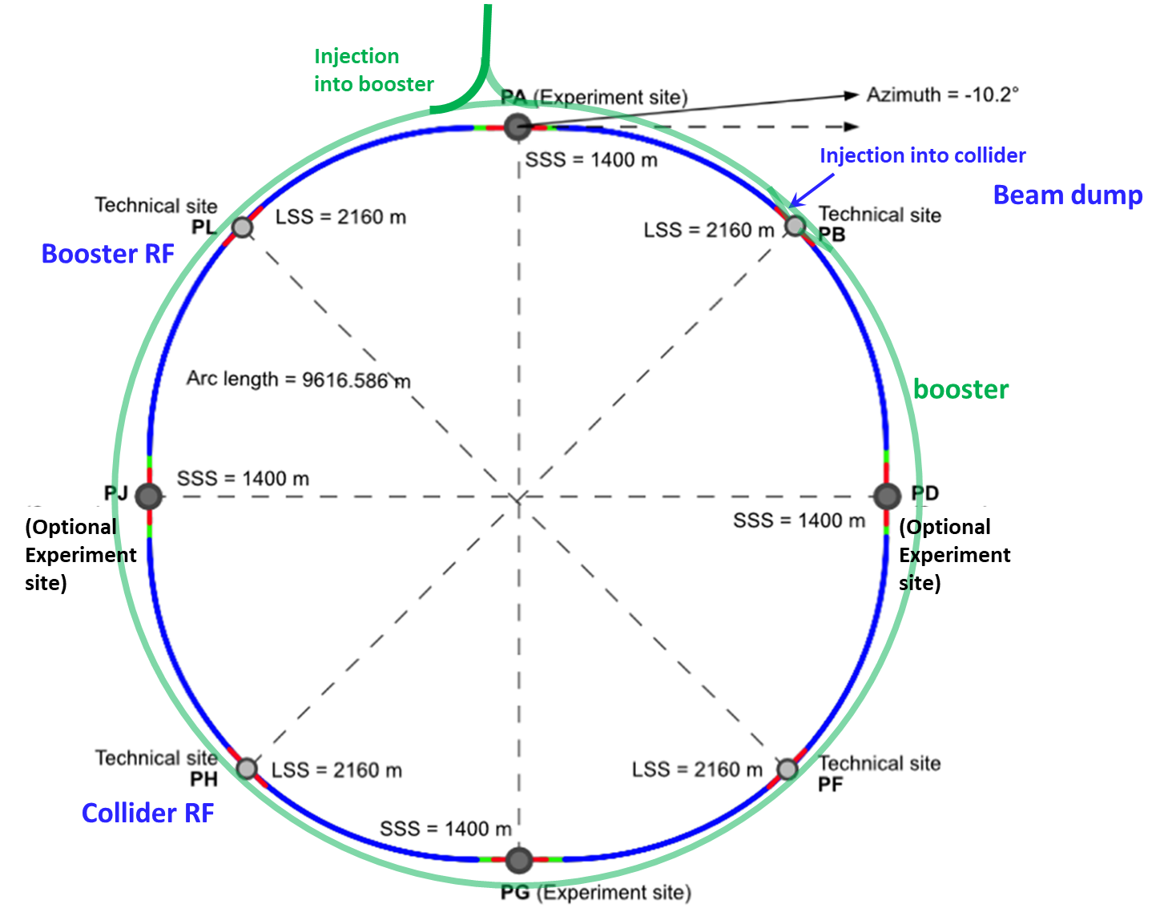
FCC-ee RF Layout
90 km two ring synchroton for $e^{+}e^{−}$ collisions between 100 MV – 11 GV per turn using 400 or 800 MHz SRF systems
Total beam power $50 MW$ (x2)
Full energy booster for top up injection

Slide 4
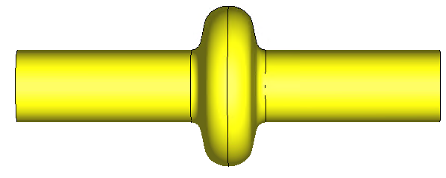
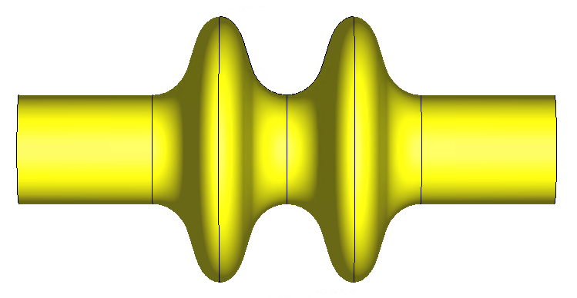
Basic Parameters
protons
electrons
 | HL-LHC | Z | W | H | $$t\overline{t}$$
Energy [GeV] | 7000 | 45.6 | 80 | 120 | 182.5
Beam current [mA] | 1100 | 1279 | 137 | 26.7 | 4.9
RF Voltage [MV] | 12-16 | 79 | 1000 | 2080 | 2100/9380
# Cavities | 16 | 112 | 264 | 264 | 264/448
RF Power [kW] | 300 | 900 | 388 | 382 | 75/177
Full energy booster not shown in the table

Slide 5
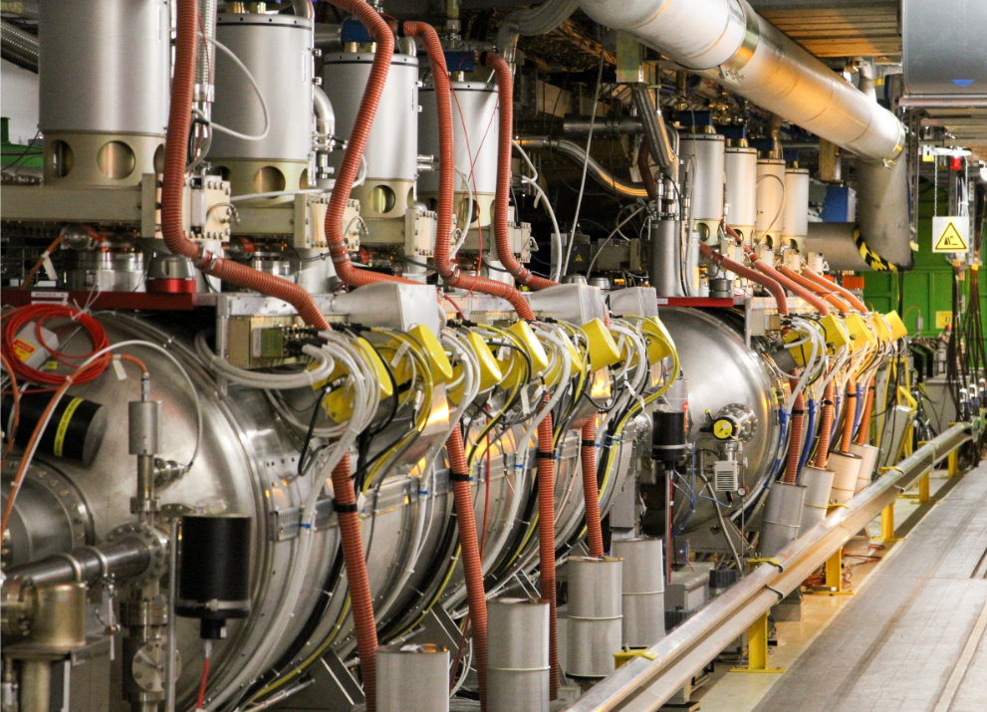
LHC Accelerating RF - Today
8 cavities (2 CM) per beam
Cavity voltage = 2 MV (max)
Beam current = 1.1 A
Input power = 300 kW (max)
HOM power < 1 kW (max)

Slide 6
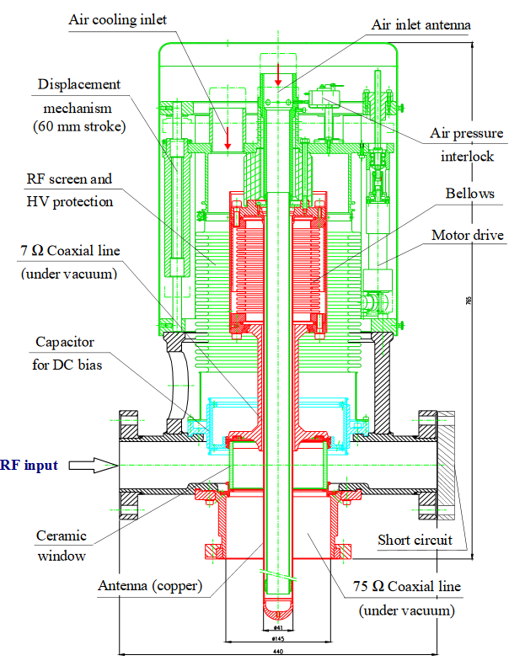
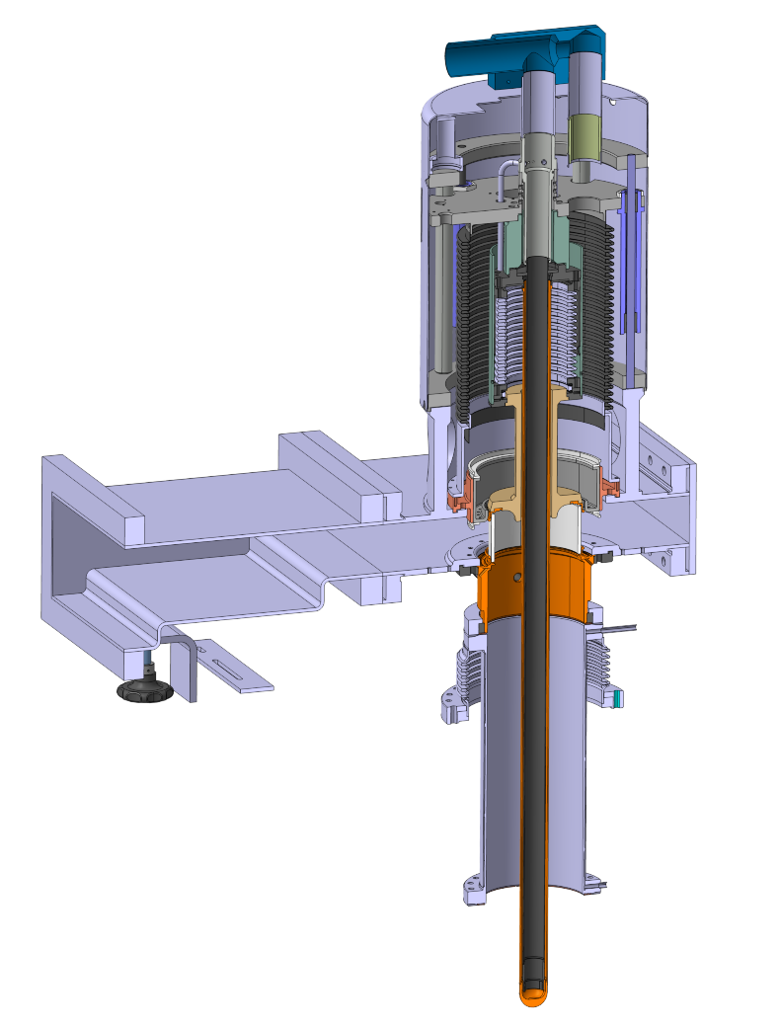
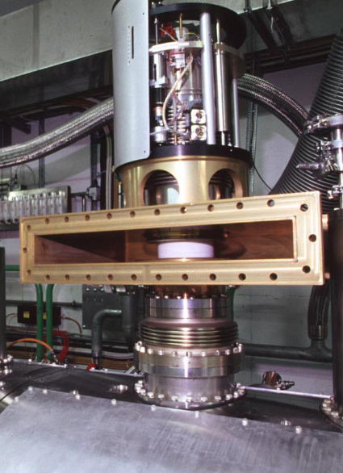
LHC RF Input Coupler
300 kW-CW air cooled coaxial scheme
Cylindrical window for waveguide transition with matching, no door-knob
$75 Ω$ coaxial line to push multipacting to higher power levels + DC bias
Remotely controlled variable couplers to change $Q_{L}$by factor 3-5 in operation

Slide 7
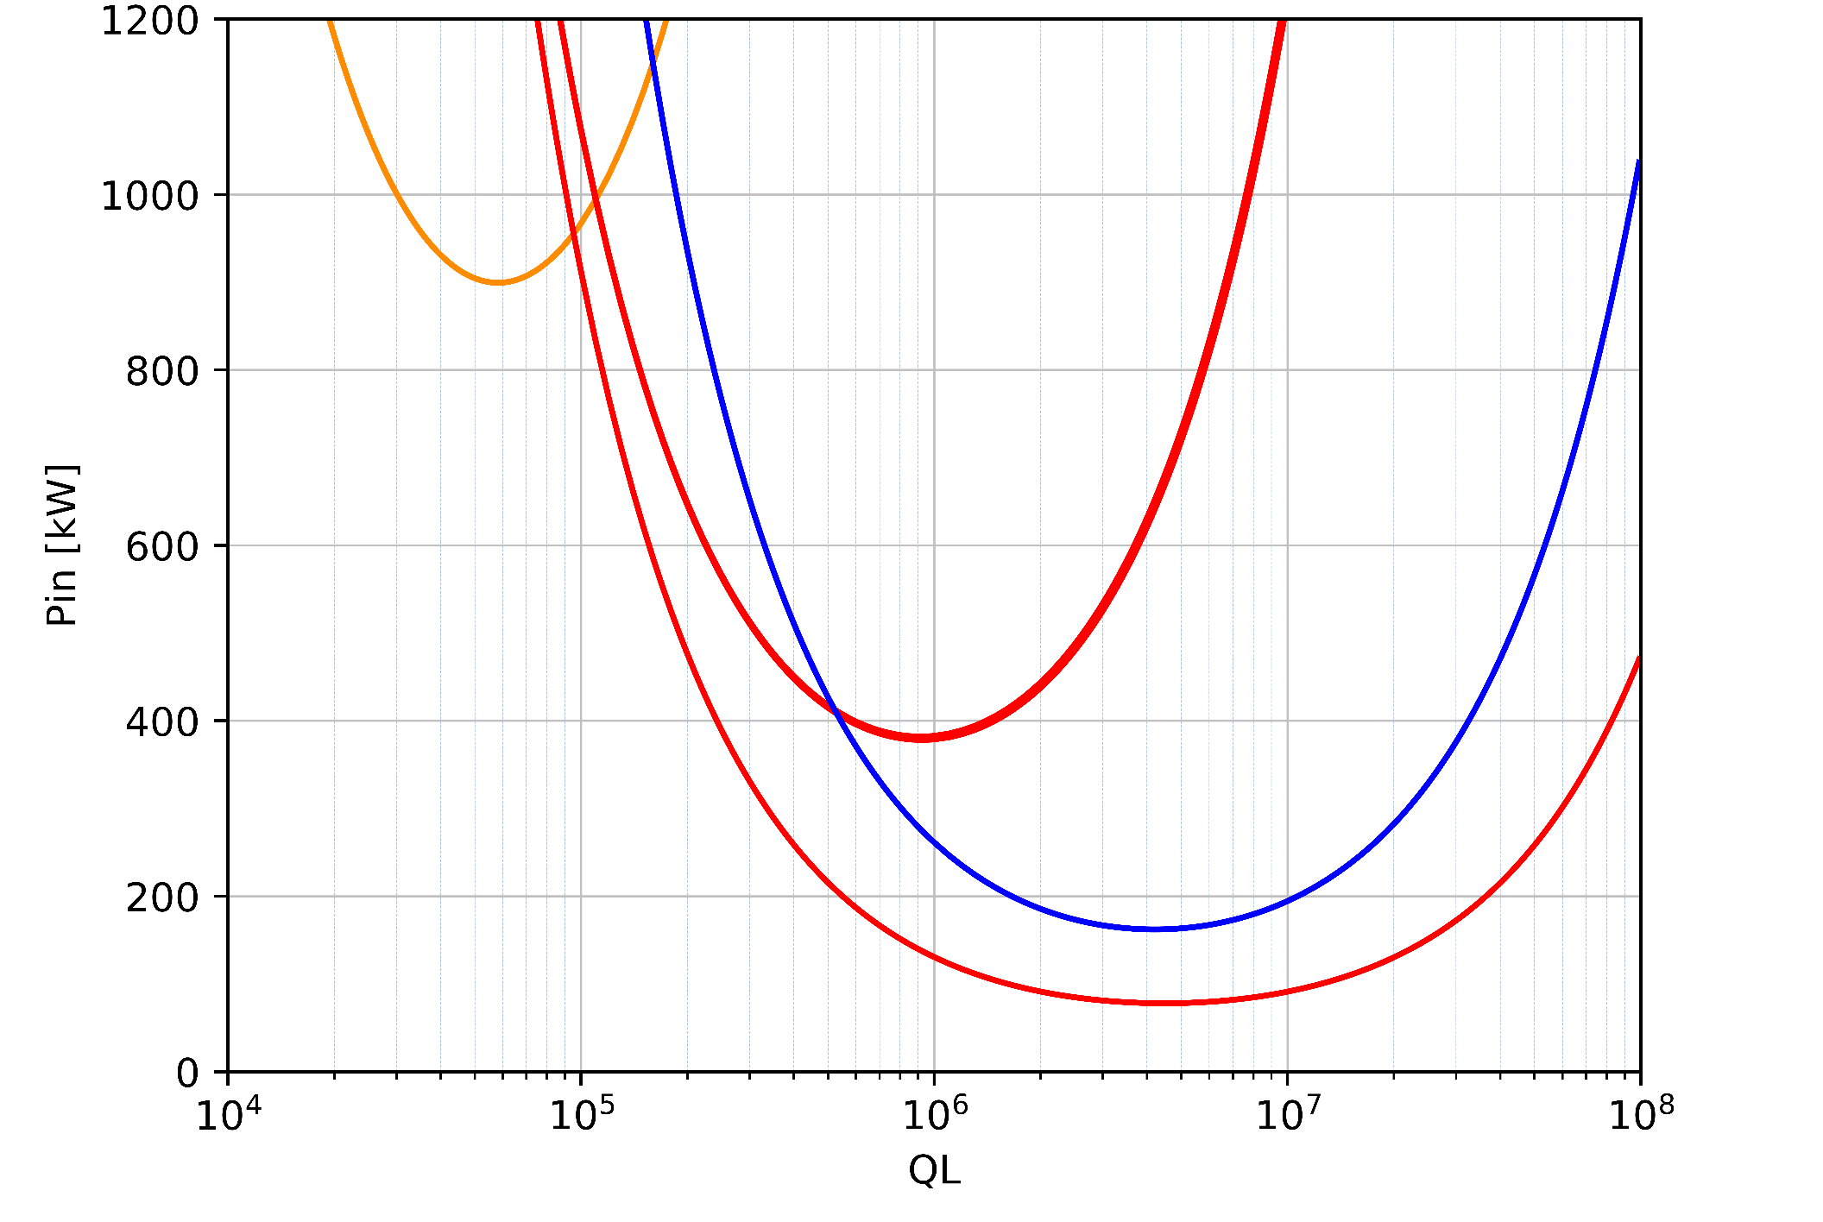
Input Power, FCC
Power vs Input Coupling
A single RF scheme is not practical to satisfy high current and high energy – Power range of factor 5 & Coupling range ($Q_{L}$) of factor 500
Present baseline → 3 RF systems with fixed coupling, reasonable approach
No movable coupler is a big simplification, a movable short on air-side is being studied to adjust coupling if needed
Z
W, H
ttbar

Slide 8
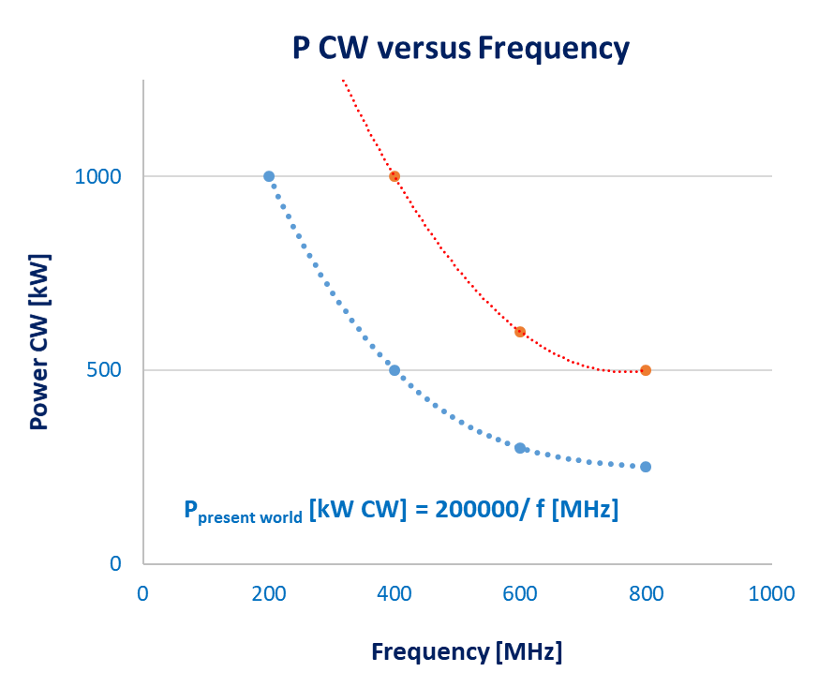
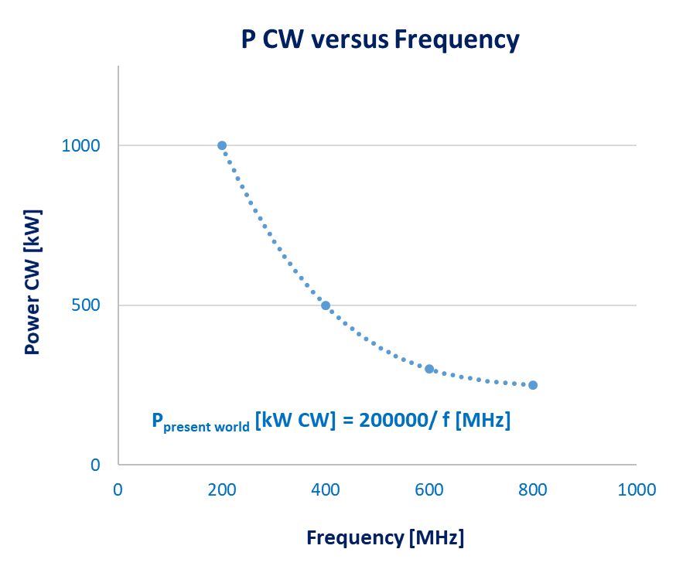
Power Handling (empirical scaling)
Experience with power couplers built at CERN since 2000 used define an empirical scaling
The FCC specification in some scenarios is requiring the power levels to about factor 2 larger
Not obvious in CW mode to increment by factor 2 w/o considering novel cooling techniques, prevent multipacting damage and arcing
future
present

Slide 9
Coupler Towards FCC
During the high gradient R&D program a MW class air-cooled coaxial-window coupler was developed for pulsed operation
This concept is used as the present baseline for the FCC. The jump to CW needs to be demonstrated, the critical point will be the RF window
An alternate disk-window outside the cryomodule is simpler option, but requires re-thinking the “clean assembly” of such a configuration
R&D on higher purity ceramic (99.5%) is ongoing

Slide 10
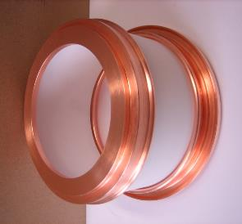
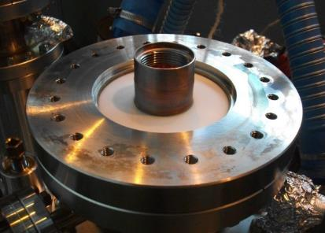
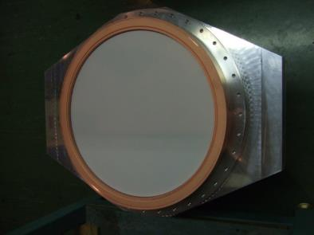
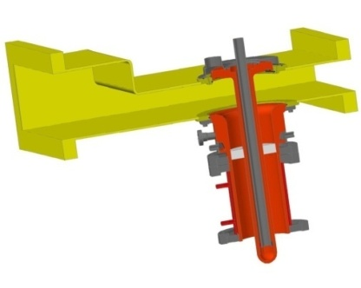
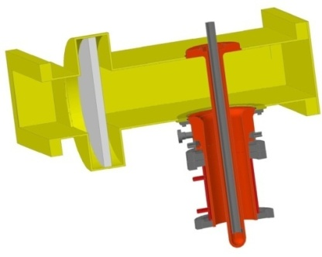
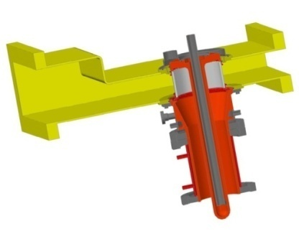
Ceramic Windows Types, CERN
Coaxial windows
HL-LHC Crab, 400 MHz
100 KW CW
Disk windows
SPS, 800 MHz
150 KW CW
Cylindrical windows
LHC, 400 MHz
500 kW CW

Slide 11
Multipacting
SEY of ceramic window very high and prone to multipacting & risk to ceramic
Improved with Ti coating on the vacuum side. Also helps to remove electrostatic discharge. Process well mastered
R&D ongoing to study low SEY ceramic. Potential simplification – pending validation & cost
DC bias (2-5 kV) is necessary to suppress multipacting – but brings additional complications. Magnetic means of suppression under study but not necessarily compatible with SRF

Slide 12
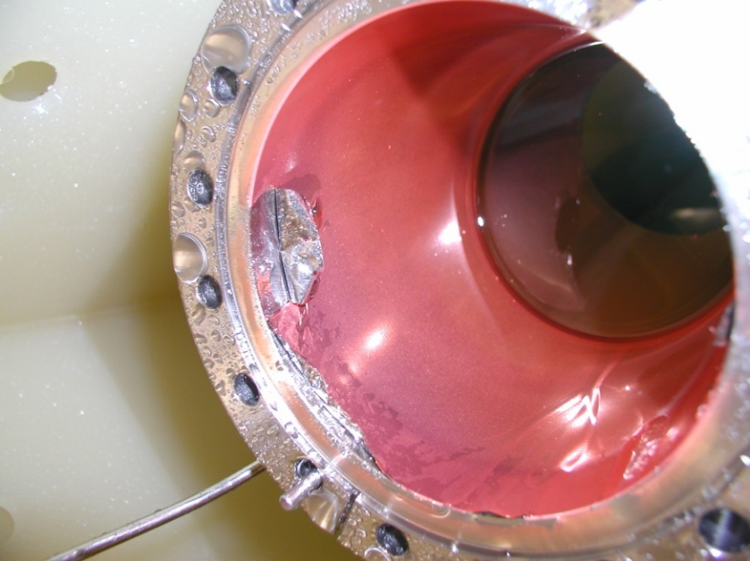
Thermal Management
Outer line: a thin Stainless Steel tube, acting as the thermal insulator to separate between the 2K and the 300K with He-gas flow or thermal intercepts
A thin layer (~µm) of copper, to minimize RF losses, not transmitting so well the thermal losses to the cryogenic system
With the recent HL-Crab 1.5 mm Stainless Steel tube + Gold 2 µm (flash) + Copper (or gold ) sputtering layer 10 µm being pursued as standard procedure
Inner line: Massive OFE copper with air cooling avoid issues with freezing water at brazed joints
Outer-line: Stainless Steel + gold
+ copper
Air-cooling
Peel off due to rinsing

Slide 13
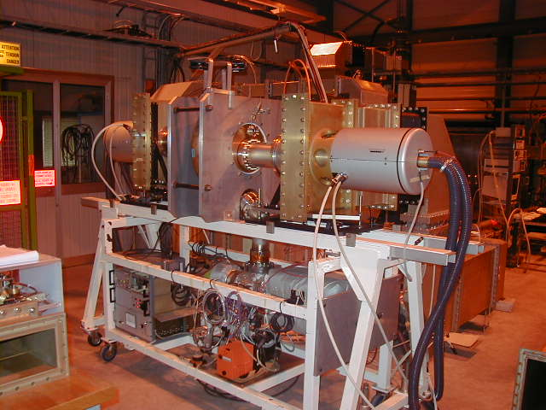
Test Box & Conditioning
High power RF (pre)-conditioning of a “clean coupler” is necessary for controlled desorption of gases from the RF surface in SW & TW conditions
This process is time consuming and there is no short-cuts especially with CW power levels considered (200 kW to 1 MW)
Almost 1000 couplers to process for the main ring and ~500 couplers for the booster
Example of LHC RF conditioning system

Slide 14
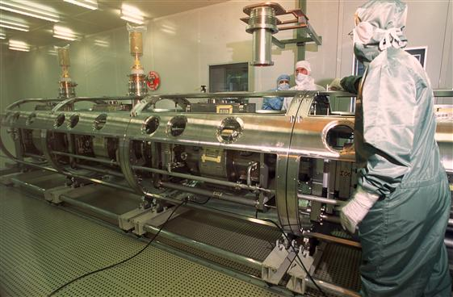
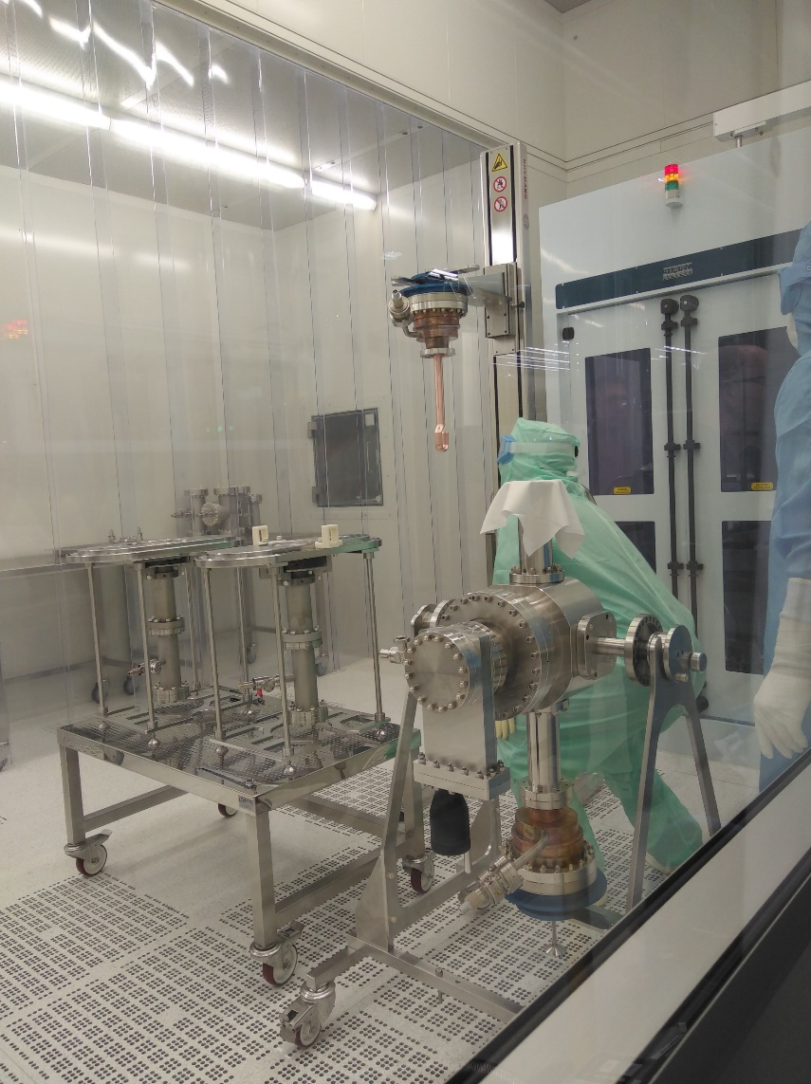
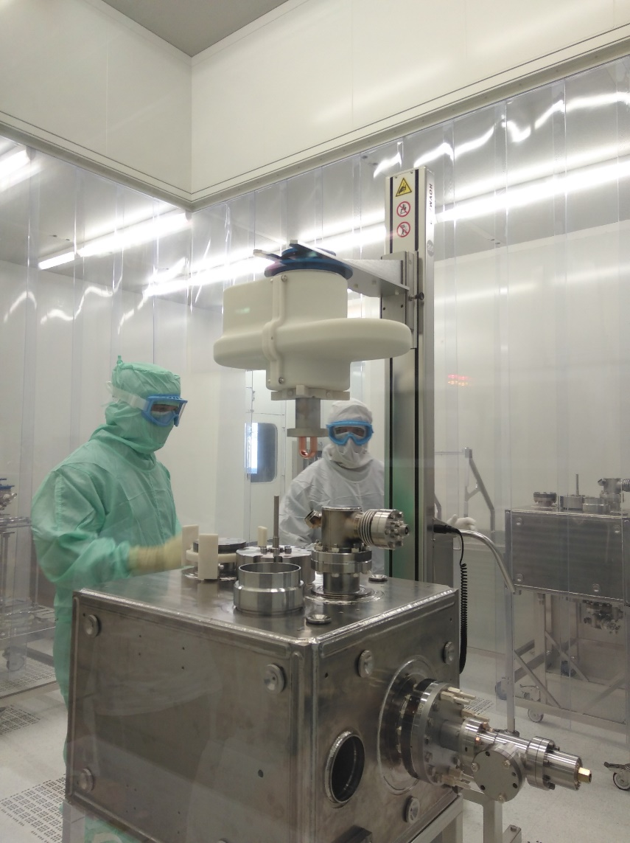
Assembly into Cavity
One of the most delicate & critical step, likely define the maximum field reach and onset of field emission. IS04 like clean room assembly makes it very cumbersome
For the HL-LHC crab cavity project, special 3D printed tooling and “semi-robotic” assembly proved to minimize the risk
Moderate gradients required for FCC, the assembly procedure needs to some re-thinking
1990’s
2017

Slide 15
Cryomodule Integration
Cryomodules are typically conceived with cavities in mind
For very high RF power like the LHC & FCC, the power coupler and HOMC are a significant part of the “cavity assembly”. They also determine the performance reach
Present concept of installing the couplers in clean room and integration into cryomodule after may not be optimum
Can we install the couplers after the cryostating “in a clean way” ? Coupler exchange w/o de-cryostating and robotic way
Minimal distance for compact cryomodule

Slide 16
Higher Order Mode Couplers
(HOMC)

Slide 17
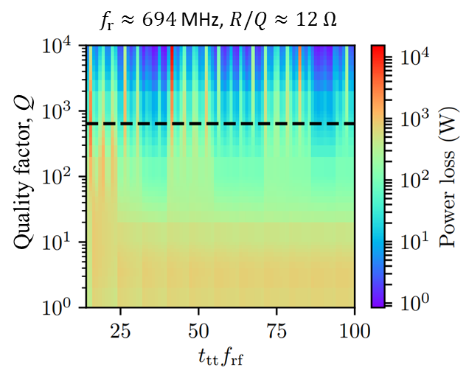
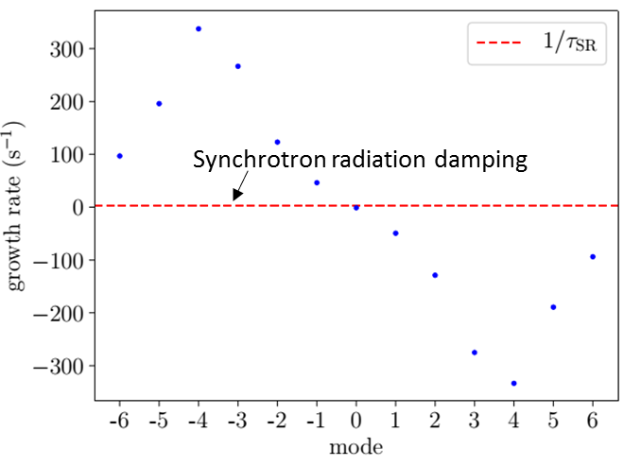
Impedance & HOMs
Three main issues to be addressed for the FCC
Strong feedback around the fundamental mode
Strong damping of the low frequency HOMs for CBI
Efficient extraction of kWs of HOM power
Fundamental mode impedance
$mode=$ -4
stability
opt detuning ($\sim 4×f_{rev}$)
PRSTAB 21, 071001 (2018)

Slide 18
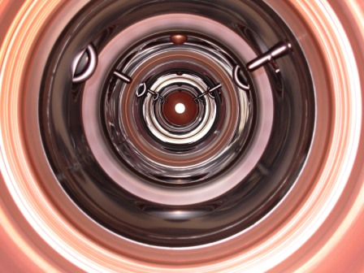
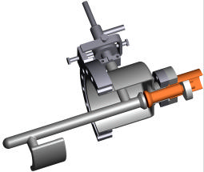
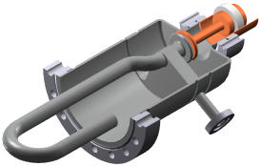
LHC RF - HOM Scheme
The LHC system uses two coaxial type HOM couplers, narrow-band (low frequency) & broadband (> 700 MHz)
The large beam pipe aperture (300mm) is key for achieving very strong damping
Look inside cryomodule
“Narrowband”
“Broadband”

Slide 19
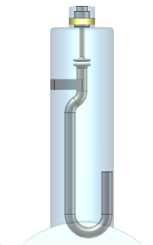
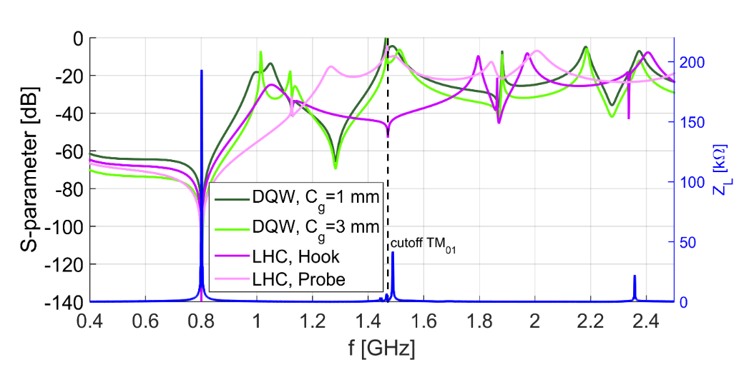
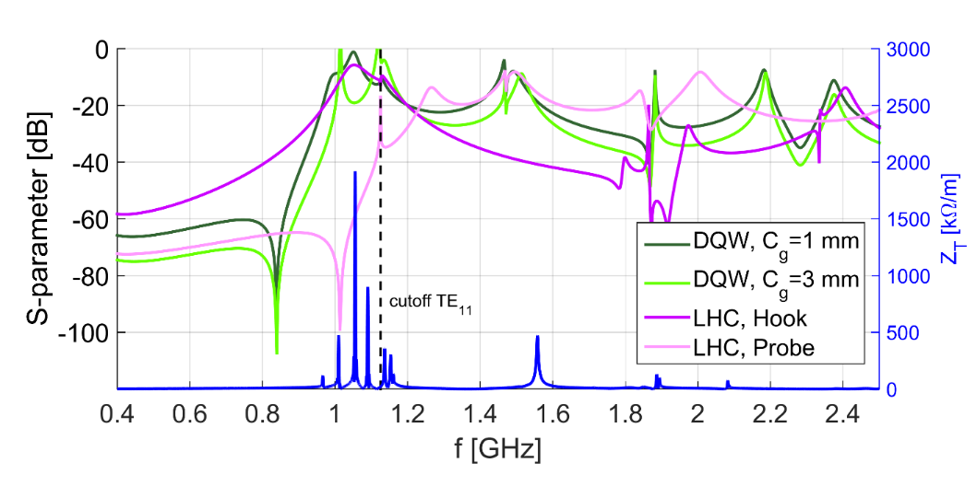
HOM Couplers, FCC
Three types of “tuned” coaxial couplers studied for strong damping targeting low frequency modes. Non-trivial geometries & tolerances
The tuning is very cavity specific, a “universal” coupler cannot be adopted as yet
LHC Hook-type
LHC Probe-type
DQW HOM Coupler
Example of transmission curves for 801.58 MHz

Slide 20
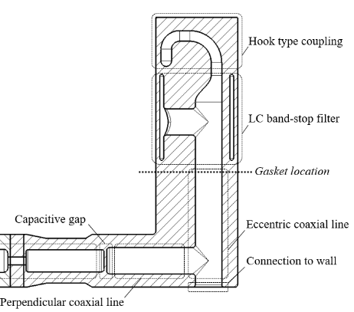
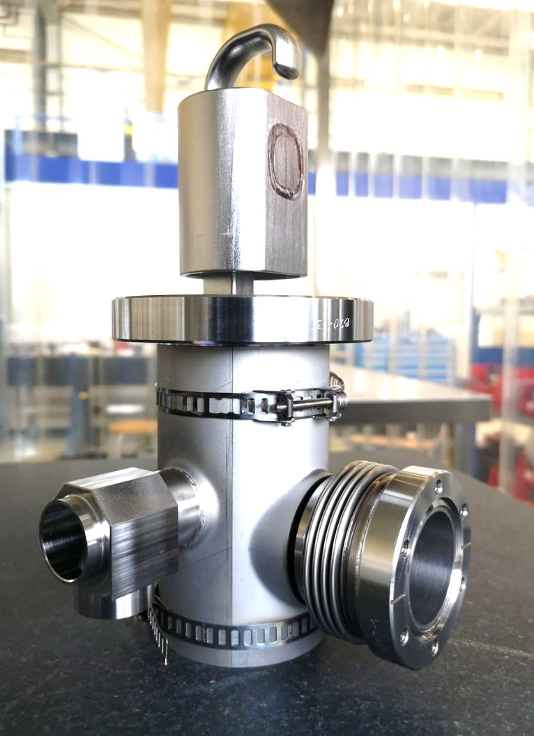
HOMC Design Considerations
DQW coupler, HL-crabs
For CW operation, the simulations and experimental experience with LHC and HL-LHC indicate
Demountable coupler with careful thermal design (gasket & feedthrough location)
Active cooling with a dedicated He-jacket
Sub-mm tolerances → cost driver
Cold RF window remains a big concern
As we approach kW level powers, we are exploring RF conditioning with a dedicated test-box
Trials with Nb-coating on Cu HOM couplers can open up a cheaper avenue, R&D started
He channel
He-Jacket

Slide 21
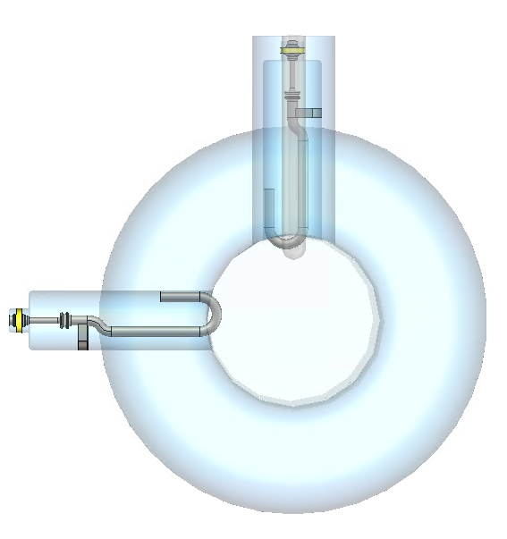
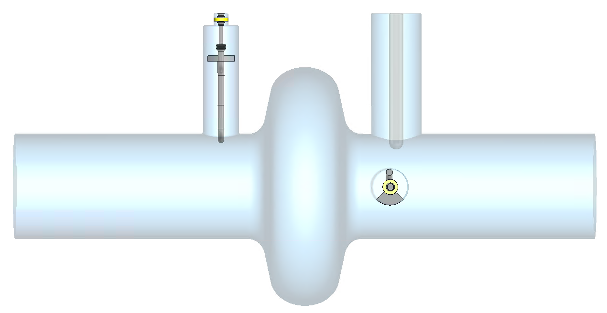
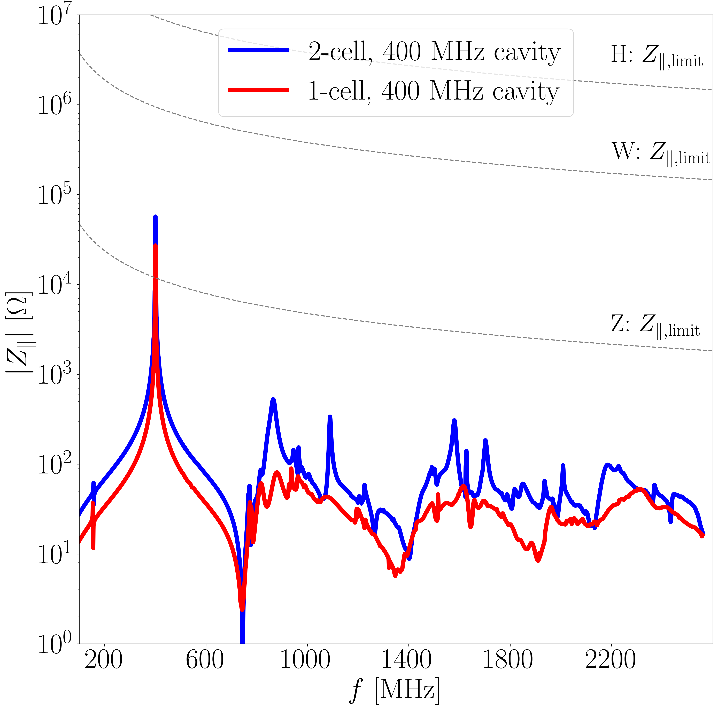
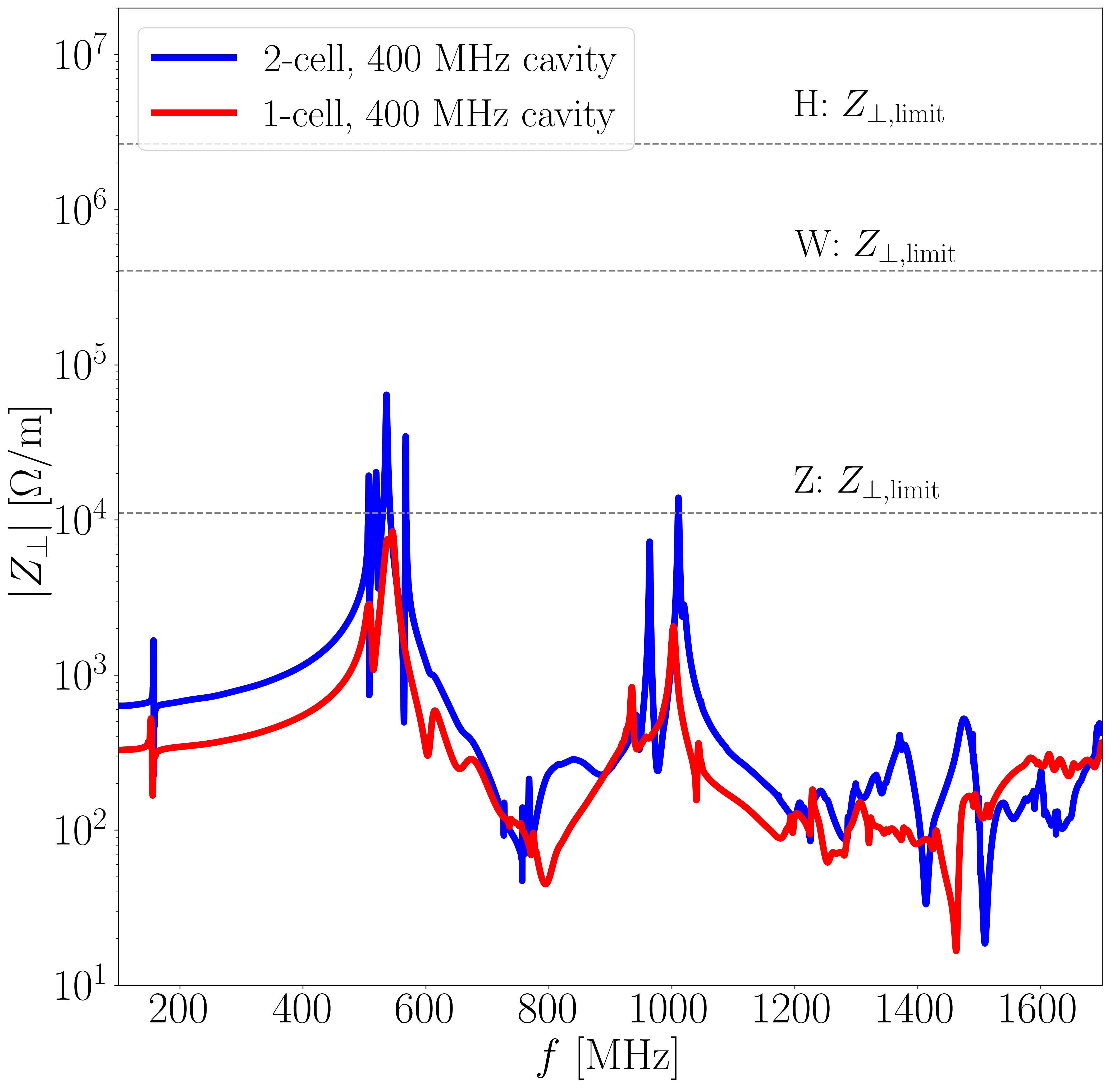
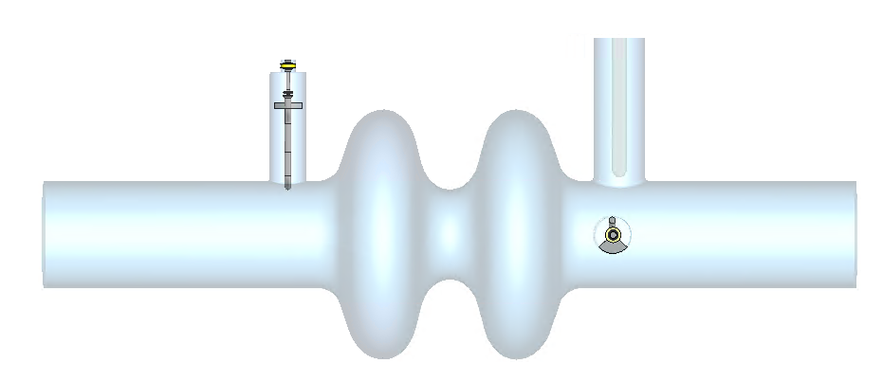
FCC HOM Couplers, 400 MHz
Even with 1-2 cells & large aperture, stability requirements demand extremely strong damping
A cavity shape improvement from the LHC & extensive damping studies allowed to reduce to single Hook type coupler – important accomplishment!
2-Hook type couplers/cav
224
528
Notes:
Review of cavity designs for FCC-ee Z, W and Higgs modes (1 cell for Z, 2 cells for W and higgs). Shape designed in a way to avoid high longitudinal impedance mode trapped in the cavity. Respective spectrums shown on the two plots. No sharp peak, especially for the single cell cavity (where current is highest). Comparison with beam stability threshold.
There are trapped modes in the transverse plane. To damp them, Shahnam has used 2 hook type coaxial couplers shown here (one for each polarisation mode). Threshold are shown with SR damping (no FB). Also added two simple rather large FPC coaxial couplers shown on next slide.

Slide 22
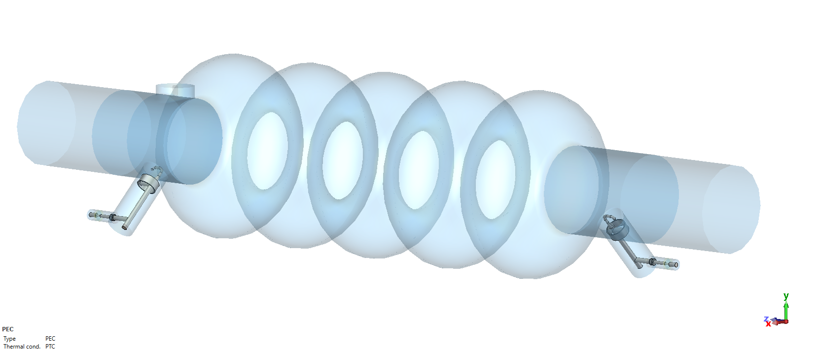
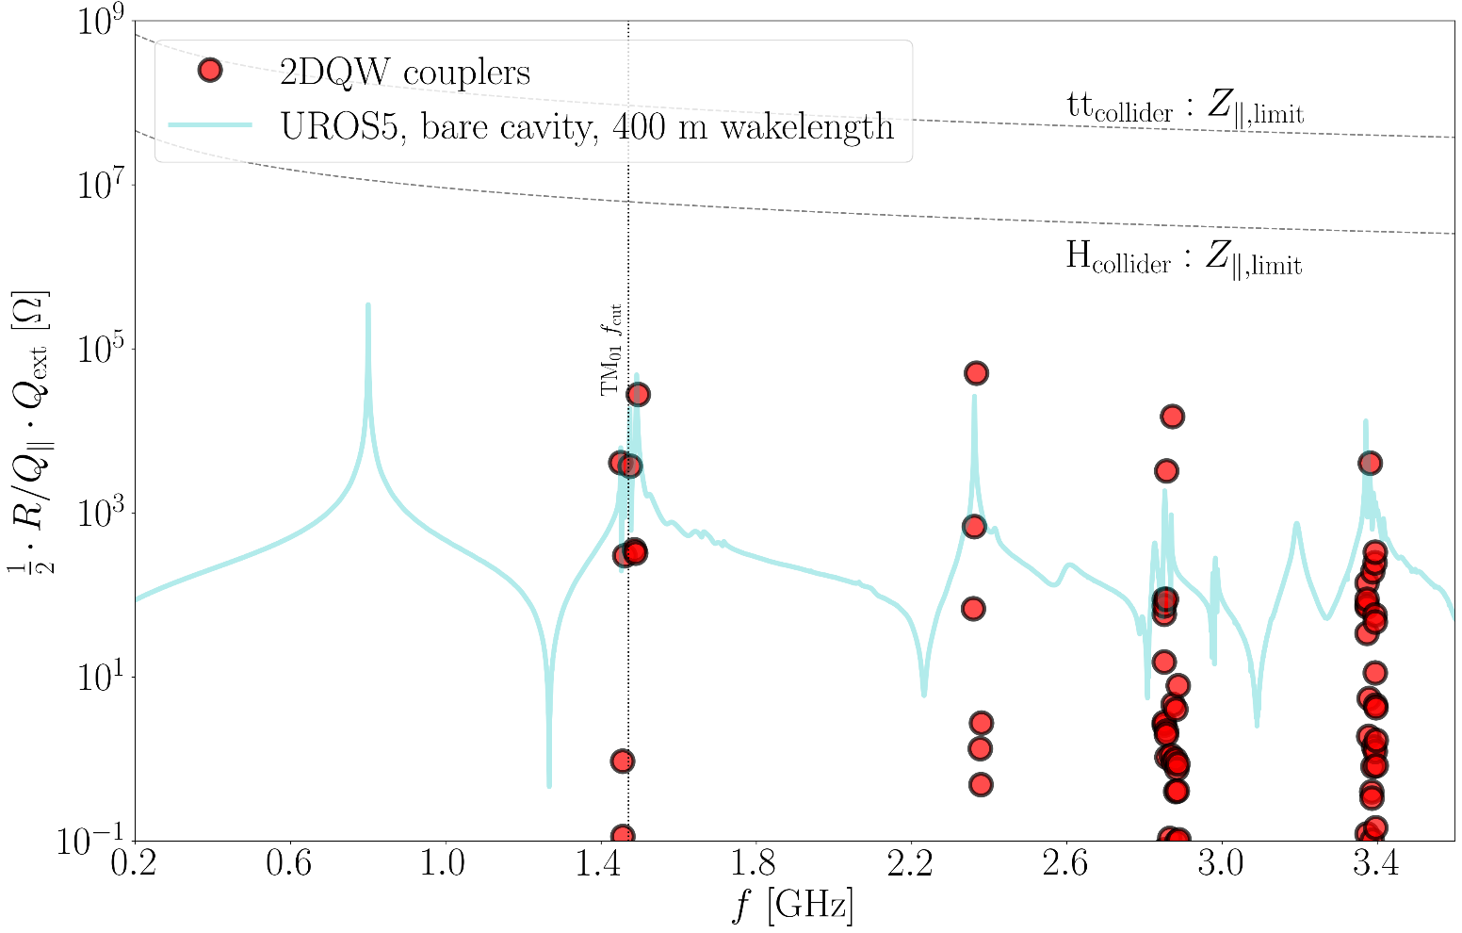
FCC HOM Couplers, 800 MHz
For 5-cell cavities at 800 MHz, exhaustive studies on cavity design & HOM configuration to reach the damping requirements with a two crab cavity type coaxial coupler
Three important lessons from crab cavity program
Tight tolerances led to machining from Nb-bulk
Careful surface treatment of the Niobium surface similar to the SRF cavities (non-trivial) & active cooling
Cold-to-warm transitions to transport the wideband HOM power is a challenge
Longitudinal modes
Low freq transverse modes at the H-limit
Notes:
Review of cavity designs for FCC-ee Z, W and Higgs modes (1 cell for Z, 2 cells for W and higgs). Shape designed in a way to avoid high longitudinal impedance mode trapped in the cavity. Respective spectrums shown on the two plots. No sharp peak, especially for the single cell cavity (where current is highest). Comparison with beam stability threshold.
There are trapped modes in the transverse plane. To damp them, Shahnam has used 2 hook type coaxial couplers shown here (one for each polarisation mode). Threshold are shown with SR damping (no FB). Also added two simple rather large FPC coaxial couplers shown on next slide.

Slide 23
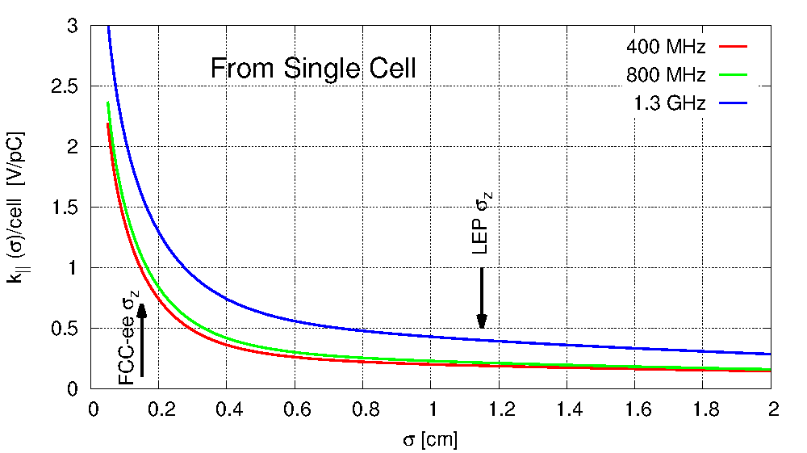
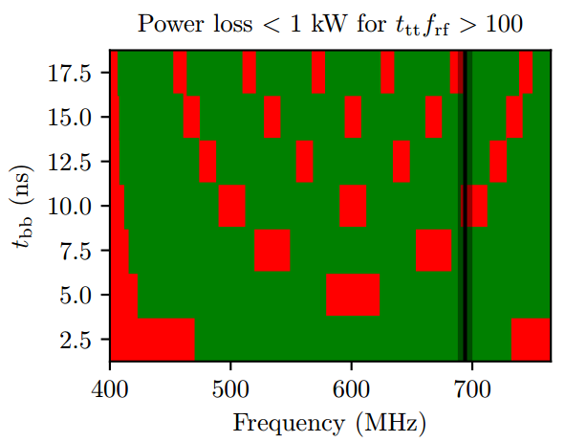
High Power
The very short bunches and high currents, the level of HOM power (CW) is 10’s of kW for the Z & up to 1 kW for the ttbar
The HOM power extracted with and w/o collisions can vary by several factors due to bunch length
For non-resonant excitation, the is not a strong dependence on bunch/train spacing for modes above cut-off
For resonant excitation, some filling schemes are forbidden
Dangerous
Safe
HOM
$$±5 MHz$$
Cut-off: 765 MHz

Slide 24
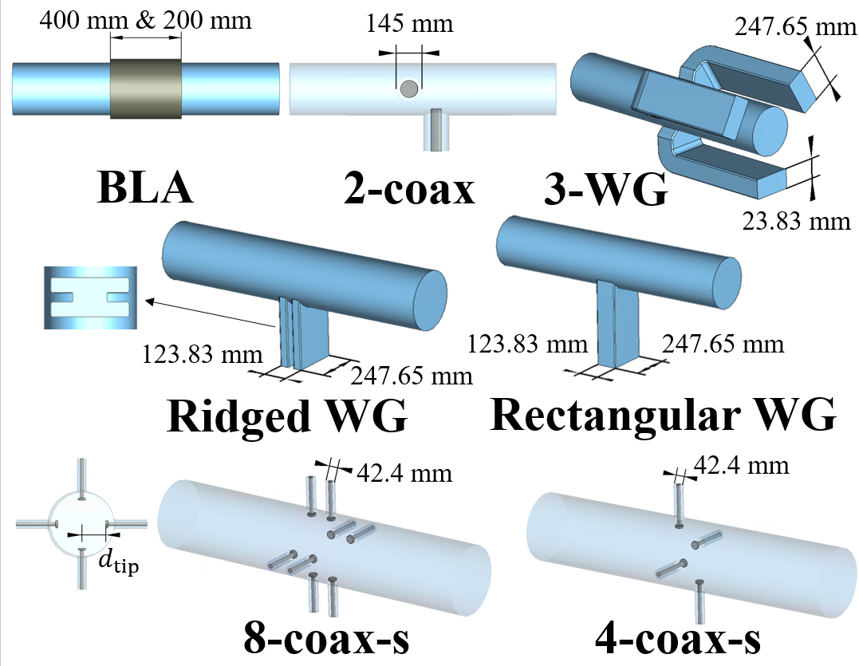
HOM Damping, Cryomodule
It was already studied since the 90’s (LHC) that the behavior of HOM damping is different in a cryomodule w.r.t a scheme optimized on a single cavity. Especially true when cavity-cavity coupling is strong due to large apertures
For FCC, inter-cavity damping and extraction of HOM power is essential. This requires accurate knowledge of power distribution in a CM and not just a single cavity

Slide 25
Inter-Cavity Damping, 400 MHz
A 2-coax solution was found to be a simple an efficient solution for damping inter-cavity trapped modes & extraction of power above cut-off
The distribution of power (total = 40 kW) to allow for uniform output at the level of 10% look reasonable
The huge power extraction and broad-band in nature poses several technical challenges – similar to FPC and complications for CM integration

Slide 26
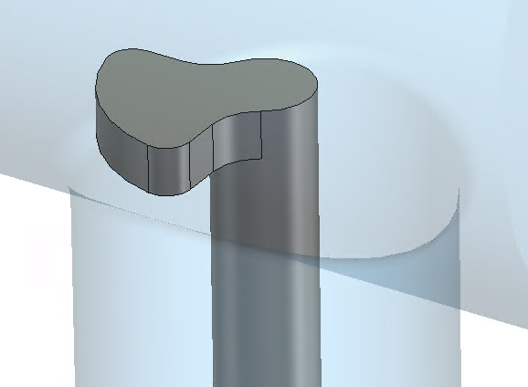
Inter-Cavity Damping, 800 MHz
A single coaxial couplers for efficient damping inter-cavity trapped modes & extraction of power above cut-off. A waveguide solution was studied but more complex to implement
Similar to 400 MHz, approx. 10% of power extraction through these couplers
Some design features to capture both longitudinal and transverse modes to capture different polarizations
$t\overline{t}$: $P_{HOM−tot}≈2.98 kW$
0.28 kW
0.06 kW
0.28 kW
0.31 kW
0.05 kW
0.78 kW
0.06 kW
0.07 kW
0.05 kW
0.73 kW
0.06 kW
0.07 kW
0.07 kW
0.08 kW
0.03 kW

Slide 27
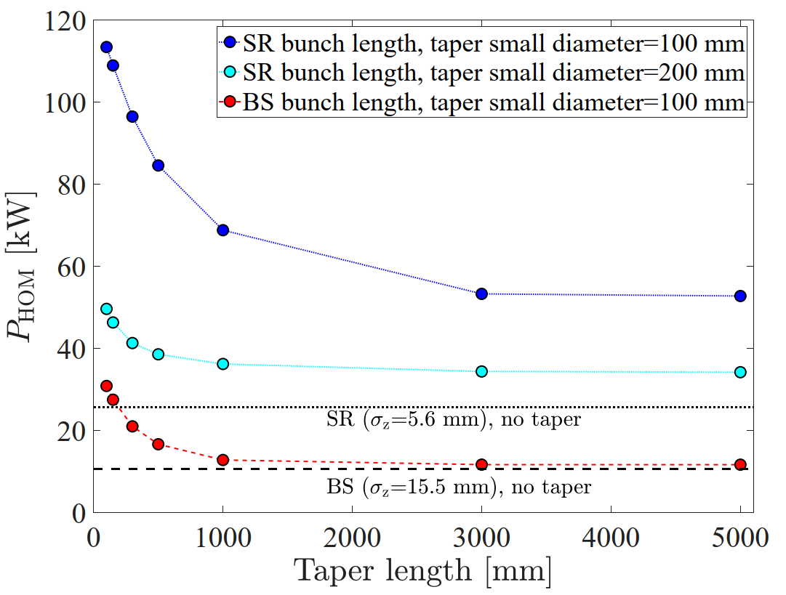
Taper or not to Taper
Taper length
300 mm
Taper small diameter
For practical reasons, it is necessary to reduce the aperture a long taper
For the FCC, the broadband part of the HOM spectrum is major contributor to HOM power
A “taper-less” cryomodule is preferable but may not be practical at 300 mm aperture
Optimum inter-cryomodule transitions with or w/o use of ferrite materials will be a challenge

Slide 28
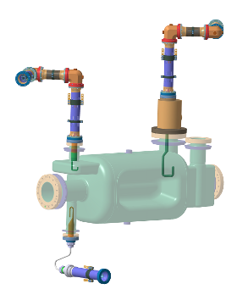
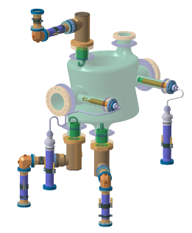
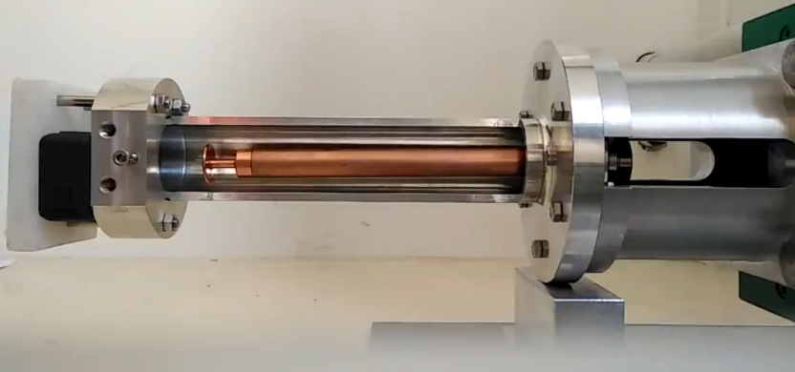
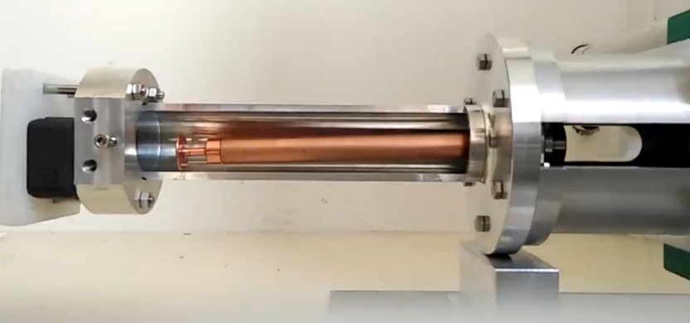
RF Feedthroughs for HOMs
HL-LHC series
1st prototype
The kW level CW power extraction through the HOM feedthrough is real challenge (much like an FPC)
With HL-LHC a substantial focus and R&D was done to develop a high-power feedthrough also taking into account transport of cryomodules ($25Ω$)
There is R&D necessary to master the bonding process of ceramic to Copper and manage stress to make a robust RF feedthrough that can handle high power in SRF environment
10cm drop test
20cm drop test

Slide 29
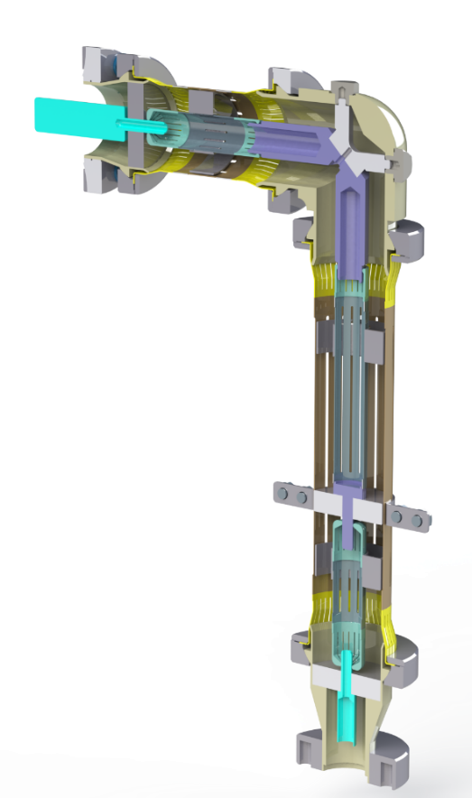
RF Lines for HOMs
The kWs of power needs to be extracted from the couplers to an appropriate RF load in vacuum
A important development during the crab cavity project at CERN led to the development of semi-rigid lines to handle ~5 kW
Stainless Steel lines with 5 µm copper coating including ceramics for thermal anchor. Special RF fingers & thermal intercepts for to account for thermal cycles
Experience shows that these are not trivial & expensive. Mass production for FCC will be a major challenge
HOM coupler feedthrough 2K
Flexible contacts
Ceramic for thermal anchor 80 K

Slide 30
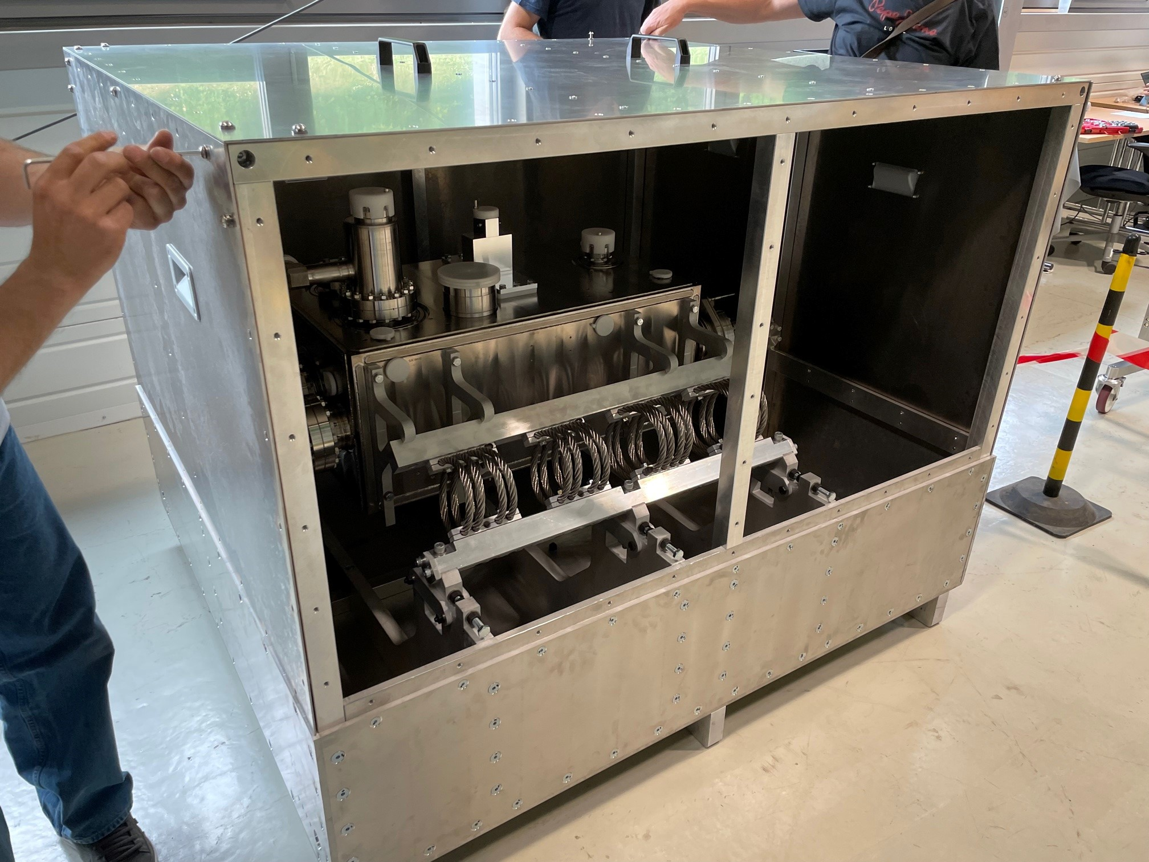
Transport
Elaborate simulations to design supporting frame and transport restraints to minimize the stress during transport (cavities, cryomodules & components)
Logistics to apply this on large number of cryomodules is not trivial
Active shock logging, accelerator meters

Slide 31
Final Thoughts
The FCC requires power couplers (0.2-1 MW level) & many HOM couplers operating at several kW’s level
Efficient power management, RF windows for high power CW operation & transport of couplers will remain the main challenges
The physics timescale proposed for the FCC-ee is very challenging (< 5yrs/working point)

Slide 32
Some References
FPC
https://www.google.com/url?sa=t&rct=j&q=&esrc=s&source=web&cd=&cad=rja&uact=8&ved=2ahUKEwjCpNOB2fiCAxXSDOwKHZoYA1sQFnoECBIQAQ&url=https%3A%2F%2Findico.frib.msu.edu%2Fevent%2F38%2Fattachments%2F159%2F1270%2F20210624_SRF_tutorial_FPC_Eric_Montesinos.pdf&usg=AOvVaw17yghM7w82RMroy5EBoLsr&opi=89978449
HOMC
https://indico.cern.ch/event/1202105/contributions/5391663/attachments/2661531/4610909/1-cell%20and%202-cell%20400%20MHz%20cavity%20RF%20designs%20for%20FCC-ee.pdf
https://indico.cern.ch/event/1280043/

Slide 33
Ceramic Window
Most sensitive part of an FPC & separates the beam vacuum to atmosphere through which very high-power RF has to be transmitted
Any leak on the window immediately leads into degradation of the cavity and nearby elements of the machine
It is commonly a ceramic brazed with metal (after metallization Mo-Mg deposition)
CERN specification report (Al₂O₃ - 97.5 %): http://cds.cern.ch/record/91419?ln=fr
R&D towards 99.5% spec is under study

Slide 34
The SWELL cavity, 600 MHz
Elliptical cavity with radial slots and coaxial couplers for strong HOM damping
A 2-cell design at 600 MHz scenario to be use across the FCC energy regime was proposed to have a single frequency and single cavity type. It is however not beig actively pursued due to beam dynamics issues at 600 MHz for the lowest energy
A prototype at 1.3 GHz is under study for validation to understand the SRF limitations with a complex interface

Slide 35
Use of Beam Pipe Absorbers
Beam pipe absorbers given their broadband damping nature has been exploited in various accelerators. Both 300 K and 77 K absorbers have been studied in great detail
The use for FCC is not obvious and not studied in much detail. Some R&D is required to push the usage of BLA’s in a more robust way than it is done today
XFEL beam line absorber (77K)
Cornell beam line absorber (77K)
CESR beam line absorber (300K)

Slide 36
HOMs of the 800 MHz 5-cell cavity
2DQW couplers
$$Q_{tot}=0.6e3$$
$$Q_{ext}=0.7e3$$
$Q_{tot}=5.9e$4
$Q_{ext}=2.0e$7
$$Q_{tot}=1.6e4$$
$$Q_{tot}=0.8e3$$
$Q_{ext}=1.0e5$
$$Q_{tot}=5.8e3$$
$Q_{ext}=6.3e4$
Some dangerous HOMs above BP cutoff weakly couple to HOM couplers → their Q-factor dominated by power propagating out through BPs
It's not enough to examine the HOMs of a single cavity → the impedance in a cavity string must be considered
$$Q_{tot}=4.4e3$$
$Q_{ext}=5.2e$7
$1/Q_{tot}=1/Q_{ext}+1/Q_{rad}$
$Q_{ext}$ corresponds to the power propagating through HOM couplers
$Q_{rad}$ correspond to radiated power through beam pipes

