Slide 1
Performance of vapor-diffused Nb₃Sn grown on Nb
Uttar Pudasaini
Notes:
Nb3Sn

Slide 2
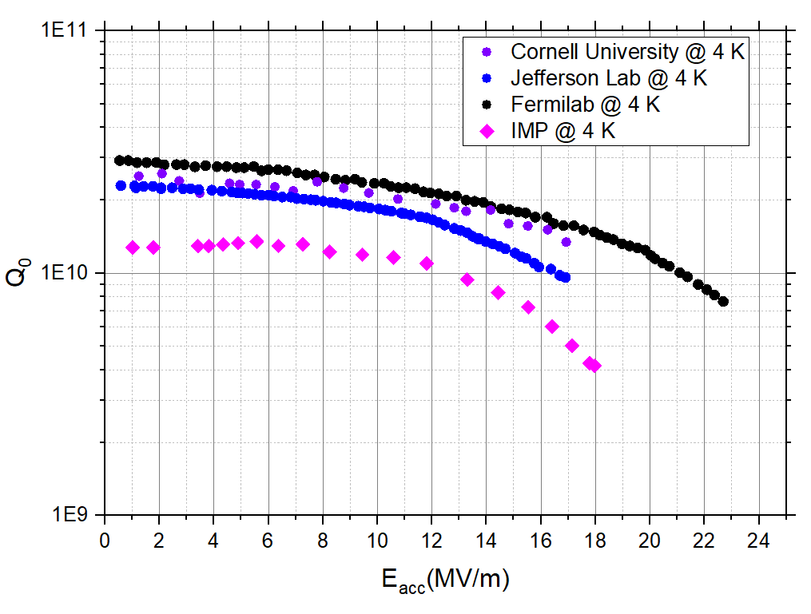
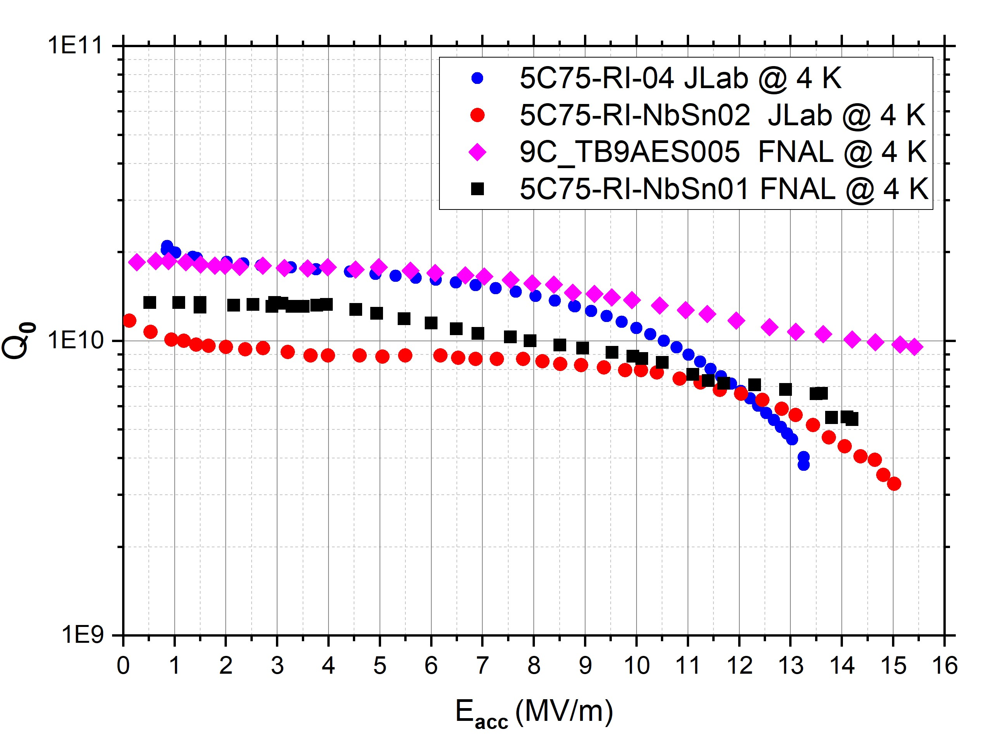
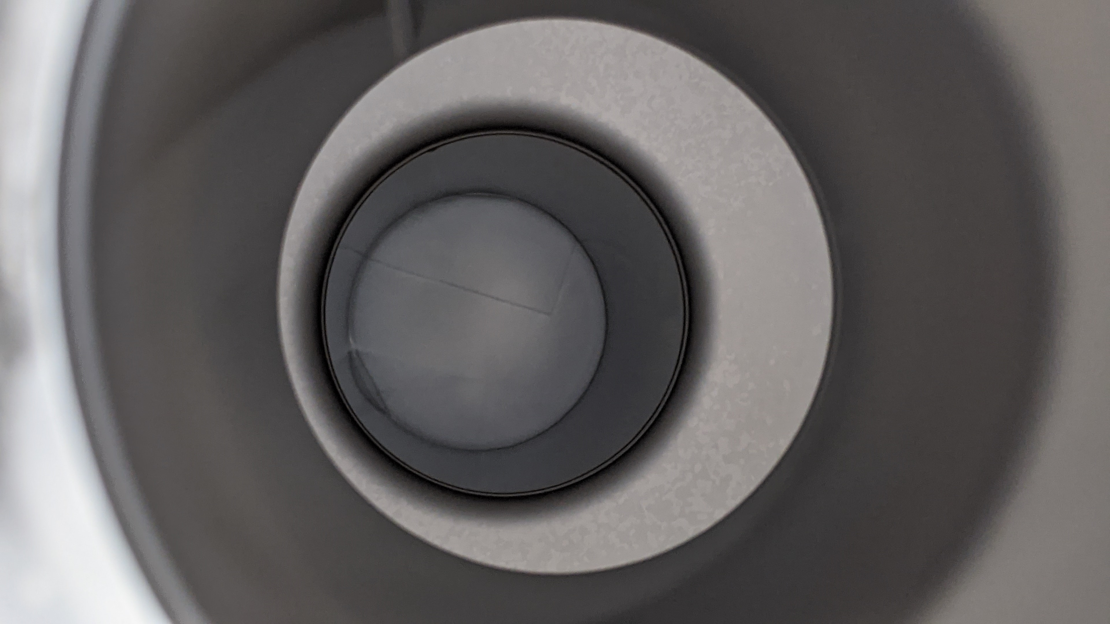
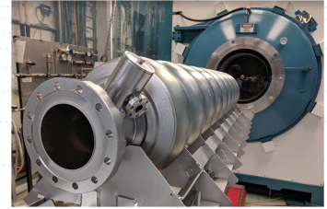
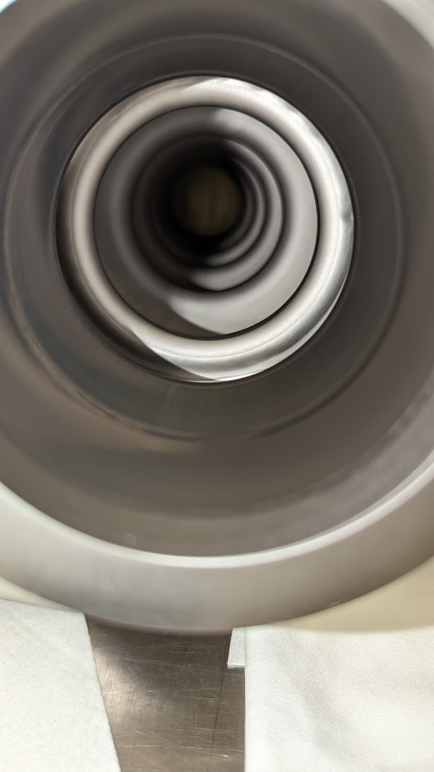
Performance of vapor-diffused Nb₃Sn grown on Nb
R&D 1.3/1.5 GHz single-cell cavity performance
Multi-cell cavity performance
1.31
1.31
1.3/1.5 GHz single-cell cavities attains accelerating gradient in excess of 20 MV/m with Q ~10¹⁰.
Cavities of various frequencies (650 MHz, 952 MHz, 2.6 GHz, 3.6 GHz) coated at different facilities show comparable performance.
952 MHz and 650 MHz cavities successfully operated with cryocoolers.
1.5 GHz five-cell and 1.3 GHz 9-cell cavities were demonstrated to reach Q ~ 10¹⁰ at 10 MV/m at 4.4 K.
Maximum gradients achieved up to ~ 20 MV/m.
Several projects are underway to build cryomodules with coated cavities aiming for 4 K operation with conduction cooling.
U. Pudasaini et al. “Managing Sn-Supply to Tune Surface Characteristics of Vapor-Diffusion Coating of Nb₃Sn”, presented at the SRF'21, East Lansing, MI, USA, Jun.-Jul. 2021, doi:10.18429/JACoW-SRF2021-TUPTEV013.
S. Posen et al. “Advances in Nb₃Sn superconducting radiofrequency cavities towards first practical accelerator applications” Superconductor Science and Technology. 2021 Jan 11;34(2):025007.
D. Hall, “New Insights into the Limitations on the Efficiency and Achievable Gradients in Nb₃Sn SRF Cavities”, PhD thesis, Cornell University (2017).
G. Jiang et al.. Understanding and optimization of the coating process of the radio-frequency Nb3Sn thin film superconducting cavities using tin vapor diffusion method. Applied Surface Science. 2024 Jan 15;643:158708.
TTC-2022

Slide 3
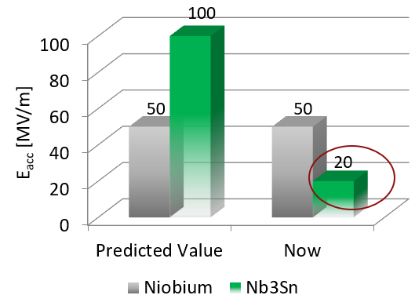
Vapor-diffused Nb₃Sn grown on Nb: current issues
Why is the attainable gradient limited?
Several approaches are being explored to push the gradient.
Roughness/Topography Management: Parameter optimization post-coating treatment and deposition of Sn before thermal diffusion……
Film thickness reduction: correlates with surface roughness reduction and improved gradient limit
What are the other limiting factors?
What causes the frequent Q-slope?
Studies are focused on correlating material properties and RF performance
Grain boundary structure and compositions
Limitations due to local defects
Facility and procedure dependent: performance sensitivity to Sn residue condensation, Ti evaporation from NbTi flanges….?
Feasibility for practical applications – how to preserve thin-film performance?
The coating process is adopted for larger/longer cavities with multiple Sn sources and coating parameter modifications.
How to deposit a high-quality coating on any arbitrary shape/sized cavities?
NbTi flanges are more practical – avoid Ti contaminations
Hardware to contain Ti and/or altering coating parameters?
Reproducibility is challenging!??
TEM analysis of grain boundaries with and without Q-slope

