Slide 1
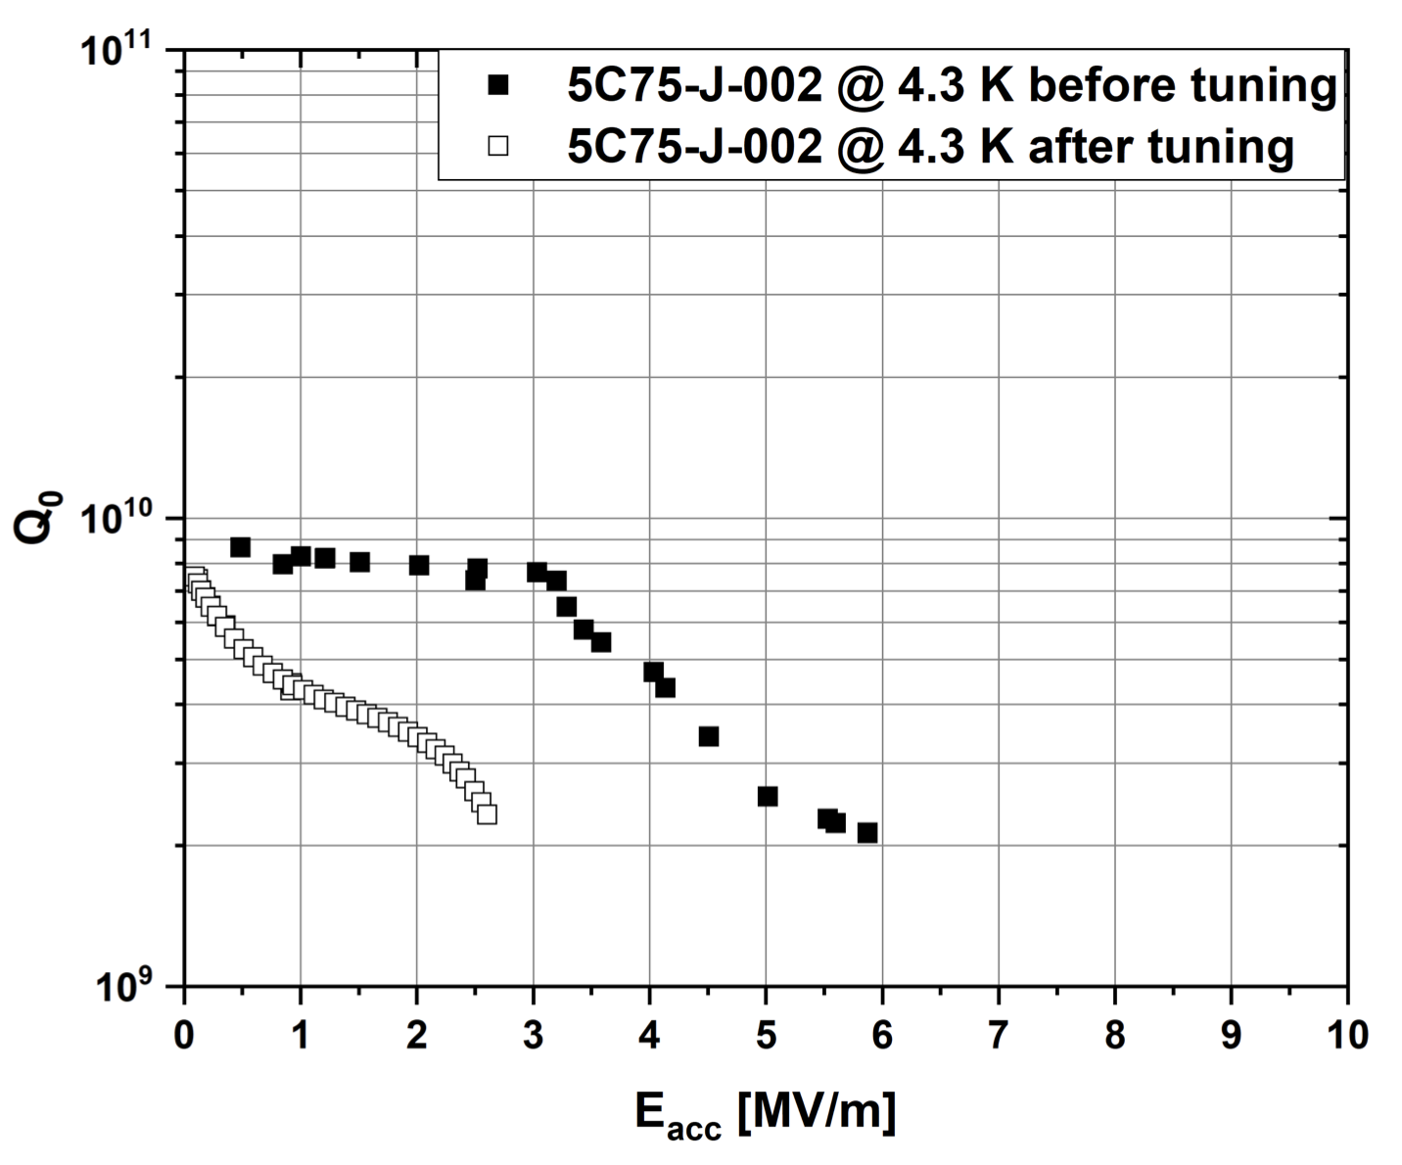
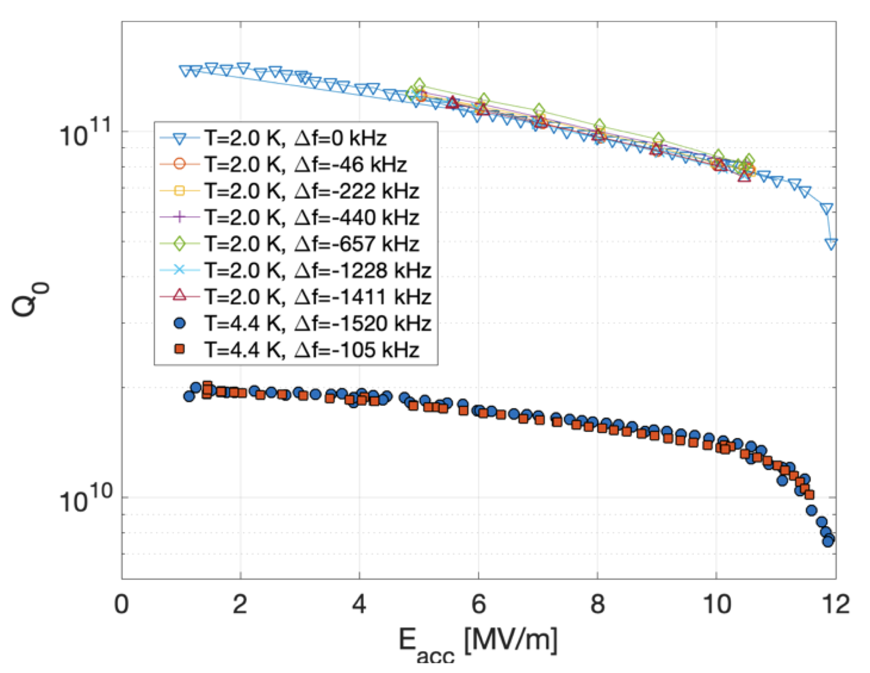
Tunability / robustness of Nb₃Sn
Coated cavities can be very sensitive to mechanical deformation
Strong degradation in the coated cavity performance after room temperature tuning for 200 kHz
Little change in the coated cavity performance after tuning up to 1400 kHz at cryogenic temperatures

Slide 2
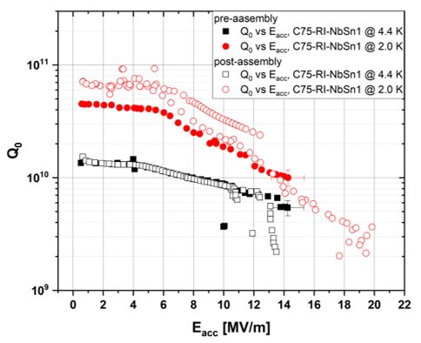
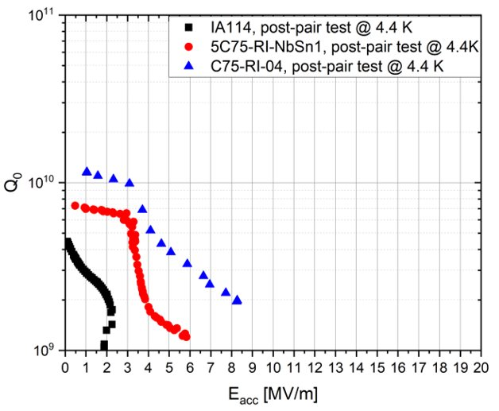
Tunability / robustness of Nb₃Sn
By now we have coated and progress towards string assembly several cavities. Unfortunately, it is not just mechanical tuning to the accelerator frequency on the tuning bench that degrades the performance
Mechanical tuning: increase in surface resistance and field dependence
No mechanical tuning: low field Q is retained, but still strong field dependence
No mechanical tuning & no “pair” test: performance is better retained in one cavity and…
This manuscript has been authored by Fermi Research Alliance, LLC under Contract No. DE-AC02-07CH11359 with the U.S. Department of Energy, Office of Science, Office of High Energy Physics.

