Slide 1

Closed cycle cryocoolers for conduction cooling of SRF cavities
Roman Kostin, Euclid BeamLabs, Bolingbrook, IL, USA
Notes:
Dr. Roman Kostin. Roman Kostin graduated from Moscow Engineering Physics Institute, Russia in 2012 with a M.S. in Physics, and received his Ph.D. in 2017. The subject of his thesis was “Superconducting Traveling-Wave Cavity Development.” In 2011, he was granted a President Scholarship to study abroad, which covered his internship at Fermilab (Batavia, IL, USA), where he worked on a normal conducting bunching cavity for Project-X. Roman Kostin became a Euclid Beamlabs employee in 2013. From 2016 to 2018, he was the PI of a project on conduction cooling and RF structures development under a CRADA with Fermilab/IARC. Dr. Kostin’s research interests include normal conducting and superconducting RF devices development, engineering design, optimization, and testing. He is currently a project lead for a compact X-ray source and an SRF gun based on conduction cooling for ultrafast microscopy. Dr. Kostin currently serves as the Principal Engineering Physicist and Director of Engineering Department of Euclid Beamlabs LLC.

Slide 2
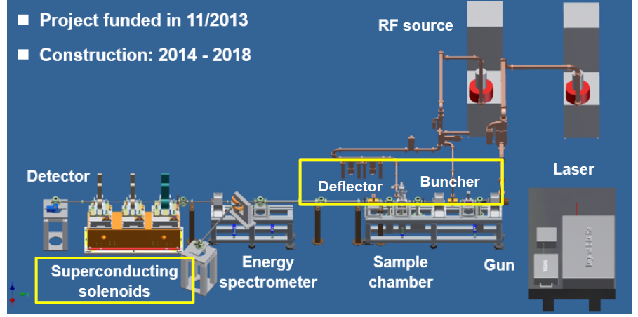
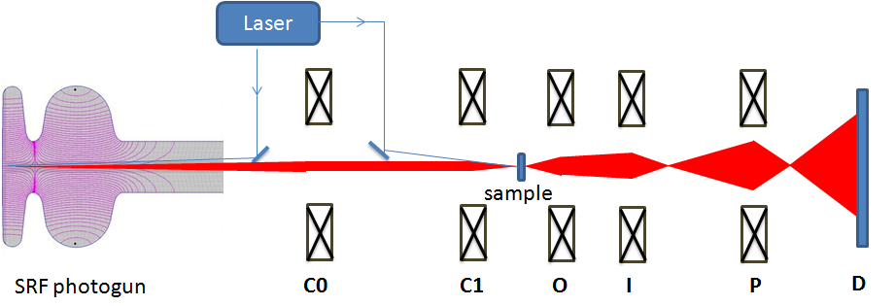
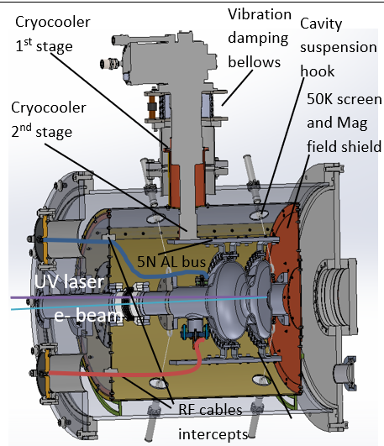
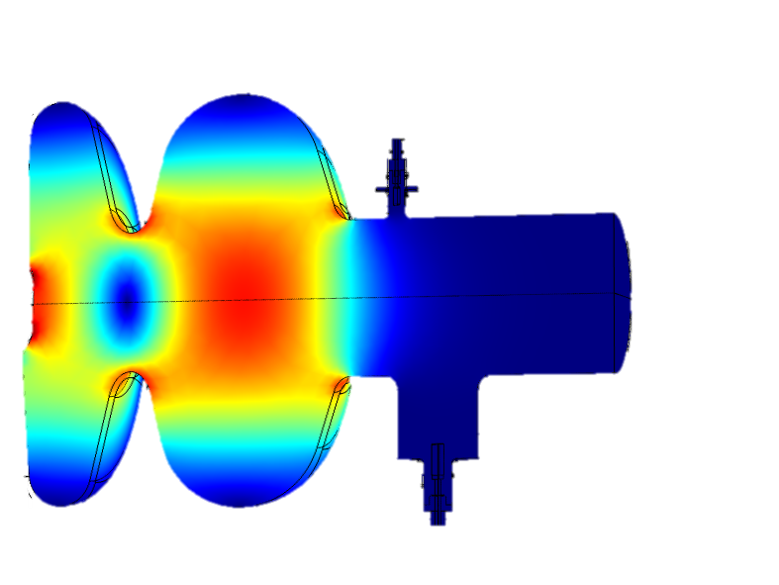
Why do we need cryocooler and what we are doing?
Conduction cooled Nb₃Sn SRF photo-gun for UED/UEM:
4K operation temperature (Nb₃Sn)
2W cryocooler is required ($50K, relatively cheap)
CW operation
Smaller footprint, 10W RF power only
Higher stability
A
Gun parameters
A
Parameter | Value
Frequency | 1.3 GHz
Length | 1.45cell (166.54mm)
Q0 at 4°K (Rs = 20 nΩ ) | 1.16×10¹⁰
R/Q | 176.9 Ω
Geometry factor | 232 Ω
Wall Power dissipation | 0.9 W
E on axis | 20 MV/m
E max | 23.5 MV/m
B max | 43.3 mT
E acc | 10 MV/m
Courtesy of Dao Xiang, talk at IPAC19
Optional
B

Slide 3
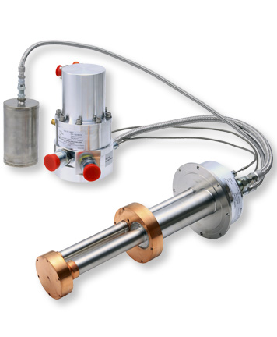
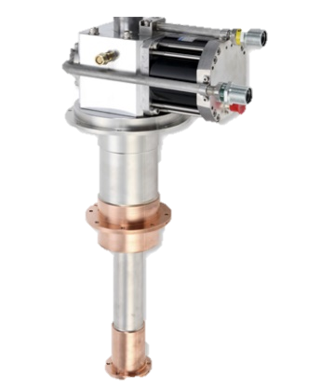
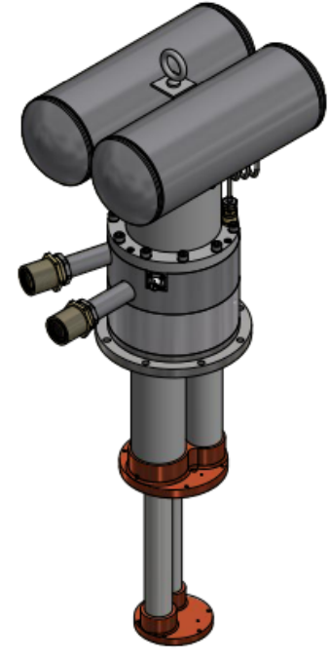
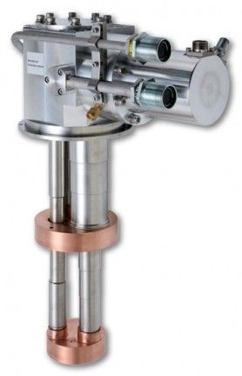
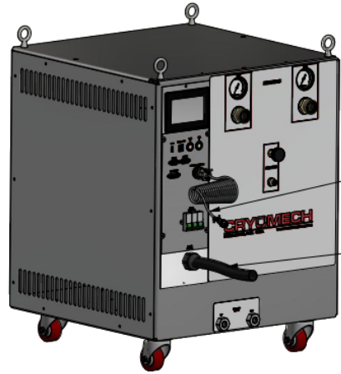
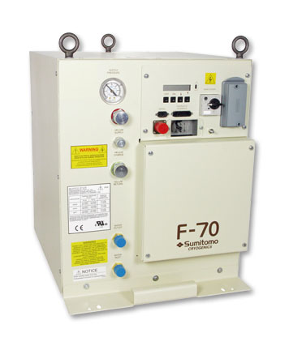
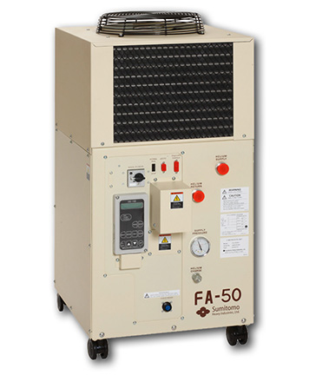
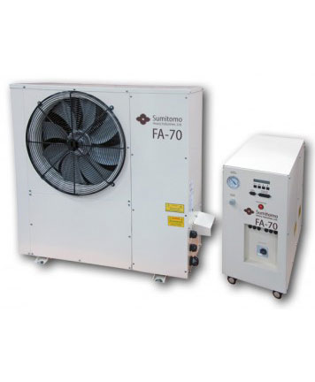
Closed-cycle cryocoolers: intro
Cryocooler consist of a cold head and a compressor
Most widely used cold heads: Gifford-McMahon (GM) and Pulse Tube (PT)
Pulse Tubes Cooling Capacity (CC) goes to 0 in horizontal orientation
Pulse Tubes have a remote valve option (less vibrations, but CC-10%)
Compressors types: air cooled, water cooled - chiller req-d (more $ and Power Consumption X1.5)
Sumitomo 4.2 [K] options: indoor/outdoor air/water cooled compressors, PT and GM cold heads
Cryomech 4.2 [K] options: water cooled compressors only, PT only
CRYOMECH
SUMITOMO
Pulse Tube (PT)
Remote valve PT
PT
Remote valve PT
GM
Cryomech water cooled
compressor
Sumitomo water cooled compressor
Indoor air cooled
Outdoor air cooled

Slide 4
Closed-cycle cryocoolers: specs
Things to consider
  PRICE
  Efficiency
  Power and cooling supply
  Maintenance: PT 20k hrs, GM 10k hrs
  Cooler scheme: pulse-tube of Gifford Mc Mahon
  Cooling capacity
  Operation conditions (vertical or not)
  Vibrations
  Sizes
Interesting correlation:
  Power consumption is driven by compressor
  Cooling capacity is driven by cold head
Euclid choice was Sumitomo air cooled because of price and no cooling water supply.
Table.1 Closed cycle cryocooler cost based on quotes collected in 2020
 | Cryomech Water Cooled PT | Sumitomo Water Cooled GM | Sumitomo Air Cooled GM
Cold head | $30k (PT420RM) | $36k (RDE-418) | $36k (RDE-418)
Compressor | $25k (CP1114) | $7k (F-70L) | $13k (FA-70L)
Misc. | $8k | $2k | $6k
Chiller | $20k | $20k | NA
Total | $83 | $65k | $55k
Same compressor
Same compressor
Notes:
Sumitomo has more options upto 2W, but unfortunately not much progress since 2020
Cryomech less efficient, PT only but CC was significantly improved

Slide 5
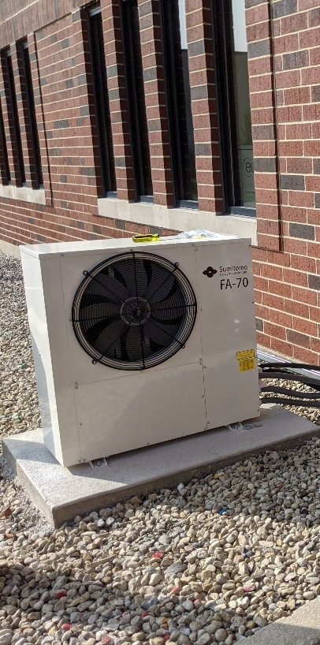
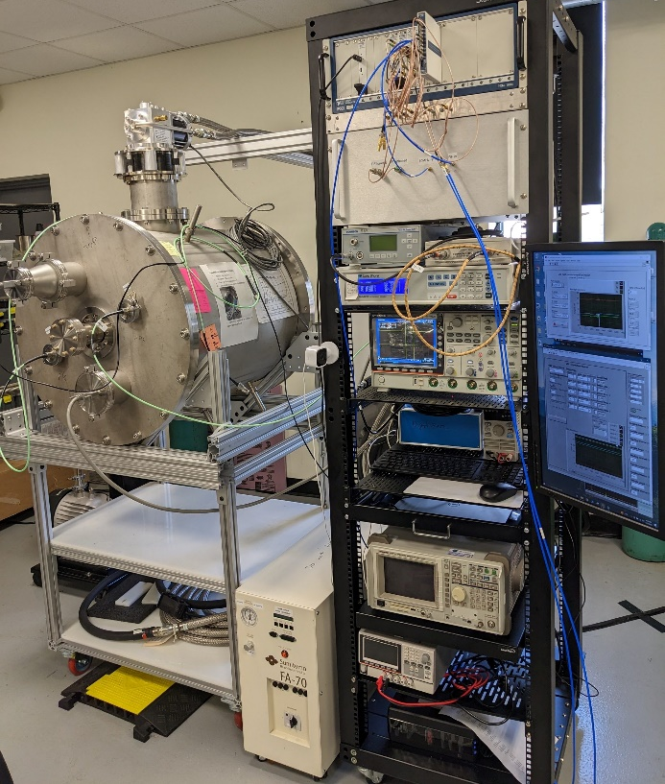
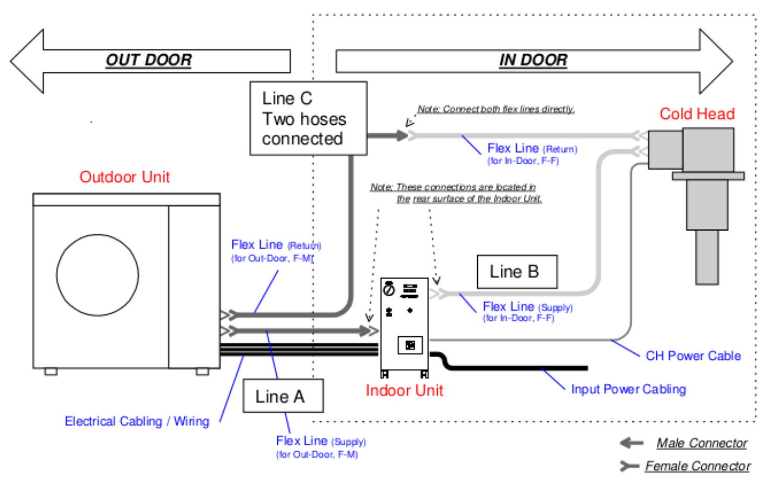
Summary
Euclid Conduction cooled Cryomodule with LLRF rack
Cryomech and Sumitomo had only 2 [W] systems back in 2020
Cryomech offered only PT cold heads and water-cooled compressors:
  Water cooled compressors require chiller:
    Increases power consumption x1.5, 20 [kW] total
    Increases price by $20k - $83k total.
  PT
    Can operate vertically only
    Maintenance in 20k [hrs]
    Lower vibrations for remote valve option only
Sumitomo offered GM/PT with air/water cooled compressors
Euclid choice was Sumitomo air cooled GM system:
  Power: 8 [kW]: 40 [Amp], 200 [V] 3 phase.
  Price: $55k
  Can operate upside down if needed
  Maintenance in 10k [hrs]
  Vibration is not an issue: Euclid cavity was locked despite 5 [Hz] bandwidth.

