Slide 1
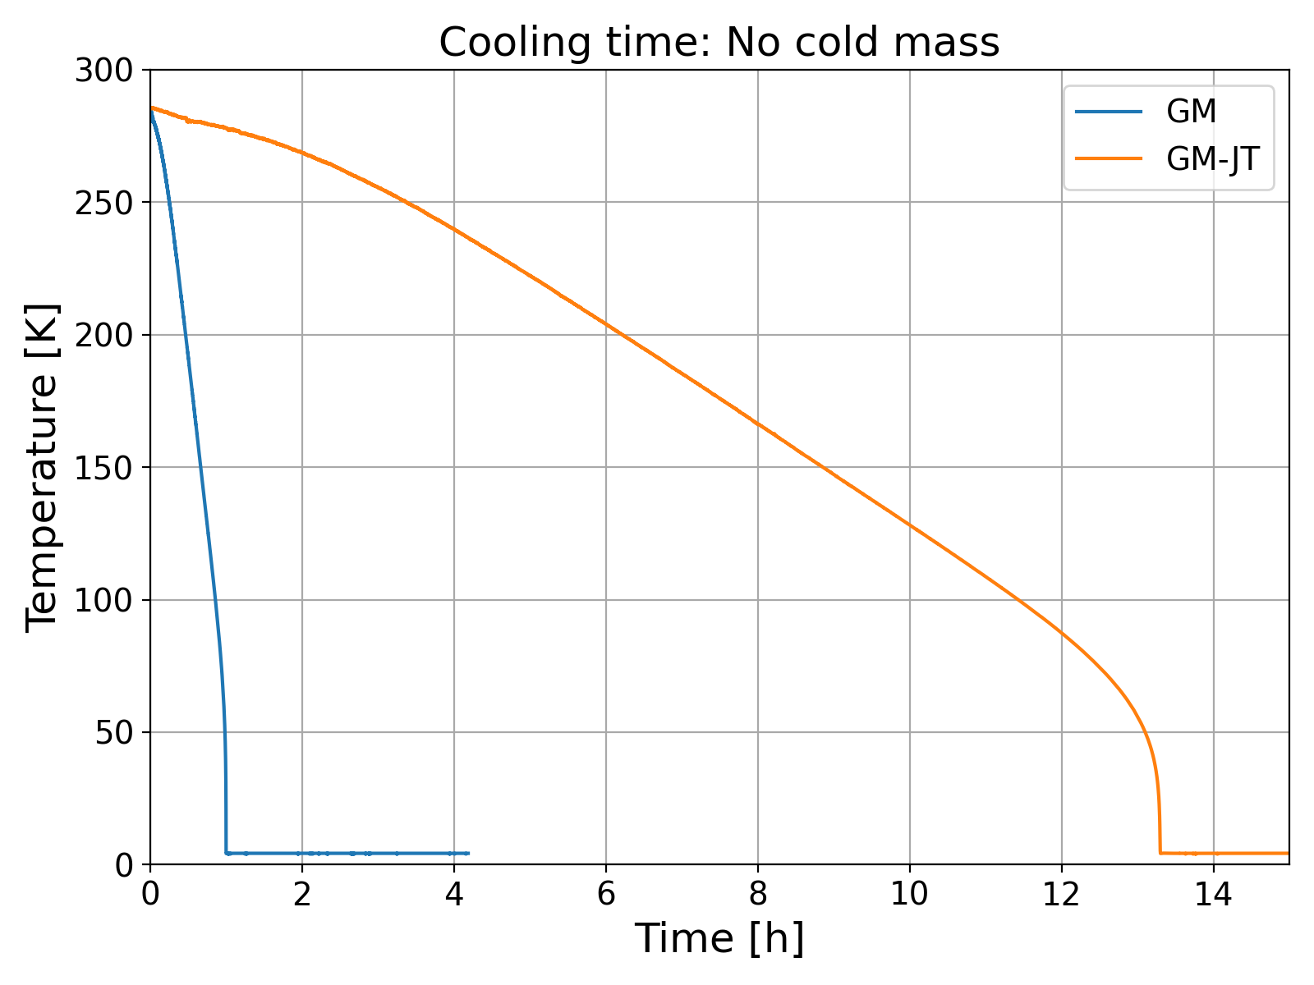
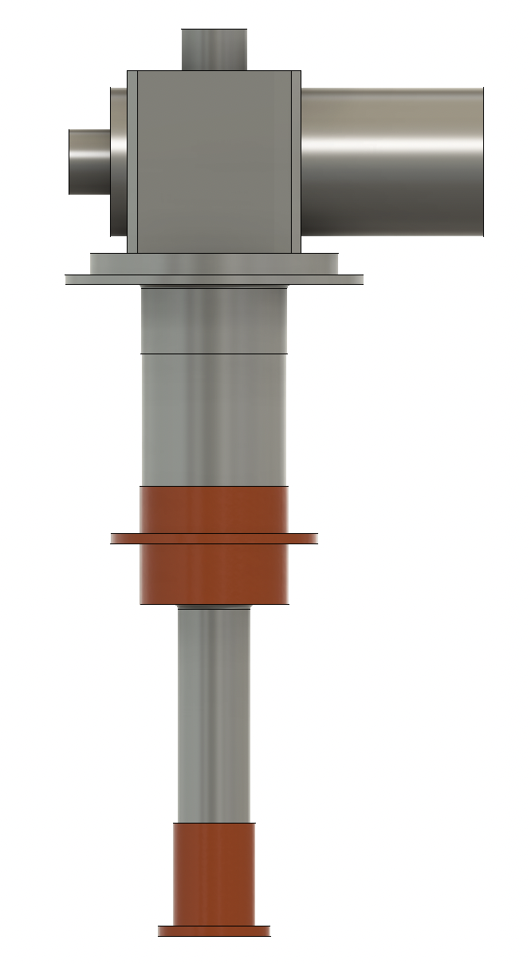
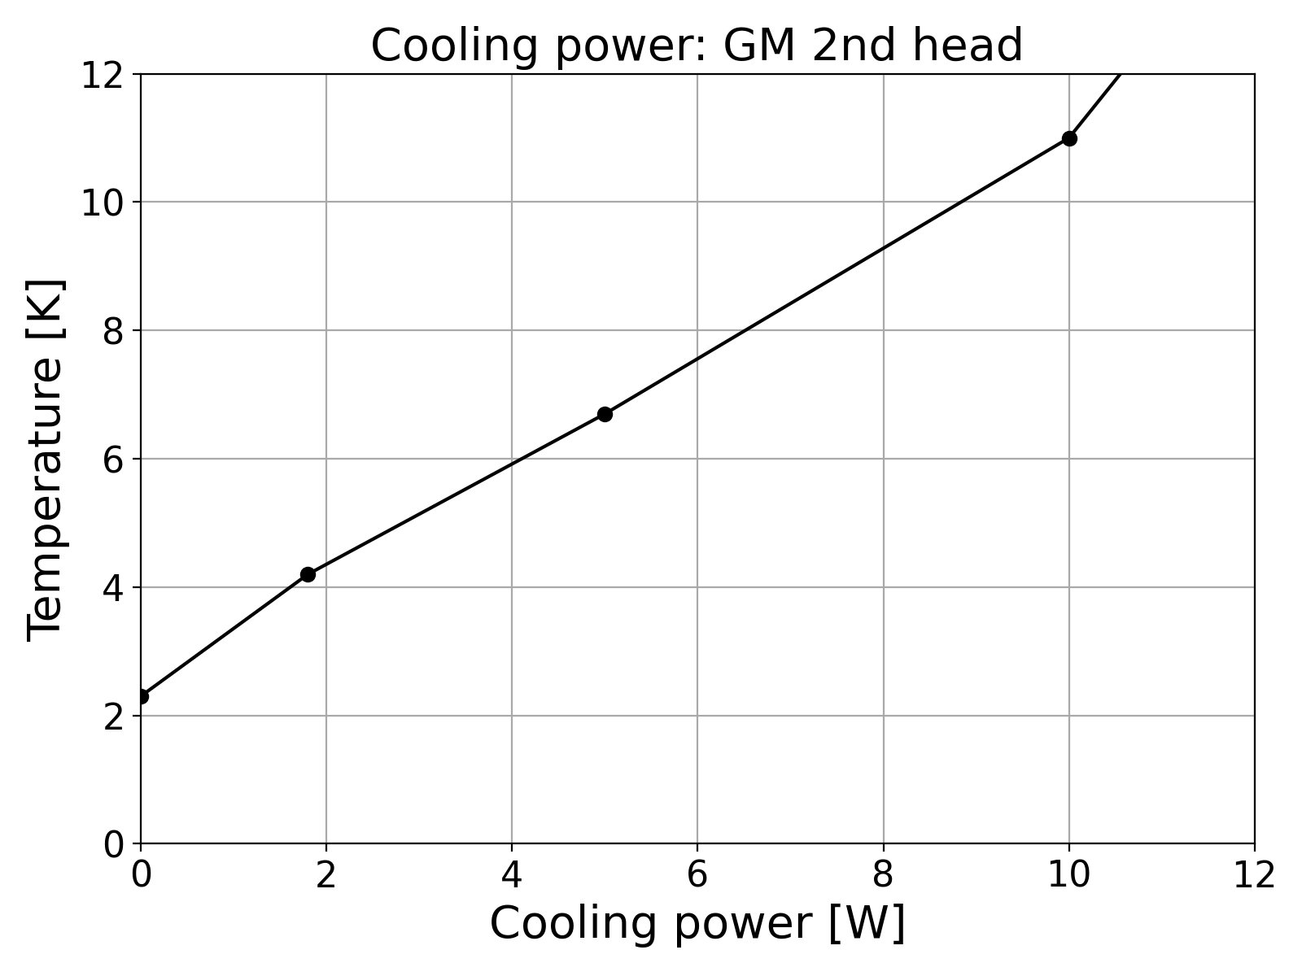
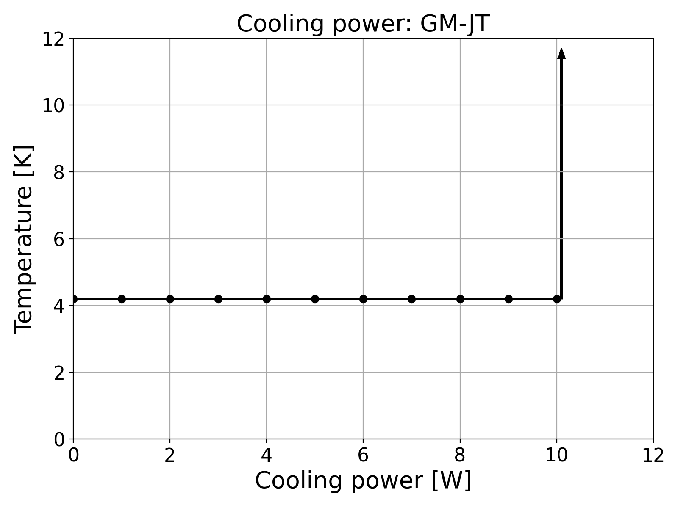
GM and GM-JT cryocoolers (by Tomohiro Yamada)
300mm
Cooling time w/o cold mass
350mm
1040mm
550mm
GM-JT: Approx. 13 hours
GM: RDE-418D4 (SHI)
GM-JT (SHI)
GM: Less than 1 hour
Above 100K
Thermal breakdown
The GM doesn’t have thermal breakdown, whereas the GM-JT will be thermally broken above allowable heat input (9-10W).
The GM-JT takes long cooling time because of its poor cooling capacity in high temperature region.
2023.12.07 Hot Topic session: Choice of cryocoolers, T. Yamada (KEK)

Slide 2
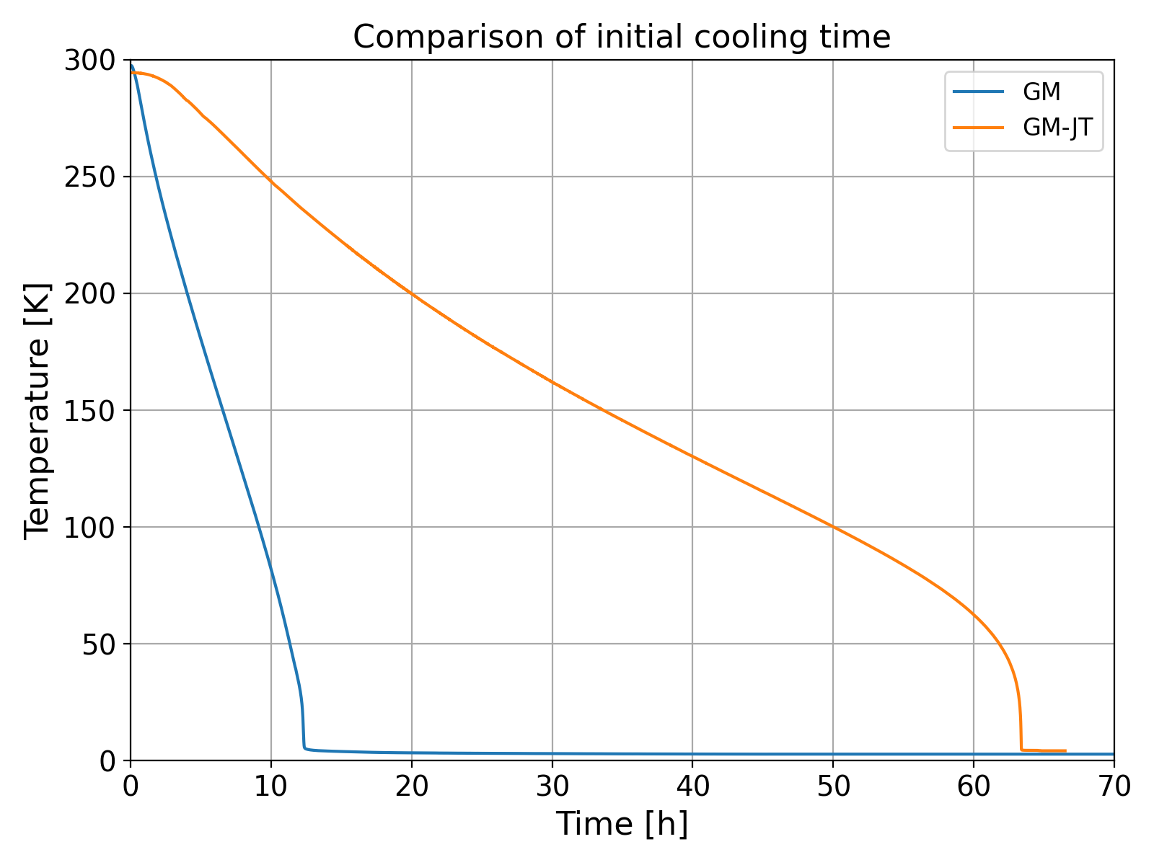
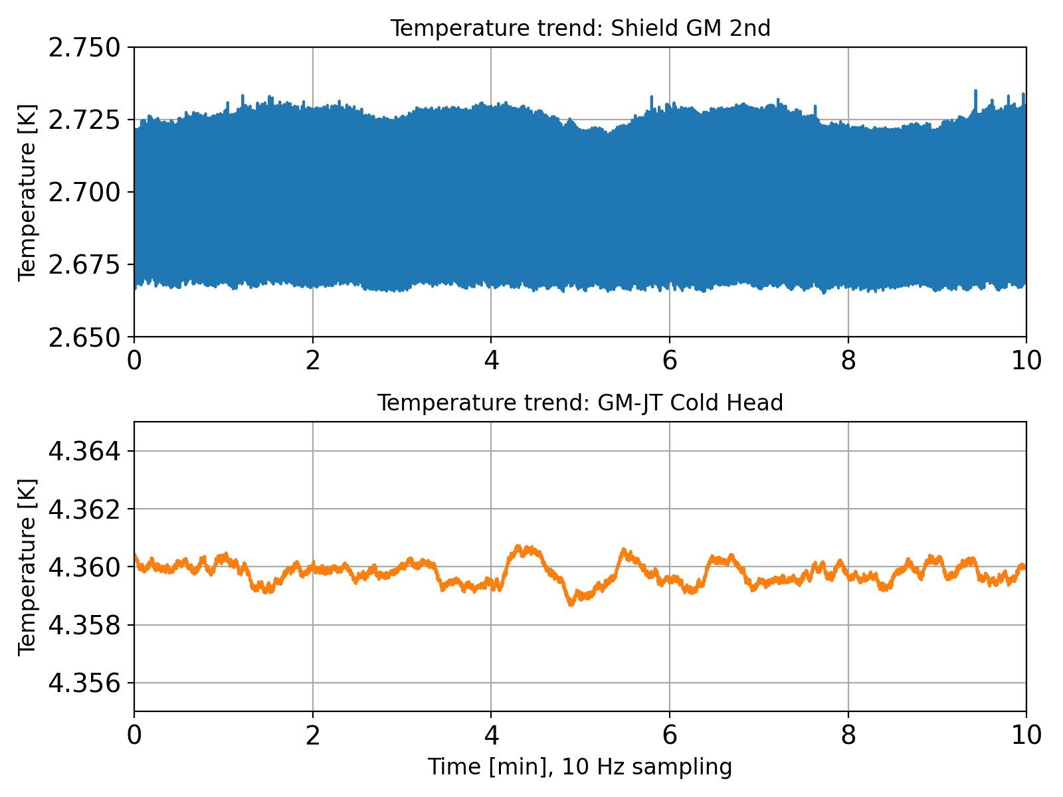
Cavity cooling (1.3GHz)
Cooling time of 1.3 GHz single cell cavity
Cold heads’ temperature oscillation
Max Min
2.735K 2.664K
Δ=70mK
100 mK
Max Min
4.361K 4.359K
10 mK
Δ=2mK
GM: 12 h
(cavity: 2.7 K)
GM-JT: 63 h
(cavity: 4.3 K)
GM-JT temperatures were quite stable.
We saw several hundreds Hz of frequency fluctuation in the GM case. <- Due to vibration or temperature?
Considering thermal resistance in the thermal link and RF heating at the cavity, the cold head temperature needs to be as low as possible to keep the cavity temperature near 4.2K.
GM-JT takes almost 5 times long time to cool down the cavity.
Minimum temperatures for cases of GM and GM-JT were 2.7 K and 4.3 K, respectively.
2023.12.07 Hot Topic session: Choice of cryocoolers, T. Yamada (KEK)

