Slide 1
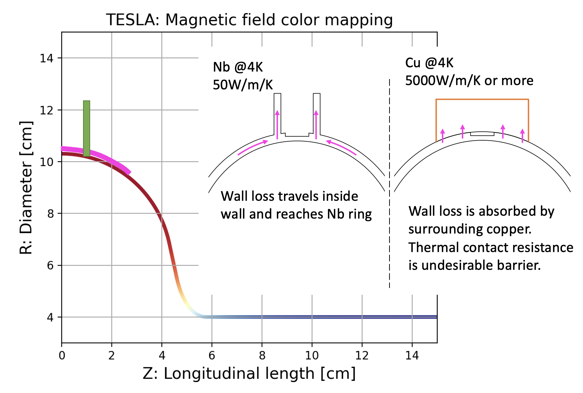
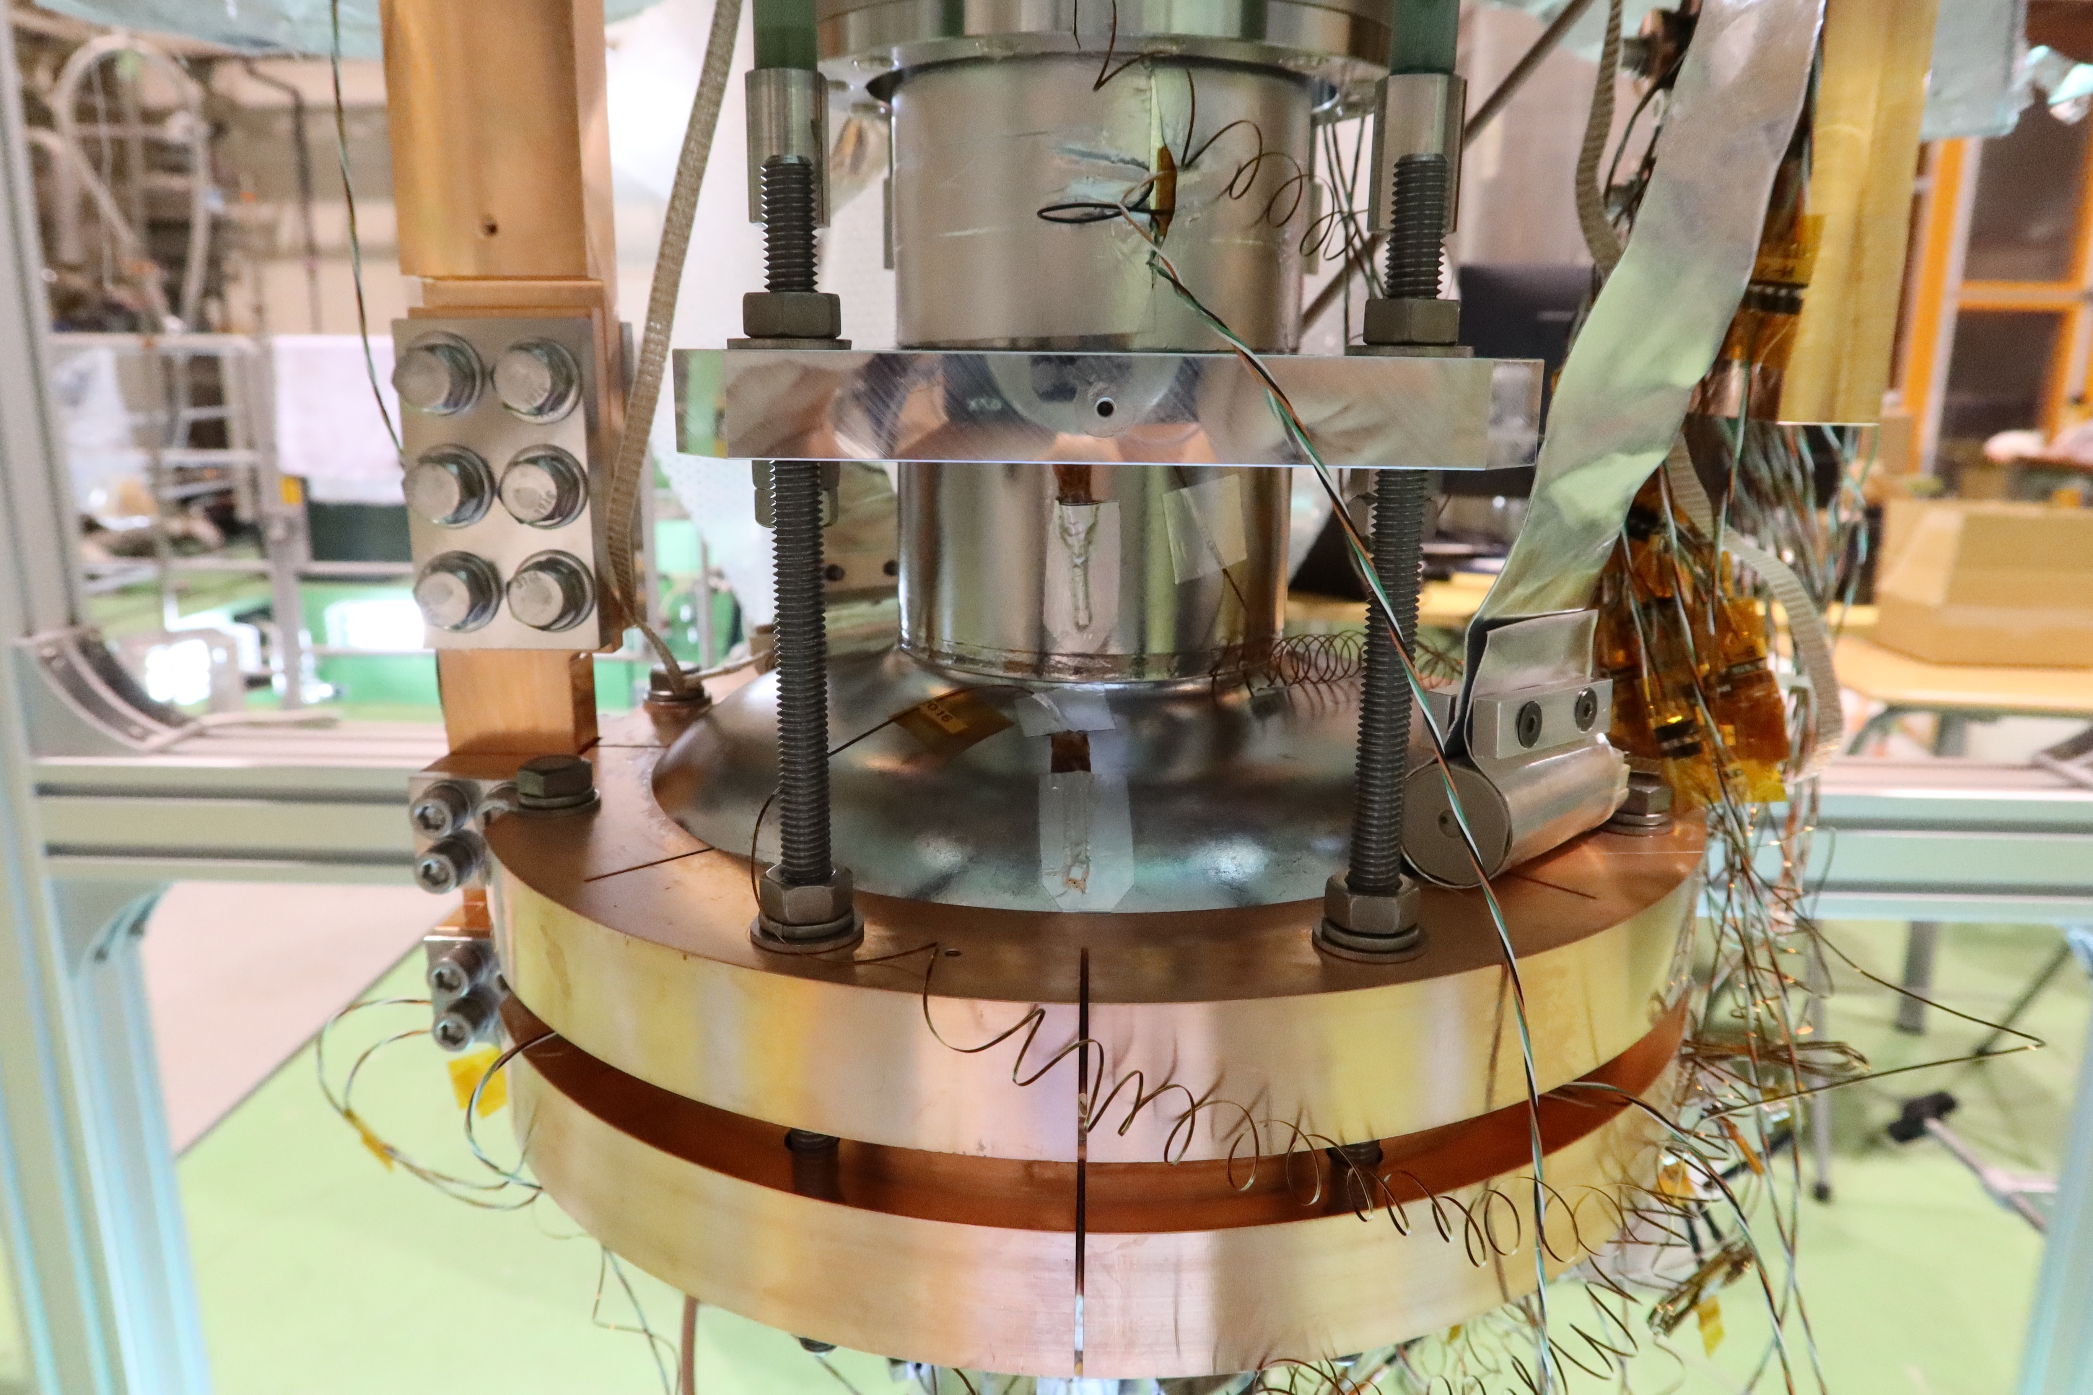
Cooper ring strategy (by Tomohiro Yamada)
KEK adapted copper ring equator clamping as a first trial of conduction cooling.
Reasons:
Cooling wide area of equator outside
Detachable system for Nb3Sn re-coating
(Short time implementation)
2023.12.07 Hot Topic session: Thermal link design, T. Yamada (KEK)

Slide 2
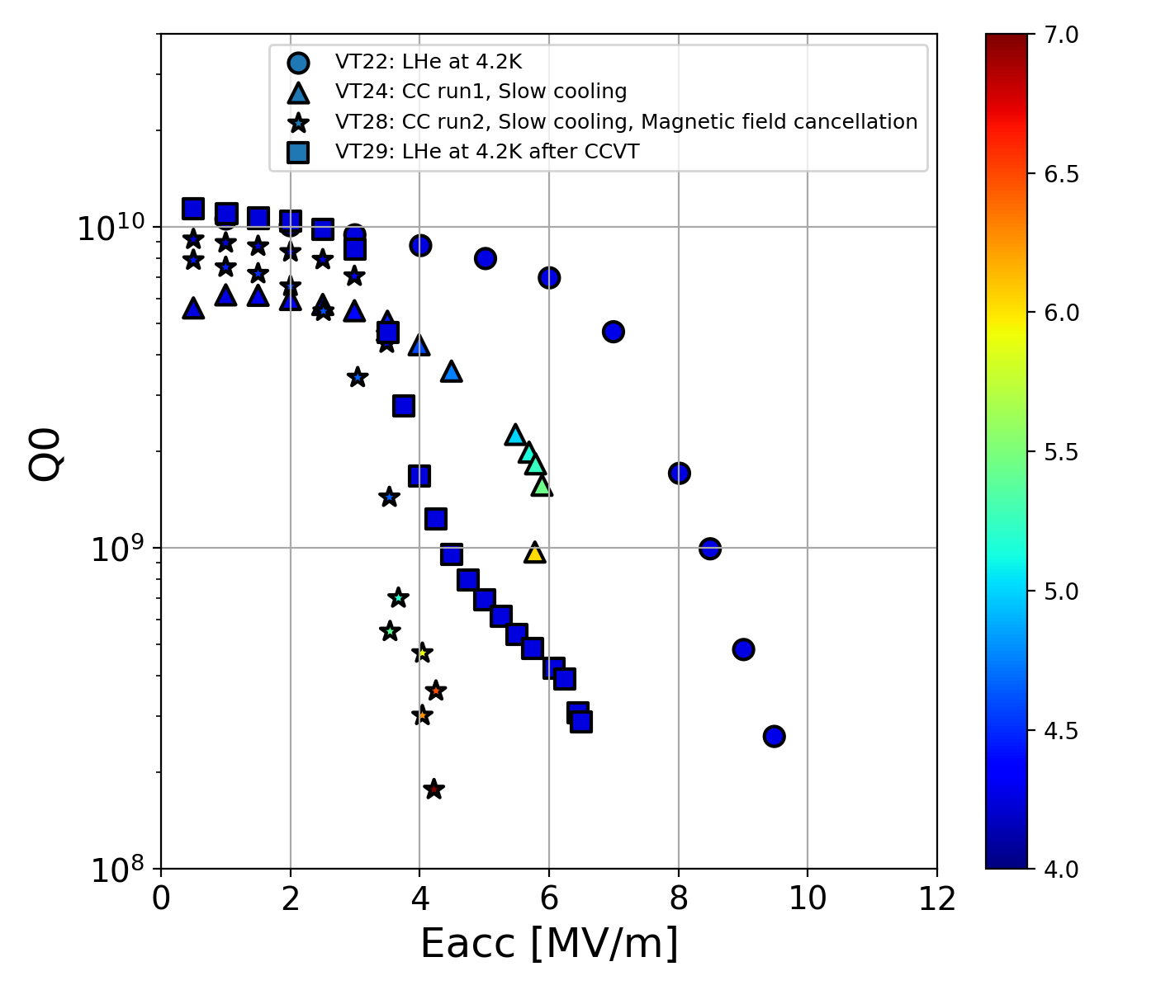
RF test with copper ring
Observation:
Cooling speed (and temperature gradient) largely affected RF performance.
Magnetic field was improved by cancelling magnetic field out.
Nb3Sn film (~3um) was broken in the process of copper ring clamping. (It is possible to avoid film-breaking by assembly carefully.)
The cavity was well cooled, however, the conduction cooling didn’t show the QE curve as high as the LHe test. (Both residual magnetic field was almost same.)
Question:
Do we need to cover wider surface area of the cell?
Cavity temperature
2023.12.07 Hot Topic session: Thermal link design, T. Yamada (KEK)

