Slide 1
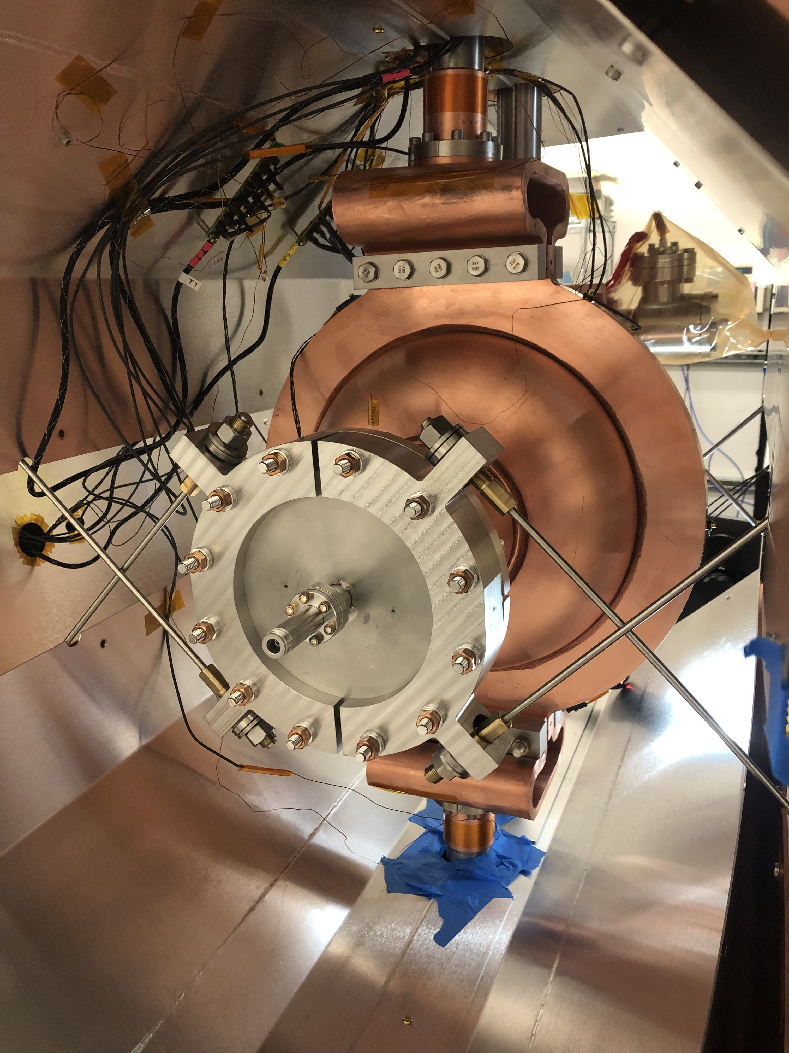
Introduction to Hot-Topic discussion
TESLA Technology Collaboration Meeting
Fermilab, Batavia, IL
4-8 December 2023
Gianluigi Ciovati

Slide 2
Conduction-Cooled SRF Cavities
Why conduction-cooled SRF cavities?
Eliminate the need for liquid He cryoplants for SRF accelerators, thereby:
Reducing footprint
Reducing capital cost
Simplifying cryomodule design
Safer to operate
Enabling industrial applications
Does conduction cooling of SRF cavities work?
Use high-quality Nb₃Sn thin films
Use commercial cryocoolers with high cooling power at 4 K
Single-cell cavities with frequency in the range 0.65 – 2.6 GHz cooled by cryocoolers have been tested up to an accelerating gradient of 10-12 MV/m

Slide 3
Challenges for Conduction-Cooled SRF Cavities
Choice of cryocooler
GM, PT, GM-JT
Thermal link design
Cu, Al, foils, straps, bulk
Nb₃Sn thin-film performance
On Nb: thermal diffusion, magnetron sputtering, electroplating
On Cu: CVD, PVD, magnetron sputtering, bronze route
Tunability of Nb₃Sn-coated cavities
Warm, cold
Cryocoolers
Low-loss fundamental power coupler
Thermoelectric magnetic flux

Slide 4
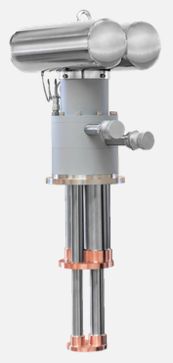
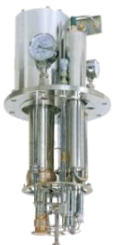
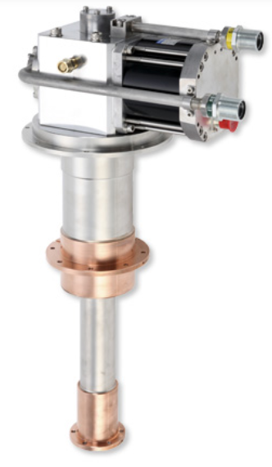
Choice of cryocoolers
GM-type
PT-type
GM-JT-type
14.1 kW for 9 W at 4 K
Fixed temperature
Limited mechanical loading to cold stage
Requires separate shield cooler
7.5 kW for 2 W at 4 K
~$45k
Limited mechanical loading to cold stage
Vibrations at 1.2 Hz
12.5 kW for 2 W at 4 K
~$60k
No moving parts

Slide 5
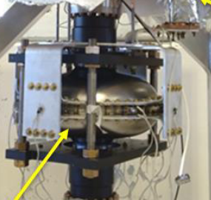
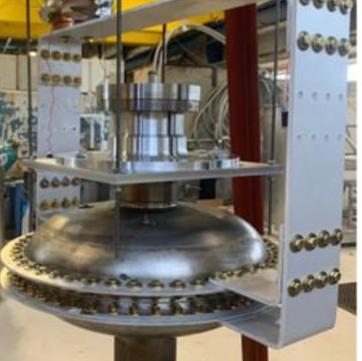
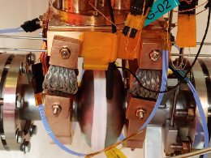
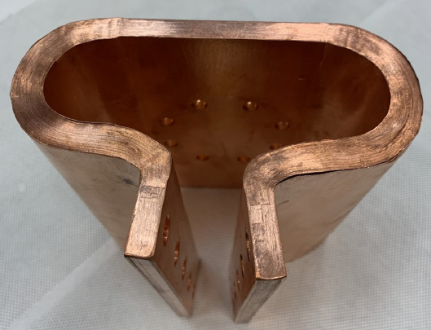
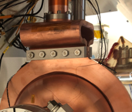
Thermal link design
Cu foils with press-welded terminals
Aluminum bus-bars
Cu thermal braids + Cu clamps
99.9999% purity Al bars
“rigid” connection
Indium foil used at interfaces
Time-consuming assembly
Braided Cu straps
Flexible connection
Indium foil used at interfaces
High clamping force (required for low thermal resistance) can damage the brittle Nb₃Sn film
99.9% purity Cu foils
Flexible connection
Apiezon N grease used at interfaces

Slide 6
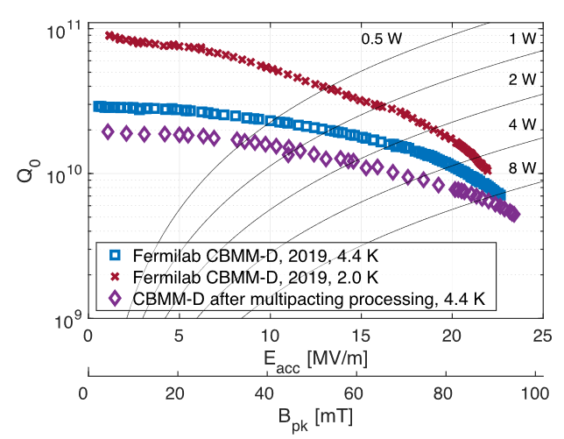
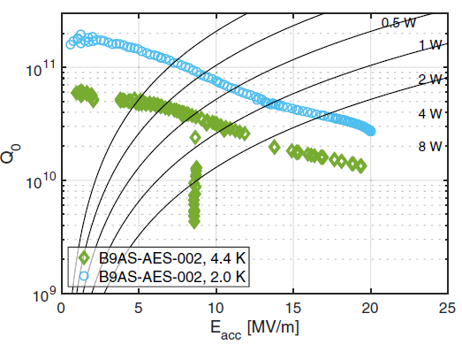
Nb₃Sn thin-film performance
State-of-the-art performance of Nb₃Sn thin-film on Nb by vapor diffusion in liquid He:
1.3 GHz single-cell
650 MHz single-cell
How do we achieve this type of performance reproducibly?
Is Ti contamination of the film from the Ti45Nb flanges as issue?
How do we achieve this type of performance on Cu?

Slide 7
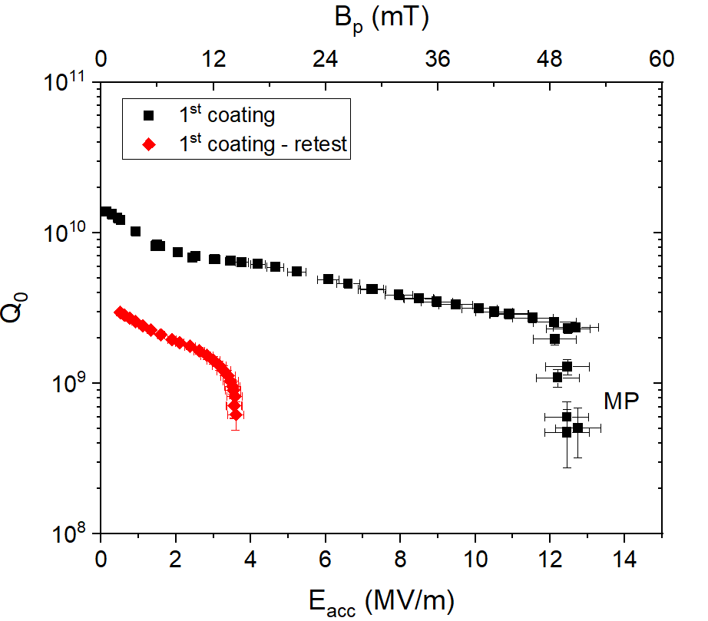
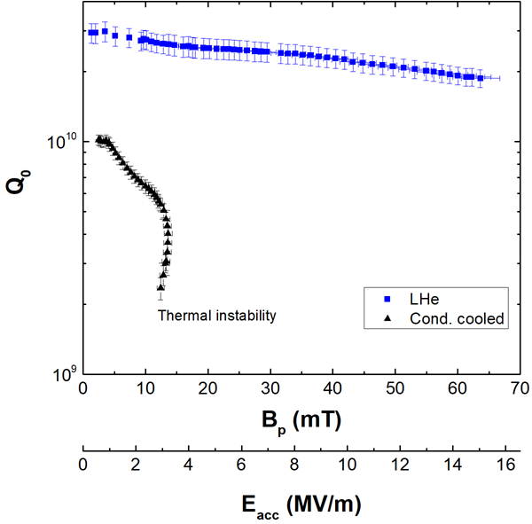
Tunability
952 MHz single-cell
1.3 GHz single-cell
-330 kHz at RT
-3.2 MHz at RT
How to overcome the brittleness of Nb₃Sn?
What is the maximum tuning range at 300 K before degrading performance?

