Slide 1
The use of high purity aluminum for conduction cooling of SRF cavities
Ram C. Dhuley on behalf of Fermilab’s conduction-cooled SRF project team
2023 TTC Meeting at Fermilab
07 December 2023

Slide 2
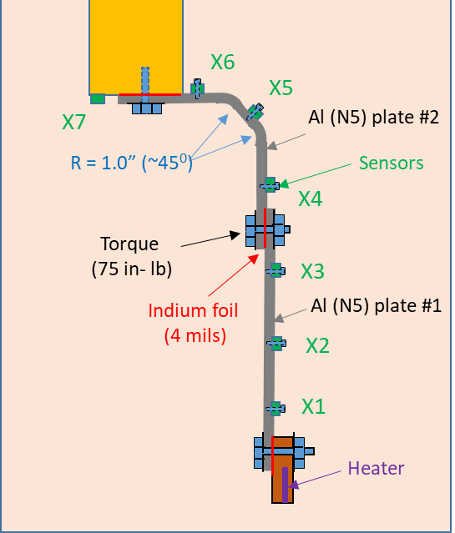
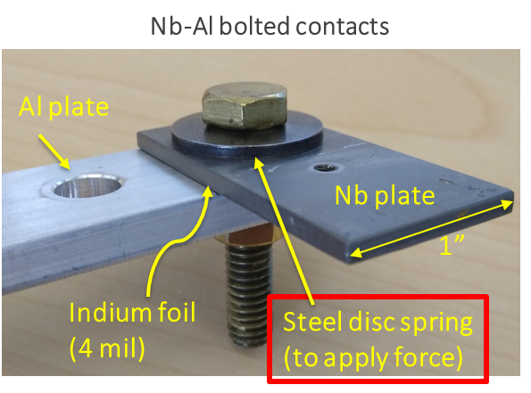
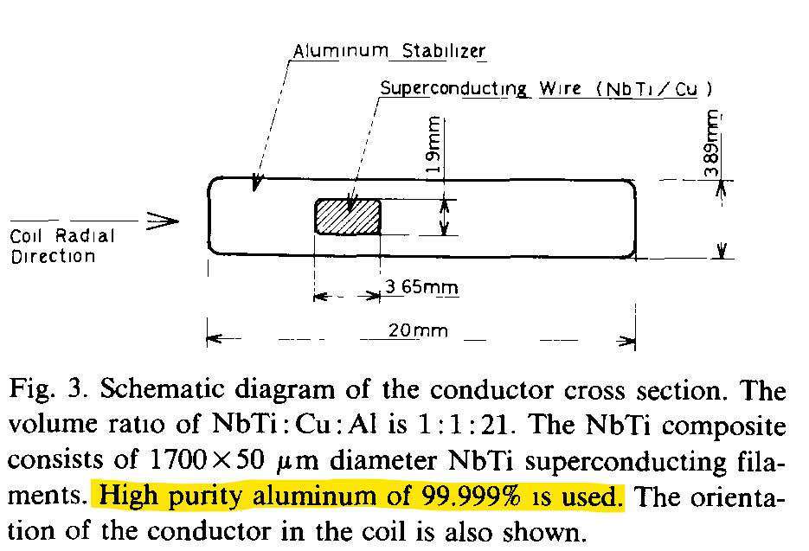
Fermilab’s conduction-cooled SRF program is built on the
use of high purity aluminum thermal links
Superconductor for Fermilab’s CDF solenoid
High purity Al thermal conductivity, Al-Al and Al-Nb contact resistance near 4 K
Minemura, Kephart*, et al. (1985) https://doi.org/10.1016/0168-9002(85)91023-X
4 K cryocooler
Data available at:
R.C. Dhuley, et al. (2018)
https://doi.org/10.1016/j.cryogenics.2018.06.003
4 mm thick
Al plate
*R.D. Kephart is also the founding member of Fermilab’s conduction cooled SRF program
Courtesy : Dr. Oleg Prokofiev (Fermilab)

Slide 3
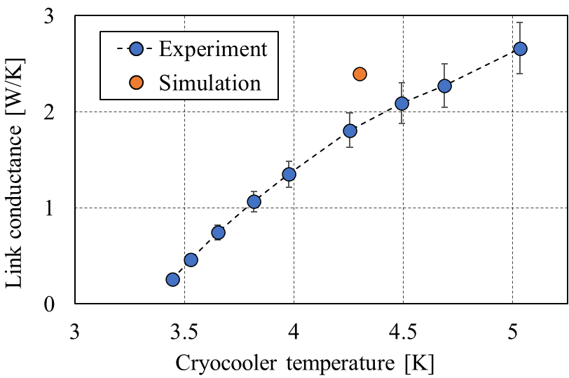
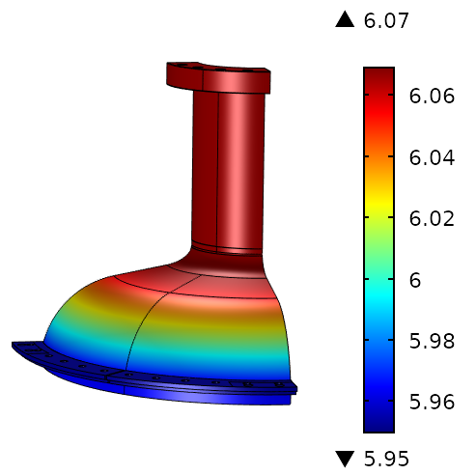
Fermilab’s conduction-cooled SRF program is built on the
use of high purity aluminum thermal links
Al conduction link bolted to the
Nb rings welded to the cavity
Comparison of measured and simulated link thermal conductance
Nb₃Sn cavity
Computed cavity surface temperature at steady state with ~10 MV/m cw
Ring temperature = 5.95 K,
RF dissipation = 2.4 W
ΔT_{spatial} ~0.12 K
Courtesy : Dr. Roman Kostin (Euclid Techlabs, LLC.)
R.C. Dhuley et al 2022 IOP Conf. Ser.: Mater. Sci. Eng. 1240 012147

