Slide 1

Cooling link design for conduction cooled SRF cavity*
Roman Kostin, Euclid BeamLabs, Bolingbrook, IL, USA
*Work supported by US DOE SBIR grant DE-SC0018621
Notes:
Dr. Roman Kostin. Roman Kostin graduated from Moscow Engineering Physics Institute, Russia in 2012 with a M.S. in Physics, and received his Ph.D. in 2017. The subject of his thesis was “Superconducting Traveling-Wave Cavity Development.” In 2011, he was granted a President Scholarship to study abroad, which covered his internship at Fermilab (Batavia, IL, USA), where he worked on a normal conducting bunching cavity for Project-X. Roman Kostin became a Euclid Beamlabs employee in 2013. From 2016 to 2018, he was the PI of a project on conduction cooling and RF structures development under a CRADA with Fermilab/IARC. Dr. Kostin’s research interests include normal conducting and superconducting RF devices development, engineering design, optimization, and testing. He is currently a project lead for a compact X-ray source and an SRF gun based on conduction cooling for ultrafast microscopy. Dr. Kostin currently serves as the Principal Engineering Physicist and Director of Engineering Department of Euclid Beamlabs LLC.

Slide 2
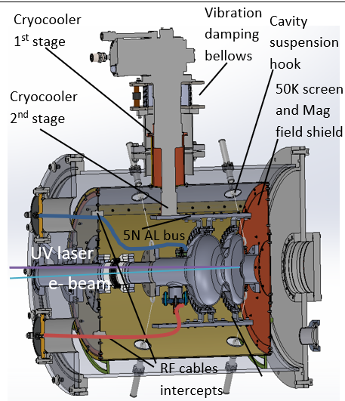
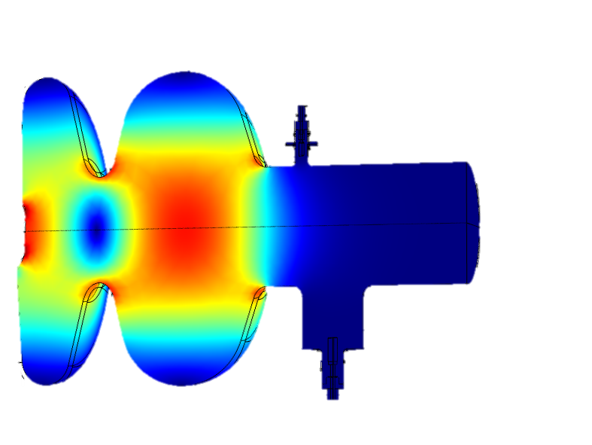
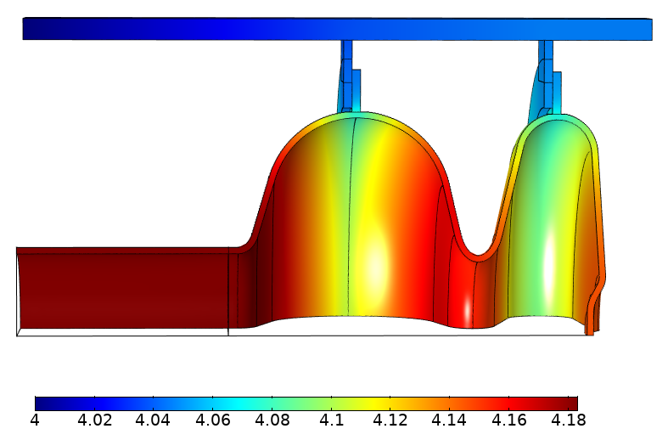
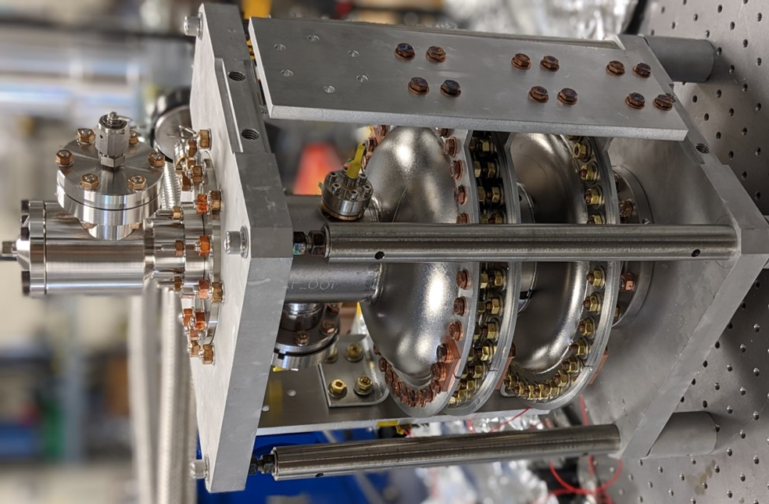
Cooling link design based on Nb equator ring and high purity AL
Euclid develops Conduction cooled Nb₃Sn SRF photo-gun for UED/UEM
Eacc=10 MV/m should be achievable with single cryocooler
Cooling link design – Fermilab’s approach:
  EBW Nb equator ring + bolted 5N AL link
  Differential thermal expansion safe
  Simple manufacturing
Stable operation regimes was simulated: 0.9 [W] dissipation; 1.1 [W] excess of cooling power
Parameter | Value
Frequency | 1.3 GHz
Length | 1.45cell (166.54mm)
Q0 at 4°K (Rs = 20 nΩ ) | 1.16×10¹⁰
R/Q | 176.9 Ω
Geometry factor | 232 Ω
Wall Power dissipation | 0.9 W
E on axis | 20 MV/m
E max | 23.5 MV/m
B max | 43.3 mT
E acc | 10 MV/m
Q0=1E10
ΔT=0.1K
Cavity with the links
T [K] at Eacc=10 MV/m
Power dissipation
Excess of cooling power
Notes:
Thermal analysis was conducted which included temperature dependent material properties, thermal contact resistance and RF power dissipation (BCS resistance). Stable operation can be achieved for Rbcs+10nOhm and 20nOhm with only one cryocooler

Slide 3
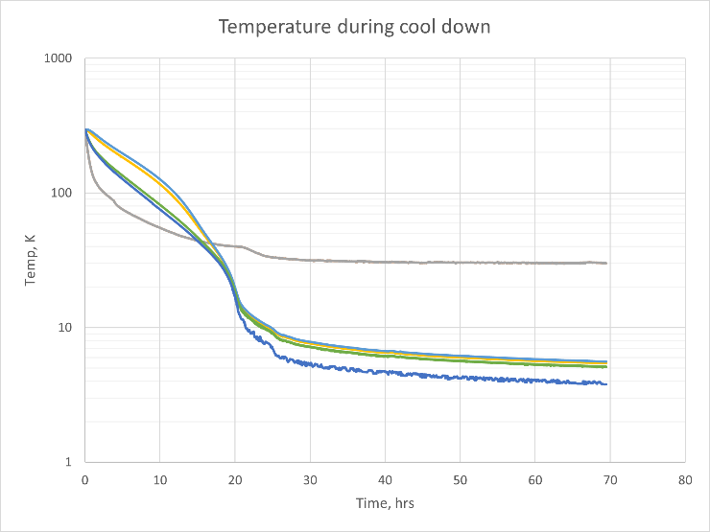
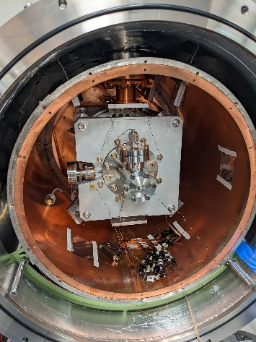
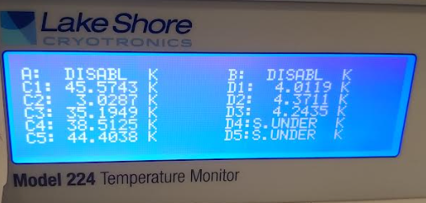
Cavity was cooled to 4.2 [K] in the conduction cooled cryomodule
Nb3Sn Cavity in VTS: Q0=7e9
  Contaminated during deposition
  Recoat is planed
1st Cryomodule results:
  Q0=1E9 - fast cool down
  Q0=5E9 – controlled cool down
  Cavity temperature ~4.2 [K] w/o Apiezon or Indium
  Links polishing and Apiezon to improve contact are underway
C1 - Back of the radiation screen
C2 - 2nd Stage of the cryocooler
C3 - Inner Braid ring: screen to chimney
C4 - 1st Stage of cryocooler
C5 - Front of the radiation screen
D1 – Cavity Top
D2 – Cavity Bottom
D3 – Cavity Middle
Q0=5E9
Q0=1E9

