Slide 1







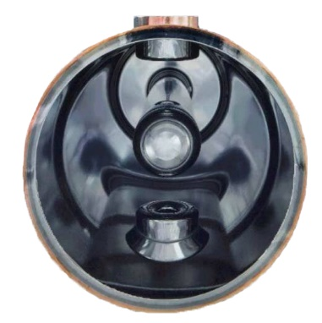


Nb₃Sn on Cu:
Different technologies under study:
PVD
  Magnetron Sputtering
    Single Target
    Double Target
  HiPIMS
CVD
Electroplating
Bronze Route
Motivations for Cu substrate
Cheaper than Nb
Higher thermal conductivity
Higher mechanical stability
PVD technology (Nb on Cu)
already used for:
LEP, LHC, HIE-ISOLDE @ CERN
ALPI @ INFN LNL

Slide 2
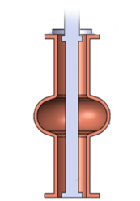

Nb₃Sn on Cu by PVD
Strategies
Single Target configuration easier to scale into cavities
R&D is Focused on Coating Parameter Optimization to get the right phase at lowest Working T possible
No RF test yet on cavities available
Only a couple of preliminary tests on QPR @CERN
@ CERN and JLab HiPIMS to densify coating
@ STFC DCMS-HiPIMS comparision
@ INFN thick Nb buffer layer
(barrier and accommodation effect) improve dramatically Tc
Multiple Challenges
A15 are Brittle materials
Complicated Phase Diagram
Substrate preparation
Low melting point substrate
Interface diffusion
Target Production
0
1
9
30
50
Nb Buffer Layer Thickness (μm)
Tc > 17 K @600 C

