Slide 1
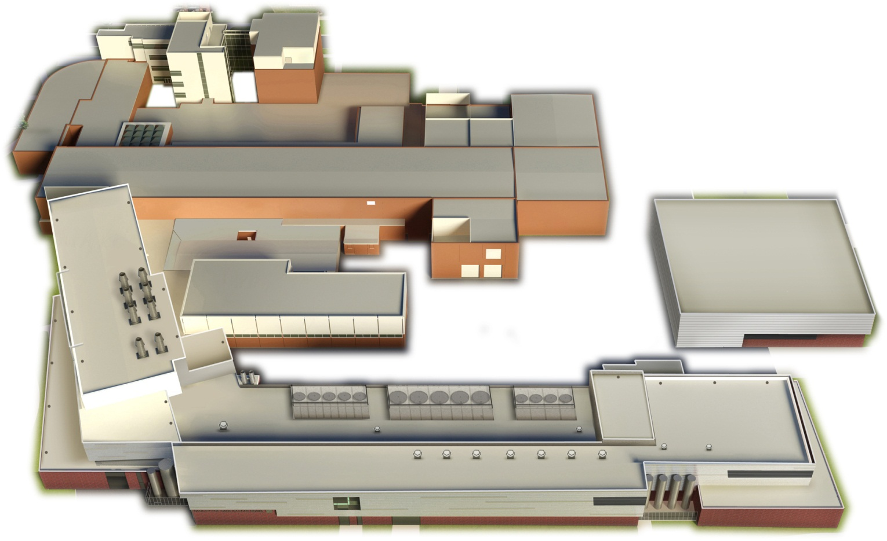

The science of FRIB: From the nuclear many-body challenge to the origin of the elements in the Universe
Alexandra Gade
Professor of Physics
Michigan State University

Slide 2
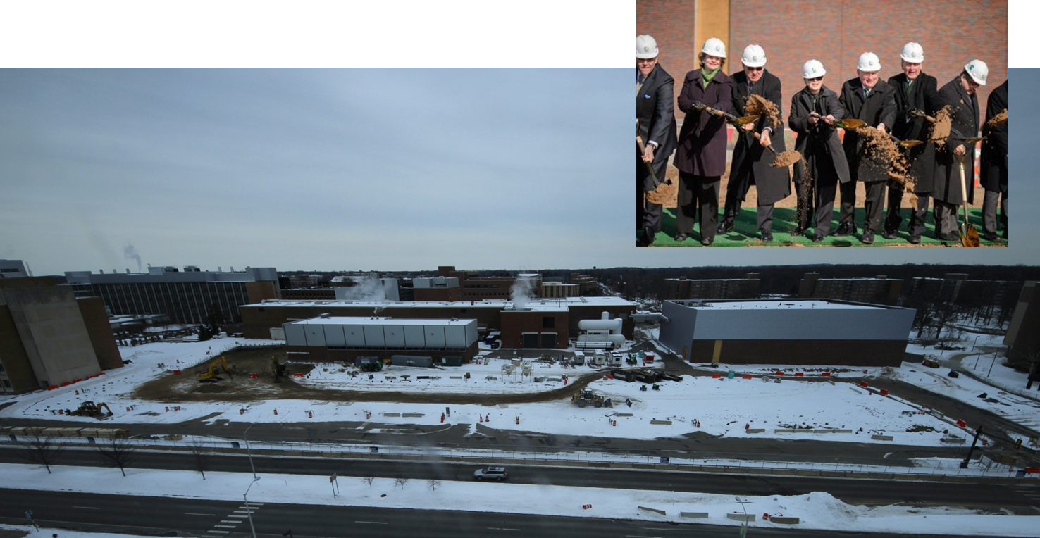
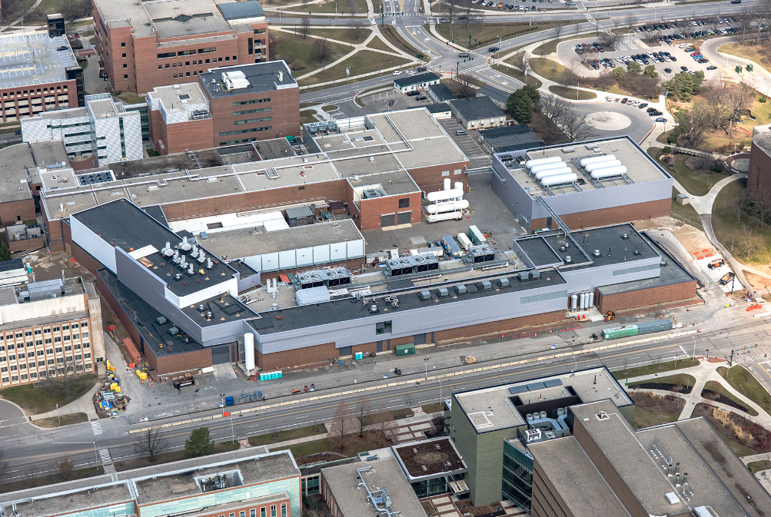
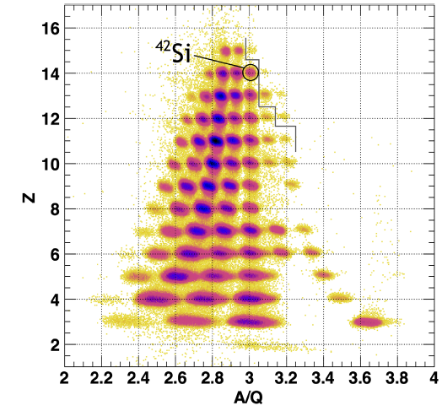
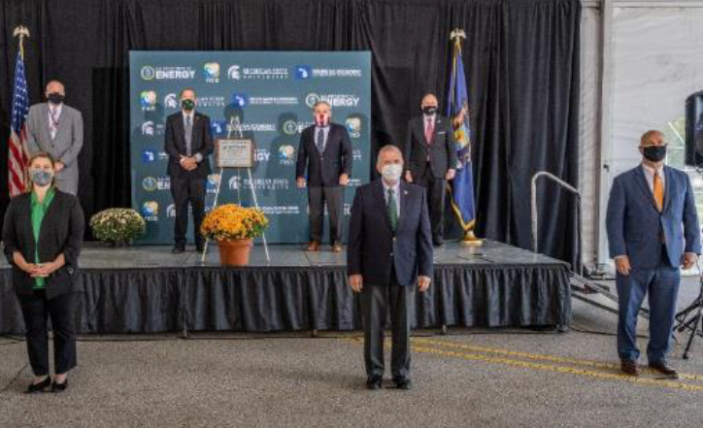
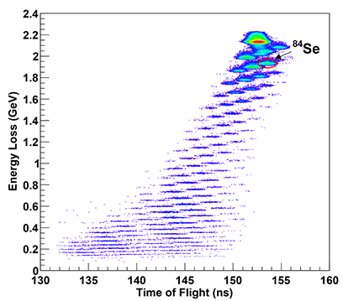
Who we are - FRIB Laboratory
~650 employees, incl. >45 faculty, 123 graduate and ~112 undergraduate students as of Fall 2023
For decades, NSCL was funded by the U.S. National Science Foundation to operate a user facility for rare isotope research and education in nuclear science, nuclear astrophysics, accelerator physics, and societal applications
FRIB Project is completed - is a national user facility for the U.S. Department of Energy Office of Science with first beam to an experiment in May 2022
Groundbreaking 03/2014
Beneficial occupancy 03/2017
First science results published 11/2022
First rare isotopes produced and identified 12/2021
Designated as DOE-SC User Facility 09/2020

Slide 3
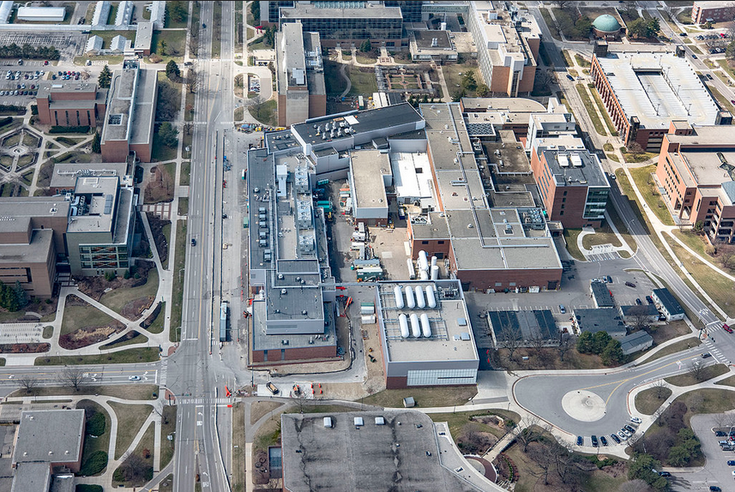
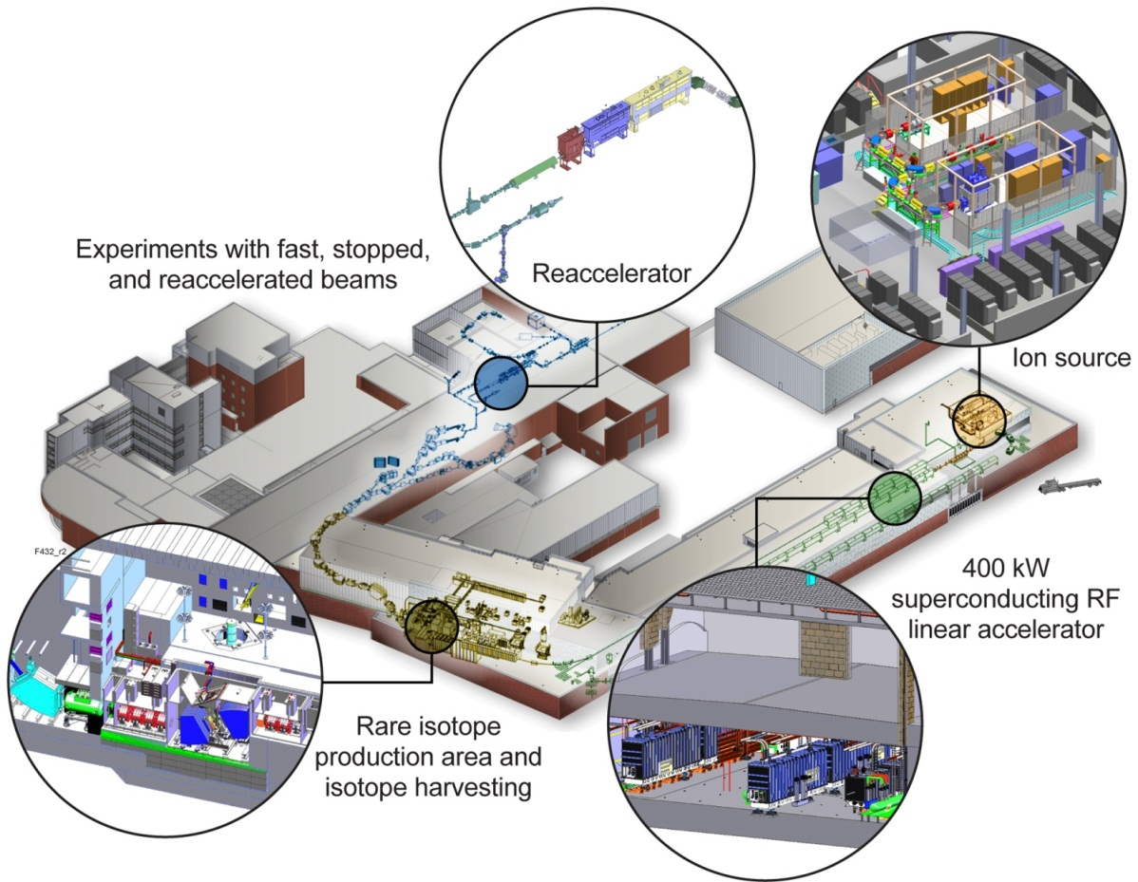
… located in the middle of the MSU Campus
Physics
Bio Chem
Chemistry
Plant Sciences
MSU Law
Vet School
Performing Arts

Slide 4
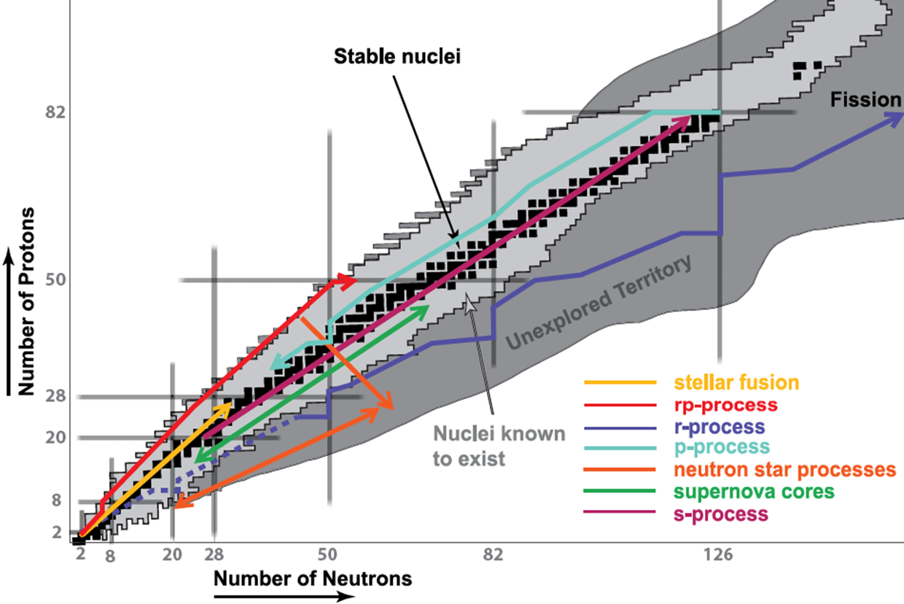
The themes of rare isotope science
Properties of nuclei
  Develop a predictive model of nuclei and their interactions
  Determine the limits of elements and isotopes
Astrophysical processes
  Origin of the elements in the cosmos
  Explosive environments: novae,
  supernovae, X-ray bursts …
  Properties of neutron stars
Societal applications and benefits
  Isotope harvesting for medicine and a variety of fields
  Surrogate reactions: nuclear security
Tests of fundamental symmetries
  Effects of symmetry violations are
  amplified in certain nuclei

Slide 5
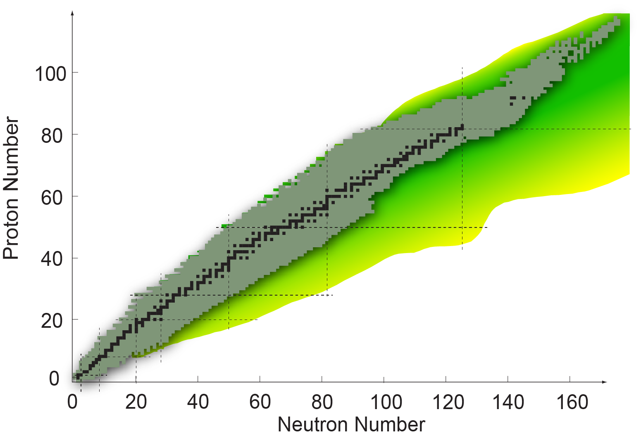
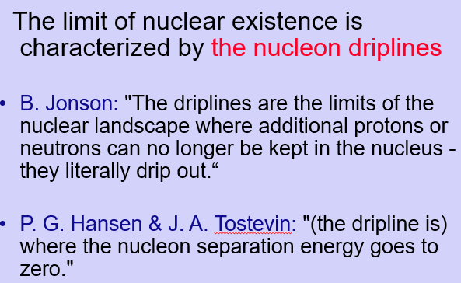

The territory: Nuclear landscape
Proton dripline
Neutron dripline
256 “Stable” – no decay observed
More than 3300 in the NNDC Database
Over 7000 predicted to exist

Slide 6
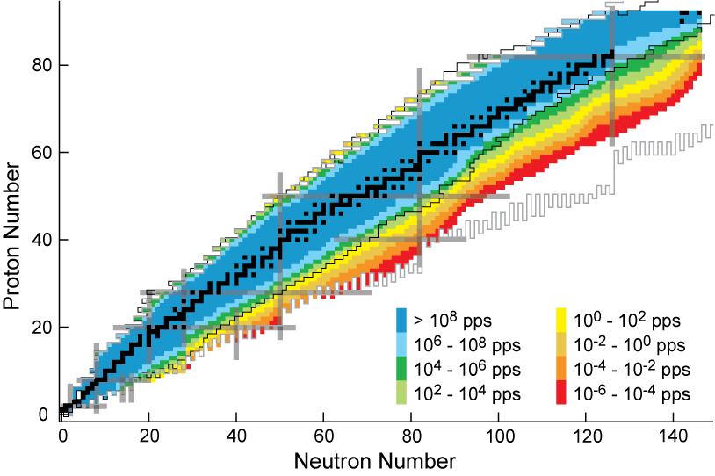
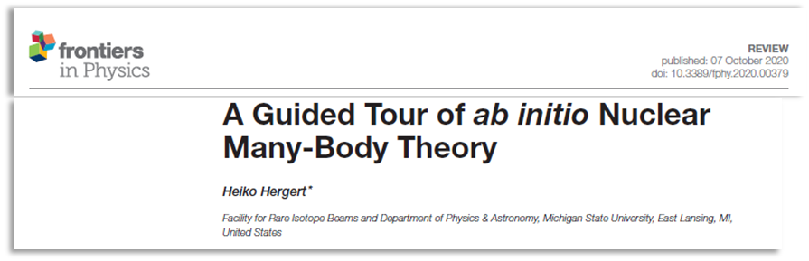
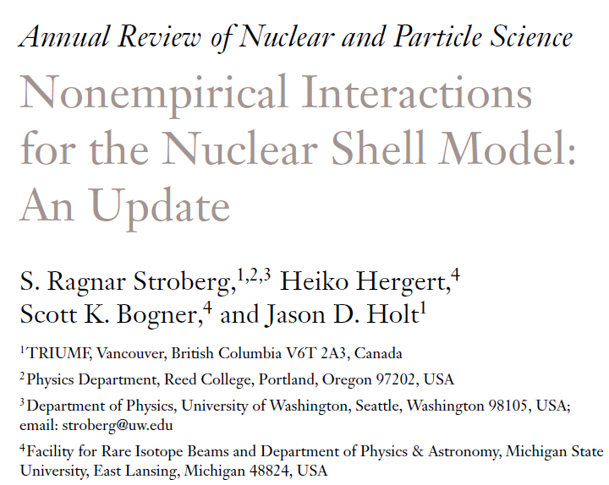
Lofty goal: Comprehensive model of nuclear structure and reactions
Energy density functional
A comprehensive and quantified model of atomic nuclei does not yet exist
A few years ago, the “road map” shown on the right would have been the state of the art in modeling nuclei
BUT – there is news!
Configuration
interaction
Ab initio
Continuum
Relationship to QCD (LQCD)

Slide 7
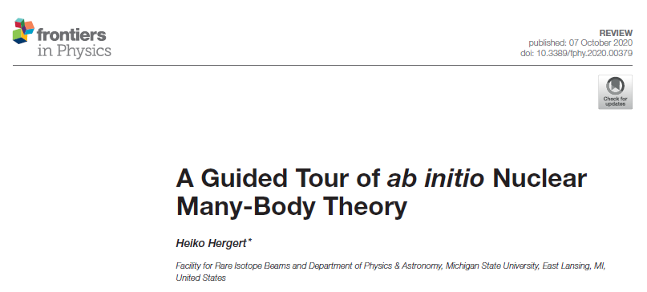
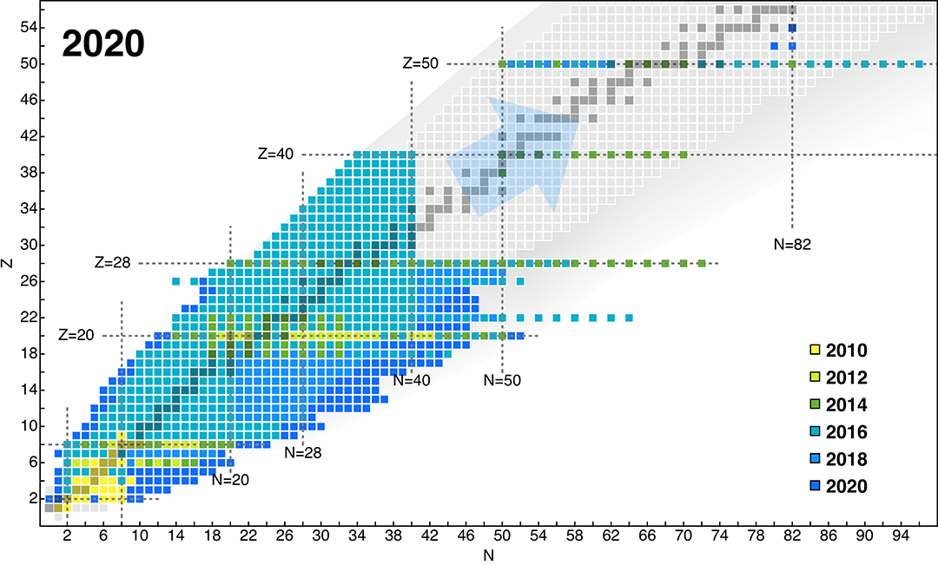
Enormous progress in nuclear many-body calculations based on QCD-inspired EFT
In recent years, enormous progress has been made with measurements of properties of rare isotopes and developments in nuclear theory and computation
New generation of nuclear forces based on consistent NN and 3N order-by-order expansions in chiral effective field theory (EFT)
Access to key regions of the nuclear chart constrains models and identifies missing physics
Theory and experiment identify key nuclei and properties to be studied
Change scale – nucleons are relevant degrees of freedom

Slide 8
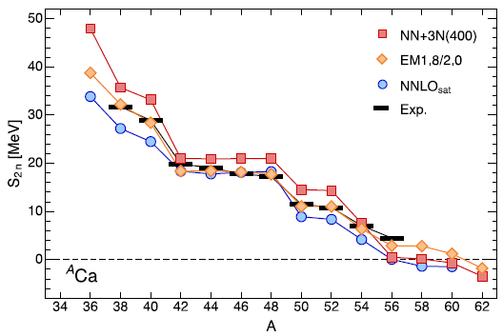
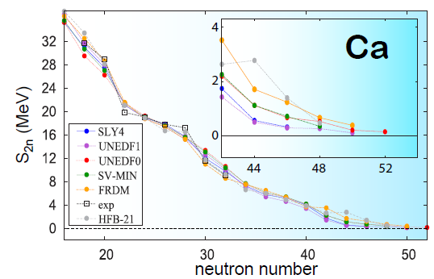
Calcium isotopes – where ab-initio, configuration interaction models and density functionals meet
How many Ca nuclei exist? ⁶⁰Ca was observed in experiments. Theory: The jury is still out …
Multi-reference in-medium similarity renormalization theory
State-of-the-art energy density functionals
Calcium isotopes bound out to about ⁷⁰Ca
⁵⁶⁻⁶⁰Ca weakly bound/unbound or right at threshold, ⁶²Ca unbound
C. Forssen et al., Physica Scripta T152 014022 (2013)
H. Hergert, Front. Phys. 8, 379 (2020)

Slide 9
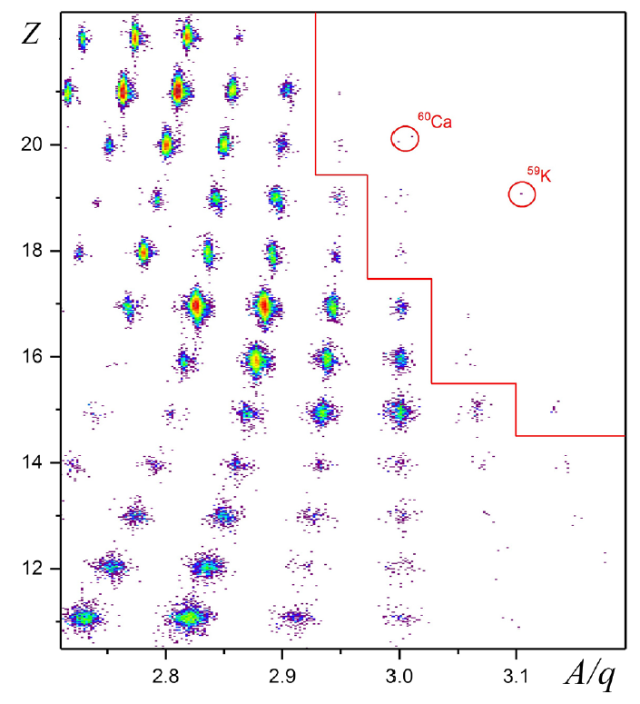
Discovery of ⁶⁰Ca - Where is the dripline in Ca?
A decade of isotope searches and cross-section measurements at NSCL [e.g. Nature 449, 1022 (2007) and PRL 102, 142501 (2009) and PRC 87, 054612 (2013)] laid out path to ⁶⁰Ca
Nine new neutron-rich isotopes were produced in an MSU-led experiment at RIBF in RIKEN from the fragmentation of a ⁷⁰Zn beam on ⁹Be at 345 MeV/u (higher beam power than at NSCL)
Comparison to mass models, including a variety of EDFs, RMF models, and phenomenology, indicates that the even-A Ca isotopes may be bound out to ⁷⁰Ca
⁶²Sc
⁶⁰Ca
^{57,59}K
⁵⁴Ar
⁵²Cl
⁴⁹S
⁴⁷P
O. B. Tarasov et al., PRL 121, 022501 (2018)

Slide 10
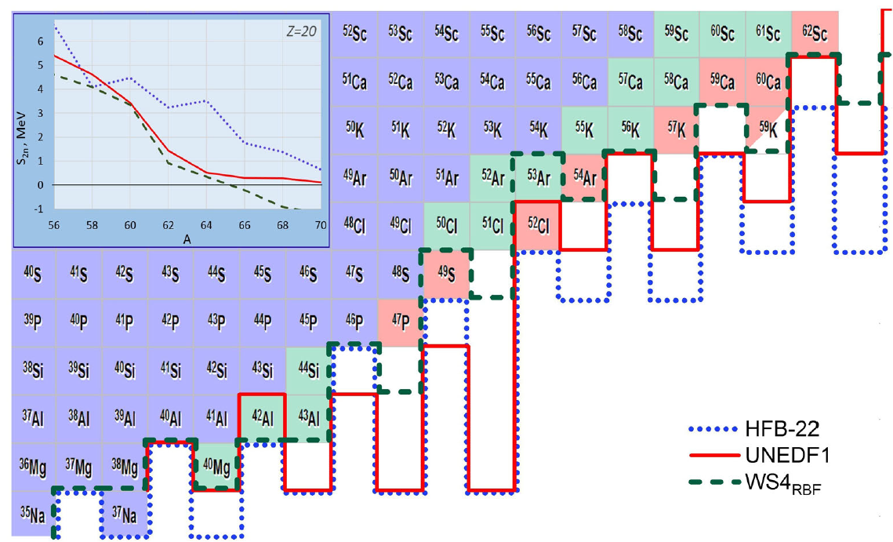
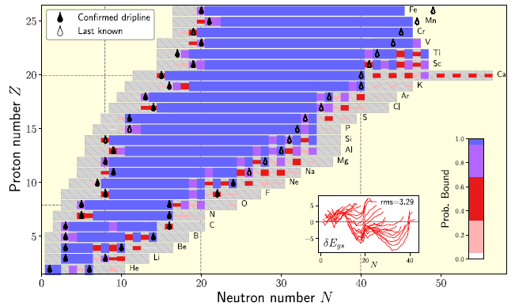
Discovery of ⁶⁰Ca - Where is the dripline in Ca? Further out than thought …
O. B. Tarasov et al., PRL 121, 022501 (2018)
PAC1 and PAC2 proposal accepted for new isotope search
S. R. Stroberg et al. PRL 126, 022501 (2021)
At FRIB: discovery of ⁶²Ca expected to possible at early FRIB, ⁷⁰Ca needs 400 MeV/u energy upgrade (FRIB400) and advances in targetry to withstand required beam power

Slide 11
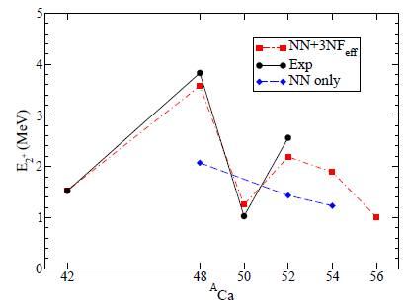
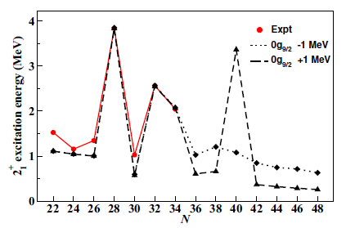
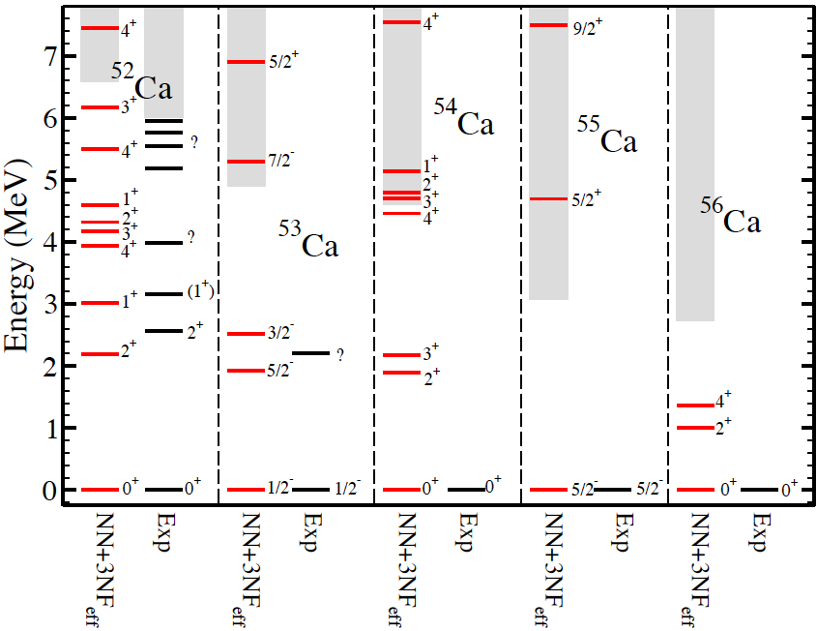
Calcium isotopes – what is important?
For the example of the coupled cluster approach
G. Hagen et al., PRL 109, 032502 (2012)
C. Forssen et al., Physica Scripta T152, 014022 (2013)
PAC1 proposal accepted to study unbound states in neutron-rich Ca
The particle continuum (e.g. asymptotic of wave functions, correlations)
L. Corragio et al., PRC 102, 054326 (2020)
Measured properties of most neutron-rich Calcium isotopes will reveal missing ingredients in interactions and many-body approaches
Calcium isotopes bound out to about ⁷⁰Ca
Several PAC1 and PAC2 proposal accepted to study bound excited states very in neutron-rich nuclei

Slide 12
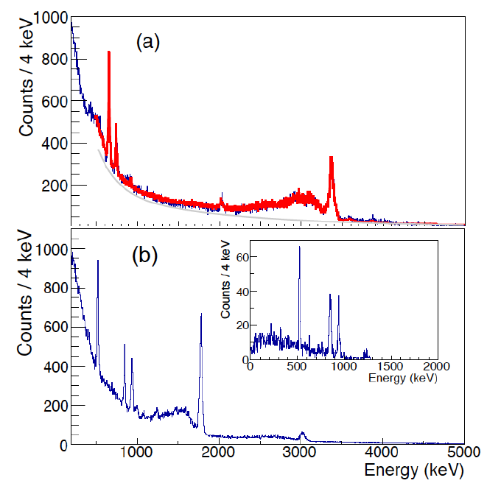
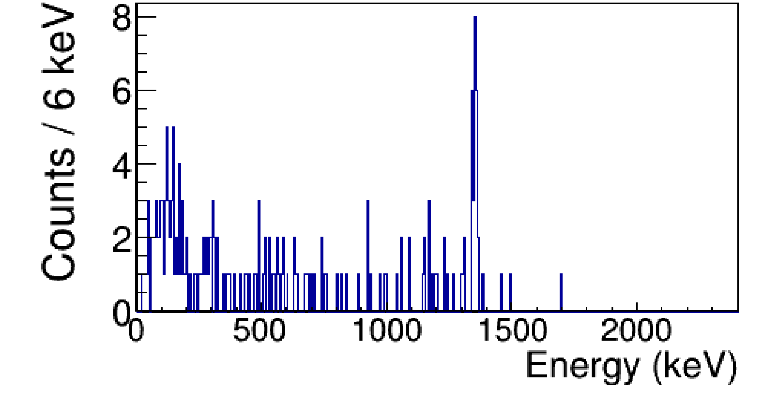
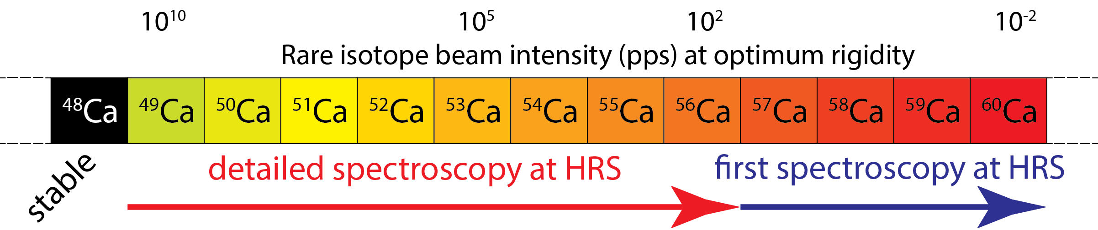
Understanding the nuclear force – Calcium isotopes, where we are and where we can go
The neutron-rich Ca isotopes beyond ⁴⁸Ca provide textbook examples of structural evolution
PAC1 proposal accepted to study unbound states in neutron-rich Ca
⁵⁰Ca -> ⁴⁹Ca
GRETINA @ NSCL
GEANT4 simulation
⁹Be(⁶¹Sc,⁶⁰Ca+γ)
GRETA@HRS
(simulated)
γ-γ
⁵⁷Ca -> ⁵⁶Ca
Enabled by the GRETA γ-ray tracking array coupled to the High Rigidity Spectrometer (HRS)
The structure around ⁶⁰Ca informs the location of the drip line at Z = 20

Slide 13
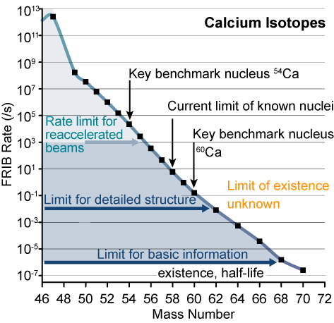
Example: Access to calcium isotopes at FRIB
Calcium isotopic chain (Z=20) is crucial
FRIB provides access to the relevant neutron-rich Ca isotopes with intensities sufficient to measure important observables
  Masses, half-lives, decay properties, single-particle and collective degrees of freedom
  Structure of heavy Ca isotopes will quantify the role of the 3N forces and weak binding
In general: Long isotopic chains are essential
  Evolution of nuclear properties can be benchmarked as a function of isospin
PAC1 and PAC2 proposal accepted to study evolution of nuclear structure towards ¹⁰⁰Sn, ⁷⁸Ni and in the Ca chain

Slide 14
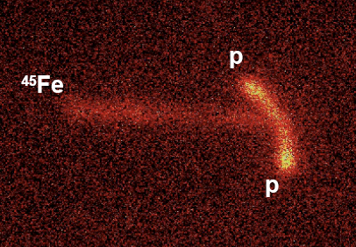
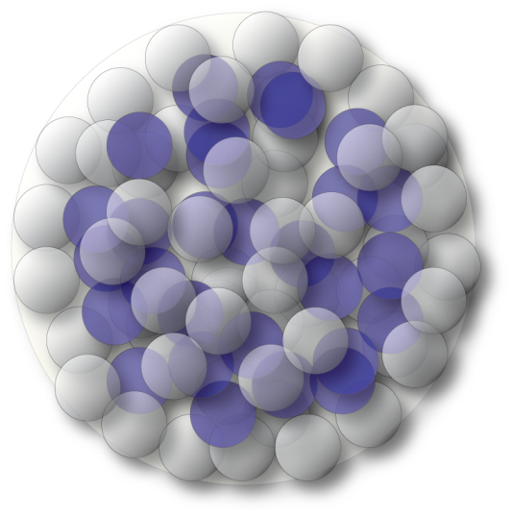
Some nuclei are special: “Designer Nuclei” as selective probes of certain aspects of weak binding
Not all nuclei are equally important to constrain nuclear models
  Nuclear theory, computational physics and experiment work in concert to identify key nuclei and properties
FRIB can produce nuclei with desired N/Z and nucleon separation energies to amplify effects of interest
  Access to nuclei with exotic decay modes, e.g. 2-proton or 2-neutron radioactivity – sensitive to pairing and spatial correlations
  Access to nuclei with extreme skins
  (>0.5 fm) – benchmark for isovector interactions/functionals, crucial for understanding neutron stars
⁴⁵Fe
From K. Miernik et al., PRL 99, 192501 (2007)
PAC1 and PAC2 proposal accepted to study correlations in 2p decay
Nuclei with large neutron skins
Nuclei can be selected to highlight a particular aspect of the nuclear many-body problem
PAC1 proposal accepted to study possible proton and neutron halos

Slide 15
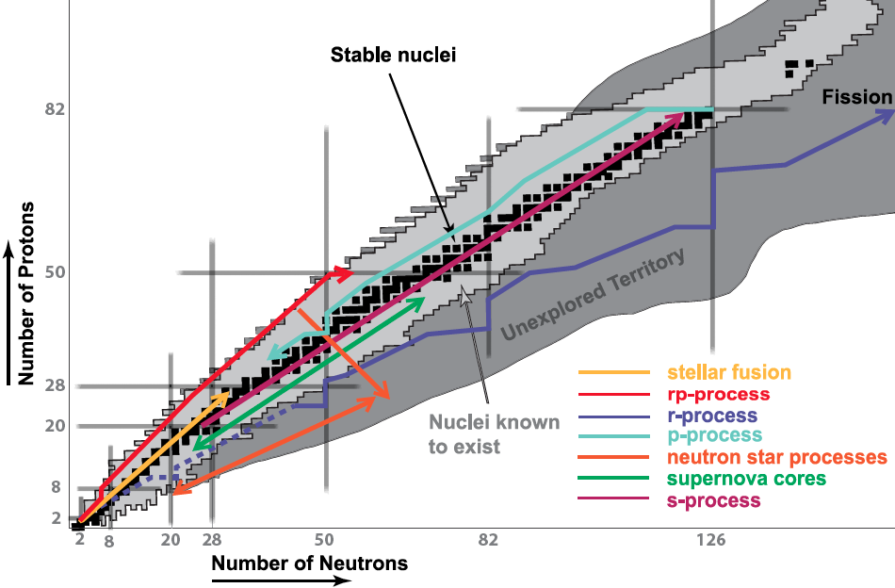
Rare isotopes are important to understand astrophysical scenarios
Several nuclear astrophysics PAC1 and PAC2 proposal accepted

Slide 16
Nuclear data is needed to understand the many nucleosynthesis processes
Big Bang nucleosynthesis
pp-chain
CNO cycle
triple α
Helium, C, O, Ne, Si burning
s-process
r-process
rp-process
νp - process
p - process
α - process
fission recycling
Electron capture
pyconuclear fusion
Sample reaction paths
(α,γ)
(p,γ)
β⁻
(α,p)
(n,2n)
^{A}Z
(n,γ)
β⁺ , (n,p)
(γ,p)
Needed: masses, T_{1/2}, β-delayed particle emission probabilities, location of capture resonances, reaction rates if possible, …
Black - data on rare isotopes needed to model process

Slide 17
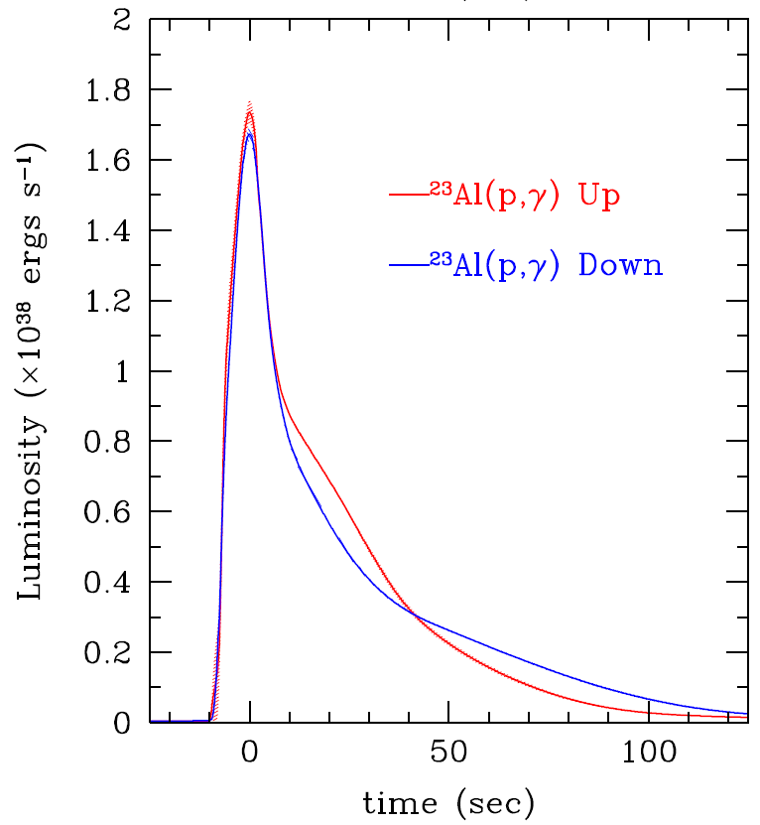
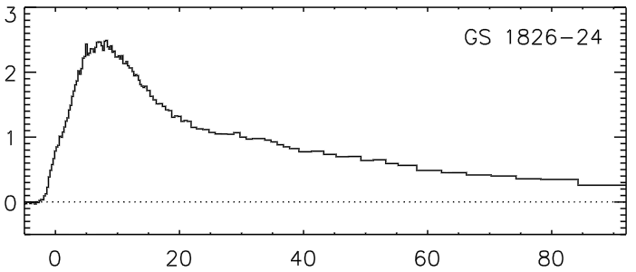
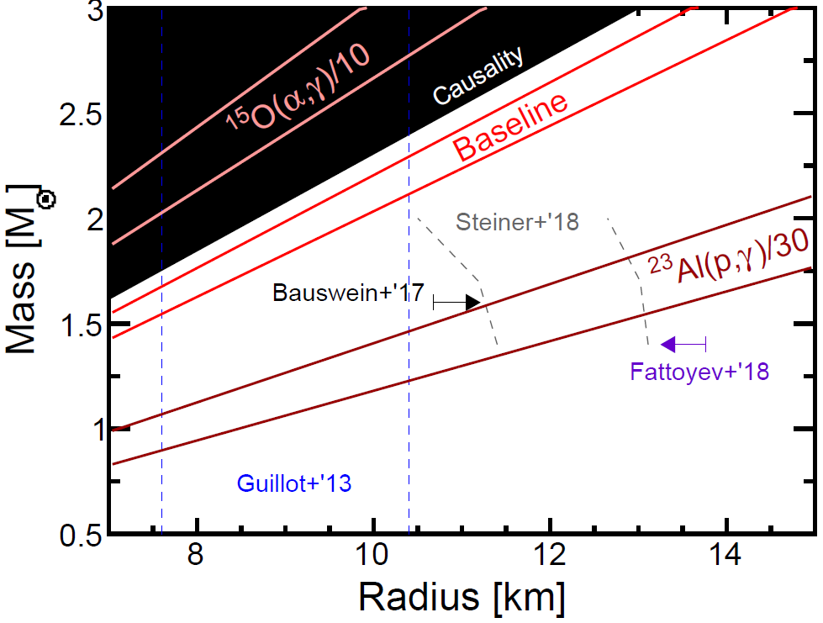
From nuclear reaction rates to neutron-star compactness
Type I X-ray bursts are some of the most frequent explosions in the Universe
  Thermonuclear flashes ignited on the surface of accreting neutron stars
  Powered by the rp process proceeding near the proton dripline
  Their light curves are observables and depend on the underlying rp process reaction rates
  They can also be used to infer information on the neutron star such as its mass-radius relationship
D.K. Galloway et al., Ap. J. Suppl. Ser. 179, 360 (2008)
C. Wolf, C. Langer, F. Montes et al., PRL 122, 232701 (2019)
Z. Meisel et al., Ap. J. 872, 84 (2019)

Slide 18
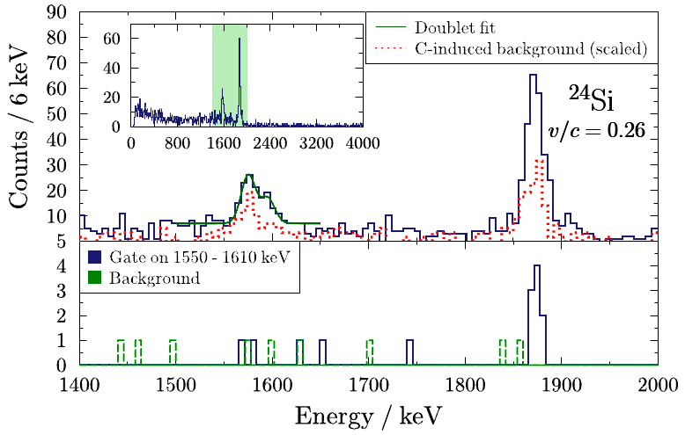
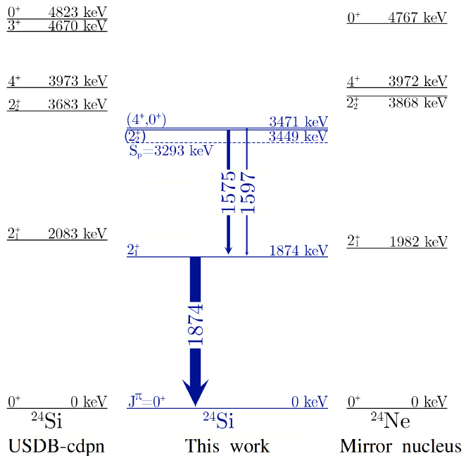
From nuclear reaction rates to neutron star compactness: ²⁴Si
²³Al(d,n)²⁴Si transfer reaction at 48 MeV/u on CD₂ target
  ²⁴Si ID’ed in S800
  γ-rays in GRETINA
  Neutrons in LENDA
A doublet of transitions was observed in coincidence with 2⁺₁ → 0⁺₁
From the comparison to the mirror, the lower resulting state is propose 2⁺₂ and the higher could be either 4⁺ or 0⁺ (4⁺ more likely)
C. Wolf, C. Langer, F. Montes et al., PRL 122, 232701 (2019)

Slide 19
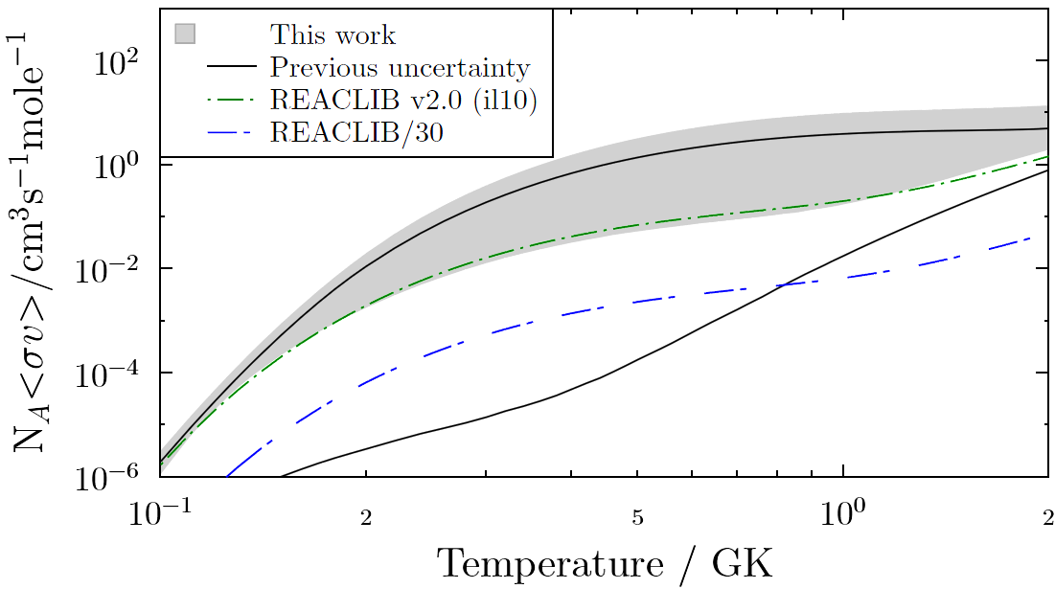
From nuclear reaction rates to neutron star compactness – Impact
Reaction-rate uncertainty significantly reduced
Scale-down factor of 30 excluded for adopted REACLIB rate
Reduced uncertainty is a significant step forward for using the textbook X-ray burst source GS 1826-24 for neutron-star compactness constraints through light-curve modeling
C. Wolf, C. Langer, F. Montes et al., PRL 122, 232701 (2019)

Slide 20
Example: FRIB reach for rp-process reaction rate studies
Several PAC1 and PAC2 proposal accepted for direct and indirect measurements of rp-process rates
10^{>10}
rp-process
10⁹⁻¹⁰
10⁸⁻⁹
key reaction rates can be indirectly measured including ⁷²Kr waiting point
10⁷⁻⁸
direct (p,γ)
10⁶⁻⁷
direct (p,α) or (α,p)
transfer
10⁵⁻⁶
10⁴⁻⁵
(p,p),
some transfer
10²⁻⁴
most reaction rates up to ~Sr can be
directly measured
All reaction rates up to ~Ti can be directly measured
Direct reaction rate measurements are possible with the Separator for Capture Reactions (SECAR)

Slide 21
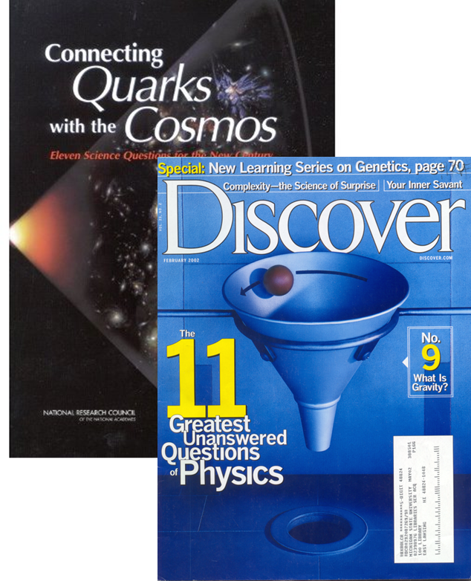
Neutron-capture process leading to elements heavier than iron
E. M. Burbidge, G. R. Burbidge, W. A. Fowler, and F. Hoyle. (1957). "Synthesis of the Elements in Stars". Rev Mod Phys 29, 547, there must be an r-process (10% of gold from s-process)
Rapid neutron capture process, r-process
  Fast, few seconds duration
  Neutron density of 10²⁰⁻²⁸ n/cm³
  Runs out to where (n,γ) and (γ,n) are similar in rate
  Adds 30-40 neutrons
Origin of the heavy elements: One of 11 Science Questions for the 21st century
Reaction path
fission
β⁻
(γ ,n)
^{A}Z
…
(n,γ)
(n,γ)

Slide 22
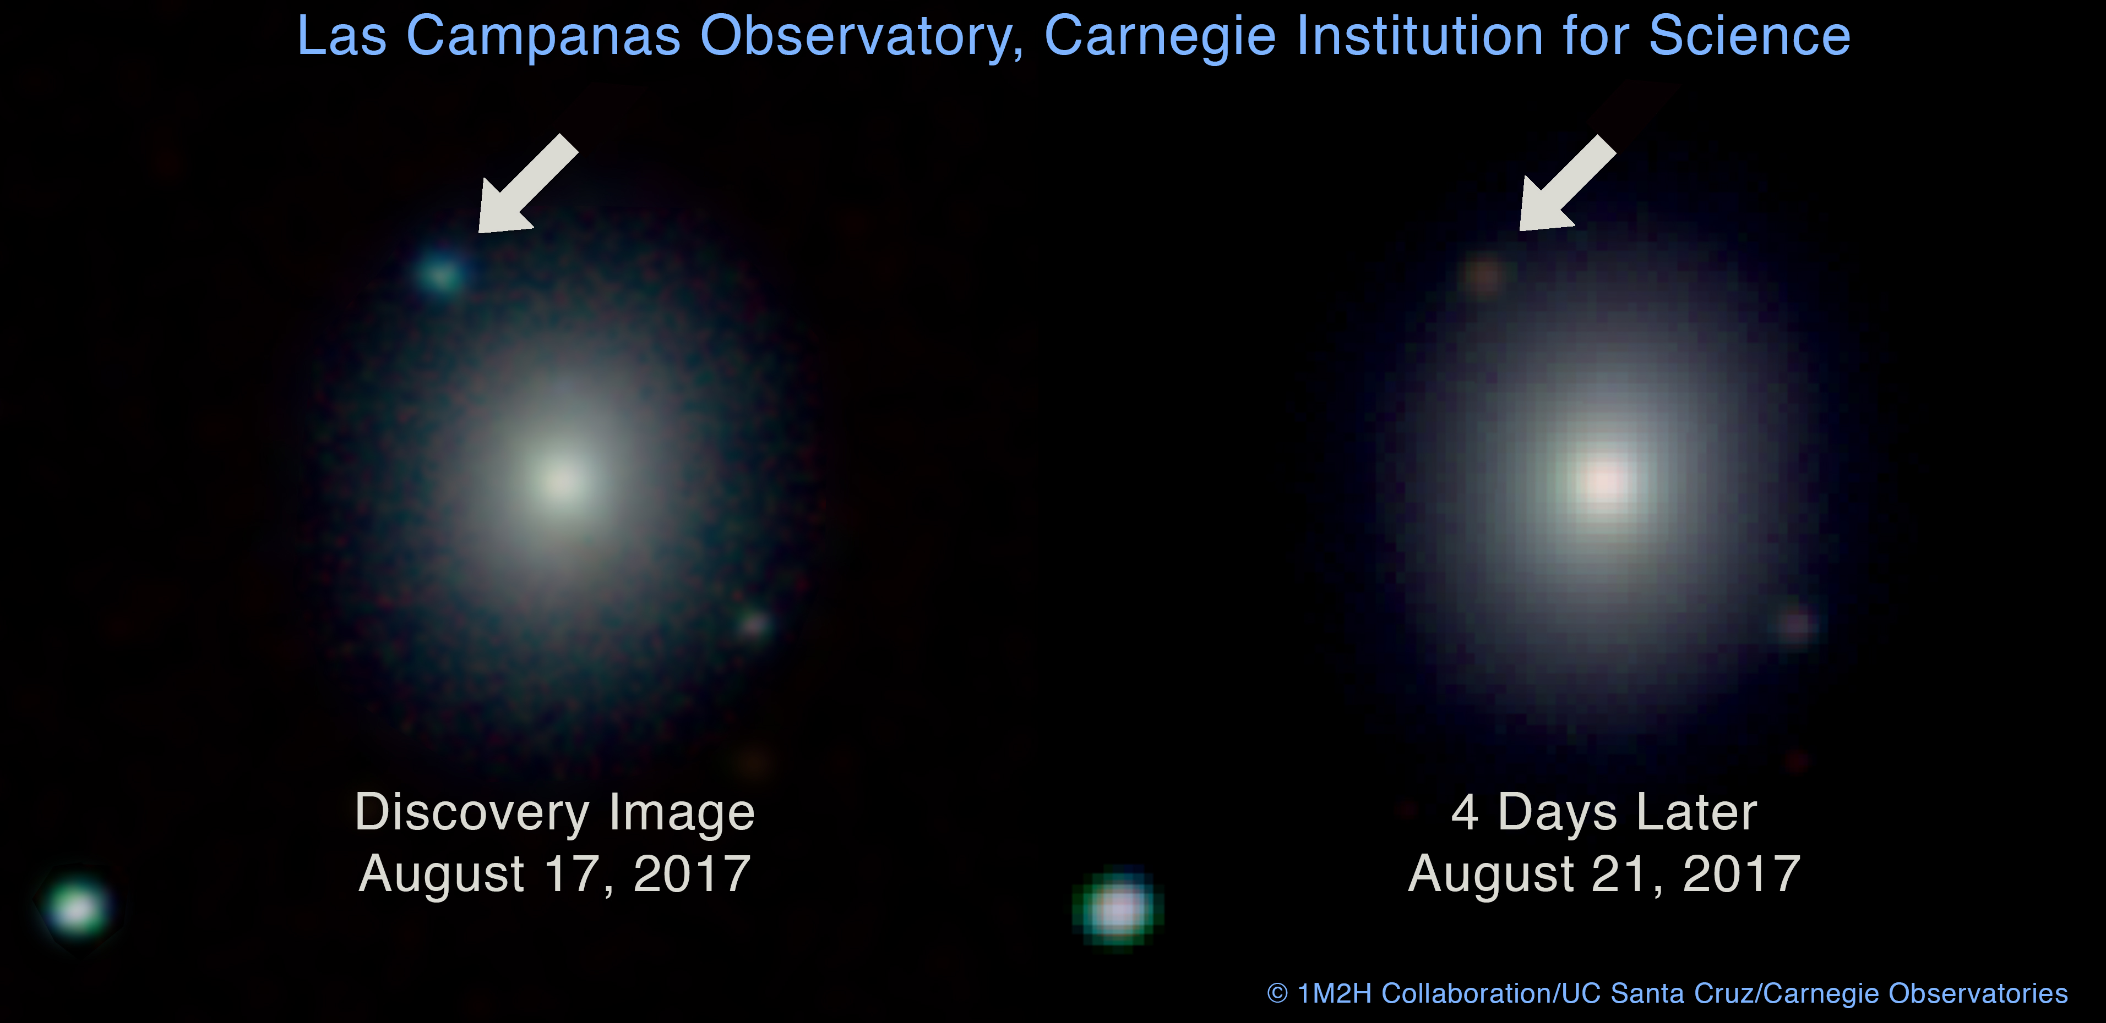
The neutron star merger event, GW170817, detected by LIGO/Virgo electrified our field
The observation of GW170817 together with a kilonova, the after glow from β-decaying rare isotopes, revealed neutron star mergers as a major source of the r process
This confirms Anna Frebel’s earlier conjecture based on abundance observations in an ultra faint dwarf galaxy that one site of the r process seems to be a rare and prolific event
A. P. Ji, A. Frebel et al., Nature 531, 610 (2016)
This defines better which nuclei are important for the r process
The gravitational wave signal itself and the amount of r process material flung out are sensitive to the equation of state of nuclear matter

Slide 23
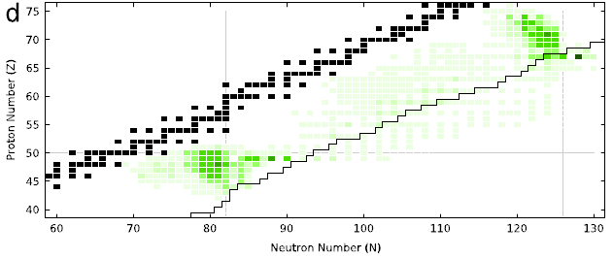
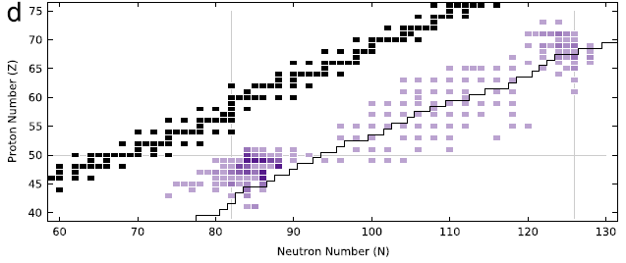
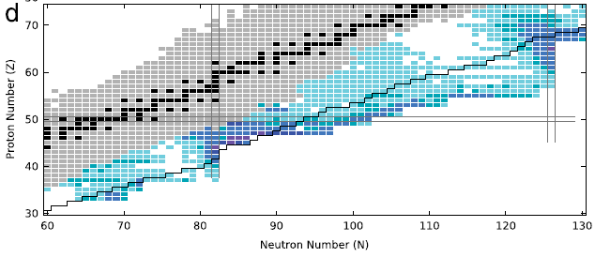
FRIB’s reach for r-process studies
– Example: neutron-star merger scenario
neutron capture rates
M.R. Mumpower et al., Prog. Part. Nucl. Phys. 86, 86 (2016)
(see this reference for other r-process scenarios)
Hoffman et al. 2008
Hoffman et al. 2008
β-delayed neutron emitters
Black line: FRIB production 10⁻⁴/s
Several PAC1 and PAC2 proposal accepted for β-decay and mass measurements of r-process nuclei
Sensitive masses

Slide 24
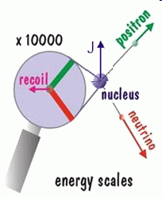
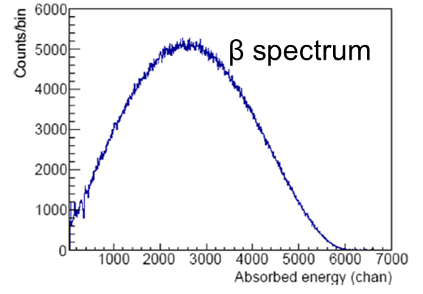
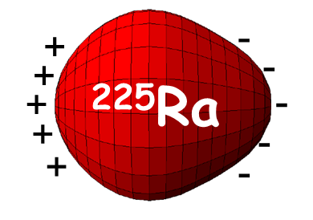
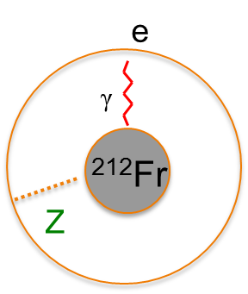
Rare isotopes put the Standard Model to the test
Angular correlations in β-decay
  Search for new particles and interactions
  Mass scale for possible new particles is comparable with LHC
Permanent electric dipole moments in atoms
  Beyond the Standard Model (BSM)
  Dominance of matter over antimatter (CP violation)
  ²²⁵Ra, ²²⁹Pa are special (several thousand times more sensitive than ¹⁹⁹Hg due to octupole deformation)
Parity non-conservation in atoms
  Weak charge in the nucleus, anapole moment (Francium isotopes)

Slide 25
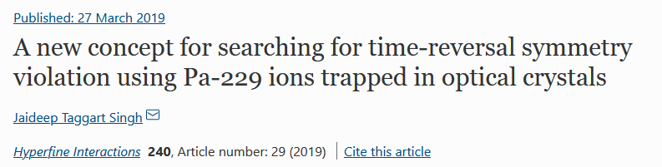
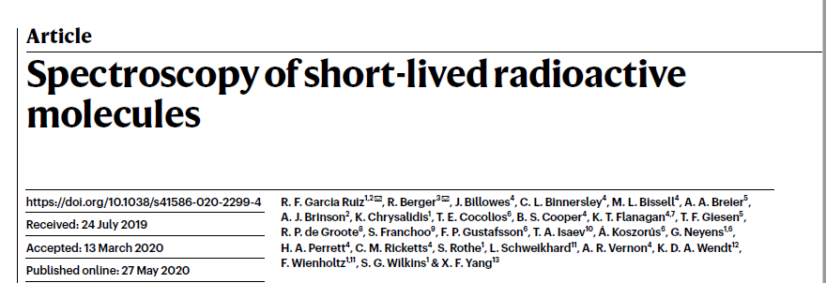
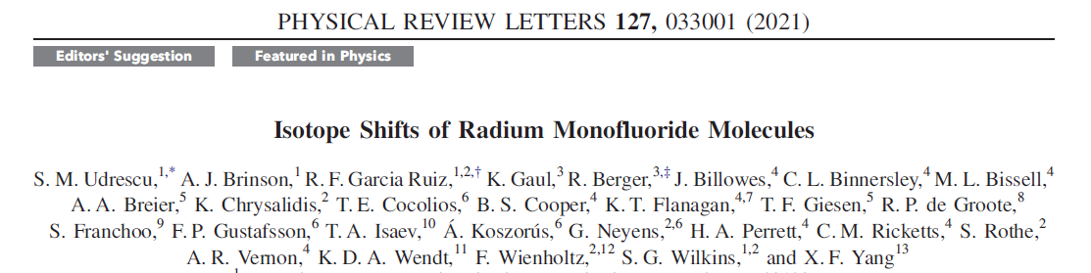
EDM searches – Exciting opportunities at FRIB
Letter of Intent accepted at FRIB to develop gas stopping of heavy nuclei, PAC 2 accepted molecular laser spectroscopy
Harvest copious amounts of EDM candidate isotopes
Characterize octupole collectivity of ²²⁹Pa and new candidates
  Measure parity doublet (if really sub keV energy separation, it may require bolometric measurement with ²²⁹Pa produced at FRIB)
  Quantify octupole collectivity using low-energy Coulomb excitation of ²²⁹Pa
Enhance signal of an EDM even more by choosing a novel physical environment
  Candidate nuclei trapped in optical crystals
  Radioactive molecules that contain octupole deformed EDM candidate nuclei

Slide 26
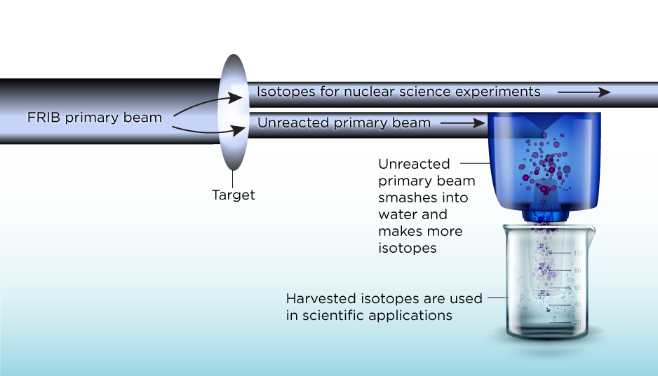




FRIB as a unique source of research isotopes for (societal) applications
FRIB produces a broad range of rare isotopes that can be made available for applications
PAC1 and PAC 2 accepted isotope harvesting proposals
¹⁴⁹Tb
  Commensal mode of operation: delivery of rare isotope beam to main user while harvesting unused rare isotopes for applications
Isotope harvesting provisions included in FRIB design - $13M grant awarded in 2021 by the DOE Isotope Program (PI: G. Severin, FRIB & Dept. of Chemistry)
Stockpile stewardship – cross sections involving rare isotopes are needed
Real-time radioisotope imaging –
nutrient uptake in plants with ³²P
S. Kanno et al., Phil. Trans. R. Soc. B 367, 1501 (2012)

Slide 27


Proof of principle measurements done at NSCL– Isotopes of interest for nuclear medicine
A 76 MeV/u ⁶⁷Cu beam produced by projectile fragmentation of ⁷⁶Ge was stopped in water and successfully separated
The chemical extraction efficiency was found to be 88(3)%
Radio immunotherapy, labeling of antibodies
Most recent aqueous harvest from ⁴⁸Ca fragmentation: ⁴⁷Ca as generator for ⁴⁷Sc (low-energy β emitter to target small tumors)

Slide 28


Proof of principle measurements done at NSCL – Isotopes of interest for stockpile stewardship
⁴⁸V+n and ⁸⁸Zr+n reaction networks play important role in stockpile stewardship and diagnostics of underground test data of nuclear devices – required amounts could be harvested at FRIB

Slide 29

FRIB, a game changer for nuclear structure, astrophysics, applications and BSM physics
about 3000 known isotopes
FRIB will produce 80% of all (predicted) isotopes of elements up to Uranium
New territory to be explored at FRIB

Slide 30
  Thank you

Slide 31

Summary- We are entering a new era in nuclei physics where we can produce and study key rare isotopes
Development of a predictive model for nuclei
  What combinations of protons and neutrons can be made into abound system? What is the nature of the nuclear force?
  Data from FRIB will tell
Foundation for astrophysical modeling
  Access to key data needed to understand the origin of the elements in nucleosynthesis processes
Search for symmetry violations, e.g. atomic EDMs
  Manifold opportunities at FRIB to contribute to the hunt for physics beyond the Standard Model
Applications of rare isotopes
  Unique opportunities to provide research quantities of rare isotopes to other communities (in commensal operation or targeted)
Addresses the field’s long range plan
Already thinking about upgrade
Enormous discovery potential!
Michigan State University designs and establishes FRIB as a DOE Office of Science National User Facility in support of the mission of the Office of Nuclear Physics under Cooperative Agreement DE-SC0000661. AG is supported by by the U.S. Department of Energy, Office of Science, Office of Nuclear Physics, under Grant No. DE-SC0020451

Slide 32

FRIB’s future – near and far https://frib.msu.edu/_files/pdfs/frib400_final.pdf
First, 3 experiment successfully completed at 1kW
Recently, ran experiments at 3 and 5 kW
Plan: 10 kW later in 2023
Next major steps (faster): 20, 50, 100, 200, 400 kW
  Challenges: Target, beam dump aka material science… ultimately an order of magnitude more beam power than any other heavy-ion machine has ever put on a target
Aspiration for the future: FRIB400, an energy upgrade to 400 MeV/u Uranium
Increased yield for most neutron-rich nuclei
Reach 2x⍴₀ for heavy-ion reactions (EOS of NS)
Huge luminosity gains for in-beam spectroscopy
Perform fast-beam reactions at optimum energies to minimize distortions

Slide 33


Crossing N = 28 Toward the Neutron Drip Line: First Measurement of Half-Lives at FRIB
⁴⁸Ca²⁰⁺ at 172.3 MeV/u at 1 kW beam power on 8.89-mm thick ⁹Be target produced cocktail including neutron-rich P, Si, Al, and Mg isotopes with unknown half-lives
FDSi used a YSO implantation scintillator and Si PIN detectors + plastic scintillator upstream for PID
  Neutron detection with VANDLE
  Gamma-ray detection with CLARION clovers
  The results from these detectors are being analyzed
Clover array frame assembly at NSCL
H.L. Crawford et al., PRL 129, 212501 (2022)

Slide 34

FRIB Laboratory
FRIB Project was funded by DOE Office of Science Office of Nuclear Physics, Michigan State University and State of Michigan
Key Feature is 400 kW beam power (5 x10¹³ ²³⁸U/s)
Separation of isotopes
in-flight
  Fast development time
  for any isotope
  Suited for all elements
  and short half-lives
  Fast, stopped, and reaccelerated beams
Sept 2020: FRIB designated as DOE Office of Science User Facility
Dec 2021: Produced and identified first rare isotopes in new FRIB fragment separator
Feb 2022: FRIB passed DOE OPA CD-4 readiness review with all charge questions answered in the affirmative
FRIB Linac Segment 1 containing 16 SRF cryomodules

Slide 35


SRF Cryomodule 1 – 15 Beam Commissioned
Met Key Performance Parameters in a Week upon Authorization
FRIB Linac Segment 1 containing 16 SRF cryomodules
FRIB Cold Box producing 4 K liquid helium
Feb 14, 2019, Ar⁹⁺ beam accelerated by cryomodule 1 – 14 above 20 MeV/u

Slide 36




Unusual isotopes to test fundamental symmetries – Atomic EDM search
An Electric Dipole Moment (EDM)
Violates T and consequently CP symmetry
Large value would be evidence for physics beyond the Standard Model (BSM) and a possible explanation for matter dominance over antimatter in the Universe
For an atomic EDM, most sensitive limit today: |d(¹⁹⁹Hg)| < 7.4x10⁻³⁰ e cm – Graner et al. (2016)
Properties of some nuclei enhance the signal of an EDM is enhanced, e.g. EDM(²²⁵Ra) / EDM(¹⁹⁹Hg) 2-3 orders of magnitude (nuclear octupole deformation), EDM(²²⁹Pa) / EDM(¹⁹⁹Hg) ~ 3 10⁴ – Dobaczewski, Engel (2005); Ban, Dobaczewski, Engel, Shukla (2010); Flambaum (2008)
Successful ²²⁵Ra EDM efforts underway at Argonne National Lab

Slide 37

Rare isotope science and neutron stars
Nuclear physics questions and needs:
  Composition of the rp-process ashes → need to understand rp capture network
  Need to model weak interactions very well for many nuclei to model neutronization
  Trends in nuclear masses of very neutron-rich nuclei need to be known to describe heating and cooling of the crust during EC
  Need to know where the limit of existence is and what nuclei may serve as seeds of pyconuclear fusion
Figure from A. Watts et al., Rev. Mod. Phys. 88, 021001 (2016)

Slide 38

Neutron stars: Rare isotopes from the proton to the neutron dripline are important
rp-process ashes left after X-ray bursts on the surface of neutron stars sink into the neutron-star crust
In the crust, the atomic nuclei are fully ionized and embedded in degenerate, relativistic electrons
In this e⁻-rich environment, electron capture (EC) drives the proton-rich, stable ashes towards the neutron dripline (neutronization)
In the regime of low S_{n} and when the neutron dripline is reached, neutron emission drives the composition to light neutron-rich systems in the range of ¹⁶⁻²⁴C, ¹⁸⁻²⁸O, ³⁰⁻⁴⁰Ne and ³⁴⁻⁴⁰Mg
At the increased density deeper and deeper in the crust, pyconuclear reactions occur, the fusion of exotic systems such as ⁴⁰Mg+⁴⁰Mg
FRIB PAC1 proposal accepted to study processes in neutron star crust (β decay)
Figure adapted from M. Beard, Notre Dame (2010)

Slide 39


Production of rare isotope beams at FRIB with provisions for commensal harvesting of isotopes
Produce a rare isotope beam for a primary user, for example ²⁰⁰W from a ²³⁸U primary beam - at the same time, up to 1000 other isotopes are produced that could be harvested and used for other experiments or applications
FRIB PAC1 proposal accepted for first harvesting at FRIB
Isotope harvesting provisions included in FRIB designs - Harvesting equipment not part of FRIB project scope but recommended in 2015 NSAC-I LRP, $13M grant awarded in 2021 by the DOE Isotope Program (PI: G. Severin, FRIB & Dept. of Chemistry)

Slide 40

FRIB facility overview
Existing NSCL
Target Facility
LINAC Building

Slide 41


FRIB ground breaking on March 17, 2014

Slide 42
Civil construction substantially complete
Beneficial occupancy since March 2017
Web cameras at www.frib.msu.edu

Slide 43


Probing the Standard Model with the β decay of ⁶He
The shape of the β spectrum is sensitive to the different terms in the electroweak theory of β decay that is embedded in the Standard Model
The Fierz term in the β decay spectrum provides one of the most stringent constraints on exotic scalar or tensor couplings that are beyond vector-axial electroweak theory of the Standard Model
Such low-energy studies complement New Physics searches at the LHC
Novel approach: Implant ⁶He produced from fragmentation deep (12 mm) into an inorganic scintillator, e.g. CsI(Na)
This implantation approach eliminates effects such as back-scattering and out-scattering of β particles on/from detectors (unique to NSCL due to the availability of high-energy ⁶He from fragmentation
β spectrum
β decay curve
X. Huyan, O. Naviliat-Cuncic et al., Hyperfine Int. 237, 93 (2016)

Slide 44


Applications of rare isotopes – Heavy-ion irradiations (NSCL unique!)
20-year history of providing heavy-ion beams to researchers from JPL, CalTech, and WashU for the calibration of heavy-ion detectors sent on space missions:
  1997: Beam for calibration of the of detectors for CRIS-ACE (Cosmic Ray Isotope Spectrometer for the Advanced Composition Explorer)
  2006: Beam for calibration of low-energy and high-energy telescopes (LET and HET) for the Solar Energetic Particle instrument of the STEREO mission
  2016: Beam for calibration of the EPI-Hi high-energy particle detector for the Solar Probe Plus (now Parker Solar Probe) – Launched last month
Also: HI irradiation of DNA
Oakland University, MI
W.R. Binns et al., Science, April 2016 (10.1126/science.aad6004)

Slide 45
Harvesting isotopes for applications
- research quantities
Isotopes obtained in commensal mode of operation from cooling water loops
  FRIB beam dump for primary beam is water-filled – the primary beam will create a bounty of rare isotopes in water. Fragment catchers will stop undesired fragments in water
Equipment for isotope harvesting not included in FRIB baseline, but provisions to incorporate are, e.g.:
  Space
  Cooling loop design
Nuclide | T_{1/2} | Use
³²Si | 153 y | Oceanographic studies; climate change
²²¹Rn | 25 m | Targeted alpha therapy
²²⁵Ra/²²⁹Pa | 15 d | EDM search in atomic systems
⁸⁵Kr | 11 y | High specific activity ⁸⁵Kr for nuclear reaction network studies, e.g., s-process
⁴⁴Ti | 60 y | Target and ion-source material
⁶⁷Cu | 62 h | Imaging and therapy for hypoxic tumors
Isotopes identified (so far) from FRIB that can not be easily produced otherwise and would be available in useful quantities (Isotope Harvesting Workshops 2010, 2012, 2014, 2016 August)
Isotopes for Fundamental Interaction studies harvested from beam dump (²³⁸U beam): ²²⁵Ra: 6 x 10⁹ /s; ²²³Rn: 8 x 10⁷ /s; ²⁰⁸⁻²²⁰Fr: 10⁹ -10¹⁰ /s. Dedicated running with ²³²Th beam: ²²⁵Ra: 5 x 10¹⁰ /s ; ²²³Rn: 1 x 10⁹ /s; ²⁰⁸⁻²²⁰Fr: 10¹⁰ /s

Slide 46

Broad experimental opportunities
Fast beams: Furthest reach towards neutron-rich nuclei – exploit variety of direct reactions, neutron, charged-particle and γ-ray spectroscopy, time-of-flight mass measurements
“Stopped” beams: Precision decay measurements (β, βn, βp, α, isomer, p, 2p …), high-precision mass spectrometry, laser spectroscopy
Reaccelerated beams: Direct reactions, fusion, capture reactions, Coulomb excitation around the Coulomb barrier (no chemistry limitation unlike with ISOL)

Slide 47


Breakthrough in astronomy – We now understand which nuclei are made in various types of r process
The main r-process
The Light Element Primary Process
Atomic number
Honda et al. 2006
[Fe/H]=-2.65
Initial: Trends in chemical abundances in old Milky Way halo stars suggested continuous production in core-collapse supernovae.
Now: Some evidence favors notion that r-process element production occurs mainly during rare events, such as neutron star mergers
Universality: r-process enhanced stars show constant abundance patterns for A ≥ 56
The main site of the r-process has been debated for ~60 years.
C. Sneden et al., Annu. Rev. Astron. Astrophys. 46, 241 (2008)

Slide 48



Breakthrough in astronomy – Ultra-faint dwarf galaxy Reticulum II (old stars, metal-poor)
Chemical abundances in stars in Reticulum II (Ret II) show an enrichment in heavy r-process elements, 2 or 3 orders of magnitude higher than in any other UFD galaxy. This implies that a single, rare event produced the r-process material in Reticulum II
A. P. Ji, A. Frebel et al., Nature 531, 610 (2016)
Abundance follows main r-process abundance not the s process
r-process yield of typical core-collapse supernovae cannot explain high heavy r-process yields in Ret II. Consistent with neutron star merger event
Clean nucleosynthesis event with info on site and environment!
Neutron star
merger
s process
Supernova
Now: Nuclear physics breakthroughs have to follow!

Slide 49

Unusual isotopes to test fundamental symmetries – electric dipole moment search
An Electric Dipole Moment (EDM)
Violates T and consequently CP symmetry
Large value would be evidence for physics beyond the Standard Model and a possible explanation for matter dominance over antimatter
For an atomic EDM, most sensitive limit today: |d(¹⁹⁹Hg)| < 7.4x10⁻³⁰ e cm – Graner et al. (2016)
Properties of some nuclei enhance the signal of an EDM is enhanced, e.g. EDM(²²⁵Ra) / EDM(¹⁹⁹Hg) 2-3 orders of magnitude (nuclear octupole deformation) – Dobaczewski, Engel (2005) and Ban, Dobaczewski, Engel, Shukla (2010)

Slide 50

EDM searches – Octupole deformation enhances the signal
A closely spaced parity doublet near ground state enhances the appearance of parity violating terms in the underlying Hamiltonian – Haxton & Henley (1983)
Large intrinsic Schiff moment due to octupole deformation – Auerbach, Flambaum & Spevak (1996)
Octupole deformation
(reflection asymmetric)
|α⟩
|β⟩
Nuclear structure physics needed to interpret an EDM signal and to identify and characterize new, more sensitive, EDM candidate nuclei (e.g. EDM (²²⁹Pa) / EDM (¹⁹⁹Hg) enhanced by: 3 x 10⁴ - Flambaum (2008))
Octupole collectivity in the region can be characterized at FRIB
Parity doublet
Ψ⁻ = (|α⟩ − |β⟩)/√2
Ψ⁺ = (|α⟩ + |β⟩)/√2
55 keV
Successful ²²⁵Ra EDM efforts underway at Argonne National Lab

Slide 51




Helium Refrigeration System Operational
Supplying Liquid Helium to Superconducting Cavities & Magnets
Cryogenic transfer line installed in FRIB tunnel (design assisted by JLab)
Warm compressor in operation
FRIB Cold Box producing 4 K liquid helium

Slide 52
Probing the Standard Model with the β decay of ⁶He
The shape of the β spectrum is sensitive to the different terms in the electroweak theory of β decay that is embedded in the Standard Model
The Fierz term in the β decay spectrum provides one of the most stringent constraints on exotic scalar or tensor couplings that are beyond vector-axial electroweak theory of the Standard Model
Such low-energy studies complement New Physics searches at the LHC
Novel approach: Implant ⁶He produced from fragmentation deep (12 mm) into an inorganic scintillator, e.g. CsI(Na)
This implantation approach eliminates effects such as back-scattering and out-scattering of β particles on/from detectors (unique to NSCL/FRIB due to the availability of high-energy ⁶He from projectile fragmentation
β spectrum
β decay curve
X. Huyan, O. Naviliat-Cuncic et al., Hyperfine Int. 237, 93 (2016)

Slide 53




Crust heating and cooling in accreting neutron stars
H. Schatz et al., Nature 505, 62 (2014)
Prediction: Cycles (Urca cycles) of electron capture and its inverse, β⁻ decay, involving neutron-rich nuclei at a typical depth of about 150 meters, cool the outer neutron star crust by emitting neutrinos.
One such cycle:
With blocked subsequent EC:
Several such cycles are predicted and their existence strongly depends on energetics and nuclear structure (Q values (masses), energetics, EC rates, …)
Notes:
TOF ~ 500ns
D TOF=100ps (resolution) and centroid determination to 1ps

Slide 54


Slide 55


Slide 56

Who we are - FRIB Laboratory
~650 employees, incl. >40 faculty, ~115 graduate and ~100 undergraduate students as of March 2023
For decades, NSCL was funded by the U.S. National Science Foundation to operate a user facility for rare isotope research and education in nuclear science, nuclear astrophysics, accelerator physics, and societal applications
FRIB Project is completed - is a national user facility for the U.S. Department of Energy Office of Science with first beam to an experiment expected in May!
2016
2011
2009
2003

Slide 57


Crossing N = 28 Toward the Neutron Drip Line: First Measurement of Half-Lives at FRIB
Results:
  First half-life measurement of ⁴⁵P, ⁴³Si, ⁴⁰Al, ⁴¹Al, and ³⁸Mg
Comparison to theory
  QRPA all over the place
  ³⁸Mg half-life lowest in the bunch and lower than any prediction
    change in deformation is not the reason as rather constant across the n-rich Mg isotopes
    unlikely, but may be due to wrong theory Q values but mass measurement/evaluation uncertainties too high to say
  Si and Al half-lives converge as high N while there are orders of magnitude in between at N=20
    Z=14 not a sub-shell closure, confirming shell model calculations
Clover array frame assembly at NSCL
H.L. Crawford et al., PRL 129, 212501 (2022)

Slide 58

From nuclear reaction rates to neutron star compactness: ²⁴Si
²³Al(p,γ)²⁴Si reaction rate is uncertain and important
  Bypass for the ²²Mg waiting point
  Compactness determination from light curves are sensitive to the rate
The energy of the 2⁺₂ state is important and the spectroscopic strength for the proton pickup into it
Previous information: 2⁺₁ energy reported twice (disagree within 1σ); higher excited states not resolved and transition energy disagreement
S_{p}(²⁴Si)=3.293 MeV
C. Wolf, C. Langer, F. Montes et al., PRL 122, 232701 (2019)

