Slide 1
WG2 Summary Report
Developments and experiences with emerging TEM- and TE-mode cavities: Spoke resonators and Crab cavities
Conveners: Jun Tamura (JAEA), Suba De Silva (ODU), David Longuevergne (IJCLab)

Slide 2
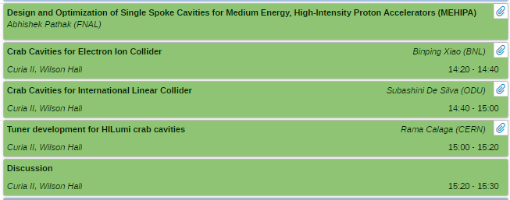
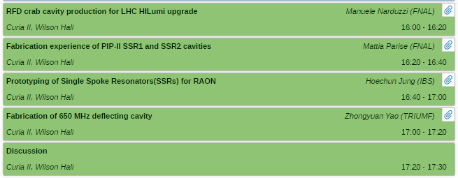
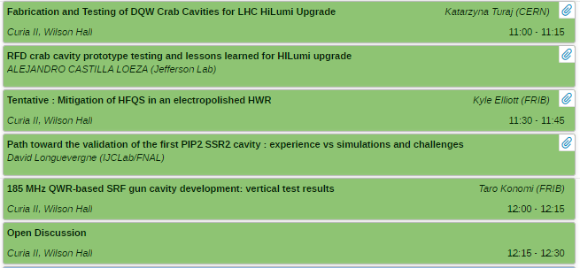
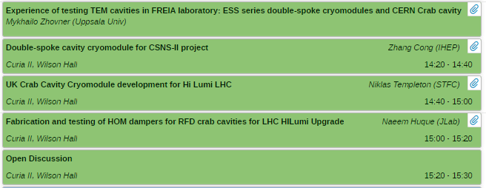
Organization : 4 sessions, 17 talks
Cavity and ancillaries design
Cavity fabrication
Wednesday
Cavity life cycle
Surface processing and testing
Cryomodule and ancillaries
Thursday

Slide 3
Cavity and Ancillaries Design
TAKE AWAY MESSAGE :
Designing
Complex HOM Damping Mechanisms in the Crab Cavities for the Future Colliders

Slide 4
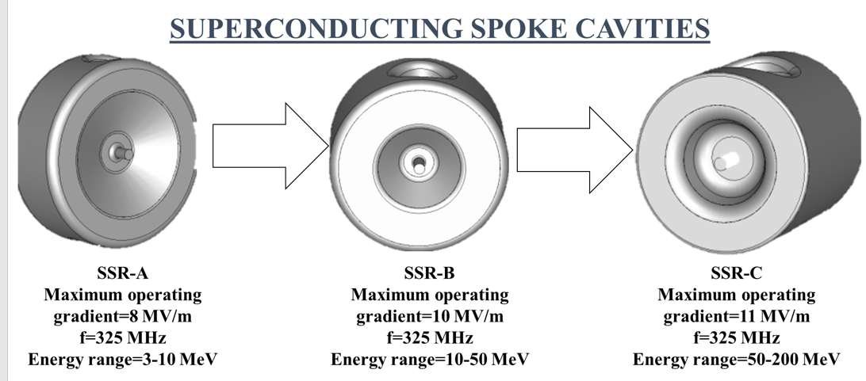
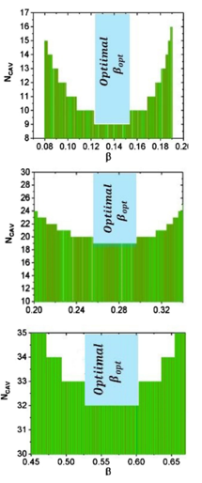
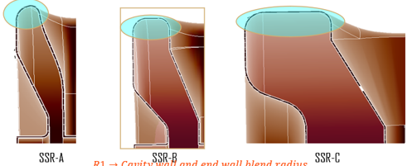
Design & Optimization of Single Spoke Cavities for Medium Energy High Intensity Proton Accelerator - Abhishek Pathak (FNAL)
MEPA in 1 GeV proton linac for subcritical accelerator systems
Medium energy region to gain 200 MeV with 3 types of single spoke cavities (8, 10, and 11 MV/m)
Optimization of D1 and D2 for peak magnetic field and T and W for peak electric field
Curvature tuning after extensive multipacting analysis to avoid 2 point multipacting

Slide 5
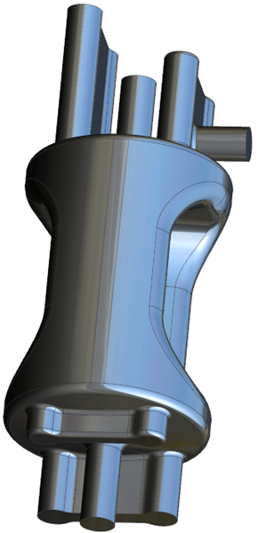
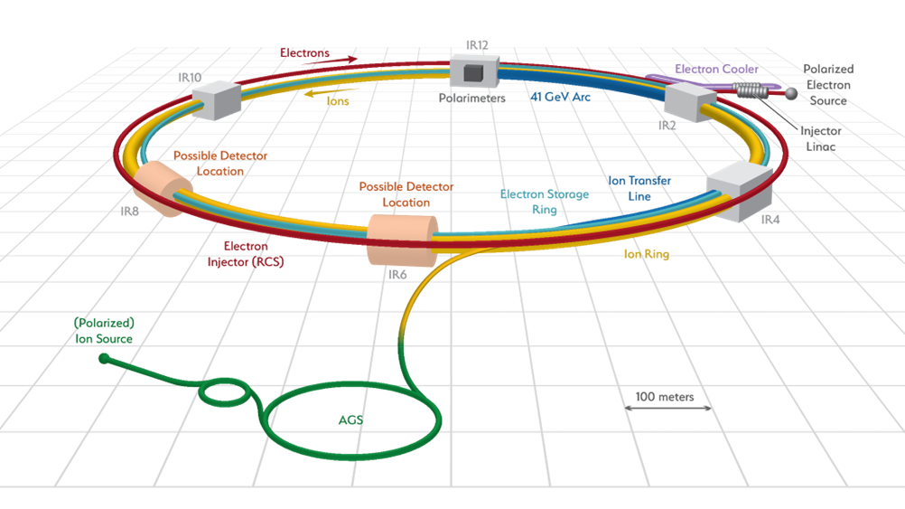
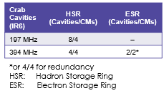
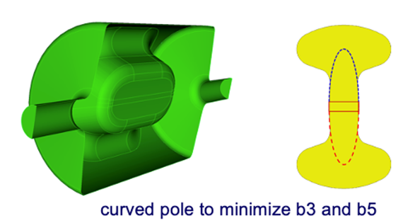
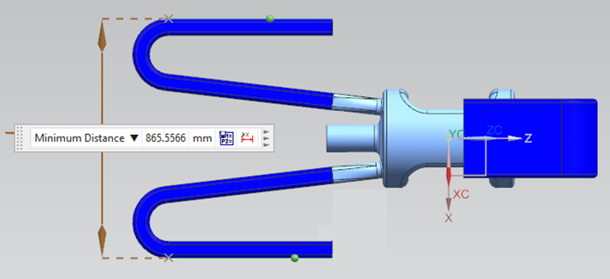
Crab Cavities for Electron Ion Collider - Binping Xiao (BNL)
Operating voltage per cavity: 8.5 MV for 197 MHz & 2.9 MV for 394 MHz.
Designed specs: 11.5MV for 197MHz & 3.5MV for 394MHz, with Epk 45MV/m & Bpk 80mT
In 197 MHz cavity HOMs are damped by transition to 3 identical coaxial couplers with no more than 2.3 kW in each
For First Article design poles are curved to suppress multipoles
In 394 MHz cavity HOMs are damped with 4 waveguide dampers
In ESR HOM power for the 4 waveguide absorbers are 25.0 kW for modes below 2 GHz and 30.3 kW above 2 GHz
<12kW for each waveguide load
~5kW each beampipe port
Further optimization going on to reduce HOM power

Slide 6
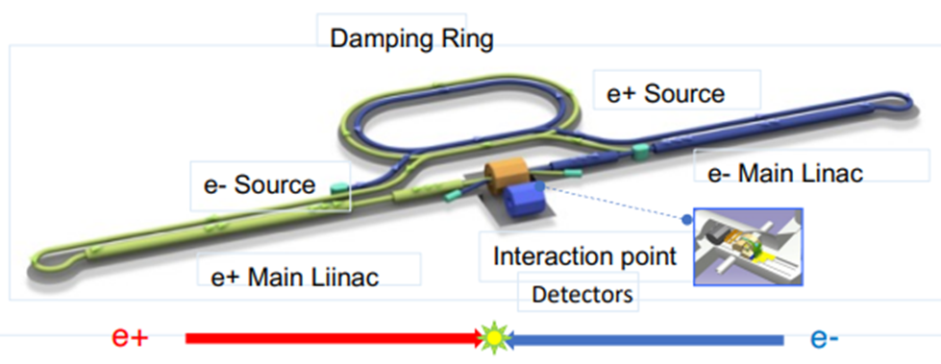
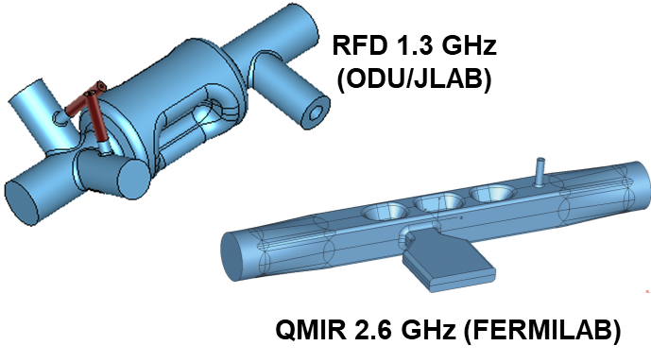
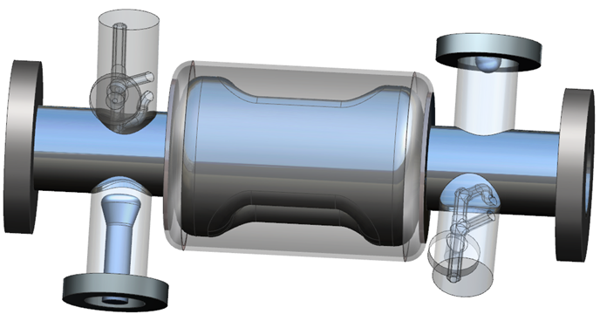
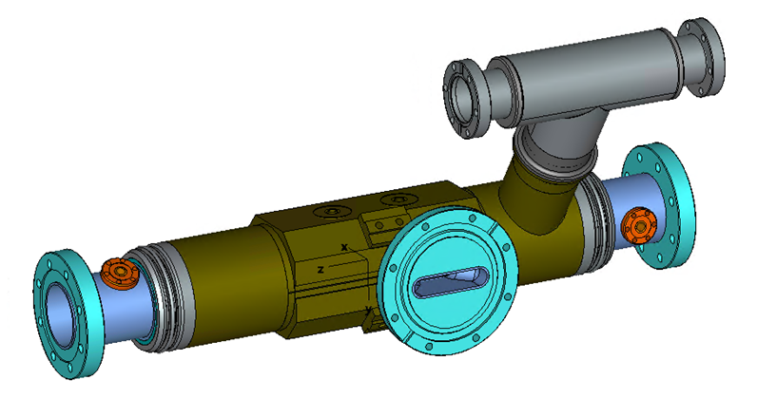
Crab Cavities for International Linear Collider - Suba De Silva (ODU)
14 mrad crossing angle
Transverse voltage –
At 1.3 GHz: 1.845 MV (125 GeV) and 7.4 MV (500 GeV)
At 2.6 GHz: 0.923 MV (125 GeV) and 3.7 MV (500 GeV)
Dimensional constraints:
Minimum beam aperture = 25 mm
Total cryomodule length < 3.8 mm
Parallel beam pipe separation = 197 mm
1.3 GHz RFD cavity - has two TESLA type HOM couplers
2 cavities in a cryomodule
2.6 GHz QMiR cavity - no HOM couplers
2 cavities in a cryomodule
Cavities fabricated by machining out of ingot - material provided by KEK

Slide 7
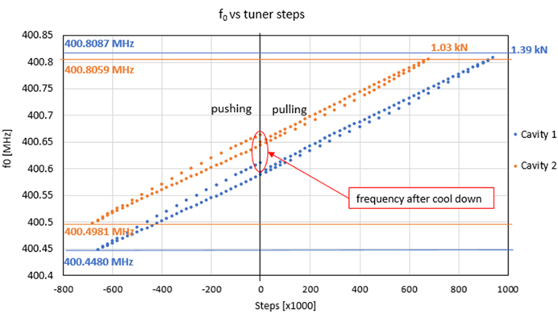
Tuner Development for HiLumi Crab Cavities - Rama Calaga (CERN)
Designed to push and pull equally
mm of action will give MHz range so precision is critical
On DQW - tuning by poles (capacitive) and on RFD - tuning by inductive part
Measured results on DQW cavity agrees well - no huge hysteresis
Measurements on RFD to be understood

Slide 8
Cavity Fabrication
TAKE AWAY MESSAGE :
Complex Cavity Structure
Detailed forming procedure investigation essential
Careful investigation for EBW condition with mock-up TPs and dedicated fixture
Good communication with vendor & sub-vendor

Slide 9
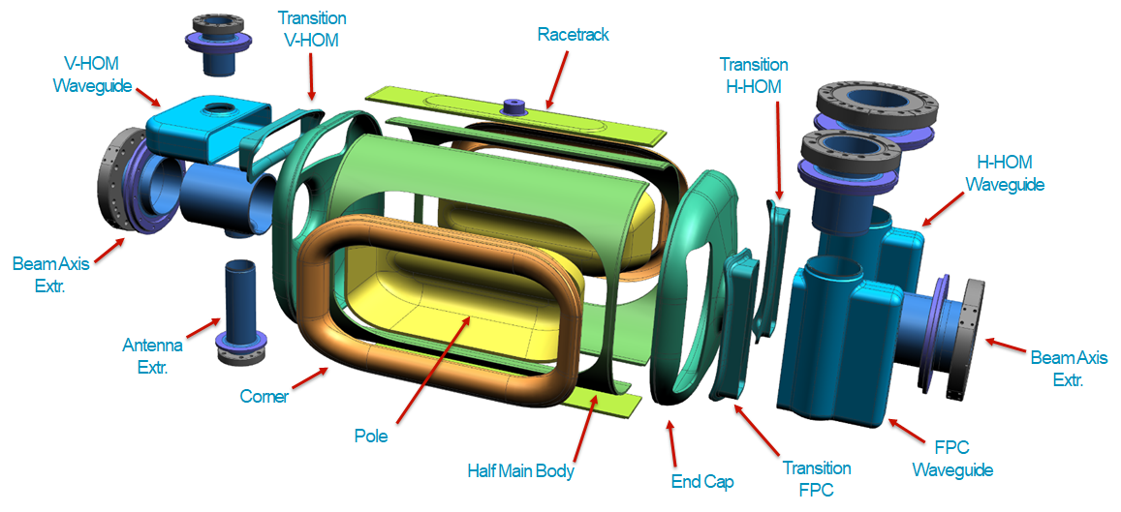
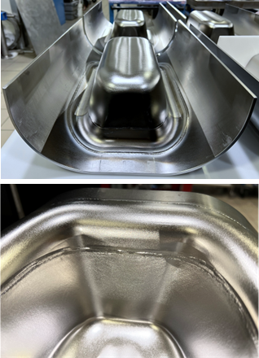
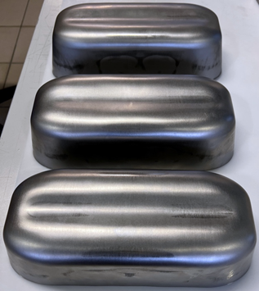
RFD Crab Cavity Production for LHC Hi-Lumi Upgrade - Manuele Narduzzi (FNAL)
3 main subcomponents
Encountered problems in poles and waveguides deep drawing.
It showed non-repeatable results.
Alignment of the three main subcomponents (Main Body and End Groups) for the final EBW required very careful CMM data analysis.
EB welding of the Pole-Corner-Half Main Body
required R&D for dedicated fixtures and procedures.
Pole deep drawing
EB weld

Slide 10
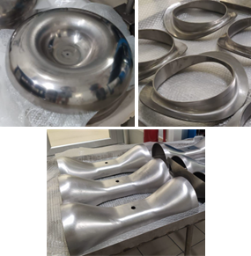
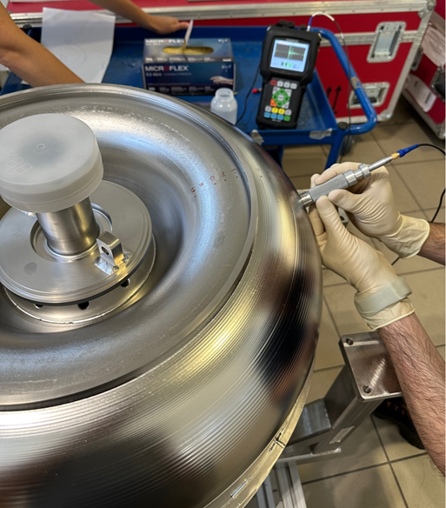
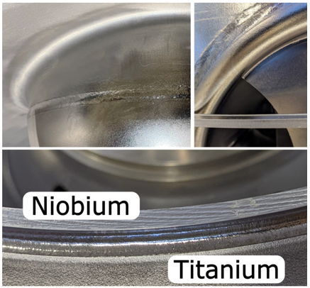
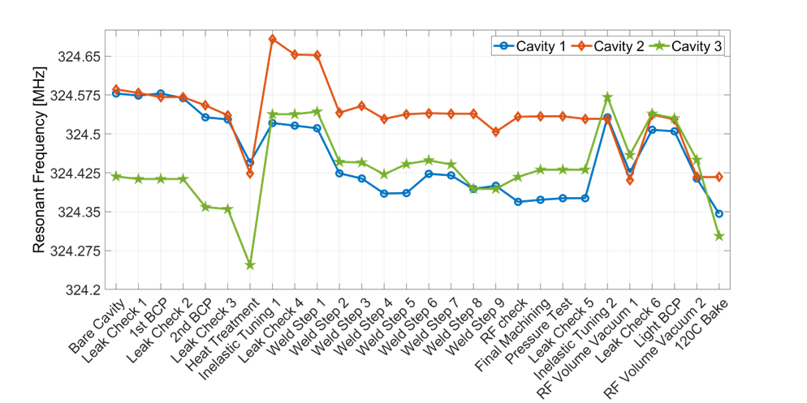
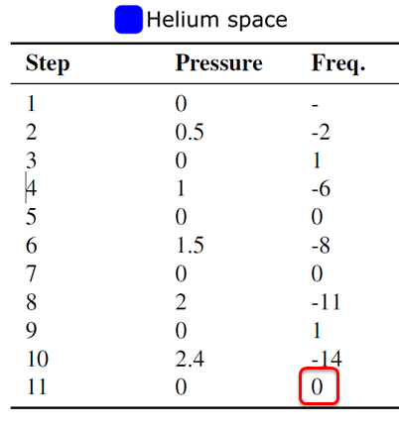
Fabrication experience of PIP-II SSR1 and SSR2 cavities - Mattia Parise (FNAL)
The most critical components to be fabricated are endwalls, spokes, and spoke collars.
- Spokes and spoke collars : Deep drawing
- Endwalls : deep drawing (one vendor) and metal spinning (another vendor)
Importance : Vendor visits (good feeling about the goodness of the measurement).
SSR2 and SSR1 cavities requires > 100 welds (EB and TIG technique).
They reached the target frequency (325.0MHz) at 2K with tuner.
Inelastic tuning proved to be successful.
Frequency shift induced by pressure test is negligible.

Slide 11
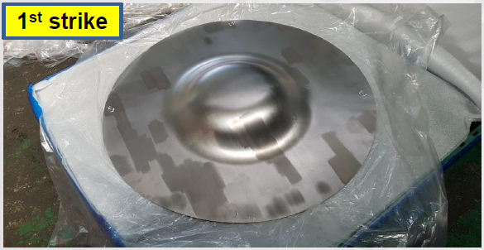
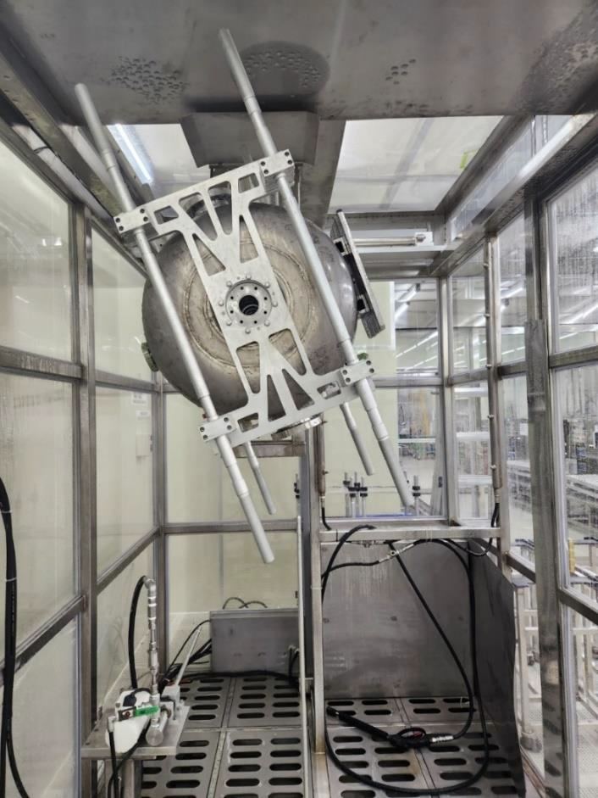
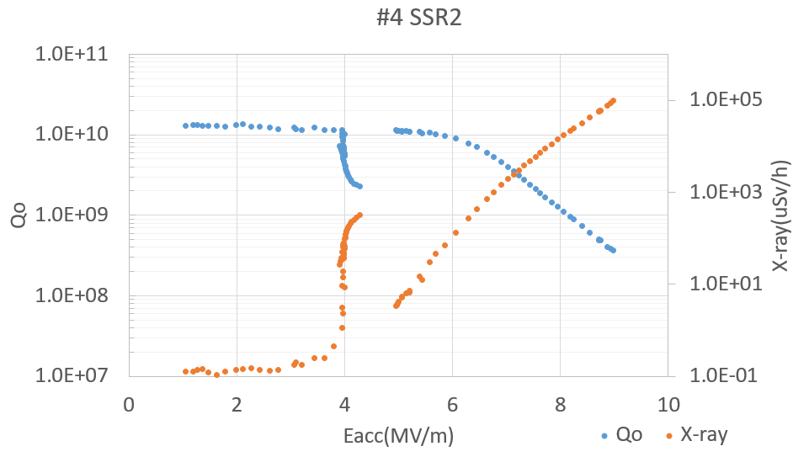
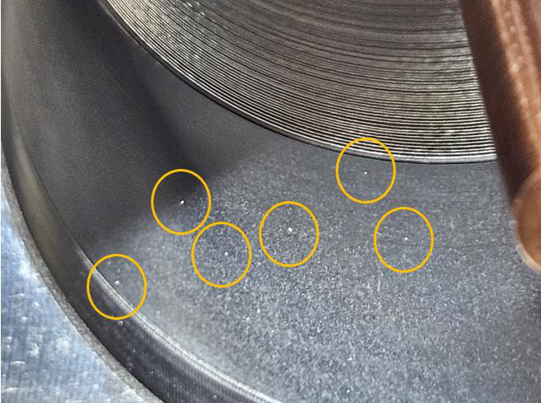
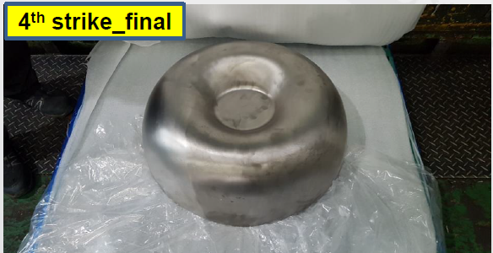
Prototyping of Single Spoke Resonators (SSRs) for RAON - Hoechun Jung (IBS)
SSR cavities are on the 2nd prototyping.
Press dies and drawing process are well optimized. -> Made balloon shapes successful.
Importance : good communication with vender
<- Fixing jig for vacuum not only for cavity cold test).
Importance : cleaning before & during the process in the vender & sub-vender.
HPR: Reduced grey zone by tilting cavity (±20°) and by optimizing nozzles.
Hard MP barrier might be due to poor surface condition ?
-> Importance : clean assembly
<- Thermal quench (contamination particle@ test coupler))
-> SSR2 will be tested again after 600℃ baking and vacuum system improvement.

Slide 12
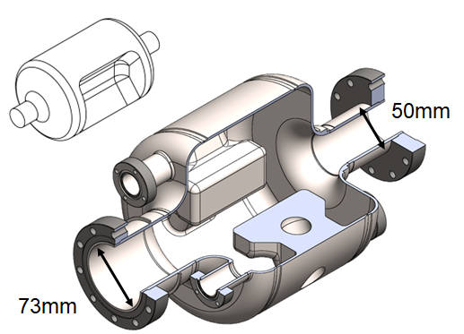
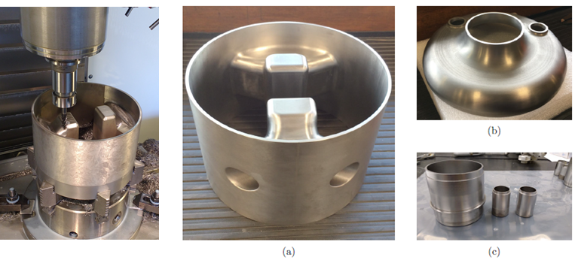
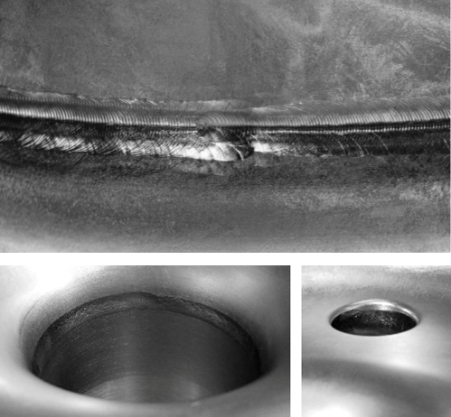
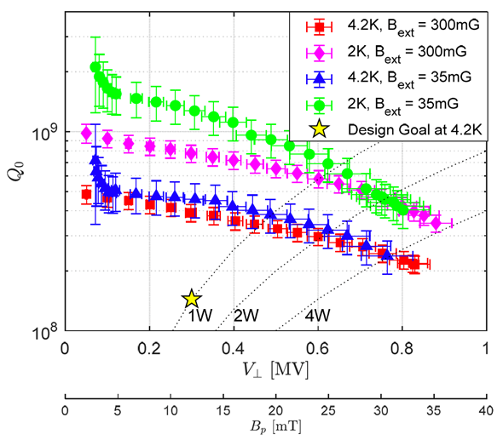
Fabrication of 650 MHz Deflecting Cavity - Zhongyuan Yao (TRIUMF)
650 MHz deflecting cavity was built in-house with novel (low-cost) fabrication technologies
- Reactor grade niobium (RRR-45)
- Machined from solid block
- TIG welding developed
Cavity surpassed design specifications for voltage and quality factor
- Peak fields 25 MV/m and 32 mT
TIG welding did not cause issues.

Slide 13
Surface Processing and Testing
TAKE AWAY MESSAGE :
Advanced processing and assembly (ancillaries) procedures, and simulation tools necessary to mitigate Field Emission in complex shape cavities

Slide 14
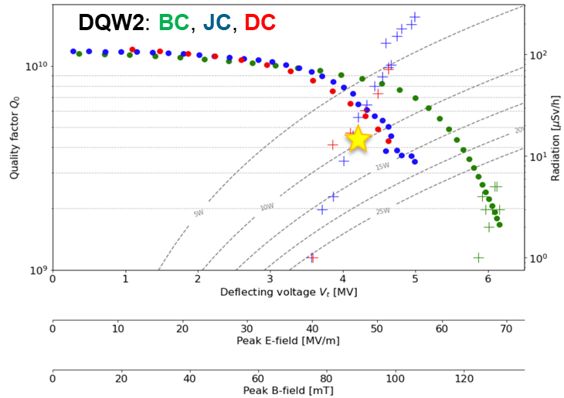
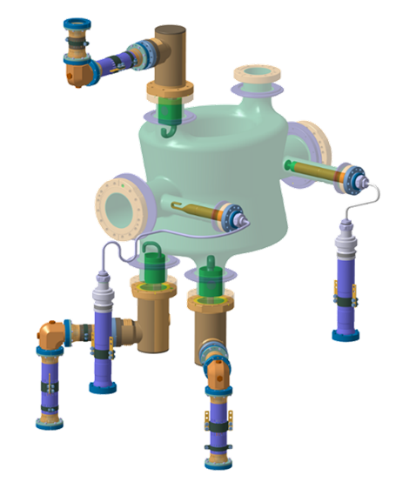
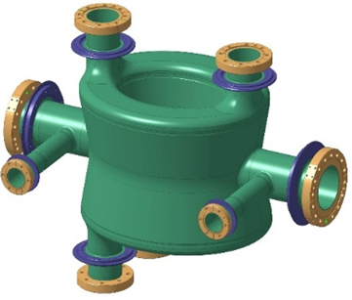
Fabrication and testing of DQW crab cavities for HL-LHC upgrade -Katarzyna Turaj (CERN)
Successful fabrication of 2 series at CERN and 8 series at RI (successfully reached frequency goal, implementation of rotational BCP).
Several cavities validated but required reprocessing (BCP) and several cold test to mitigate FE
Thermal cycle at 20K is required to reach good Qo
Fully dressed cavity (4 HOM) validated but stronger FE
Continually learning and implementing actions to improve quality and meet project deadlines

Slide 15
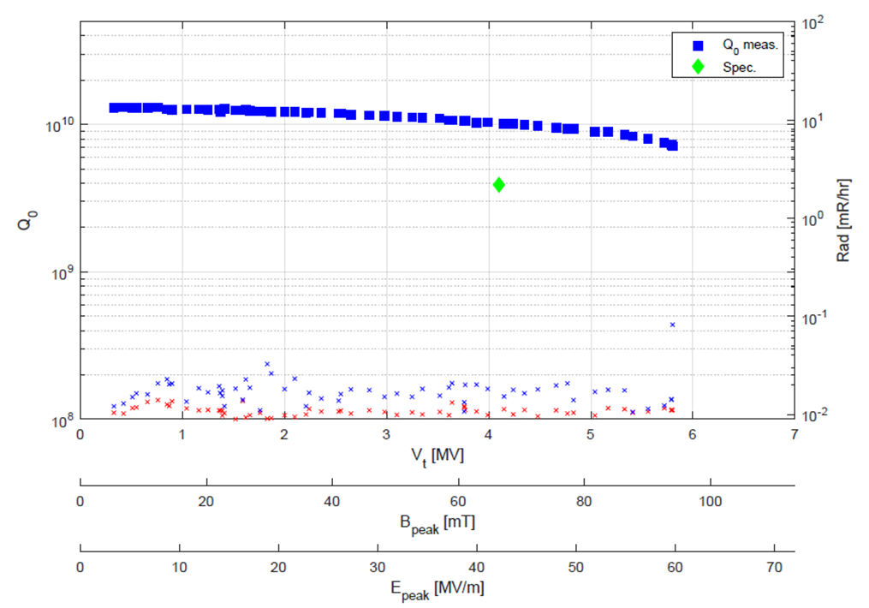
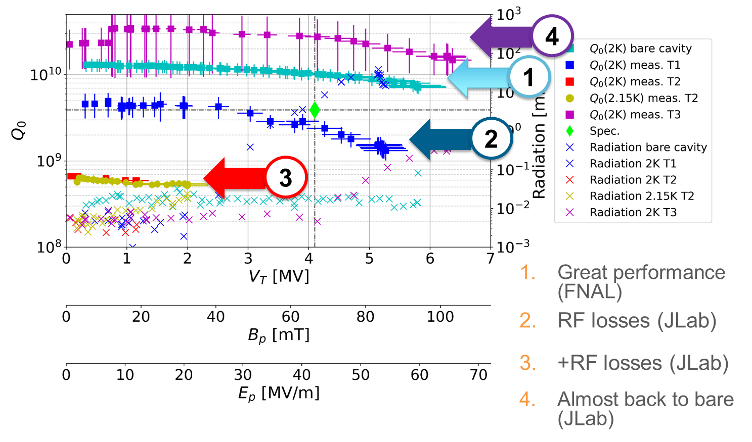
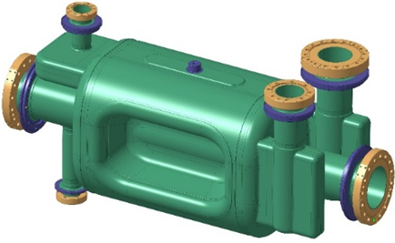
RFD Cavity Prototype and Testing for the HiLumi LHC Upgrade - A. Castilla (JLab)
2 prototypes successfully manufactured at ZRI
Both exceeding specifications after processing at ANL/FNAL
First tests with HOM not successful : problems with RF contacts with HOM, problem with assembly procedures and tooling (US - EU), HPR not optimal (manual car wash)
Final test successful, no evident reduction although uncertainties in Q-measurement (HOM)
Ready for jacketing!

Slide 16
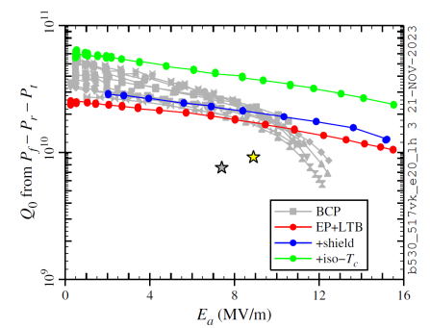
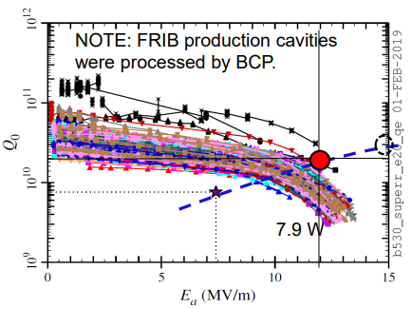
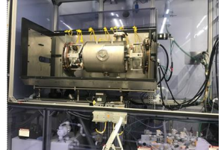
Mitigation of High Field Q Slope in a electropolished HWR Cavity - K. Elliot (FRIB)
Field emission (FE) and high field Q slope (HFQS) are major issues to be resolved, for high Q&G performance
From experience, HFQS can be mitigated only by EP+LTB (1.3 GHz, ANL HWR)
EP facility built at FRIB (fall 2022) for energy upgrade
HFQS successfully mitigated
Qo improved with B compensation and uniform cooling !
HWR 0.53

Slide 17
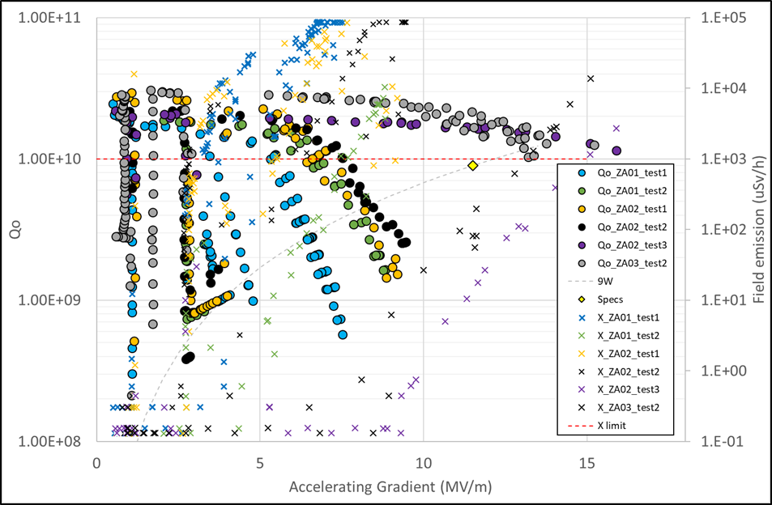
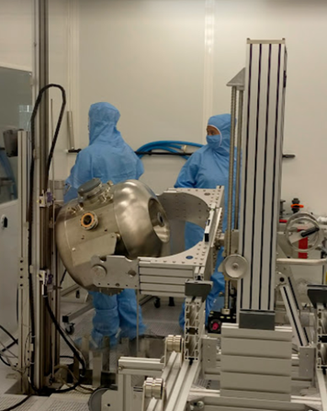
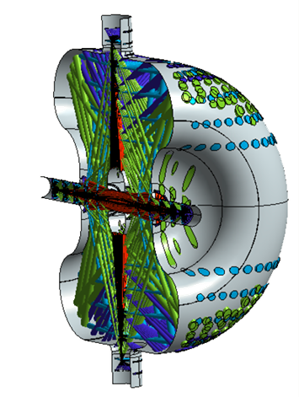
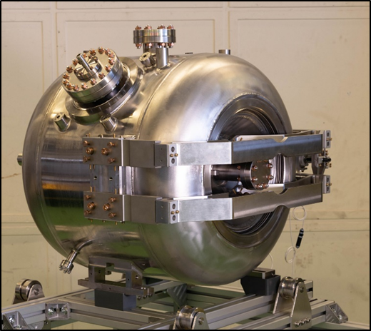
Path toward the validation of the first PIP2 SSR2 cavity - D. Longuevergne (IJCLab)
PIP-II first project to transfer surface processing of Spoke to industry (rotational BCP, strong oversight).
Very strong FE emission. Long process to solve problem
Past successful experience on similar geometry didn’t solve problem => required simulations and upgrade of procedure (tilted HPR) and tooling (nozzle)
Several development of HPR simulation tools (FNAL, FRIB) => very helpful.
Should be implemented in simulation package during design (RF, meca, multipacting, HPR)

Slide 18
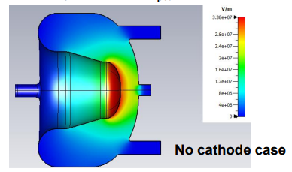
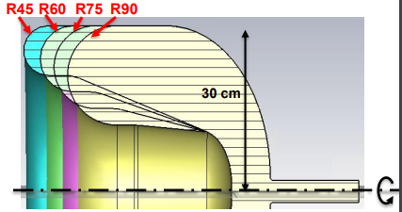
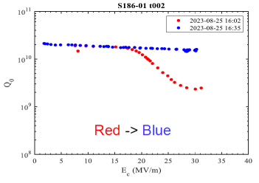
185 MHz QWR-based SRF gun cavity development: vertical test results of First Cavity without cathode port - T. Konomi (FRIB)
Development of SRF to improve emittance for LCLS-II HE (30 MV/m)
Optimization of geometry for multipacting mitigation (barriers as expected and easy conditioning
1 prototype fabricated and processed EP at ANL and FRIB
Cavity is validated but ignition of field emitters during test
Cavity ready for integration at ANL

Slide 19
Cryomodule and Ancillaries
TAKE AWAY MESSAGE :
Cryomodule Assembly
FPC and HOM ancillaries with tight tolerances requires more detailed procedures + QA

Slide 20
Experience of Testing TEM Cavities in FREIA Laboratory - Mykhailo Zhovner
During cavity MP conditioning we deal with superposition MP bands from cavity and FPC
Both MP sources have influence on the beam vacuum
Low field multipacting can be easy conditioned
Pulse operation during cavity conditioning prevent from global quench
Thermal cycles help to treat FE

Slide 21
Double Spoke Cavity Cryomodule for CSNS-II Project - Zhang Cong (IHEP)
2 cavity cryomodule
Cavity - 3.2 mm/4.2 mm, Stiffening ribs - Low purity Nb, He vessel - 4 mm Ti sheet, Cryomodule - SS
Multipacting processed for several hours
Cryomodule assembled in Class-10 clean room with 2 DSR cavities, 2 FPC, 2 gate valves, 3 bellows
Mock cavity cryomodule - Liquid nitrogen cold tested, vacuum tested, magnetic permeability < 1.1
DSR cryomodule assembly is completed
Waiting for horizontal testing

Slide 22
HiLumi LHC Crab Cavity Cryomodules - Niklas Templeton (STFC)
Double Quarter Wave (DQW) – vert. crabbing at CMS
RF design by BNL & CERN
Supplied by CERN & R.I.
Radio Frequency Dipole (RFD) – horiz. crabbing at ATLAS
RF design by ODU
Supplied by US-AUP & Zanon
Detailed build procedures including tooling and infrastructure, QA travellers, critical requirements, …….
Lessons learned from issues
Dent in hydroform bellows pre-cleanroom - improved communication
Redesign of test rig and requalification of Bi Phase line - due to poor supplier QA
Removal and replacement of bellows subassembly - due to QA processes not followed
Damage to power couplers - Analysis on going

Slide 23
HHOM Coupler Fabrication and Testing for RFD Crab Cavity
- Naeem Huque (JLAB)
Fabricate sets of RFD Cavity Ancillaries (HOM dampers and Field Antennas)
Prototype: 3 sets
Pre-Series: 3 sets
Series: 8 sets
HHOM Damper is constructed primarily of Nb, with 316LN Stainless Steel flanges brazed on, and a 316LN helium jacket
Relative positions of the “Hook” and “Tee” are the most important dimensions in the assembly
Improved weld parameters give good weld of T and Hook
Challenges still remain for ceramic feedthroughs with radial cracks and loss of vacuum
Plans to test with high purity ceramics

