Slide 1
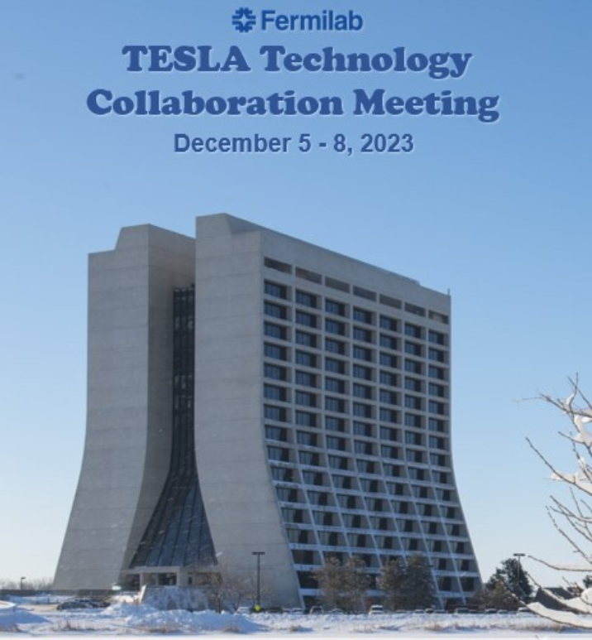
WG-3 Summay Novel clean assembly techniques, in-situ mitigation, and recovery processes
Conveners: Naruhiko Sakamoto (RIKEN),
Martina Martinello (SLAC), Enrico Cenni (CEA)
TTC2023 Fermilab Dec. 5 -8

Slide 2
WG-3 Sessions (Please find details on Indico)
TTC2023 Fermilab Dec. 5 -8

Slide 3
WG-3 Objectives and Presentations
Novel clean assembly techniques including robotics and semi-automated procedures to prevent dust particle contaminations and migrations.
6 talks from KEK, FNAL, CEA, BSCE, FRIB
2. Methods to carefully install “clean” cryomodules into existing “dirty” facilities or techniques to reduce particulate migration to maintain on-line performance.
5 talks from IBS, ESS, RIKEN, SLAC, TRIUMF
3. Diagnostics of field emission to understand where and how field emission is occurring.
3 talks from ESS, CEA, INFN Milano
4. Off-line techniques like high pressure rinsing to mitigate field emission in various types of cavities and cryomodules.
2 talks from JLAB, FRIB
5. In situ cleaning techniques like pulsed RF conditioning, plasma processing, and helium processing.
4 talks from FRIB, IJCLAB, JLAB, RIKEN
TTC2023 Fermilab Dec. 5 -8

Slide 4
Topic 1: Novel clean assembly techniques
-Ultimate goal is assembly made by robots, “no humans no dusts”.
-So far collaborative robot for cleanroom has been introduced and tested in some laboratories.
-Various effort is under way to have much more accuracy by utilizing cameras to be able to assemble string components
-It is pointed out that cost effectiveness is one of the important issues.
-Mechanical design of cryomodules and cavities considering robotic assembly including HPR would be crucial for effective robotic work.
- Collaborations are in place to share experience between various lab (in the spirit of TTC)
TTC2023 Fermilab Dec. 5 -8

Slide 5
Topic 2: Methods to carefully install “clean” cryomodules
-Most of laboratories tried to have “clean” installation with best effort.
-It is still not well understood what is the critical (enough) condition for clean installation.
-Coupler substitution of running machine is a common issue. Cryomodule design should take this into account.
TTC2023 Fermilab Dec. 5 -8

Slide 6
Topic 3: Diagnostics of field emission
-New attempt to understand the mechanism of FE many efforts have been made for different structure cavities.
-Particle tracking and particle through matter simulation would be a mighty tool.
-Also, development new diagnostics is crucial to compare the experimental data with simulations.
-Hopefully, this approach will give us hints to avoid FE increase of operating machines.
-It will help to better qualify recovering operations on emitting cavities
TTC2023 Fermilab Dec. 5-8

Slide 7
Topic 4: Off-line techniques to mitigate field emission
-Liquid Nitrogen high pressure cleaning is a combination of HPR(high pressure) and Dry-ice cleaning(No drying no residue) .
-Offline rehearsal of coupler cold gauge and/or coupler itself is carefully made using spare cryomodules.
TTC2023 Fermilab Dec. 5 -8

Slide 8
Topic 5: In situ cleaning techniques
-FE mitigation technique has been discussed repeatedly for a long time.
-Even though, not small number of operating machines have been suffered from FE which limits the available voltage.
-Historically pulsed rf conditioning, plasma processing, helium processing were adopted.
-Their effect is not guaranteed and looks strongly depend the geometry of cavities and cryomodules.
TTC2023 Fermilab Dec. 5 -8

Slide 9
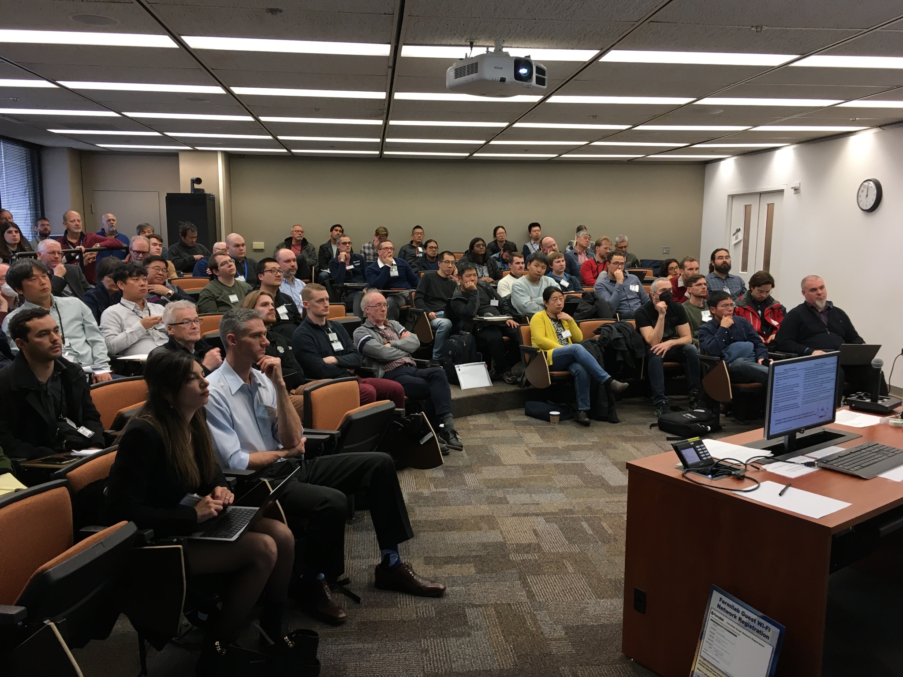
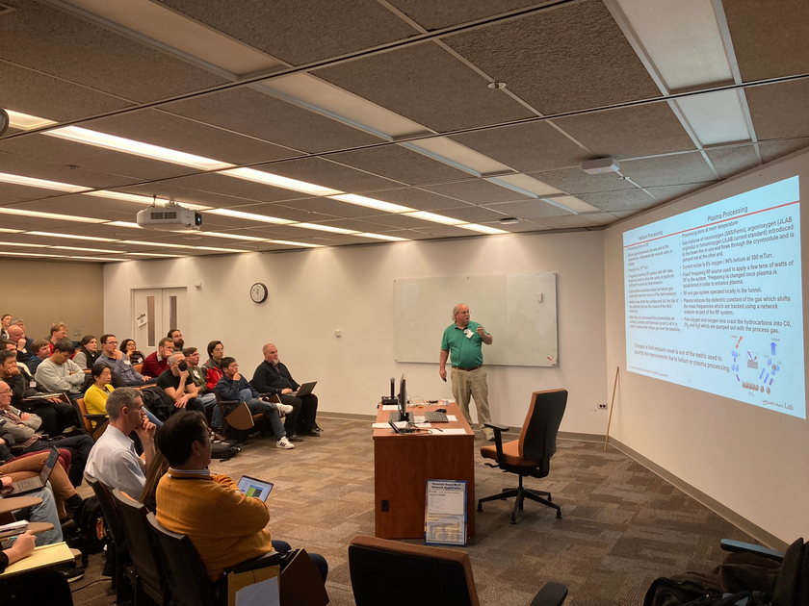
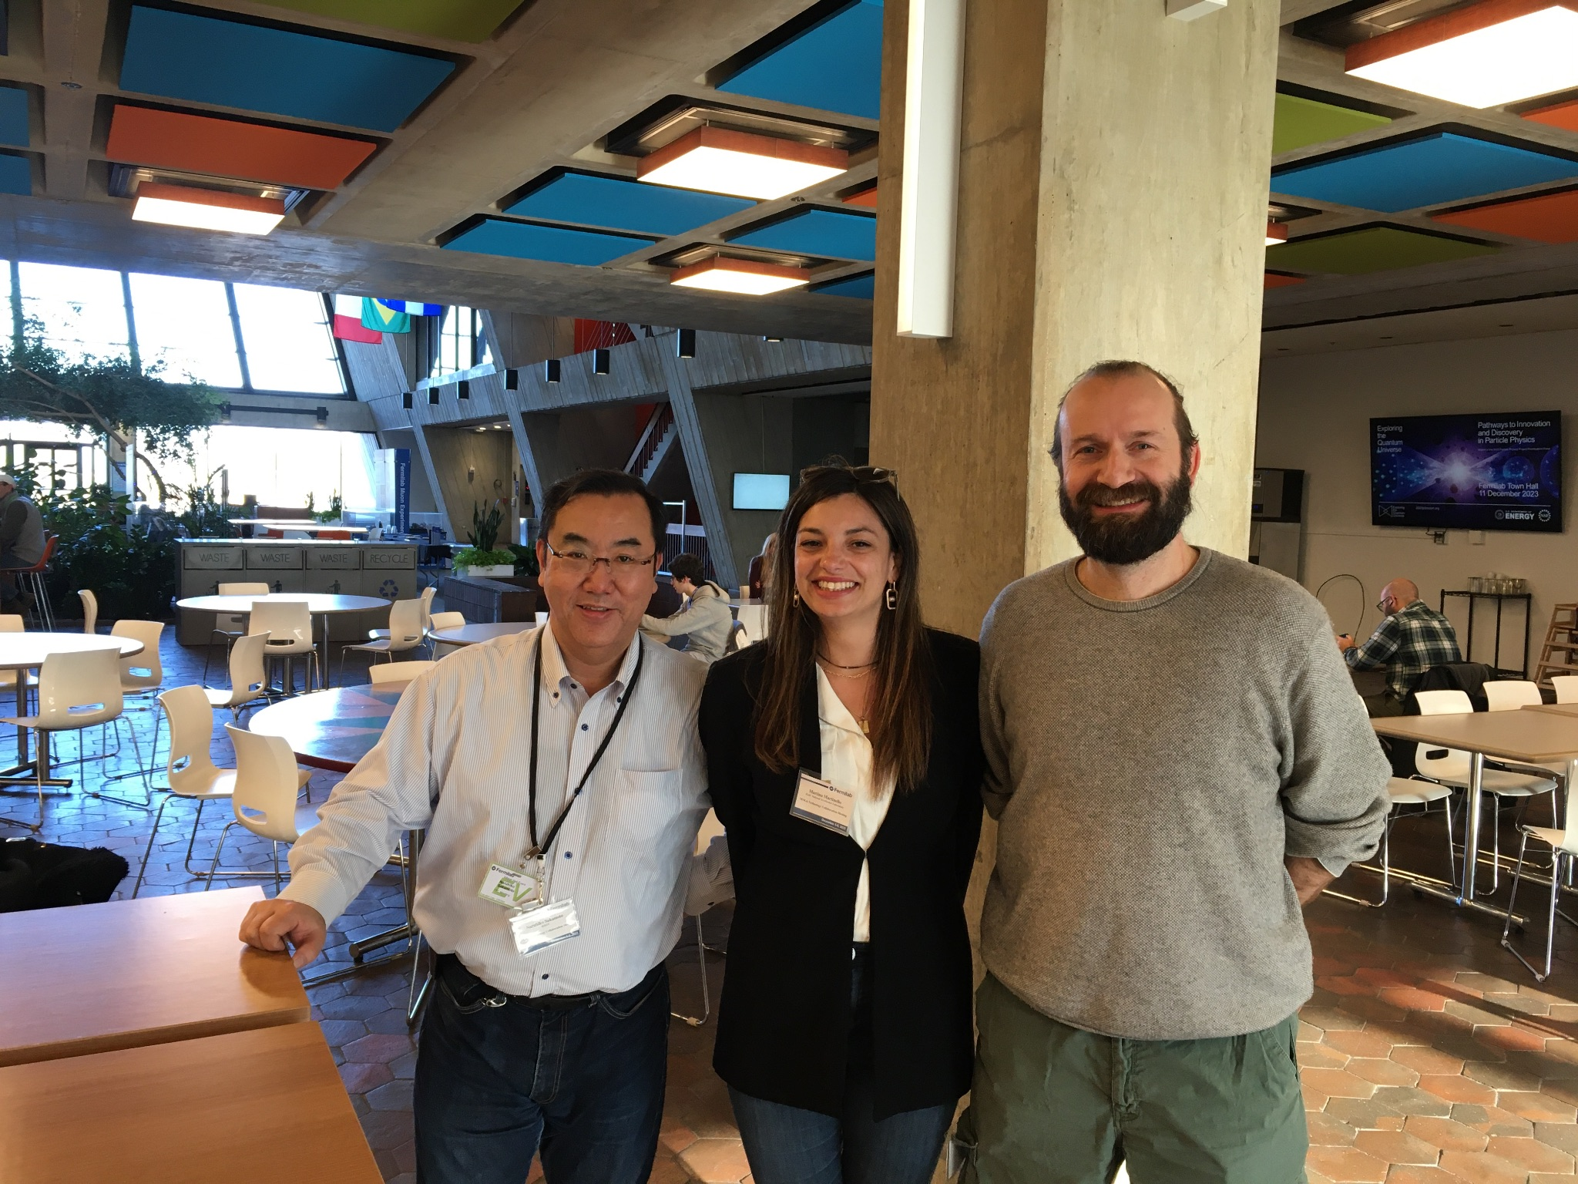
Let’s continue to have discussions!
We thank all the speakers and audiences for fruitful discussions in in-person TTC meeting.

