Slide 1
WG4 Summary
Design, Experience, and Operation with High Beta/Beta=1 Cryomodules and Sub-components
Conveners: Dan Gonnella (SLAC), Han Li (IASF), Serena Barbanotti (DESY)

Slide 2
Organization of the Working Group
Divided into 4 sections:
Operational experience
Hot Topic on heat load measurements
Cool down experience
Non-cavity components and special topics: alignment, pressure regulations, couplers, etc.

Slide 3
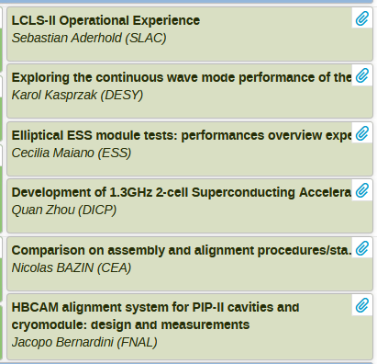
WG4, session 1
Topics:
  Operational Experience
  Alignment strategies

Slide 4
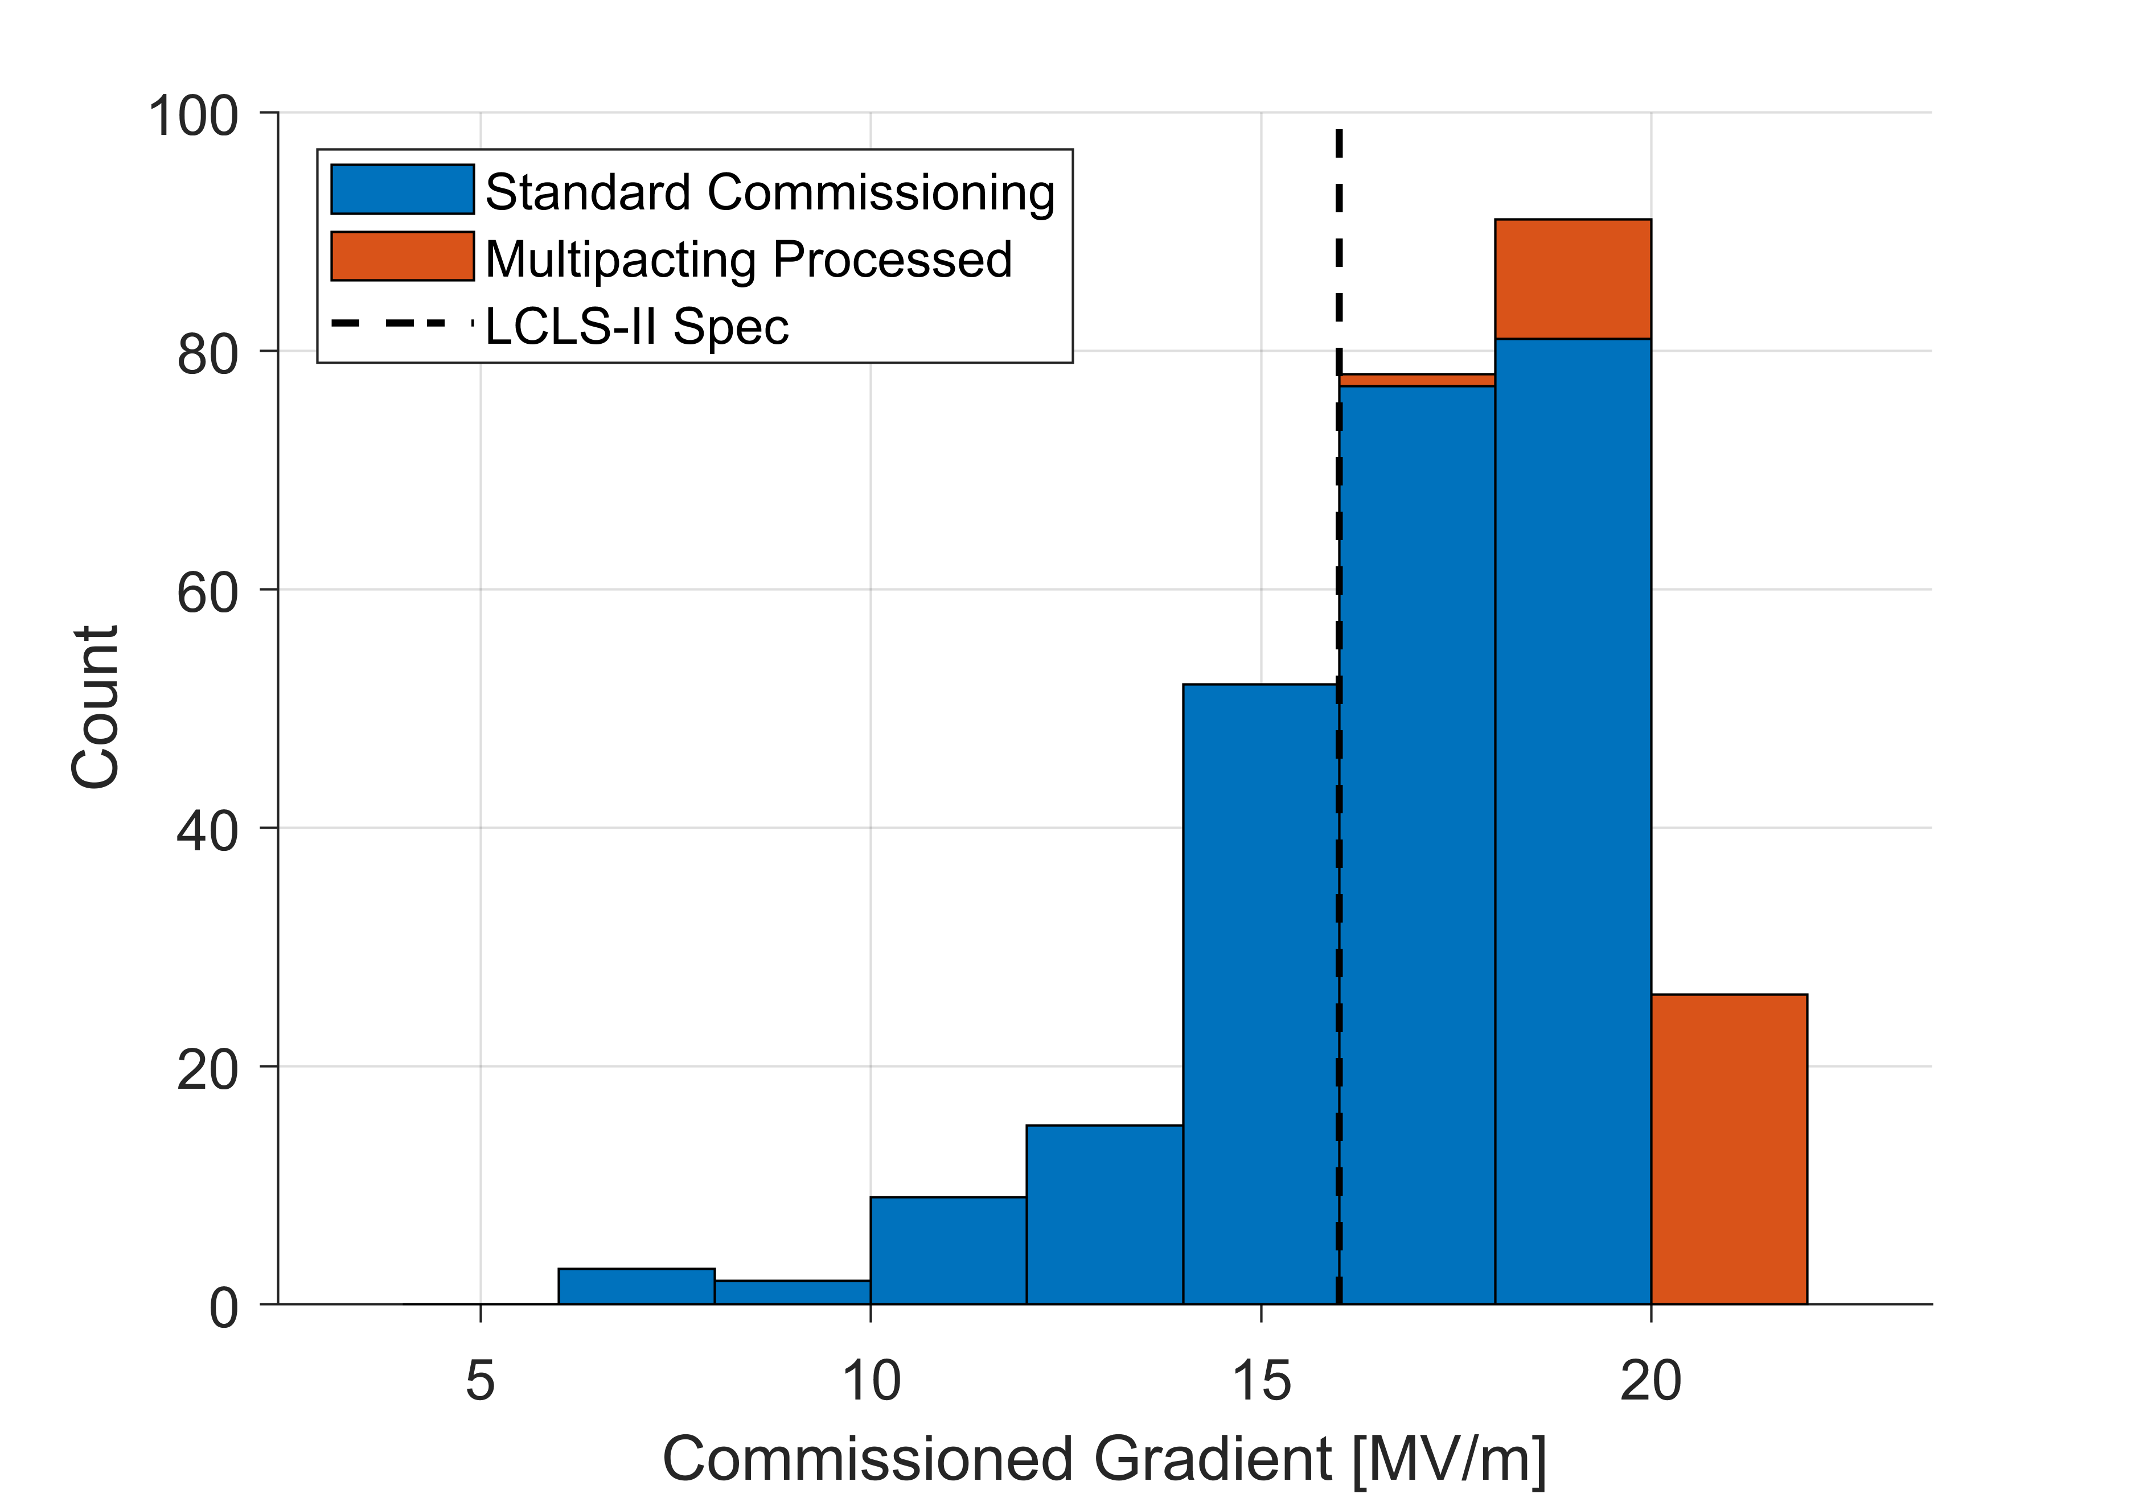
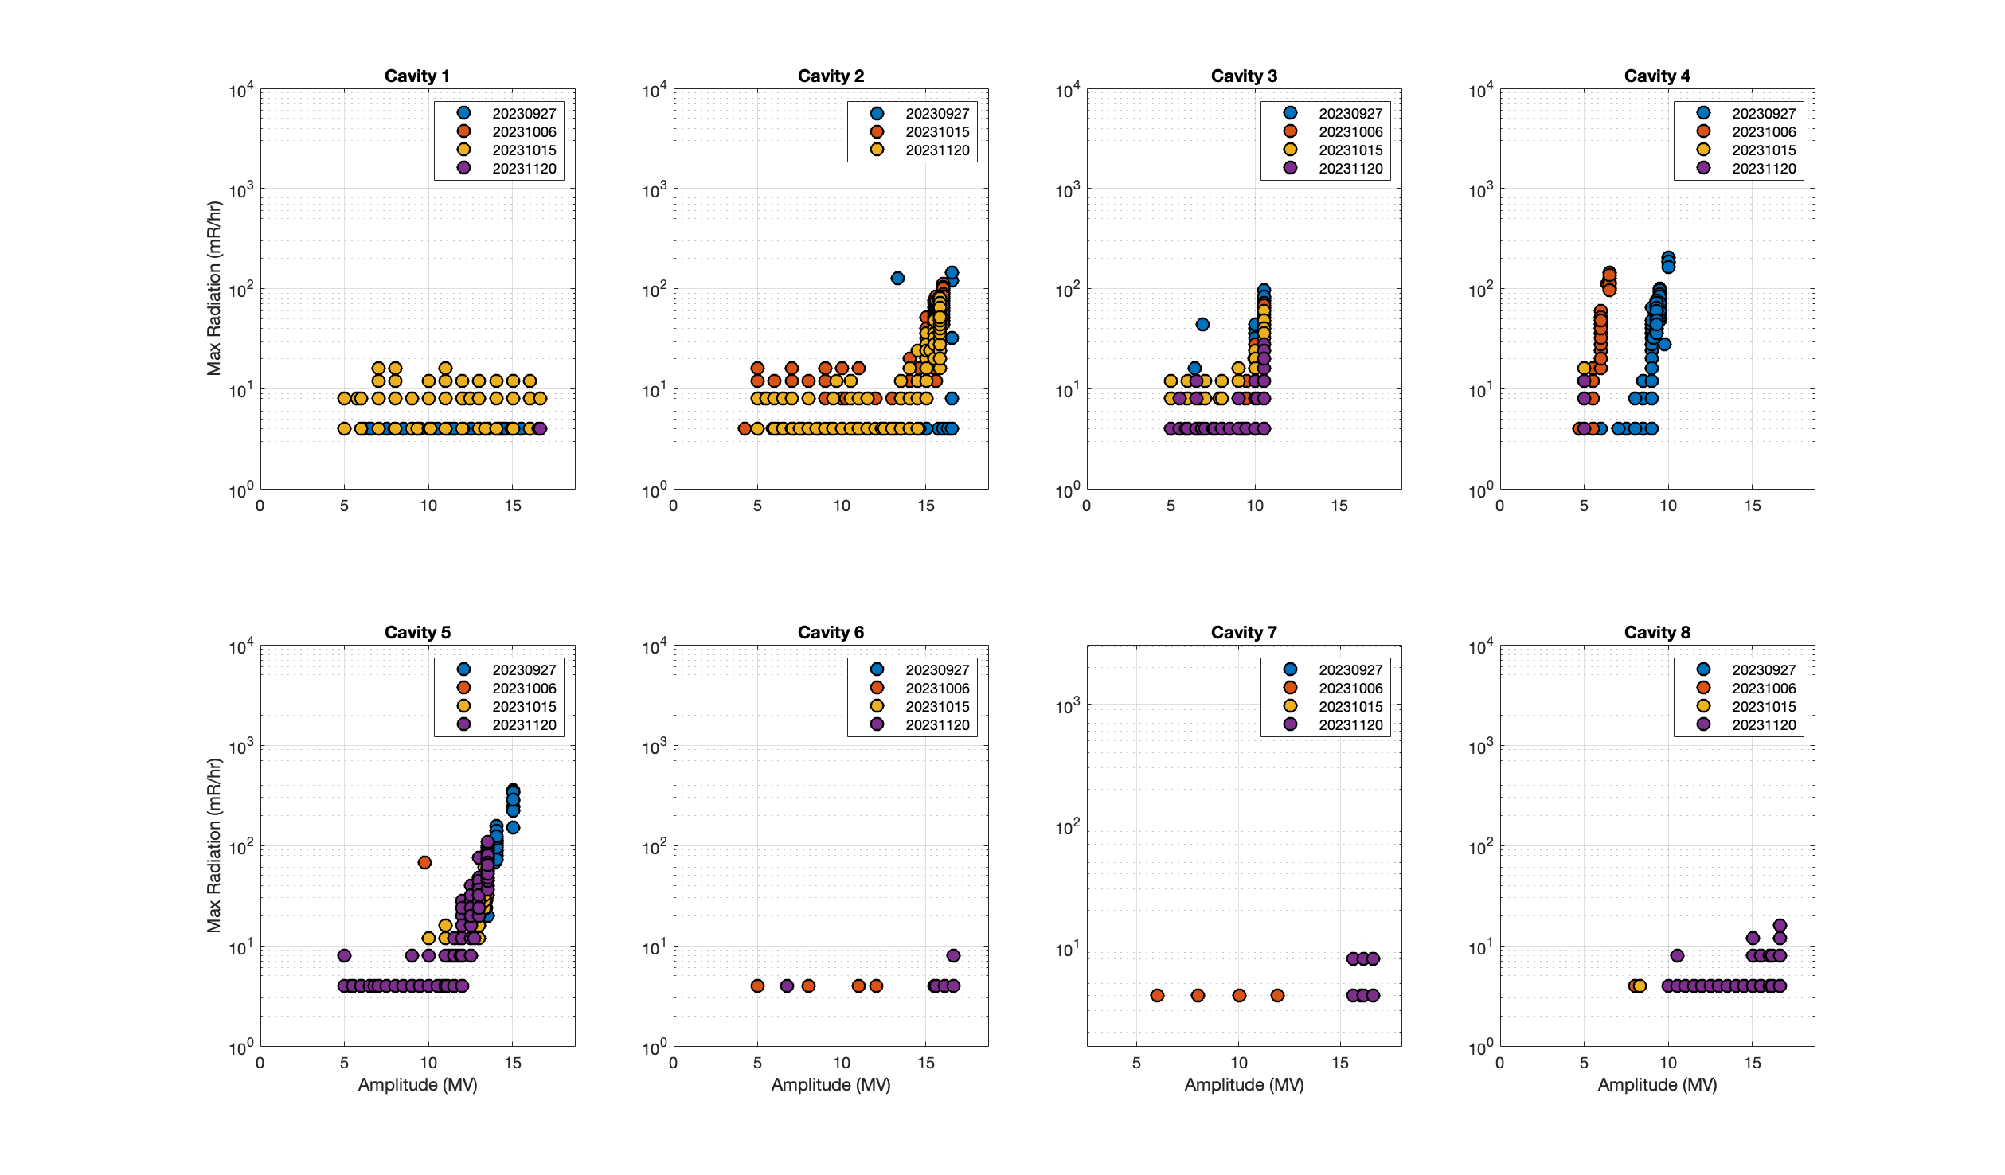
LCLS-II: SRF Commissioning and Operations Recap
Gradient Performance
Higher than expected static heat load
 | EXPECTED CM STATIC | OBSERVED CM STATIC (Initial) | OBSERVED CM STATIC (with Additional Pump)
LO-L2 | 9 W / CM → 150 W | 9 W / CM → 150 W | 9 W / CM → 150 W
L3-UPSTREAM | 9 W / CM → 90 W | 47 W / CM → 470 W | 17 W / CM → 170 W
L3-DOWNSTREAM | 9 W / CM → 90 W | 16 W / CM → 160 W | 16 W / CM → 160 W
TOTAL CM STATIC | 330 W | 800 W | 500 W
Newly Discovered FE in CM01

Slide 5
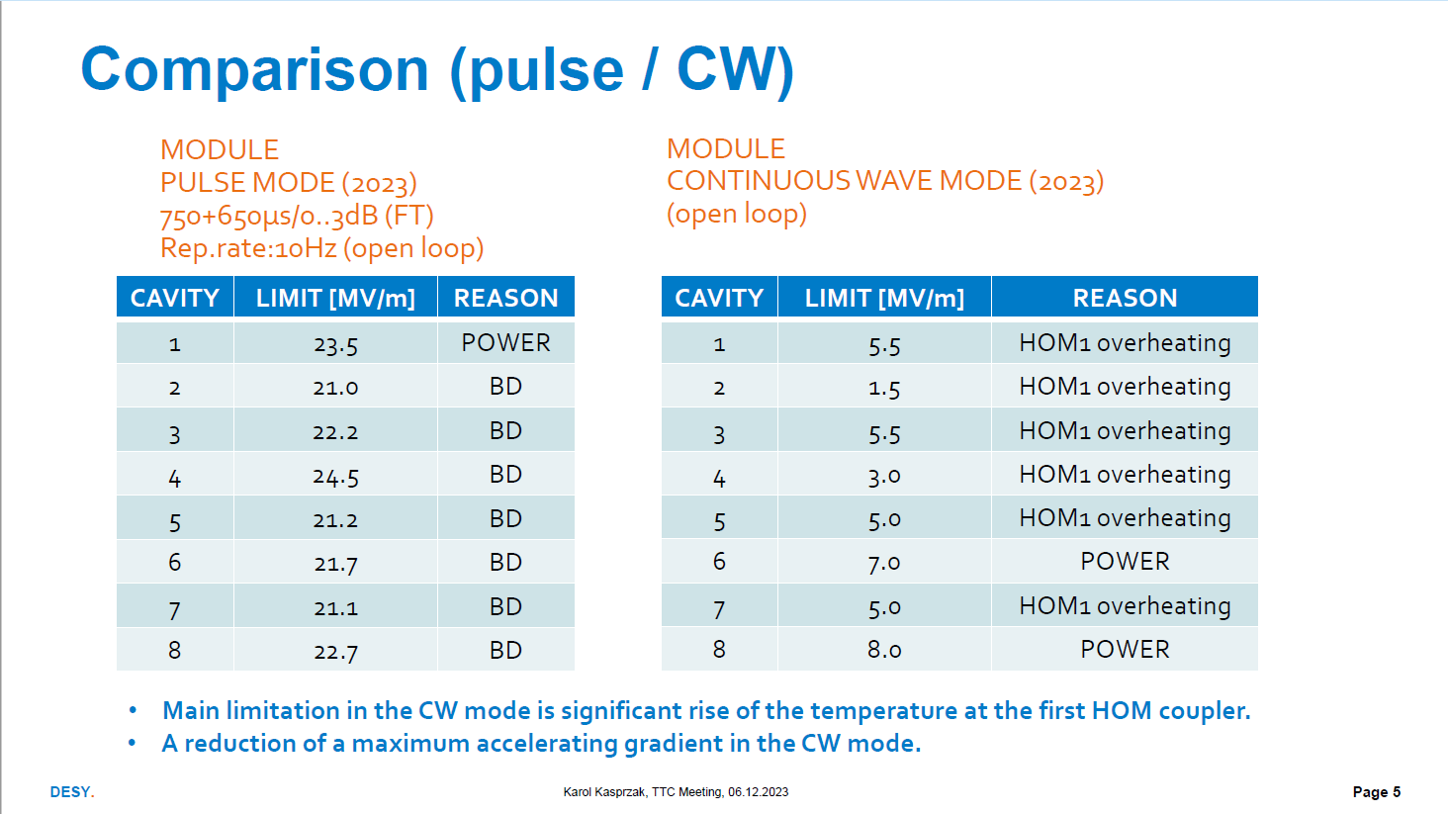
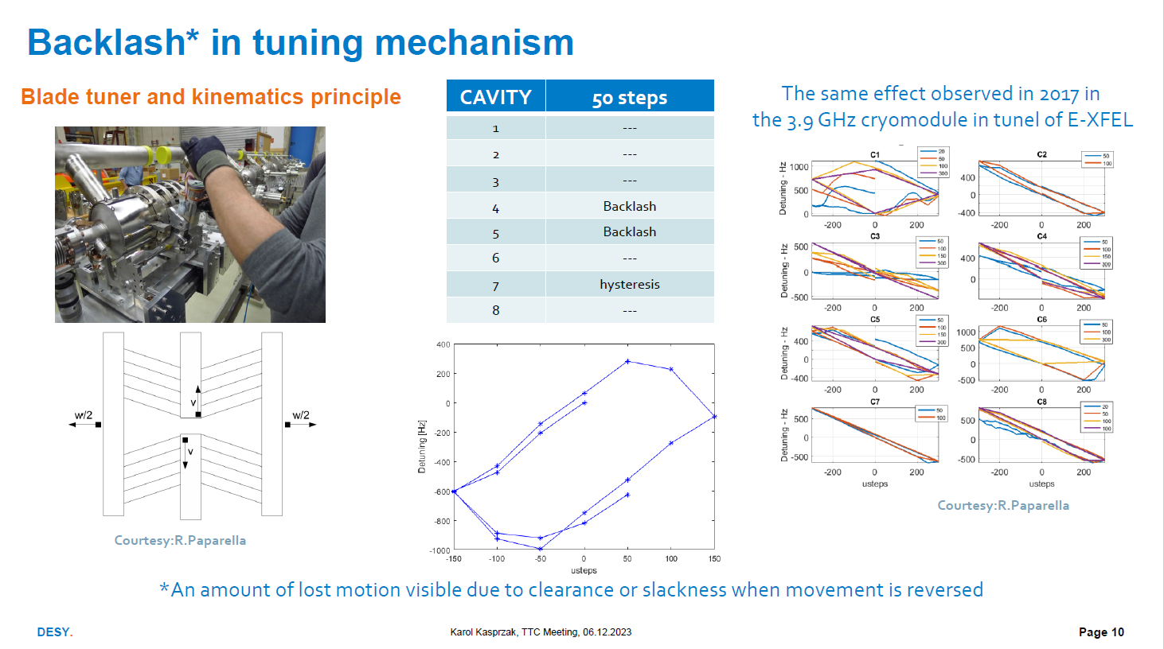
Studying 3.9 GHz operation in CW at DESY

Slide 6
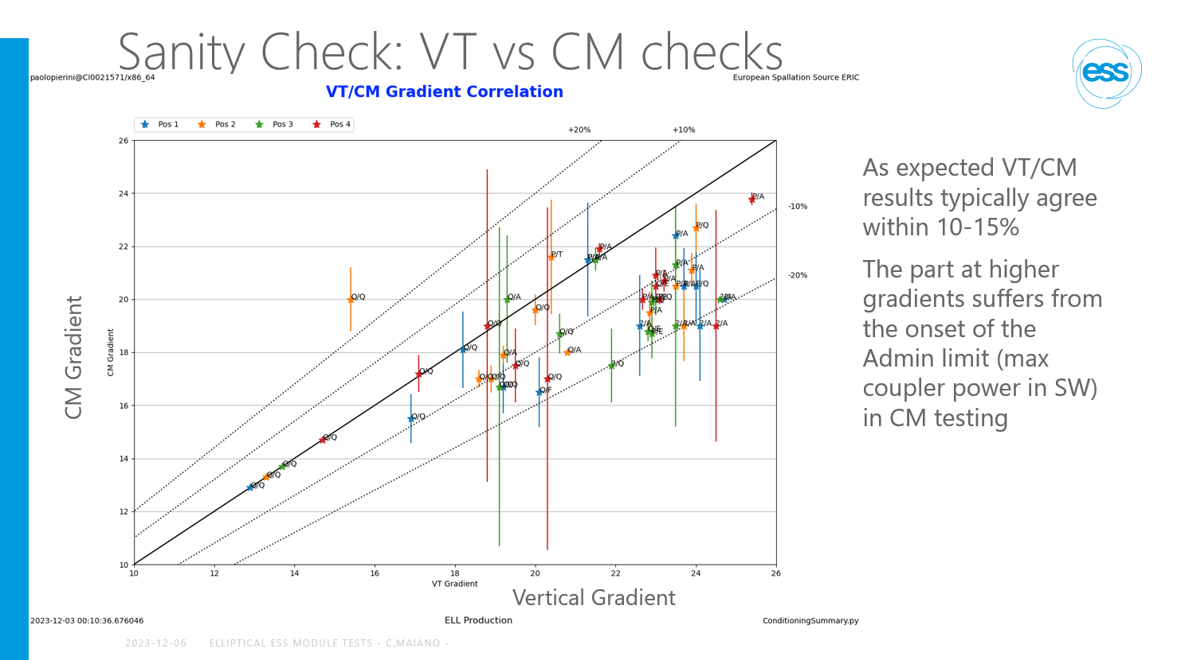
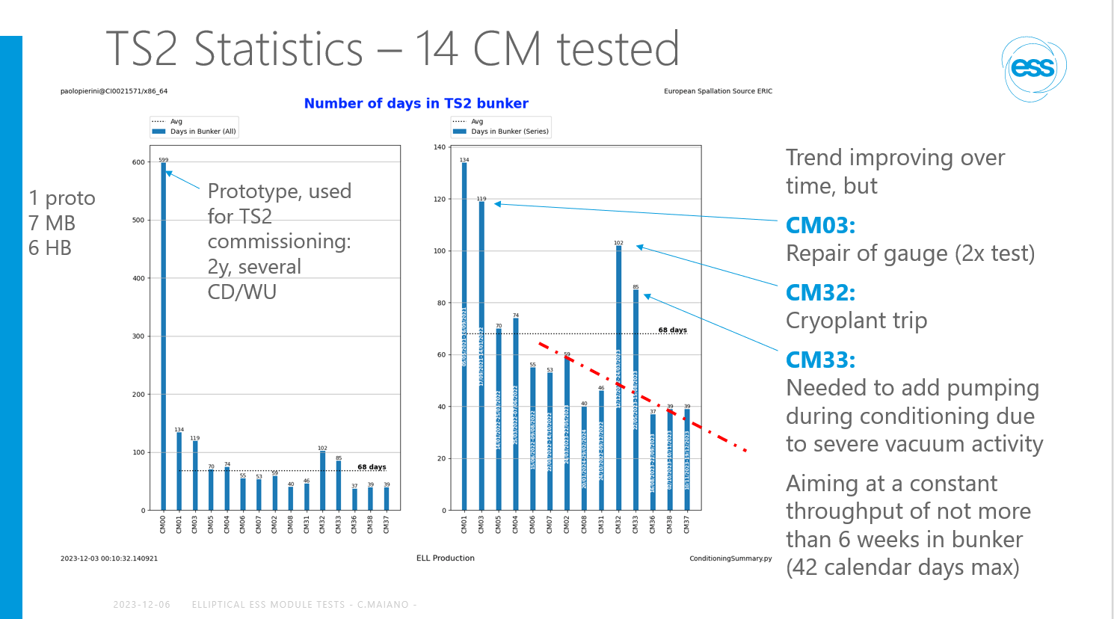
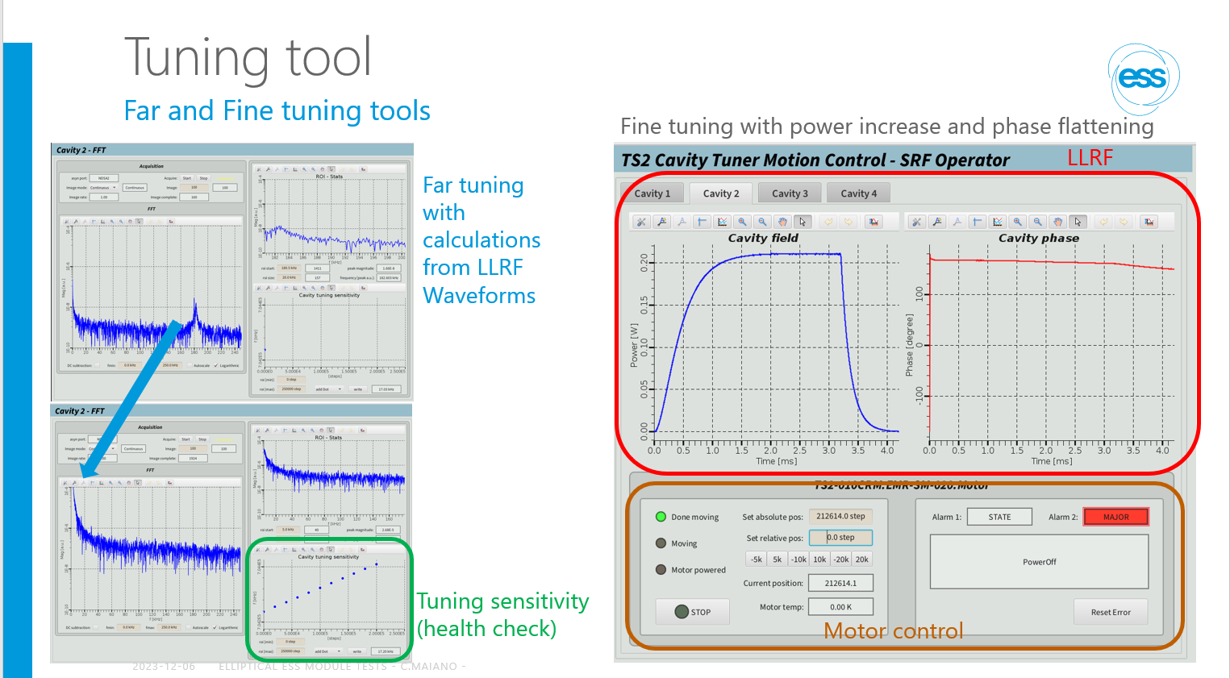
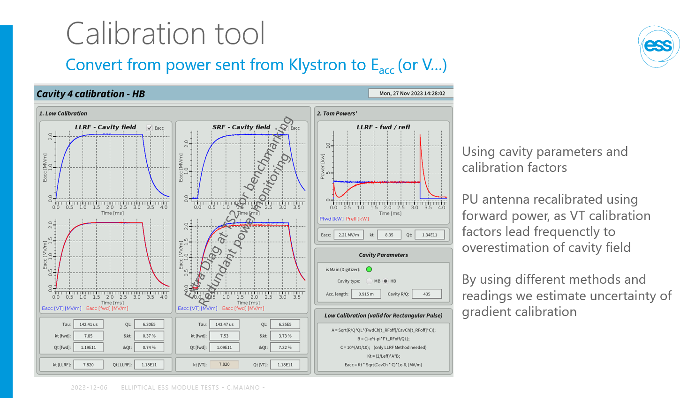
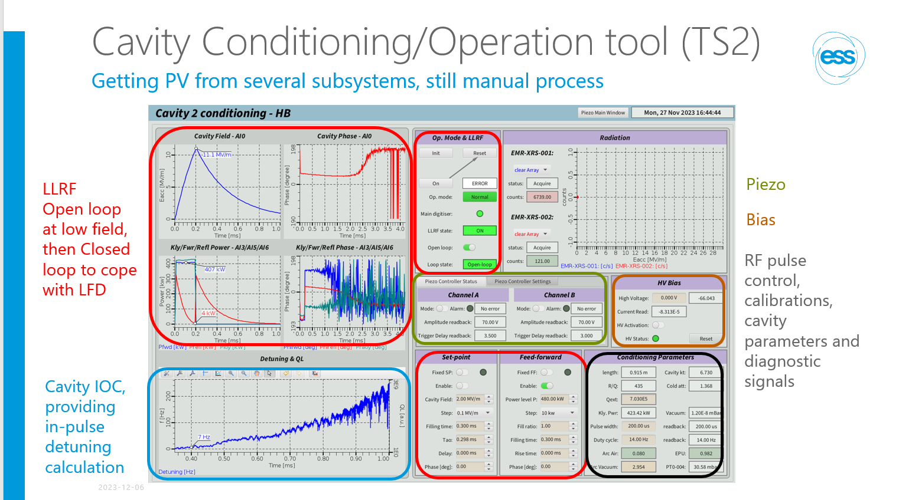
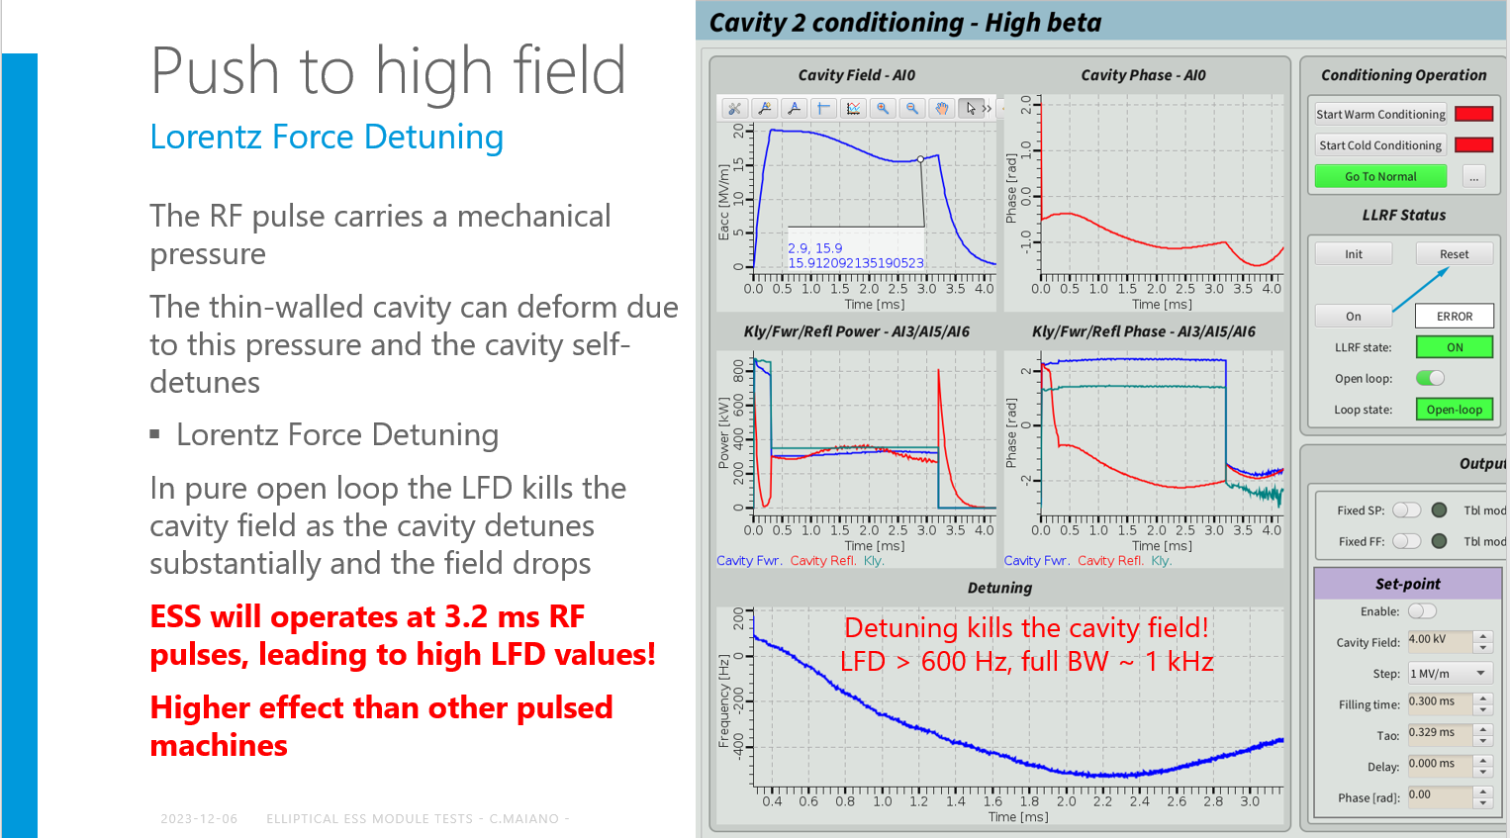
Testing of elliptical CMs for ESS

Slide 7
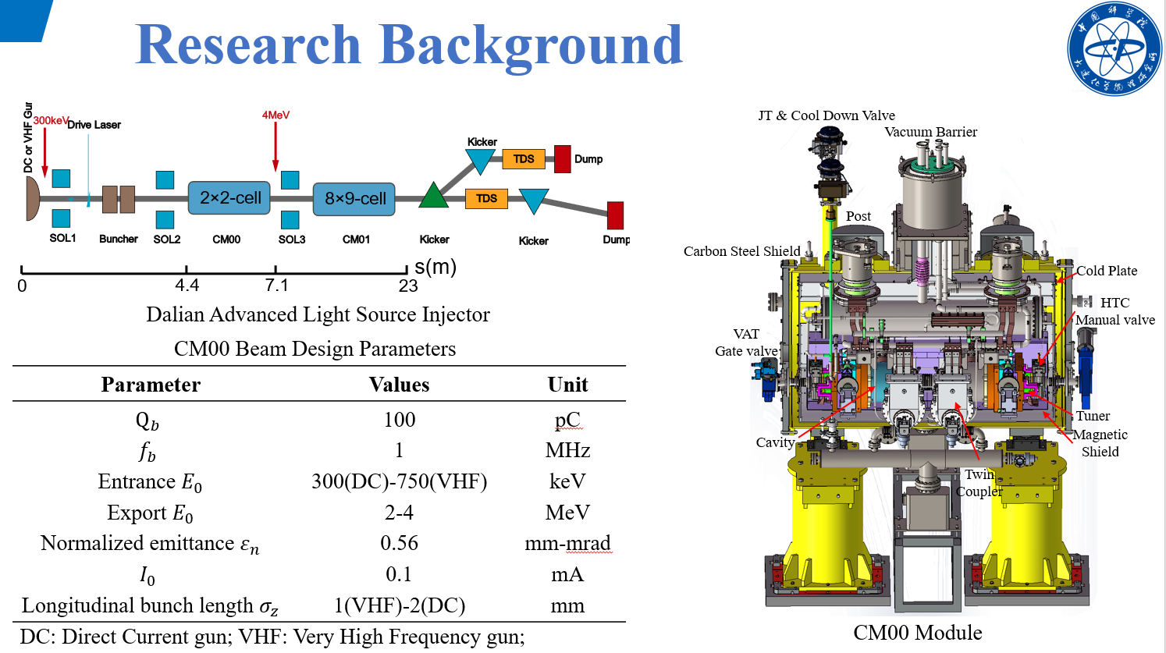
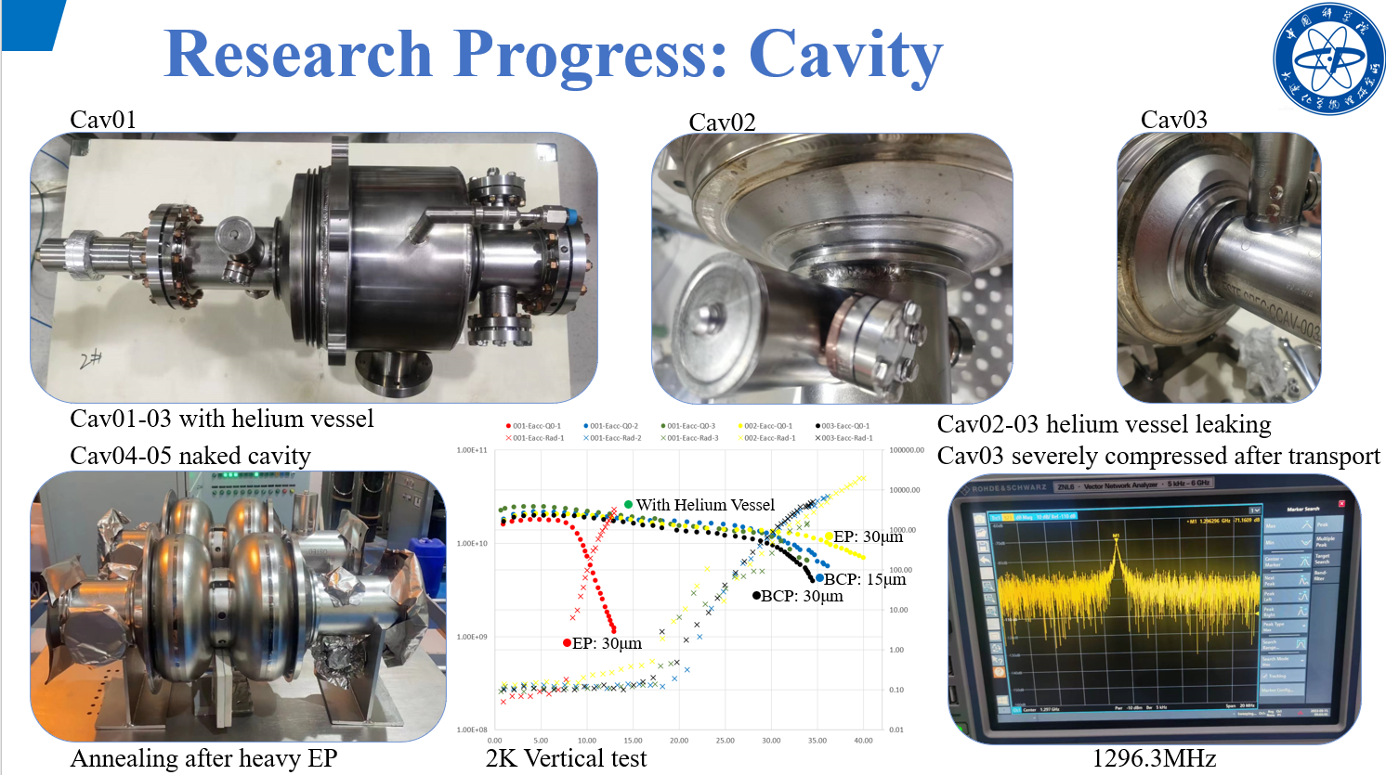
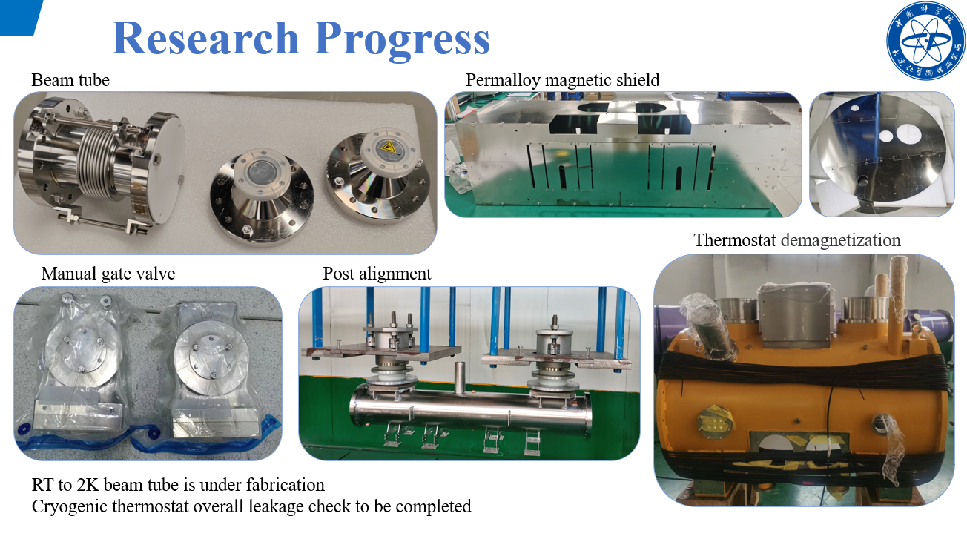
Progress in development of 2-cell CM for the DALS Injector (DICP)

Slide 8
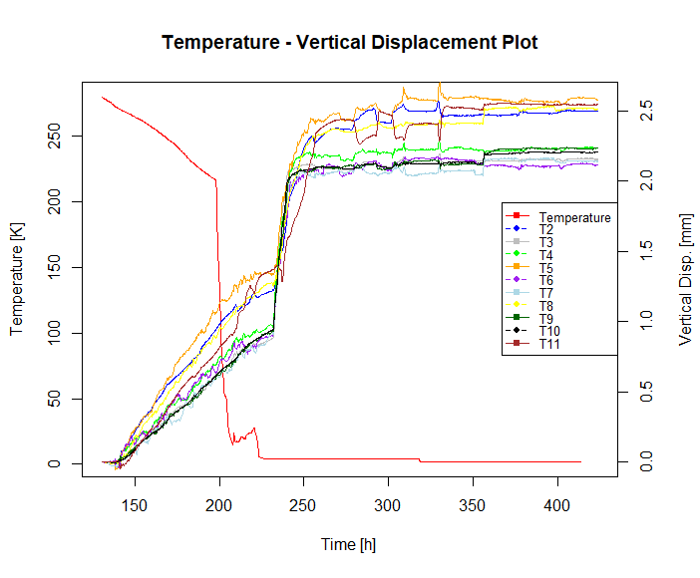
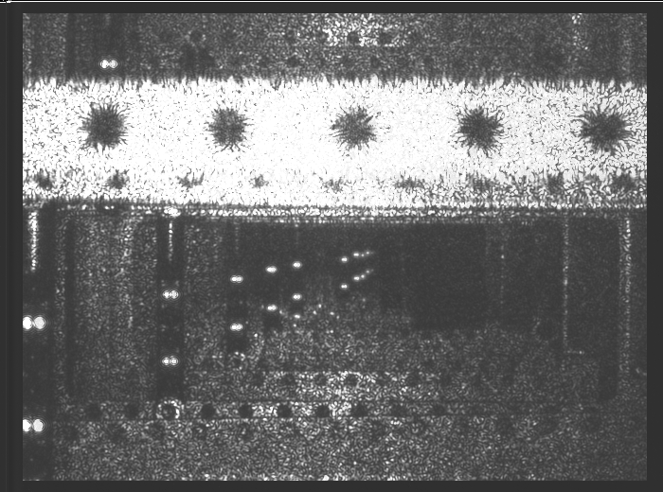
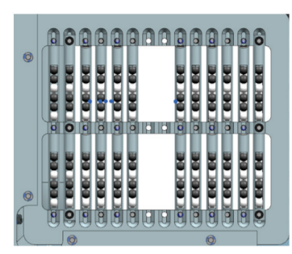
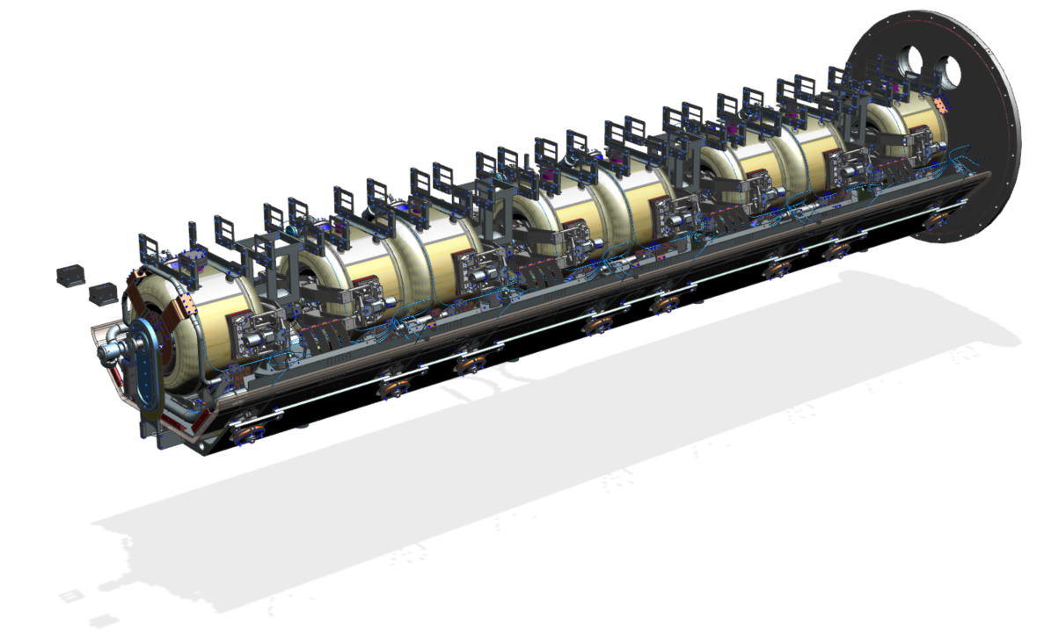

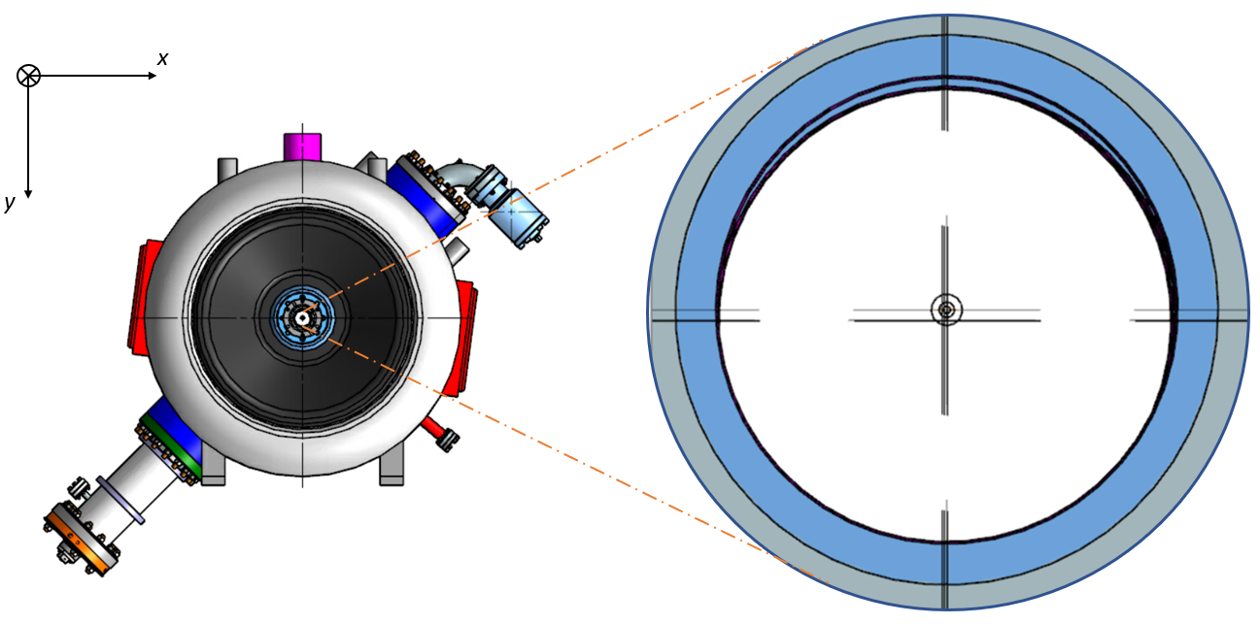
H-BCAMs for PIP-II
BCAMs (Boston CCD Angle Monitor) are optical instruments developed by Brandeis University;
Technology already adopted in the field of High Energy Particle Accelerators (HIE-ISOLDE at CERN);
Technology employed at Fermilab to monitor PIP-II cryomodules internal alignment.

Slide 9
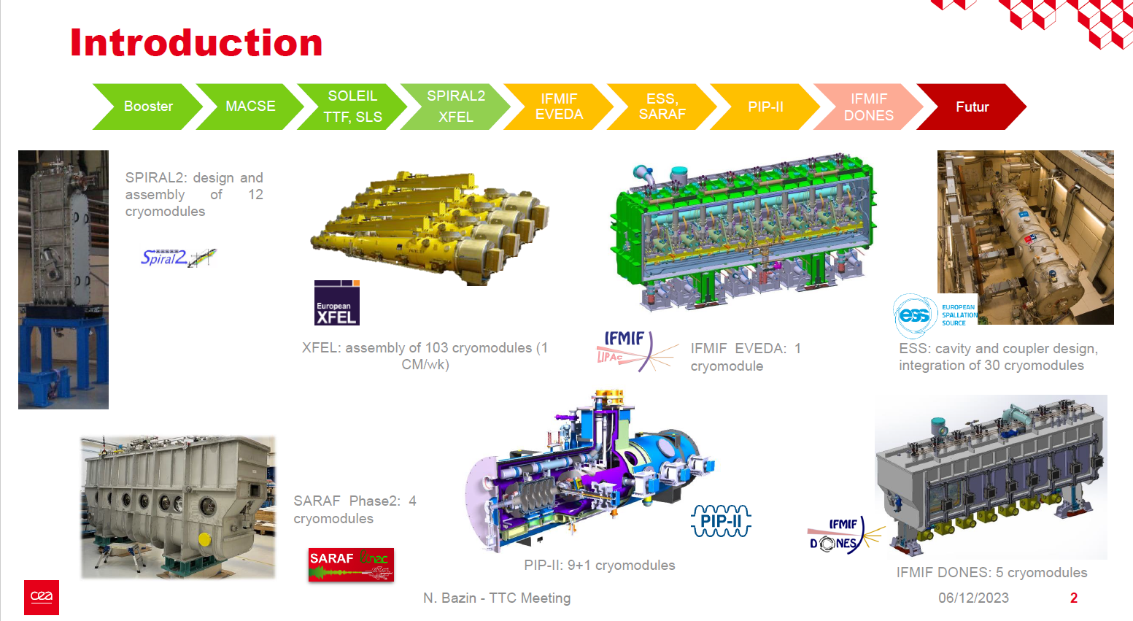
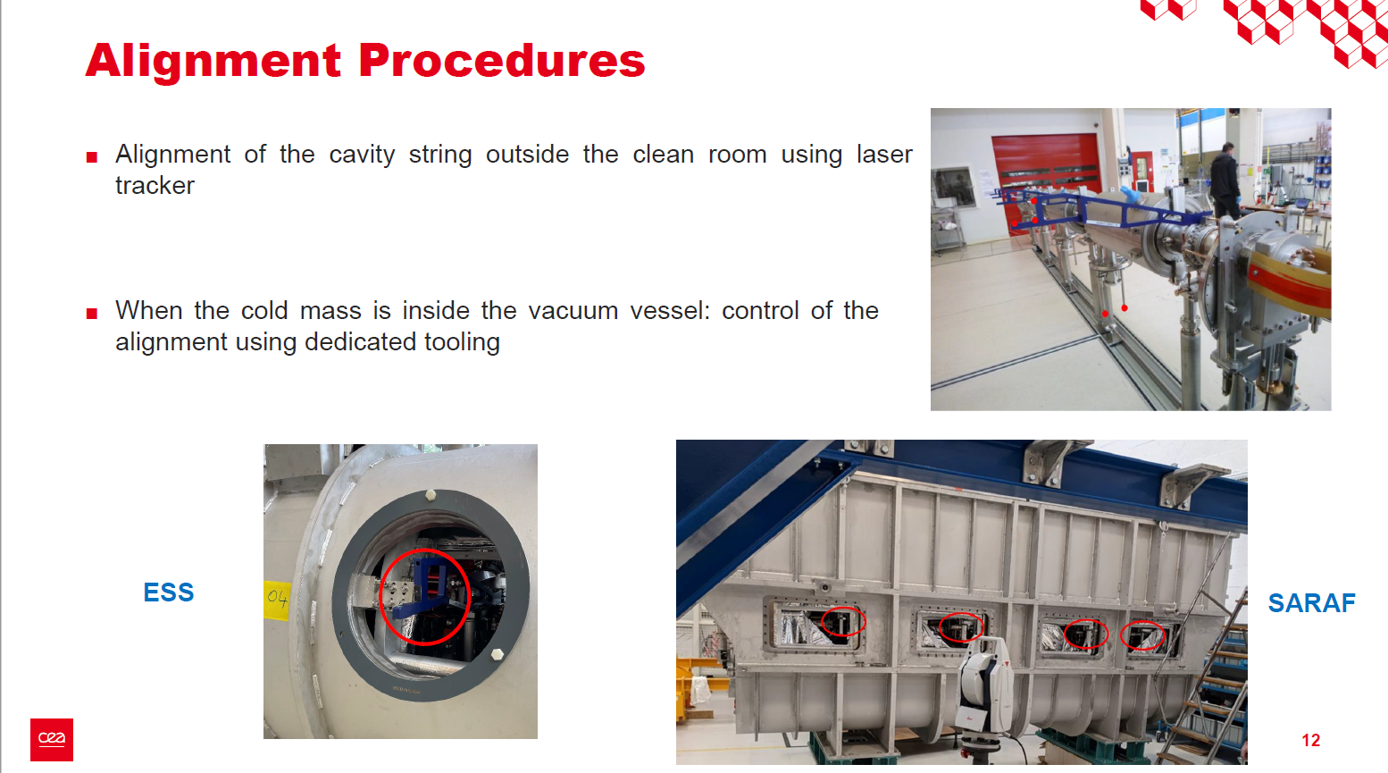
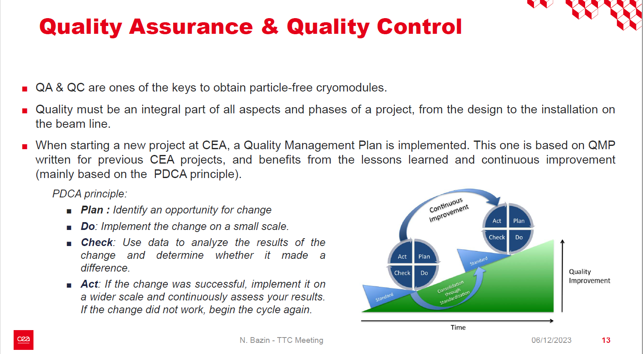
Alignment and assembly strategies for multiple CM types at CEA

Slide 10
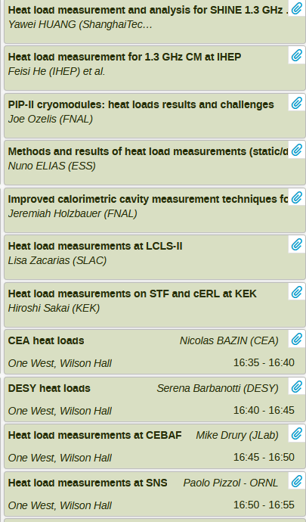
Hot Topic Discussion on CM Heat Loads
Presentations from 11 individuals on methods and results for measuring heat loads in cryomodules
Mix of CMs in operating machines and on test stands
Overall methods are similar, 3 main methods:
  Liquid level drop
  Mass flow
  dP/dt
Discussion following the presentations:
  Static heat loads are challenging to measure, inconsistent results
  In many cases, static loads are higher than design
    LCLS-II in particular shows significantly higher static heat loads in some sections due to insulating vacuum leak
  Calculated and measured errors across various institutions are consistent - ~15-20%

Slide 11
Comparison of CM static heat load
Serial # | CM type | Static heat load@ 2K |  |  |  | Project/ Lab
 |  | Pstat [W] | Uncertainty [W] | Method | Measurement range
1 | 1.3GHz 9-cell CM | ~ 18 W | ~1 W | Helium Pressure rising(ΔP/Δt) *Not a viable measurement for connected LCLS-II CMs | LH pressure 18 - 33 torr | LCLS II/JLab * Calculate from typical measurement
2 |  | -- | -- | Liquid level method (ΔLL/Δt) | LH level 95%-90% | LCLS II/JLab
3 |  | Good correlation shown with ΔP/Δt method | -- | flow rate reading @ cold | -- | LCLS II/JLab
4 | 1.3GHz 9-cell CM (LO-L2 ) | 9 | ~10% | Liquid level method (ΔLL/Δt) |  | LCLS II/ SLAC
5 | 1.3GHz 9-cell CM (L3-UPSTREAM ) | 17 | ~10% |  |  | LCLS II/ SLAC * with Additional Pump
6 | 1.3GHz 9-cell CM (L3-DOWNSTREAM ) | 16 | ~10% |  |  | LCLS II/ SLAC
7 | 1.3GHz 9-cell CM | 5.5 | ~10% | flow rate reading @ RT | -- | FLASH and XFEL / DESY
8 | 1.3GHz 9-cell CM (BCP) | 23.4 | ~1W | Liquid level method | -- | SHINE/SARI
9 | 1.3GHz 9-cell CM (High-Q) | 21.0 | ~1W |  | LH level 90%-85% | SHINE
10 | 1.3GHz 9-cell CM (1st production ) | 14.5 | ~1W |  | HL level 85%-75%
11 | 1.3GHz 9-cell CM (mid-T) | 28.6 | ±0.4 | flow rate reading @ RT | HL level 80%-75% | DALS /IHEP
12 |  | 27.5 | ±0.8
13 |  | 25.8 | ±1.3

Slide 12
Comparison of CM static heat load
Serial # | CM type | Static heat load@ 2K |  |  |  | Project/ Lab
 |  | Pstat [W] | Uncertainty [W] | Method | Measurement range
14 | MBL CM (include 6-cell *4 cavities) | 16.8 | ~30% | flow rate reading @ RT | HL level 93.2%-84.1% | ESS/ESS
15 |  | 16.84 | ~ 1W | Helium Pressure rising(ΔP/Δt) | HL level 85.4%
16 |  | 17.36 | ~ 1W | Liquid level method | HL level 93.2%-84.1%
17 | HB650 Prototype CM | 38.2 | -- | flow rate reading @ RT | -- | PIP II /FNAL
18 | 2-cell injector CM (include 3 cavities) | 11 | 10% | flow rate reading @ RT | HL level 77%-67% | cERL / KEK
19 | 9-cell main Linac CM (include 2 cavities) | 11 | 10% |  | HL level 28%-18% | cERL / KEK
20 | 1.3 GHz 9-cell CM (4+8 cavities)(1.5 module) | 32.6 | 10% |  | HL level 55%-51% | STF / KEK
21 | 704MHz CM | ~ 18 | -- | flow rate reading @ RT | -- | ESS /CEA
22 | Medium Beta CM | ~ 25 | -- | Heat vs %JT opening | -- | SNS/ ORNL
23 | High Beta CM | ~ 28 | -- | 4.2 | -- | in CM1
24 | PPU CM | ~ 25 | -- | Heat vs %JT opening | -- | for further study

Slide 13
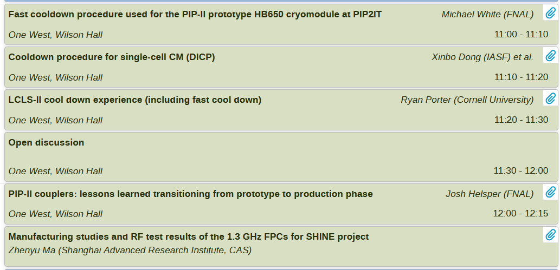
WG4, session 3
Two topics:
  (fast) cool down
  Couplers
30 min discussion
time after cool down
talks fully used!

Slide 14
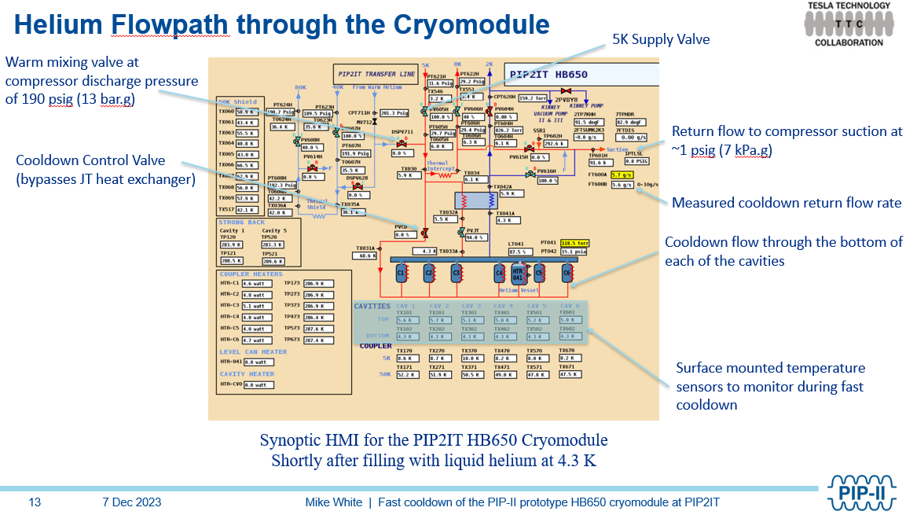
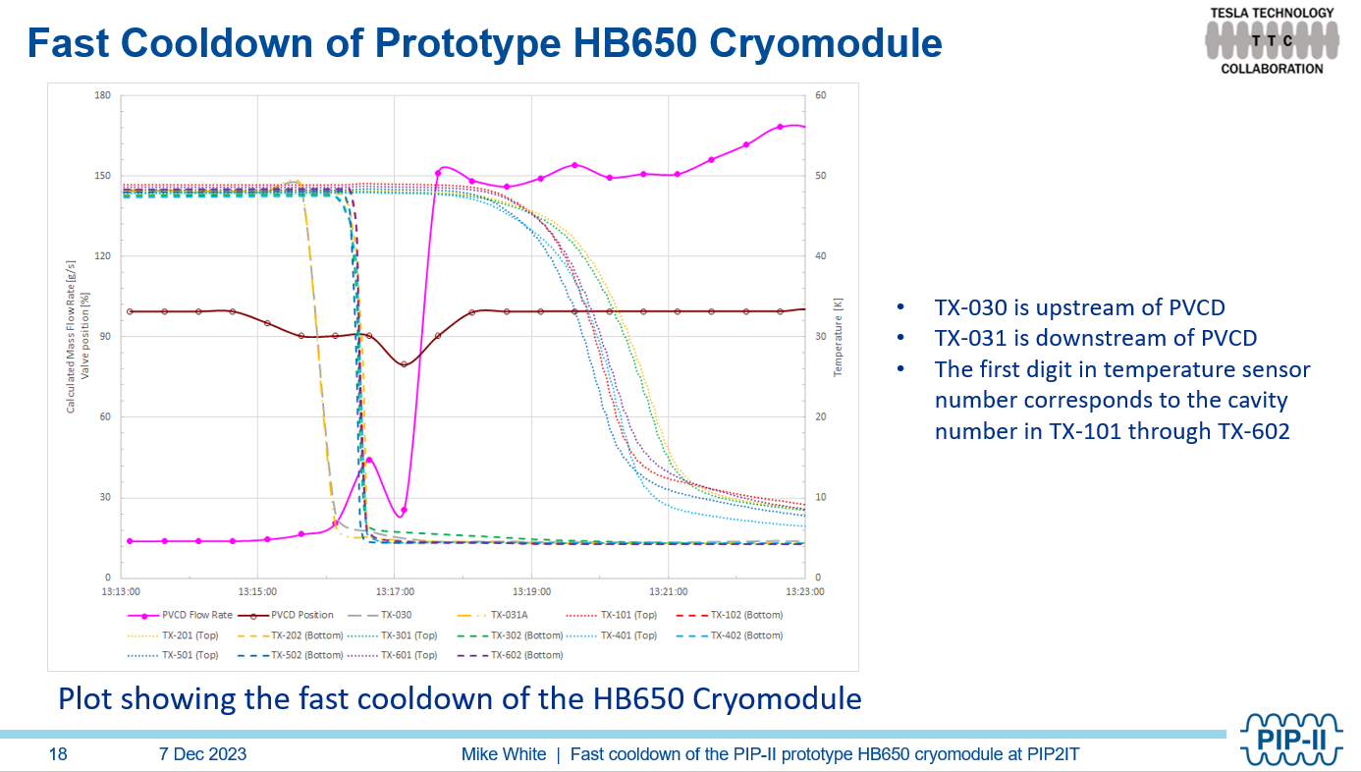
(fast) cool down
PIP-II HB650 module
  Successful fast cooldown of new cryomodule
  type: prototype HB650 module
  Required 80 g/s
  achieved (calculated) ~150 g/s
  Use of dewar to increase cryoplant
  cooldown speed
  Thermal sensors installed on the tank

Slide 15
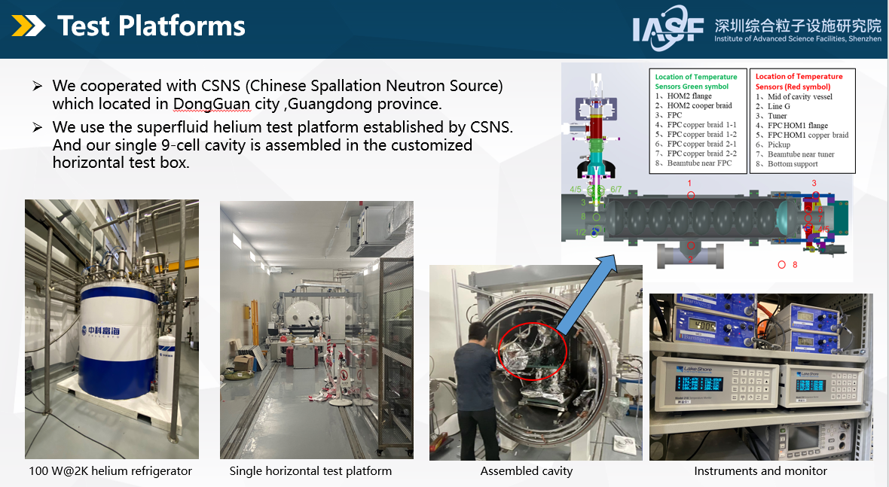
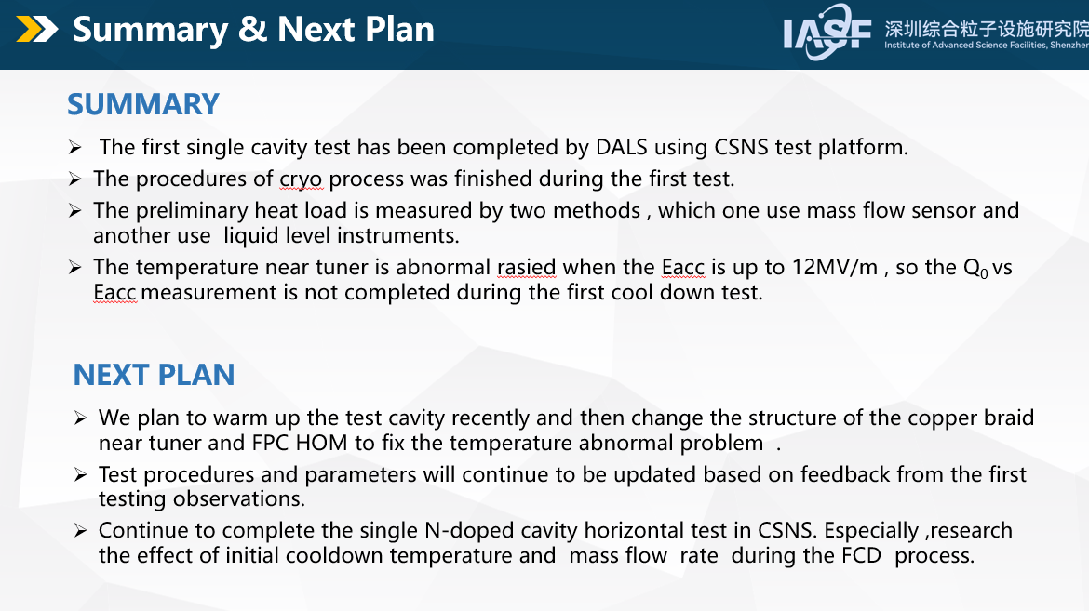
(fast) cool down
Single cavity CM for DASL
  Fist cooldown test on N-Doped Tesla type
  cavity
  Flows above 10 g/s (limit of flowmeters)
  Heating of tuner observed, thermal braid
  design needs optimization

Slide 16
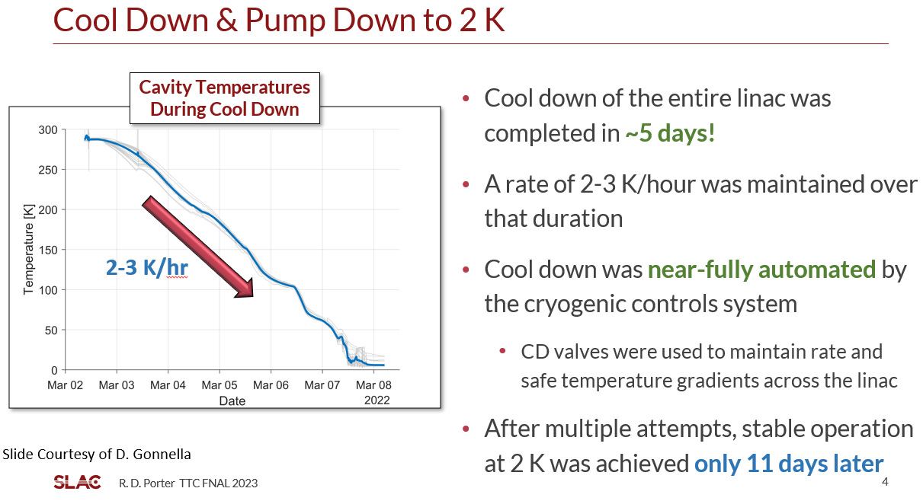
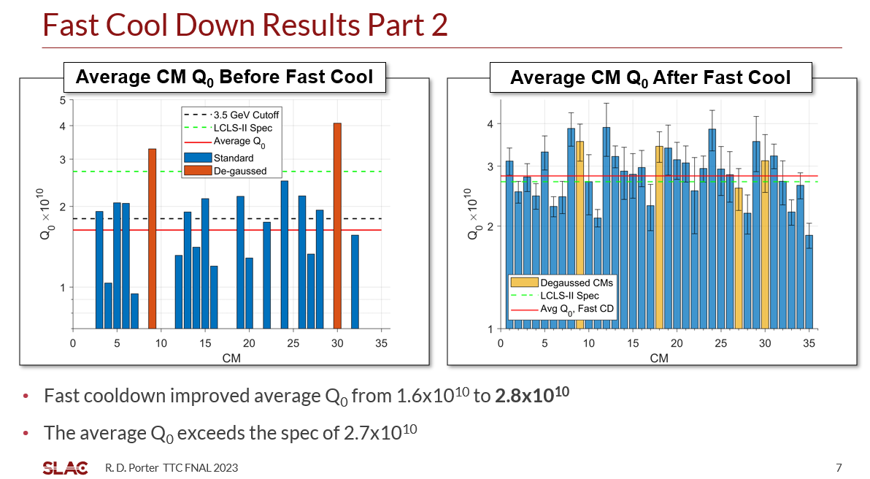
(fast) cool down
LCLS-II
  Fist cool down to 2K very successful
  Fast cooldown:
    Well established procedure repeated a few times
    Warm up to 40K and cool down again 2 modules
    at a time
    Automated procedure, total duration ~2 days for
    the full linac
    From comparison with module tests Q0 results
    → cooling speed ~80 g/s

Slide 17
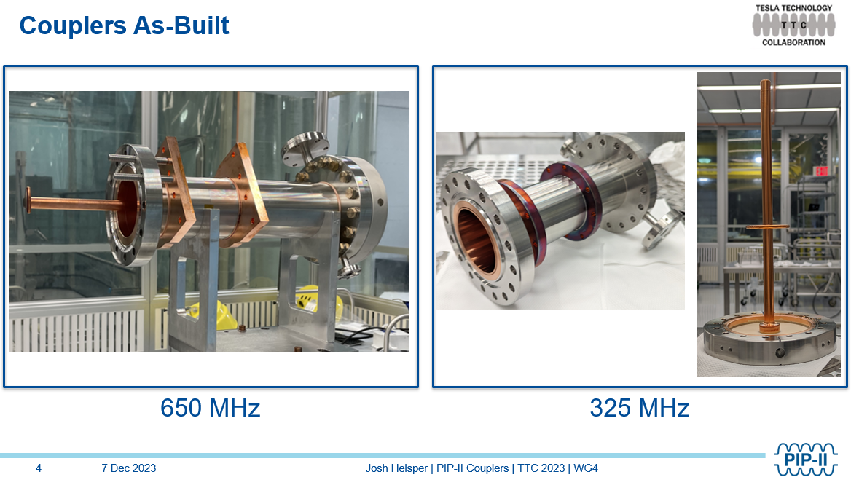
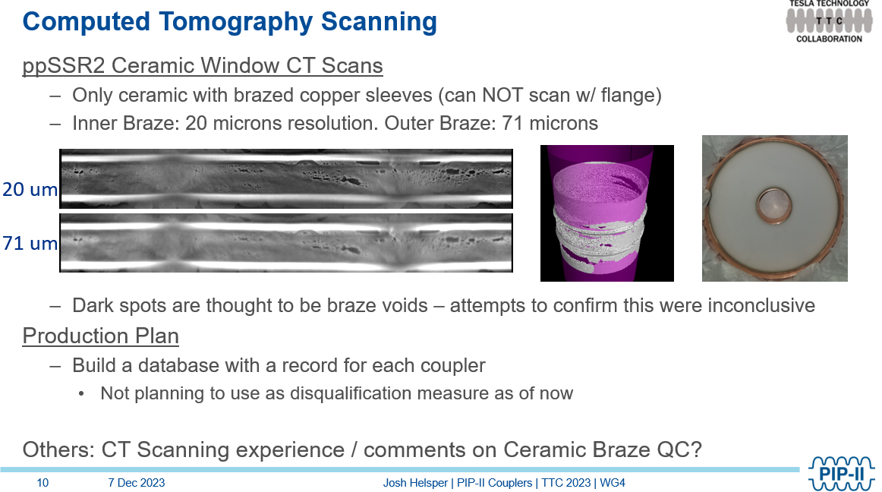
Couplers
PIP-II
  Developed for 325 and 650 MHz cavities
  High Voltage Bias always used
  Ti-N coating:
    No improvements for 325 MHz
    To be tested for 650 MHz
  CT scanning implemented for brazed ceramic
  Issues observed with cold cathode gauges

Slide 18
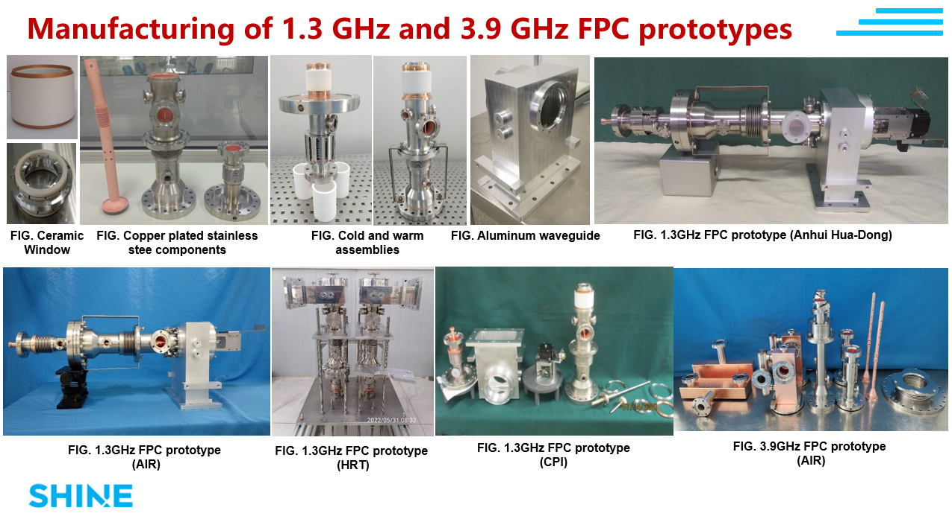
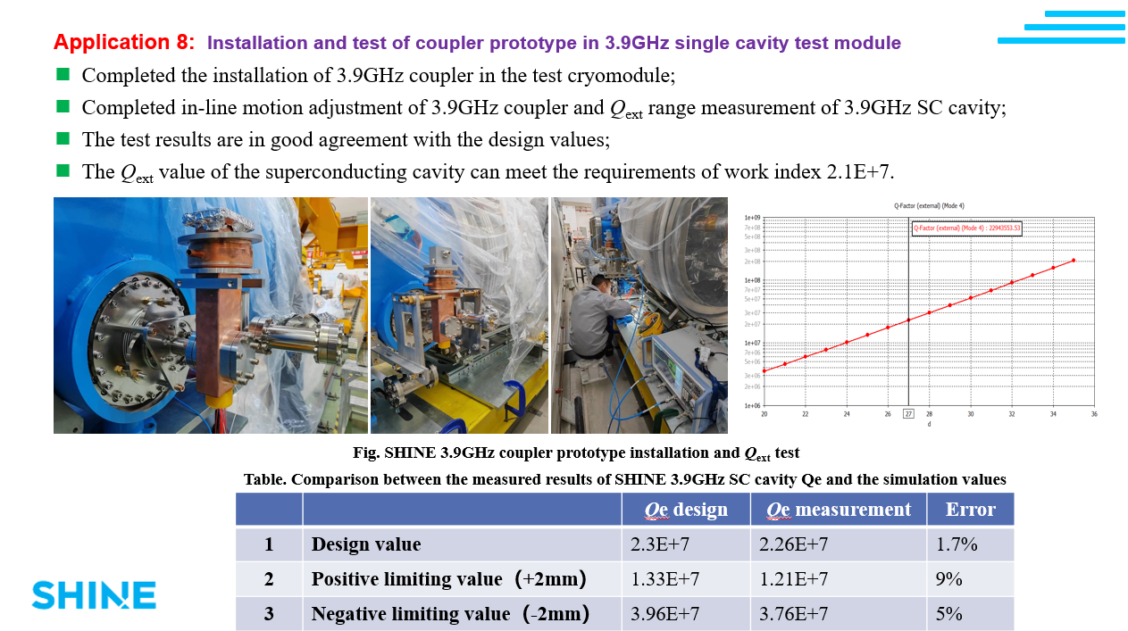
Couplers
SHINE
  Technology developed for 3.9 GHz and
  1.3 GHz couplers
  Couplers manufactured at 4 different vendors
  Couplers conditioned, tested and qualified
  Both coupler designs successfully tested
  on a cryomodule

Slide 19
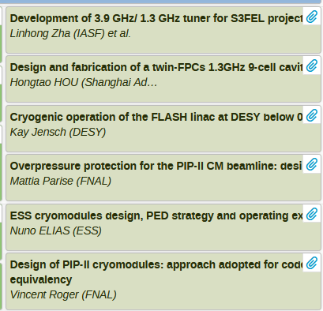
WG4, session 4
Two topics:
  Tuners
  Couplers
  Pressure code compliance and strategy

Slide 20
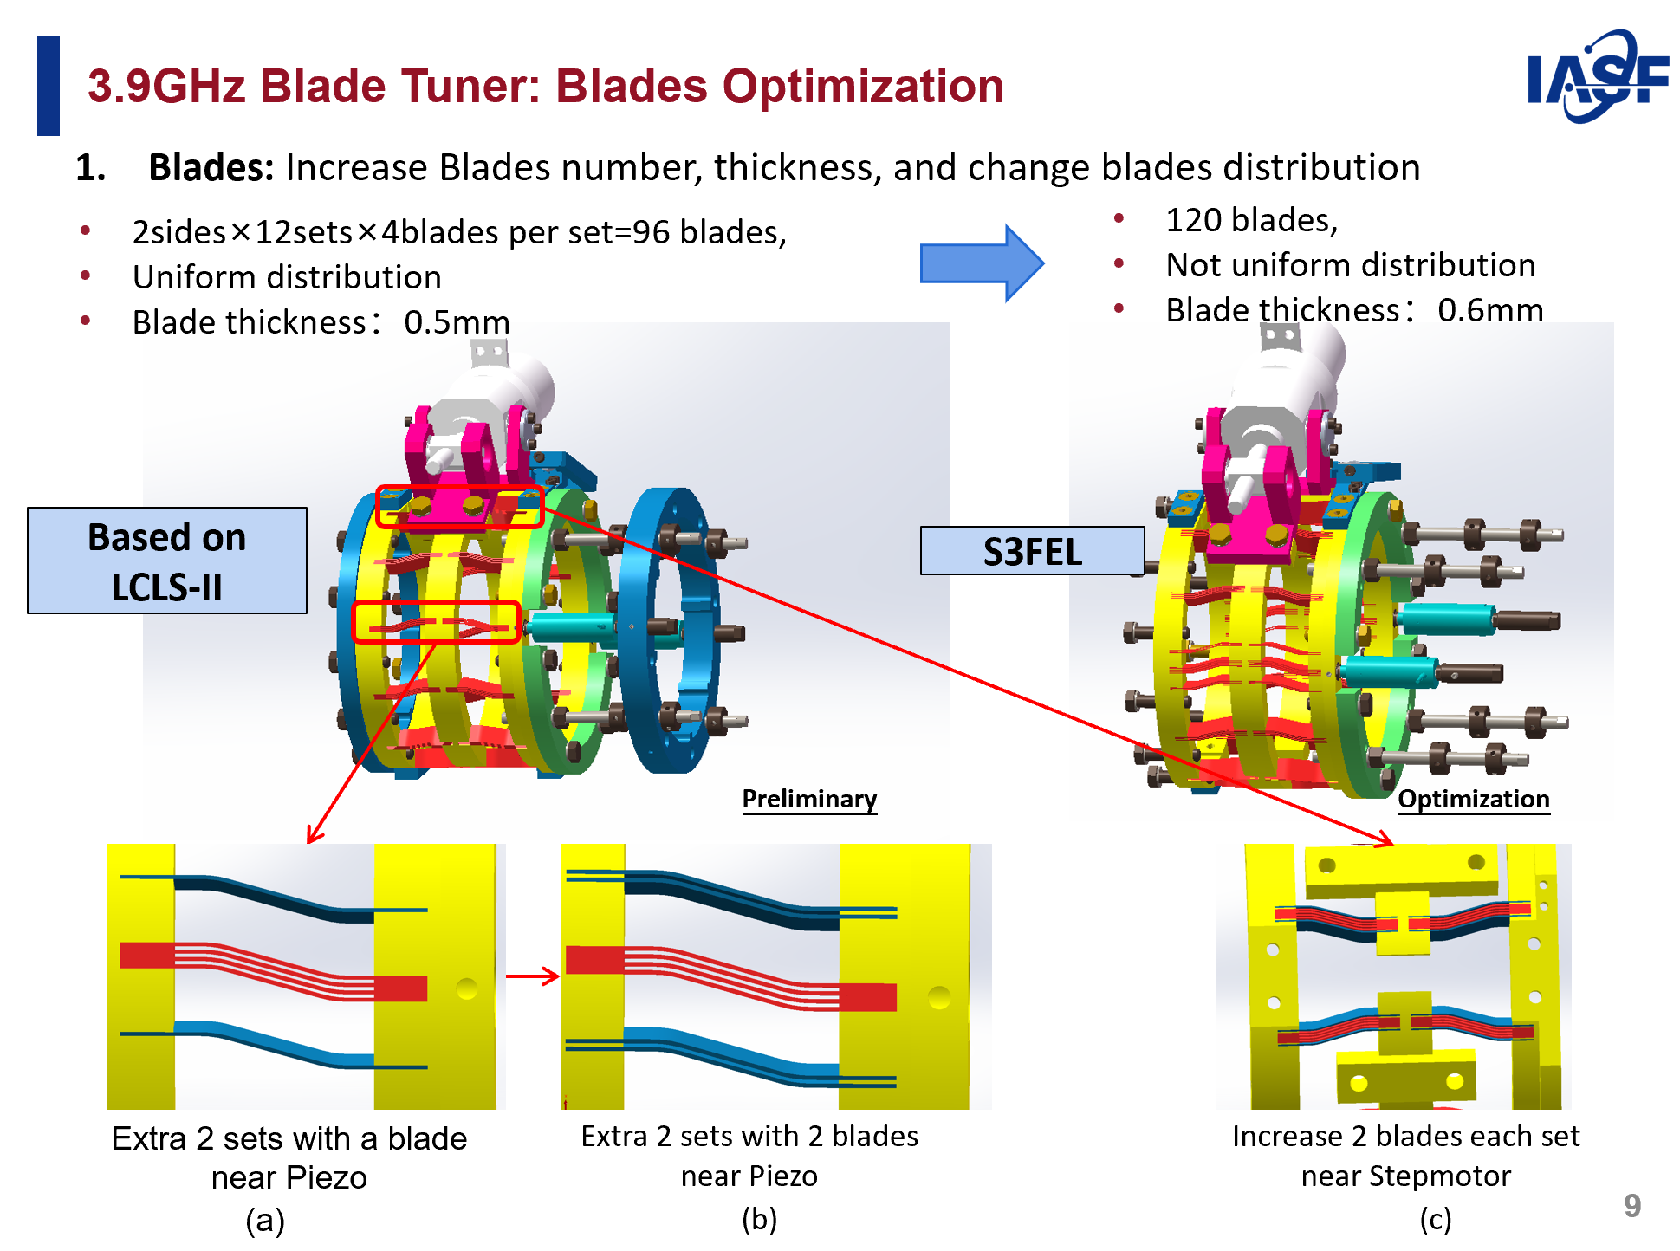
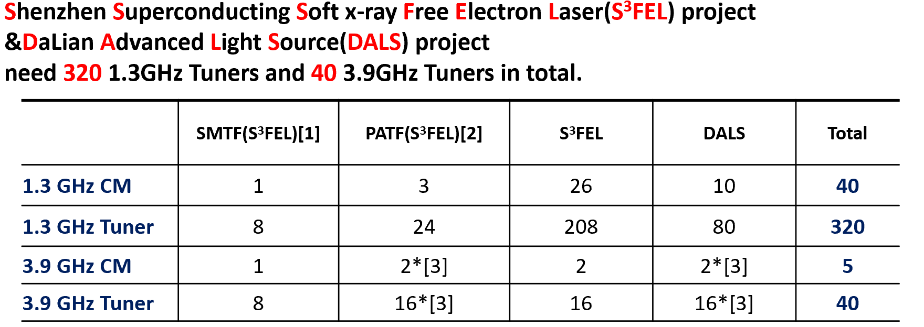
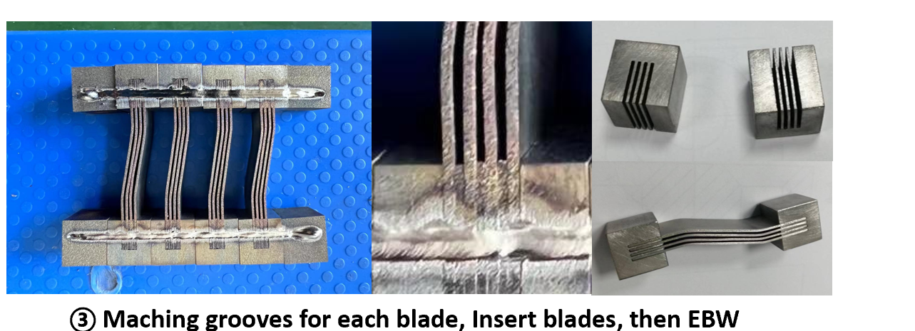
sub-components development high-beta/beta=1 cryomodules
3.9 GHz tuner for S³FEL project & DALS project
Original based on LCLS II tuner design;
Modification of 3.9 GHz blade tuner has been made in order to reach more uniformful stress distribution;
Prototype R&D is on going

Slide 21
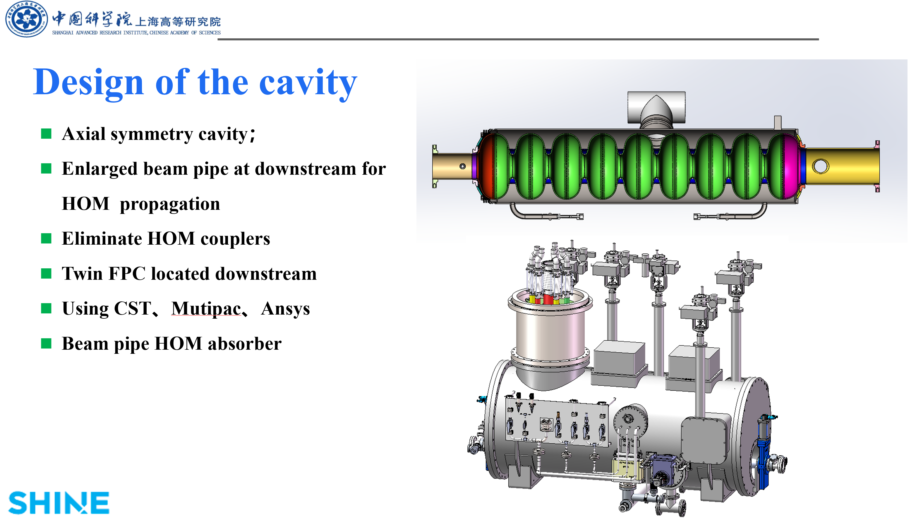
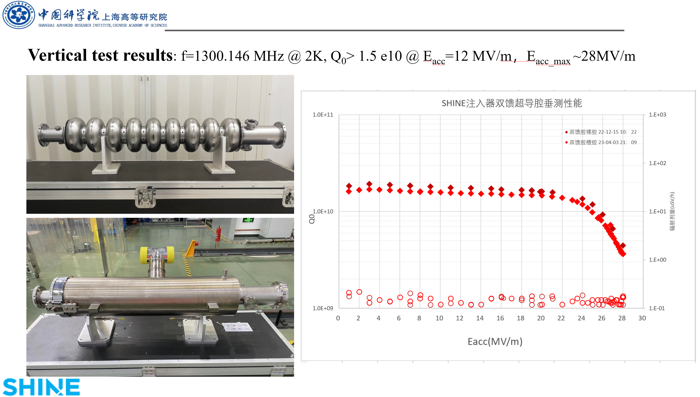
sub-components development high-beta/beta=1 cryomodules
a twin-FPCs 1.3GHz 9-cell cavity for SHINE project

Slide 22
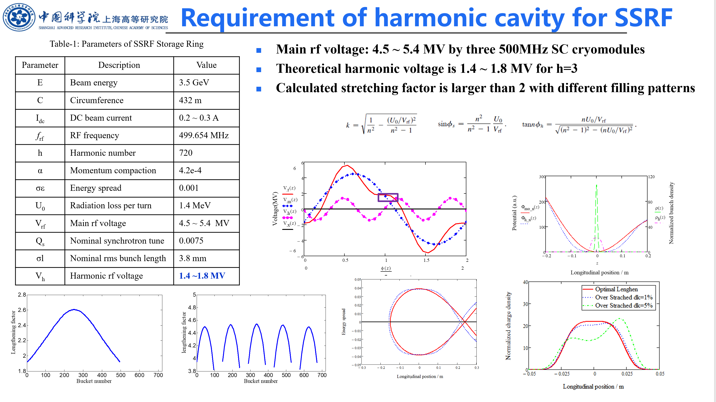
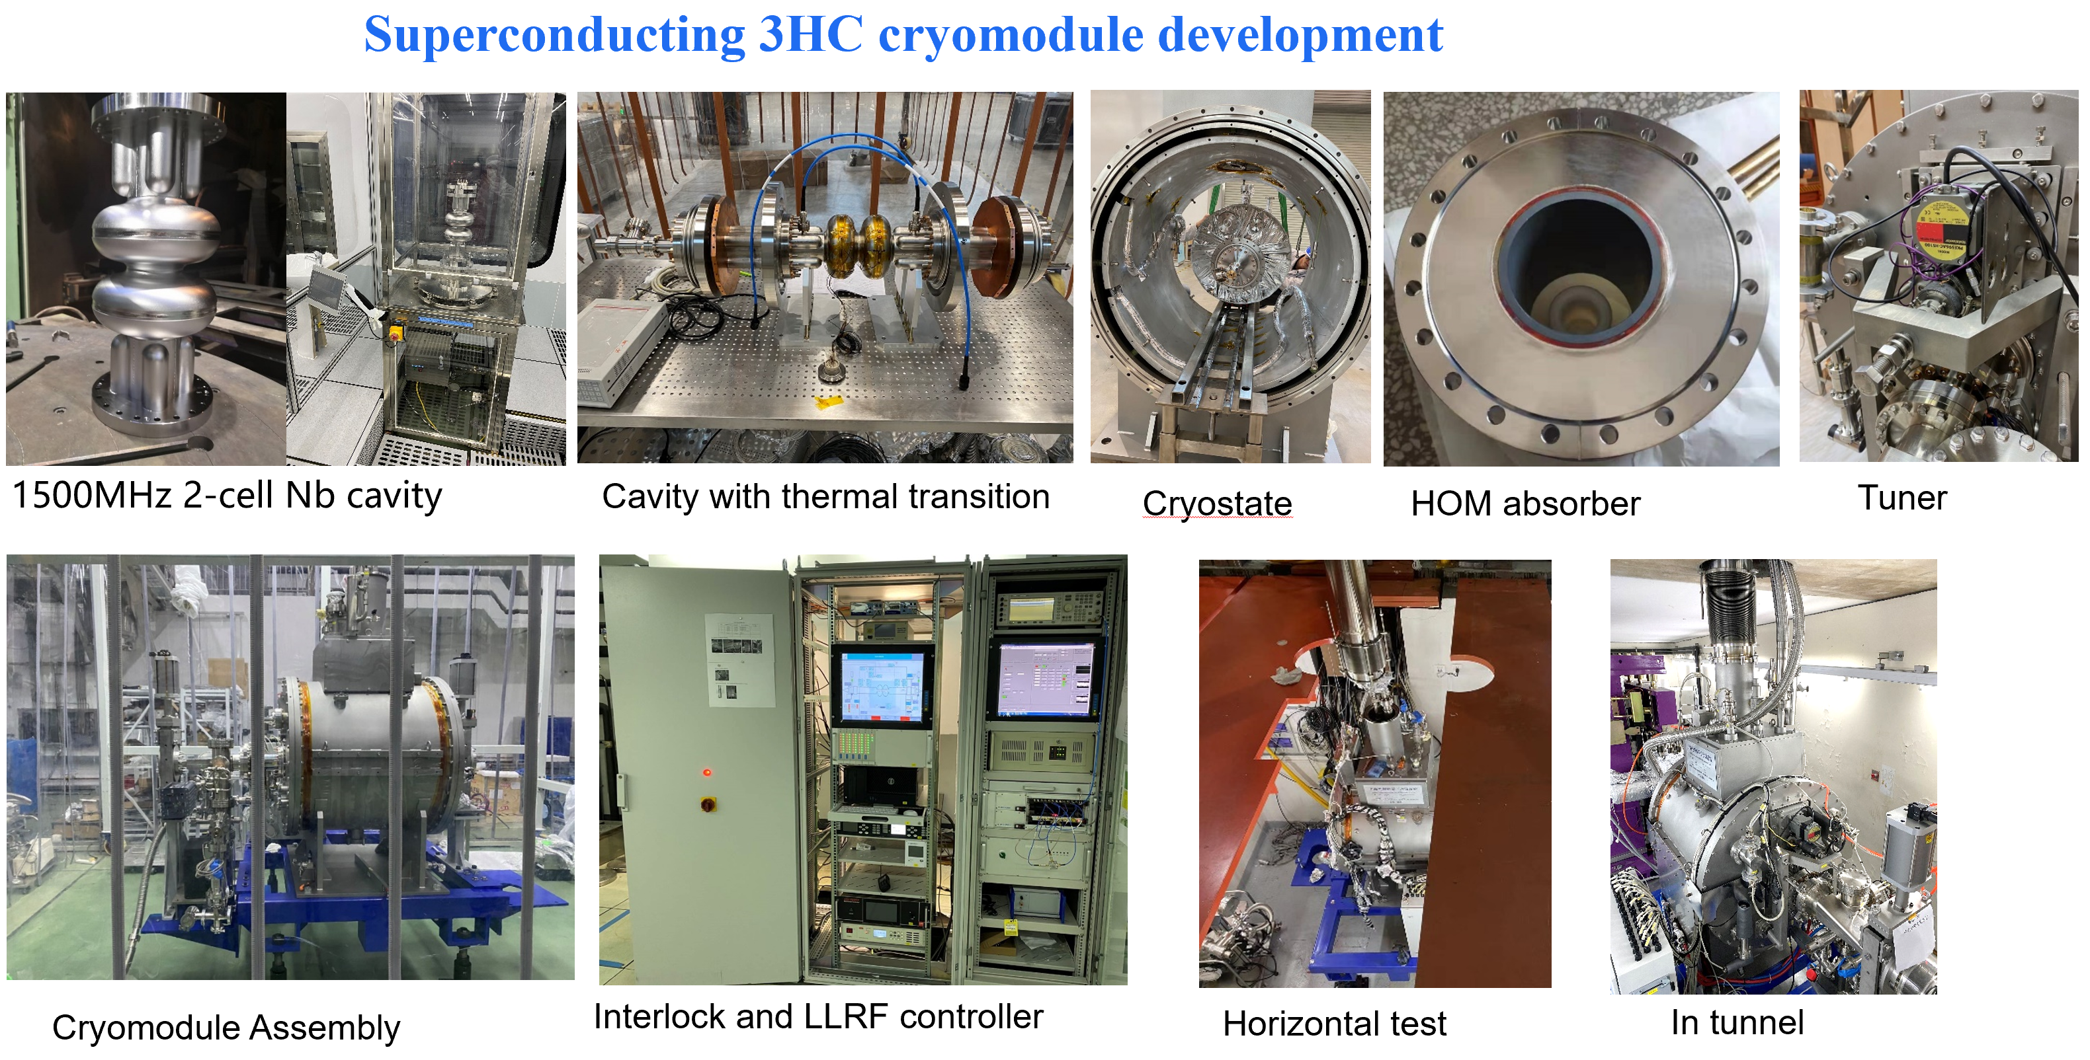
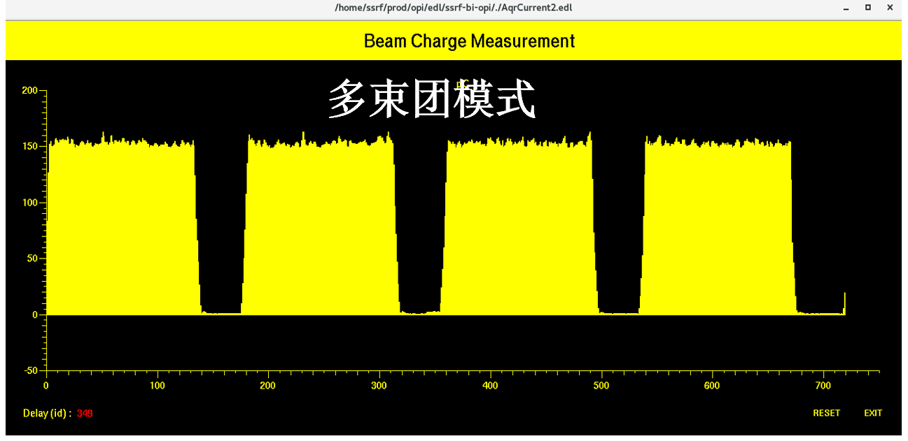
sub-components development high-beta/beta=1 cryomodules
Third Harmonic SRF Cryomodule for the SSRF Storage Ring
Improve beam quality and increase lifetime
Passive or Active, SC or NC was compared before choosing a passive SC cryomodule
One 3 harmonic cryomodule has commissioned with Beam

Slide 23
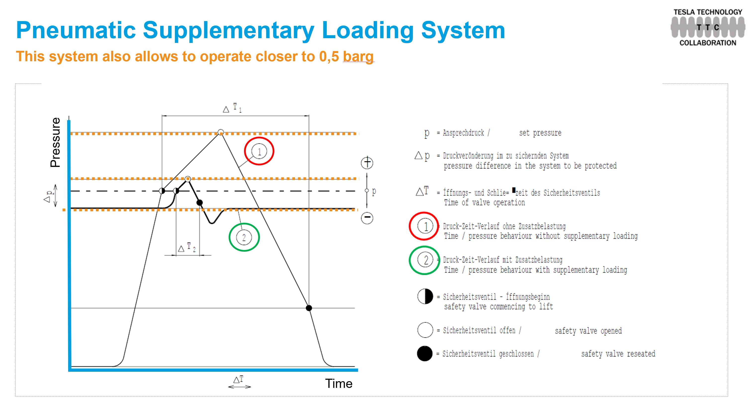

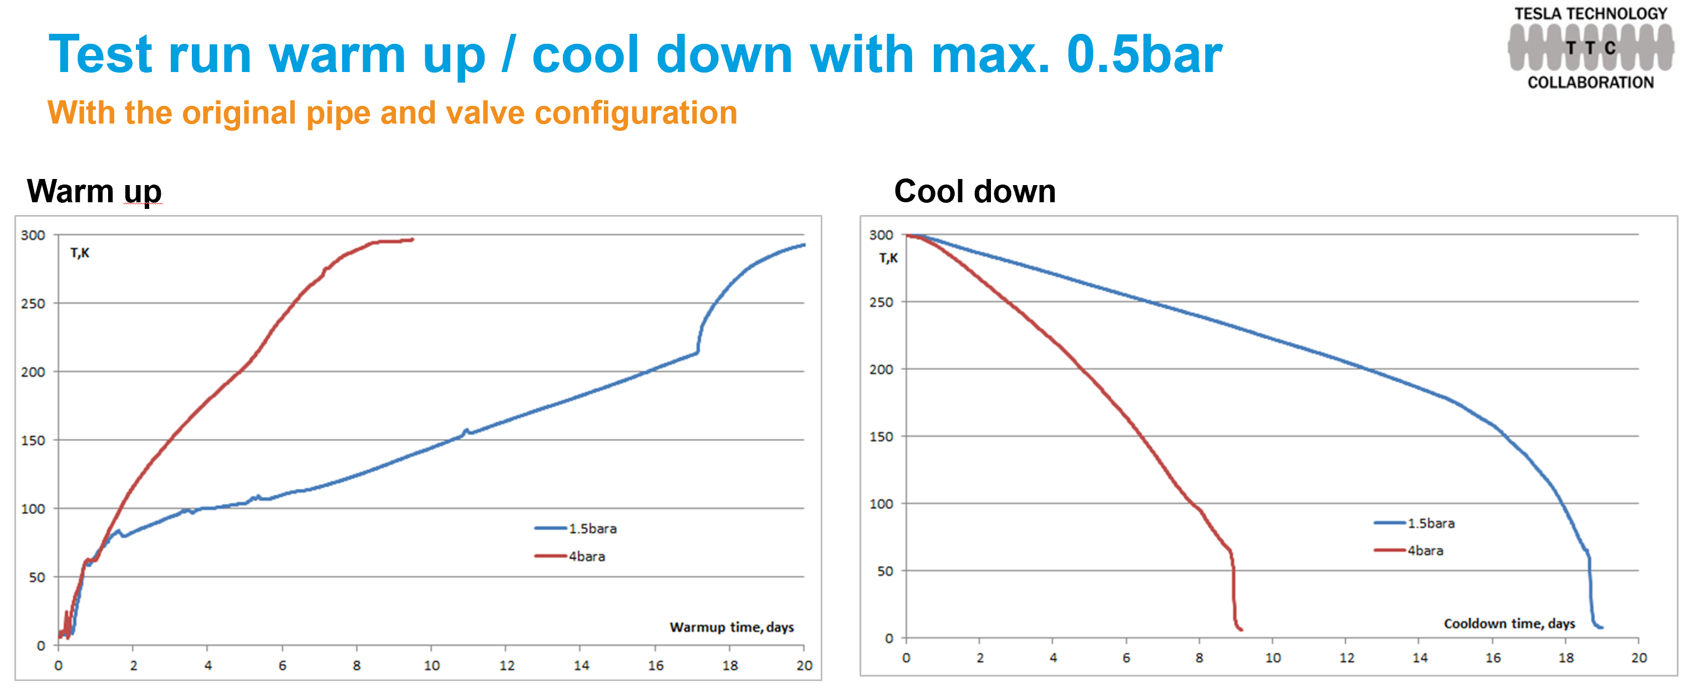
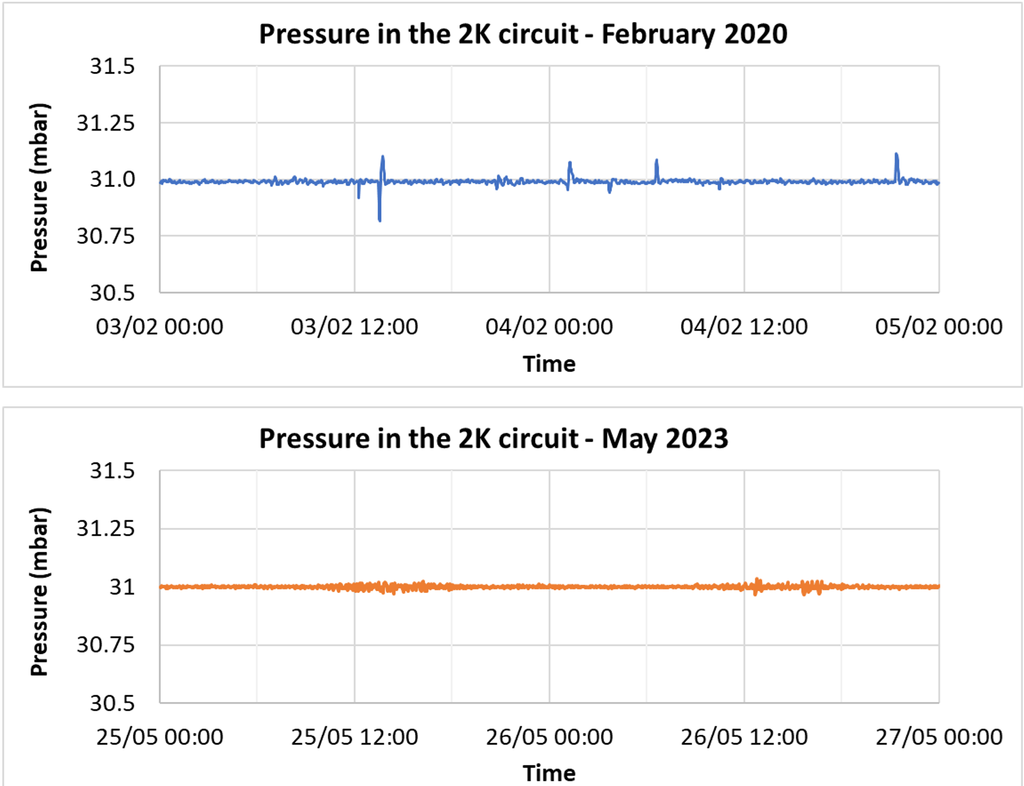
Cryogenic operation of the FLASH linac at DESY below 0.5 bar
FLASH accelerator is manage to operate at 0.5 bar for one year
Slight higher static heat loads due of more and larger safety lines
The system is more sensitive to disturbances
The system is more sensitive to changes in parallel systems
Recovery after a outage takes longer, more caution needed to avoid opening of relief valves

Slide 24
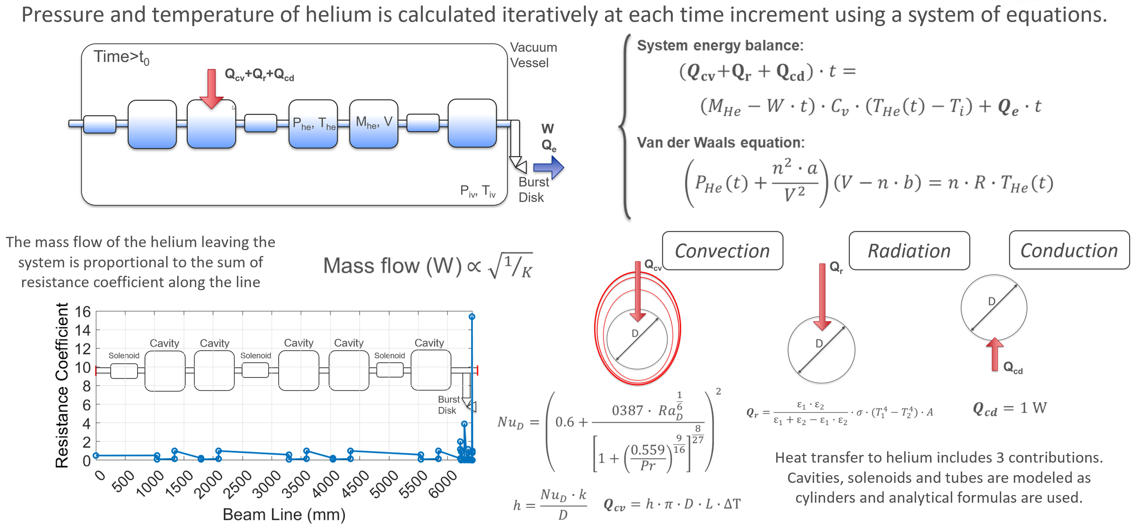
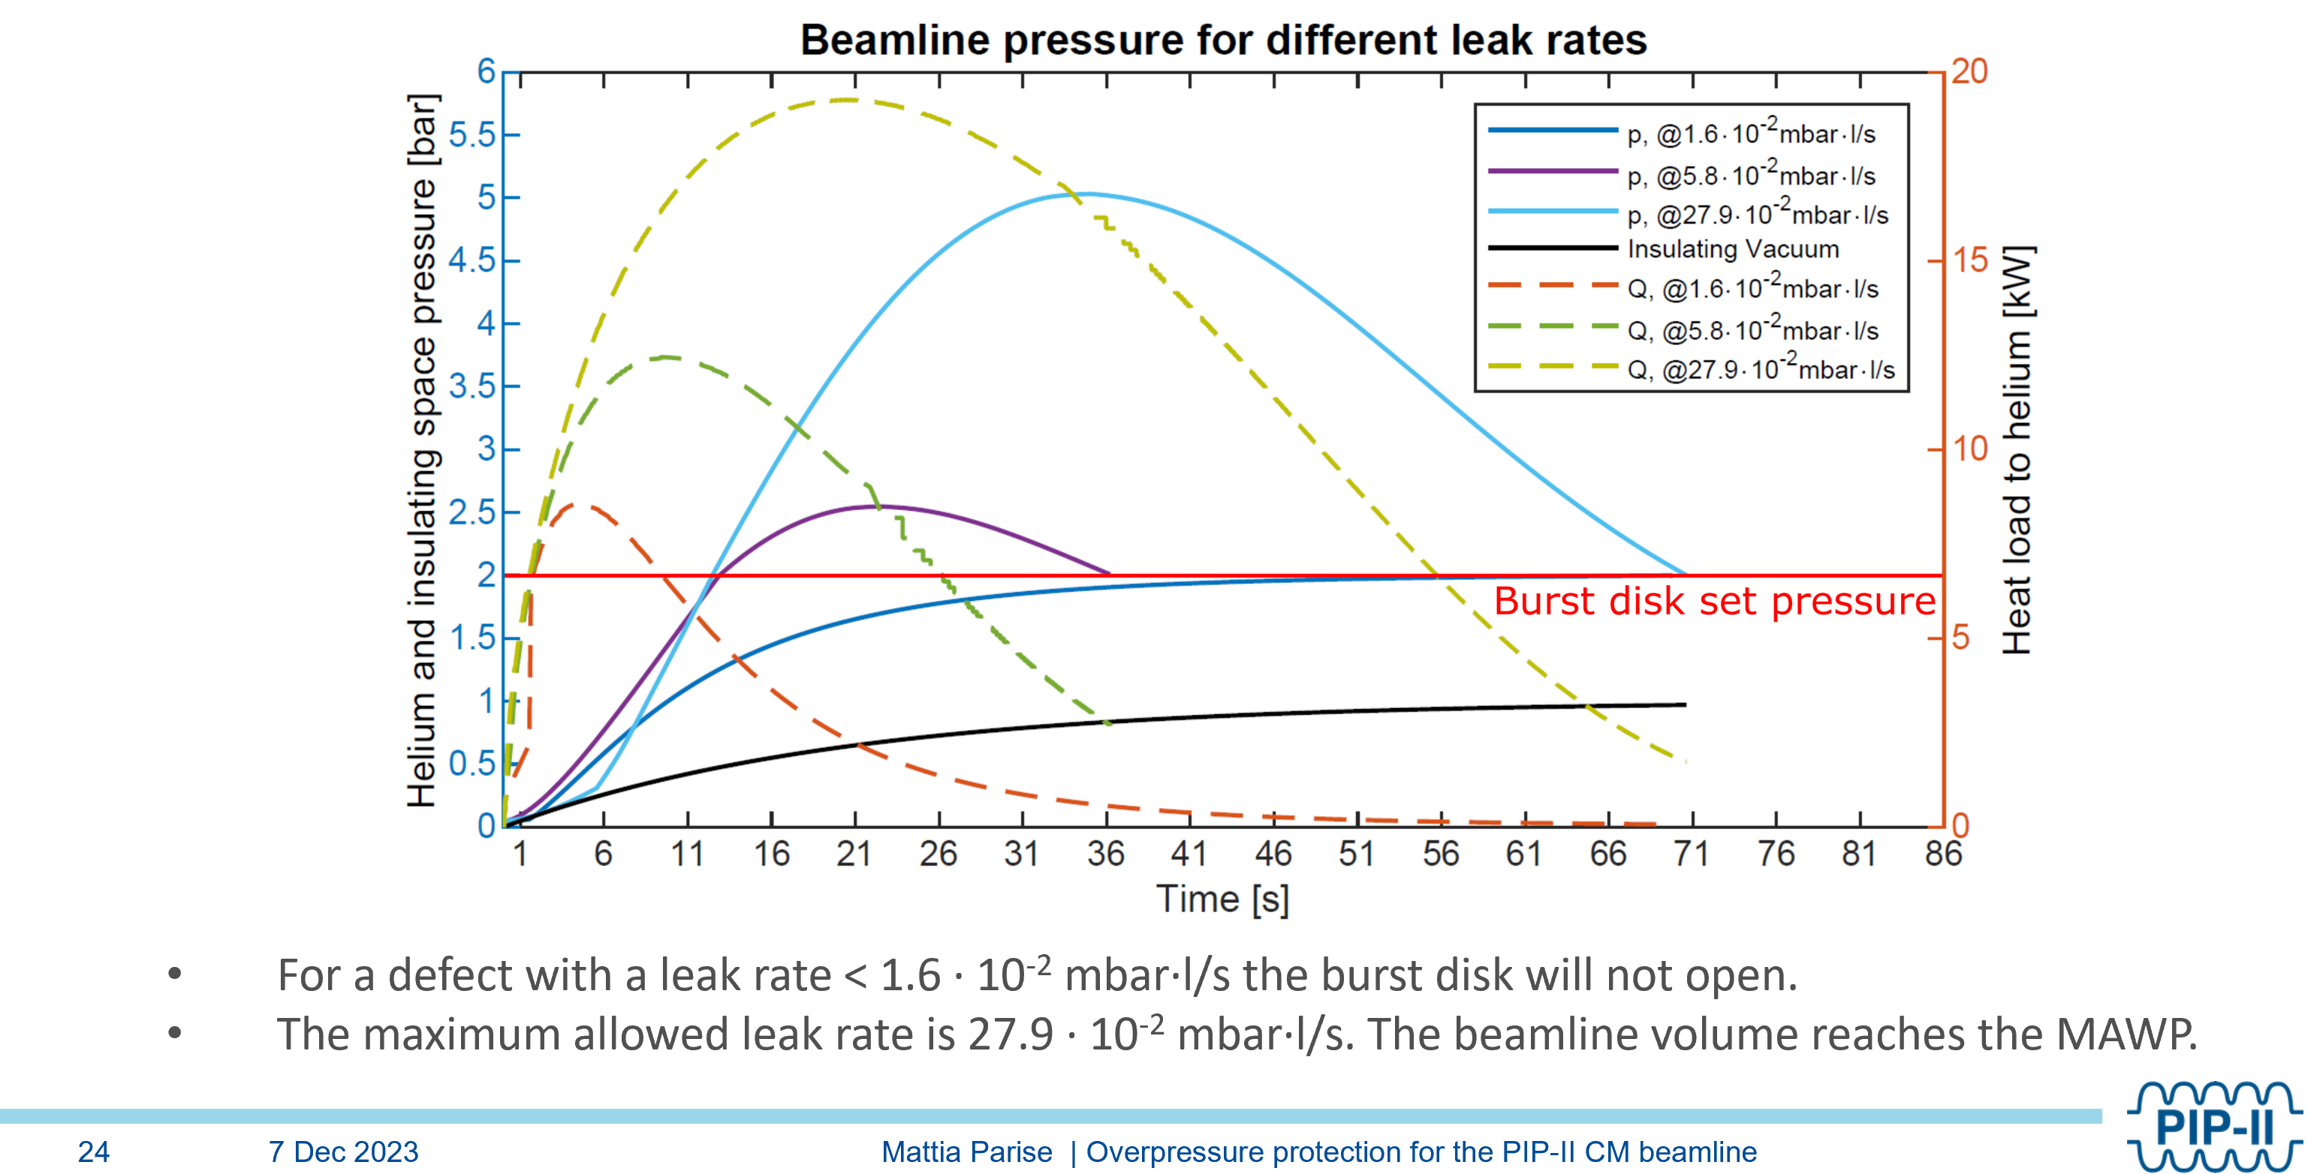
Overpressure protection for the PIP-II CM beamline
All the beamline components go through rigorous inspections
the burst disk is correctly sized

Slide 25
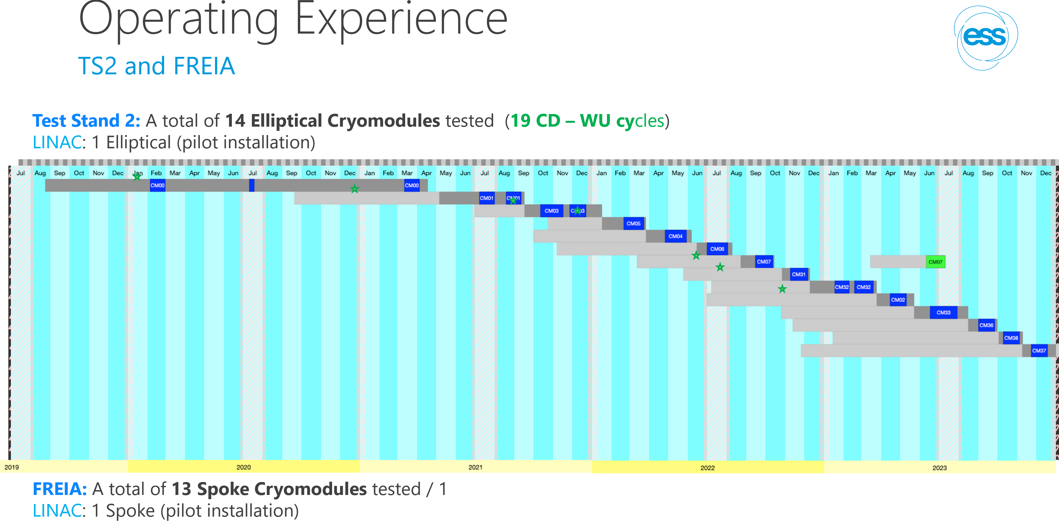
ESS Cryomodule design, PED strategy and operating experience

Slide 26
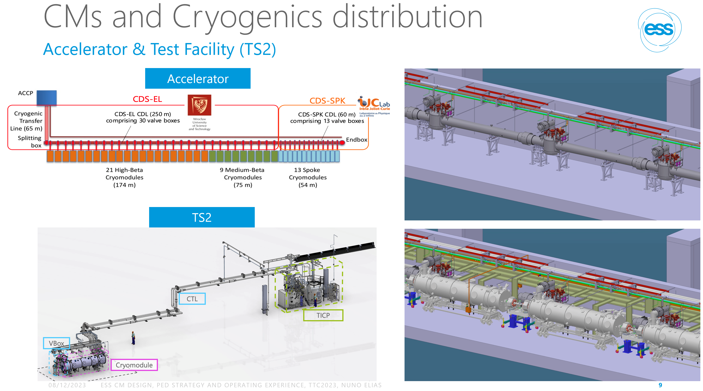

ESS Cryomodule design, PED strategy and operating experience

Slide 27


Design of PIP-II Cryomodules: Approach adopted for code equivalency
mandatory verifications of safety per ASME will be done for each piece of the cryomodule.
This will be mitigated due to the work done while writing the cryomodule design handbook and while setting up the standardization among PIP-II Cryomodules.
PIP-II Cryomodule engineering notes process flow

