Slide 1
LCLS-II-HE Cavity and Cryomodule Test Progress
James Maniscalco | SRF Engineer | SLAC National Accelerator Laboratory
5 December 2023

Slide 2
LCLS-II-HE project scope
Slide adapted from G. Hays / F. Garcia
Add 23 additional cryomodules (L4 linac) to increase the LCLS-II accelerator energy to 8 GeV.
Install new cryogenic distribution box and transfer line between the cryoplant and the new L4 linac.
Upgrade soft X-ray undulator for 8 GeV operation.
Upgrade the LCLS Hard X-ray endstations for MHz beam and data rates.
Develop conceptual design of a Low Emittance Injector including a tunnel design; also fund construction of a prototype high-gradient SRF gun for the LEI.

Slide 3
LCLS-II-HE SRF plan overview
Building on the success of LCLS-II cavity production to meet higher performance requirements
E_{acc} ≥ 23 MV/m
Quality factor: Q₀(21 MV/m) ≥ 2.5×10¹⁰ (in vertical test)
No field emission accepted in vertical test
Improvements to LCLS-II cavity production strategy
Updated nitrogen doping recipe following R&D program
Expanded process reporting requirements (QA/QC)
Frequent in-person visits to cavity supplier
Cavity acceptance testing at Fermilab and Jefferson Lab
Cavities tested as-is from vendor (static vacuum)
HPR as needed to recover from field emission

Slide 4
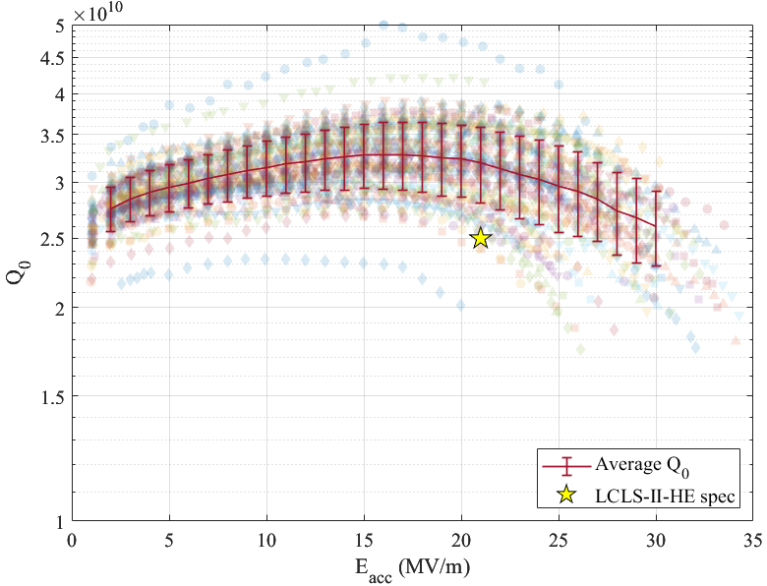
Vertical test performance so far – as of Dec. 1, 2023
167 cavities tested, of which:
132 qualify (79%)
109 as received
12 after 1 rerinse
11 after 2+ rerinses
8 placed “on hold” (marginal E_{acc}) (4.8%)
7 with marginal E_{acc}
1 with marginal Q0
9 disqualified (5.8%)
4 with low Eacc
1 with low Q0
3 with persistent FE
1 with HOM scratch
11 undergoing other rework (6.6%)
7 bellows damage
4 surface rework at labs
6 awaiting re-test after high-pressure rinse to mitigate field emission (3.6%)
13 of the above recently sent back to the supplier for repair/rework
All cavities with no FE

Slide 5
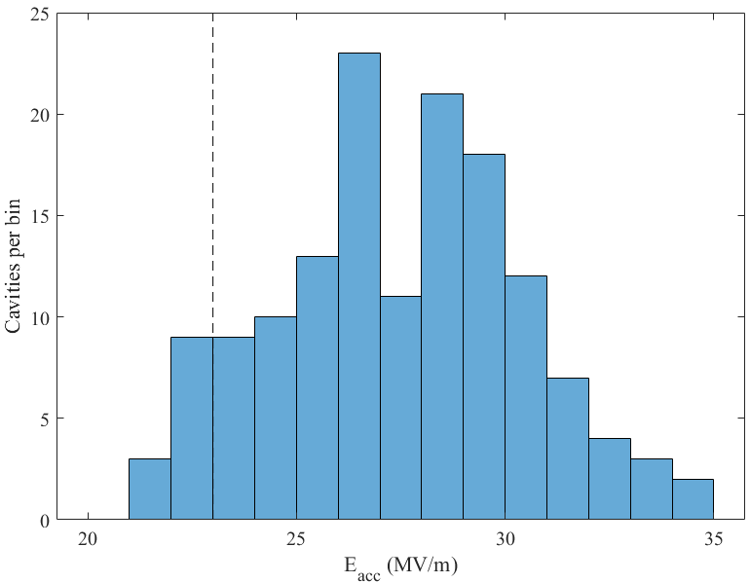
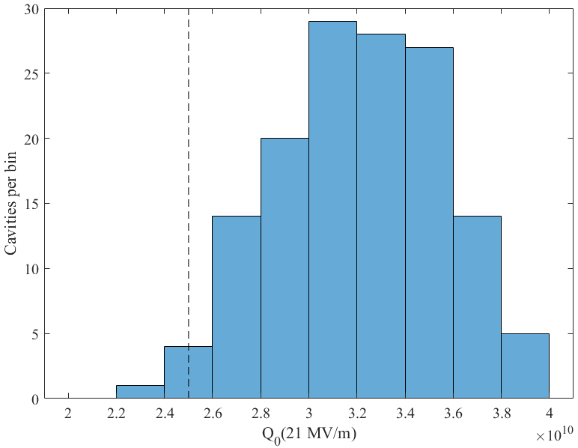
Vertical test performance so far – E_{acc} and Q₀
Accelerating gradient
Quality factor @ 21 MV/m
Average quench gradient: 27.0±3.5 MV/m
Average Q₀:
3.24±0.38×10¹⁰

Slide 6
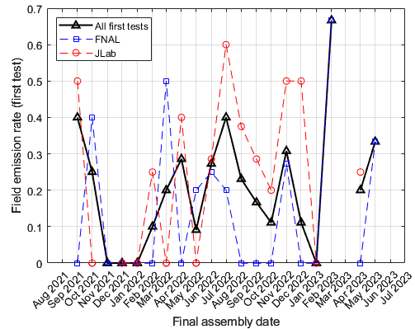
Cavity production challenges – field emission radiation
Early and continuing issue
40% of initial cavities had FE in first vertical test
Has been a recurring issue, similar long-term average rate to LCLS-II (20%)
Higher E_{acc} for LCLS-II-HE means we are likely cleaner now than in earlier project
High pressure rinsing (HPR) has removed FE in some cavities (29 of 38 so far)
Some FE may be due to issues at labs
Site visits
Initial visit to evaluate clean room practices & recommend changes
Periodic follow-on site visits
Rework at cavity supplier
2 FE cavities included in rework plan
Clean room site visit

Slide 7
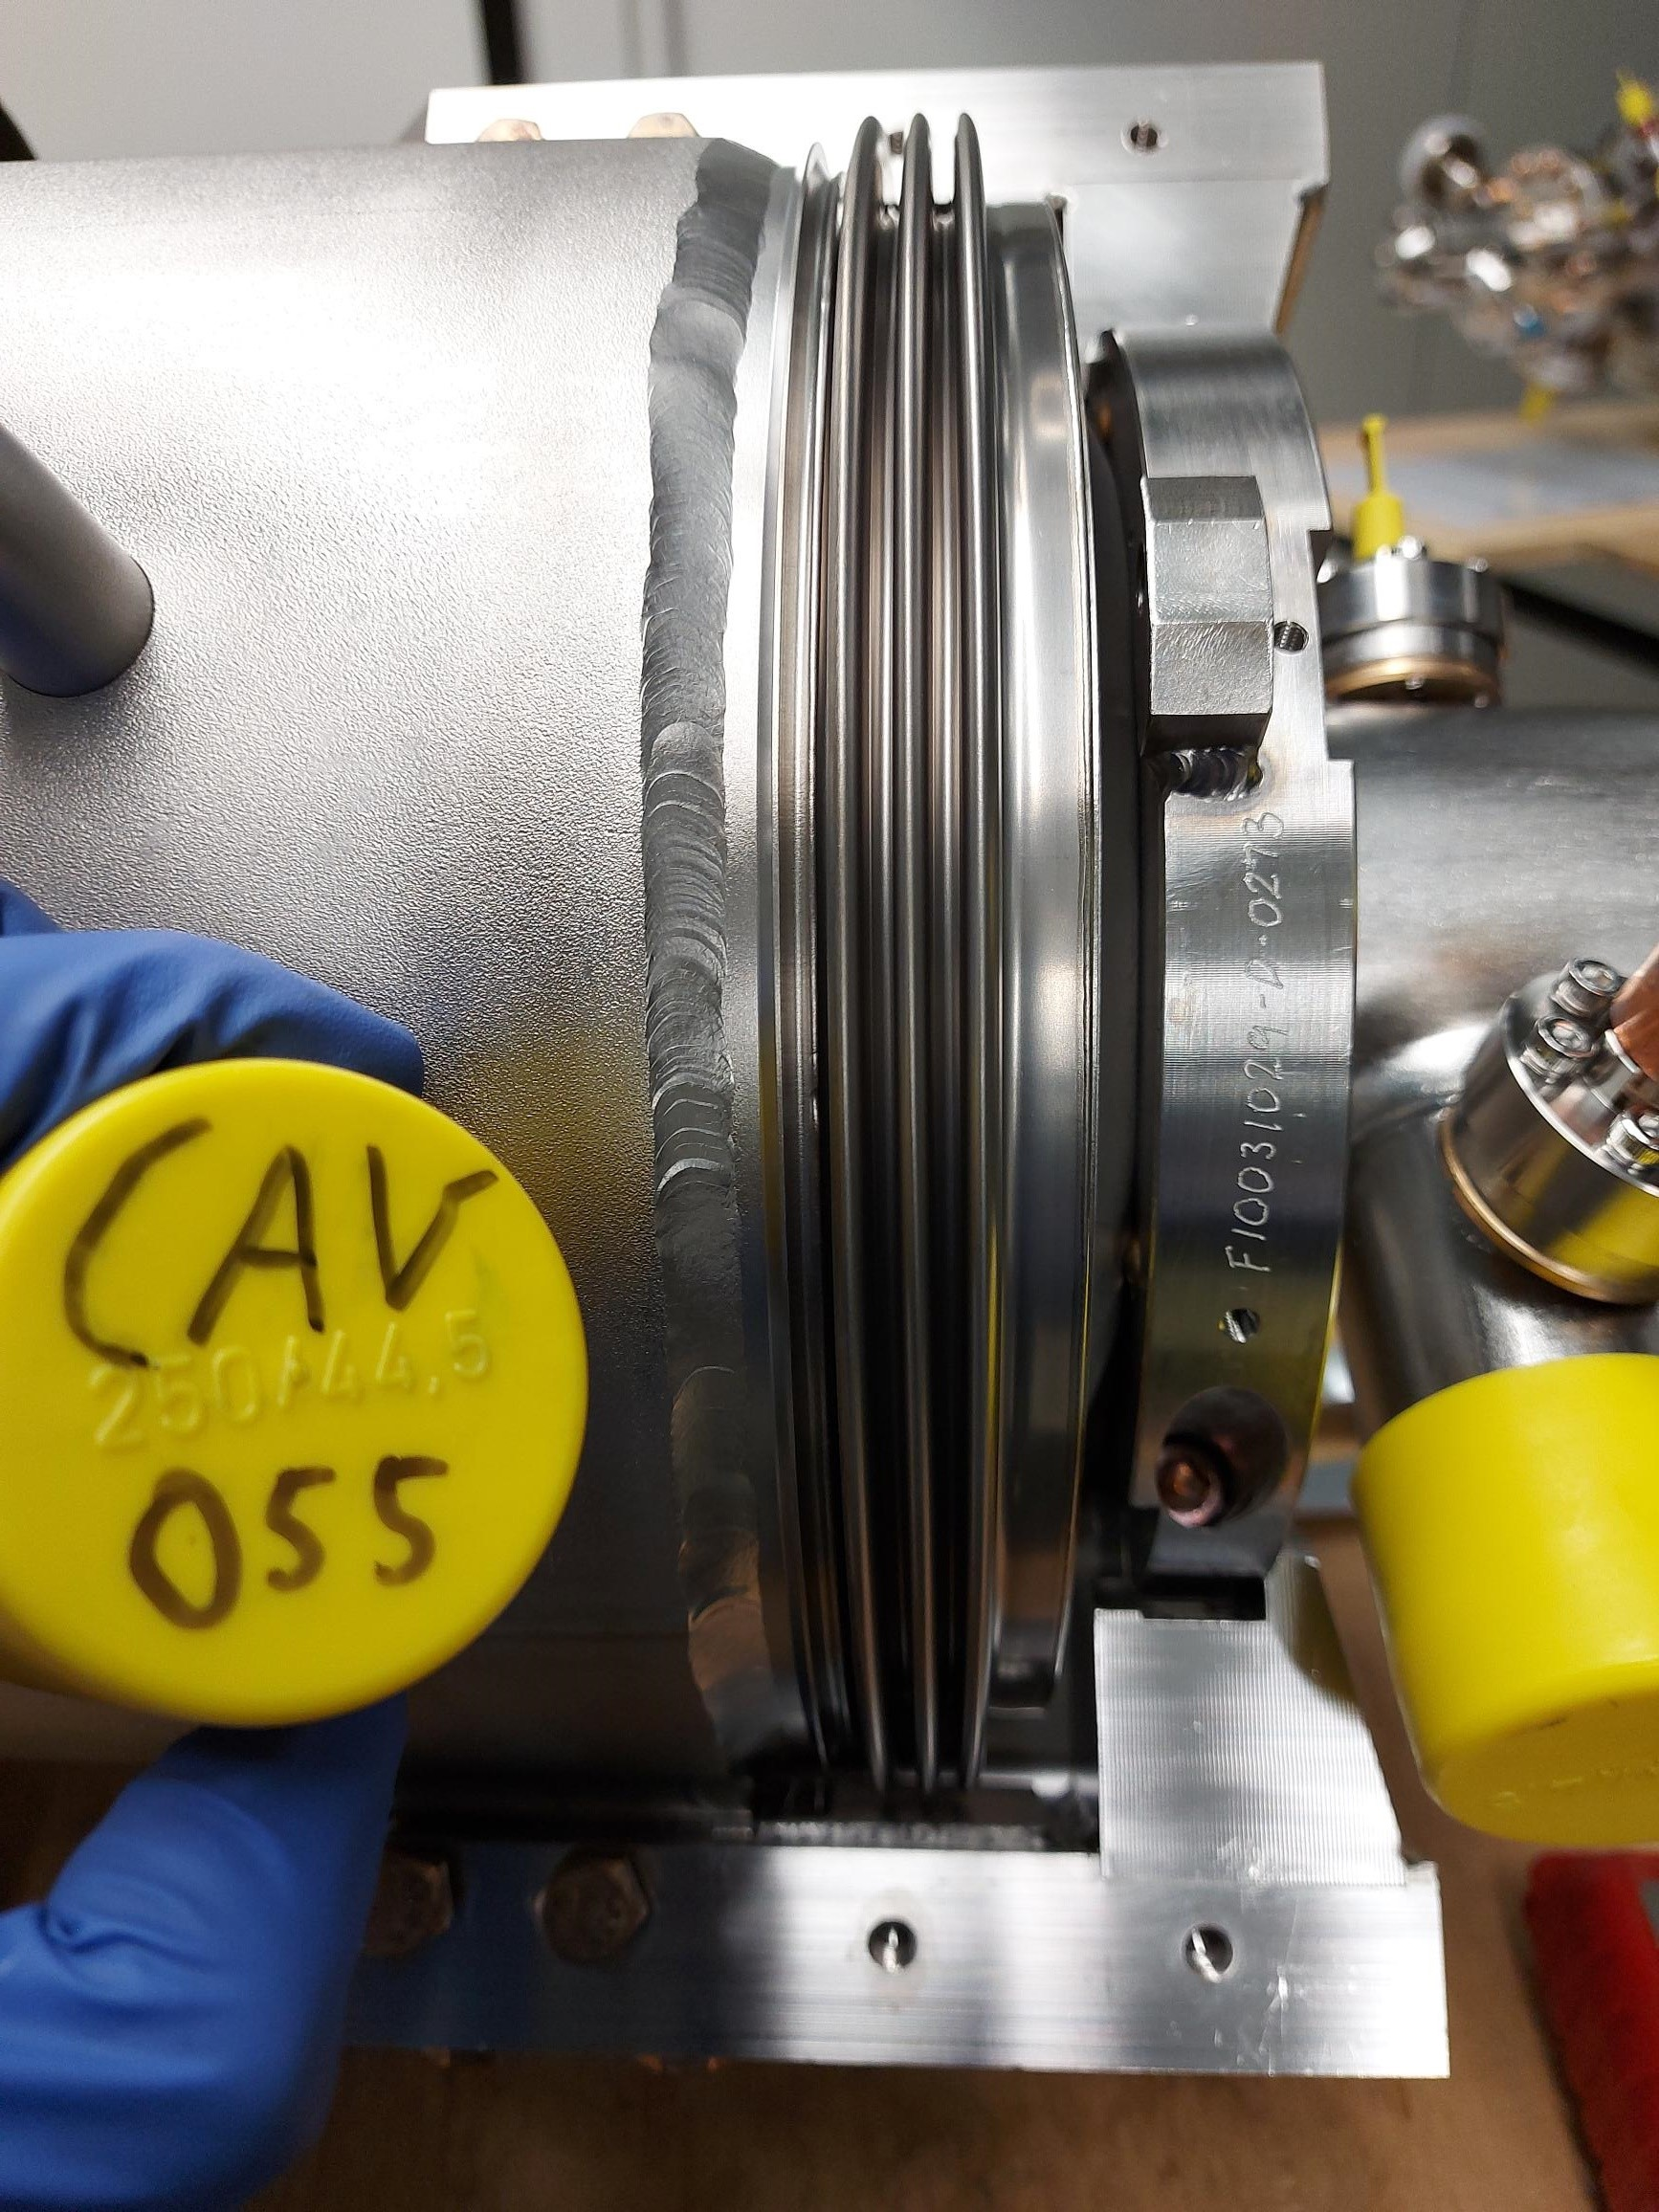
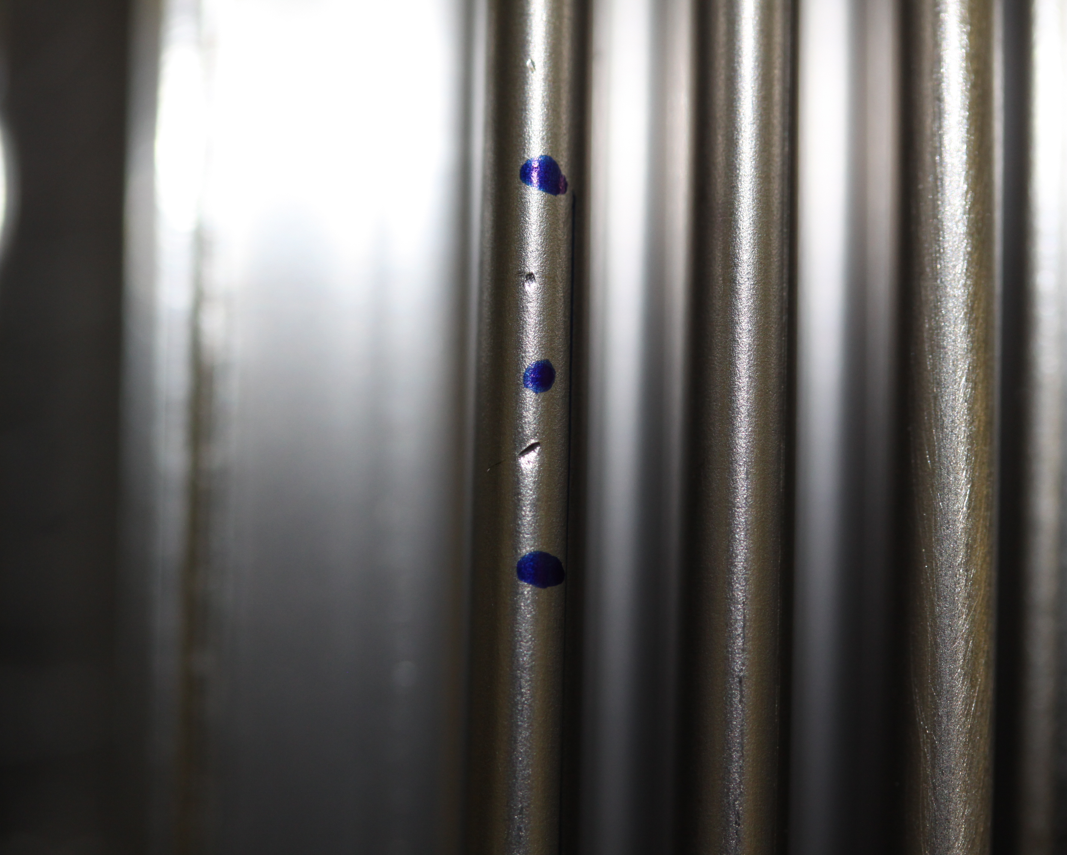
Cavity production challenges – bellows damage
Damage at supplier and laboratory to ~8% of cavities
Delicate external bellows is a weak point in the LCLS-II/LCLS-II-HE cavity design
Problem early in production despite using incumbent vendor (“rusty” technicians; loss of expertise/training)
Damage also caused due to mishandling at the laboratories
Schedule and cost impact
Several months total delay to shore up deficient procedures at supplier and lab
Cost to repair cavities damaged after receipt
Mitigations effective but imperfect
External covers and retraining only go so far
Typical bellows unit – covers normally installed during handling and transport
Damage encountered early in production

Slide 8
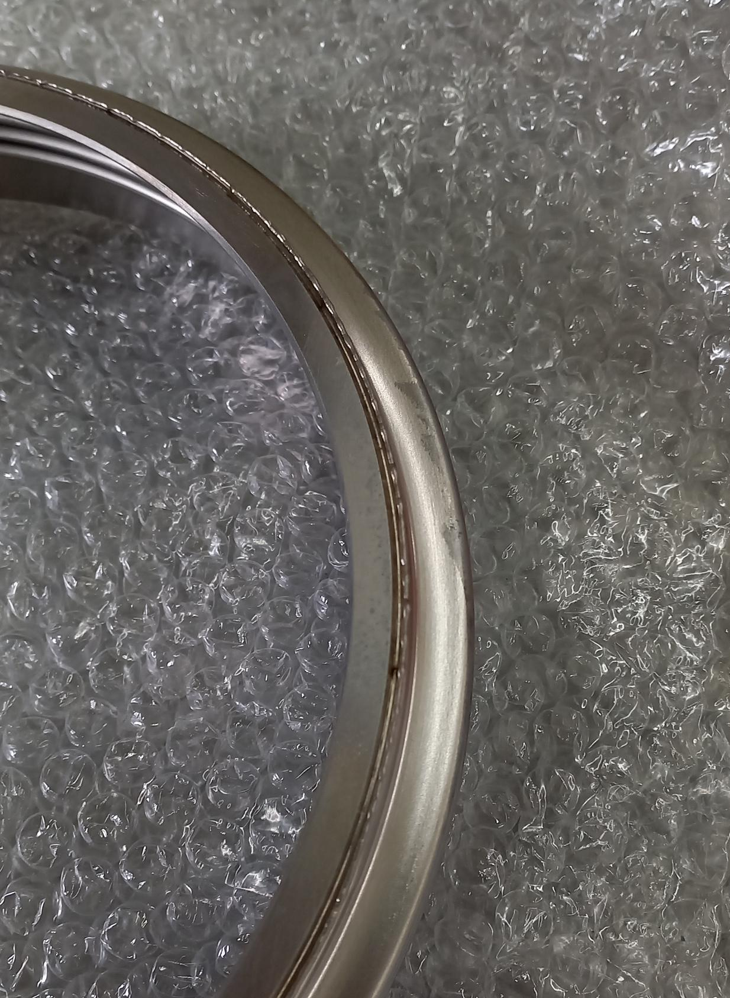
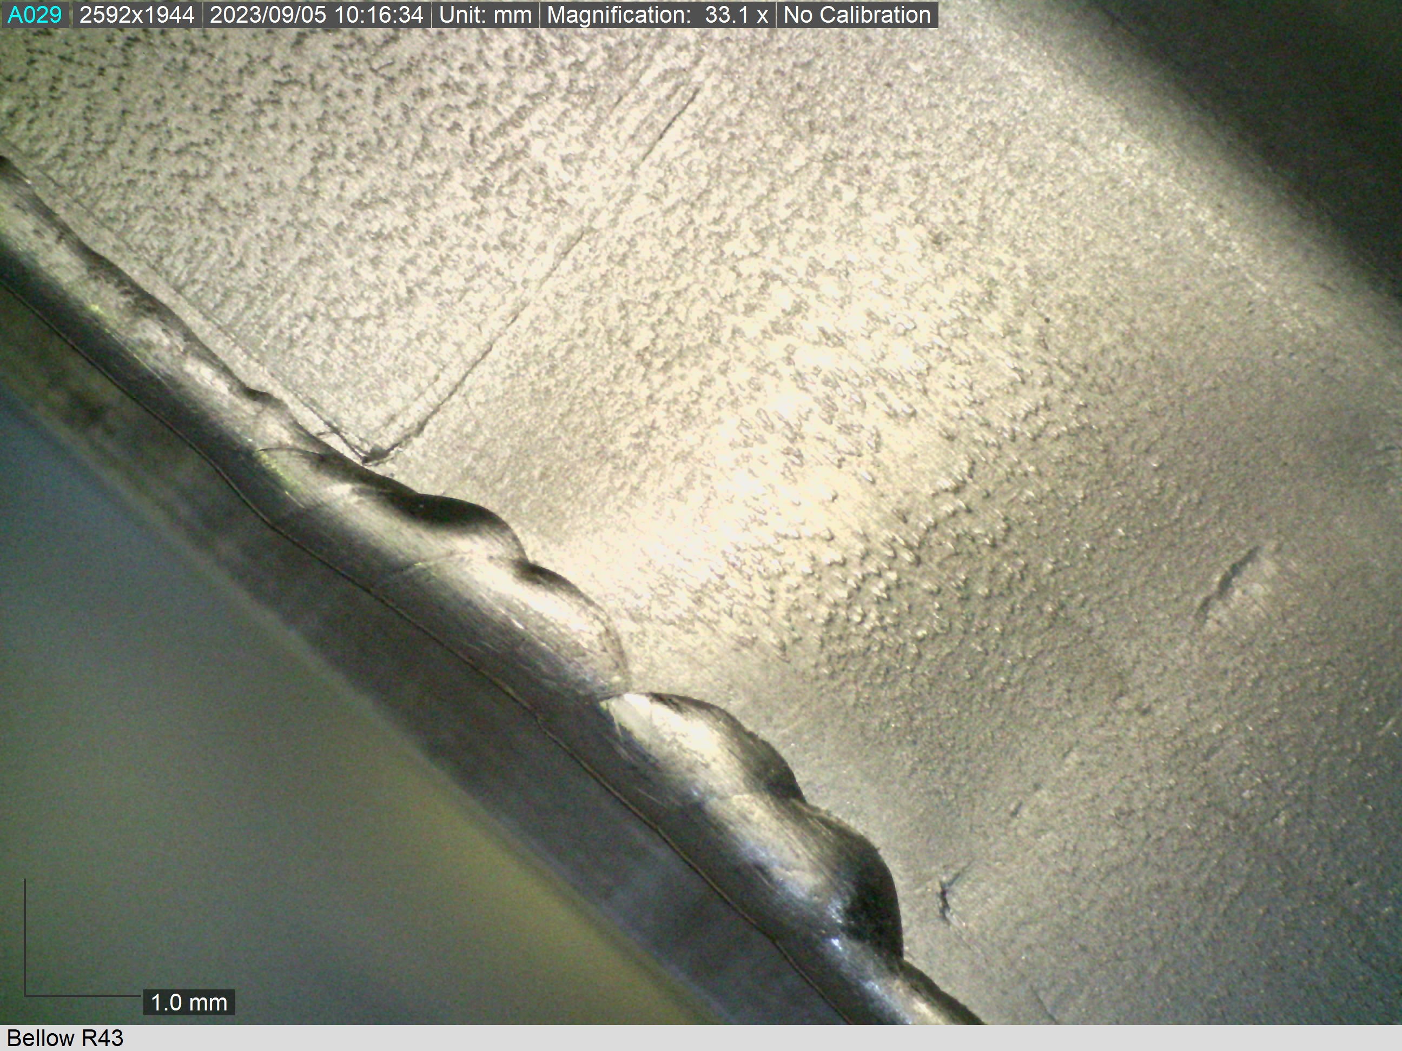
Cavity production challenges – further bellows issues
Incumbent bellows supplier not willing to continue supply
Cavity supplier could not reach an agreement with incumbent supplier
Quality issues with new supplier
Many months of prototyping and QA/QC to produce acceptable parts
Titanium supply chain issues caused further delays
Parallel effort to identify another supplier took very long, quality issues resolved first.
Good quality achieved after 5-6 months
Additional QC in place at cavity supplier
Poor weld quality
Surface defects

Slide 9
Cavity production challenges – weak vacuum
Cavities found in a state of “weak vacuum” at time of string assembly
Vacuum well below atmosphere but above acceptance level (1e-3 – 1e-1 torr)
9 cavities encountered so far (7 FNAL, 2 JLab)
All > 3.5 months with static vacuum
7 had last vacuum pulled at supplier; 2 at labs
Root cause study in progress
Strongly suspected: VAT right angle valves
Not rated for cryogenic use; known to develop intermittent leaks
Does anyone know of a different valve type that is rated for particle-free UHV and cryo use?
Also suspected: other re-used cavity accessories (burst disks, etc.)
Leak checking has been inconclusive
Ongoing “sleeper” issue – likely that this will be encountered again as work continues

Slide 10
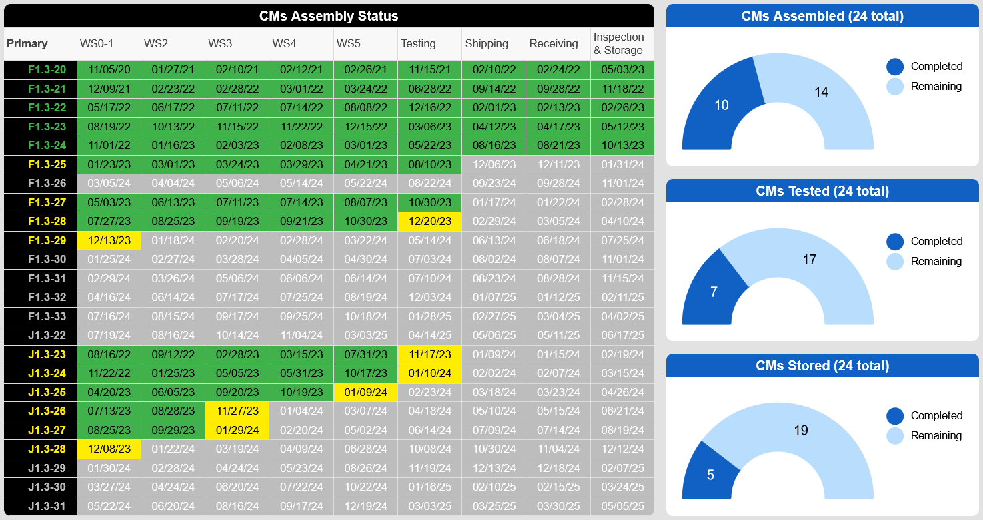
Cryomodule assembly and testing in progress

Slide 11
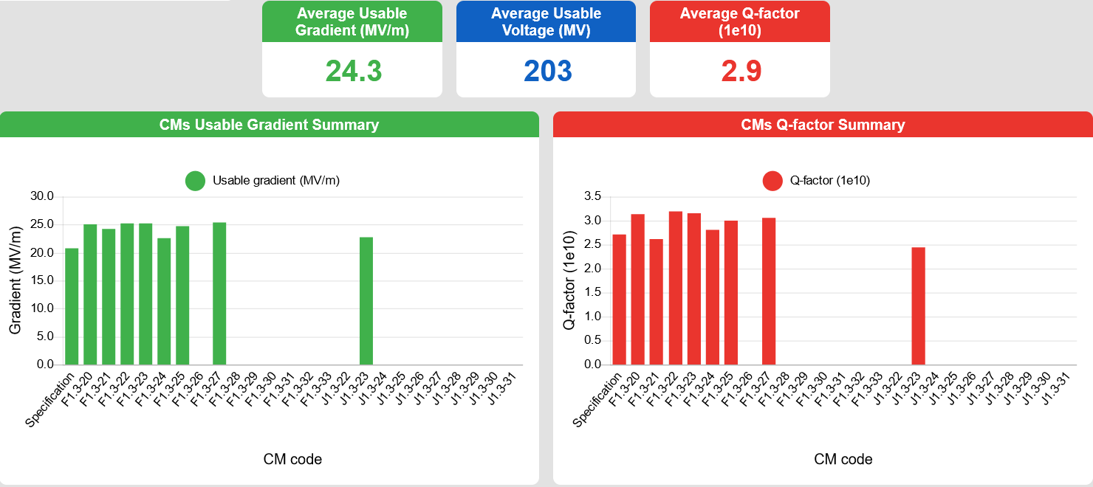
Cryomodule assembly and testing in progress
F1.3-21 built using recovered LCLS-II cavities

Slide 12
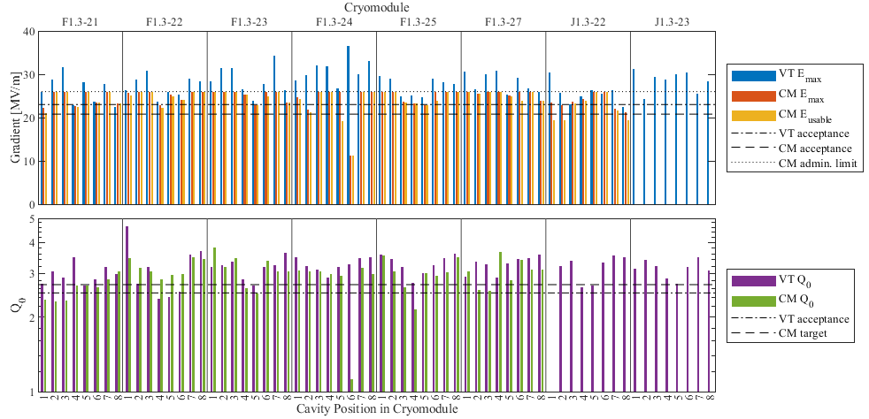
Cavity performance in cryomodules

Slide 13
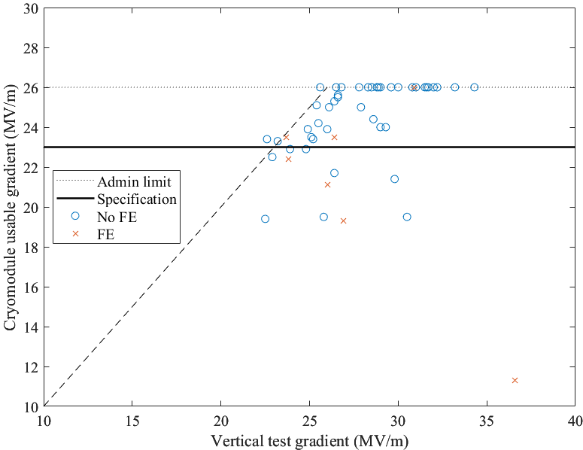
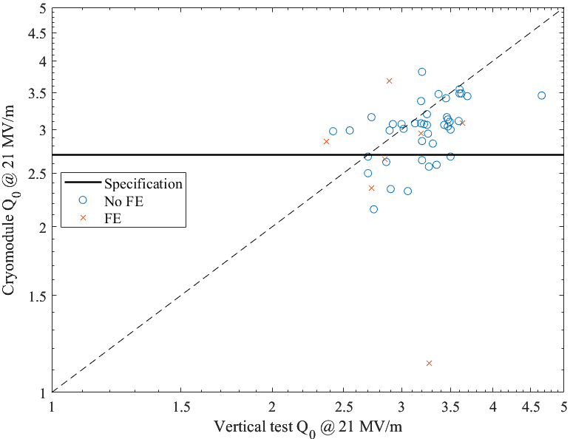
Cavity performance in cryomodules
Accelerating gradient
Quality factor @ 21 MV/m
ΔE_{acc} = 2.7±2.8 MV/m
Excluding field emission and administrative limits
ΔQ₀ = 2.1±3.8×10⁹

Slide 14
Cryomodule issues
Field emission encountered in approximately 13% of cavities
2 worst cases caused by off-normal work to repair damaged beamline bellows
No root cause determined for other cases
No captured dark current detected so far, only X-rays
Partial rebuilds to correct other issues
Another case of damaged beamline bellows
Lessons learned from first case → revised disassembly scheme & requalification of cavities
Beamline leak
Leak localized to field probe feedthrough; full rebuild required
Leak only appeared after > 6 thermal cycles! Will be investigated after disassembly.
Chipped FPC ceramics
Rebuild required
We are taking a conservative approach, prioritizing quality over schedule.

Slide 15
Outlook
13 of 192 production cavities remaining to be delivered
Final delivery coming in May 2024
13 rework cavities to be delivered Dec 2023 – Feb 2024
Vertical test qualification to continue through June/July 2024
Cryomodule assembly and test to continue through mid 2025
Installation scheduled to start Summer 2025

Slide 17
Backup slides

Slide 18
LCLS-II-HE cavity and cryomodule requirements
Bare 1.3 GHz LCLS-II/LCLS-II-HE cavity
Objective: increase beam energy from 4.0 to 8.0 GeV
23 new cryomodules added to existing 35
Quantity | LCLS-II Cavities | LCLS-II Cavities in HE | HE Cavities in HE | Unit
Number of 1.3 GHz cavities | 280 | 280 | 193†
Minimum average cavity Q₀ at nominal E_{acc} | 2.7 | 2.7 | 2.7 | 10¹⁰
Vertical test qualifying gradient | 19 |  | 23 | MV/m
Assumed fraction of failed cavities | 6 | 3 | 6 | %
Nominal average operating gradient | 15.7 in L2-3 | 16.9 in L2-3 | 20.8 | MV/m
Vertical test field emission onset min. | 17.5 |  | No FE allowed | MV/m
Maximum CM captured dark current | 10 | 10 | 30 | nA
† includes injector CM (8) and BCC (1)

Slide 19
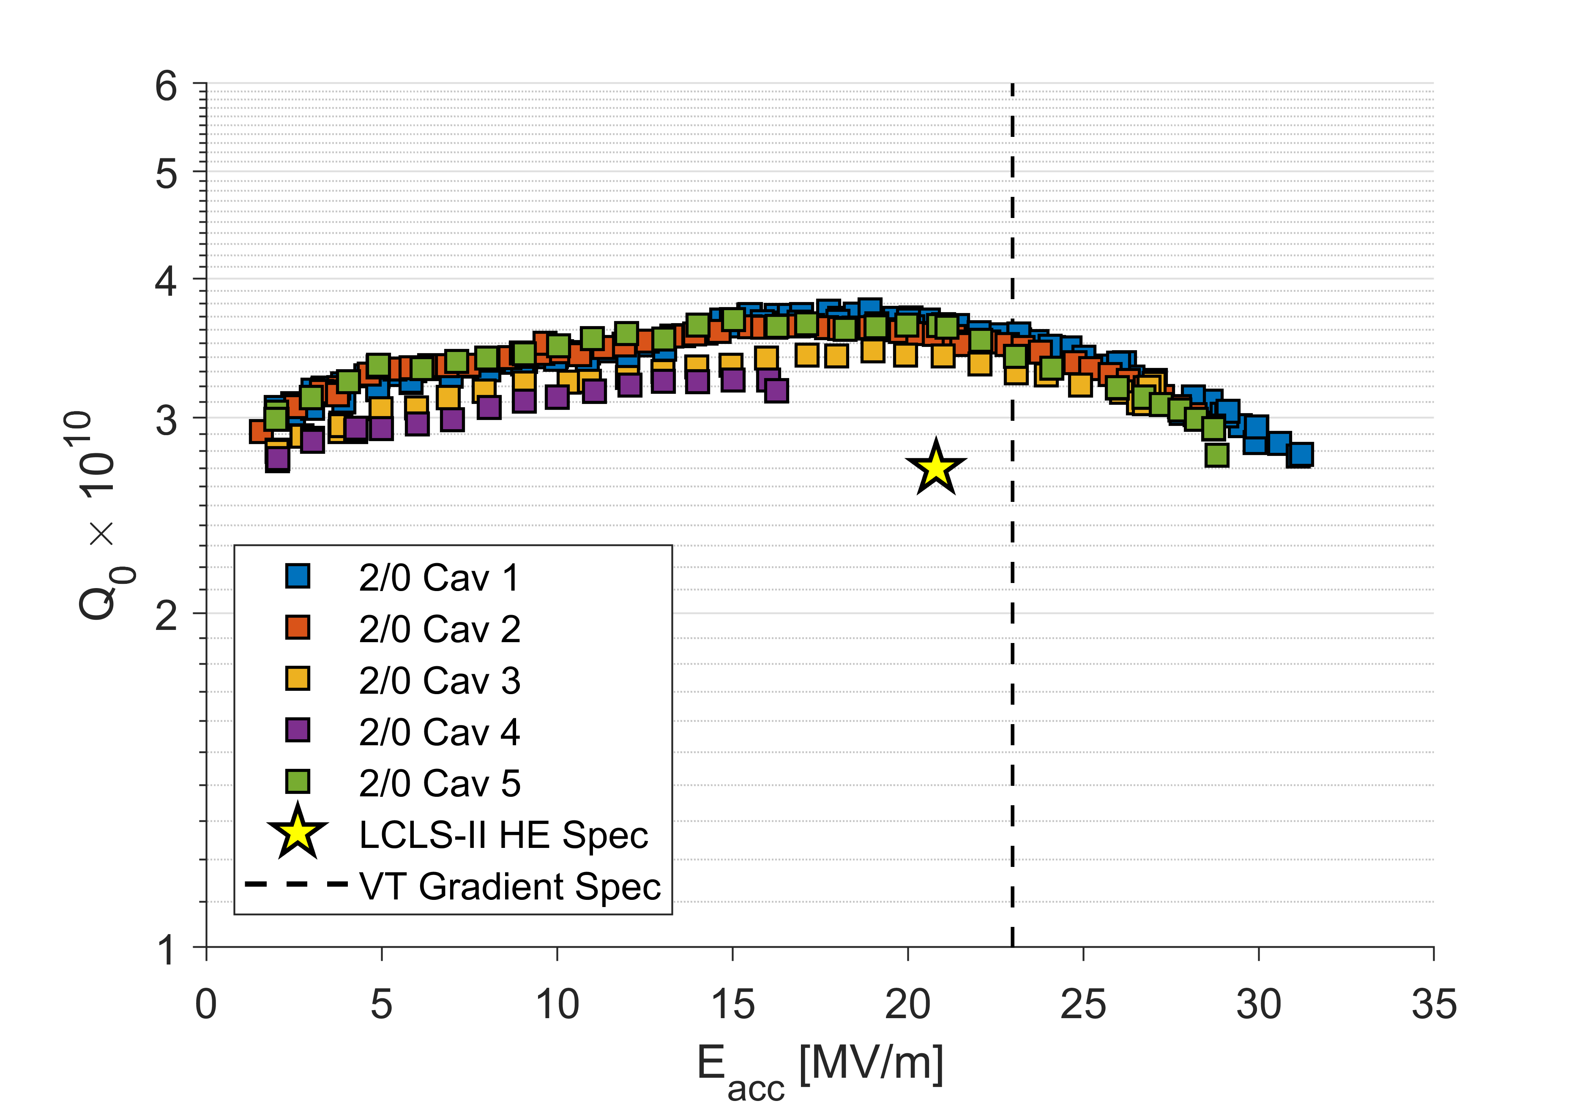
High-Q/High-Gradient R&D
R&D program following LCLS-II project to improve nitrogen doping recipe and surface processing (2018-2020):
Research collaboration between SLAC, Fermilab, Jefferson Lab, Cornell University
Increase cavity gradient without degrading Q₀
Improve uniformity of performance with tighter QA
Challenge: long lag between vendor activities and cavity tests (2-3 month minimum)
New “2N0” recipe chosen
Update to LCLS-II “2N6” recipe
R&D results:
4 of 5 cavities exceeded 30 MV/m
Average Q₀(21 MV/m) ≈ 3.5×10¹⁰
2N0 R&D results (9-cell cavities)
Plot from D. Gonnella

Slide 20
LCLS-II-HE recipe
LCLS-II | LCLS-II-HE
Bulk EP High Temperature Furnace Treatment & Doping (2N6) Fine EP | Bulk EP 1 High Temperature Furnace Treatment Bulk EP 2 (last portion cold) Doping (2N0) Fine EP (all cold)
Additional changes:
Require continuous RGA spectrum during furnace runs
Require continuous monitoring of temperatures during electropolishing runs
Sort cavity half-cell material by required heat treatment temperature

Slide 21
LCLS-II-HE cavity scope
10 qualification + 168 main production + 24 additional cryomodule cavities ordered from an industrial vendor in Europe, following competitive bid process
Qualification cavities went into “verification cryomodule” (vCM)
Cavity qualification testing overseen by Cavity Technical Board (CTB)
Manufacture @ vendor
Vertical qual.
@ partner labs
PASS
Cryomodule
assembly
FAIL /
MARGINAL
minor issue: light rework at labs
reporting
oversight
Analysis by cavity technical board
Analysis by cavity technical board
Set aside for possible rework
major
issue
CTB: SRF experts from SLAC, JLab, and FNAL

Slide 22
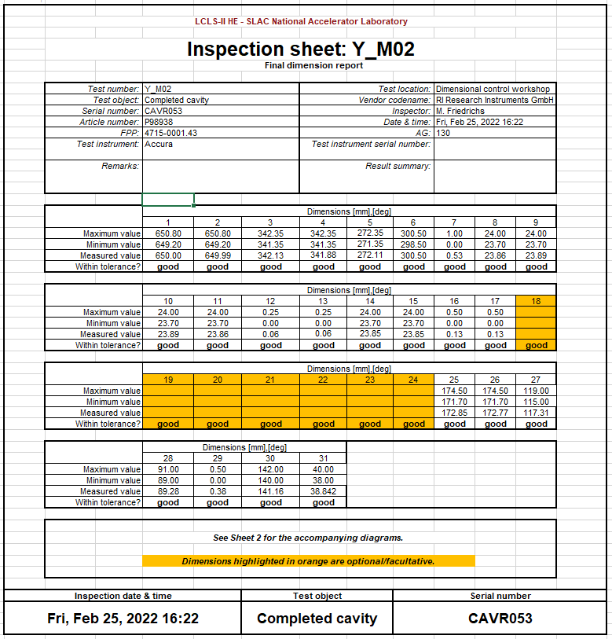
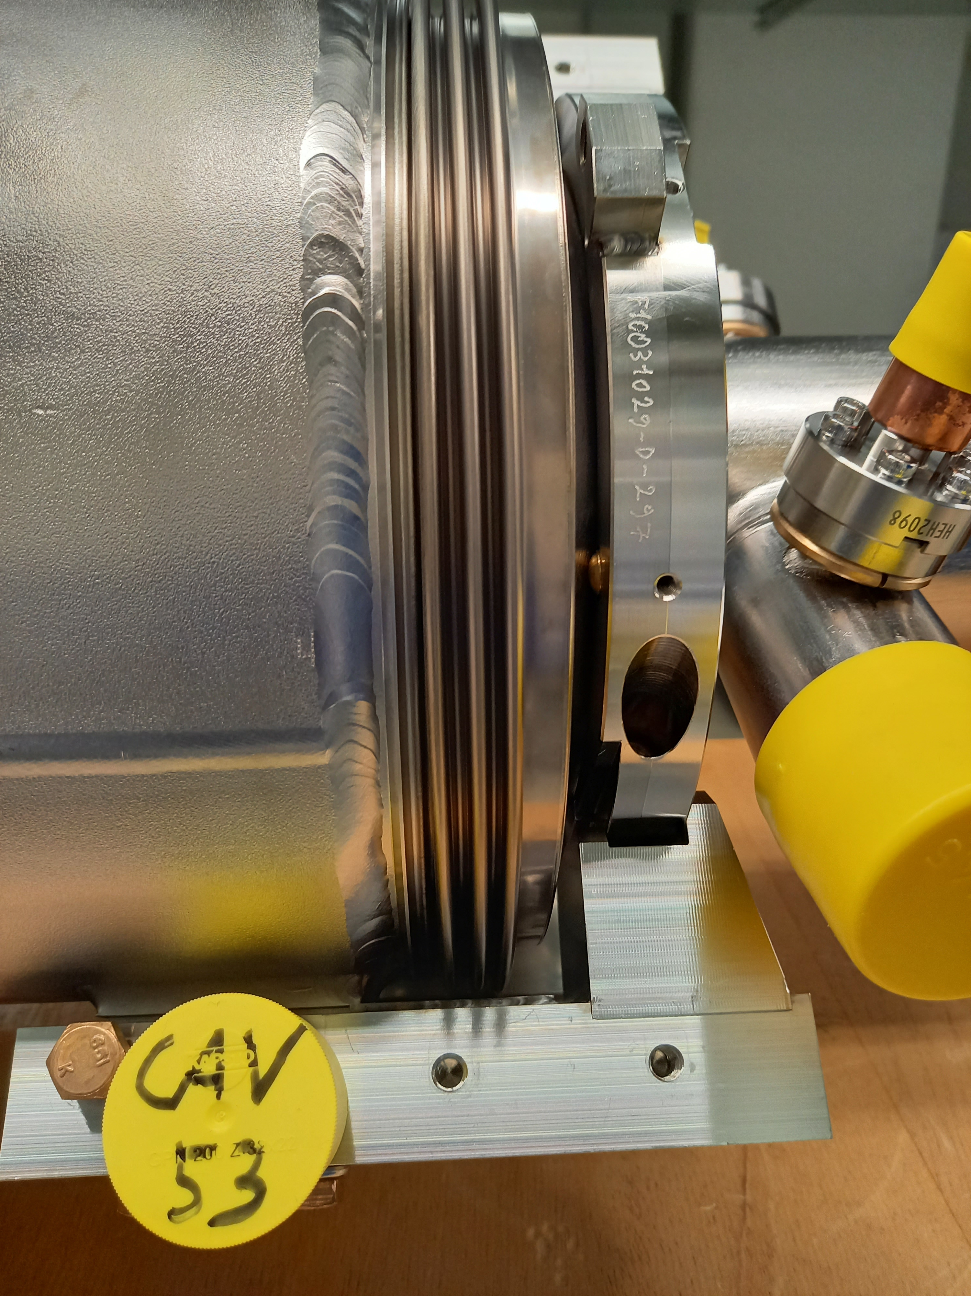
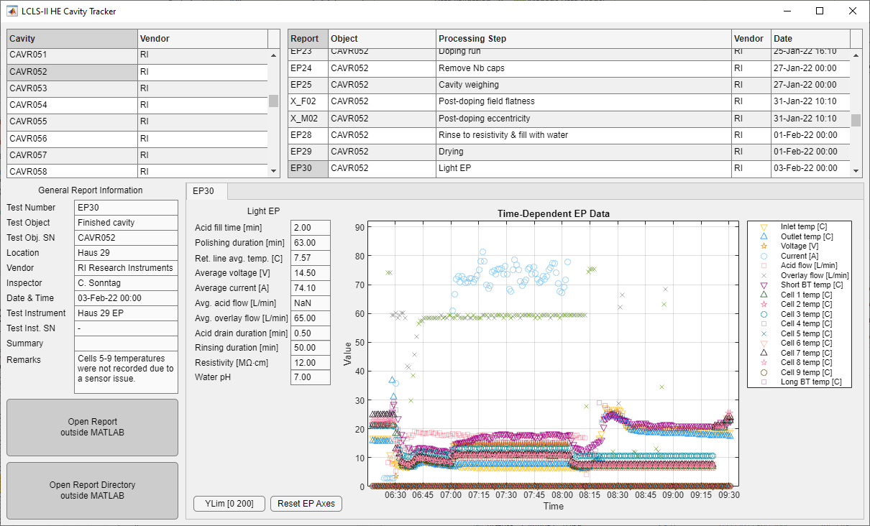
Cavity hold point data (some examples)
Example final inspection photo
Example hold point data form
Mechanical measurements
CMM reports
Eccentricity
Frequency & field measurements
Passband modes
9x9 field flatness measurements
Process data
Furnace temps and RGA
EP temps, voltage, current
Assembly particle counts
Other inspections
Final visual inspection
Weld reports
~16 MB per cavity + photos
Database & GUI for data review

Slide 23
LCLS-II-HE cavity timeframes
Mechanical fabrication begins: t=0
Bare 9-cell cavity complete: 6 months
Hold Point 1 data submitted and reviewed
Steps through doping: +1 month
Hold Point 2 data submitted and reviewed
Steps through final assembly: +1.5-2 months
Hold Point 3 data submitted and reviewed
Shipping: +2 weeks
First vertical test: +1 week – 3 months
Prioritization scheme in place to ensure new and old cavities tested
High pressure rinse and retest: +1-2 months
Timely review of process/hold point data is crucial for identifying production issues

Slide 24
Vertical qualification testing – requirements
Gradient: E_{acc} ≥ 23 MV/m
Quality factor: Q₀(21 MV/m) ≥ 2.5×10¹⁰
VT stainless steel flange R = 0.8 nΩ
HOM coupling: Q_{ext} > 2.7e11
HOM power: P_{HOM}(21 MV/m) < 1.7 W
Field emission: no detectable FE up to quench
Frequency: f = 1300.25±0.10 MHz
Field probe coupling: 2.5×10¹¹ < Q_{ext} < 7.0×10¹¹
Multipacting: fully processed before final Q vs. E
7π/9 mode: avoid mode buildup → quick measurements

Slide 25
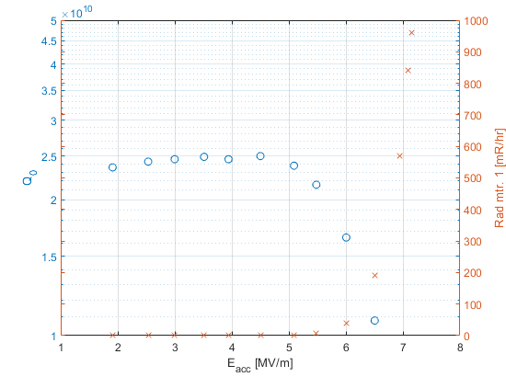
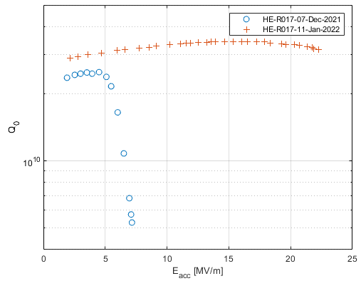
High pressure rinse to mitigate field emission
HPR
FE example: CAVR017

