Slide 1
Performance of the First Mid-T 1.3 GHz Module
Jiyuan Zhai (IHEP, Beijing, China)
Presented by Han Li (IASF, Shenzhen, China)
TTC Meeting, FNAL, Dec. 5, 2023

Slide 2
Outline
Introduction
Cryomodule assembly
Horizontal test result
Summary

Slide 3
Mid-T Bake Cavity and Cryomodule Development
Fermilab: in-situ mid-T bake of assembled cavity (S. Posen, et al, SRF19 MOP043, Jul. 2019; PHYSICAL REVIEW APPLIED 13, 014024, 2020). Discovery of high Q by 250~400 C mid-T bake.
KEK: regular furnace mid-T bake of unassembled cavity (K. Umemori, TTC meeting at CERN, Feb. 2020; H. Ito, et al, Prog. Theor. Exp. Phys. 2021, 071G01). Simplified the implementation of mid-T bake.
IHEP:
Further simplified furnace mid-T bake procedure (only one bulk EP, no light EP).
Successfully applied mid-T bake to 1.3 GHz 9-cell cavities in Oct. 2020 (F. He, et al, Superconductor Science and Technology, 34, 2021, 095005). 14 mid-T 9- cell cavities tested in 2020-2022.
Cryomodule with eight mid-T 9-cell cavities achieved world leading high Q and high gradient in June 2023 (https://arxiv.org/abs/2312.01175) for Dalian Advanced Light Source (DALS) R&D, based on the important experience gained in Euro-XFEL and LCLS-II (&HE) cryomodules.
Advantages: mid-T 1 EP vs N-doping 3 EPs, no NbN precipitates, no careful EP after doping, stable and reliable performance … (H. Padamsee. Superconducting Radiofrequency Technology for Accelerators: State of the Art and Emerging Trends. Wiley-VCH, Feb. 2023)
Application: PIP-II 650 MHz β=0.61 5-cell cavities will use mid-T bake. SHINE, S³FEL, DALS, CEPC, CW upgrade of Euro-XFEL and other projects are considering to use mid-T bake for large number of cavities.

Slide 4
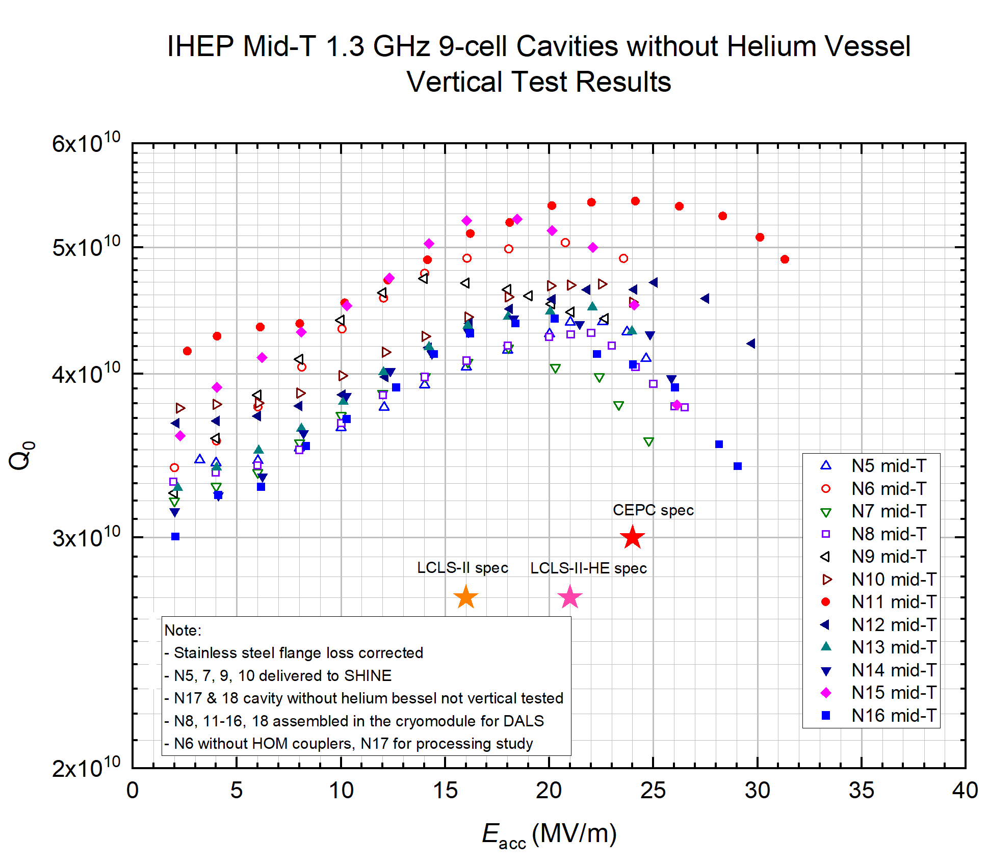
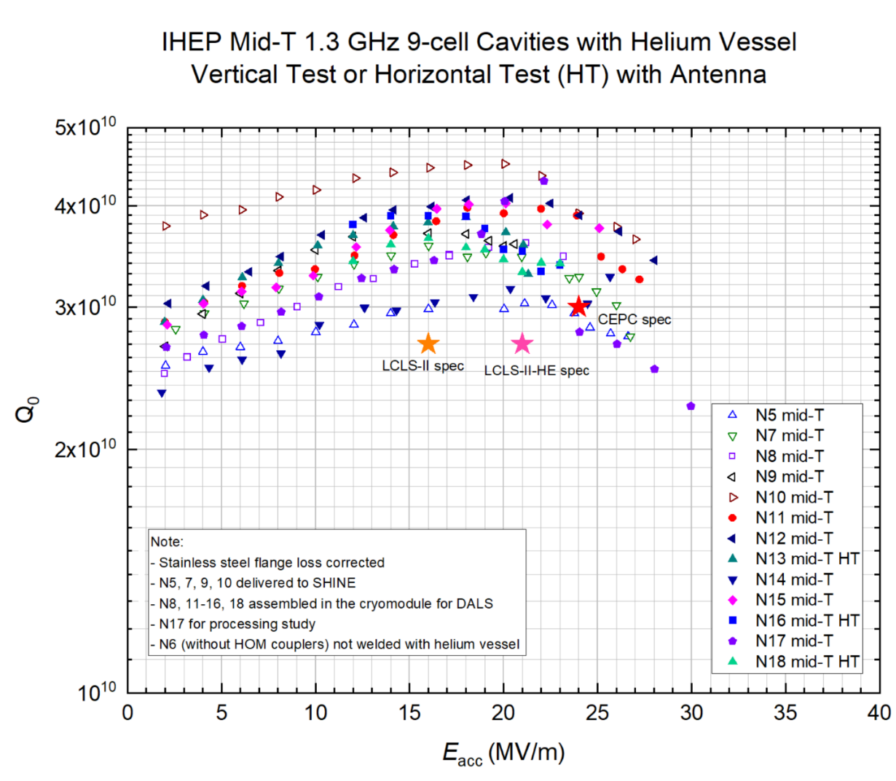
Vertical Test Results of Mid-T Bake 9-cell Cavities at IHEP
Average Q₀ 4.5E10 at 16~21 MV/m of 12 mid-T 9-cell cavities. Q₀ corrected for stainless steel flange loss (0.8 nΩ) in order to compare with module test results directly.
Due to tight schedule, no time to warm-up and cool down some of the dressed cavities to recover the degraded Q₀ after quench, or with not-optimized fast cool down, or by thermal current.

Slide 5
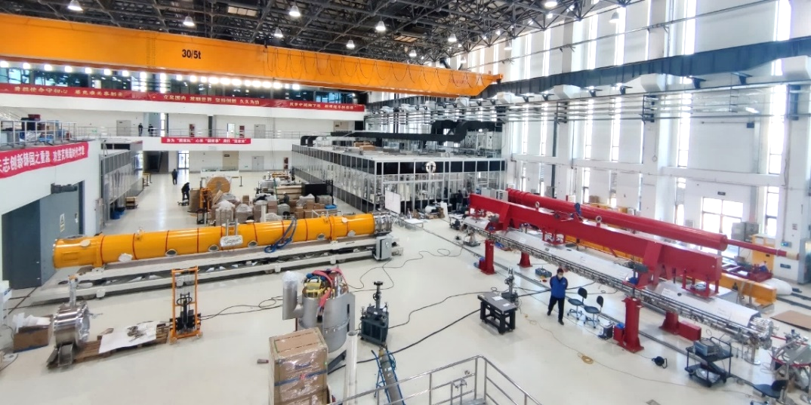
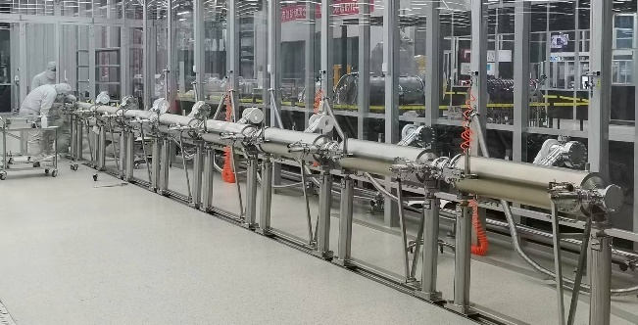
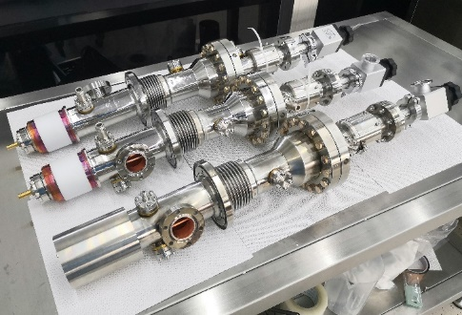
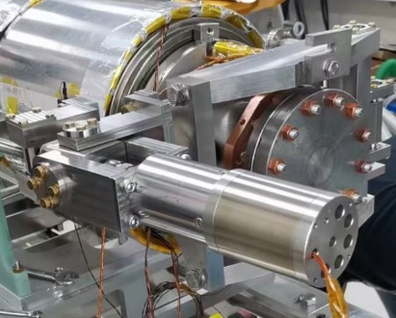
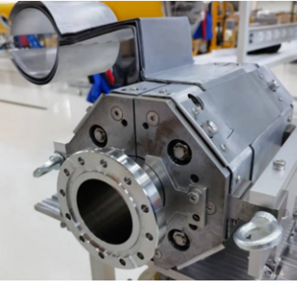
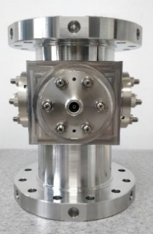
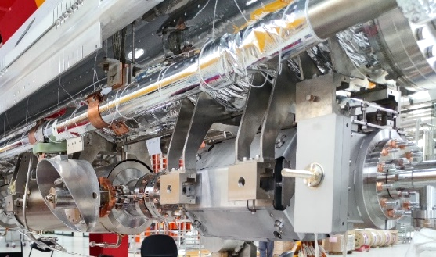
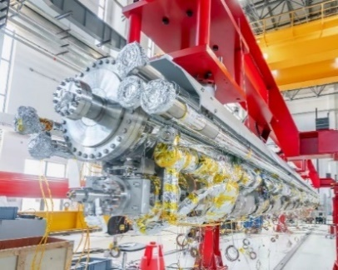
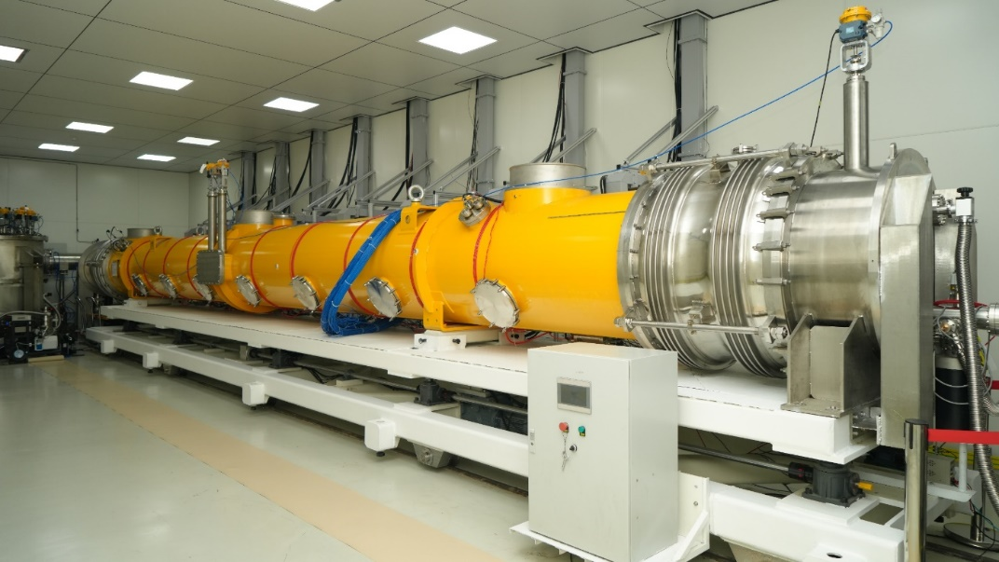
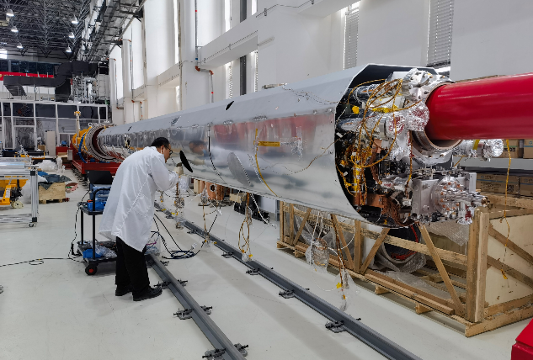
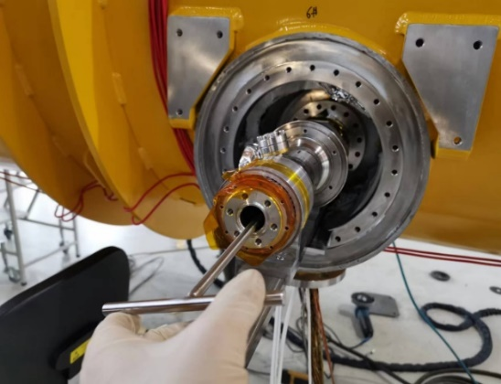
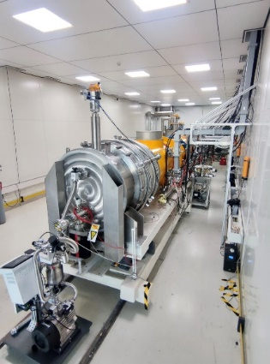
Module Assembly
cavity string kept in vacuum during the cold mass assembly all through to the horizontal test.
cavity string pumped by TMP whenever possible during the cold mass assembly outside the clean room.

Slide 6
Module Instrumentation
143 temperature sensors, 12 flux gates, 6 radiation detectors…e.g. important to find:
overheating of the HOM coupler caused by poor thermal conduction (limit to < 10 MV/m)
overheating of input coupler caused by poor mechanical connection of the warm part and cold part of the inner conductor …

Slide 7
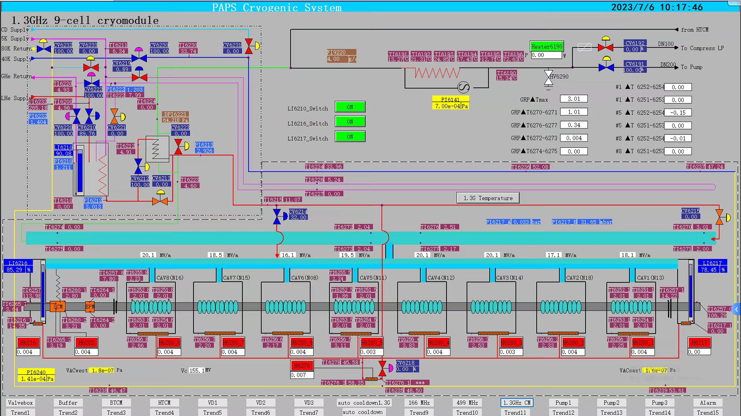
Module Cooldown

Slide 8
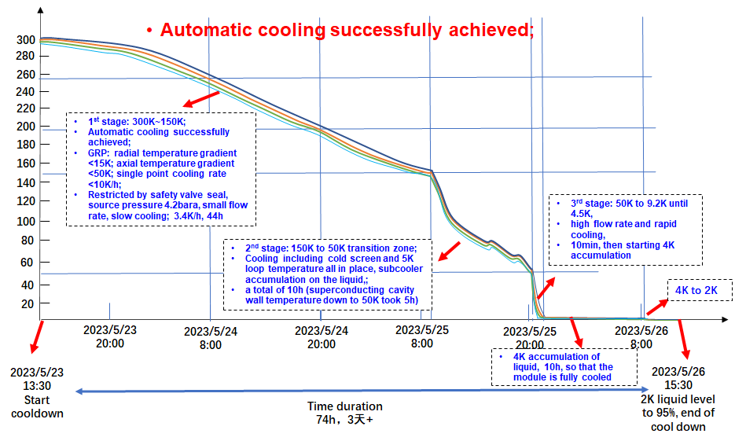
Module Cooldown

Slide 9
Cavity Processing
High Q TESLA cavities (MP band at 17-24 MV/m) sometimes need more multipacting processing than baseline (EP+120C) cavities, especially in the module.
Two of the eight (25 %) cavities show repetitive quenching.
Cavity processing takes two days (May 28-29, 2023).
1#: 5.28 10:16-10:40, 2 quenches at 20-21 MV/m.
2#: 5.28 9:29-13:26, 14 quenches at < 14 MV/m, 12 quenches at 17-19 MV/m. HOM2 heating and quench at > 20 MV/m with X-ray
3#: 5.28 9:17-10:40, no MP quench.
4#: 5.28 13:02-13:30, 1 quench at 19 and 23 MV/m.
5#: 5.29 outgassing by pulsed processing, reach 26 MV/m after 80 min. Quench number NA.
6#: 5.28 12:42-12:49, no MP quench.
7#: 5.28 10:30-13:05, no MP quench.
8#: 5.28 10:37-15:50, 57 quenches at 17-24 MV/m.

Slide 10
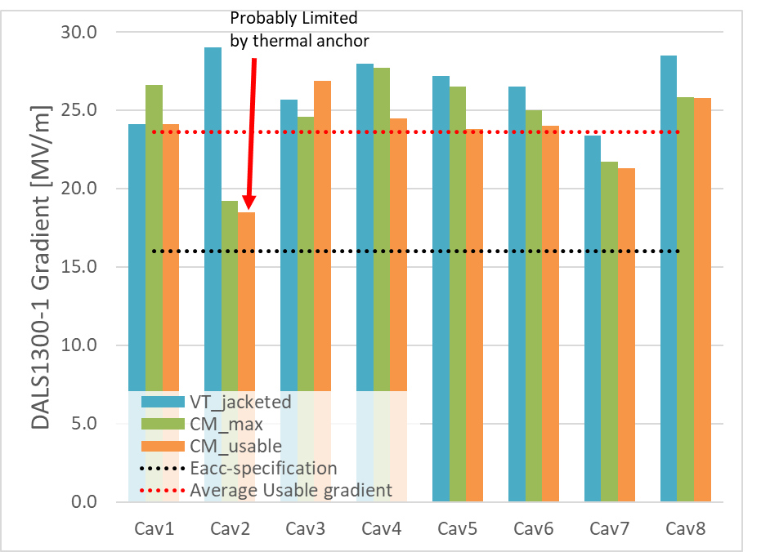
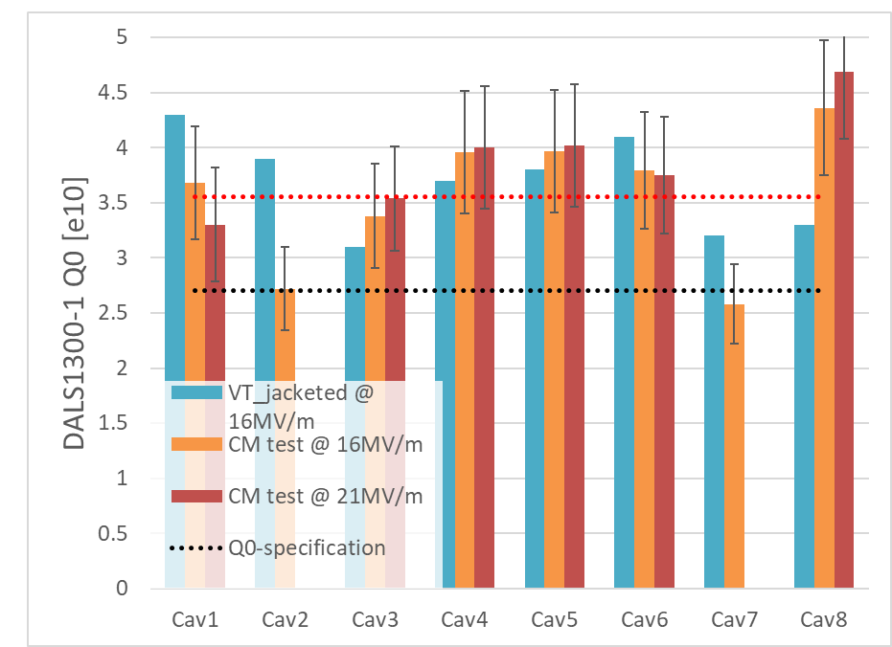
Cryomodule Performance
Parameters | IHEP Mid-T CM1 test results | DALS, SHINE, S³FEL spec. | CEPC Spec.
CM usable RF voltage (MV) | > 191.2 | 128 | 180
Average usable E_{acc} (MV/m) | > 23.1 | 16 | 21.8
2 K heat load @ 128 MV (W) | 83.5 | 93 | /
Average Q₀ @ 16 MV/m | 3.8×10¹⁰ | 2.7×10¹⁰ | /
2 K heat load @ 173 MV (W) | 133 | / | 140
Average Q₀ @ 21 MV/m | 3.6×10¹⁰ | / | 3.0×10¹⁰

Slide 11
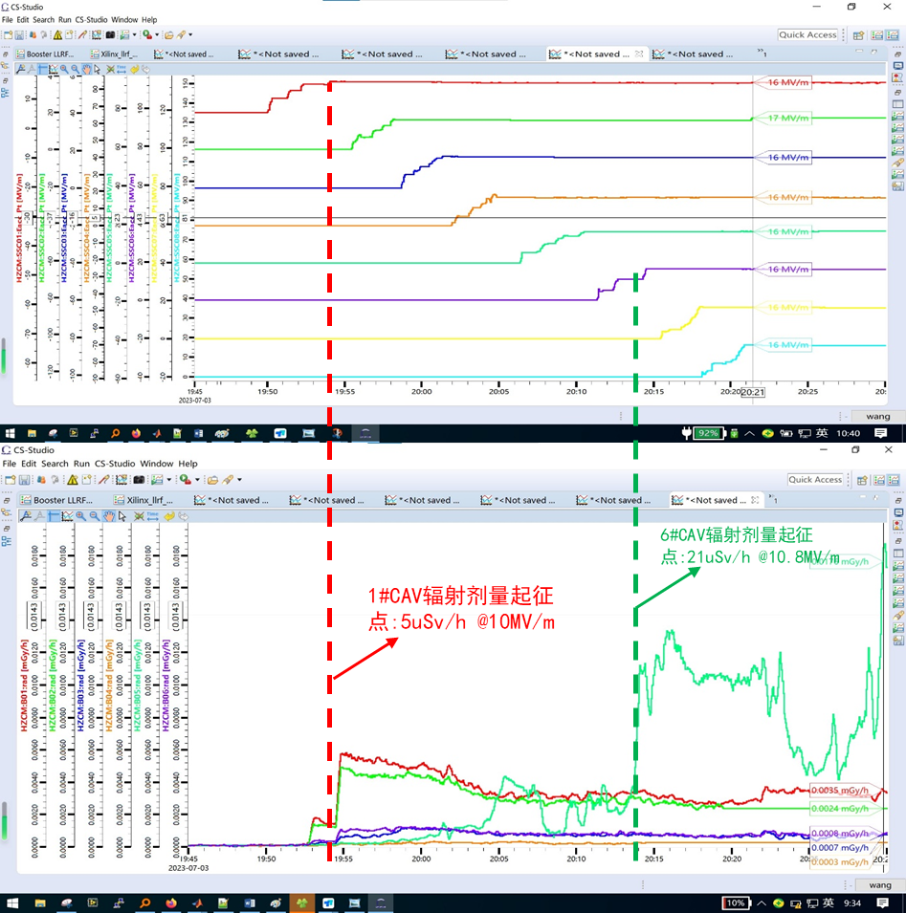
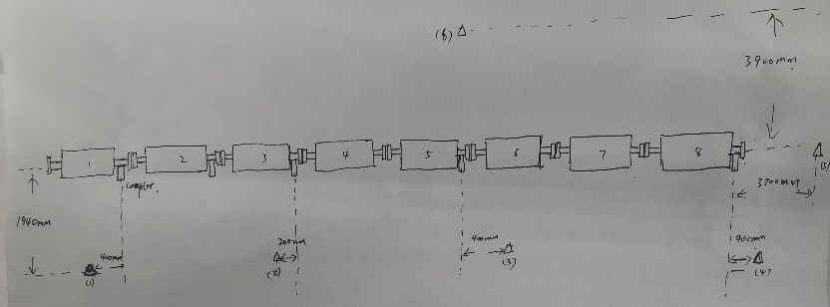
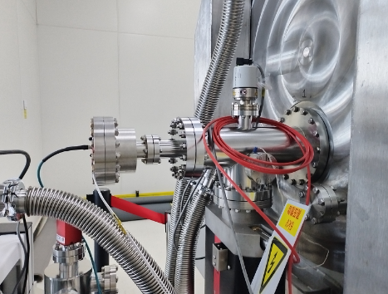
Radiation Dose and Dark Current
Each of the eight superconducting cavities powered to 16 MV/m, and the radiation dose parameters of each cavity were monitored separately.
CAV1: onset@10 MV/m, ~ 5 uSv/h
CAV6: onset@10.8 MV/m, ~ 13 uSv/h
Other cavities: NO FE
8 cavities radiation dose ＜0.08 mSv/h (spec 0.5 mSv/h)
The dark current is smaller than the spec (1 nA)
CAV6: onset
@10.8 MV/m
CAV1: onset
@10 MV/m
Radiation Detectors
Faraday Cup

Slide 12
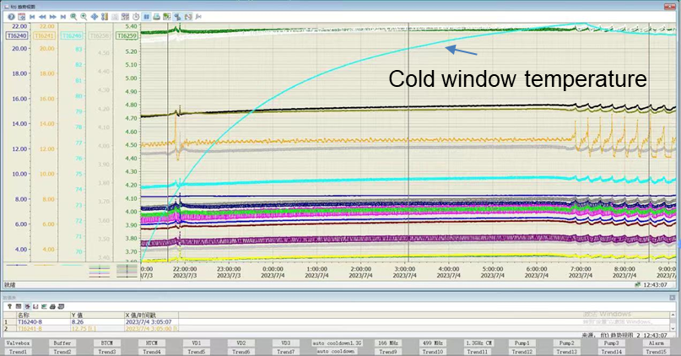
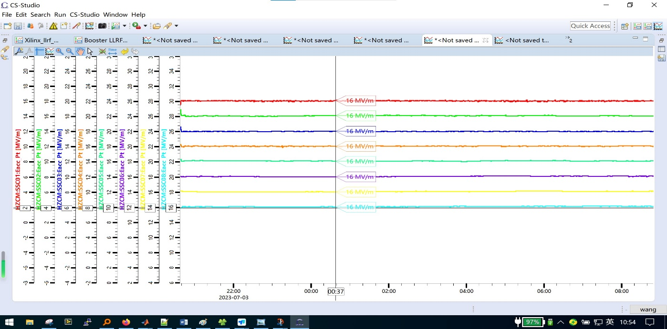
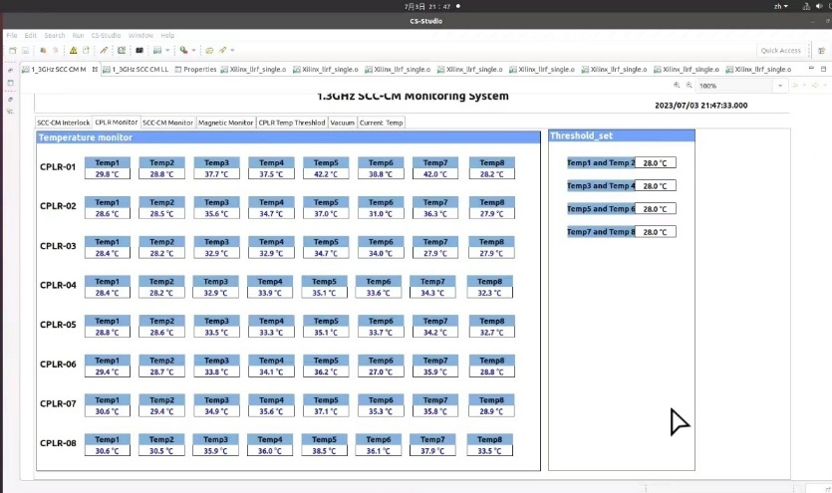
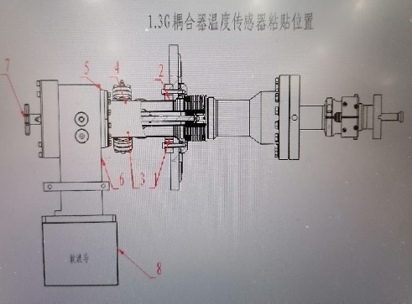
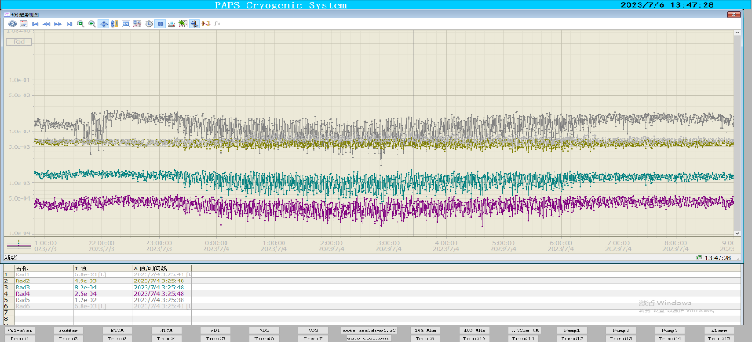
Stable Operation
Continuous stable operation for 12 hours at 133 MV (each cavity working at 16.0 MV/m)
Coupler cold window maximum temperature < 100 K；Radiation dose ＜0.08 mSv/h
Eacc
radiation
Coupler warm part temperature

Slide 13
Cool Down Rate and Average Q₀
Single cavity Q₀：
Average Q₀ of 8 cavities：
RF Voltage, cool down (date) | Measurement Date | Average E_{acc} [MV/m] | Q_{dyn} [W] | Average Q₀
133 MV, fast cool down (6.1) | 6.12 | 15.9±0.9 | 60.5±1.9 | (3.6±0.4)E10
133 MV, fast cool down (6.1) | 6.12 | 15.9±0.9 | 62.3±1.9 | (3.5±0.4)E10
133 MV, slow cool down (6.19) | 7.3 | 16.1±0.9 | 57.2±1.9 | (3.8±0.4)E10
133 MV, slow cool down (6.19) | 7.4 | 16.1±0.9 | 58.4±1.9 | (3.7±0.4)E10
174 MV, fast cool down (6.1) | 6.12 | 20.9±1.2 | 104.4±1.7 | (3.6±0.4)E10
Heat load measurement details in Feisi He’s talk on Wed, WG4.

Slide 14
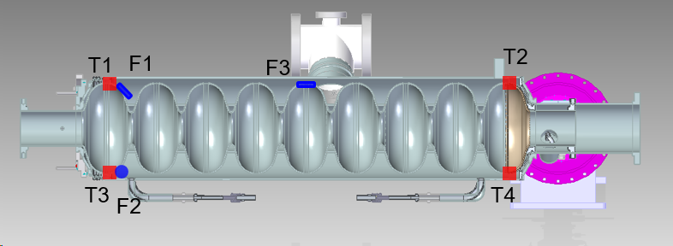
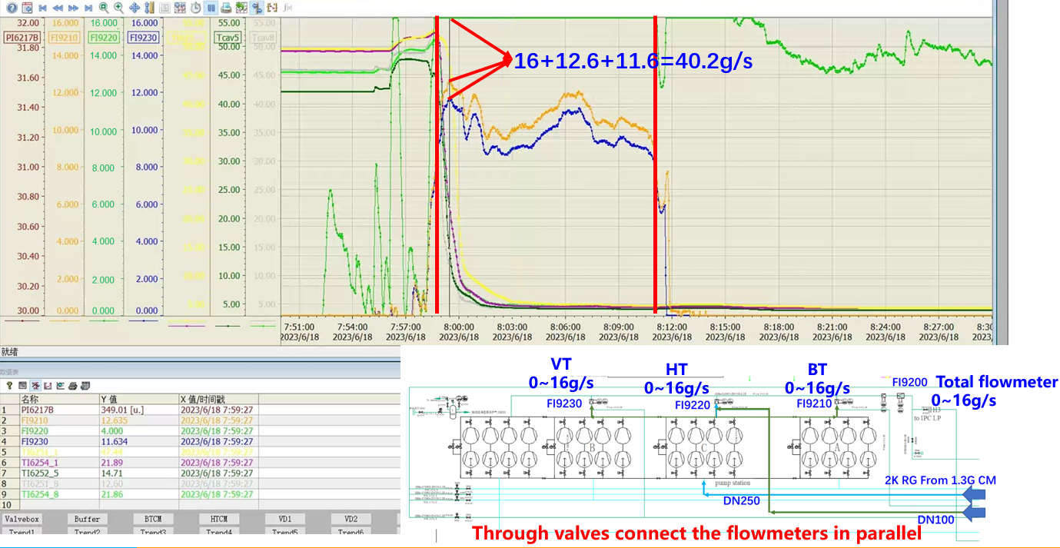
Temperature Difference of Fast / Slow Cooldown
Out of measurement range of flow meter FI9220.
ΔT: top (T1, T2) to bottom (T3, T4) temperature difference of a cell
Total flow rate estimated to be max ~ 60 g/s.
CAV# | Cool down rate* [g/s] | 1#cell ΔT [K] | 9#cell ΔT [K] | 45° [mG] | Trans-verse [mG] | Axial [mG]
1 | > 39 | 6.4 | 3.6
5 | > 41 | 5.23 | 3.94
8 | > 39 | 5.76 | 5.57
1 | 8 | 3.89 | 3.96 | -1.84 | -0.49
5 | 12 | 7.45 | 7.49 | - 3.91 |  | 1.93
8 | 8~11 | 12.16 | 4.64 |  | 0.36 | 2.54
* when cell bottom reaches critical temperature of 9.2 K
14

Slide 15
Future Work
Optimize VT procedure of jacketed cavity to have similar Q₀ with bare cavity (for mass production without VT of bare cavities).
Reduce module static heat load (25 W, details in Feisi He’s talk on Wed, WG4).
Investigate the relation of Q₀ with different cooldown speed, top to bottom cavity temperature difference at critical temperature, flux expulsion, remnant magnetic field and thermal current etc.
Investigate gradient drop of individual cavities and avoid systematic risk.
Investigate cavity processing and input coupler outgassing issues and reduce processing time.
Increase cavity gradient, reduce Q spread. Statistics with more mid-T cavities and cryomodules.

Slide 16
Summary
IHEP successfully developed world's first medium temperature baking (mid-T) high Q₀ 1.3 GHz cryomodule. Main performance meets the requirement of DALS / S³FEL / SHINE, and is beyond LCLS-II-HE and CEPC spec.
Module total CW RF voltage greater than 191 MV ( > 23 MV/m). Multipacting processing time quite different for the eight cavities.
Unprecedented high average Q₀ of 3.8E10 at 16 MV/m and 3.6E10 at 21 MV/m of eight mid-T bake 9-cell cavities in the module. Preliminary results show the slow and fast cooldown have similar Q₀.
Will make more mid-T module prototypes for SHINE and S³FEL in next few years for more data and further investigation.

Slide 17
Thank you!

Slide 18
Backup

Slide 19
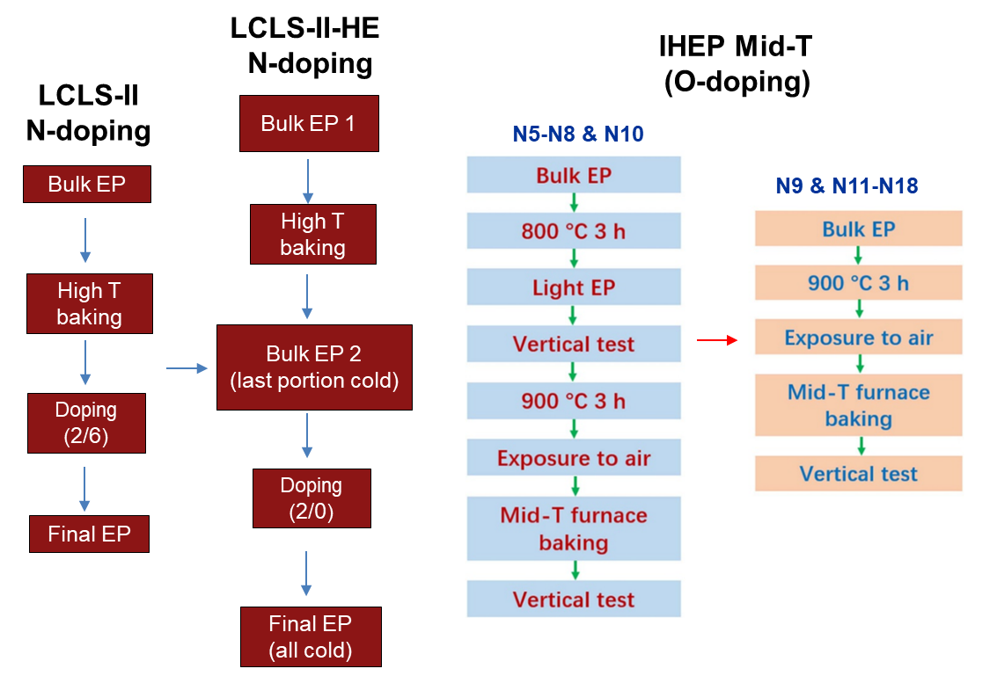
Mid-T Furnace Bake and Nitrogen Doping

Slide 20
Comparison of Cavity Performance in VT and CM
Cavity Serial # | CAV# in DALS-CM1 | Bare Cavity Vertical Test |  |  |  | Jacketed Cavity Vertical Test |  |  |  | Cryomodule Test |  |  |  | Note
stainless steel flange loss corrected for Q₀ |  | Max Eacc [MV/m] | Q0 at 16 MV/m [1E10] | Q0 at 21 MV/m [1E10] | Q0 at 23 MV/m [1E10] | Max Eacc [MV/m] | Q0 at 16 MV/m [1E10] | Q0 at 21 MV/m [1E10] | Q0 at 23 MV/m [1E10] | Max Eacc [MV/m] | Usable Eacc [MV/m] | Q0 at 16 MV/m [1E10] | Q0 at 21 MV/m [1E10]
N5 | / | 24.6 | 4.0 | 4.4 | 4.3 | 26.6 | 3.0 | 3.0 | 3.0 | / | / | / | / | delivered to SHINE
N6 | / | 23.6 | 4.9 | 5.0 | 4.9 | / | / | / | / | / | / | / | / | bare tube without HOM
N7 | / | 24.8 | 4.1 | 4.0 | 3.8 | 26.7 | 3.6 | 3.5 | 3.3 | / | / | / | / | delivered to SHINE
N8 | CAV6 | 26.5 | 4.1 | 4.3 | 4.2 | 23.2 | 3.5 | 3.6 | 3.5 | 25.0 | 24.0 | 3.8 | 3.8 | in CM1
N9 | / | 22.7 | 4.7 | 4.5 | / | 20.6 | 3.7 | / | / | / | / | / | / | delivered to SHINE
N10 | / | 24.0 | 4.4 | 4.7 | 4.6 | 27.0 | 4.5 | 4.4 | 4.2 | / | / | / | / | delivered to SHINE
N11 | CAV5 | 31.3 | 5.1 | 5.4 | 5.4 | 27.2 | 3.8 | 4.0 | 3.9 | 26.5 | 23.8 | 4.0 | 4.0 | in CM1
N12 | CAV4 | 29.7 | 4.4 | 4.6 | 4.6 | 28.0 | 4.0 | 4.1 | 4.0 | 27.7 | 24.5 | 4.0 | 4.0 | in CM1
N13 | CAV1 | 24.0 | 4.4 | 4.5 | 4.4 | 23.3 | 4.2 | 4.4 | 4.3 | 26.6 | 24.1 | 3.7 | 3.3 | in CM1
N14 | CAV3 | 25.9 | 4.3 | 4.4 | 4.3 | 25.7 | 3.0 | 3.1 | 3.0 | 24.6 | 26.9 | 3.4 | 3.5 | in CM1
N15 | CAV7 | 26.1 | 5.2 | 5.0 | 5.0 | 25.1 | 4.0 | 3.9 | 3.8 | 21.7 | 21.3 | 2.6 | / | in CM1
N16 | CAV8 | 29.1 | 4.3 | 4.2 | 4.0 | 29.1 | 4.3 | 4.3 | 4.1 | 25.9 | 25.8 | 4.4 | 4.7? | in CM1
N17 | / | / | / | / | / | 30.0 | 3.4 | / | / | / | / | / | / | for further study
N18 | CAV2 | / | / | / | / | 32.0 | 2.6 | 2.5 | 2.5 | 19.2 | 18.5 | 2.7 | / | in CM1
Average all |  | 26.0 | 4.5 | 4.6 | 4.5 | 25.7 | 3.8 | 3.8 | 3.7 | / | / | / | / | Average Q0 from total dynamic heat load: 3.8E10@16 MV/m, 3.6E10@21 MV/m
Average of CAVs in CM1 |  | 27.5 | 4.5 | 4.6 | 4.6 | 26.7 | 3.7 | 3.7 | 3.6 | 24.7 | 23.6 | 3.6 | 3.8?

Slide 21
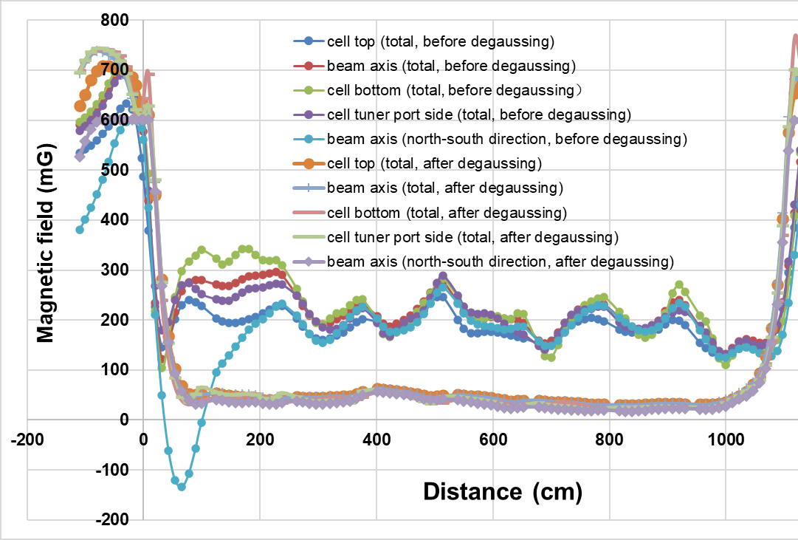
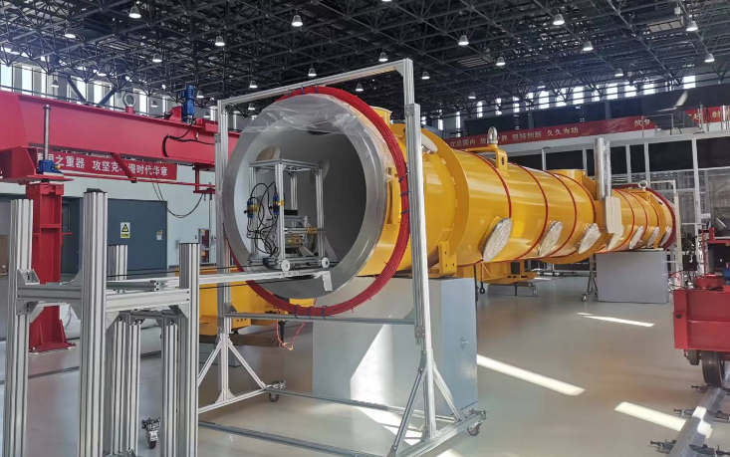
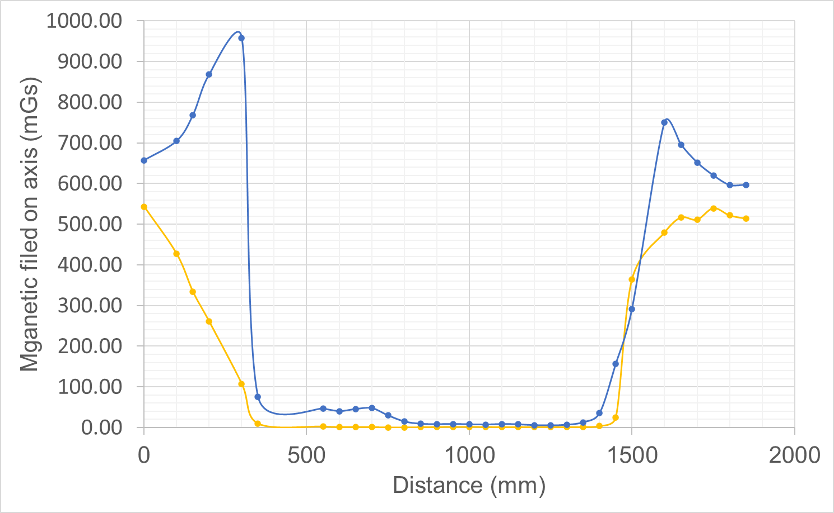
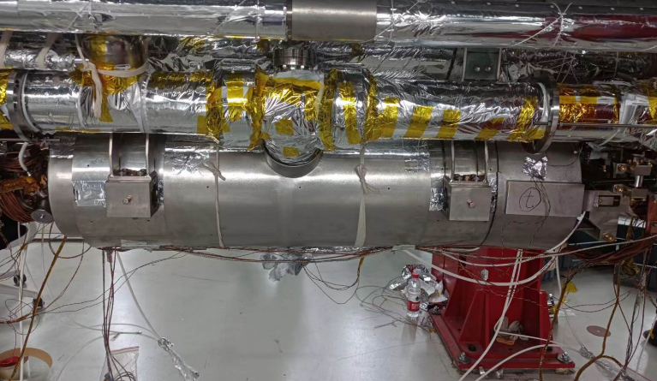
Magnetic Field Control
Vacuum vessel degaussing
Measured in 500 mGs earth magnetic environment (50 mGs inside cryomodule vacuum vessel)
Average field:
East-west: 2.2 mGs
North-south: 26.1 mGs
North-south
East-west
Cavity cells: 350 - 1400 mm
Double-layer magnetic shield

Slide 22
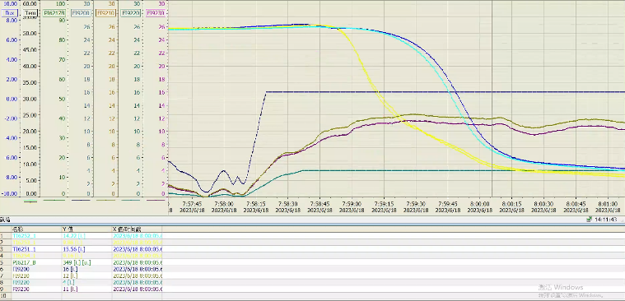
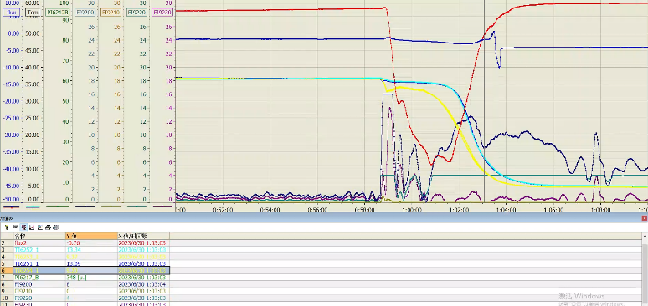
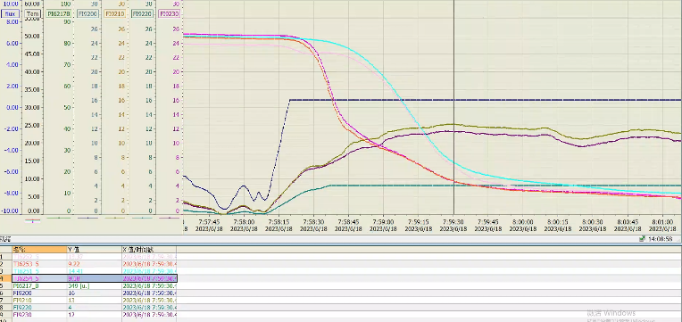
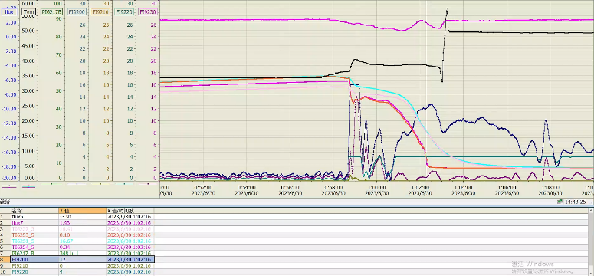
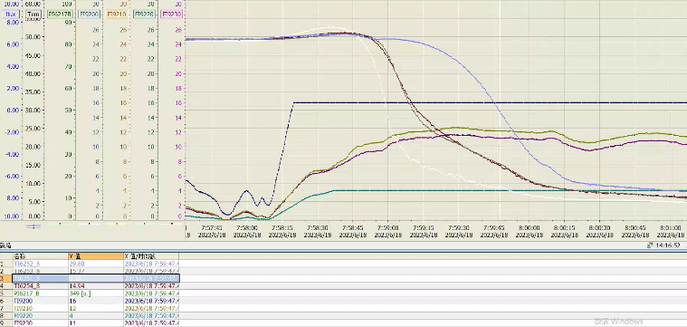
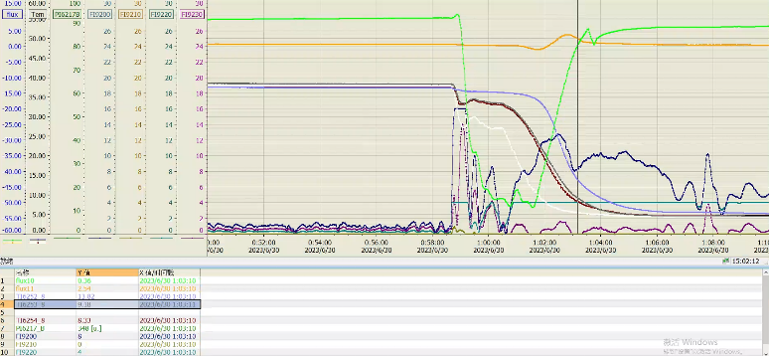
Fast / Slow Cooldown
> 40 g/s
8 ~ 12 g /s
CAV#1
CAV#1
CAV#5
CAV#5
CAV#8
CAV#8

Slide 23
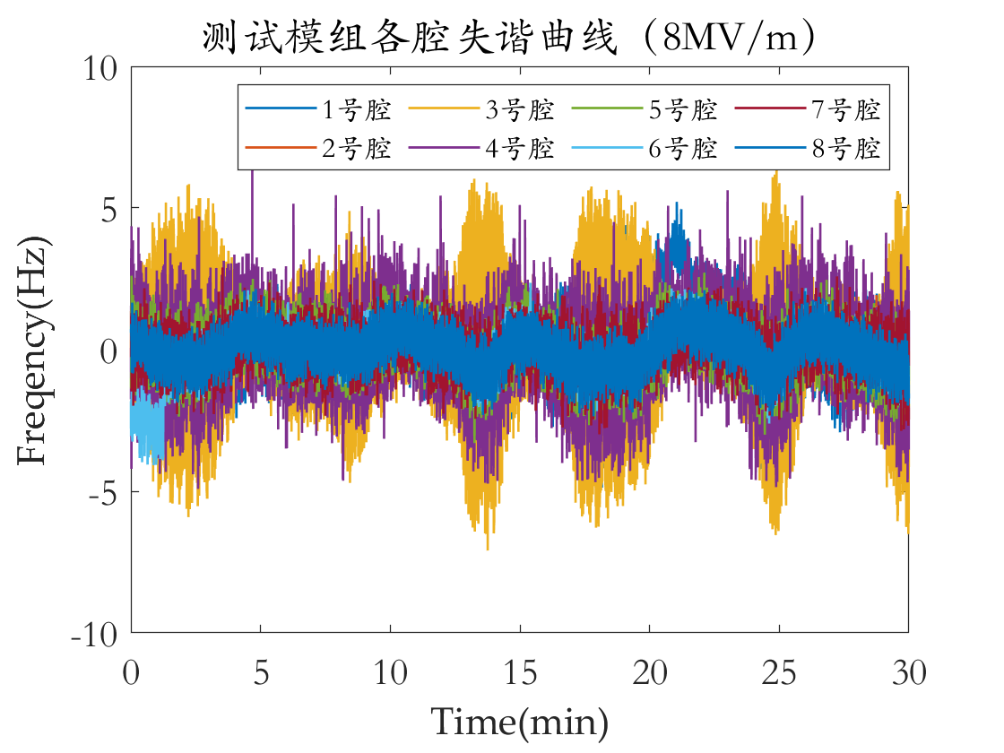
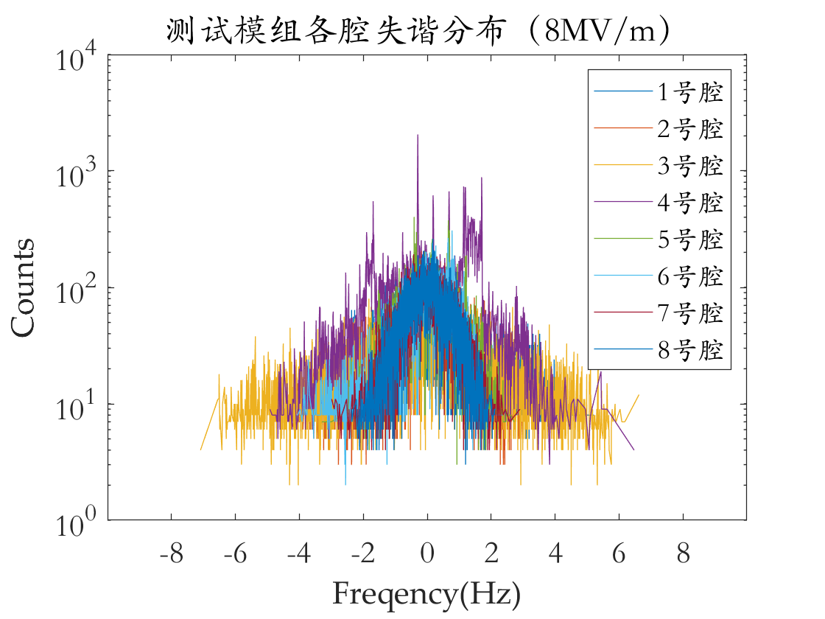
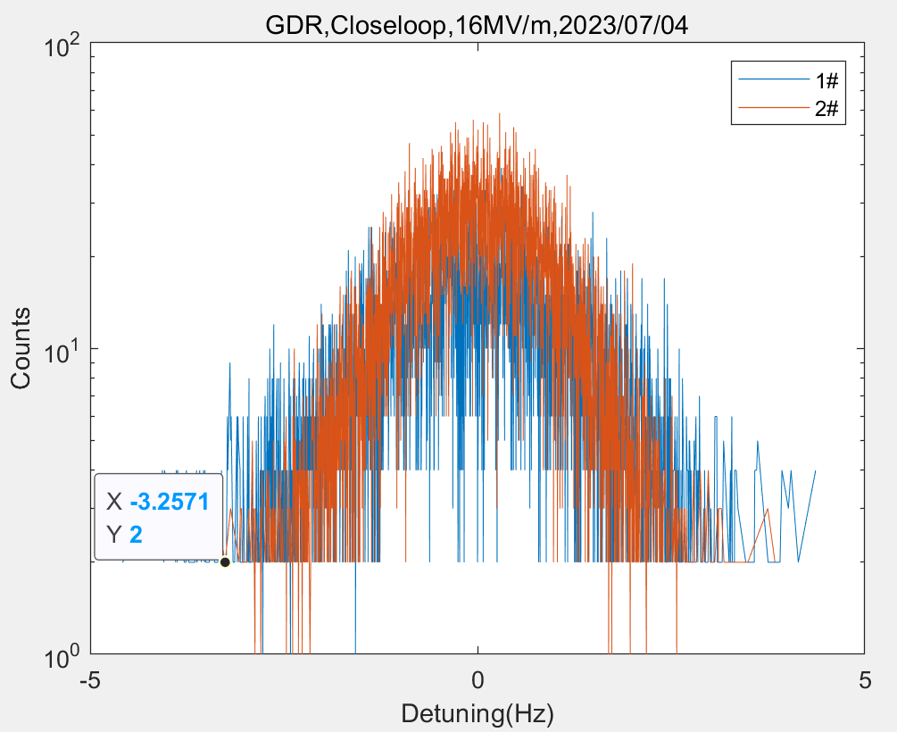
Microphonics
Spec: Δf (Peak to Peak) < 10 Hz
Test result：
± 4 Hz（3 MV/m open loop, eight cavities）
± 7 Hz（8 MV/m open loop, eight cavities）
± 4 Hz（16 MV/m closed loop, two cavities）
GDR open or closed, calculate detuning with the phase: $Δf=\left(f_{0}/2Q_{L}\right)⋅tan\left(Δφ\right)$
Open loop @ 8 MV/m
Closed loop @ 16 MV/m

