Slide 1
The first horizontal test results of TESLA-type large grain 9-cell cavity at KEK
TTC meeting
2023/12/5
Tomohiro Yamada/Kensei Umemori
on behalf of KEK iCASA-SRF group

Slide 2
Motivation
Obtain the technology needed for the horizontal test of Large Grain TESLA 9-cell cavity
First trial of horizontal test for large grain 9-cell cavity
First trial of horizontal test for TESLA cavity
There are several challenge!
First welding of He jacket to TESLA 9-cell cavity
Can cavity performance be maintained during jacket welding?
First trial of HPR for dressed 9-cell cavity
Effective to suppress field emission?
Firstly designed the magnetic shield for TESLA 9-cell cavity
How is flux trapping for horizontal test? How is Q-value?

Slide 3
Procedure to Horizontal Test of KEK-7
Month | Procedure | Place
2022/June | Vertical test | STF
July | Ar purge＆flange exchange | STF cleanroom
July ~ August | He jacket welding | CFF
August ~ Sept. | Pressure test | CFF
Oct. ~ Nov. | Disassembly HPR & Assembly for Jacketed cavity | COI cleanroom
Dec. ~ January | Preparation for HT | AR East
2023/January | HT | AR East

Slide 4
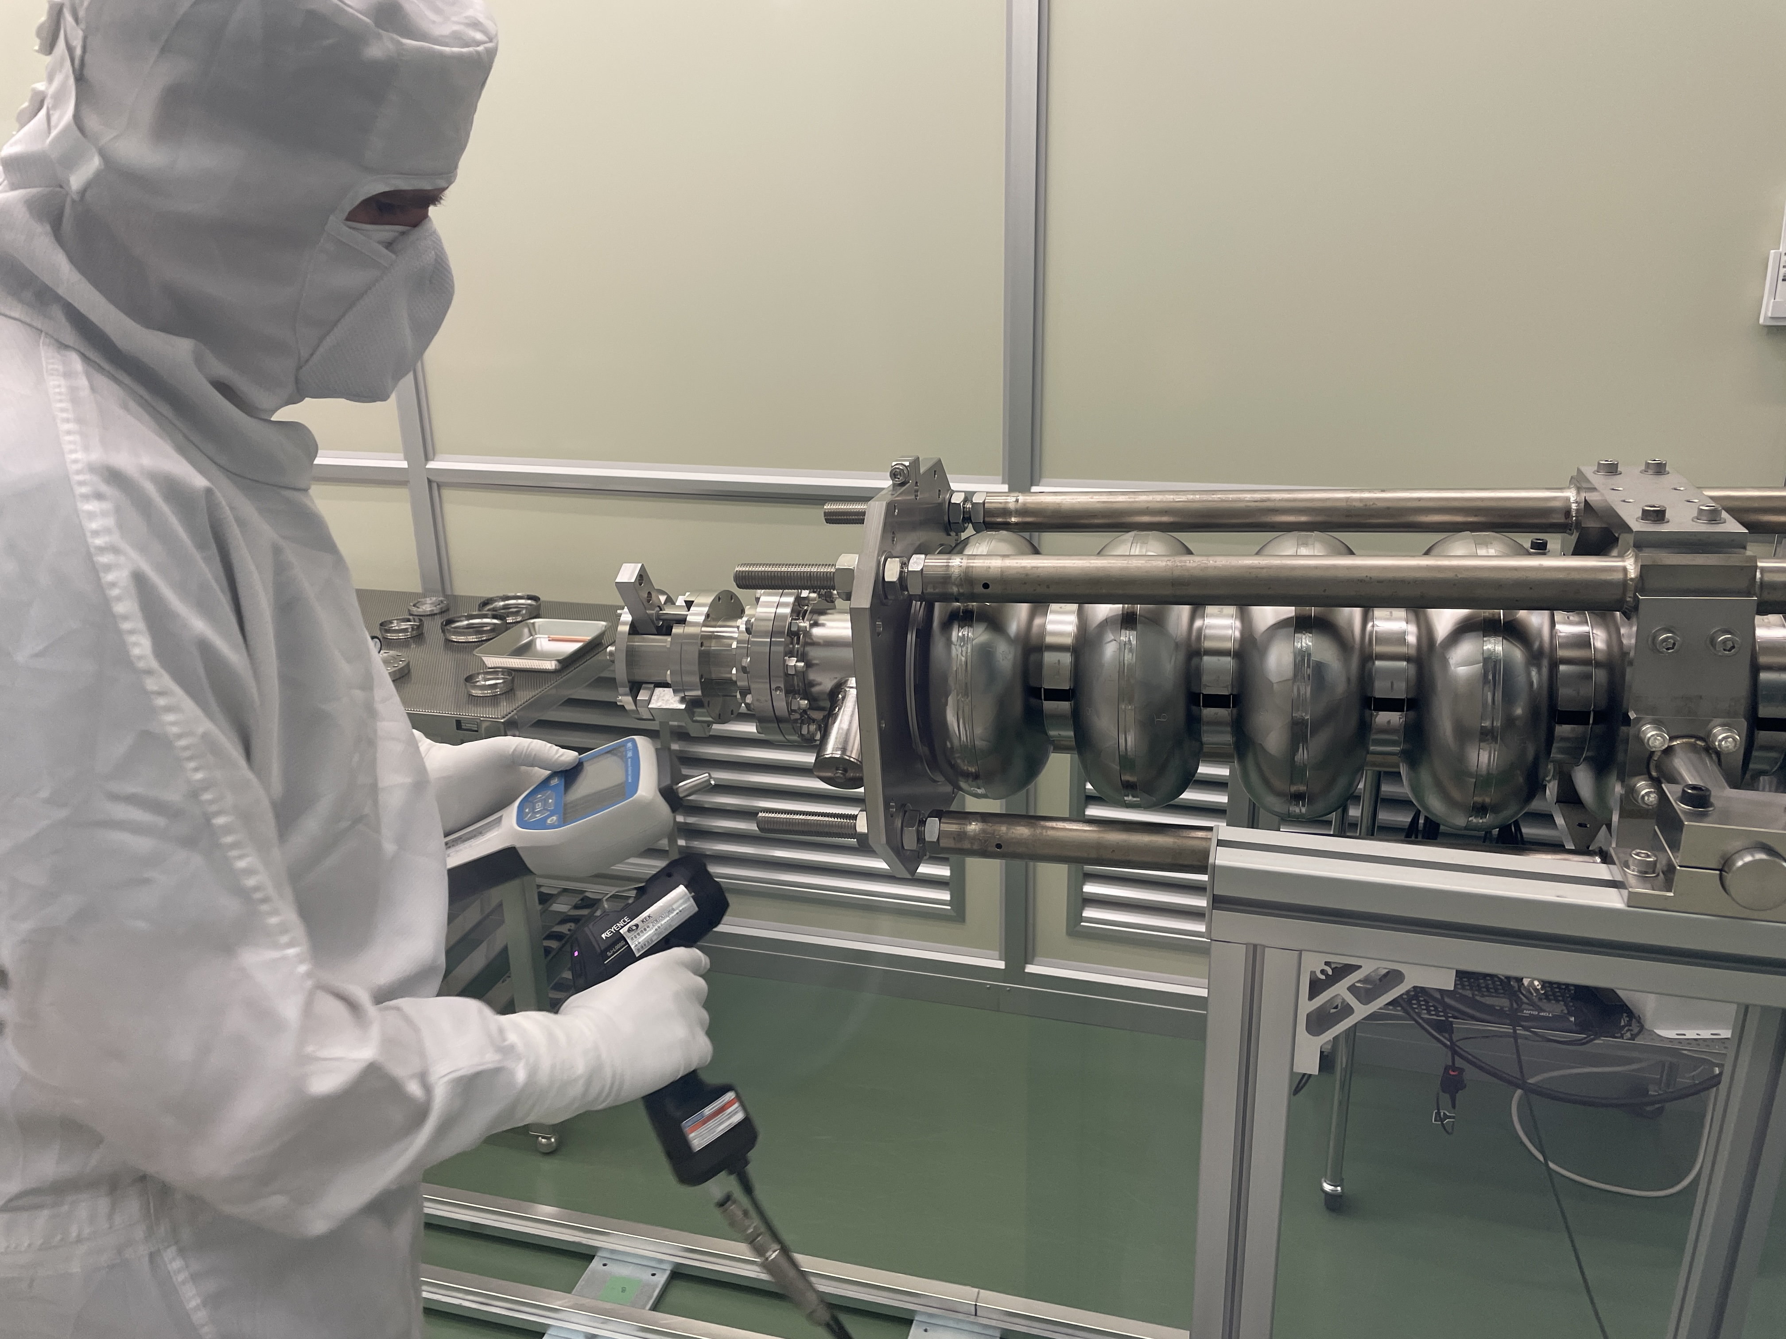
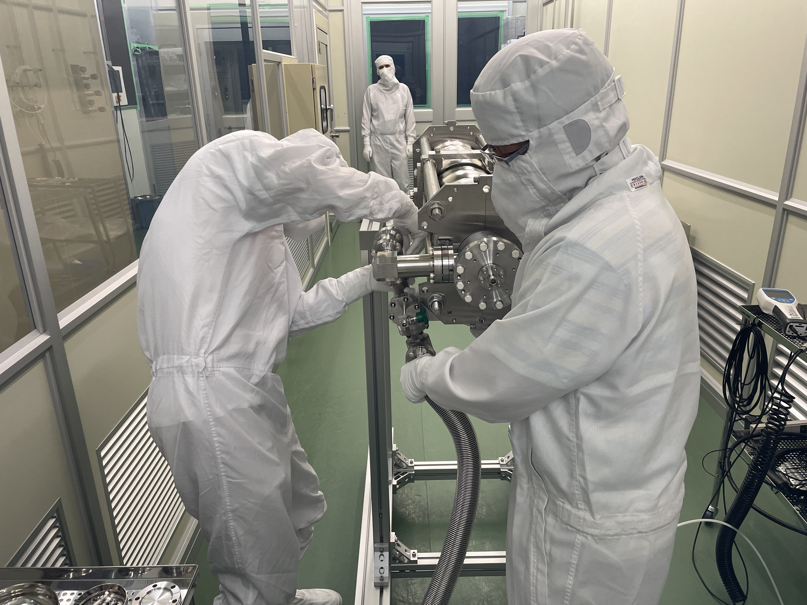
Flange exchange for jacket welding
Cavity flange was exchanged for jacket welding, under Ar flow.
Slow pump/purge system was used for the pumping and purge.

Slide 5
Large grain cavity
Cavity
Surface treatment
Local grinding
Pre-EP (5 μm) + EP-1(100 μm)
Heat treatment (900 C, 3h)
EP-2 (20 μm)
HPR & Assembly
Baking (120C, 48h) ⇒ VT1
HPR & Assembly ⇒ VT2
HPR & Assembly ⇒ VT3
TESLA shape 9-cell cavity
Large grain Nb cavity
High RRR, high Ta content
Manufactured at KEK CFF
Standard recipe (EP+120C baking) was applied on the cavity

Slide 6
Vertical test results
1st VT showed degradation after quench.
2nd and 3rd VT was suffered from F.E.
Final VT results before HT was 24 MV/m.
VT1(final)
VT3(final)
VT1(initial)
VT2(final)
VT1: 36MV/m (initial) -> 30 MV/m (after quench)
VT2: 24 MV/m with field emission
VT3: 24 MV/m with field emission

Slide 7
He jacket welding
It was first time to weld TESLA (Euro-XFEL) type Helium jacket to the cavity at KEK.
He jacket welding was successfully carried out.

Slide 8
Frequency/flatness during jacket welding
During jacket welding procedure, cavity frequency is observed using antenna.
Frequency change before/after jacket welding was 24 kHz
Field flatness was compared before/after jacket welding
Before welding 98%
After welding 97 %
Almost no change.
He jacket welding was successfully carried out.

Slide 9
HPR for dressed cavity
It was first trial to apply HPR to the cavity with He jacket at KEK.
New HPR stand at KEK-COI building was used for HPR of dressed cavity.
Cavity assembly was carried out at COI clean room.

Slide 10
Clean room assembly after HPR
HPR and assembly works were successfully carried out.
As later show, source of field emission at VT3 was removed and cavity performance was improved at Horizontal test.

Slide 11
Magnetic shield
It was first time to design and fabricate magnetic shield for TESLA (Euro-XFEL) type cavity at KEK.
Thanks for the help from DESY and CEA.
Separated to upper and bottom parts and both sides of cap.
Additional magnetic shields (patches and boxes) to prevent halls.

Slide 12
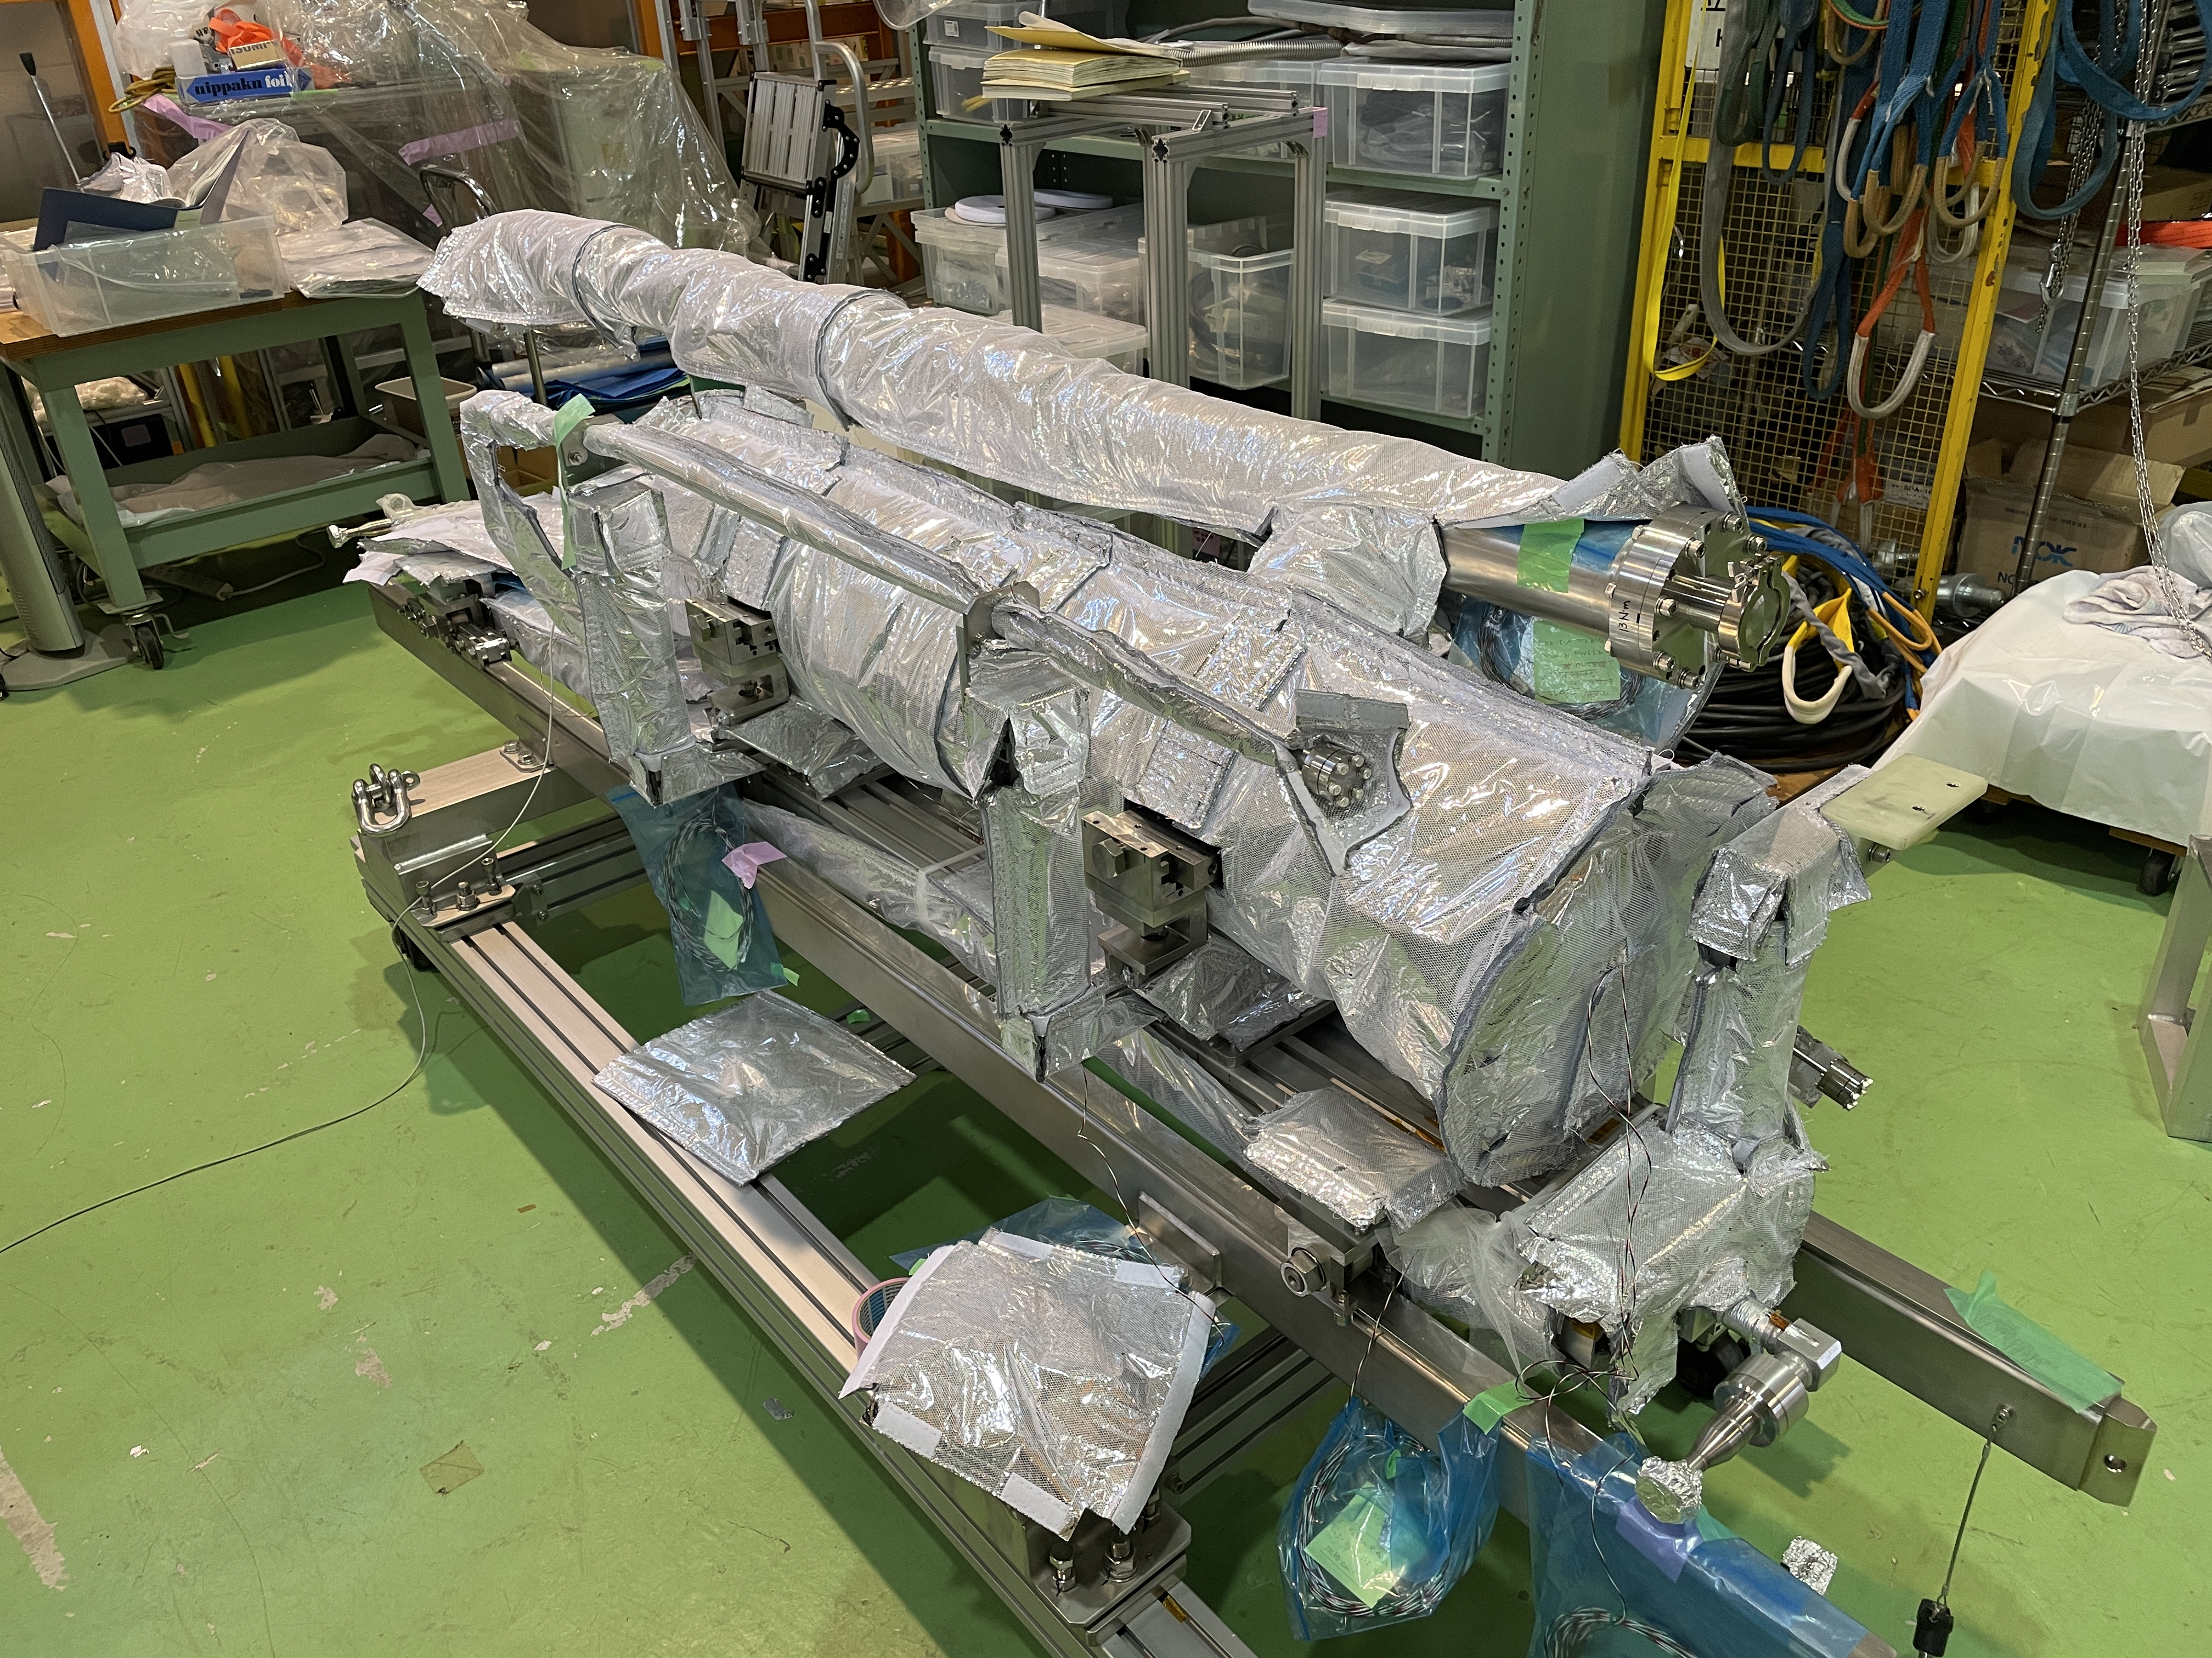
Preparation for Horizontal Test

Slide 13
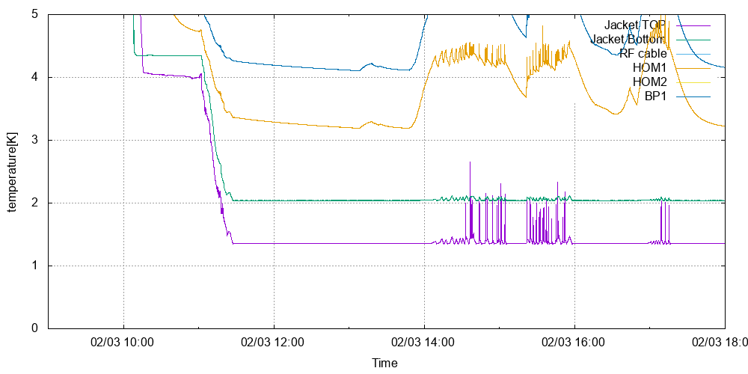
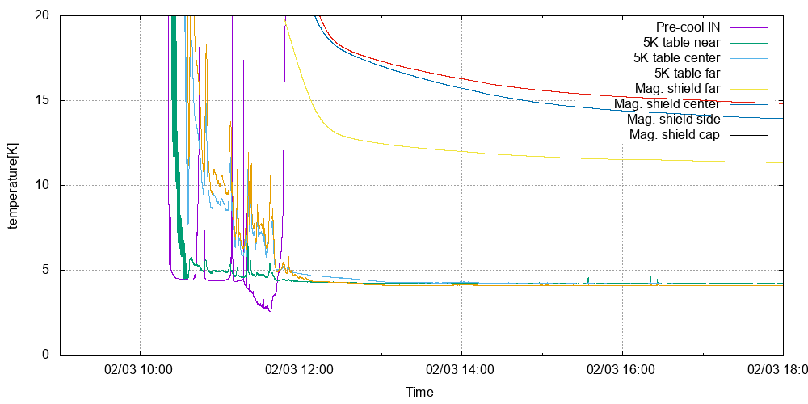
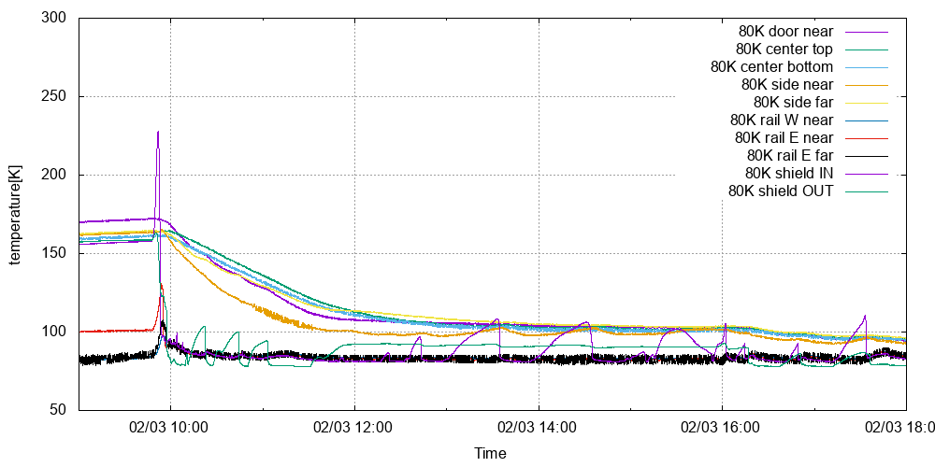
Cool down of Horizontal Cryostat
2K line
5K line
80K line
He jacket: cooled 2K
HOM, beampipe: cooled to 3~6 K
5K rail: cooled to 4 K
Magnetic shield: 12~15 K, end cap < 50 K
80K rail: cooled to 80 K
80K shield: cooled to less than 100 K

Slide 14
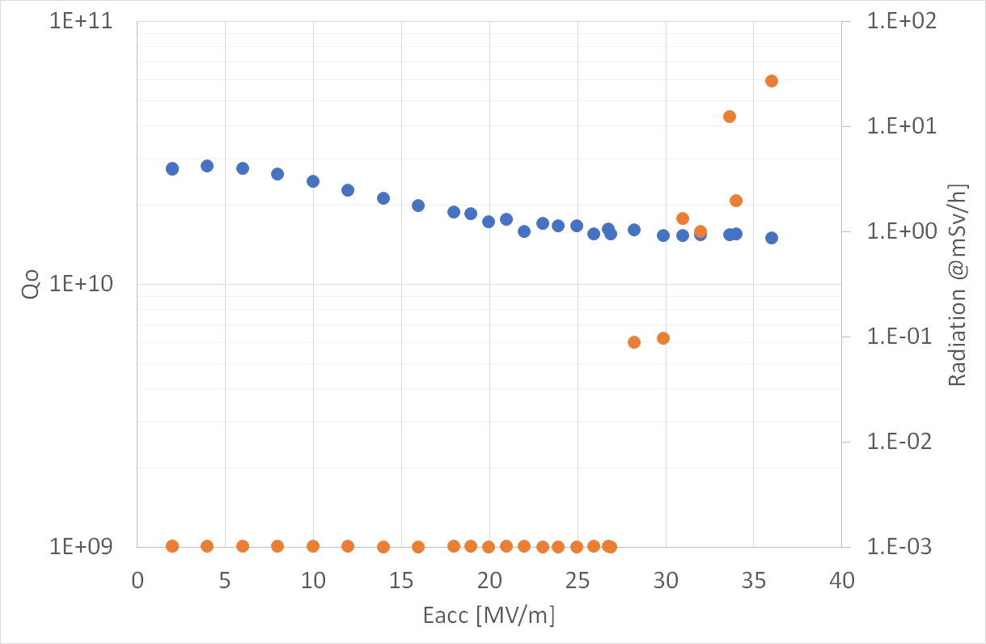
1st day of HT
Horizontal test results
2nd day of HT
1st day’s results were limited by F.E. But it was processed.
Eacc = 36 MV/m with Qo > 1e10 was obtained.
Above Po = ~ 20 W, field can not keep, because of increase of He temperature.
The data points on high field were taken by short pulse-like mode.

Slide 15
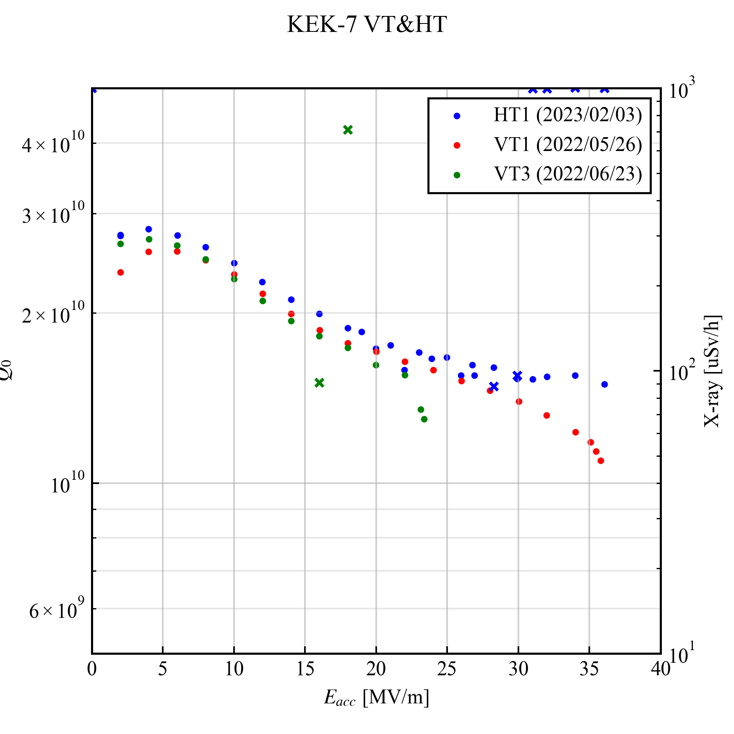
Comparison with VT
Surface treatment: EP & 120C, 48h baking
Q-value was very good.
Magnetic shield works well?
Flux was effectively expelled??
Little bit better than VT.
Q-value of high-field is excellent, 1.5e10 @ 36MV/m. (Because of short pulse??)
VT3
HT
VT1

Slide 16
Summary
TESLA-type 9-cell large grain cavity was fabricated at KEK-CFF.
After surface treatment and vertical test, the He jacket was successfully welded on the cavity. The dressed cavity was cleaned by HPR and re-assembled.
Magnetic shield, thermal anchor and so on were prepared and mounted on the cavity, which was installed into the horizontal cryostat at KEK-AR-East.
Cooldown process was smoothly carried out and temperature of cavity was reached to 2K.
Field emission existed at the initial stage was processed and the cavity performance of Eacc = 36 MV/m and Qo > 1e10 was obtained. ILC specification was satisfied.

