Slide 1
Exploring Mode Mixing in PIP-II LB650 Cavities: Impact of 350°C Furnace Baking on its Reduction post-HPR and Vertical Tests
Genfa Wu, Alex Netepenko, Vijay Chouhan, Akshay Murthy
TESLA Technology Collaboration Meeting
5-8 December 2023

Slide 2
Outline
Mode mixing introduction
300 - 350°C Furnace Baking and mode mixing reduction
Sample analysis
Summary

Slide 3
LB650 Cavity mode mixing introduction

Slide 4
Mode mixing in PIP-II LB650 cavities
Mode excitation
Mode suppression

Slide 5
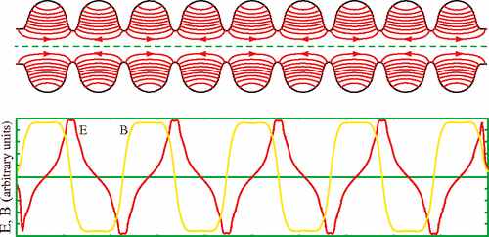
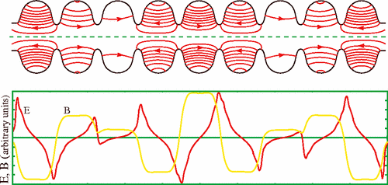
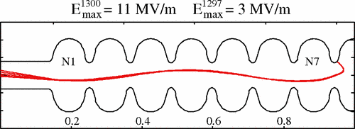
Mode mixing in 1.3 GHz 9-cell cavities
Pi-mode
Mode mixing may be caused by electron activities.
The electrons work like those in a klystron.
7Pi/9-mode
V. Volkov, J. Knobloch, and A. Matveenko, “Monopole passband excitation by field emitters in 9-cell TESLA-type cavities”, Phys. Rev. Spec. Top. Accel Beams, vol. 13, no. 8, 2010
Field emitted electrons gaining up to 830 keV

Slide 6
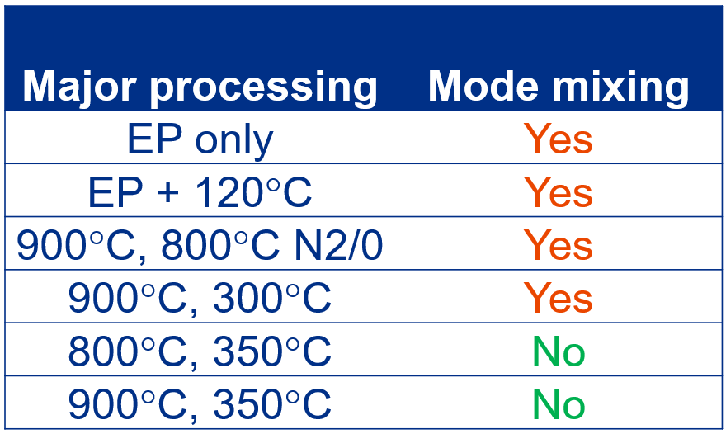
Mode mixing in LB650 5-cell cavities
Passband frequencies
1 pi/5 | 644.071 MHz
2 pi/5 | 645.775 MHz
3 pi/5 | 647.754 MHz
4 pi/5 | 649.380 MHz
5 pi/5 | 649.962 MHz
FNAL: Five cavities, 12 vertical tests.
All experienced mode mixing with 4pi/5 mode
INFN: The prototype cavity also experienced mode mixing with 4pi/5 mode.
Major processing | Mode mixing
EP only | Yes
EP + 120°C | Yes
900°C, 800°C N2/0 | Yes
900°C, 300°C | Yes
800°C, 350°C | No
900°C, 350°C | No
During the mode mixing event, no MP and no X-ray were detected above background.
Starts 7-8 MV/m or 15 MV/m

Slide 7
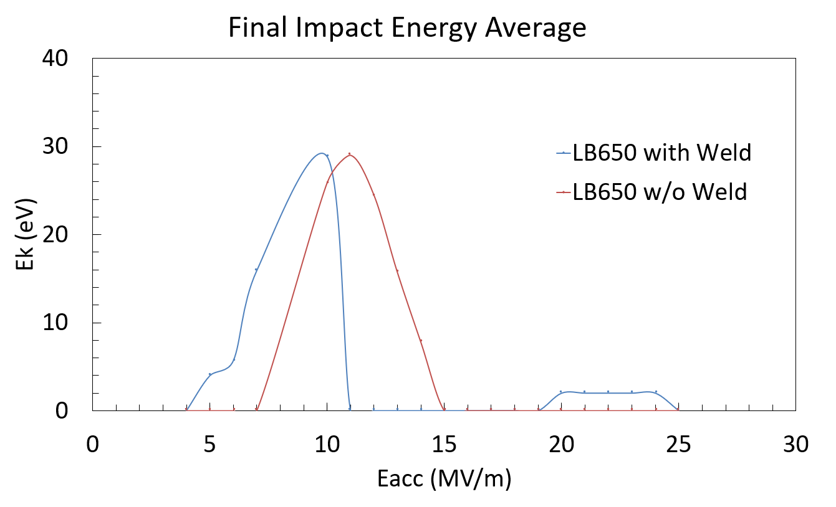
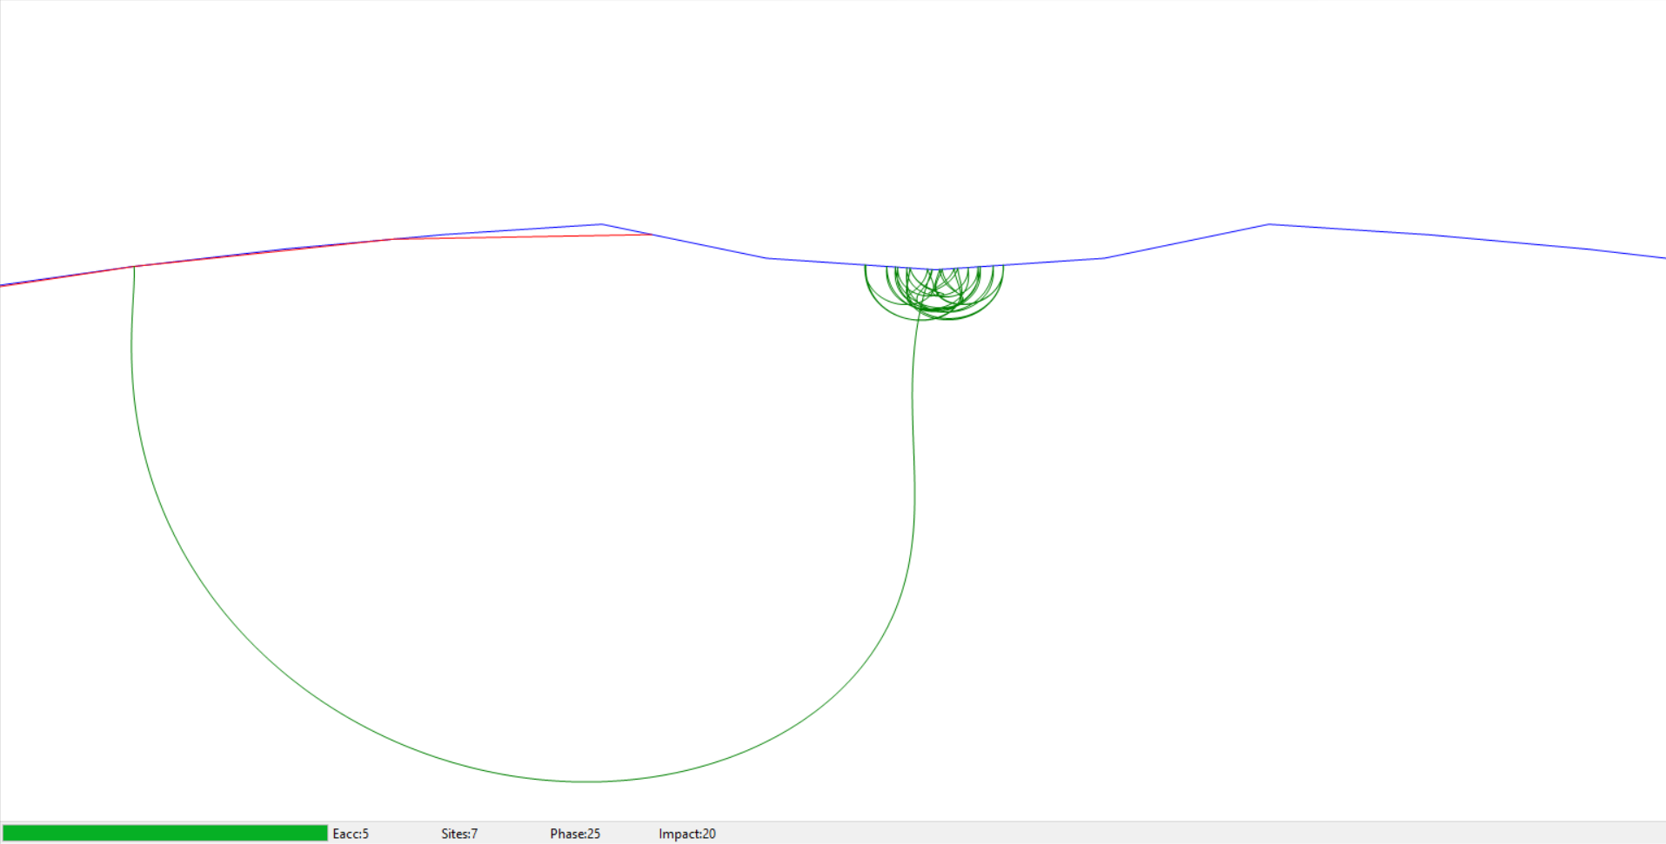
LB650 cavity multipacting simulation
CST simulation by G. Romanov
FishPact simulation by Z. Ninan
Predicted MP band : 7 – 14 MV/m
Measured mode mixing : from 8 (15) MV/m all the way to quench

Slide 8
Furnace baking and mode mixing reduction

Slide 9
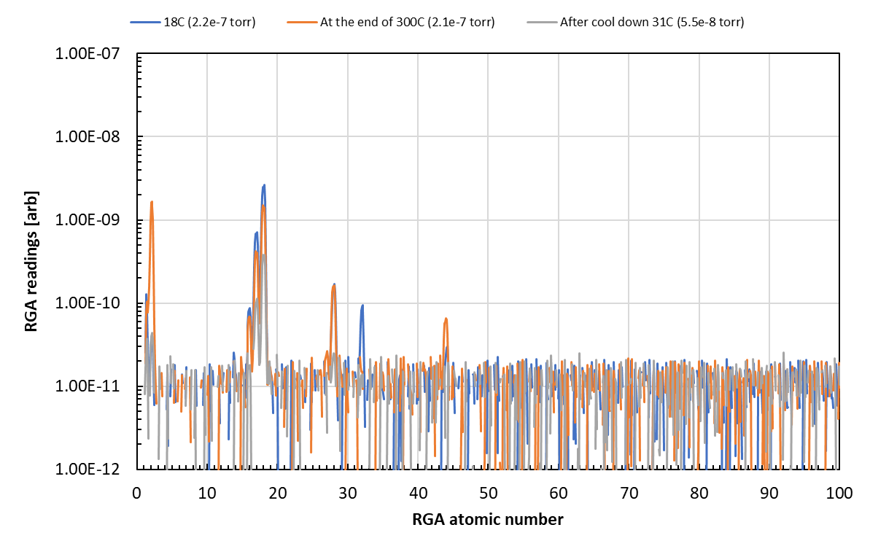
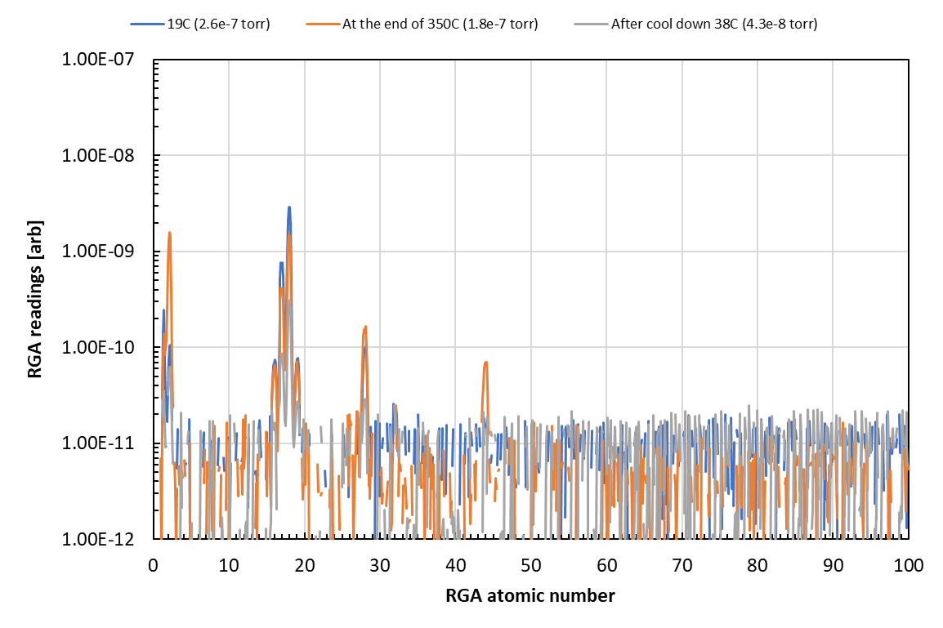
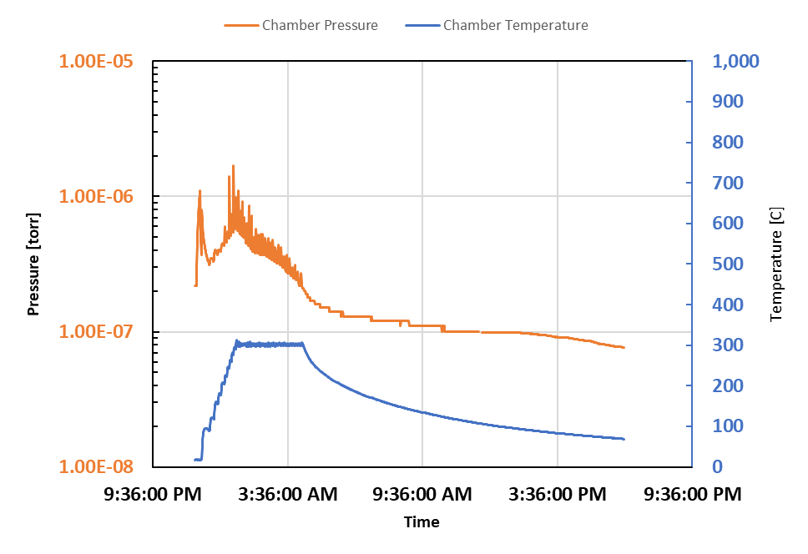
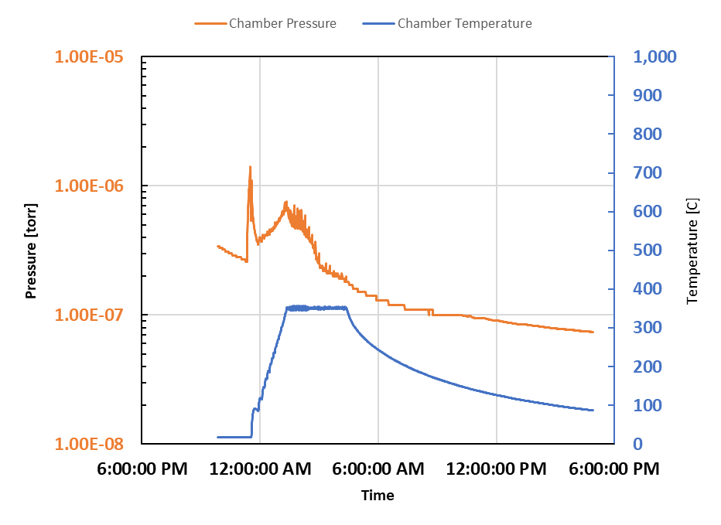
Medium temperature furnace baking
B61C-EZ-102
B61C-EZ-101
300°C
350°C

Slide 10
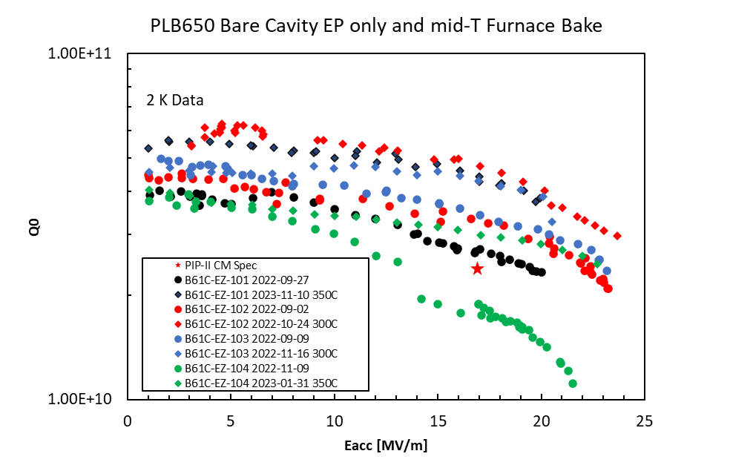
LB650 Cavity Performance Summary EP only and mid-T Furnace Baking
Each cavity has its own color
Diamond: mid-T baked
Round: EP only

Slide 11
Mode mixing in PIP-II LB650 cavities
Cavity | Major processing | Mode mixing
B61C-EZ-101 | 800°C, 350°C | No
B61C-EZ-104 | 800°C, 350°C | No
B61C-EZ-104 | 900°C, 350°C | No
B61C-EZ-101 | 900°C, 350°C | Yes*
*cavity was shelved for four weeks, compared to routine test 1-week after evacuation
Fermilab vertical test has no active pumping.

Slide 12
Sample Analysis

Slide 13
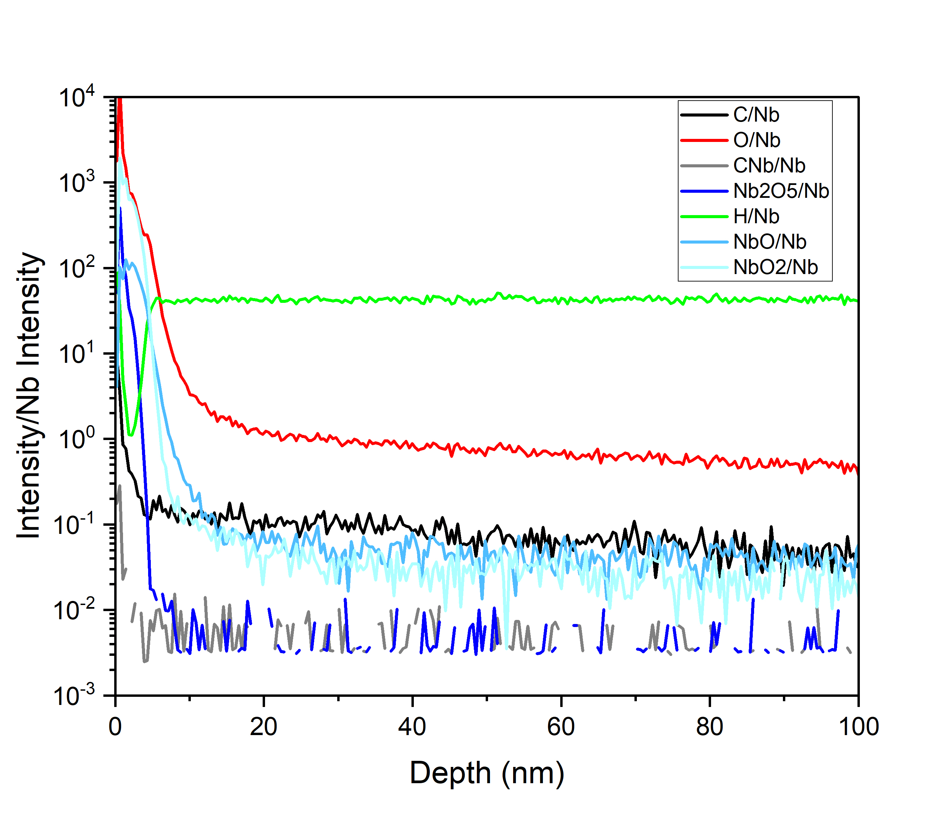
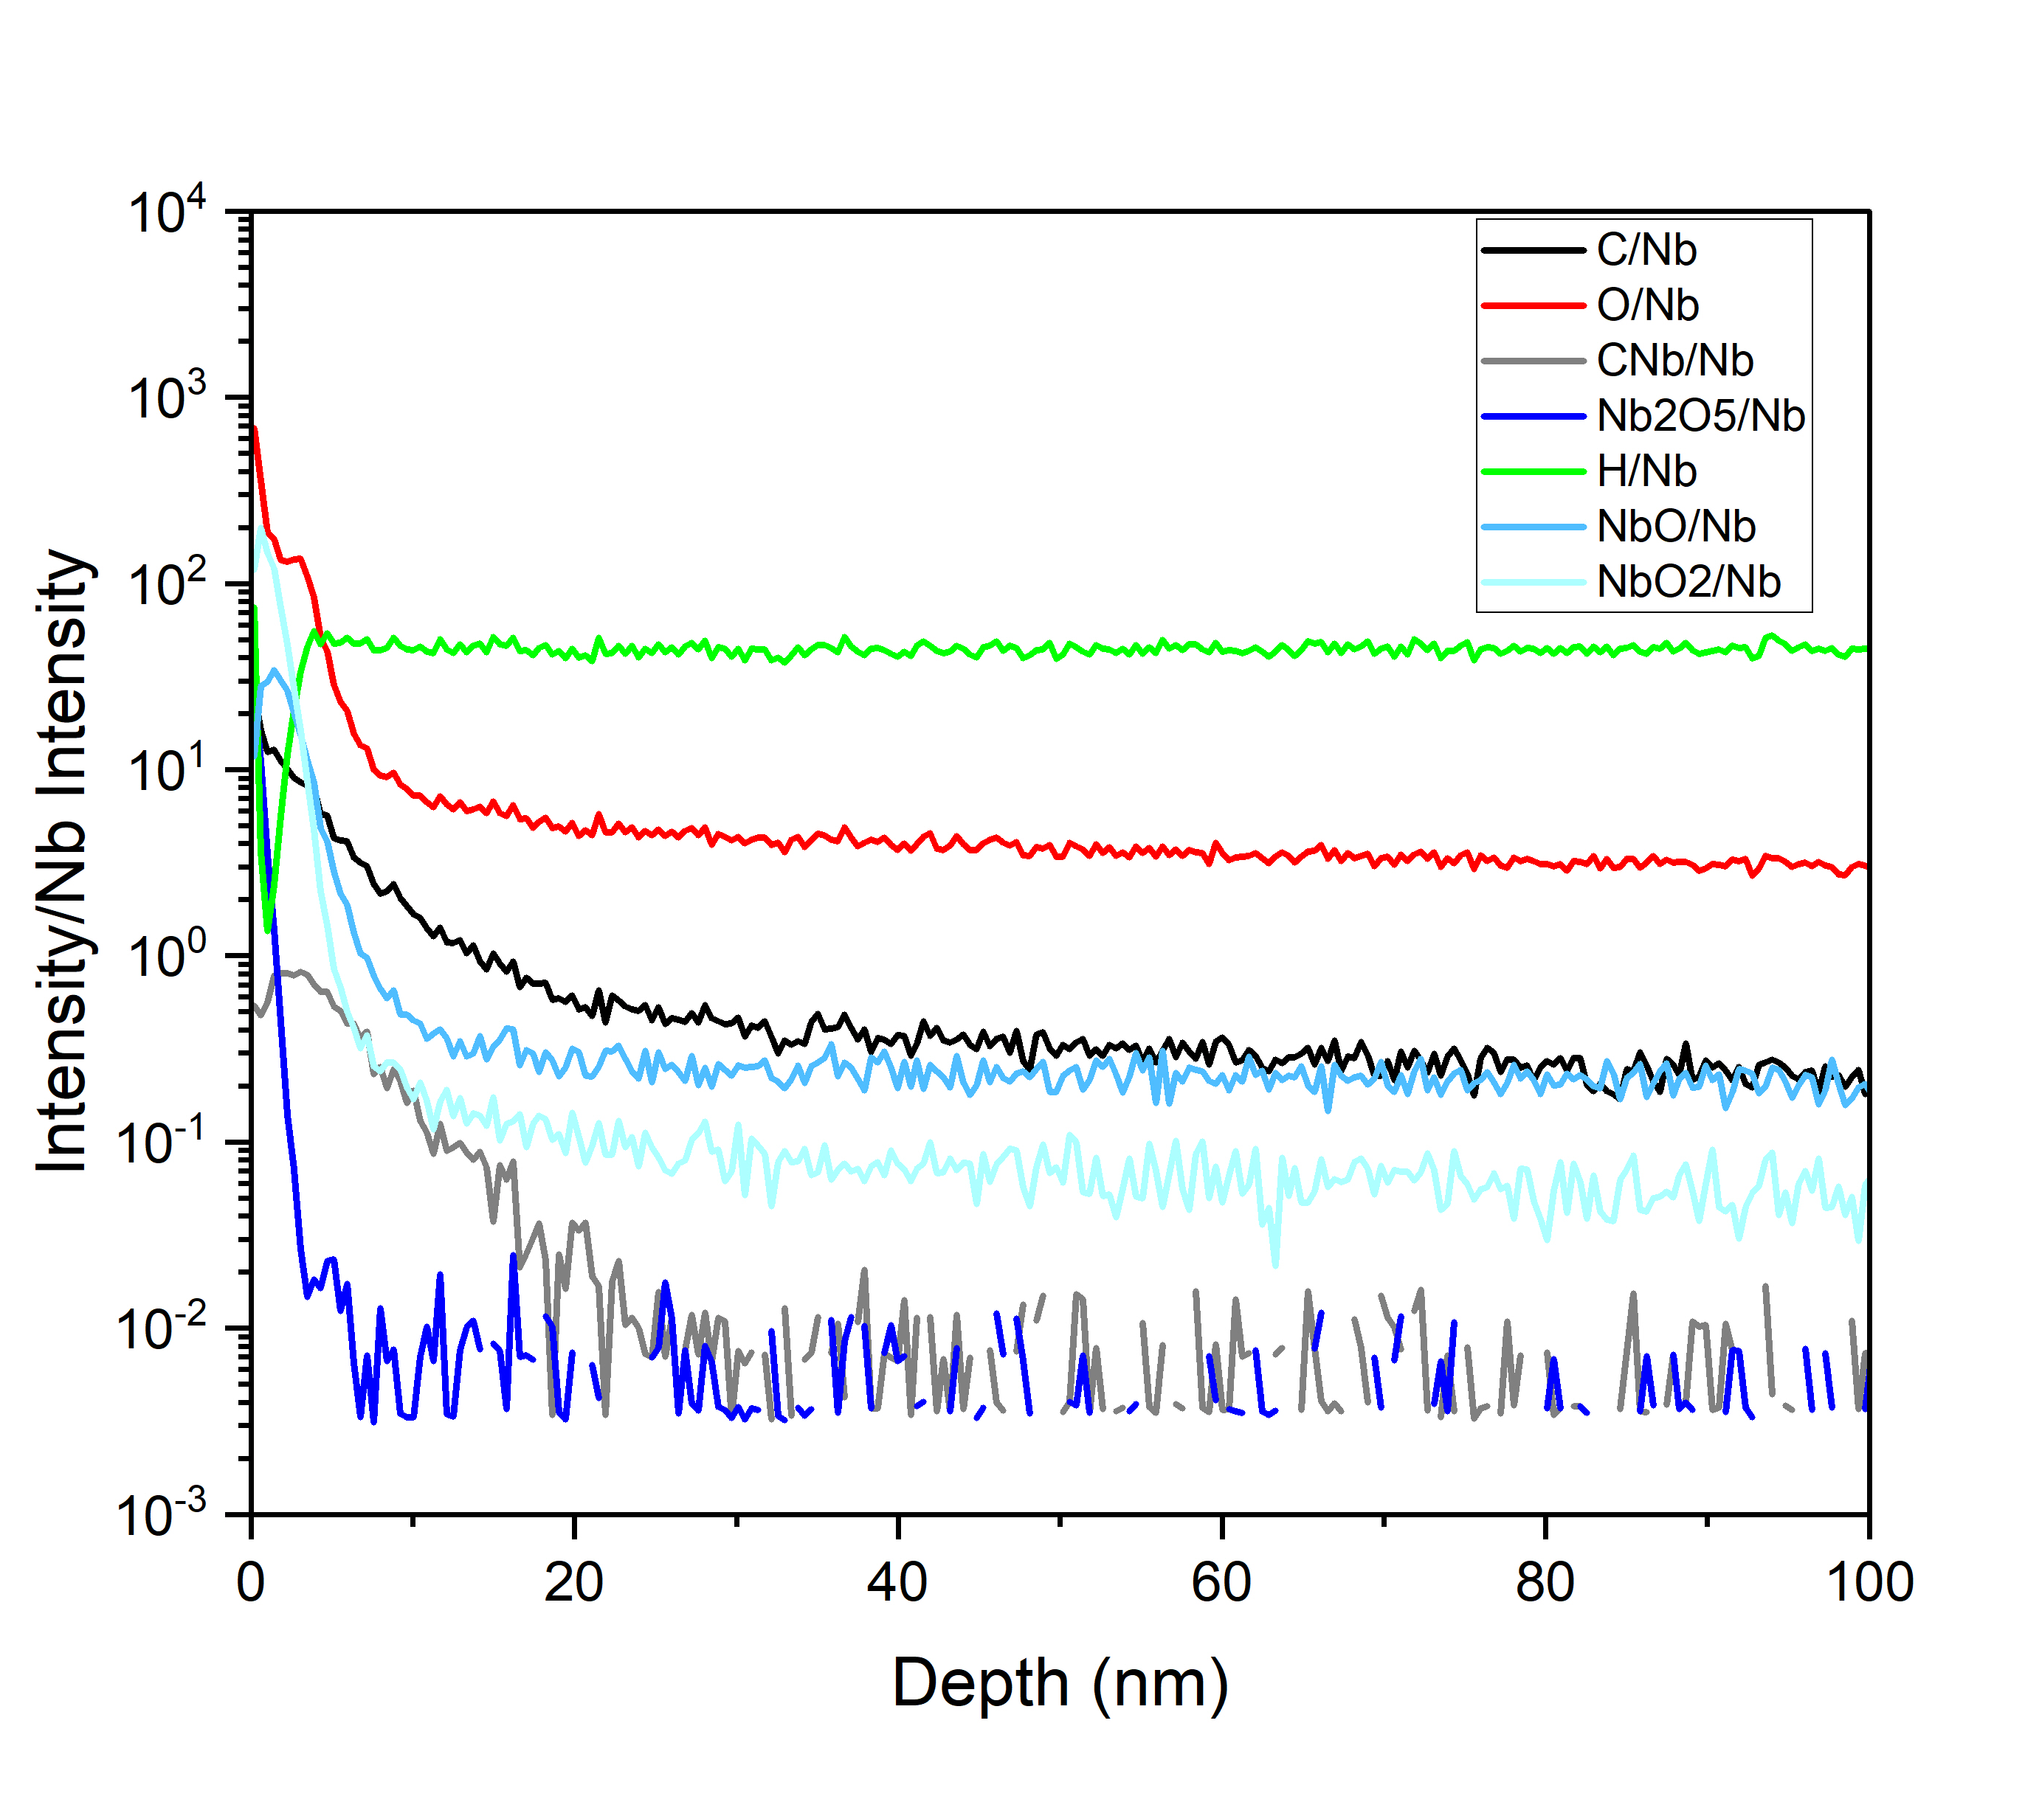
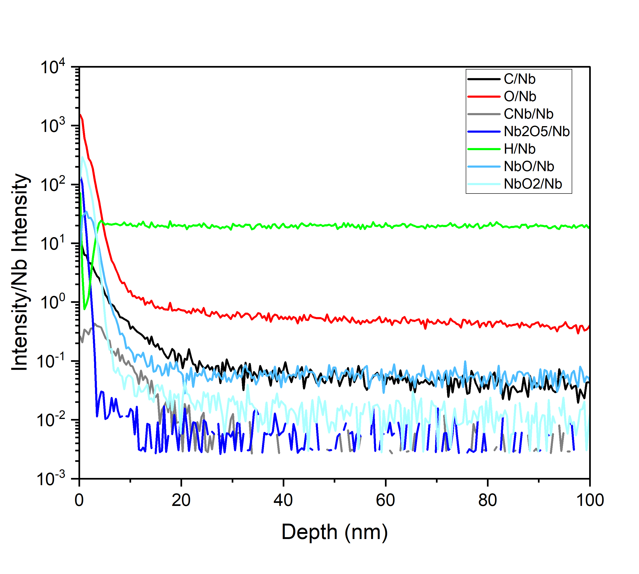
SIMS analysis of witness samples (Preliminary)
21_EP
L39-2_300C/3hrs
0101_350C/3hrs
Mode mixing present
High H concentration
Mode mixing present
High H concentration
Thinner but high O concentration
Mode mixing absent
Correlation with MP/Mode-mixing inconclusive

Slide 14
Summary
Mode mixing has been observed in almost all LB650 cavity tests except some 350°C baked cavities.
Predicted MP band has no MP signature but coincided with some of the mode mixing power level.
There is no explanation when the Eacc is higher than the MP band.
Surface elements of the witness sample is inconclusive.
SEY measurement may be useful. (Future work)

Slide 15
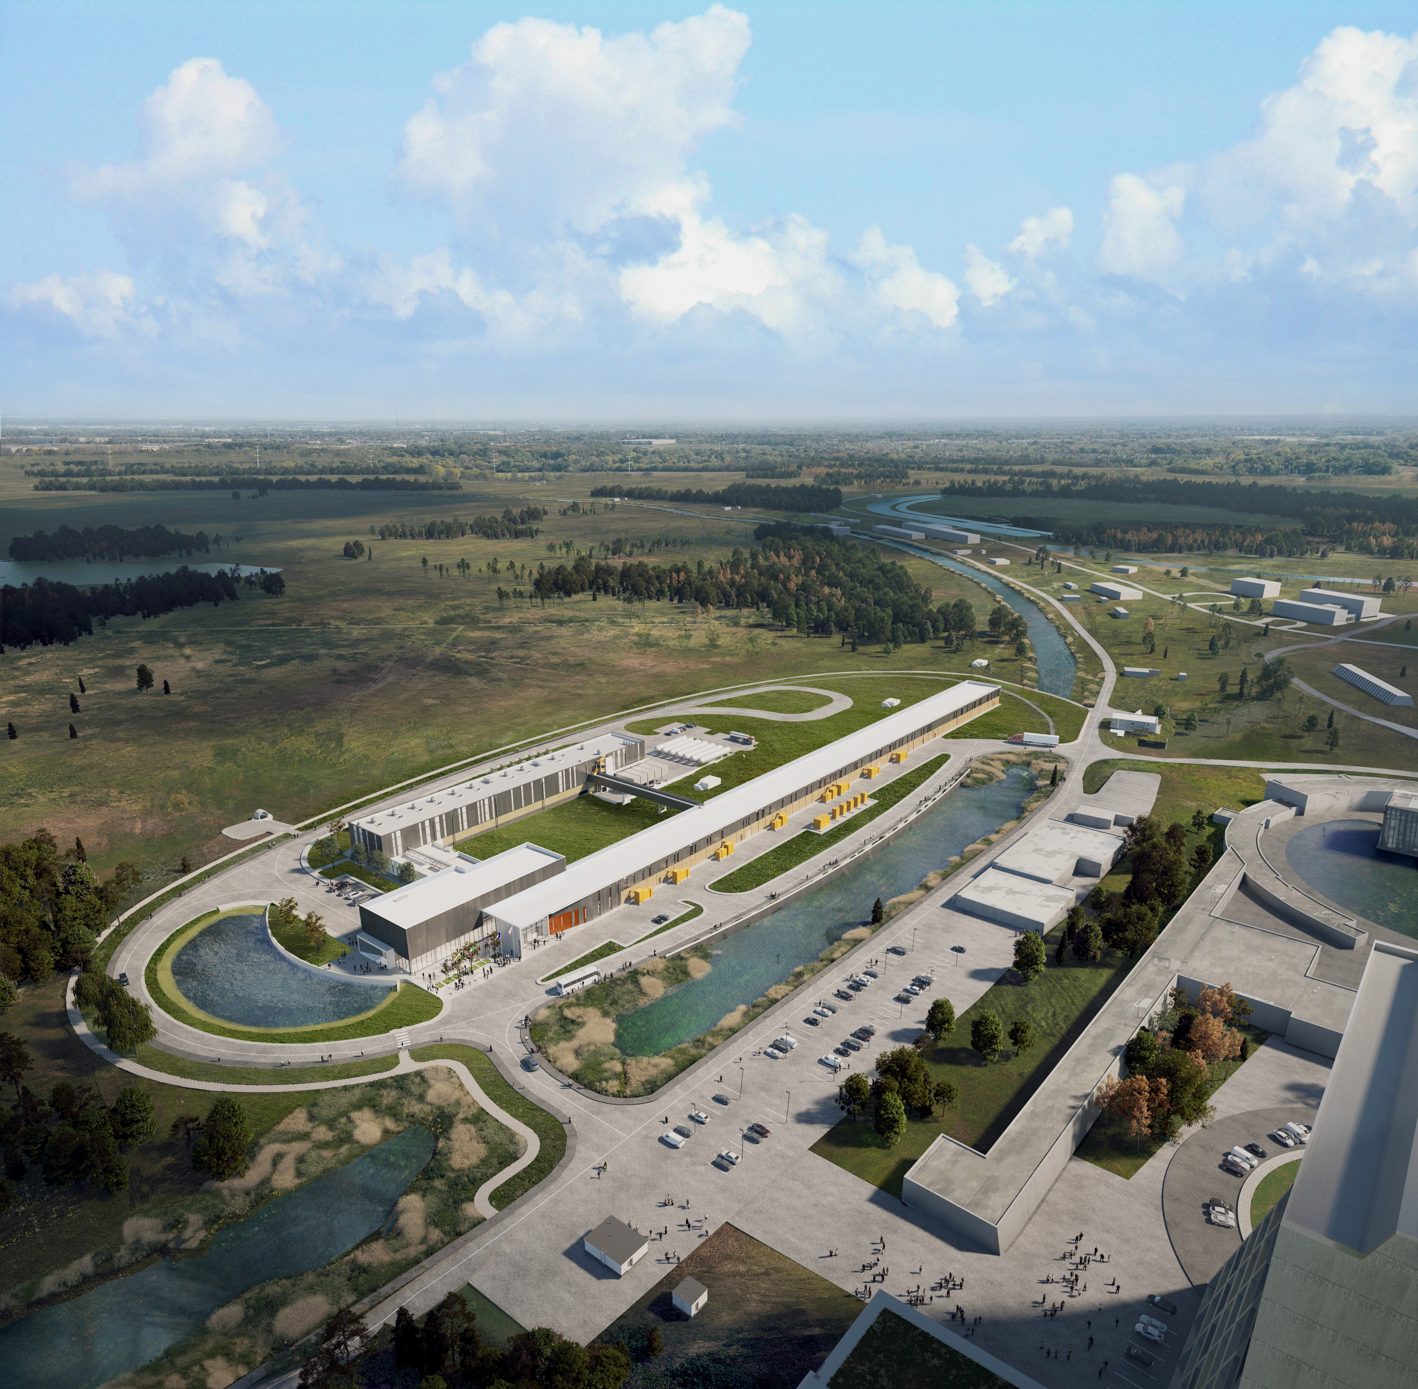
THE FUTURE OF FERMILAB
Thanks for the attention!
Questions?
Follow us:
http://pip2.fnal.gov/
/showcase/pip-ii/

