Slide 1

Mid-T Baking:
Development of a Recipe for a Simple and Inexpensive in-situ Processing
A. Prudnikava, Y. Tamashevich, A. Matveenko,
A.Neumann, O. Kugeler, J. Knobloch
Alena.Prudnikava@helmholtz-berlin.de

Slide 2
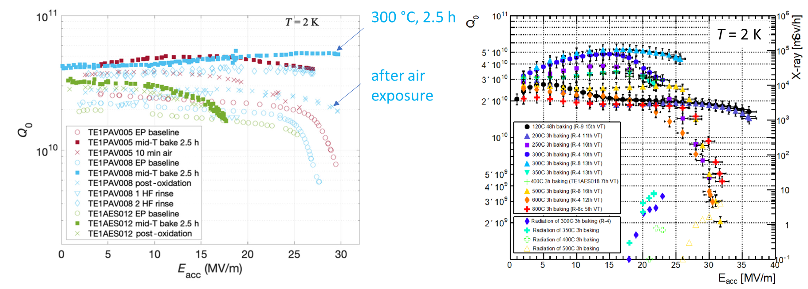
Making Defects: Mid-T Baking Worldwide
Ultralow Surface Resistance via Vacuum Heat Treatment of Superconducting Radio-Frequency Cavities
S. Posen , A. Romanenko, A. Grassellino, O.S. Melnychuk , and D.A. Sergatskov, 2020
Systematic Investigation of Mid-T Furnace Baking for High-Q Performance.
Ito, H., Araki, H., Takahashi, K. and Umemori, K., 2021.
Best results at T = 300–350 °C, t = 2.5–3 h
Some Q-degradation after air exposure
Often: E_{max} reduction and FE or Quench
A.Prudnikava TTC 2023
Notes:
The examples of the latest studies of Mid-T baking:
the best cavity performance has been achieved after 300-350C/2.5-3h of baking.
Usually maximal gradient reduced by FE or Quench.

Slide 3
Why using Nb Samples?
Different labs give different “best” recipes for cavities. Reasons:
before baking: cavity treatment and cleaning history is very important
state of the vacuum furnace has huge impact on results -> can cause Q₀ and E_{max} degradation and FE
after baking (before test): careful cavity handling is very important
It is important to study the Mid-T baking process under controlled conditions
Nb samples by in-situ synchrotron XPS at BESSY II beamline:
Ultra High Vacuum in the analytical chamber eliminates the influence of the furnace condition
High brightness synchrotron X-Ray source gives very strong signal => fast data acquisition
In-situ measurements: kinetics of oxides dissolution, carbides growth and Nb interactions with impurities
A.Prudnikava TTC 2023

Slide 4
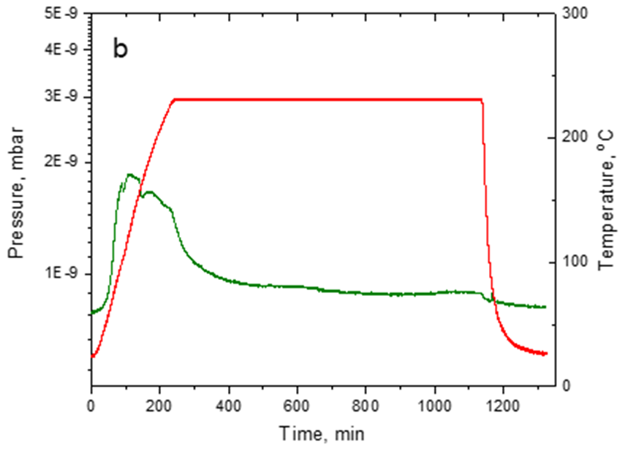
In-situ Study of Mid-T Baking via Synchrotron XPS
Series of baking experiments at 200-400°C
Before baking: all samples treated together
UHV: p = 3e-9 mbar and better during baking
Baking T behaves as in real furnace (no fast heating)
Determined all NbO_{x} phases at Nb surface
Analyzed interaction of surface impurities
Kinetics of the native oxide dissolution studied
Slow temperature rise to mimick real furnace
A.Prudnikava TTC 2023

Slide 5
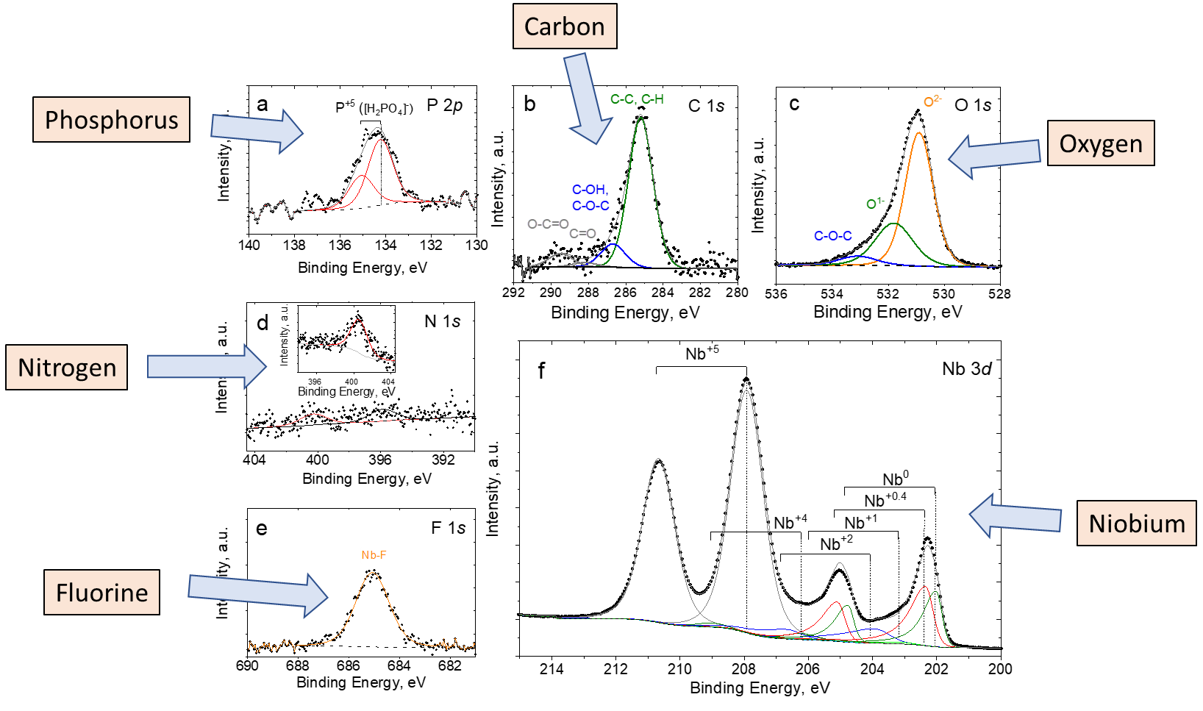
Composition of the cavity surface
Set of spectra
every 20 min!
A.Prudnikava TTC 2023
Notes:
For every measurement point we collect high resolution XPS data for every element: niobium, oxygen, carbon, phosphorus, nitrogen, fluorine.
The full set of spectra is collected for each 20 min.

Slide 6
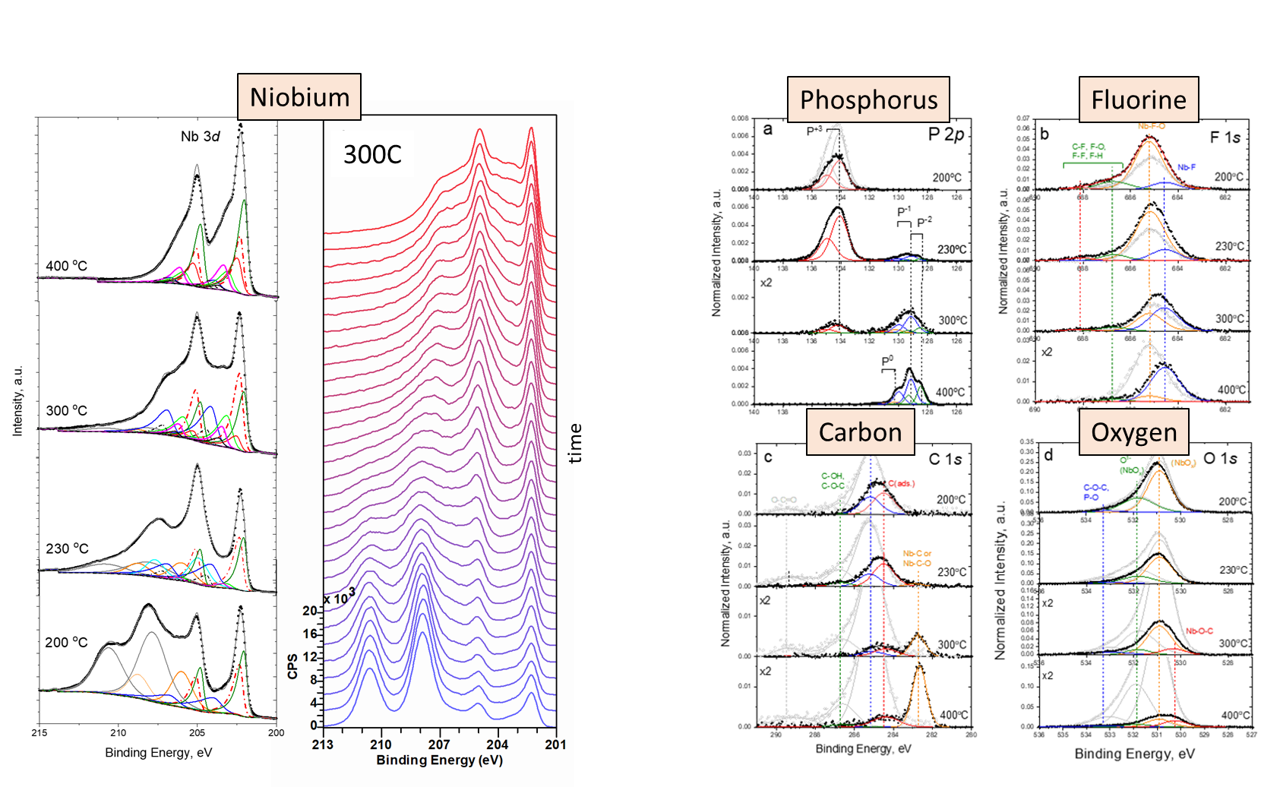
Evolution of spectra: kinetics of reactions
A.Prudnikava TTC 2023
Notes:
Synchrotron source provides very strong signal, so we can se the evolution of spectra even during short treatment.

Slide 7
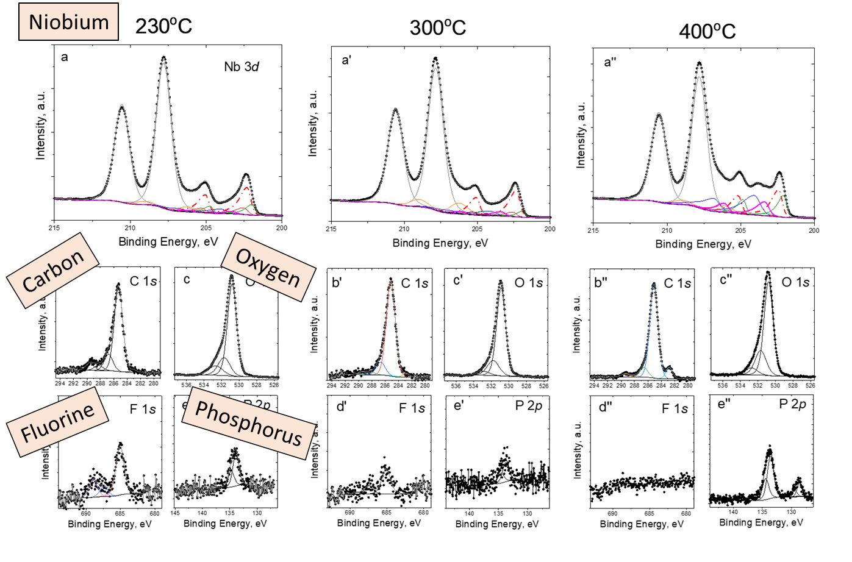
Open the cavity: air oxidation
A.Prudnikava TTC 2023
Notes:
We also studied oxidation process of Mid-T baked samples.
Samples after baking were exposed to air and XPS spectra were collected.

Slide 8
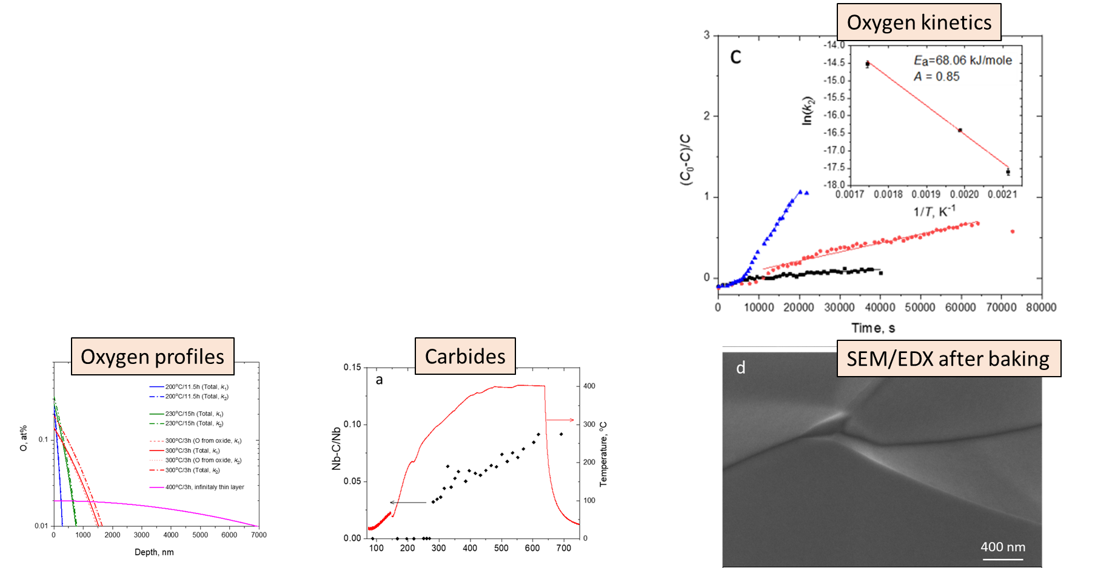
XPS Results
Oxides dissolution kinetics
Oxygen profiles
Huge role of fluorine (masked by Nb2O5 !)
Carbides formation kinetics
Carbides grow even in UHV at elevated temperatures.
A.Prudnikava TTC 2023
Notes:
Oxides kinetics: coefficients for Arrhenius equation
Oxygen distribution under the surface (measured and calculated)
We have revealed that fluorine plays a very significant role: its concentration is not negligible (above 5 at%).
We also have measured the growth of carbides which occurs even in ultra-high vacuum (p at 10e-10 mbar).

Slide 9
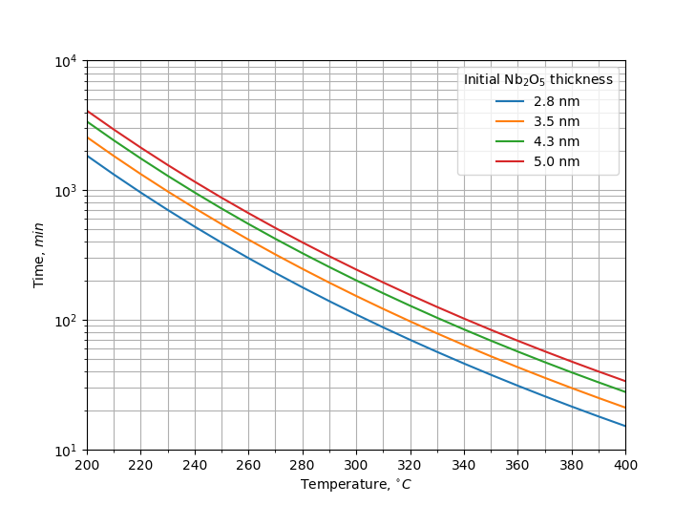
Protective layer of Nb₂O₅
Knowing O and C kinetics we can calculate a phase diagram
Protective layer of Nb₂O₅
If pentoxide is thicker than 1 nm, carbides growth is suppressed
Based on kinetics of O and C we calculated the safe regions for baking even in non-UHV furnaces
Carbides formation
No carbides
“old” cavity or after intense HPR
fresh BCP, EP or HF rinsing
A.Prudnikava TTC 2023
Notes:
Studying carbides kinetics gave us a rule of thumb: about 1nm-thick pentoxide is enough to suppress fast niobium carbides growth.
If pentoxide is thinner, carbides will grow even in ultra-high vacuum, let alone industrial furnaces.
Based on our data we have calculated a plot for the “safe baking”. If in your process you stay below the 1-nm line you will have no carbides.
Unless you have a really dirty surface or oven.
Note: Crossing the line will lead to carbides formation, but their quantity will depend on cleanliness of the furnace and the surface.
So you might be lucky to get good results even above this line.

Slide 10
Is 300-350 °C required?
What we learned from the XPS data
(kinetics of oxygen dissolution, impurities and contaminations):
Higher temperature -> faster reactions -> shorter time to achieve “the best” profile
Higher temperature -> faster Nb carbides formation -> high R_{s}
Can the controlled oxide dissolution be realized on cavities?
Mid-T baking at temperatures: 230 - 270 °C
reasonable baking duration (ca 12 h)
Low amount of carbides
Let’s prove it with a cavity!
A.Prudnikava TTC 2023
Notes:
What we learned from the XPS data is that at 300C the oxygen dissolution occurs pretty fast, and also contamination of the surface is more likely to occur. Knowing the kinetics of the process one can achieve the same result at lower T and higher baking duration. So we proposed to perform the Mid-T baking at lower T.

Slide 11
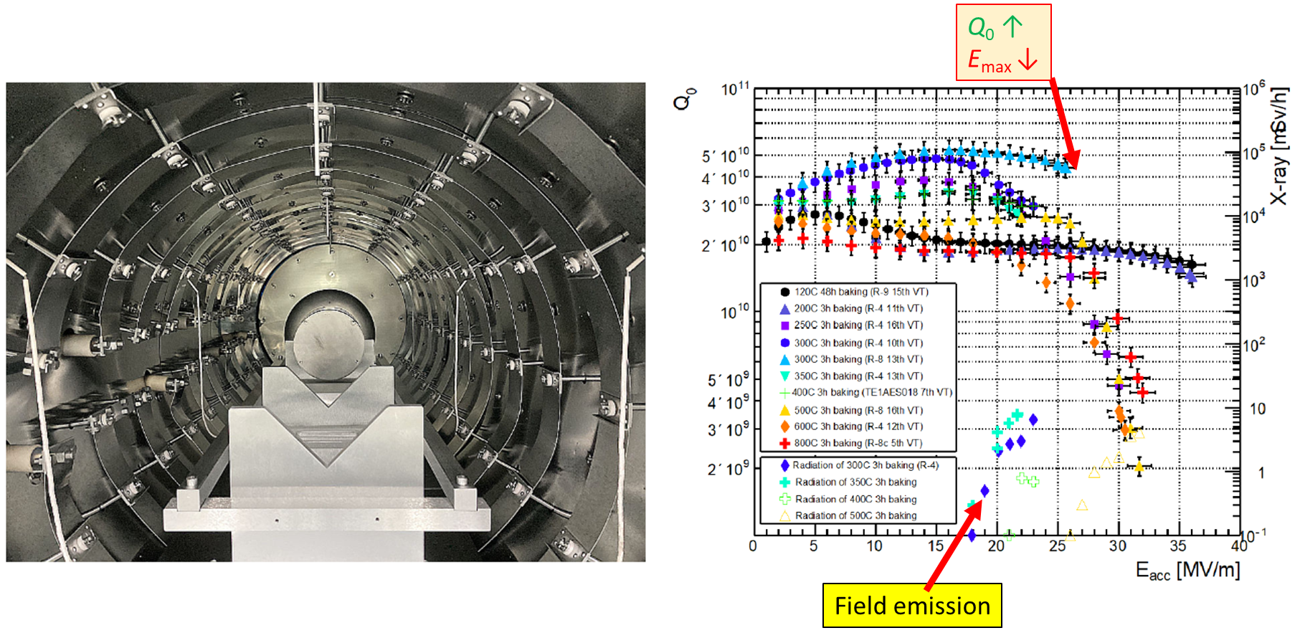
Mid-T in the furnace: risk of contamination
Systematic Investigation of Mid-T Furnace Baking for High-Q Performance.
Ito, H., Arakio, H., Takahashio, K. and Umemorio, K., 2021.
Vacuum furnace and single-cell cavity with Nb caps
(to protect the cavity from contamination)
A.Prudnikava TTC 2023
Notes:
Before that, let’s see how the Mid-T baking has been realized on cavities.
the 1st option is a large furnace => risk contaminations (Emax ↓, emission) because the cavity is open to the furnace volume.

Slide 12
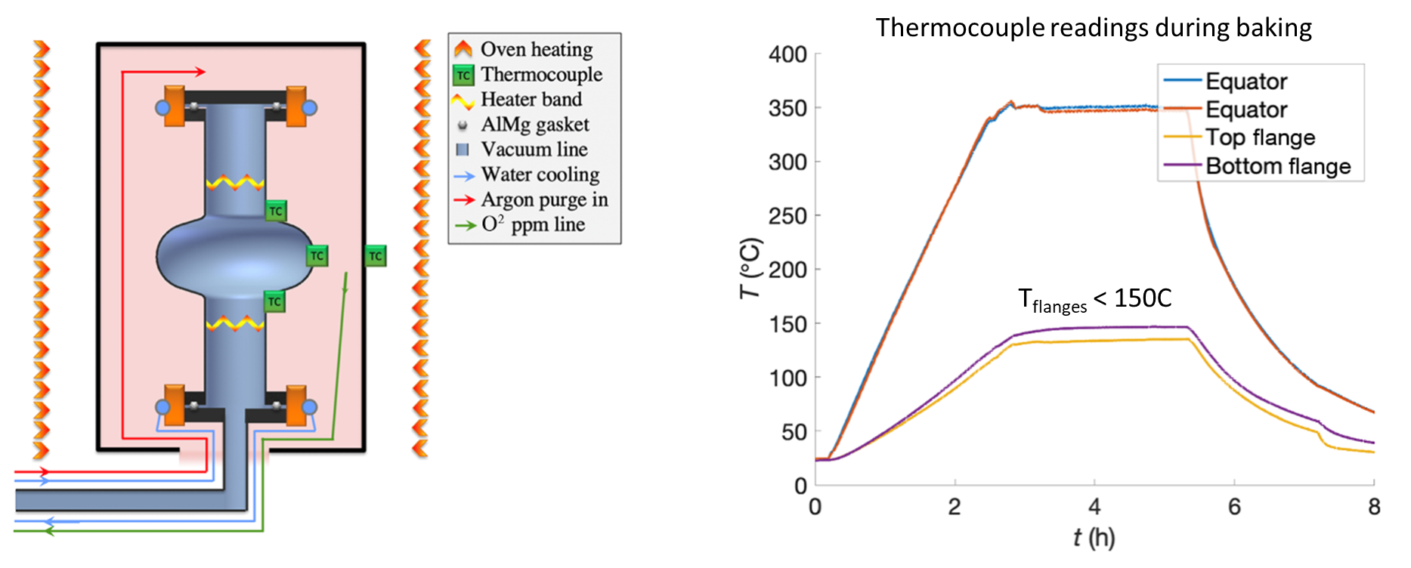
Mid-T in the furnace: double volume
Ultralow surface resistance via vacuum heat treatment of superconducting radio-frequency cavities.
Posen, S., Romanenko, A., Grassellino, A., Melnychuk, O.S. and Sergatskov, D.A., 2020
A vacuum furnace + a single-cell cavity with a flange-cooling system
rf test can be performed, but one need to break vacuum for installation into cryomodule => post-oxidation, particles, etc.
A.Prudnikava TTC 2023
Notes:
one can additionally pump the cavity interior as well , (i.e. pumping separately the cavity and the furnace volumes);
Problem: flanges must be cooled down!!!! (AlMg gaskets should stay below 300C to be able to withstand the following cryo-test).
That’s why additional water cooling is used inside the oven.

Slide 13
Other Options to Perform Baking?
Furnace
Any alternative?
Functions
Vacuum vessel
Cavity heating
We can use any vacuum chamber
We can use “local” heaters
Advantages
Uniform heating
We can use several heaters
Disadvantages
Uniform heating (flanges also!)
Requires intermediate disassembly
Poor vacuum
Contamination
Extra mounting process
High power
High cost
We can heat only High B-field region
Cavity vacuum can be separated
No contamination if separate vacuum
Much less work required
Low power
Low cost
And we do not have it (ca. 500 kEuro )
A.Prudnikava TTC 2023
Notes:
Is there any other options to perform Mid-T baking?
What are the functions of the furnace? Vacuum vessel with heating -> we can use local heaters and any vacuum chamber;
What are the advantages of the furnace? It can provide uniform heating -> several heaters can be used for that purpose.
What are the disadvantages of the furnace? – one has to care about the temperature of flanges
Poor vacuum in most cases and therefore a contamination problem -> cavity vacuum can be separated, no contamination.
Finally, a furnace consumes much power so it is costly. The most important drawback of cavity baking in a furnace is that disassembly is needed if cavity to be installed into cryomodule.

Slide 14
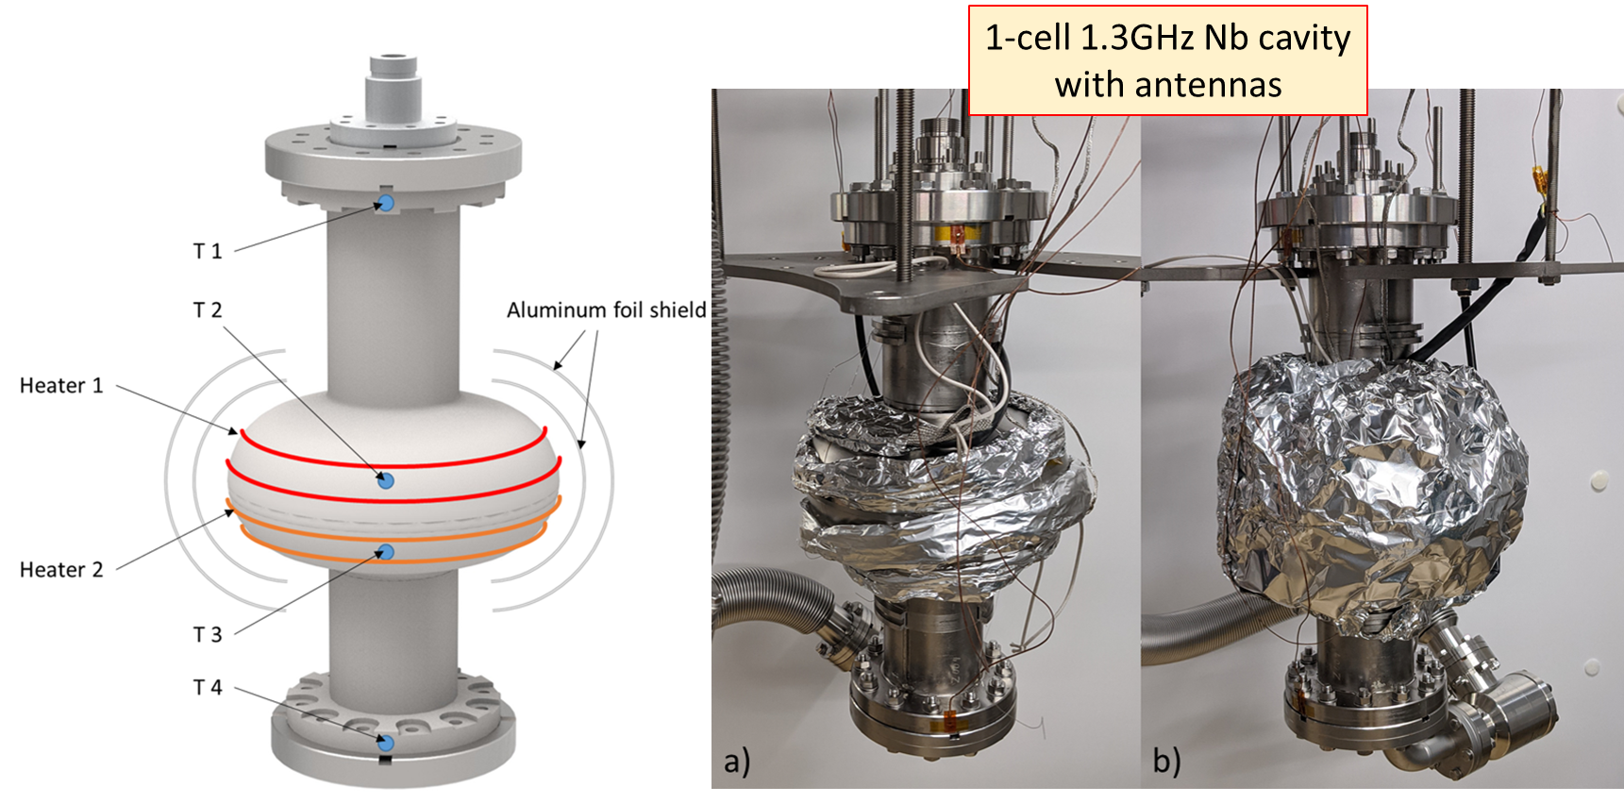
Baking in Cryostat!!!
Vacuum inside and around the cavity is separated
=> no contamination
No disassembly required
=> reproducible results
The set up can be used for cavity baking and rf cavity testing
              in a vertical test stand;
              directly in a cryomodule!
see Y. Tamashevich et al, arXiv:2307.09094
A.Prudnikava TTC 2023
Notes:
We decided to use a cryostat instead of a furnace, and use several local heaters - only in the High B-field region.
Here you can see 1,3 GHz single-cell cavity. All antennas are installed.
We used standard heating bands, it was enough to use 50W of power to reach the designed temperatures.
As will be showed later, you can leave the cables connected and start the cold test right after the baking.
Vacuum inside and around the cavity is separated => no contamination
No disassembly required => reproducible results
This set-up can be used also directly in a cryomodule!
For more details please see [Y. Tamashevich et al, arXiv:2307.09094]

Slide 15
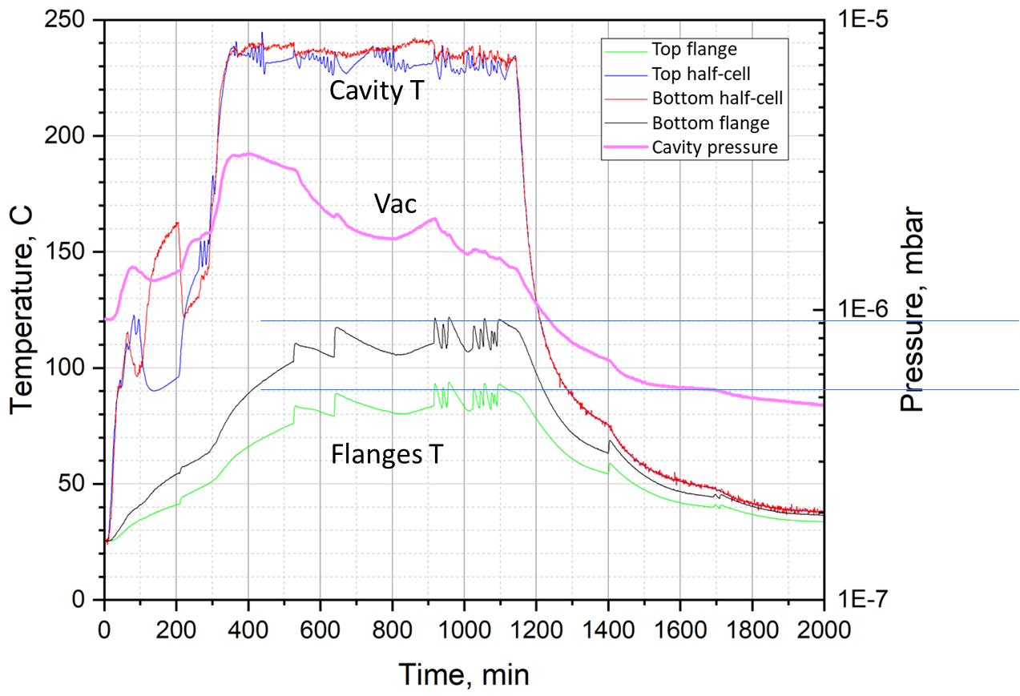
1st heat treatment: 13 hours
Goal: keep 1nm Nb₂O₅
230°C baking during 13h
Flanges and gaskets
Below 120C
Below 90C
Flanges below 120°C without cooling!!!
A.Prudnikava TTC 2023
Notes:
Two heat treatments have been conducted on the same cavity.
The 1st was 13h to reach 1nm Nb2O5 boundary.
Both top and bottom cavity flanges were below 120C – without any cooling! So you can leave the cables connected to antennas.

Slide 16
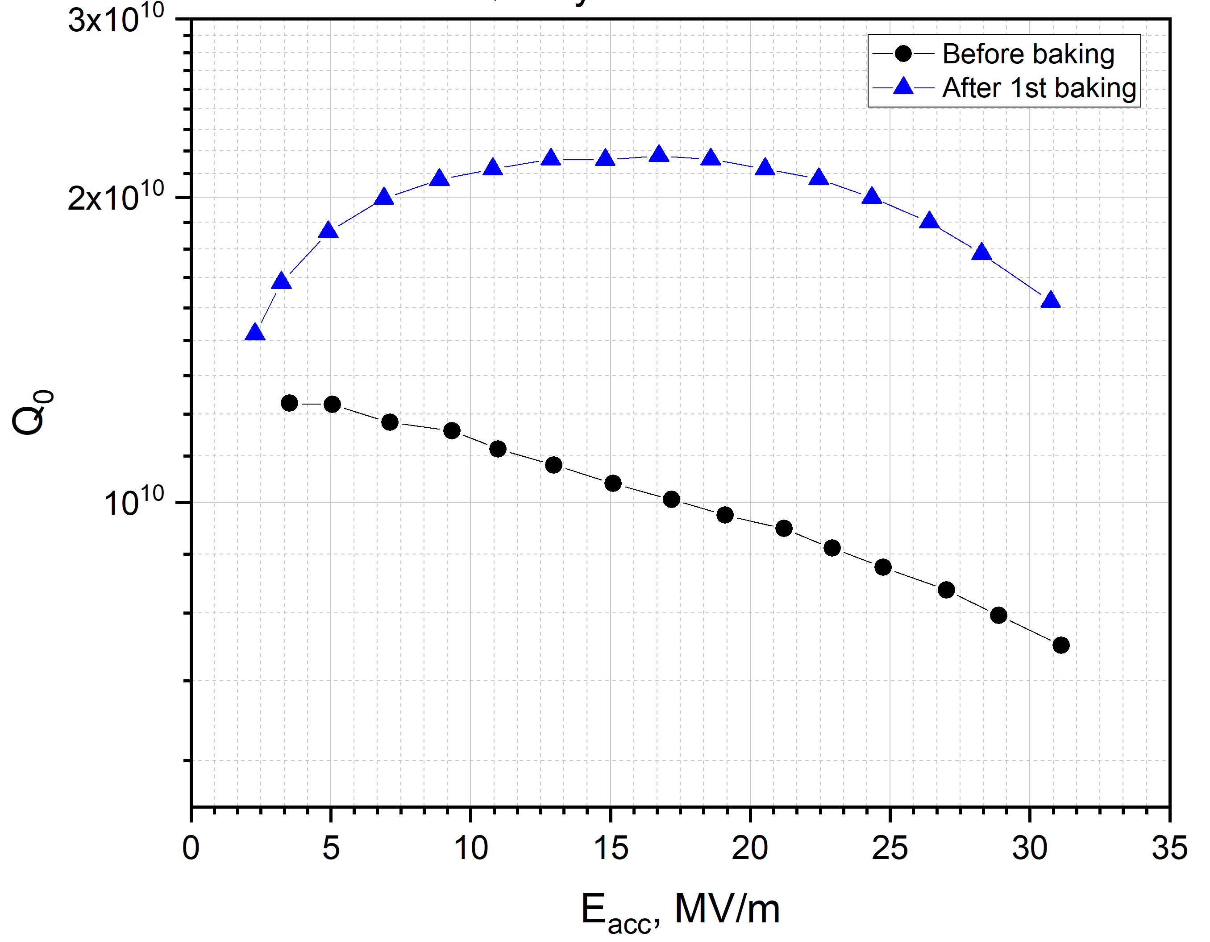
Cold test results at 1.8K
1.8 K
Anti-Q slope!
No E_{max} degradation!!!
No Field emission!
A.Prudnikava TTC 2023
Notes:
Cold test results at 1.8K showed anti-Q slope and no degradation of maximal E acc.
It is not a world record, but the initial cavity performance was quite moderate – the cavity was stored open during 3 years and got only HPR before the experiment.
We see indeed an anti-Q slope – Q rises until 18 MV/m.
There were no FE and quench, so no Emax degradation.

Slide 17
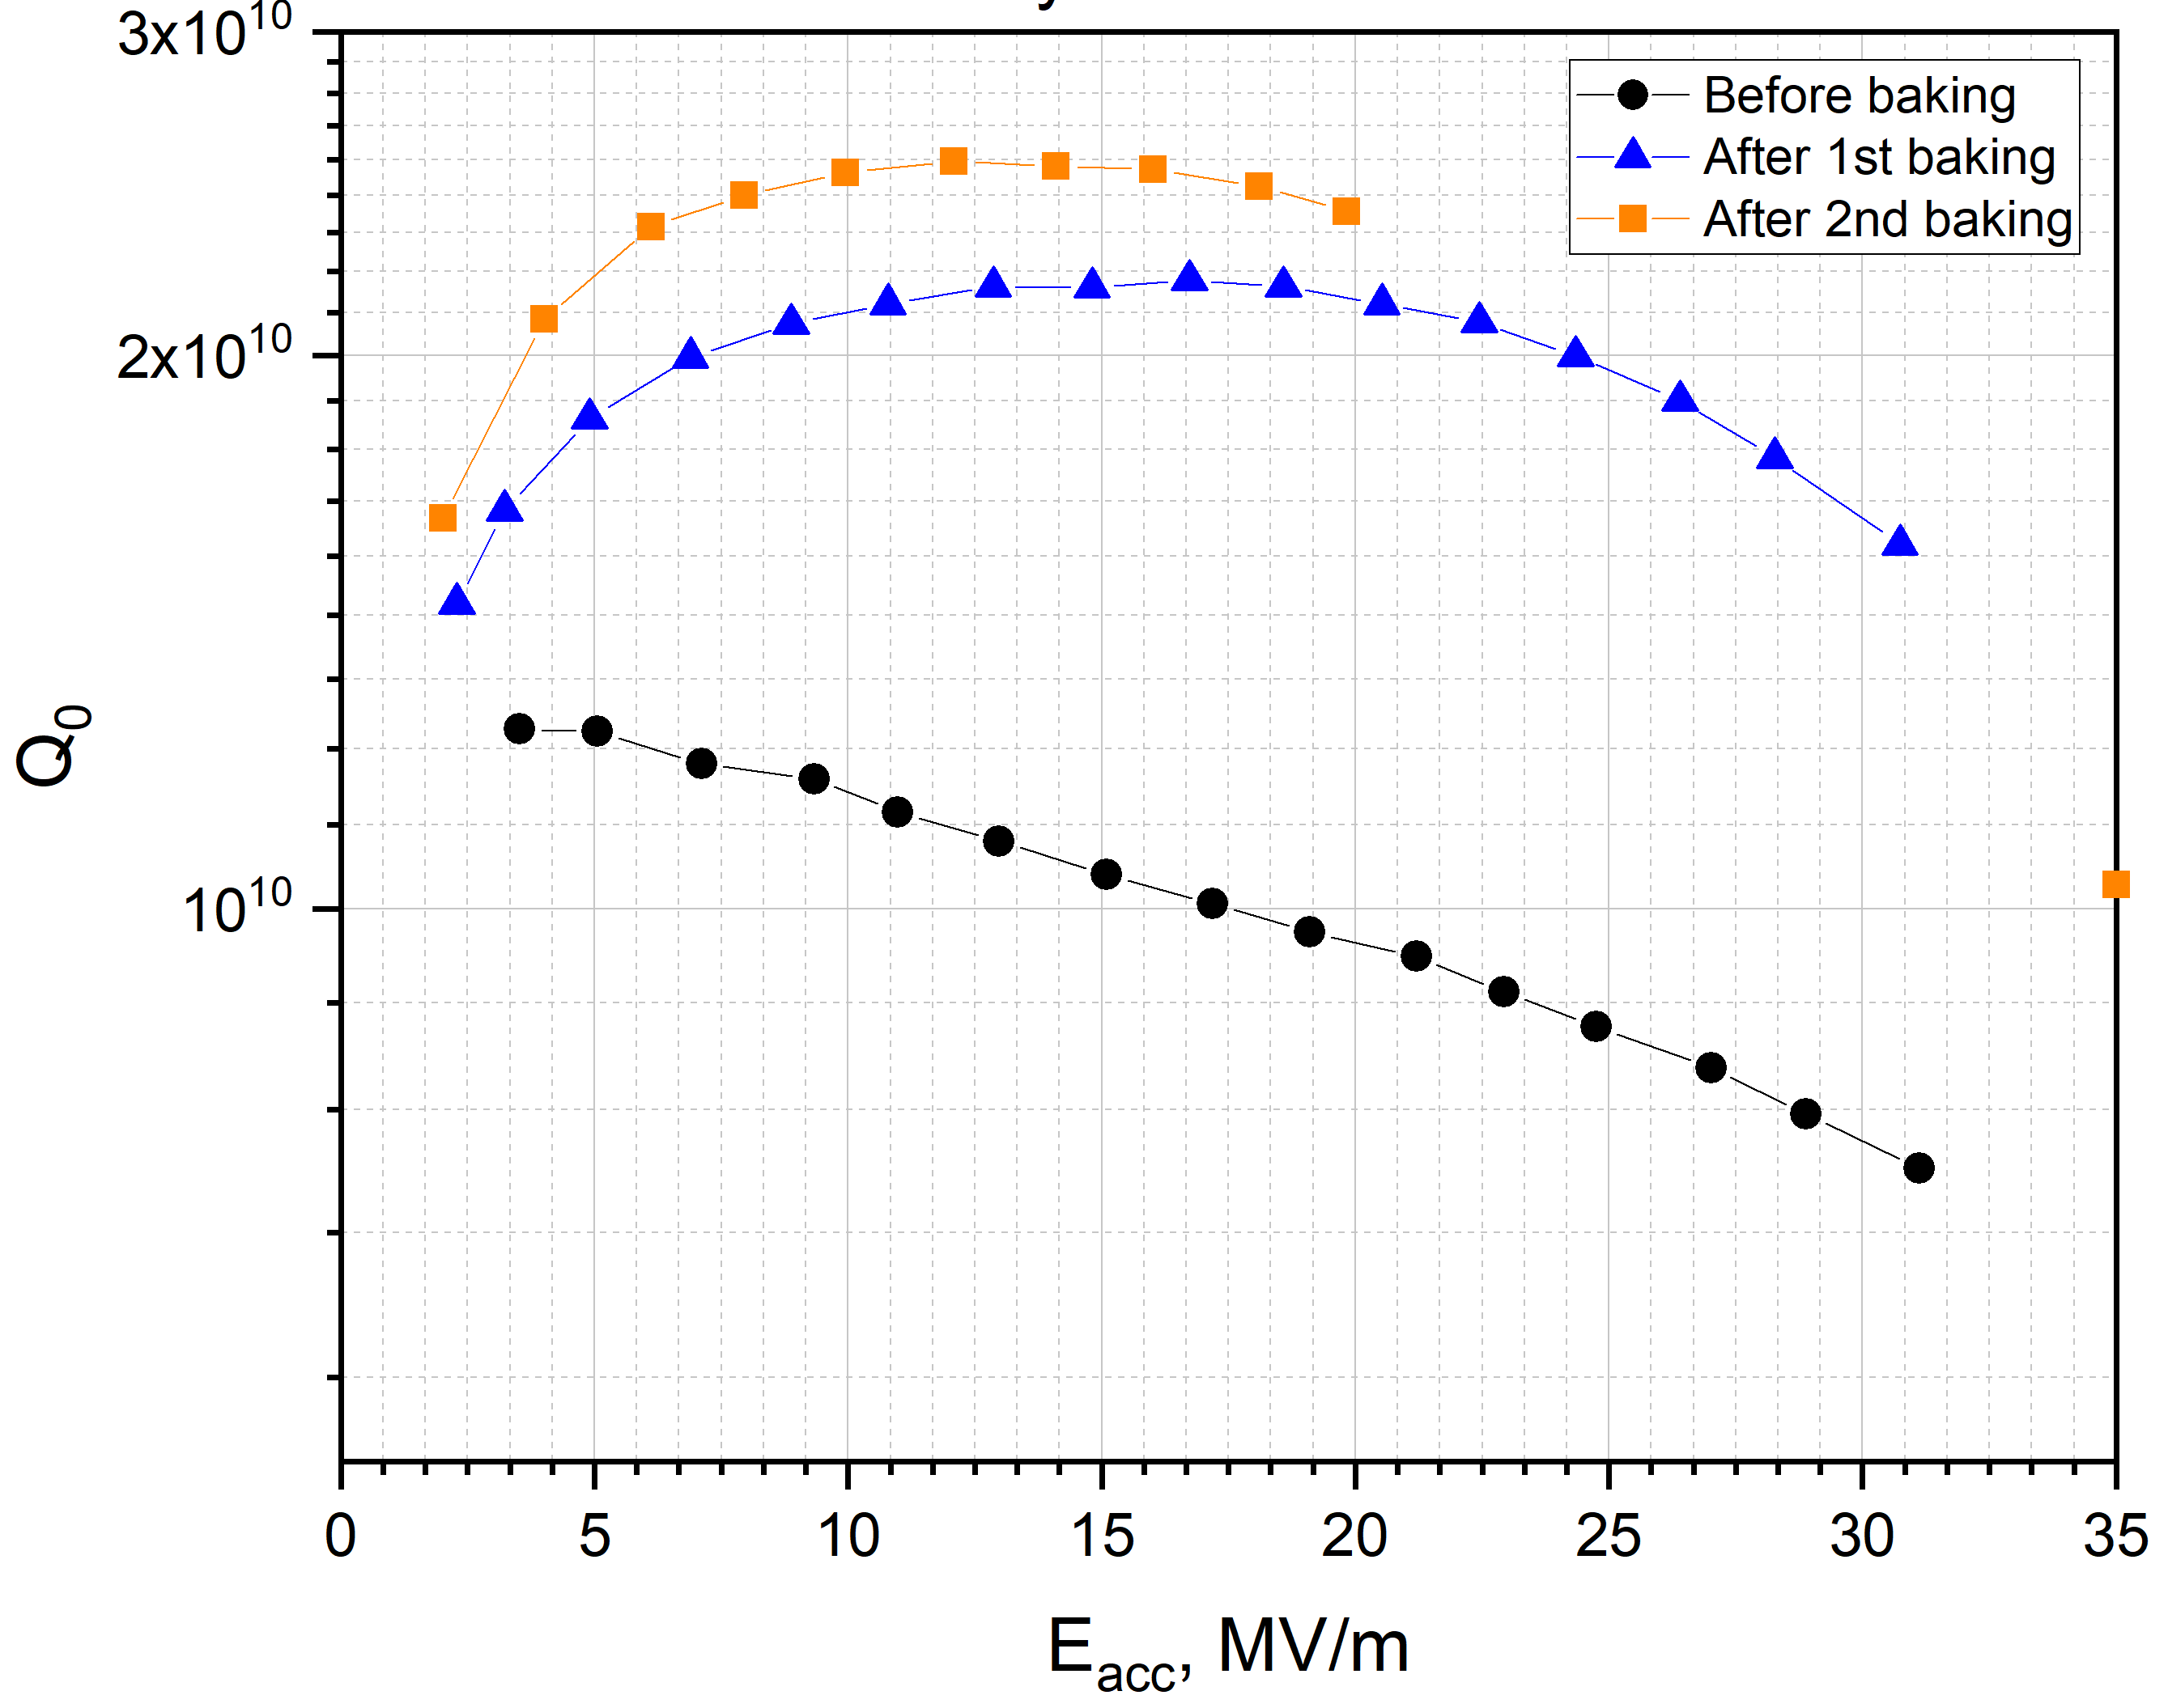
2nd baking (+11h): even better
20 MV/m was
an administrative limit!
1.8 K
Continue
230°C baking during 11h more
No E_{max} degradation!!!
E_{max} check
HZB PC network down.
No allowance from safety
officers for systematic tests >20MV/m
But we did E_{max} check
A.Prudnikava TTC 2023
Notes:
2nd baking was 11h: to continue Nb2O5 reduction.
Qmax increases. E max did not degrade actually but could not be measured properly owing to administrative limit.
HZB PC network was down. We were not allowed to run systematic (QvsT) tests above 20 MV/m.
However we checked the maximal field. Cavity reached 36 MV/m.

Slide 18
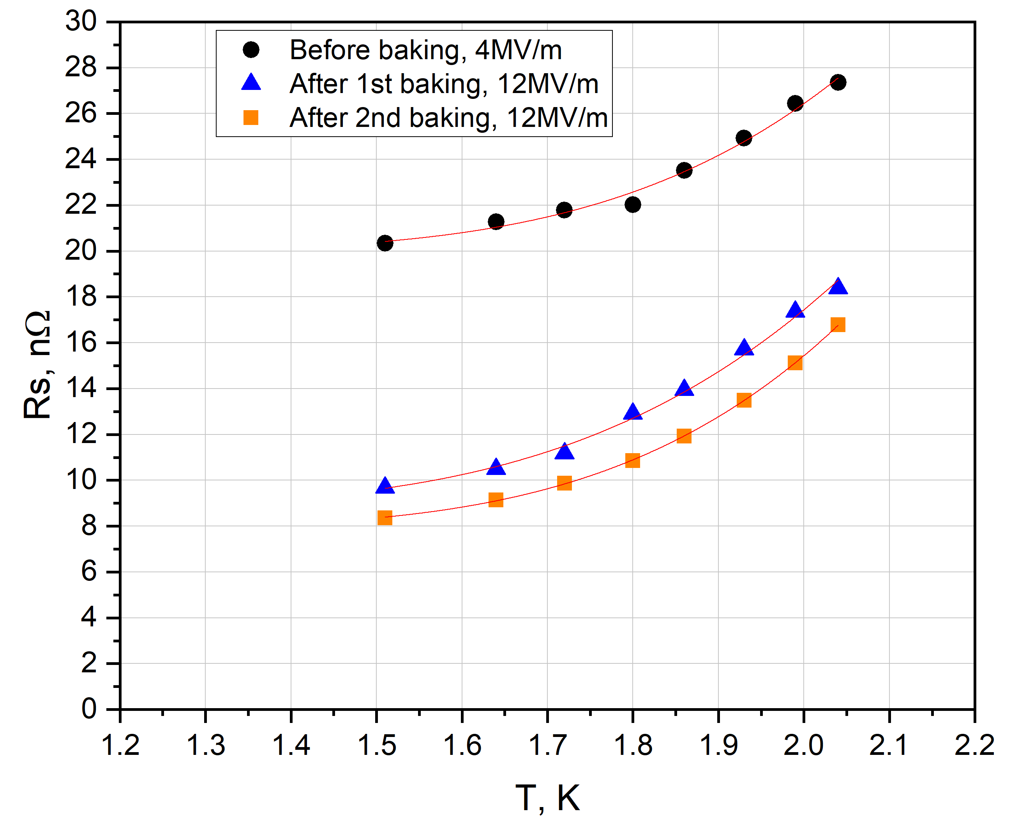
Surface Resistance, R_{s}
20 nΩ to 9 nΩ
A.Prudnikava TTC 2023
Notes:
From this plot one can see that Rs decreased from 20 to 8 nOhm.

Slide 19
Protective layer of Nb₂O₅
You can do clean baking in the furnace too!
Carbides will start formation after crossing the 1nm line
At low temperatures they will form slowly
Above 300C carbides form very fast
2nd baking
1st baking
Carbides formation
No carbides
“old” cavity or after intense HPR
fresh BCP, EP or HF rinsing
A.Prudnikava TTC 2023
Notes:
This is the “Safe baking plot” with our baking parameters for this experiment.
Send us you parameters for more statistics!

Slide 20
It works! No furnace needed!
successful Mid-T baking without oven demonstrated
reliable and inexpensive procedure for cavity baking established.
This procedure can be used for the systematic study of heat-treatment effects in cavities:
    cavity vacuum is always isolated.
Low-power local heating allows all RF cables stay connected
Potentially the method can be used to treat the existing infrastructure
Mid-T baking can be done directly in the cryomodule!
(Patent pending!)
Paper pre-print: A. Prudnikava et al, arXiv:
Paper pre-print: Y. Tamashevich et al, arXiv:2307.09094
A.Prudnikava TTC 2023

Slide 21
Thank you!
use this plot in your experiments
A.Prudnikava TTC 2023

