Slide 1



Cooldown and thermal budget dependencies of mid-T treated cavity performance
Overview on DESY mid-T campaign
Christopher Bate for the SRF team of DESY and Uni Hamburg

Slide 2
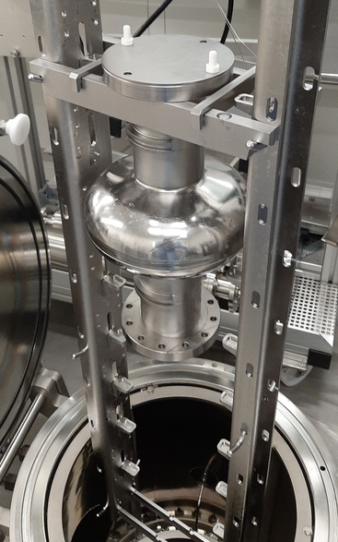
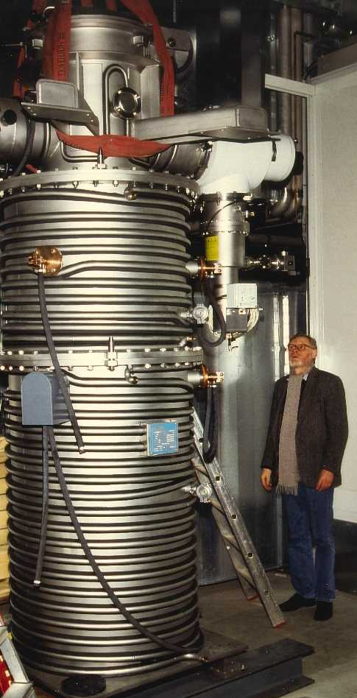
Medium temperature (mid-T) treatments at DESY
DESY mid-T campaign started in 2021
Refurbished furnace infrastructure at DESY
  Nb retort furnace attached to ISO4 cleanroom
  Vertical assembly of 2x single-cell or 1x nine-cell
  Separate inner vac system; 2x cryo pumps
  Start pressure ~ 2x10⁻⁸ mbar; clean vac system
  Pressure at 300°C ~ 1x10⁻⁷ mbar
Total of 18 Mid-T treatments were conducted!
  On 16 cavities
  Only on 1.3 GHz single cell cavities so far

Slide 3
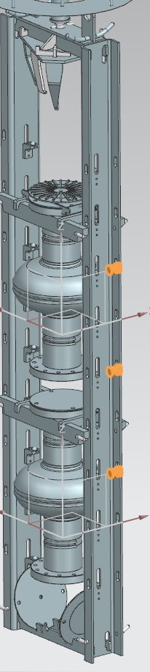
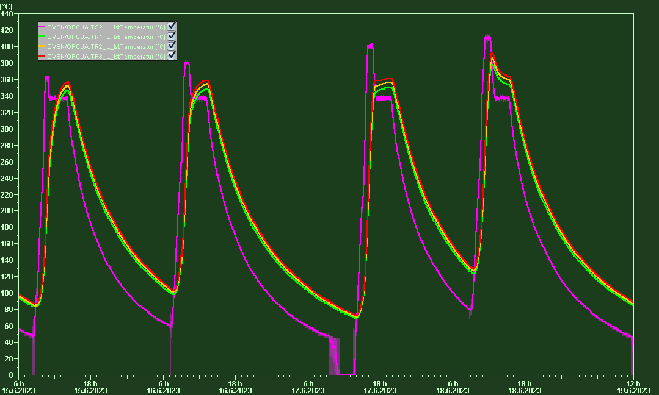
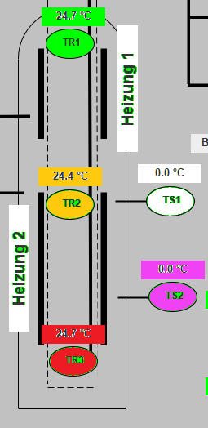
Commissioning and fine-tuning the furnace
Delayed temperature control solved by overshooting
T1
T2
T3

Slide 4
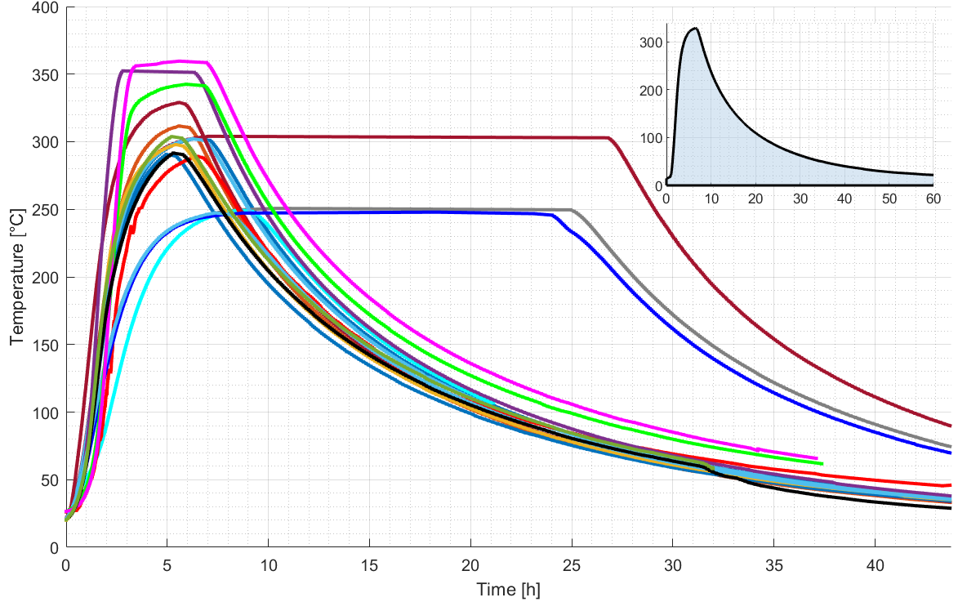
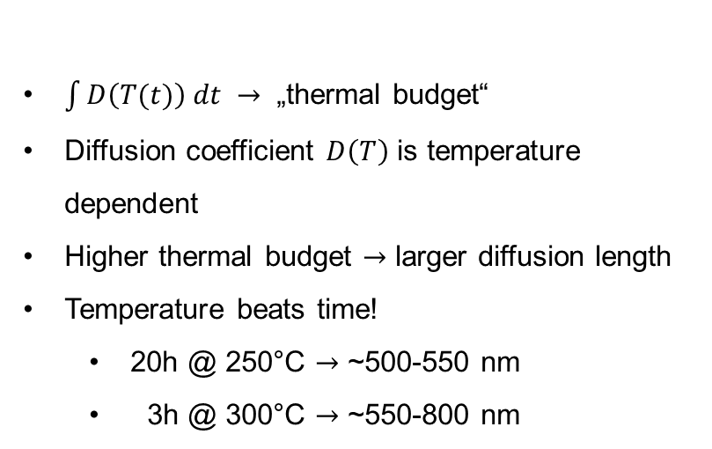

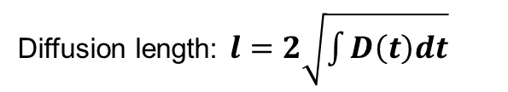
Improved oxygen diffusion length calculation
Temperature profile used to calculate the oxygen diffusion length („thermal budget“)
$$D\left(T\right)=D_{0}∙e^{−\frac{E_{a}}{kT(t)}}$$
Diffusion length: $l=2\sqrt{\int{D\left(t\right)dt}}$
T1
$\int{D\left(T(t)\right) dt →}$ „thermal budget“
Diffusion coefficient $D\left(T\right)$ is temperature dependent
Higher thermal budget $→$ larger diffusion length
Temperature beats time!
  20h @ 250°C $→$ ~500-550 nm
  3h @ 300°C $→$ ~550-800 nm
T2
T3
Temperature profiles of all mid-T treatments

Slide 5
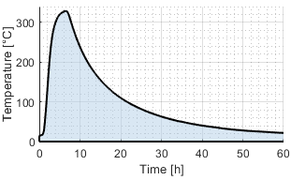
Mid-T treatments sorted by diffusion length „thermal budget“
Nominal treatment against calculated diffusion length as classification attempt
Cavity | Nominal treatment | Calculated diff. Length (nm)
1RI04 | 3h @ 250 | 234
1DE12 | 3h @ 250 | 249
1DE26 | 3h@300 | 501
1RI02 | 20 h @ 250 | 512
1DE04 | 3h@300 | 528
1DE03 | 3h@300 | 537
1DE07 | 20h @ 250 | 560
1DE07 18x HPR | 3h@300 | 641
1AC07 | 3h@300 | 697
1DE10 coated | 3h@300 | 749
1DE18 coated | 3h @ 300 | 773
1AC03 | 3h @ 300 | 789
1AC02 | 3.25h @ 325 | 865
1DE19 | 4.5h @ 335 | 1248
1DE11 | 3h@350 | 1839
1DE17 | 20h @ 300 | 2039
1RI01 | 3h@350 | 2354
1DE12 | 3h@350 | 2655
  First cavity (1DE19) with two caps;
  others top cap only as dust protection
  final HPR & assembly, only
  3x large grain cavity
  2x coated cavity
  2x tandem runs (2 cavities simultaneously)

Slide 6
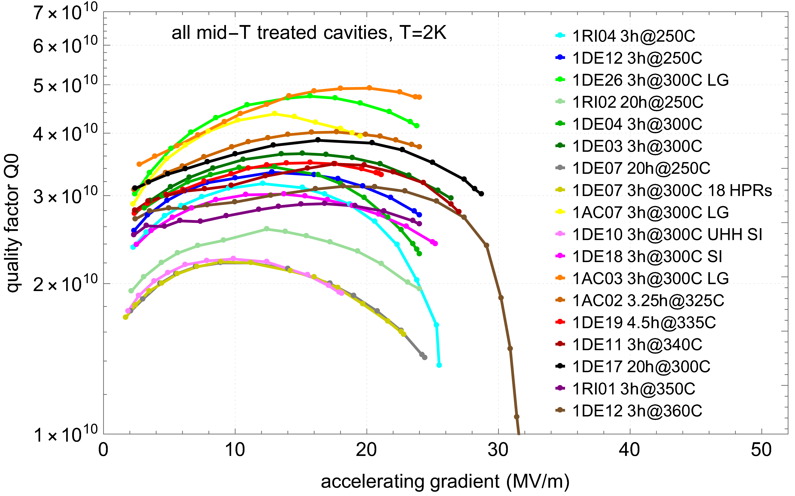
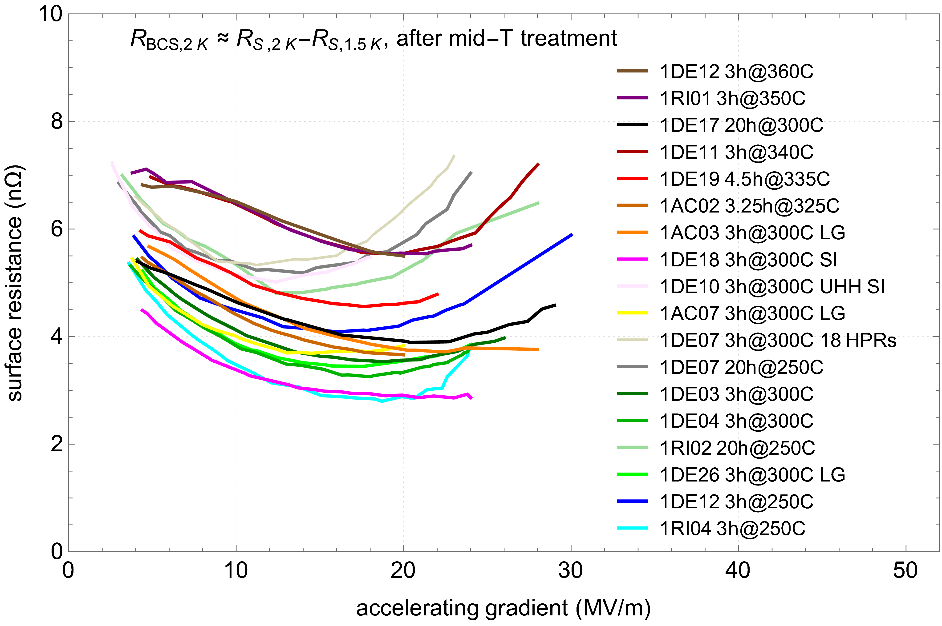
Collected lots of data
Q₀ vs E_{acc} & R_{BCS} of 18 single cell cavity treatments
Multitude of treatments with very high reproducibility and characteristic features
7 of 18 cavities degraded in Q₀ after quench

Slide 7
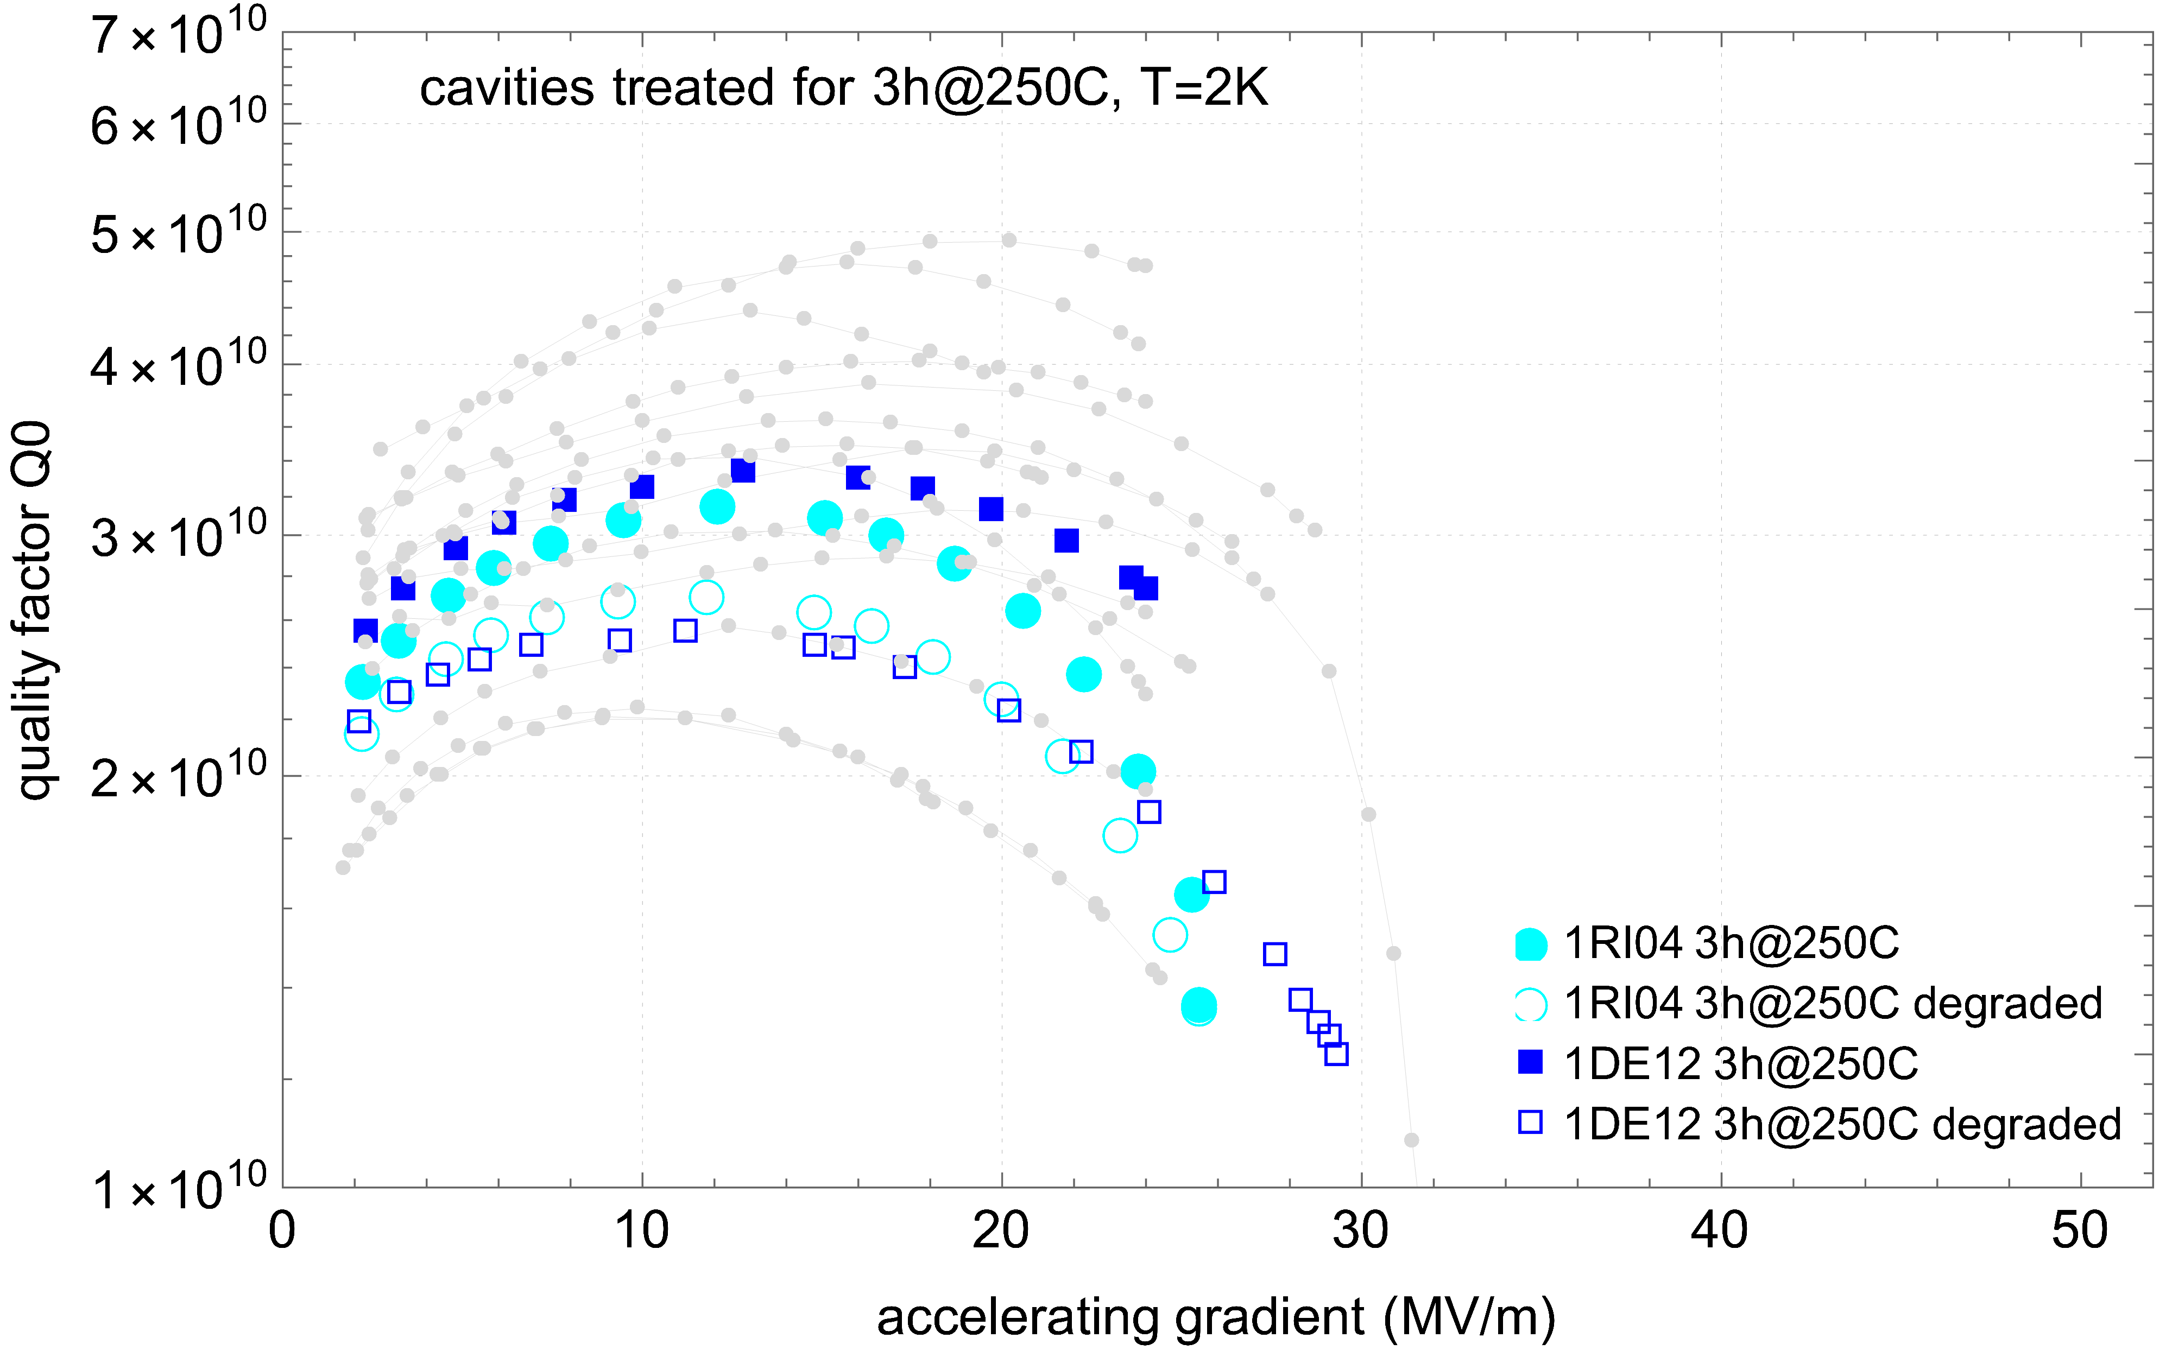
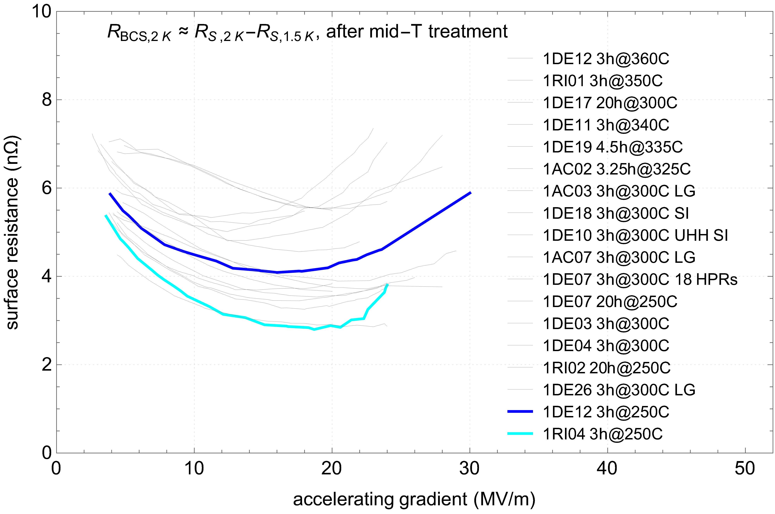
Short 250°C leads to reduced Q₀
Q₀ vs E_{acc} & R_{BCS} - thermal budget similar to 3h 250°C
250°C exhibits behavior similar to mid-T but with inferior performance
But lowest R_{BCS} !
Q₀ degraded after a quench

Slide 8
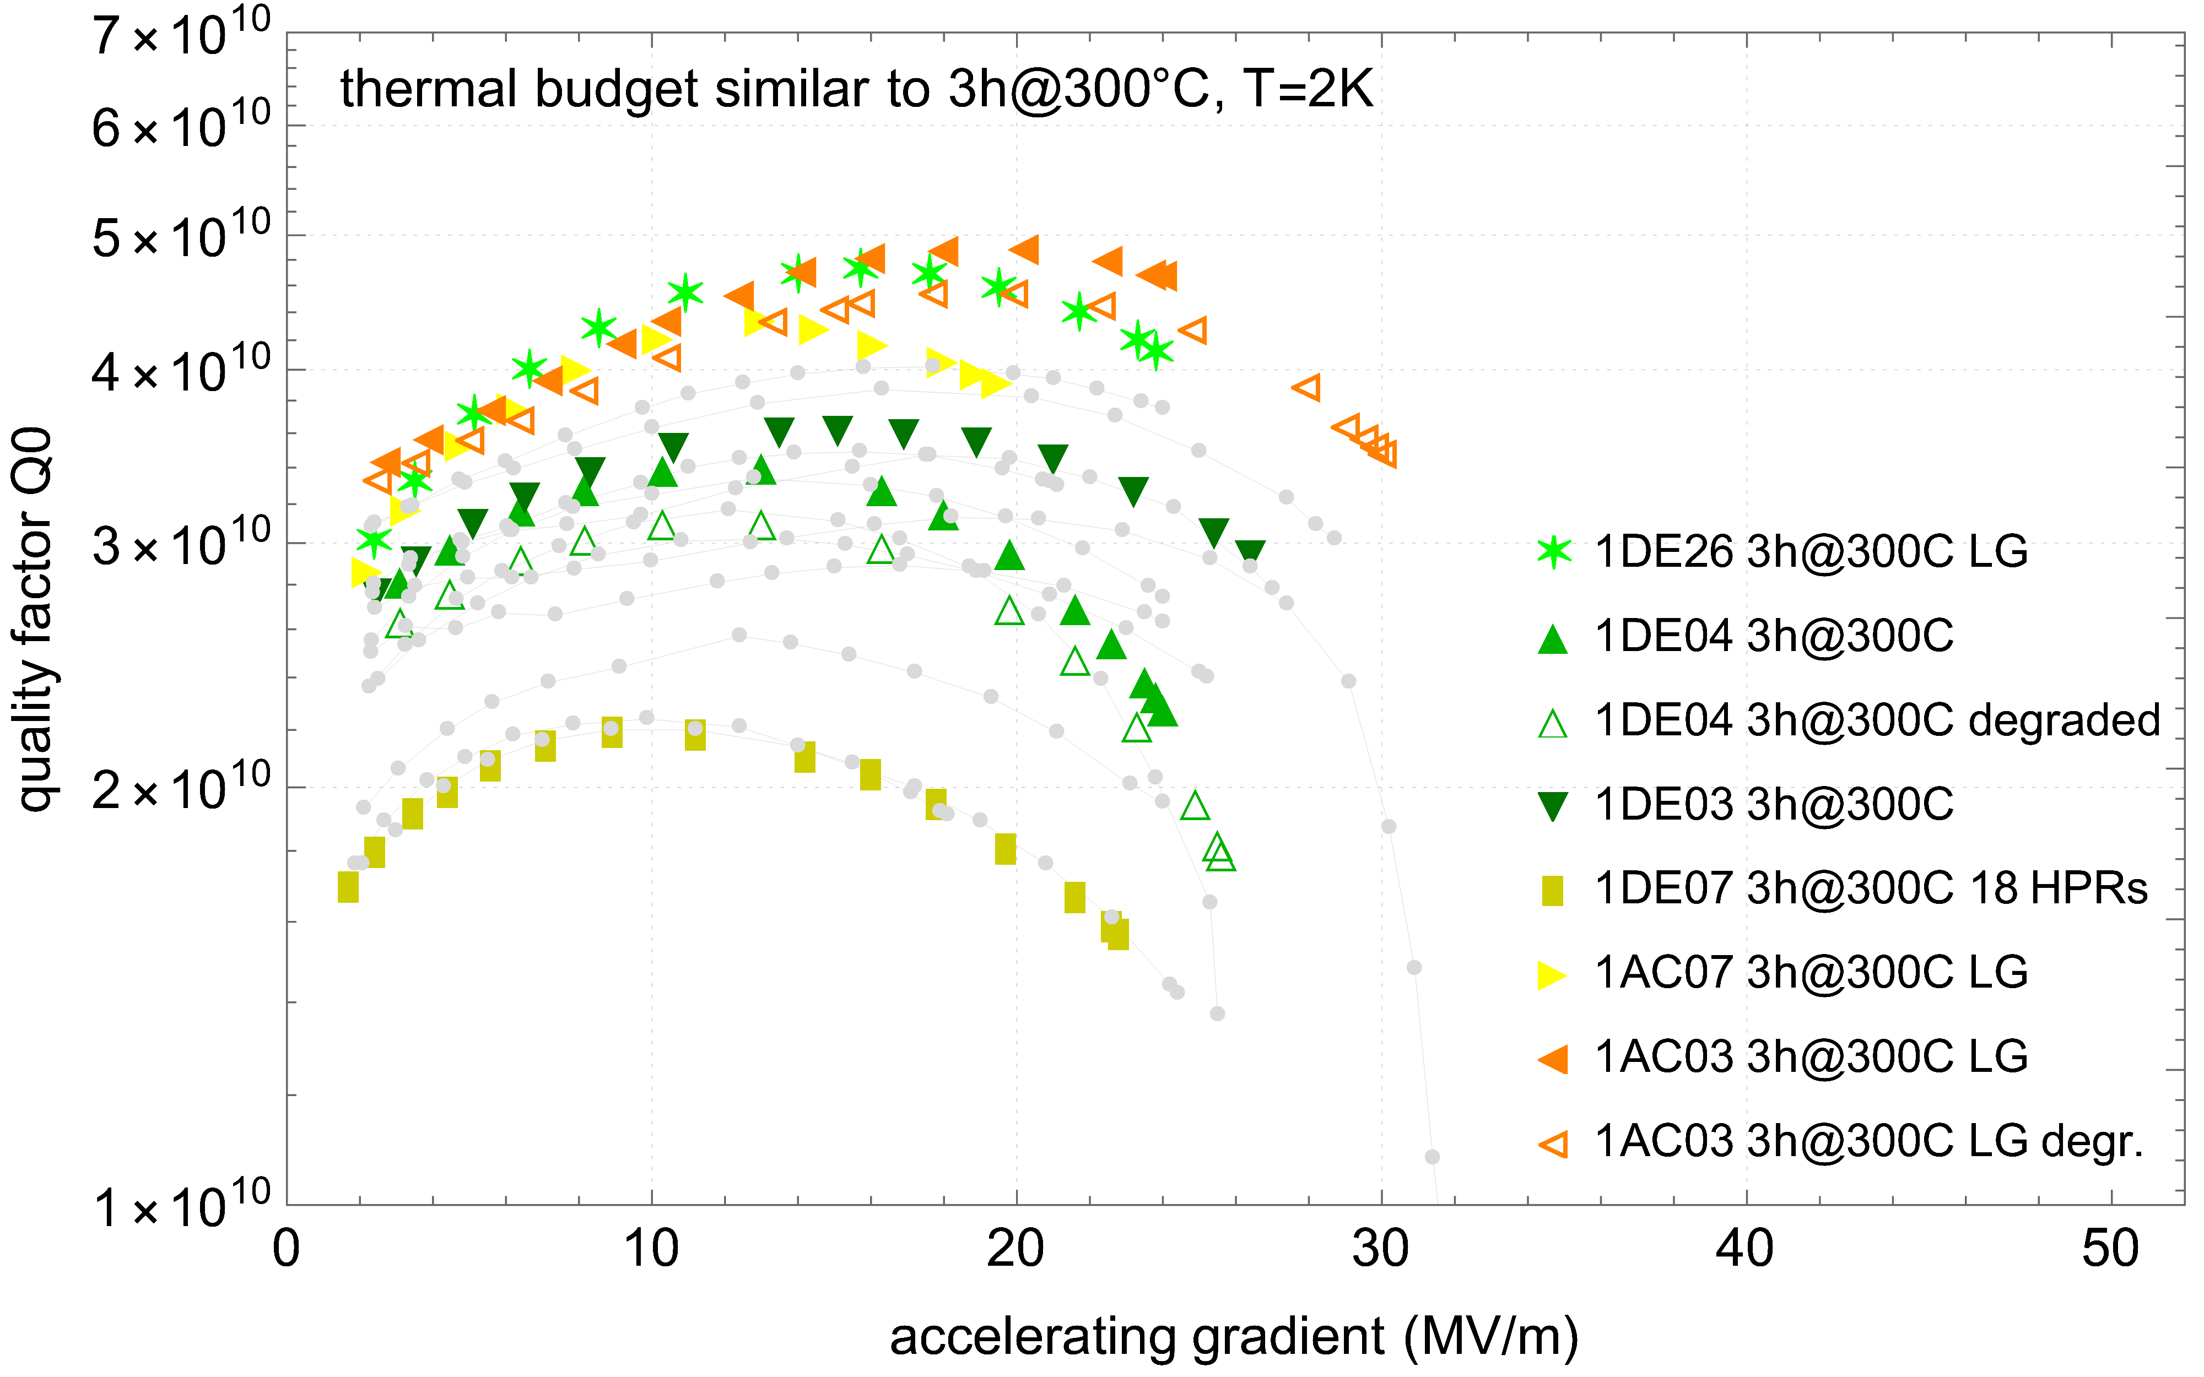
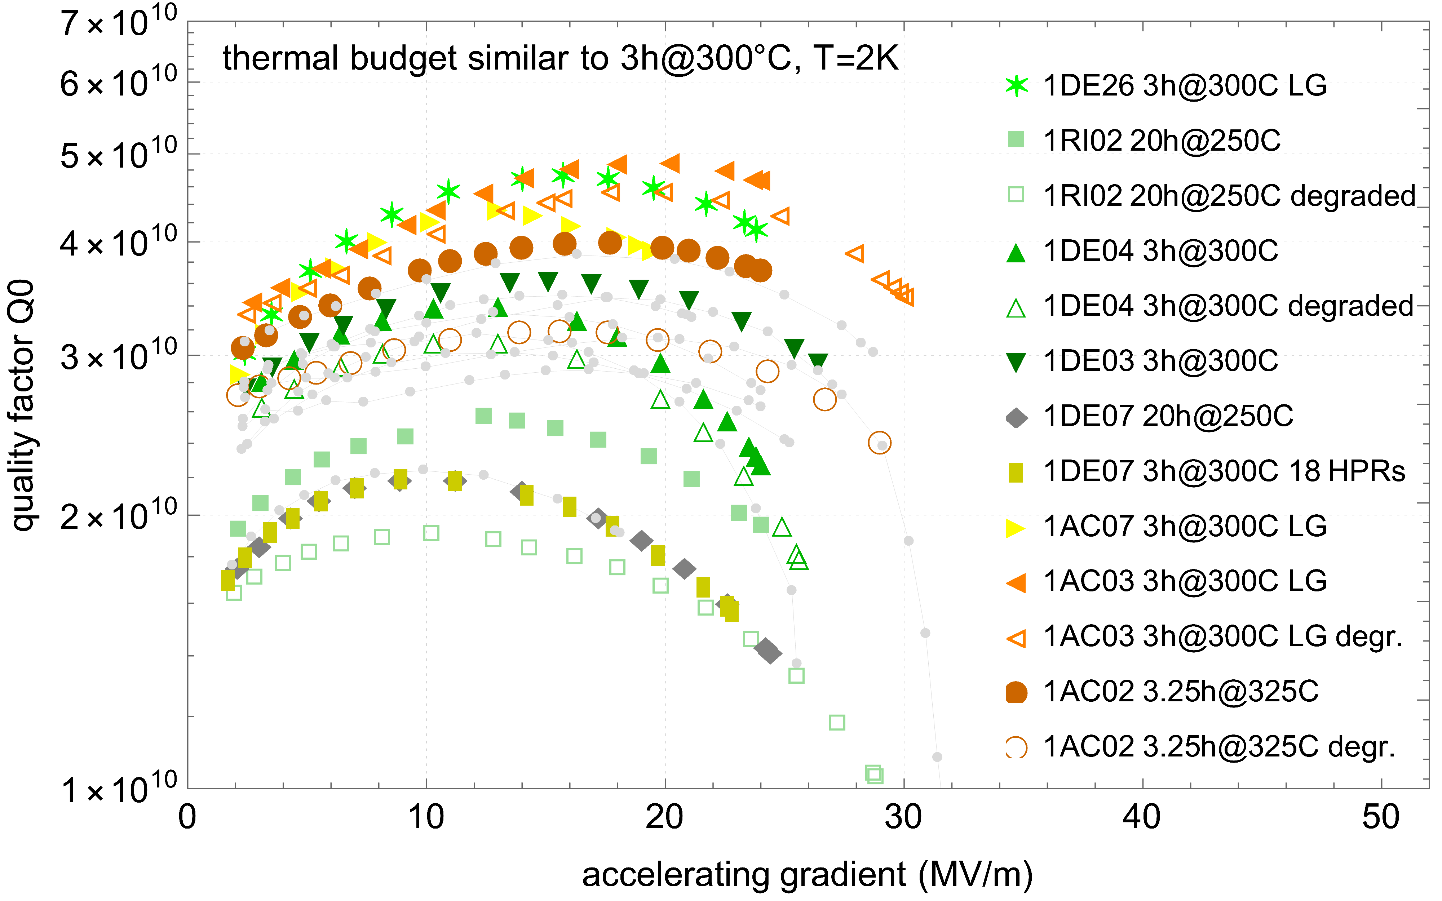
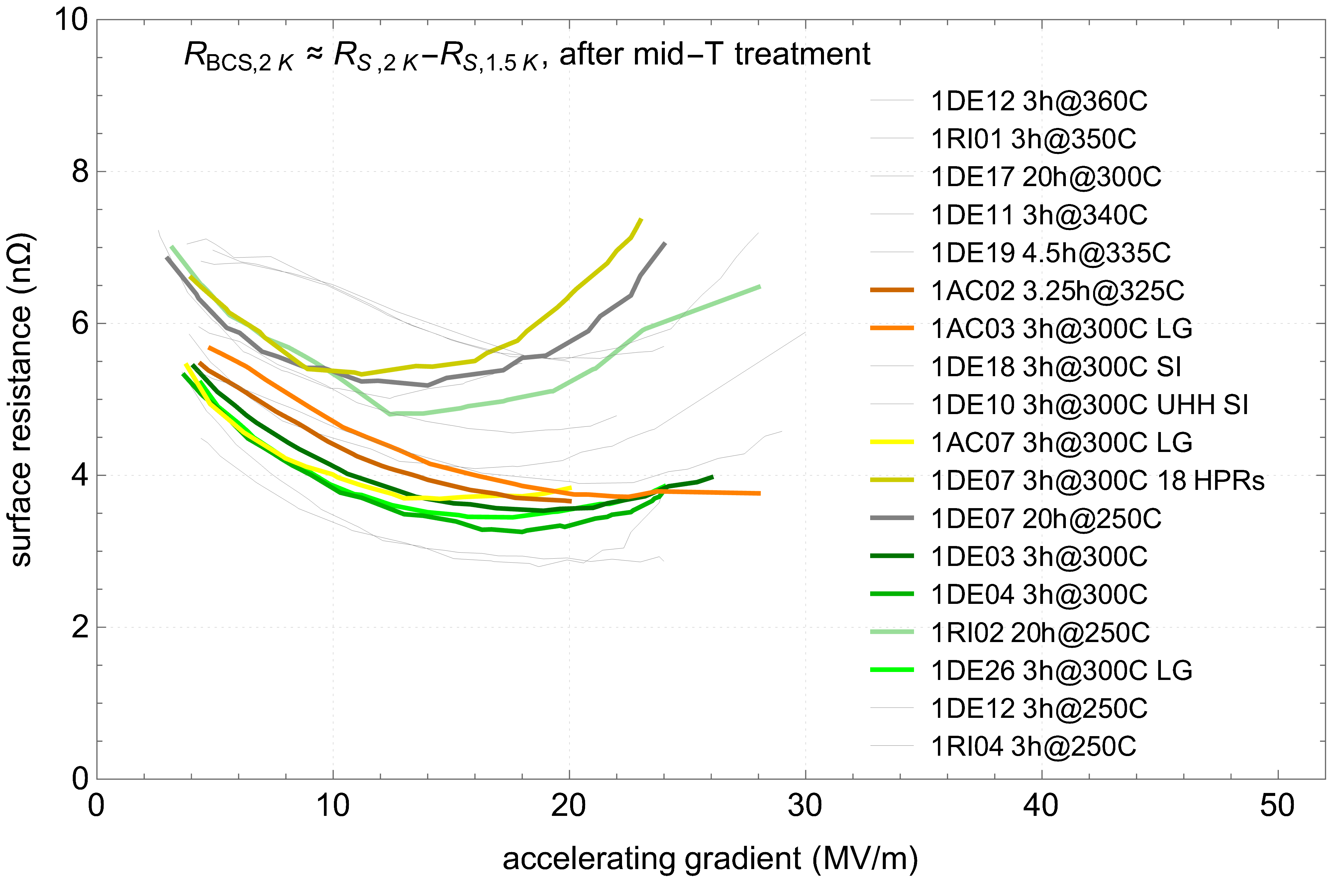
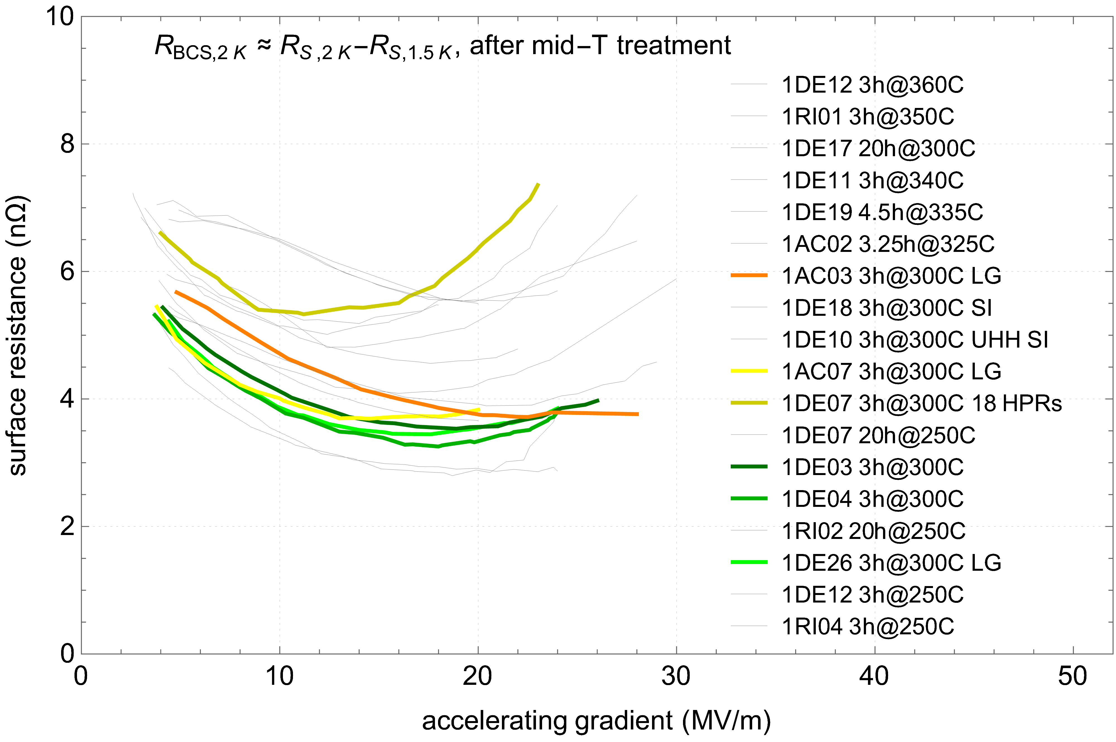
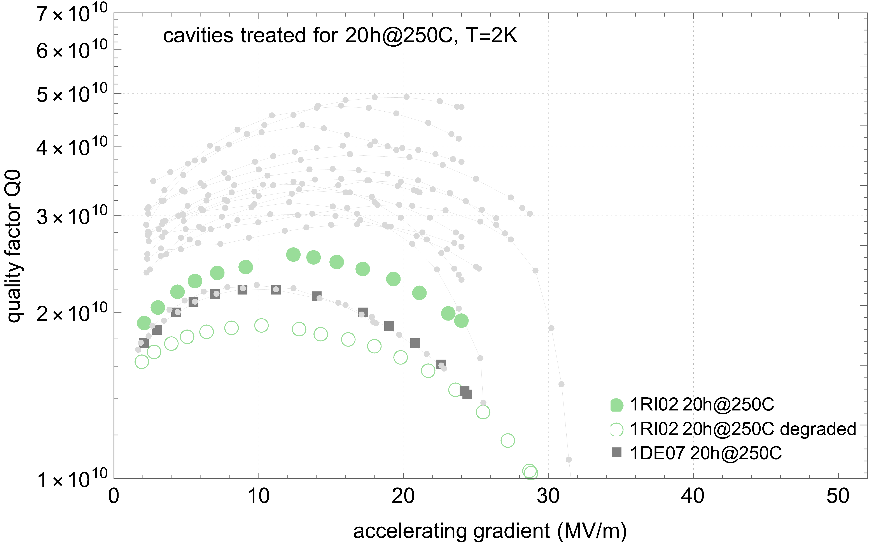
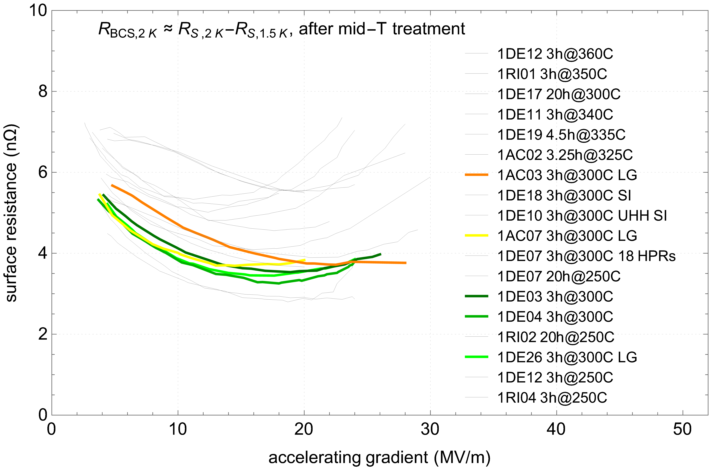
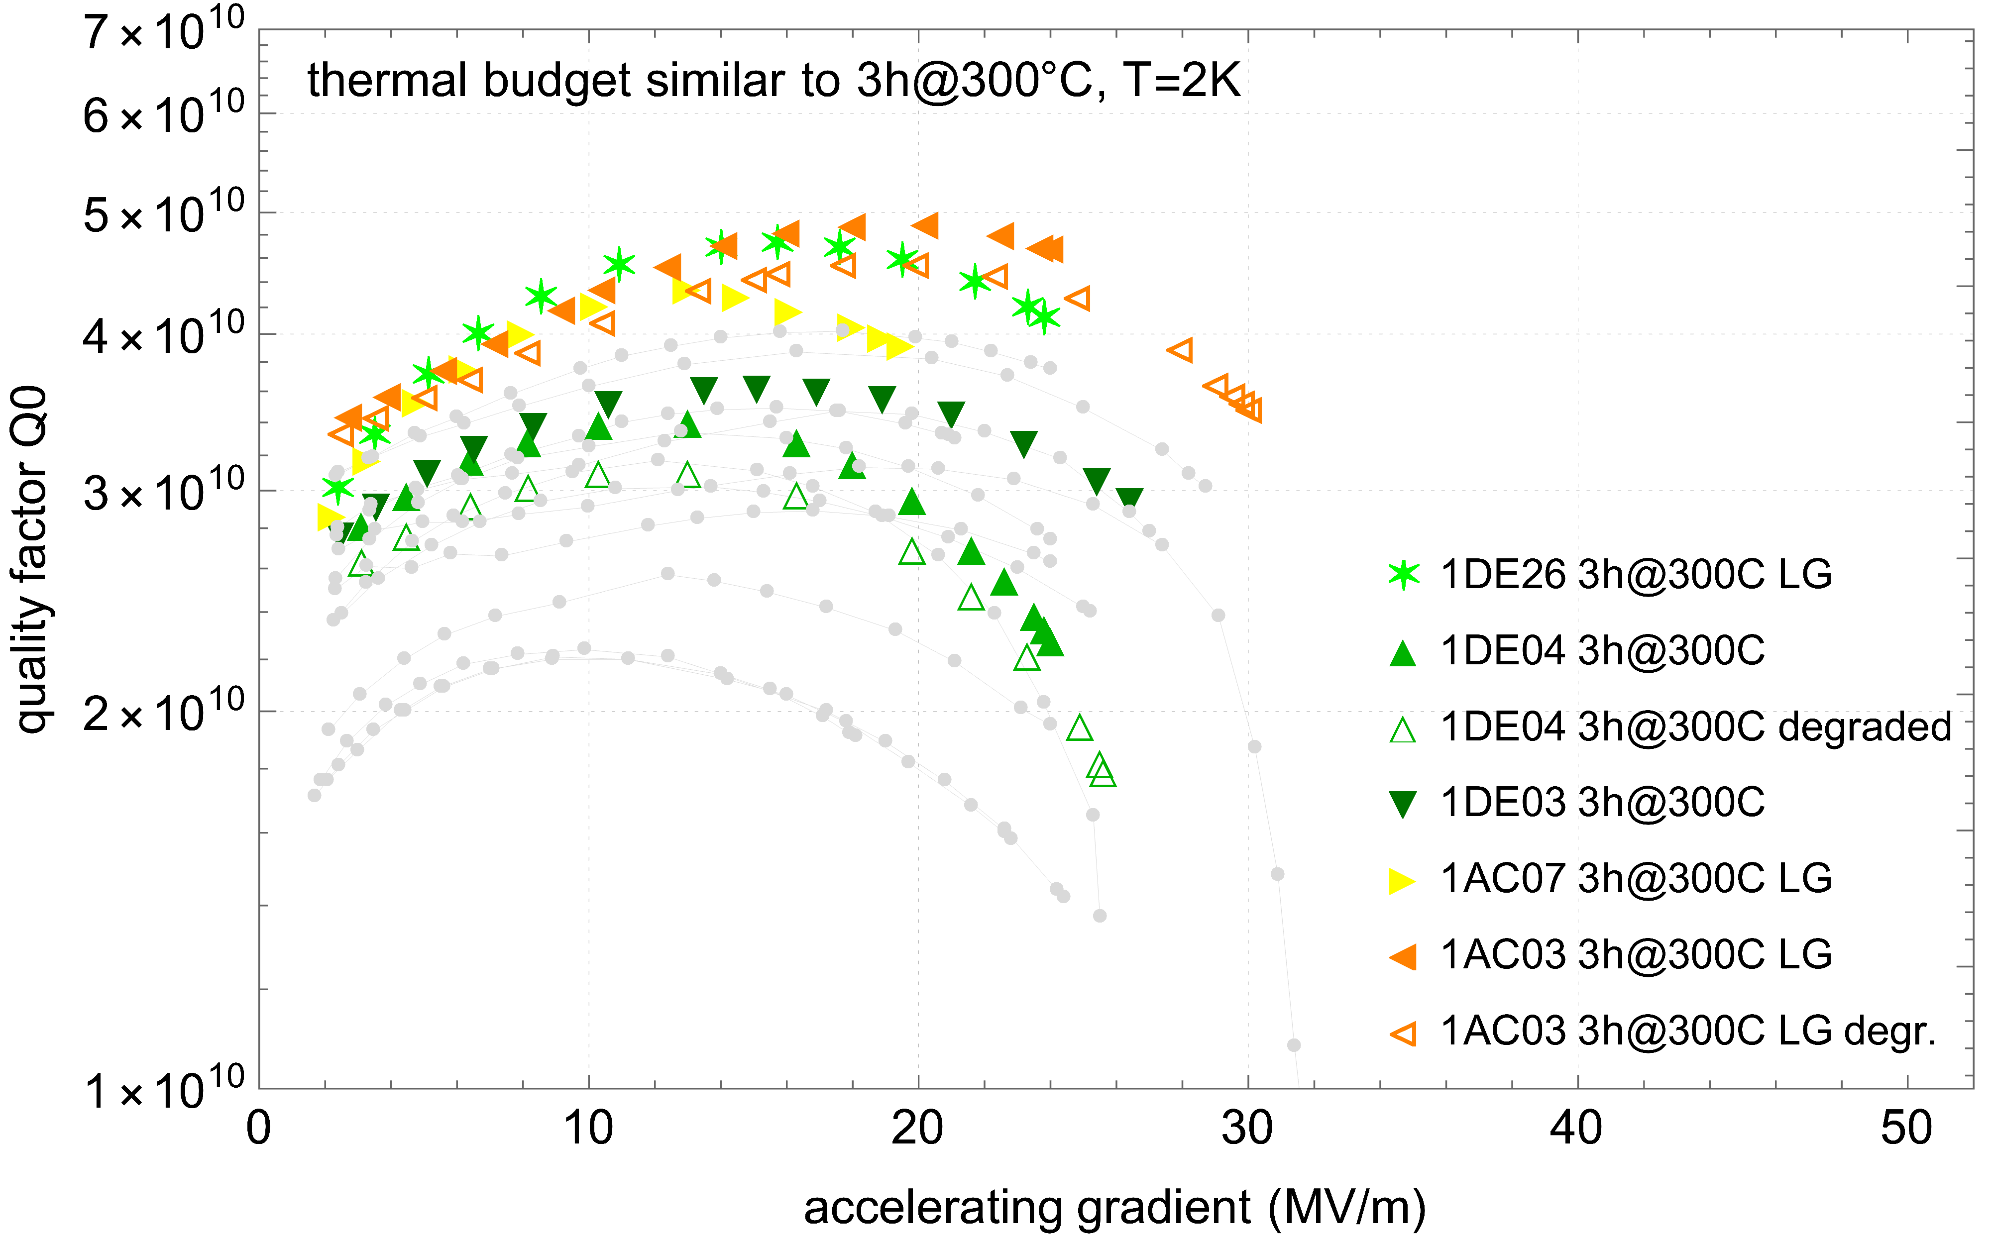
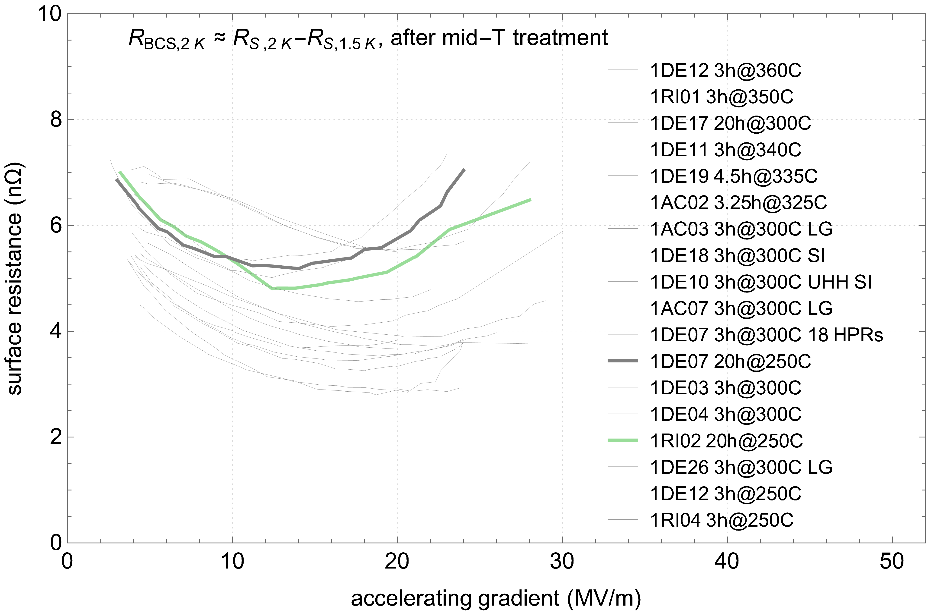
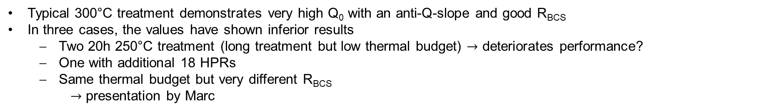
300°C treatments lead to best results
Q₀ vs E_{acc} & R_{BCS} - thermal budget similar to 3h 300°C
Typical 300°C treatment demonstrates very high Q₀ with an anti-Q-slope and good R_{BCS}
In three cases, the values have shown inferior results
  Two 20h 250°C treatment (long treatment but low thermal budget) $→$ deteriorates performance?
  One with additional 18 HPRs
  Same thermal budget but very different R_{BCS}
    $→$ presentation by Marc

Slide 9
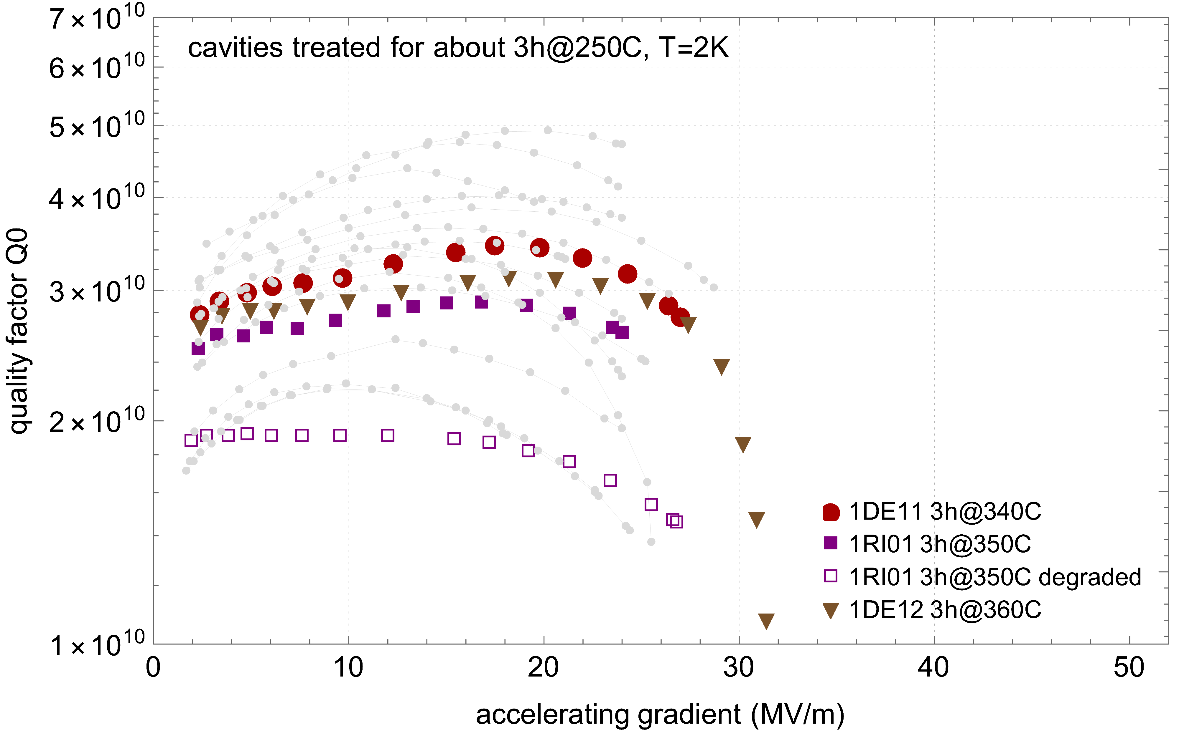
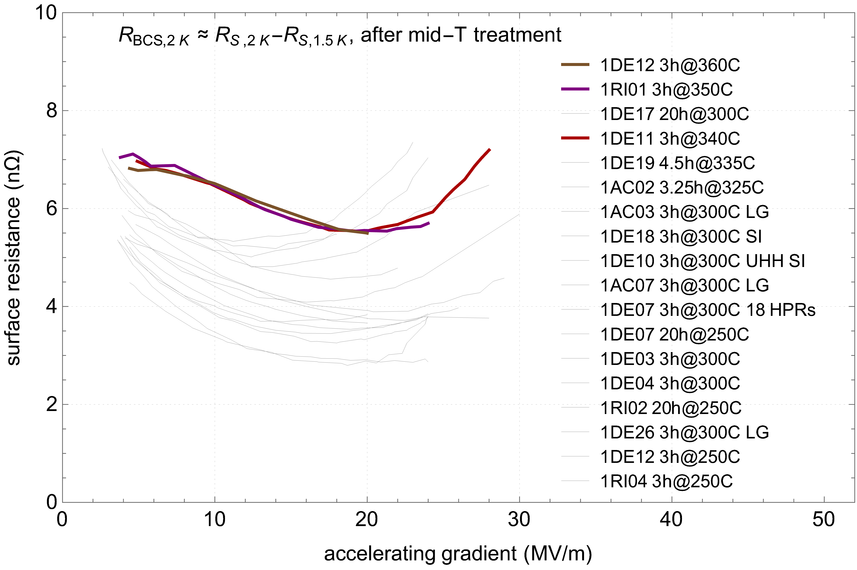
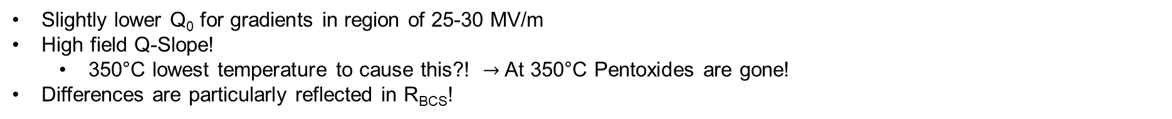
On the edge of Mid-T - 350°C lead to HFQS
Q₀ vs E_{acc} & R_{BCS} – thermal budget similar to 3h 350°C
Slightly lower Q₀ for gradients in region of 25-30 MV/m
High field Q-Slope!
  350°C lowest temperature to cause this?! $→$ At 350°C Pentoxides are gone!
Differences are particularly reflected in R_{BCS}!

Slide 10
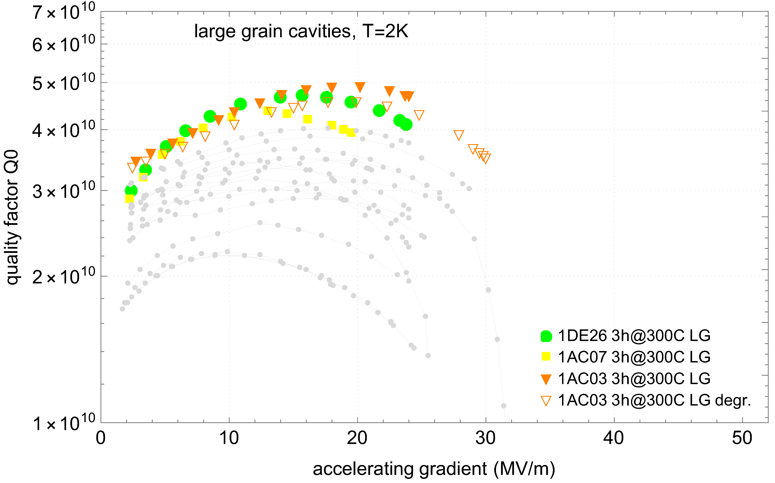
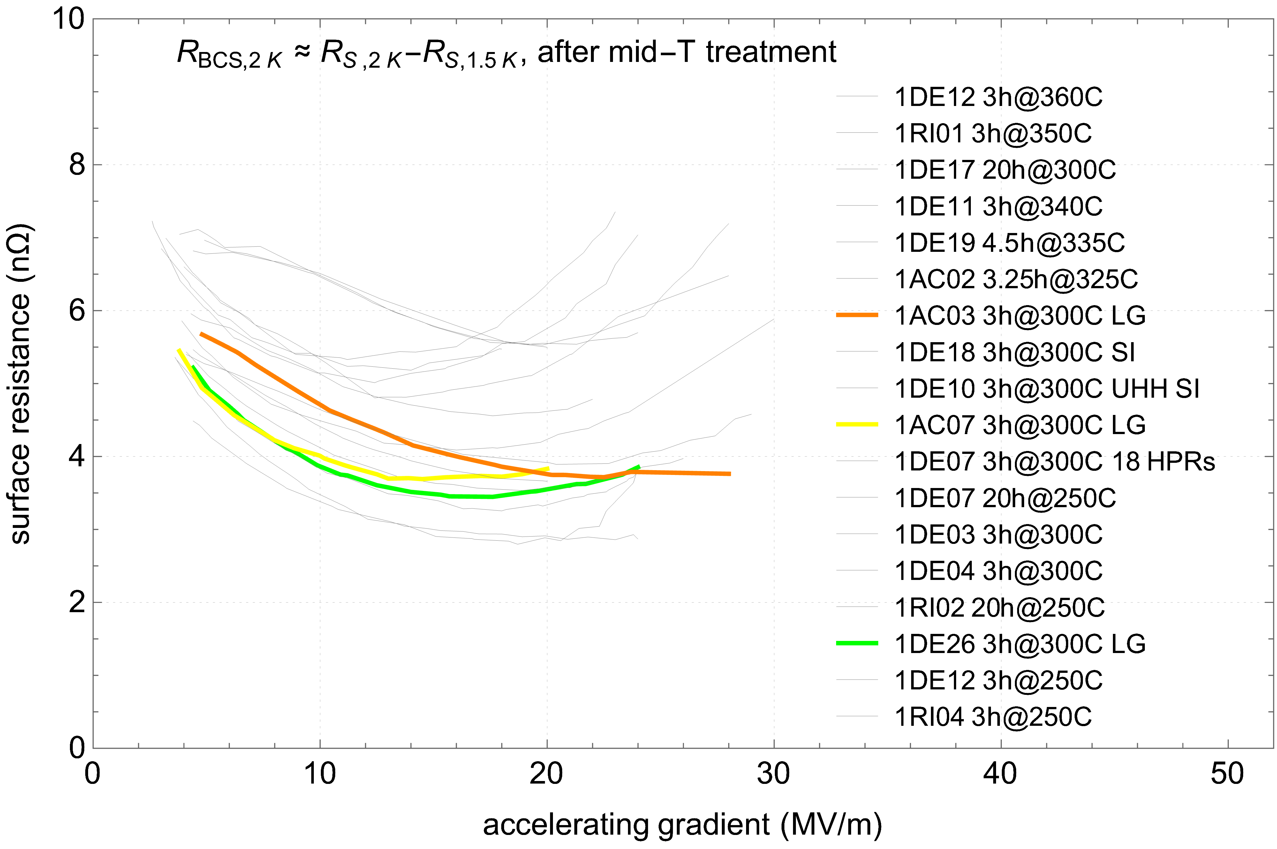
Large grain cavities are high performer!
Q₀ vs E_{acc} & R_{BCS} – large grain cavities treated with typical mid-T 3h 300°C
Mid-T treatments works very well with LG cavities
R_{BCS} values similar to FG $→$ main improvement comes from R_{res}!

Slide 11
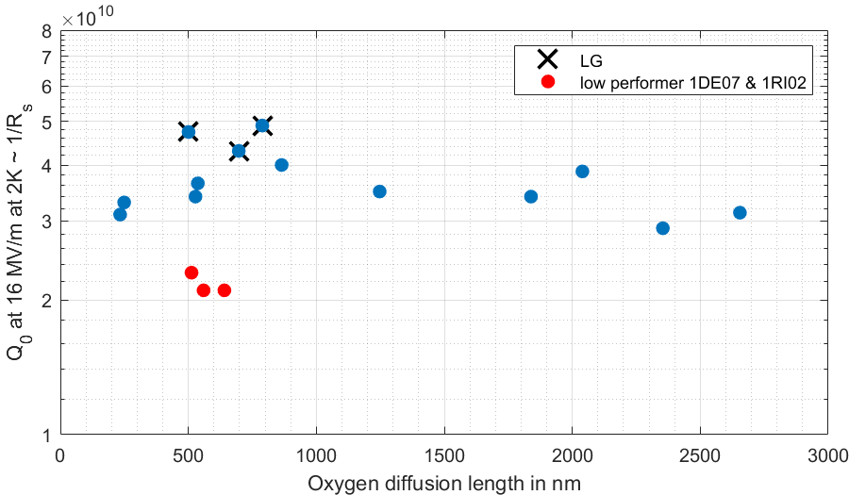
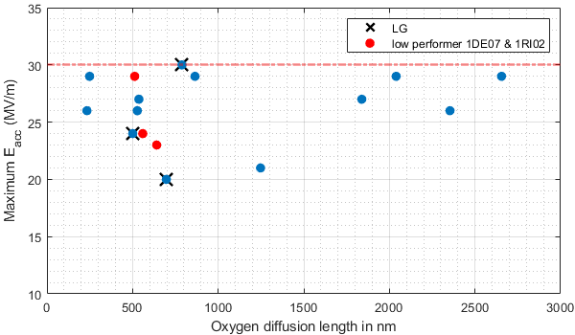
Correlation of performance with oxygen diffusion length
Q₀ & E_{acc}
No clear trend for Q₀ or E_{acc} against diffusion length (thermal budget)
  Or maybe for Q0?

Slide 12
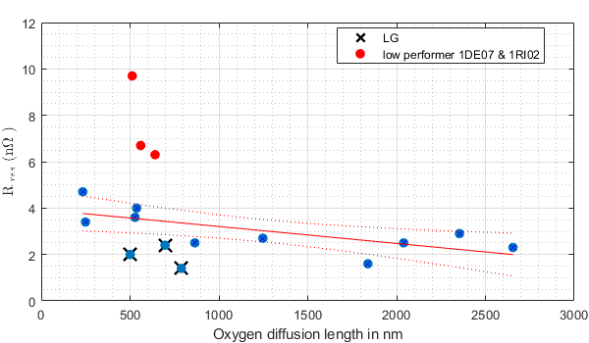
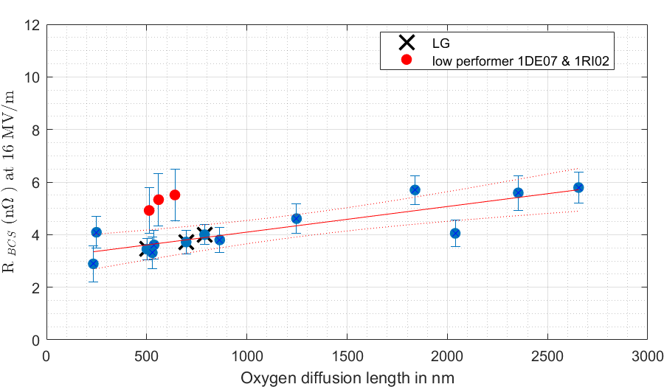
Correlation of performance with oxygen diffusion length
R_{res} & R_{BCS}
Neglecting outliers, a trend is observable
Data suggests the possibility of an optimization issue related to diffusion length (thermal budget)
More data needed to fill the gaps

Slide 13
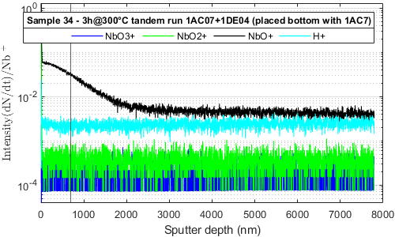
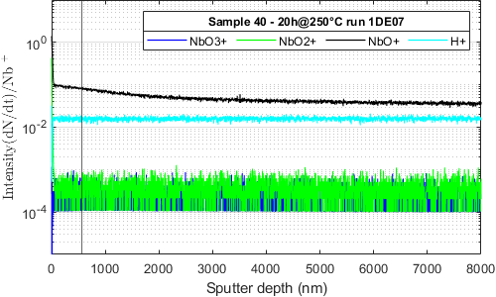
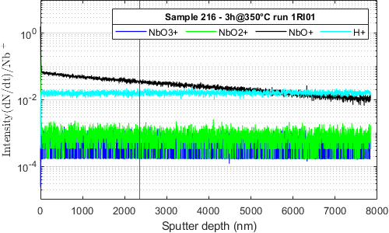
Oxygen diffusion length measurements on samples
SIMS profiles - deep sputtering
Calculated diffusion length from temperature profile:
697 nm
560 nm
2354 nm
3h@300°C
20h@250°C
3h@350°C
Measurement conducted at IFAM, Bremen, Germany
Calculated diffusion length same order of magnitude as measured value for the 3h 300°C treatment
The increased treatment duration appears to flatten the profile
The 350°C treatment also exhibits a relatively flat and deep profile, making it challenging to compare with the diffusion model

Slide 14
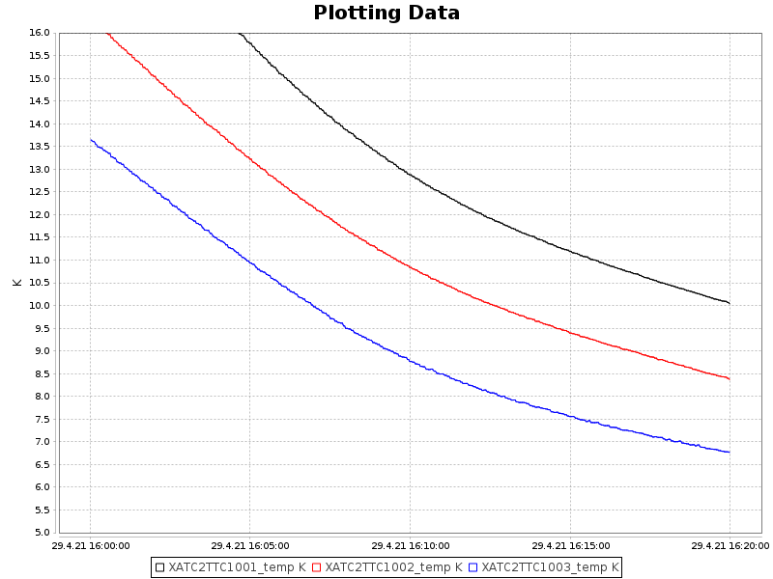



Spatial temperature gradient of cooldown
Determined by temperature sensors at cavity
T1
$$∆T$$
T2
~317mm
$$T_{c}$$
$$\frac{∆T}{∆x}=\frac{T3\left(at 9.2K\right)−T1}{∆x=317 mm}$$
T3
T1
T2
T3

Slide 15
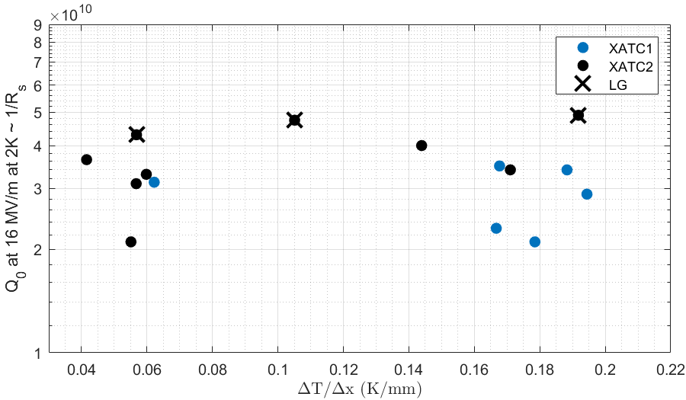
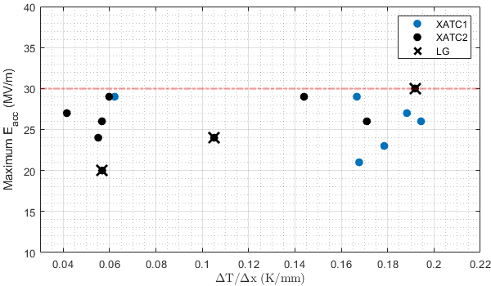
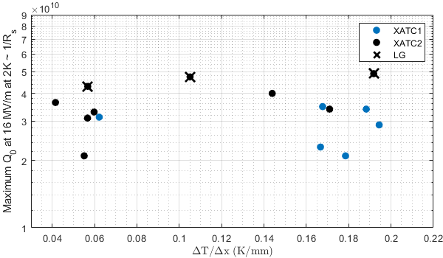

Spatial cooldown gradient dependency to performance
Q₀ & E_{acc} - divided into two cryo test setups
No correlation to performance observed
Two ranges of ${∆T}/{∆x}$ observable $→$ attributed to our two test setups

Slide 16
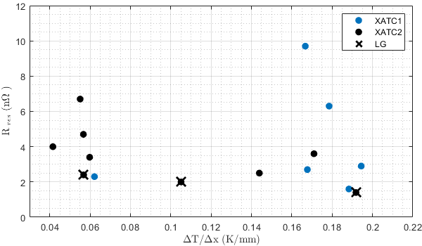
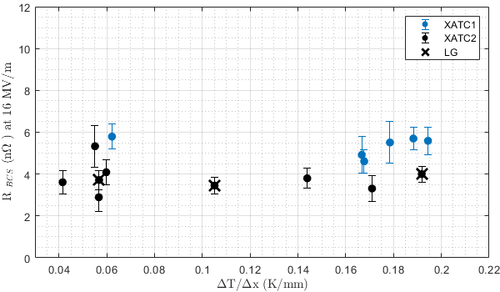
Spatial cooldown gradient dependency to performance
R_{res} & R_{BCS} - divided into two cryo test setups
No correlation to to R_{res} and R_{BCS}
Lower limit of ~2nΩ for R_{res} observed (without magnetic field compensation)
We can exclude the impact of different cryostats and inserts
Observable difference between the test setups exists for R_{BCS} (?!)

Slide 17
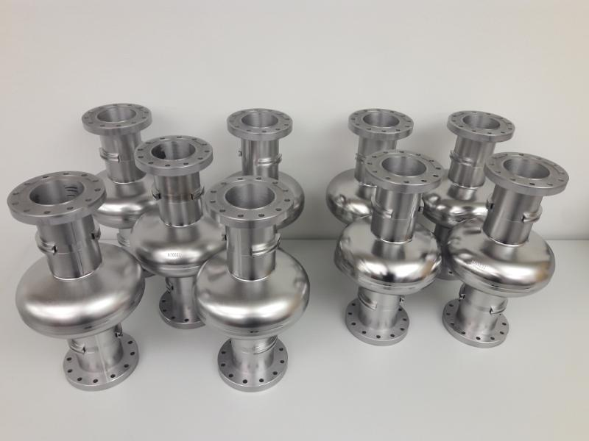
Summary and outlook for the mid-T campaign at DESY
The amount of data has increased and we are filling the gaps
Very high reproducibility of characteristic results
  The 30 MV/m is still an unbreakable wall
  7 out of 18 cavities degrade after quenching (restorable by T_{c} cycling)
LG cavities show best performances
Sorting by thermal budget appears to provide insights
350°C edge to new characteristic regime
SIMS measurements only partially conclusive
Additional diagnostics & studies ongoing
  flux trapping sensitivity via new B-mapping system
  frequency vs. temperature measurements
  => presentation by Marc
Optimisation potential
  New/alternative recipes necessary?
  Role of caps?
Transfer to 9-cell cavity Mid-T treatments ongoing
18 new single cell cavities produced to increase the statistics even further

Slide 18
Thank you

Slide 19
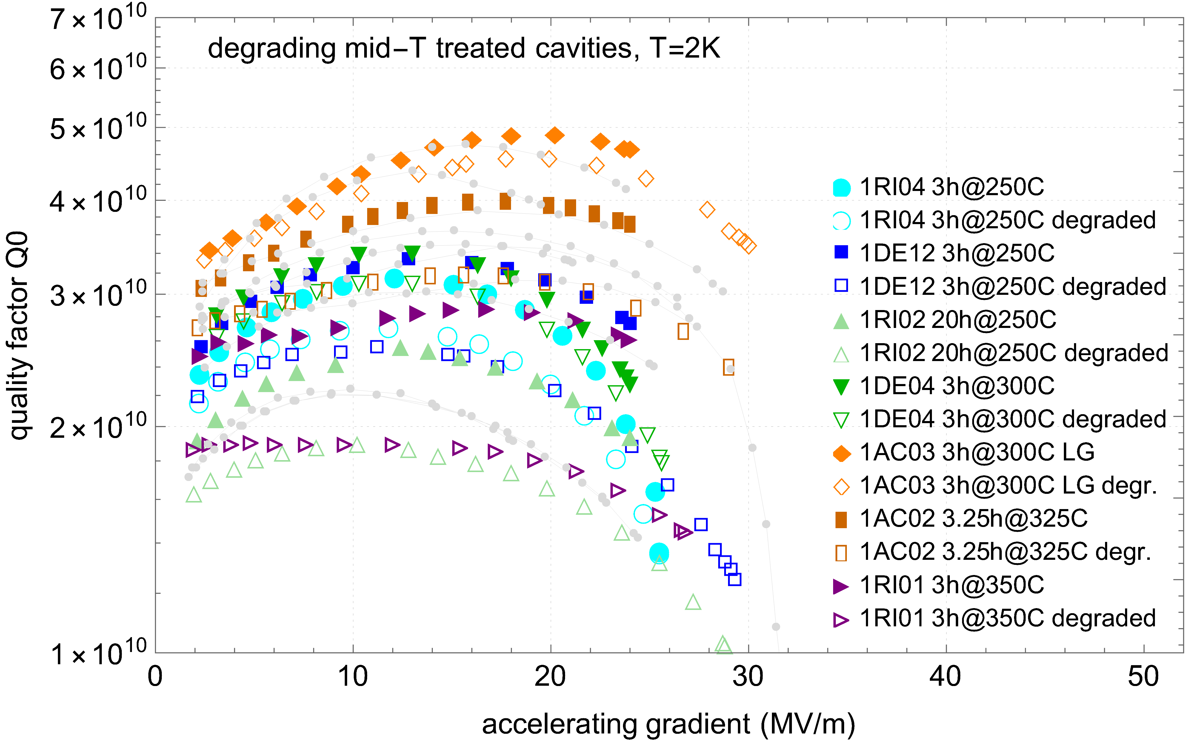
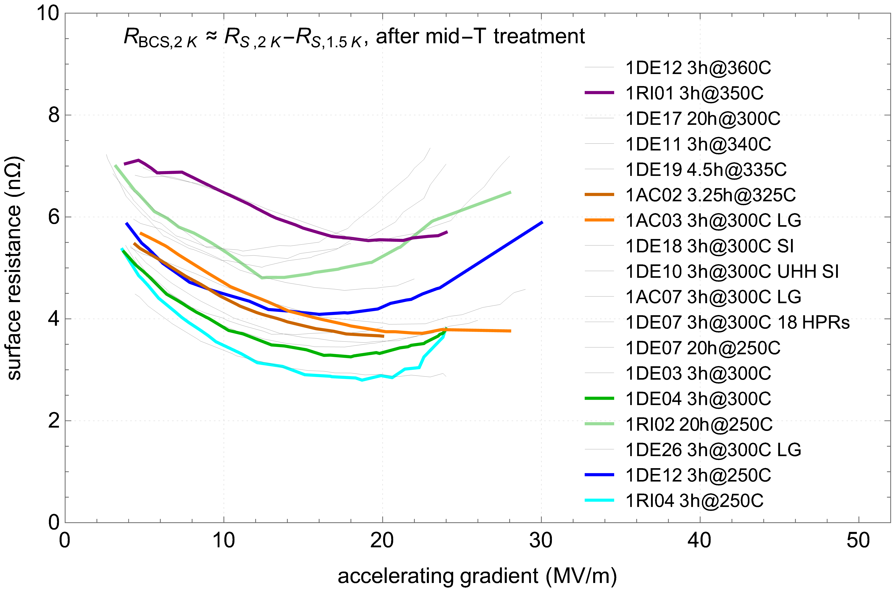
Q₀ Degradation after quench
Some cavities degrade in Q₀ after a quench
Some cavities exhibit the phenomenon of degrading in quality after quenching
Not attributable to any specific treatment group $→$ not yet understood the cause

