Slide 1
WG1 TTC: Impact of Baking on the Performance of Low-beta, Low-frequency QWRs at 4 K
Jacob Brown, Walter Hartung, Sang-hoon Kim, Ting Xu

Slide 2
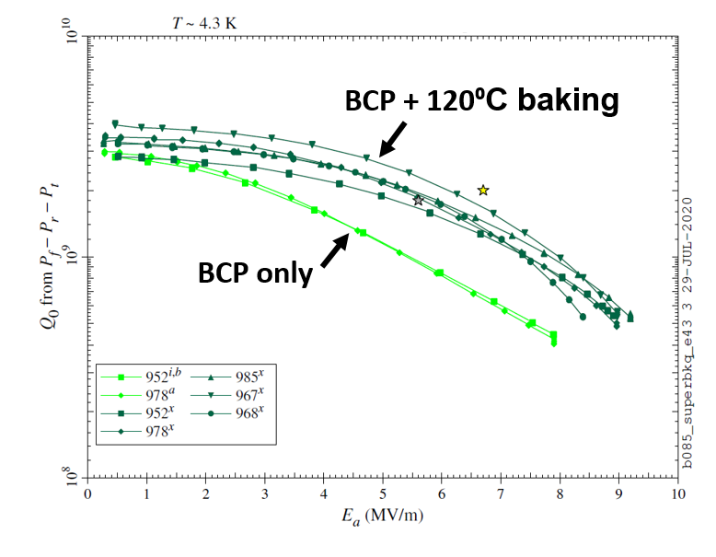
Introduction
FRIB linac contains 94 quarter-wave resonators with $β=0.085$ (QWR, f = 80.5 MHz, T = 2 K, 4.3 K); prep: buffered chemical polishing (BCP)
BCP + in-situ low-temperature bake (LTB,120 C, 48hrs) improves medium field Q-slope (MFQS) at 4.3 K
Cause for reduction in MFQS? How to utilize it?
Examine the BCS resistance in three different baking scenarios
In-situ LTB: 120 C 48hr
Furnace LTB: 120 C 48hr
Furnace medium temp. bake (MTB): 350 C 3hr

Slide 3
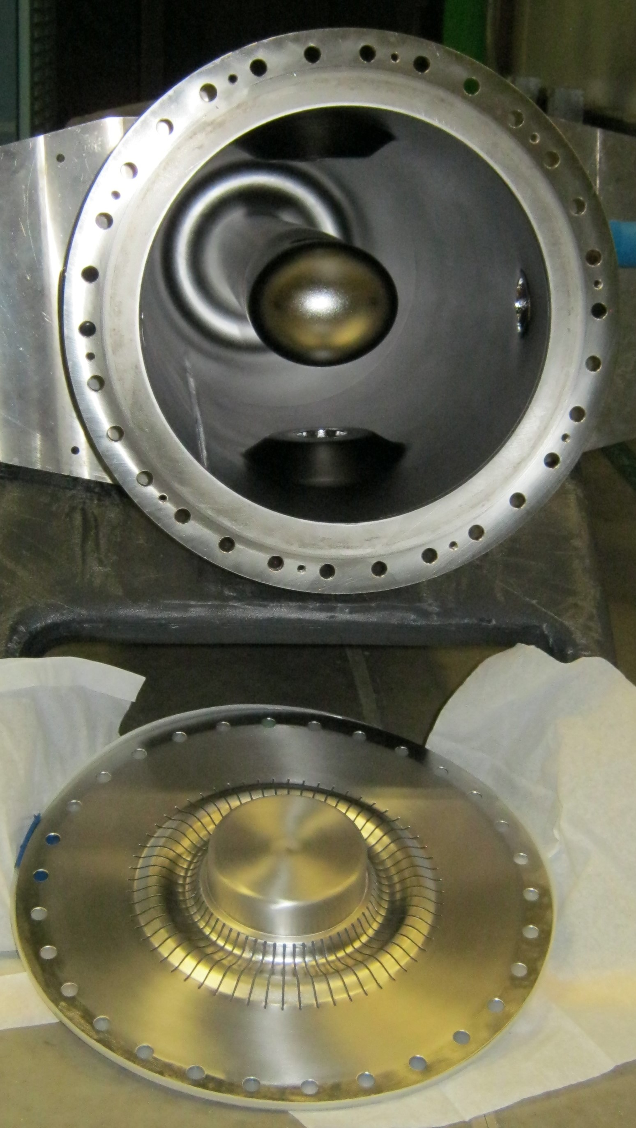
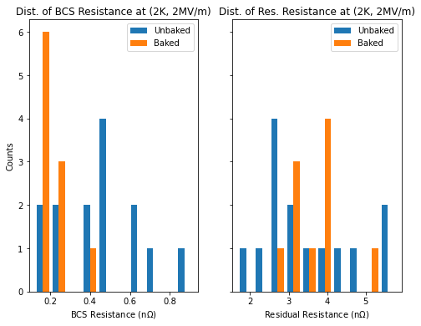
Goal and Methodology
Goal: isolate BCS resistance and the effect of baking
Note: FRIB QWRs use indium gasket as RF seal
Seating of gasket has impact on residual resistance
Residual resistance is dominant component for FRIB QWR at 2 K
In rough approximation, ignore BCS contribution at 2K
$R_{s}\left(2K, B_{pk}\right)≈R_{res}(B_{pk})$
$R_{BCS}≈R_{s}\left(4.3K, B_{pk}\right)−R_{res}(2K, B_{pk})$

Slide 4
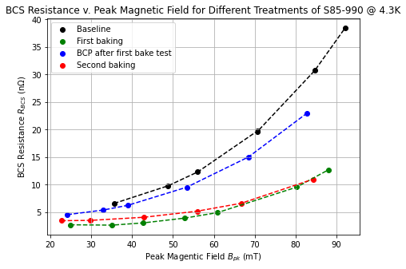
Effect of BCP Reset
Hypothesis: improvement in MFQS is due to improved thermal impedance
Shown anodized cavity has increased performance ~4 K [1]
First case to look at: S85-990
Baseline
BCP + 120C in-situ bake
Post-test BCP, then retest. Performance within variation for un-baked cavities
BCP + 120C in-situ again
Effect of first bake reset by BCP
Then recovered by second bake
Conclusion: improved MFQS not necessarily due to improved thermal impedance
[1] M. Checchin, et. al., Proc. Of SRF2013

Slide 5
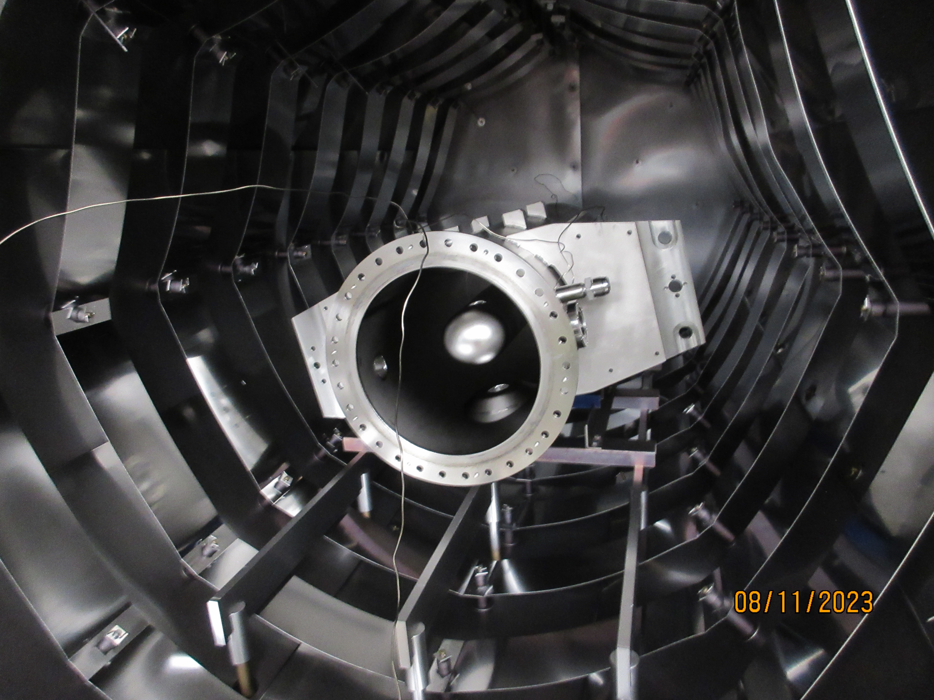
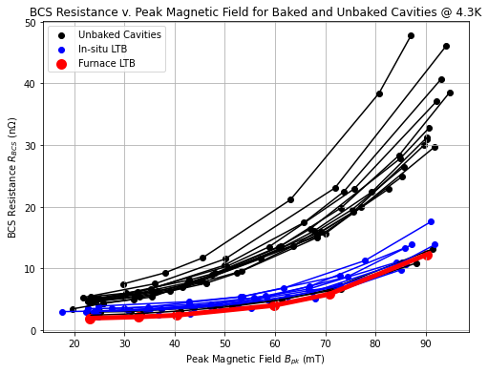
In-situ vs. Furnace LTB
Test furnace LTB and compare the result with in-situ LTB
Resulting Q-curve is in red
Can see that furnace configuration yields similar MFQS improvement
Bottom flange (Ti) and tuning plate (Nb) are not baked in furnace baking
Furnace bake setup. Image courtesy of B. Barker

Slide 6
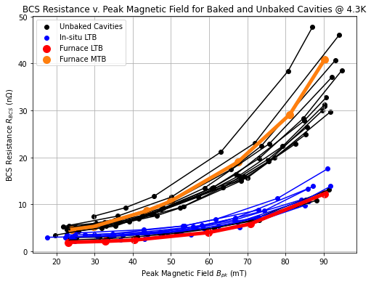
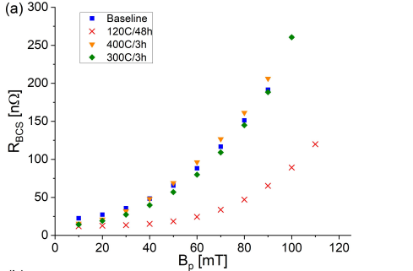
Furnace MTB
Test for our first furnace MTB (350 C, 3hr)
Isolate BCS resistance at 4.3 K, compare with other bake tests
Included are baseline tests, dots
Performance is more in-line with unbaked cavity at 4.3 K
Trend agrees with findings of mid-T bake at 4 K by TRIUMF [2]
Results shown from 220 MHz multimode QWR and HWR
Cannot preform in-situ MTB due to indium seal for bottom flange
TRIUMF
[2] P. Kolb et. al., Mid-T Heat Treatments of BCPed Coaxial Cavities at TRIUMF, 2023, https://doi.org/10.48550/arXiv.2306.12588

Slide 7
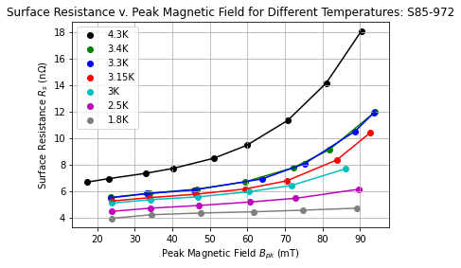
Rs v. Field and T
Previously: had testing availability to take CW data at multiple temperatures for furnace LTB
Cryogenic stability: $±0.01 K$on average
Interested in transition in trend from quadratic and linear as T decreases
Expected sharp transition in curve through $T_{λ}$, as seen in other geometries/freq. [3]
Next steps: use simple fitting model at first [4]:$c_{0}+c_{1}b+c_{2}b^{2}$
$c_{1}$ is associated with hysteresis losses, $c_{2}$ carries thermal feedback and pair-breaking losses information [5]
Redo this measurement when available
Measure another LTB cavity with more data sets below $T_{λ}$
Measure an un-baked cavity to compare with; reduction of $c_{1}$ would suggest diffusion of oxygen away from surface [6, 7] as explanation of MFQS reduction
[3] C. C. Compton, et. Al, Phys.
Rev. Accel. Beams 8.042003, 2005
[5] G. Ciovati, J. Halbritter, Physica C: Superconductivity, Issues 1-2
Vol. 441, pp 57-61, https://doi.org/10.1016/j.physc.2006.03.053.
[7] K. Saito, Proc. Of SRF 2021, https://doi.org/10.18429/JACoW-SRF2021-WEPFDV004
[4] K. McGee, et. al.,, Phys. Rev. Accel. Beams 24.112003, 2021,
https://doi.org/10.1103/PhysRevAccelBeams.24.112003
[6] A. Romanenko, proc. of TTC 2020, https://indi.to/mfBdR

Slide 8
Summary
Found that LTB improves MFQS for FRIB $β=0.085$, 80.5 MHz QWRs at 4.3 K
See from decomposition of $R_{s}$ that improvement comes from change in BCS
Furnace LTB has similar improvement to in-situ LTB
MTB doesn’t offer improved MFQS for FRIB QWRs
Difference in frequency, much lower
Difference in surface treatment: EP v. BCP
When available, continue examination of trend of MFQS with temperature
Developed a new recipe for spare FRIB QWRs production
Bulk BCP, 600 C H degas, light BCP, 120 C 48hr furnace LTB, and high pressure rinse

Slide 9
Thank you! Questions?

Slide 10
Full Citations
[1] M. Checchin, et. al., Heat Transfer at the
Interface Between Niobium and Liquid Helium
For 6 GHz SRF Cavities, proc. Of SRF 2013
[6] A. Romanenko, New Low-T Sample Studies Highlighting the Important Role of Oxygen Diffusion, proc. of TTC 2020, https://indi.to/mfBdR
[2] P. Kolb et. al., Mid-T Heat Treatments of BCPed Coaxial Cavities at TRIUMF, 2023, https://doi.org/10.48550/arXiv.2306.12588
[7] K. Saito, A New Model for Q-Slope in SRF-Cavities: RF Heating
at Multiple Josephson Junctions to Weakly-Linked Grain Boundaries or Dislocations,
Proc. Of SRF 2021, https://doi.org/10.18429/JACoW-SRF2021-WEPFDV004
[3] C. C. Compton, et. Al, Phys.
Rev. Accel. Beams 8.042003, 2005,
https://doi.org/10.1103/PhysRevSTAB.8.042003
[4] K. McGee, et. al., Medium-velocity Superconducting Cavity for High Accelerating Gradient Continuous-wave Hadron Linear Accelerators, Phys. Rev. Accel. Beams 24.112003, 2021,
https://doi.org/10.1103/PhysRevAccelBeams.24.112003
[5] G. Ciovati, J. Halbritter, Analysis of the Medium Field Q-slope in
Superconducting Cavities Made of Bulk Niobium, Physica C: Superconductivity,
Vol. 441, pp 57-61, https://doi.org/10.1016/j.physc.2006.03.053.

Slide 11
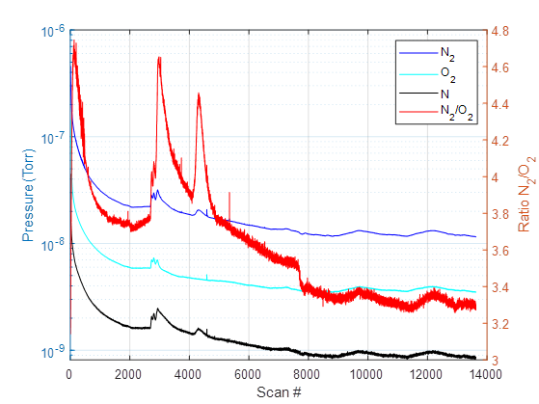
Extra Slides: Partial Pressure Readouts for LTBs (Furnace left, in-situ right)
Partial Pressures for In-situ LTB

Slide 12
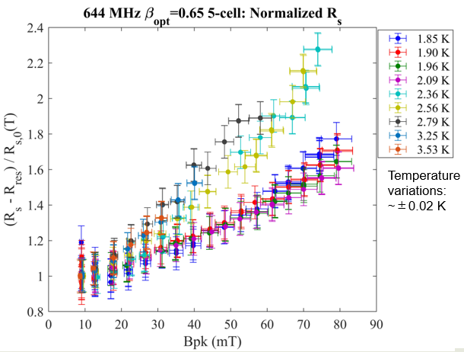
Extra Slides: Motivation
Case of EP+In-situ LTB FRIB $β=0.65$ 644 MHz upgrade cavity
Simple model of normalized resistance using a constant residual resistance
CW data over MF region, see two distinct bands for Q-slope as function of field
$T>T_{λ}$ and $T<T_{λ}$
See shift in slope as LHe transitions to superfluid
Suggests MFQS can be improved by further improving thermal impedance
Plethora of QWR LTB and baselines for FRIB
Reproduce and refine analysis with more updated model

Slide 13
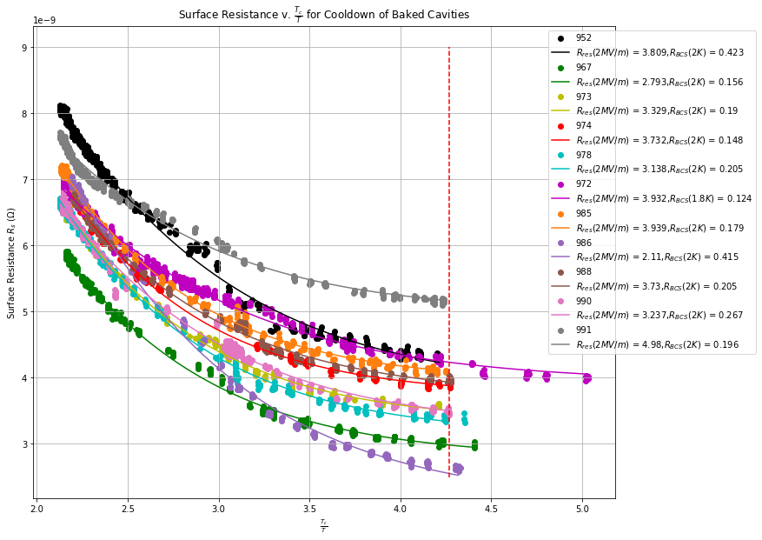
Extra Slides: Data Treatment
Previously: taking residual resistance to be a constant
In reality, residual resistance changes with cool down sensitivity and that $R_{res}=R_{res}(B_{pk})$
Want: isolate the BCS resistance at 4.3K to examine change in MFQS
How: From idealized model: $R_{BCS}\left(2K, 80.5MHz\right)≈0.04 nΩ$
For 11 baked cavities: $R_{BCS,avg}=0.199 nΩ$ at 2K-1.8K
For 13 baked cavities: $R_{BCS,avg}=0.506 nΩ$ at 2K
First order approx: ignore BCS at 2K for QWR
$→R_{s}\left(2K, B_{pk}\right)≈R_{res}(B_{pk})$

Slide 14
Extra Slides: Unbaked Cooldown

Slide 15
Extra Slide: 2 K Q-curves

