Slide 1
RF and Material Studies on Interstitial Impurities in Bulk Nb Cavities
Hannah Hu¹, Daniel Bafia², Young-Kee Kim¹
¹University of Chicago, ²Fermi National Accelerator Laboratory
TTC 2023
December 5, 2023

Slide 2
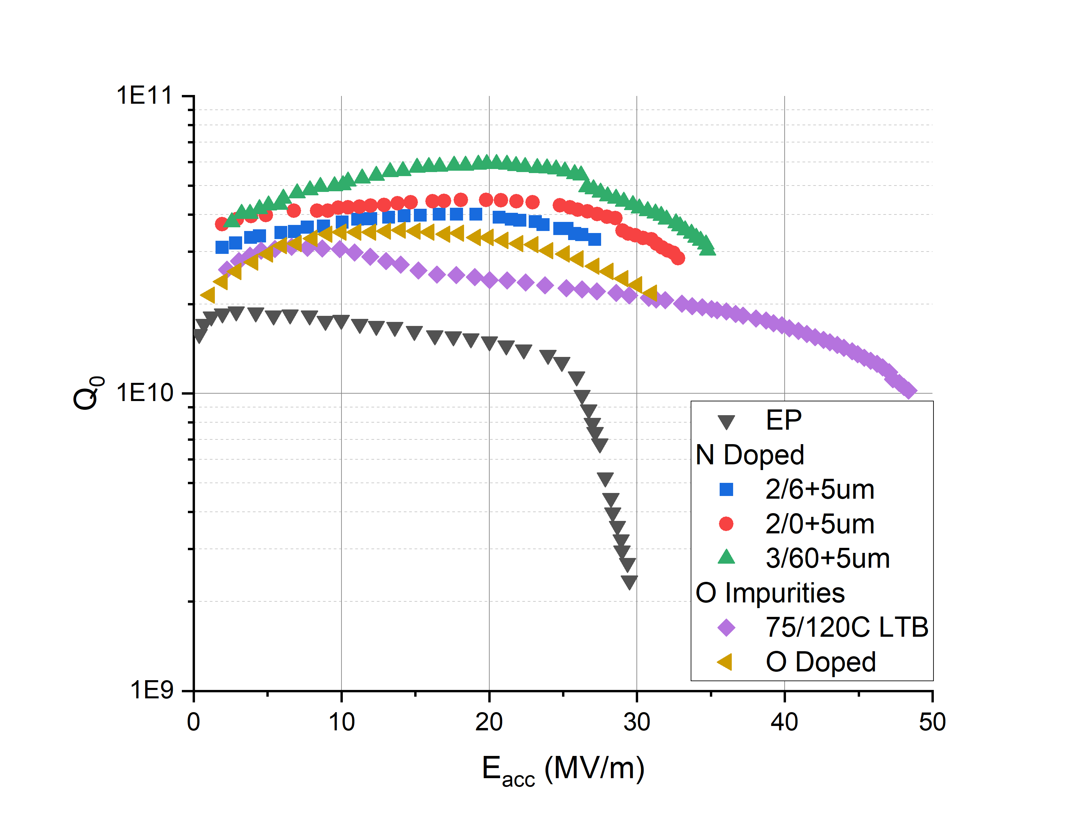
Motivation
O and N enable high Q or high E_{acc} performance
A. Grassellino et al., doi: 10.1008/0.953-2048/26/10/102001
D. Bafia et al., doi:10.18429/JACoW-SRF2021-THPTEV016
E. Lechner et al. arXiv:2106.06647
H. Ito et al., doi:10.1093/ptep/ptab056
How to achieve simultaneous high Q and high E_{acc}?
Study the role of O and N impurities to fully understand their microscopic properties
Corroborate differences in RF performance through material studies of samples subjected to N and O based treatments.

Slide 3
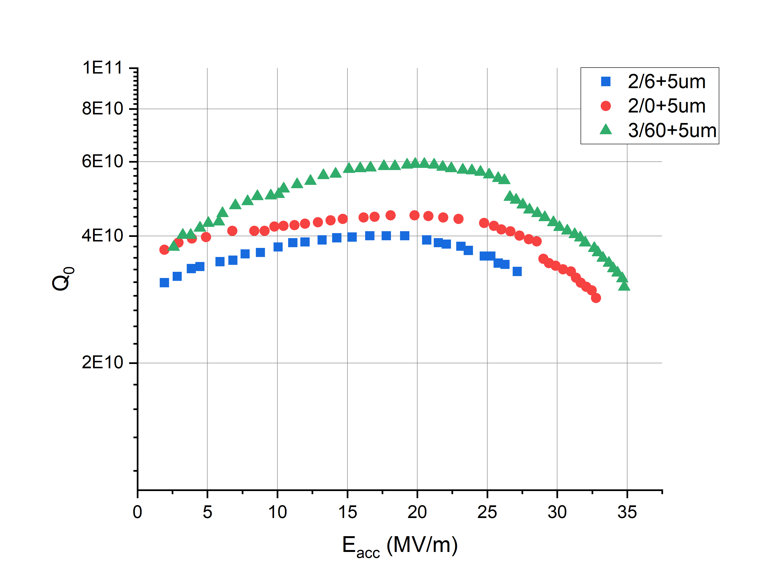
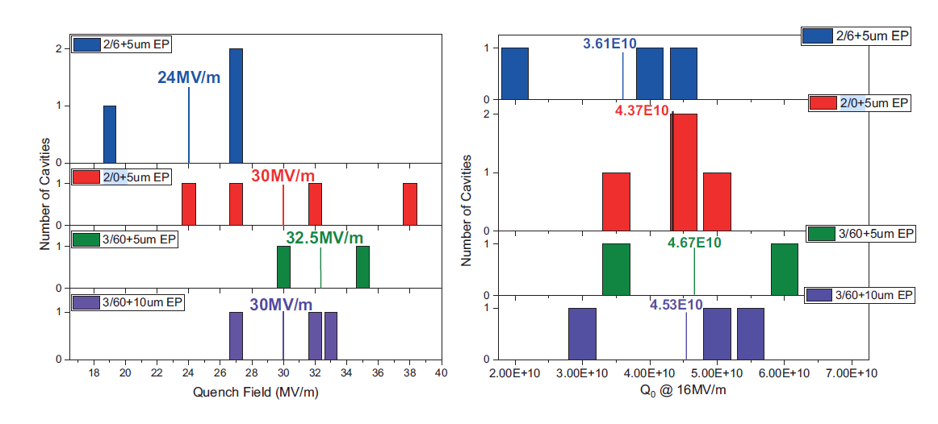
Nitrogen Doping
Start with an in-depth analysis of nitrogen
LCLS-II HE: 2/0+5µm cold EP
LCLS-II: 2/6+5µm EP
3/60+5µm EP
Is observed improvement due to a change in N concentration?
Can we correlate RF performance to material properties?
D. Bafia, PhD Dissertation, IIT, 2020.

Slide 4
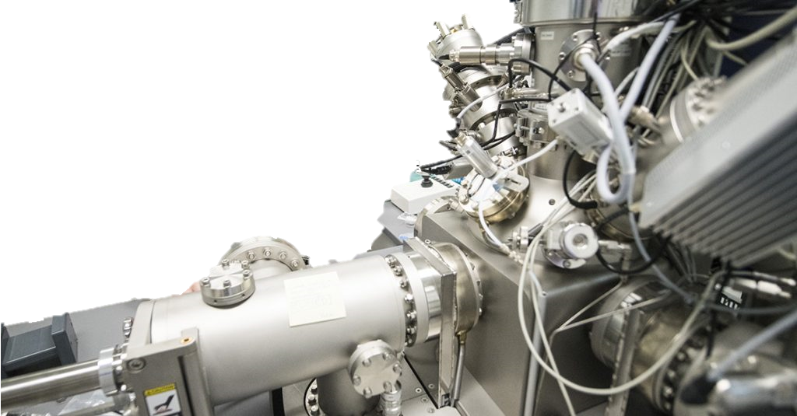
Sample Prep and Measurement
2/6 Doping
800°Cx3hr UHV
800°Cx2min w/ 25mTorr N₂
2/0 Doping
800°Cx3hr UHV
800°Cx2min w/ 25mTorr N₂
3/60 Doping
800°Cx3hr UHV
800°Cx3min w/ 25mTorr N₂
800°Cx6min UHV
N/A
800°Cx60min UHV
5μm EP removal
5μm EP removal
5μm EP removal
Time-of-Flight Secondary Ion Mass Spectrometry (TOF-SIMS)
Depth profiling with Cs+ gun sputtering
3D imaging
Removal of particle contaminant data
Retroactive spectrum fitting
In-situ baking up to 800°C
Vacuum < 4 e-10 mbar

Slide 5
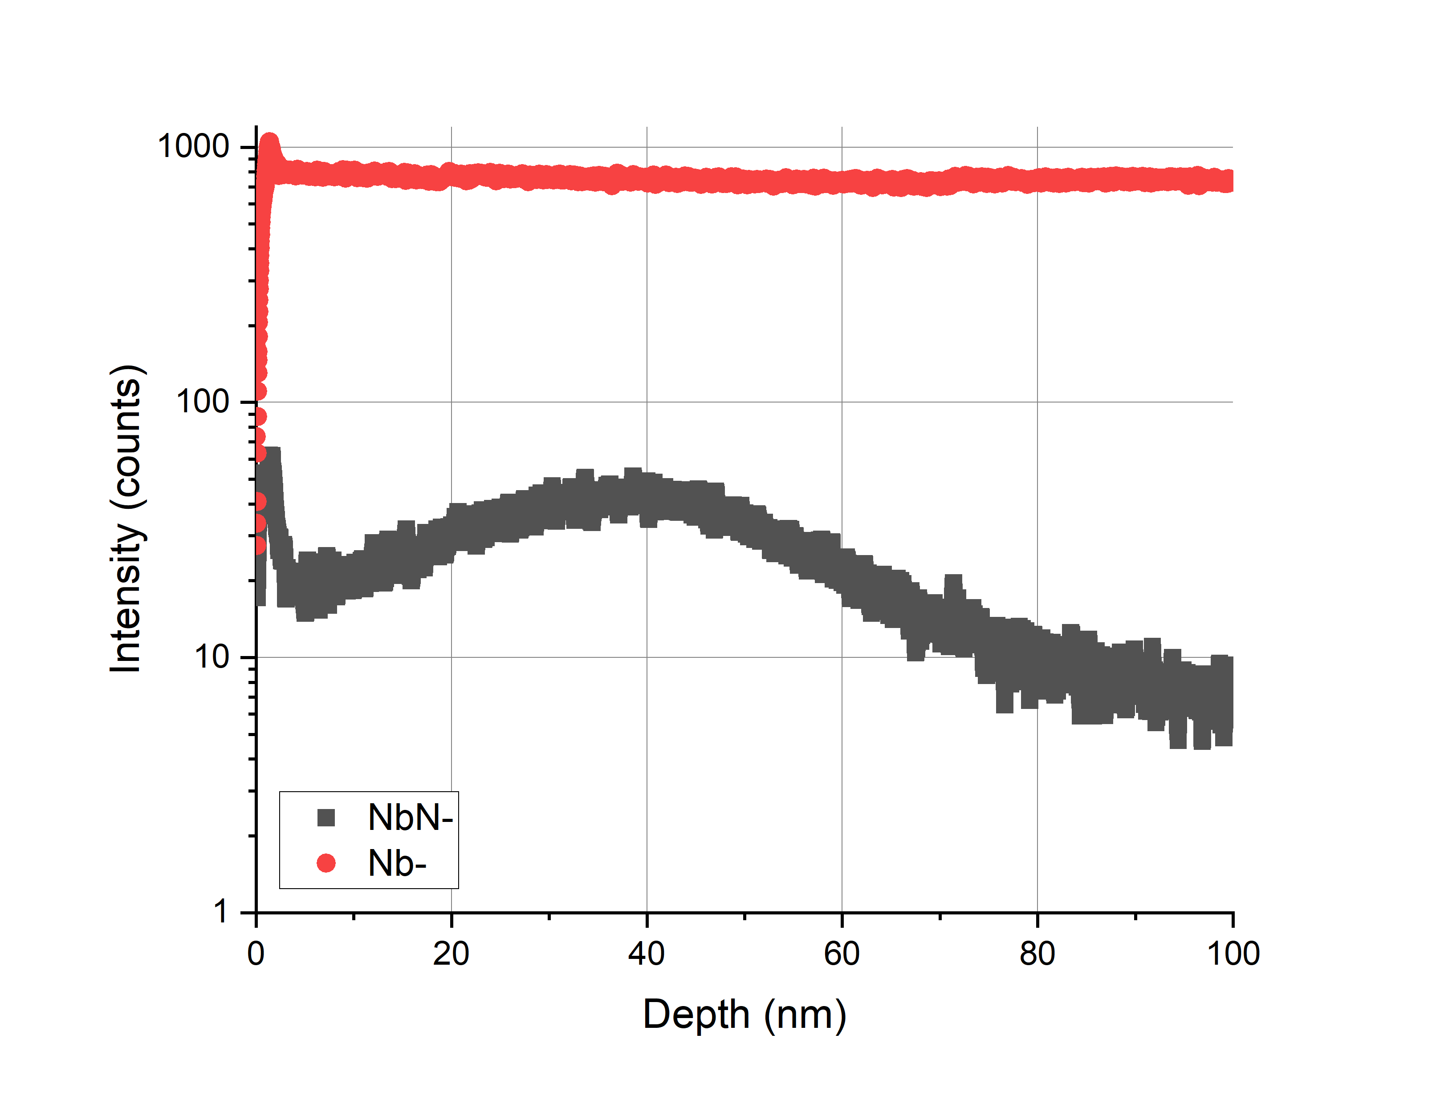
SIMS Absolute Concentration
O and N implanted standards for absolute concentration.
Nb implanted with dose: 6.37E14 of N at 100 keV
Concentration of N: C_{N} [ions/cm^3]
Secondary ion yield of NbN-: I_{NbN-} [ions/s]
Secondary ion yield of Nb: I_{Nb-} [ions/s]
Relative Sensitivity Factor: RSF = C_{N} x I_{Nb-} / I_{NbN-} = 2.098E21[ions/cm^3]

Slide 6
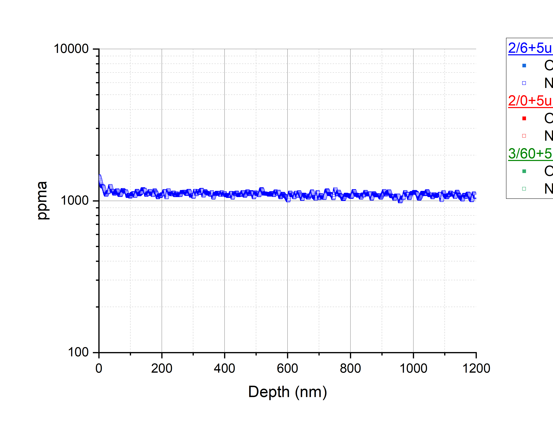
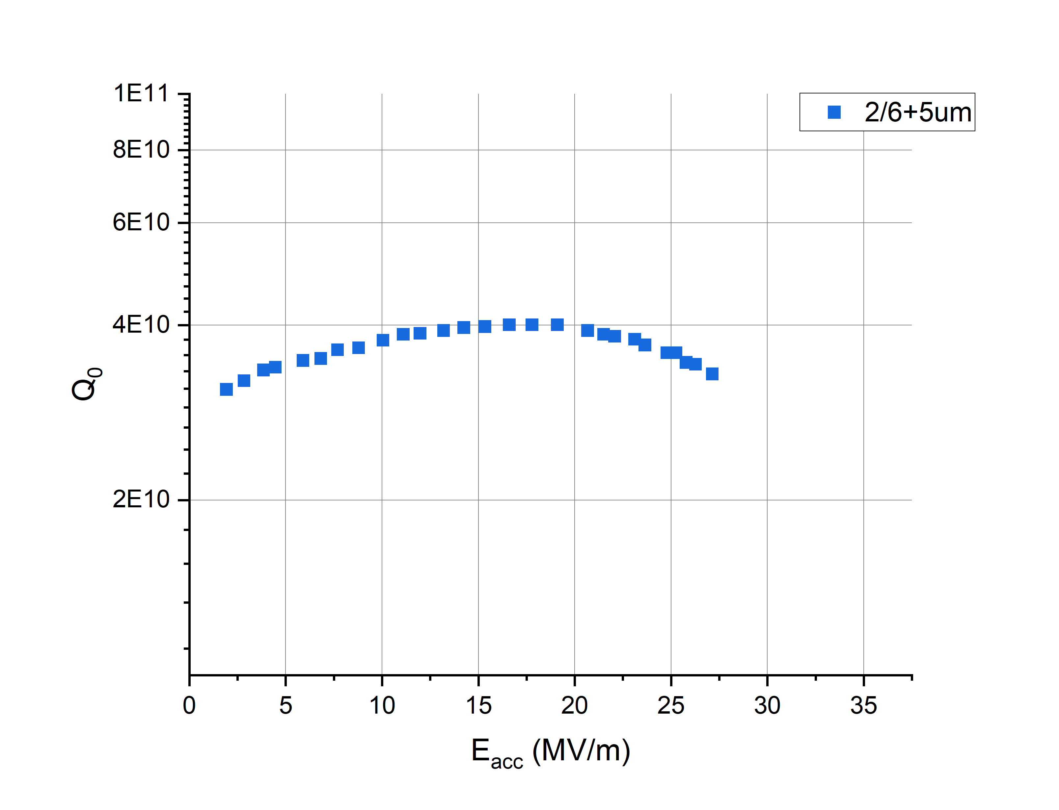
N-Doped Nitrogen Concentration
2/6+5µm EP
N concentration in N-Doped Samples

Slide 7
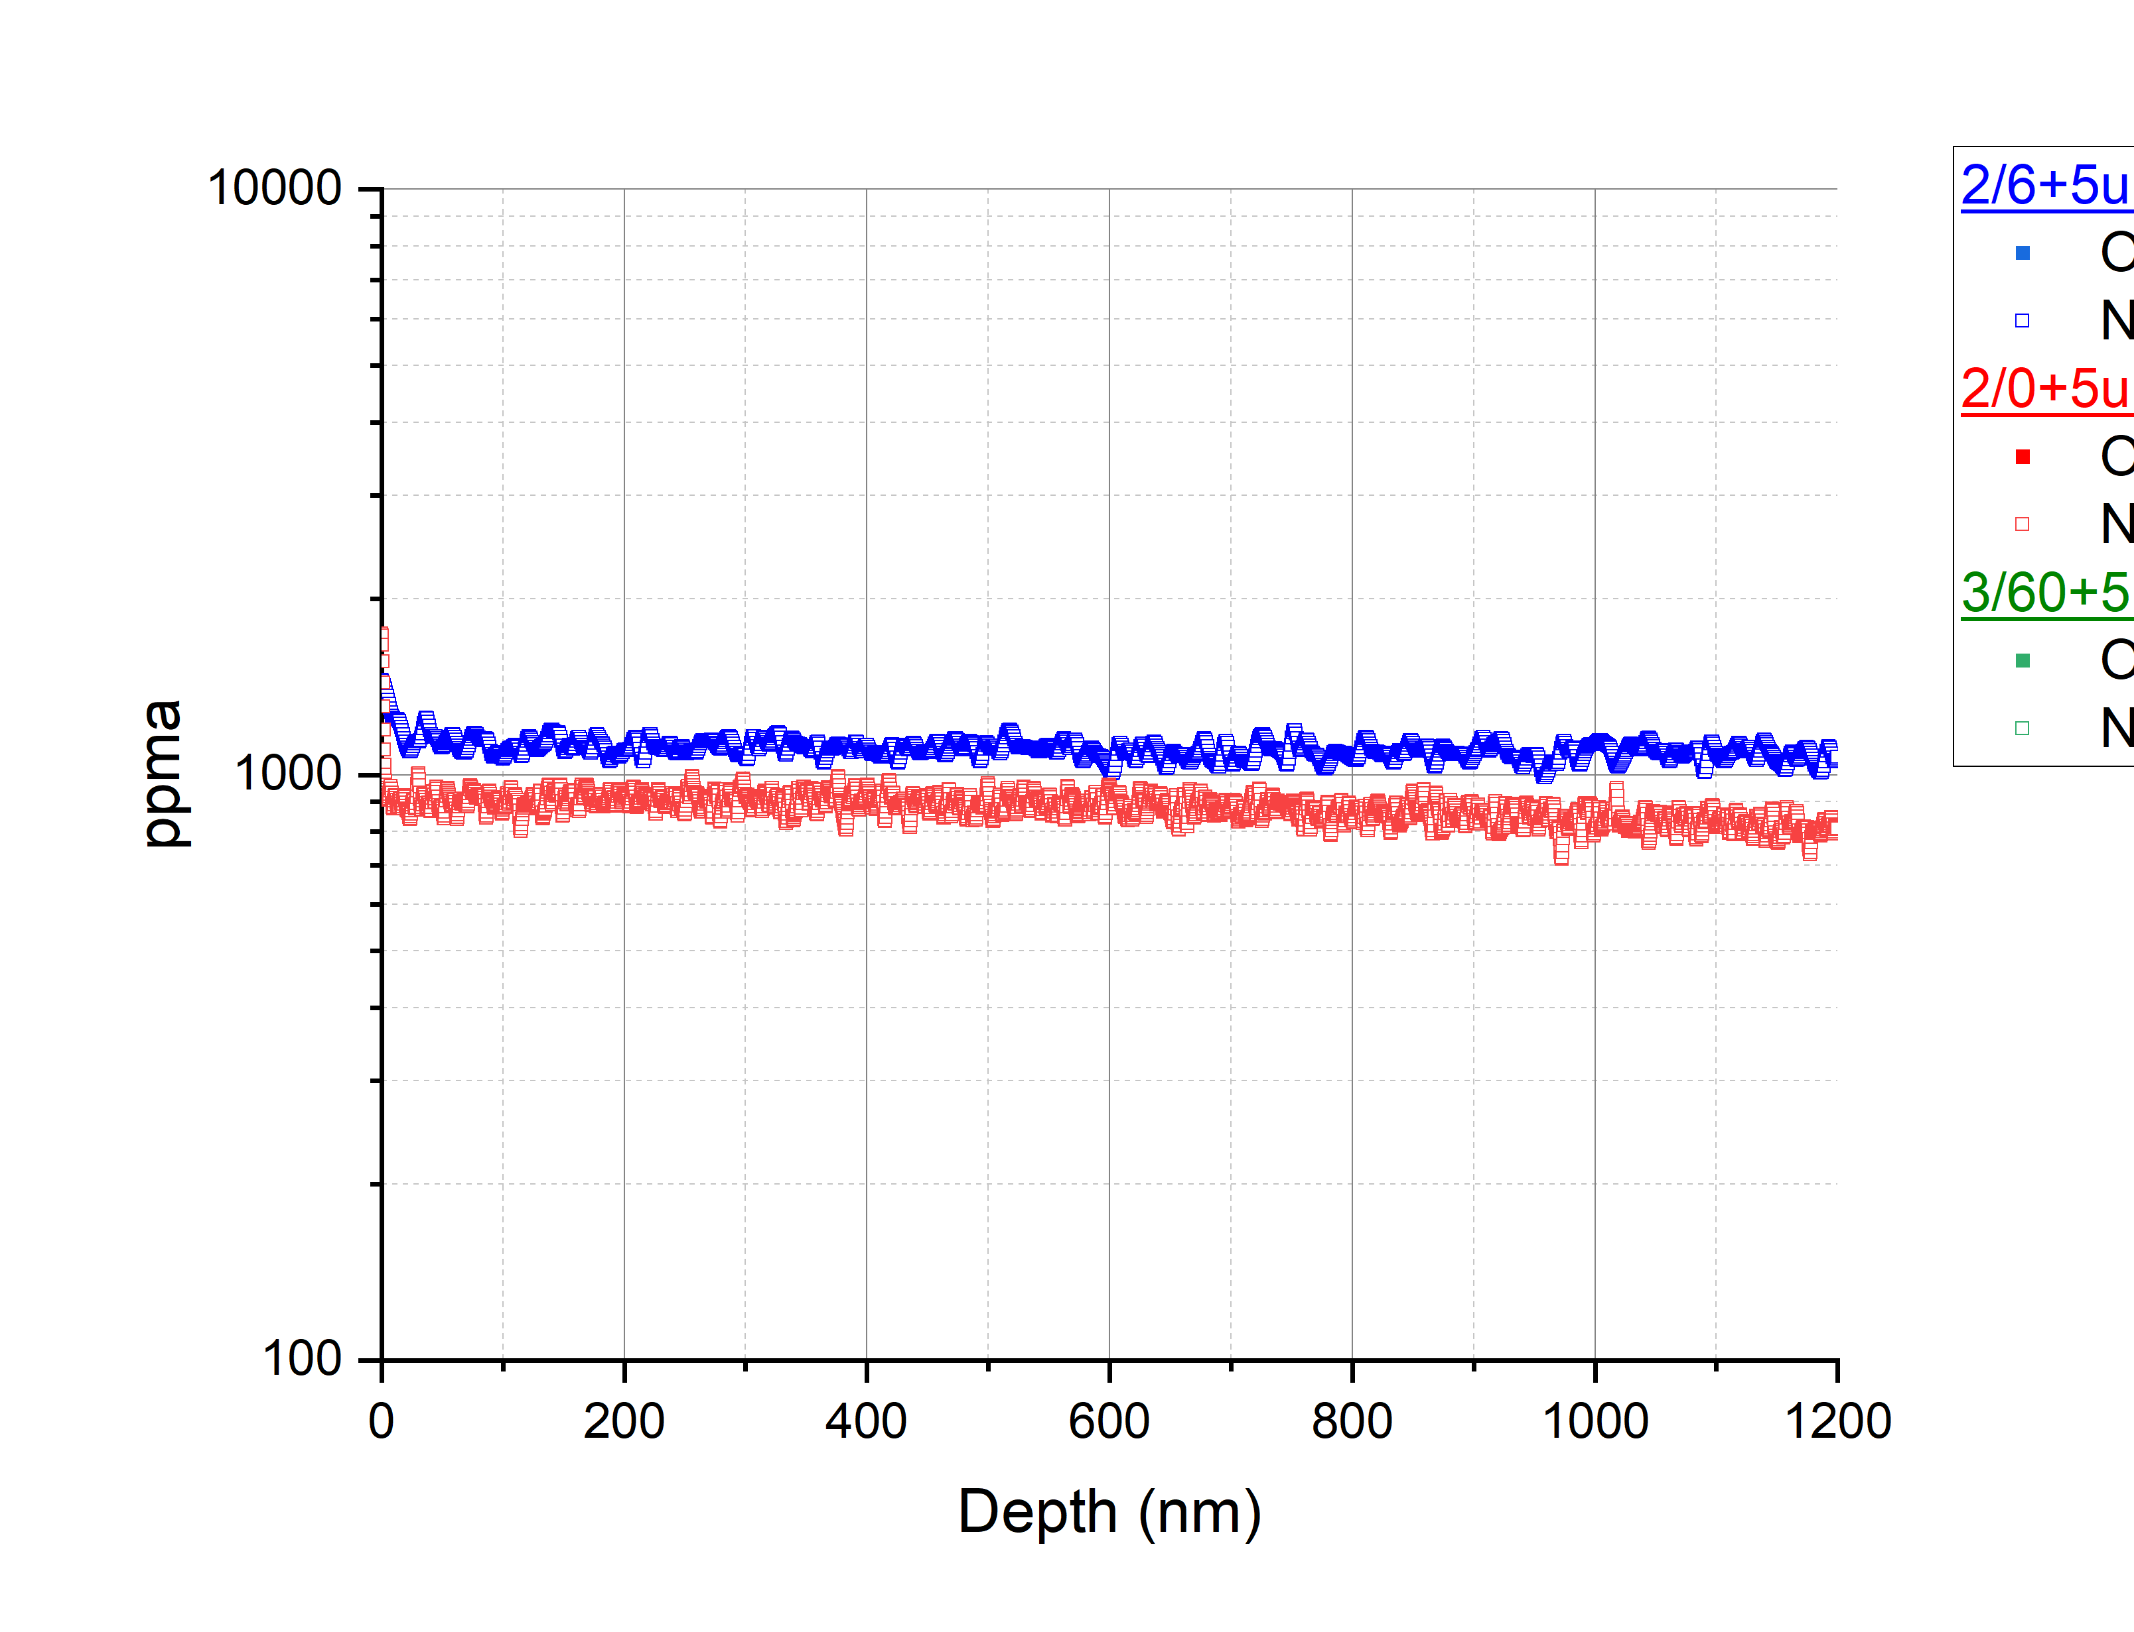
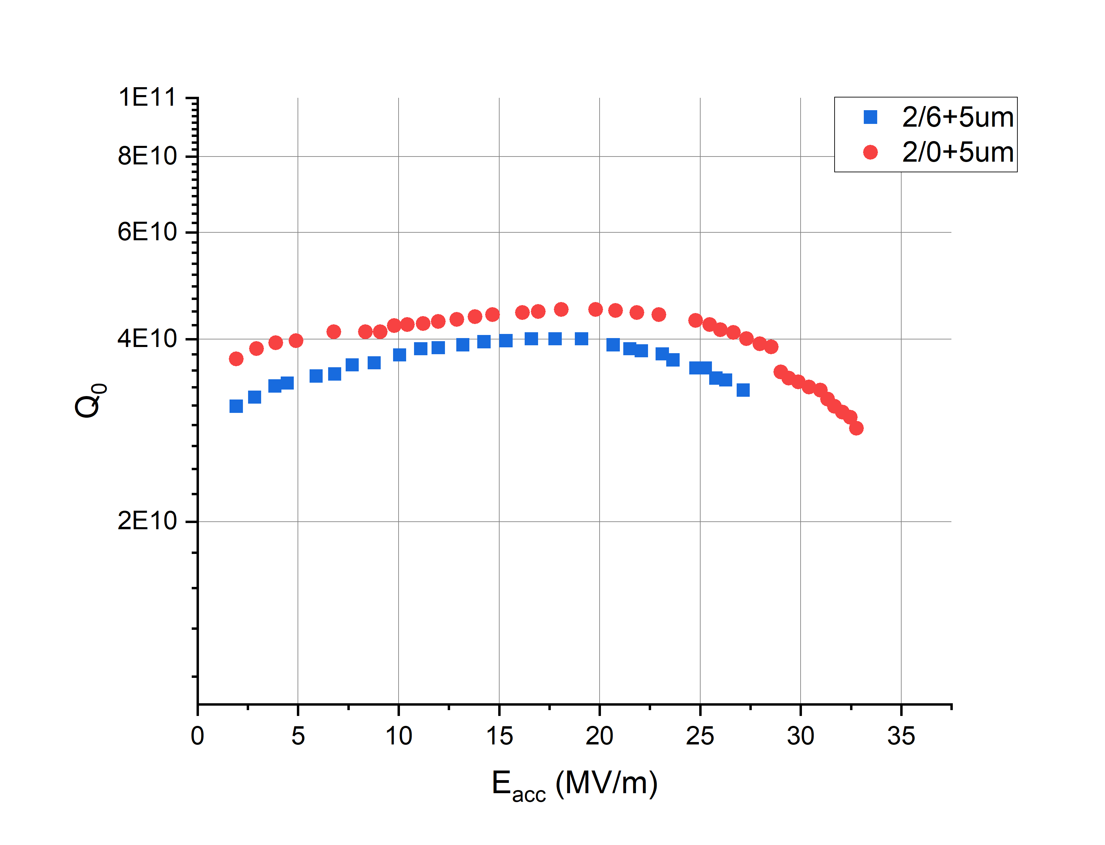
N-Doped Nitrogen Concentration
2/6+5µm EP
2/0+5µm EP
N concentration in N-Doped Samples

Slide 8
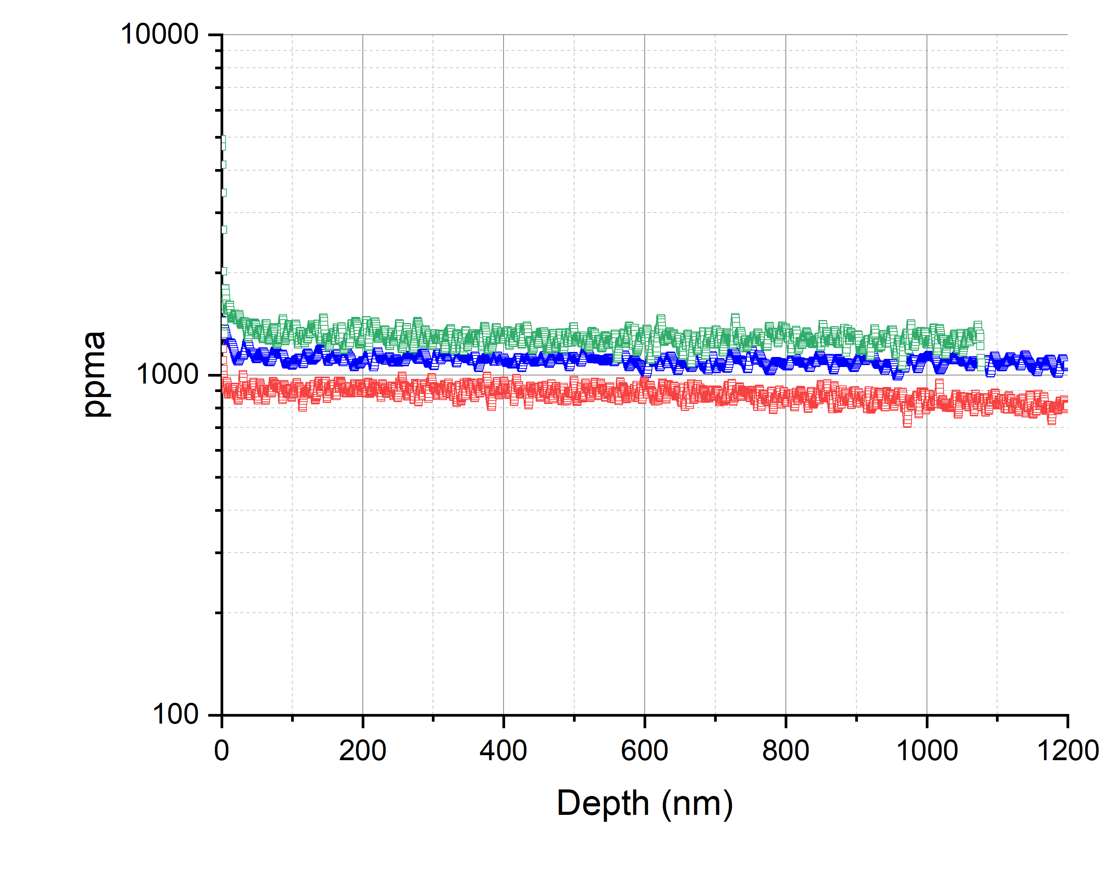
N-Doped Nitrogen Concentration
2/6+5µm EP
2/0+5µm EP
3/60+5µm EP
N concentration in N-Doped Samples

Slide 9
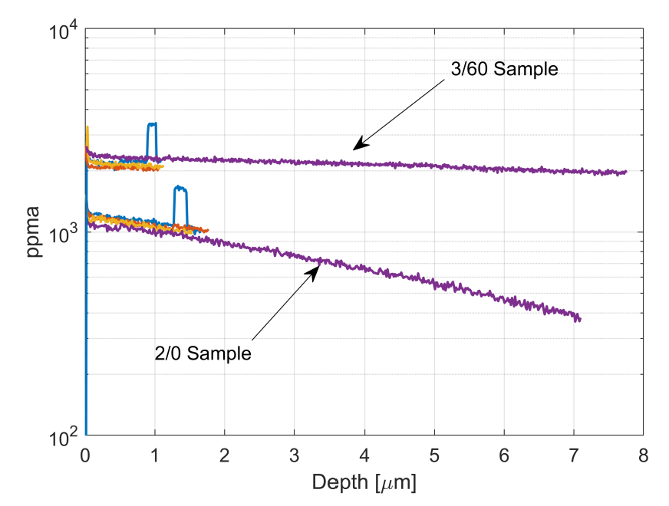
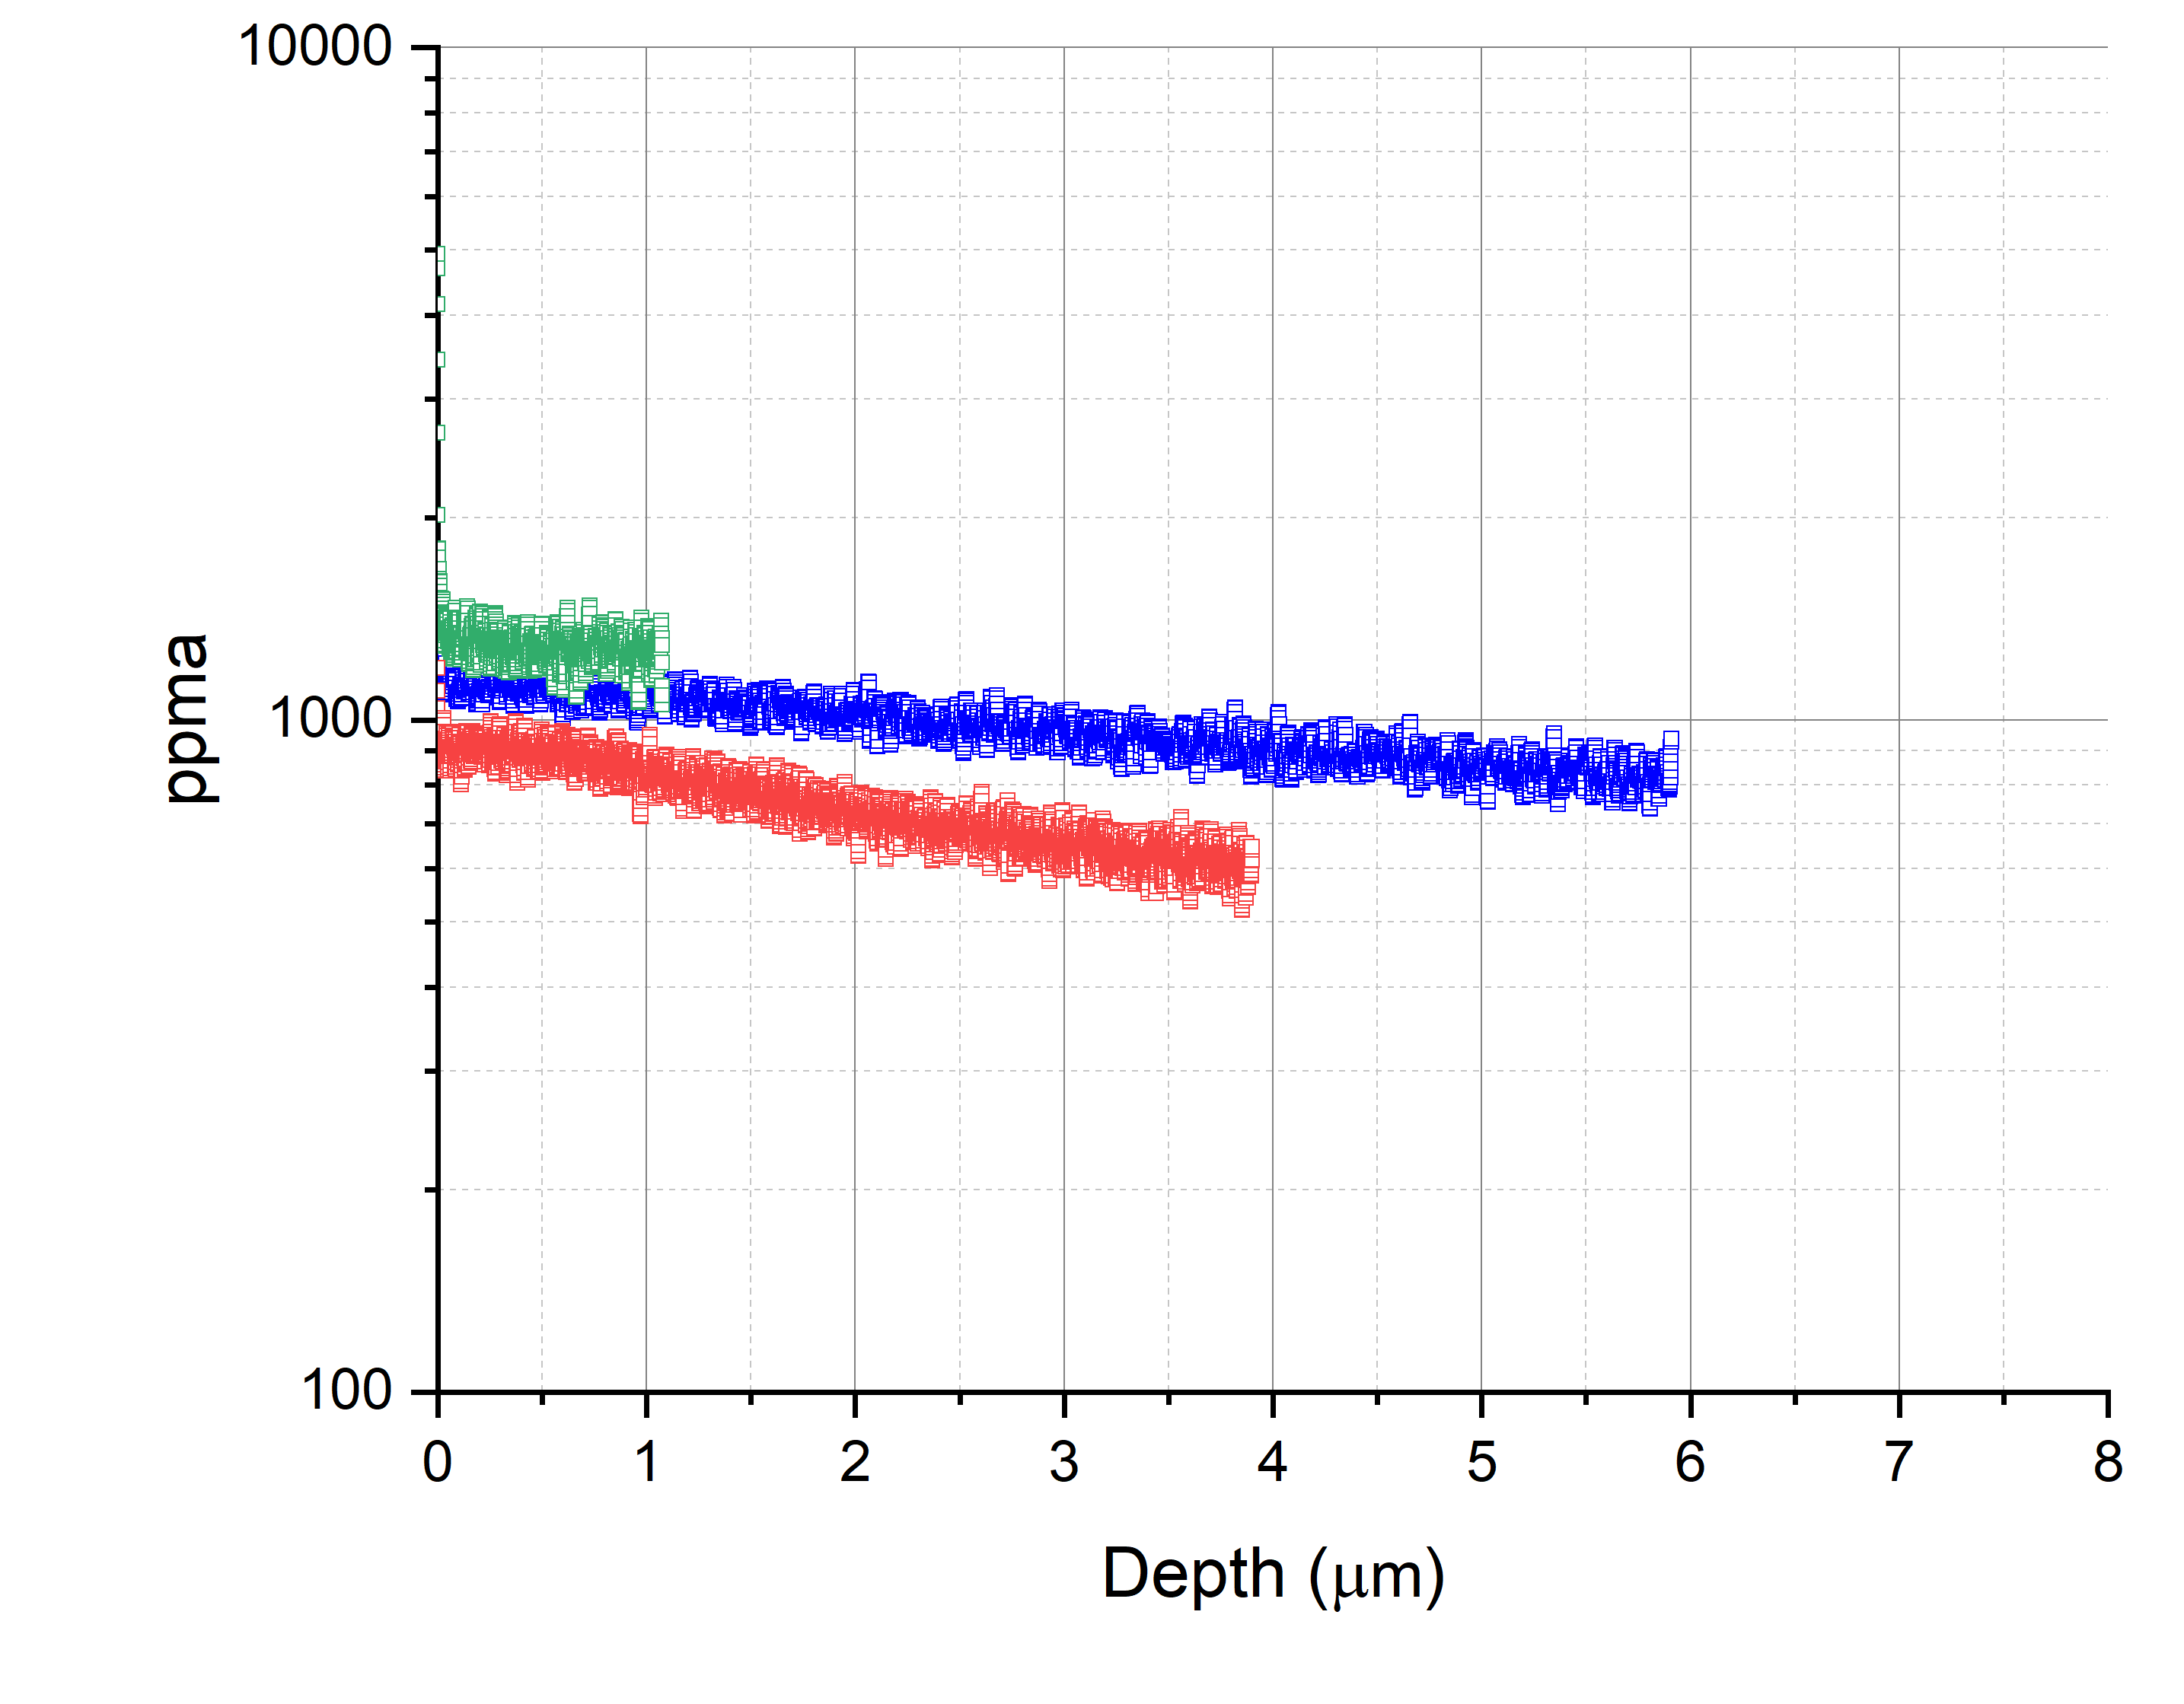
Comparison with Previous Work
N concentration in N-Doped Samples
D. Gonnella, SRF’19 doi:10.18429/JACoW-SRF2019-MOP045
Not as high 3/60 N concentration as previous work. Why?
N concentration is inversely proportional to mean free path
 | Avg. N conc. in 1st 100 nm (ppma) | Mean free path from RF (nm)
2/0 | 900 | 125 ±37
3/60 | 1390 | 94 ± 7
MFP from D. Bafia, PhD Dissertation, IIT, 2020.

Slide 10
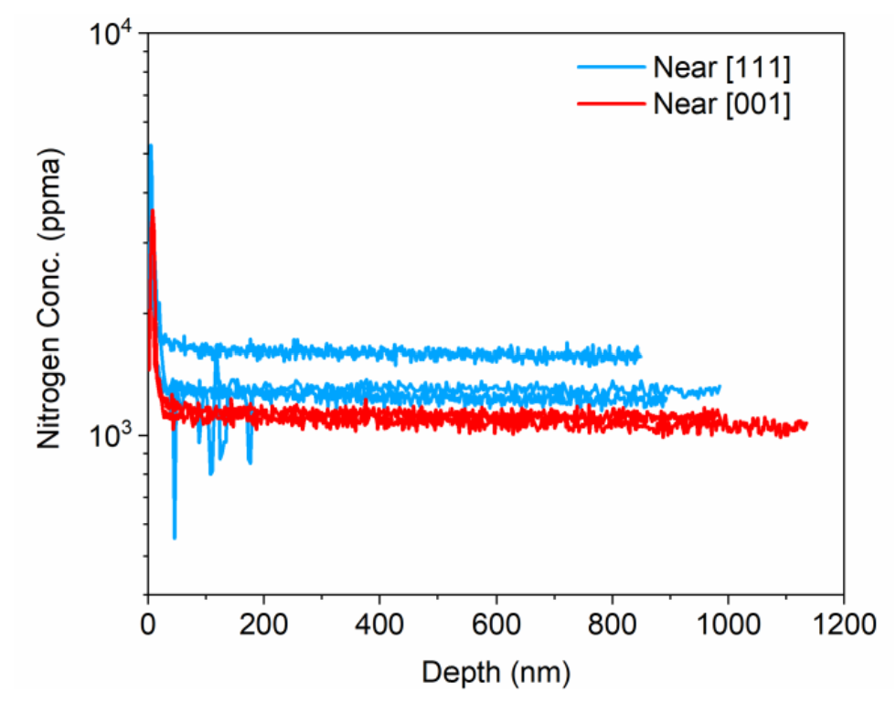
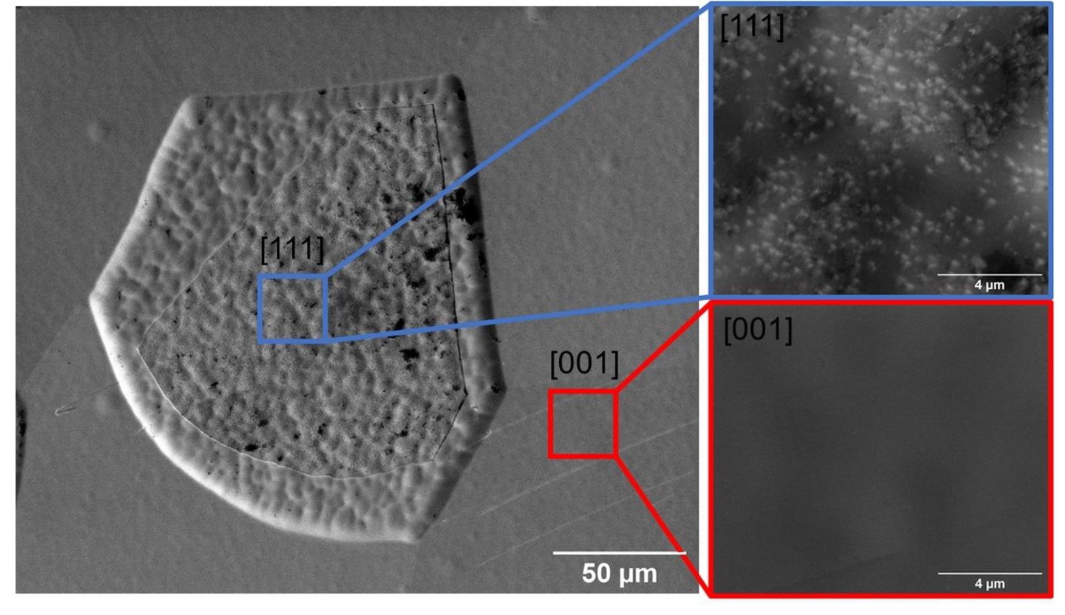
Comparison with Previous Work
N concentration in N-Doped Samples
J. Angle, PhD Dissertation, 2022.
3/60
What about the contribution of oxygen?
Not as high 3/60 N concentration as previous work. Why?
Differences could be attributed to grain variation
Nano-nitrides not observed

Slide 11
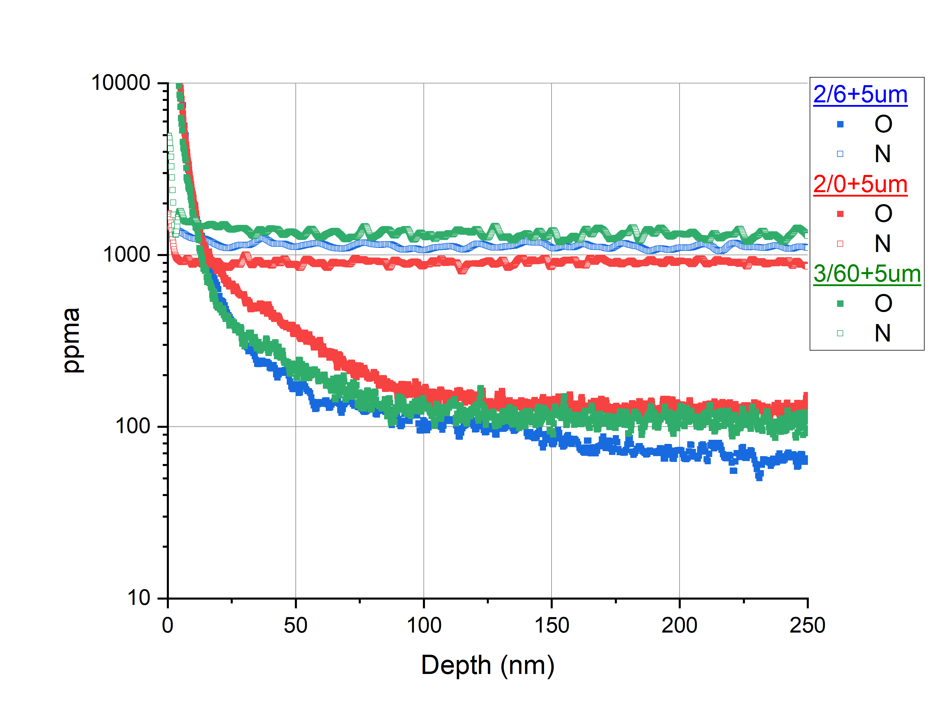
Oxygen in N-Doped Samples
N and O concentration in N-Doped Samples
Much lower concentration of oxygen, perhaps O is playing a lesser role
How does this oxygen compare to other cavity treatments?

Slide 12
Comparison with other treatments: Cavity Cutouts
EP
Baseline
75/120°C modified LTB
Baseline
O Doping
Baseline
205°Cx19hr in-situ bake
75°Cx4hr in-situ bake
120°Cx48hr in-situ bake
Time-of-Flight Secondary Ion Mass Spectrometry (TOF-SIMS)
Comparing oxygen concentration profiles of these cavity cutouts of treatments for which it is known that oxygen plays a key role with nitrogen doped samples

Slide 13
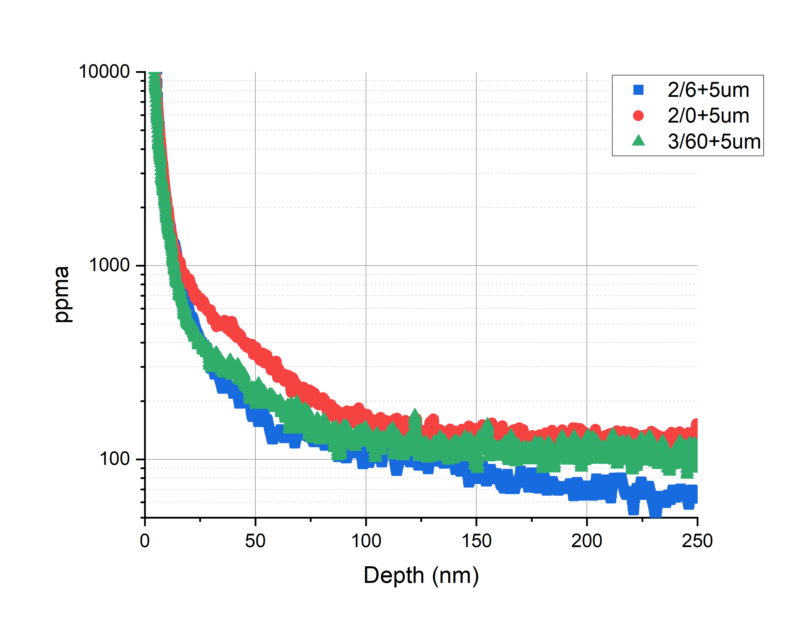
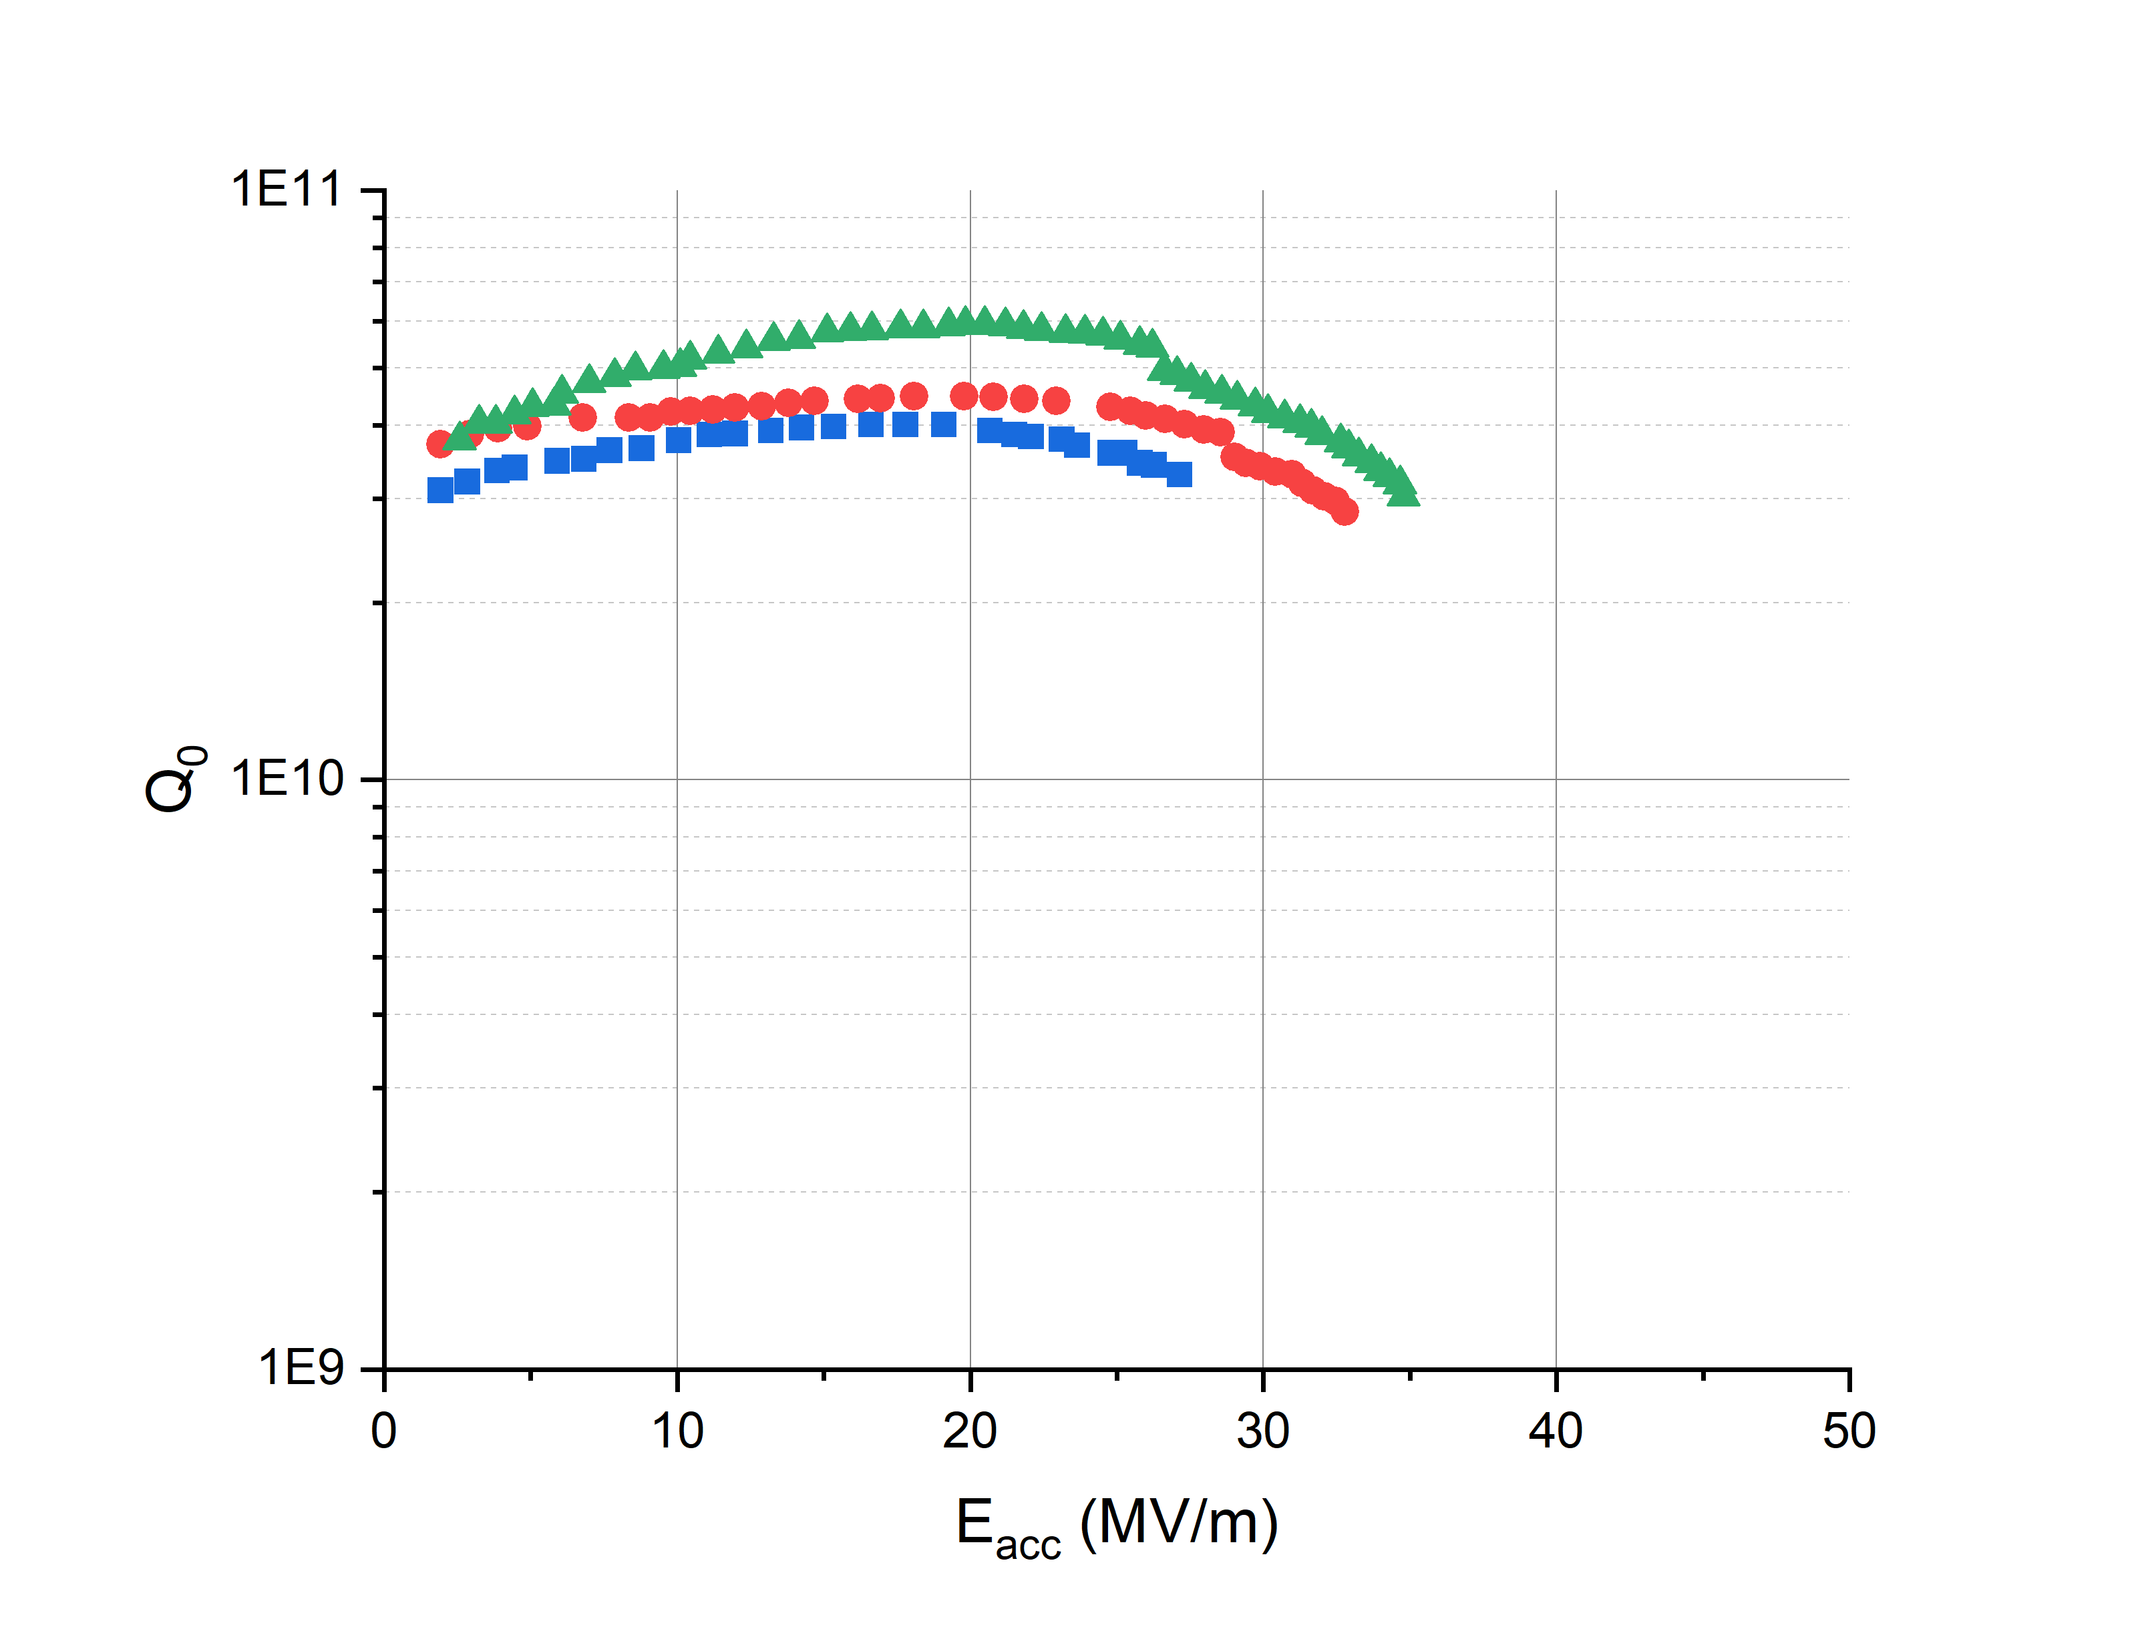
Comparing O Profiles: N-doped vs other treatments
Q₀ vs. E_{acc}
SIMS Profile: O Concentration

Slide 14
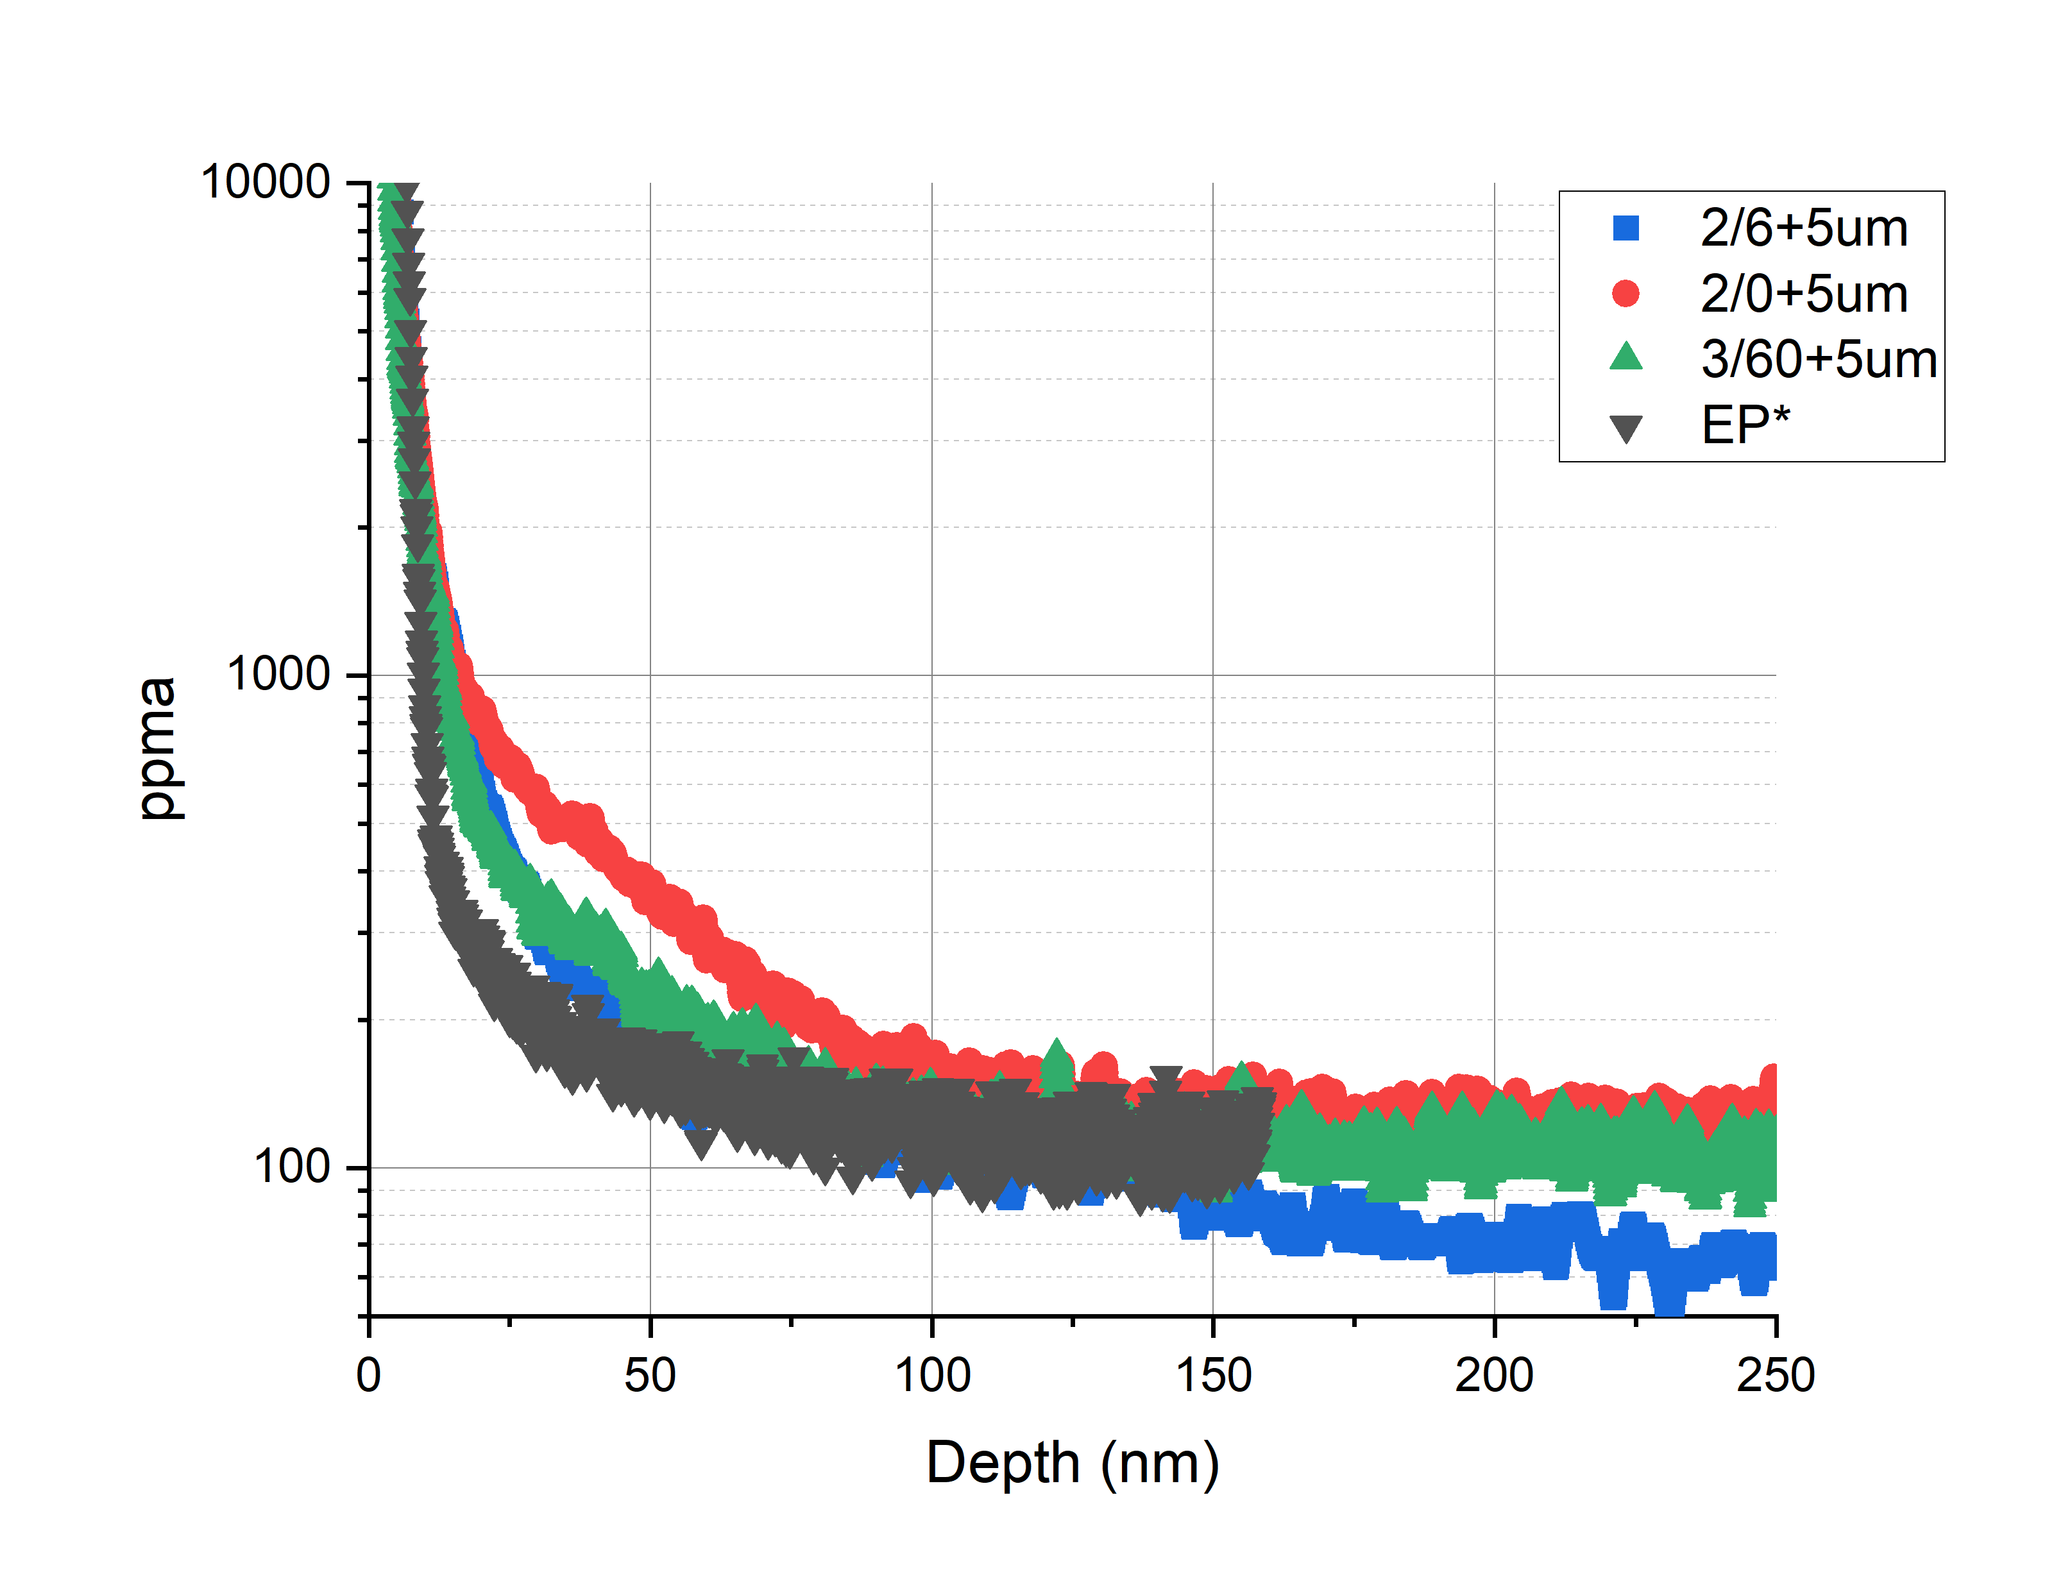
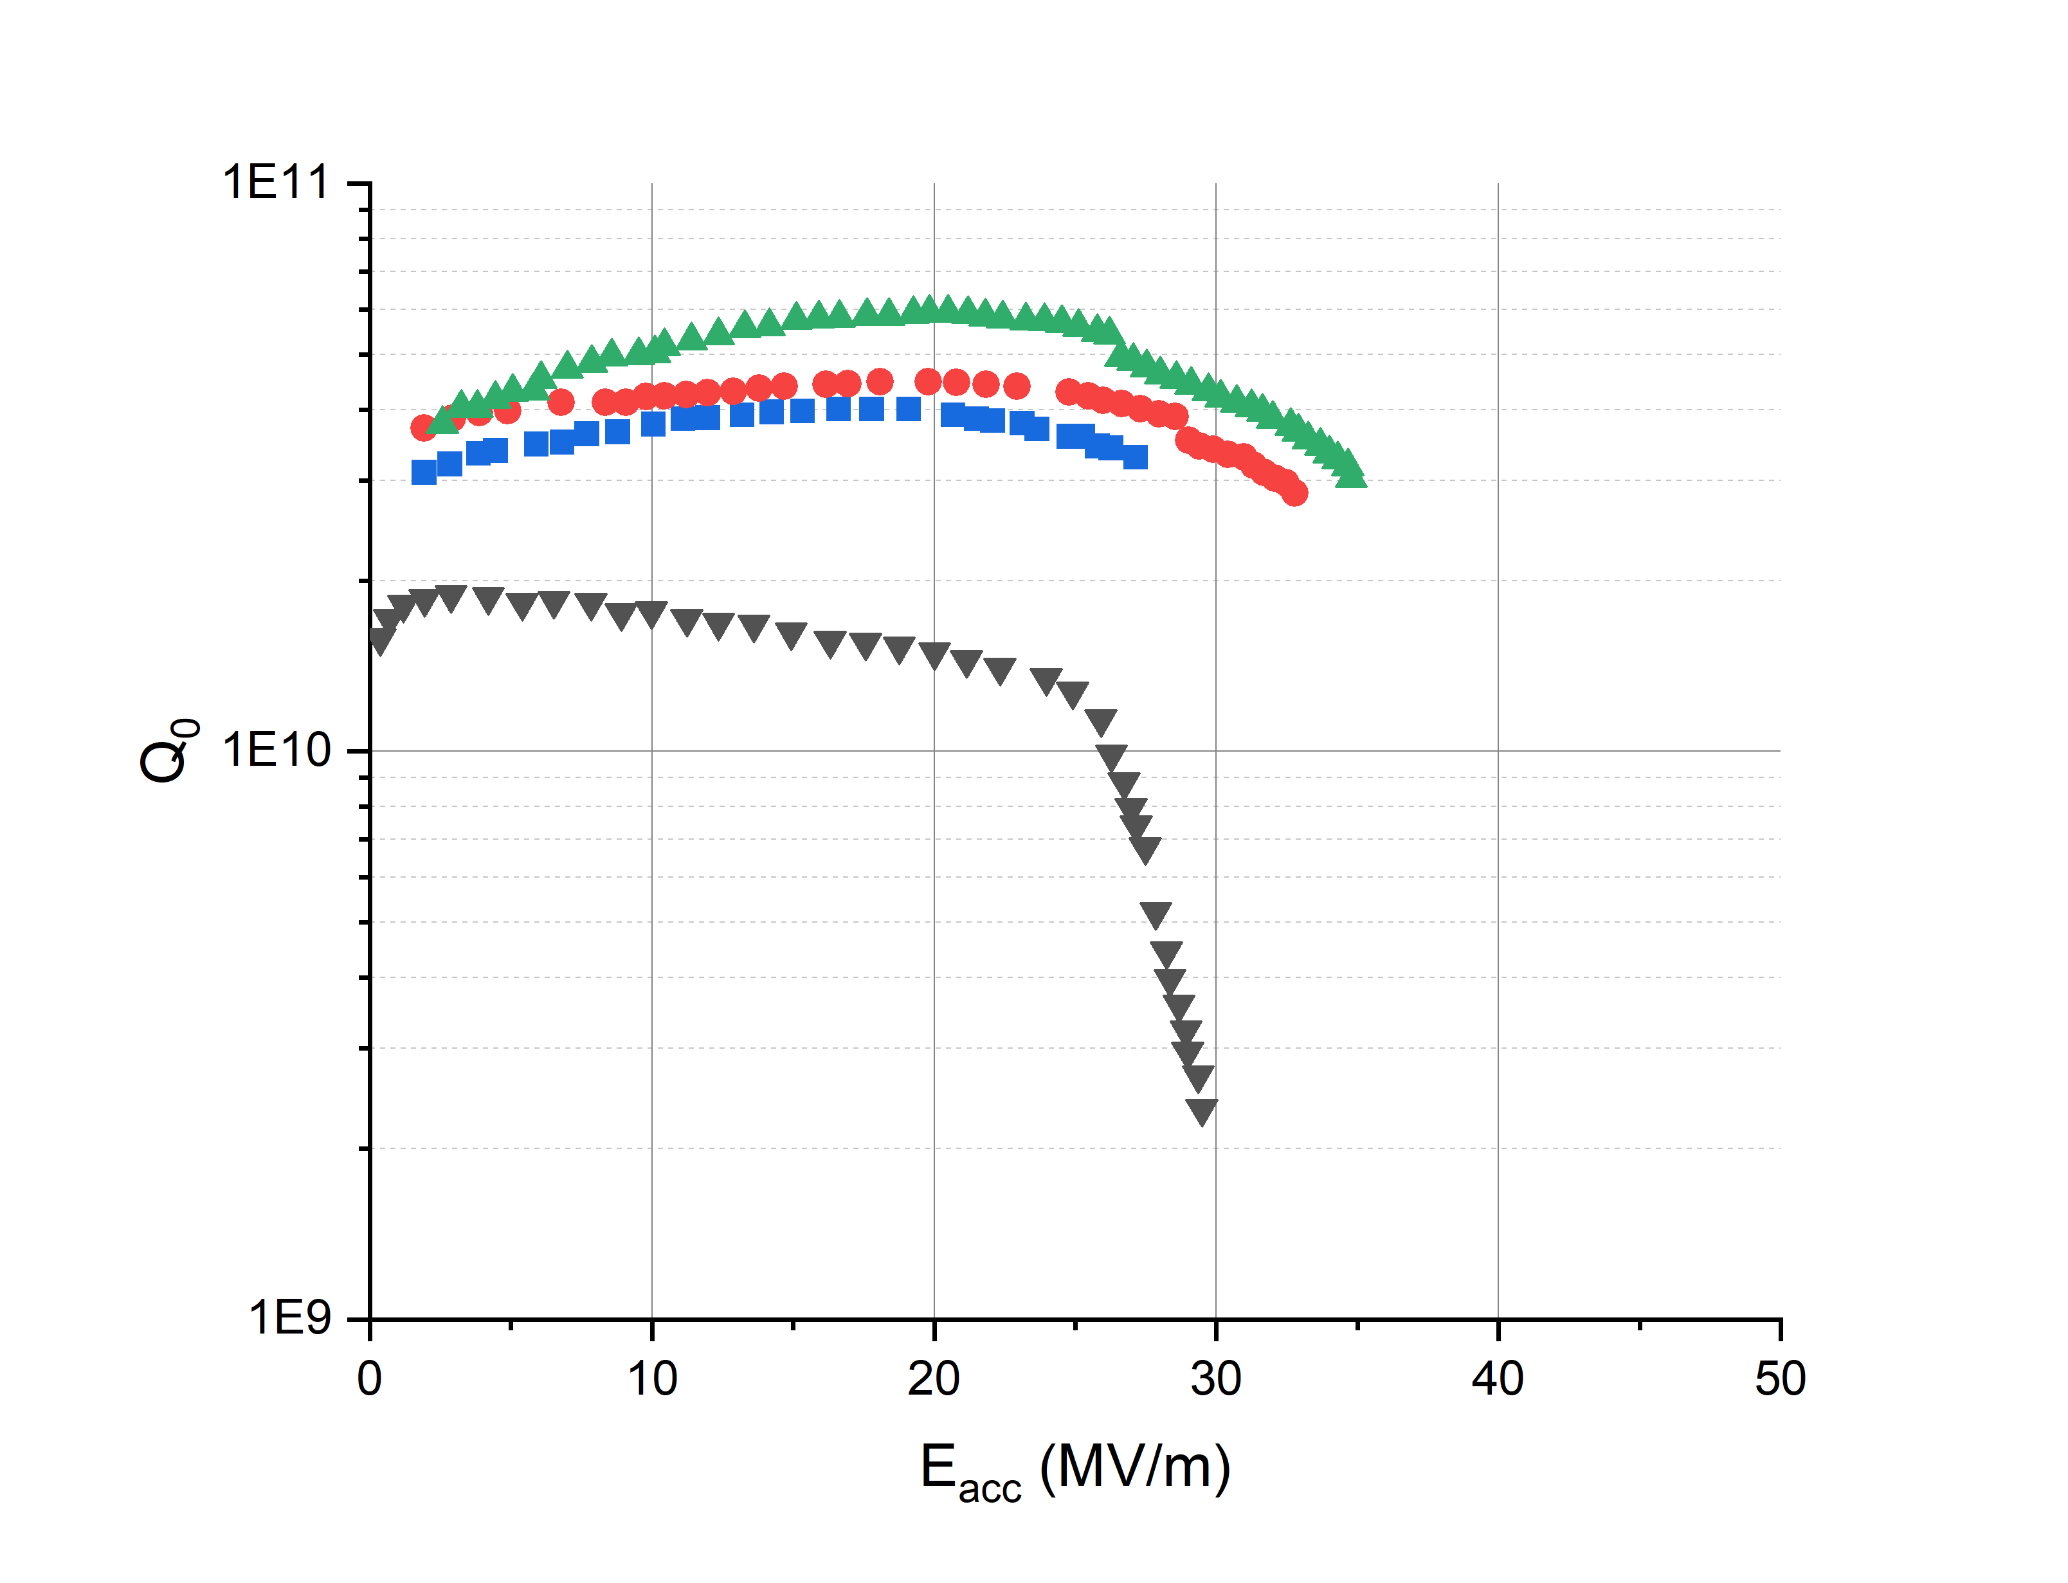
Comparing O Profiles: N-doped vs other treatments
Q₀ vs. E_{acc}
SIMS Profile: O Concentration
EP: HFQS from breakdown of niobium hydrides from lack of interstitial impurities as confirmed with SIMS
N-doped: Comparable but slightly elevated O concentration. Negligible effect?
*EP absolute concentration was not directly measured. Data is scaled relative to 75/120C modified LTB absolute concentration. Will verify will future measurements

Slide 15
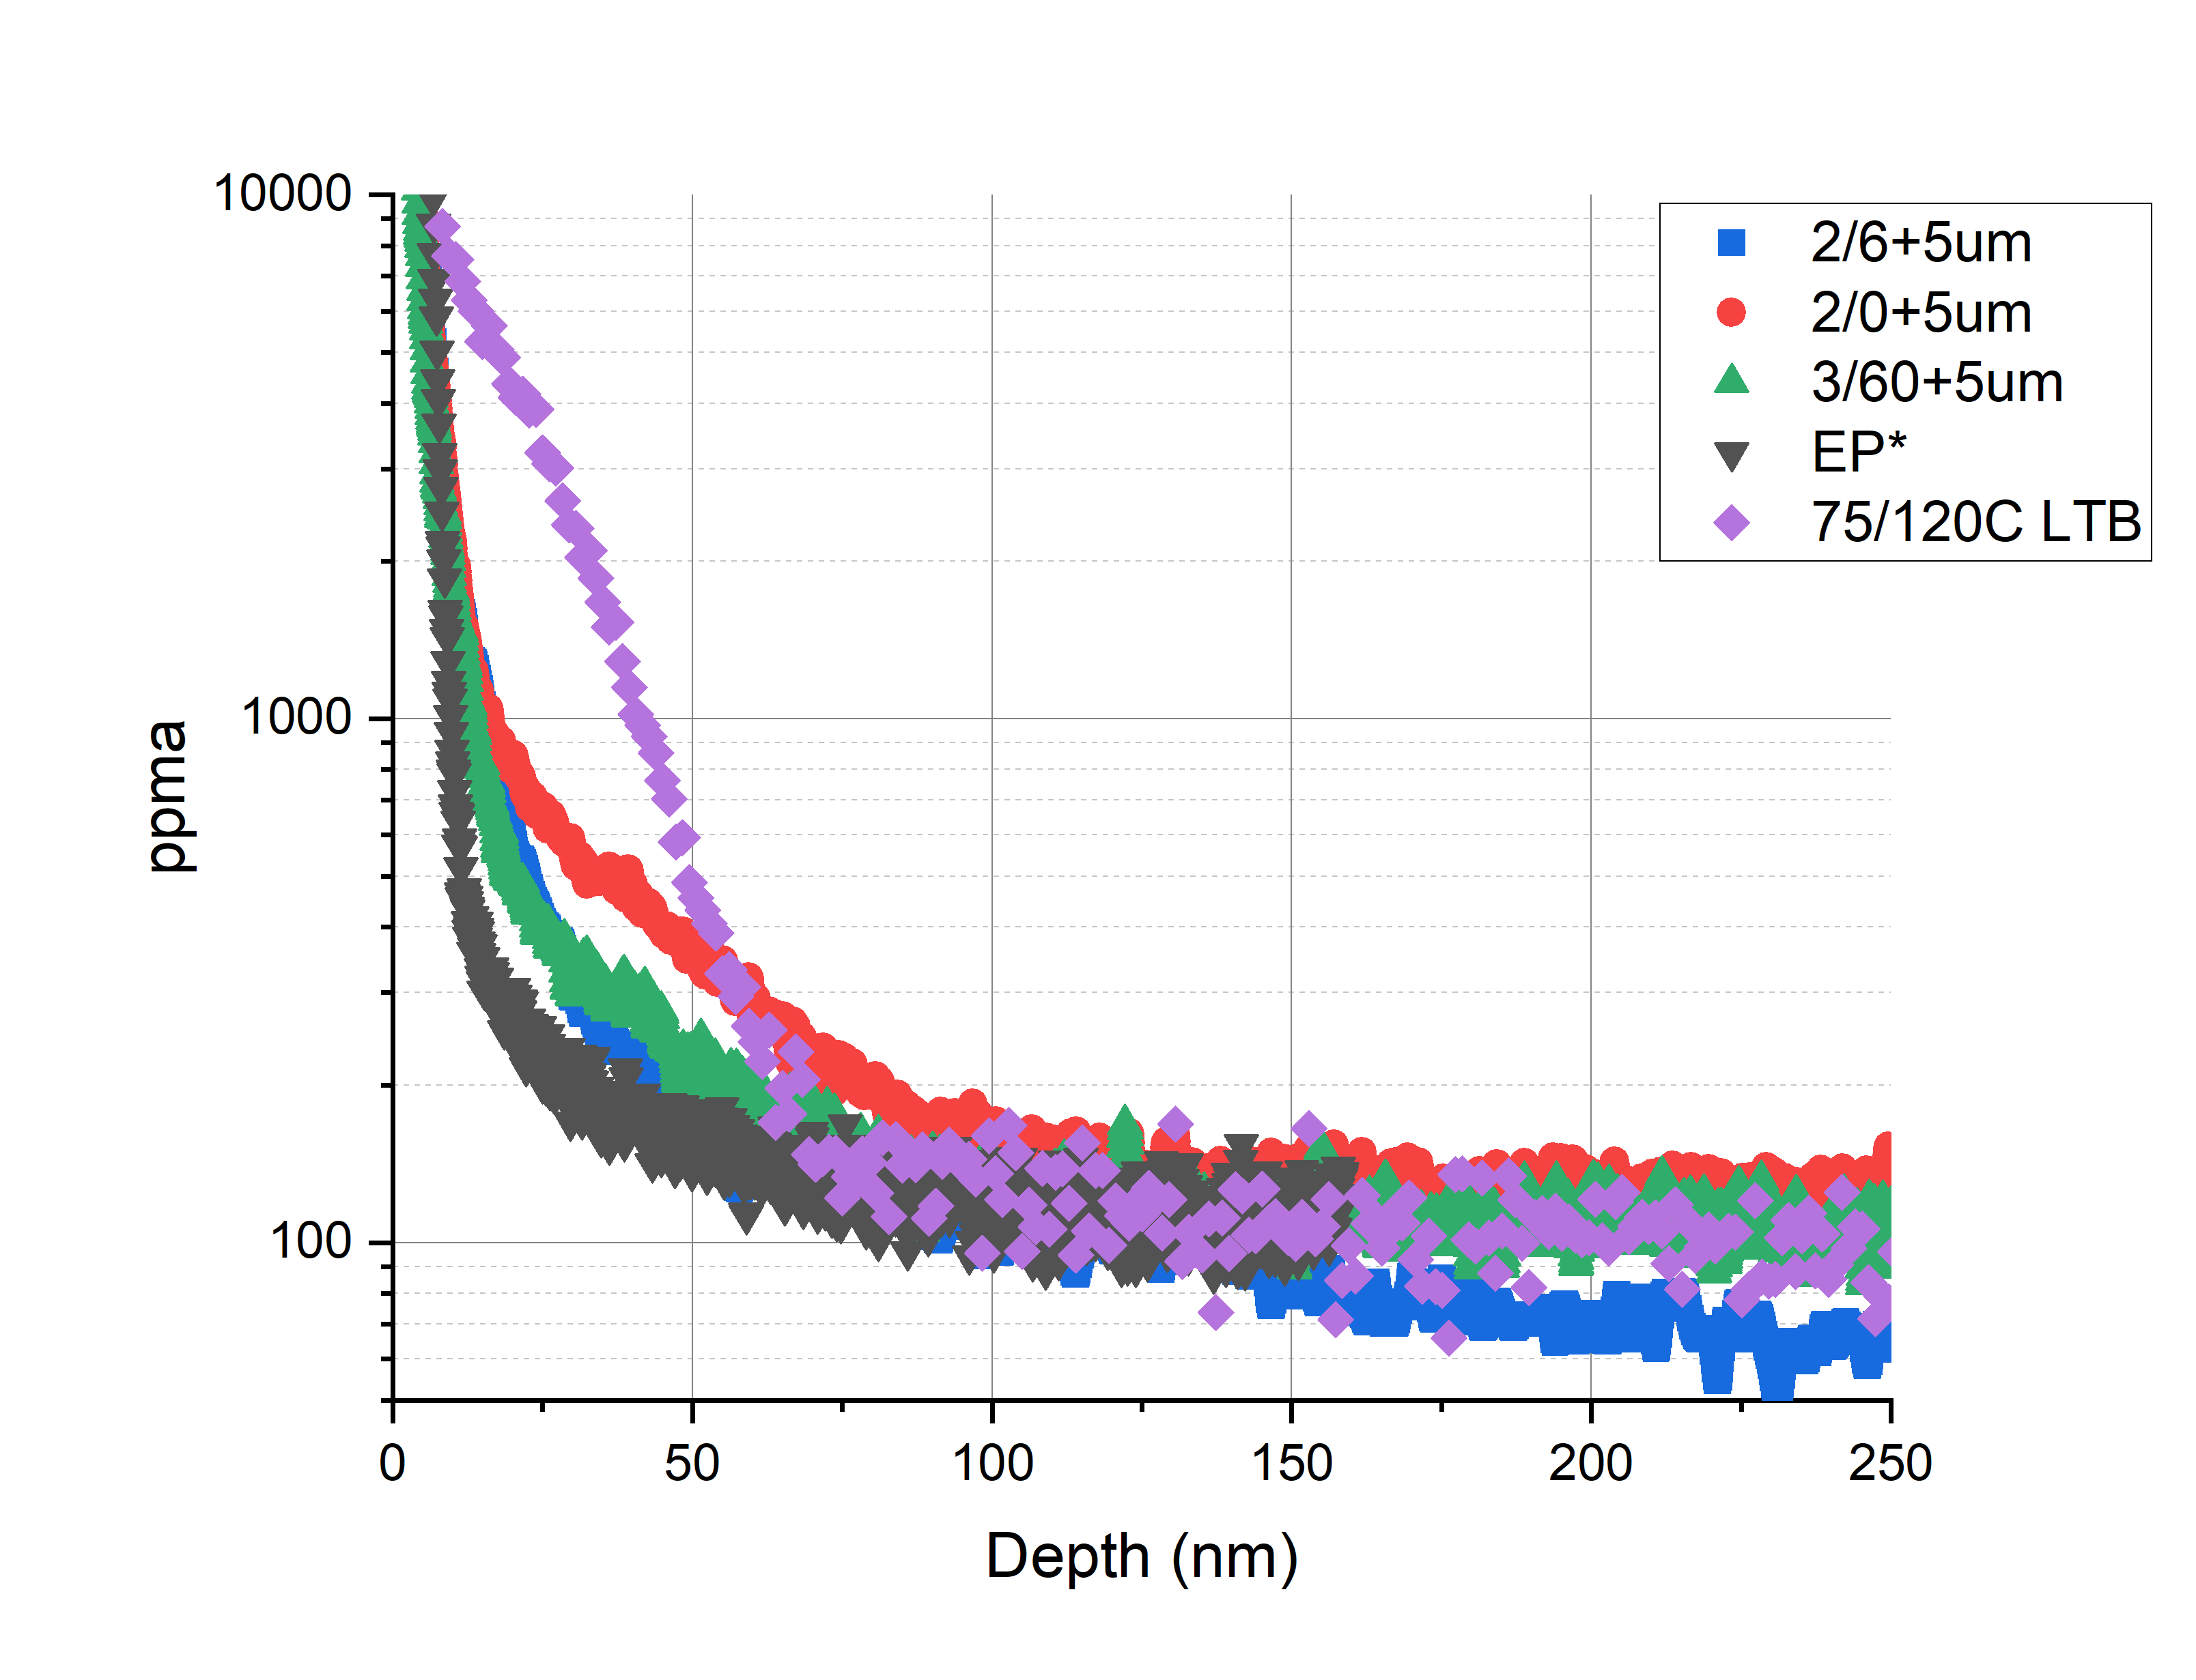
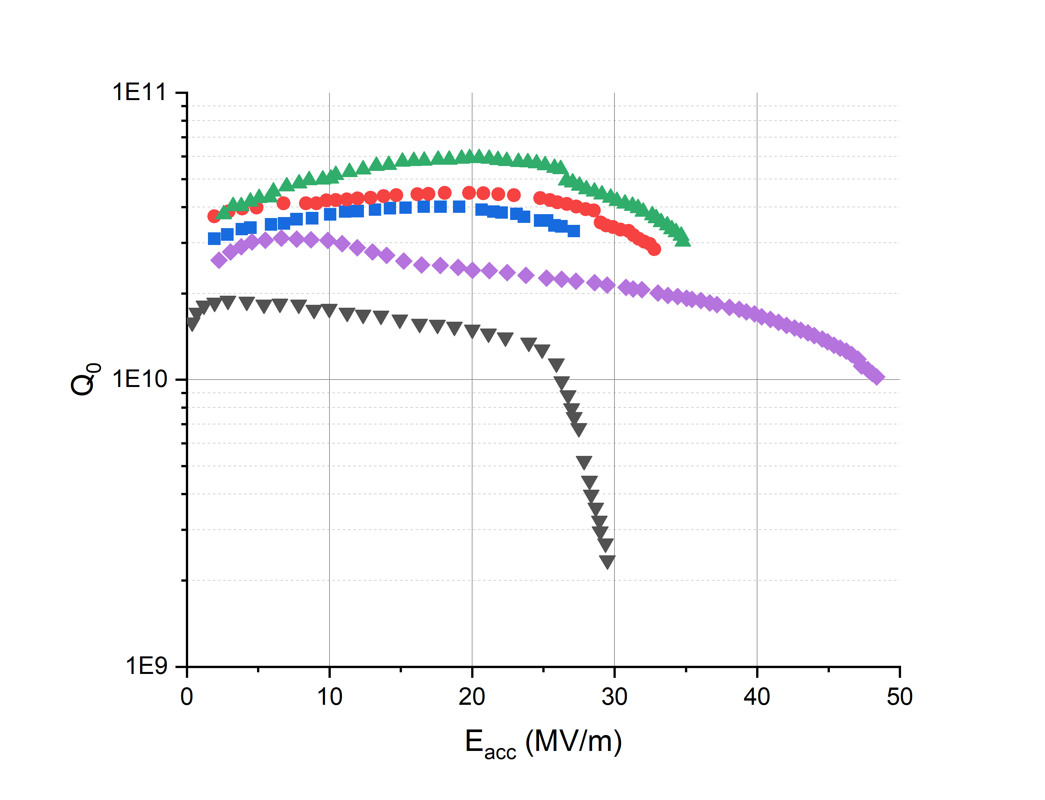
Comparing O Profiles: N-doped vs other treatments
Q₀ vs. E_{acc}
SIMS Profile: O Concentration
75/120C LTB: significant improvement in RF performance from roughly 2 – 3 times more oxygen in the first 100 nm of the surface than N-doped
Dirty surface extends high gradient RF performance

Slide 16
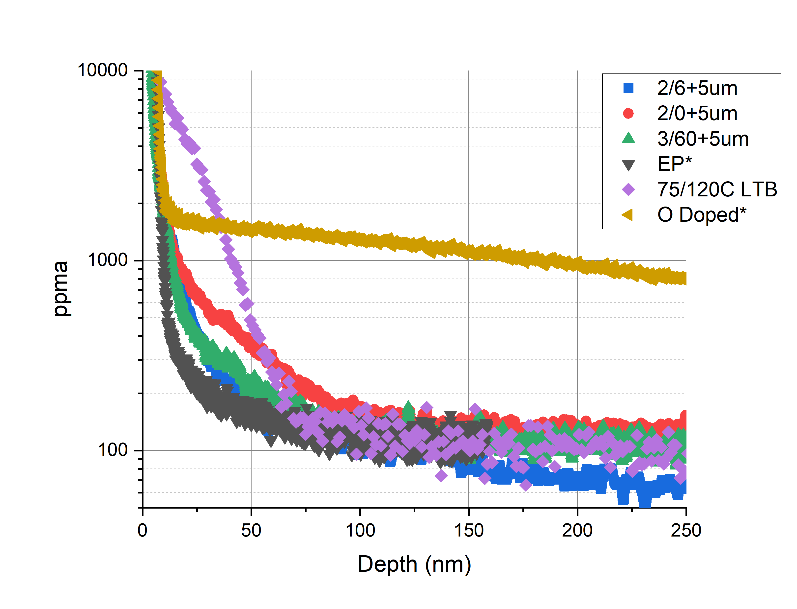
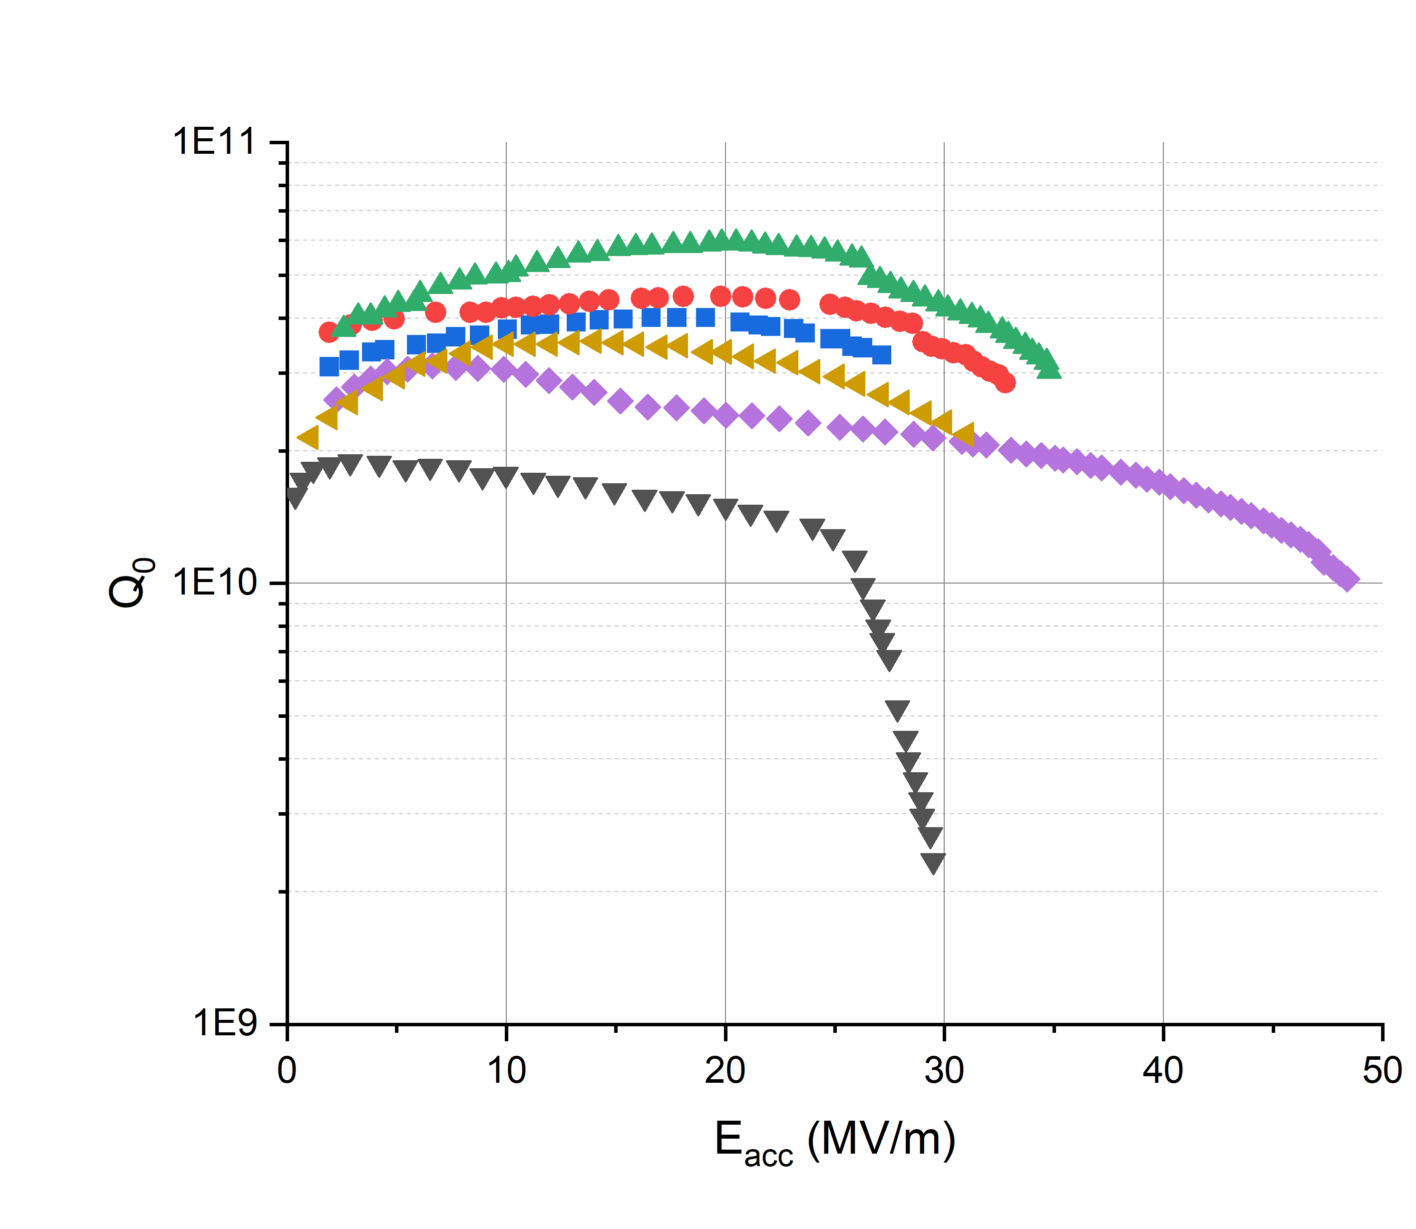
Comparing O Profiles: N-doped vs other treatments
Q₀ vs. E_{acc}
SIMS Profile: O Concentration
O doped: Lower concentration at surface, but more uniform
Uniform concentration gives anti-Q slope and high Q₀, similar to the effect of N in N-doped
*Absolute concentration was not directly measured. Data is scaled relative to 75/120C modified LTB absolute concentration.

Slide 17
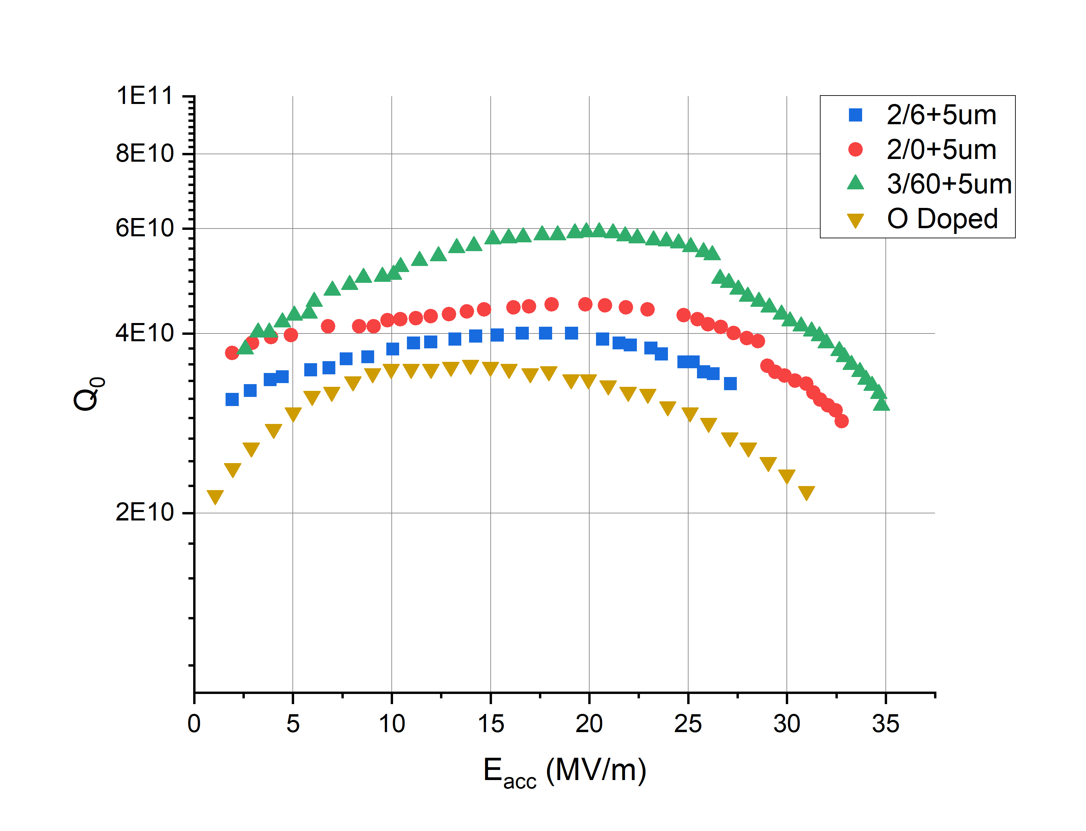
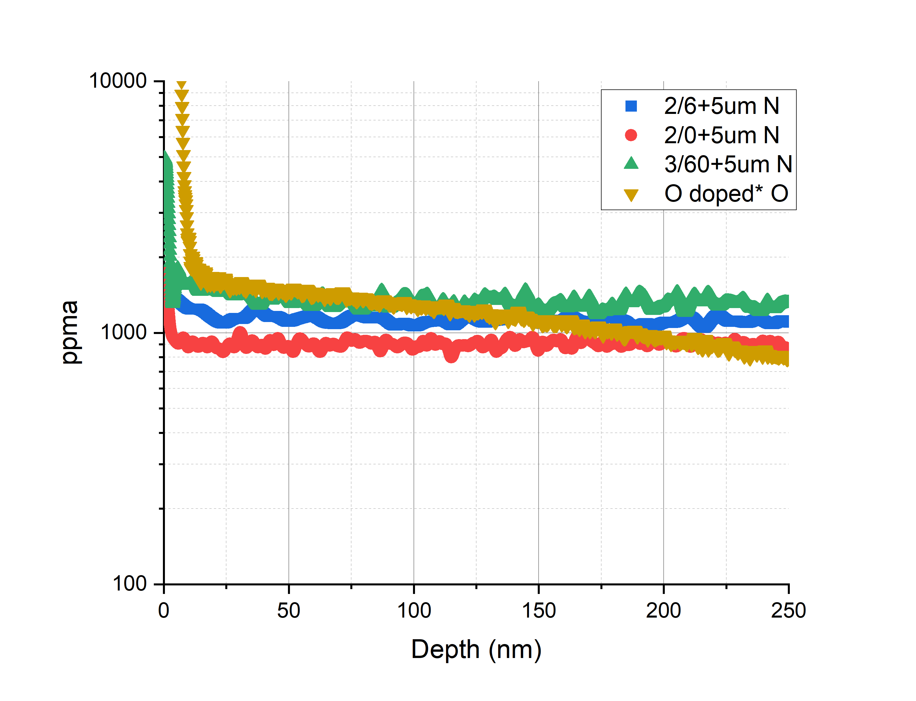
Comparing O doped and N doped
Similar RF cavity performance and impurity profile
If we slightly increase O conc., will that increase Q₀ like with 2/x → 3/60 for N-doped?
Since O-doped cavity is slightly lower in Q₀ but with similar concentration, does that mean O is slightly less effective than N at trapping H?
DFT study by D. Ford (2013) showed that the binding energy of -0.06 eV for H bonding with Nb-O instead of with Nb compared to -0.10 eV for Nb-N
D. C. Ford et al., doi:10.1088/09-2048/26/10/105003

Slide 18
Next Steps
Get absolute concentration for EP, O doped treatments
Alternative absolute concentration measurement techniques: Atom Probe Tomography (APT) at Northwestern University
DFT calculations comparing O and N and their interactions with hydrogen (binding energies, bond lengths, lattice strain energy, etc.)
Extension of the work by D. Ford (2013), which focused on the interaction of oxygen and hydrogen, to nitrogen and hydrogen interaction as well
Looking for collaborators and hoping to discuss more on this topic

Slide 19
Conclusion
Small differences in N concentration may be responsible for noticeable differences in N-doped RF performance
SIMS results suggests minimal role of O in N-doped samples
N in N-doped and O in O-doped drive the same key performance features in RF results
Roughly equivalent O in O-doped and N in N-doped absolute concentrations (to be verified) yielding different RF performance
To what degree do minor differences in impurity concentration drive differences in RF performance?
Is oxygen less effective than nitrogen at trapping hydrogen? → DFT studies required

Slide 20
Backup Slides

Slide 21
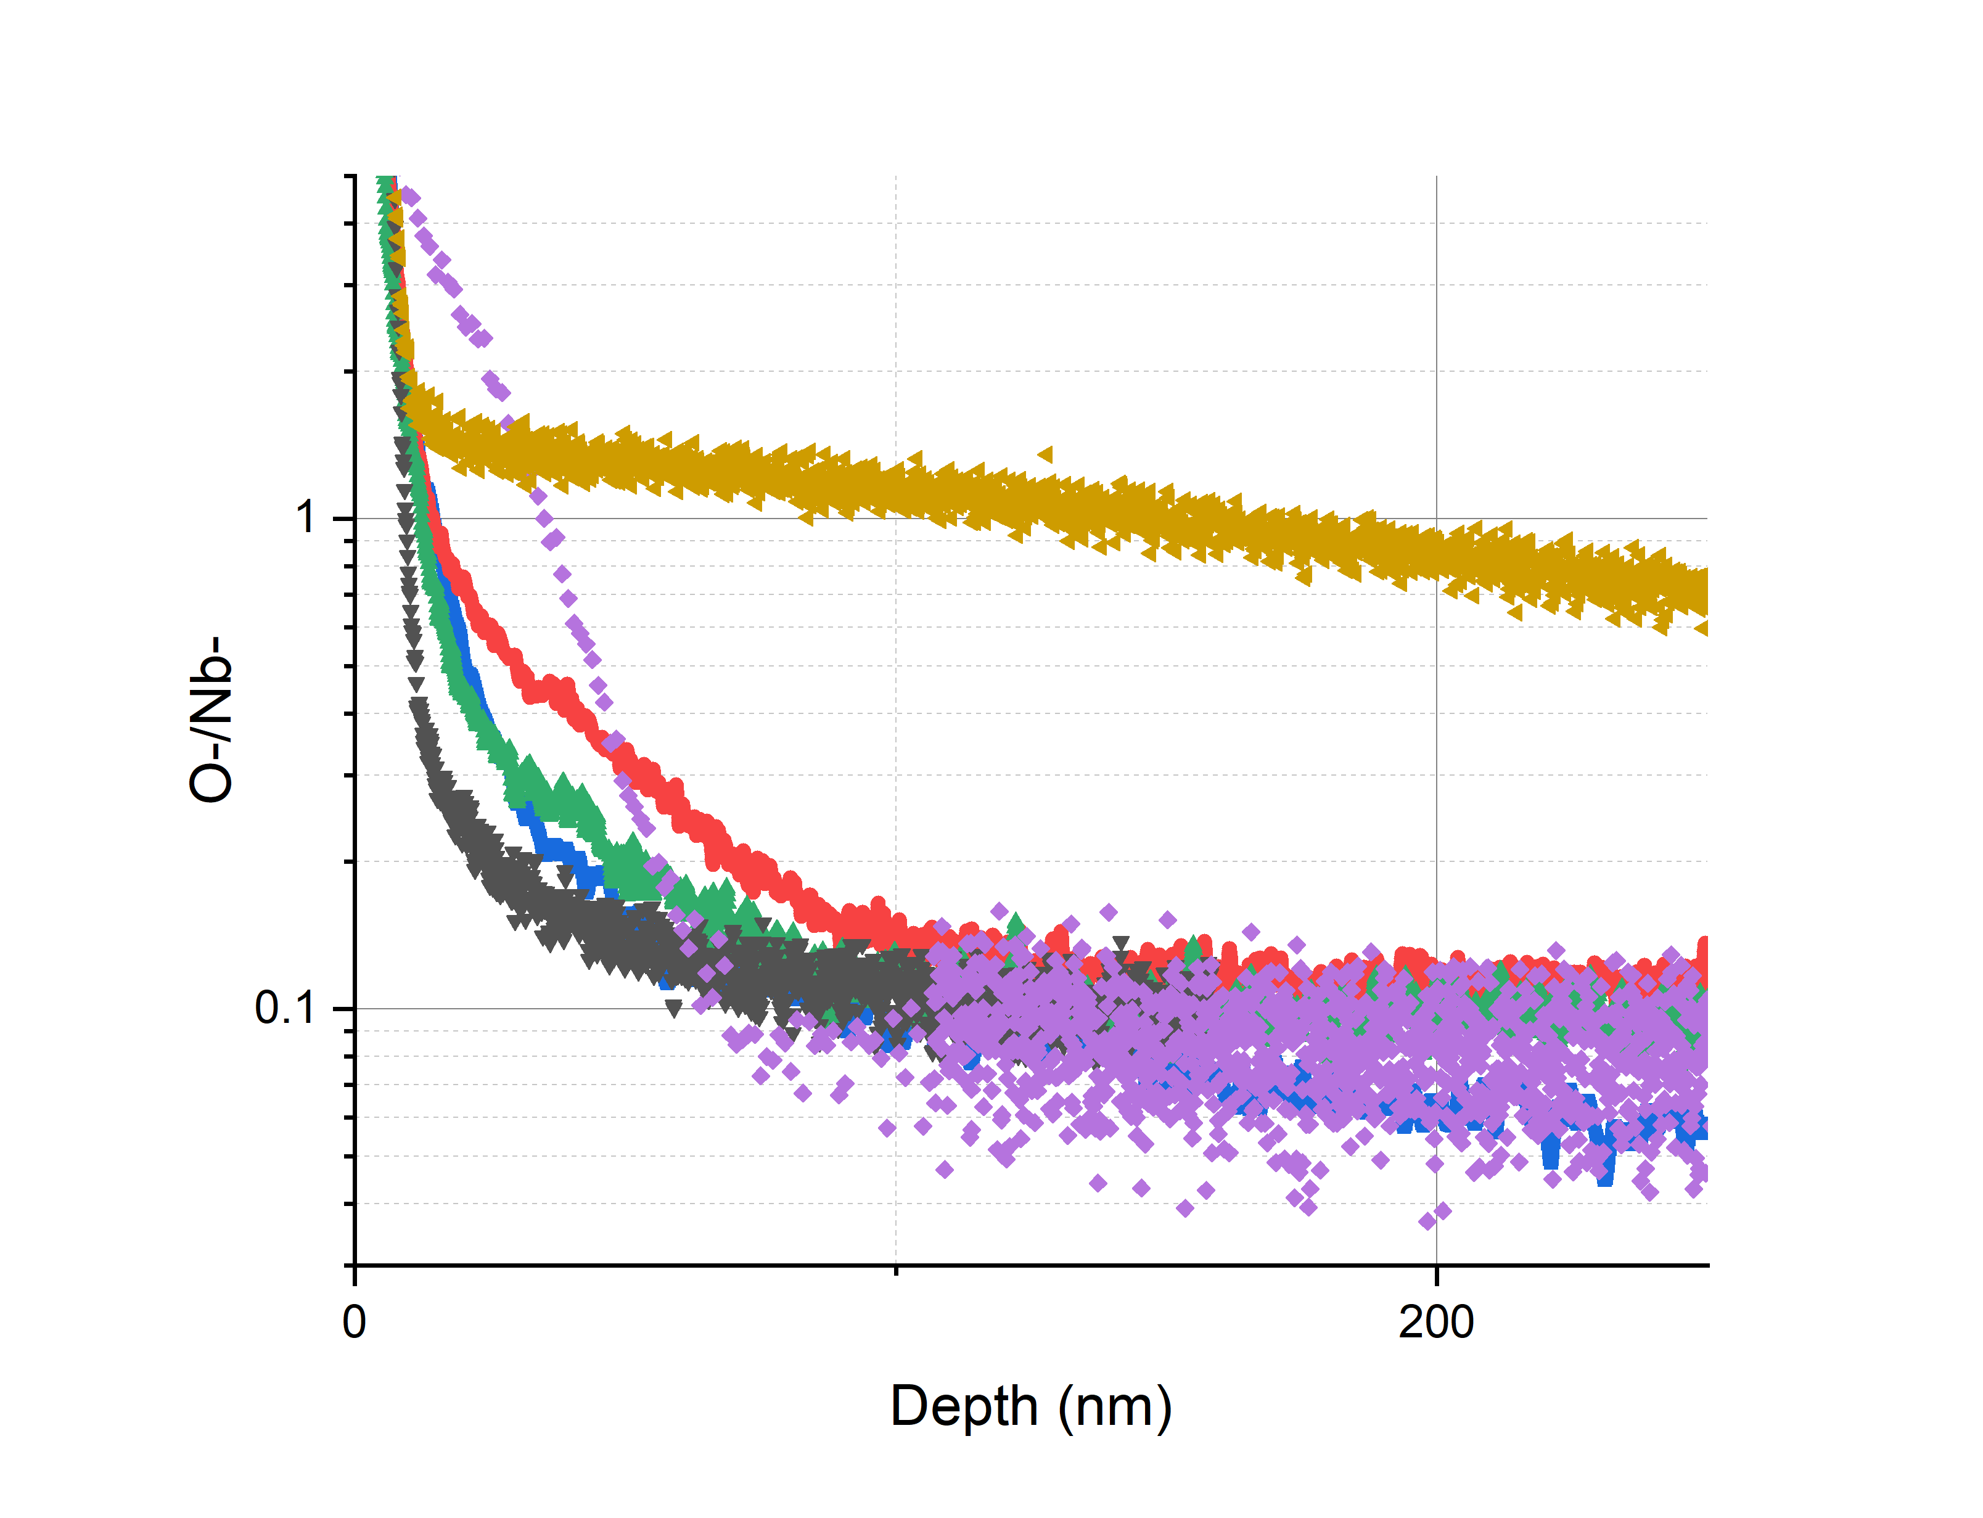
Point-to-point normalizations

Slide 22
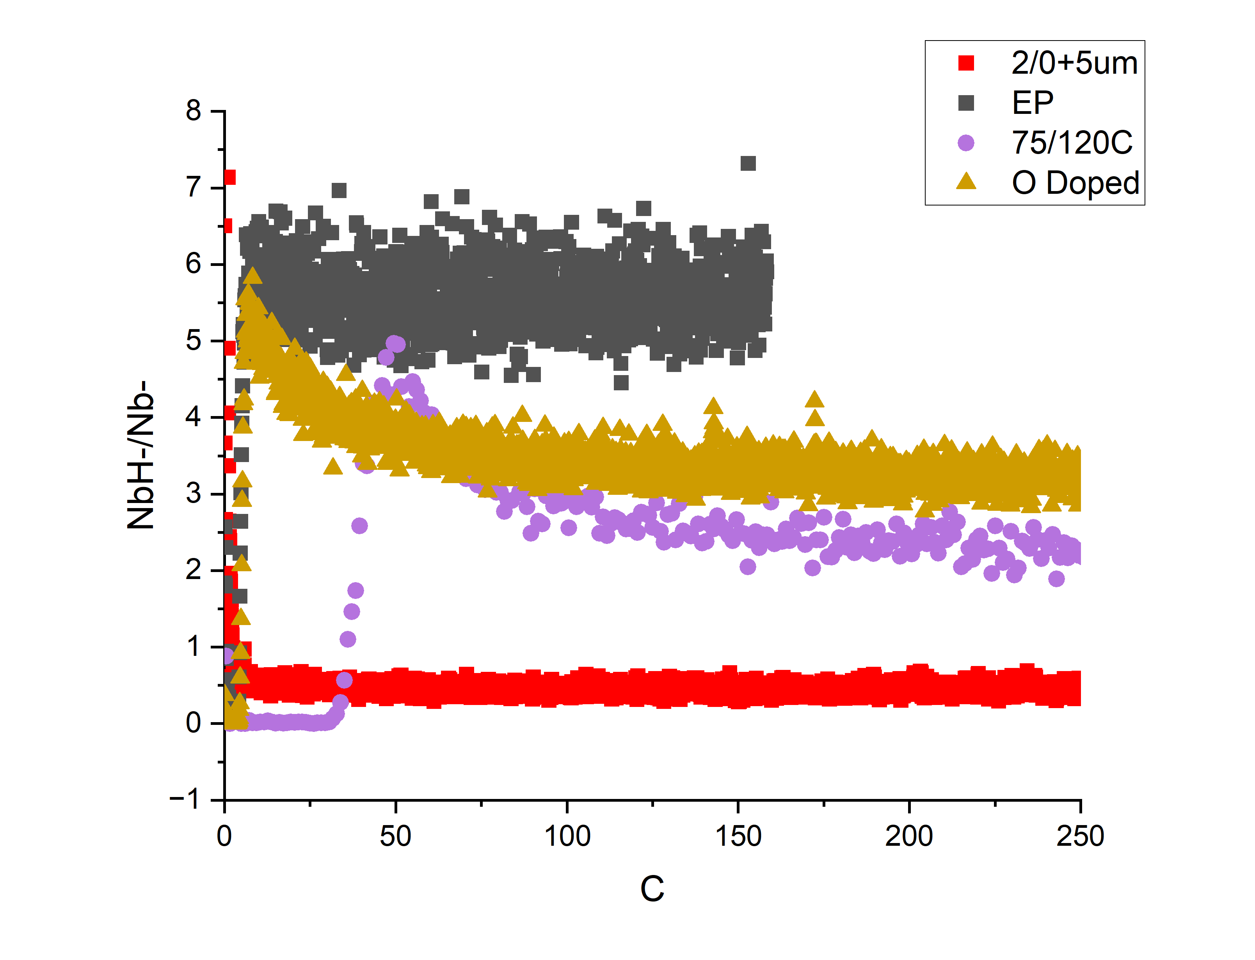
NbH-/Nb-
NbH- as a measure of free hydrogen, lower NbH- indicates more trapped H

Slide 23
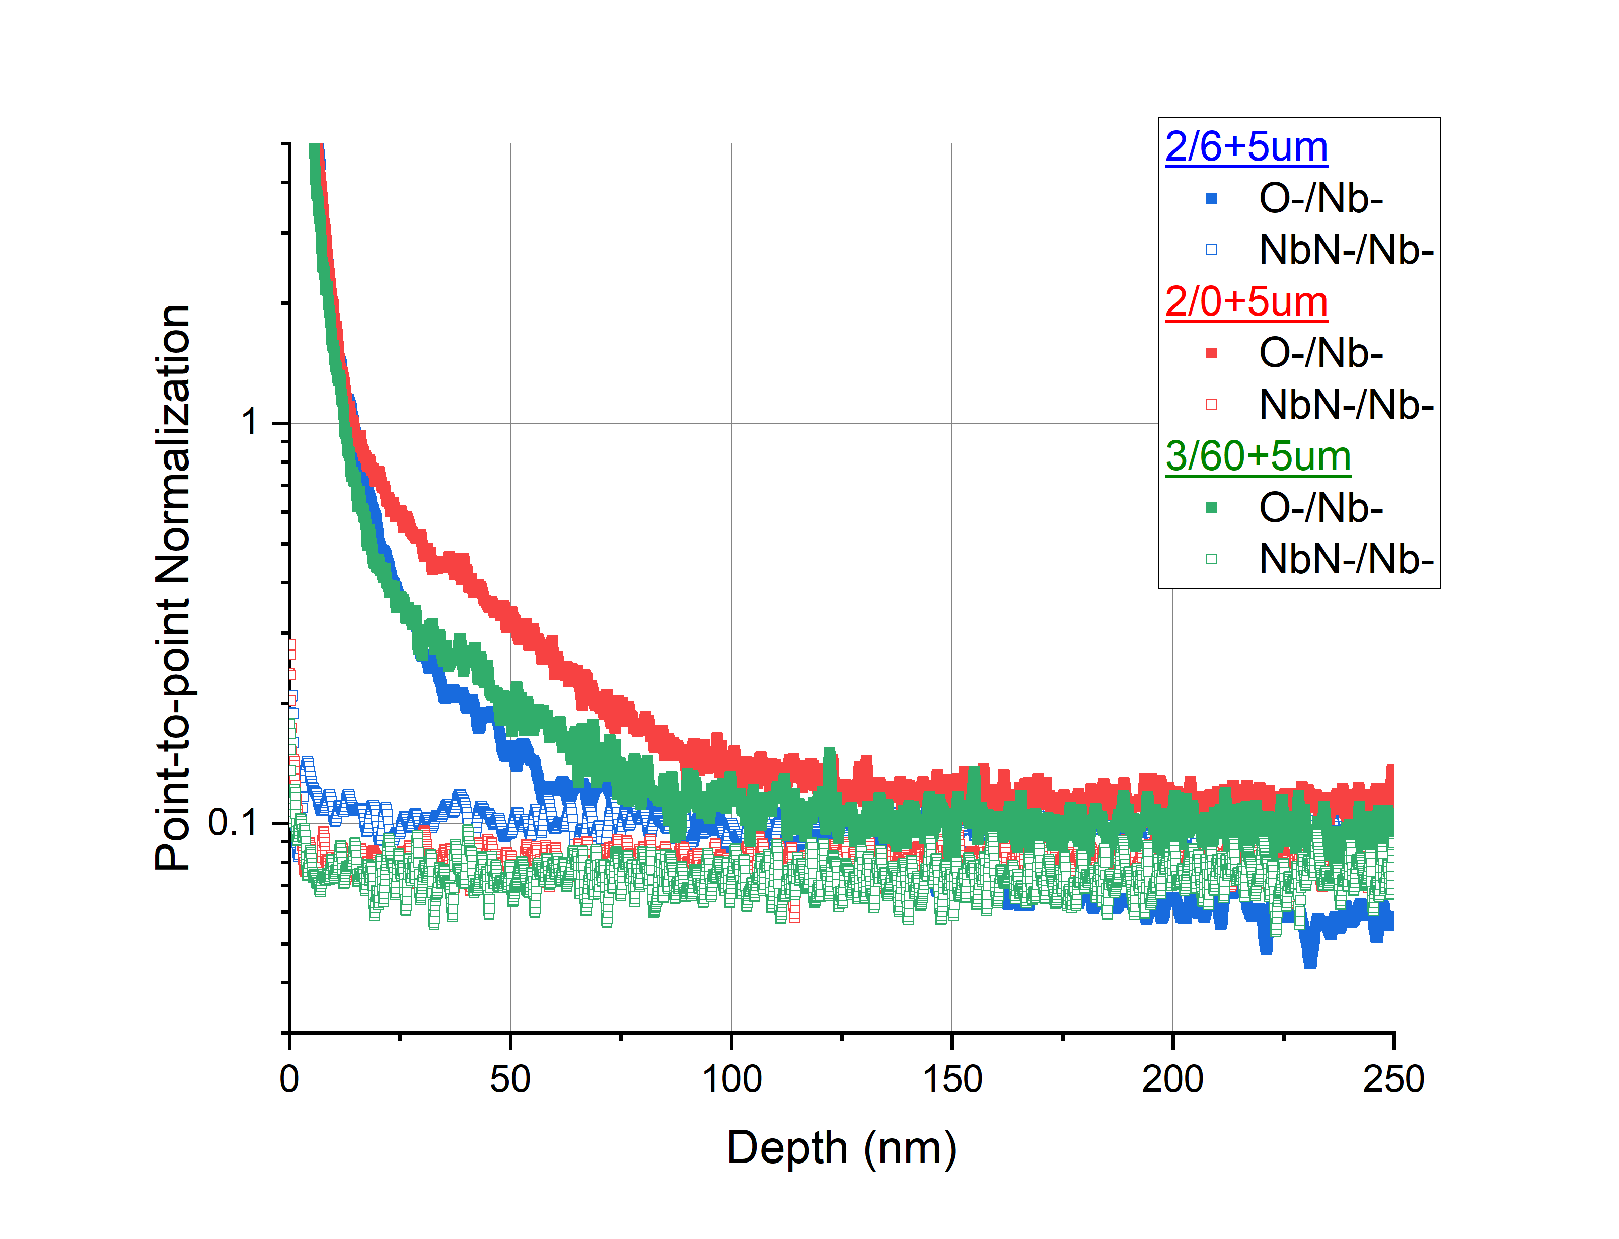
Note on absolute vs relative concentrations
When normalized to Nb, N and O appears to be similar, but actually much more N in absolute concentration

