Slide 1
Interstitial oxygen tailoring by various surface treatments and how it impacts Q₀
Rezvan Ghanbari, Marc Wenskat – on behalf of the UHH SRF R&D Team

Slide 2
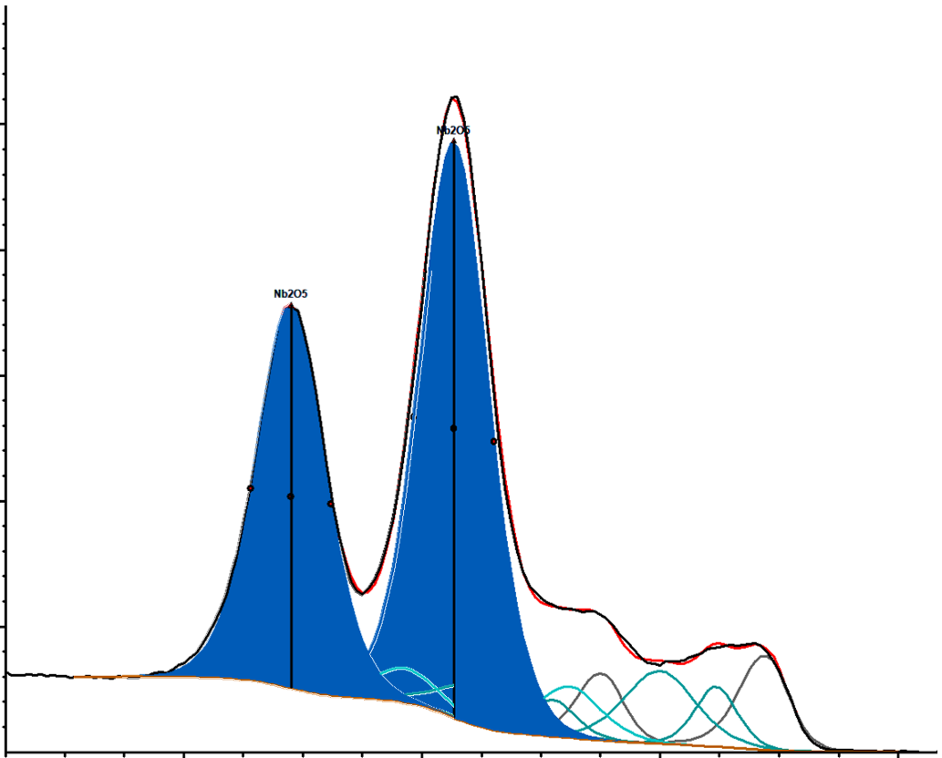
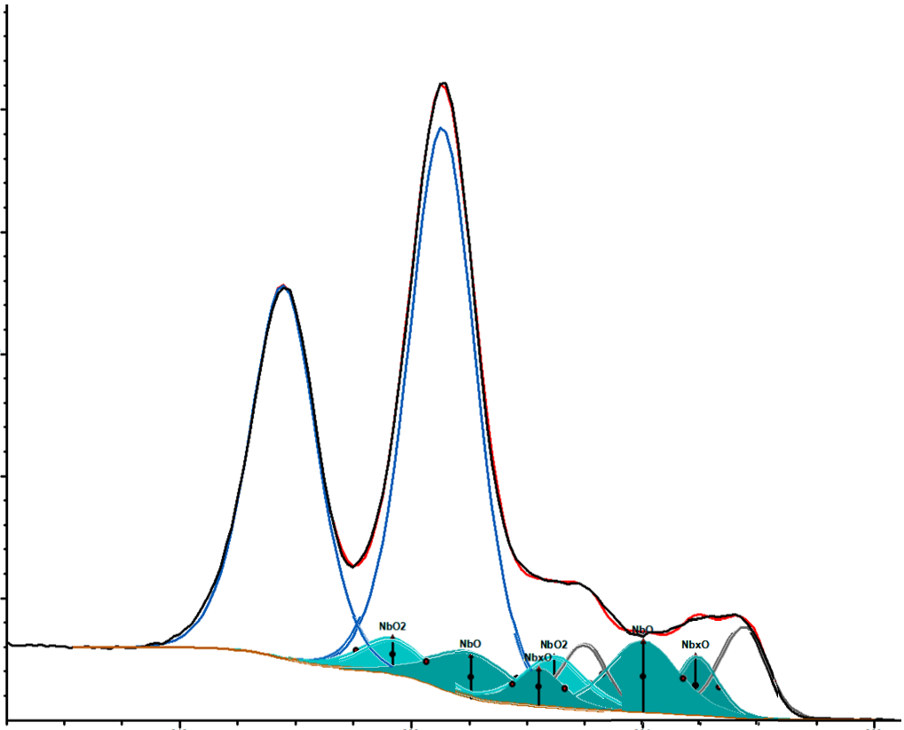
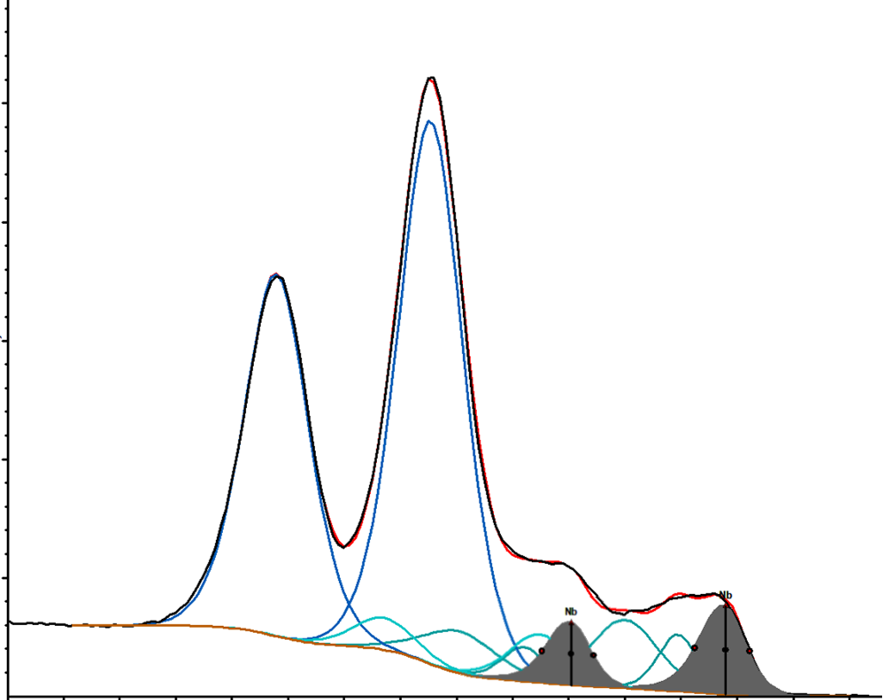
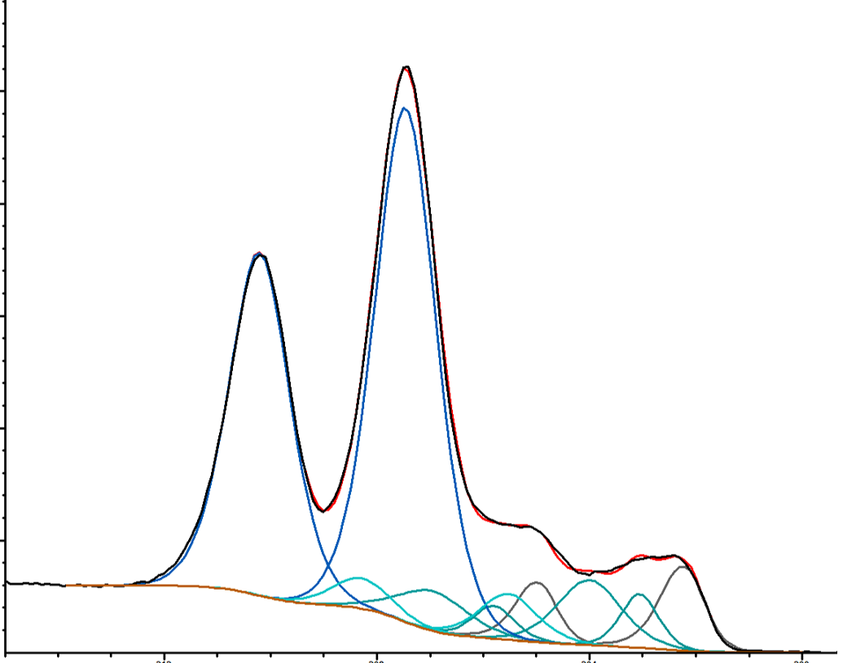
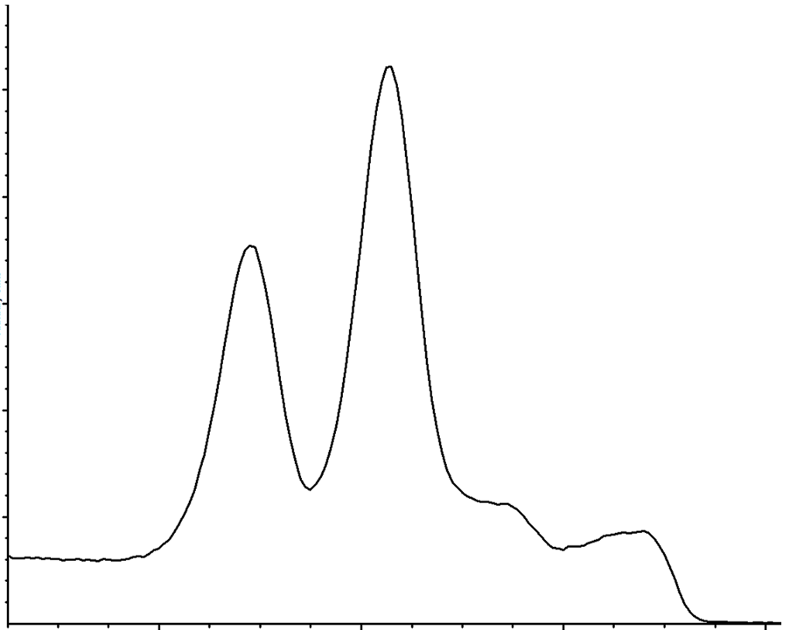
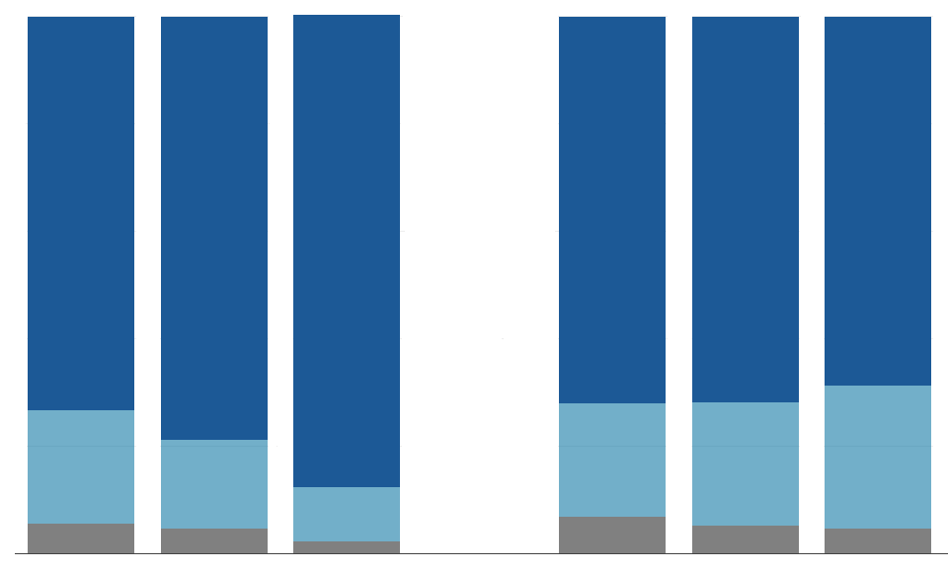
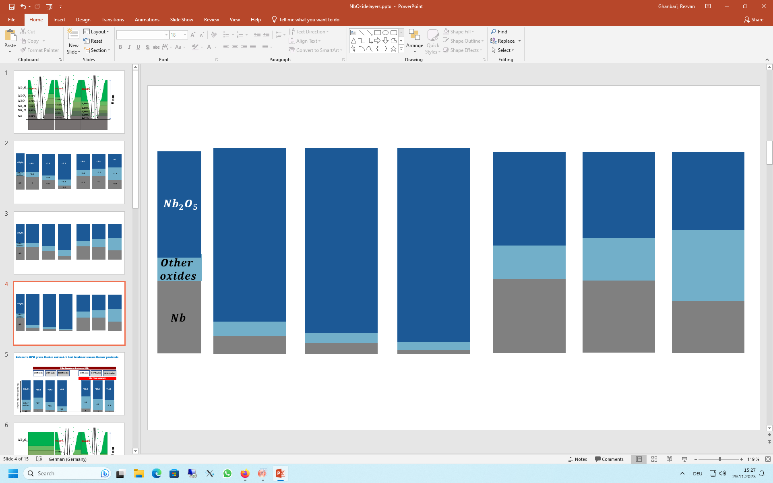






Extensive HPR → thicker Nb₂O₅ → more O for mid-T
[Ghanbari, R. TTC Workshop 2022, Aomori]
$$\frac{ component doublet peaks area}{total Nb 3d peak area}$$
X-Ray Photoelectron Spectroscopy (XPS)
Reference
0 HPR cycle
Standard recipe
6 HPR cycles
18 HPR cycles
$${Nb}_{2}O_{5}$$
Nb 3d core level
Arbitrary unit
~ 6.9
~ 7.2
$${Nb}_{2}O_{5}$$
82%
87%
~ 7.6
90%
$$The first 5 nm of the surface$$
$$Nb$$
$$Other$$
$$oxides$$
200
6%
212
208
204
$$Nb$$
12%
5%
4%
Binding energy
8%
5%

Slide 3
18x HPR is not beneficial for Q₀
2K

Slide 4
Different treatments – same rf behaviour
2K

Slide 5
It‘s not the cavity!
2K
20µm EP between black and red
40µm EP between red and blue

Slide 6
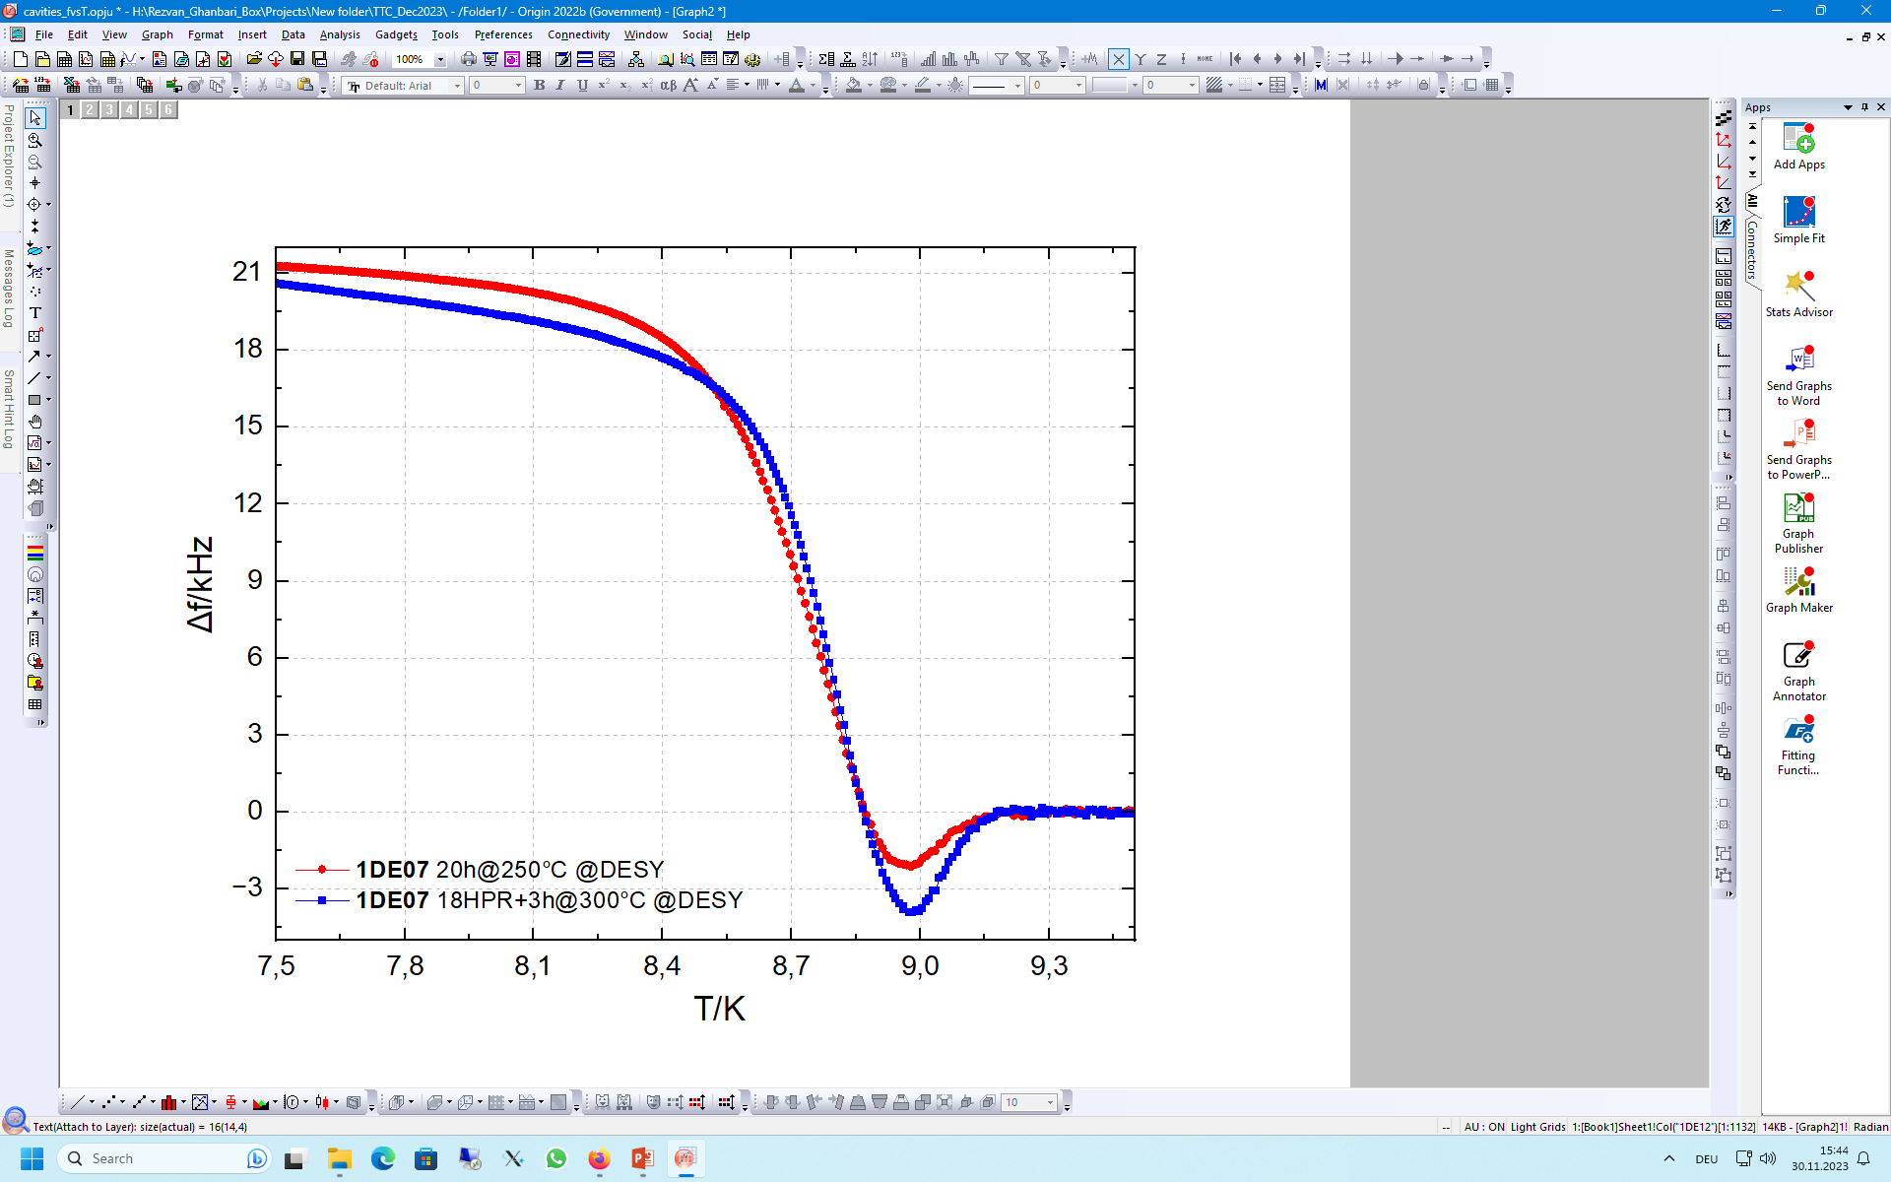
Dip is deeper for 18xHPR – Δf_{tot} similar
Cavity | Treatment | Δf_{dip}/kHz
1DE19 | 4.5h @ 335°C | 1.1
1AC02 | 3.25h @ 335°C | 1.4
1RI04 | 3h @ 250°C | 0.9
1DE07 | 20h @ 250°C | 2.0
1DE79 | 18xHPR + 3h @ 300°C | 3.9
T(f_{min}) ≈ 9.04K
T(End) ≈ 8.9K

Slide 7
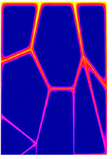
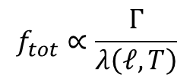
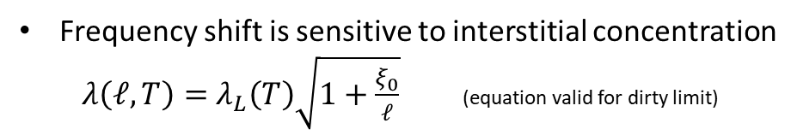

What information is encoded in f vs. T?
T_{c}
$$f_{tot}∝\frac{Γ}{λ\left(ℓ,T\right)}$$
Frequency shift is sensitive to interstitial concentration
$λ\left(ℓ,T\right)=$ $λ_{L}\left(T\right)\sqrt{1+\frac{ξ_{0}}{ℓ}}$ (equation valid for dirty limit)
Δf_{tot} for EXFEL type cavities is typcially 5-6 kHz
Mid-T: more interstitials → larger Δf, but yet no dip
T
j
Skin depth
$$λ\left(ℓ,T\right)$$

Slide 8
Microscopic model for disordered superconductor
An increased oxygen concentration reduces T_{c} of Nb by 0.93K per 1 at.%
- to have a dip minimum at 9.1K we would need ≈ 0.2 at.%
    - „end of dip“ around 8.9K ≈ 0.3 at.%
Solubility limit of O in Nb is 1 at.% @ 500°C and 0.33 at.% at 145°C
We have shown that C diffusion speed in Nb along GB vary with GB orientation, increasing disorder by spatially varying concentration
→ Assume same is true for O: not homogenous distributed within the rf layer, but clusters with uneven O-concentration
→ Expect non-constant (gaussian shaped) T_{c} reduction
→ Lowest T_{c} equal to the max. at.% concentration at RT (≈ 0.33 at.%)
→ Only locally saturated – not globally. If SIMS spot size ≈ multiple grains, obtained c_{O} below saturation limit
[Desorbo, W. Phys. Rev. 132 (1963): 107.]
[Benvenuti, C., et al. 10th SRF (2001): p441.]
[Kolchin, O.P., et al. Soviet Atomic Energy 45 (4) (1978): p999.]
[Dangwal Pandey, A., et al. Appl. Phys. Lett. 119(2021): 194102]
Notes:
1nm Nb2O5 can easily saturate several hundred nm of Nb!

Slide 9


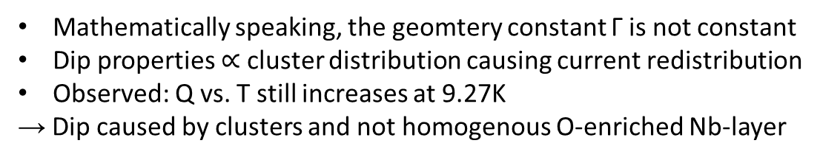
Disordered superconductor show dip
[Barra, M., et al. SUST 18.3 (2005): 271.]
T_{c,Nb}
$$f_{tot}∝\frac{Γ}{λ\left(ℓ,T\right)}$$
Mathematically speaking, the geomtery constant Γ is not constant
Dip properties $∝$ cluster distribution causing current redistribution
Observed: Q vs. T still increases at 9.27K
→ Dip caused by clusters and not homogenous O-enriched Nb-layer
<T_{c}>
T
j
Skin depth
T_{c} < T_{c,Nb}
T_{c} < T_{c,Nb}
$$λ\left(ℓ,T\right)$$

Slide 10
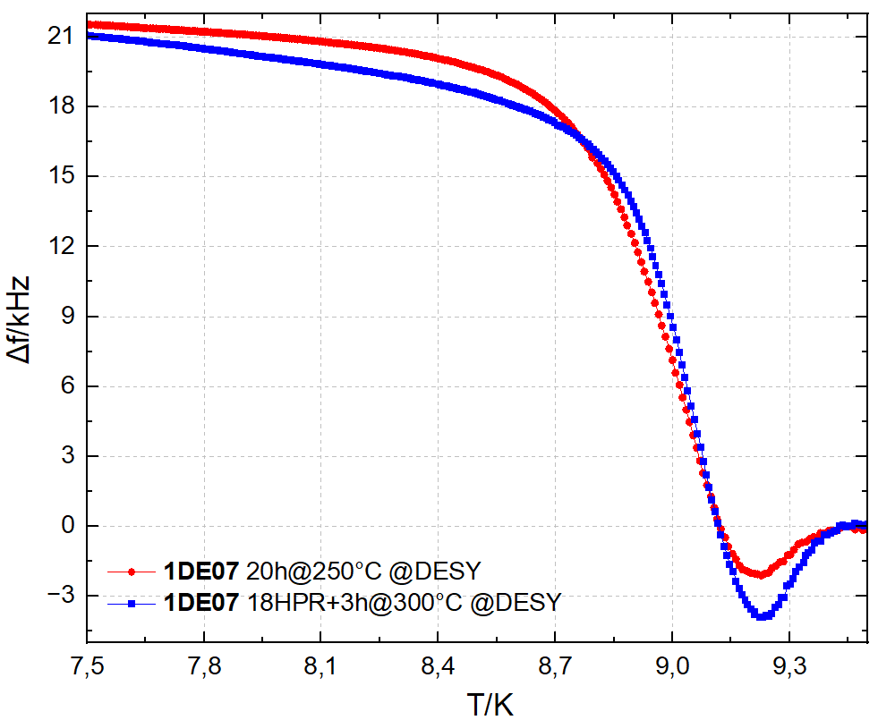
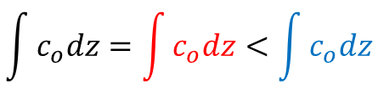
If it acts the same – is it the same?
≈ saturation concentration
$$\int{c_{o}dz}=\int{c_{o}dz}<\int{c_{o}dz}$$
Too high NSF c_{O} is not good for Q₀
3h@300C
18HPR+3h@300C
20h@250C
@2K
near T_{c}
Notes:
From N_black = N_red which is simply particle conservation, we can predict an anticorrelation between df_tot and df_dip * dT which is what we observe

Slide 11
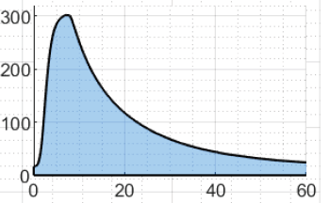
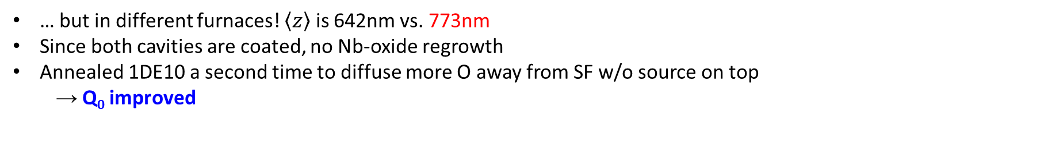
3h@300°C ≠ 3h@300°C
[Wenskat, M., et al SRF2023 TUIBA02.]
[Wenskat, M., et al Supercond. Sci. Technol. 36 (2023) 015010 (11pp).]
1DE18 and 1DE10 performed similar before and after coating
Coating was done with same parameters
Both cavities underwent 3h@300°C …
2K
Too high NSF c_{O} is not good for Q₀
$\int{T dt}$ = „thermal budget“
T / °C
… but in different furnaces! $\left\langle z\right\rangle$ is 642nm vs. 773nm
Since both cavities are coated, no Nb-oxide regrowth
Annealed 1DE10 a second time to diffuse more O away from SF w/o source on top
  → Q₀ improved
t /h

Slide 12
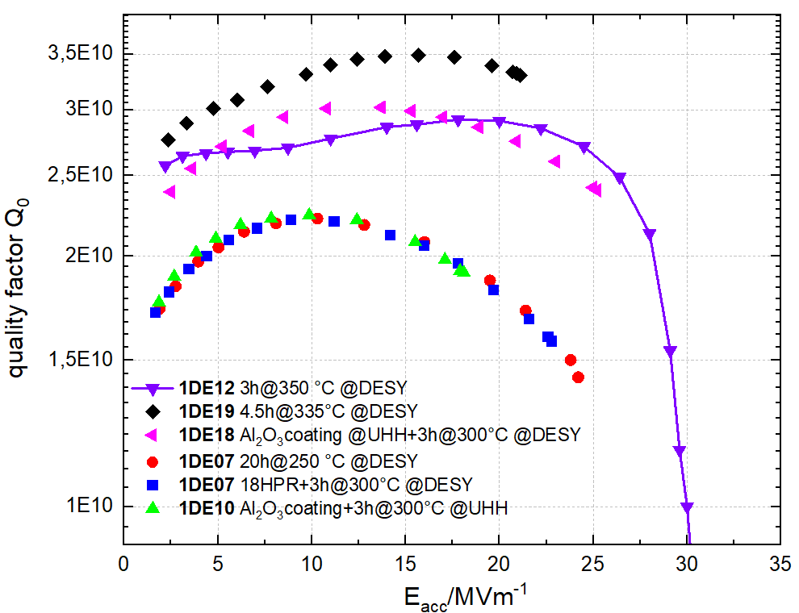
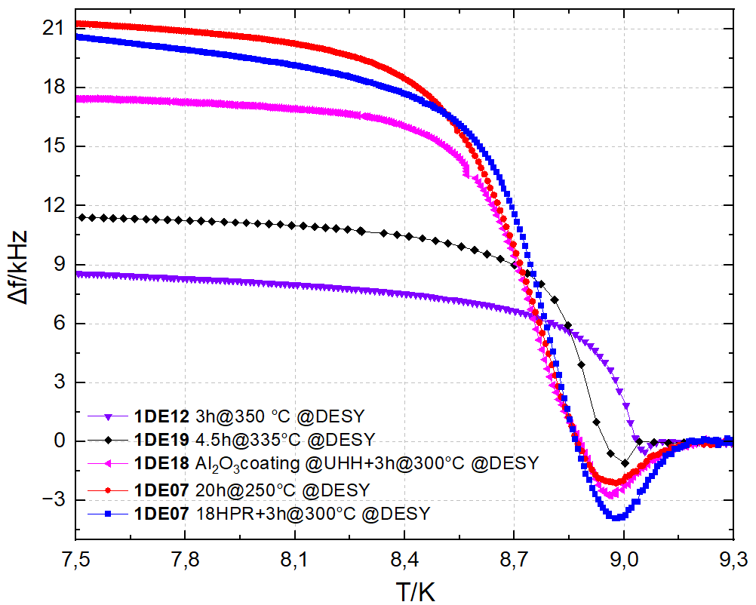
High thermal budget → HFQS reappears
2K
3h@350°C
Cavity | Treatment | Δf_{tot}/kHz | Δf_{dip}/kHz
1DE19 | 4.5h @ 335°C | 11.7 | 1.1
1AC02 | 3.25h @ 335°C | 12.3 | 1.4
1RI04 | 3h @ 250°C | 18.4 | 0.9
1DE12 | 3h @350°C | 8.3 | 0.52
Diffuse O out of RF layer
→ HFQS reappears and Δf_{tot} / Δf_{dip} decreases again

Slide 13
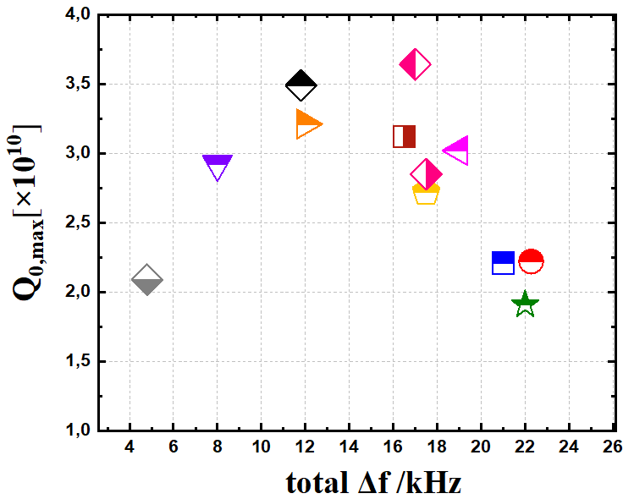
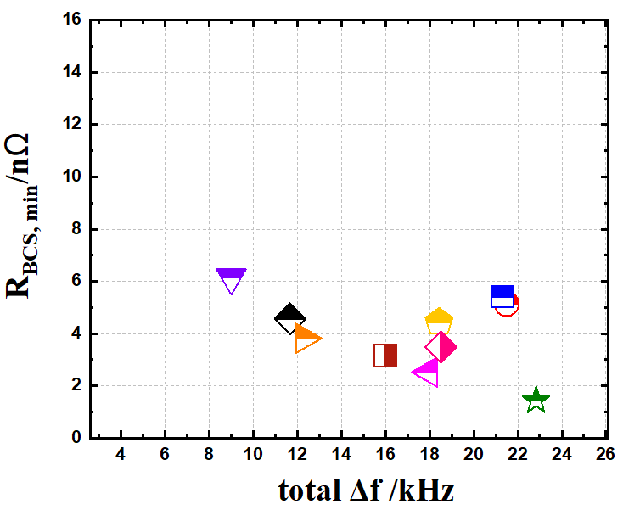
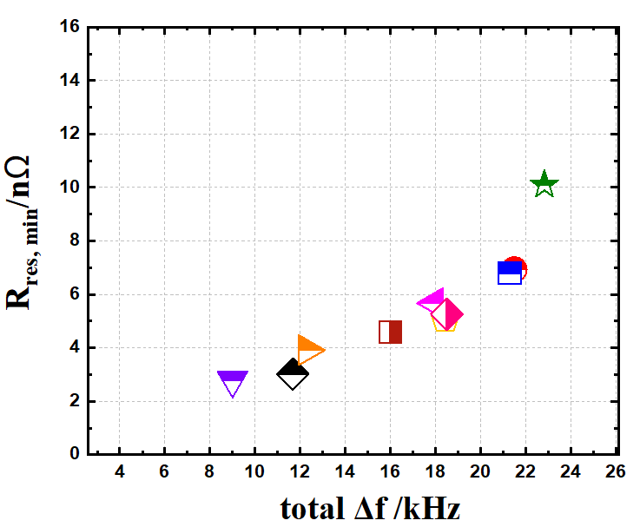
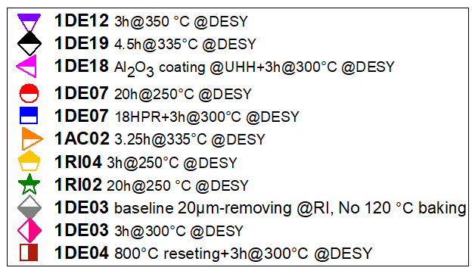

Is there an optimal O-concentration?
Too high NSF c_{O} is not good for Q₀ (1DE7 / 1DE10)
Too low NSF c_{O} causes HFQS again (1DE12 / 800°C reset)
Is there a sweet spot?
Need a substitute: assuming Δf_{tot} depends on c_{O} …
… look for correlation between Q₀ and Δf_{tot}
Q_{0,max} @ 2K
Δf = f(7K) – f(T>T_{c})
$R_{BCS}(2K)≈$ $R_{S}\left(2K\right)−R_{S}(1.5K)$
$$≈R_{res}$$
Problematic
Deconvolution

Slide 14
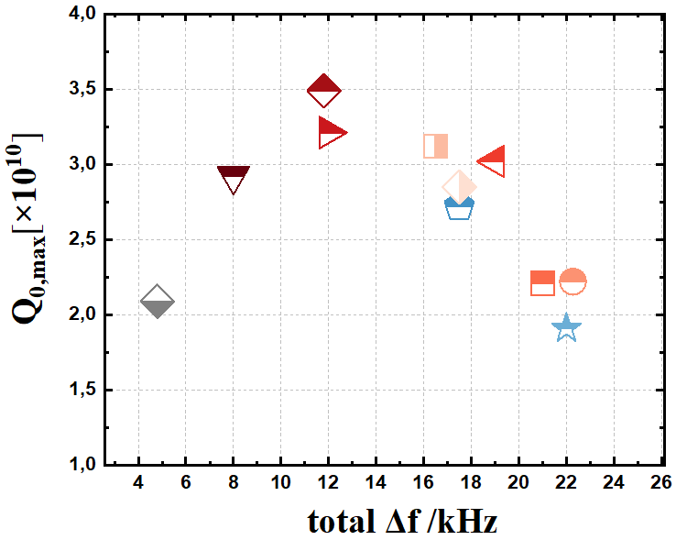
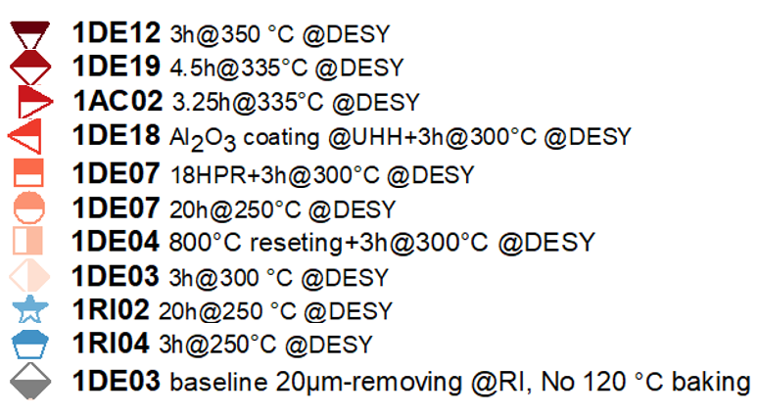
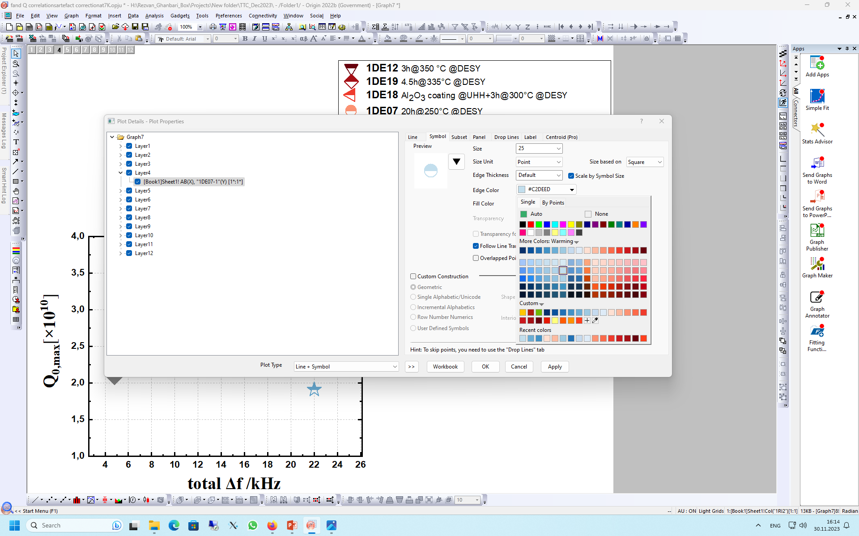
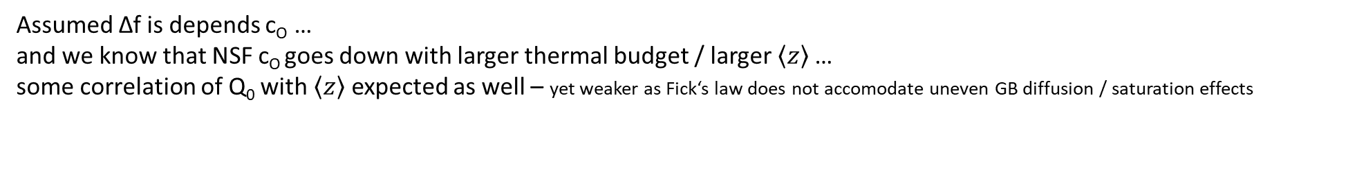
Correlation with thermal budget?
Assumed Δf is depends c_{O} …
and we know that NSF c_{O} goes down with larger thermal budget / larger $\left\langle z\right\rangle$…
some correlation of Q₀ with $\left\langle z\right\rangle$ expected as well – yet weaker as Fick‘s law does not accomodate uneven GB diffusion / saturation effects
2655 nm
1248 nm
865 nm
773 nm
641 nm
560 nm
537 nm
528 nm
512 nm
234 nm

Slide 15
Conclusion
Too high c_{O} near the surface is not good
        - 18xHPR before midT of 1DE7
  - 1xmidT vs. 2xmidT of 1DE10
Too low c_{O} leads to HFQS again
  - 1DE12 or every 800°C reset
Optimal recipe depends on furnace – „thermal budget“
  - 1DE10 vs. 1DE18
Sweet spot for Q₀ seems to exist – right amount of disorder ?
    - continue investigation & model building (Δf_{tot} vs. Δf_{dip}, E_{acc}, grain mapping)

Slide 16

Thanks…
to DESY for the cavity measurements
to you for listening
to the conveners for the opportunity to present this work
Questions?
Contact:
Rezvan Ghanbari
Universität Hamburg
Institute of Experimental Physics
E-Mail: rezvan.ghanbari@desy.de

Slide 17
Back Up

Slide 18
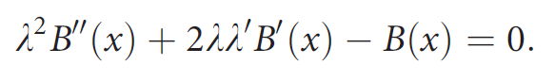
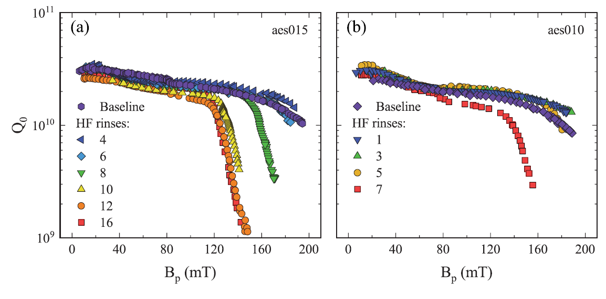
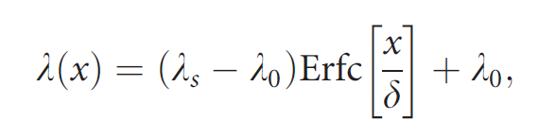
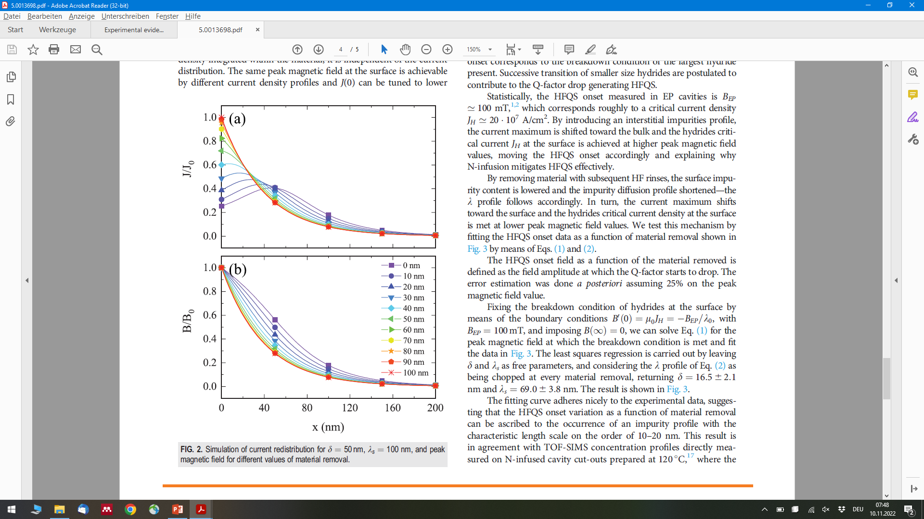
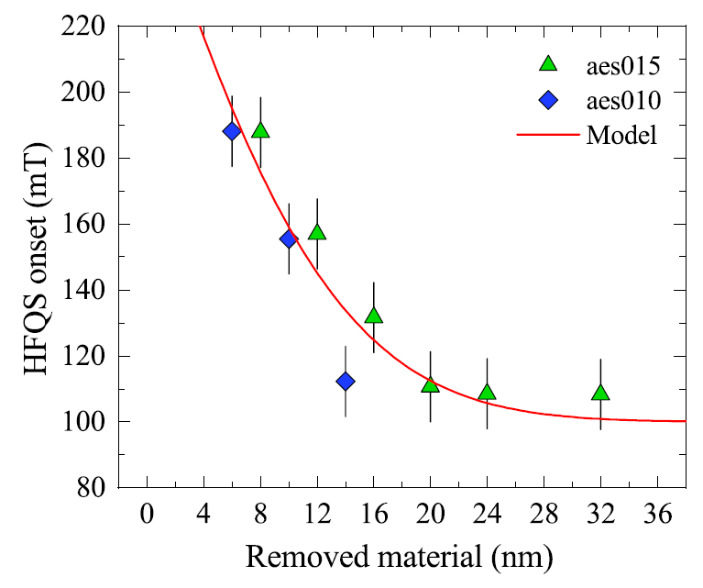
Current Redistribution
[Checchin, M. et al., Appl. Phys. Lett. 117, 032601 (2020)]
[Pambianchi, M. et al., Phys. Rev. B 50, 13659]
Consequence:
Currents shifted away from the surface where “lossy mechanism(s)” occur

Slide 19
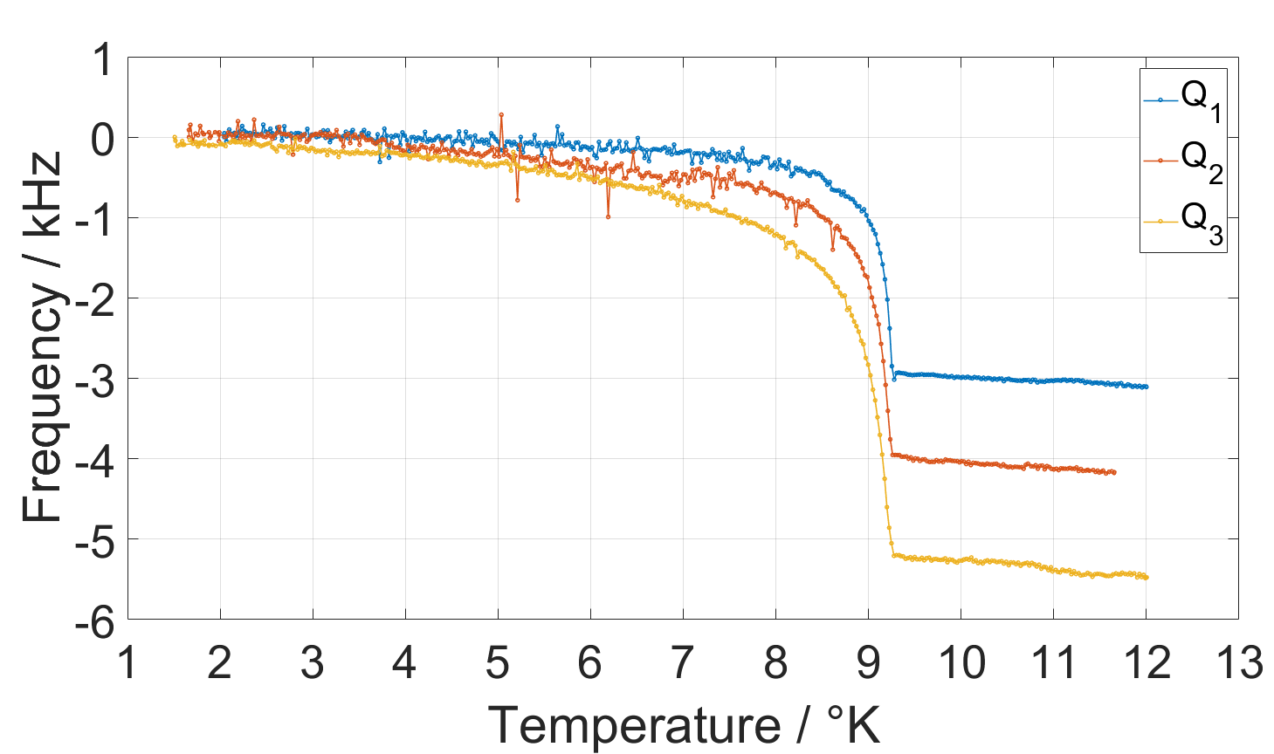
Frequency shift is frequency dependent
Q_{n} = n x 433MHz
Lower frequency f_{op} → lower Δf_{tot}
That is because Γ is frequency dependent
If the dip is caused by current redistribution → Δf_{dip} should depend on f_{op} as well

