Slide 1
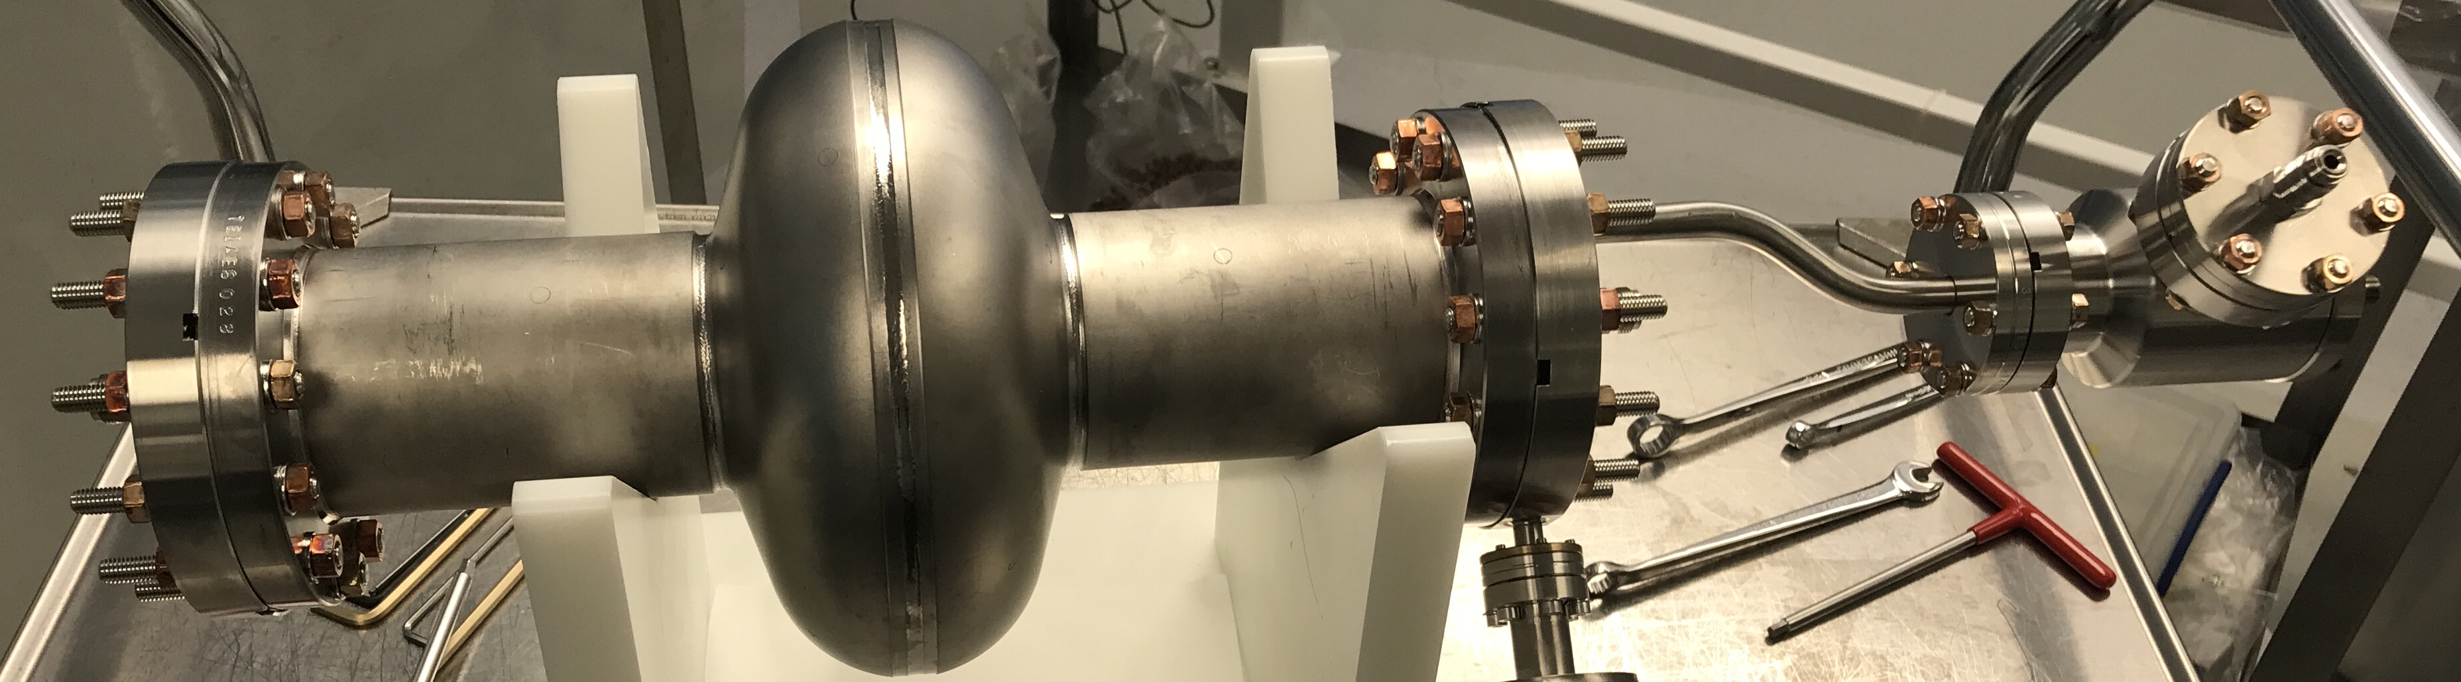
Update on Analysis of Low RRR SRF Cavities
Katrina Howard, Daniel Bafia, Young-Kee Kim
TTC2023 at Fermilab
5 December 2023

Slide 2
Continuation of Low RRR Studies
Many SRF studies follow a “clean bulk dirty surface” technique to optimize the BCS resistance by adding extrinsic impurities
Low temperature bake and N-doping are current focus
What role do intrinsic impurities serve?
Might perform similar functions as extrinsic impurities which have been shown to improve performance
Goal: use understanding of intrinsic impurities to design future surface treatments for high gradient and quality factor
Taking new avenue by studying low RRR cavities
Low purity Nb → increased concentration of intrinsic impurities
Taking a deep dive in characterizing performance with TMAP

Slide 3
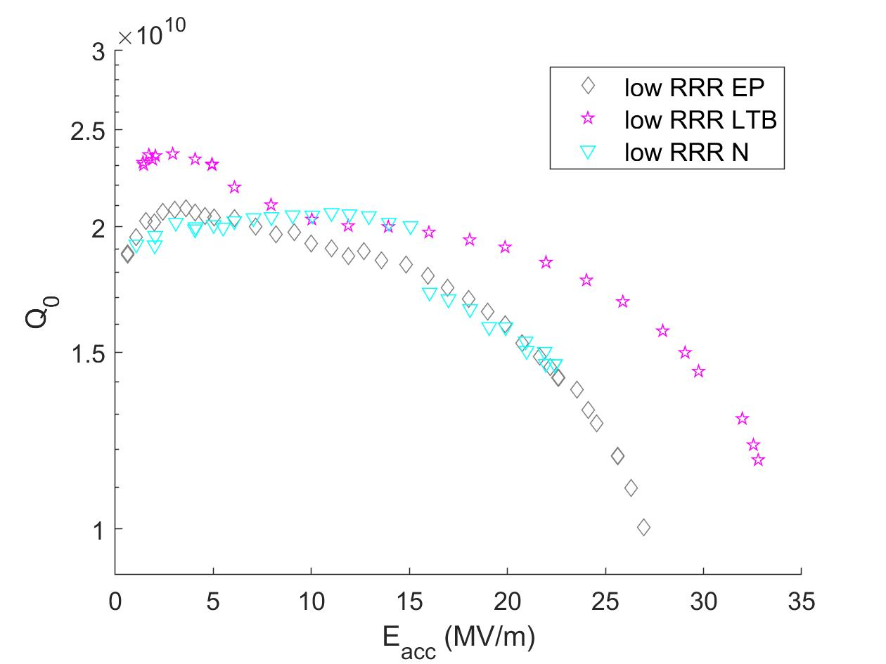
Continuation of Low RRR Studies
Many SRF studies follow a “clean bulk dirty surface” technique to optimize the BCS resistance by adding extrinsic impurities
Low temperature bake and N-doping are current focus
What role do intrinsic impurities serve?
Might perform similar functions as extrinsic impurities which have been shown to improve performance
Goal: use understanding of intrinsic impurities to design future surface treatments for high gradient and quality factor
Taking new avenue by studying low RRR cavities
Low purity Nb → increased concentration of intrinsic impurities
Taking a deep dive in characterizing performance with TMAP
Surface treatments appear to vary cavity performance, but slightly differently when compared to high RRR cavities

Slide 4
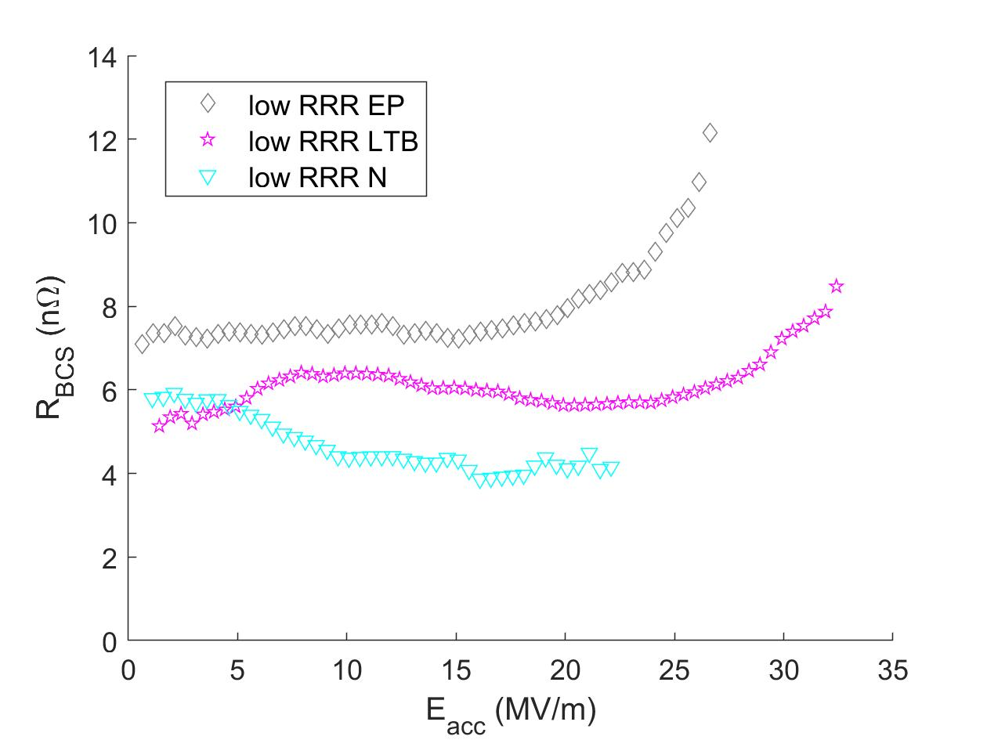
Continuation of Low RRR Studies
Observe many of the phenomena characteristic of each treatment, but again to slightly different extents
Many SRF studies follow a “clean bulk dirty surface” technique to optimize the BCS resistance by adding extrinsic impurities
Low temperature bake and N-doping are current focus
What role do intrinsic impurities serve?
Might perform similar functions as extrinsic impurities which have been shown to improve performance
Goal: use understanding of intrinsic impurities to design future surface treatments for high gradient and quality factor
Taking new avenue by studying low RRR cavities
Low purity Nb → increased concentration of intrinsic impurities
Taking a deep dive in characterizing performance with TMAP

Slide 5
Using TMAP to Further Characterize Performance of Low RRR Cavities

Slide 6
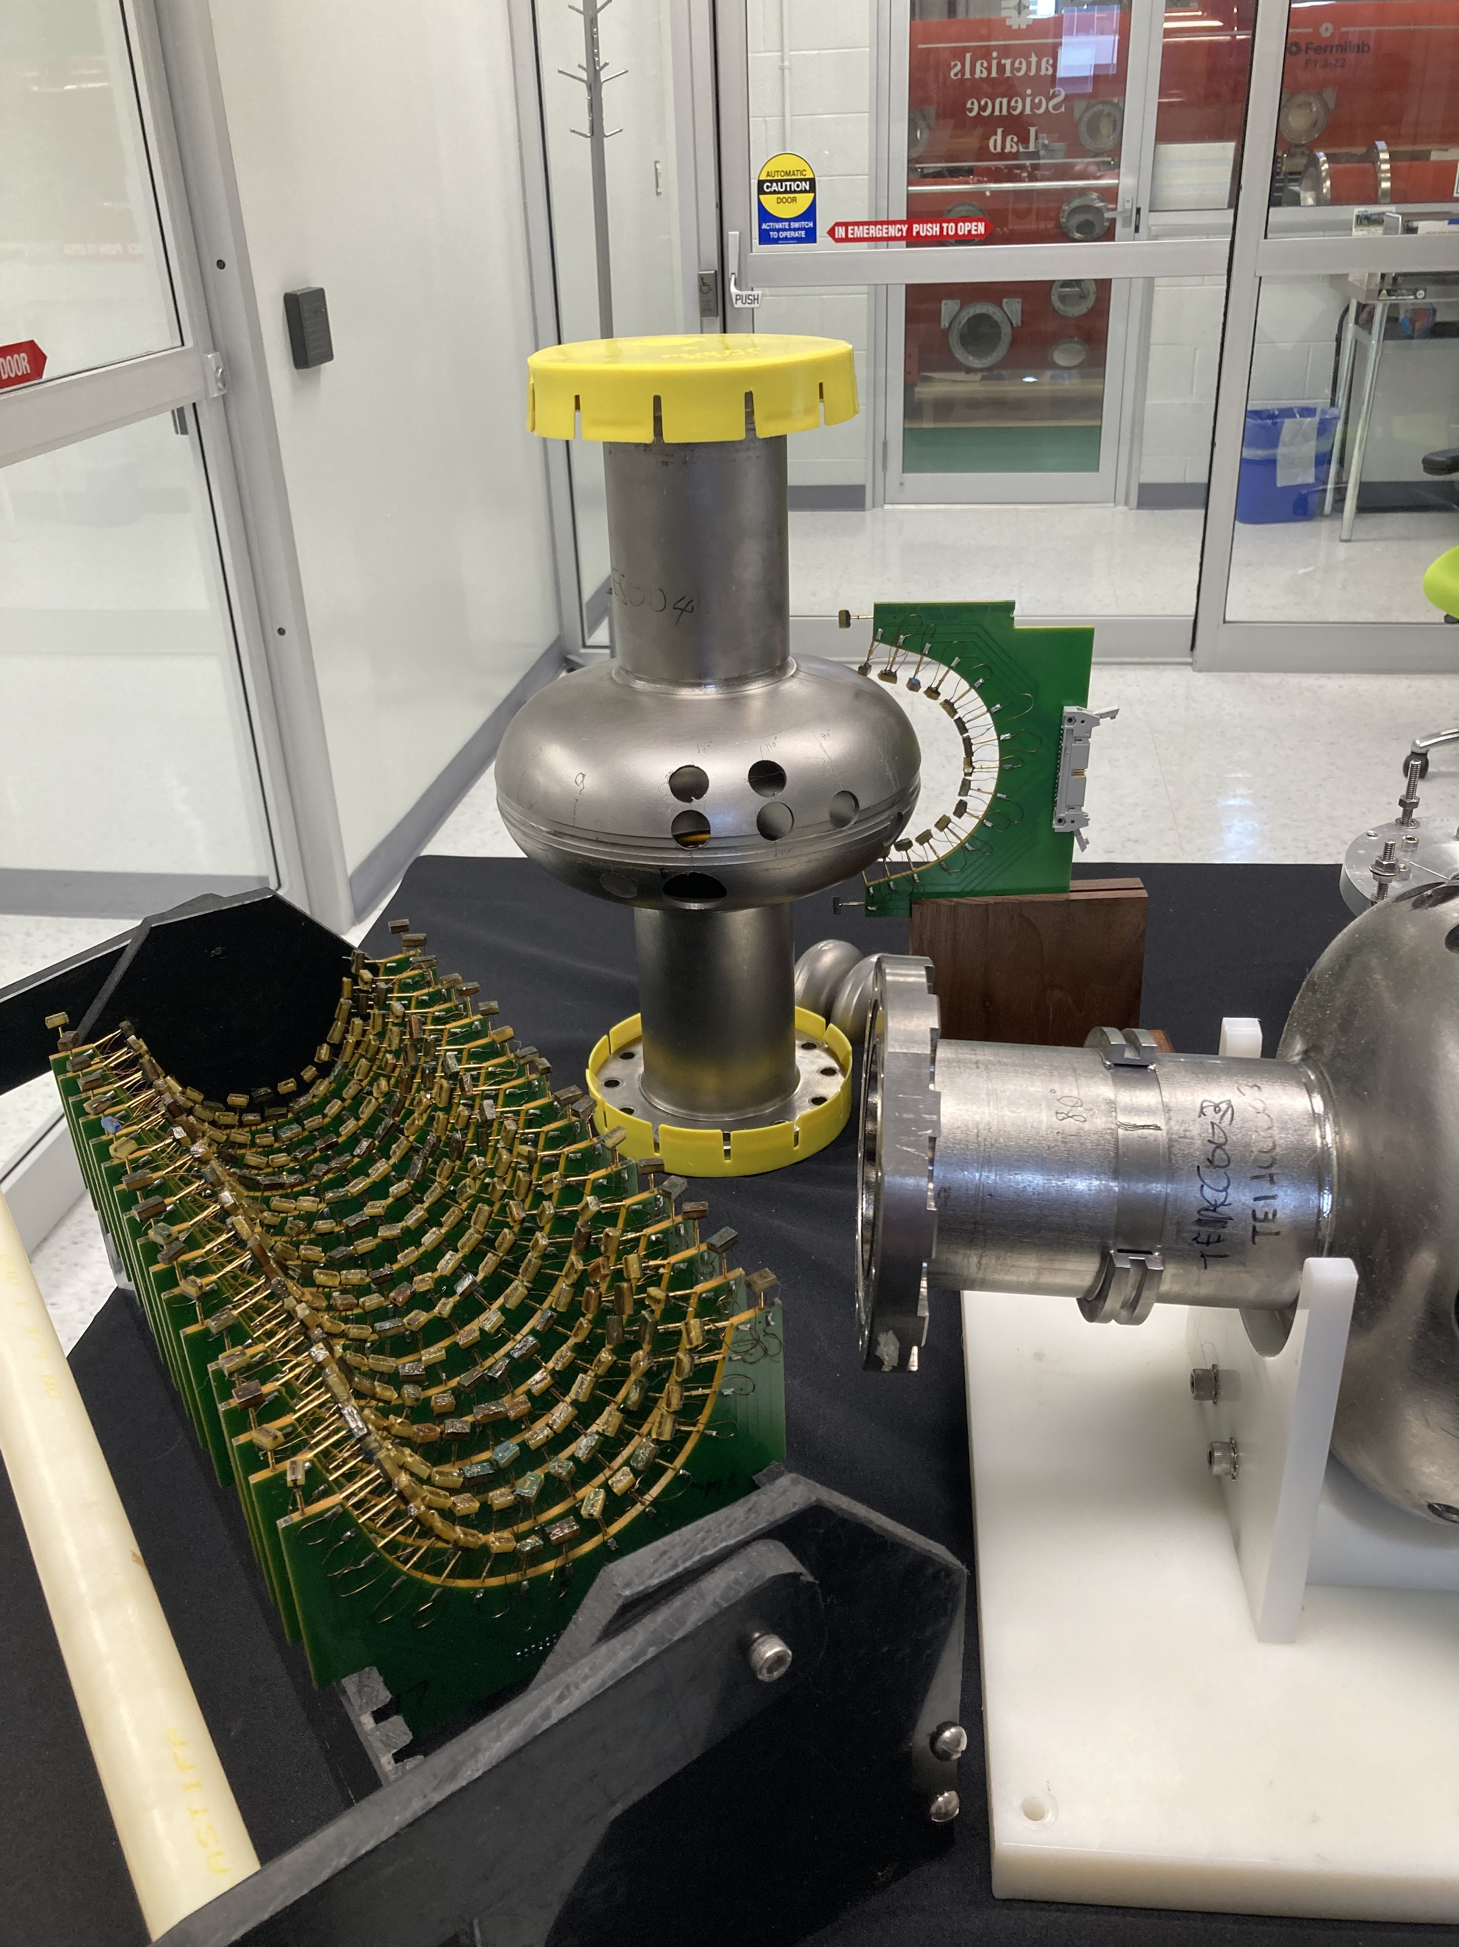
Sequential TMAP Study on Single Low RRR Nb SRF Cavity
1.3 GHz TESLA-shaped single-cell low RRR (= 61) cavity
RF testing after surface treatments
Electropolished (40 μm EP for baseline)
Low temperature bake (120 ℃ x 48 hours)
N-doping (2/6 recipe with 5 μm EP)
Underdoped (additional 2 μm EP from N-doped surface)
16 RTD’s per board
36 boards

Slide 7
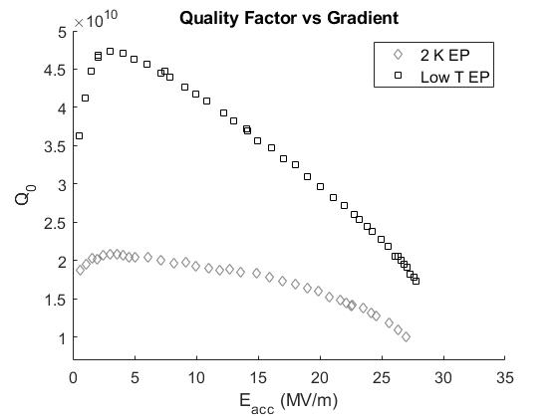
Sequential TMAP Study 1/4: EP
Cavity received 40 μm EP to reset surface
Low RRR has slightly lower Q₀ than high RRR
Q₀ slope begins sooner but less sharp than high RRR

Slide 8
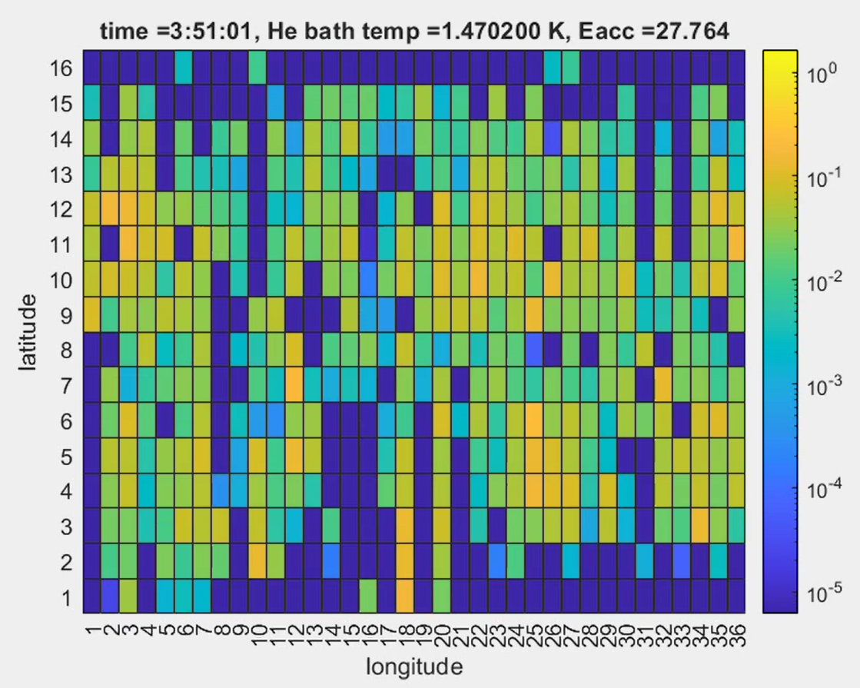
Sequential TMAP Study 1/4: EP
Cavity received 40 μm EP to reset surface
More localized heating but not only at quench location
TMAP Profile Just Before Quench
top iris
equator
bottom iris

Slide 9
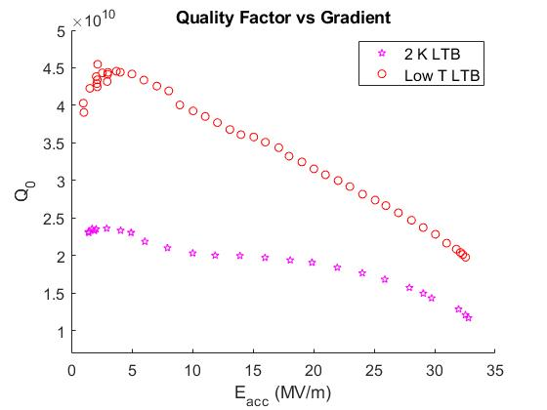
Sequential TMAP Study 2/4: LTB
Low temperature bake (120 ℃ x 48 hours)
Low RRR experiences reduced response to LTB treatment
9

Slide 10
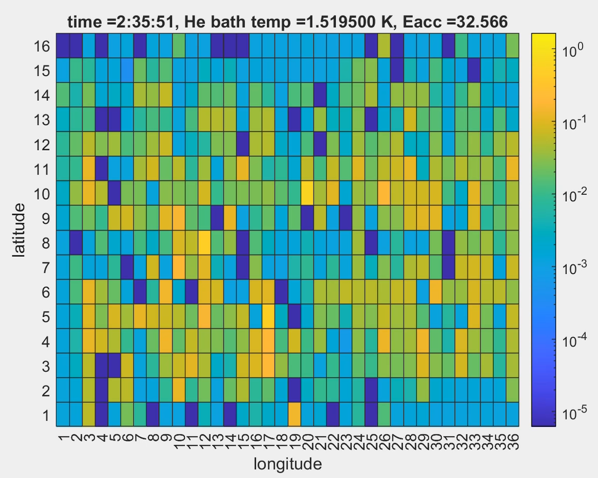
Sequential TMAP Study 2/4: LTB
Low temperature bake (120 ℃ x 48 hours)
More widespread heating, including at quench location
TMAP Profile Just Before Quench
top iris
equator
bottom iris
10

Slide 11
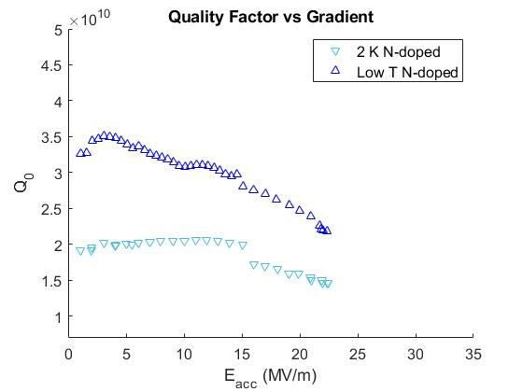
Sequential TMAP Study 3/4: N-doped
N-doping 2/6 recipe with 5 μm EP
Much lower Q₀ than high RRR but similar gradients reached
11

Slide 12
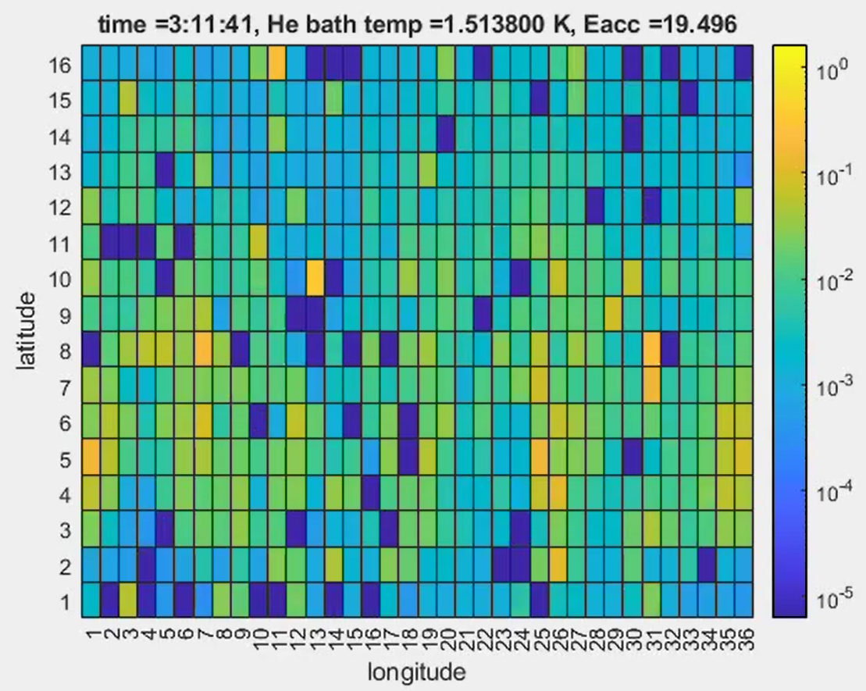
Sequential TMAP Study 3/4: N-doped
N-doping 2/6 recipe with 5 μm EP
More widespread heating, not specifically at quench location
TMAP Profile Just Before Quench
top iris
equator
bottom iris
12

Slide 13
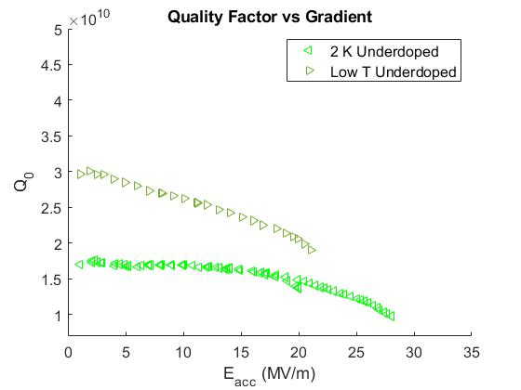
Sequential TMAP Study 4/4: Underdoped
Underdoped (additional 2 μm EP from N-doped surface) to see how decreasing N concentration changes performance
Significantly lower Q₀ but reaches higher gradient than N-doped
13

Slide 14
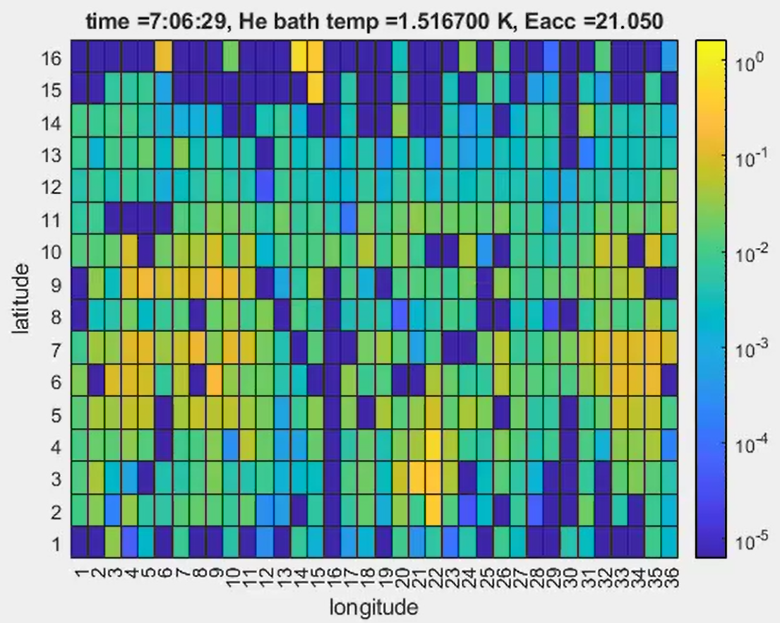
Sequential TMAP Study 4/4: Underdoped
Underdoped (additional 2 μm EP from N-doped surface) to see how decreasing N concentration changes performance
More localized heating, including at quench location
TMAP Profile Just Before Quench
top iris
equator
bottom iris
14

Slide 15
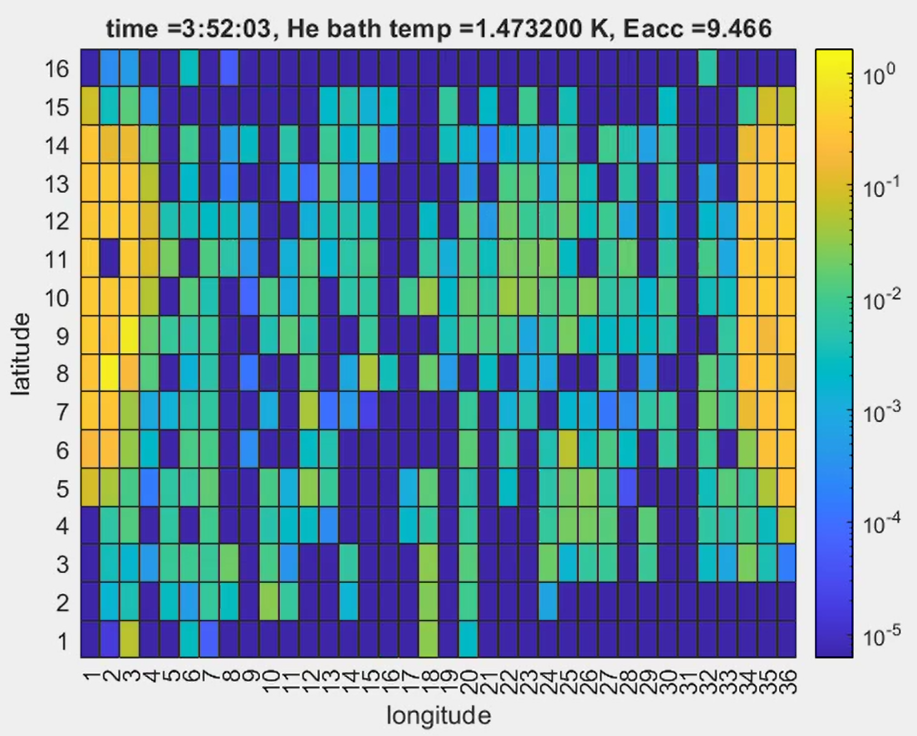
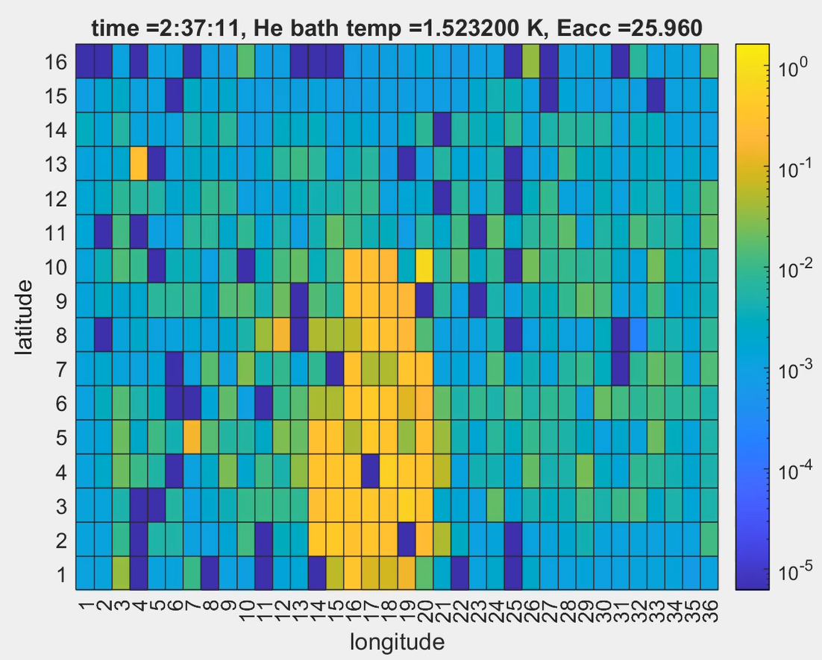
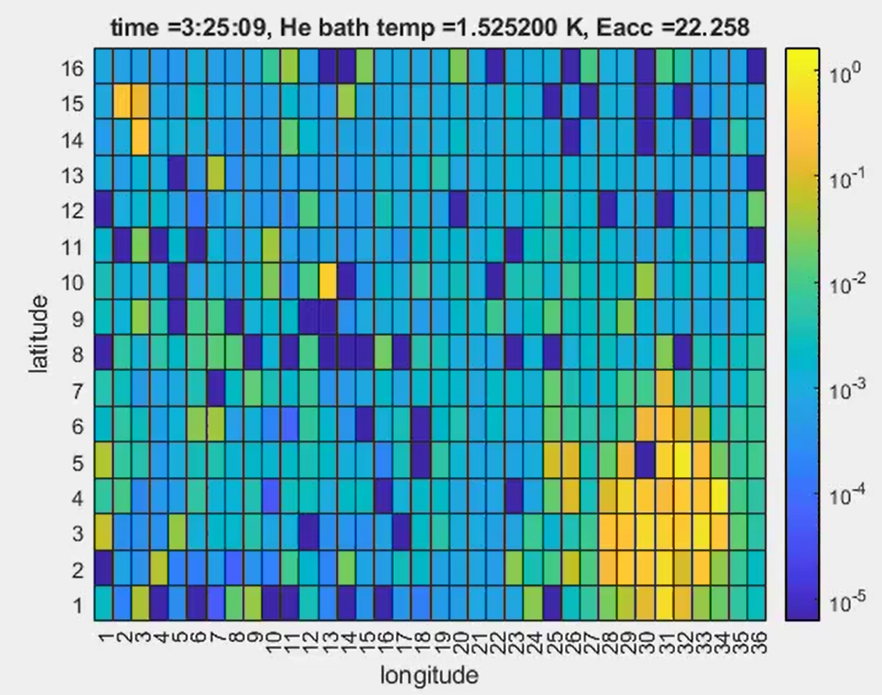
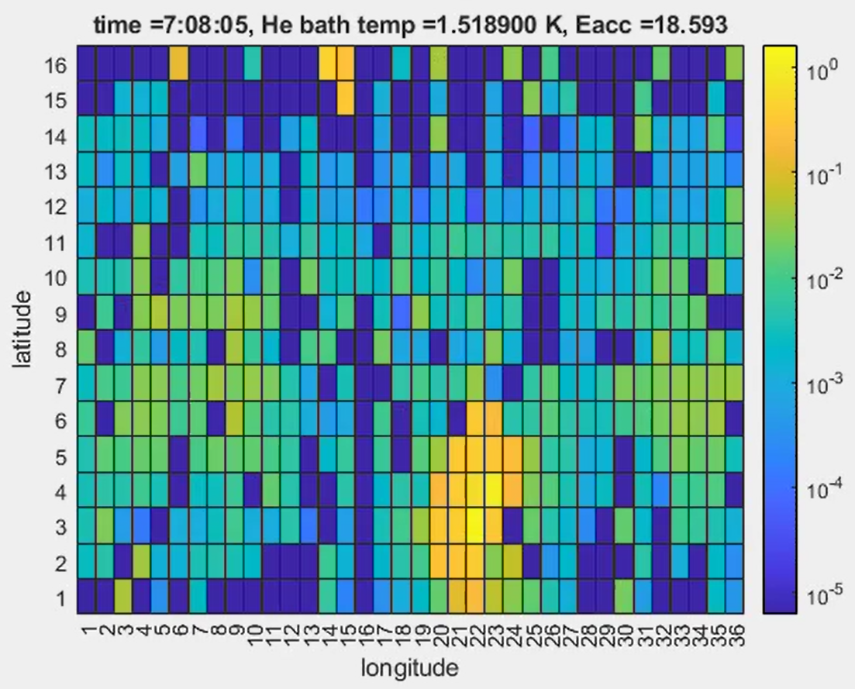
Comparing TMAPs for All Studied Treatments
EP LTB N-doped Underdoped

Slide 16
Comparing TMAPs for All Studied Treatments
EP LTB N-doped Underdoped
Quench locations change between surface treatments
Does the heating behavior at the quench locations also change?

Slide 17
Comparing Quench Spot Heating Profiles
EP: Change in slope corresponds to onset of HFQS

Slide 18
Comparing Quench Spot Heating Profiles
EP: Change in slope corresponds to onset of HFQS
LTB: Delay in Q-slope means we do not see onset of additional losses

Slide 19
Comparing Quench Spot Heating Profiles
EP: Change in slope corresponds to onset of HFQS
LTB: Delay in Q-slope means we do not see onset of additional losses
N-Doped: quench of magnetic origin so we do not see change in heating slope

Slide 20
Comparing Quench Spot Heating Profiles
EP: Change in slope corresponds to onset of HFQS
LTB: Delay in Q-slope means we do not see onset of additional losses
N-Doped: quench of magnetic origin so we do not see change in heating slope
Underdoped: Large heating corresponds to large losses

Slide 21
Comparing Quench Spot Heating Profiles
EP: Change in slope corresponds to onset of HFQS
LTB: Delay in Q-slope means we do not see onset of additional losses
N-Doped: quench of magnetic origin so we do not see change in heating slope
Underdoped: Large heating corresponds to large losses
Compare against high RRR EP:
Lower initial heating due to low impurity concentration
Sharper change in slope than low RRR EP because of stronger HFQS onset (thermal quench)

Slide 22
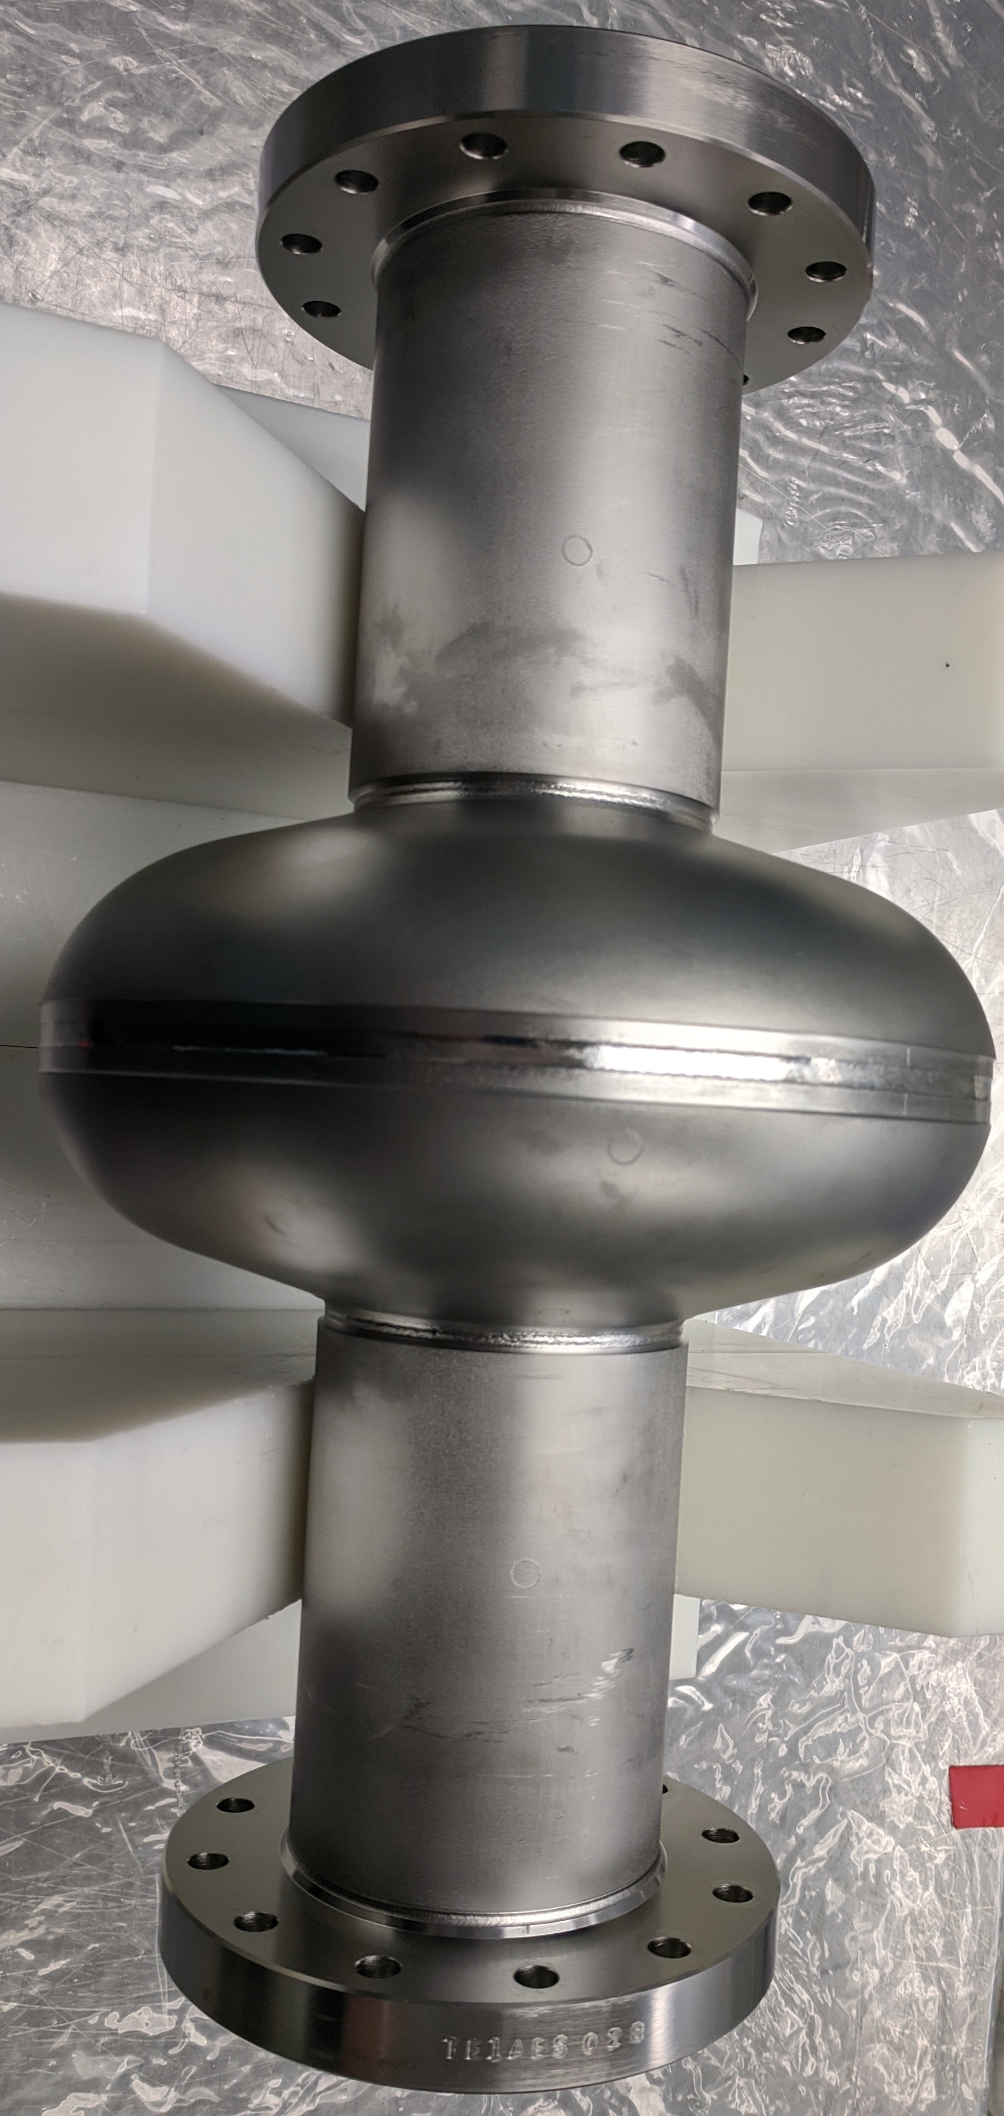
Cavity Performance Summary
Lower quality factors but reach similar gradients
~1.5e10 at ~20 MV/m for 2K
Larger heating at quench locations but less sudden changes in slope
More magnetic quench behavior (less thermal)
Combined effects of intrinsic and extrinsic impurities
Sample Study: identifying key impurity
Calculation of mean free path from frequency vs temperature data
N-infusion cavity testing and sample study
Next Steps

Slide 23
Discussion Topics
How was RRR determined and how can we remeasure?
Cell material from Tokyo Denkai (Ta Wt % .0193, RRR = 61)
How might oxygen and nitrogen behave differently in a Nb lattice with more impurities?
How can intrinsic impurities affect the sensitivity to trapped flux?
Especially in N-doped and underdoped
This manuscript has been authored by Fermi Research Alliance, LLC under Contract No. DE-AC02-07CH11359 with the U.S. Department of Energy, Office of Science, Office of High Energy Physics. This work was supported by the University of Chicago.

Slide 24
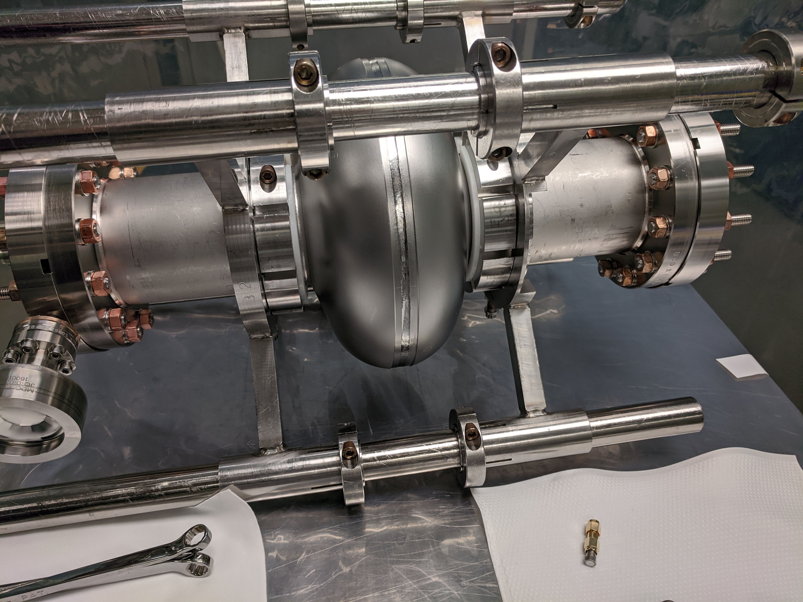
Extra Slides

Slide 25
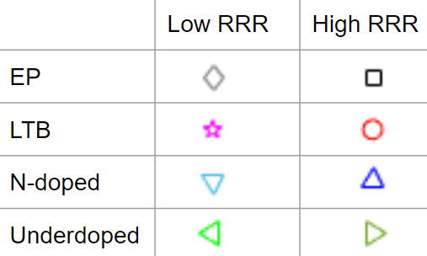
Quality Factor vs Accelerating Gradient at 2 K
Performance of EP, LTB, and N-doped are similar at medium gradients
LTB delays Q₀ slope and reaches highest Q₀ and gradient
N-doping reaches lowest gradient
Underdoped has lowest Q₀

Slide 26
Residual Resistance vs Accelerating Gradient
Low RRR EP and LTB R_{r} equal at low and mid fields
LTB treatment enables smallest increase with gradient
N-doped R_{r} always slightly larger than EP and LTB
Underdoped shows increase from N-doped

Slide 27
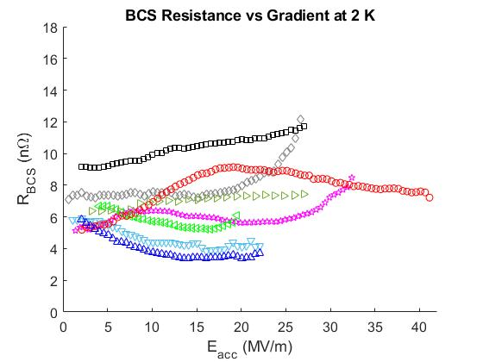
BCS Resistance vs Accelerating Gradient
Low RRR exhibits low BCS behavior
Low RRR R_{BCS} is lowest at mid field
Any benefit of dirty surface is lost at high field in EP and LTB
N-doped has lower R_{BCS} than EP and LTB

Slide 28
Effect of Doping Severity
Response of RTD Sensor Closest to Quench Spot vs Magnetic Field
N-doping severity effect on BCS resistance
Daniel Bafia’s Thesis Fig 6.7b
N-doping severity effect on heating at quench spots
Daniel Bafia TTC’20

