Slide 1
EP parameter investigation for low and high beta 650 MHz niobium cavities
V. Chouhan
TESLA Technology Collaboration Meeting
5-8 December 2023

Slide 2
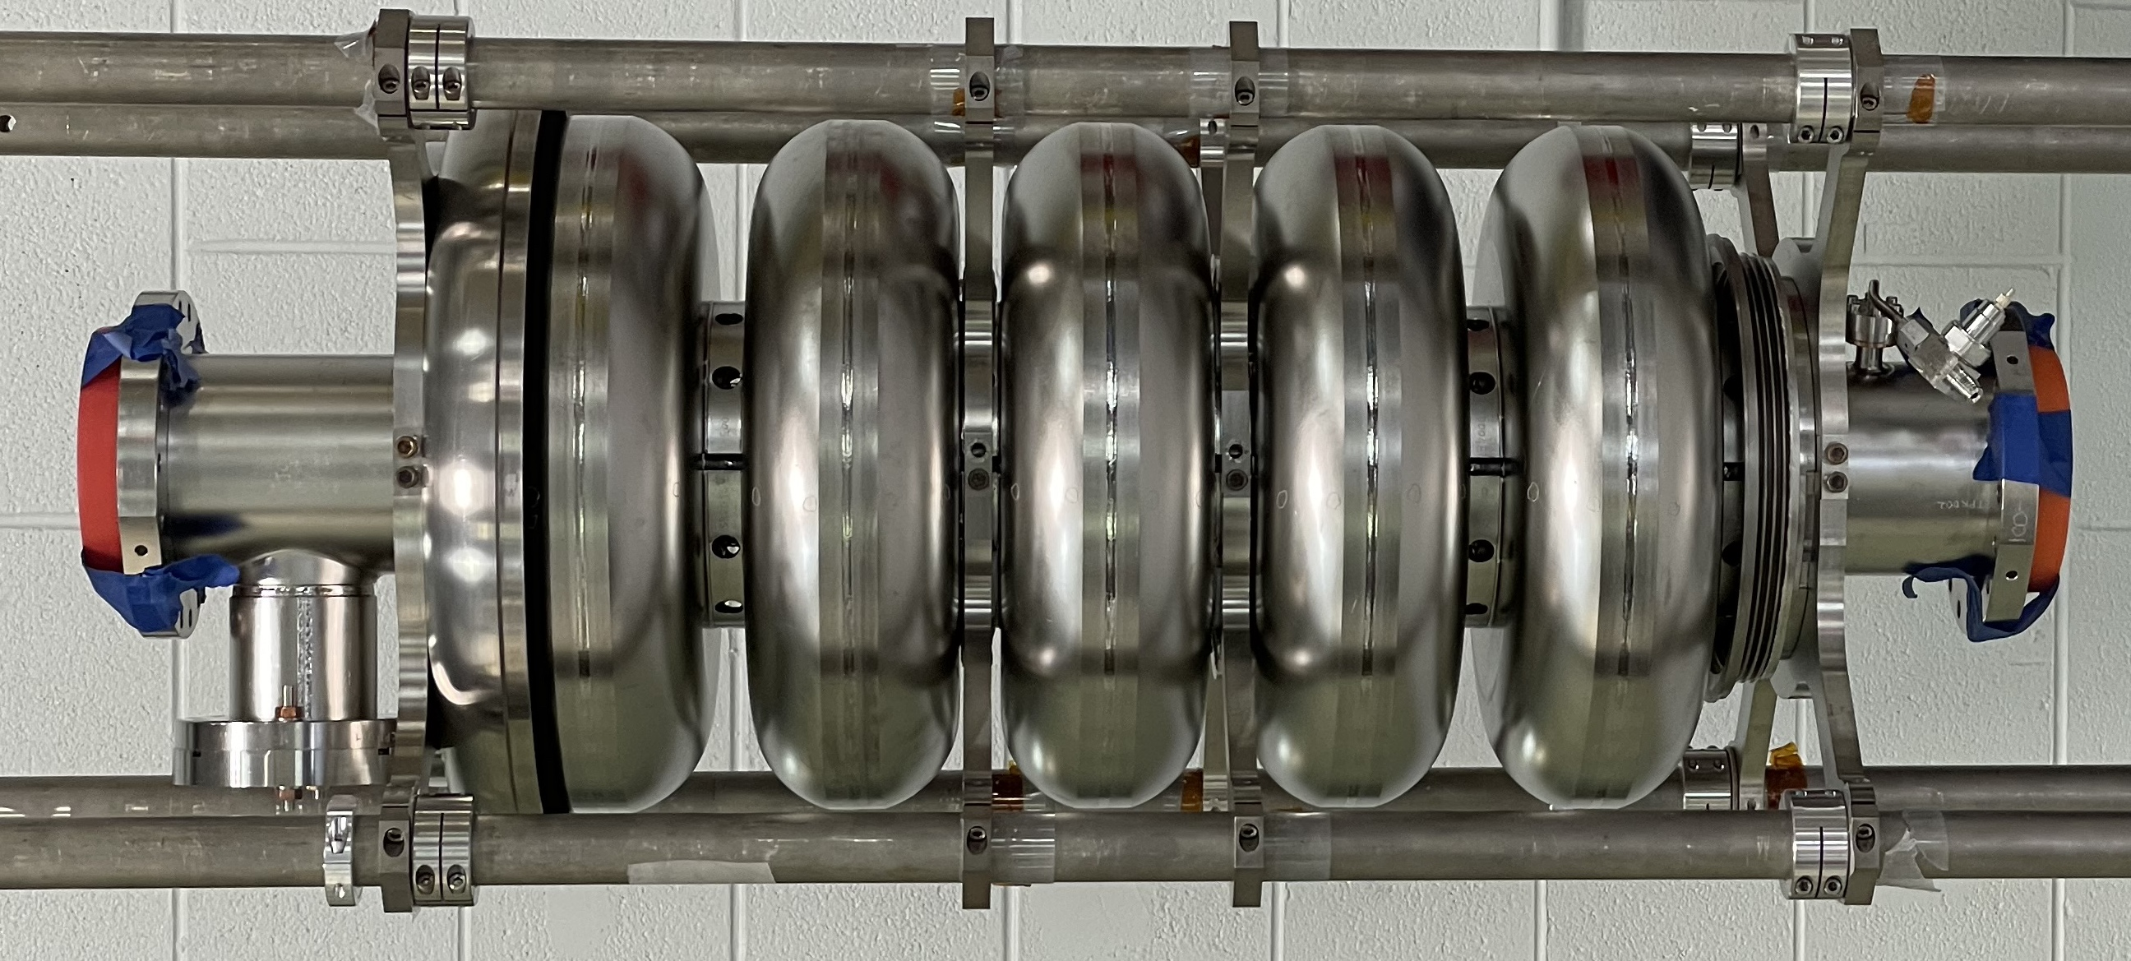
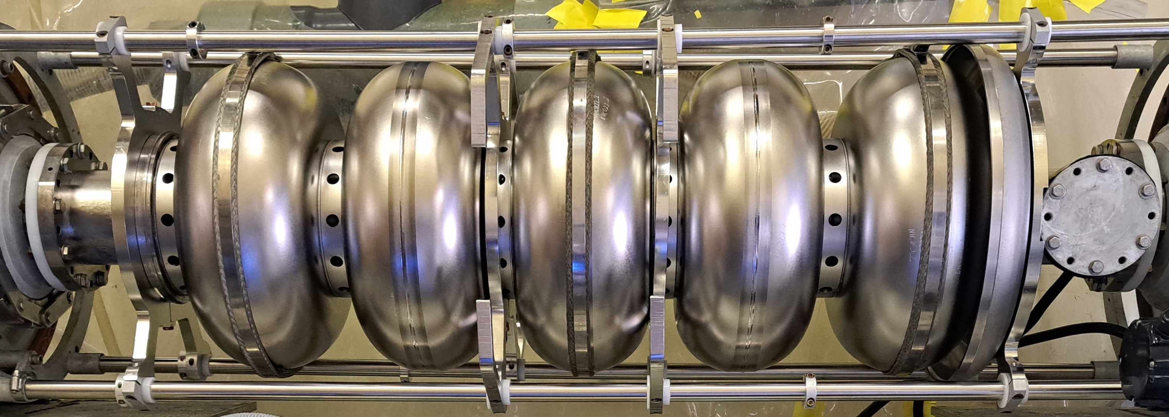
Outline
Introduction and motivation
Initial EP parameters and results
EP optimization for LB650 and HB650 cavities
Cavity performance
Summary
LB650 (0.61) cavity
HB650 (0.92) cavity

Slide 3
WG1 High-Q/High-G

Slide 4
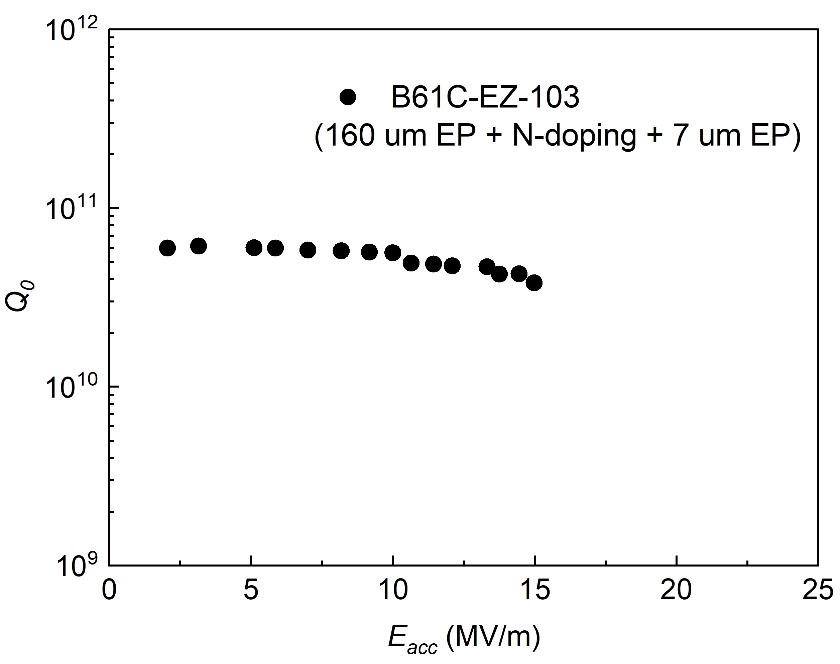
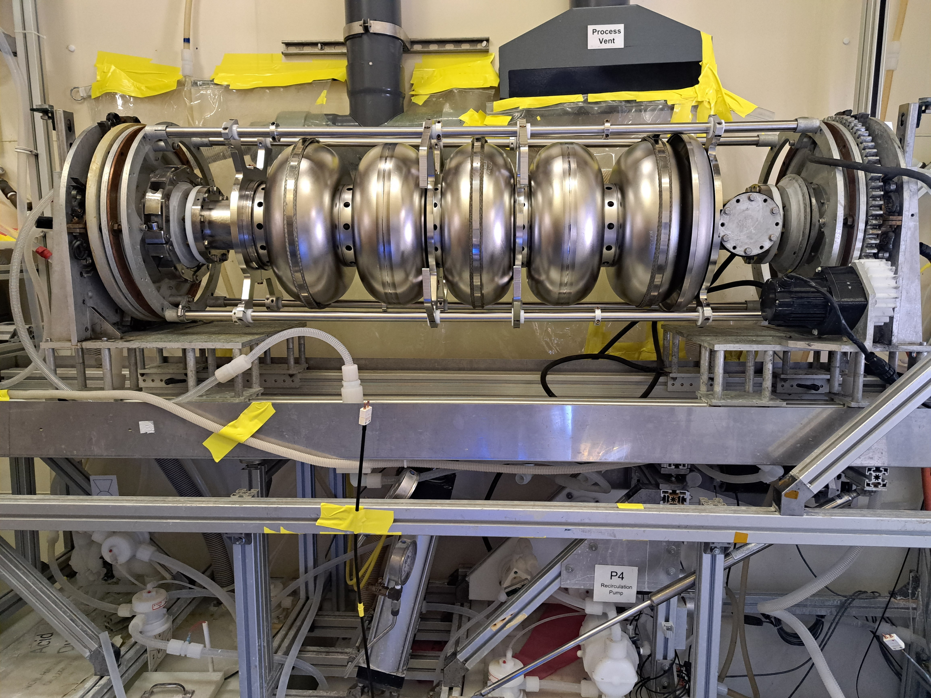
Introduction and Motivation
PIP-II linac will accommodate different types of SRF cavities including 5-cell low beta (0.61) and high beta (0.92) 650 MHz elliptical cavities.
The surface of these elliptical cavities are processed with electropolishing (EP).
Horizontal EP tool ANL/FNAL
Initial vertical test result of LB650
2K
PIP II CM Spec
Limited by quench
Cavity cooling: Water spray on cavity exterior,
Acid: H₂SO₄+HF
Cavity prematurely quenched at 15 MV/m.
Motivation: To investigate impact of EP conditions on the surface of these cavities.

Slide 5
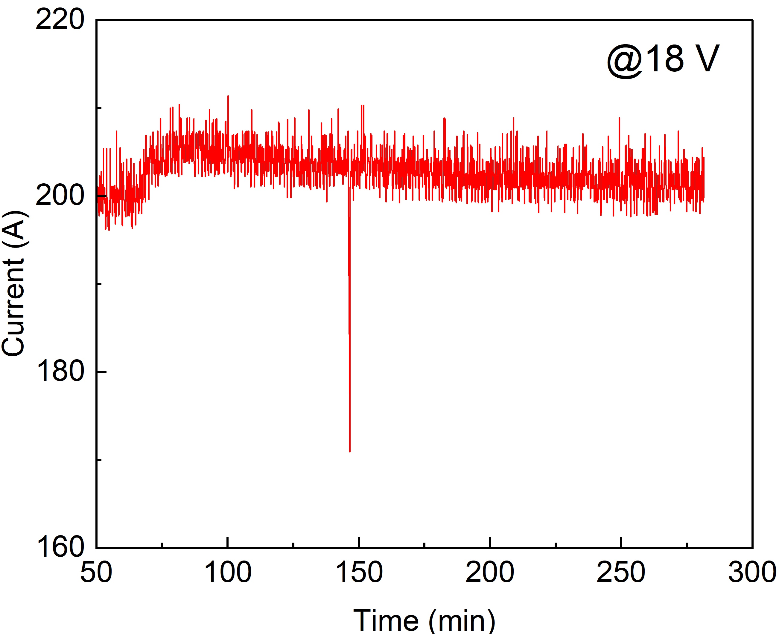
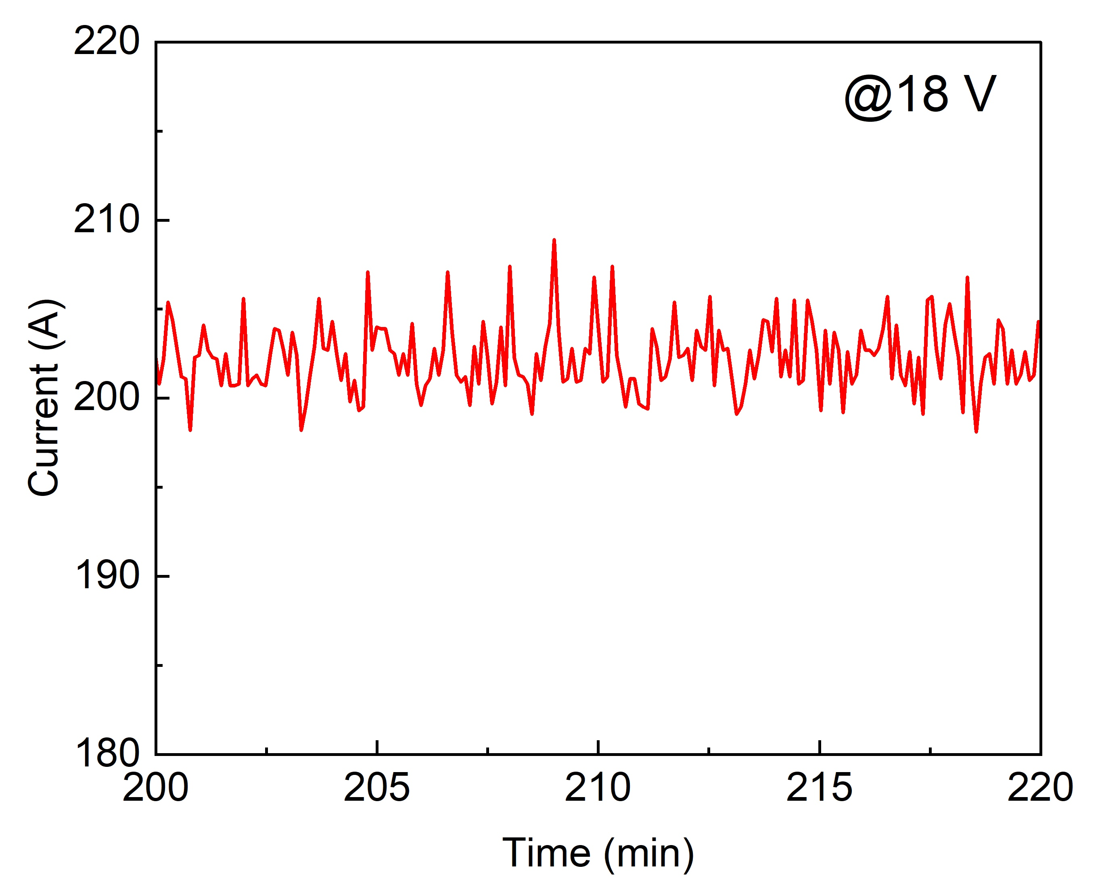
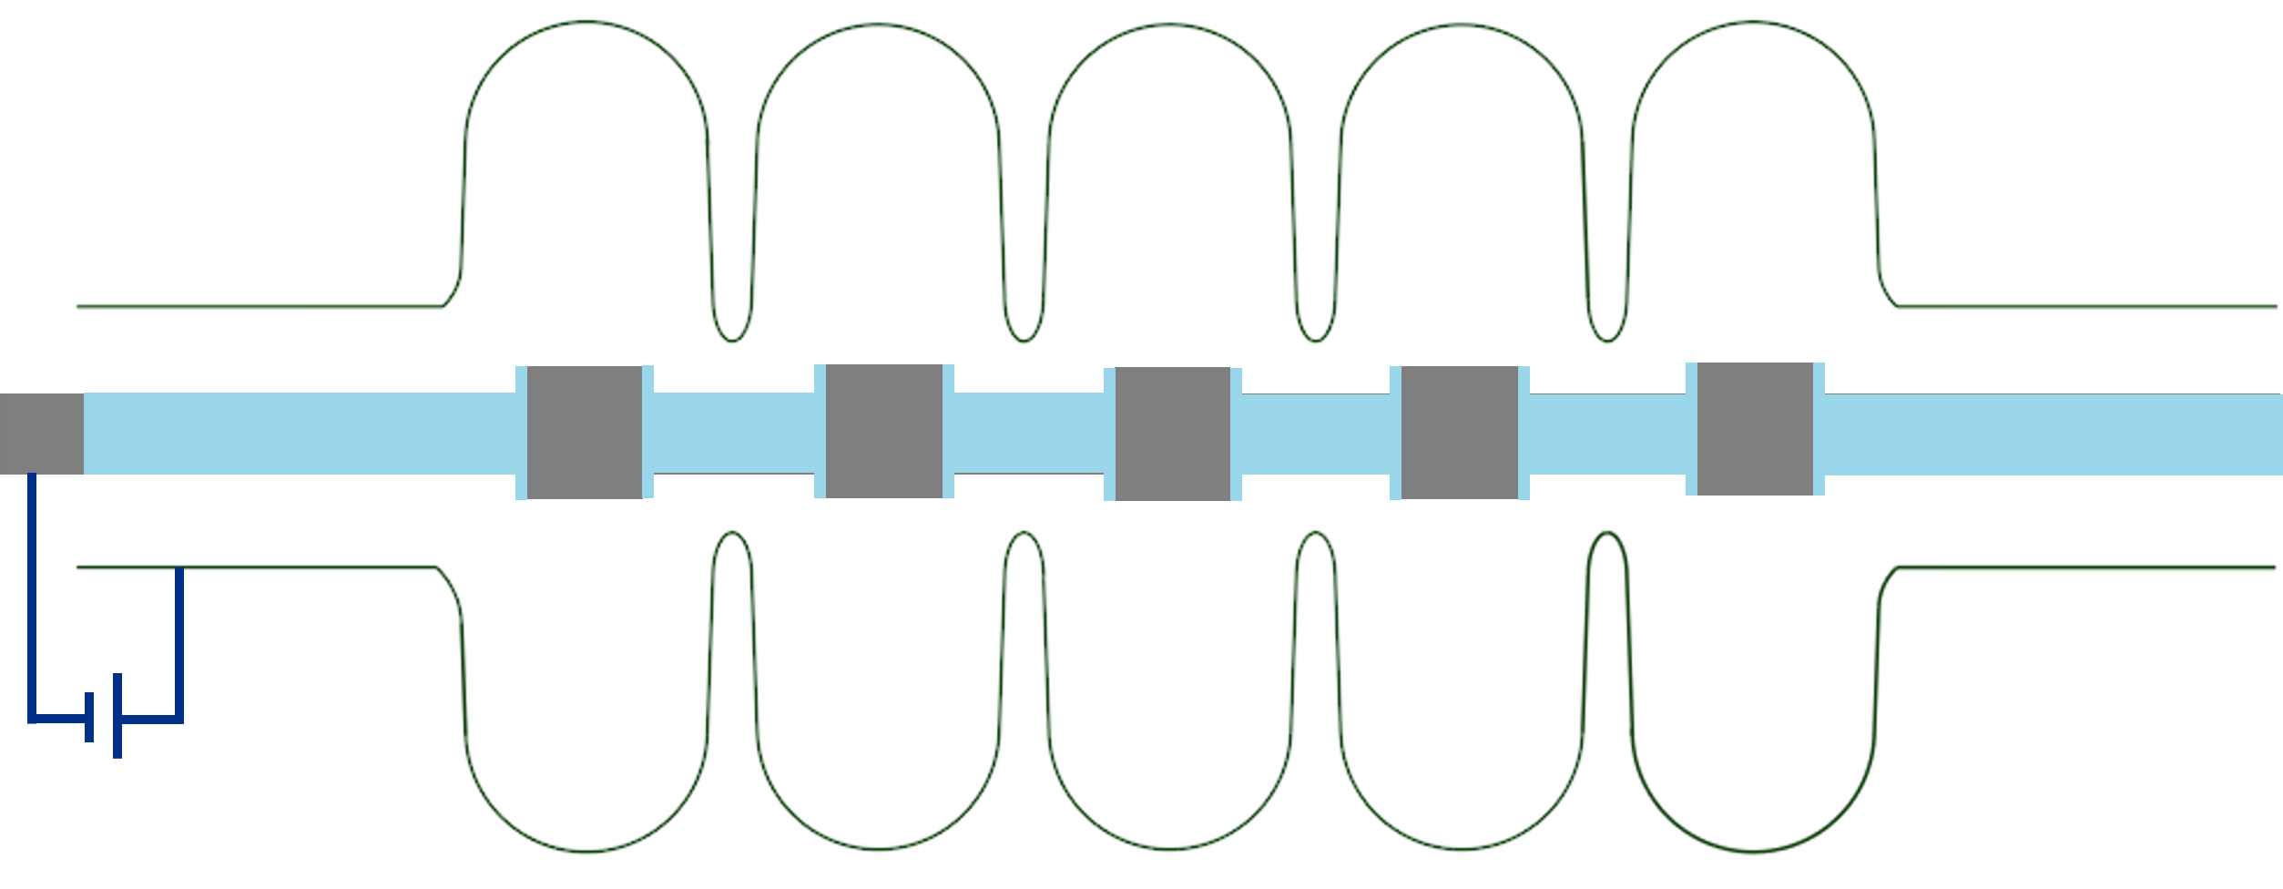
Standard EP Conditions
Current profile (warm EP)
Parameters | Value
Voltage | 18 V
Cavity temperature | < 25 °C/12 °C
Acid flow rate | ~10 L/min
Cavity rotation | ~1 rpm
Cathode:anode surface area | 5%
22 °C
18 V
Bulk EP
Current with low amplitude oscillations
Initial cathode (cathode-I)
Current oscillations suggested that EP was optimal?
Aluminum cathode
Removal rate:
  0.14 um/min at 22 °C (Bulk EP)
  0.07 um/min at 12 ° C (Cold EP)
Insulating mask
Are these EP conditions optimal for 650 MHz cavities?

Slide 6
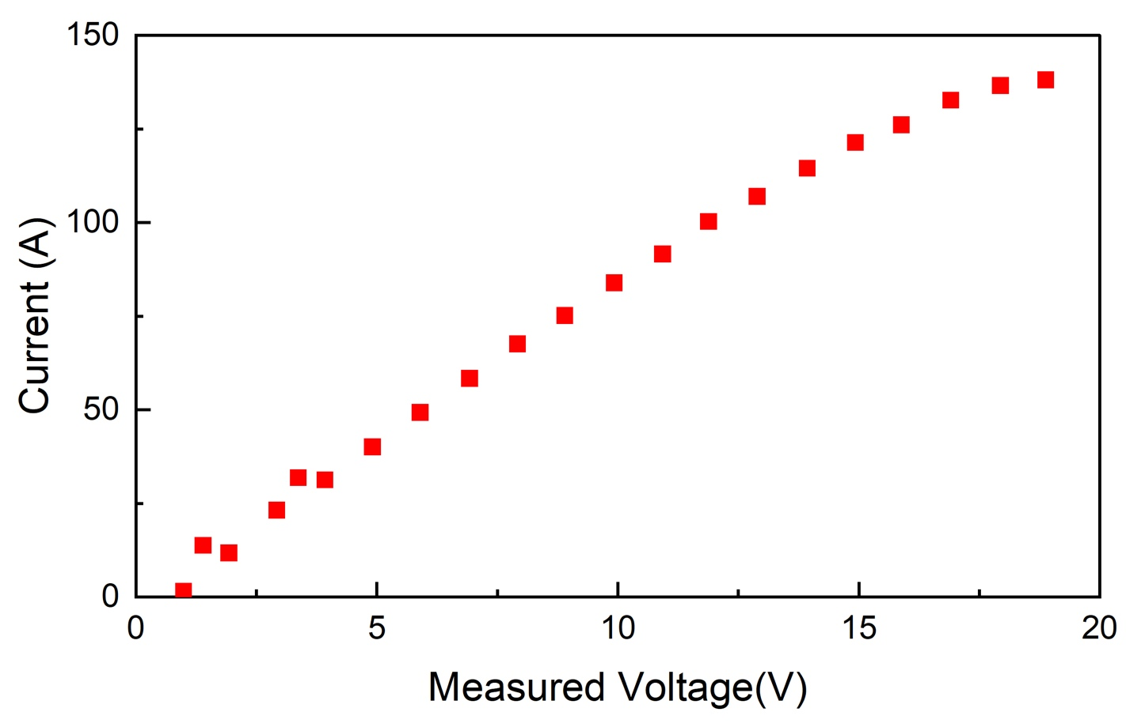
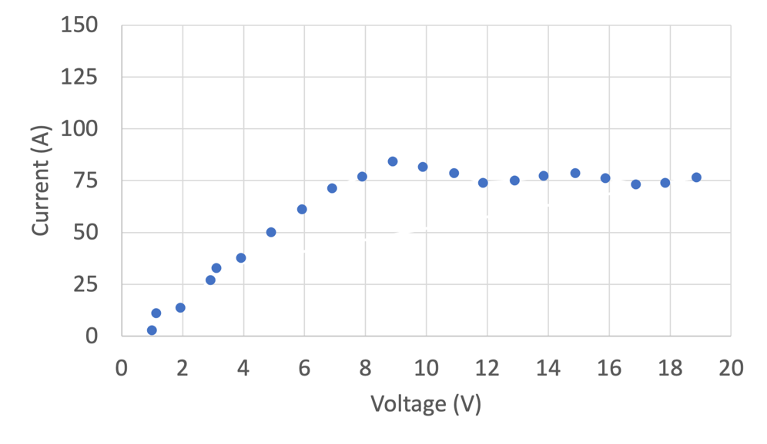
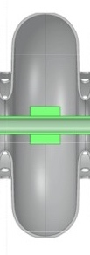
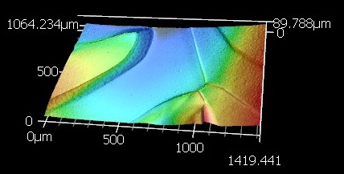
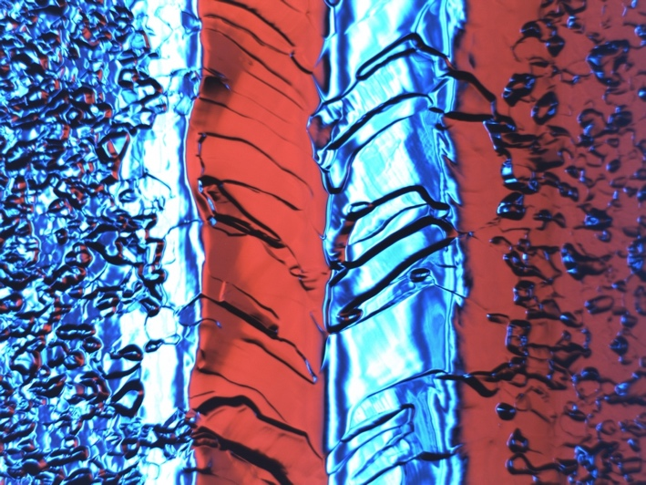
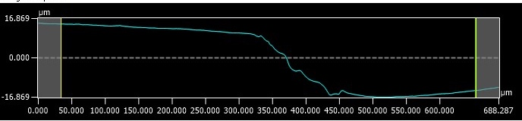
I-V curve and surface of LB650
I-V curve_LB650 (5-cell Cavity)
Typical I-V curve (1.3 GHz 9-cell Cavity)
Linear region: etching region
Initial cathode
Cavity temperature~12℃
Etching
EP
Cavity temperature~12℃
Surface (LB650)
Step height ~ 32 µm
EP with standard parameters
No current plateau in the I-V curve.
A current plateau is necessary for EP.
The standard EP parameters seem inadequate for EP of 650 MHz cavities.
9 mm

Slide 7
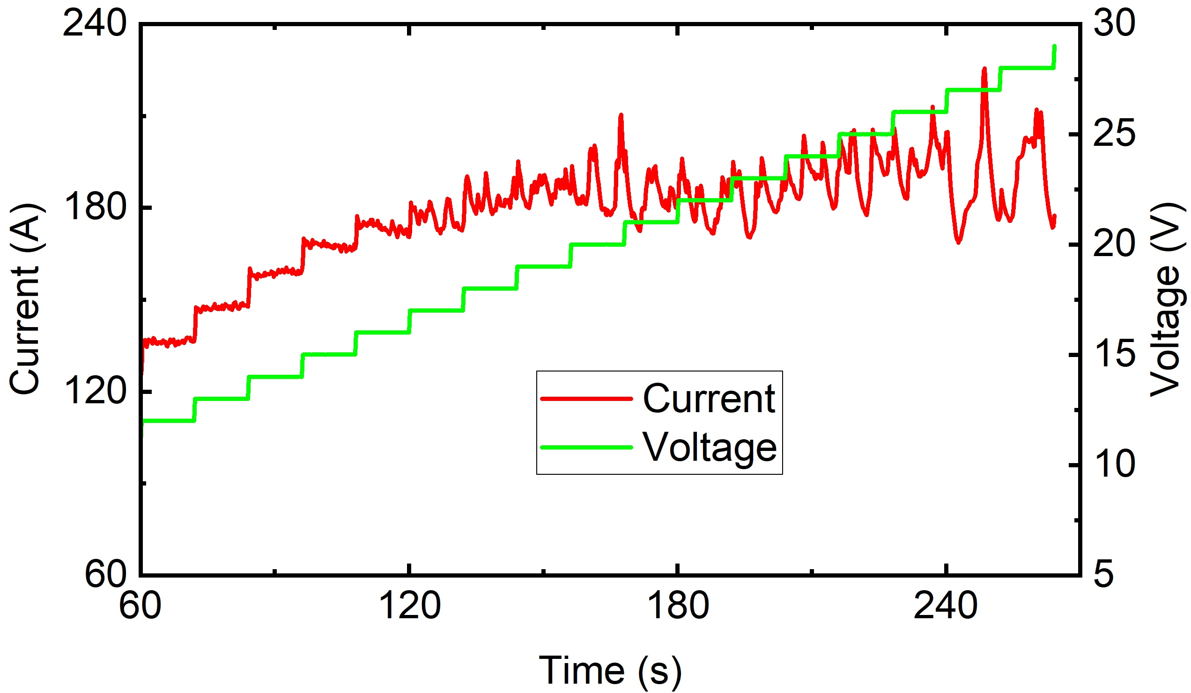
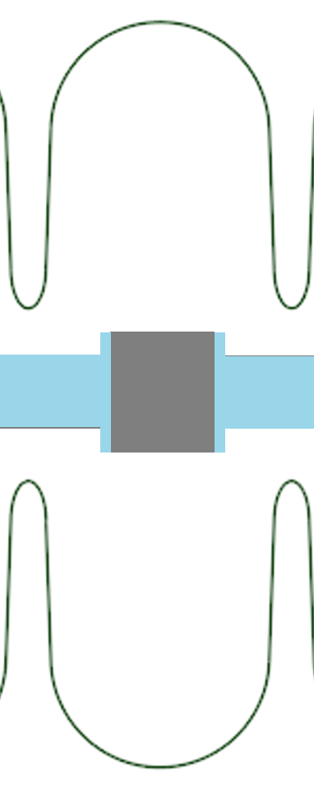
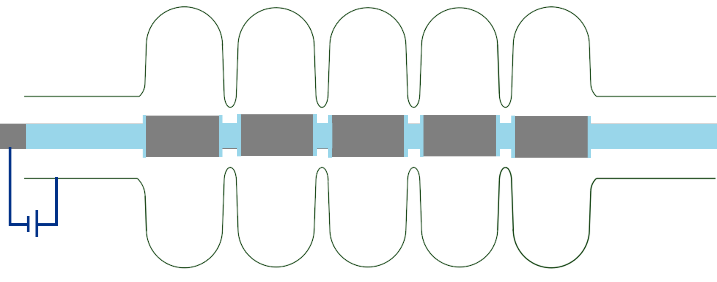
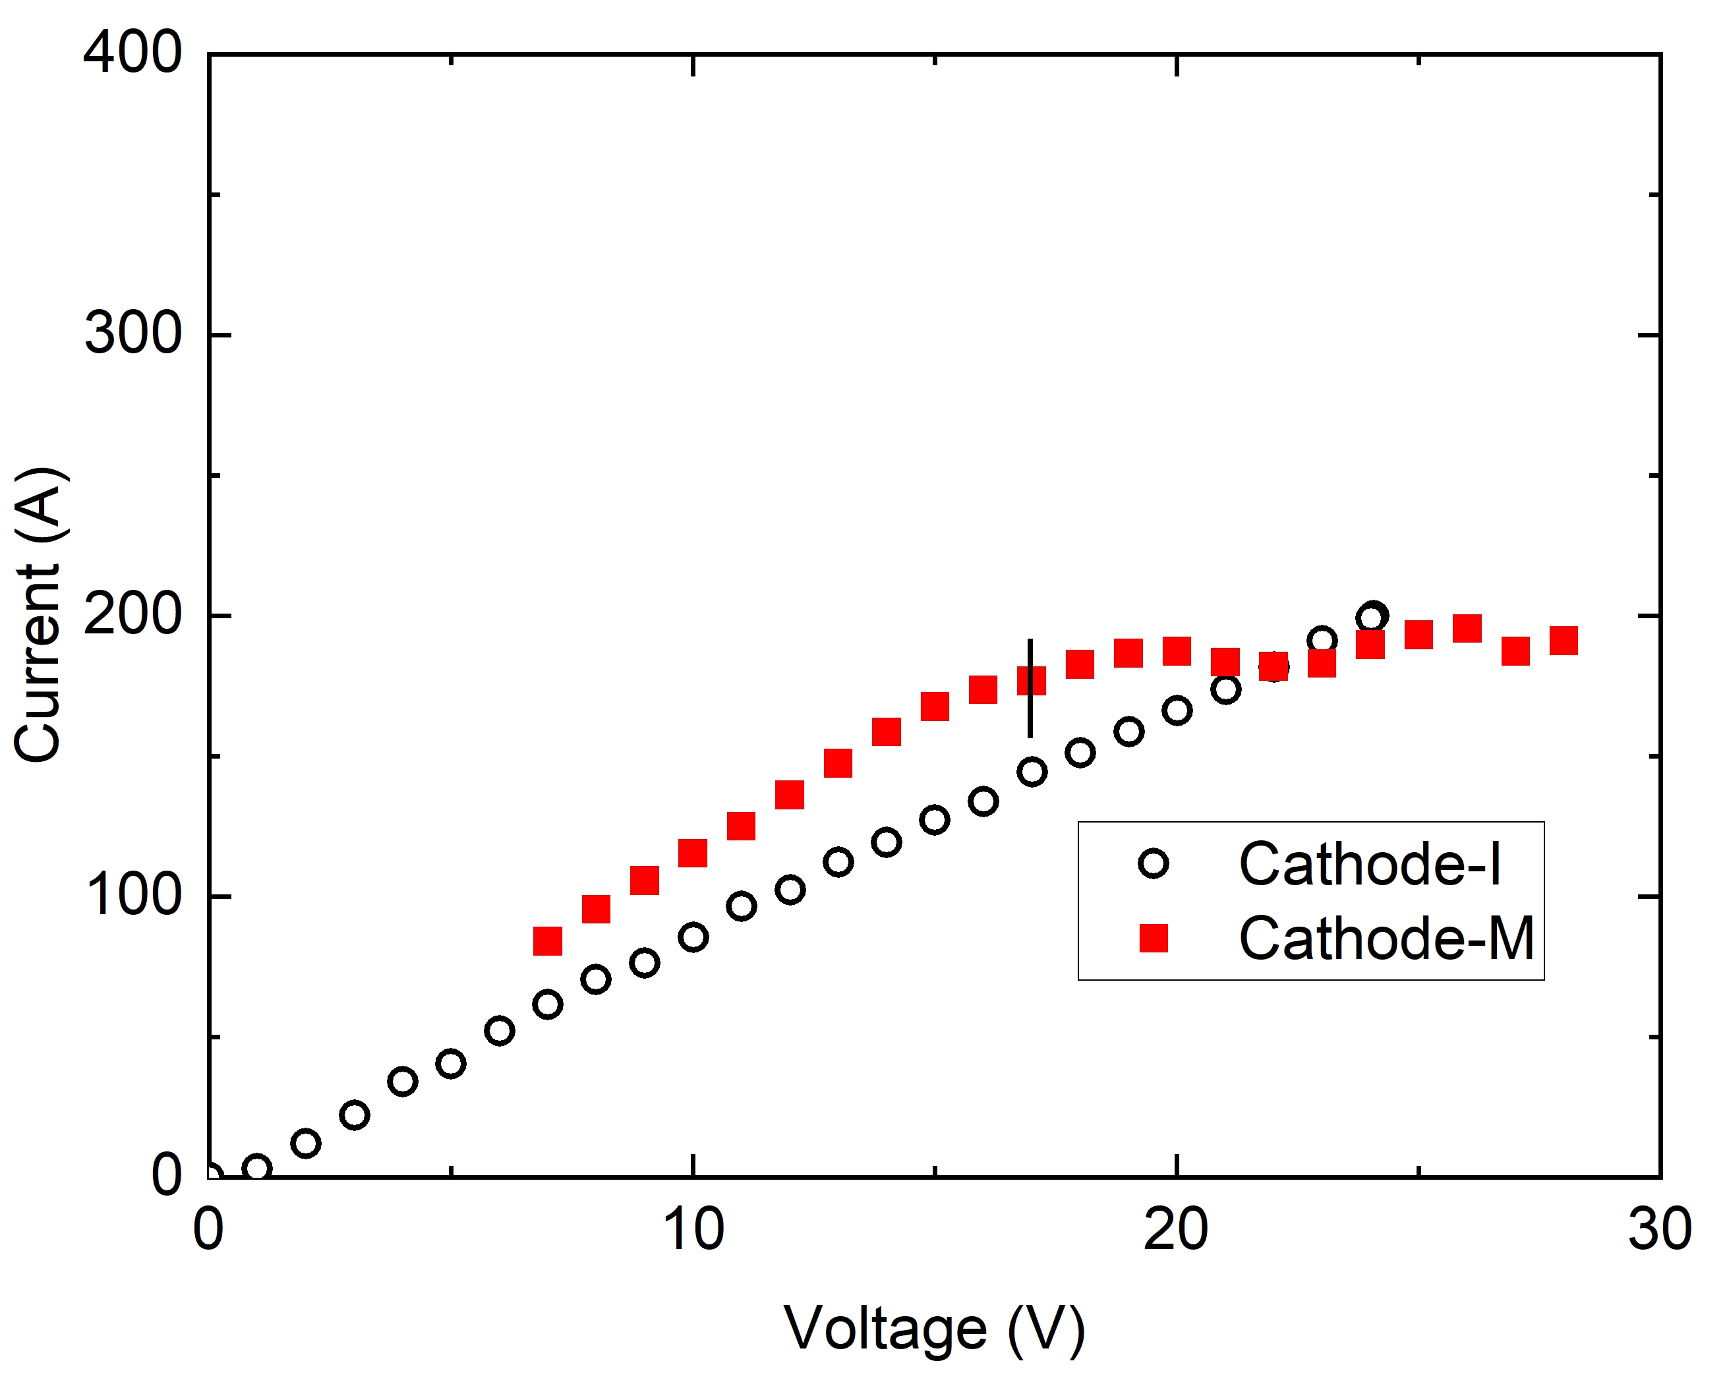
Modified cathode for LB650 cavities
15 °C
Cathode surface area was enlarged to make it close to 10% of the cavity surface area.
Initial cathode (Cathode-I)
Modified cathode (Cathode-M)
Ramp rate: 1 V/12 s
The modified cathode yielded an apparent current plateau (EP plateau).
A large cathode surface may reduce cathode polarization by reducing cathode-acid interface resistance and hydrogen bubble screening effect.
V. Chouhan et al., Nucl. Instrum. Methods Phys. Res. A 1051 (2023) 168234.
V. Chouhan et al., TUPTB041, TUPTB042 SRF2023.

Slide 8
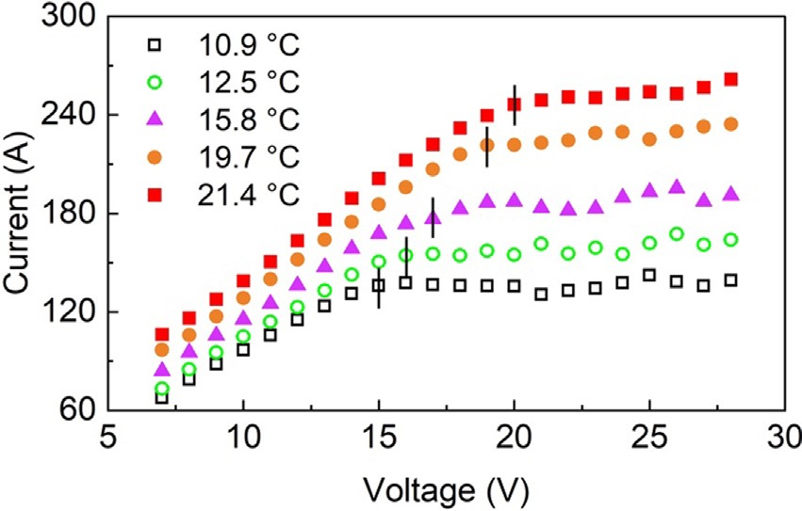
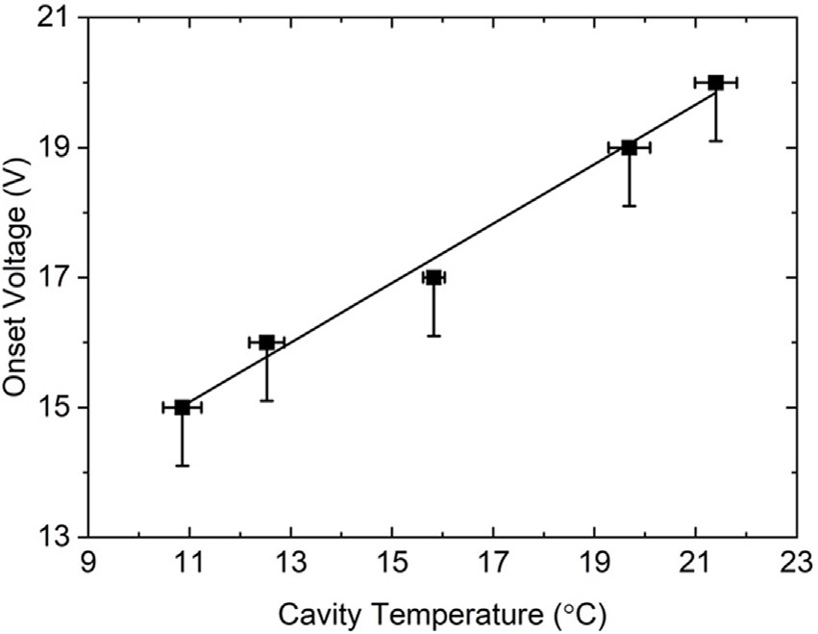
I-V curves at different cavity temperatures (LB650)
I-V curves with modified cathode
Onset voltage vs cavity temperature
Onset voltage increases with increase in cavity temperature.
V. Chouhan et al., Nucl. Instrum. Methods Phys. Res. A 1051 (2023) 168234.
V. Chouhan et al., TUPTB041, TUPTB042 SRF2023.
Different EP voltages might be suitable to perform warm and cold EP.
The standard EP voltage (18 V) is not high enough for warm EP of 650 MHz cavities.

Slide 9
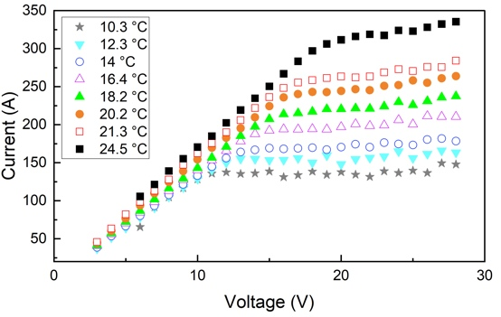
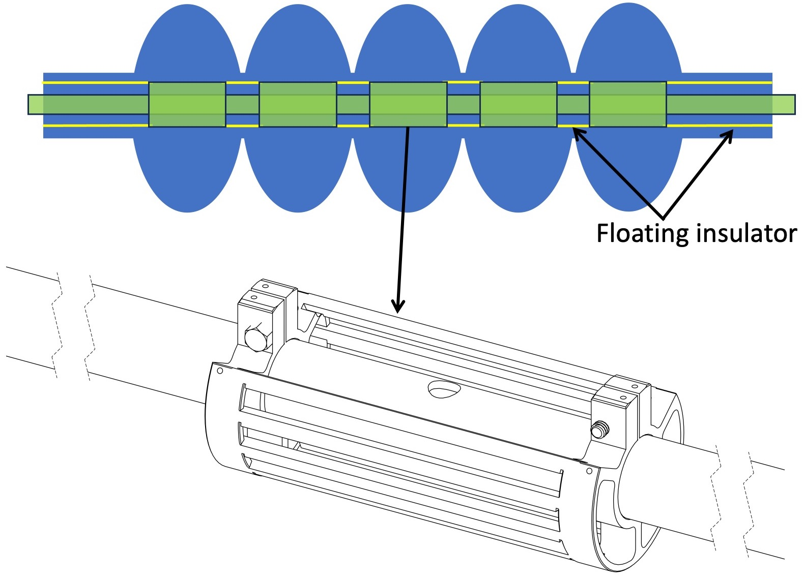
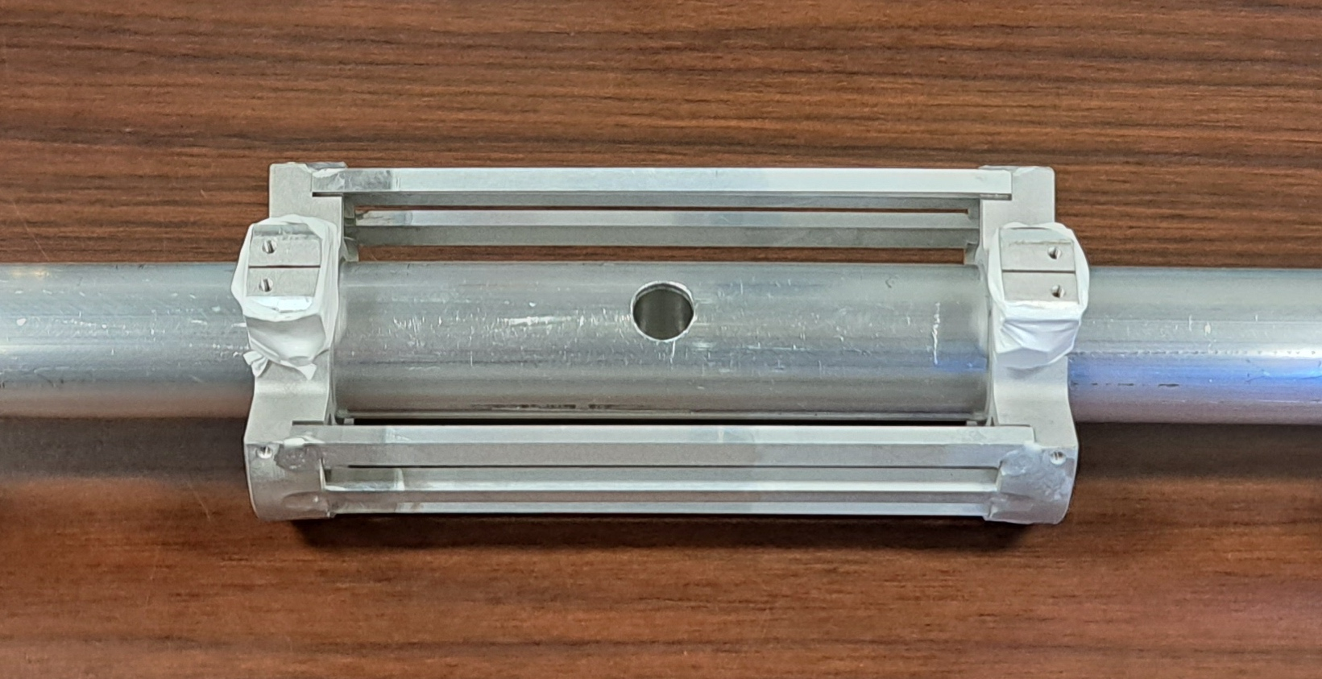
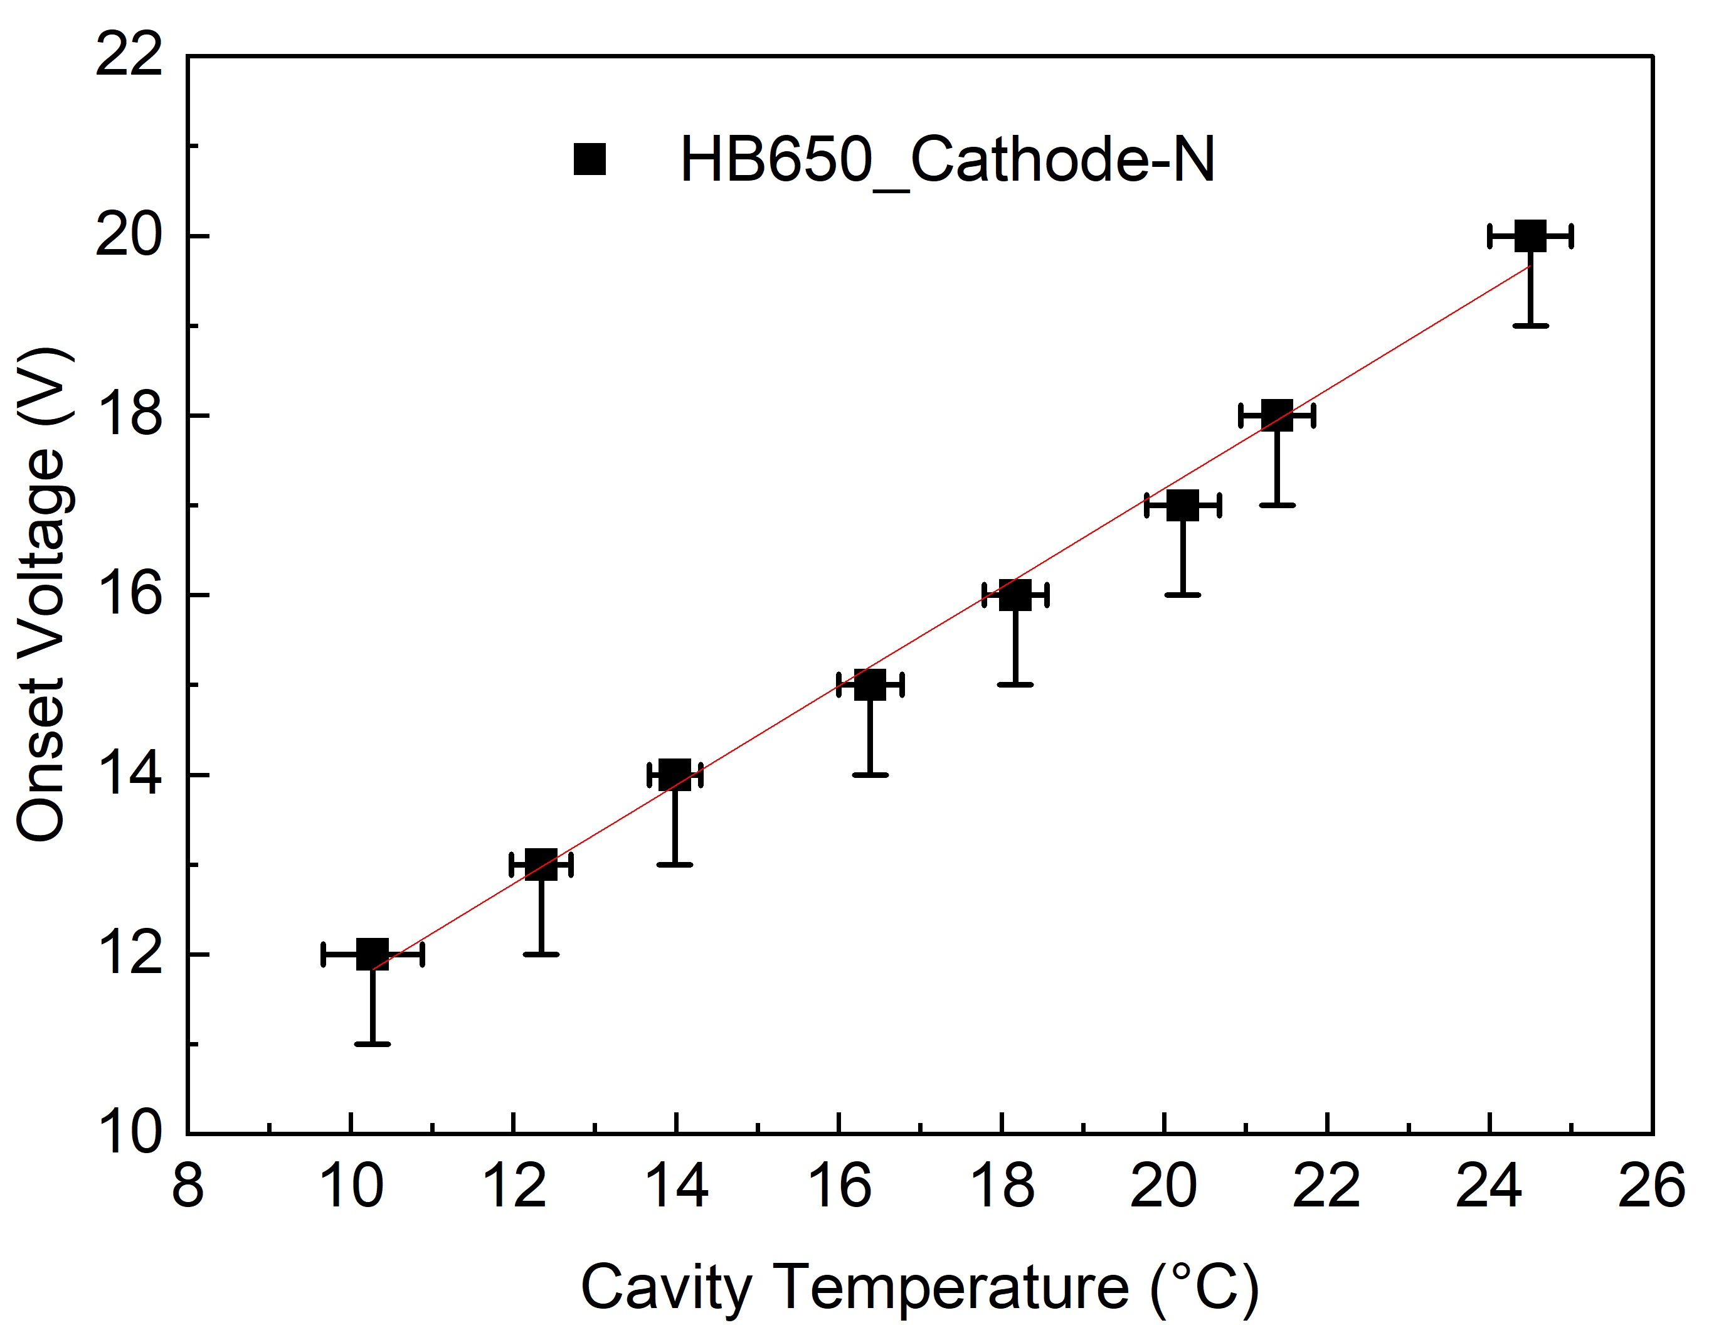
Study with HB650 (5-cell cavity)
A new cathode with a larger surface area was designed.
New cathode (Cathode-N)
(cathode:anode surface area = 3:10)
The cathode design may:
  Reduce cathode polarization
  Improve acid flow conductance to improve removal uniformity

Slide 10
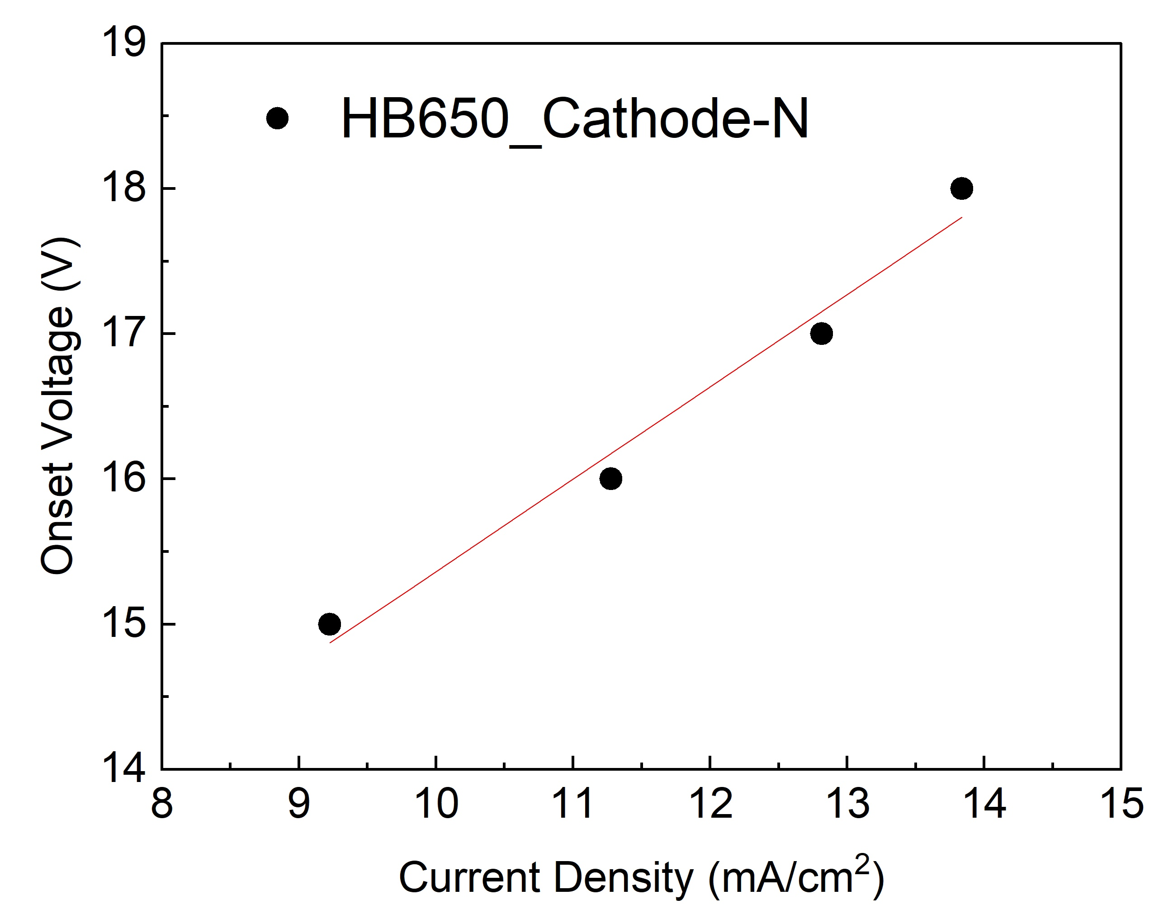
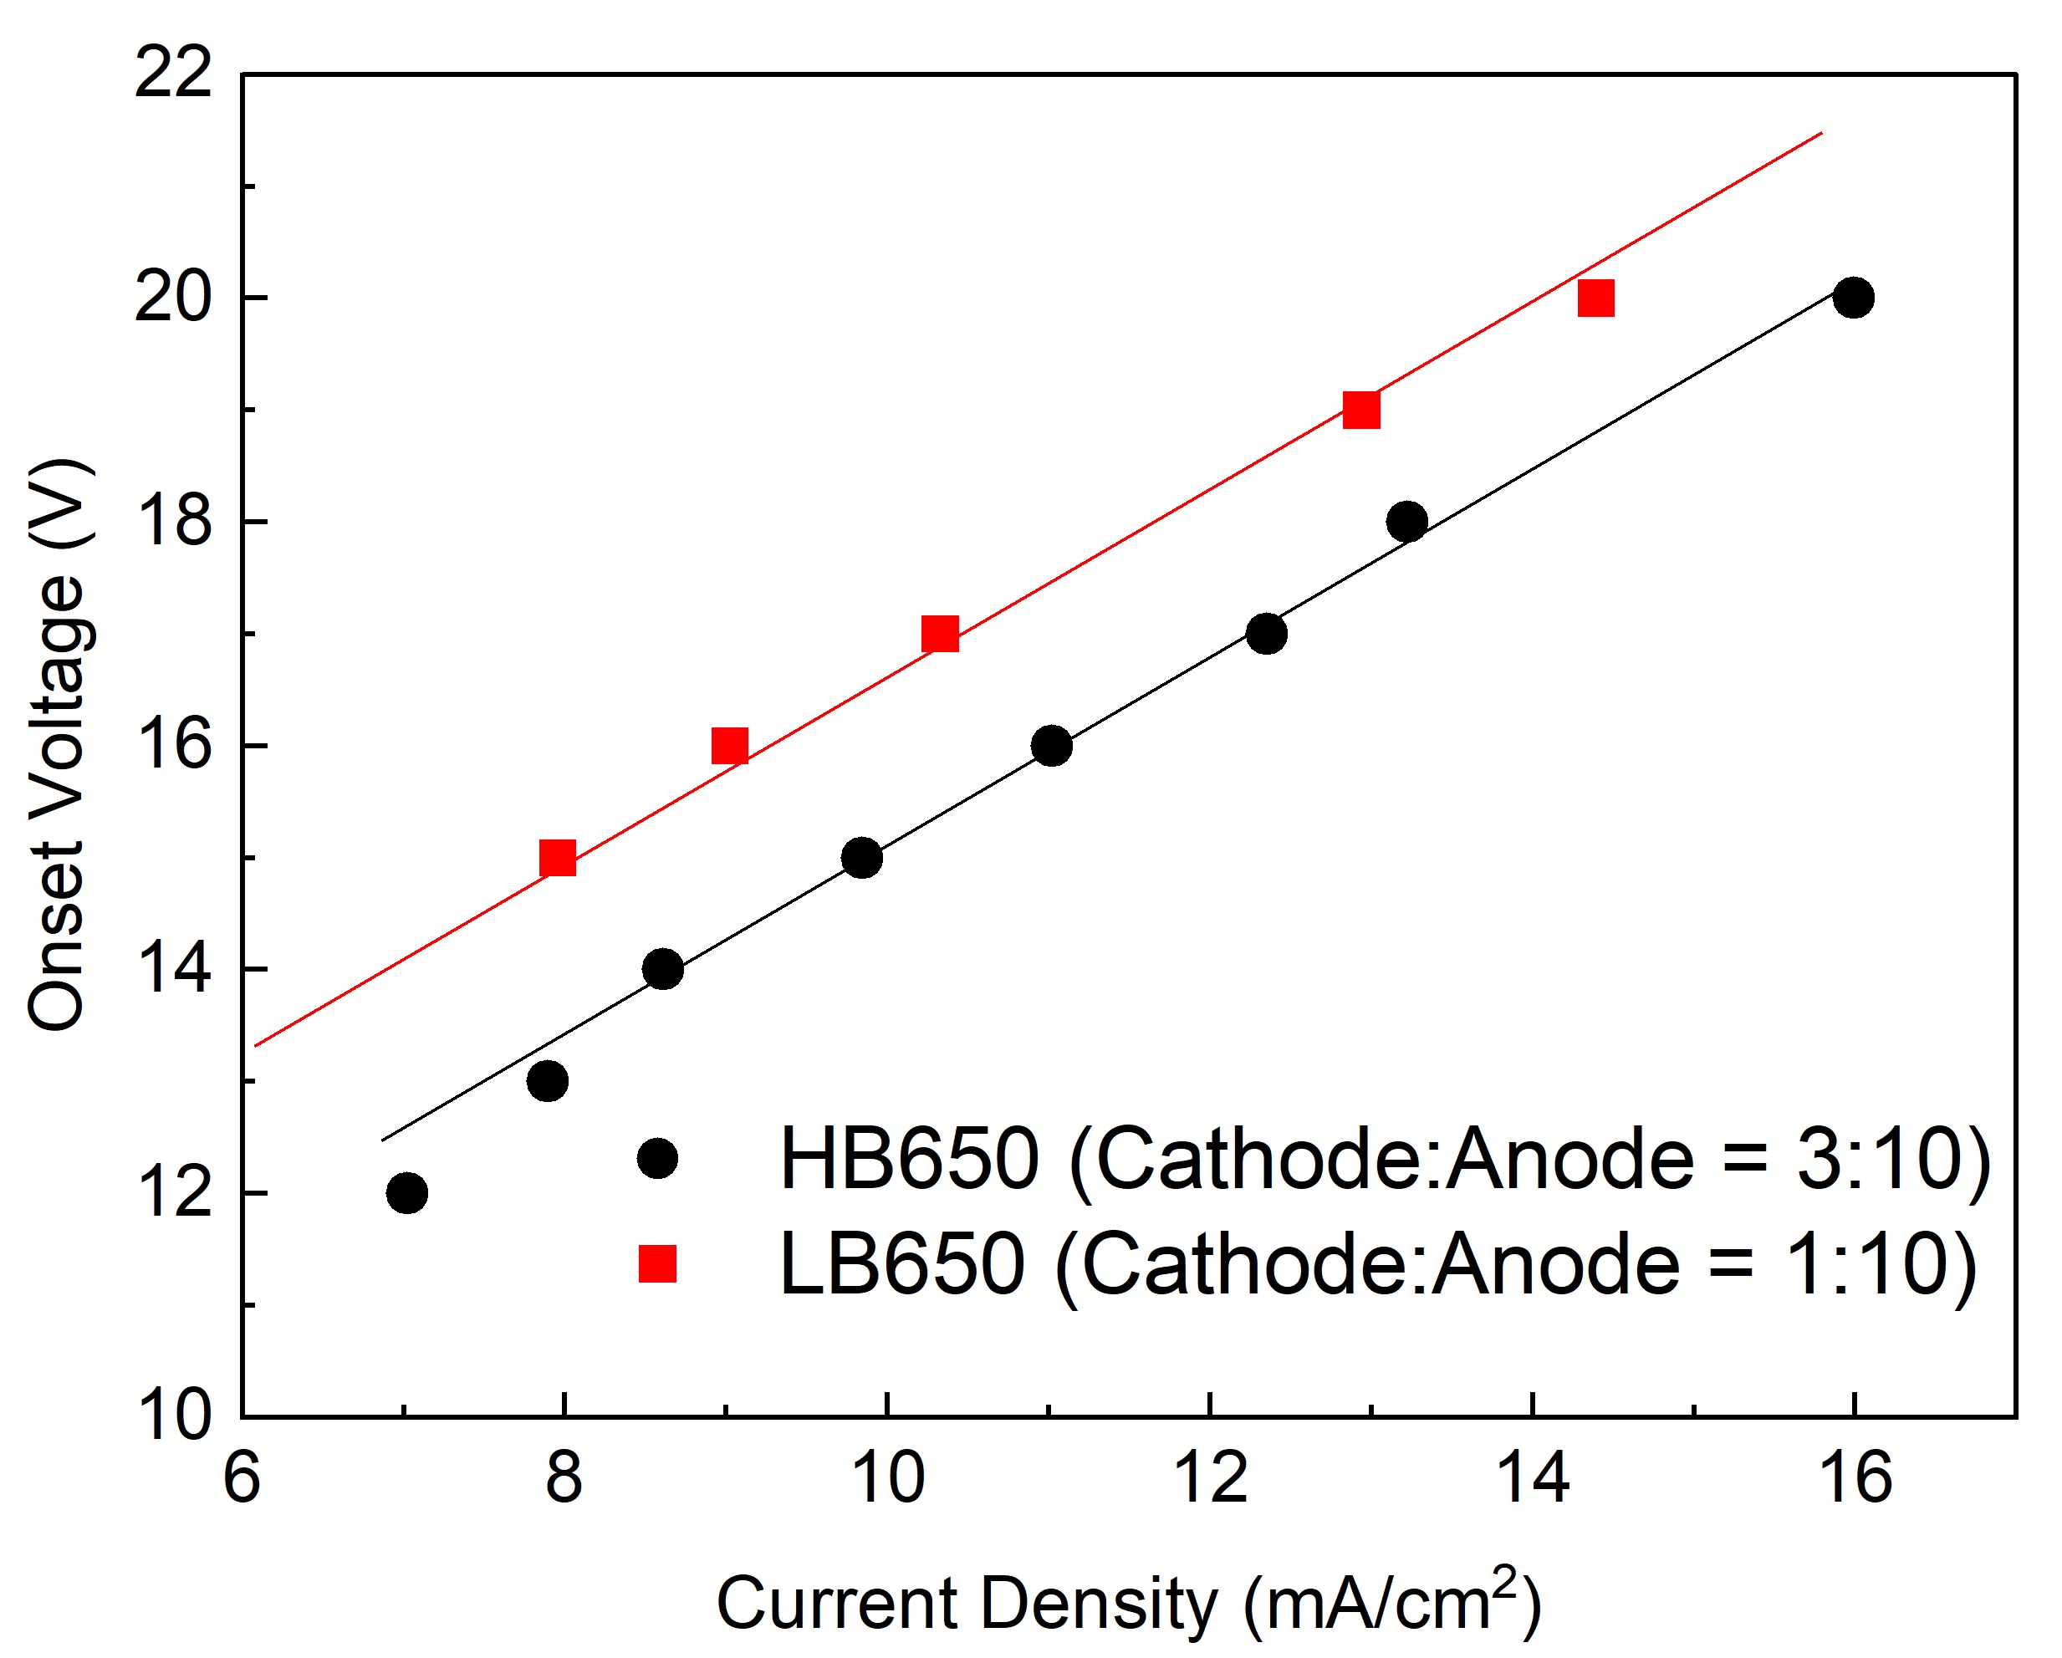
Onset voltage and acid aging
Onset voltage vs current density at ~21 °C
Onset with cathode-M and -N
~21 °C
Acid aging
Onset voltage varied with different acid conditions even at the same temperature.
Reaction rate seems responsible for variation in the onset voltage.
Higher reaction rate (higher current):
  Difficult to meet diffusion limited conditions when anode-cathode distance is large?
  High potential drop at cathode-acid interface?

Slide 11
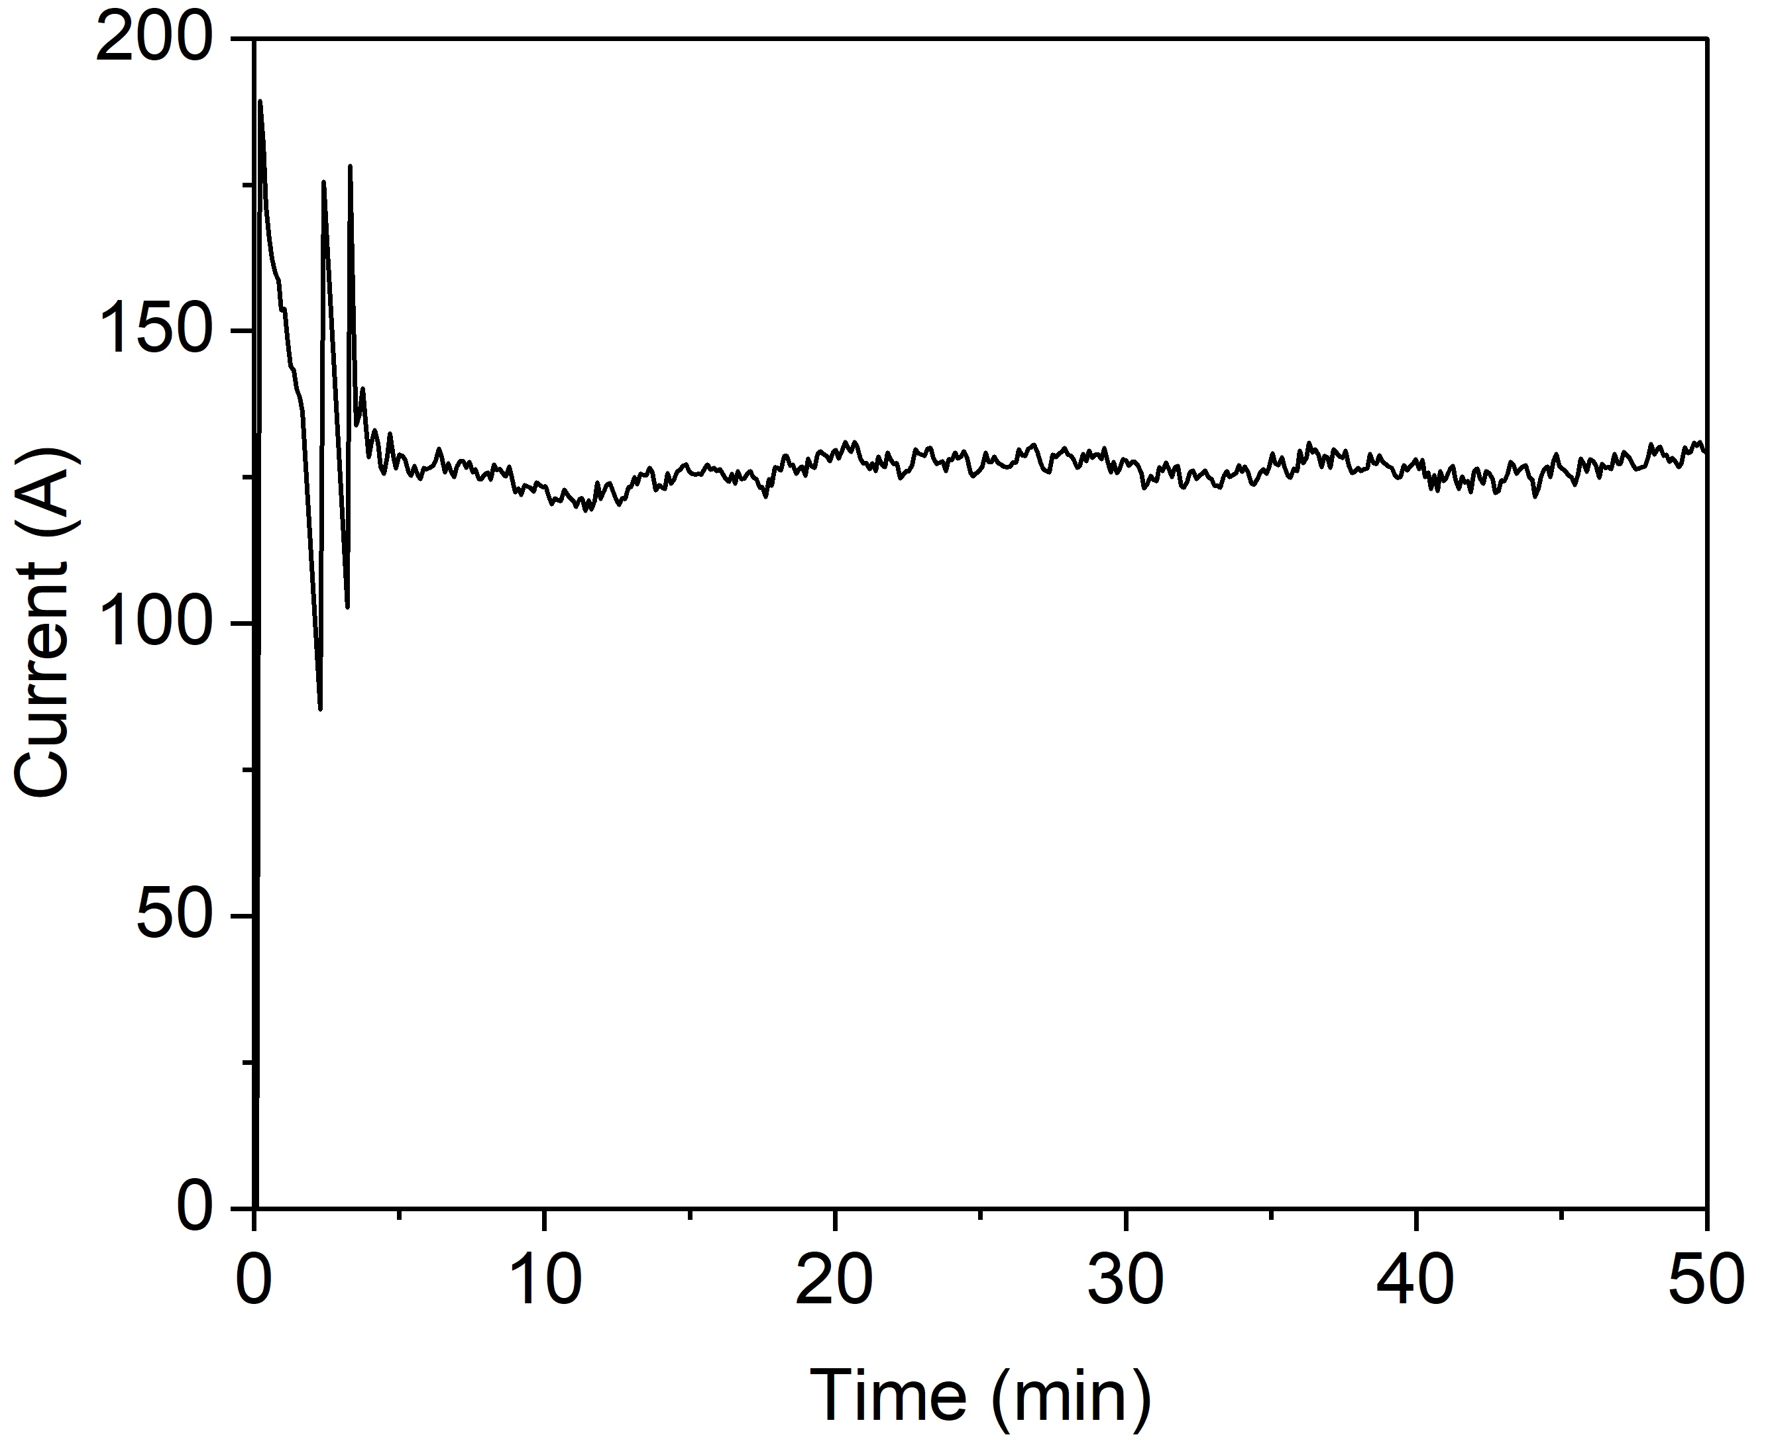
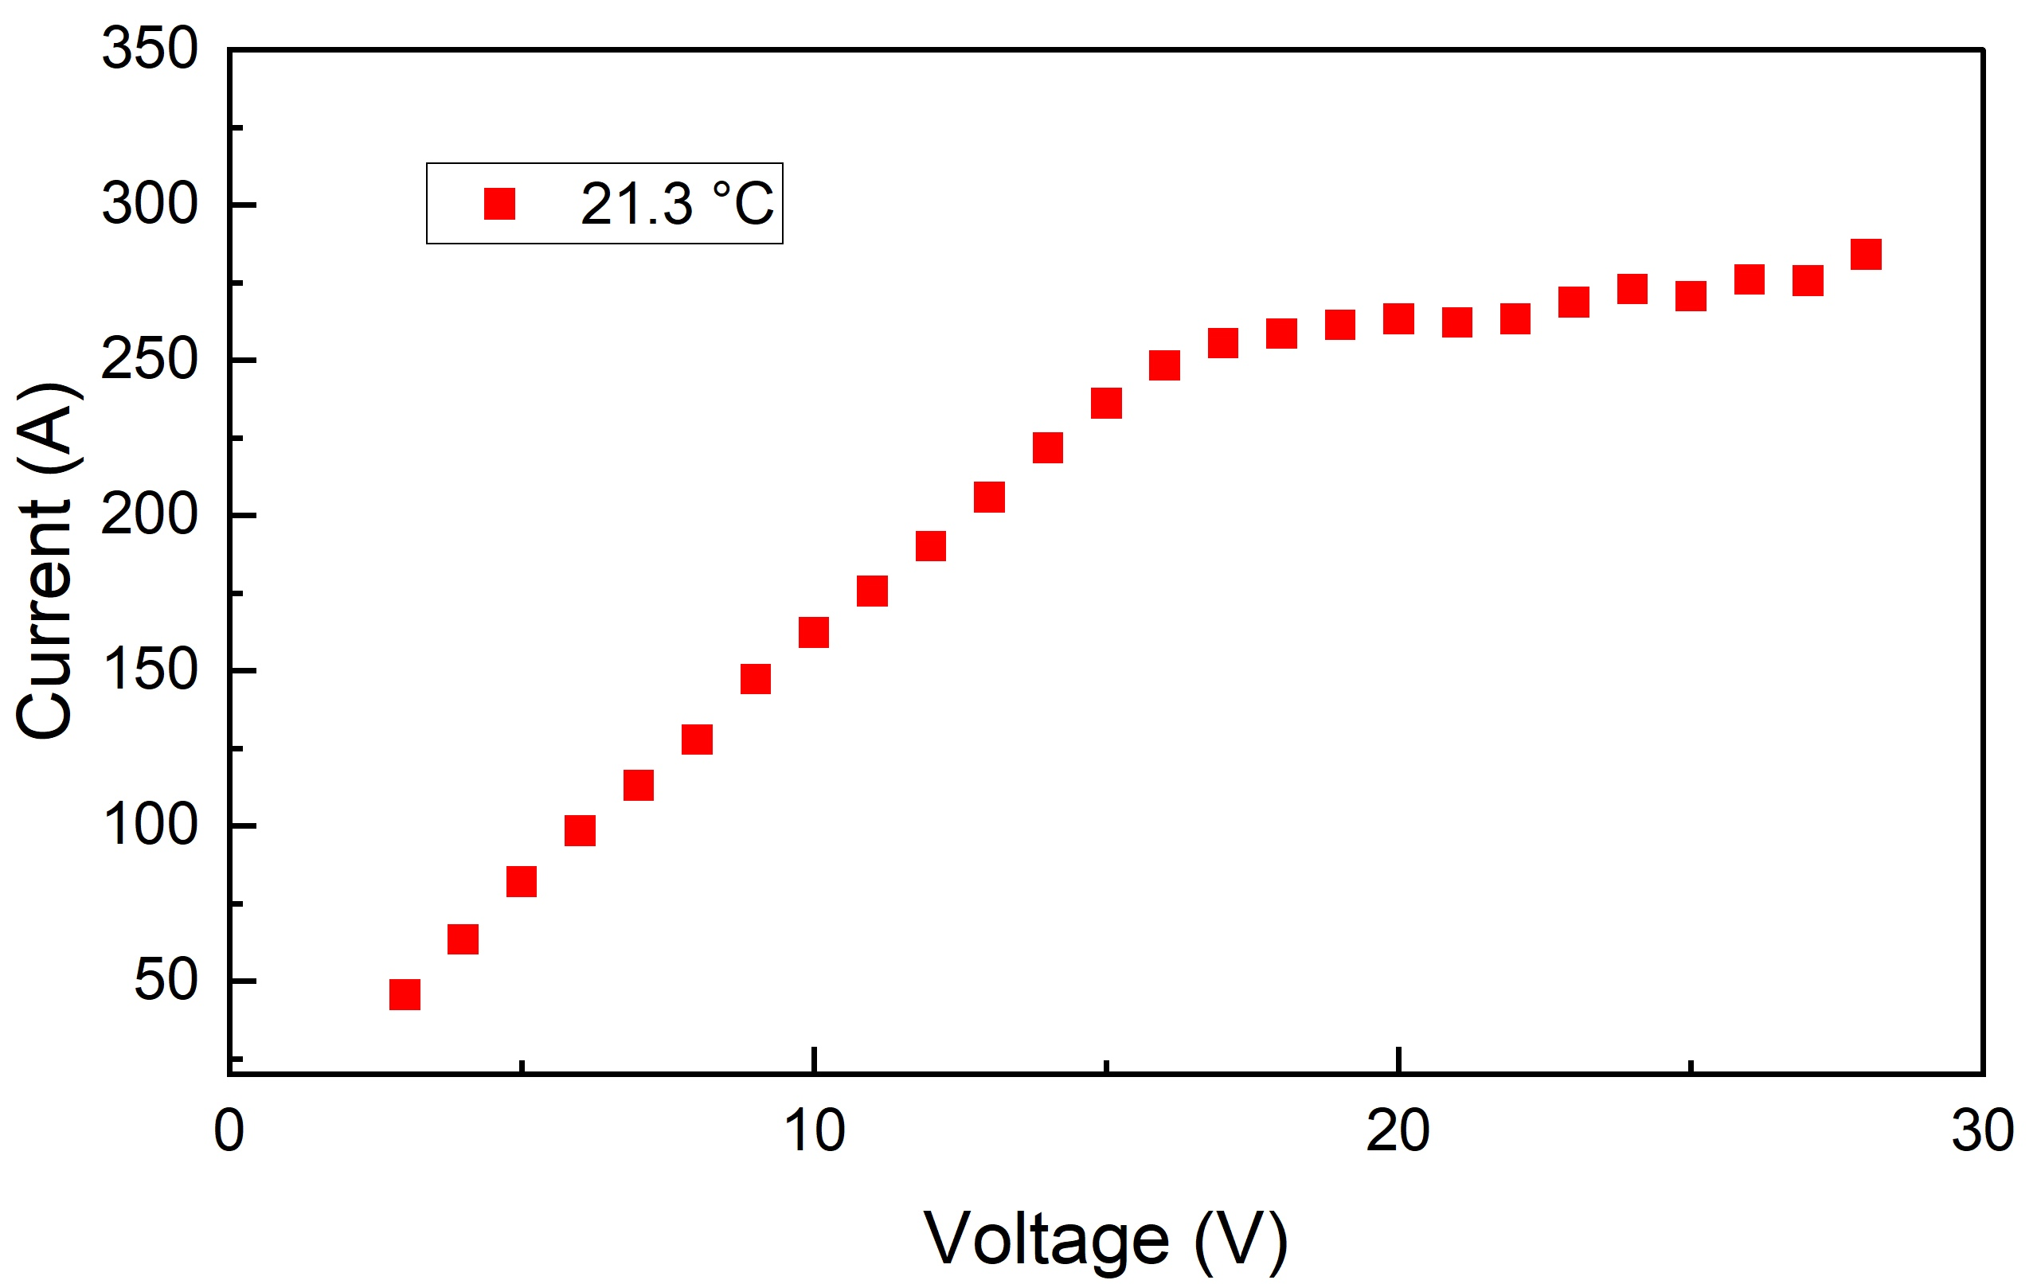
Optimal EP conditions
Current oscillations usually signify favorable EP conditions that provides a smooth surface finish of the cavities.
The oscillations amplitude diminishes and eventually disappear with acid aging, particularly at a low temperature.
In such cases, relying solely on current oscillations may not be suffice.
No oscillations but smooth surface
Onset
EP voltage
Parameters | Initial EP | Modified EP
 | Warm/cold EP | Warm EP | Cold EP
Voltage | 18 V | 20-25 V | 16-22 V
Cavity temperature | 22 °C/12 °C | 22-25 °C | 12 °C
Cathode type | Cathode-I (initial) | Cathode-M (modified) Cathode-N (large sized)
5V
EP voltage = Onset + 5 V
Optimum EP voltage was defined to be at least 5 V above the onset.

Slide 12
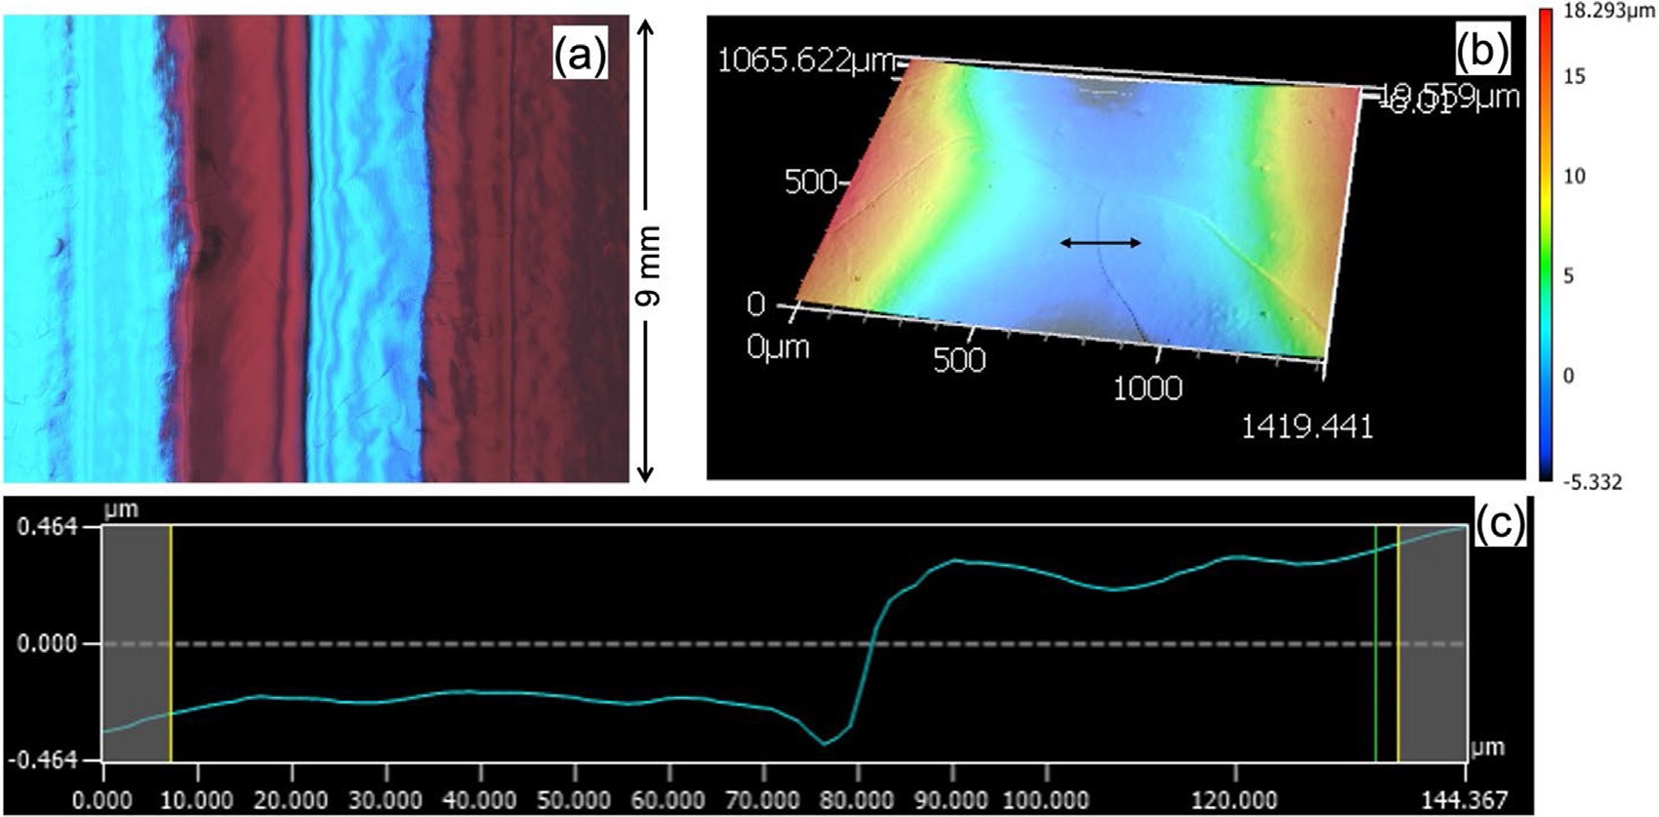
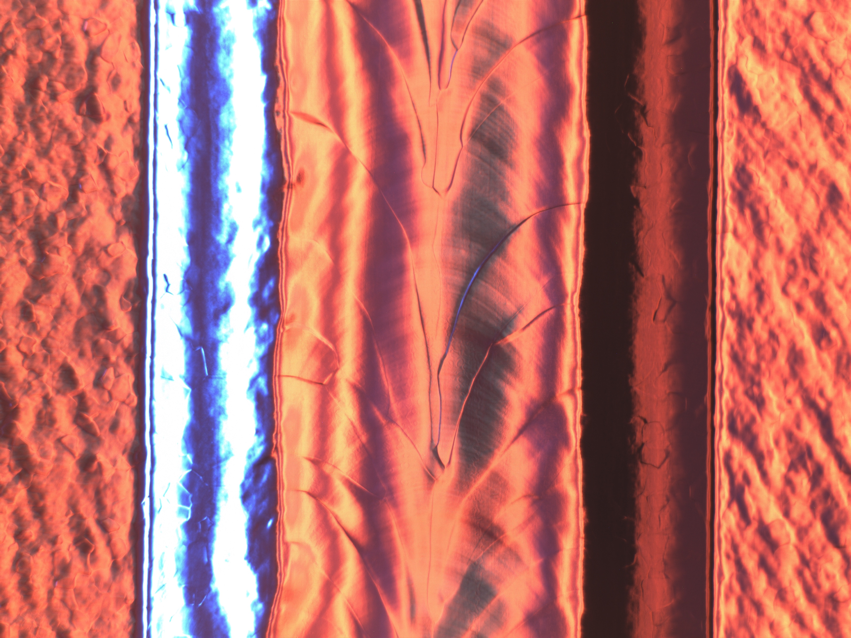
Cavity surface after modified EP
Equator surface after modified EP
LB650 cavity (B61C-EZ-104)
Replica image representing equator surface
HB650 cavity (B92F-RI-203)
23 V, 22 °C, 120 µm
25 V, 25 °C, 160 µm
9 mm
Average roughness Ra was ~0.5 µm.
A smooth surface was obtained with the modified cathode and a higher voltage.

Slide 13
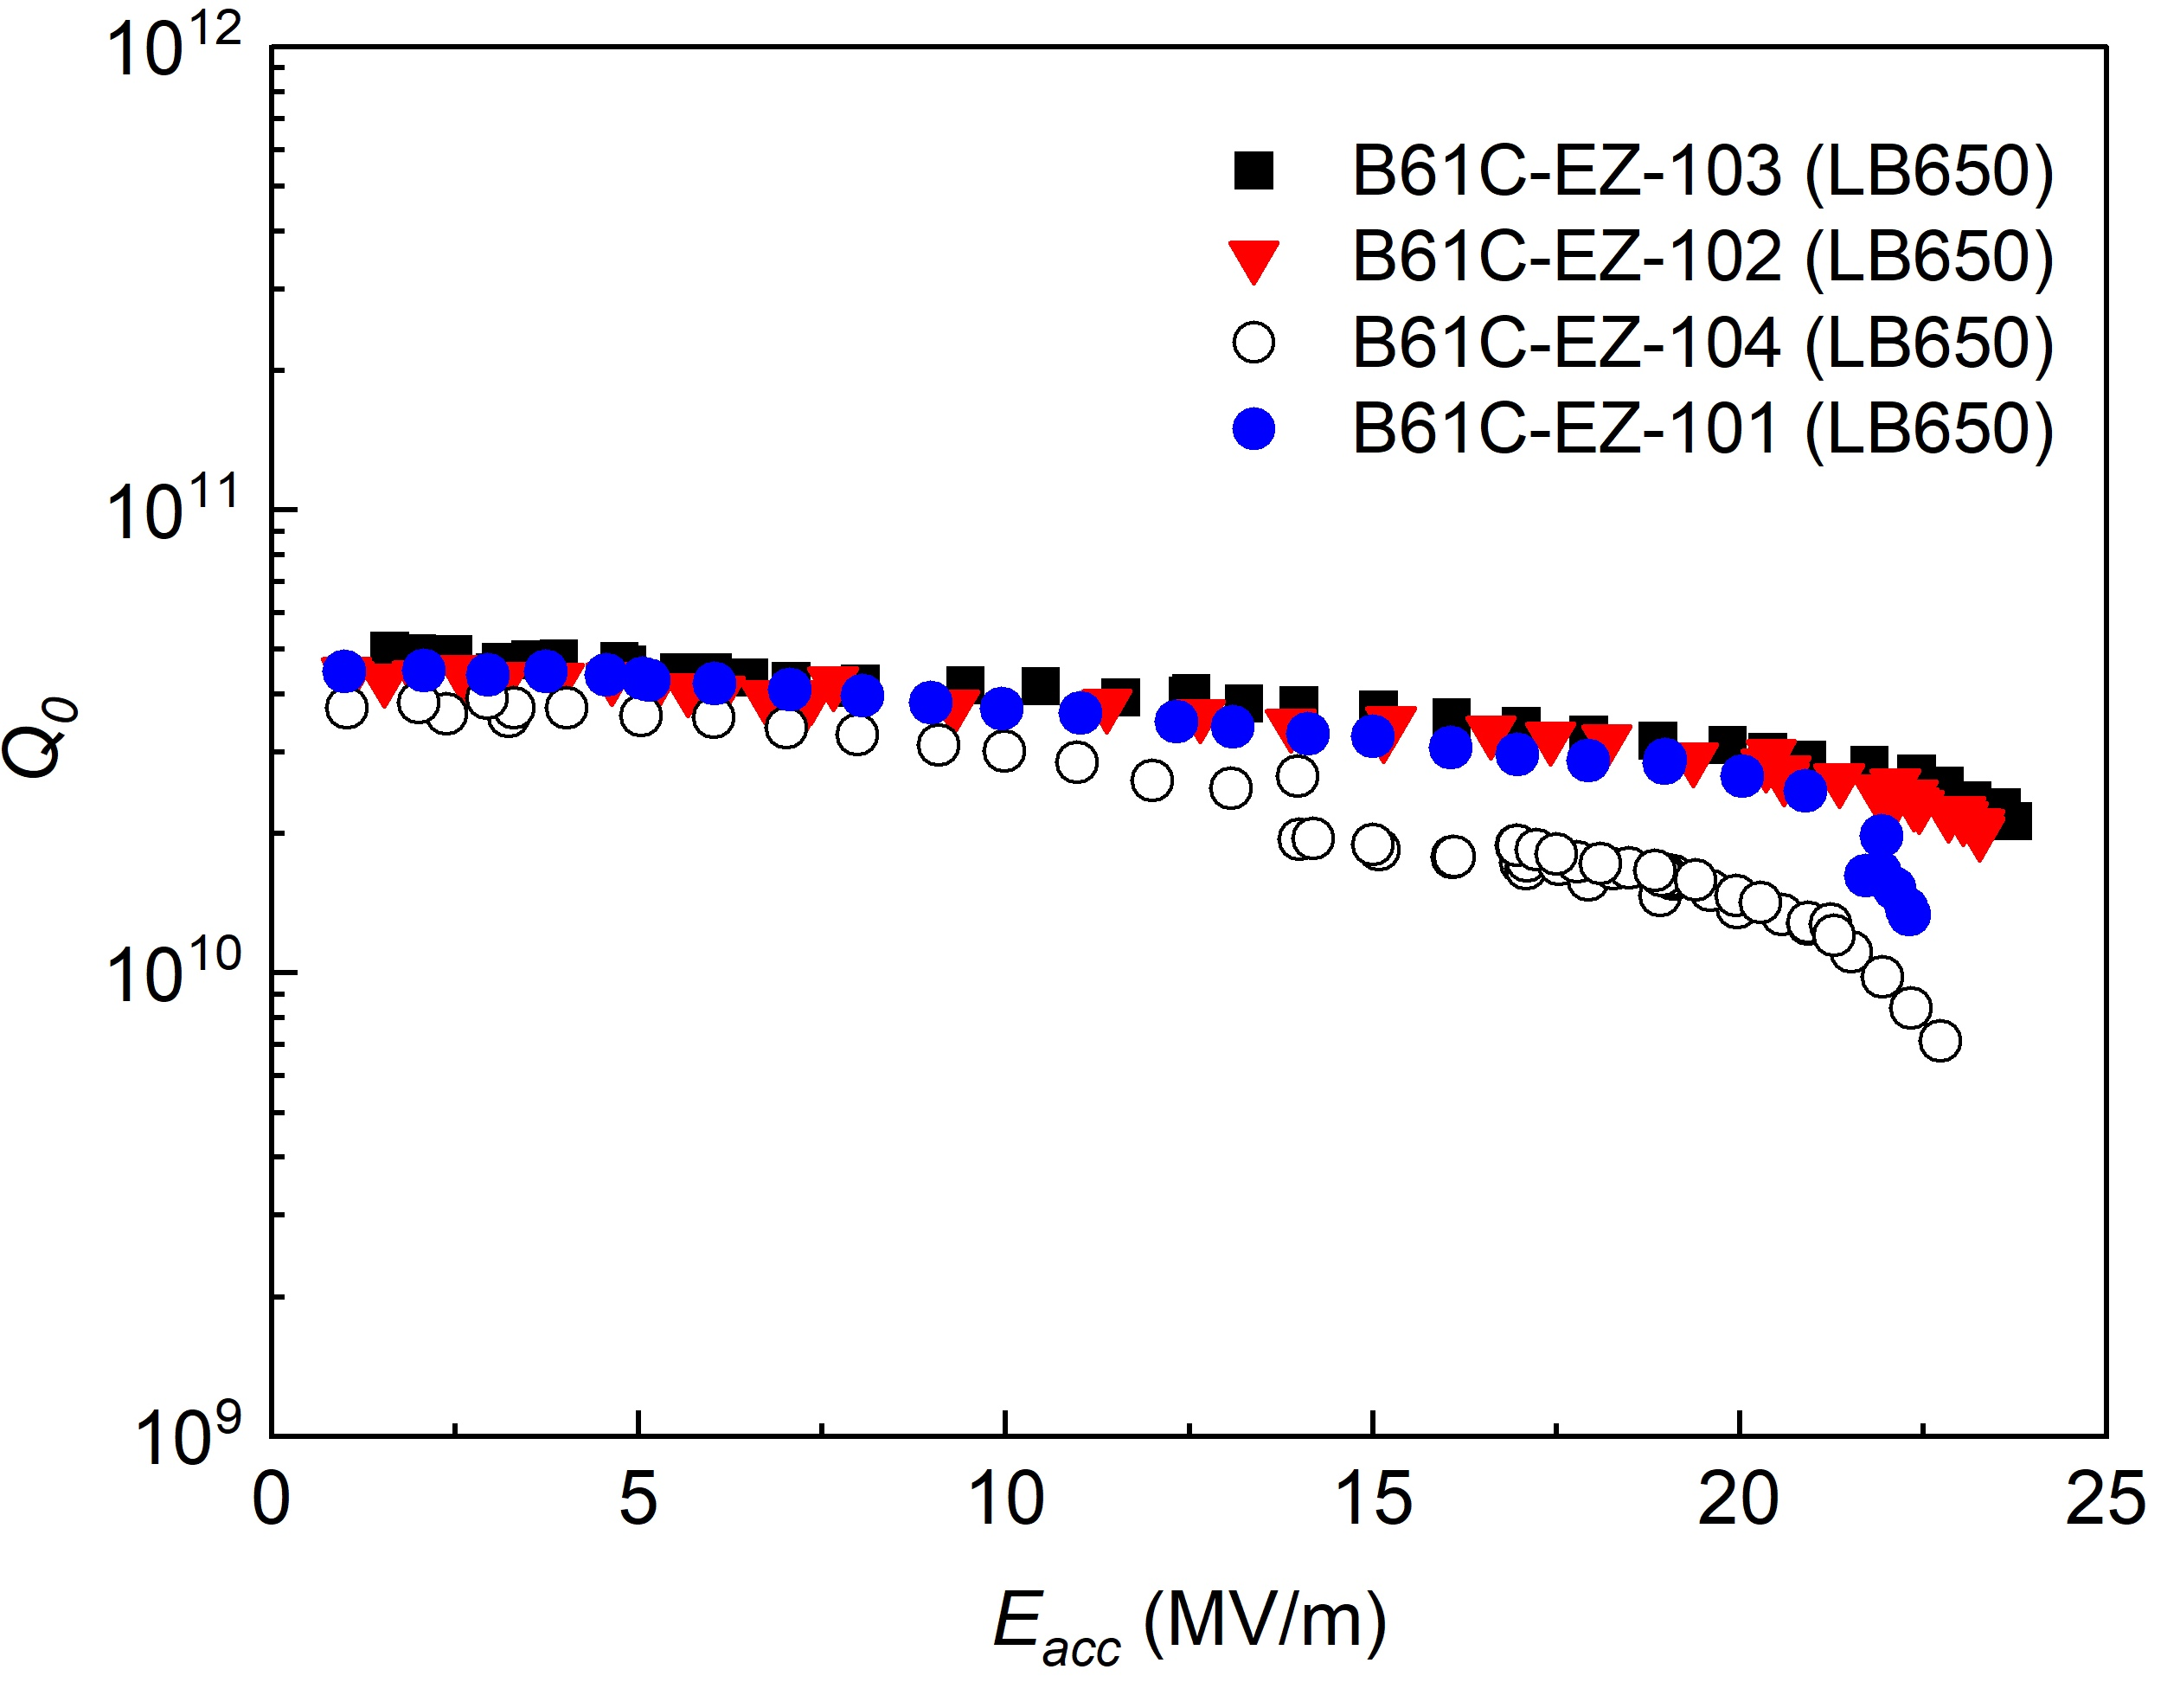
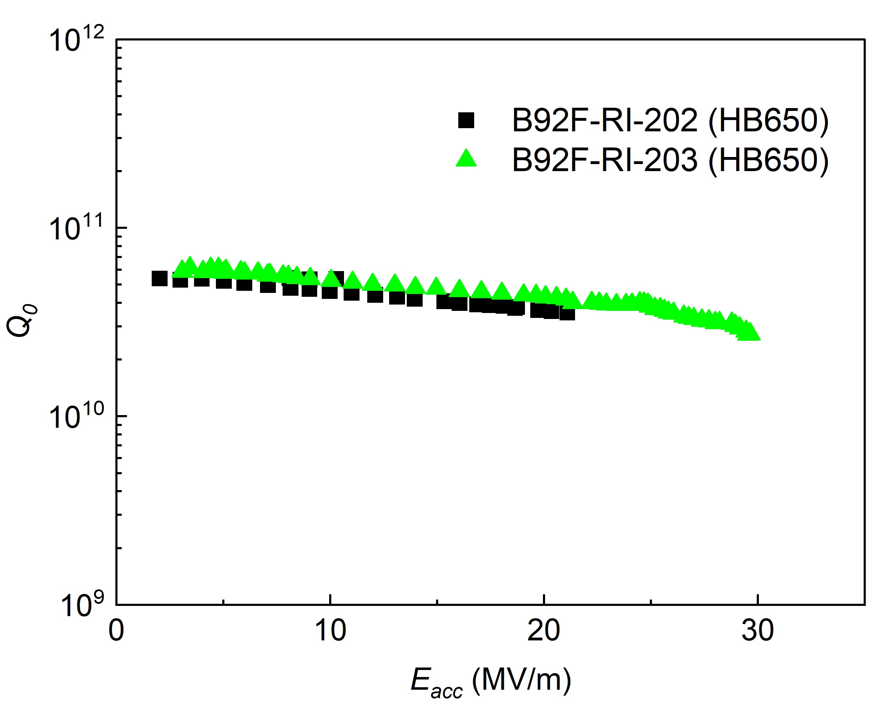
Baseline vertical test results (modified EP)
Process: EP + 800/900 °C + light EP
LB650 (5-cell cavities)
HB650 (5-cell cavities)
at 2K
at 2K
PIP II CM Spec
PIP II CM Spec
Limited by FE
No quench
(Admin limit)
No quench
EP with the modified cathode and parameters showed good performance in the baseline vertical tests.
The cavities are in process of mid-T or N-doping to improve Q₀ value.

Slide 14
Summary
Initial standard EP conditions yielded a rough equator surface and poor performance of 650 MHz cavities.
EP parameters were studied. The cathode and EP conditions were modified.
The modified cathode and EP conditions yielded a smooth surface and good performance of the LB650 and HB650 cavities.
No significant higher removal on the iris due to cathode proximity and higher voltage was observed.

Slide 15
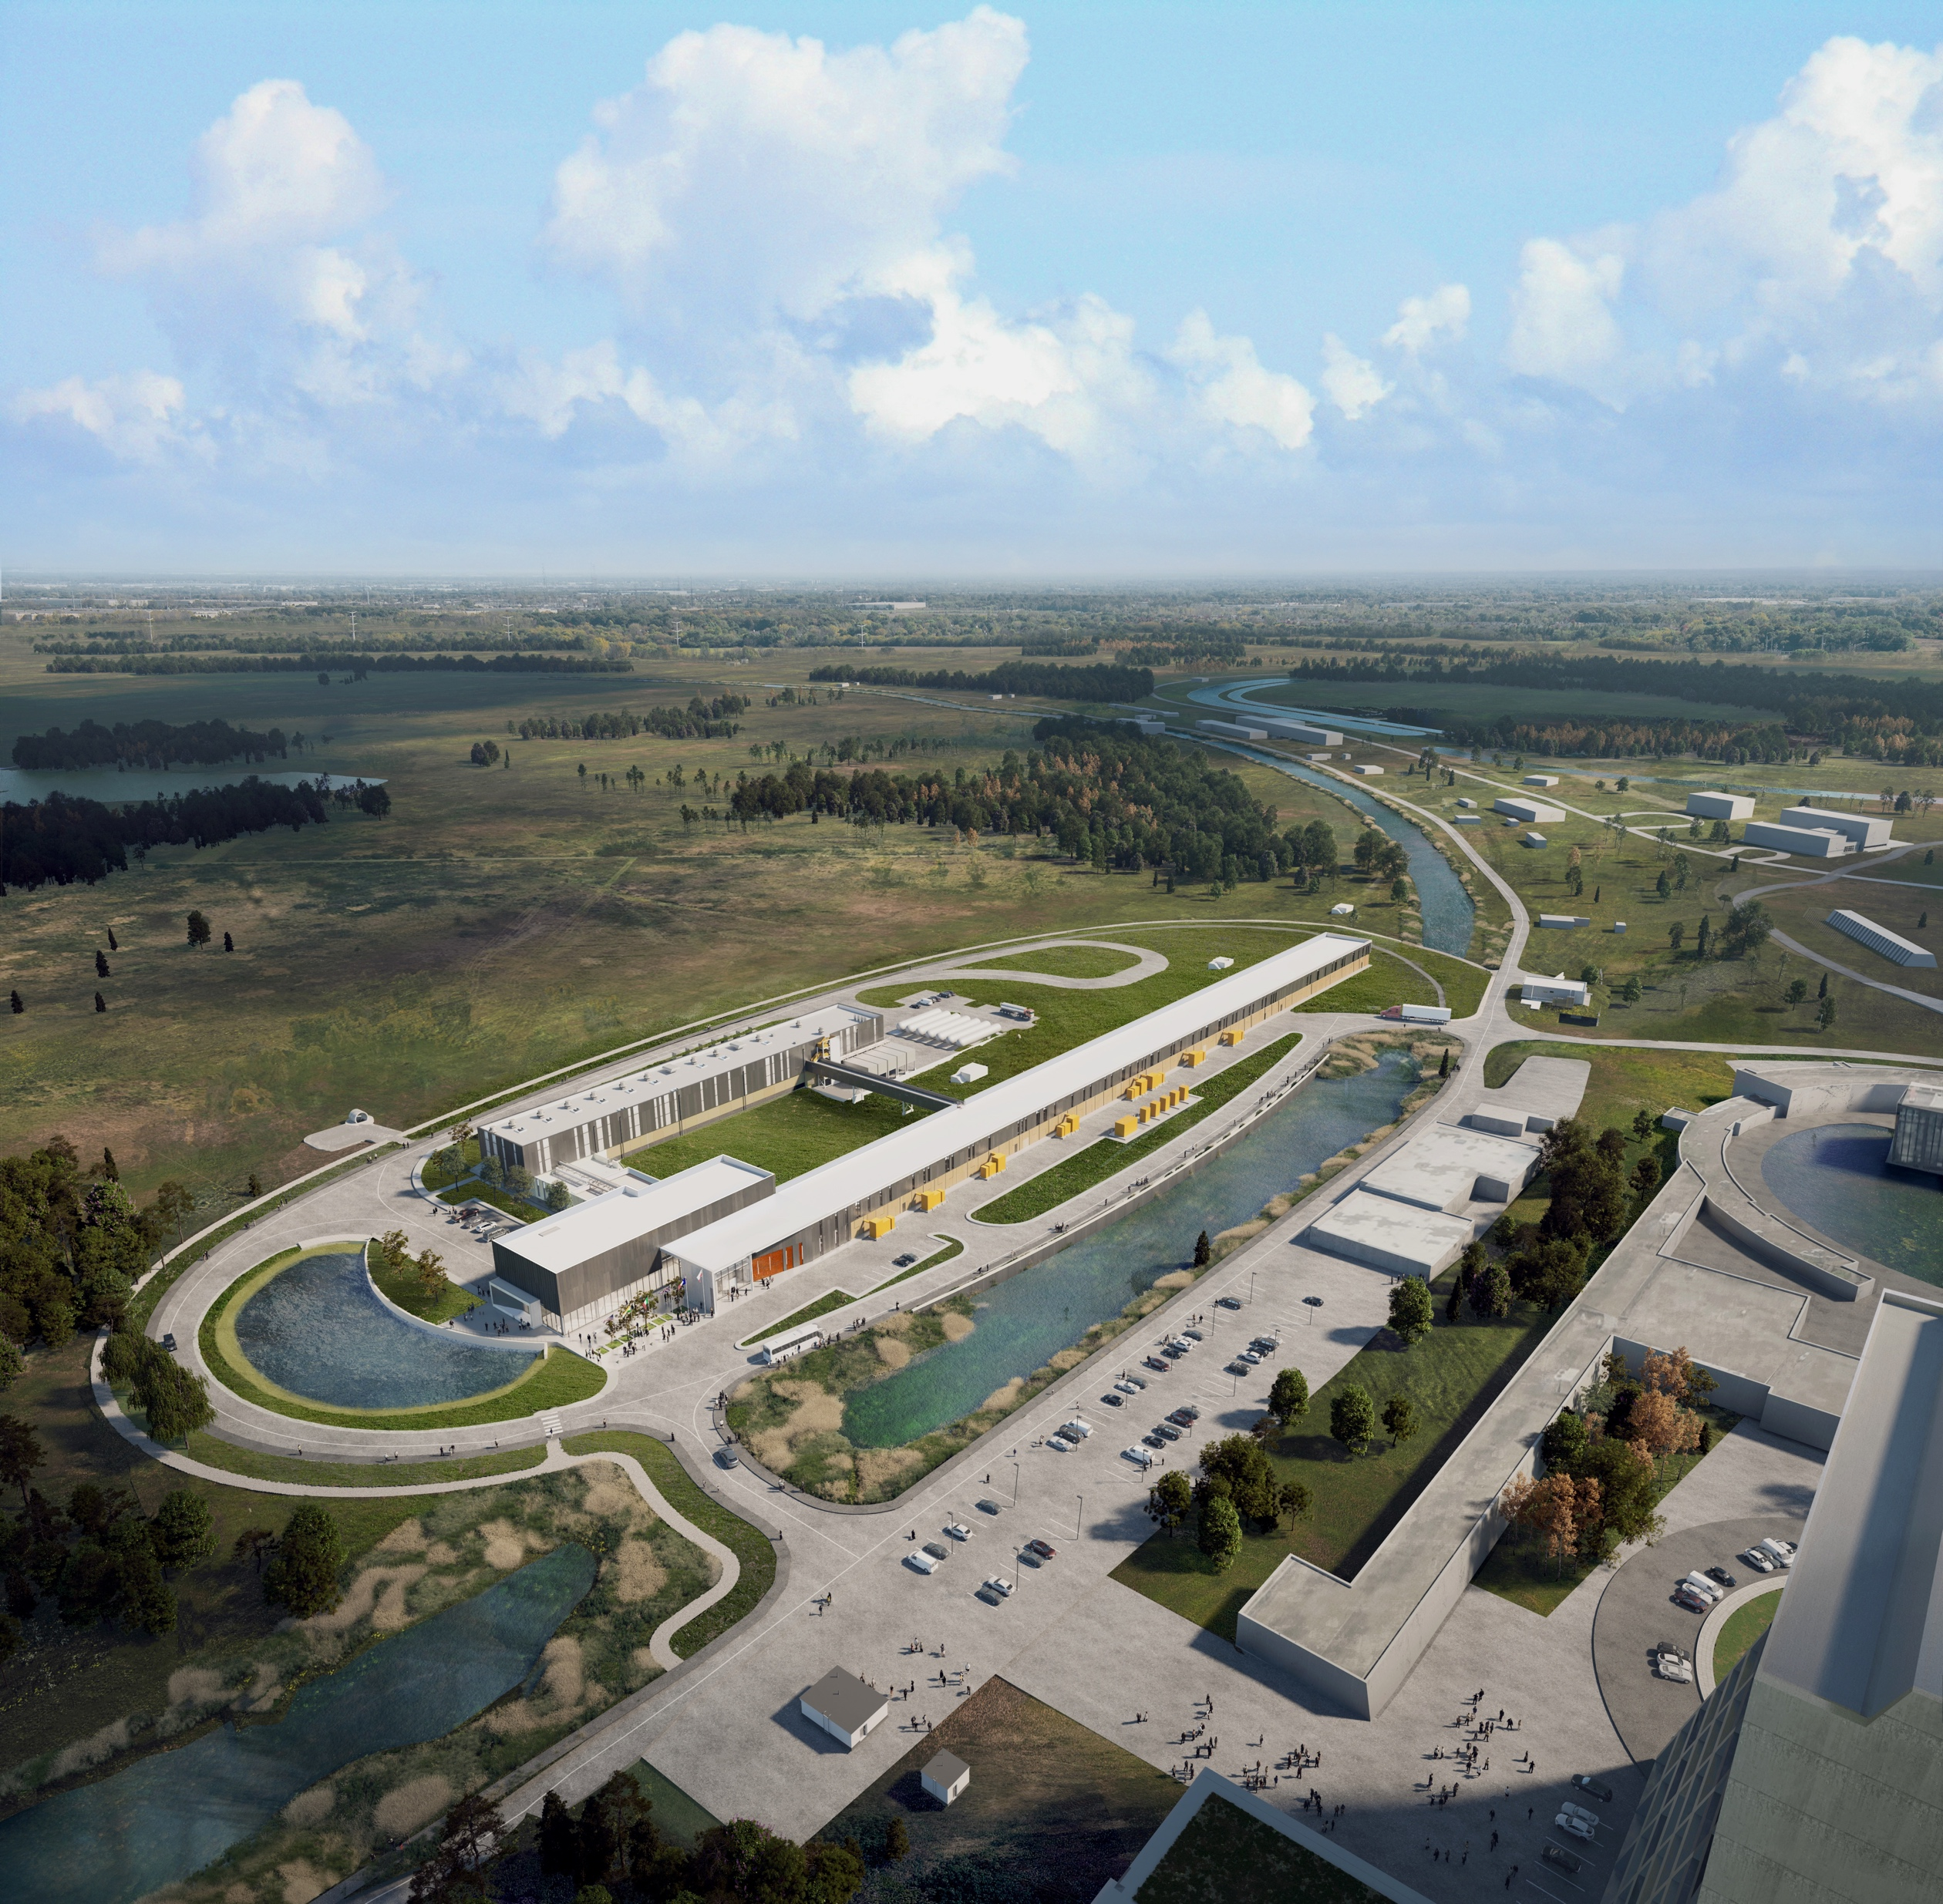


THE FUTURE OF FERMILAB
Follow us:
http://pip2.fnal.gov/
/showcase/pip-ii/

Slide 16
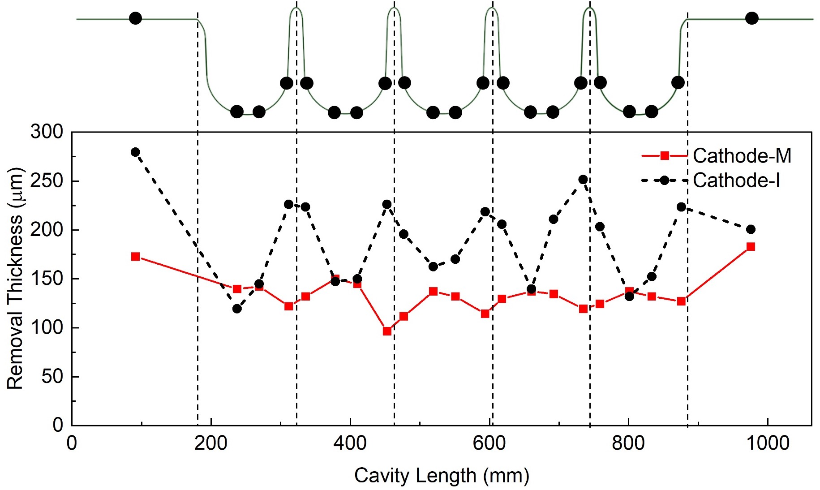
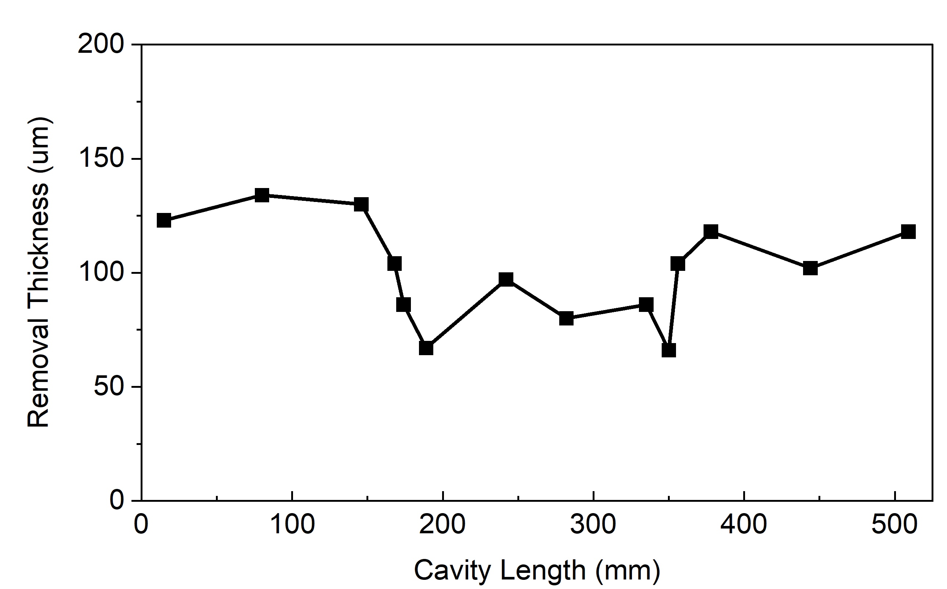
Removal profiles
LB650 5-cell cavity
HB650 1-cell cavity
Cathode-N
The large cathode surface area, cathode proximity to the iris, and higher EP voltage do not enhance removal on the iris.

Slide 17
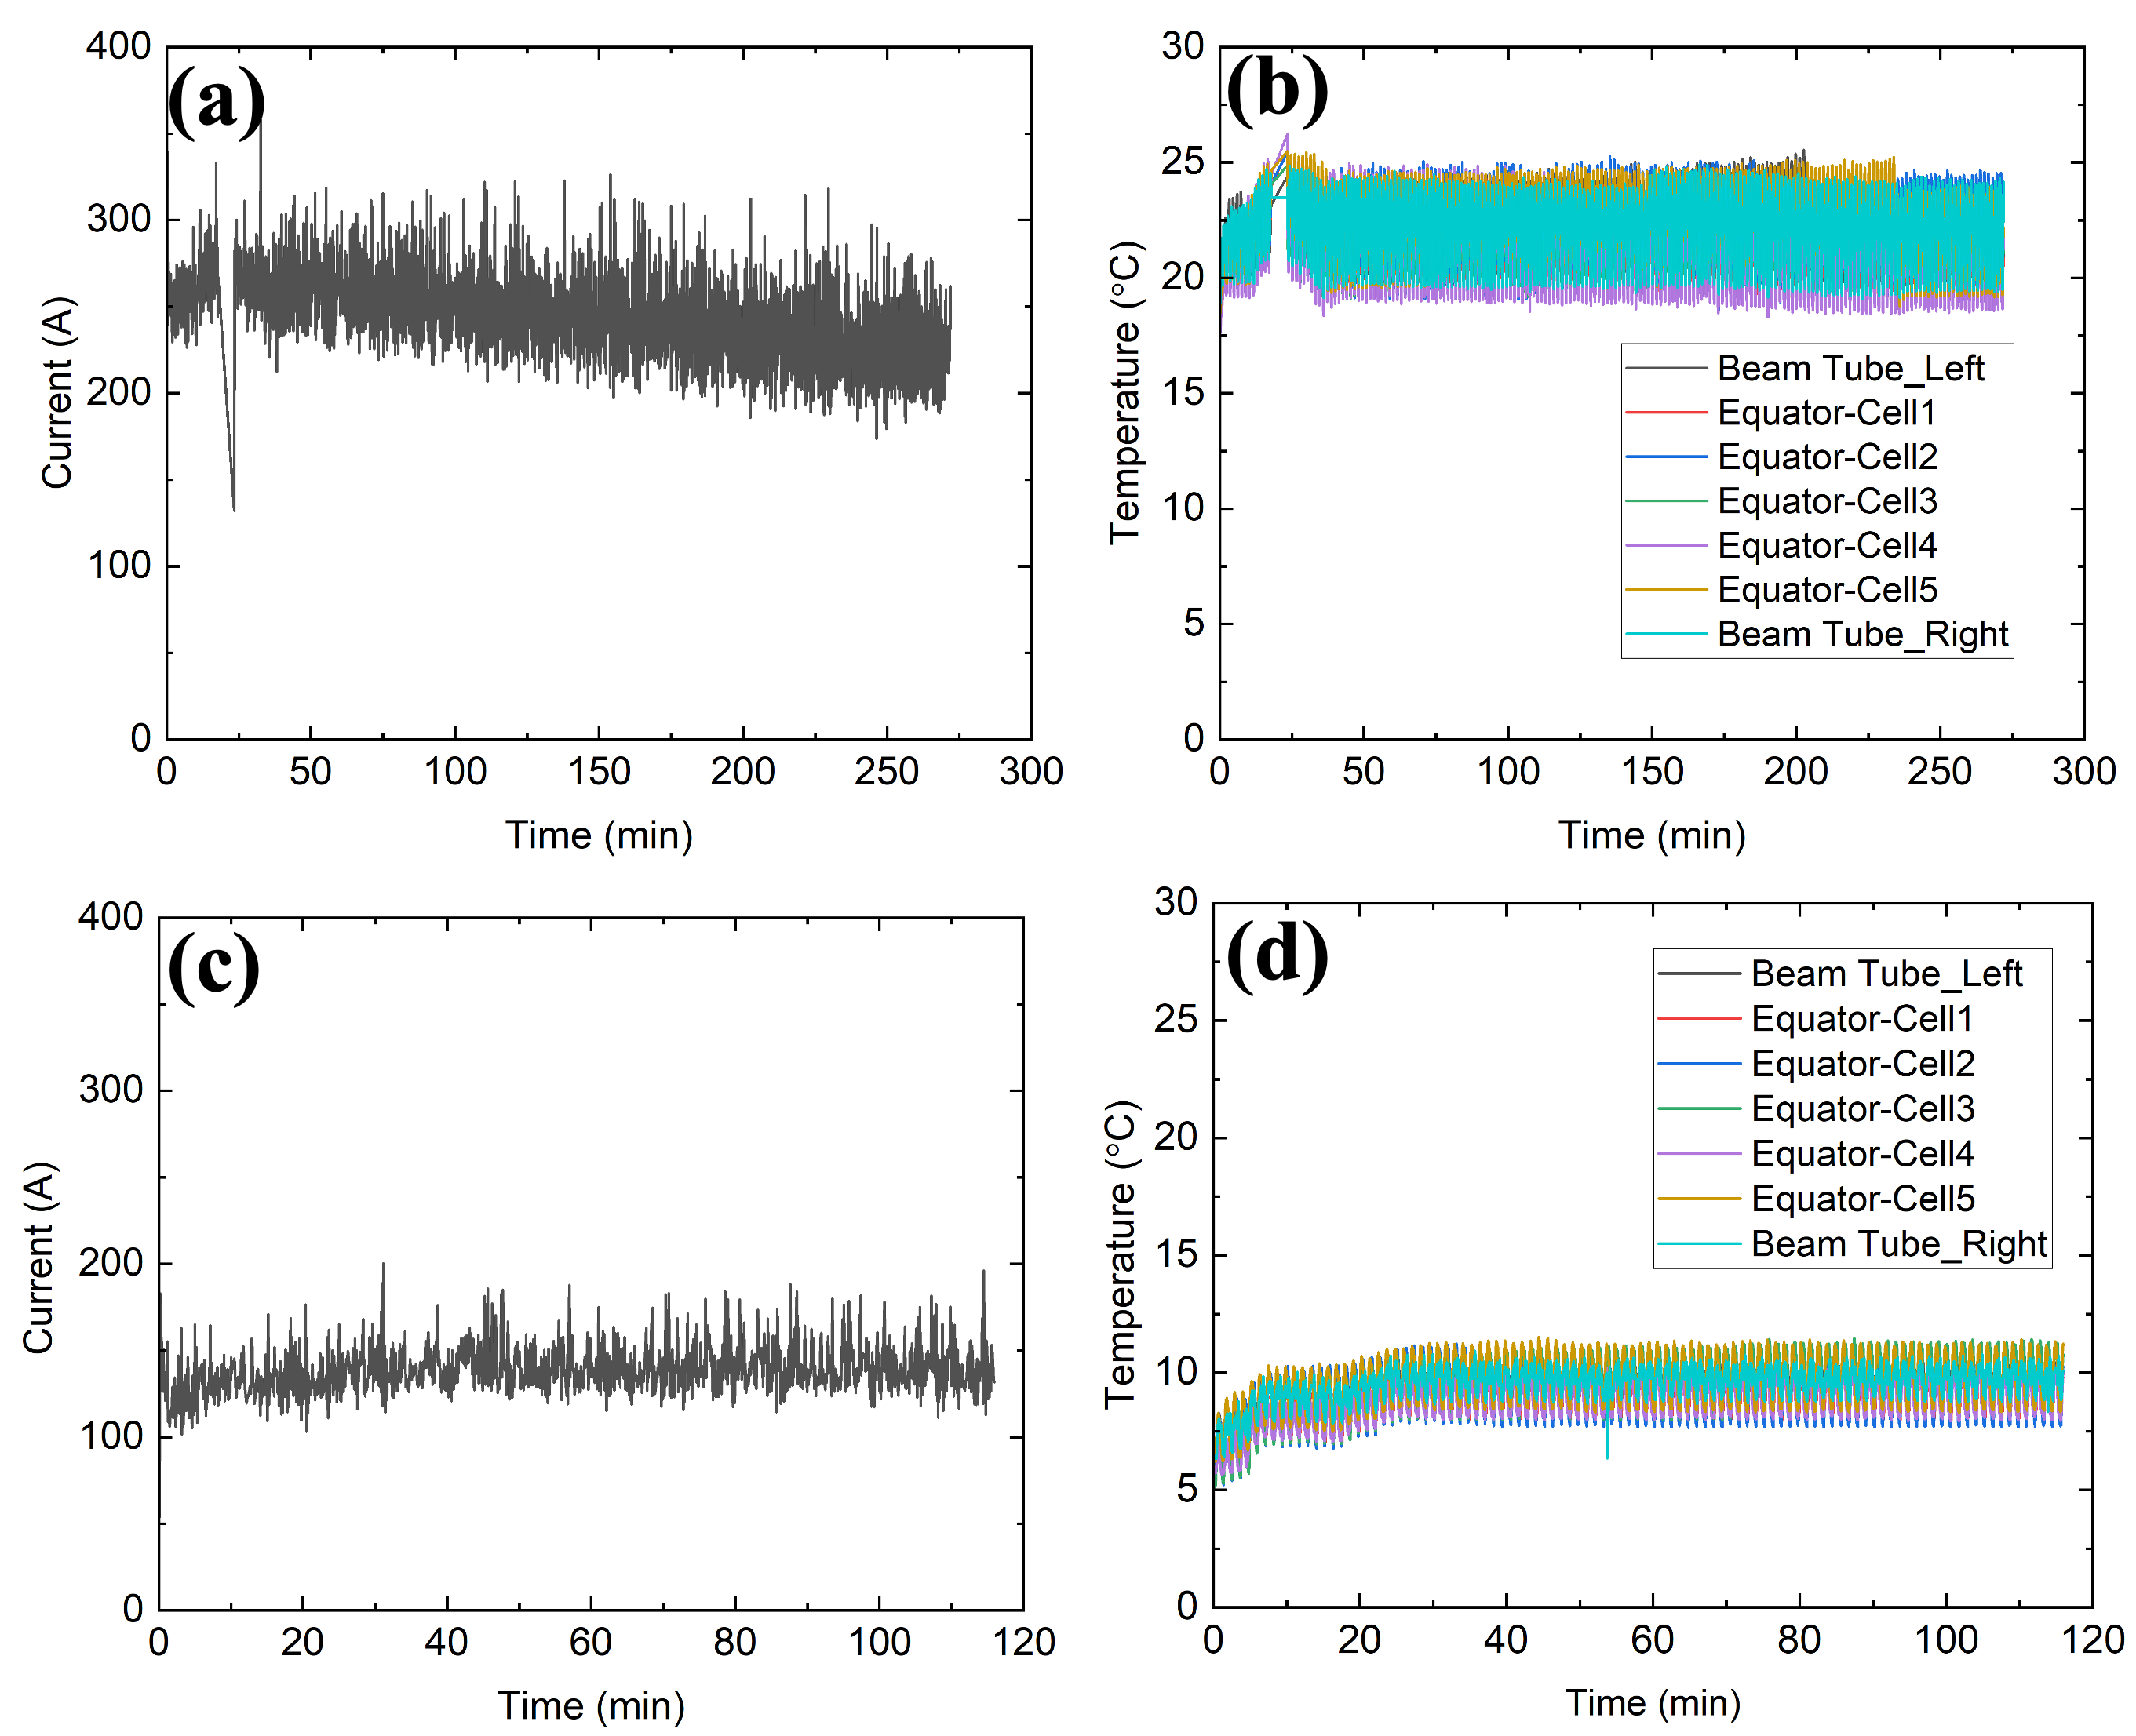
Current and temperature profiles (HB650)
25 °C
25 V
< 12 °C
22 V
A large cathode surface and higher voltage do not increase EP current.

